Slide 1


CMS Status Report
Sam Harper on behalf of the CMS collaboration
LHCC Open Session
27 February 2019

Slide 2
Outline
Summary of Heavy Ion Run
Plans & Status for LS2
Computing & Subsystems Status
Latest Physics Results & Publications

Slide 3
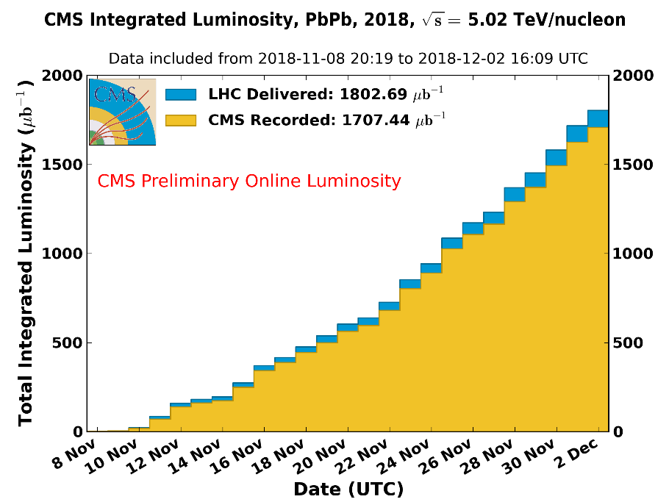
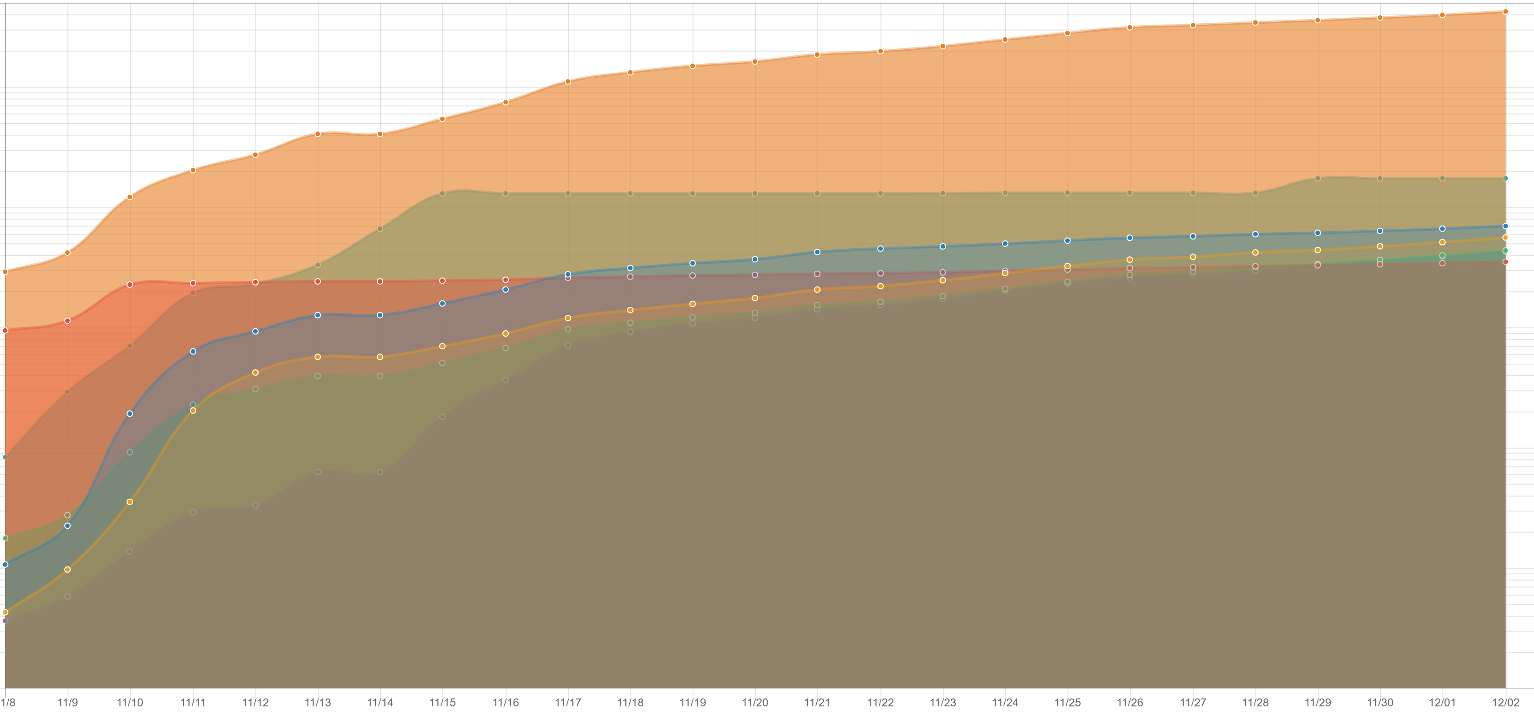
Heavy Ion Run Summary
HI: 1.80nb-1 delivered, 1.71nb-1 recorded
  ~95% data taking efficiency
~4.5 billion minimum bias events collected
  sustained ~7GB/s HLT rate
  non-trivial to achieve, for example required custom tracker firmware to achieve
highly successful run, full dataset is now in the hands of eager analysers
5E9
2E9
1E9
number of events by dataset
5E8
1E8
2E7
1E7
1E6
1E5
1E4
8th Nov
2nd Dec
Notes:
21 days, 2.5KHz

Slide 4
Heavy Ion Run Summary (II)
Last physics fill of Run2 dumped on Dec 2nd @17:05
LHC schedule optimised up to the last moment to give us maximal lumi!
  last fill was just 2hrs long but gave us an additional 0.5% lumi!
a very successful end to a very successful Run
Many thanks to the LHC team and LPC coordinators!
See you in Run3!

Slide 5
Outline
Summary of Heavy Ion Run
Plans & Status for LS2
Computing & Subsystems Status
Latest Physics Results & Publications

Slide 6
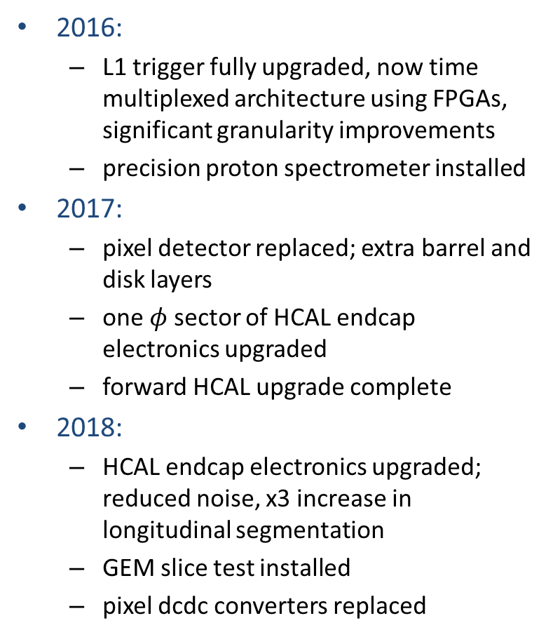
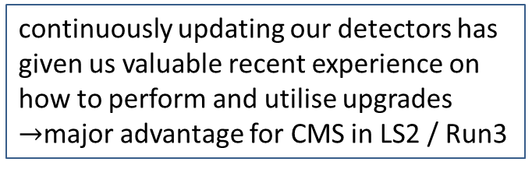
First a reminder, CMS detector was far from static over Run2, evolved significantly
2016:
  L1 trigger fully upgraded, now time multiplexed architecture using FPGAs, significant granularity improvements
  precision proton spectrometer installed
2017:
  pixel detector replaced; extra barrel and disk layers
  one $φ$ sector of HCAL endcap electronics upgraded
  forward HCAL upgrade complete
2018:
  HCAL endcap electronics upgraded; reduced noise, x3 increase in longitudinal segmentation
  GEM slice test installed
  pixel dcdc converters replaced
continuously updating our detectors has given us valuable recent experience on how to perform and utilise upgrades $→$major advantage for CMS in LS2 / Run3

Slide 7
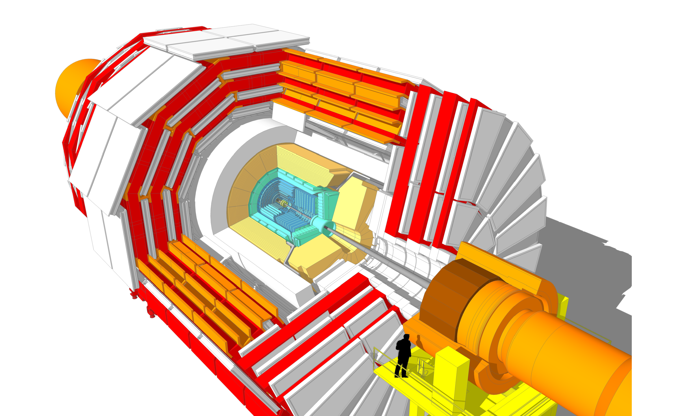
LS2 Major Projects
Summary: Finish Phase-1, Prepare for Phase-2
Pixel detector:
replace barrel layer 1
replace all DCDC converters
HCAL barrel (last phase-1):
upgrade detector electronics
Near beam & Forward Systems
BCM/PLT refit
new T2 track det
PPS: RP det & moving sys upgrade
Muon system (already phase-2):
install GEM GE1/1 chambers
upgrade CSC FEE for HL-LHC trigger rates
shielding against neutron background
Install new beam pipe for phase-2
Civil engineering on P5 surface to prepare for Phase-2 assembly and logistics
SXA5 building
temporary buildings for storage/utility
Coarse schedule:
2019: Muons and HCAL (interleaved)
2020: beam pipe installation, then pixel installation

Slide 8
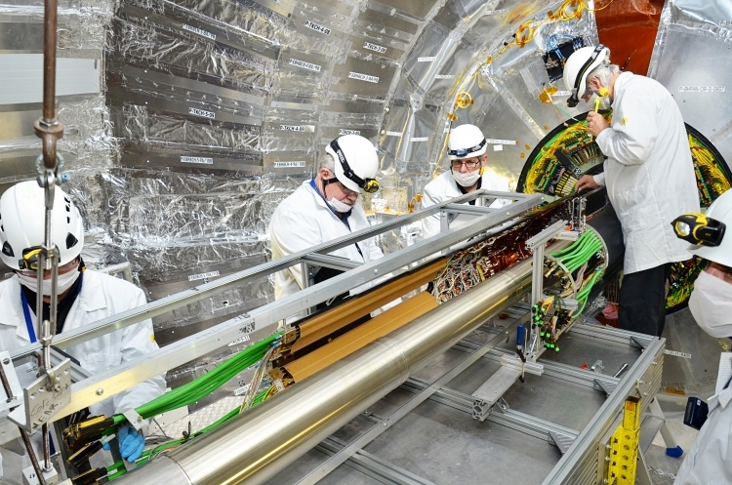
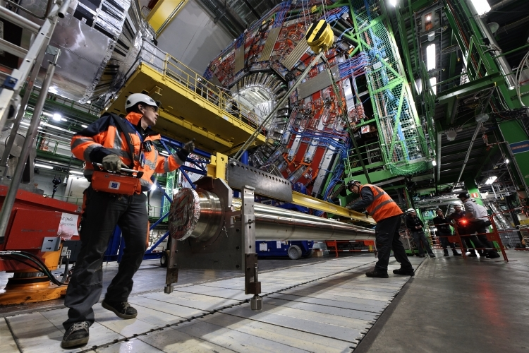
LS2 Status
LS2 progressing well and on schedule
pixel detector and beam pipe now removed!
HCAL barrel electronics upgrade on going
  completes phase-1 upgrade
muon endcap upgrades about to proceed
  marks start of phase-2 upgrade!

Slide 9
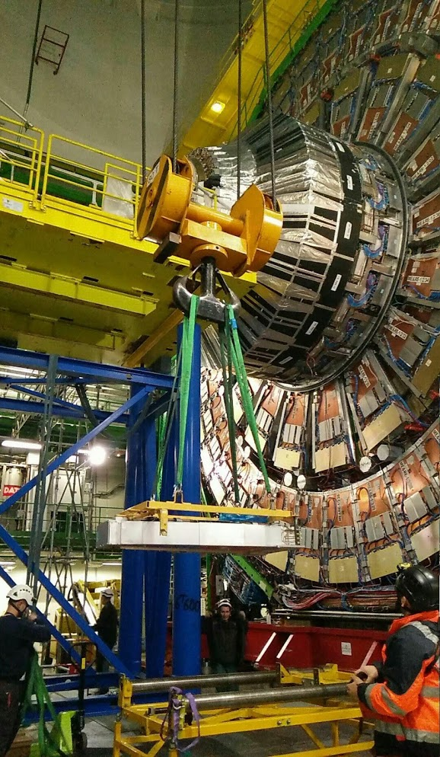
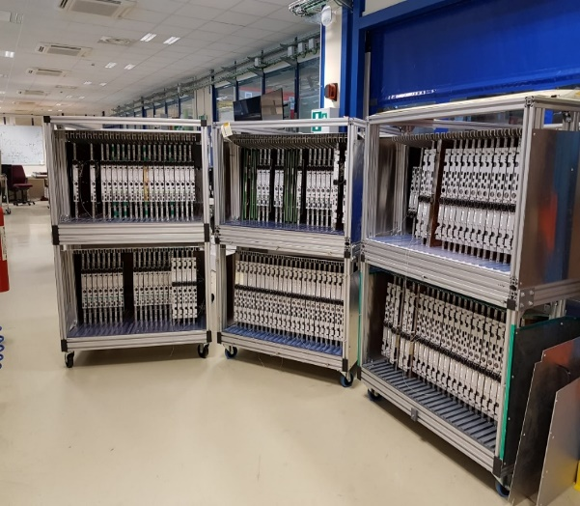
LS Status (II):
Phase-2 Muon Upgrade
the first ME1/1 is extracted on Jan 22
for electronics upgrades
1) replacement of all on-CSC and part of on-disk electronics
component production for new on-chamber electronics is on schedule → on target for the “ready for installation” milestone (11 Mar 2019)
2) 144 triple-GEM chambers to be added to the first endcap station
additional layer in front of existing muon station (ME1/1) at 1.6≤|𝜂|≤2.2
necessary for phase-2 to control trigger rates but get to reap benefits in Run3
all GE1/1 chambers have been built and validated
electronics production on-going
on schedule to start installation at end of Aug 2019
GEM chambers ready to install

Slide 10
Outline
Summary of Heavy Ion Run
Plans & Status for LS2
Computing & Subsystems Status
Latest Physics Results & Publications

Slide 11
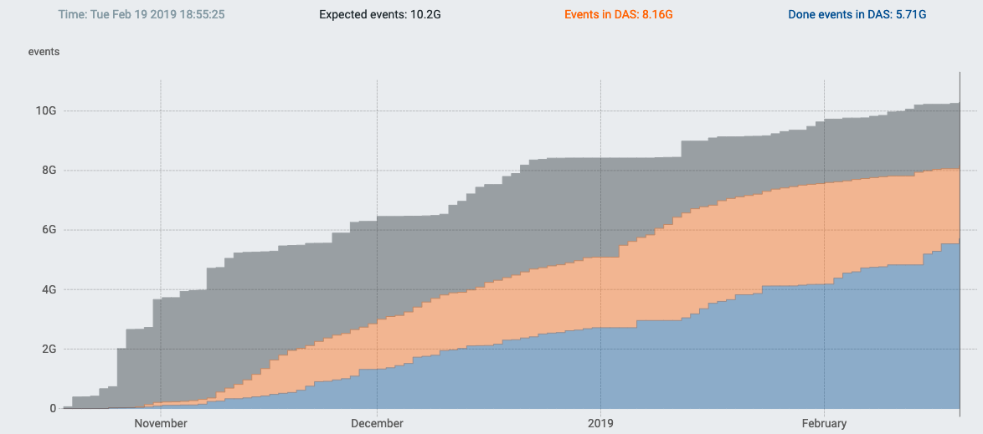
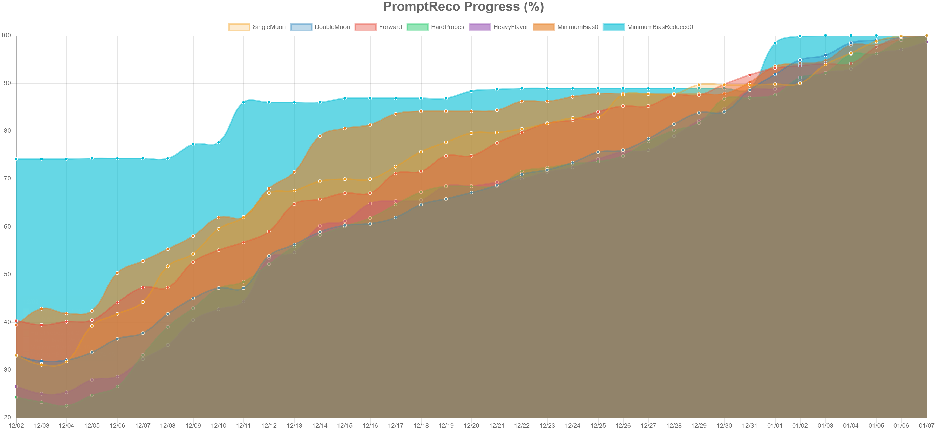
Computing: Production activities since last LHCC
samples for Moriond 19 finalized → 8.2B events done, at AOD/Mini/Nano level
  nanoAOD: very light weight dataformat
  now routinely used by analysis teams
sample @PU=200 for the MTD TDR done
HI reco done just after winter break, using Tier-0 and HLT resources → ~4.7B events ready for analysis
~ 300kCores available for offline (prod + analysis) jobs during the break
  a record for CMS!
we are well prepared for the complete reprocessing of Run2 data & MC
  improved detector calibrations & object reco required for precision analyses
  scheduled to start in May
8.2 B events ready for analysis
November
Now
100% Threshold
Dec 2nd Jan 7th

Slide 12
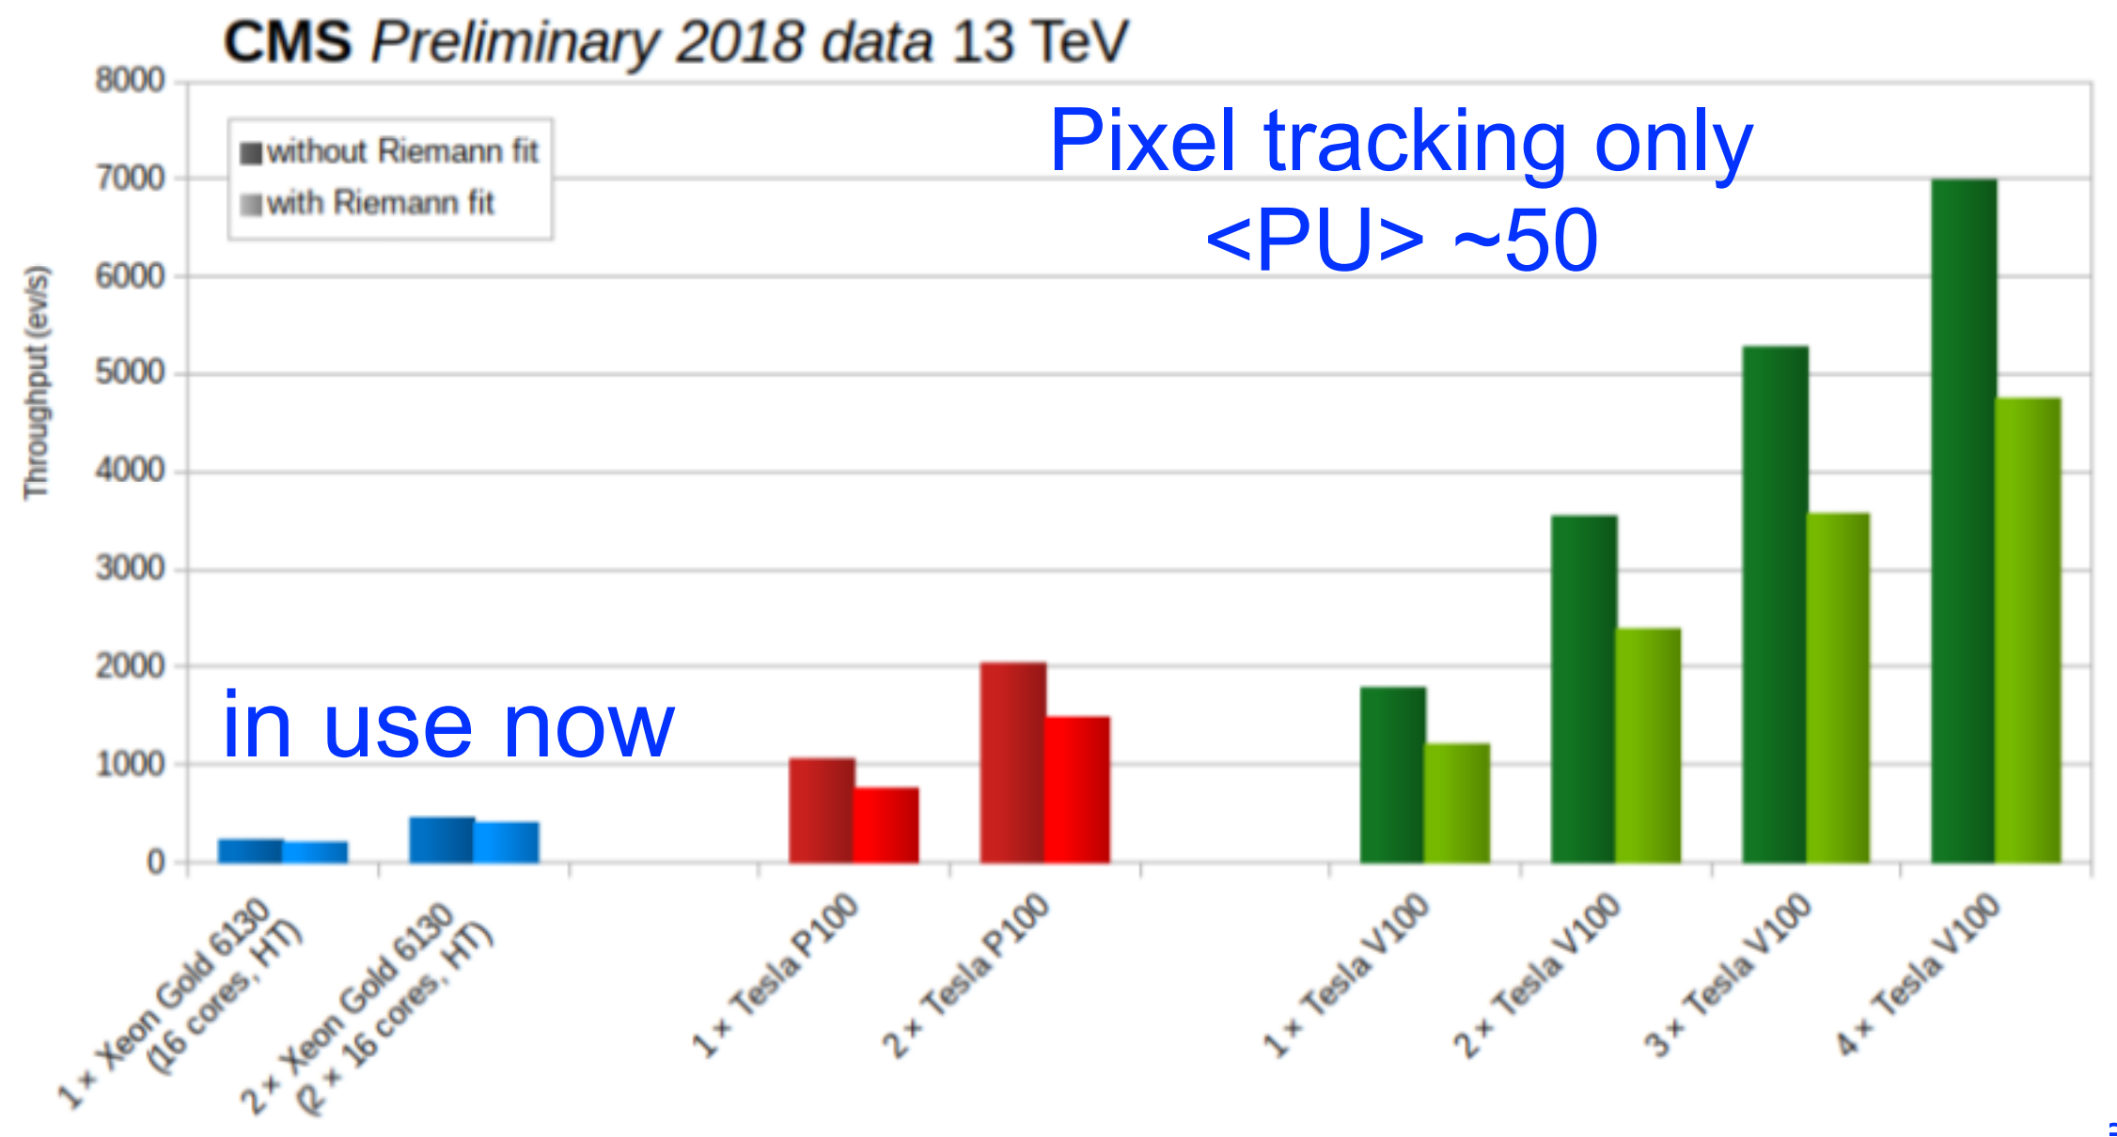
Computing: Other relevant activities
about to start the full processing of the 12B event b parking dataset
  includes new optimized electron reco specifically developed for this analysis
  extends the physics reach of CMS to a new phase space!
transition to new (Run3) software stack progressing as expected
  Rucio (Data Management), DD4HEP (Geometry Description), CRIC (Information System)
latest CMSSW version contains the first framework code to handle heterogeneous architectures
  FPGA, GPU/CUDA already prototyped
  a per module, per event, per job, per… granularity
  expands our robust multithreading framework which has been critical to Run2 data taking
  to be finalized in next major version (expected late spring)
advantages of using GPUs in tracking in HLT
throughput increases by order of magnitude

Slide 13
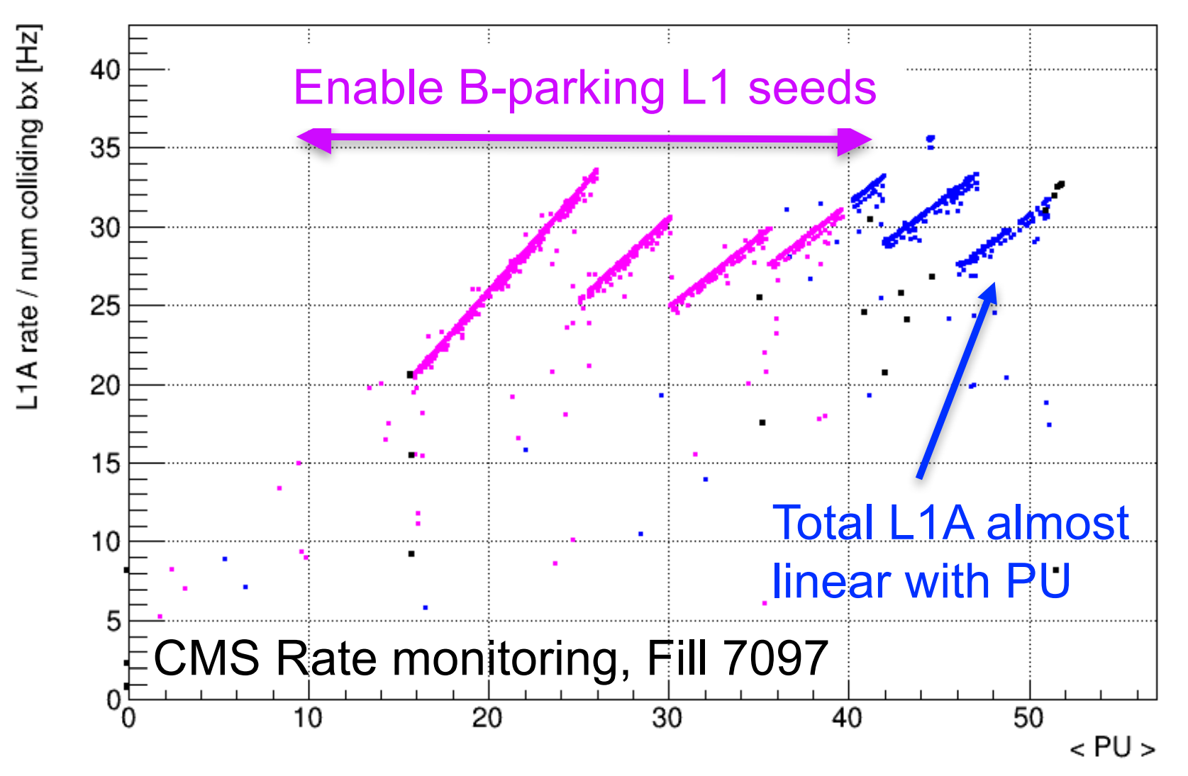
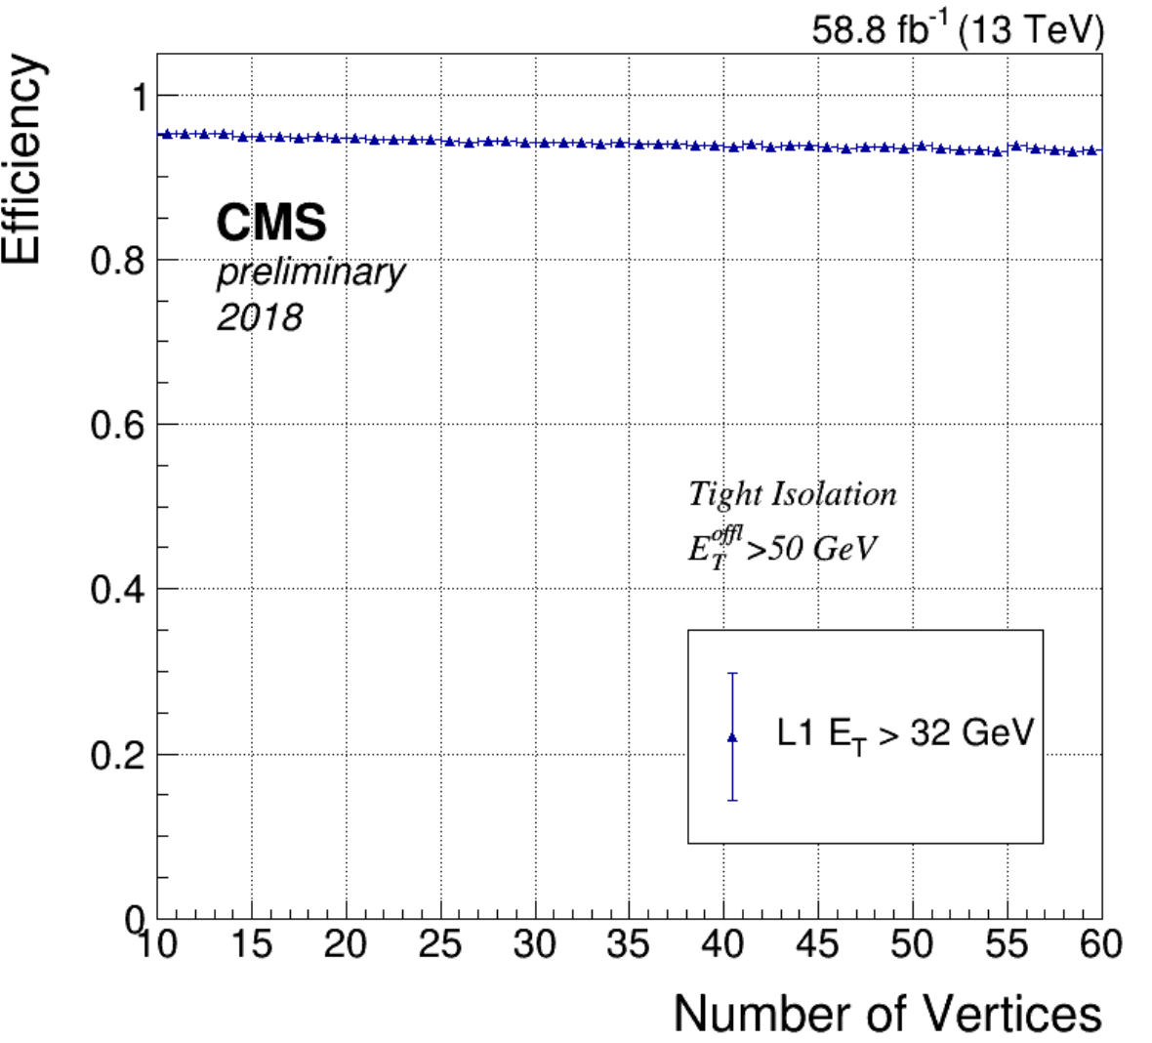
L1 Trigger
operations
extremely good year for L1T
downtime was 50% of 2017
performance in 2018
performance improved w.r.t 2017
  lowered to ~28 GeV electrons, ~22 GeV muons
rate linear with PU
  significant work here into refining noise/PU suppression algos
L1 accept rate typically 90kHz with approx. 340 L1 seeds
improvements in LS2
exploit new information in Run3 available at L1: HCAL depth, GE1/1
Kalman-filter based muon track finding for barrel, tested in 2018

Slide 14
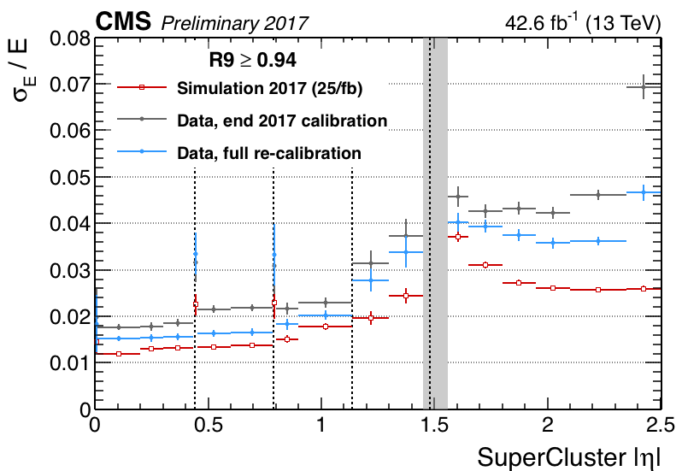
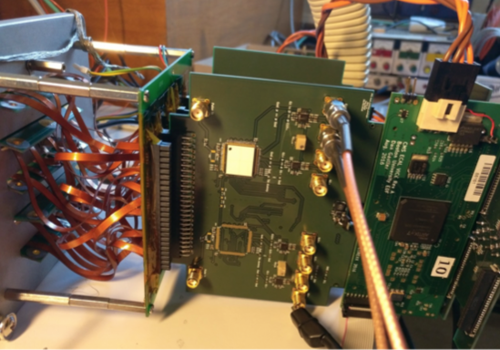
Calorimeters
ECAL:
prepared final calibrations for precision re-reconstruction of Run2 data
first test chips available for phase-2 (very) front end drivers
  ASIC works with all features functional
  qualitative performance in agreement with expectations
HCAL:
endcap upgraded detector understood and has good data/MC agreement
  improvements will be fed into the re-reco Run2 data scheduled to start in May
barrel upgrade in progress
Analog test setup at Saclay for ECAL VFEDs

Slide 15
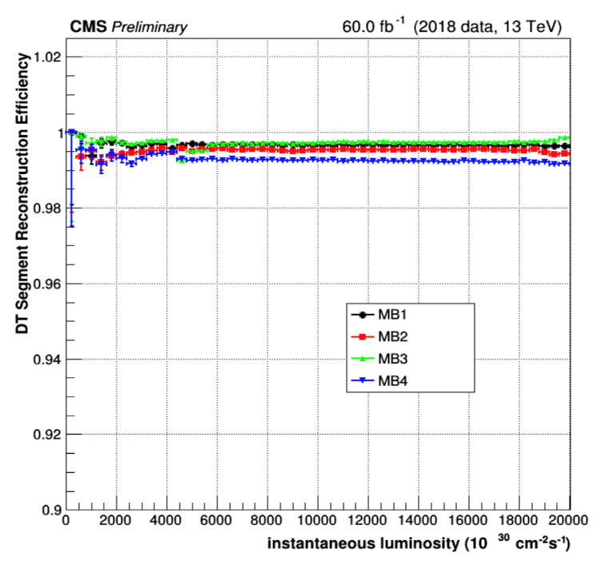
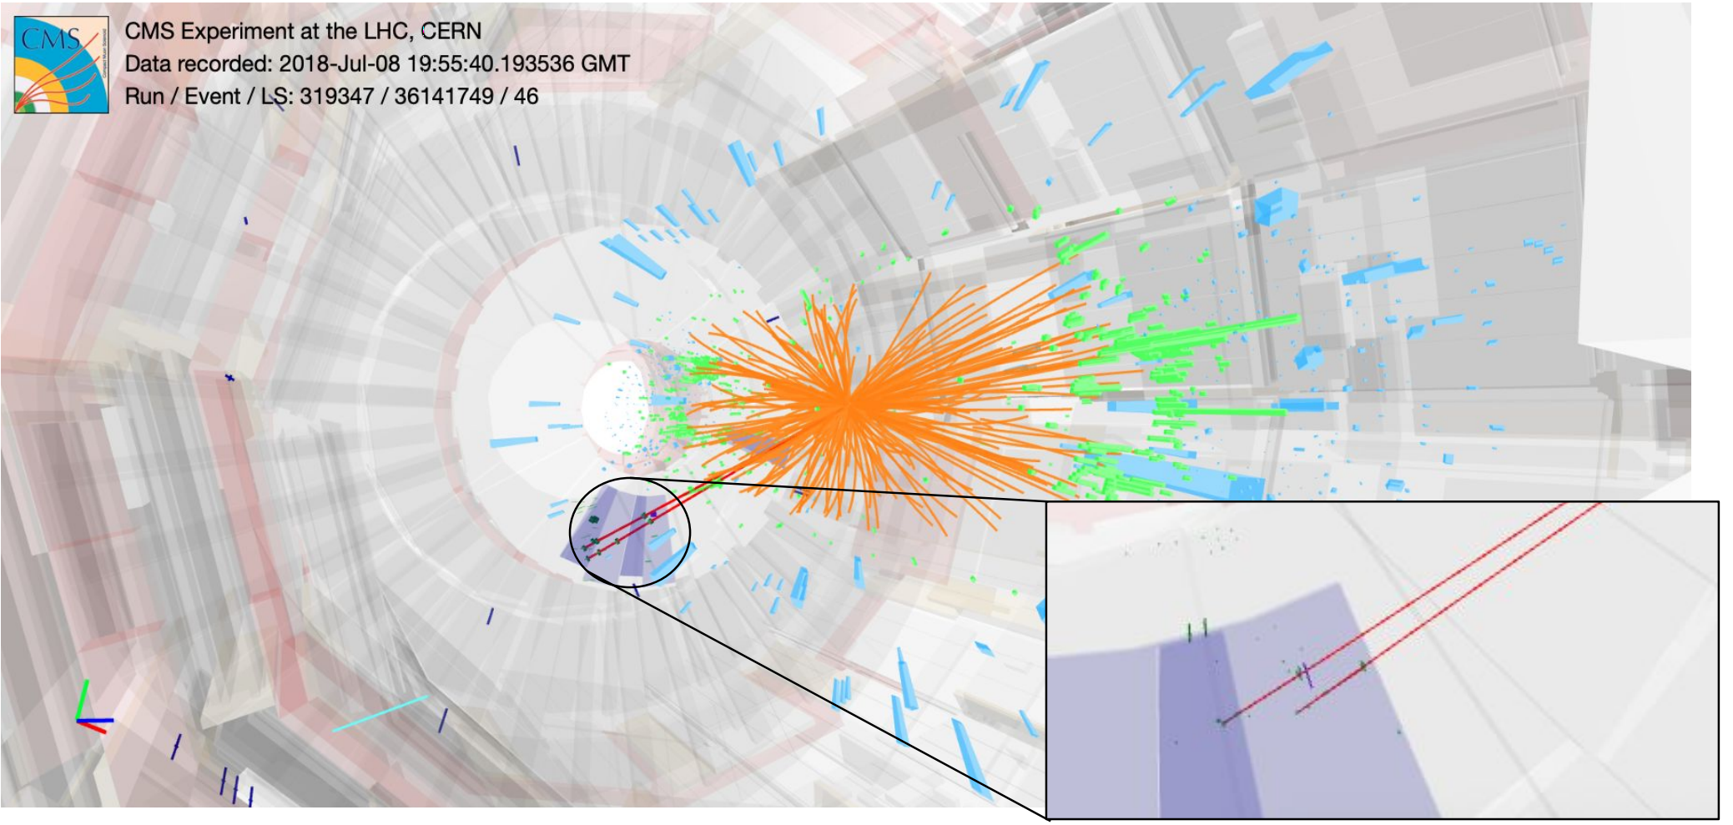
Muon System
analysis of the full 2018 data set confirms the excellent performance of the CMS muon systems
  already submitted physics results using it!
2018 saw the introduction of a single slice of the new GEM upgrade
  regular part of the readout system
  obtained valuable experience in operating it
  now studying the performance while the full system is being installed
purple = gem test slice

Slide 16
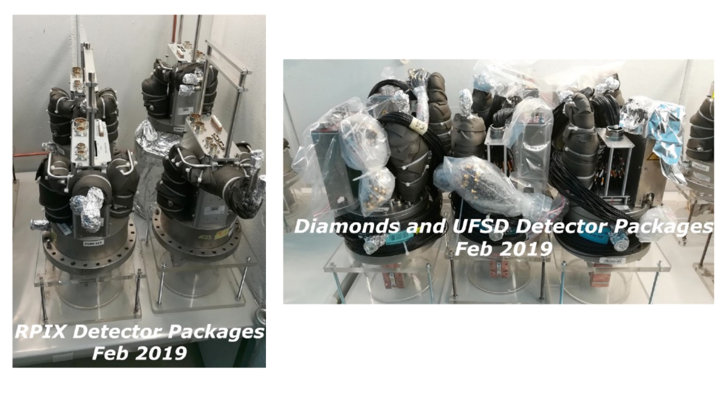
Precision Proton Spectrometer
Run2: summary
  total of >100fb-1 recorded for physics with Roman Pots inserted from 2016-2018
LS2: status
  RP tracking and timing detector packages removed from tunnel for upgrades/refurbishment for Run3
  work proceeding on schedule
HL-LHC : motivation for continuing PPS program beyond Run3
  feasibility of machine interface, detectors, under evaluation

Slide 17
Outline
Summary of Heavy Ion Run
Plans & Status for LS2
Computing & Subsystems Status
Latest Physics Results & Publications

Slide 18
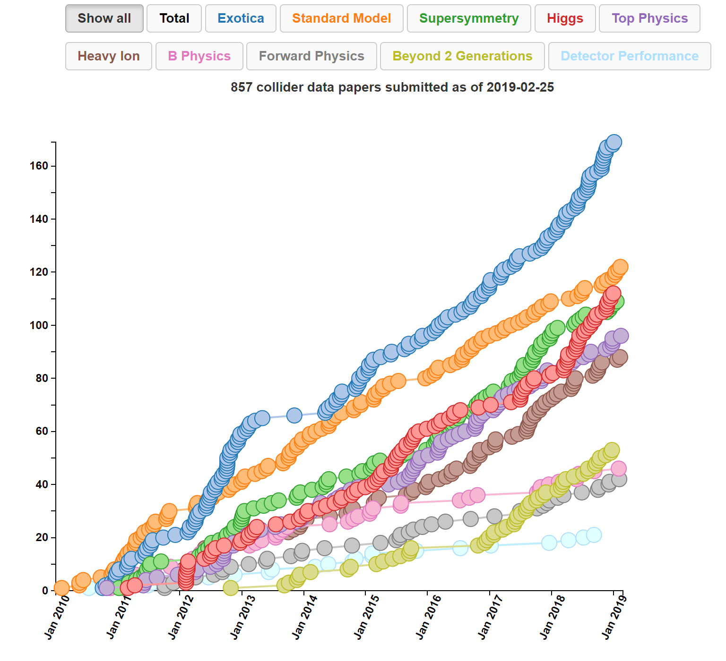
Publications Report
CMS has now submitted 857 collider data papers since 2010
  30 since last LHCC meeting in Nov
  full list: https://tinyurl.com/y9odauv6
2018 was a record year, submitted 141 papers!
  highest ever in any HEP experiment
  previous record was CMS with 132 papers in 2017

Slide 19
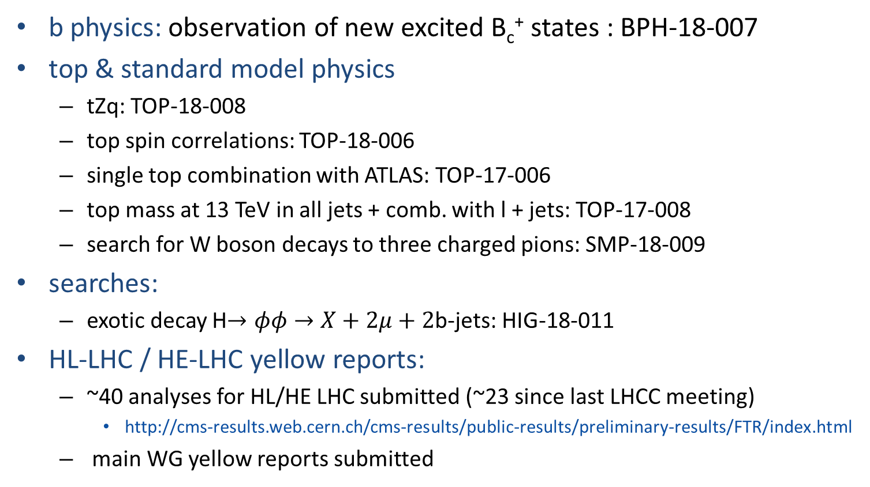
Physics results since the last LHCC meeting
b physics: observation of new excited B_{c}⁺ states : BPH-18-007
top & standard model physics
  tZq: TOP-18-008
  top spin correlations: TOP-18-006
  single top combination with ATLAS: TOP-17-006
  top mass at 13 TeV in all jets + comb. with l + jets: TOP-17-008
  search for W boson decays to three charged pions: SMP-18-009
searches:
  exotic decay H$→φφ→X+2μ+2$b-jets: HIG-18-011
HL-LHC / HE-LHC yellow reports:
  ~40 analyses for HL/HE LHC submitted (~23 since last LHCC meeting)
    http://cms-results.web.cern.ch/cms-results/public-results/preliminary-results/FTR/index.html
  main WG yellow reports submitted

Slide 20
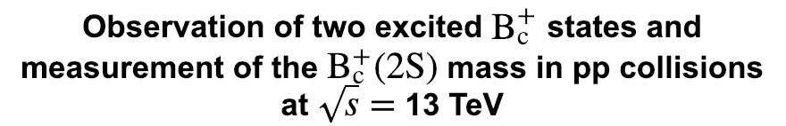
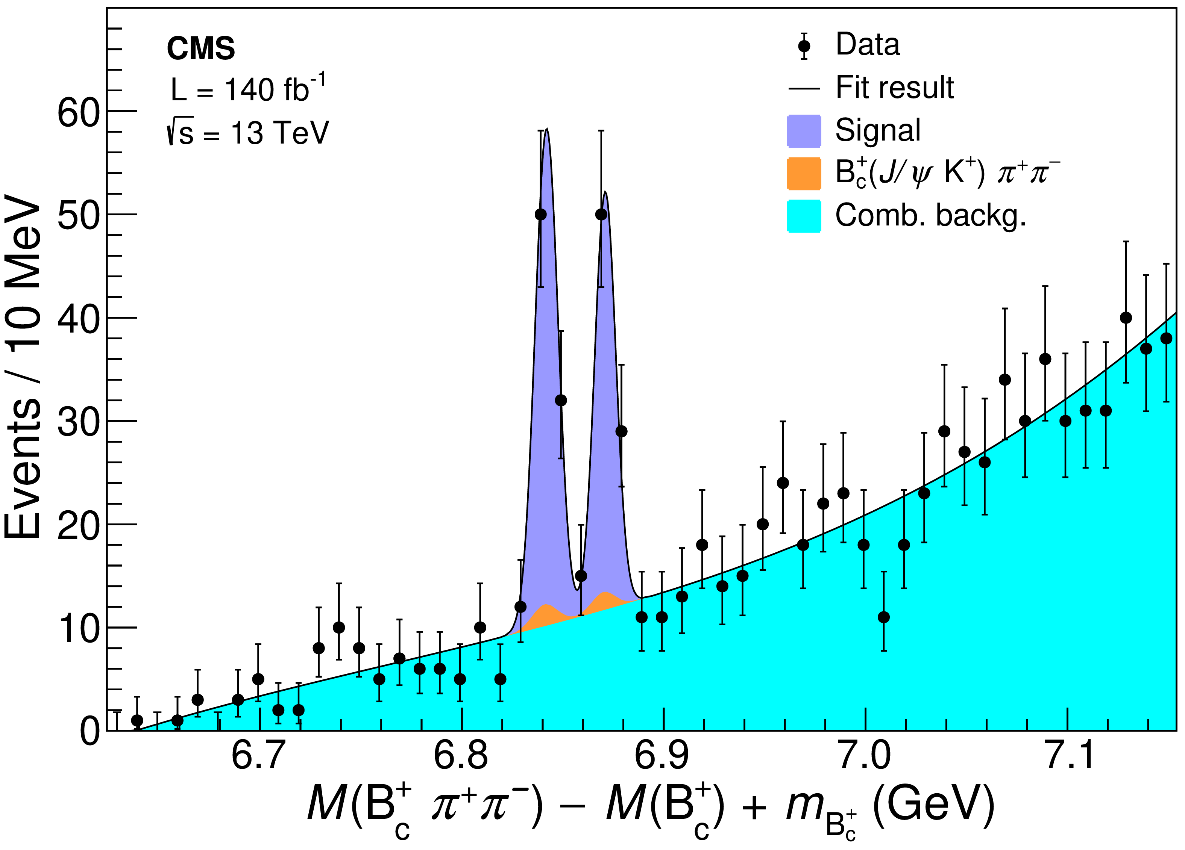
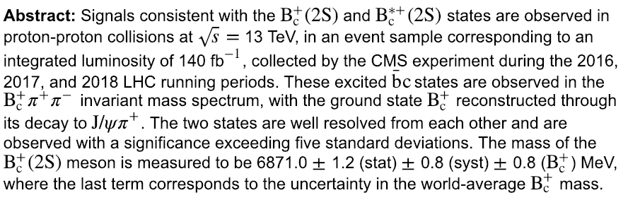
First (in LHC) Run2 paper submitted!
BPH-18-007
https://arxiv.org/abs/1902.00571
submitted to Phys Rev Lett.
Ready with 140 fb⁻¹ after just two months from the end of the run demonstrates that that the detector and computing work flows are performing extremely well!

Slide 21
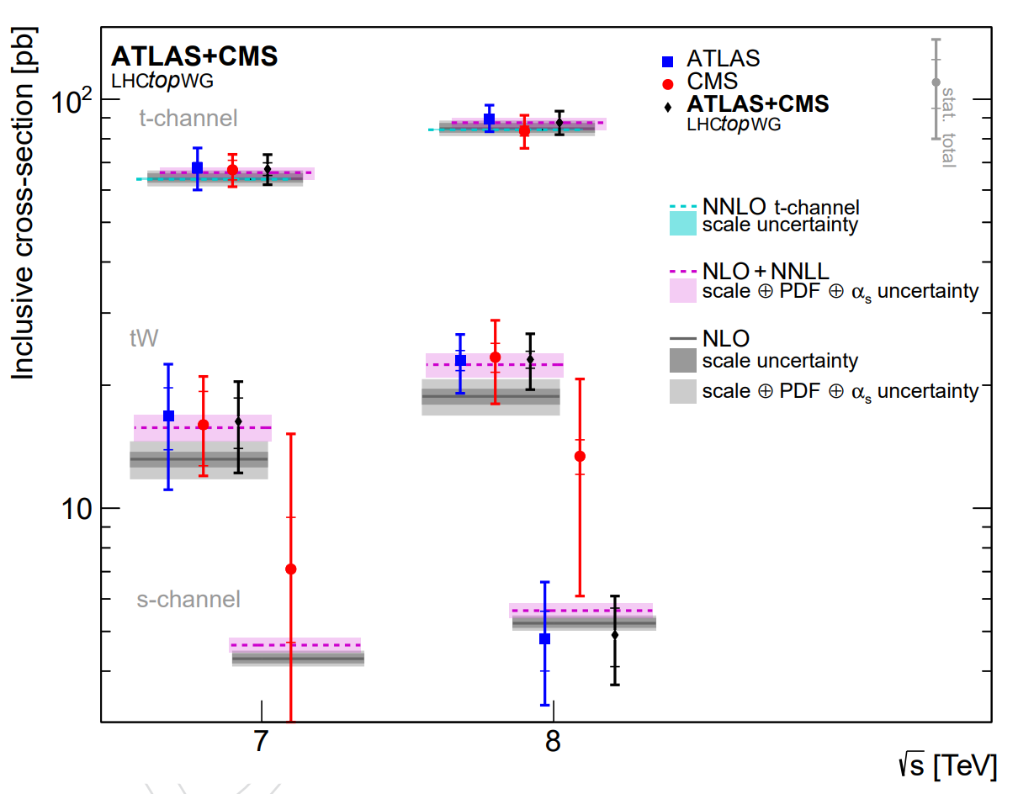
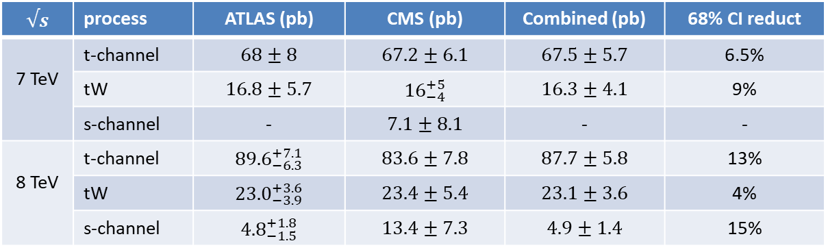
Single Top: ATLAS + CMS Run1 Combination
TOP-17-006
https://arxiv.org/abs/1902.07158
submitted to JHEP
sensitive test of new physics that modify tWb couplings or have new particles/interactions
combine with ATLAS to maximise sensitivity to any SM cross-section deviations
  combination reduces the 68% confidence interval on x-sec by 4 to 15% depending on process
  excellent example of what can be achieved together
  ATLAS will show the extracted V_{tb} results
compatible with SM prediction
$$√s$$ | process | ATLAS (pb) | CMS (pb) | Combined (pb) | 68% CI reduct
7 TeV | t-channel | $$68±8$$ | $$67.2±6.1$$ | $$67.5±5.7$$ | 6.5%
 | tW | $$16.8±5.7$$ | $${16}_{−4}^{+5}$$ | $$16.3±4.1$$ | 9%
 | s-channel | - | $$7.1±8.1$$ | - | -
8 TeV | t-channel | $${89.6}_{−6.3}^{+7.1}$$ | $$83.6±7.8$$ | $$87.7±5.8$$ | 13%
 | tW | $${23.0}_{−3.9}^{+3.6}$$ | $$23.4±5.4$$ | $$23.1±3.6$$ | 4%
 | s-channel | $${4.8}_{−1.5}^{+1.8}$$ | $$13.4±7.3$$ | $$4.9±1.4$$ | 15%

Slide 22
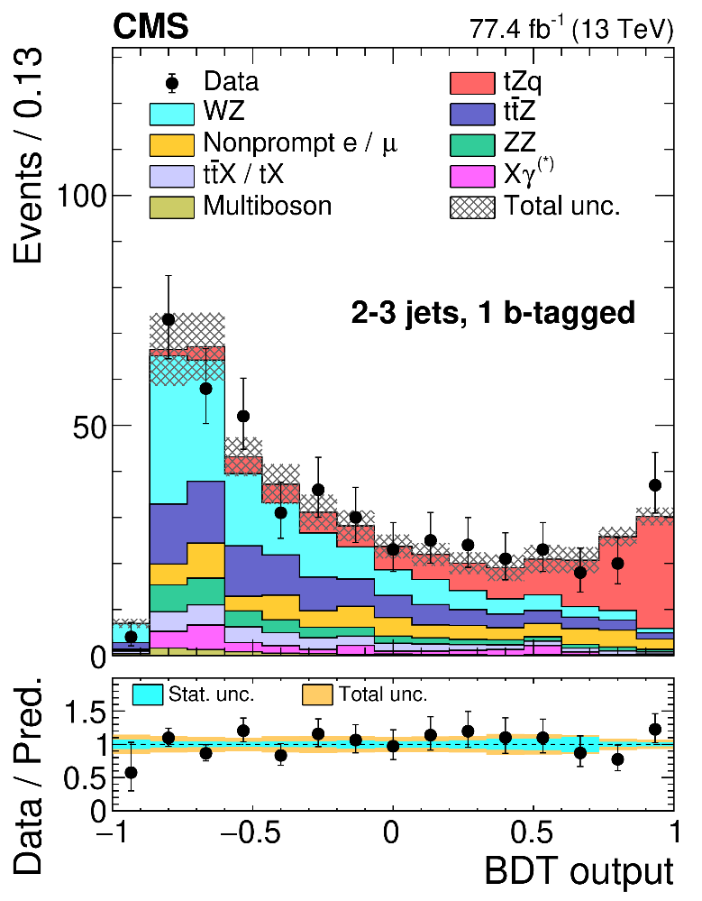
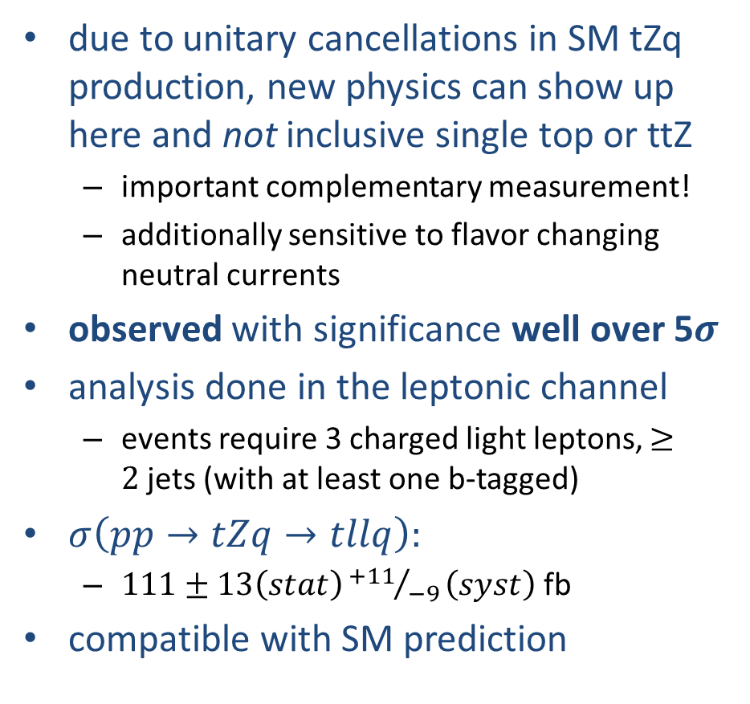
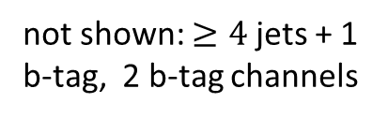
Observation of Single Top with associated Z boson
TOP-18-008
https://arxiv.org/abs/1812.05900
submitted to Phys Rev Lett.
due to unitary cancellations in SM tZq production, new physics can show up here and not inclusive single top or ttZ
  important complementary measurement!
  additionally sensitive to flavor changing neutral currents
observed with significance well over 5$σ$
analysis done in the leptonic channel
  events require 3 charged light leptons, $≥2$jets (with at least one b-tagged)
$σ\left(pp→tZq→tllq\right):$
  $111±13\left(stat\right){+11}/{−9}\left(syst\right)$ fb
compatible with SM prediction
not shown: $≥4$jets + 1 b-tag, 2 b-tag channels

Slide 23
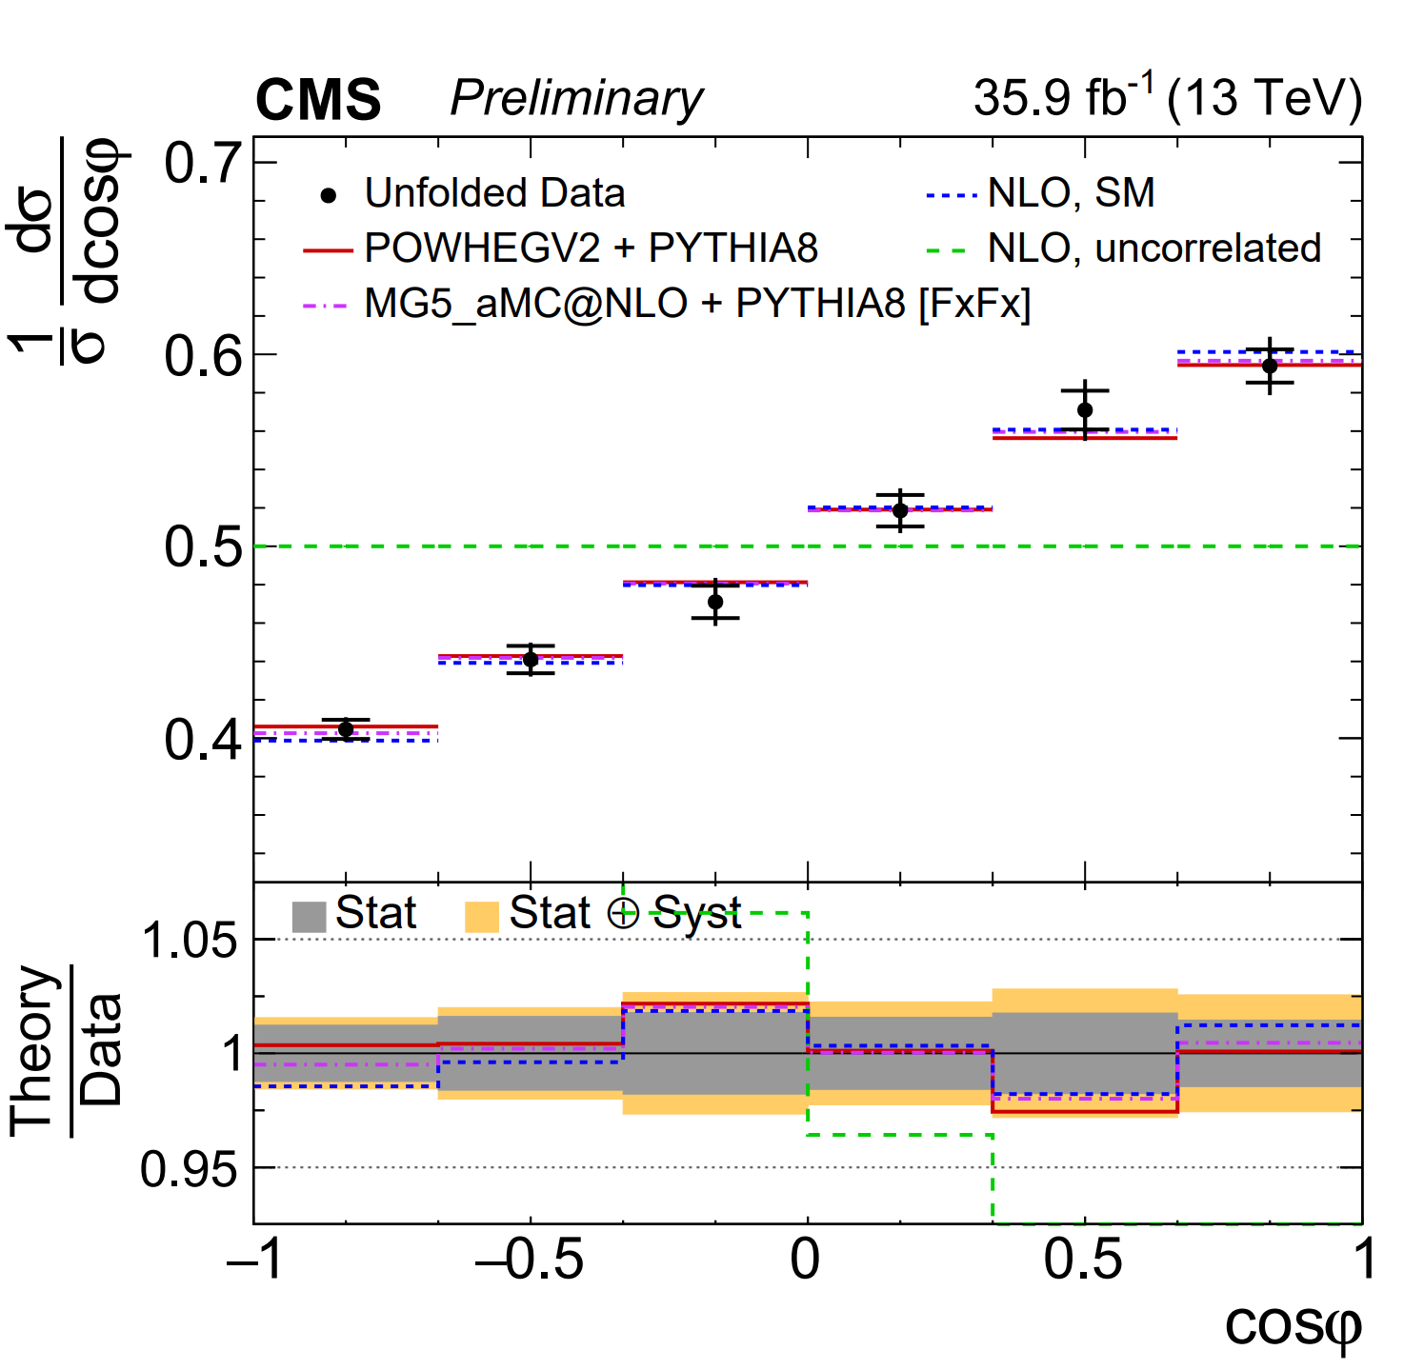
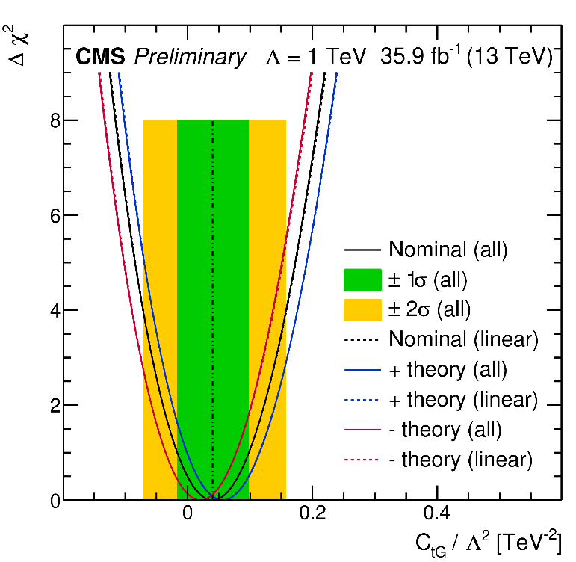
Top spin correlation
TOP-18-006 (PAS)
http://cds.cern.ch/record/2649926/
fast decay of top quark allows unique probing of their spin structure
spin structure sensitive to tt prod processes
  powerful tool to probe new physics not accessible at the LHC
measures all 15 coefficients of the spin density matrix
  first time done at 13 TeV!
  compatible with SM (with latest theory calcs)
constrains anomalous chromomagnetic dipole moment of t quark
strongest direct constraint to date!
  factor 2 improvement w.r.t previous CMS result
  more interpretations and Rivet data on release of the paper

Slide 24
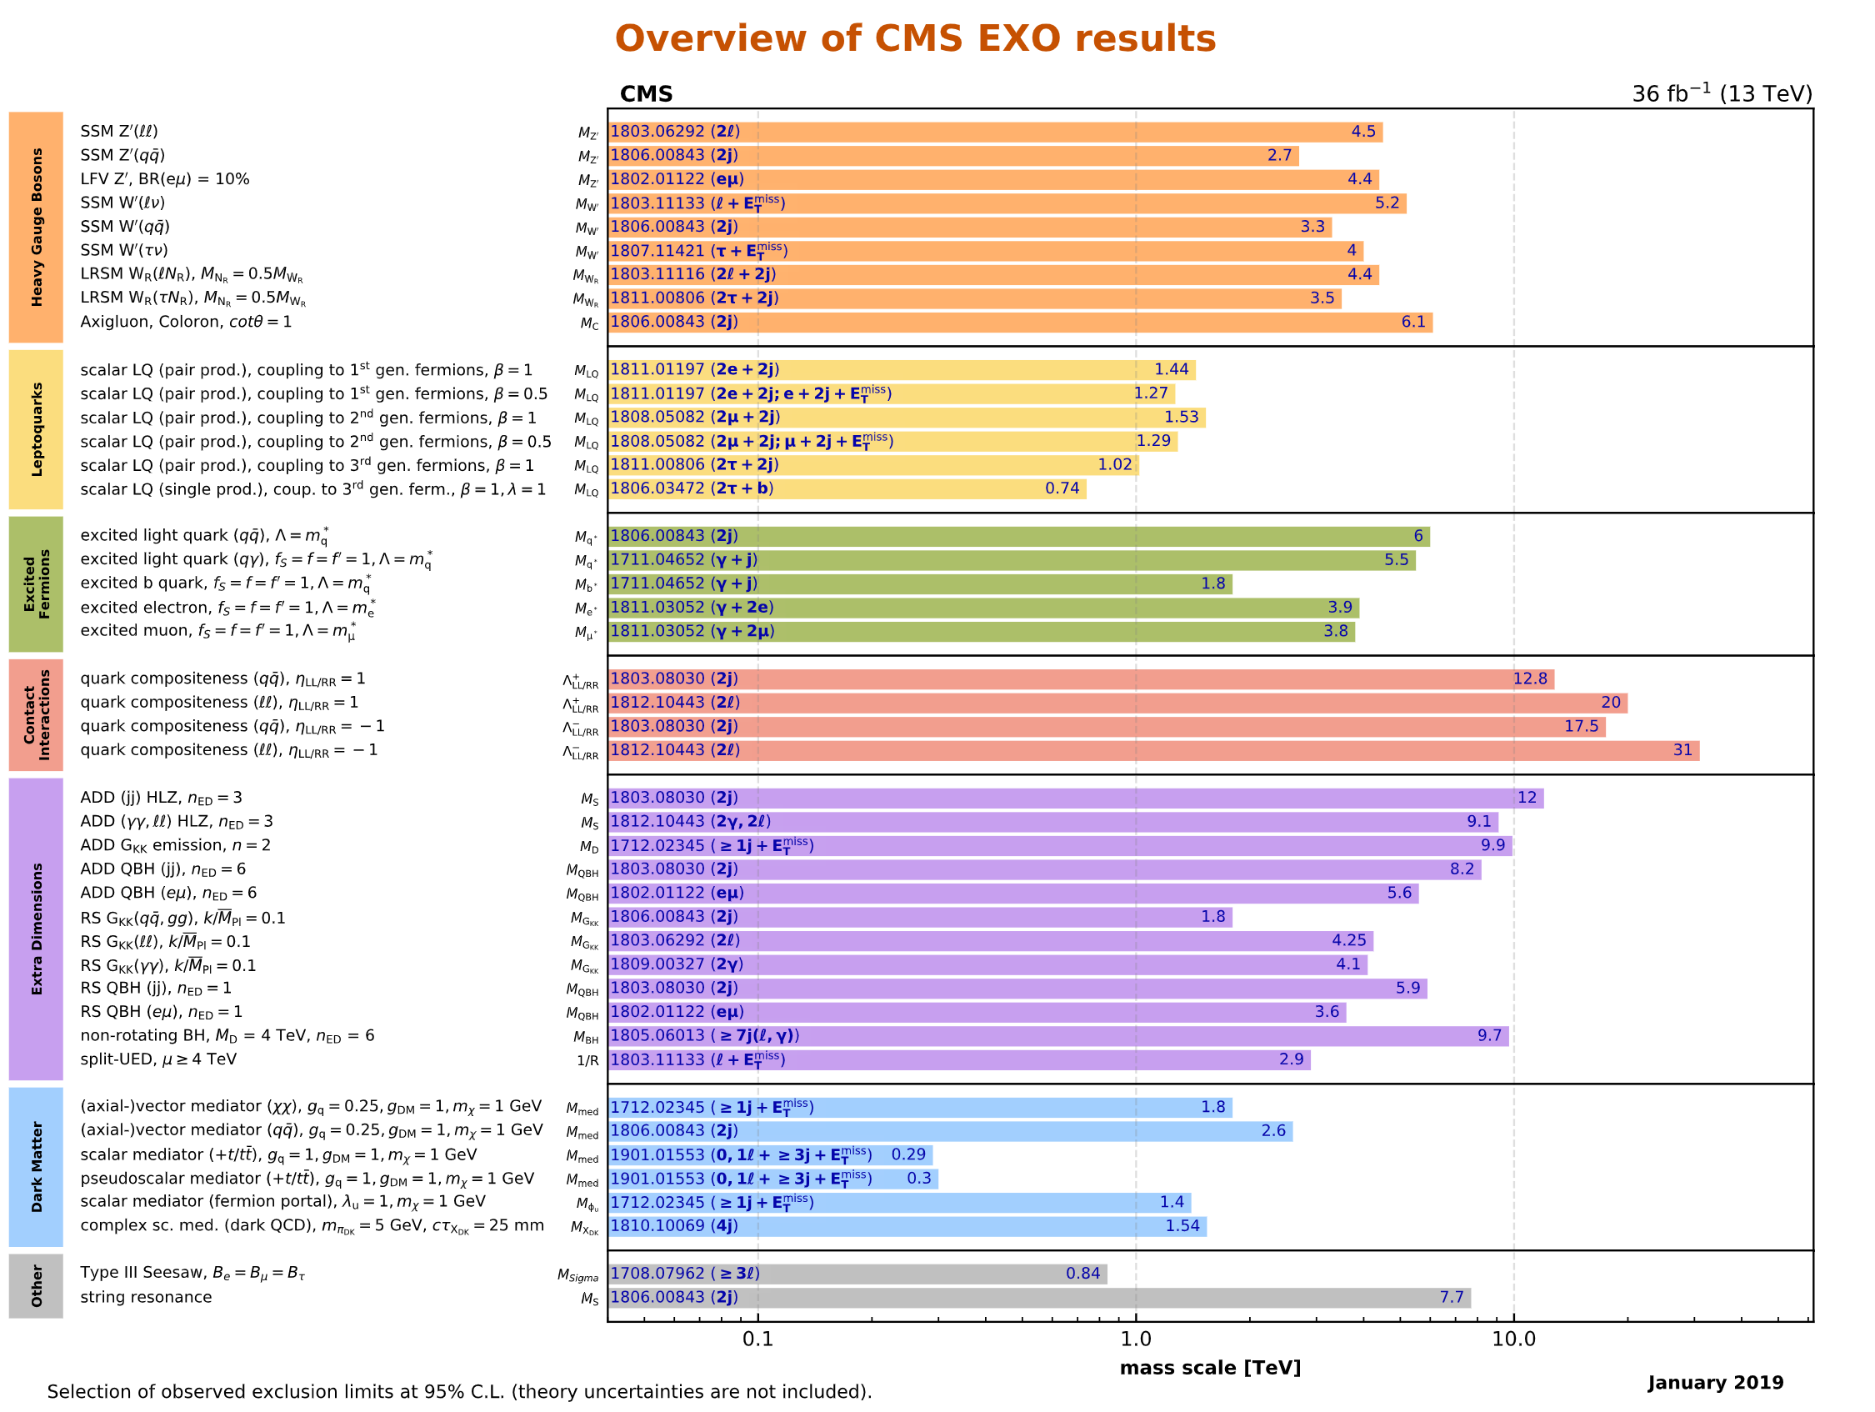
Exotic Searches: Status
significant number of search results using partial Run2 data
currently working on full Run2 dataset updates!

Slide 25
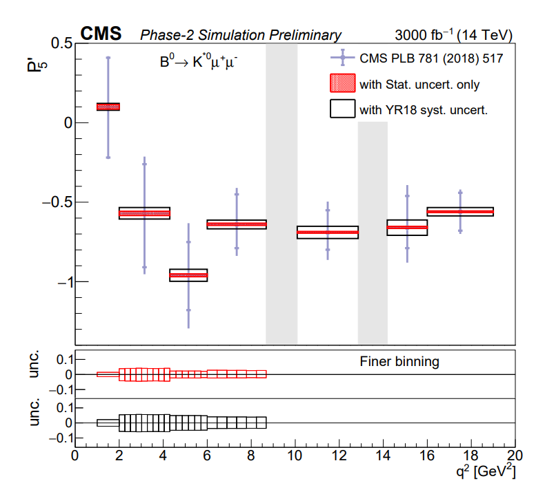
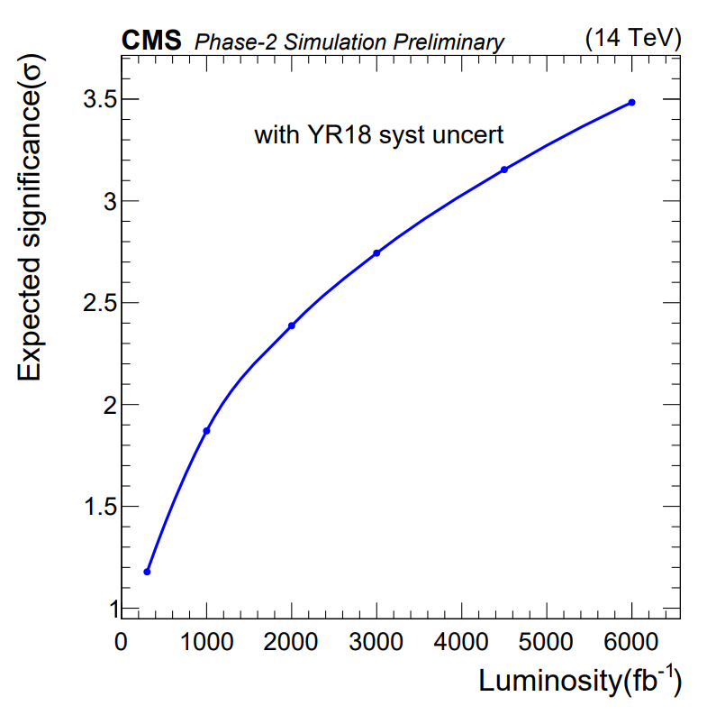
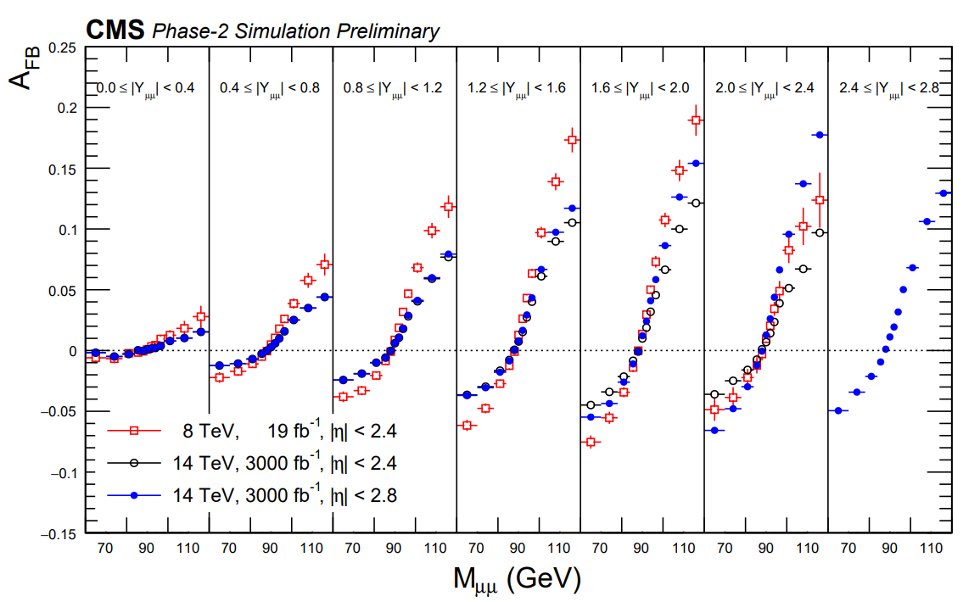
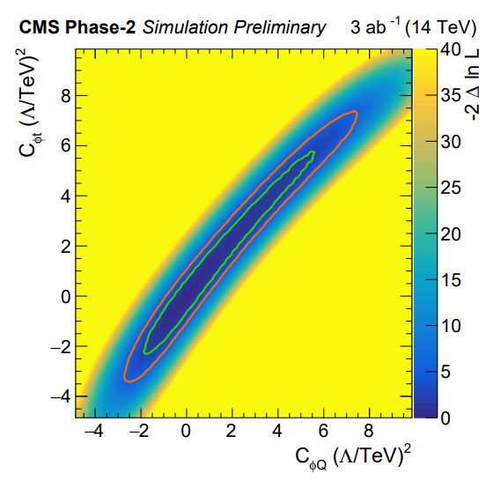
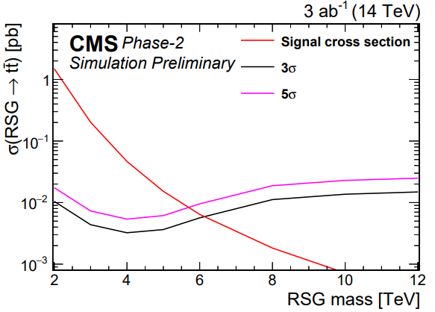
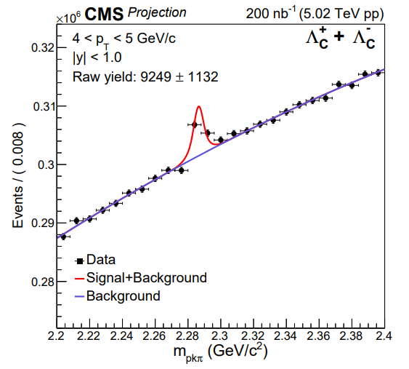
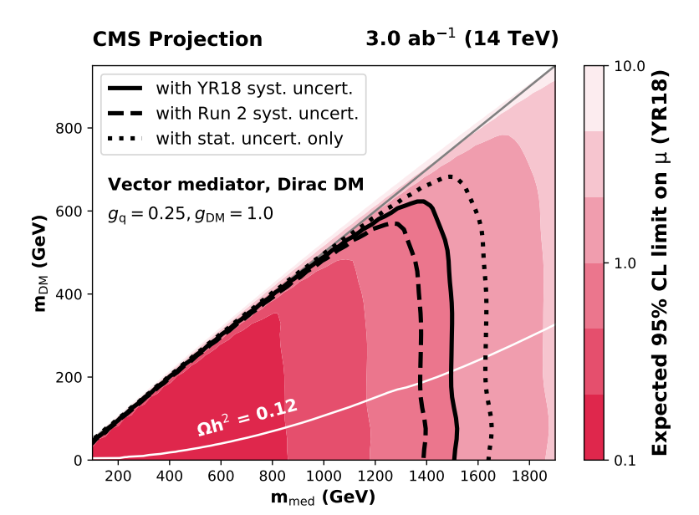
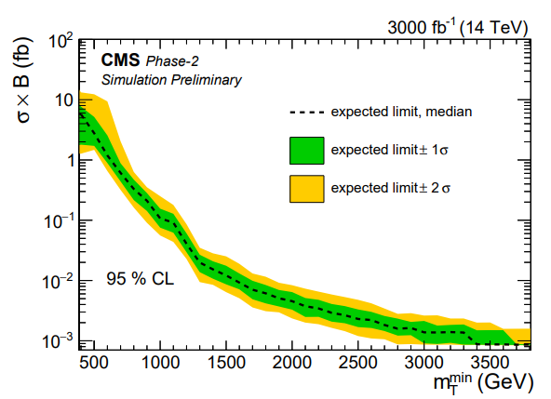
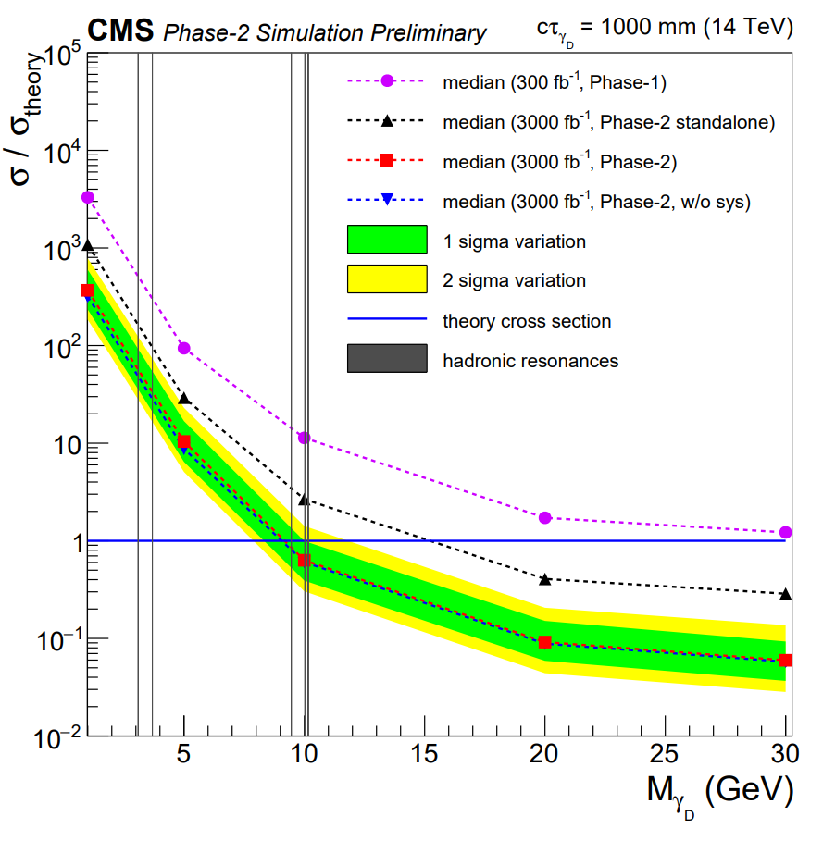
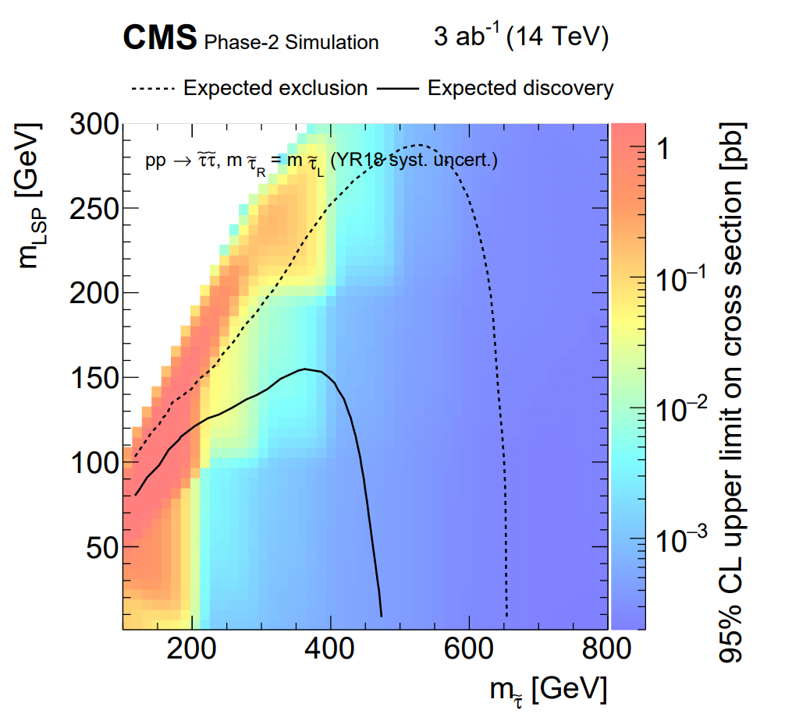
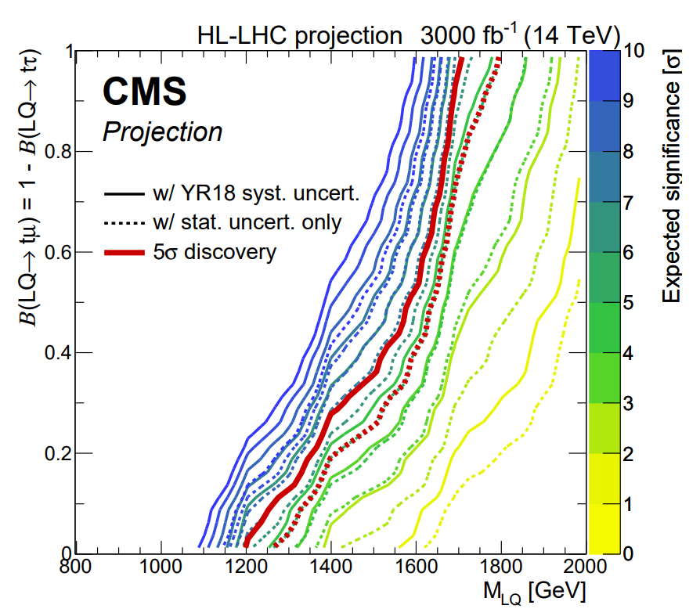

HL-LHC Yellow report
flavour anomalies
HL/HE-LHC workshop now concluded
~40 CMS physics analyses contributed across all topic areas
  precision standard model, Higgs physics, BSM models, flavour physics, heavy ion
  displayed results only a fraction of total
wrap up session on Friday: https://indico.cern.ch/event/783141
long. polarized WW scattering
DY forward backward asymmetry
ttZ anomalous couplings
mono-Z (DM)
X->ttbar
quarkonia in heavy ion
dark photons
W'→$τν$
Leptoquarks
direct stau production

Slide 26
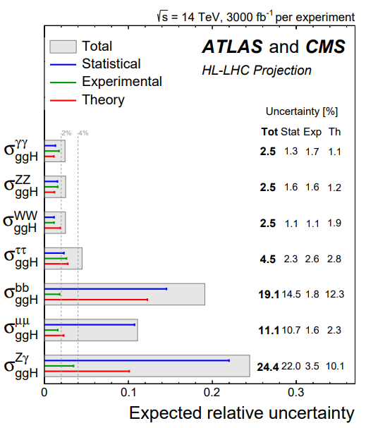
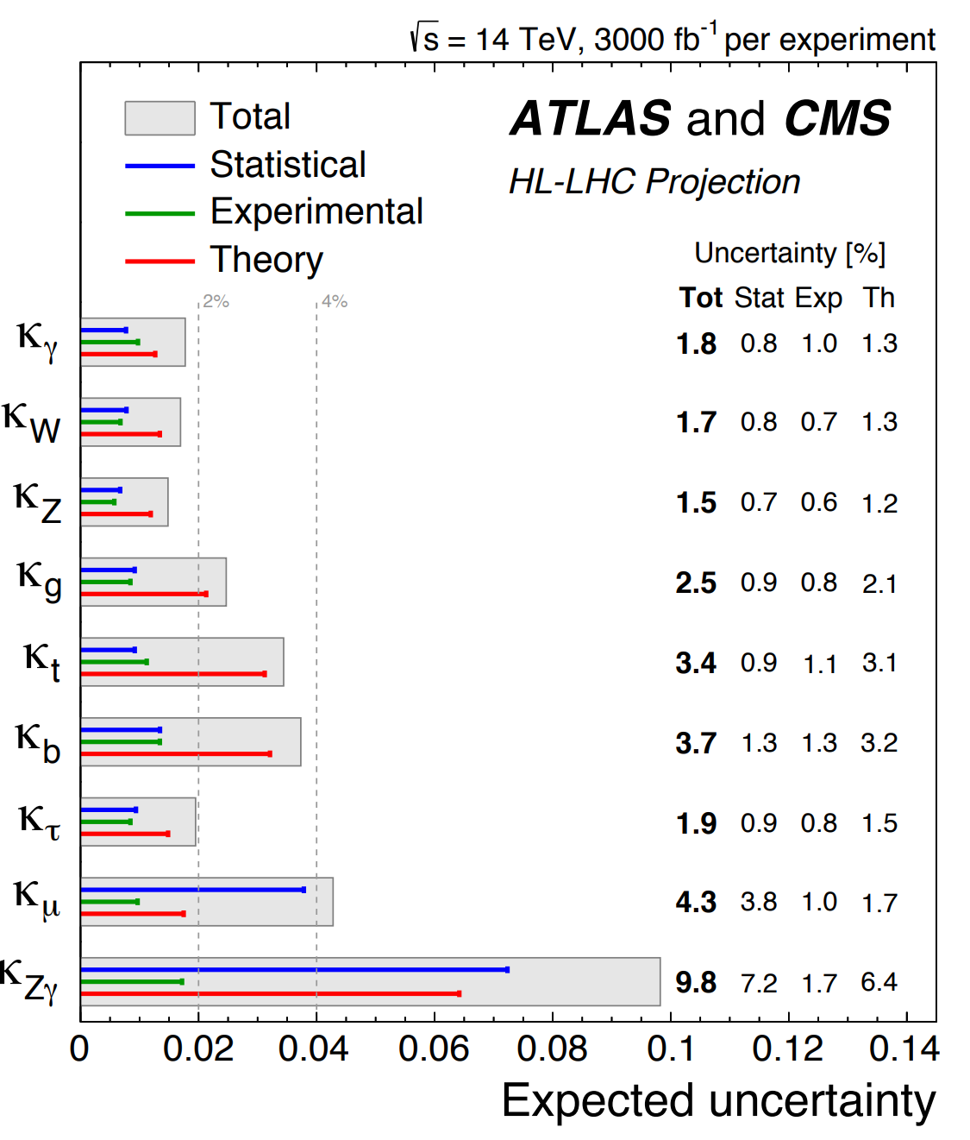
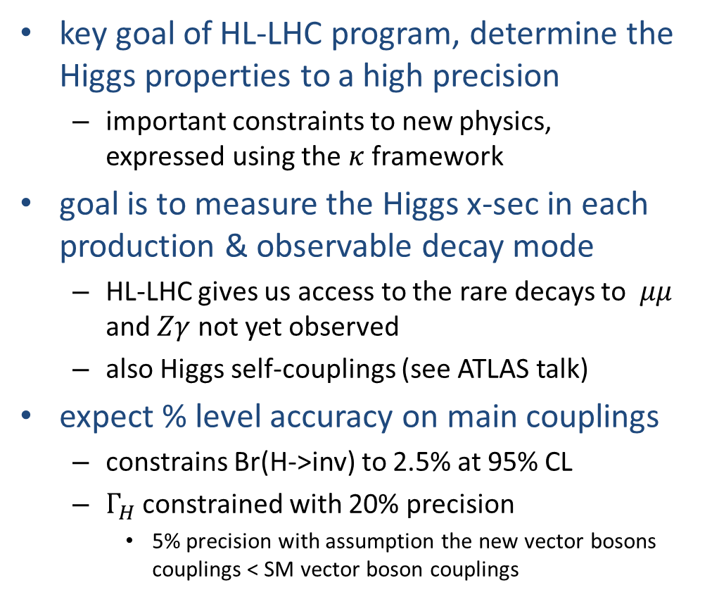
HL-LHC Yellow Report:
Higgs couplings
key goal of HL-LHC program, determine the Higgs properties to a high precision
  important constraints to new physics, expressed using the $κ$ framework
goal is to measure the Higgs x-sec in each production & observable decay mode
  HL-LHC gives us access to the rare decays to $μμ$ and $Zγ$ not yet observed
  also Higgs self-couplings (see ATLAS talk)
expect % level accuracy on main couplings
  constrains Br(H->inv) to 2.5% at 95% CL
  $Γ_{H}$ constrained with 20% precision
    5% precision with assumption the new vector bosons couplings < SM vector boson couplings
https://cds.cern.ch/record/2650162/

Slide 27
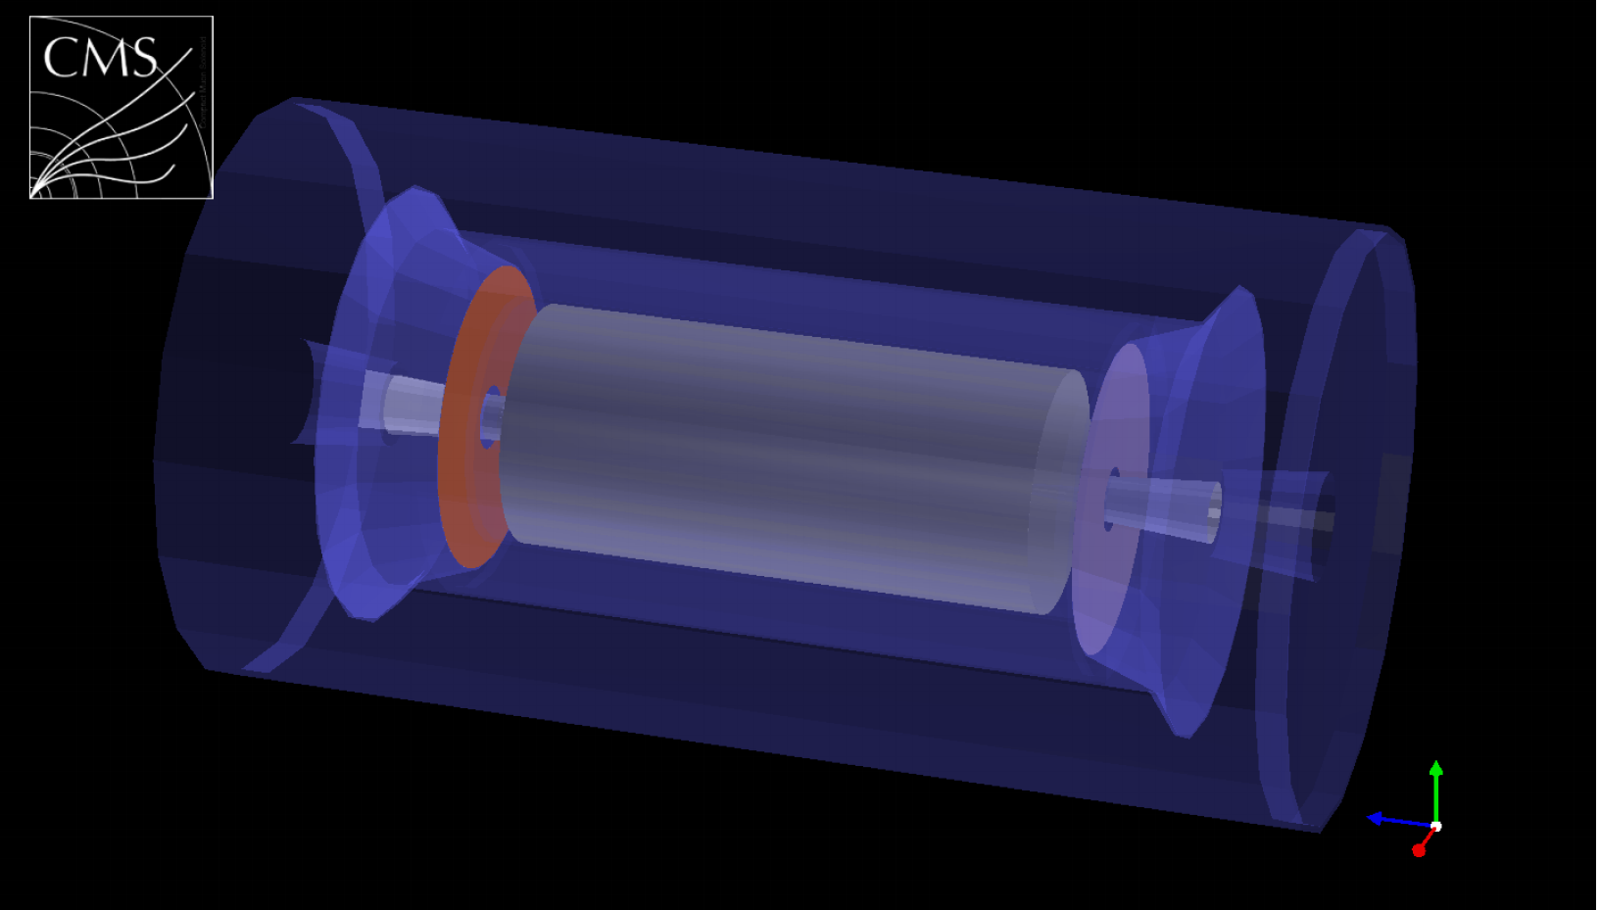
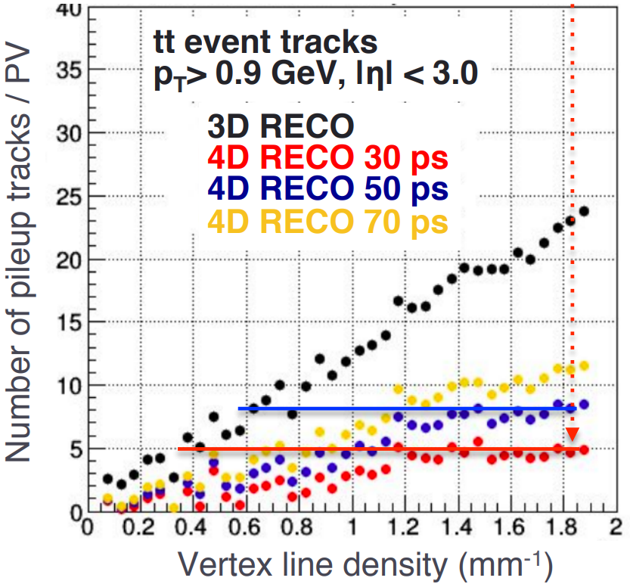
Phase-2 TDRs
remaining Phase-2 TDRs progressing as expected
MTD TDR due end of March
L1 TDR due in Q1 2020
DAQ/ HLT TDR due in Q2 2021
MIP Timing detector + performance

Slide 28
Summary
Run2 is over, highly successful!
  thank you LHC for all the data!
CMS operations were extremely smooth in 2018
  publication quality data & MC available to analysis teams around the winter break
  analysers are eagerly studying the data, expect a significant number of new results for upcoming conferences
LS2 is now fully underway
  proceeding on schedule, upgrades for muons & HCAL, definitive fixes for the CMS pixels

Slide 29
backups

Slide 30
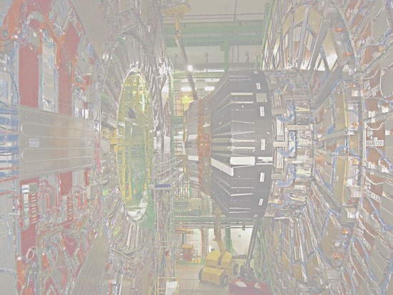
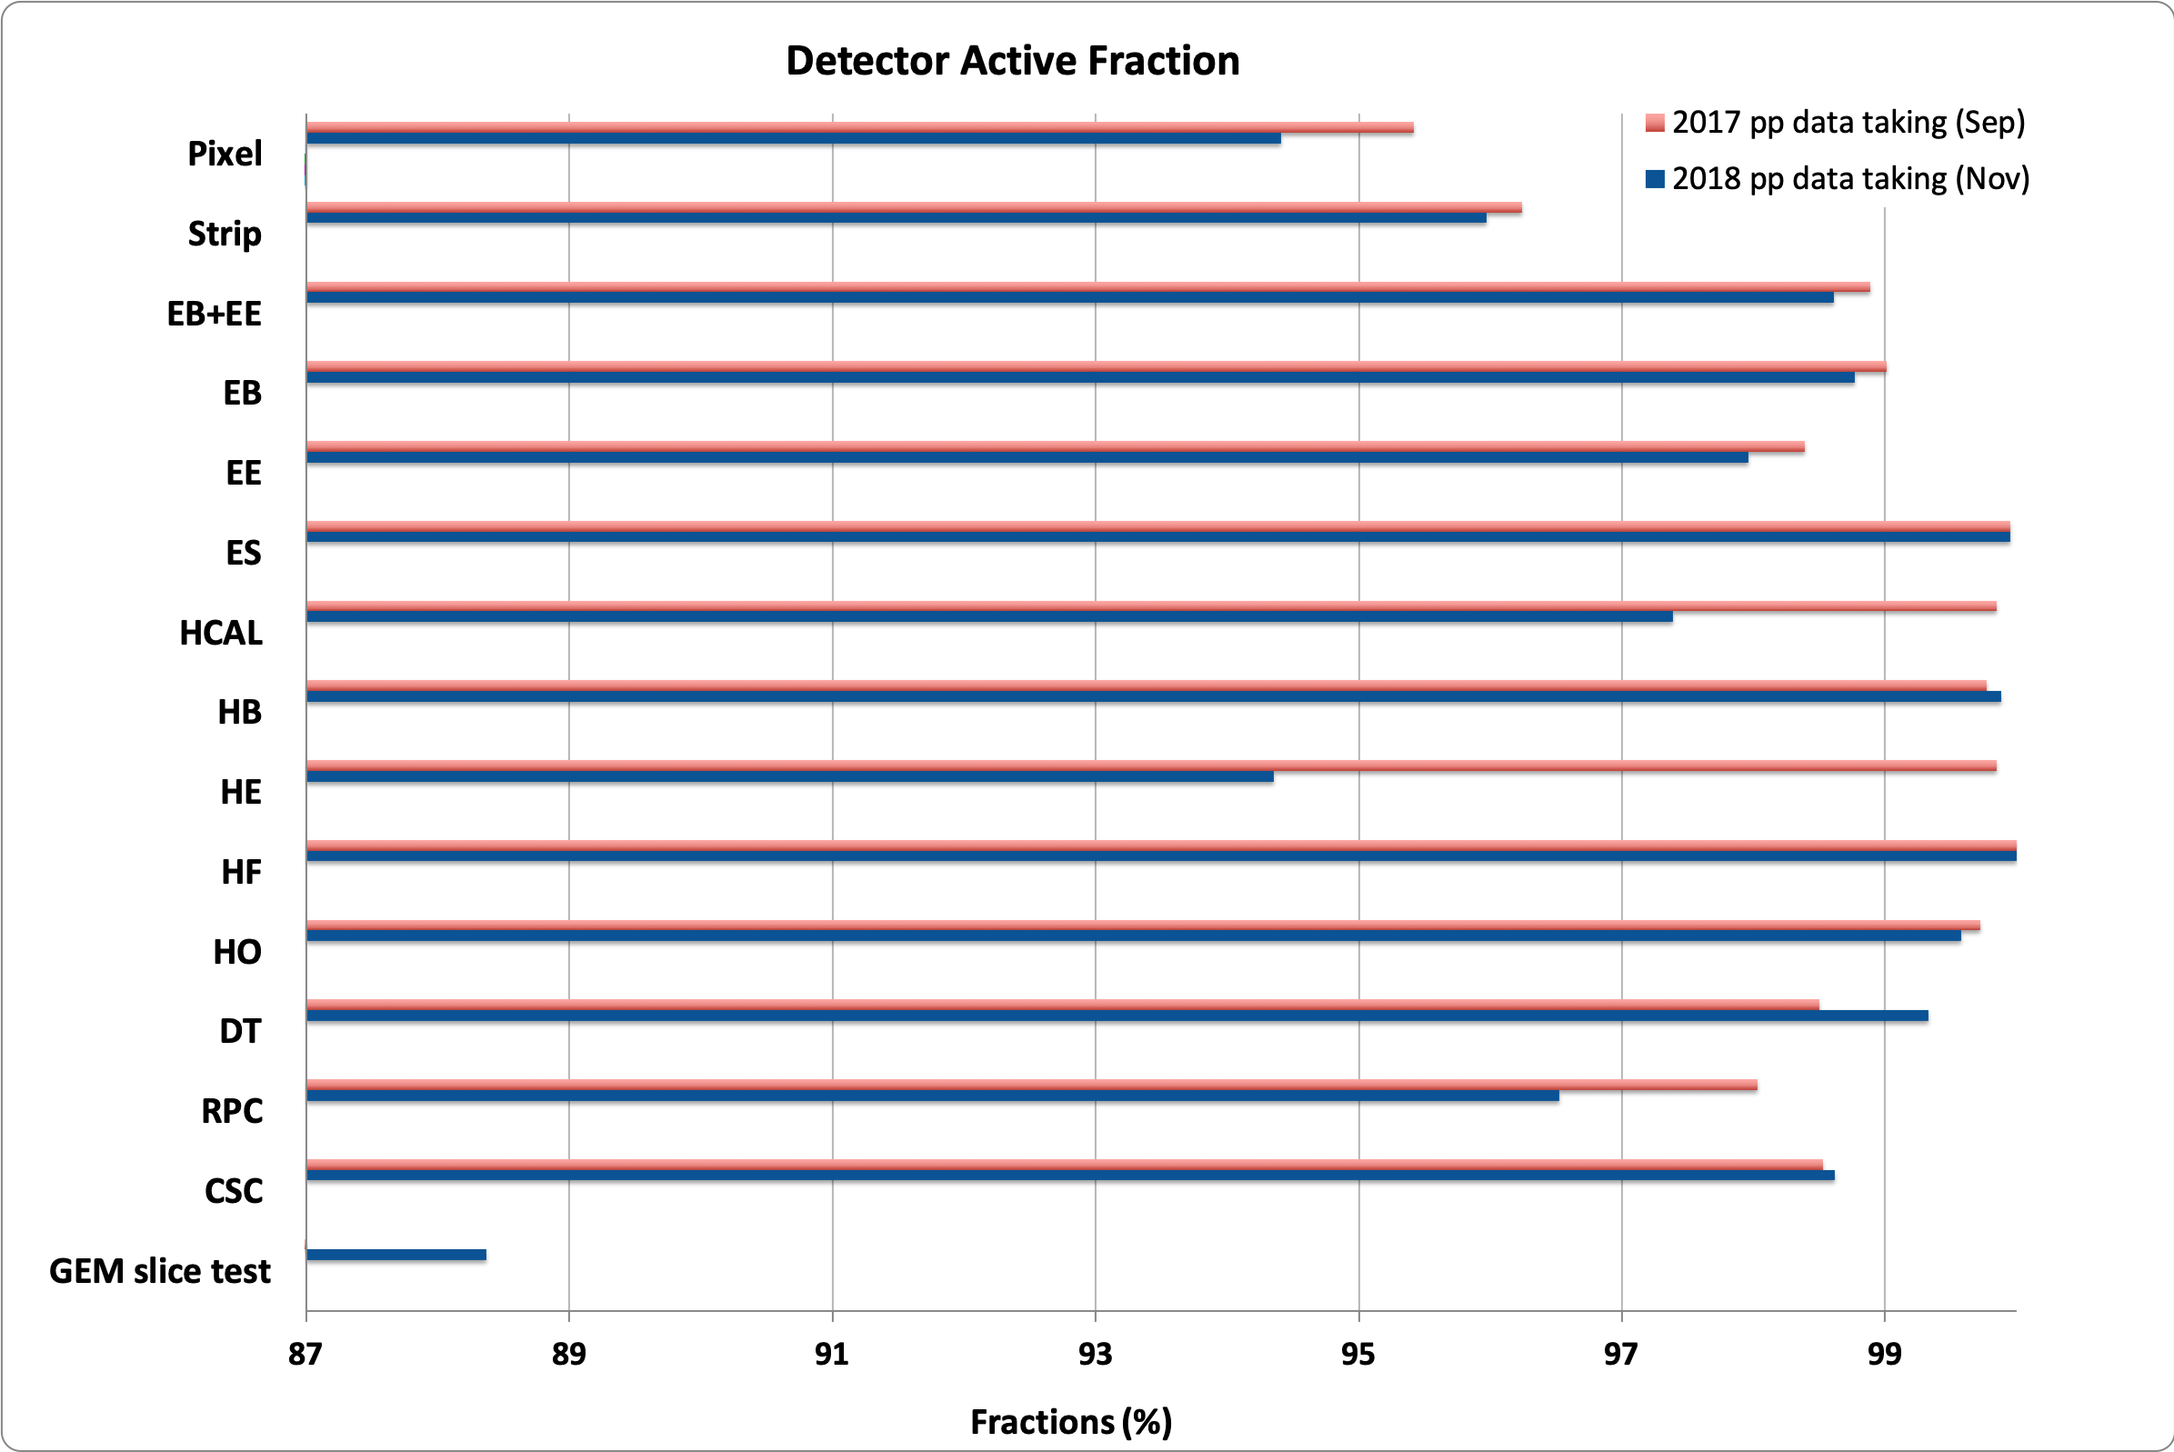



2018 pp Summary: CMS Detector Status
Excellent and stable performance of all sub detectors
a step toward phase-2 !!
Notes:
The decrease of about 1.15 % of the RPC active channel in 2018 with respect of 2017 is mainly due to the intervention done in YETS 17/18. We disconnected 14 gas leaking chambers (even if working fine and all located in station RB3 and RB4) in order to reduce the total leak rate. Plan is to recover them during LS2.

Slide 31



Top Spin: $Δφ_{ll}$
 | Measured | POWHEGV2 | MG5_aMC@NLO | NLO calculation
$$A_{|Δφ_{ll}|}$$ | $$0.103±0.008$$ | $${0.125}_{−0.005}^{+0.004}$$ | $$0.115±0.001$$ | $${0.112}_{−0.012}^{+0.009}$$
result is compatible with ATLAS measurement
  ATLAS-CONF-2018-027, http://cds.cern.ch/record/2628770
  note CMS analysis optimised for coefficient measurements not $A_{|Δφ_{ll}|}$ measurement
since the ATLAS measurement, there have been found to be significant NNLO corrections to $A_{|Δφ_{ll}|}$
  https://arxiv.org/pdf/1901.05407.pdf
at this time we consider the results to be compatible with the SM prediction

Slide 32



HL-LHC & HE-LHC Studies:
Higgs self couplings
key goal of HL program, constrains Higgs potential close to minimum, verification of EWK SB of SM
  $κ_{λ}$ : ratio of observed Higgs self couplings to SM prediction
3ab⁻¹ at 14 TeV, CMS + ATLAS
  observe able at $4σ$
  $κ_{λ}$precision ~ 50%
15ab⁻¹ at 27 TeV, CMS + ATLAS
  $b\overline{b}γγ$, $b\overline{b}ττ$ only
  $κ_{λ}$precision ~ 10-20%
  no sys considered and with caveats that this assumes a given experimental performance with 800-1000 pileup events

