Slide 1
Review of DFH key concepts
DFH-DFM meeting : 13 Feb. 2019
Installation general strategy
Leads layout in DFHx1 & DFHx2
Splices cooling principle

Slide 2
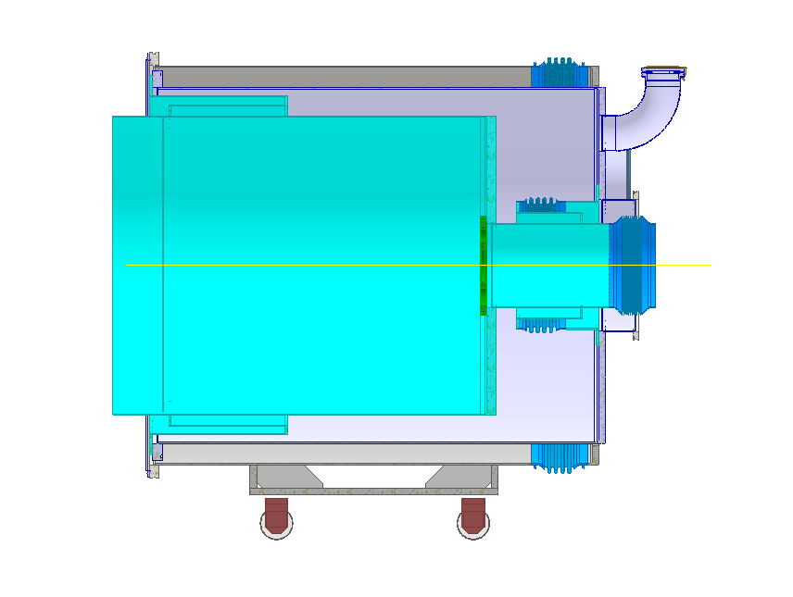
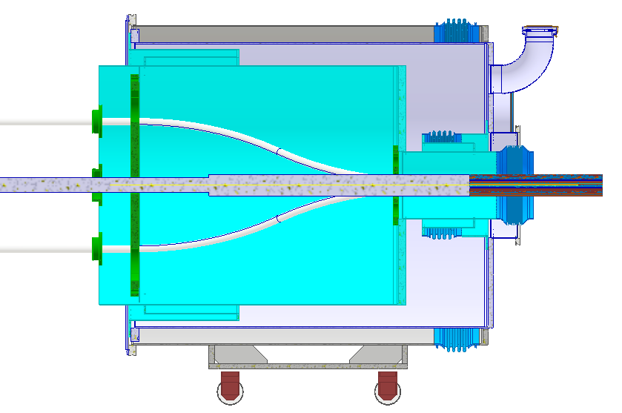
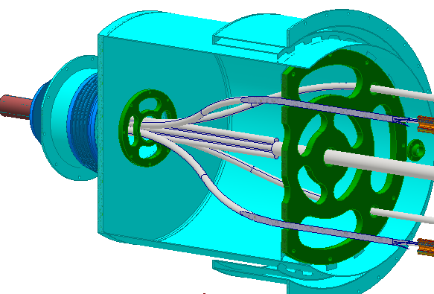
1. Installation general strategy
UR
UL
Interface flange with DFHx1
Option July 18. Shaping MgB2 cables in UR
  Test in SM18 with extra MgB2 length
  Transport & install compact unprepared MgB2 cables
  Shape, cut to length and prepare in UR
➔ handling of MgB2 cables in UR identified as critical
➔ new proposal
MGB2 cable protected
SCLink final cryostat
DFHx2
DFHx1
MgB2 cables with extra length

Slide 3

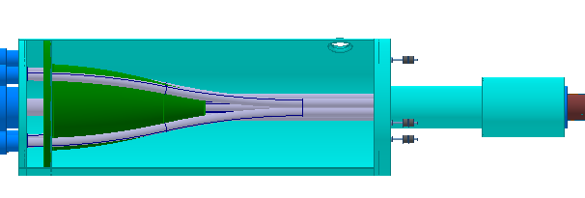

1. Installation general strategy
Indico775038
MgB2 cables in flexibles
Cable opening in rigid structure
Option November 18 :
No direct MgB2 handling
  Insertion of MgB2 cable in SCLink
  Pre-shape MgB2 ends in protective flexibles & reservoirs in laboratory
  Test of SCLink in SM18
  Transport configuration (on reel) with flexibles and reservoirs on
  Deploy in the tunnel (MgB2 cable untouched)
DFHx1
DFHx2

Slide 4
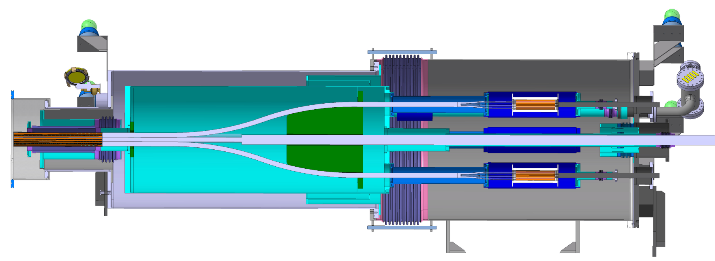
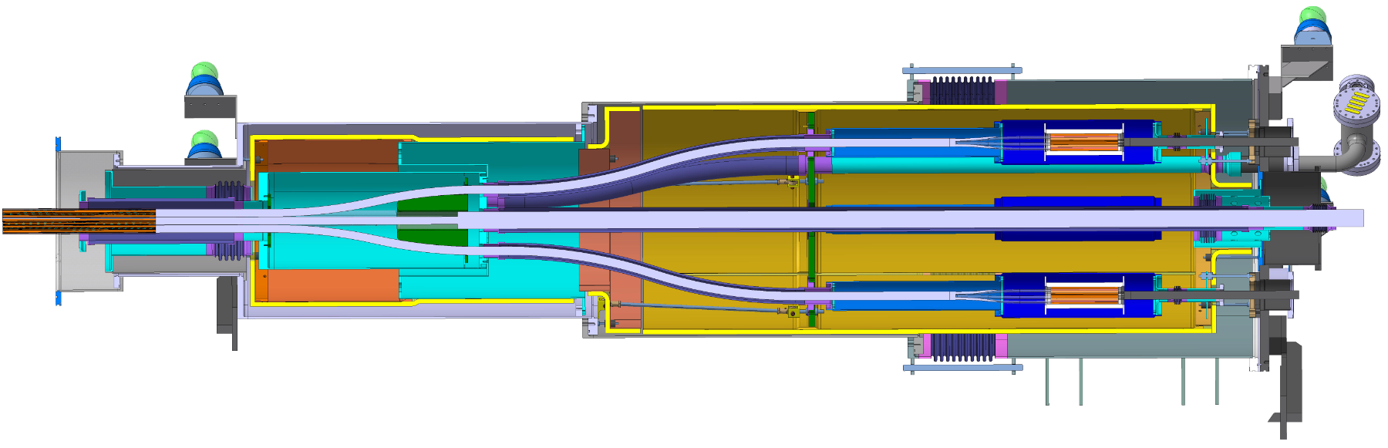
1. Installation general strategy
July Option: Shaping MgB2 cables in UR
Limited handling at a cost of:
  Transport of bigger Reel
  Slightly longer DFH cryostats
  DFH mechanical assembly higher complexity
July option not compatible with MgB2 handling limitations
Our proposal is the November option
3.0m
1.0m
November Option: MgB2 cable untouched
3.5m
1.0m

Slide 5
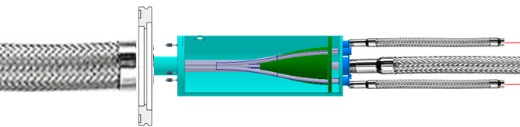

1. Installation general strategy
No direct MgB2 handling in the tunnel has a (useful) cost
Is this approach compatible for the cables?
Do we go ahead with the next steps ?
  Move on with more detailed design work
  Prepare for a conceptual design review in march
  DDR by May (in view of FC in June)
November Option: MgB2 cable untouched
Transport configuration
November Option: MgB2 cable untouched
Nominal configuration
3.5m
1.0m

Slide 6
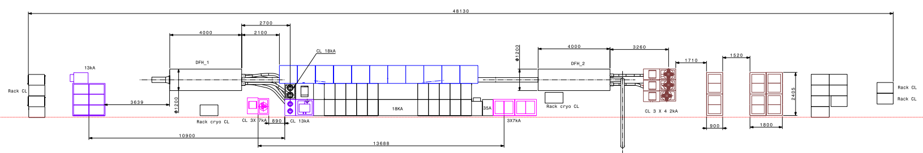
2. Leads distribution
Initial distribution
  DFHx1 : 2 x 18 kA + 2 x 13kA
  DFHx2 : 3 x 7 kA + 12 x 2 kA
➔ EM issues identified
Proposed new layout to be confirmed
  DFHx1 : 2 x 18kA + 2 x 13kA + 3 x 7kA
  DFHx2 : 12 x 2kA
  Do we go ahead with this layout for the DFH design ?

Slide 7






3. Splices forced cooling principle indico786623
2 discussed designs
  Splice in series with associated current lead + parallel bypass for transient and non nominal operation
  Pros:
    Abnormal splices needs << CL mass flow
    Mass flow around splice independent from local pressure drop
    Big bypass for transients and control
  Cons:
    ↗ bypass flow does not increase splice flow (only inlet temperature)
    If splices needs more than CL flow ➔ CL may be overcooled (very high margin though)
  Splices in parallel circuits with same upstream & downstream pressures
  Pros:
    CL flows independent from splices needs
    ↗ Recovery line flow ➔ ↗ T_{inlet} + flow around splices (limited effect though)
  Cons:
    Difficult to ensure equal parallel flows
    Limited margin to increase splice flow
    Small flowing sections around splices may limit transient and abnormal high total flows
P1, T1
$${\dot{m}}_{CLc}$$
P1, T1
P2, T2
$${\dot{m}}_{CLc}$$
Pc, Tc
$${\dot{m}}_{bypass}$$
$${\dot{m}}_{bypass}$$
P2, T2
$${\dot{m}}_{CLa}$$
$${\dot{m}}_{CLa}$$
Pa, Ta
Do we go ahead with this concept ?

Slide 8
Spare slides

Slide 9
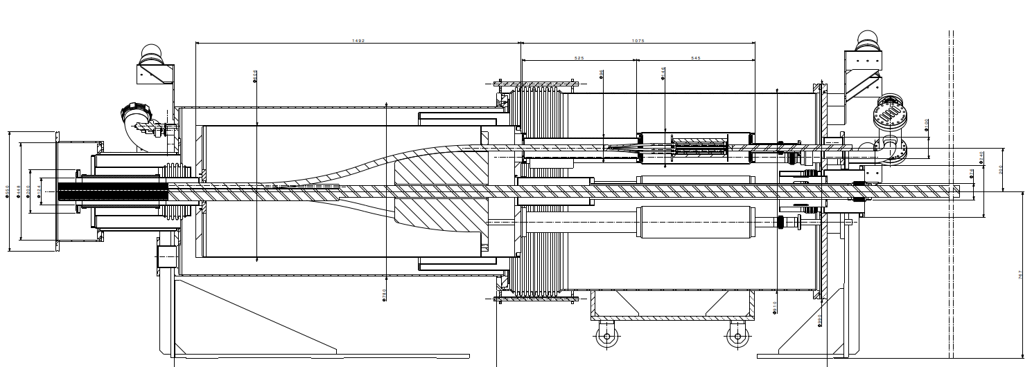
Design MgB2 prepared in UR

Slide 10
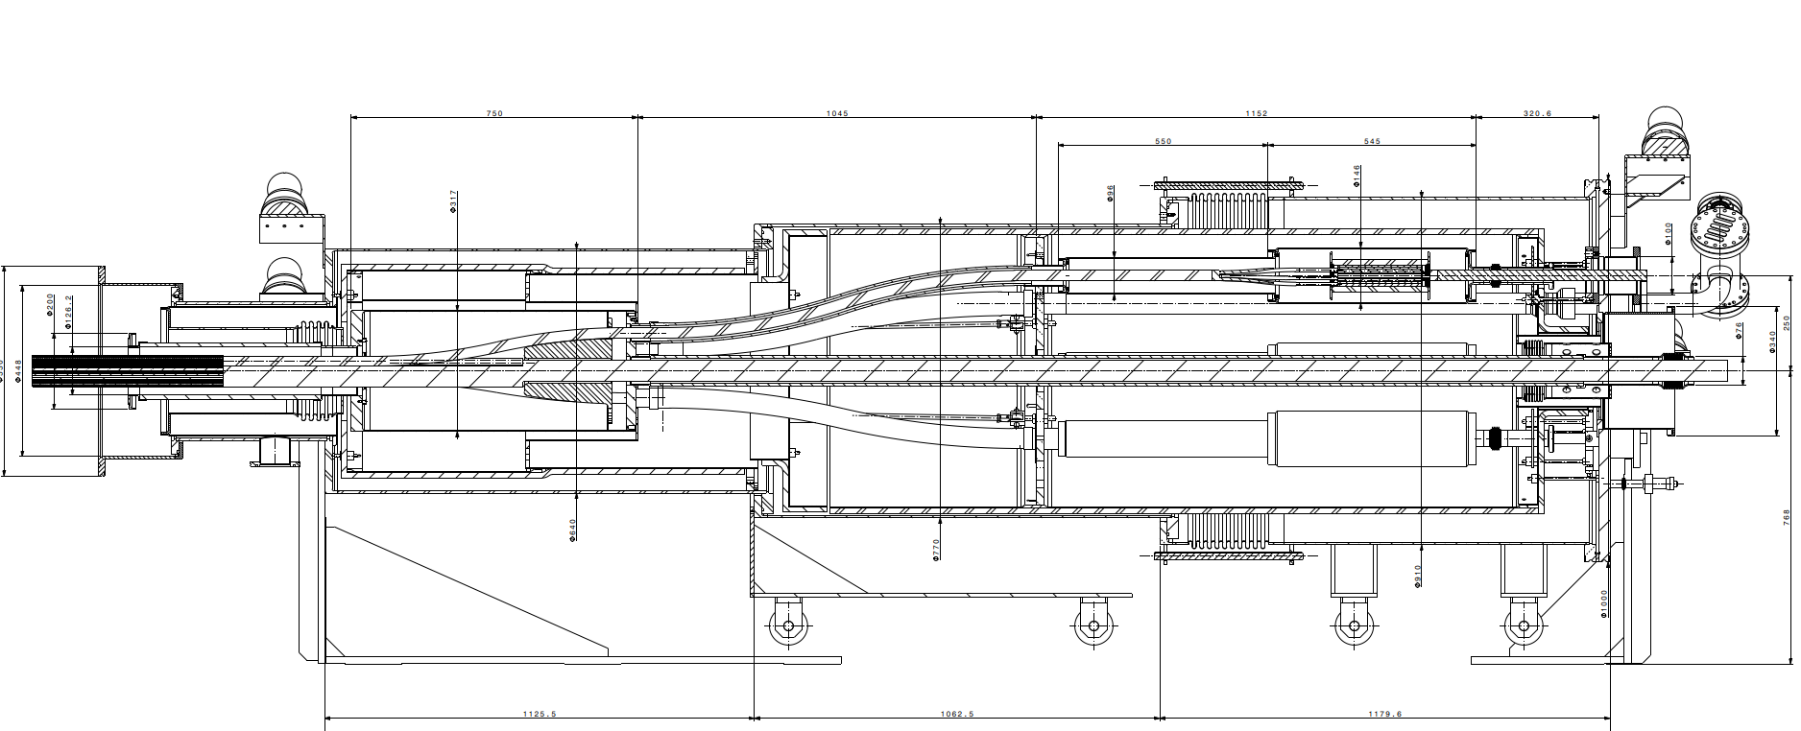
Design MgB2 prepared in SM18

Slide 11
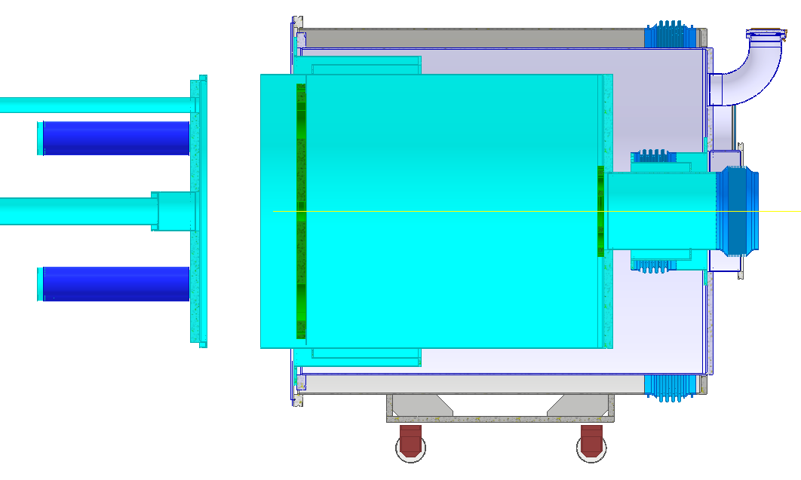
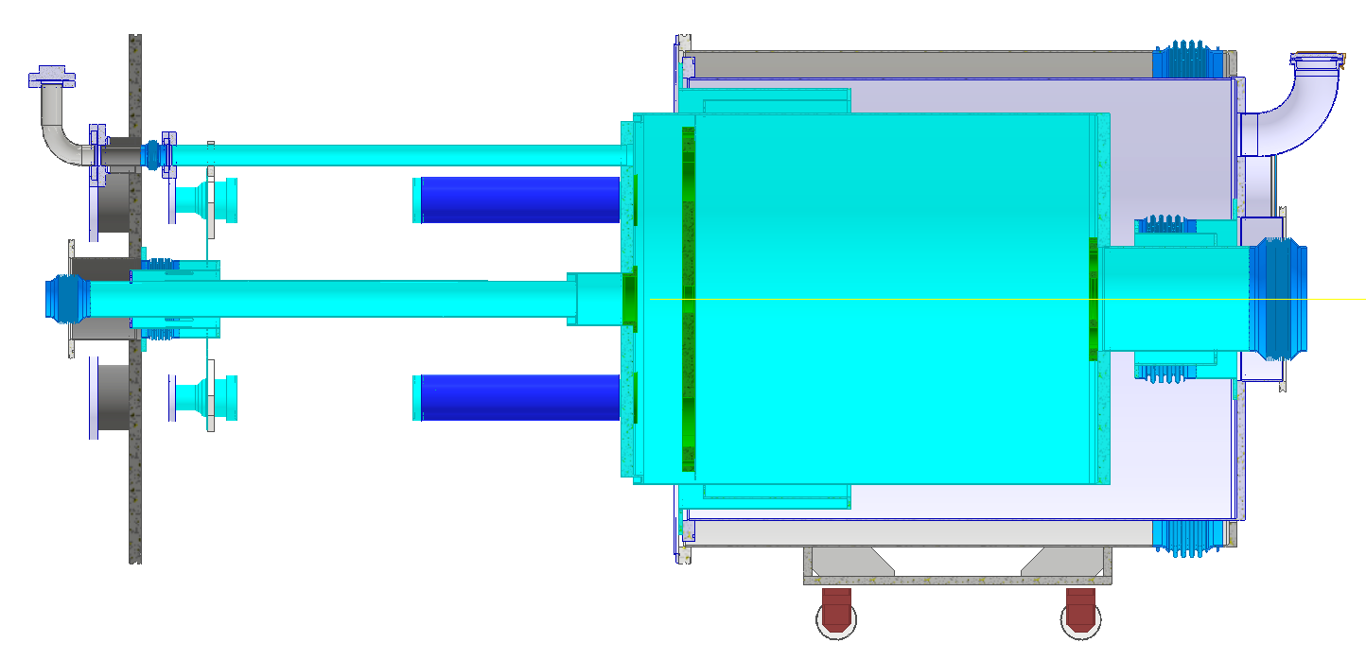
Sequence proposal
Matching lead with Current lead radial positions (opening of cables bundle)
The MgB2 cables are internally routed and fixed in radial position in the DFHx1 to match the current leads interfaces. (+ installation instrumentation)
Insertion module 2 (sleeves opened)
Installation interfaces with current leads
Environment : no racks installed
SCLink cables ends on supports
SCLink is pre-assembled before all other components. Fixed in position on DFX side. Interface with DFHx1 located within cm. The cable bundle is reduced to minimum diameter for transport purposes.
Insertion module 1: VV1+HeV1
The DFHx1 module is “rolled” around the SCLink cable all the way from DFHx2.
UR
UL
Interface flange with DFHx1
MGB2 cable protected
SCLink final cryostat
Once cables are radially positioned, the internal helium vessel is closed with MgB2 extra length going out in individual tubes (to ease access to individual splice, ease welding, perform clean splice, increase & individualise turbulent flow locally at splice level).
DFHx2
DFHx1
MgB2 cables with extra length
Few cm positioning flexibility
Installation of interface with DFHx2 and interface flange with current leads.

Slide 12
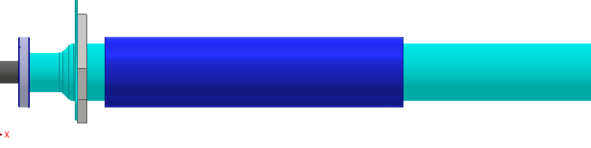
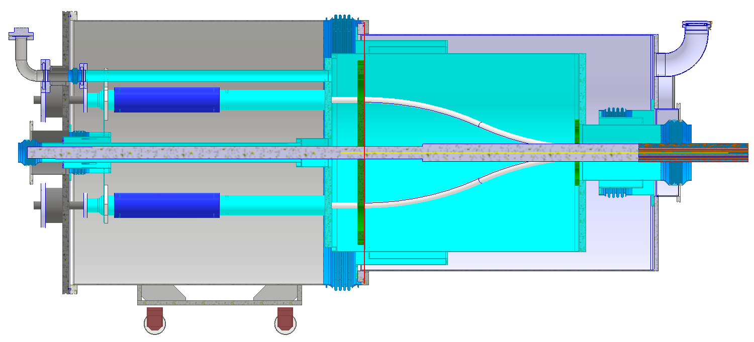
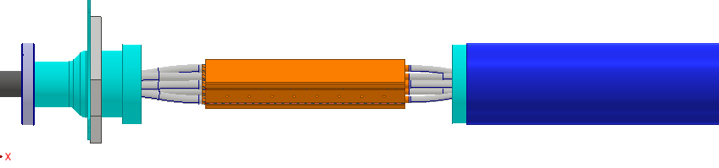
Sequence proposal
Close sleeves
It is suggested to use standard interconnection sleeves with standard tooling for cutting and welding.
Close vacuum vessel
The vacuum vessel is a sleeve itself closed with standard elastomer O-rings (LHC type connection).
Transient phase
The insulation vacuum is common with current leads and SCLink. Pumps and relief plates are assembled on module1.
During cool down, the internal helium vessel is fixed in the middle, splices are longitudinally fixed relatively to the helium vessels.
Thermal contraction of the cable is covered form the entry in the DFHx1. The helium vessels contractions is covered on SCLink side by bellows, on current leads side by current leads internal bellows.
The geometry allow to individually control each mass flow around splices.
Assembly current leads
Racks and current leads are installed around the DFHx1. flexible ends of current leads are connected to DFHx1 interface flange.
Adjust MgB2 leads to length
HTS end lengths of current leads are fixed, in order to face few cm positioning of the SCLink in the tunnel + solder on “fresh unsoldered MgB2 + to optimise the splice performance, it is suggested to cut the extra length of MgB2 at this stage.
Splice
Splices are independent (for DFHx1 18kA and 13 kA leads). Other splices can be independently protected when working around. Installation of V-taps
← to DFHx2

Slide 13
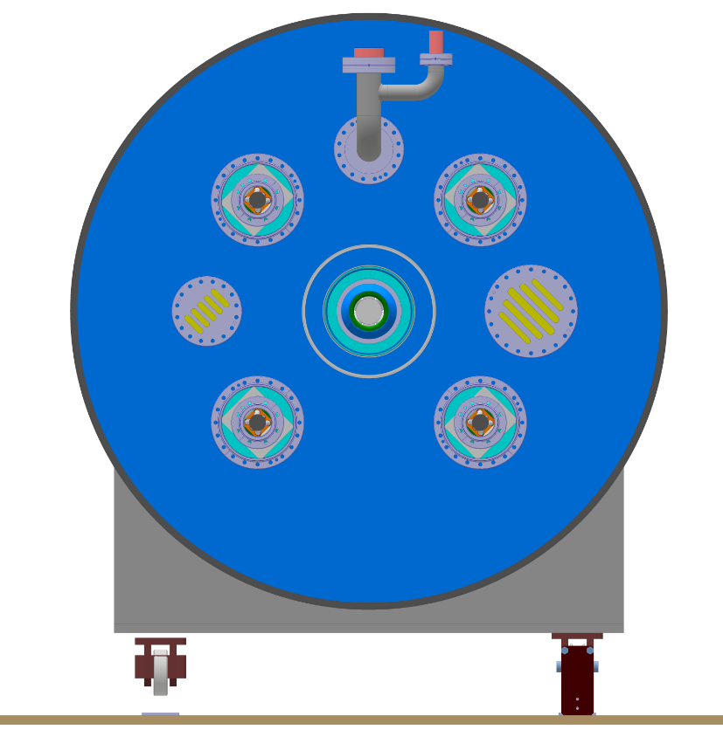
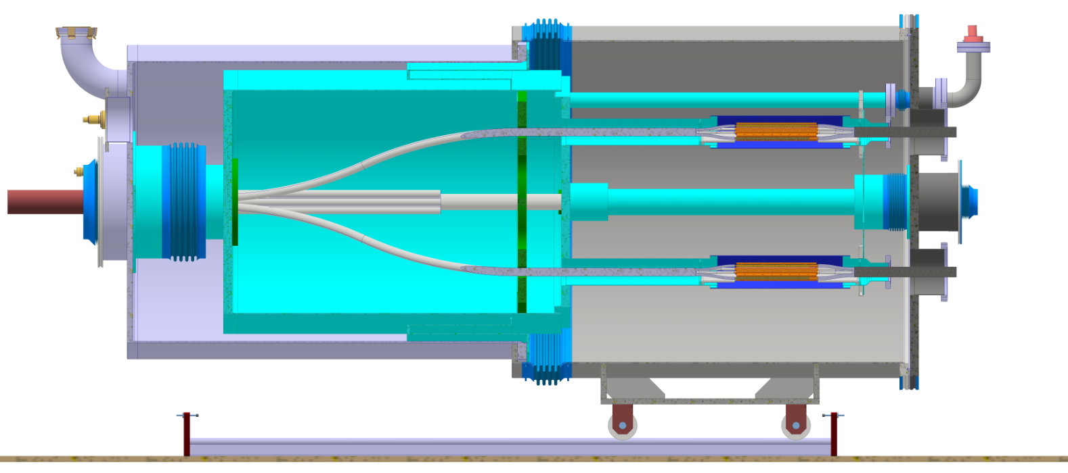
Sequence proposal
Safety relief devices
Operation:
A gaseous helium mass flow up to 10 g.s-1 enters the DFHx. The flow is separated for allowing individual splice, current leads cooling.
Leads are routed and fixed inside the helium vessel and longitudinally fixed at the splice level.
+18 kA
-18 kA
VV instrum.
TS instrum.
He. Vessel instrum.
T-sensors
V-taps
+13 kA
-13 kA
≈ 2.8 m
Helium vessel fixed point
Vacuum bellows rigid fix.
≈Ø 1.5m
DN100 relief plate on vacuum volume
Helium vessel
Vacuum vessel
Splices with Peek bi-lateral fixation to pipe
Port for pumping interfaces
Bellows He-VV vessels
Safety relief device covering DFHx + SCLink helium volumes
PT
Mass flow indiv. controlled
Current leads flexible
To DFHx2 ➔
Current leads flexible
Bellows VV vessels
DFHx1-SCLink
Bellows He vessels
DFHx1-SCLink
Connection to ground to design
G10 guiding supports
Connection to ground to design
Note: thermal shield not shown

Slide 14
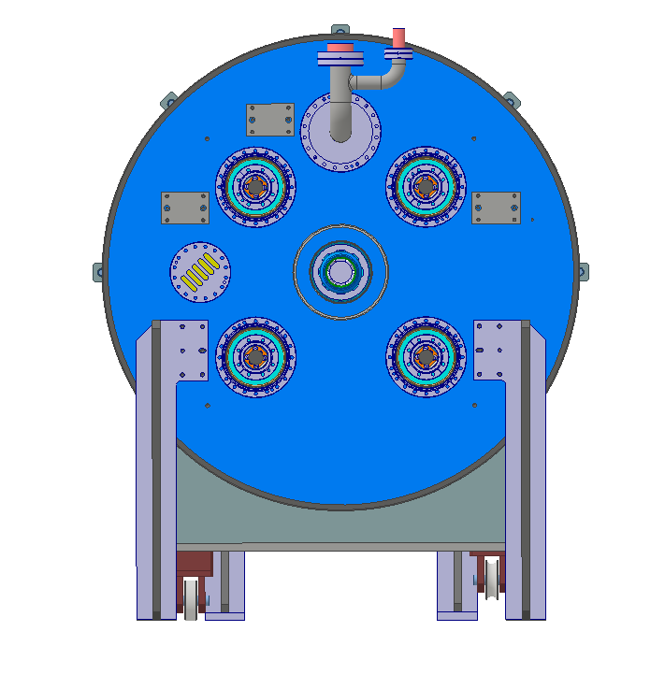
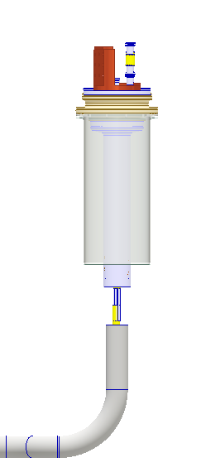
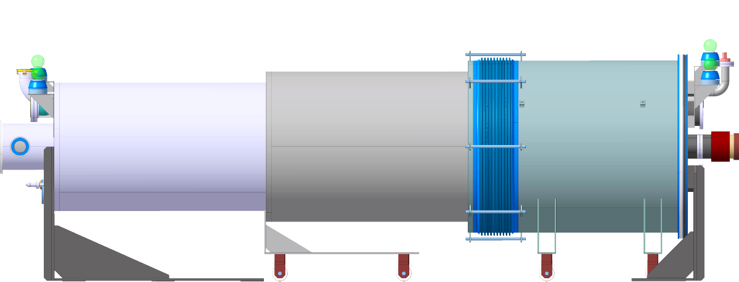
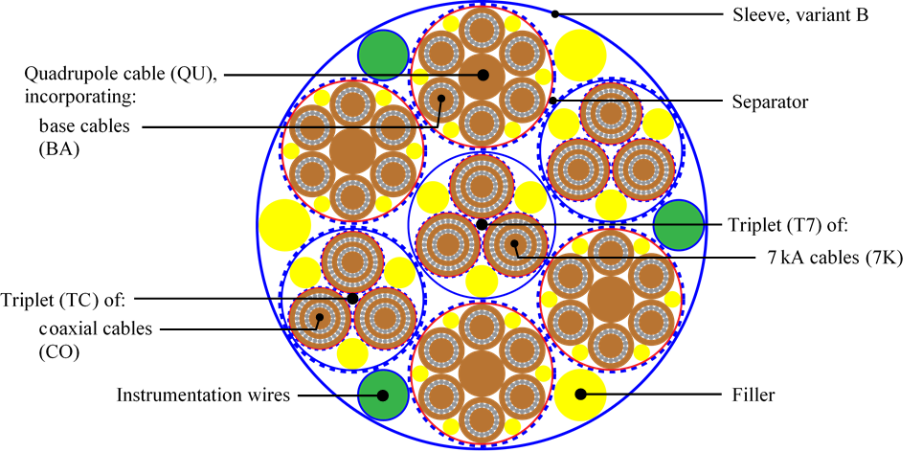
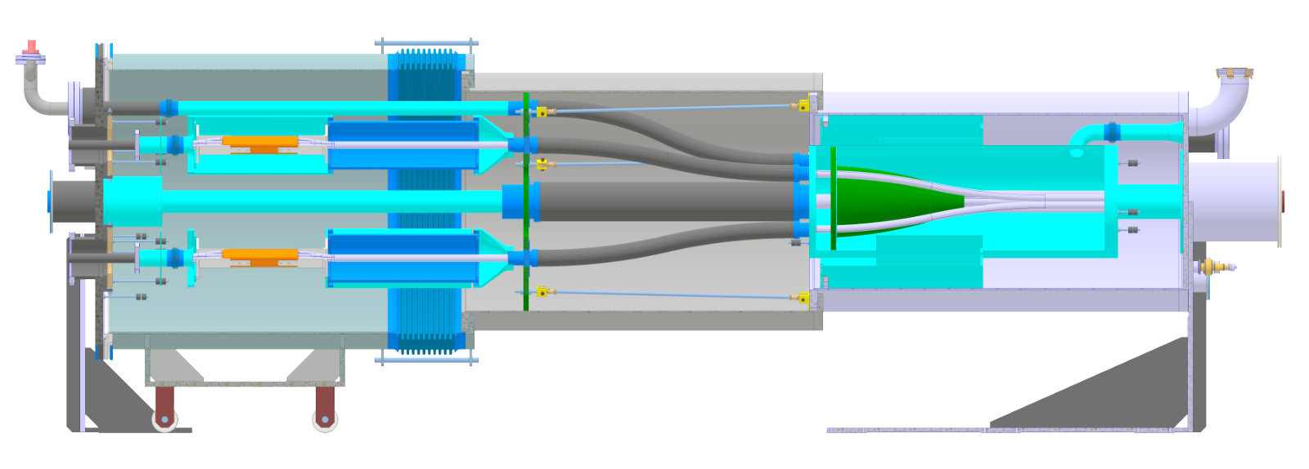

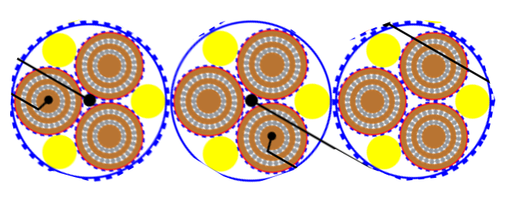
DFHx design proposal
Safety relief devices
Leads interface
Integration & interfaces layout
DFH in series between SCLink and current leads
Envelope: ≈Ø1.5m x 4m on rails
Electrical layout
MgB2 – HTS – Current leads
Cryogenic layout
1 common helium volume
Heat extracted through convective heat transfer
Insulation Vacuum layout
Vacuum barrier at SCLink-DFHx interface
Mechanical layout
Splices fixed to helium vessel
Flexible structures for thermal contractions and installation
Instrumentation
Interface
Current
leads
DFHx1
SCLink
PT
Ω
Interlink ➔ to DFHx2
Ω
PT
PT
Safety relief device
Gaseous He
Insulation vacuum
Fixed point
Flex. Point
Passive TS
HTS
MgB2
NbTi
Warm cable
Splice

Slide 15
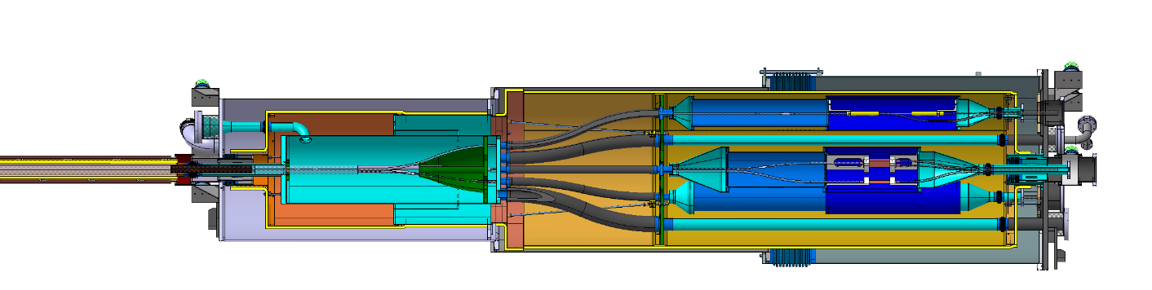
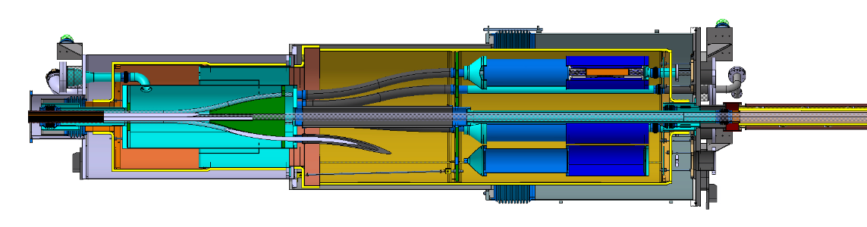


Proposed conceptual installed configuration
Guidelines for the assembly:
  MgB2 cable protected at all times
  MgB2-HTS splices fixed to He vessel
  Orientate angularly the MgB2 leads to the corresponding HTS leads
DFHx layout for analysis
2 x 18 kA
2 x 13 kA
3 x 7 kA
12 x 2 kA
Superfluid @ 1.9K
Liquid He @ 4.5 K
Gaseous He
Heater
Vacuum barrier
HTS
MgB2
NbTi
Warm cable
Splice
$$T_{CL}$$
$$T_{CL}$$
DFHx1
DFHx2
DFHx 3D pre-design for illustration
DSHx

Slide 16
Proposal installation sequence
DFHx1
Protected MgB2 ends
DFHx2
SCLink end preparation for SM18 test
  He vessels pre-mounted once for all before SM18 test
  Only MGB2 ends (temporary protected are visible)
  Only final welds around splices will be further performed
SM18 test installation (DFH proto)
  90% of He vessels are done
  Insertion DFHx1 VV
  Insertion of Interlink
  Insertion of DFHx2
  Opening of flexibles + angular orientation
  Splicing + Current leads
Transport configuration
  Procedure backward
  2 x 1m rigid section
SCLink installation (same as SM18)
MgB2 cables in flexibles
Cable opening in rigid structure
DFHx1
DFHx2

Slide 17
Key influencing parameters
10 m
The pre-opening of the MgB2 cables directly influences:
  The rigid boxes 10m distant to be installed in the turret for transport
  The SCLink vacuum jacket interface flange diameter
  The openings in the vacuum vessels
    ➔ increase radial distance to splices ➔ length of DFH due to bending radius of MgB2
  The interlink vacuum jacket ID (could use it for waving only inner pipe)
Today orders of magnitudes:
  DFHx length ≈ 4m (bending radius 1.5m)
  DFHx Vacuum vessels OD ≈ up to 1.5m
  Interlink OD ≈ 400mm
Ø
Ø
DFHx layout for analysis
2 x 18 kA
2 x 13 kA
3 x 7 kA
12 x 2 kA
Superfluid @ 1.9K
Liquid He @ 4.5 K
Gaseous He
Heater
Vacuum barrier
HTS
MgB2
NbTi
Warm cable
Splice
$$T_{CL}$$
$$T_{CL}$$
Ø
DFHx1
Ø
DFHx2
DFHx 3D pre-design for illustration
DSHx

Slide 18
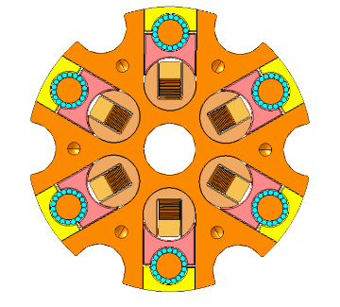


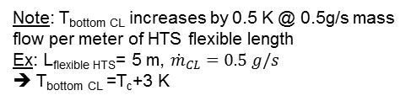



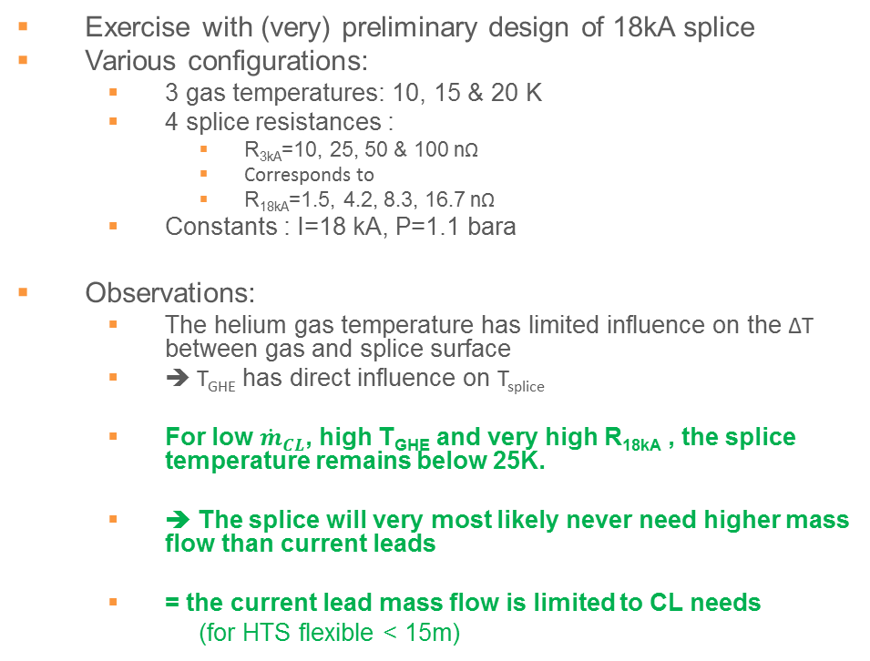
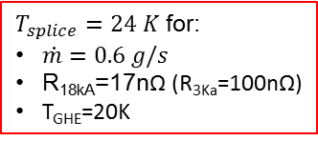
Needs to cool/maintain a 18kA-splice temperature within spec.
$${\dot{m}}_{CLc}$$
Pc, Tc
Note: T_{bottom CL} increases by 0.5 K @ 0.5g/s mass flow per meter of HTS flexible length
Ex: L_{flexible HTS}= 5 m, ${\dot{m}}_{CL}=0.5 g/s$
➔ T_{bottom} _{CL} =T_{c}+3 K
Exercise with (very) preliminary design of 18kA splice
Various configurations:
  3 gas temperatures: 10, 15 & 20 K
  4 splice resistances :
    R_{3kA}=10, 25, 50 & 100 nΩ
    Corresponds to
    R_{18kA}=1.5, 4.2, 8.3, 16.7 nΩ
  Constants : I=18 kA, P=1.1 bara
Observations:
  The helium gas temperature has limited influence on the ∆T between gas and splice surface
  ➔ T_{GHE} has direct influence on T_{splice}
  For low ${\dot{m}}_{CL}$, high T_{GHE} and very high R_{18kA} , the splice temperature remains below 25K.
  ➔ The splice will very most likely never need higher mass flow than current leads
  = the current lead mass flow is limited to CL needs
  (for HTS flexible < 15m)
Current leads requirement range
$T_{splice}=24 K$ for:
$\dot{m}=0.6 g/s$
R_{18kA}=17nΩ (R_{3Ka}=100nΩ)
T_{GHE}=20K
$$T_{GHE}=20K$$
$$T_{GHE}=15K$$
$$T_{GHE}=10K$$
Flowing areas
SPLICE PROPERTIES | Unit | Value
Splice length | [mm] | 220
Flowing area Equivalent diameter | [-] [mm] | 6 x ½ DN10 + central DN10 DN20
Deq | [mm] | 20
Heat transfer area | [mm²] | 27600
Dissipated power Current 3kA Resistance | [W] [kA] [nΩ] | From 0 to 5 W 6 X 3 From 10 to 100
LHC 13kA current leads mass flow
3kA splices
Preliminary early design MgB2-HTS

Slide 19
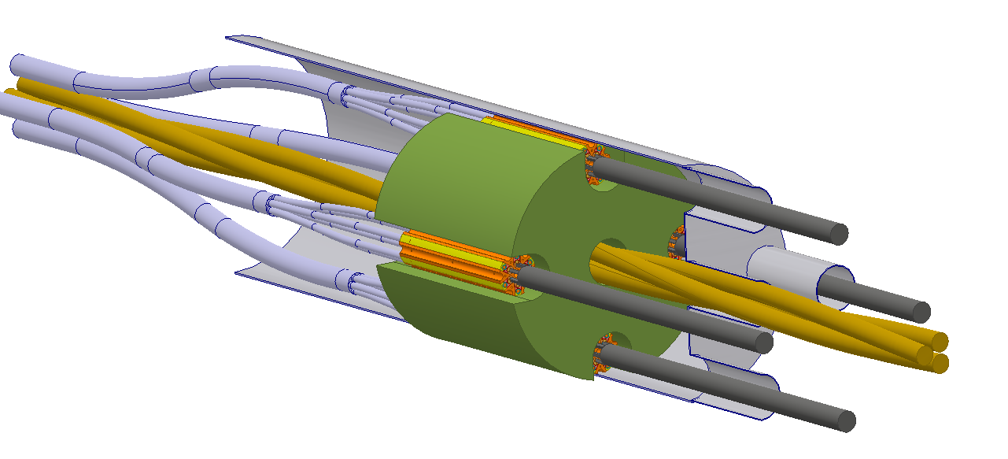
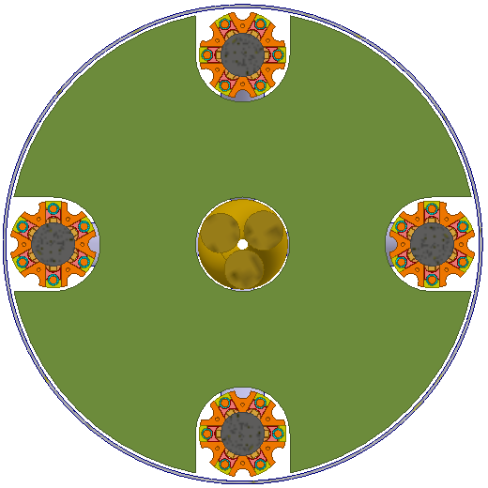
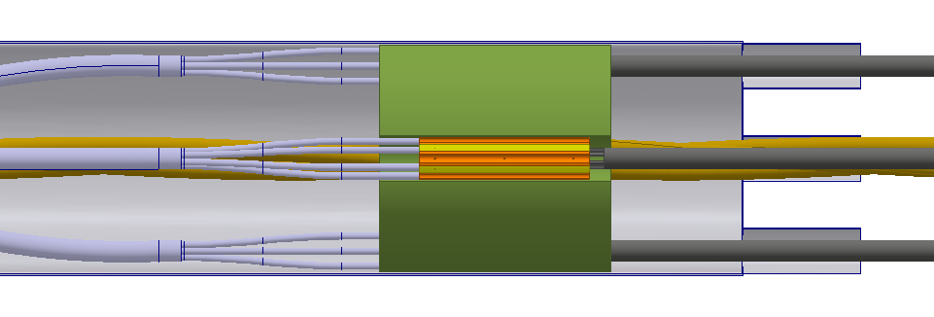




Hydraulic studies for parallel flow options
Exercise with DFHx1 and 18kA splice preliminary design: 4 x 18kA splice + 1 path for DFHx2 leads
Observations:
  Most of the flow goes to the biggest Deq circuit
      ≈20% to the 4 splices (5% each) , ≈80% to central outer circuits
  ➔ Install upstream orifices for similar parallel mass flows (common practice)
      Order of magnitude : Ø10 mm ➔ Integration of upstream orifices unreliable around MgB2 cables (various Ø, Kapton, solder geometry)
What if:
  ➔ A limited diffirence between parallel circuits implies high mass flows unbalance (higher R, Kapton, solder)
      One splice sub-hole is blocked ➔ Atr reduced by 15% ➔ Q reduced by 15%: Non critical
      One splice is warmer ➔ ∆P increase ➔ local mass flow decreases further
      One splice needs twice more heat extraction ➔ total mass flow +150%
      Support and flowing areas obstructions not perfect ➔ mis balance between hydraulic parallel circuits
18kA flowing area :
DN20 5% total flow
$${\dot{m}}_{splice}$$
$${\dot{m}}_{total}$$
$${\dot{m}}_{DN40}$$
central flowing area :
DN40 38% of total flow
To CL
To CL
$${\dot{m}}_{splice}$$
Ext flowing area :
DN40, 38% of total flow
To CL
To DFHx2
To CL
$${\dot{m}}_{DN40}$$
$${\dot{m}}_{splice}$$
0.5 g/s around one splice ➔ total 7 g/s
1.0 g/s around one splice ➔ total 17 g/s

Slide 20
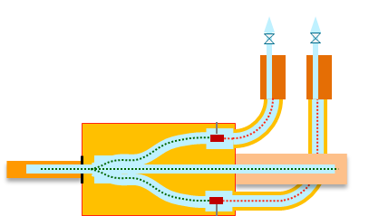
Starting data :
Bending radius : 1000 mm
Interlink diameter : 250 mm
MgB2 opening in surface
How to match angularly MgB2 and HTS cables ?
Rotation in helium tank
(MgB2 cables)
+500 mm length or +200 mm diameter for
Helium tank
DFH
MgB2 cables (+500 mm length in any case)
Need to close Helium tank in UR
In DFHx1, manipulation problem for other cables (depend of layout)
Only very local guide for cables
How to be sure to not rotate the cable in the link ?
MgB2 manipulation in situ
Complicated manipulation due to bad access
Illustration – rotation 0°
Illustration – rotation 180°
Rotation with internal flexibles (MgB2 cables)
+1000 mm length for
DFH
MgB2 cables
Instrumentation and safety flexible will be also rotated
Cables are protected during rotation
Illustration – rotation 0°
Illustration – rotation 180°
Rotation with external flexibles (HTS cables)
+ 4000 mm length for
HTS cables
No impact on DFH enclosure
Need to have a rotatable output flange
Cables are protected during rotation
Possible impact on integration
Illustration – rotation 180°

Slide 21
Main points to be confirmed to develop final design

