Slide 1

B-L Gauge Model at the LHC and beyond
arXiv:1804.04075 JHEP 1808 (2018) 181
arXiv:1811.11452
Wei Liu
In behalf of F.F. Deppisch, J.M. Butterworth, M. Mitra, D. Yallup, S. Amrith, A. Varma
_{March 2019}

Slide 2
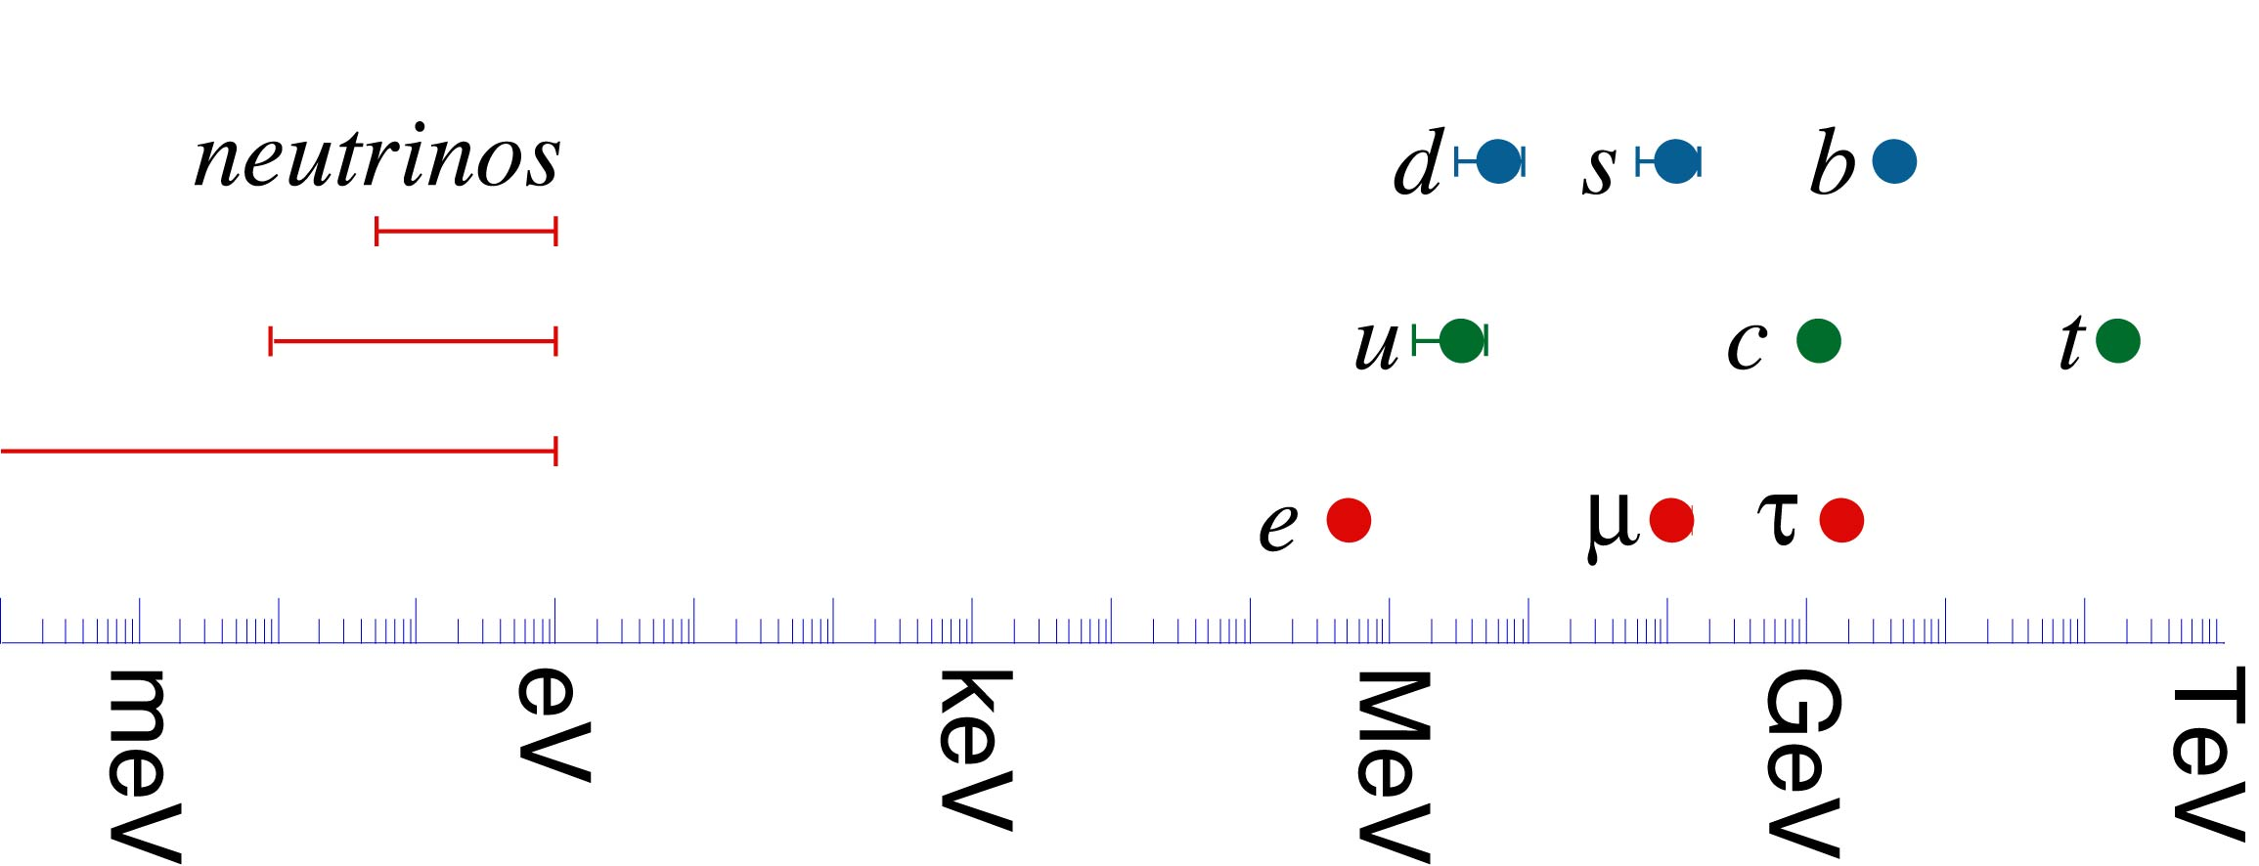
Neutrino Mass
Introduction and Motivation

Slide 3
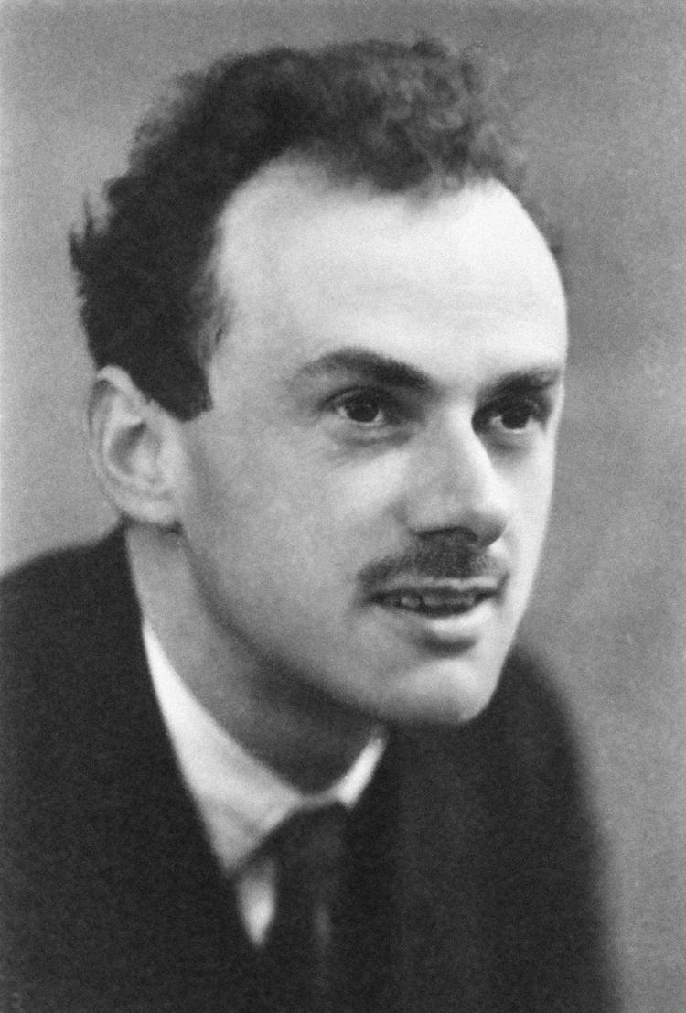
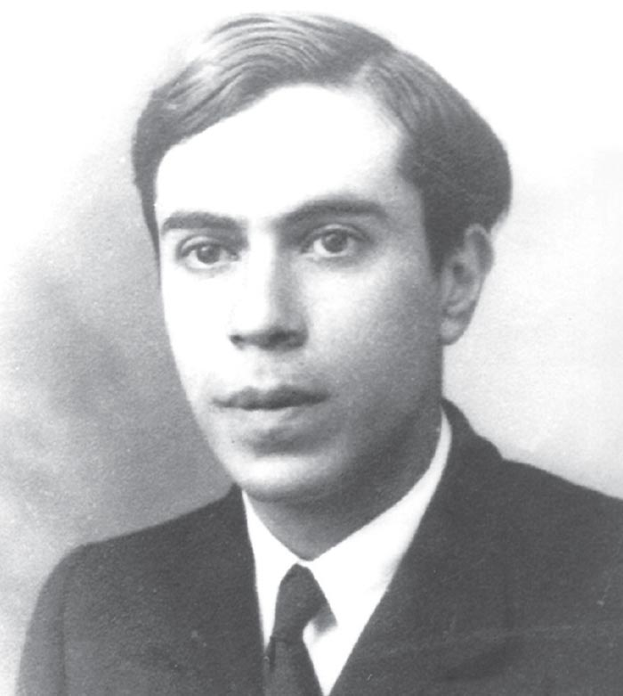
Dirac or Majorana?
Introduction and Motivation

Slide 4









Seesaw Mechanism – Heavy Neutrinos
Introduction and Motivation
$$\left\langle H\right\rangle$$
$$\left\langle H\right\rangle$$
$$ν_{R}$$
$$L$$
$$L$$
$$\left(\begin{matrix}0 & M_{D} \\ M_{D} & M_{R}\end{matrix}\right)$$
$$m_{1}≈−\frac{{M_{D}}^{2}}{M_{R}}$$
$$m_{2}≈M_{R}$$

Slide 5
A conserved B-L quantum number?
Baryon and lepton numbers
Accidental symmetries in the SM,
can be broken by anomalies
B-L number
Anomaly free
What is the origin of
this symmetry?
Introduction and Motivation

Slide 6
Contents
Model
“Minimal” B-L gauged Model
RGE
Maximal Scale for Benchmark scenarios
Sensitivities at the LHC and Beyond
A. Current LHC, Contur Method B. LHC and Beyond, Displaced Vertex
Introduction and Motivation

Slide 7



Gauged B-L Model
${SU(3)}_{C} ×SU{\left(2\right)}_{L}×U{\left(1\right)}_{Y}×U{\left(1\right)}_{B−L}$
Phys. Rev. Lett. 44 (1980) 1316
Additional $Z^{′}$ and Higgs singlet $χ$
B-L symmetry breaking
close to EW scale
Model
$$v_{EW}=246 \text{GeV}$$
$$v_{B−L}>4 \text{TeV}$$

Slide 8

Heavy Neutrinos and Mixing
Additional heavy neutrinos ${ν_{R}}_{i}$
Only charged under $U{\left(1\right)}_{B−L}$
Yukawa couplings → Majorana mass
$L_{Majorana}=−y_{jk}^{M}\overline{{{(ν}_{R})}_{j}^{c}}{{(ν}_{R})}_{k}χ$
Naturally small Yukawa couplings
Only parameters (spurions) breaking B − L
Neutrino mixing
$\left[\begin{aligned}ν_{L} \\ ν_{R}\end{aligned}\right]=\left[\begin{matrix}V_{LL} & V_{RL} \\ V_{LR} & V_{RR}\end{matrix}\right]\left[\begin{aligned}ν \\ N\end{aligned}\right]$
We only consider one heavy neutrino
mixing with one light lepton, specifically $V_{μN}$
Model

Slide 9
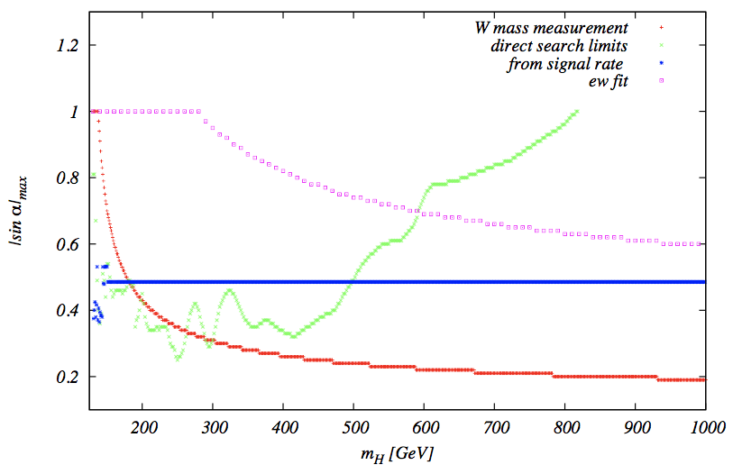

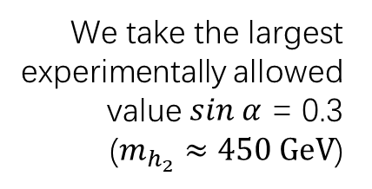
Symmetry Breaking and Higgs Mixing
Scalar potential
$V\left(H,χ\right)=m^{2}H^{+}H + μ^{2}{\left|χ\right|}^{2}+λ_{1}{\left(H^{+}H\right)}^{2}$
$+ λ_{2}{\left|χ\right|}^{4} +λ_{3}H^{+}H{\left|χ\right|}^{2}$
Higgs mixing
$\left[\begin{aligned}h_{1} \\ h_{2}\end{aligned}\right]=\left[\begin{matrix}cos α & −sin α \\ sin α & cos α\end{matrix}\right]\left[\begin{aligned}H \\ χ\end{aligned}\right]$
Model
We take the largest experimentally allowed
value $sin α$ = 0.3
($m_{h_{2}}≈450 \text{GeV}$)

Slide 10

Symmetry Breaking and Higgs Mixing
Mass Matrix
  $M=\left(\begin{matrix}λ_{1}v^{2} & \frac{λ_{3}v_{B−L}v}{2} \\ \frac{λ_{3}v_{B−L}v}{2} & λ_{2}{v_{B−L}}^{2}\end{matrix}\right)$
  ${M_{h_{1,2}}}^{2}=\frac{1}{2}[M_{11}+M_{22}±\sqrt{{(M_{11}−M_{22})}^{2}+4{M_{12}}^{2}}]$
  $tan 2α=\frac{2M_{12}}{M_{11}−M_{22}}=\frac{λ_{3}vv_{B−L}}{λ_{1}v^{2}−λ_{2}{v_{B−L}}^{2}}$
Model

Slide 11

Symmetry Breaking and Higgs Mixing
Vacuum Stability
  $λ_{1}=\frac{1}{4v^{2}}{{[(M}_{h_{1}}}^{2}+{M_{h_{2}}}^{2})−{{\cos{2α}(M}_{h_{2}}}^{2}−{M_{h_{1}}}^{2})$]
  $λ_{2}=\frac{1}{4{v_{B−L}}^{2}}{{[(M}_{h_{1}}}^{2}+{M_{h_{2}}}^{2})+{{\cos{2α}(M}_{h_{2}}}^{2}−{M_{h_{1}}}^{2})$]
  $λ_{3}=\frac{1}{2vv_{B−L}}{{\cos{2α}(M}_{h_{2}}}^{2}−{M_{h_{1}}}^{2})$
  $4$ $λ_{1}$ $λ_{2}−{λ_{3}}^{2}>0$
  $λ_{1}>0,λ_{2}>0.$
Perturbativity Constraints
  ${|λ}_{i}|<1, i=1,2,3$
Model

Slide 12
Renormalization Group Evolution
Run the RGEs of the Model
Scan the benchmark points
Output the Maximal scale
The Maximal scale is defined to satisfy the vacuum stability and perturbativity condition for all couplings
RGE

Slide 13
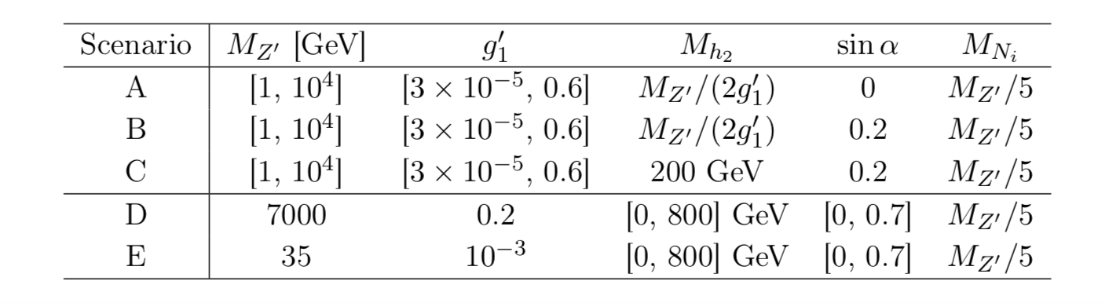
Benchmark Points
RGE

Slide 14
Maximal Scale for Case B
RGE

Slide 15
Maximal Scale for Case D
RGE

Slide 16
Contur Method
To be covered By
Prof. Jon Butterworth tomorrow
Contur

Slide 17
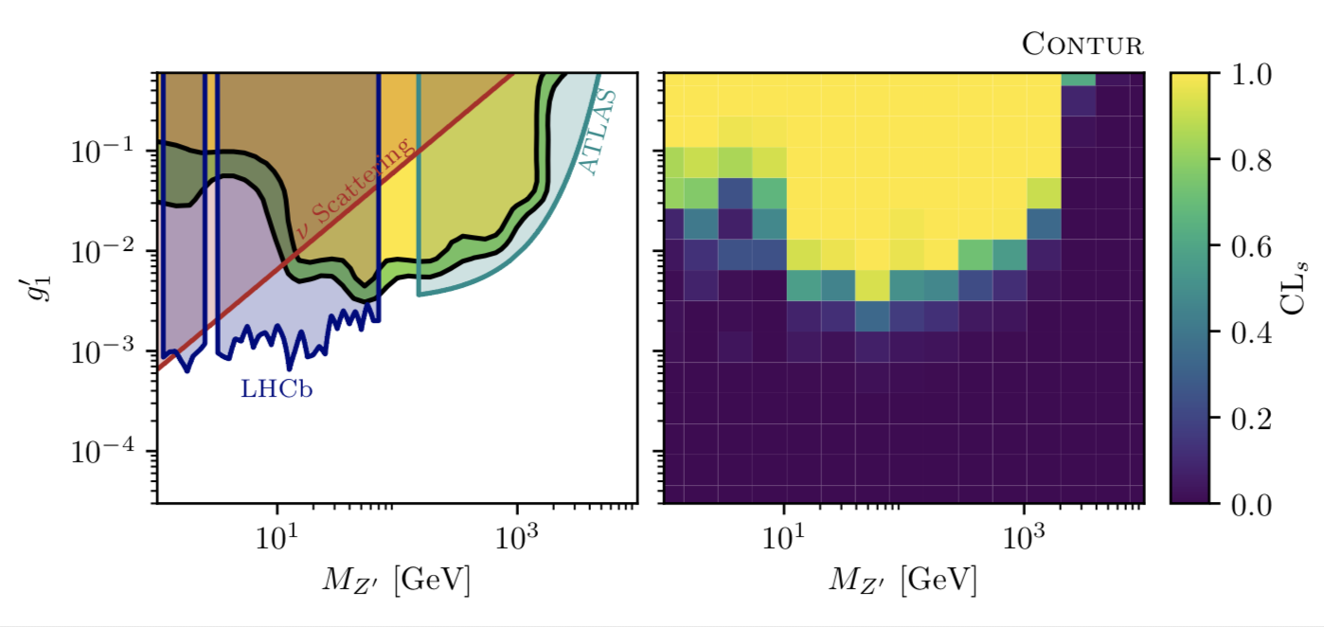
Contur Results
Case A
Contur

Slide 18
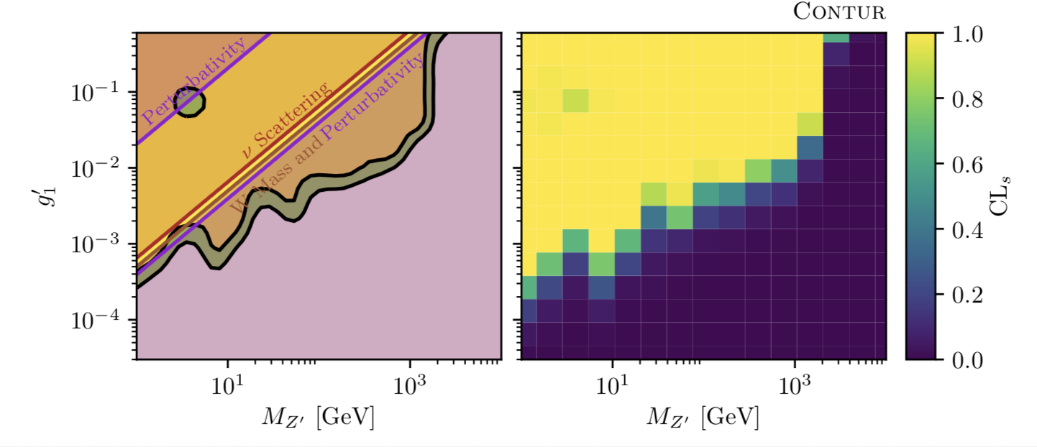
Contur Results
Case B
Contur

Slide 19
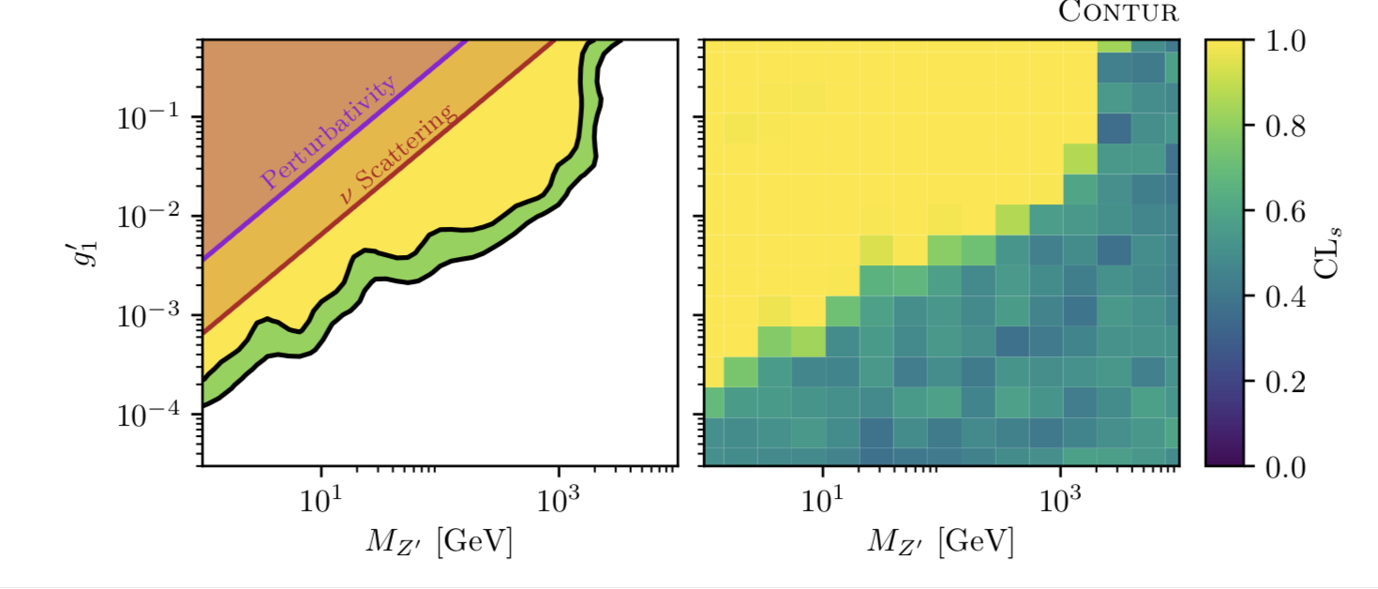
Contur Results
Case C
Contur

Slide 20
Contur Results
Case D
Contur

Slide 21
Contur Results
Case E
Contur

Slide 22












Effective Operators
Weinberg operator
Mass for light neutrinos
Higgs Decay
Heavy Neutrinos from Higgs Decays
$$\left\langle H\right\rangle$$
$$\left\langle H\right\rangle$$
$$ν_{R}$$
$$L$$
$$\left\langle χ\right\rangle$$
$$L$$
$$\left\langle H\right\rangle$$
$$χ$$
$$ν_{R}$$
$$H$$
$$ν_{R}$$
$$\left\langle χ\right\rangle$$

Slide 23
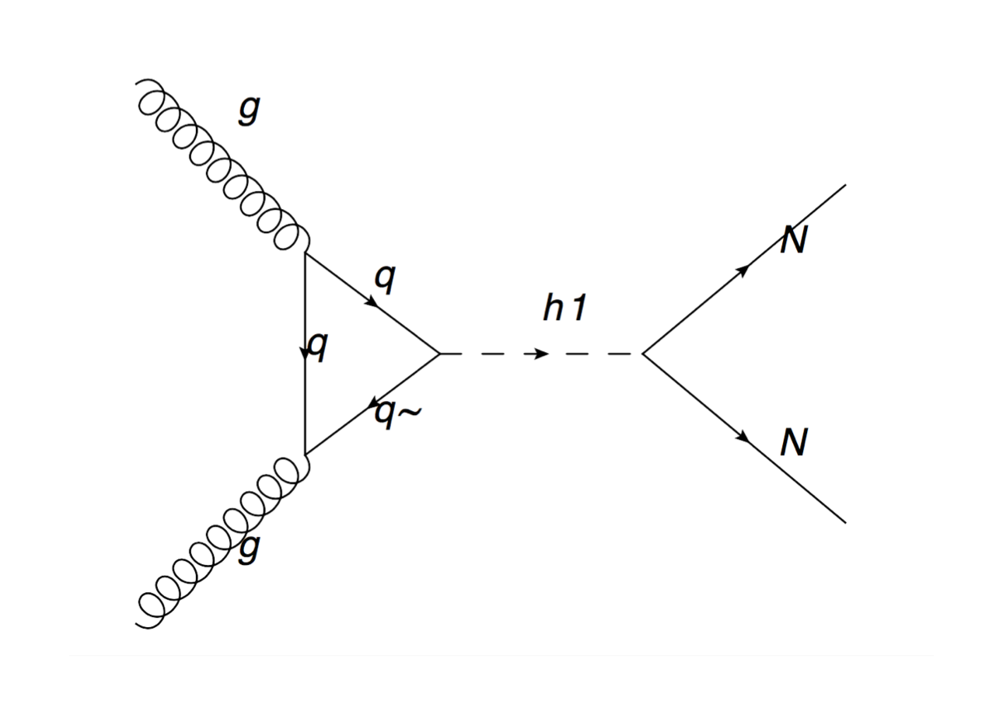
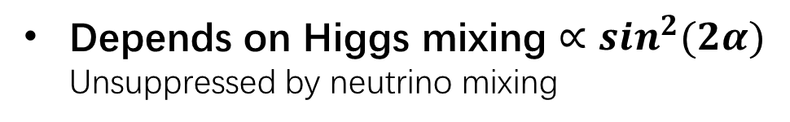



Pair-Production of $N$ at the LHC
Depends on Higgs mixing $∝sin^{2}(2α)$
Unsuppressed by neutrino mixing
Heavy Neutrinos from Higgs Decays
Higgs mixing to $χ$ = $sinα$
Higgs mixing to $H$ = $cosα$

Slide 24
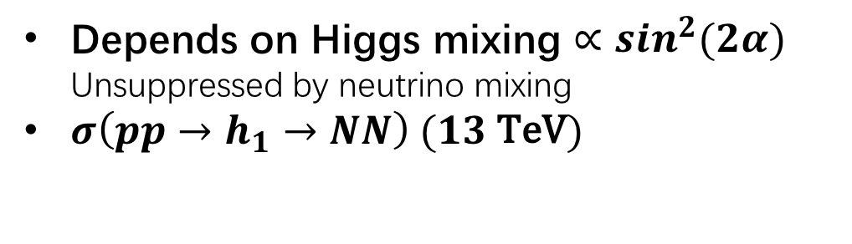
Pair-Production of $N$ at the LHC
Depends on Higgs mixing $∝sin^{2}(2α)$
Unsuppressed by neutrino mixing
$σ\left(pp→h_{1}→NN\right) (13 \text{TeV})$
Heavy Neutrinos from Higgs Decays

Slide 25
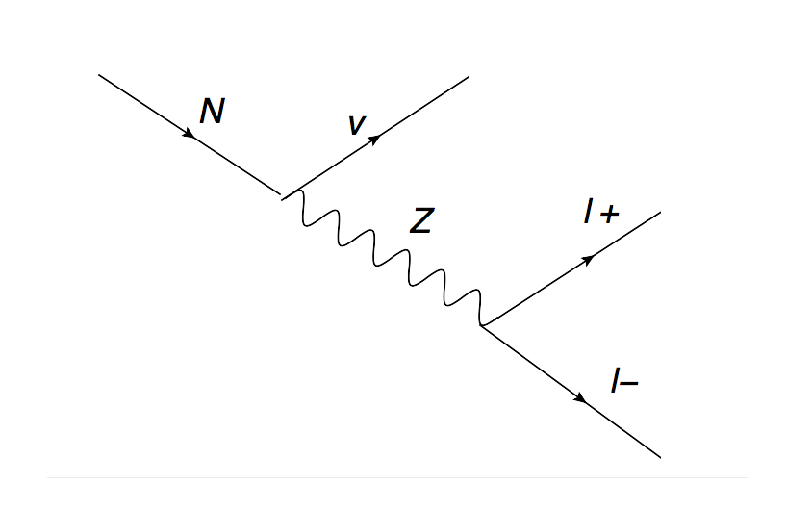
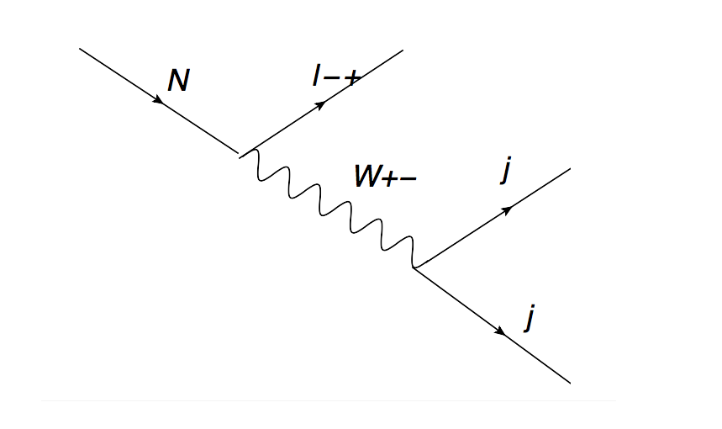

Neutrino Decay Channels
Heavy Neutrino Decays
$M_{N}$(GeV)
Neutrino mixing
Neutrino mixing
Notes:
3 body decays, so constrained

Slide 26
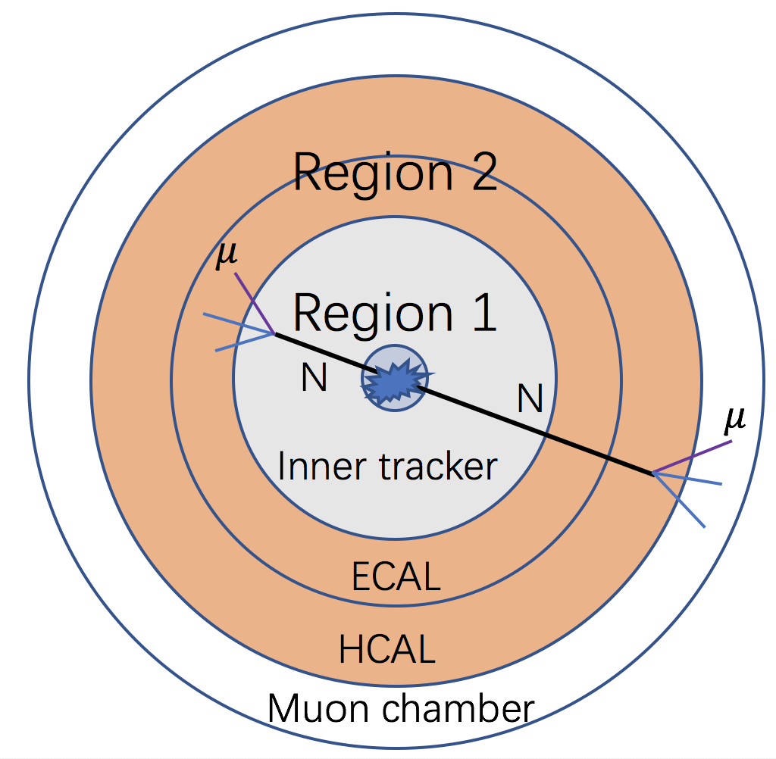

Neutrino Decay Length
Long-lived heavy neutrinos
$L≈3 cm×{\left(\frac{{10}^{−6}}{V_{μN}}\right)}^{2}×{\left(\frac{100 GeV}{M_{N}}\right)}^{5}$
Displaced vertices
Inner tracker and inside muon chamber
Heavy Neutrino Decays

Slide 27

Theoretical Estimation
Effective Event Rate
$σ_{Eff}=σ\left(pp→h_{1}→NN\right)$
$×Br\left(N→X\right)×P\left(x_{1}<x_{N}<x_{2}\right)$
Probability of $N$ decay
within certain distance
$P(x_{1}<x_{N}<x_{2})$=
$\int_{0}^{π}{dφ_{N}\int_{0}^{1}{dβ_{H} p\left(x_{1}<x_{N}<x_{2}\right)f\left(β_{H}\right)g(φ_{N})}}$
Probability of a single N
$p\left(x_{1}<x_{N}<x_{2}\right)=e^{−\frac{x_{1}}{l_{N}^{′}}}−e^{−\frac{x_{2}}{l_{N}^{′}}}$
Heavy Neutrino Decays

Slide 28
Event Generation Tools
FeynRules
MG5@aMC (Patron Level)
LHE (Les Houches event file)
Monte Carlo Simulation
Upgraded FeynRules model from arXiv:0812.4313
https://feynrules.irmp.ucl.ac.be/wiki/B-L-SM

Slide 29


Displaced Vertex Geometry
Monte Carlo Simulation
Region 2
$$μ$$
Region 1
N
N
$$μ$$
Inner tracker
Illustration of a
signal with one or
two displaced vertices
ECAL
HCAL
Muon chamber
perpendicular to the beam line

Slide 30
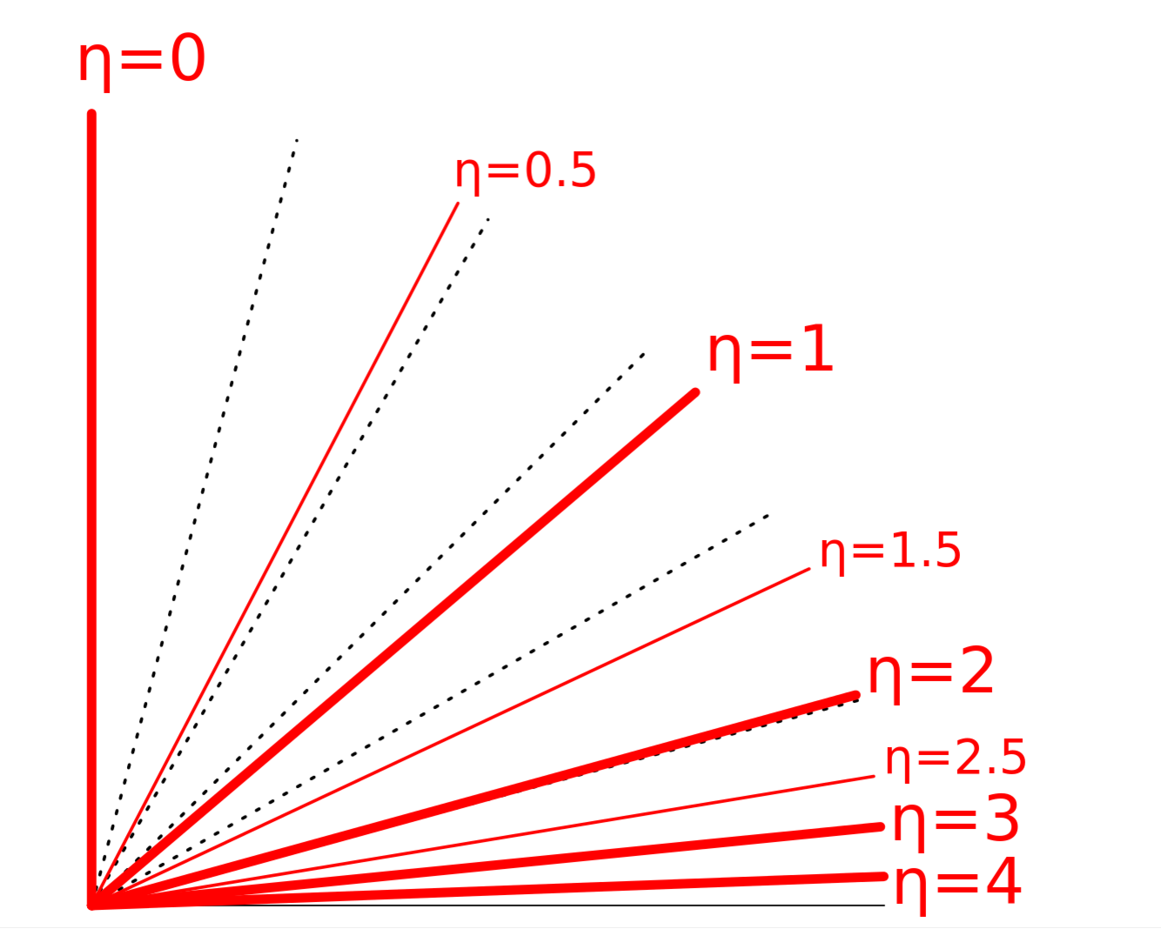


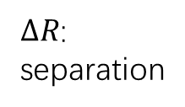


Kinematical Cuts
CMS, Phys. Rev. D 91 052012
$$p_{T}$$
$p_{T}\left(μ\right)>26 GeV ,two muons$
$\left|η\right|<2.0$
$∆R>2.0$
$cosθ_{μμ}>−0.75$
$$p$$
Monte Carlo Simulation
Beam line
Pseudo
rapidity
$∆R$:
separation
$$θ_{μμ}$$
Cosmic ray muons

Slide 31




Geometric Selection
Heavy neutrinos decay
in Region 1 or 2
Cut on transverse distance
from interaction point
Monte Carlo Simulation
$$σ_{t}^{d}$$
$p_{T}$of lepton track
$${|d}_{0}|=|x p_{y} −y p_{x}|/p_{T}$$
Position of N decay
$$d_{0}$$
Transverse distance

Slide 32
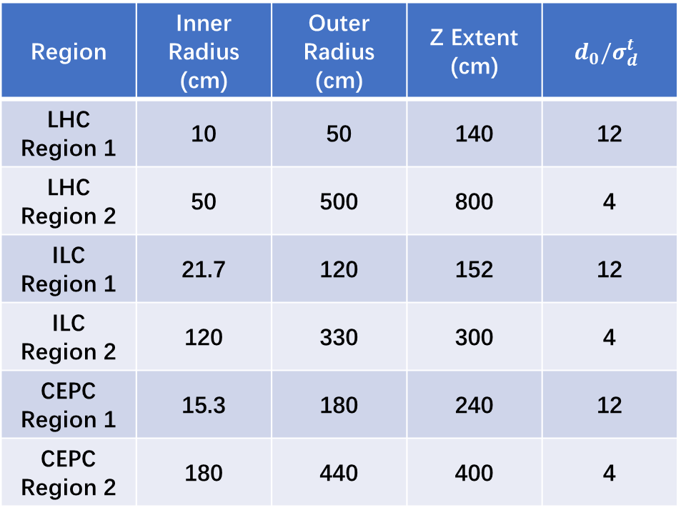
Dimensions of Generic Detectors
Region | Inner Radius (cm) | Outer Radius (cm) | Z Extent (cm) | $$d_{0}/σ_{d}^{t}$$
LHC Region 1 | 10 | 50 | 140 | 12
LHC Region 2 | 50 | 500 | 800 | 4
ILC Region 1 | 21.7 | 120 | 152 | 12
ILC Region 2 | 120 | 330 | 300 | 4
CEPC Region 1 | 15.3 | 180 | 240 | 12
CEPC Region 2 | 180 | 440 | 400 | 4
Monte Carlo Simulation

Slide 33
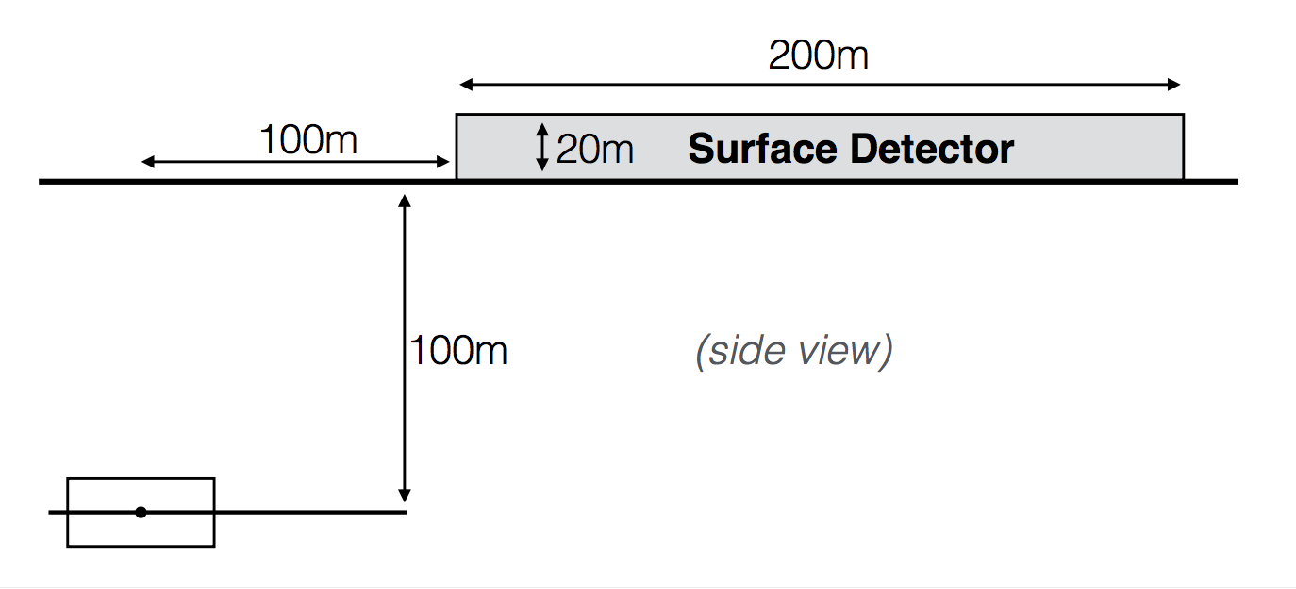
MATHUSLA
MAssive Timing Hodoscope
for Ultra Stable neutraL pArticles
Proposed surface detector
Monte Carlo Simulation
segmented scintillator
CMS or ATLAS

Slide 34
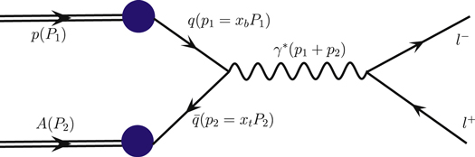

Background
Long-lived mesons
Drell-Yan dilepton production
Faking displaced vertex due to resolution
Efficiently cut by $d_{0}/σ_{d}^{t}$
(CMS, Phys. Rev. D91 (2015) 052012)
Cosmic ray muons
Removable by $cosθ_{μμ}$ cuts and beam collision time
We consider above backgrounds
negligible after cuts from CMS [1][2][3]
Future Sensitivity Estimates

Slide 35
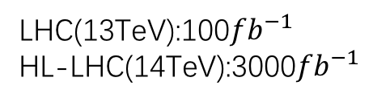
Sensitivities of Different Colliders
Excluded parameter space at 95% C.L.
Assuming no events with single displaced vertex
in any region are observed
Future Sensitivity Estimates
LHC(13TeV):100${fb}^{−1}$
HL-LHC(14TeV):3000${fb}^{−1}$

Slide 36
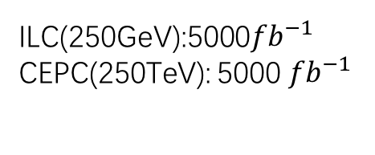
Sensitivities of Different Colliders
Excluded parameter space at 95% C.L.
Assuming no events with single displaced vertex
in any region are observed
Future Sensitivity Estimates
ILC(250GeV):5000${fb}^{−1}$
CEPC(250TeV): 5000${ fb}^{−1}$

Slide 37
Example: Seeing Two Event
Allowed parameter space at 95% C.L.
Assuming two events with two displaced vertices
in either region 1 or 2 are observed
Future Sensitivity Estimates

Slide 38
Contur Method
Using Current measurements,
Sensitive to all parameters except neutrino
Displaced vertices
Sensitive to Neutrino sector
Conclusions

Slide 39
References
[1] CMS Collaboration Phys. Rev. D91 052012(2015)
[2] CMS-PAS-EXO-14-012
[3] CMS-PAS-EXO-12-037

Slide 40
Sensitivities of Different Colliders
Excluded parameter space at 95% C.L.
Assuming no events with two displaced vertices
in any region are observed
Future Sensitivity Estimates

Slide 41
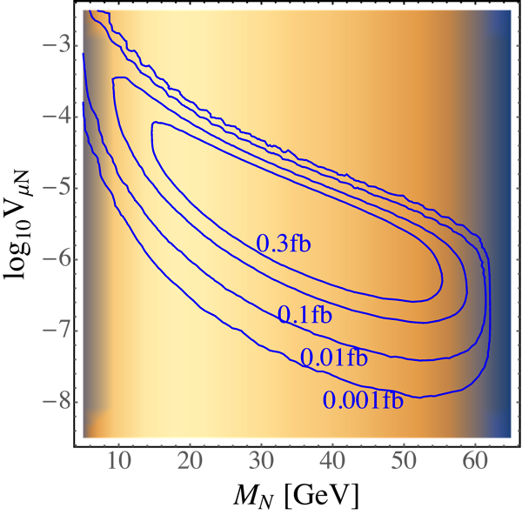
Comparison with Theoretical Estimation
Theoretical Estimation Monte Carlo Simulation
Monte Carlo Simulation
Kinematical
efficiency

Slide 42

Light neutrino masses
Not explained in the Standard Model
Spontaneous breaking of gauged B-L
Generate heavy neutrino masses
Type-I seesaw mechanism
Heavy neutrino ~50 GeV, neutrino mixing $V_{lN}$~${10}^{−6}$
The process $pp→W^{∗}→lN$ undetectable
$$m_{ν}=\frac{m_{D}^{2}}{M_{N}}= V_{lN}^{2}M_{N}=0.1\text{eV}∙{\left(\frac{V_{lN}}{{10}^{−6}}\right)}^{2}∙{\left(\frac{M_{N}}{100 \text{Ge}\text{V}}\right)}^{2}$$
Pair-production of $N$ through SM Higgs
  Suppressed by potentially sizeable Higgs mixing
  Can reach neutrino mixing as small as ${10}^{−7}$
  at the LHC and lepton colliders
  1-2 magnitude improvement at HL-LHC
Conclusions

Slide 43
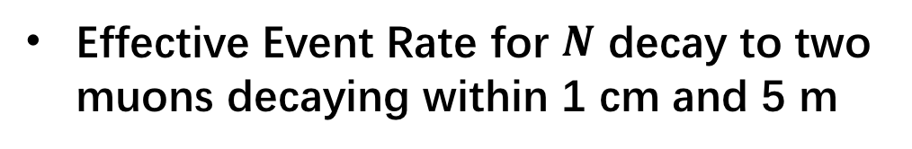
Theoretical Estimation
Effective Event Rate for $N$ decay to two muons decaying within 1 cm and 5 m
Heavy Neutrino Decays

Slide 44
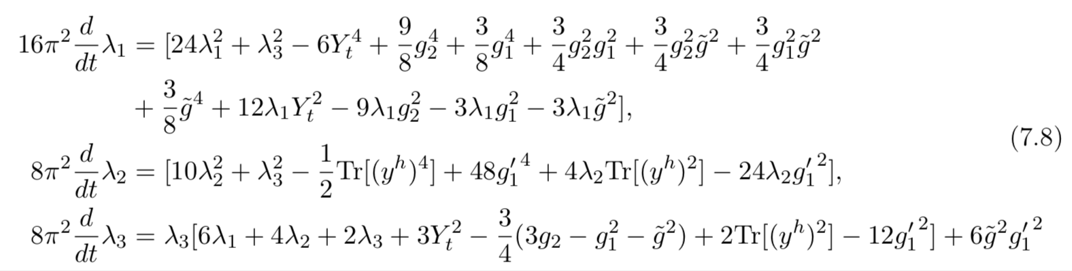
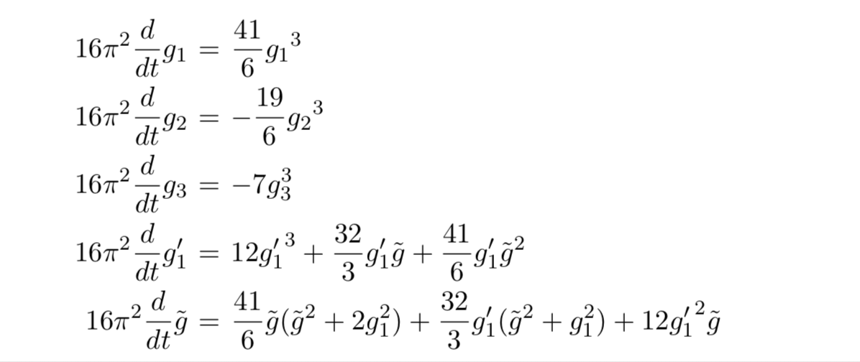
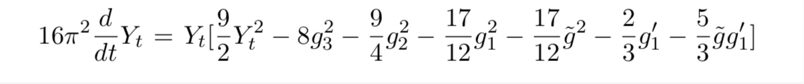
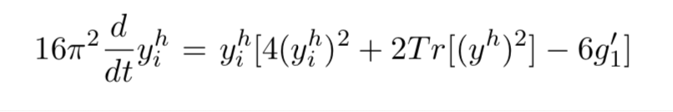
Renormalization Group Evolution
RGE

