Slide 1


the CLIC PBS and costing tool
6th february 2019
C. Rossi

Slide 2
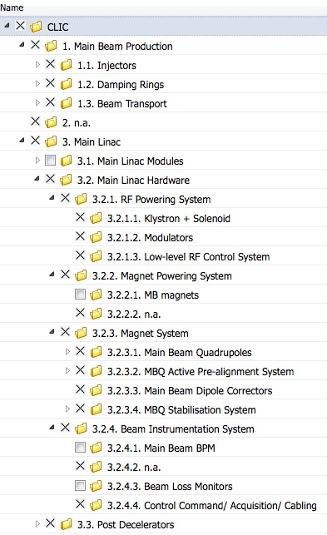
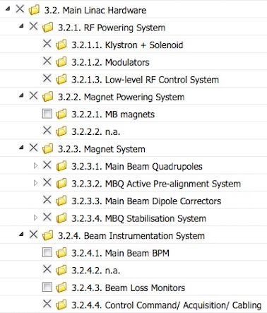
PBS for the klystron-based accelerator
CLIC Project Breakdown Structure (PBS)

Slide 3
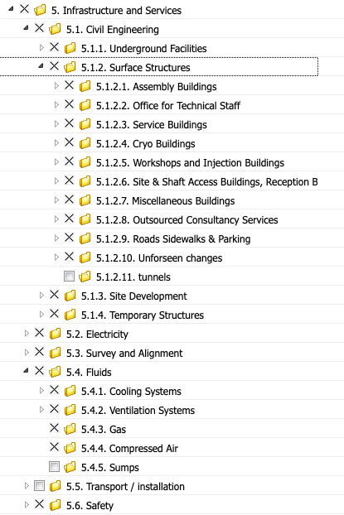
PBS for the klystron-based accelerator
Persons responsible for each node have been identified.
The CLIC PBS include all costing for the project.

Slide 4
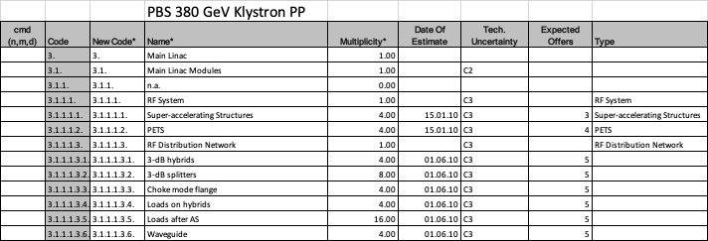
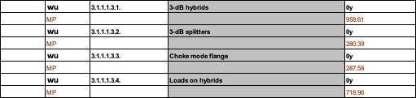
PBS for the klystron-based accelerator
The tool is fed with the costing information, through an Excel sheet for ex.

Slide 5
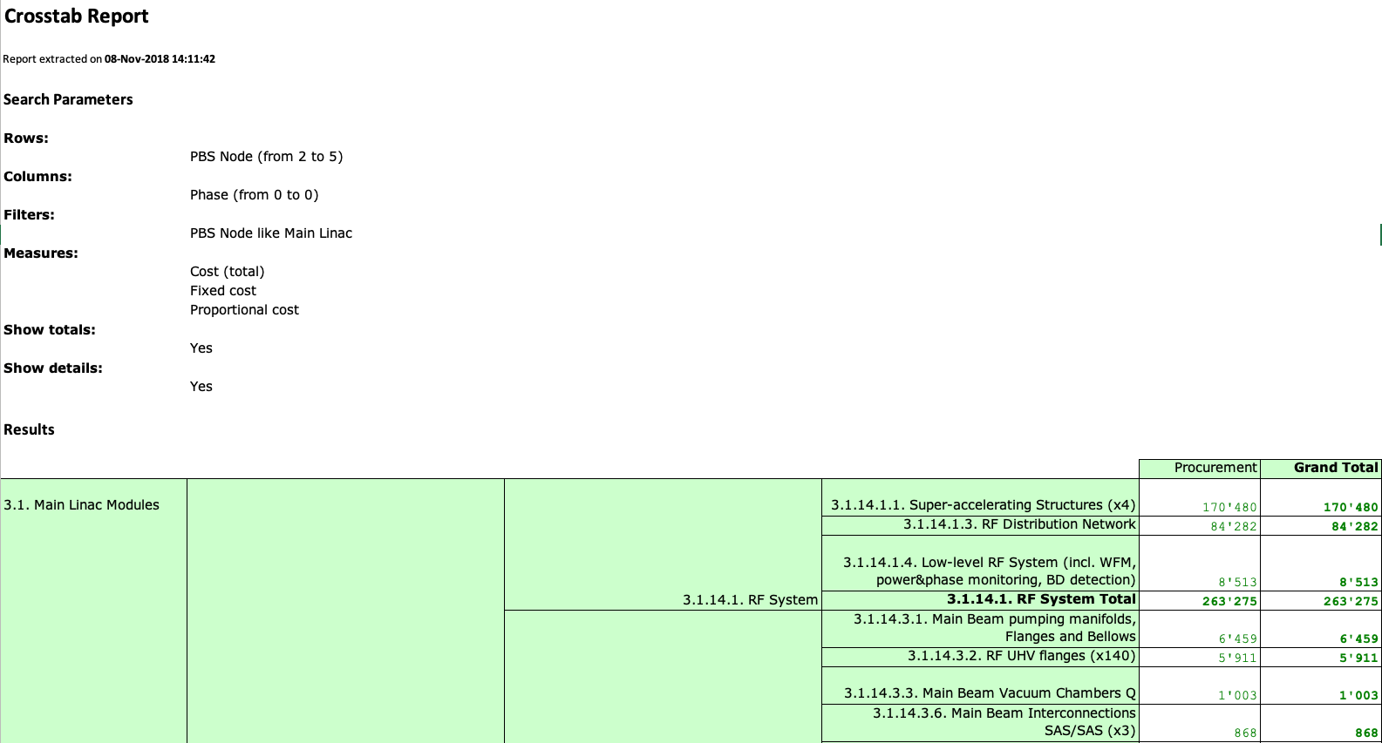
PBS for the klystron-based accelerator
And provides detailed and aggregated cost figures

Slide 6
Other ingredients …
Establish a shared strategy for cost estimates, including :
Estimate of cost uncertainties (must be quantified and discussed);
Application of learning curves for items with great multiplicity;
Offers from industrial partners (to be discussed and, in case, renegotiated);
Technical uncertainties (should be estimated and included in the cost uncertainty).
Regular meetings have been organized by the costing team with cost node owners.

