Slide 1
Advances Detector Technologies 1/3
CERN Fermilab Hadron Collider Physics Summer School
Werner Riegler, CERN, werner.riegler@cern.ch
Sept 3rd , 2019

Slide 2
History of Particle Physics
1895: X-rays, W.C. Röntgen
1896: Radioactivity, H. Becquerel
1899: Electron, J.J. Thomson
1911: Atomic Nucleus, E. Rutherford
1919: Atomic Transmutation, E. Rutherford
1920: Isotopes, E.W. Aston
1920-1930: Quantum Mechanics, Heisenberg, Schrödinger, Dirac
1932: Neutron, J. Chadwick
1932: Positron, C.D. Anderson
1937: Mesons, C.D. Anderson
1947: Muon, Pion, C. Powell
1947: Kaon, Rochester
1950: QED, Feynman, Schwinger, Tomonaga
1955: Antiproton, E. Segre
1956: Neutrino, Rheines
etc. etc. etc.

Slide 3
History of Instrumentation
1906: Geiger Counter, H. Geiger, E. Rutherford
1910: Cloud Chamber, C.T.R. Wilson
1912: Tip Counter, H. Geiger
1928: Geiger-Müller Counter, W. Müller
1929: Coincidence Method, W. Bothe
1930: Emulsion, M. Blau
1940-1950: Scintillator, Photomultiplier
1952: Bubble Chamber, D. Glaser
1962: Spark Chamber
1968: Multi Wire Proportional Chamber, C. Charpak
Etc. etc. etc.

Slide 4
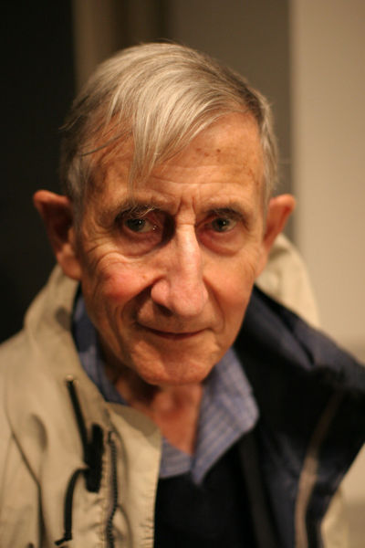
On Tools and Instrumentation
“New directions in science are launched by new tools much more often than by new concepts.
The effect of a concept-driven revolution is to explain old things in new ways.
The effect of a tool-driven revolution is to discover new things that have to be explained”
From Freeman Dyson ‘Imagined Worlds’

Slide 5
Physics Nobel Prices for Instrumentation
1927: C.T.R. Wilson, Cloud Chamber
1939: E. O. Lawrence, Cyclotron & Discoveries
1948: P.M.S. Blacket, Cloud Chamber & Discoveries
1950: C. Powell, Photographic Method & Discoveries
1954: Walter Bothe, Coincidence method & Discoveries
1960: Donald Glaser, Bubble Chamber
1968: L. Alvarez, Hydrogen Bubble Chamber & Discoveries
1992: Georges Charpak, Multi Wire Proportional Chamber
All Nobel Price Winners related to the Standard Model: 89 !
(biased personal statistics by W. Riegler
http://www.nobelprize.org/nobel_prizes/physics/)
31 for Standard Model Experiments
13 for Standard Model Instrumentation and Experiments
3 for ‘Standard Model Instrumentation’
23 for Standard Model Theory
9 for Quantum Mechanics Theory
9 for Quantum Mechanics Experiments
1 for Relativity
56 for Experiments and Instrumentation
33 for Theory

Slide 6

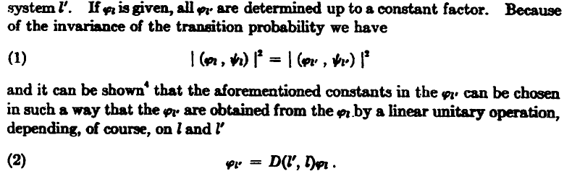
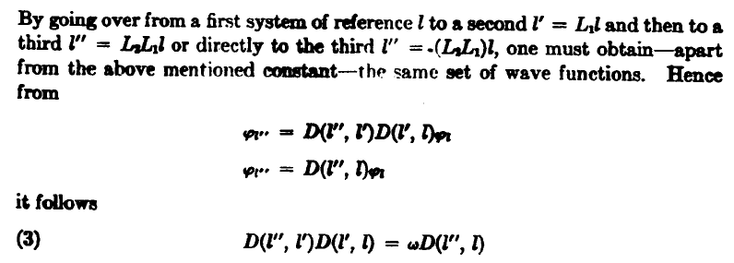
The ‘Real’ World of Particles
E. Wigner:
“A particle is an irreducible representation of the inhomogeneous Lorentz group”
Spin=0,1/2,1,3/2 …
Mass ≥ 0
E.g. in Steven Weinberg, The Quantum Theory of Fields, Vol1

Slide 7
Particle Detector
W. Riegler:
A particle detector is a classical device, that is collapsing wave functions of quantum mechanical states, which are linear super positions of irreducible representations of the inhomogeneous Lorentz group (Poincare group).

Slide 8
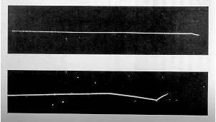
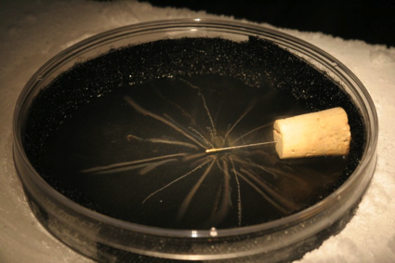
Solvay Conference 1927, Einstein:
“A radioactive sample emits alpha particles in all directions; these are made visible by the method of the Wilson Cloud Chamber. Now, if one associates a spherical wave with each emission process, how can one understand that the track of each alpha particle appears as a (very nearly) straight line …. “
Born, Heisenberg:
“As soon as such an ionization is shown by the appearance of cloud droplets, in order to describe what happens afterwards one must reduce the wave packet in the immediate vicinity of the drops. One thus obtains a wave packet in the form of a ray, which corresponds to the corpuscular character of the phenomenon.”
According to this reasoning the whole process is described in terms of the interaction of a quantum system (the alpha particle) with a classical measurement apparatus (the atoms of the vapour).
Nevill Mott (1929):
Assuming the atoms of the vapour also to be part of the quantum mechanical system, “ … it is a little difficult to picture how it is that an outgoing spherical wave can produce a straight track; we think intuitively that it should ionise atoms at random throughout space.”

Slide 9

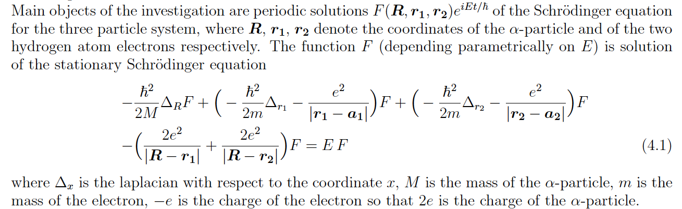

Mott considers and example with and alpha particle at the origin, one hydrogen atom at position a₁ and another hydrogen atom at a₂ , and the two hydrogen atoms only having EM interaction with the alpha particle:
H-atom1
H-atom2
a₁
α
a₂
Result: The two hydrogen atoms cannot both be excited (or ionized) unless a₁ , a₁ and the origin lie on the same straight line.
(see Also Werner Heisenberg, Chicago lectures 1930)
This example (i.e. moving the boundary between the quantum system and classical measurements device) is also used by S. Coleman in the lecture
Quantum Mechanics in Your Face [1994] https://www.youtube.com/watch?v=EtyNMlXN-sw
to show how the collapse of the wave function and other ‘interpretations of QM’ become unnecessary if one removes this boundary and simply considers the entire world (including us) as QM systems.

Slide 10
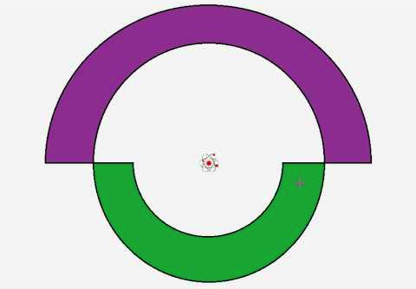
Renninger's negative-result experiment (1953)
A radioactive atom (emitting and alpha particle) is placed in the center of a detector that consists of two hemispheres and that are 100% efficient to alpha particles.
Considering the second (purple) hemisphere to be very large, the absence of the a signal on the green detector after a given time will indicate that the alpha particle will hit the purple detector.
The QM analysis will come out right, with a given probability for the red or the green part to fire and zero probability that both fire.
The semi-classical analysis is however confusing:
The wave-function has collapsed although there was no measurement performed with the green detector ?
A non measurement collapses a wave-function ?

Slide 11
The ‘Real’ World of Particles
W. Riegler:
“…a particle is an object that interacts with your detector such that you can follow it’s track,
it interacts also in your readout electronics and will break it after some time,
and if you a silly enough to stand in an intense particle beam for some time you will be dead …”

Slide 12
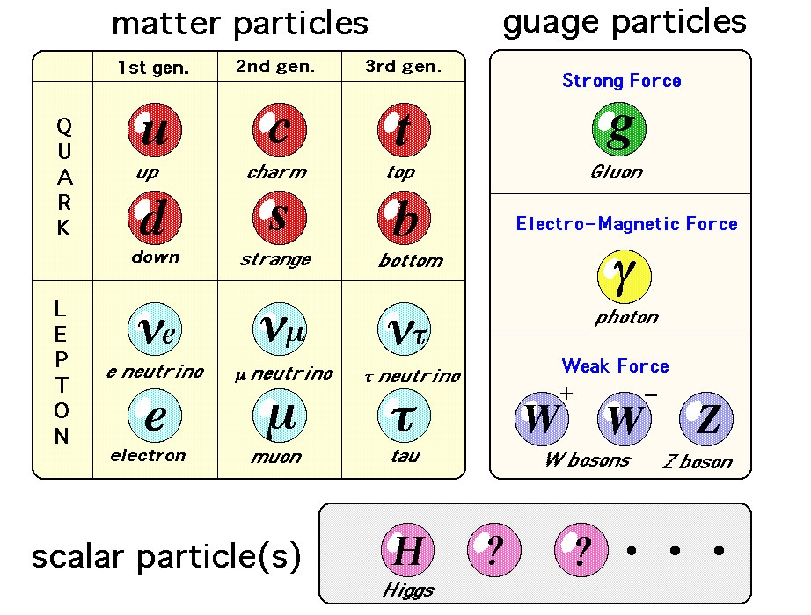
The ‘Real’ World of Particles
Quarks are not seen as free particles, they form Mesons and Baryons, jets at high energies
Gluons not seen as free particles
W, Z, H decay ‘instantly’
Neutrinos do not interact in our collider detectors
…
A lot of tricks needed to be invented to ‘see’ this standard model …
Elektro-Weak Lagrangian
Higgs Particle

Slide 13
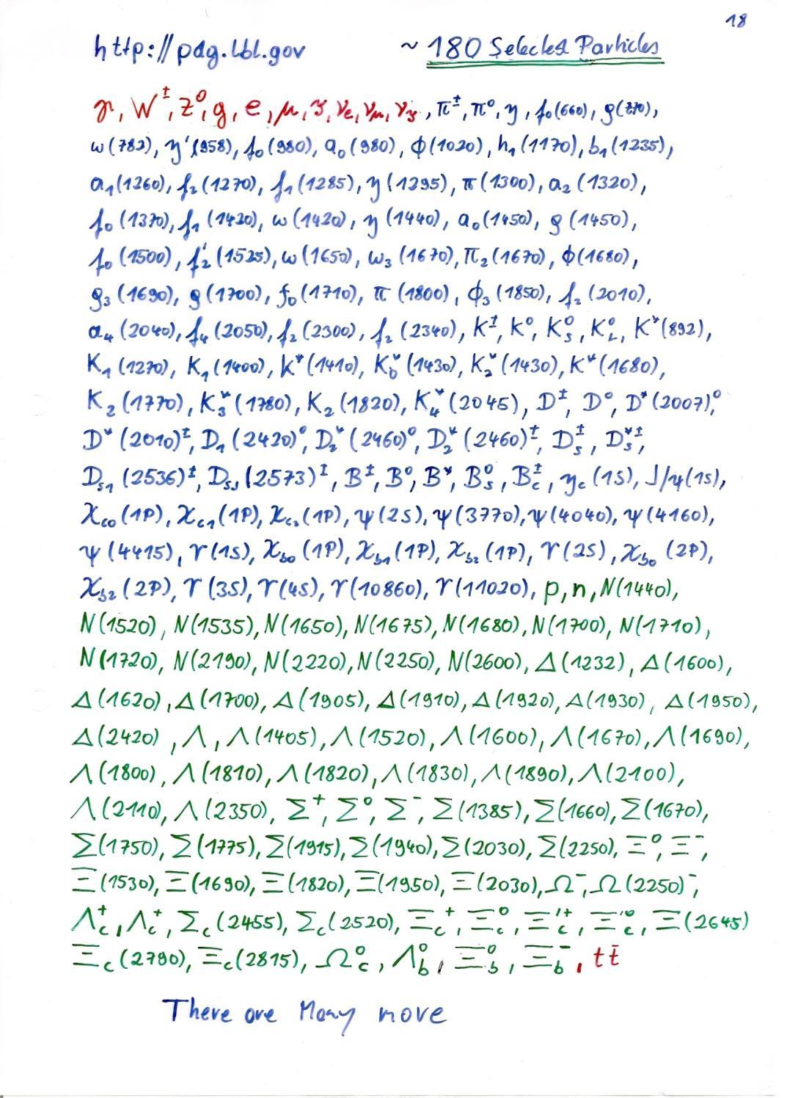
A selection of particles listed by the particle data group.
How can we tell them apart in our detector ?!

Slide 14
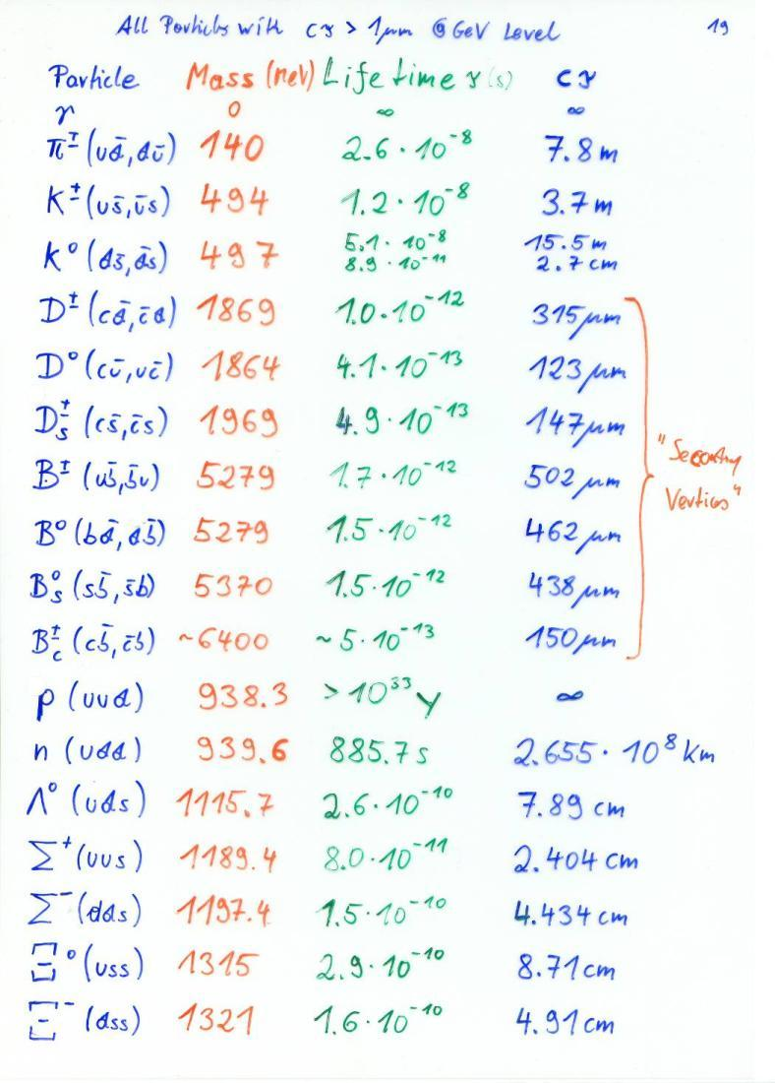
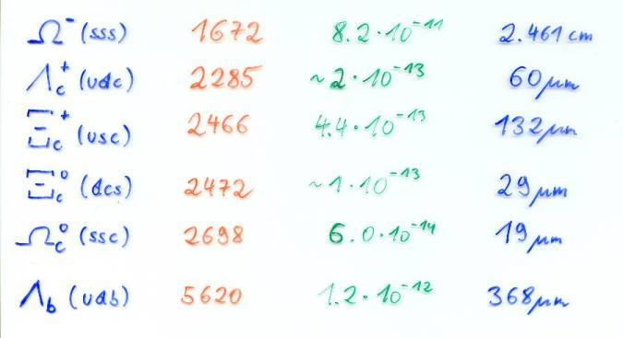
Out of the hundreds of known particles, these are the only hadrons that have a lifetime long enough to produce a track of >1um before they decay (at GeV Level).
Some of them decay after flying only a few hundred um.
Others traverse the entire detector.

Slide 15
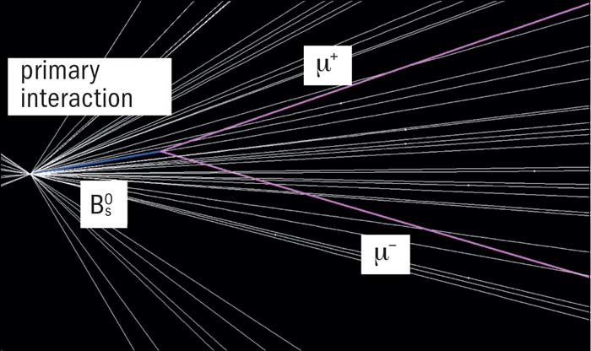
LHCb B decay

Slide 16
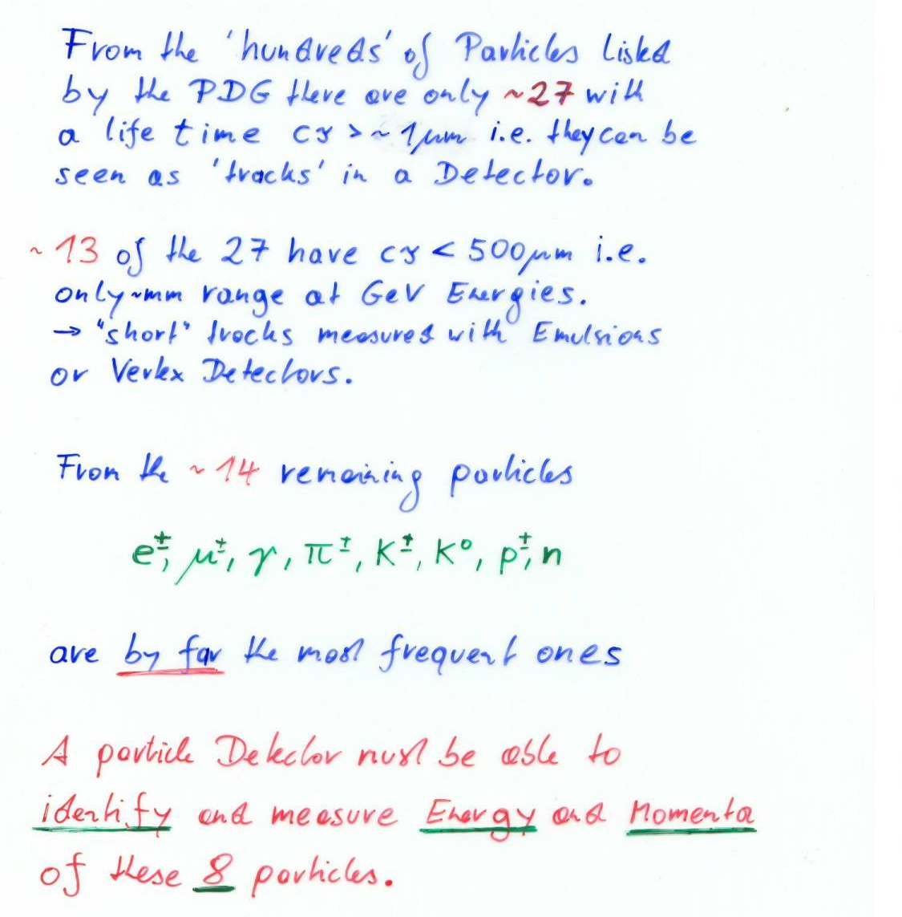
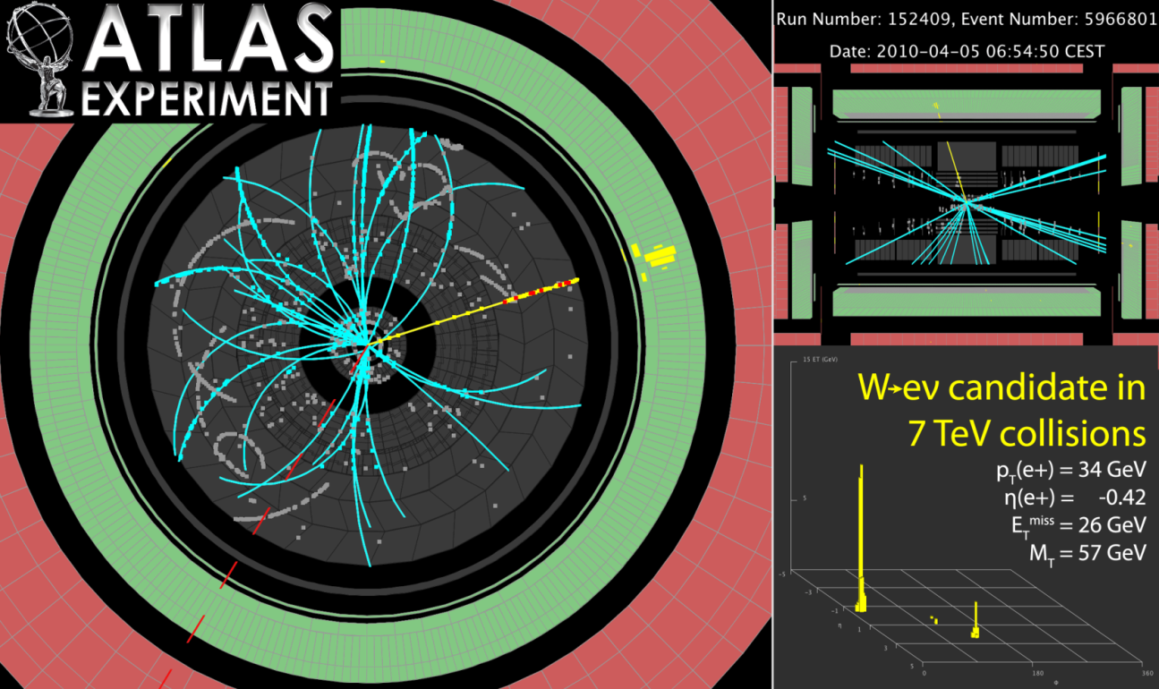
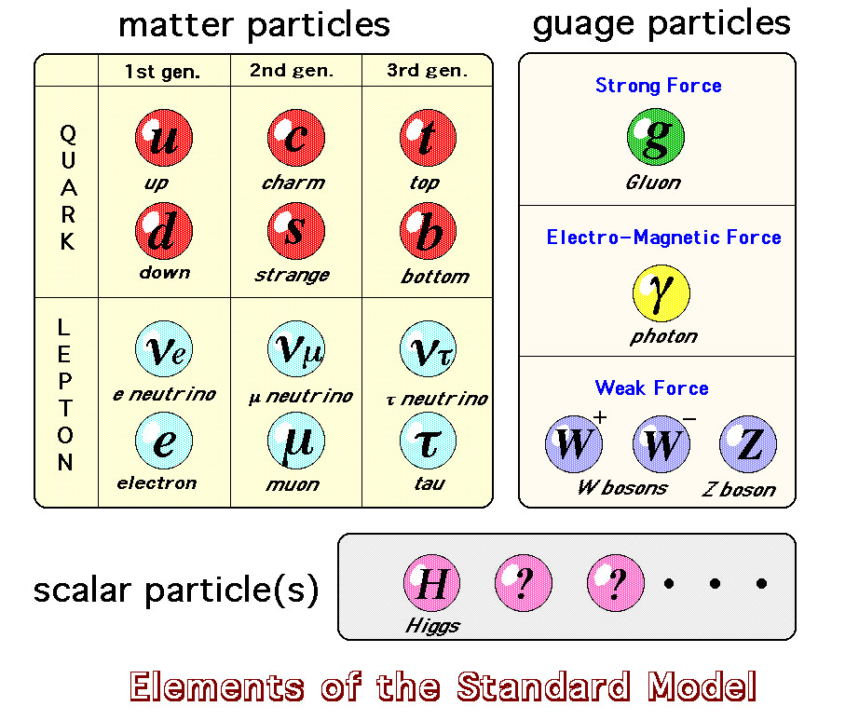

Slide 17
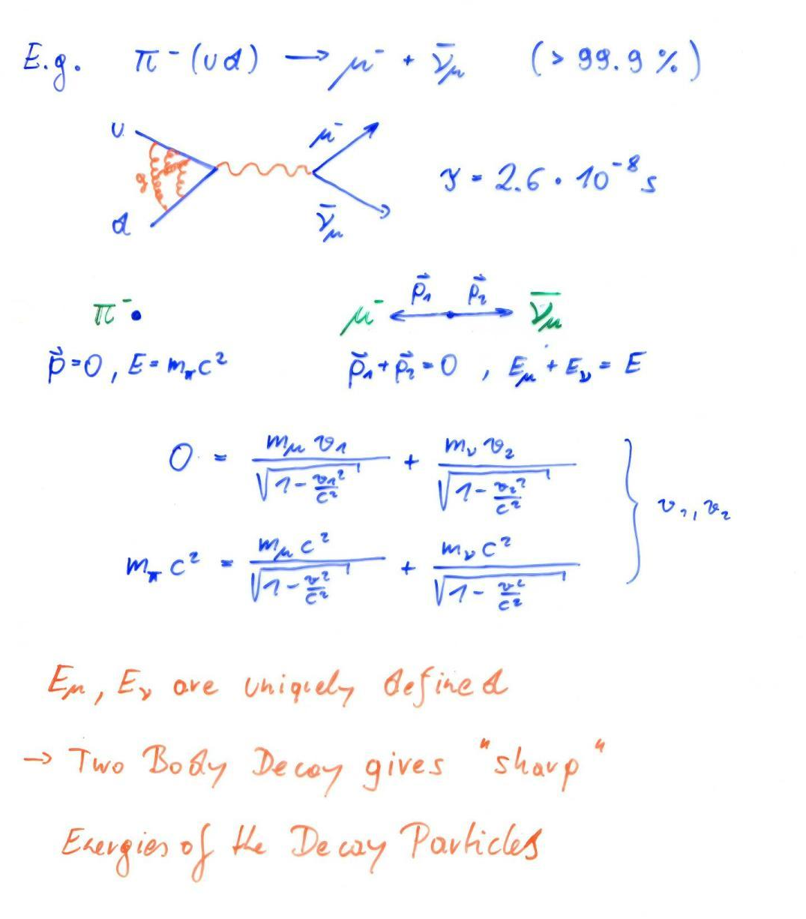
Basics:
Two Body Decay

Slide 18
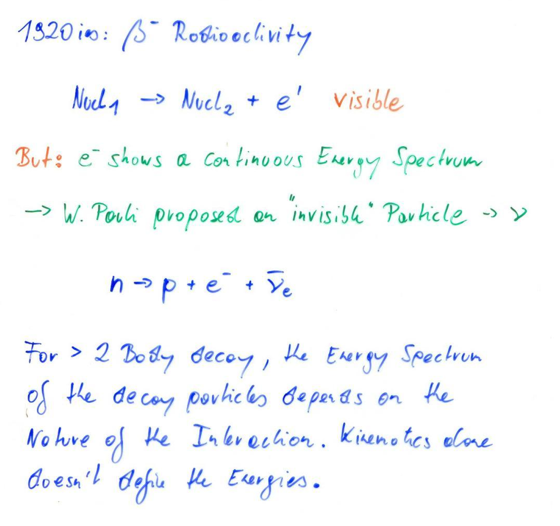
Basics:
Three Body Decay

Slide 19
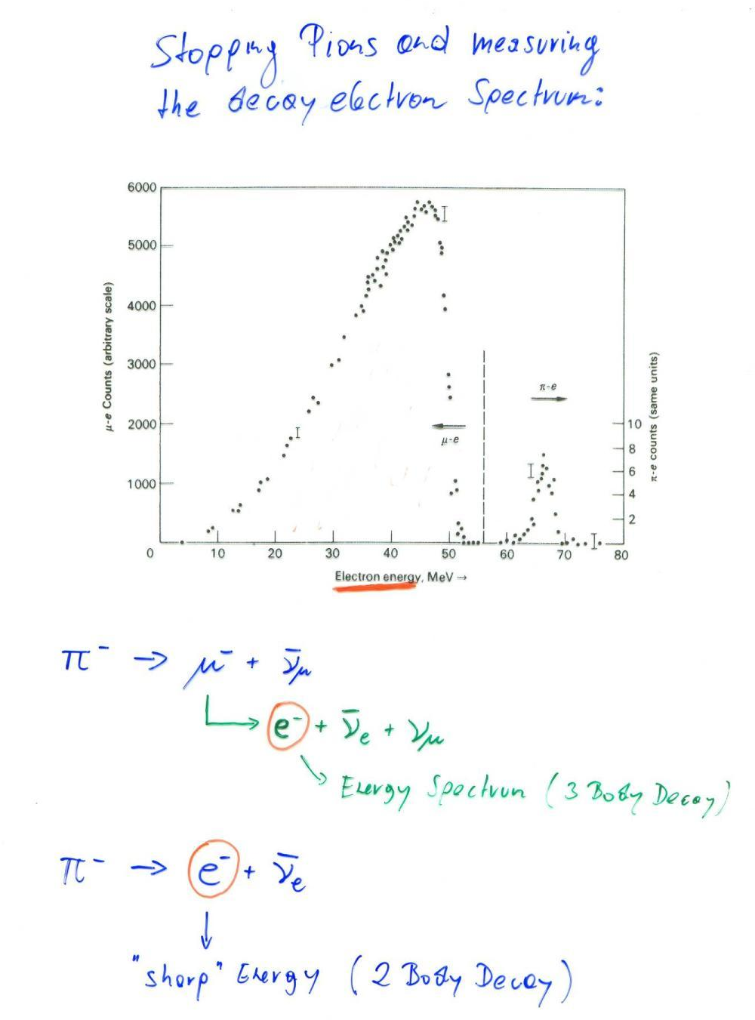
Basics:
Two Body and Three Body Decay

Slide 20
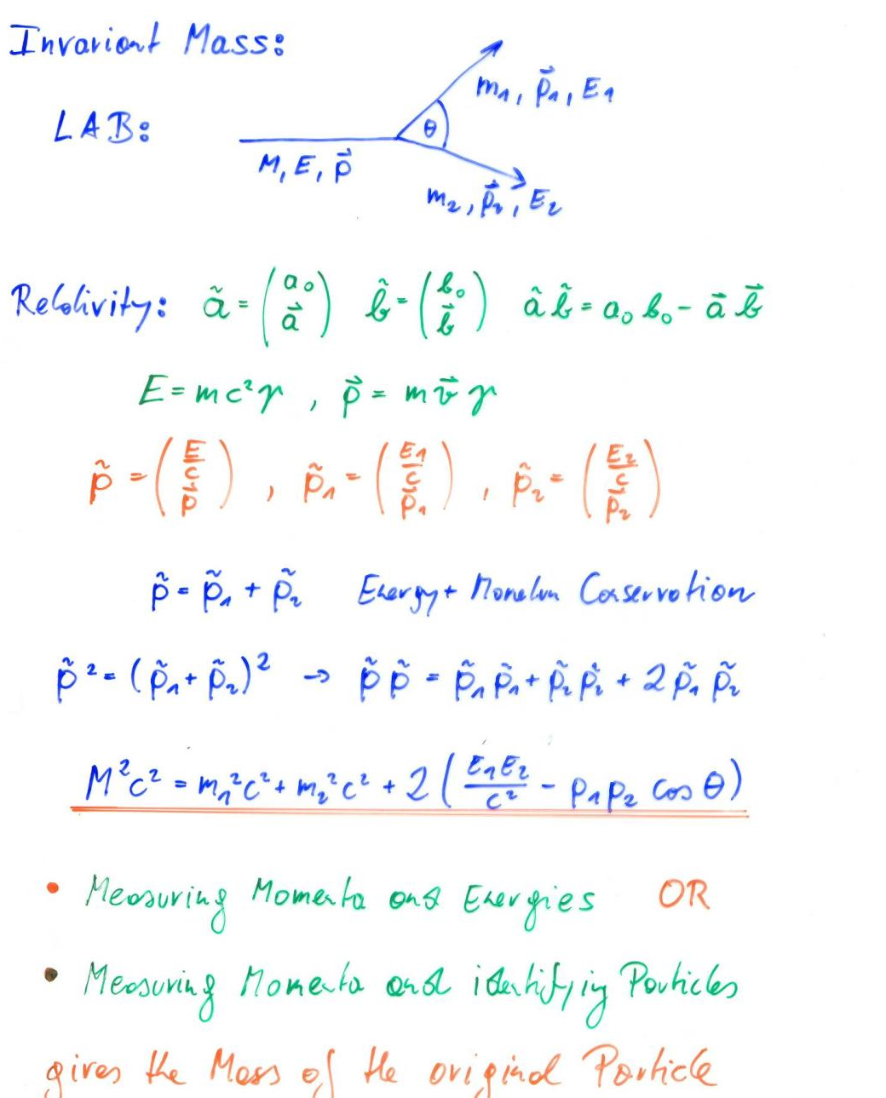
Basics:
Invariant Mass

Slide 21
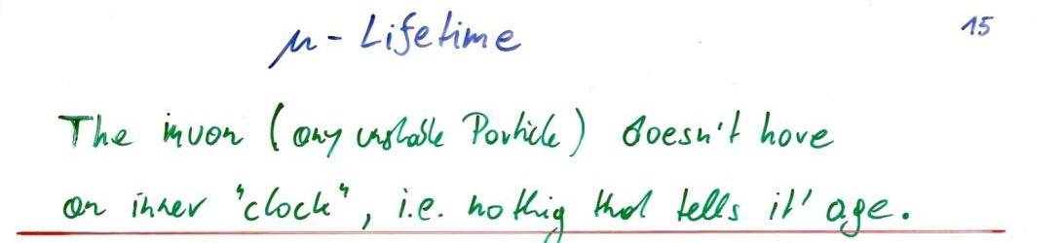
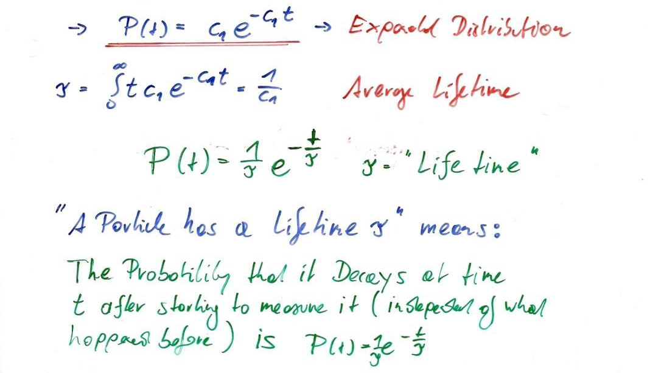
Lifetime of a Particle → Exponential distribution
What is the probability P(t)dt that the muon will decay between time t and t+dt after starting to measure it – independently of how long it lived before ?
Probability p that it decays within the time interval dt after starting to measure = p=P(0) dt = c₁ dt.
Probability that is does NOT decay in n time intervals dt but the (n+1)^{st} time interval
= (1- p)^{n} p ≈ exp(-n p) p with p = c₁ dt.
n time intervals of dt means a time of t = n dt →
Probability that the particle decays between time t and t+dt = Exp(- c₁ t) c₁ dt = P(t) dt !

Slide 22
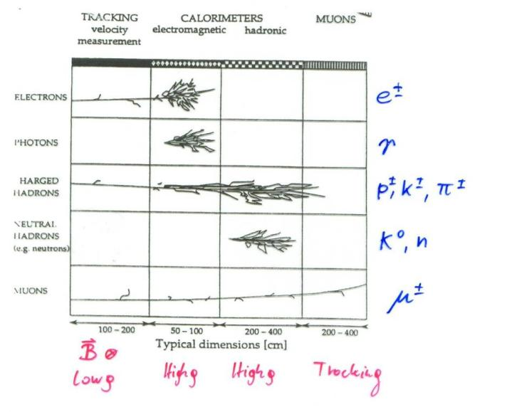
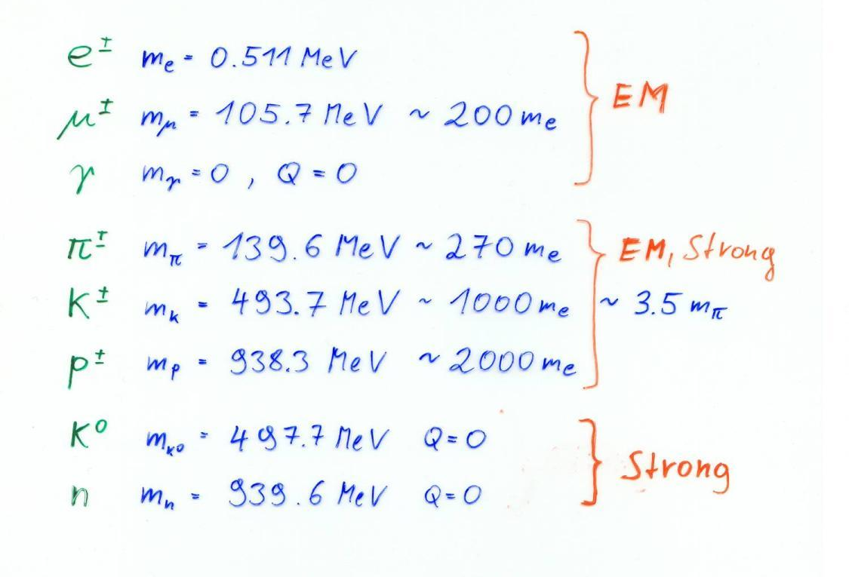
Now that we know all the Interactions we can talk about Detectors !

Slide 23
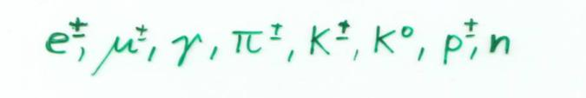
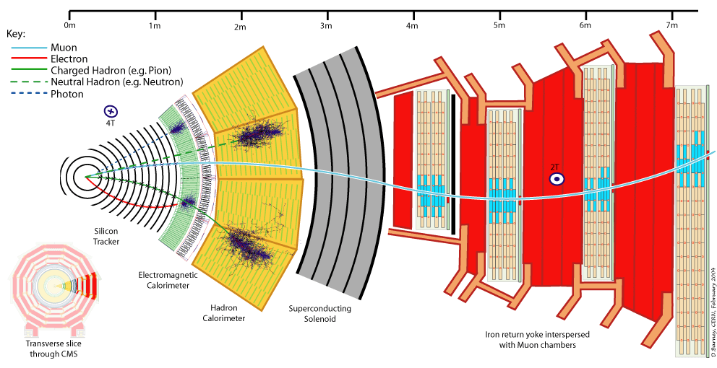
Collider Detector
A particle detector is an (almost) irreducible representation of the properties of these 8 particles

Slide 24
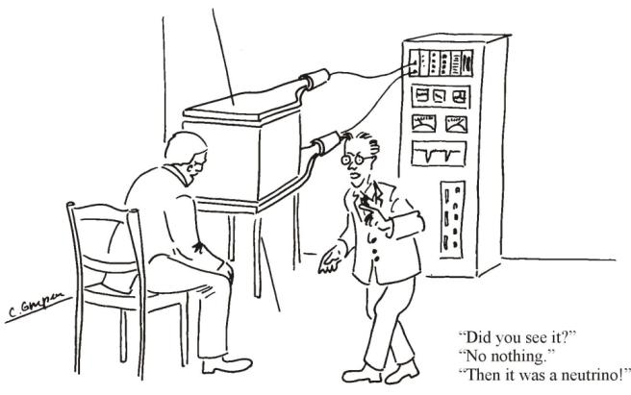
Interaction of Particles with Matter
Any device that is to detect a particle must interact with it in some way → almost …
In many experiments neutrinos are measured by missing transverse momentum.
E.g. e⁺e⁻ collider. P_{tot}=0,
If the Σ p_{i} of all collision products is ≠0 → neutrino escaped.
Claus Grupen, Particle Detectors, Cambridge University Press, Cambridge 1996 (455 pp. ISBN 0-521-55216-8)

Slide 25
Neutrinos and other invisible particles
They are seen by missing momentum vectors – if you are sure your detector is hermetic !

Slide 26
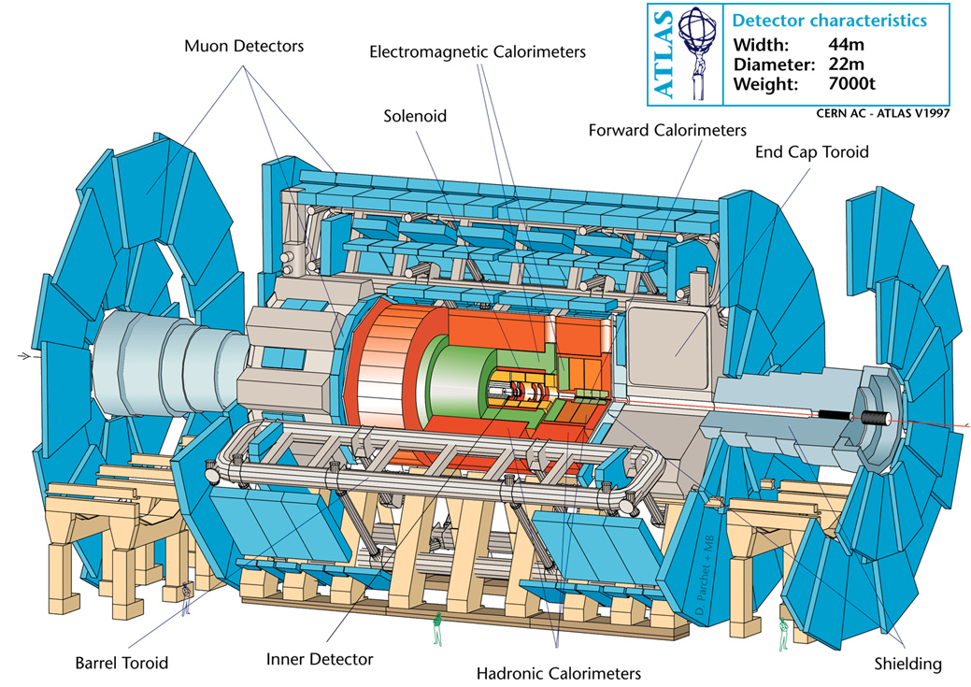
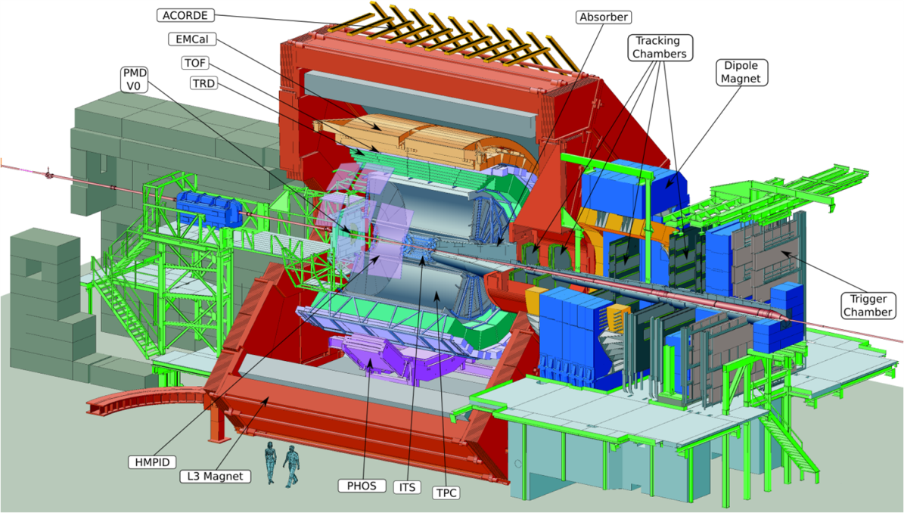
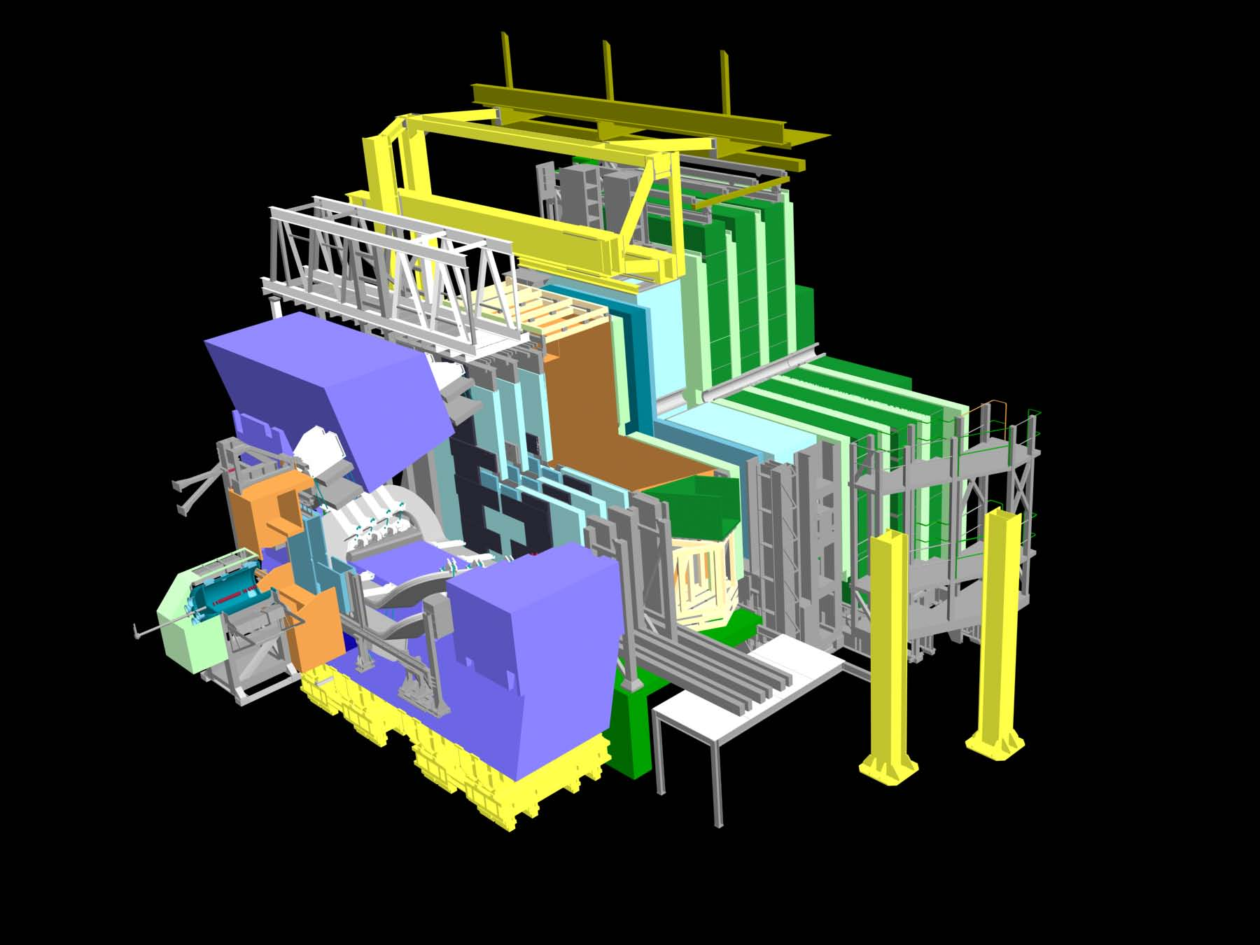
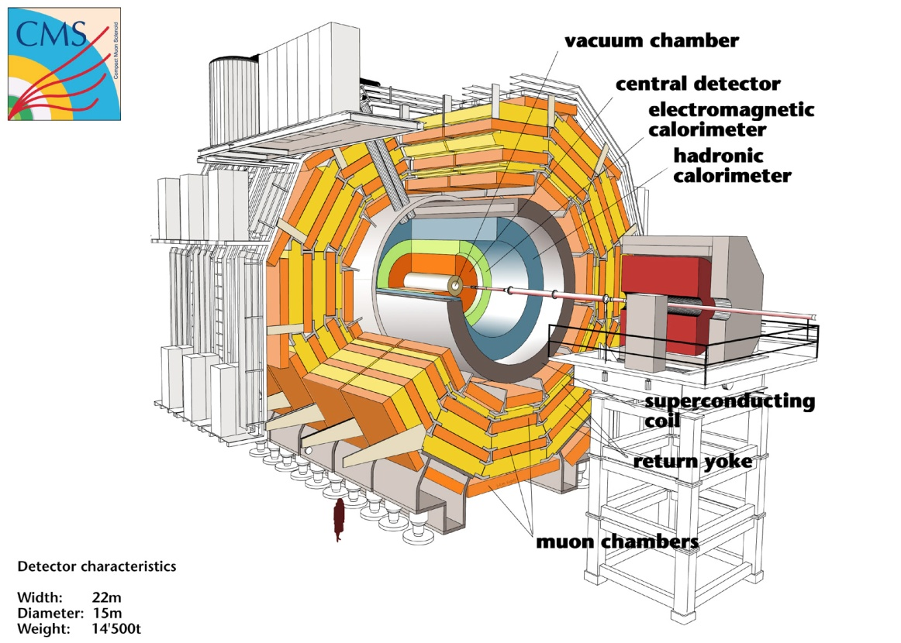

Slide 27
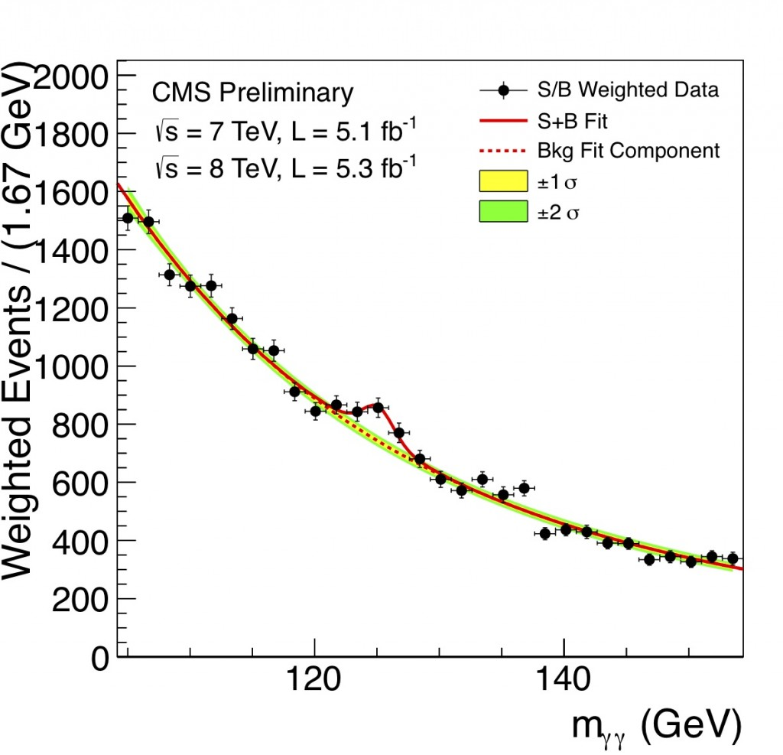
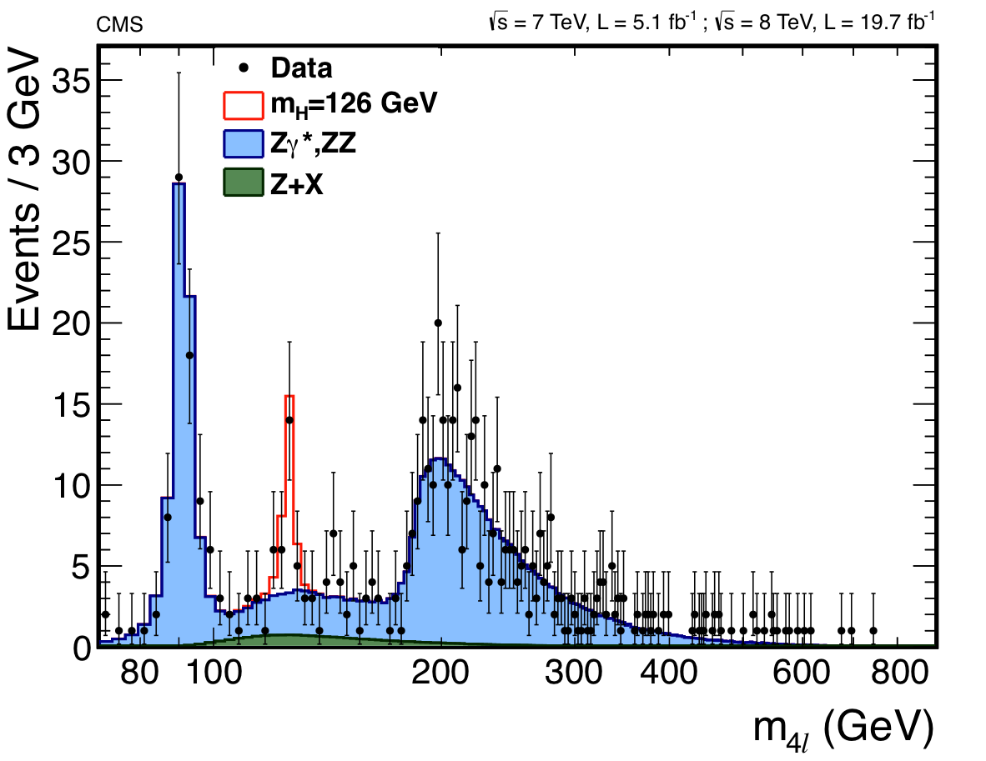
Principles
Only a few of the numerous known particles have lifetimes that are long enough to leave tracks in a detector.
Most of the particles are measured though the decay products and their kinematic relations (invariant mass).
Some short lived particles (b,c –particles) reach lifetimes in the laboratory system that are sufficient to leave short tracks before decaying → identification by measurement of short tracks → secondary vertex tagging
Detectors are built to measure the 8 particles
Their difference in mass, charge and interaction is the key to their identification.

Slide 28
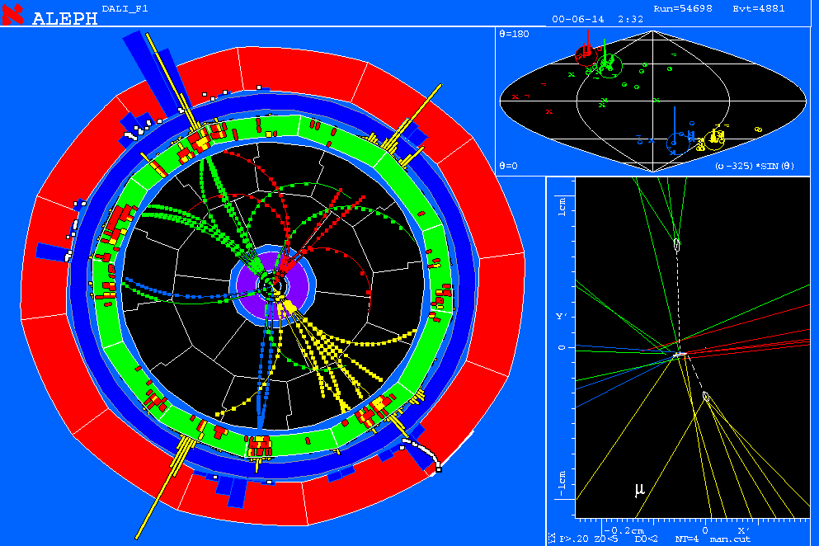
What determines the Size, Material and Geometry of the Detector ?
Impact Parameter Measurement (displaced vertices)
Momentum Measurement (bending of tracks in the B-field)
Energy measurement (absorption of particles in the calorimeters)
Muon measurement (identification)
Particle identification and lot’s of practical considerations

Slide 29
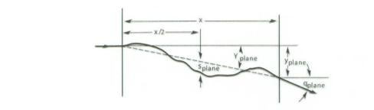
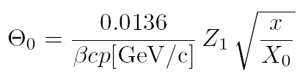
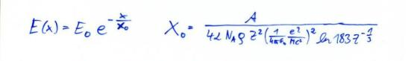
Multiple Scattering
Statistical (quite complex) analysis of multiple coulomb collisions (Rutherford scattering at the nuclei of the detector material) gives:
Probability that a particle is deflected by an angle θ after travelling a distance x in the material is given by a Gaussian distribution with sigma of:
X₀ ... Radiation length of the material
Z₁ ... Charge of the particle
p ... Momentum of the particle
For small deflection of the particles by our detector we want:
→ Large Radiation length X₀ – i.e. low Z and low density material (Be, C …)
→ Small x i.e. very thin detector elements.

Slide 30
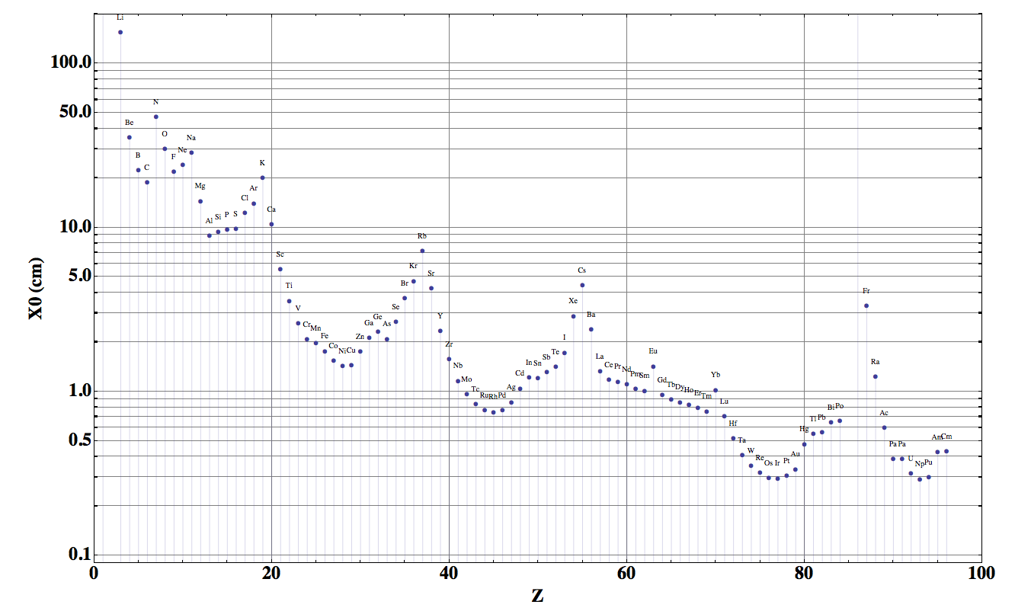
Radiation length of the different elements
Be
Carbon
Aluminum

Slide 31
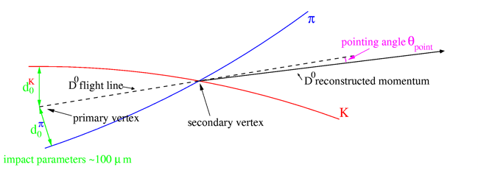
Heavy Flavour – Experimental measurement
Impact Parameter:
Prolongation of a track to the primary vertex. Distance between primary vertex and prolongation is called impact parameter.
If this number is ‘large’ the probability is high that the track comes from a secondary vertex.

Slide 32
What determines the impact parameter resolution?
What determines the impact parameter resolution
Vertex projection from two points: simplified telescope equation
pointing resolution = ( a ⊕ b ) μm
from
detector
position
error
from
coulomb
scattering
Δx
detector layer 2
θ_{m}
Δx
detector layer 1
r₁
r₂
r₁
r₂
perceived
vertex
perceived
vertex
a
true vertex
b
true vertex
Detector Granularity, minimize Δx:
e.g. 50um pixel and r₂ very large compared to r₁
→ a=Δx=50/√12 = 15um
First layer as close as possible to the vertex and First layer with minimal amount of material.
e.g. x/X₀ = 0.0114, r₁= 39mm
→ b= 57um for p=1GeV/c

Slide 33
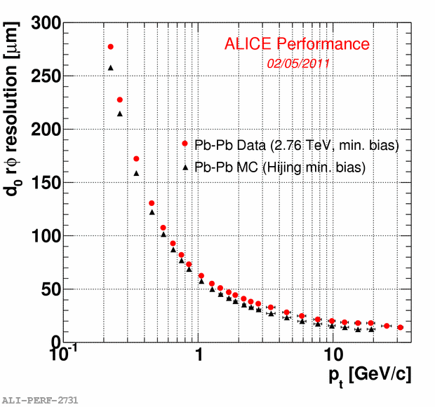
Heavy Flavour – Experimental measurement
Example of ALICE Silicon Tracker
Impact parameter resolution
For ‘low’ particle momenta i.e. p < 10GeV/c the impact parameter resolution is dominated by the material and distance of the first layer.
For high particle momenta the resolution is dominated by the detector granularity.
Alice x/X₀ = 0.014 and r1= 39mm is already very good !
Try to improve for upgrade.
Very ambitious goal x/X₀ = 0.003 and r1= 22mm !
→ Very small beampipe
→ Monolithic silicon sensors <50um
Optimized carbon fiber supports and cooling tubes.
a = 15um
b = 57um for p=1GeV/c

Slide 34
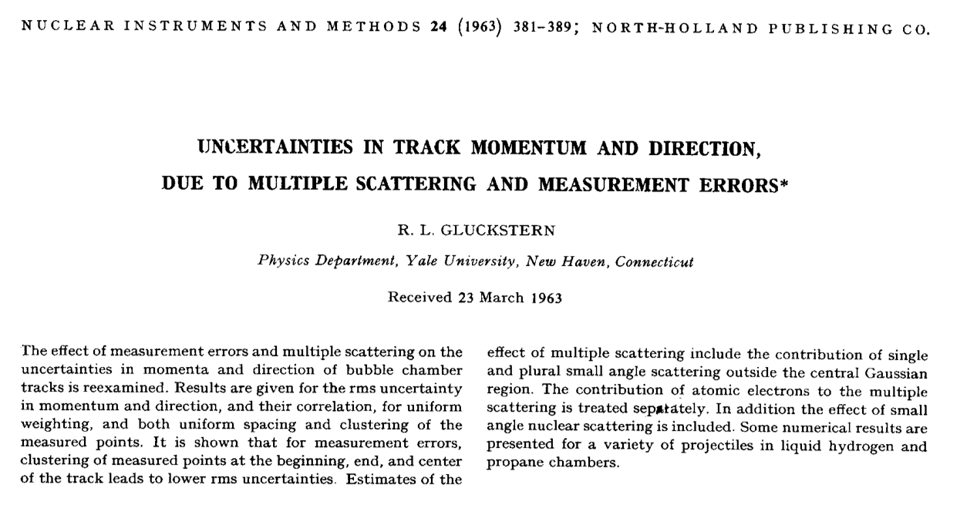
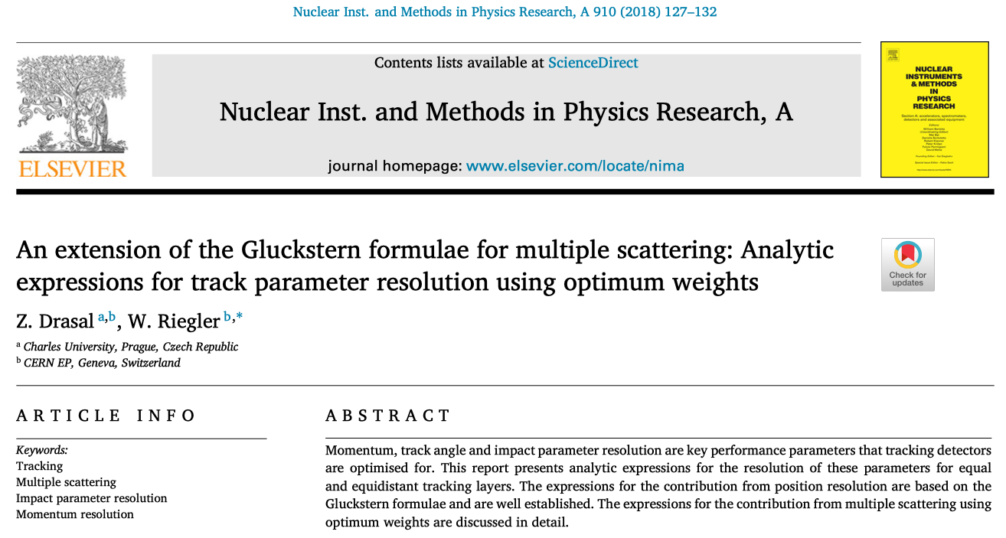
Explicit formulas for N equal and equidistant detector layers

Slide 35
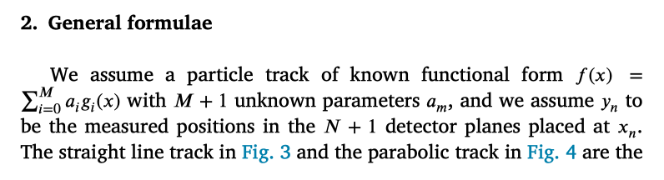
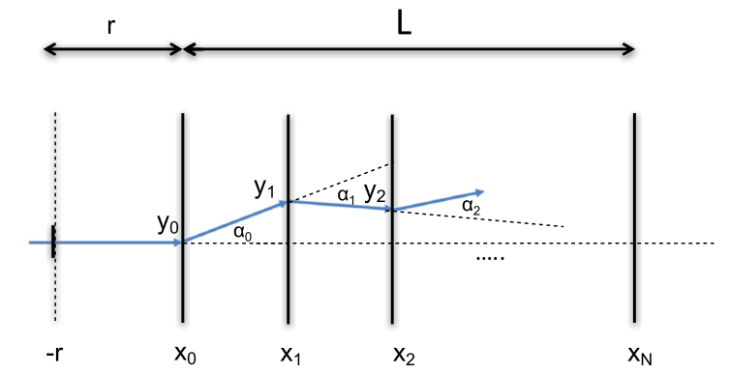
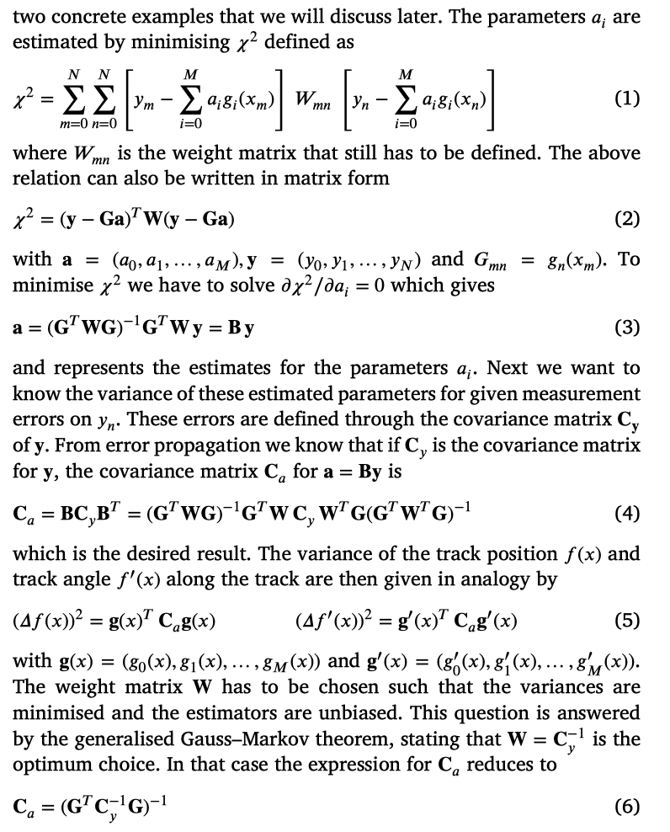
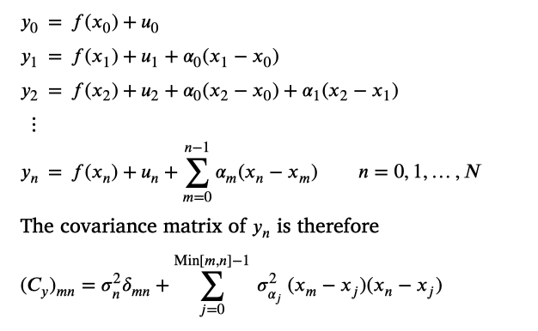
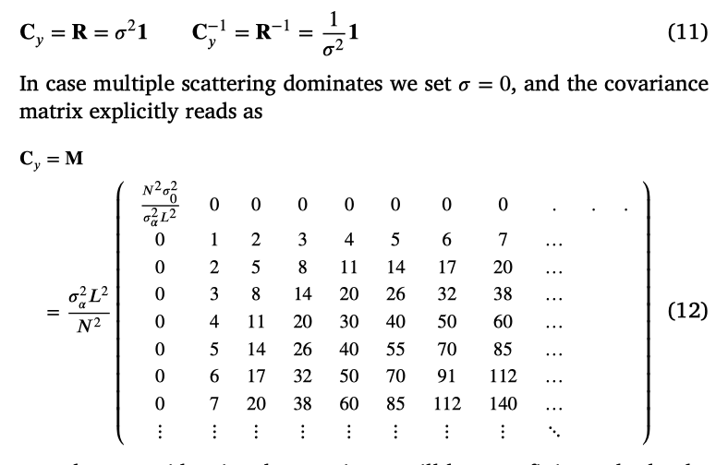
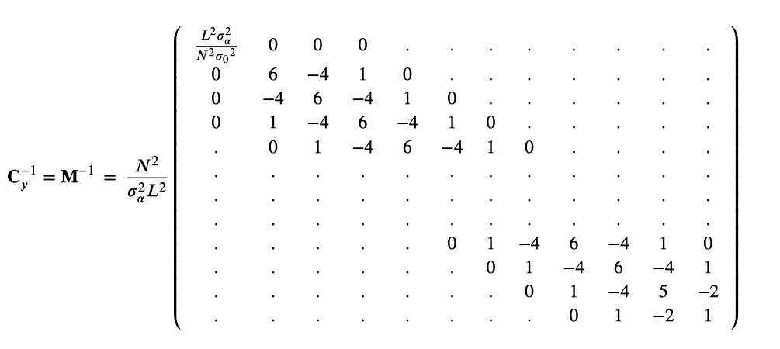

Slide 36
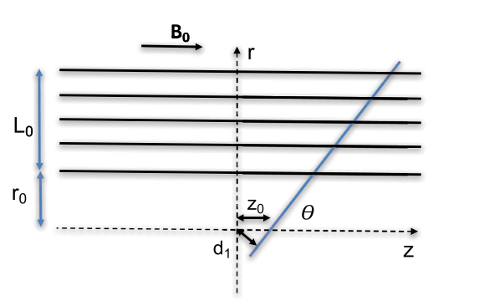
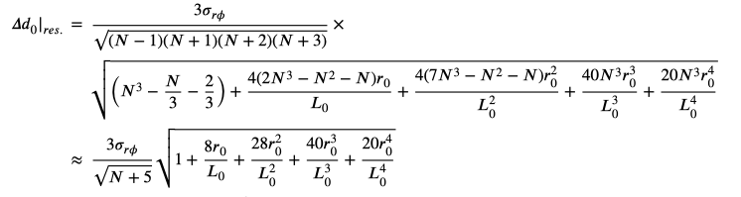
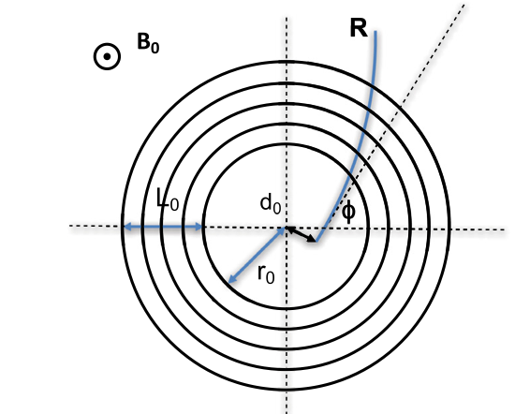



Transverse Impact Parameter Resolution
Position resolution
Multiple scattering
For a given
r₀ (distance between the first detector layer and the beamline)
L₀ (tracker radius)
there is an optimum number of layers.
Position resolution
Multiple scattering

Slide 37


Transverse Impact Parameter Resolution
r₀=5cm, L₀=125cm
Effect from multiple scattering on d₀ resolution almost independent of number of layers
Another layer gives more information but destroys the new information by the scattering in it’s material.
Material budget of the first layer and distance of the first layer to the beampine are the key contributors !

Slide 38



Longitudinal Impact Parameter Resolution
Position resolution
Multiple scattering
M.S. contribution is independent of the number of layers
Two layers as good as any number of layers !
Position resolution
Multiple scattering

Slide 39


Momentum resolution
Momentum measurement by measuring the curvature of a track in the B-field
Position resolution
Multiple scattering
Position resolution
Multiple scattering

Slide 40




Momentum resolution
L₀ ≈ 1.1m
Material budget
The momentum resolution is dominated by M.S.
Up to 50GeV/c at eta=0
Up to 100GeV in the forward regions
Tracker material is THE essential ingredient to performance !!

Slide 41
Excursion to Silicon Detectors
Silicon trackers are used for vertex measurement in all LHC experiments and for momentum spectroscopy on most LHC experiments (ALICE TPC, LHCb fiber tracker)

Slide 42

Si-Diode used as a Particle Detector
At the p-n junction the charges are depleted and a zone free of charge carriers is established.
By applying a voltage, the depletion zone can be extended to the entire diode → highly insulating layer.
An ionizing particle produces free charge carriers in the diode, which drift in the electric field and induce an electrical signal on the metal electrodes.
As silicon is the most commonly used material in the electronics industry, it has one big advantage with respect to other materials, namely highly developed technology.

Slide 43
Under-Depleted Silicon Detector
-
-
+
+
+
+
+
+
-
+
+
-
+
+
+
+
-
+
+
-
+
+
+
+
+
+
+
+
+
-
p
n
Zone without free charge carriers positively charged.
Sensitive Detector Volume.
Zone with free electrons. Conductive.
Insensitive to particles.
Electric Field

Slide 44
Fully-Depleted Silicon Detector
-
-
+
+
+
+
+
+
+
+
+
+
-
+
+
+
+
-
+
+
+
+
+
+
+
+
+
+
-
+
+
+
+
+
-
+
+
+
+
+
+
+
+
-
+
+
+
+
p
n
Zone without free charge carriers positively charged.
Sensitive Detector Volume.
Electric Field

Slide 45
Over-Depleted Silicon Detector
-
-
+
+
+
+
+
+
+
+
+
+
-
+
+
+
+
-
+
+
+
+
+
+
+
+
+
+
-
+
+
+
+
+
-
+
+
+
+
+
+
+
+
-
+
+
+
+
p
n
Zone without free charge carriers positively charged.
Sensitive Detector Volume.
Electric Field

Slide 46

Depletion Voltage
-
-
+
+
+
+
+
+
-
+
+
-
+
+
+
+
-
+
+
-
+
+
+
+
+
+
+
+
+
-
p
n
The capacitance of the detector decreases as the depletion zone increases.
Full depletion

Slide 47





Silicon Sensor
p-in-n
ca. 50-150 μm
readout capacitances
SiO₂
passivation
300μm
Fully depleted zone
N (e-h) = 11 000/100μm
Position Resolution down to ~ 5μm !
Solid State Detectors

Slide 48
Silicon Sensor before Irradiation
p(strips)-in-n
V=0
V>0
V>>0
→ depletion grows from the segmented side
n+(strips)-in-n
V=0
V<0
V<<0
depletion grows from the un-segmented side
This detector does not work properly unless it is fully depleted.
For partial depletion the ‚charge collection‘ is very inefficient and the ‚cluster size‘ is increasing.

Slide 49

Radiation Effects, Type Inversion
Type inversion ! An n-type Si detector becomes a p-type Si detector !
More voltage is needed to fully deplete the detector.
It might happen that the full depletion voltage becomes larger than the breakdown voltage
→ have to work in under depleted regime.
LHC
HL-LHC

Slide 50
Silicon Sensor after Irradiation and type inversion
p(strips)-in-n
V=0
V>0
V>>0
→ depletion grows now from the unsegmented side !
V=0
V<0
V<<0
depletion now grows from the segmented side
can work in under-depleted mode
For high radiation environment, where one might not reach full depletion after some time, n-in-p detectors are preferred.

Slide 51

p-in-n and n⁺-in-n sensors
p-in-n single sided processing
n-in-n double sided processing
from P. Riedler

Slide 52
n-in-p Silicon Sensors
Since recently p-bulk material is available in a quality that is sufficient for these detectors. Baseline for large areas of HL-LHC trackers !
Advantage of n-in-p technology:
No type inversion
Depletion from the ‘correct’ side (i.e. from the readout side)
Single sided processing is possible
Electrons drift towards the readout side and are trapped less because electrons are faster → still good signal after irradiation.
n implant
p bulk

Slide 53

Radiation Effects ‘Aging’
LHC Pixels: 10¹⁵ n/cm² 14 TeV 300fb⁻¹
HL-LHC Pixels: 10¹⁶n/cm² 14TeV 3000fb⁻¹
FCC-hh Pixels: 2x10¹⁸ 100TeV 30 000fb⁻¹
First Pixel layer only !! The rest of the tracker volume has significantly less radiation.

Slide 54



Radiation Effects ‘Aging’
Increase of leakage current
Increase of depletion voltage
Decrease of charge collection efficiency due to under-depletion and charge trapping.
Use silicon material engineering to limit radiation damage
Use cooling to decrease leakage current
(approx. factor two every 8 degrees)
from P. Riedler

Slide 55
Sensor Technology in Present Experiments
p-in-n, n-in-p (single sided process)
n-in-n (double sided process)
Choice of sensor technology mainly driven by the radiation environment
 | Fluence 1MeV n_{eq} [cm⁻²] | Sensor type
ATLAS Pixel* | 1 x 10¹⁵ | n-in-n
ATLAS Strips | 2 x 10¹⁴ | p-in-n
CMS Pixels | 3 x 10¹⁵ | n-in-n
CMS Strips | 1.6 x 10¹⁴ | p-in-n
LHCb VELO | 1.3 x 10^{14**} | n-in-n, n-in-p
ALICE Pixel | 1 x 10¹³ | p-in-n
ALICE Drift | 1.5 x 10¹² | p-in-n
ALICE Strips | 1.5 x 10¹² | p-in-n
G. Kramberger, Vertex 2012
n-side readout (n-in-n, n-in-p):
Depletion from segmented side (under-depleted operation possible)
Electron collection
Favorable combination of weighting field and
Natural for p-type material
** per year

Slide 56
Key Sensor Issues for the Upgrades
Radiation damage will increase to several 10¹⁶ n_{eq} cm⁻² for the inner regions in ATLAS and CMS
  Example of common activities to develop radiation harder sensors within the RD50 collaboration
  Operational requirements more demanding (low temperature and all related system aspects)
Increased performance:
  Higher granularity
  Lower material budget
Control and minimize cost
  Large areas
  Stable and timely production
Upgrades | Area | Baseline sensor type
ALICE ITS | 10.3 m² | CMOS
ATLAS Pixel | 8.2 m² | n-in-p
ATLAS Strips | 193 m² | n-in-p
CMS Pixel | 4.6 m² | n-in-p
CMS Strips | 218 m² | n-in-p
LHCb VELO | 0.15 m² | n-in-p
LHCb UT | 5 m² | n-in-p

Slide 57


3D Sensors
0°
Both electrode types are processed inside the detector bulk
Max. drift and depletion distance set by electrode spacing - reduced collection time and depletion voltage
Very good performance at high fluences
Production time and complexity to be investigated for larger scale production
Used in ATLAS IBL
0°
15°
ATLAS IBL Sensor (Threshold: 1600 e
proton-irrad: 5x10¹⁵ n_{eq}/cm² with 24 MeV protons
neutron-irrad: 5x10¹⁵ n_{eq}/cm² by nuclear reactor)
From: Prototype ATLAS IBL Modules using the FE-I4A Front-End Readout Chip"
(JINST 7 (2012) P11010)

Slide 58


CMOS Sensors
CMOS sensors contain sensor and electronics combined in one chip
  No interconnection between sensor and chip needed
Standard CMOS processing
  Wafer diameter (8”)
  Many foundries available
  Lower cost per area
  Small cell size – high granularity
  Possibility of stitching (combining reticles to larger areas)
Very low material budget
CMOS sensors installed in STAR experiment
ALICE ITS upgrade
Hybrid Pixel Detector
300um
150um
CMOS (Pixel) Detector
50um

Slide 59



High Resolution Low Mass
Silicon Trackers, Monolithic Detectors
Linear Collider Physics requirement:
Large variety of
monolithic pixel
Detectors explored,
mostly adapted to low
collision rates of LC.
Radiation Resistance (<10¹³ neq/cm², <10kGy) and charge collection time (> ≈ microseconds) do for the moment not allow application in high rate environments of ATLAS, CMS, LHCb.
But ! Stay tuned for developments in the near future.

Slide 60


ITS TDR CERN-LHCC-2013-024

Slide 61


ALICE ITS upgrade
Inner Barrel: 3 layers
Outer Barrel: 4 layers
Detector module (Stave) consists of
Carbon fiber mechanical support
Cooling unit
Polyimide printed circuit board
Silicon chips (CMOS sensors)

Slide 62




Inner Barrel Detector Stave
MECHANICS &COOLING
Design optimization for material budget reduction
Total weight
1.4 grams

Slide 63
Tracking
Silicon sensors are the key detectors for vertex determination and momentum spectroscopy.
In addition to position resolution, material budget and radiation hardness are the key requirements for silicon trackers.
n-in-p strips sensors and hybrid pixels feature prominently at the HL-LHC.
Monolithic silicon sensors have significantly improved over the last years in terms of speed and radiation hardness and will have a large scale application in ALICE.

