Slide 1
Cooling of particle detectors
Bart Verlaat, 15 February 2017

Slide 2
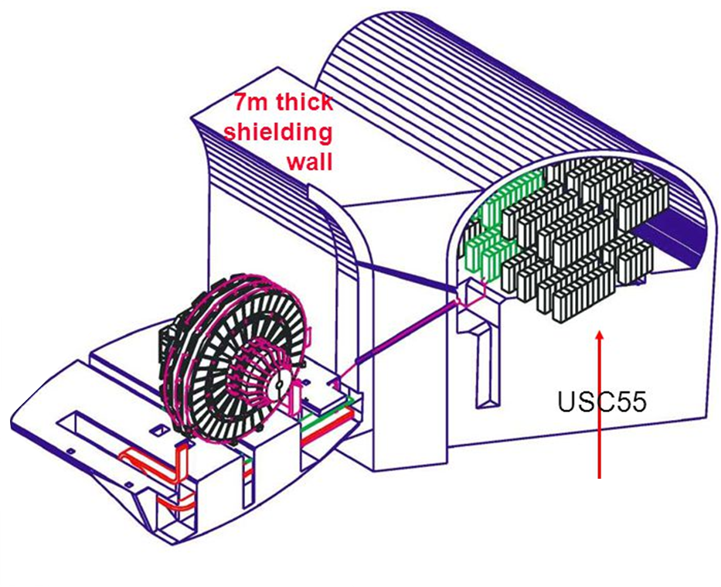
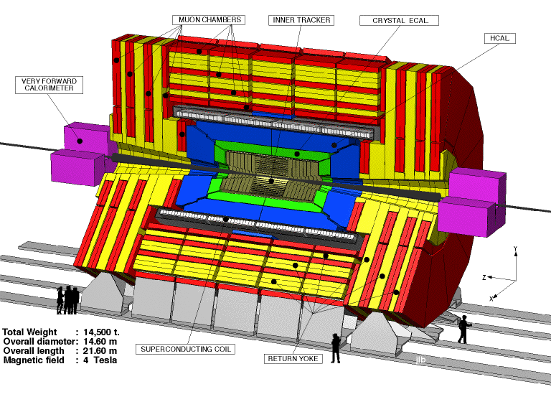
Why is cooling needed in particle detectors?
Electronics produce heat
When the heat is not removed, the temperature will increase
Too warm electronics will be damaged
A detector is full of electronics
Some of them need to be cold <-10°C
Total heat load of CMS:
Inside the detector:
Warm (10°C- 40°C): 700 kilowatt (2000 game PC’s)
Cold: (<- 10°C): 140 kilowatt (400 game PC’s)
Outside the detector:
Warm (10°C- 40°C): 2.600 kilowatt (7.600 game PC’s)
Cooling systems need to cool and reject the heat of about 10.000 game PC’s (325 Watt each)
2600 kW
700 kW
140 kW

Slide 3
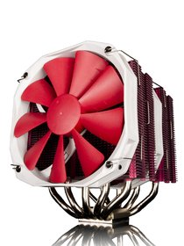
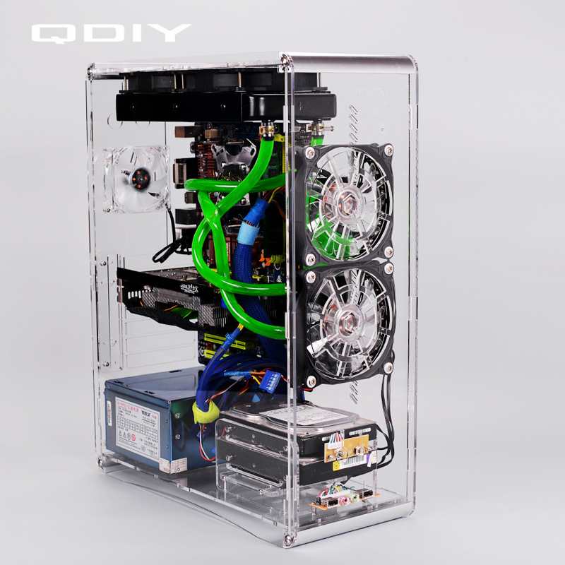
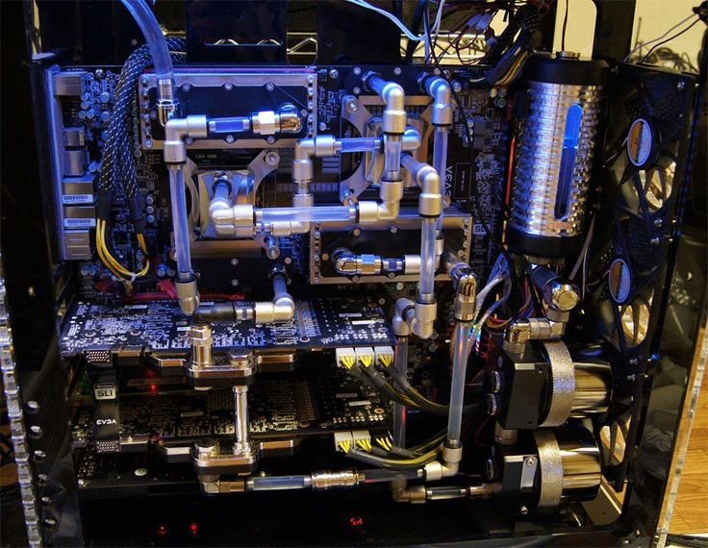
Processor cooling
The limit of processor speed is by the temperature,
faster processors need better cooling.
Same problem with detectors, but we don’t want the usual processor cooling in our detector.
We need something much smaller and much lighter.

Slide 4
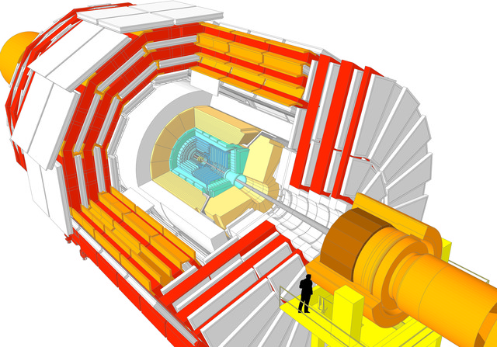
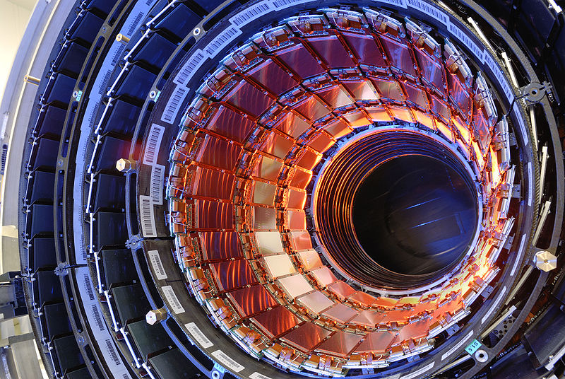
Silicon detector cooling
The silicon tracker need to be cold <-10’C, otherwise the silicon will get damaged due to radiation.
Silicon get damaged
Silicon is not cold enough
Silicon produces
more heat
Silicon layers
Silicon gets warmer

Slide 5
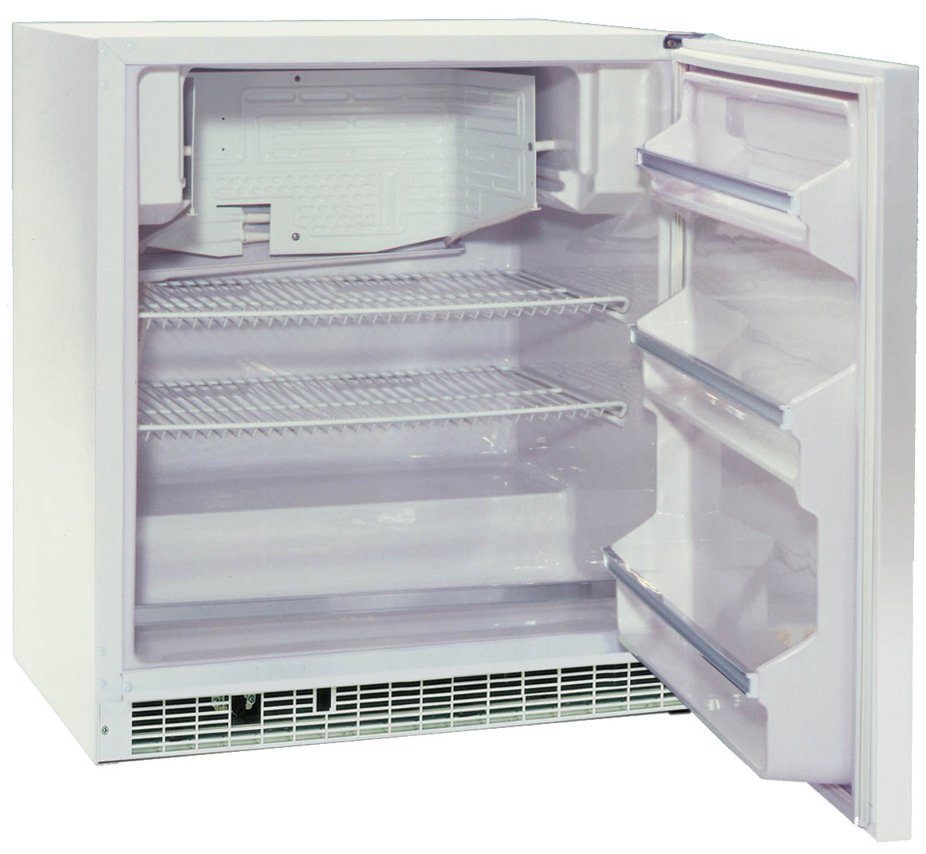
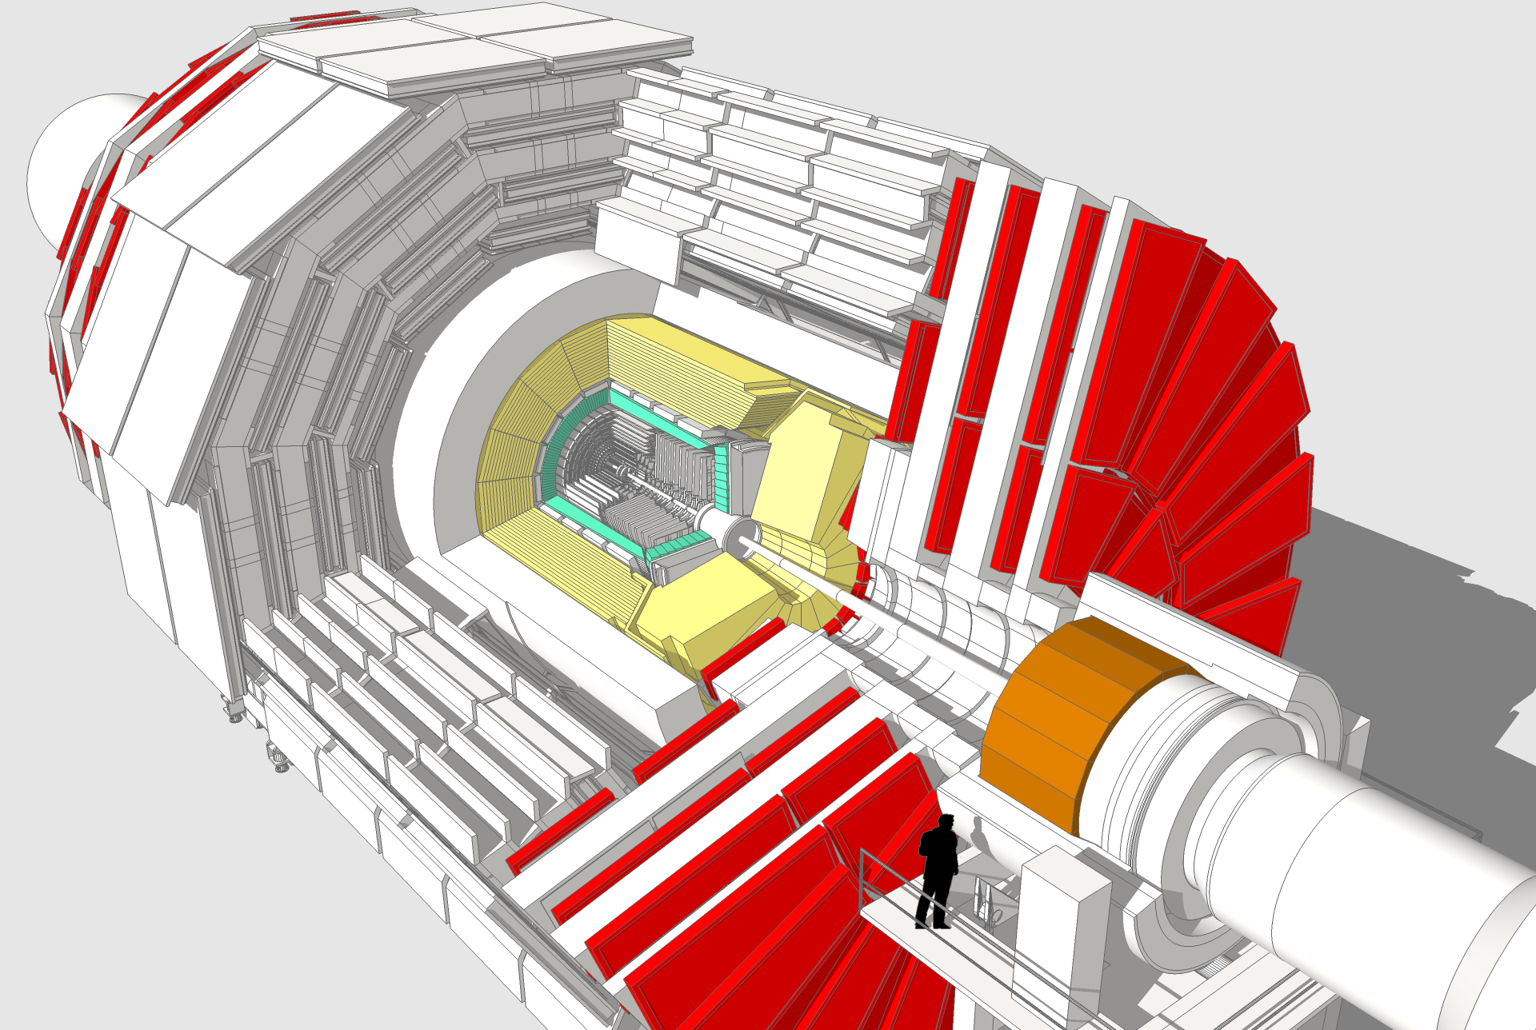
Detector cooling
Detectors generate a substantial amount of waste heat, just putting it in a cold environment is not enough.
Heat must be removed at the heat source and transferred to the cooling machine.
Like the advanced processor cooling systems
Just like a processor, the heat must be cooled close to the silicon detector
Heat

Slide 6
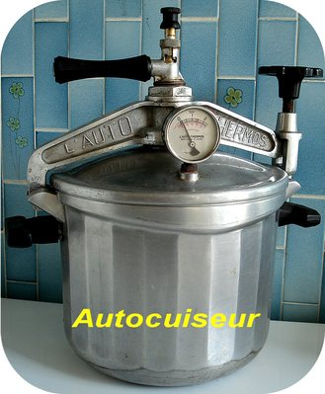
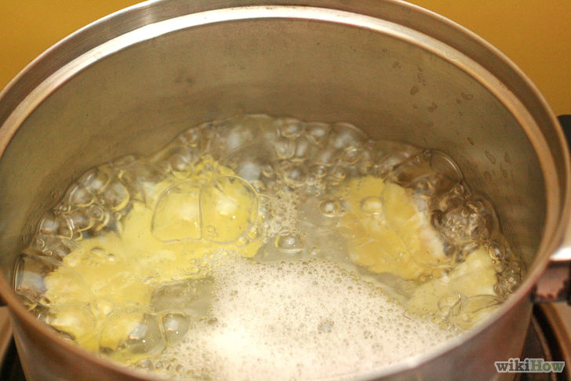
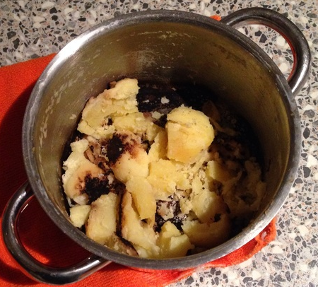
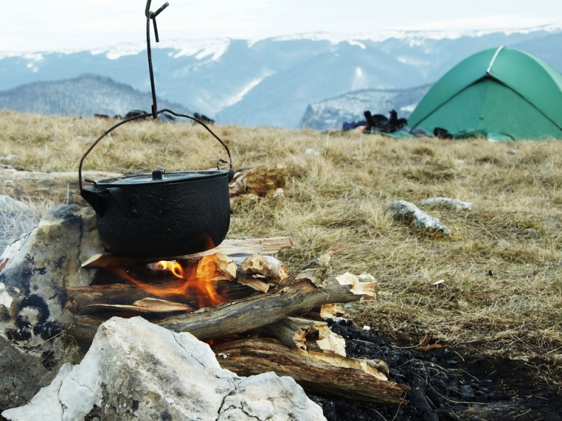
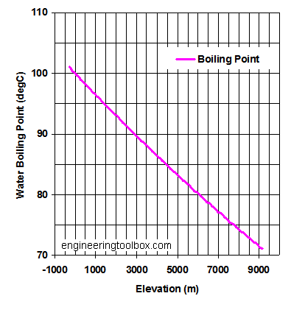
Boiling water
Dry-out, potatoes are burning at high temperature
Boiling at 100’C
Fast boiling (115’C) under pressure
B
Slow cooking (90’C) in the mountains
A
C

Slide 7
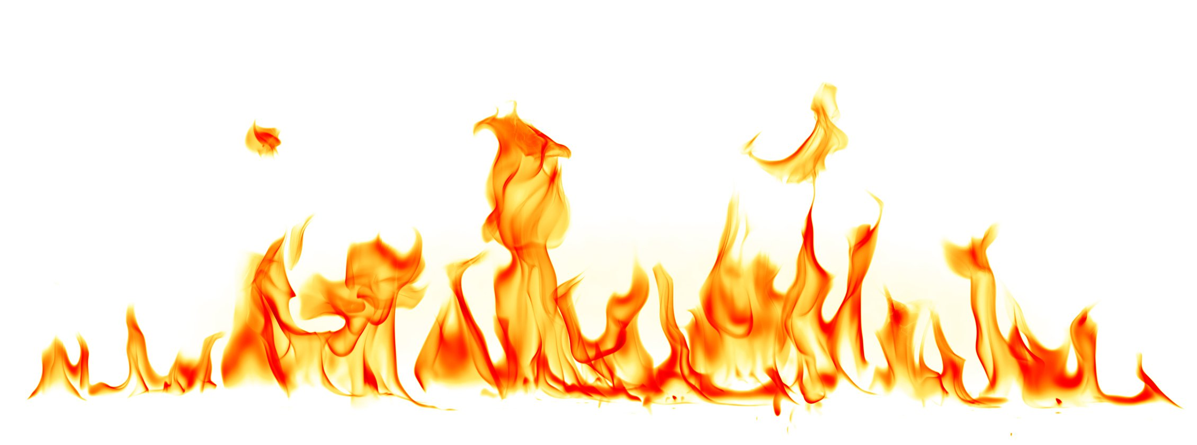
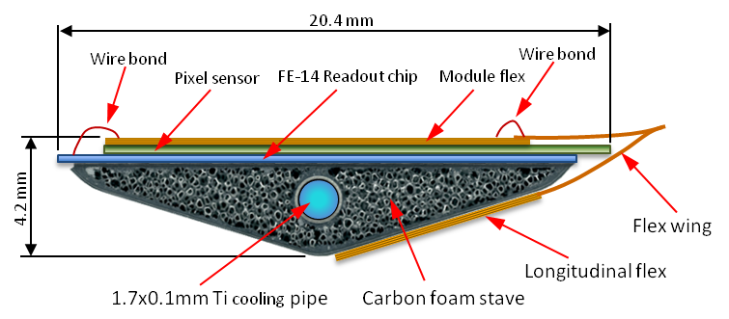
Liquid and evaporative cooling
Tube wall
Temperature
Fluid
Cross section of an ATLAS stave
Flow
Best performance
Tube wall
Temperature
Fluid
Flow
Bubbles

Slide 8
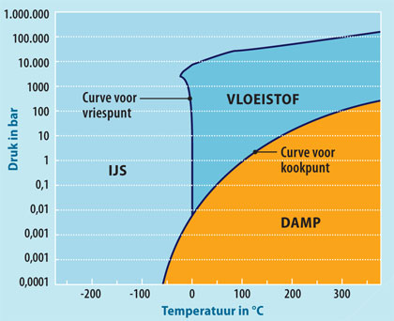
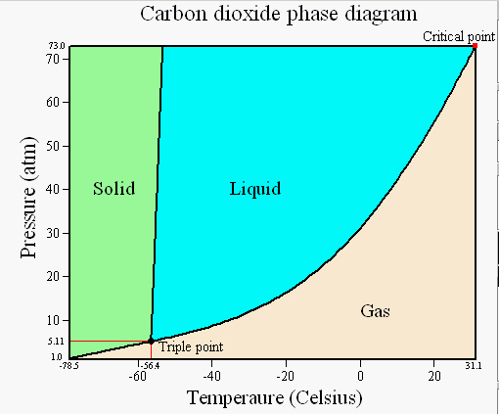
So the boiling temperature depends on the pressure
Water (H2O)
We can make 20’C water boil and freeze, just by lowering the pressure
Detector cooling range
But we cannot go lower than 0’C, we need another fluid which can do this => Carbondioxide (CO2)

Slide 9
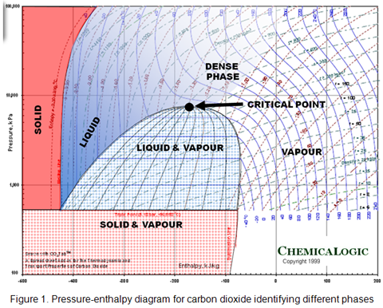
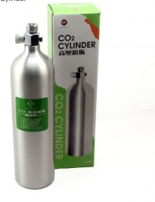
The Pressure-Enthalpy diagram
Density line
20’C
400 (g/l)
100
-40’C
Pressure (Bar)
10
5.2
A 10 liter bottle with 4kg CO2
-78’C
1
0
100
200
300
400
500
600
Enthalpy (Energy) (kJ/kg)

Slide 10
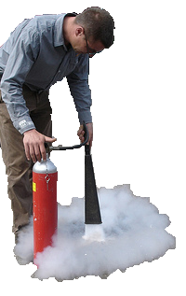
How does a CO2 fire extinguisher works?
-40’C
20’C
400 (g/l)
100
Pressure (Bar)
10
5.2
-78’C
1
0
100
200
300
400
500
Enthalpy (Energy) (kJ/kg)
Expanding liquid to atmosphere (1 bar) from a 20’C bottle makes CO₂ ice and gas. The ice cools the fire, the gas shields the fire from oxygen.

Slide 11
How to cool a detector with CO2?
In reality we do not vent to atmosphere but reuse the gas by pumping it back into the bottle
-40’C
20’C
400 (g/l)
100
Pressure (Bar)
Expansion without heat exchange
10
5.2
Heat exchange without pressure change
-78’C
1
0
100
200
300
400
500
Enthalpy (Energy) (kJ/kg)
If we expand to 10 bar we have a liquid-gas mixture of -40’C, and can cool electronics

Slide 12

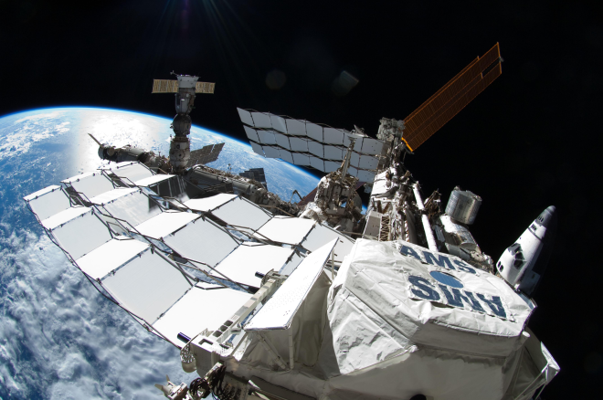

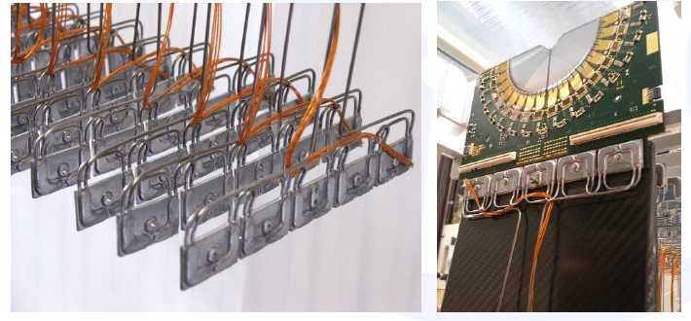
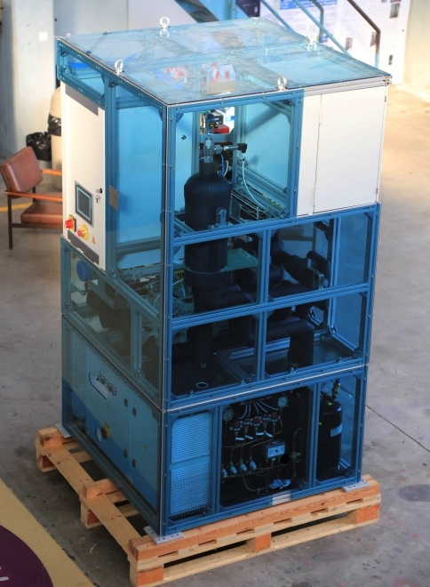

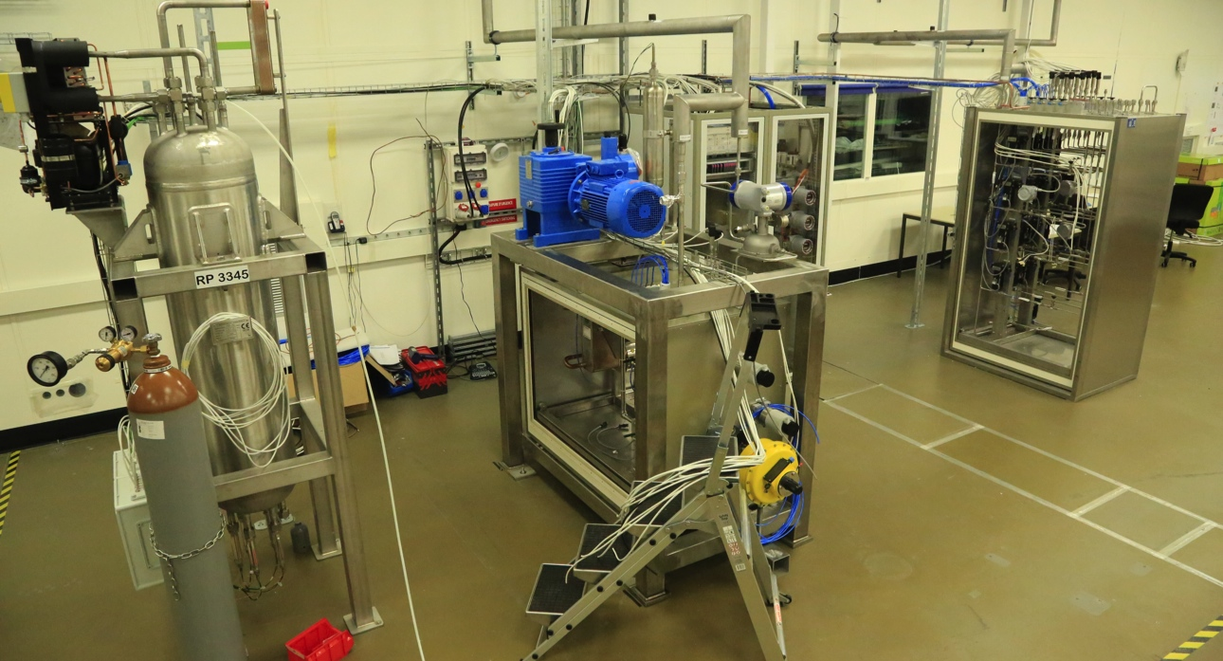
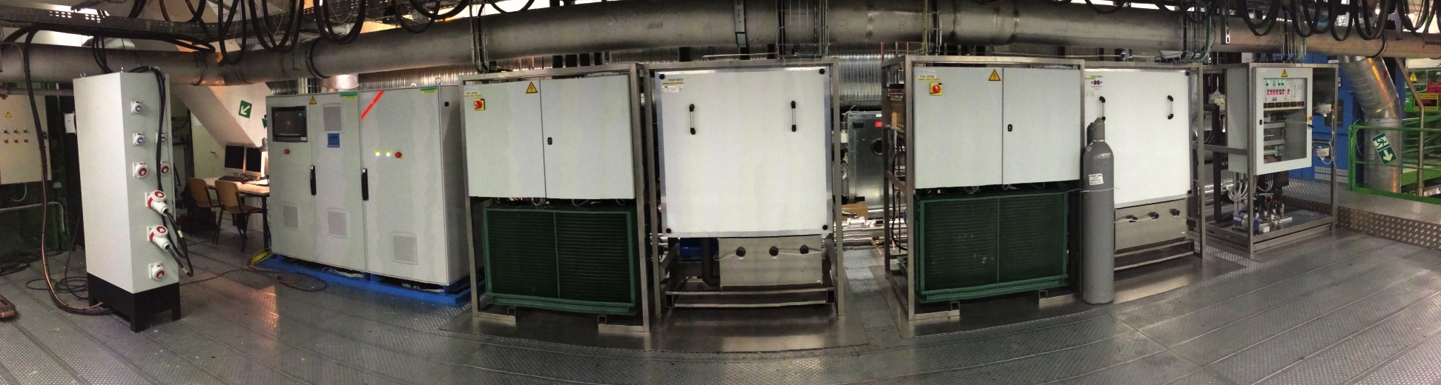
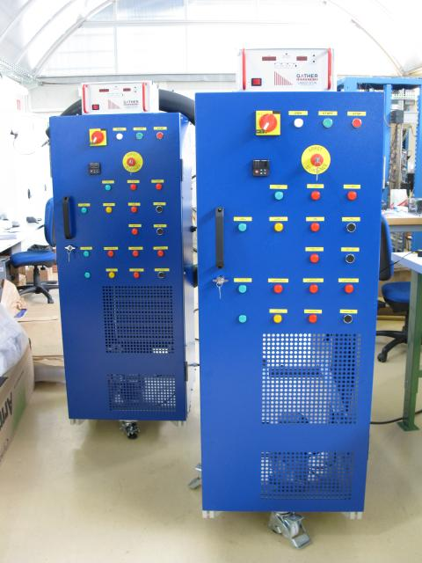
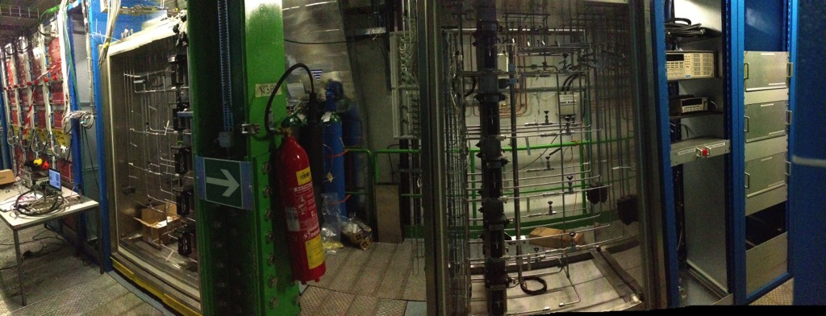
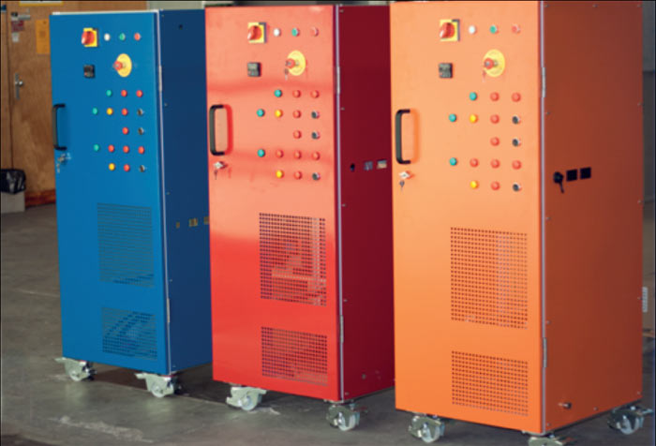
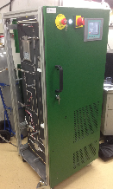
CO₂ cooling systems for HEP detectors
2PACL concept
AMS 2
CORA/SR1 (+Nikhef, Lyon, Aachen, DESY…): ~2 kW @ -20 ˚C
LHCb Velo
MARCO: 1 kW @ -40 ˚C
CMS Pix-Ph1 “TIF proto”: 15 kW @ -25 ˚C
ATLAS IBL: 2 x 3 kW @ -35 ˚C
2008
2009
TRACI V1 (2/2)
2010
CMS Pix-Ph1 “P5”: 2 x 15 kW @ -25 ˚C
(in construction)
2011
TRACI V2 (3/3)
2012
2013
High power and low temperature systems for CMS and Atlas inner detector upgrades
TRACI V3 (1/4)
PLC-based logic
Touch-screen
New pump(s)
Improved piping design
Portable laboratory units:
~100 W @ -30 ˚C

Slide 13

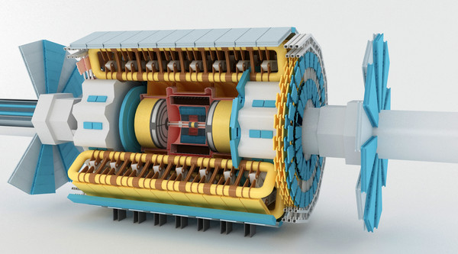
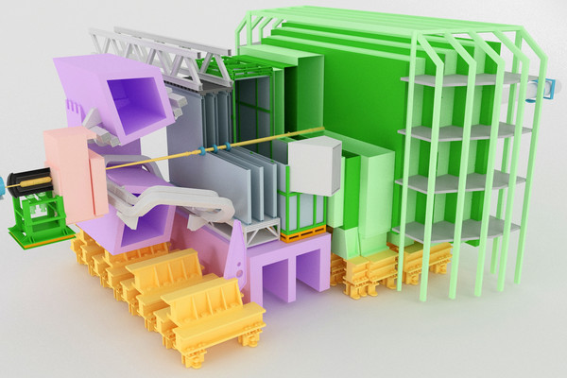
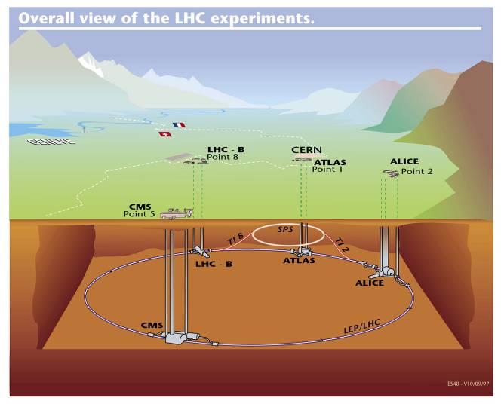

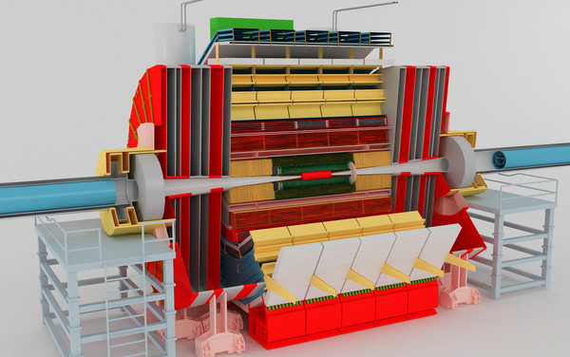

CO₂ cooling projects in LHC
VELO detector: 1.5 kW@-30°C
(Running successfully since 2007)
Atlas IBL: 1.5 kW@-40°C
(Operational 2013)
Ca. 100m
27 km
LHC
CMS pixel: 15 kW@-20°C
(Operational 2014)

Slide 14
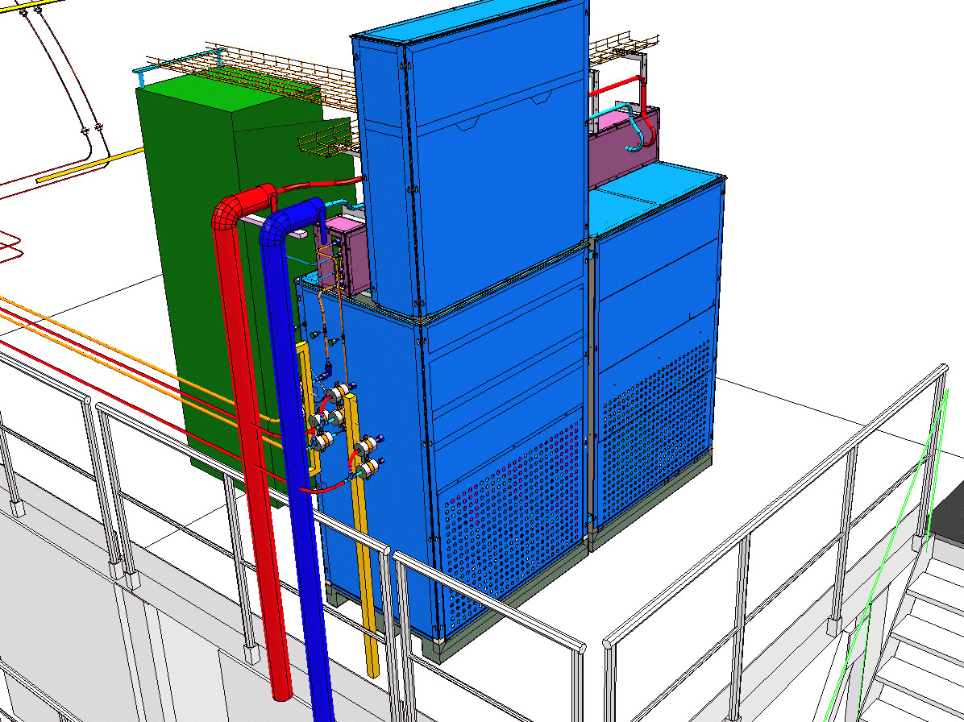
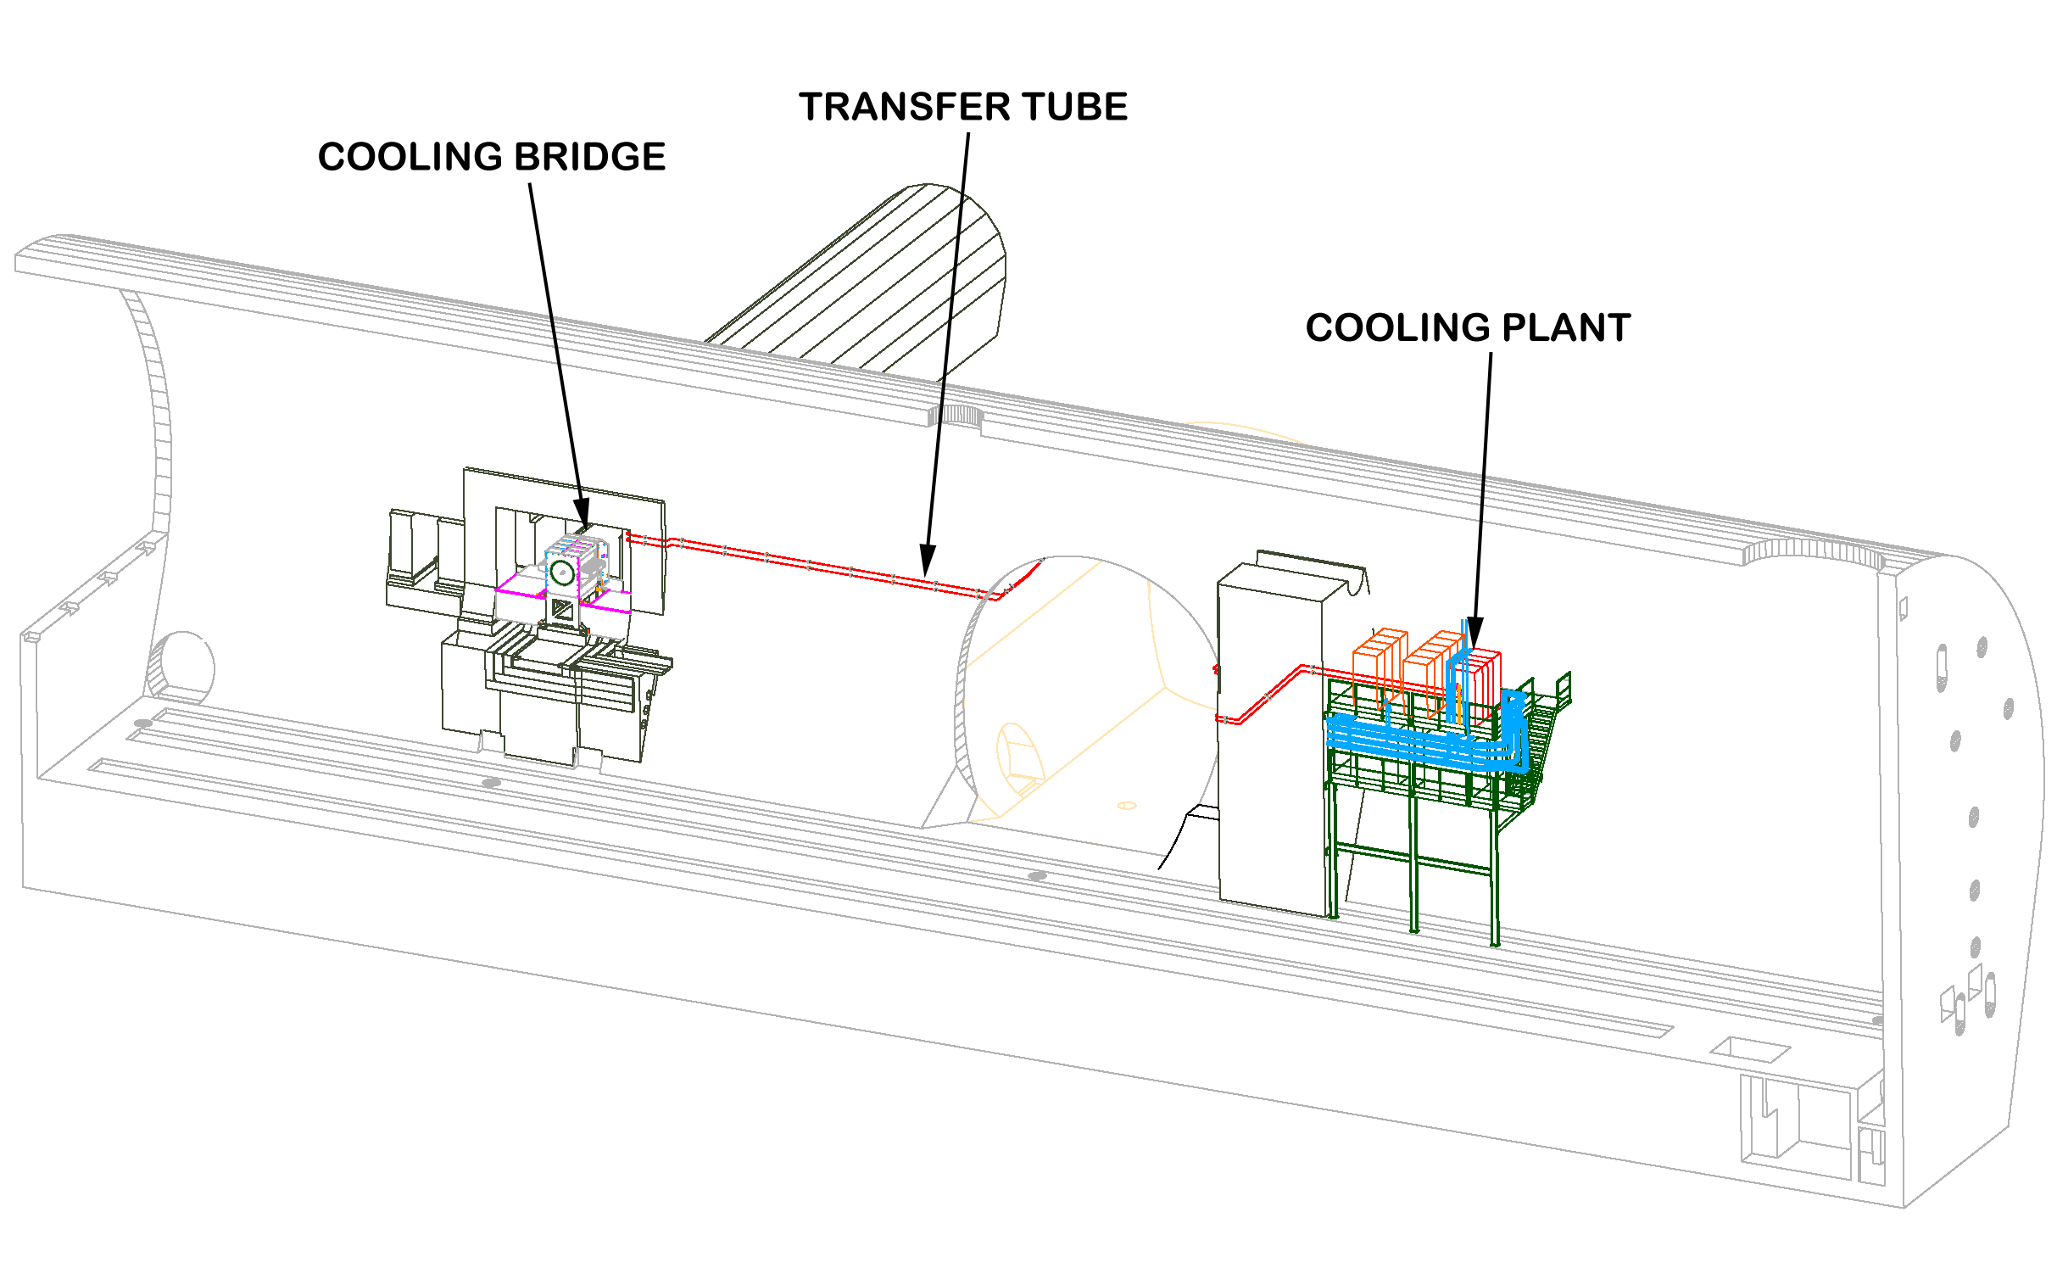
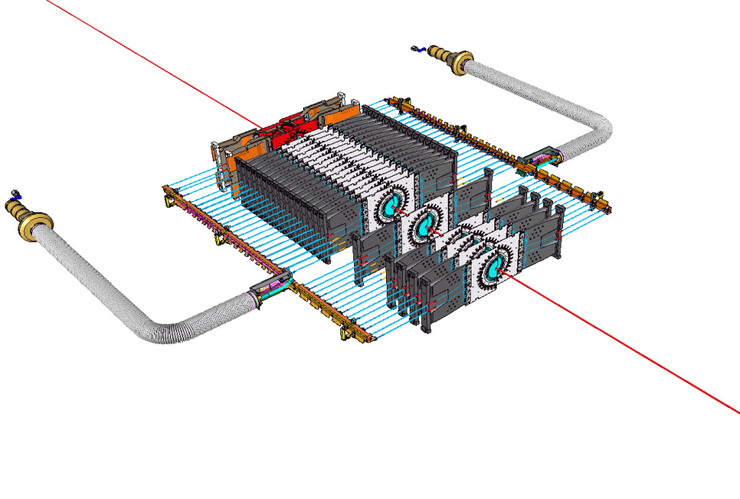
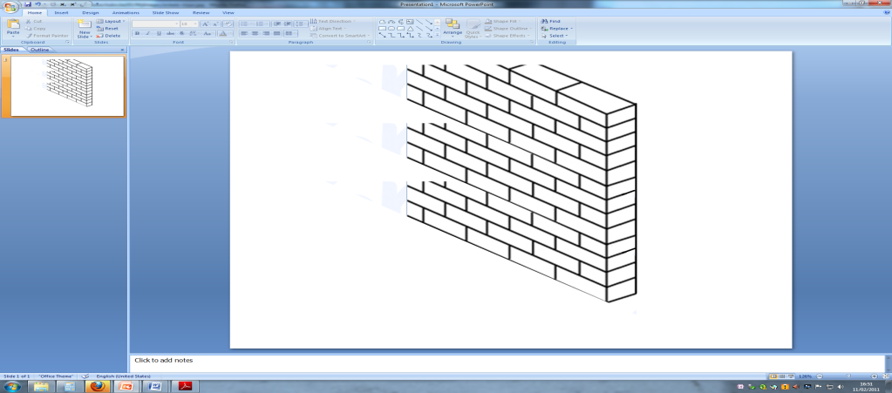



LHCb-Velo Thermal Control System (LHCb-VTCS)
Transfer tube
Concentric assembly
Evaporator
Passive tubing only
Cooling Plant
All active hardware
LHCb experimental cavern
Cooling capacity: 1.5 kW@-30°C

Slide 15
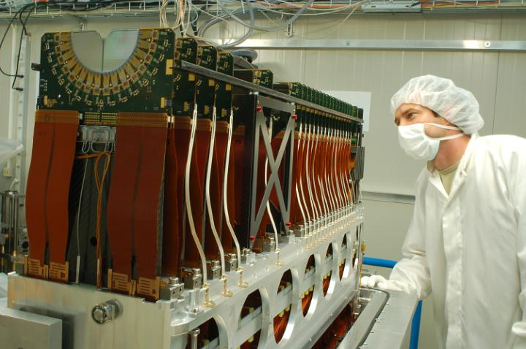
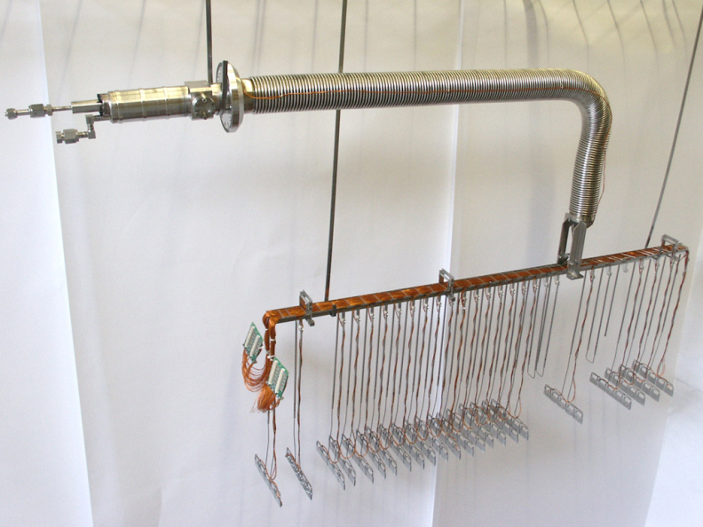
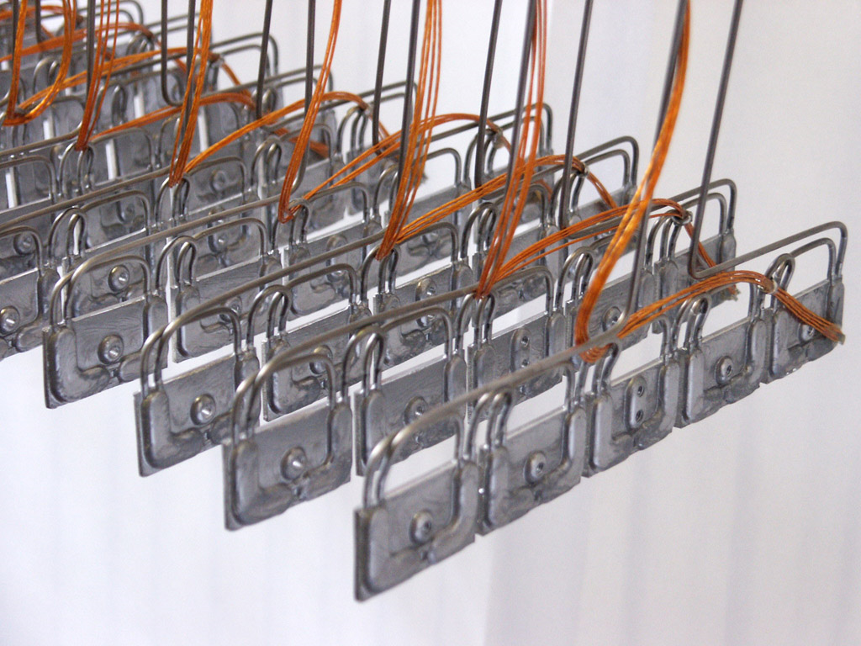
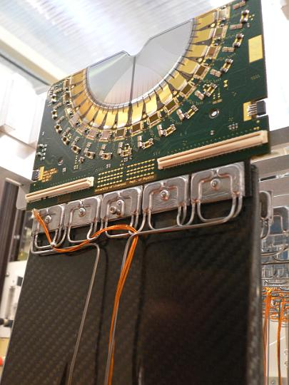
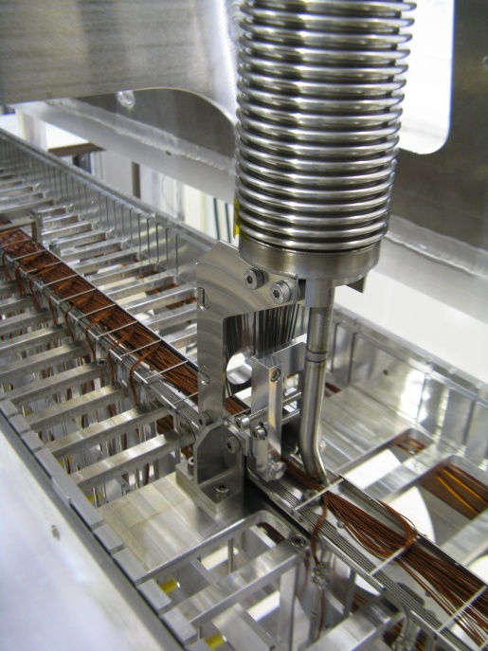
VTCS Evaporator

Slide 16
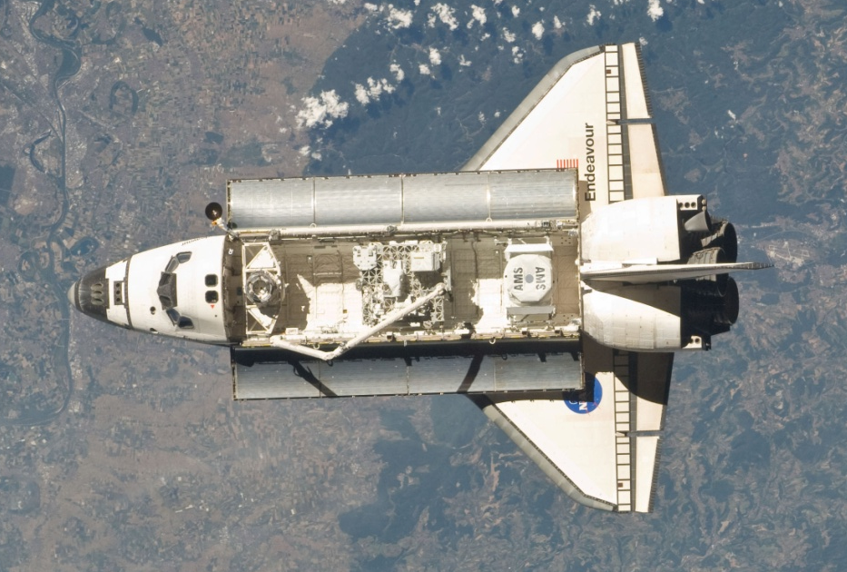

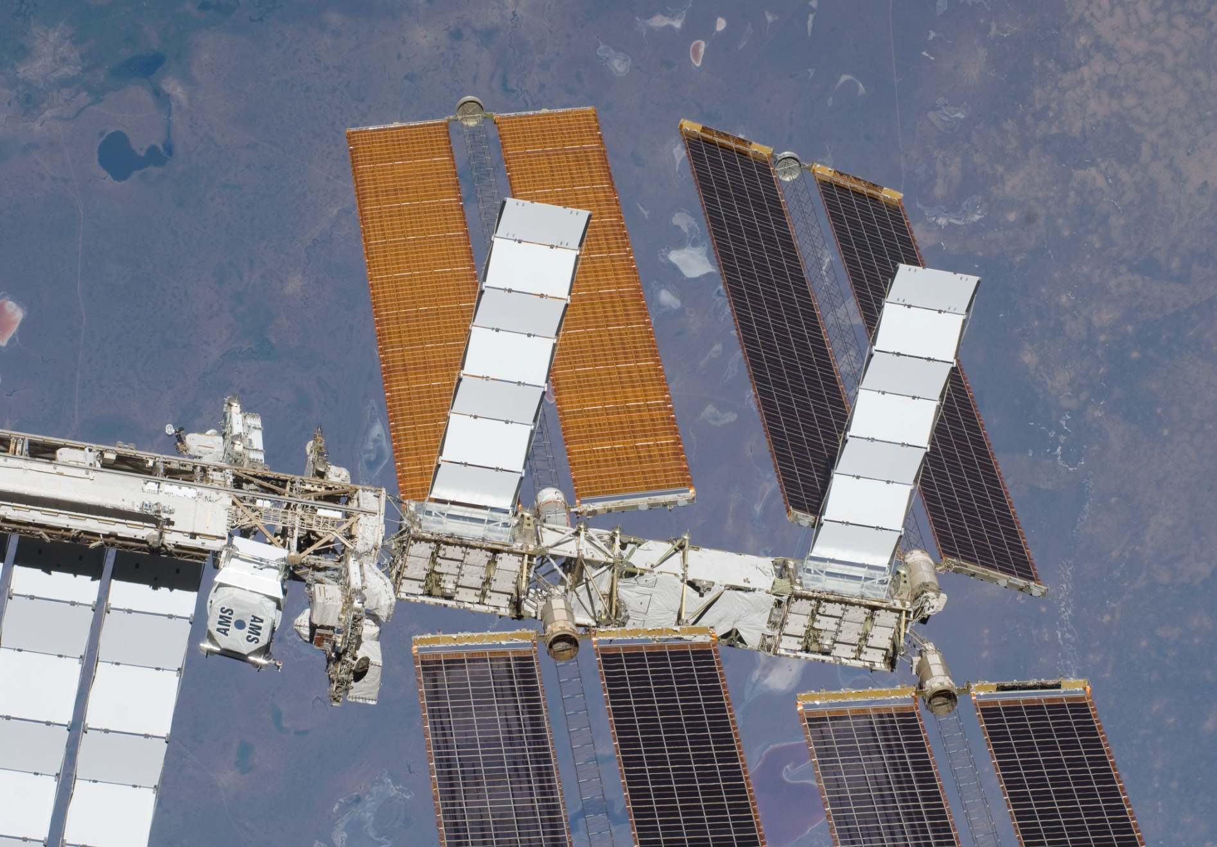
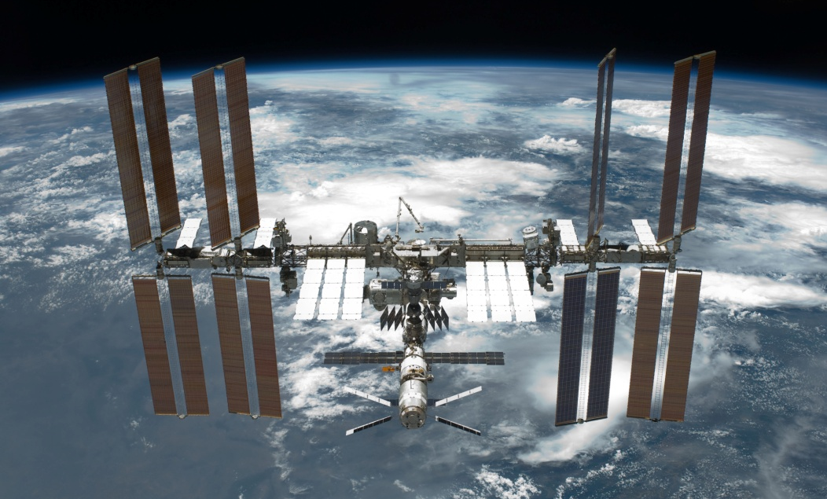
The 1st CO₂ cooling system in Space!
A CO₂ cooling system for Alpha Magnetic Spectrometer (AMS) Tracker Detector on the International Space station (ISS)
CO₂ cooling radiator
AMS in the Shuttle (STS-134, May 2011)
AMS on the ISS

Slide 17










AMS-Tracker Thermal Control System (AMS-TTCS)
Ram radiator with condensers
Wake radiator with condensers
Primary cooling not needed in space as environment is cold. Direct radiation to space
Cooling system component boxes
(1 redundant)
150 Watt detector with evaporator rings
17

Slide 18
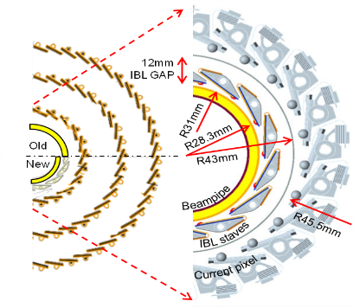
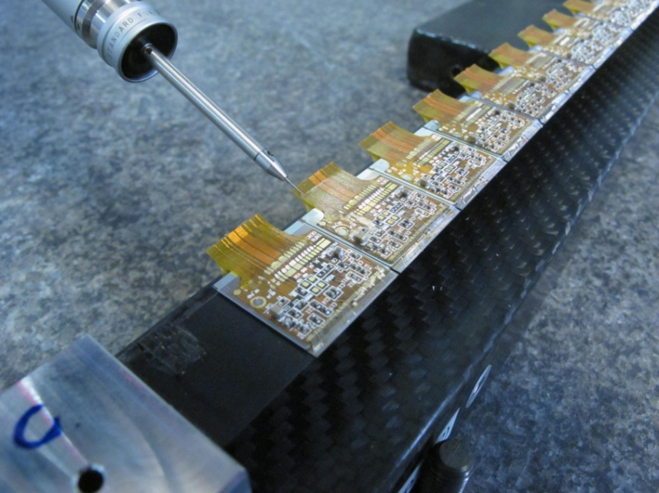
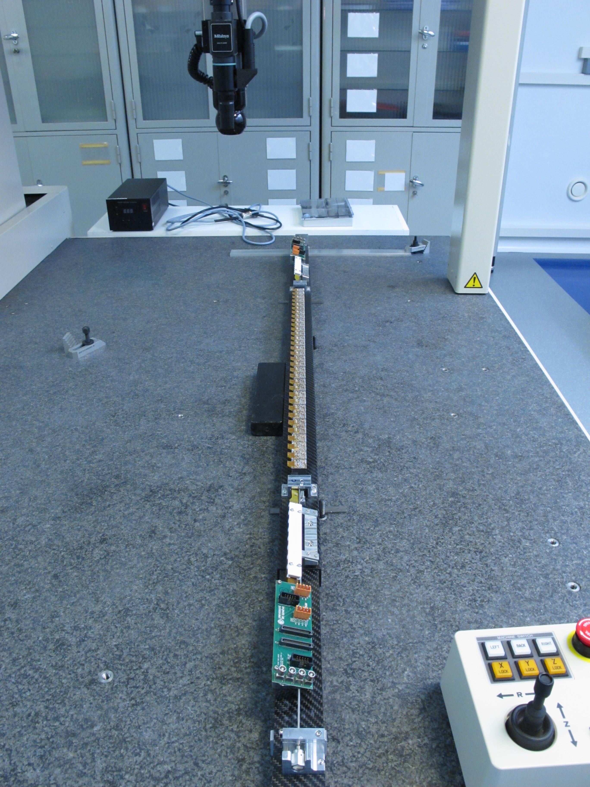
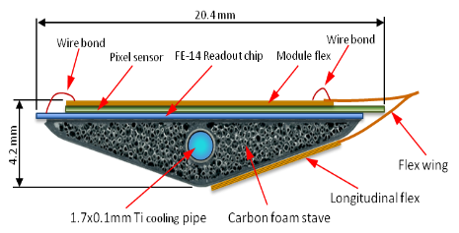

ATLAS IBL: A new 1st layer around a reduced beam pipe
IBL an extra pixel layer
IBL pixel sensors
Component (32 per stave) | Power (W/unit) | Power (W/stave)
FEI4 chip | 1.12 | 35.84
Pixel sensor (after irradiation) | 0.68 | 21.61
Stave flex | 0.17 | 5.38
Type 1 cables | 0.17 | 5.38
Total per stave |  | 68.21
Total for 14 staves |  | 954.94
IBL Carbon stave with cooling pipe
IBL Stave
Cooling temperature required: <-35°C

Slide 19




The IBL cooling loops
Flex line routing in IDEP
7 miniature vacuum insulated flexible cooling lines (<18mm)
Evaporator tubes in staves 1.5mm
1 round trip = 1 loop = 31m
PP1 connectors
Splitter box
Splitter box in IDEP
Manifold box in S5

Slide 20



Cooling plants in USA-15
IBL has 2 redundant CO₂ systems, in case of failure it swaps transparent to the other system. Detector is minimal affected (small temperature fluctuation)
Accumulator
Freon
Freon
CO
2
CO
2
Control
Transfer line
Controls
System B
Front view
System A
Rear view

Slide 21



CMS upgrade pixel cooling system
Replacement and upgrade of current pixel detector
15kW @ -20ºC
Very long serial lines with relative high heat flux
F-PIX
(Forward)
B-PIX (Barrel)

Slide 22

CMS pixel plant

Slide 23
Practicum
Let’s build a CO2 cooling machine!!!

Slide 24








Blow system
-
+
-

Slide 25


Slide 26
Temperature (C) | Pressure (bar) | Density (kg/m3) | Enthalpy liquid (J/g) | Enthalpy gas (J/g) | Latent heat (J/g) | Joule-Thomson (K/bar) | VQ from 20'C expansion | Max Heatload @ 0.5 g/s | Max Heatload @ 1 g/s | Max Heatload @ 1.5 g/s | Max Heatload @ 2 g/s | Max Heatload @ 2.5 g/s
-53.115 | 6 | 1166 | 86.796 | 431.65 | 344.854 | 2.5073 | 49.55% | 86.99 | 173.98 | 260.97 | 347.96 | 434.95
-49.369 | 7 | 1152.2 | 94.191 | 432.87 | 338.679 | 2.3962 | 48.27% | 87.6 | 175.2 | 262.8 | 350.4 | 438
-46.005 | 8 | 1139.6 | 100.87 | 433.86 | 332.99 | 2.3031 | 47.09% | 88.095 | 176.19 | 264.285 | 352.38 | 440.475
-42.941 | 9 | 1127.9 | 106.99 | 434.65 | 327.66 | 2.2235 | 45.99% | 88.49 | 176.98 | 265.47 | 353.96 | 442.45
-40.122 | 10 | 1116.9 | 112.66 | 435.3 | 322.64 | 2.1542 | 44.94% | 88.815 | 177.63 | 266.445 | 355.26 | 444.075
-37.504 | 11 | 1106.5 | 117.95 | 435.81 | 317.86 | 2.0929 | 43.96% | 89.07 | 178.14 | 267.21 | 356.28 | 445.35
-35.057 | 12 | 1096.7 | 122.93 | 436.22 | 313.29 | 2.0381 | 43.01% | 89.275 | 178.55 | 267.825 | 357.1 | 446.375
-32.757 | 13 | 1087.2 | 127.65 | 436.54 | 308.89 | 1.9886 | 42.09% | 89.435 | 178.87 | 268.305 | 357.74 | 447.175
-30.583 | 14 | 1078.2 | 132.13 | 436.77 | 304.64 | 1.9436 | 41.21% | 89.55 | 179.1 | 268.65 | 358.2 | 447.75
-28.521 | 15 | 1069.5 | 136.41 | 436.93 | 300.52 | 1.9023 | 40.35% | 89.63 | 179.26 | 268.89 | 358.52 | 448.15
-26.557 | 16 | 1061 | 140.52 | 437.02 | 296.5 | 1.8642 | 39.51% | 89.675 | 179.35 | 269.025 | 358.7 | 448.375
-24.682 | 17 | 1052.8 | 144.46 | 437.06 | 292.6 | 1.8288 | 38.69% | 89.695 | 179.39 | 269.085 | 358.78 | 448.475
-22.886 | 18 | 1044.8 | 148.27 | 437.04 | 288.77 | 1.7957 | 37.88% | 89.685 | 179.37 | 269.055 | 358.74 | 448.425
-21.162 | 19 | 1037 | 151.95 | 436.97 | 285.02 | 1.7646 | 37.09% | 89.65 | 179.3 | 268.95 | 358.6 | 448.25
-19.503 | 20 | 1029.4 | 155.52 | 436.85 | 281.33 | 1.7353 | 36.31% | 89.59 | 179.18 | 268.77 | 358.36 | 447.95
-17.903 | 21 | 1021.9 | 158.99 | 436.69 | 277.7 | 1.7075 | 35.53% | 89.51 | 179.02 | 268.53 | 358.04 | 447.55
-16.359 | 22 | 1014.5 | 162.36 | 436.49 | 274.13 | 1.6811 | 34.77% | 89.41 | 178.82 | 268.23 | 357.64 | 447.05
-14.864 | 23 | 1007.3 | 165.64 | 436.25 | 270.61 | 1.656 | 34.01% | 89.29 | 178.58 | 267.87 | 357.16 | 446.45
-13.417 | 24 | 1000.2 | 168.85 | 435.97 | 267.12 | 1.6321 | 33.25% | 89.15 | 178.3 | 267.45 | 356.6 | 445.75
-12.013 | 25 | 993.2 | 171.98 | 435.66 | 263.68 | 1.6091 | 32.50% | 88.995 | 177.99 | 266.985 | 355.98 | 444.975
-10.65 | 26 | 986.27 | 175.05 | 435.32 | 260.27 | 1.5872 | 31.74% | 88.825 | 177.65 | 266.475 | 355.3 | 444.125
-9.3243 | 27 | 979.42 | 178.06 | 434.94 | 256.88 | 1.5661 | 30.99% | 88.635 | 177.27 | 265.905 | 354.54 | 443.175
-8.0342 | 28 | 972.64 | 181.01 | 434.53 | 253.52 | 1.5457 | 30.24% | 88.43 | 176.86 | 265.29 | 353.72 | 442.15
-6.7775 | 29 | 965.92 | 183.9 | 434.08 | 250.18 | 1.5261 | 29.49% | 88.205 | 176.41 | 264.615 | 352.82 | 441.025
-5.5521 | 30 | 959.25 | 186.75 | 433.61 | 246.86 | 1.5072 | 28.73% | 87.97 | 175.94 | 263.91 | 351.88 | 439.85
-4.3564 | 31 | 952.63 | 189.56 | 433.11 | 243.55 | 1.4888 | 27.97% | 87.72 | 175.44 | 263.16 | 350.88 | 438.6
-3.1886 | 32 | 946.05 | 192.32 | 432.57 | 240.25 | 1.471 | 27.20% | 87.45 | 174.9 | 262.35 | 349.8 | 437.25
-2.0474 | 33 | 939.5 | 195.05 | 432.01 | 236.96 | 1.4537 | 26.43% | 87.17 | 174.34 | 261.51 | 348.68 | 435.85
-0.93132 | 34 | 932.97 | 197.74 | 431.42 | 233.68 | 1.4368 | 25.65% | 86.875 | 173.75 | 260.625 | 347.5 | 434.375
0.16082 | 35 | 926.47 | 200.39 | 430.8 | 230.41 | 1.4203 | 24.86% | 86.565 | 173.13 | 259.695 | 346.26 | 432.825
1.2302 | 36 | 919.98 | 203.02 | 430.15 | 227.13 | 1.4041 | 24.06% | 86.24 | 172.48 | 258.72 | 344.96 | 431.2
2.2778 | 37 | 913.5 | 205.62 | 429.47 | 223.85 | 1.3883 | 23.25% | 85.9 | 171.8 | 257.7 | 343.6 | 429.5

Slide 27
Temperature (C) | Pressure (bar) | Density (kg/m3) | Enthalpy liquid (J/g) | Enthalpy gas (J/g) | Latent heat (J/g) | Joule-Thomson (K/bar) | VQ from 20'C expansion | Max Heatload @ 0.5 g/s | Max Heatload @ 1 g/s | Max Heatload @ 1.5 g/s | Max Heatload @ 2 g/s | Max Heatload @ 2.5 g/s
3.3047 | 38 | 907.02 | 208.19 | 428.76 | 220.57 | 1.3727 | 22.43% | 85.545 | 171.09 | 256.635 | 342.18 | 427.725
4.3117 | 39 | 900.54 | 210.74 | 428.02 | 217.28 | 1.3574 | 21.60% | 85.175 | 170.35 | 255.525 | 340.7 | 425.875
5.2997 | 40 | 894.05 | 213.27 | 427.25 | 213.98 | 1.3423 | 20.75% | 84.79 | 169.58 | 254.37 | 339.16 | 423.95
6.2695 | 41 | 887.54 | 215.78 | 426.44 | 210.66 | 1.3275 | 19.89% | 84.385 | 168.77 | 253.155 | 337.54 | 421.925
7.2218 | 42 | 881.02 | 218.28 | 425.61 | 207.33 | 1.3127 | 19.00% | 83.97 | 167.94 | 251.91 | 335.88 | 419.85
8.1574 | 43 | 874.47 | 220.75 | 424.74 | 203.99 | 1.2981 | 18.10% | 83.535 | 167.07 | 250.605 | 334.14 | 417.675
9.0767 | 44 | 867.89 | 223.22 | 423.84 | 200.62 | 1.2836 | 17.17% | 83.085 | 166.17 | 249.255 | 332.34 | 415.425
9.9804 | 45 | 861.27 | 225.68 | 422.9 | 197.22 | 1.2692 | 16.22% | 82.615 | 165.23 | 247.845 | 330.46 | 413.075
10.869 | 46 | 854.6 | 228.12 | 421.93 | 193.81 | 1.2548 | 15.25% | 82.13 | 164.26 | 246.39 | 328.52 | 410.65
11.743 | 47 | 847.88 | 230.56 | 420.92 | 190.36 | 1.2405 | 14.24% | 81.625 | 163.25 | 244.875 | 326.5 | 408.125
12.604 | 48 | 841.1 | 233 | 419.88 | 186.88 | 1.2261 | 13.20% | 81.105 | 162.21 | 243.315 | 324.42 | 405.525
13.45 | 49 | 834.25 | 235.43 | 418.79 | 183.36 | 1.2118 | 12.13% | 80.56 | 161.12 | 241.68 | 322.24 | 402.8
14.284 | 50 | 827.32 | 237.87 | 417.66 | 179.79 | 1.1974 | 11.01% | 79.995 | 159.99 | 239.985 | 319.98 | 399.975
15.105 | 51 | 820.3 | 240.3 | 416.48 | 176.18 | 1.1829 | 9.86% | 79.405 | 158.81 | 238.215 | 317.62 | 397.025
15.913 | 52 | 813.18 | 242.74 | 415.26 | 172.52 | 1.1682 | 8.65% | 78.795 | 157.59 | 236.385 | 315.18 | 393.975
16.71 | 53 | 805.96 | 245.19 | 413.99 | 168.8 | 1.1535 | 7.39% | 78.16 | 156.32 | 234.48 | 312.64 | 390.8
17.495 | 54 | 798.61 | 247.65 | 412.66 | 165.01 | 1.1386 | 6.07% | 77.495 | 154.99 | 232.485 | 309.98 | 387.475
18.269 | 55 | 791.13 | 250.13 | 411.28 | 161.15 | 1.1234 | 4.68% | 76.805 | 153.61 | 230.415 | 307.22 | 384.025
19.031 | 56 | 783.49 | 252.62 | 409.83 | 157.21 | 1.108 | 3.21% | 76.08 | 152.16 | 228.24 | 304.32 | 380.4
19.783 | 57 | 775.69 | 255.13 | 408.32 | 153.19 | 1.0923 | 1.66% | 75.325 | 150.65 | 225.975 | 301.3 | 376.625
20.525 | 58 | 767.69 | 257.67 | 406.73 | 149.06 | 1.0762 | 0.00% | 74.53 | 149.06 | 223.59 | 298.12 | 372.65
21.256 | 59 | 759.48 | 260.24 | 405.07 | 144.83 | 1.0598
21.978 | 60 | 751.03 | 262.85 | 403.32 | 140.47 | 1.0429
22.69 | 61 | 742.31 | 265.49 | 401.47 | 135.98 | 1.0254
23.392 | 62 | 733.26 | 268.19 | 399.52 | 131.33 | 1.0074
24.084 | 63 | 723.84 | 270.96 | 397.44 | 126.48 | 0.98865
24.768 | 64 | 713.99 | 273.79 | 395.22 | 121.43 | 0.9691
25.442 | 65 | 703.62 | 276.72 | 392.84 | 116.12 | 0.94861
26.108 | 66 | 692.62 | 279.76 | 390.27 | 110.51 | 0.92701
26.765 | 67 | 680.85 | 282.95 | 387.47 | 104.52 | 0.90405
27.413 | 68 | 668.1 | 286.32 | 384.37 | 98.05 | 0.87939
28.052 | 69 | 654.08 | 289.93 | 380.9 | 90.97 | 0.85253
28.683 | 70 | 638.31 | 293.88 | 376.91 | 83.03 | 0.82261

