Slide 1



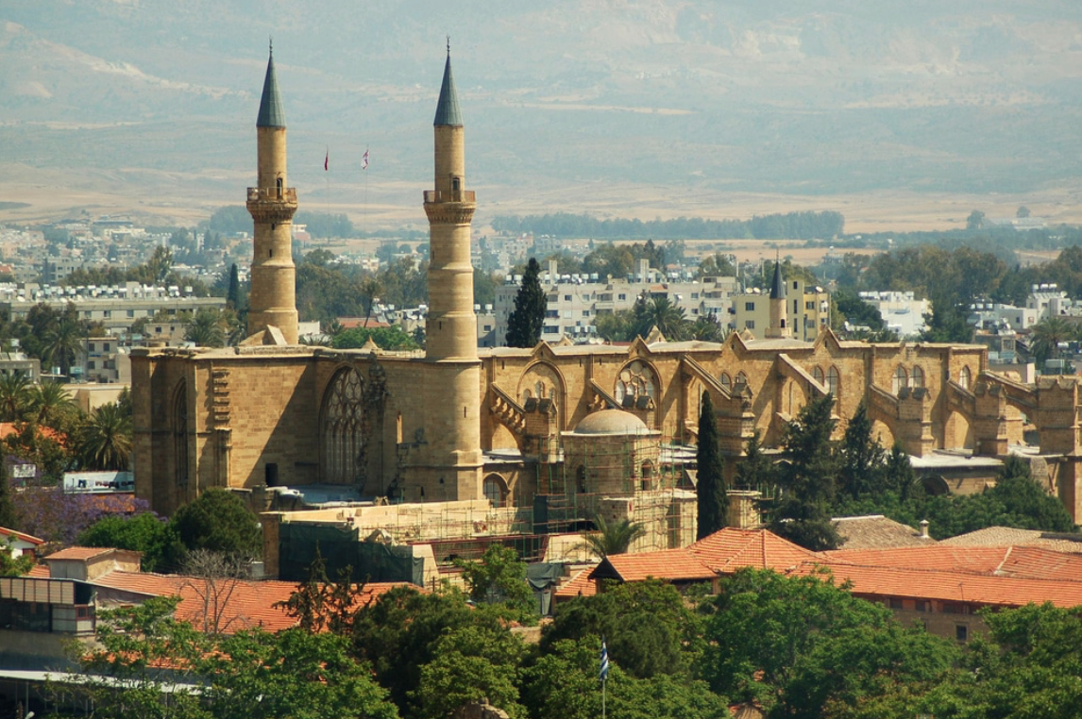
Recent CMS+TOTEM Results on Exclusive Production,
Diffraction and Light-by-Light Scattering
Michael Albrow, Fermilab
On behalf of CMS & TOTEM
Low-x 2019, Nicosia, Cyprus
& other reactions
p
X
p

Slide 2
Contents
Introduction
Central (semi-)exclusive π⁺ π⁻ production at √s = 5, 7, & 13 TeV
- protons not detected, forward rapidity gaps
(Double Pomeron Exchange – hadron spectroscopy, including elusive glueballs)
To come: p + p → p + X + p where X = exactly 2 or 4 hadrons
Diffractive dijets: p + p → p + JJ + anything. Proton in Totem Roman pots, jets in CMS
Light-by-light scattering in heavy-ion collisions 𝛾 + 𝛾 𝛾 + 𝛾
Summary
Note: Physics with Precision Proton Spectrometers (PPS) not covered:
See Andrea Bellora’s talk

Slide 3
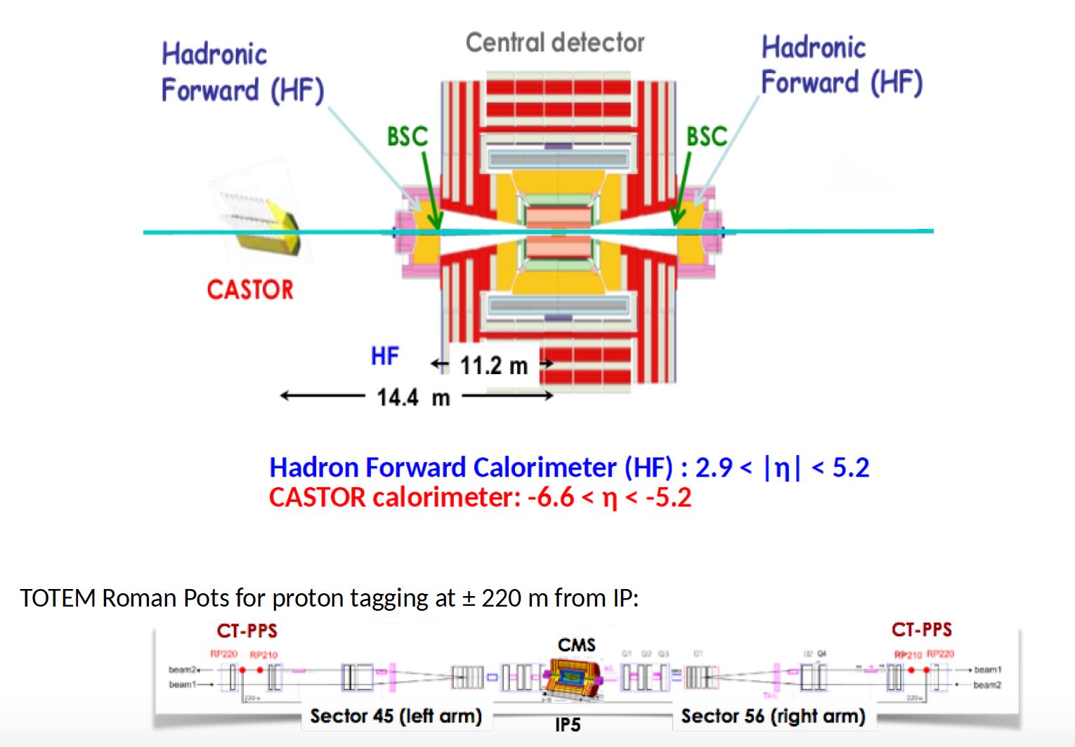
TOTEM
TOTEM

Slide 4
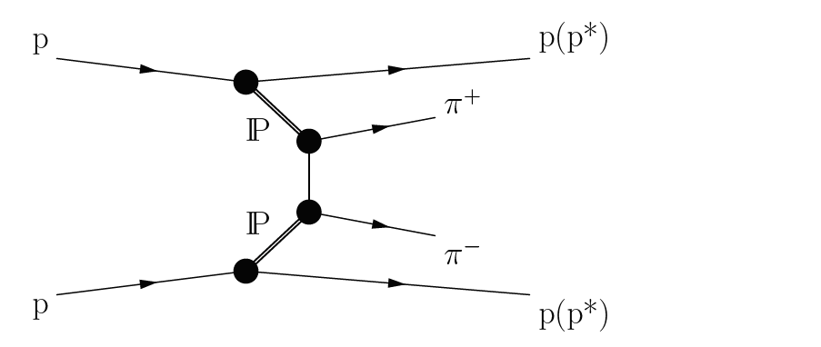
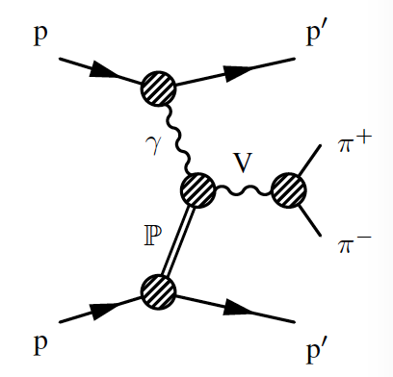
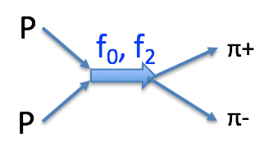
Exclusive and semi-exclusive π+ π- production in pp collisions
at √s = 7 TeV (paper submitted)
and at √s = 5.02 and 13 TeV (in preparation)
Exclusive final state: p + π⁺ π⁻ +p. Semi-exclusive allows dissociation p* e.g. p → p π⁺ π⁻
These studies do not detect protons, so dissociation is included, and all |t|, Δφ of protons
Double pomeron exchange
Photoproduction
Smaller cross section (EM)
One proton p’ at very small |t|
Alsp K⁺K⁻, K⁰_{s} K⁰_{s}, K*K*, φφ, p-p, etc.
Why interesting?
4-momentum transfer in elastic scattering carried by pomeron –
Strongly interacting color singlet – challenge to QCD as low Q² = large distance, non-perturbative
Meson spectroscopy not well understood, especially non-{q-qbar} states like glueballs {gg}, {ggg}

Slide 5
pp Collisions at √s = 7 TeV taken in 2010 at low luminosity
Mean number of inelastic collisions/bunch crossing μ ~ 1
Trigger: only bunch-crossing from BPTX = bunch pick-ups : zero-bias
(Highly prescaled - 33.2 million triggers) Integrated luminosity L = 450 μb⁻¹
Off-line selection:
Exactly 2 charged tracks with common vertex on beam-line
Impact parameter track – beam line < 3.2 mm, |z_{vtx}| < 15 cm
Only one vertex
Fiducial cut on tracks: p_{T} > 0.2 GeV/c and |η| < 2.
Number of events selected = 57.6 K
But most of these have activity in calorimeters which extend to |η| = 4.9
Due to additional neutral particles and forward or low-p_{T} charged particles

Slide 6
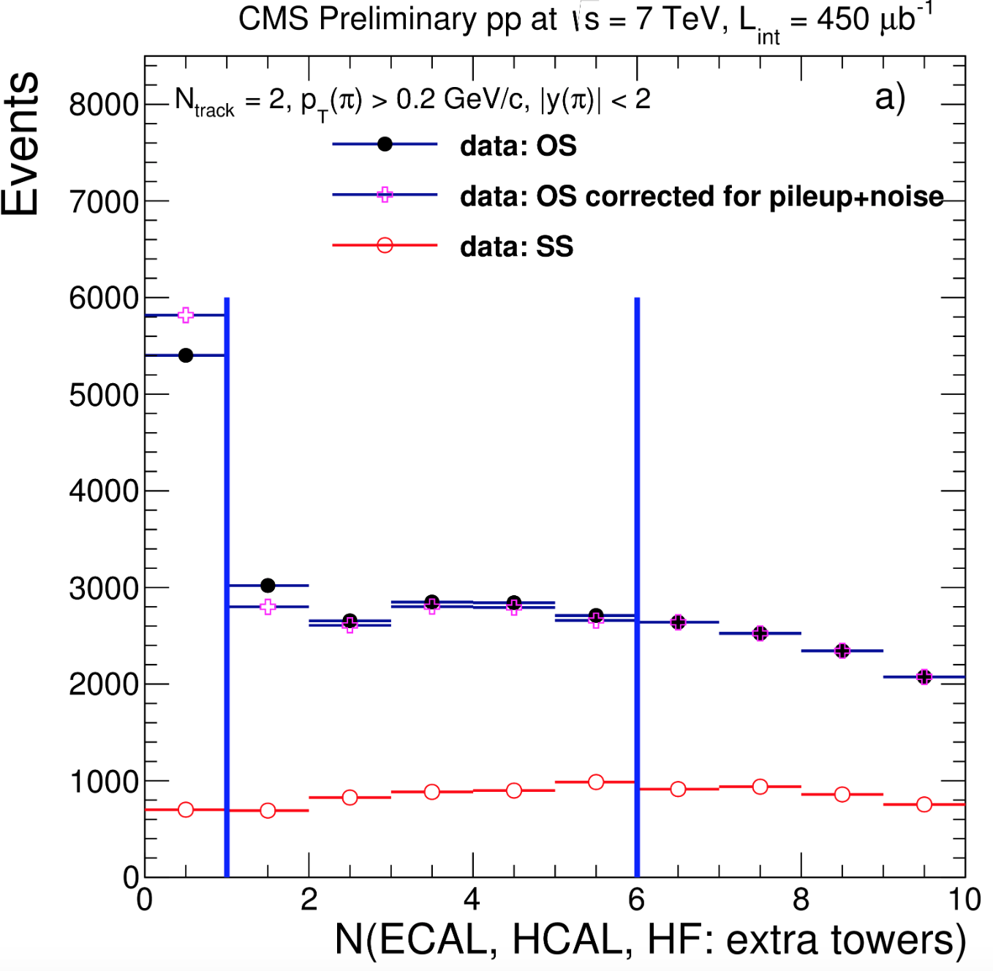
Then require: No activity in calorimeters above noise levels in |η| < 4.9
Levels vary from 0.52 GeV (EM Barrel) to 4 GeV (HF = Hadron Forward)
Excluding calorimeter towers
hit by tracks, plot shows distribution
of number of extra towers in calorimeters.
Clear excess in Q = 0 (+-) (OS) pairs at N_{extra} = 0
5,402 events
Not in Q = 2 (++, - -) (SS) pairs, 700 events
N_{extra} > 2 distributions fit Negative Binomial
Distribution (NBD) – extrapolate to estimate
background under ‘signal’.
‘Signal’ defined as [p or p*] + [π⁺ π⁻] + [p or p*]
where p* = all hadrons in blind region |η| > 4.9
→
Diffractive dissociation with M(p*) up to ~ 27 GeV
included as not detected (‘semi-exclusive’)
Q: Are they all pions?

Slide 7
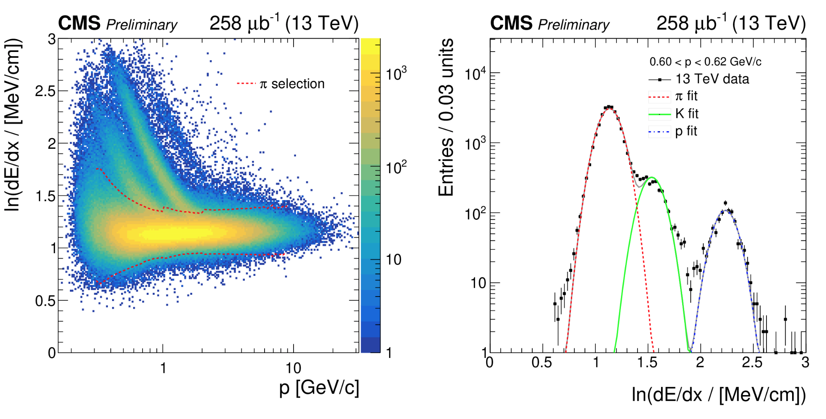
Q: Are they all pions?
Hadron identification only by ionization loss dE/dx in silicon strip trackers
Example for illustration from higher statistics 13 TeV data, N_{track} <= 4 - not fully exclusive
At low momenta some separation, but even at p = 0.6 GeV/c π & K merge.
Note that K/π ratio ~ 10%.
In 7 TeV 2-track sample for p_{T} < 0.7 GeV 89.4% π+π-, 2.5% K+K-, 0.1% pp, 8% other
Since π efficiency/background changing, all tracks are given pion mass, plots include ~ 10% B/G

Slide 8
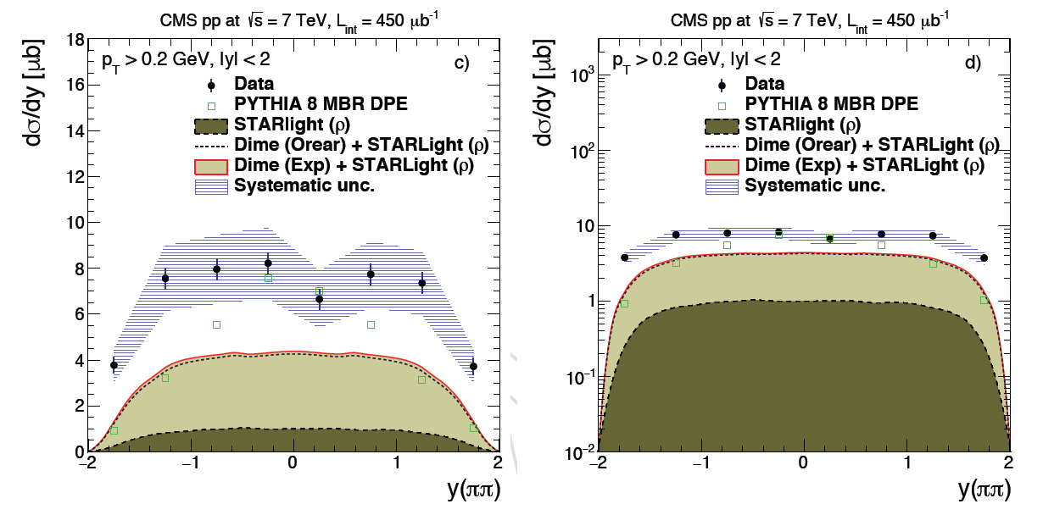
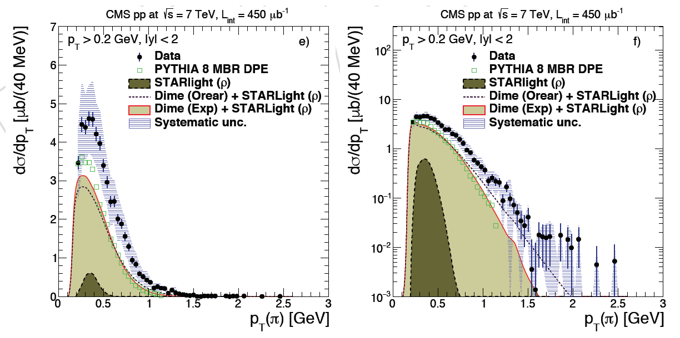
7 TeV final 2-track sample
Left plots: linear, Right :log
Comparison to event generators
+ GEANT4 detector simulation
PYTHIA 8 MBR DPE
STARLIGHT (𝜌 – photoproduction)
- Minor contribution
DIME + STARLIGHT (2 F.F.)
True rapidity (assuming pions)
of pair.
Drop at |y| = 2 is acceptance
(tracks have |y| < 2)
Transverse momentum p_{T}
of single pions
Data are higher than predictions
but include p* dissociation,
generators do not.

Slide 9
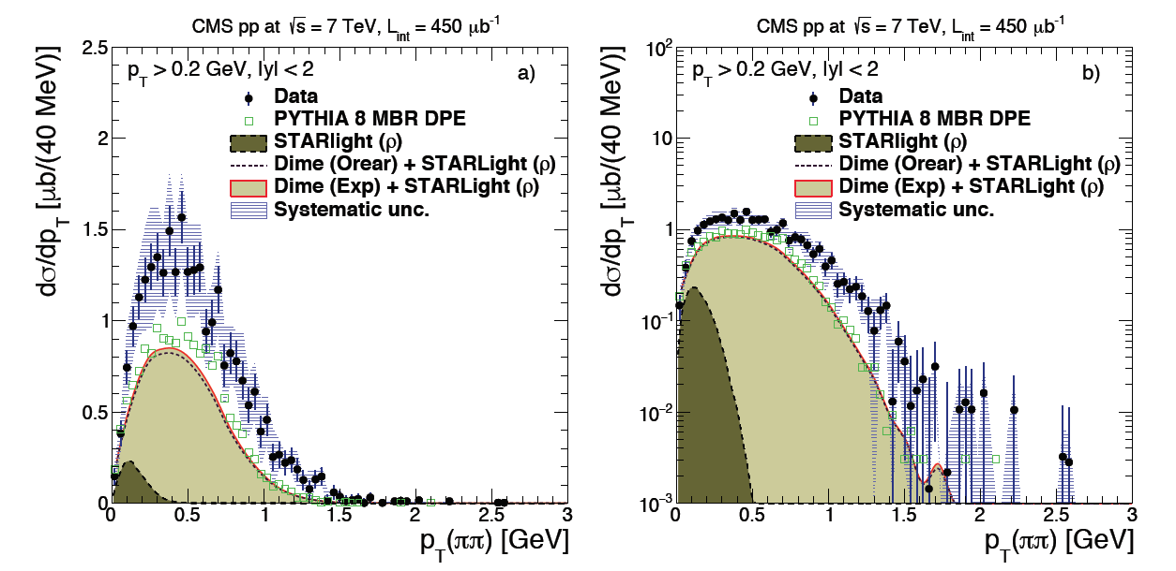
p_{T} distribution of central π+ π- pair : linear scale (Left) and log (Right)
Phase-space rise from p_{T} = 0 (including that of forward p/p*)
Shapes in reasonable agreement with expectation.
Photoproduction (STARLIGHT) only at small p_{T}

Slide 10
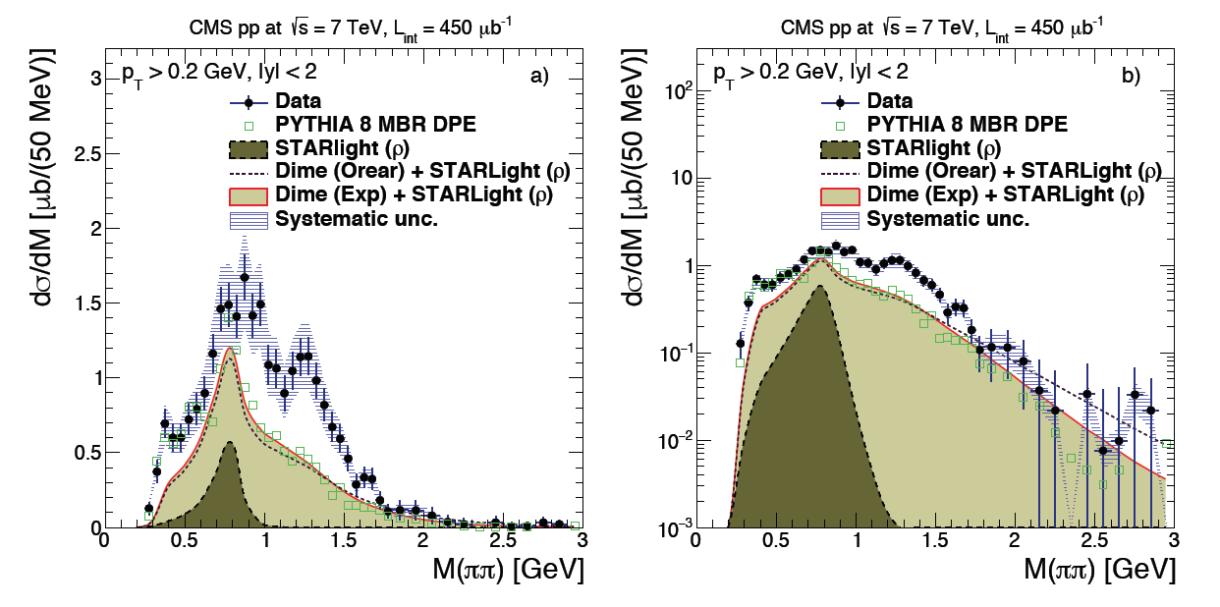
Differential cross sections as functions of M(π+π-) [include ~10% non-ππ]
Integral is 26.5 ± 0.3(stat) ± 5.0(syst) ± 1.1 (lumi) μb. ~ 50% larger than models w/o p*
Compatible with some 𝜌(770), drop at 1 GeV - f₀(980) region & KK threshold), f₂(1270)
Small ‘blip’ at 350 MeV is compatible with φ -> K⁺K⁻ with K given m(π)

Slide 11
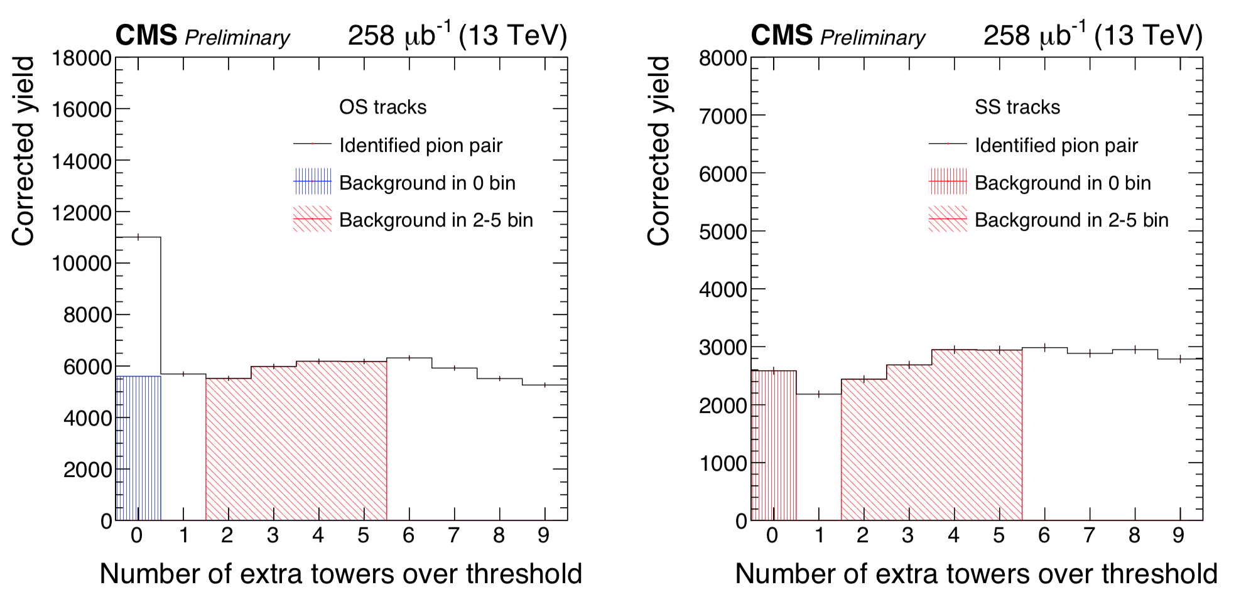
Repeat GAP - π⁺ π⁻ - GAP study at √s = 5.02 and 13 TeV
As for 7 TeV analysis:
Exclusive final state: p + π⁺ π⁻ +p. Semi-exclusive allows dissociation p* e.g. p → p π⁺ π⁻
These studies do not detect protons, so dissociation is included, and all |t| of protons
Expect very little √s - dependence
√s = 5.02 TeV run was made for comparison with Pb-Pb run
Conditions and selections similar but not identical.
Calorimeter thresholds changed
|η(π)| extended from 2.0 to 2.4 .
Opposite sign pairs
Same sign pairs
Signal

Slide 12
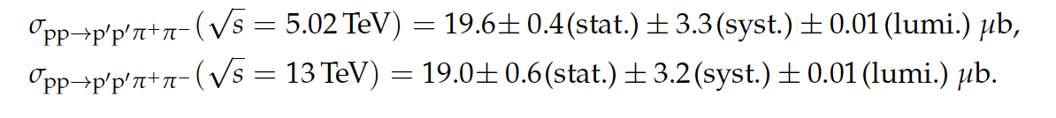
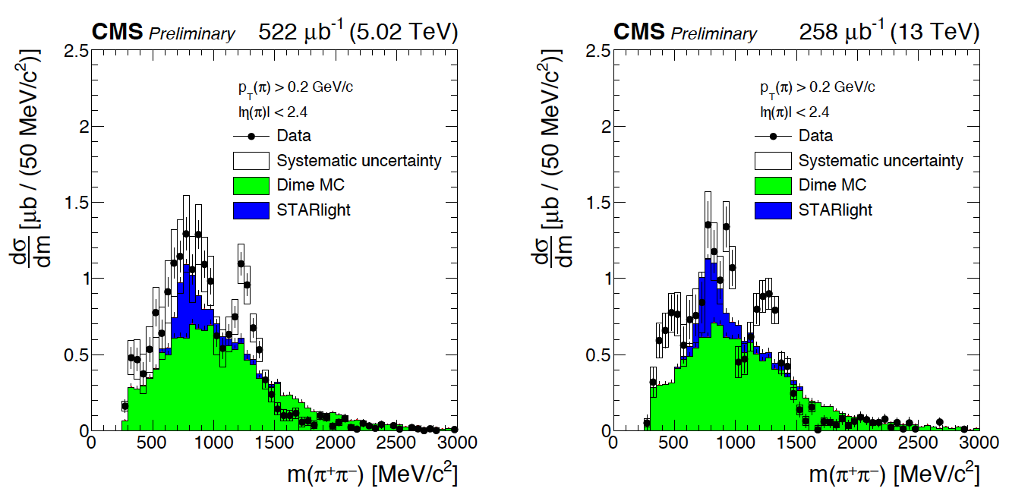
CMS PRELIMINARY
Spectra all show: Low mass bump*, including possible small 𝜌 photoproduction signal,
drop at 1 GeV/c² associated with f₀(980), clear f₂(1270) and tail to ~ 3 GeV/c²
* Broad f₀(500) = 𝜎 should contribute
Need: much higher statistics, and protons detected to select exclusive and t₁, t₂, Δφ

Slide 13
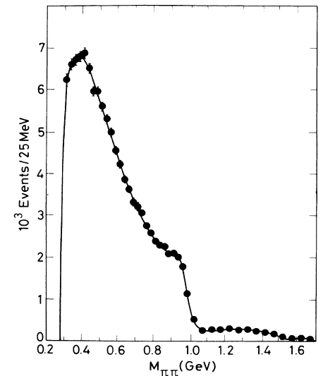
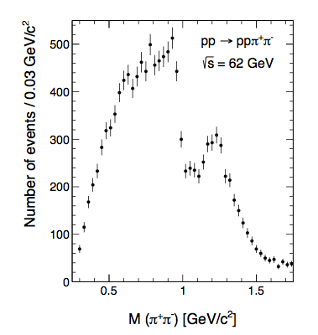
Other Experiments
DPE → π+π-
Several expts. at lower √s
E.g. two for comparison
Intersecting Storage Rings
(ISR) √s = 63 GeV
Axial Field Spectrometer (R807)
PL 133 B (1983) 268 & NP B 264 (1986) 154
Exactly two central π+ π-
2C constraint with 2 forward p’s x_{F} > 0.95
p’s non-colinear (UP*UP or DN*DN = = TT or BB for TOTEM)
-t = 0.01 – 0.06 GeV² |y(ππ)| < 1
Shown to be dominated by S-wave (J=0) - f₀(500) = 𝜎
f₀(980) as « cliff » and broad state ~ 1300 MeV
Split Field Magnet : Breakstone et al.
Z.Phys.C 31 (1986) p.185 & ibid. 40 (1988) p.41
-t > 0.1 GeV² with e^{6t} distribution
Also sharp f₀(980) then f₂(1270) dominant.
Similar to GAP - (π+ π-) – GAP data (all |t|)
Why different? Low mass acceptance, but
Small |t| and larger |t| ?
J_{z} = 0 rule at t → 0 suppresses J = 2 states

Slide 14
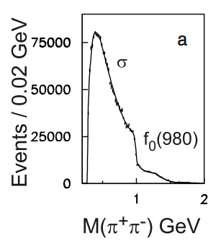
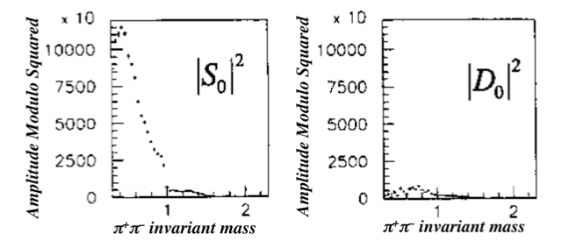
Other Experiments
DPE → π+π-
WA102 (SPS FT 450 GeV/c)
E710 (Fermilab FT)
S-wave
These were at lower (fixed target) energies √s, measured the protons
and selected S-wave (J = 0) with phase-shift analysis.
f₂(1270) dominates in GAP-ππ-GAP data (all |t| - mostly |t| > 0.1

Slide 15
Where are the glueballs?
Especially : Where is the lightest scalar glueball (vacuum-like)?
f₀(600)? Very broad ππ resonance.
Not on pomeron trajectory (only J > 1) … on a “daughter trajectory”?
Lattice QCD : around 1650 MeV +/- about 100 MeV
One widely studied scenario:
Two scalar-isoscalar quarkonia : nn == (uu + dd)/√2 and ss
And one bare glueball : gg
Mix & give 3 states:
f0(1370), f0(1500), f0(1710)
T.Gutsche (PPNP 67 (2012) 380:
On the other hand:
W.Ochs (2015)
0.75 0.60 0.26 nn
= -0.59 0.80 -0.14 G
1710 -0.29 -0.15 0.95 ss
0.86 0.13 -0.50 nn
= 0.43 -0.61 0.61 ss
1710 0.22 0.76 0.60 G
The situation is confusing! f₀(1710) -> K+K- >> π+ π- unlike glueball domination.
And at least one of these states may be an excited q- q
Good high statistics DPE data with PWA (p’s detected) & different channels should resolve.
Other (non-)production mechanisms e.g. γ + γ → X and γ + IP → Y should help, Radiative Y decay

Slide 16
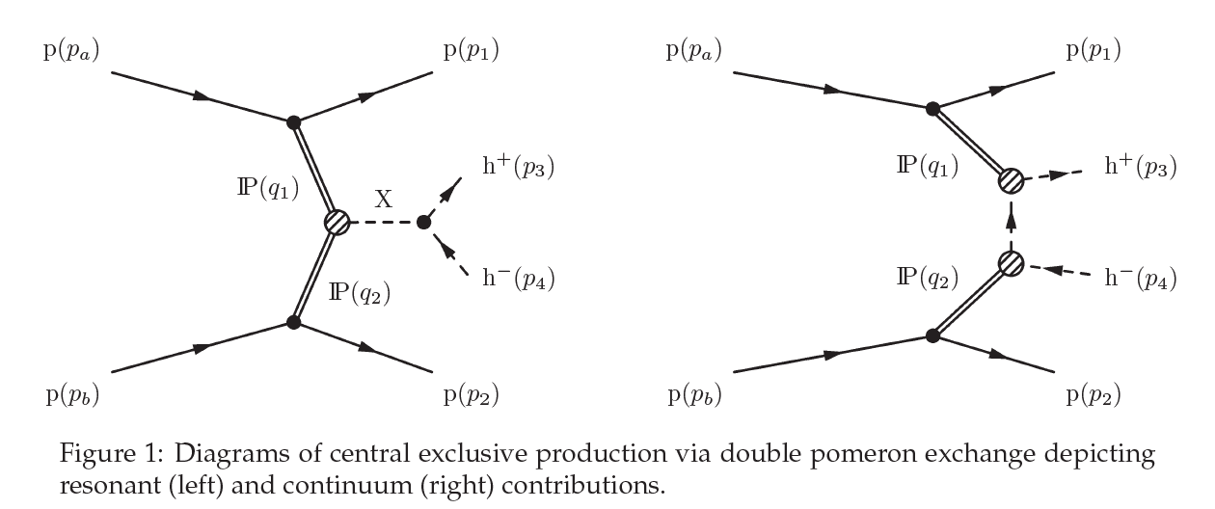
Looking Forward: TOTEM + CMS Common Data taking
Special High-β* (90m) runs for TOTEM at √s = 13 TeV
TOTEM: Elastic scattering d𝜎/dt and total cross section 𝜎_{T}
Low pile-up: μ ~ 0.2 collisions per bunch crossing.
Latest and best set in July 2018, 4 days, total integrated luminosity ~ 6 pb⁻¹
CMS detectors operated, selecting coincident events with minimal track activity.
Analysis on-going of exclusive p + p → p + X + p events, X = 2 or 4 charged tracks
|t|_{min} ~ 0.05 GeV²
Suppresses 𝛾 exchange
Data dominated by double pomeron exchange: continuum + resonances
Quantum number filter: I^{G} J^{PC} = 0⁺ 0⁺⁺ and 0⁺ 2⁺⁺ (Isospin = 0, J even)
Long-standing puzzles in scalar mesons and glueball spectrum

Slide 17
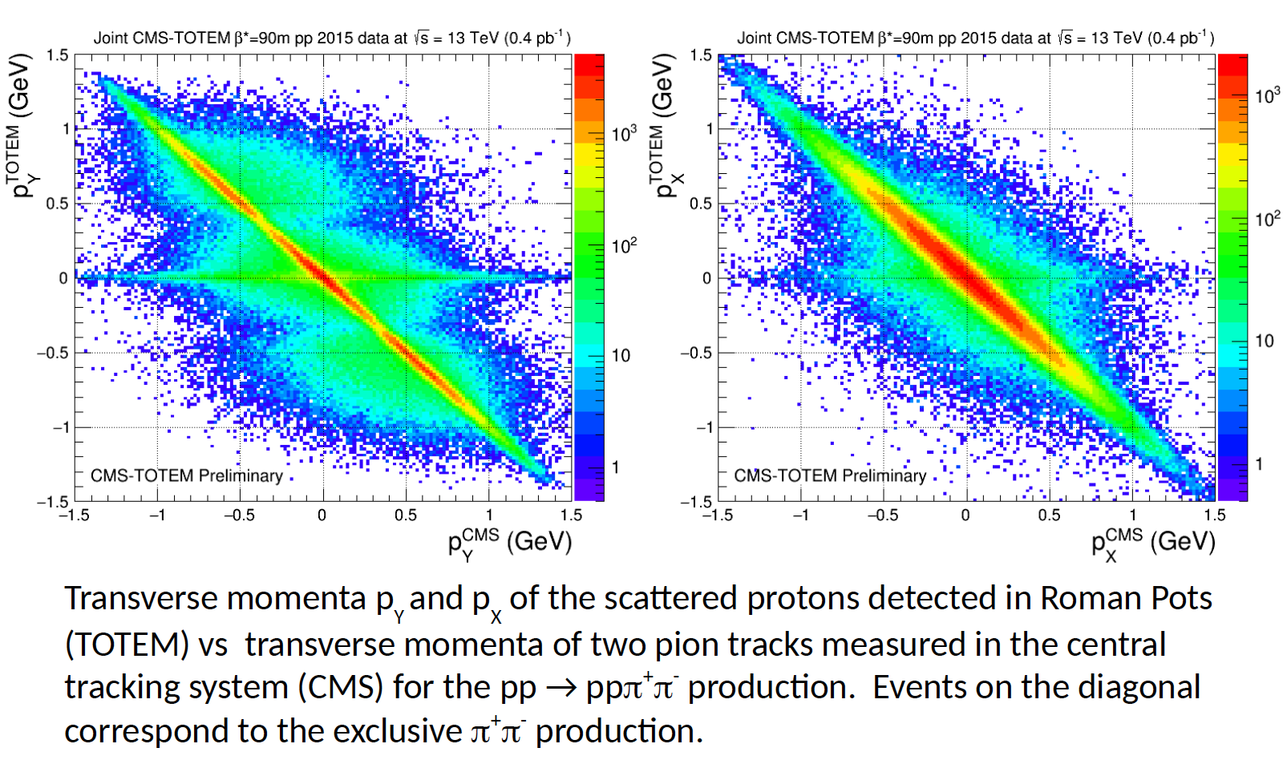
Selection of exclusive 2-track h⁺h⁻ events by p_{x}, p_{y} balance
Total transverse momentum of 4 tracks Σp_{T} < ~ 100 MeV/c
Unlike Gap-X-Gap events can study dependence on protons’ t₁, t₂, Δφ
-> Phase shift analysis to separate spectra of J = 0, 2, … states

Slide 18
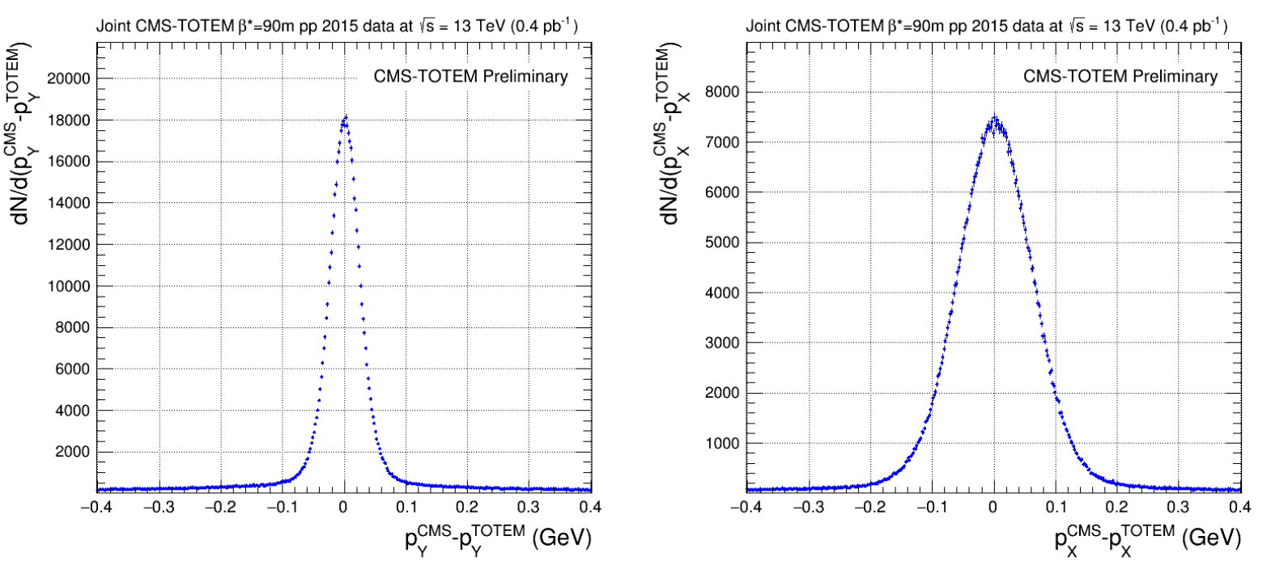
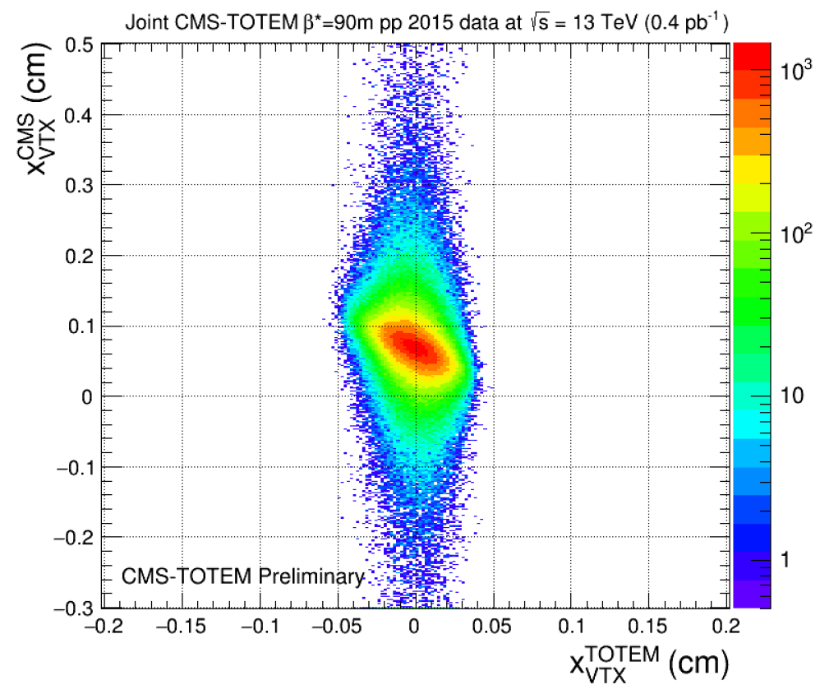
Good balance in px and py required between protons and CMS central tracks
Ensures exclusivity
The x-position of the vertex (interaction point)
can be reconstructed independently from the
two protons in TOTEM and the two tracks in CMS.
(Opposite sign convention – tilt)

Slide 19
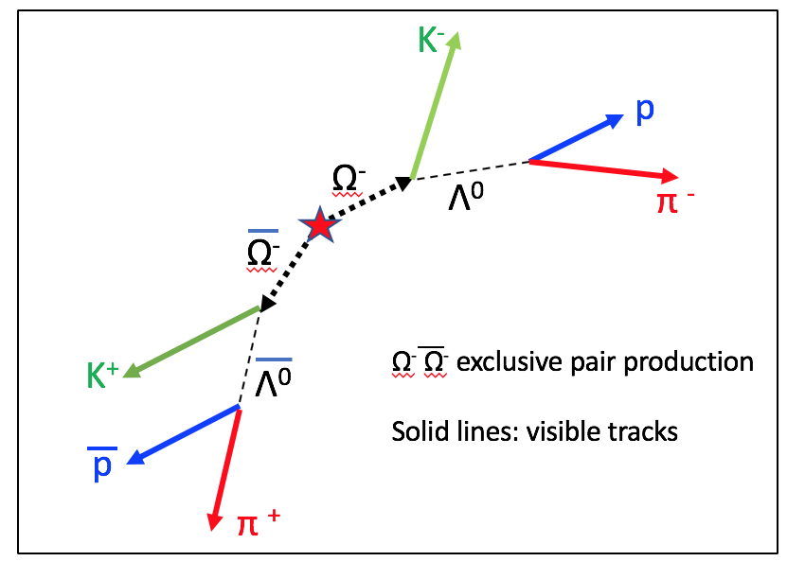
Future: DPE should be ‘flavor-blind’ for same mass baryons. Interesting potential study:
Exclusive central production of baryon pairs with 0, 1, 2, 3 strange quarks
pp , Λ⁰ Λ⁰ , Ξ⁻ Ξ⁻ , Ω⁻ Ω⁻ are accessible
Charmed meson pairs D⁰-D⁰bar
→ D⁰_{s} + D⁰_{s} even more so!
Imagine the value:
Dedicated 2-day run
Could give ~ 100 million
fully measured DPE events!
Ω⁻ : M = 1672.45 MeV, c𝜏 = 2.46 cm, 68% BR - > Λ K
Λ⁰ : M = 1115.68 MeV, c𝜏 = 7.89 cm, 64% BR - > p π
For
Ξ⁻ → Λ π - same topology, replace K with π
M = 1321.71 MeV, c𝜏 = 4.91 cm, 99.9% BR - > Λ π

Slide 20
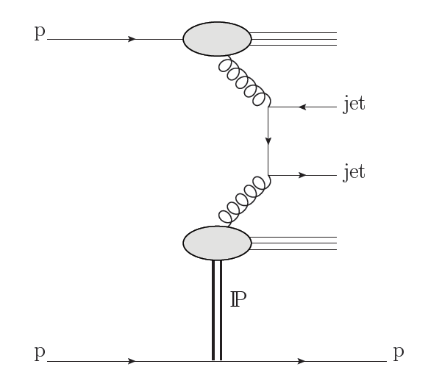
CMS-PAS-FSQ-12-033
TOTEM-NOTE-2018-001
Two jets measured in CMS
E_{T} > 40 GeV |η| < 4.4
Leading proton x_{F} = 0.90 – 0.97
i.e. ξ = 0.03 – 0.1
0.03 < |t| < 1 GeV²
Measured in TOTEM Roman pots
Including L R
Observed first at CERN p-pbar collider (UA8), √s = 630 GeV, jets E_{T} > 5GeV
Measured at Tevatron p-pbar collider by CDF and D0 at √s = 1800, 1960 GeV
Structure probe of pomeron, understanding ‘survival probabilities’
and factorisation breaking between e-p (HERA) and hadron-hadron

Slide 21
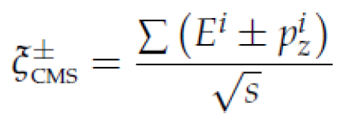
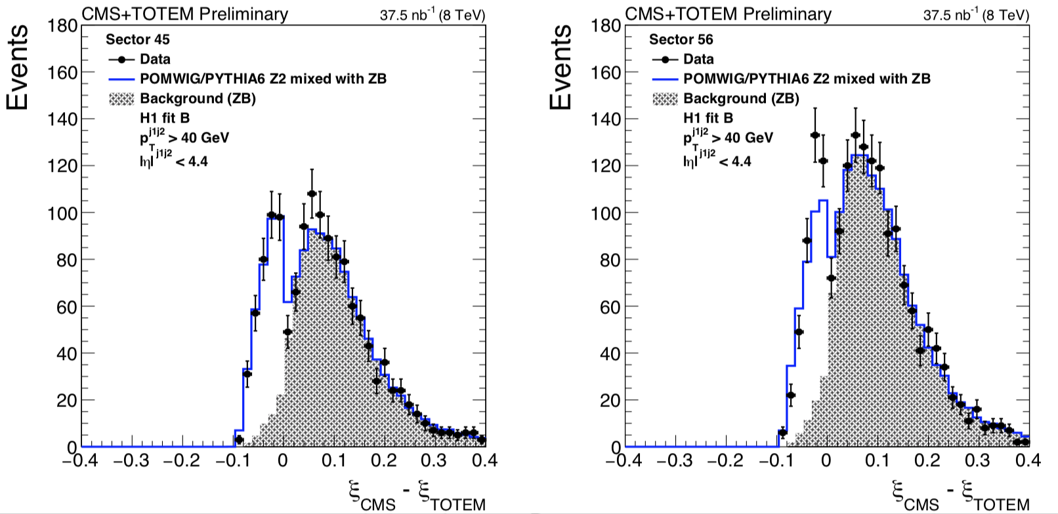
Background from random coincidence between proton and jets from different collisions
Fractional momentum loss ξ_{TOTEM} of proton measured through machine lattice -> 215 – 220m
It can also be estimated, ξ_{CMS} from all particles in CMS detector |η| < 4.9
TWO DIRECTIONS
Missed particles (especially forward) make ξ_{CMS} < ξ_{TOTEM}
Additional particles from another collision make ξ_{CMS} > ξ_{TOTEM}
Good single events
Pile-up background
(Decreases as luminosity decreases)

Slide 22
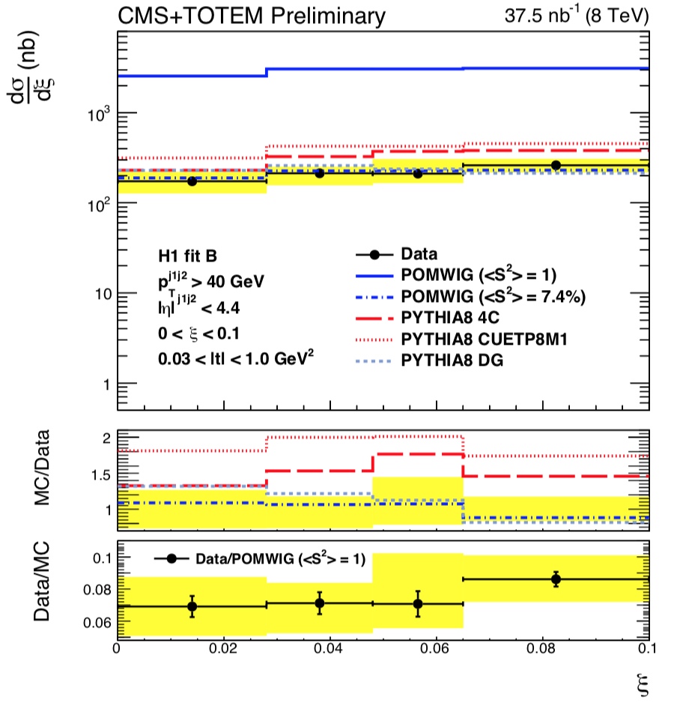
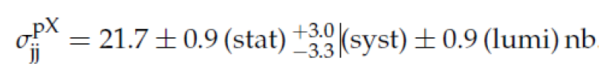
Distribution in ξ = 1 - x_{F}
d𝜎/dξ ~ flat in agreement with MC’s.
> Low mass diffraction peaks at low-ξ
and by ξ ~ 0.05 Regge (non-IP) exchange
becomes more important.
Here two high-E_{T} jets enhance high-ξ
Q: Is it still pomeron exchange?
Measured integrated cross-section for:
ξ < 0.1, 0.03 < |t| < 1.0 GeV²
>= 2 jets p_{T} > 40 GeV, |η| < 4.4
Average of L-going and R-going proton configurations

Slide 23
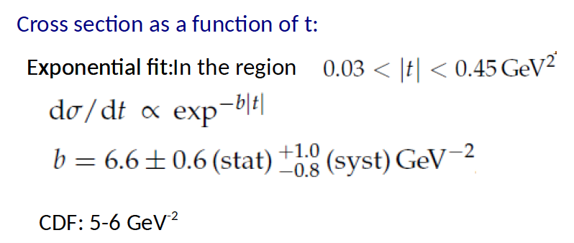
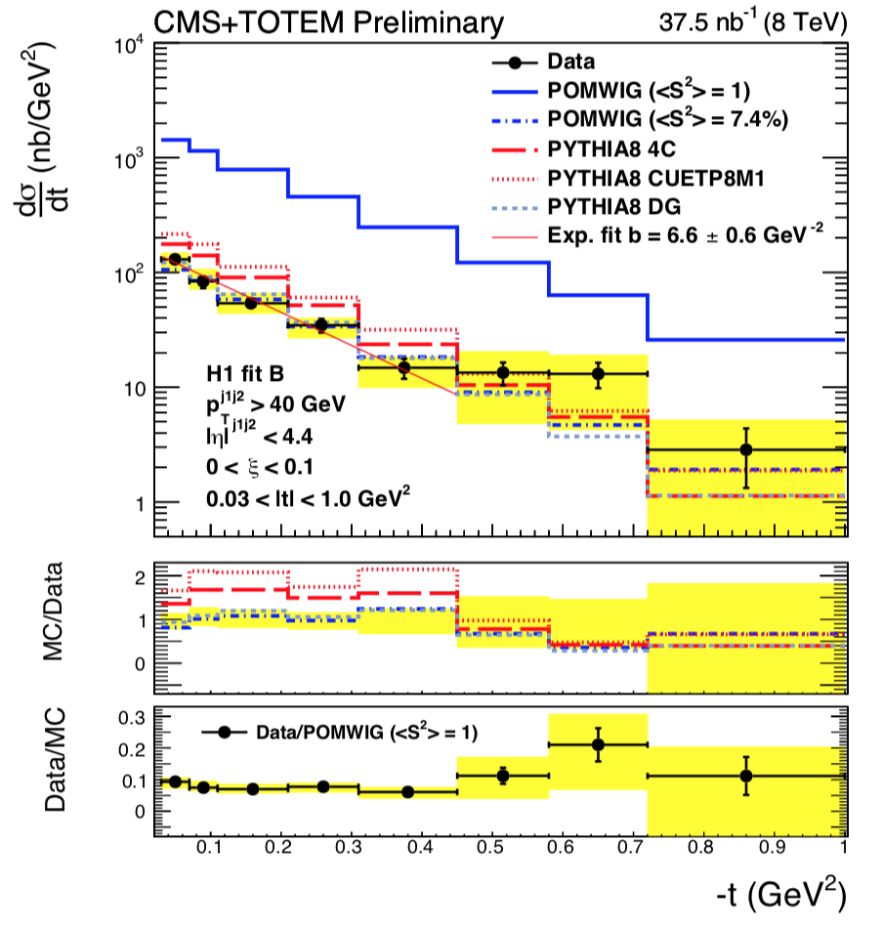
t-distribution, slope as in soft diffaction
~ ½ that of elastic scattering.
But flattens above |t| > ~ 0.5 GeV⁻²
Event generators in fair agreement on shape
Top line is with no gap survival probability factor
for illustration only. <S²> = 1
Good fit has <S²> = 0.074
Other quark and gluon interactions destroy the gap

Slide 24
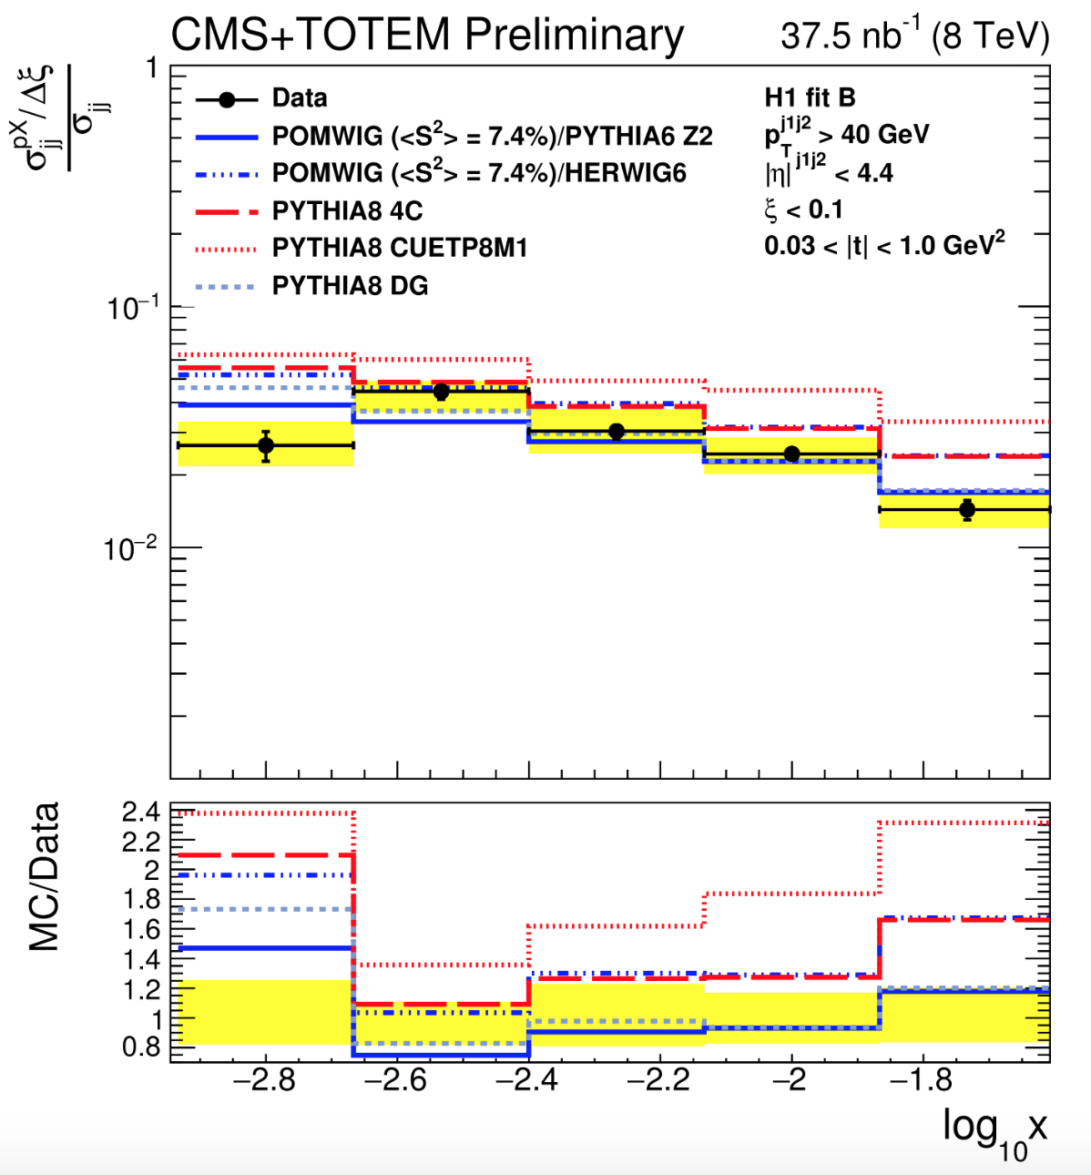
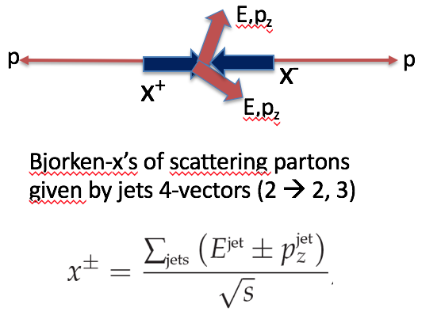
Ratio of diffractive dijets to all dijets
vs x = momentum fraction in proton
of partons initiating the hard scattering
X = 0.0016
X = 0.01

Slide 25
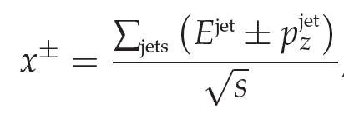
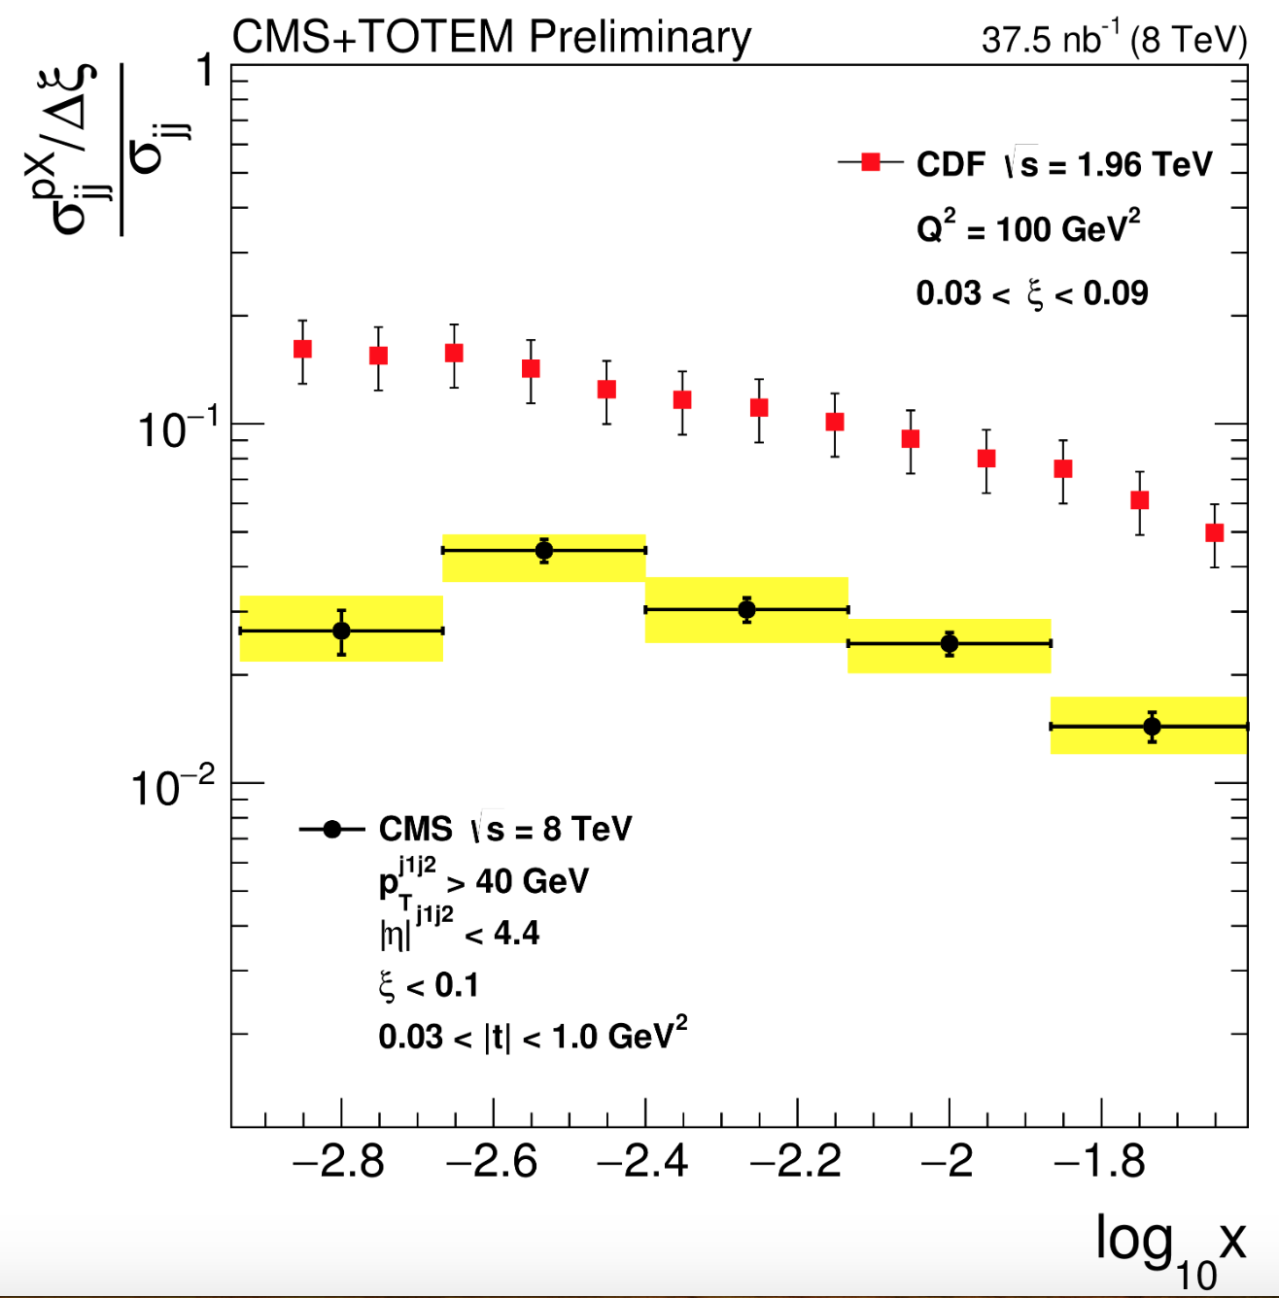

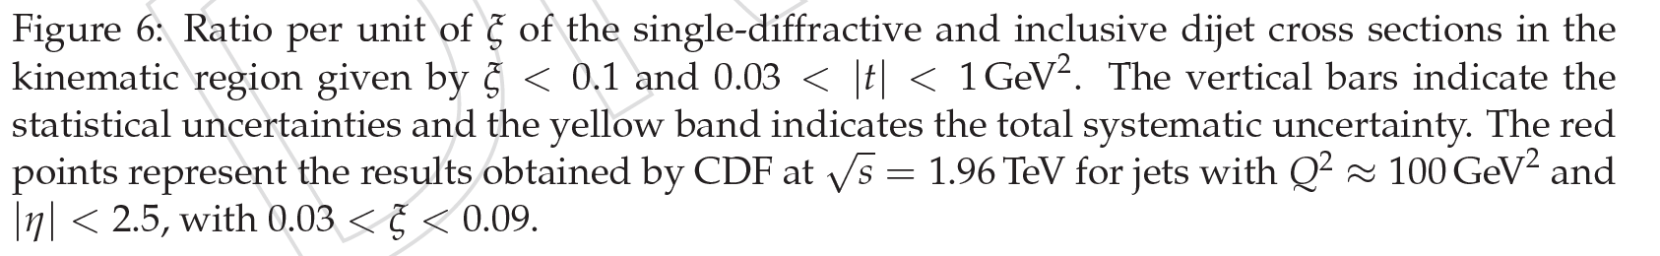
‘Diffractive dijet fraction of all dijets ’
> decrease from Tevatron, but higher E_{T}
If pomeron exchange, fraction of
pomeron momentum carried by
scattering parton = β, with:

Slide 26
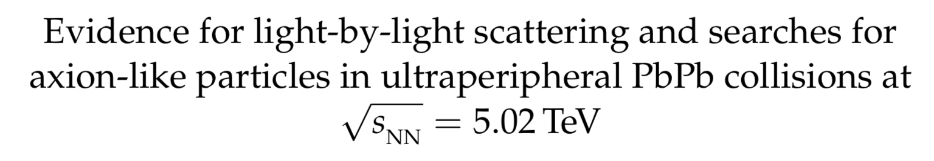
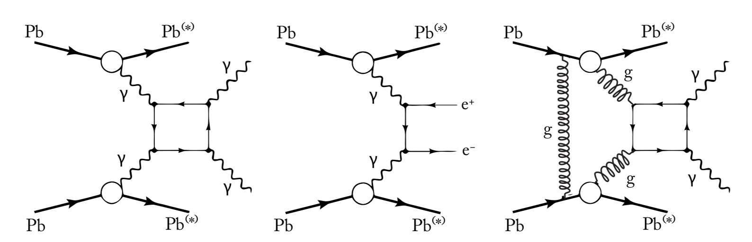
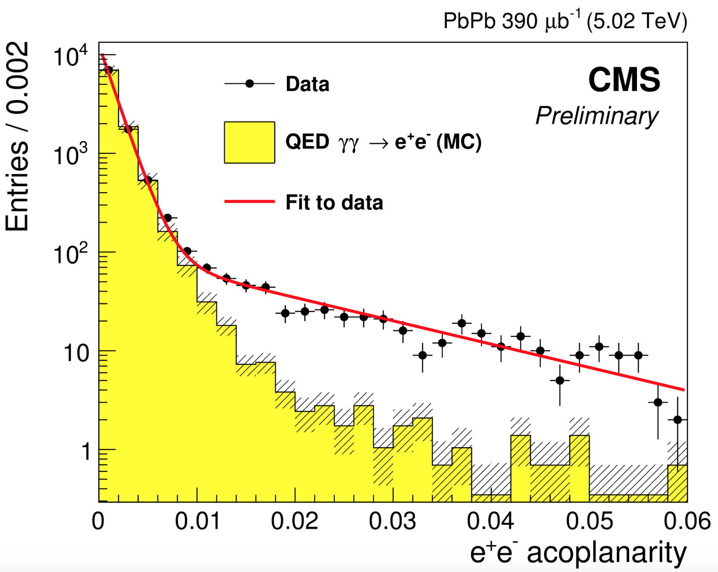
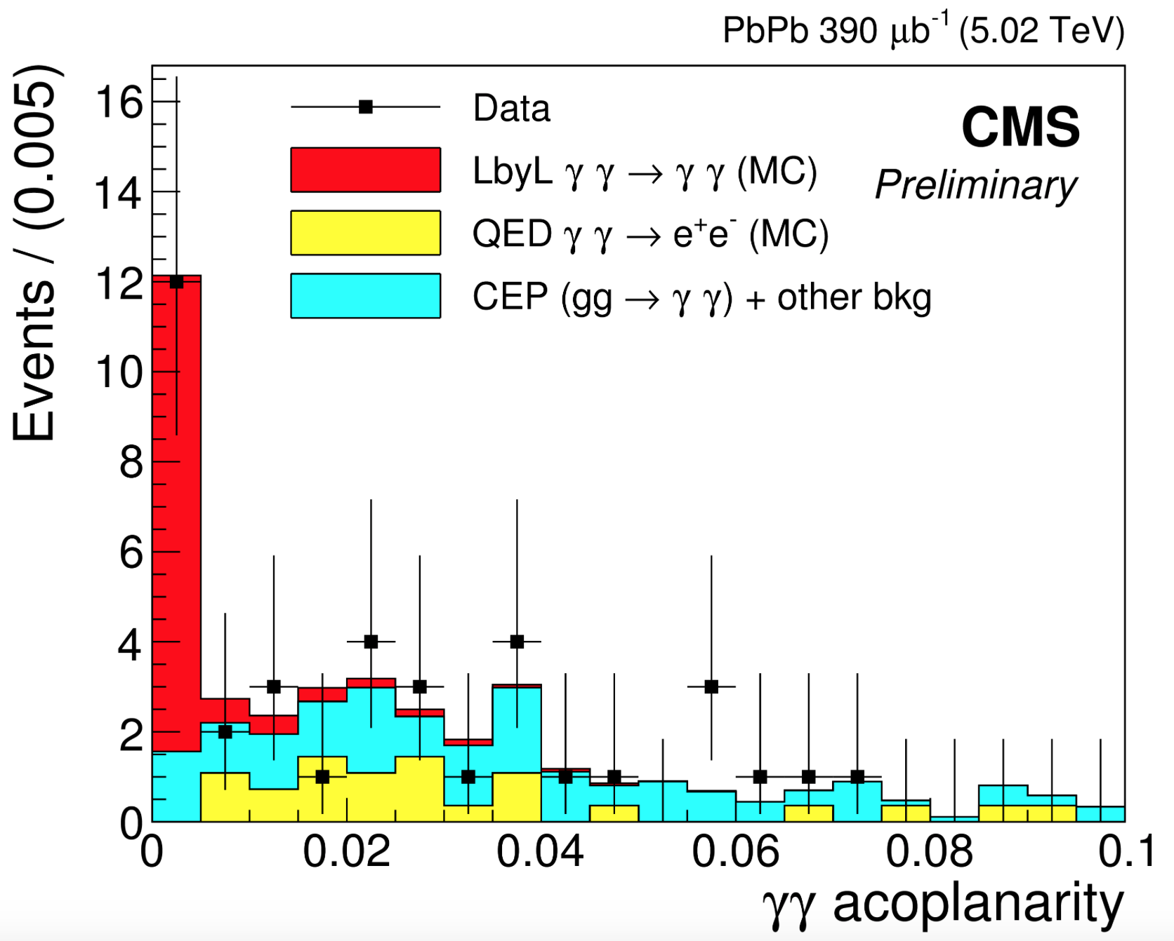
arXiv:1810.04602 [hep-ex]
Phys. Lett. B (subm.)
Photons with E_{T} > 2 GeV |η _{𝛾}| < 2.4
IP + IP → 𝛾 + 𝛾
Observed in pp in CDF
(Not yet claimed at LHC)
Acoplanarity A_{φ} larger
because p_{T}(IP) > p_{T}(𝛾)
Process of interest
Cross section small - 𝛼⁴ ~ 3 x 10⁻⁹
But enhanced by Z⁴ = 5 x 10⁷ cf pp
Quasi-real 𝛾 have Q² < 10⁻³ GeV²
and E _{𝛾} up to ~ 80 GeV
Control sample, 𝜎 much higher
Same trigger and selections
but two tracks, e+ e-
Background if tracks missed

Slide 27
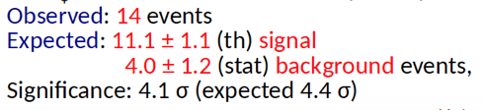

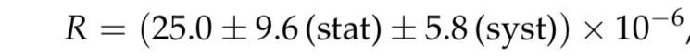
Distributions agree well with
LbL scattering Monte Carlo:
Theoretical predictions: D’Enterria and da Silveira
Phys Rev Lett 111(2013) 080405
Ratio 𝛾 + 𝛾 : e⁺ + e⁻

Slide 28
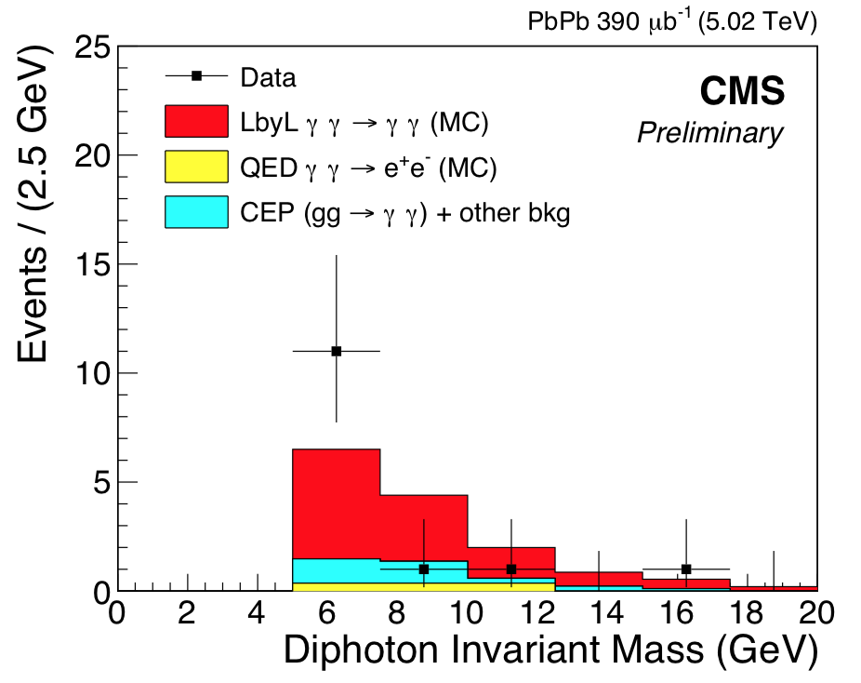
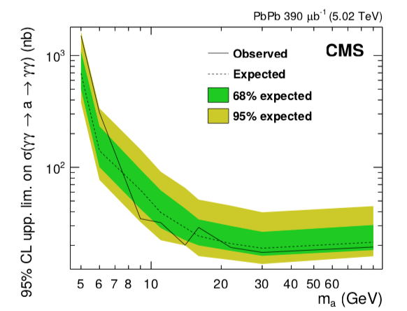
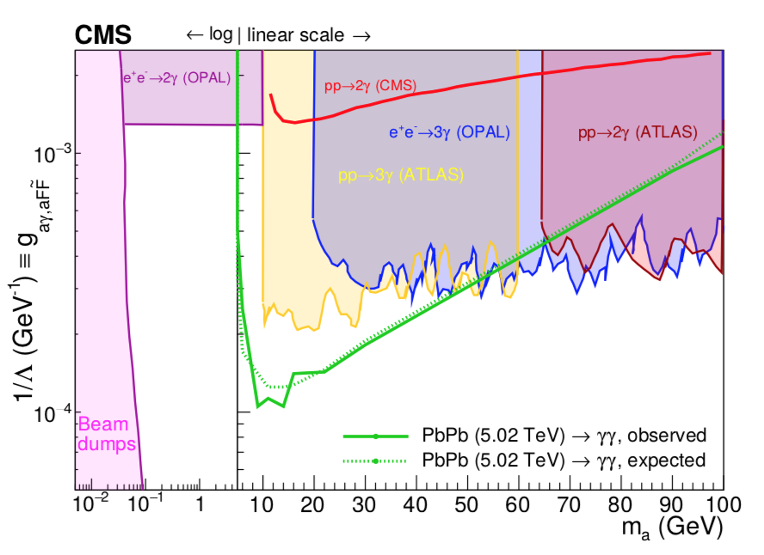
Observed M(𝛾𝛾 ) limits PseudoScalar axion-like
particles (a) through 𝛾𝛾 → a → 𝛾𝛾
Sensitive to higher masses
New limits very competitive for
M(a) = 5 – 50 GeV
~ ATLAS, and better than e⁺e⁻ at LEP

Slide 29
SUMMARY
Small selection of some recent CMS & [TOTEM + CMS] results – all low pile-up
Color singlet exchanges : pomeron and/or photon interactions
Central exclusive production of low mass hadron systems (resonances, glueballls?)
DPE: Potentially a large field of study (tagged IP + IP collisions, jets …)
High-E_{T} jet production from pomeron interactions - high mass diffraction.
Pb + Pb collisions as 𝛾𝛾 collider and 𝛾𝛾 → 𝛾𝛾 as probe of new physics e.g. axions?
Stay tuned!

Slide 30
Thank You

