Slide 1
SAS@LHC / VFHS
A Very Forward Hadron Spectrometer
for Multi-TeV Forward Particles at the LHC
Michael Albrow, Fermilab
A few introductory slides here
Low-x Nicosia, August 2019

Slide 2
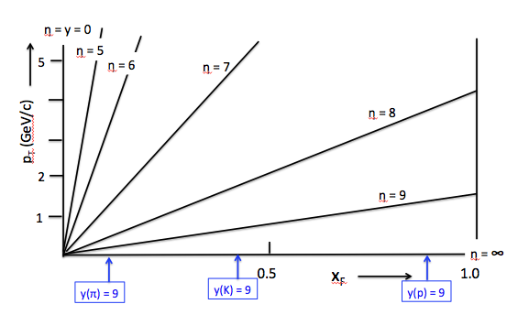
At √s = 13 TeV
Terra Incognita
ATLAS, CMS, etc
Last explored at ISR at √s = 63 GeV, 200 x lower
All fixed target experiments < ISR (≅ 2000 GeV FT)
ROMAN POTs
y(π) = 10
y(π) = 11
y_{BEAM} = ln (√s/m_{p}) = 9.54
ZDC & LHCf measure neutrals (n + K⁰_{L} , π⁰ →γγ) at θ ~ 0º.

Slide 3
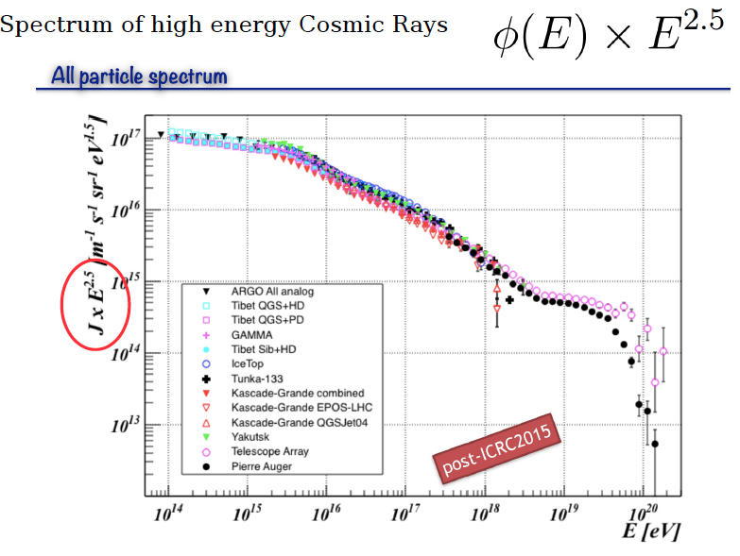
COSMIC RAY SHOWERS: ASTROPHYSICS CONNECTION
Knee
Intermediate region
ISR-63 GeV
Ankle
GZK Cut-off
LHC-13 TeV
AUGER
x 200 in √s = x 40,000 in FTE
100,000 TeV!

Slide 4
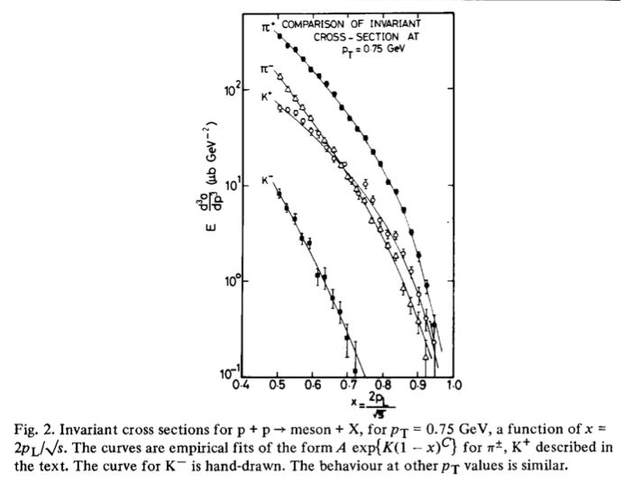
√s = 45 GeV,
CHLM (MGA inter alia) SAS @ ISR
Nucl Phys B 140 (1978) 189
Small transverse momentum
p_{T} (Mean p_{T} ~ 350 MeV/c)
41 years ago !
Feynman x_{F} = p_{z}/p_{BEAM}

Slide 5
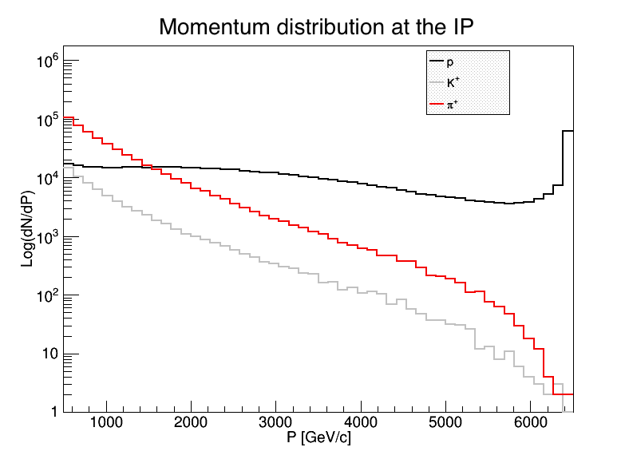
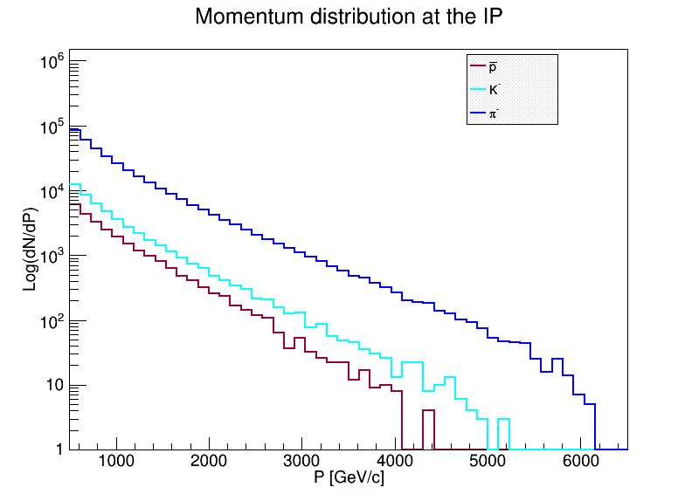
DPMJET prediction
Very uncertain! Illustration only
Spectra generated by /DPMJET-MARS
With 10⁶ pp events, √s = 13 TeV
(N.Mokhov and O.Fornieri)
In 1 second, with 2808 bunches,
Have 30 x 10⁶ bunch crossings and
30 x 10⁶ x μ(= interactions/X) events.
Notes:
At 0.5 TeV (~ central)
π⁺ = π⁻ & K⁺ ≅ K⁻ & K/π ~ 10%
p’s > π⁺ above 1.5 TeV and flattish;
High x_{F} peak from diffraction
K⁻(s-ubar) steeper than K⁺ (u-sbar)
π⁻ (d-ubar) steeper than π⁺ (u-dbar)
Antiprotons < K⁻ but only by a factor ~ 0.5
Anti-deuterons/tritons/He³ to measure too
p
Number per 125 GeV/c bin
π+
K+
~ 100 x Acc/bin/sec if μ ~ 3
Number per 125 GeV/c bin
π-
p-bar
K-
Neutrons not = protons, K⁰ not = K^{+/-}

Slide 6
A Spectrometer for Multi-TeV
Forward Particles at the LHC
An idea for a new LHC experiment - collaboration needed!
Introduction: Terra Incognita! Strong interactions and cosmic ray showers
Some physics topics: single- and two- particle inclusive production (& anti-nuclei)
Q & H ? Stan Brodsky’s talk Ilias Cholis talk
TeV particles through 30 Tm spectrometer magnets, special vacuum chamber
Tracking, Calorimetry and Muon detectors
Charged hadron identification : π, K, p with transition radiation detectors
Anatoli Romaniouk’s talk
What’s next? A new collaboration – experiment co-existing with ALICE or LHCb?

Slide 7
Idea, using 10 – 15 m of space in front of TAN:
Use MBX dipoles (Integral B.dL ~ 30 Tm) as spectrometer magnets.
Use straight section from ~ 85m to 140m (TAN absorber) space.
Special vacuum chamber design for particles to emerge through minimal material
Precision tracking (silicon strips or pixels) over ~ 2 m (θx, θy to a few μrad) – or included in
Transition Radiation Detectors for γ = E/m in 10³ – 3. 10⁴ region (novel – Romaniouk’s talk)
Hadron Calorimeter for energy measurement and muon filter
Muon tracking behind calorimeter
Possible later extension (not discussed here):
Bent crystal to channel and so accept highest momenta (>~ 4.5 TeV, ~4 mrad bend)

Slide 8
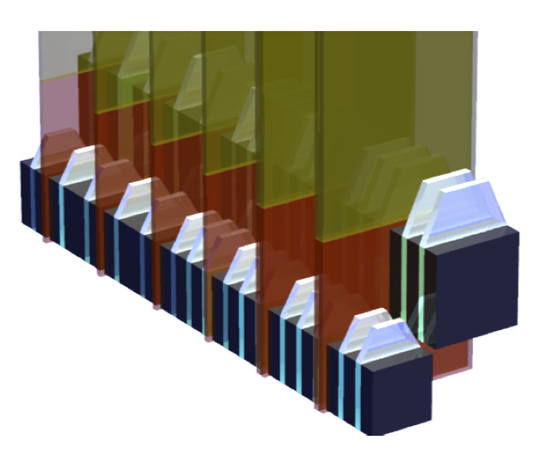
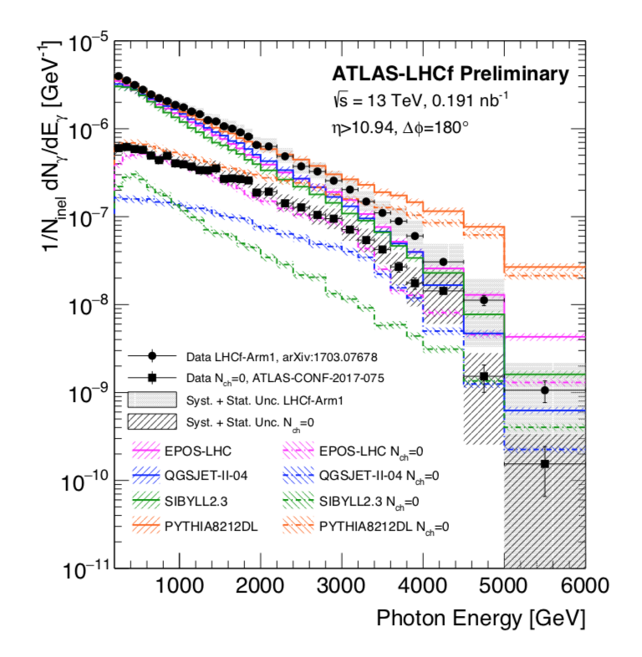
LHCf is a small 0º calorimeter measuring photon-like and n-like showers
Only 1.6 λ_{I} and 4 cm in size, σ(E)/E ~ 40% for neutrons.
Low-PU, High β* runs
Large spread in predictions:
X 40
Arm 1: 2cm x 2cm & 4cm x 4cm
Arm 2: 2.5 x 2.5 & 3.2 x 3.2 cm
Common data with ATLAS for some
Low-PU runs: diffractive events
ZDC in CMS
7 λ_{I} and 8cm x 10 cm
Expect σ(E)/E ~ 15% at 3 TeV
A good 3D-imaging calorimeter
for SAS : σ(E)/E ~ 5%

Slide 9
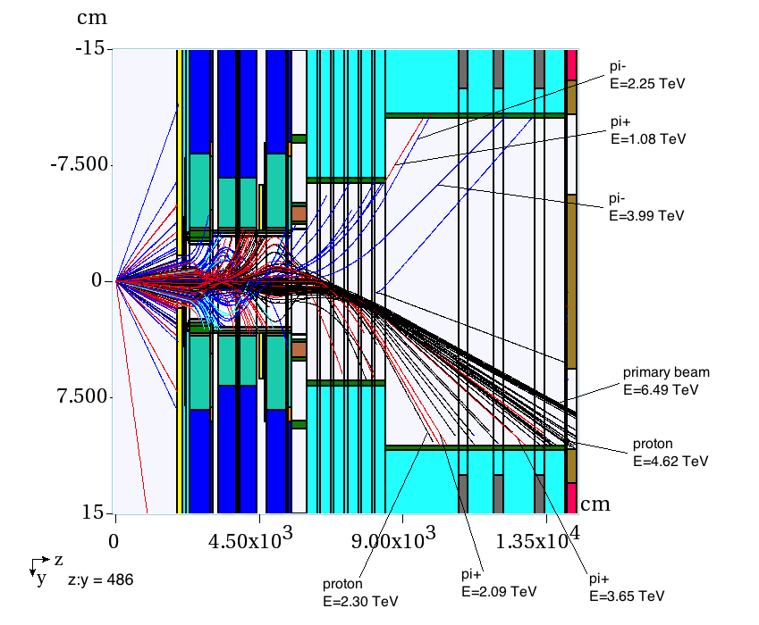
Conical pipe 80 – 130 m
Circular or elliptical
~ 25º inclination
10-12m for spectrometers
Back plate schematic
50 cm
Elliptical option
CIRCULAR option
Incoming beam pipe
.
NEGATIVES
o
x
POSITIVES
Outgoing beam pipe
(minimize if possible)
Only neutrals here (+B/G)
(0º calorimeter- LHCf’/ZDC’)
Extends their physics program
to correlations, e.g. h⁰ h⁺ states
Shielding – can be moved out (?)

Slide 10
Beam pipe design for small angle spectrometer (schematic)
20 cm - 50 cm diameter conical pipe from 85m to 130m (from collision)
Window (Be? Al?) Safe while
Minimizing scattering/interactions
z ~ 80 m from IP
TOP VIEW
10-15m for detectors
20 cm
VACUUM
TAN
50 cm
Inner wire grid if needed
for impedance reasons
~ 40 m large pipe
10-15m for detectors
NEUTRALS
particles
-ves
+ves
TRACKING + TRDs
Calorimeter
Muons
6 -8 m
~3 m
~1 m
iNCOMING
BEAM
OUTGOING
BEAM

Slide 11
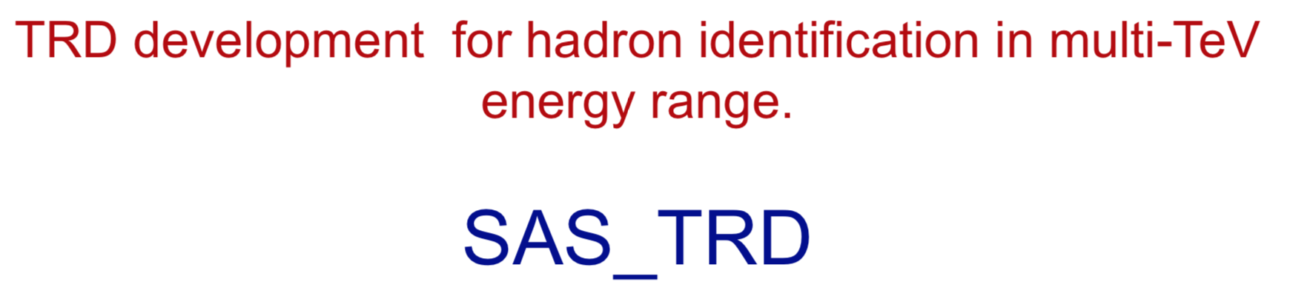
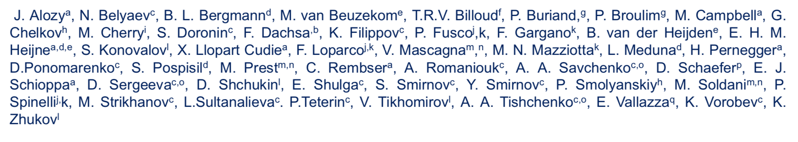
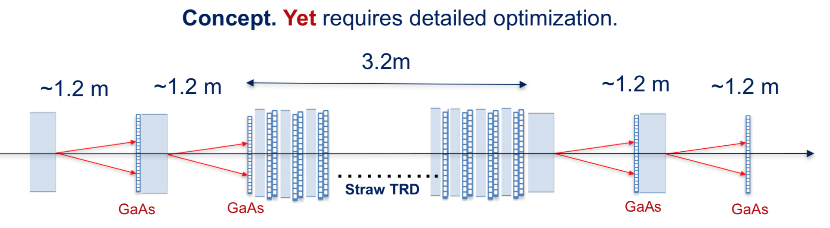
Transition Radiation Detectors : Only known way to identify multi-TeV π/K/p
Anatoli Romaniouk’s talk this morning, on behalf of team:
Note : Measurement of π/K/p spectra does not require perfect separation.
But « better is better » especialy for S:B in e.g. D⁰ - > π+K-

Slide 12
SAS as a Multi-particle Spectrometer
Acceptance for 2 or more particles from same event.
Positive and negative particles on opposite sides of pipe, near horizontal plane.
Neutrals at 0º between pipes
Acceptances need to be calculated for realistic design.
Potentially:
J/ψ, ψ(2S) → μ+μ-, χ_{c} → J/ψ + γ, Drell-Yan μ+μ- , γγ → μ+μ-
K⁰_{s} → π⁺π⁻, Λ → p π. P* → n π+ ?
D⁰ → K⁺π⁻ … χ_{c} → π⁺π, K⁺K⁻, etc.
Very forward charm and beauty also measured with single leading e and μ
Leptons can be identified (how well? Background from fakes?)
Muons from π, K decay will be known, and their decay lengths are very long!
γcτ (π) = 139 km at 2.5 TeV ! But abundant and - > forward HE μ-neutrinos! (FASER)
γcτ (K+) = 18.5 km at 2.5 TeV !

Slide 13
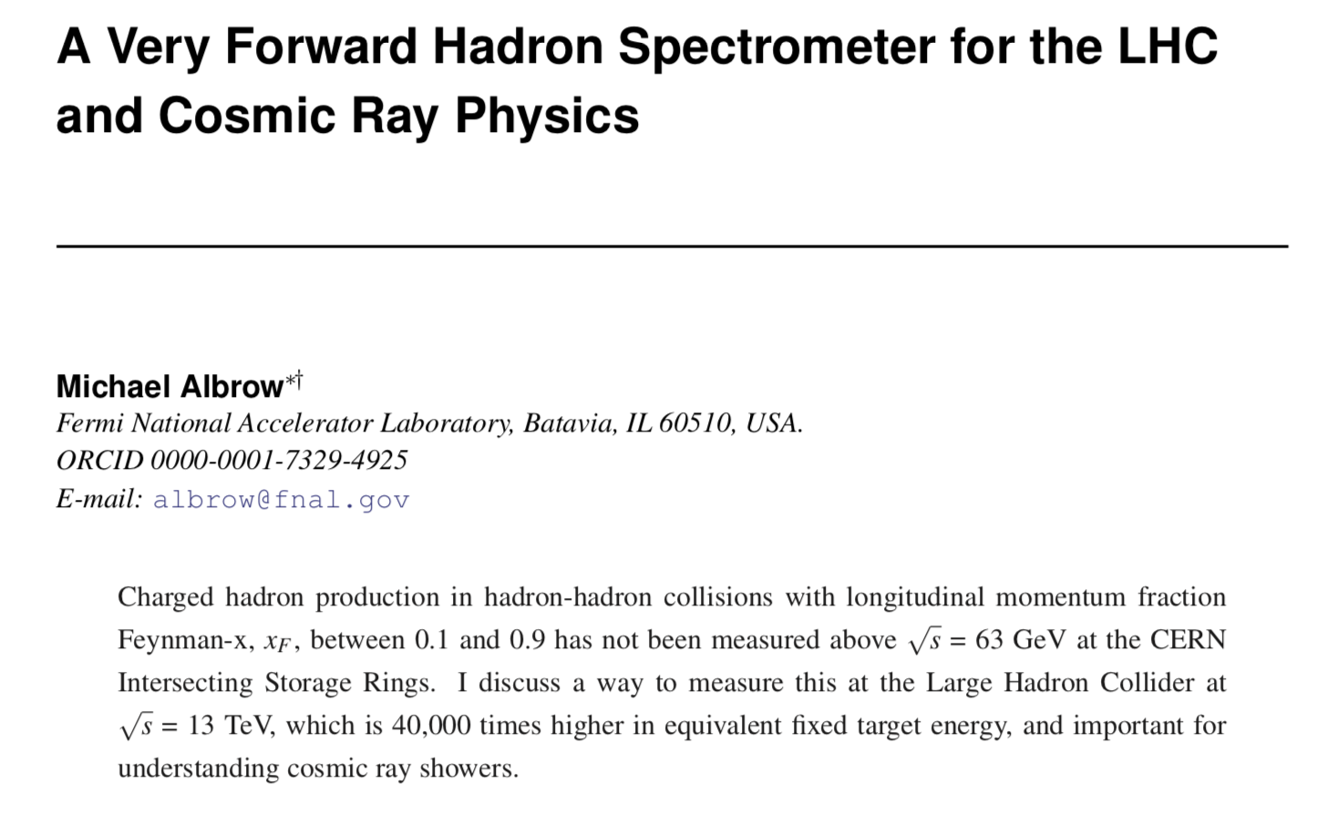

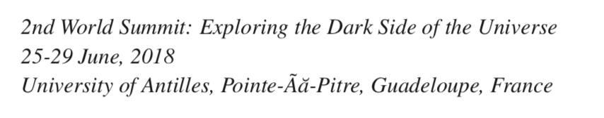
Short write-up

Slide 14
Job List – How can we make it happen?
New collaboration : Independent experiment at an existing collision point
More likely homes of LHCb and/or ALICE :
Physics synergy and eventual collaboration possible.
GOAL for discussion:
Studies towards a Letter of Intent → Proposal to LHCC:
Need collaborators to develop project – areas of interest?
Need CERN contributions – Vacuum pipe, infrastructure, beam conditions etc.
Physics, hardware, computing - including Monte Carlo simulations, theory, …
Develop physics case (SM, Beyond SM including DM, Cosmic rays, astrophysics,…
Housekeeping:
Set up Web site, Twiki page/repository of papers etc, Indico for meetings, etc.
Initial designs: TRDs (include tracking), calorimetry, muon chambers, trigger, DAQ
Initial estimates of « who does what », costs and timescale

Slide 15
Summary
Terra Incognita : large phase space (in x_{F}, p_{T}) unexplored from √s = 63 – 14,000 GeV !
Justification in itself, but …
Need to understand Strong Interaction in non-perturbative sector
Important to understand UHE cosmic rays : Sampled shower → primary, UHE collisions, muons
Exist: Spectrometer magnets and 85m vacuum chamber + 50m straight section
Need special vacuum chamber with “thin” exit windows. Feasible.
Technology for tracking, calorimeter, muon tracking exist
Particle ID with transition radiation possible (π,K,p) … interesting challenge being developed
Open & accessible & small so evolution of techniques natural.
How and where?
Downstream of (ALICE) has good conditions and alignment with physics (pp + pO + OO).
Downstream of – LHCb – forward but not this forward.
Both should find addition of VFHS enhances their physics program, both pp and nuclei
Strategically: Independent new experiment (allowing for later merger)
TRD experts are developing suitable TR detectors
[ Crystal channeling experts are developing Xtals – could extend x_{F} range]
It can be done and it should be done!

Slide 16
Can you join or do you know someone who can?
Leadership especially needed!
Thank You
Back Ups →

