Slide 1
ROOT7
Fit Panel - Browser
Iliana Betsou
National Technical University of Athens

Slide 2
Objectives of the new version
What we want from the new version to be:
Client/Server program
  Web based application
  Run directly in a browser
Modern and user friendly
Responsive layout

Slide 3
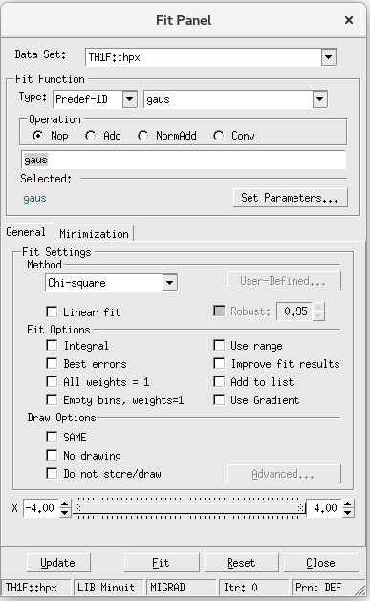
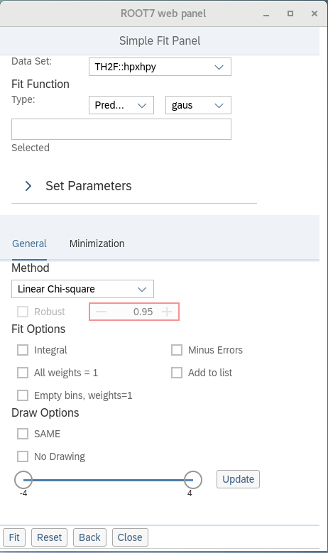
ROOT7 version – Fit Panel
Before
After

Slide 4
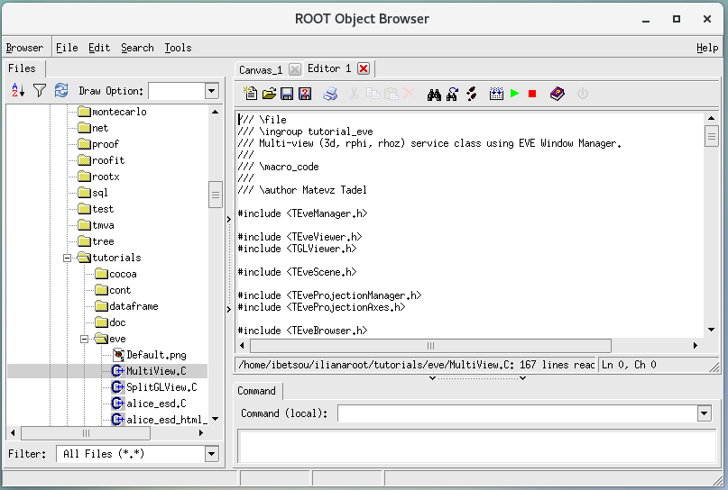
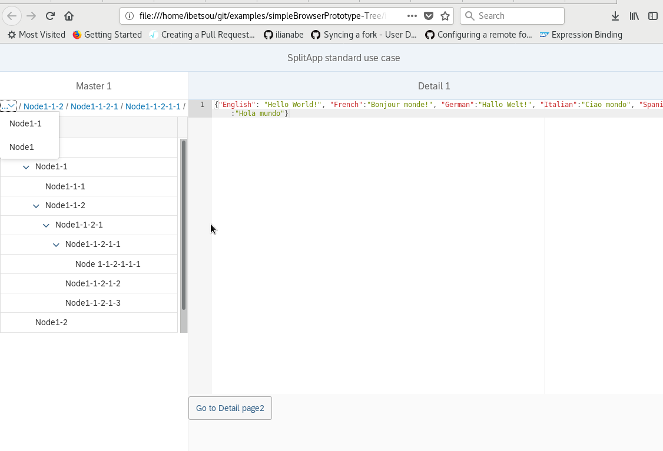
ROOT7 version - Browser

Slide 5
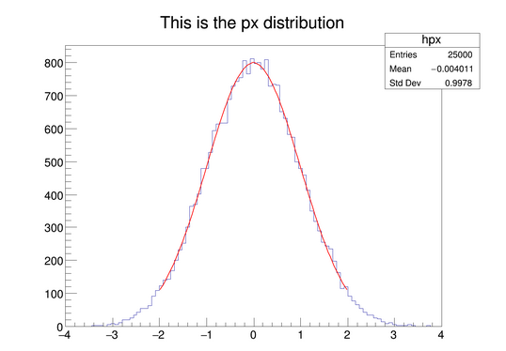
Fit Panel…
…is a GUI, which can use all the power of ROOT Fitting tools and interactively fit histograms.
Predefined or User Function
Draw Options
Libraries
Different Minimization Methods
Range
Print Options

Slide 6
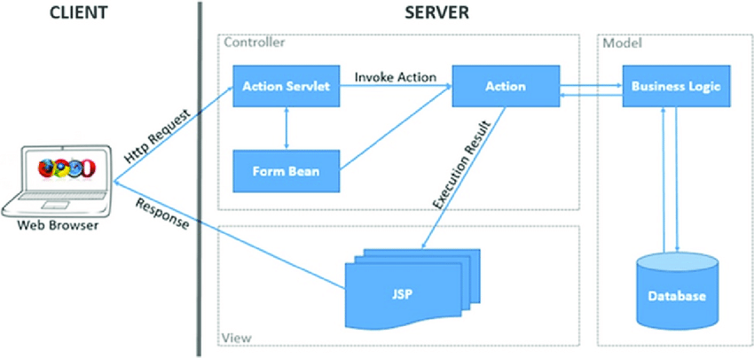
Client Server Model
Organizes network traffic
Client sends requests to server
Server responds by returning results

Slide 7
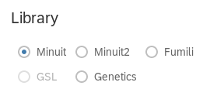
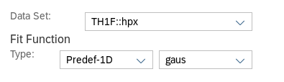
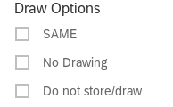
OpenUI5
OpenUI5 is the new technology we have used to design the new version of the Fit Panel. It is a JavaScript UI library consisting of a really large number of UI controls.
Combo Boxes
Radio Buttons
Check Boxes

Slide 8
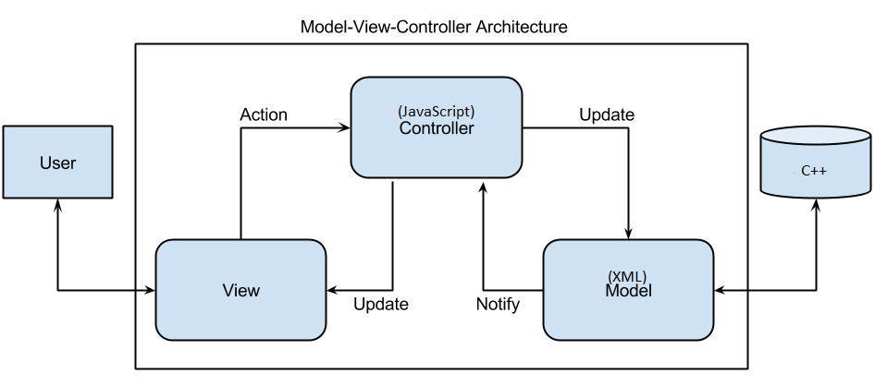
MVC Architecture
Model Component → Dynamic data structure
View Component → Display of the data (UI)
Controller → Contains control logic

Slide 9
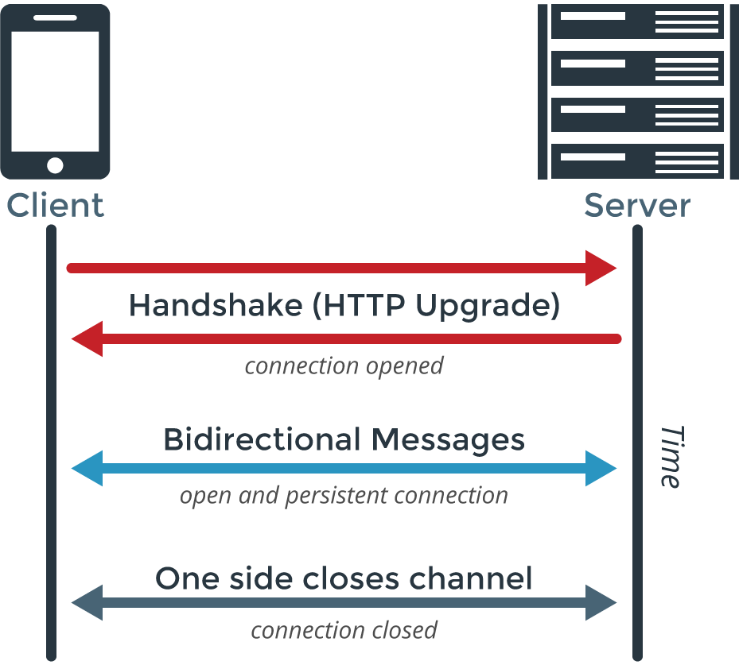
WebSocket Protocol
Communication Protocol
Duplex communication channels
Compatible with HTTP and almost all browsers

Slide 10
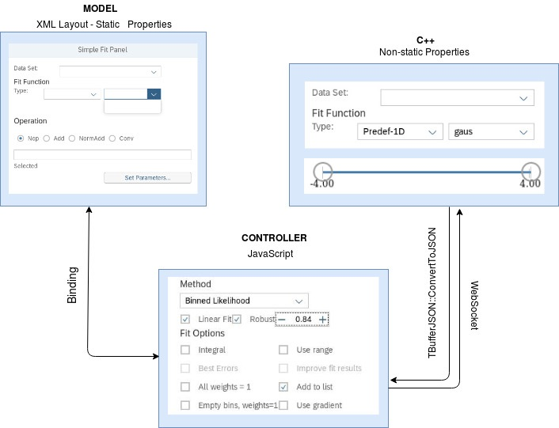
How it’s working
Model Component – XML
with the static values
Server side – C++
the non-static values
Client side - JavaScript
View Component
HTML file

Slide 11
The Fit Panel Layout (1/4)
The containers:
Vbox
<VBox class="sapUiSizeCompact">
Toolbar
<Toolbar>
Form
<form:layout> <form:ResponsiveGridLayout/>
</form:layout>
GridData
<l:Grid
class="sapUiSizeCompact"
vSpacing="0"
defaultSpan="L4 M6 S10">
<l:content>
LayoutData
<layoutData>
<l:GridData span="L4 M6 S3"/>
</layoutData>

Slide 12
The Fit Panel Layout (2/4)
We need more compact design:
Compact Layout: for achieving a compact layout we are using:
Forms
GridData
Compact Class
<VBox class="sapUiSizeCompact">

Slide 13


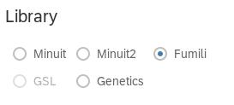
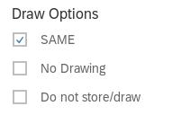

The Fit Panel Layout (3/4)
The controls:
ComboBox
RadioButton
Step Inputs
RangeSlider
CheckBox
Text Inputs
Buttons

Slide 14
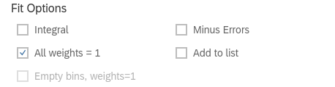
The Fit Panel Layout (4/4)
Binding: We are using data binding to communicate with the client.
<RadioButtonGroup selectedIndex="{/fOperation}">
//the selected value from the RadioButtonGroup is stored in fOperation
<CheckBox text=“Empty bins, weights=1" selected="{/fBins}"
enabled="{= ${/fWeights} !== true}"/>
// the checkbox is enabled only if All Weights=1 option is not selected(false)

Slide 15
More binding
We can copy the initial state of the FitPanel, store it in a new model, apply it on our main model and update the FitPanel.
resetPanel: function(oEvent){
if(!this.copyModel) return; JSROOT.extend(this._data, this.copyModel); this.getView().getModel().updateBindings();
return;
},

Slide 16
Server Side in C++ (1/3)
Structures for most complicated controls (ComboBox) for implement the controls to ROOT
struct ComboBoxItem {
std::string fId;
std::string fSet;
ComboBoxItem() = default;
ComboBoxItem(const std::string &id, const std::string &set) : fId(id), fSet(set) {}
};

Slide 17
Server Side in C++ (2/3)
FitPanelModel Structure with the definition of all types
struct FitPanelModel {
std::vector<ComboBoxItem> fDataSet;
std::string fSelectDataId;
float fMinRange{0};
bool fLinear{false};
int fLibrary{0};
bool fBestErrors {false};
};

Slide 18
Server Side in C++ (3/3)
We give values to the parameters in our model follow the structure we have defined before.
FitPanelModel model;
//ComboBox for Data Set model.fDataSet.push_back(ComboBoxItem("1", "No Selection")); model.fDataSet.push_back(ComboBoxItem("2", "TH1F::hpx")); model.fDataSet.push_back(ComboBoxItem("3", "TH2F::hpxhpy"));
model.fSelectDataId = "2";
model.fMinRange = -4;
model.fLinear = true;
model.fLibrary = 0;
model.fBestErrors = false;

Slide 19
Communication between C++ and JavaScript
The communication between the server side and the client side
TString json = TBufferJSON::ConvertToJSON(&model,
gROOT->GetClass("FitPanelModel"));
fWindow->Send(fConnId, std::string("MODEL:") + json.Data());
TBufferJSON::ConvertsToJSON()→ converts an object to JSON string

Slide 20
Client Side on JavaScript
Function for the communication with the server, OnWebSocketMessage
  OnWebsocketMsg: function(handle, msg){ if(msg.startsWith("MODEL:")){
  var json = msg.substr(6);
  var data = JSROOT.parse(json);
  if(data) {
  this.getView().setModel(new JSONModel(data)); this._data = data; }
  }
  else { }
  },

Slide 21
Fit Function on Client Side
Button on the layout
doFit: function() {
  var data = this.getView().getModel().getData();
  //We get the value from the ComboBox for the function and store it func.
  var func = this.getView().byId("TypeXY").getValue();
  //We pass the value from func (JavaScript Side) to fRealFunc(C++ Side).
  data.fRealFunc = func;
  var range = this.getView().byId("Slider").getRange(); data.fRange[0] = range[0]; data.fRange[1] = range[1];
  //Refresh the model
  this.getView().getModel().refresh();
  if (this.websocket) this.websocket.Send('DOFIT:'+this.getView().getModel().getJSON());
},

Slide 22
Fitting Function on C++ (1/2)
We transform the selected values on the right form:
if (obj) {
  if (!obj->fRealFunc.empty()) {
  printf("GOT fRealFunc: %s\n", obj->fRealFunc.c_str()); }
  else { obj->fRealFunc = "gaus";
  printf("%s\n", obj->fRealFunc.c_str()); }
  if(obj->fIntegral){
  obj->fOption = "I"; }
  else if(obj->fBestErrors){
  obj->fOption = "E"; }
  else {
  obj->fOption = ""; } }
  }

Slide 23
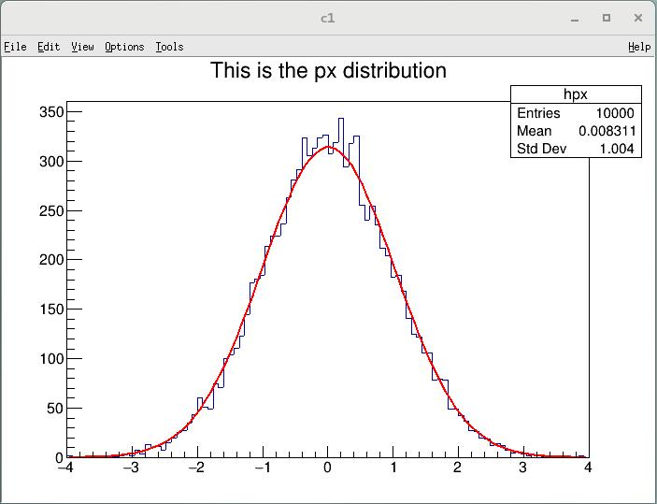
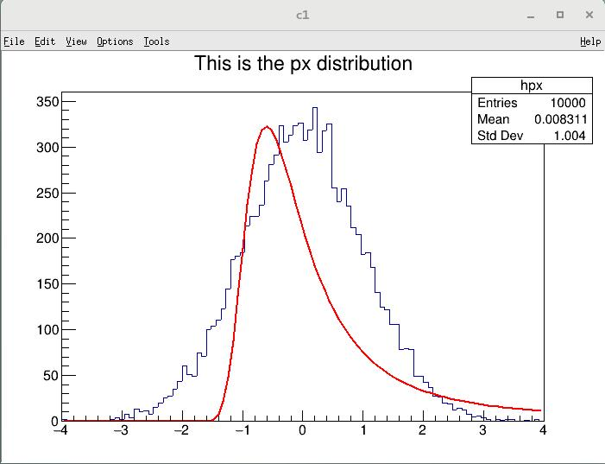
Fitting Function on C++ (2/2)
We assign the edited values to fit function and update
if (fHist) {
  fHist->Fit(obj->fRealFunc.c_str(), obj->fOption.c_str(), "*", obj->fRange[0], obj->fRange[1]);
  gPad->Update(); }
}

Slide 24
Create Window in C++
void Show(const std::string &where = "") {
fWindow =ROOT::Experimental::TWebWindowsManager::Instance() ->CreateWindow(false);
//defines the OpenUi5 element which will run on client-side
fWindow->SetPanelName("localapp.view.SimpleFitPanel");
//receive the model via WebSocket
fWindow->SetDataCallBack([this](unsigned connid, const std::string &arg) { ProcessData(connid, arg); });
//configure predefined geometry
fWindow->SetGeometry(450, 550);
fWindow->Show(where);
//instead showing of window just generate URL, which can be copied into the browser
std::string url = fWindow->GetUrl(true);
printf("Example: %s\n", url.c_str()); }

Slide 25
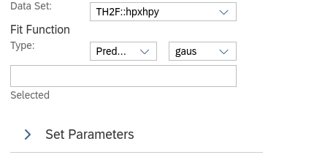

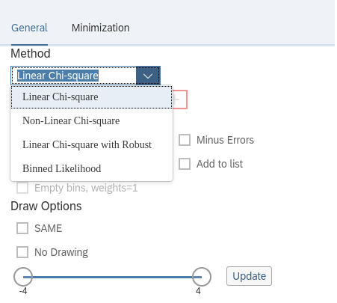
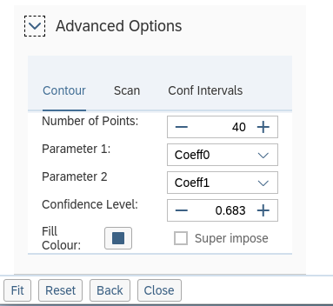
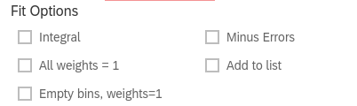
Changes on the FitPanel

Slide 26
Summary
Model Component Creation – XML (static values)
Server side in C++ (non static values)
Client side in JS
View Component
Web Based Fit Panel

Slide 27
Future Work
There are a few things that still missing from the new version of Fit Panel and will be completed in the next months.
  Picking on Rpad
  Provide list of primitives on RPad to fit panel on C++ side
  Add functionality to Update Range Button
  Create a Back function

Slide 28
Browser Layout

Slide 29

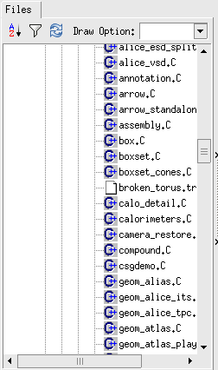
The perfect control
Huge amount of data
Easy to use
Responsive

Slide 30
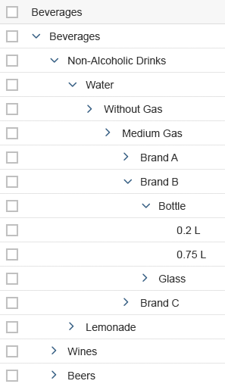
Tree vs TreeTable
Tree is responsive but it is able to handle a limited amount of data
TreeTable can handle any amount of data using OData protocol, but it is not responsive

Slide 31
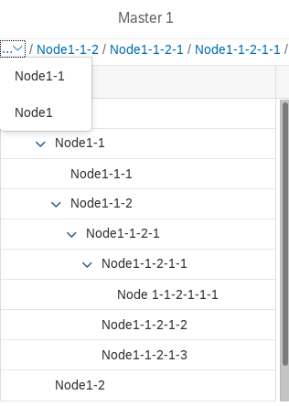
Breadcrumbs Navigation
Easier way to navigate through TreeTable
onToggle: function(oEvent) {
...
if(!(paths.includes(lItem))){
arr.push(sNode); rows.push(sNode, rowIndex);
}
else{
var index = arr.indexOf(sNode);
paths.length = index+1;
arr.length = index+1;
}
paths.push(lItem);
this.getView().getModel("aModel").setData(arr);
},

Slide 32
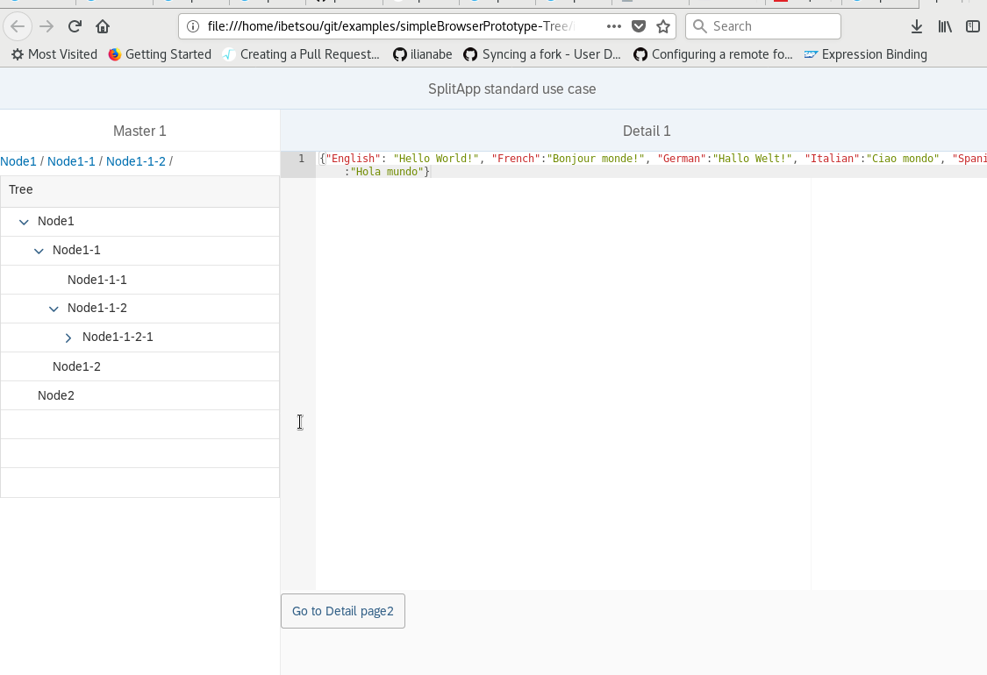
SplitApp – Responsive layout
<m:SplitApp id="SplitAppDemo" initialDetail="detail" initialMaster="master" orientationChange="onOrientationChange"> <m:detailPages>
<m:Page id="detail" title="Detail 1" class="sapUiStdPage"> <m:content>
<m:Label text="Detail page 1" />
</m:content>
</m:Page>

Slide 33
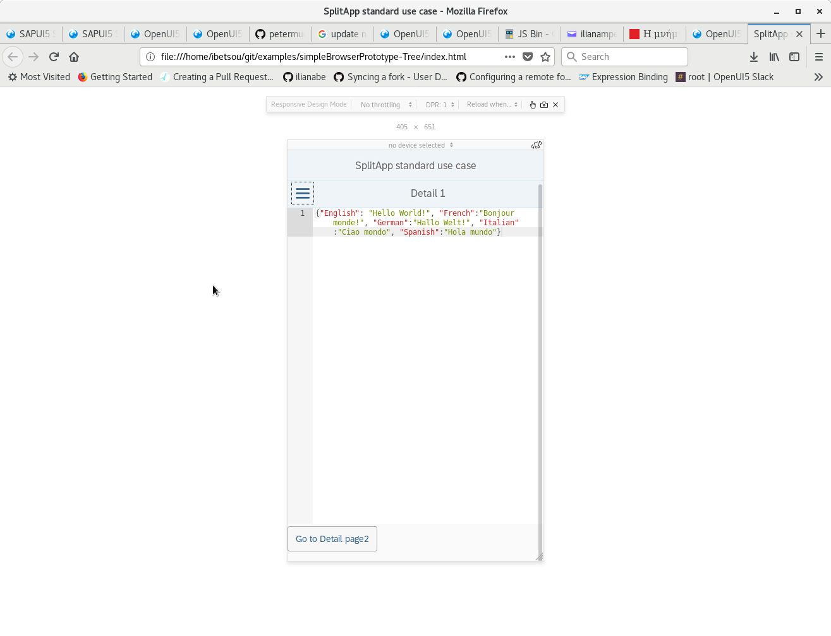
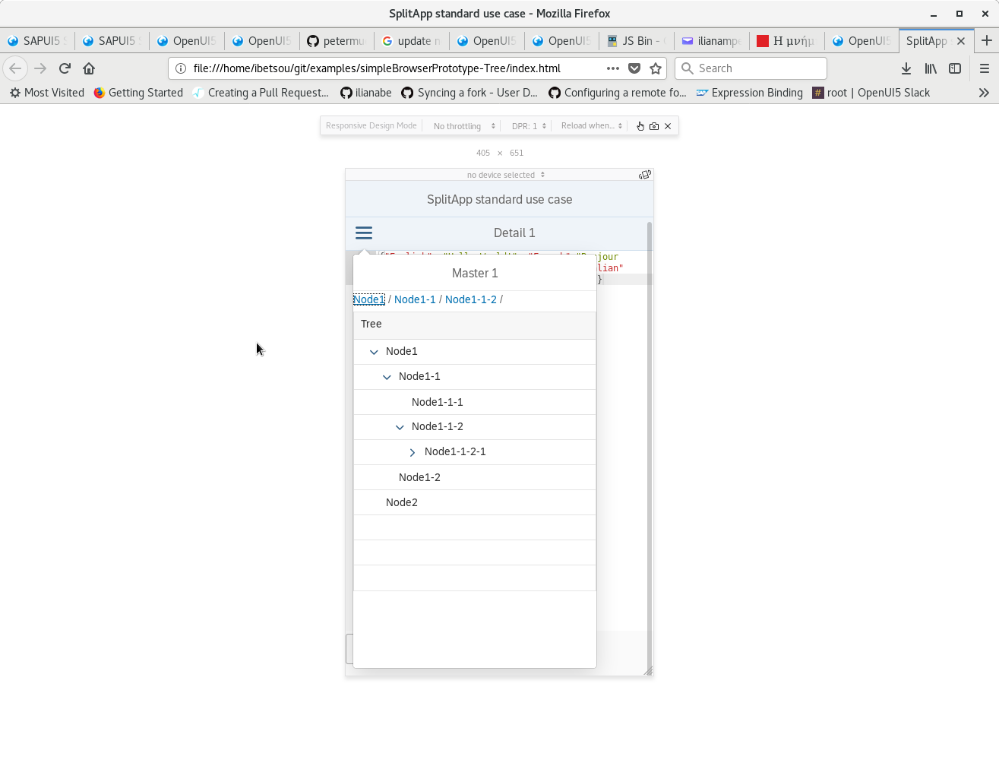
Browser in smartphones

Slide 34
Next steps
Fully implemented Fit Panel with all the functionalities in ROOT
Implement TreeTable in ROOT
Create and test a Prototype of the Browser in ROOT

Slide 35
More Stuff!
Dependant Combo Boxes, Layout with code,
Controls with code,
MVC architecture (SAP)

Slide 36
The Fit Panel Layout (2/4)
The controls:
ComboBox
<ComboBox id="DataSet" selectedKey="{/fSelectDataId}"
items="{ path: '/fDataSet', sorter: { path: 'fSet' } }"> <core:Item key="{fId}" text="{fSet}" />
</ComboBox>
RadioButton
<RadioButton id="RB1-1" text="Nop"/>
CheckBox
<CheckBox id="Integral" text="Integral"/>
RangeSlider
<RangeSlider id="Slider" range="{/fRange}" min="{/fMinRange}" max="{/fMaxRange}" step="{/fStep}"/>

Slide 37
Functions for handling the values
The selected function from the ComboBox appears directly on the TextArea.
onTypeXYChange: function(){
var data = this.getView().getModel().getData();
var linear = this.getView().getModel().getData().fSelectXYId; data.fFuncChange = linear; this.getView().getModel().refresh();
//updates the text area and text in selected tab, depending on the choice in TypeXY ComboBox
var function = this.getView().byId("TypeXY").getValue(); this.byId("OperationText").setValueLiveUpdate(); this.byId("OperationText").setValue(function); this.byId("selectedOpText").setText(function);
},

Slide 38
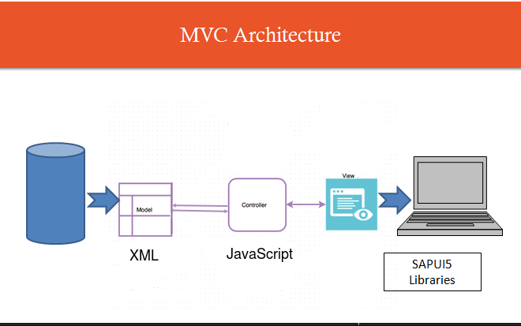
MVC Architecture

Slide 39
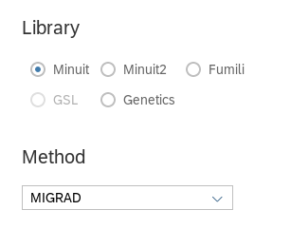
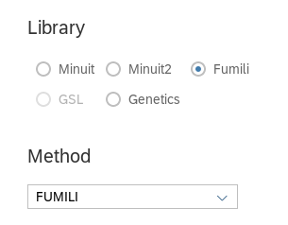
Dependent ComboBox (1/2)
There are some ComboBoxes which values are dependant
from the selection of a previous control.
Definition:
std::vector<std::vector<ComboBoxItem>> fMethodMinAll;

Slide 40
Dependent ComboBox (2/2)
We give the values:
// corresponds to library == 0 model.fMethodMinAll.emplace_back();
std::vector<ComboBoxItem> &vect0 = model.fMethodMinAll.back();
vect0.push_back(ComboBoxItem("1", "MIGRAD")); vect0.push_back(ComboBoxItem("2", "SIMPLEX"));
// corresponds to library == 2 model.fMethodMinAll.emplace_back();
std::vector<ComboBoxItem> &vect2 = model.fMethodMinAll.back();
vect2.push_back(ComboBoxItem("1", "FUMILI"));

