Slide 1
Cooling of Bunched Beams
S. Albright, H. Bartosik, N. Biancacci, A. Saa Hernandez, M. Zampetakis

Slide 2
Layout
Motivation
Cooling of a Coasted Beam vs. Bunched Beam
  Single Harmonic
  Double Harmonic
Exploring Parameter Space
  Tune Scan
  Intensity Scan
Future Work

Slide 3



Motivation
PhD Thesis Title: Studies of non-linear and incoherent effects and their mitigation in low emittance rings.
Cooling Effects
Heating Effects
CLIC’s Damping Rings:
Synchrotron Radiation
Space Charge
IBS
LEIR:
Space Charge
IBS
$e^{−}$ Cooler
Equilibrium emittances reached in both cases.
Goal: Develop a framework in order to study the interplay of all three effects and compare it to some measurements.

Slide 4
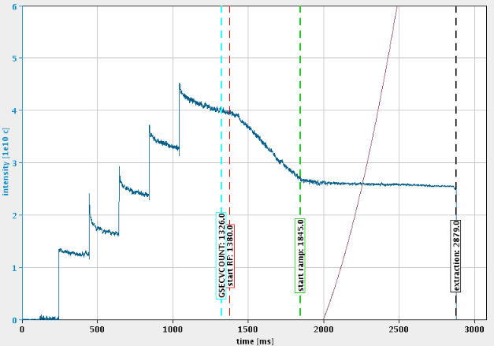
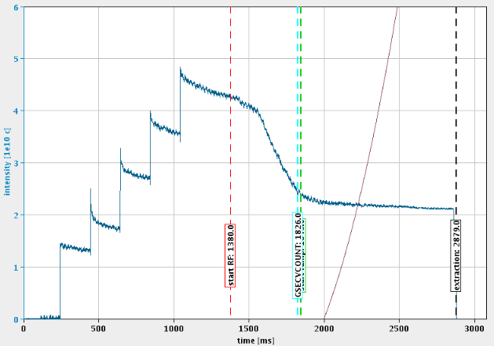
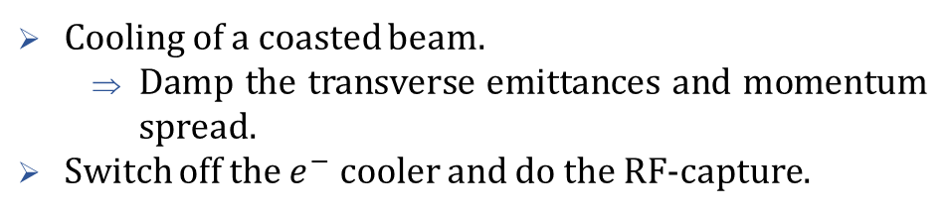
Cooling of a Coasted Beam VS Bunched Beam 1/3
Typical Case
Our Case
Cooling
Cooling
Cooling of a coasted beam.
  Damp the transverse emittances and momentum spread.
Switch off the $e^{−}$ cooler and do the RF-capture.
Cooling time is extended.
  Cooling of a bunched beam.
  Beam is damped in all 3 planes leading to complicated dynamics.

Slide 5
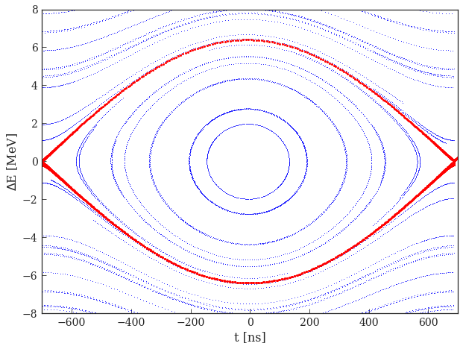
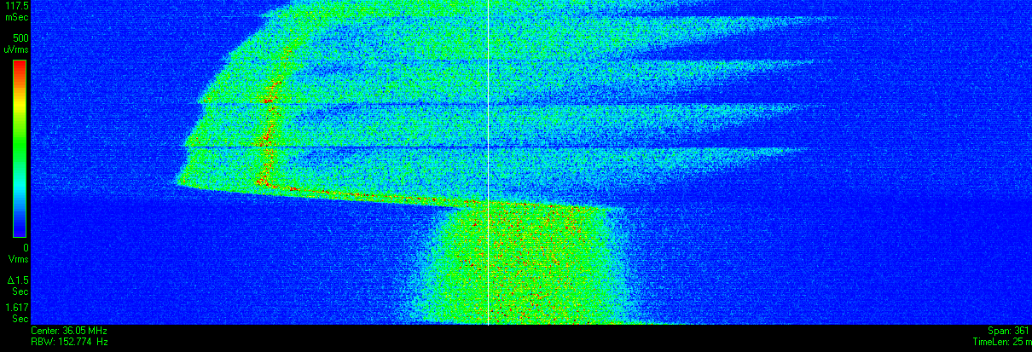
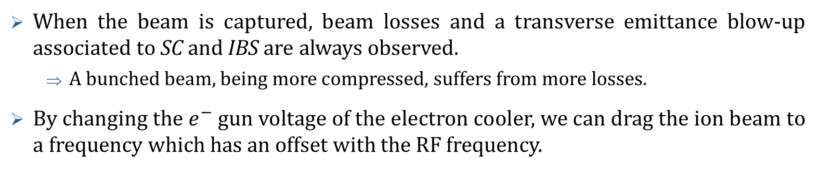

Cooling of a Coasted Beam VS Bunched Beam 2/3
When the beam is captured, beam losses and a transverse emittance blow-up associated to SC and IBS are always observed.
  A bunched beam, being more compressed, suffers from more losses.
By changing the $e^{−}$ gun voltage of the electron cooler, we can drag the ion beam to a frequency which has an offset with the RF frequency.
Longitudinal dynamics due to RF cavity
Longitudinal dynamics due to $e^{−}$Cooler
Time
Frequency

Slide 6
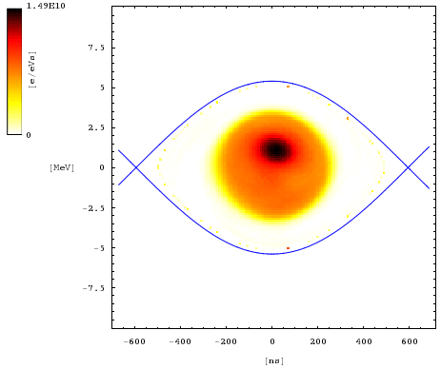
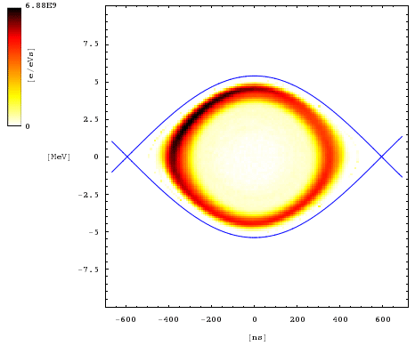
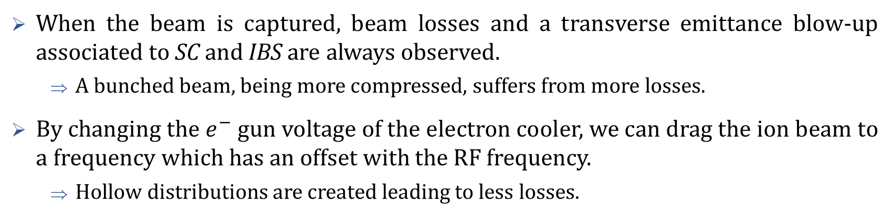


Cooling of a Coasted Beam VS Bunched Beam 3/3
When the beam is captured, beam losses and a transverse emittance blow-up associated to SC and IBS are always observed.
  A bunched beam, being more compressed, suffers from more losses.
By changing the $e^{−}$ gun voltage of the electron cooler, we can drag the ion beam to a frequency which has an offset with the RF frequency.
  Hollow distributions are created leading to less losses.
$$Ion equivalent energy of the electrons$$
:
$$Ion equivalent energy of the electrons$$

Slide 7
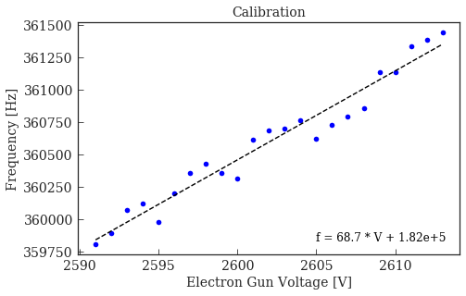
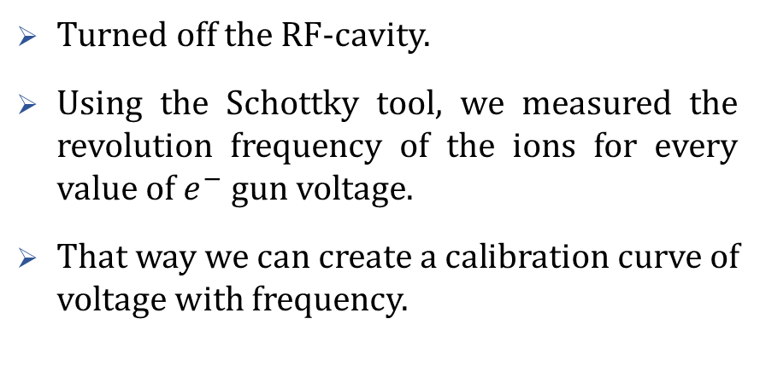

Calibration of Frequency - $e^{−}$gun voltage
Turned off the RF-cavity.
Using the Schottky tool, we measured the revolution frequency of the ions for every value of $e^{−}$ gun voltage.
That way we can create a calibration curve of voltage with frequency.

Slide 8
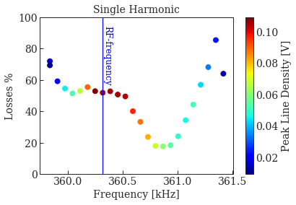
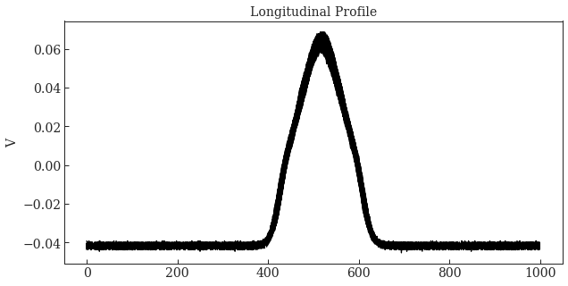
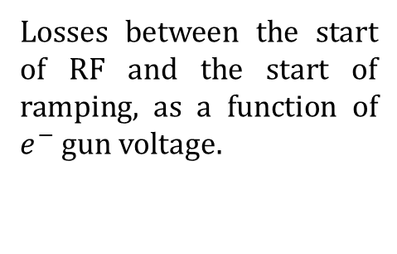
Single Harmonic 1/2
Losses between the start of RF and the start of ramping, as a function of $e^{−}$ gun voltage.
Peak Line
Density
*Best case losses ~18%

Slide 9
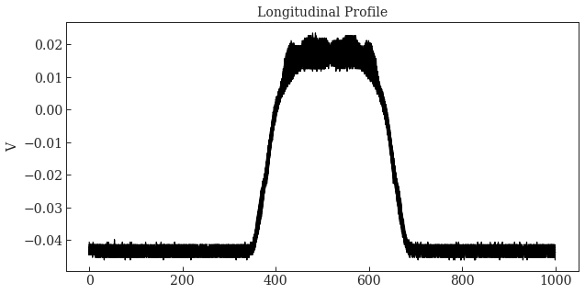
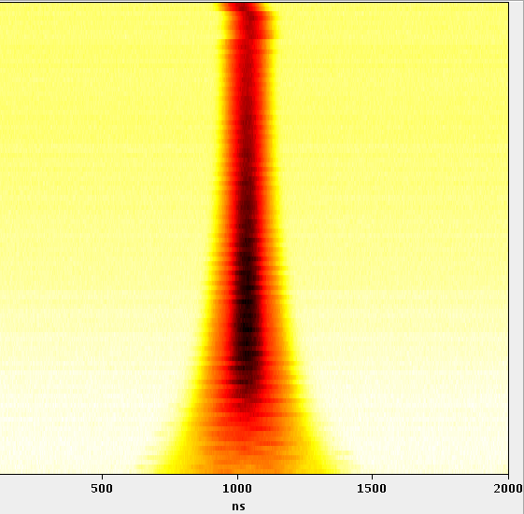
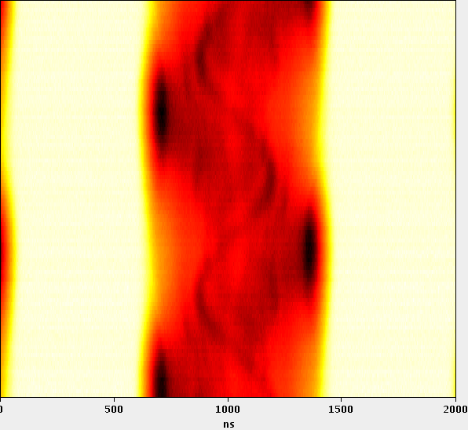
Single Harmonic 2/2
Profiles for minimum losses
Profiles for central case

Slide 10
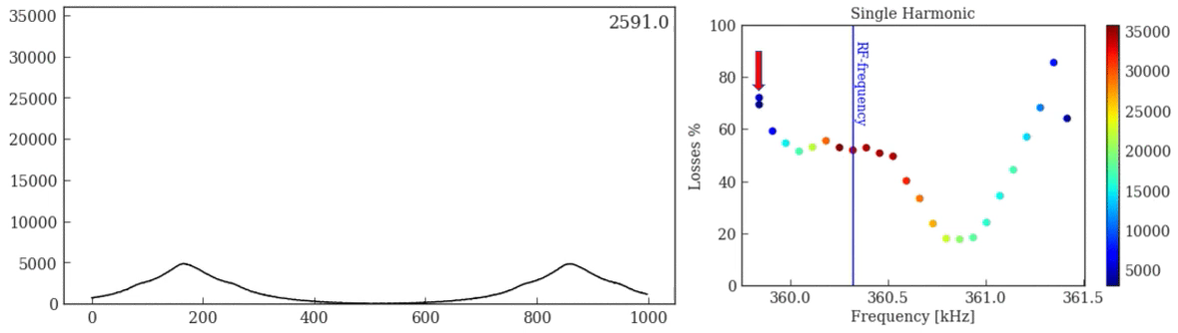
Longitudinal Profiles – Single Harmonic
*Colorbar not calibrated.

Slide 11
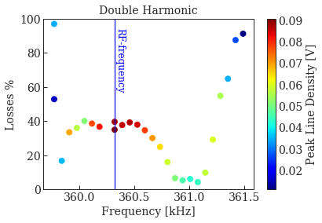
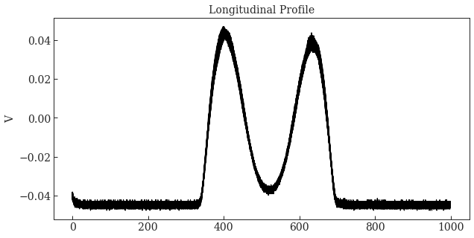
Double Harmonic 1/2
Losses between the start of RF and the start of ramping, as a function of $e^{−}$ gun voltage.
Peak Line
Density
*Best case losses ~4%

Slide 12
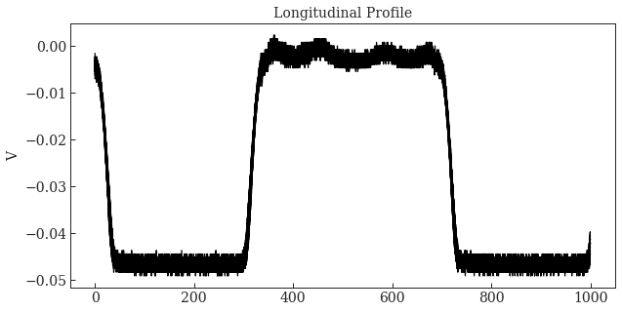
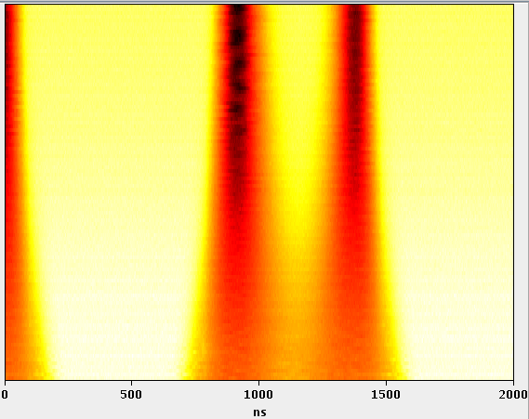
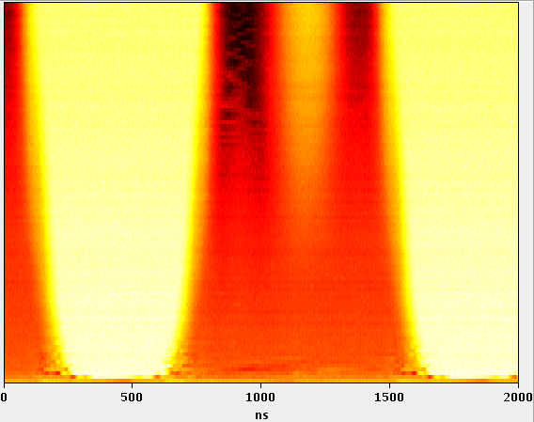
Double Harmonic 2/2
Profiles for minimum losses
Profiles for central case

Slide 13
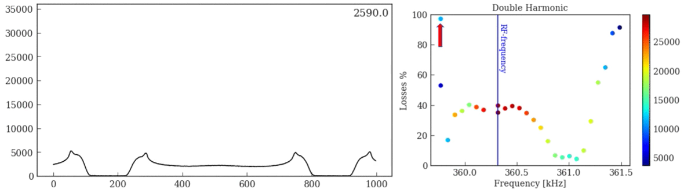
Longitudinal Profiles – Double Harmonic
*Colorbar not calibrated.

Slide 14
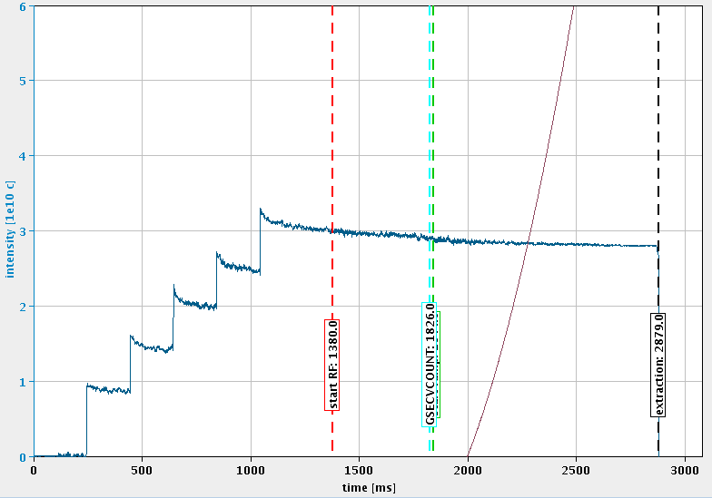
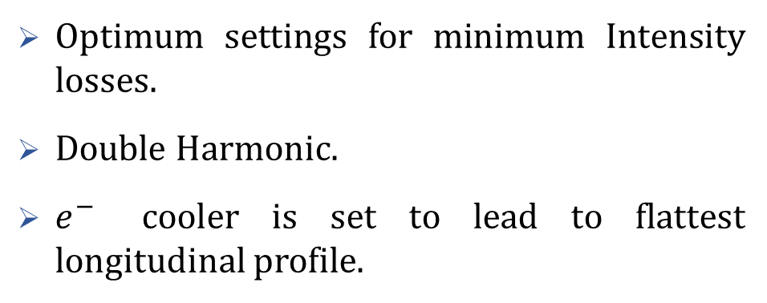
Some Conclusions
Optimum settings for minimum Intensity losses.
Double Harmonic.
$e^{−}$ cooler is set to lead to flattest longitudinal profile.
Can we get the same for high Intensities?

Slide 15
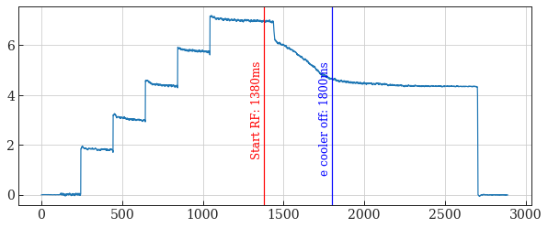
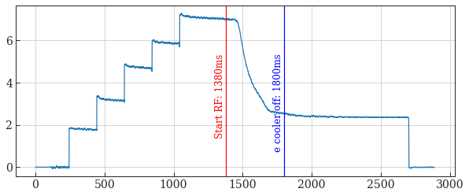

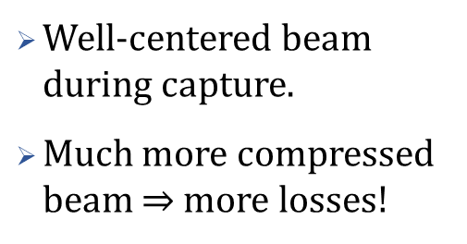
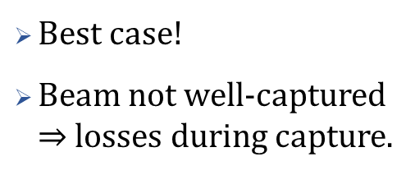

And for High Intensity… (1/3)
AMDNOM Cycle
Accumulated $\sim 6.5∙{10}^{10}$charges
Best case!
Beam not well-captured $⇒$ losses during capture.
Intensity (1e10 charges)
Time (ms)
Low Intensity - AMDOPTIC Cycle
Accumulated $\sim 3∙{10}^{10}$charges
Well-centered beam during capture.
Much more compressed beam $⇒$ more losses!
Intensity (1e10 charges)
Time (ms)

Slide 16
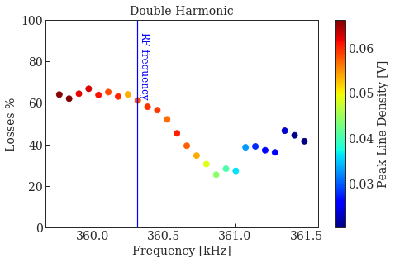
And for High Intensity… (2/3)
Losses evaluation between the (usual) times, 1440ms and 1800ms
Much more losses (~25%) due to the higher Intensity.

Slide 17
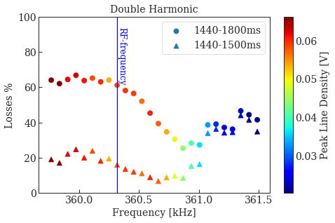
And for High Intensity… (3/3)
Less losses (~6%) if evaluated for shorter time.
Well-centered beams suffer from less losses during capture but are affected more by SC and IBS.
Off-centered/flat beams suffer from less losses, long-term.
Intensity (1e10 charges)
Time (ms)

Slide 18
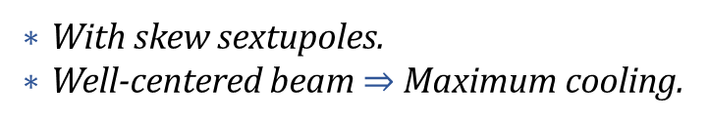
Tune Scans
With skew sextupoles.
Well-centered beam$⇒$ Maximum cooling.

Slide 19
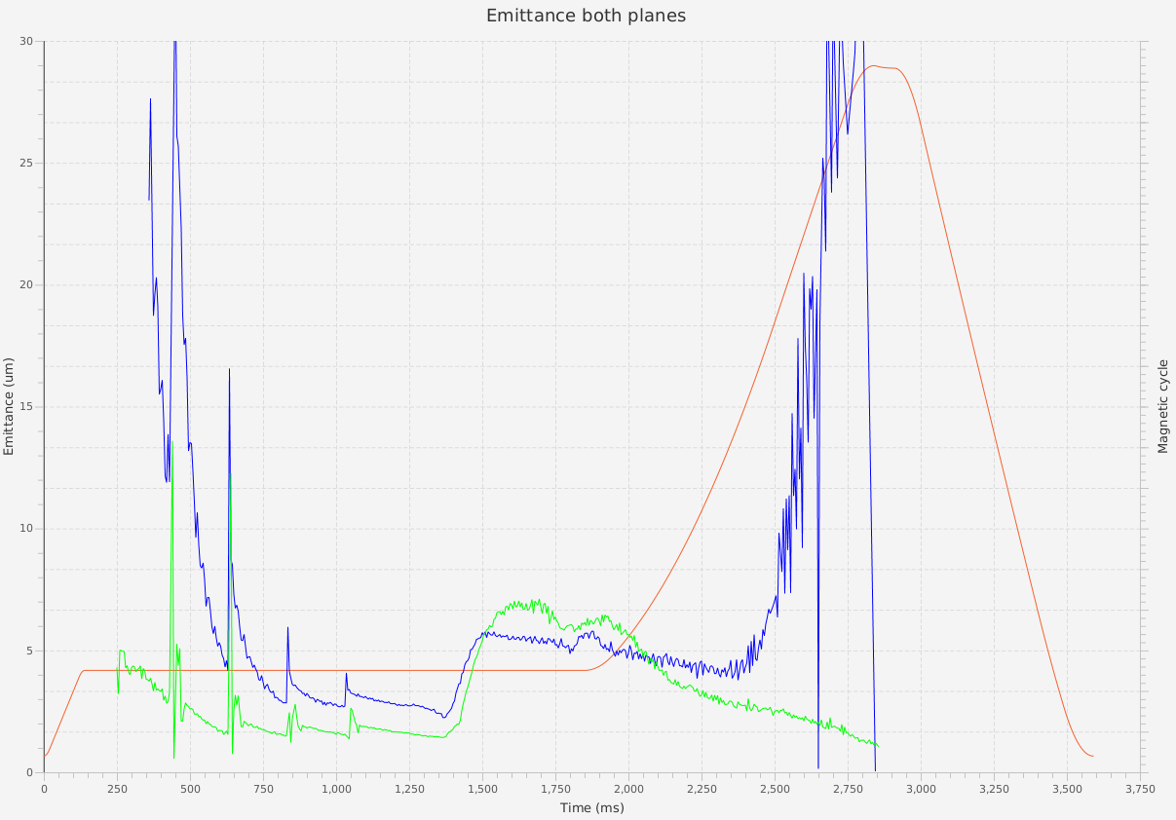
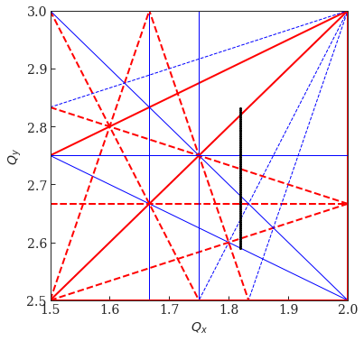

Vertical Tune Scan
Excited Resonance!
Sextupoles at
XSK41 = -1.5
XSK42 = 1.5
Cooling
Blow-up…
Capture…
$e^{−}$Cooler is turned off…
1380ms
1800ms

Slide 20
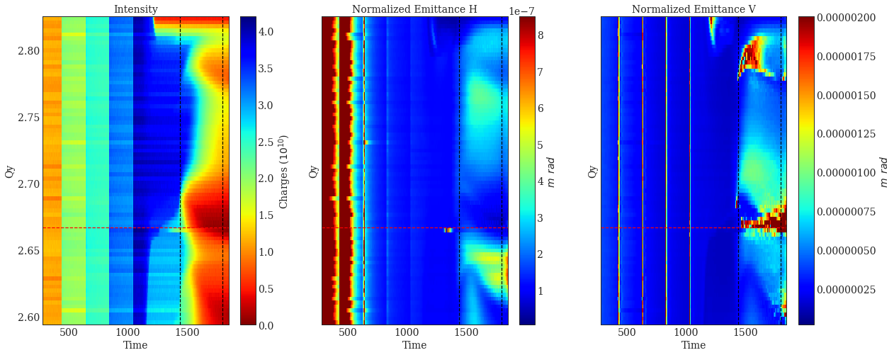
Single Harmonic – Excited Sextupoles
Almost no intensity close the 2.66 resonance.
Not sure about the emittance blow-ups due to the “noisy” areas.

Slide 21
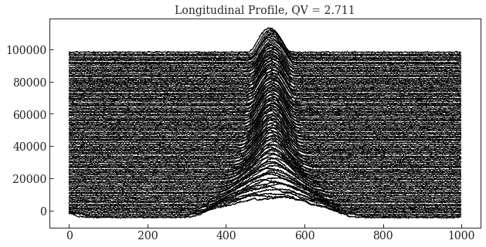
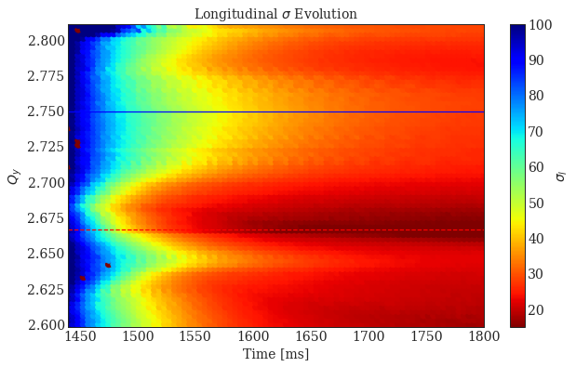
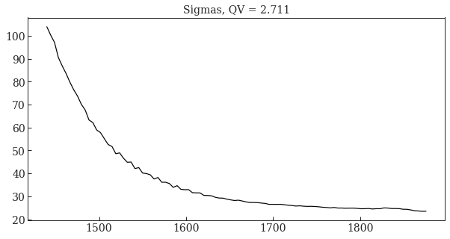

Slide 22
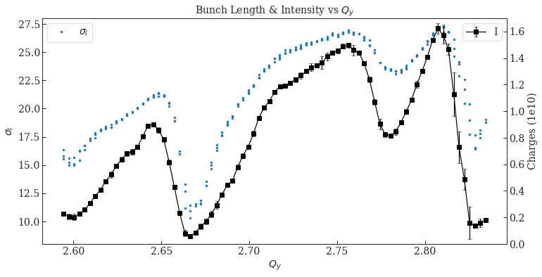
Single Harmonic – Excited Sextupoles
Bunch length follows the intensity behavior $⇒$ No evidence that IBS affects the beam longitudinally.

Slide 23
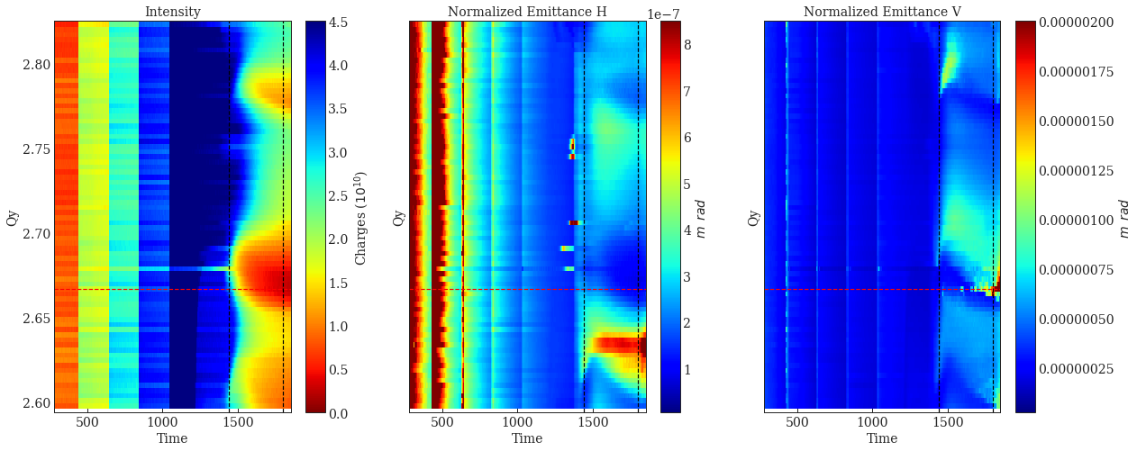
Double Harmonic – Excited Sextupoles
Almost no intensity close the 2.66 resonance.
Much smaller “noisy” areas.

Slide 24
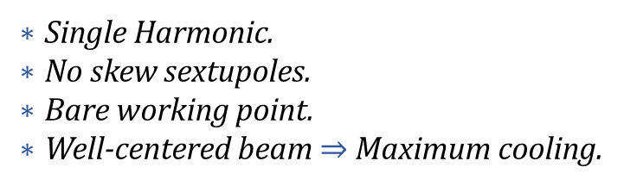
Intensity Scan
Single Harmonic.
No skew sextupoles.
Bare working point.
Well-centered beam$⇒$ Maximum cooling.

Slide 25
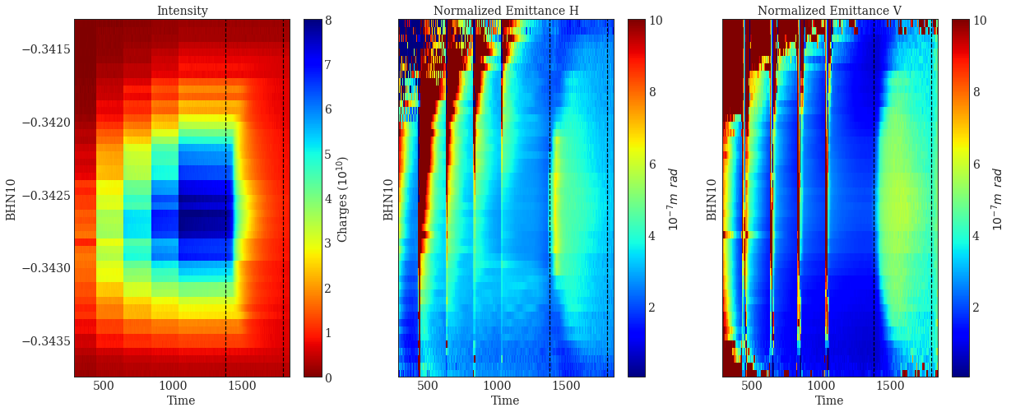
Intensity Scan
Done by changing the position of a corrector magnet (“BHN10”) in the transfer line.

Slide 26
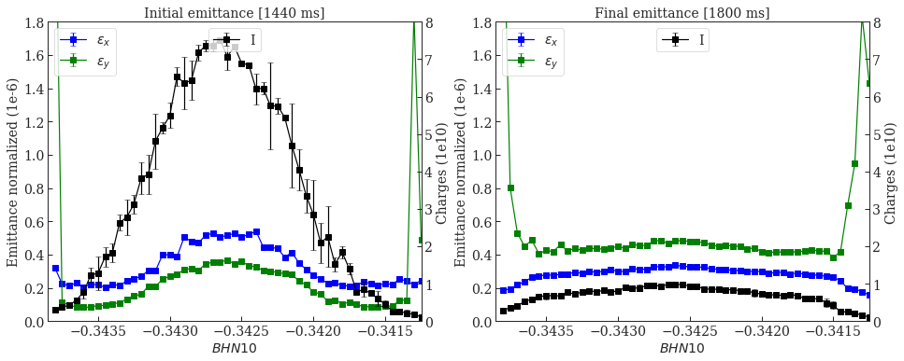
Intensity Scan

Slide 27
Next Steps…
Further investigation of the “noisy” areas.
Study in more detail the bunch length and the SC Tune Spreads.
Start implementing a tracking code with IBS and SC to see if similar results will be produced.
Maybe there will be a distinction between the IBS or SC dominance in our cases.

Slide 28
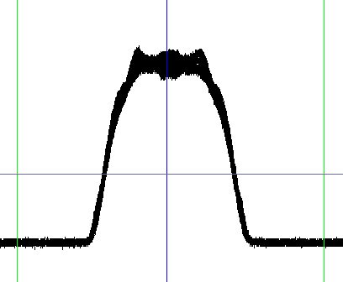


Thanks for your attention…

Slide 29
Reserve…

Slide 30
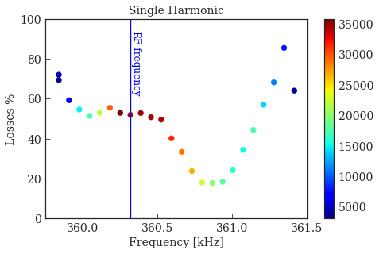
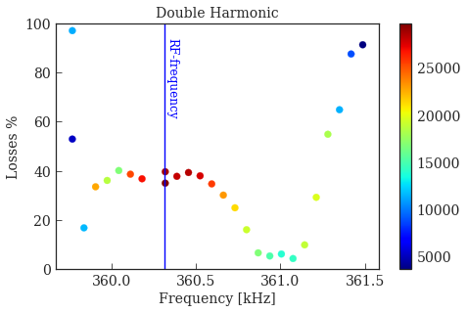
Comparison

Slide 31
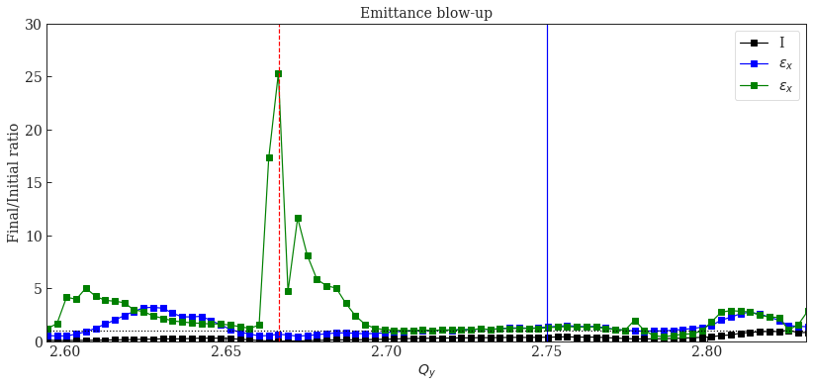
Single Harmonic– Excited Resonance

Slide 32
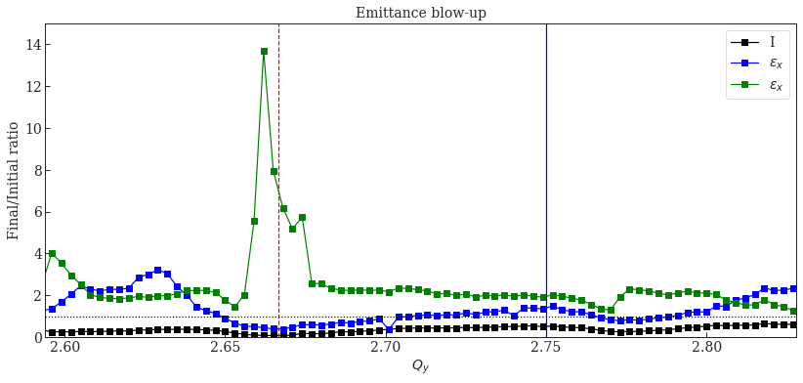
Double Harmonic – Excited Resonance

Slide 33
Single Harmonic - No Sextupoles

Slide 34
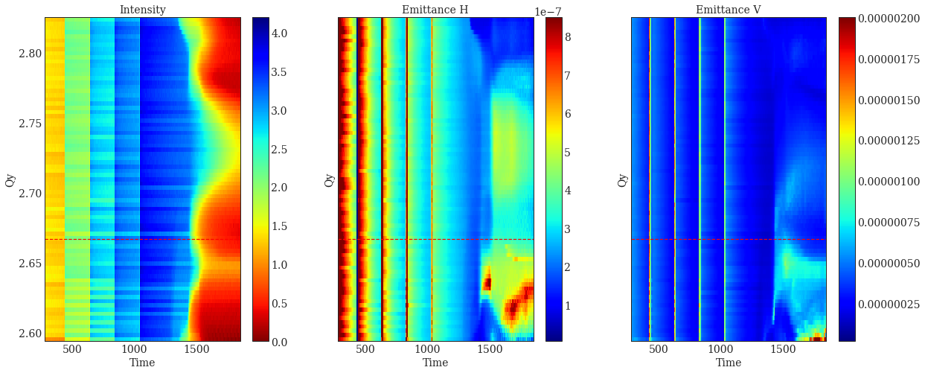
Tune Scan – Bunched beam – Single Harmonic

Slide 35

Initial VS Final Emittance

Slide 36

Tune Scan – Bunched beam

Slide 37


Slide 38

Tune Scan – Bunched beam

Slide 39



Tune Shift Evolution
$${ΔQ}_{x,y}=−\frac{N{ r}_{ions}}{2π ε_{x,y}{ β}^{2}{ γ}^{3}}\left(\frac{2πρ_{ring}}{l_{bunch}}\right)=−\frac{ρ_{ring}^{2} N{ r}_{ions}}{α^{2}{ β}^{2}{ γ}^{3} Q_{x0,y0} l_{bunch}}$$

Slide 40
Double Harmonic – No Sextupoles

Slide 41

Tune Scan – Bunched beam – Double Harmonic

Slide 42

Initial vs Final Emittance

Slide 43

Emittance Blow-up

Slide 44

Emittance Blow-up – Intensity Scan

