Slide 1
XCET Threshold Cerenkov counter
5th EABI – WG meeting
Michael Lazzaroni EN-EA-DC, 15-02-2019

Slide 2
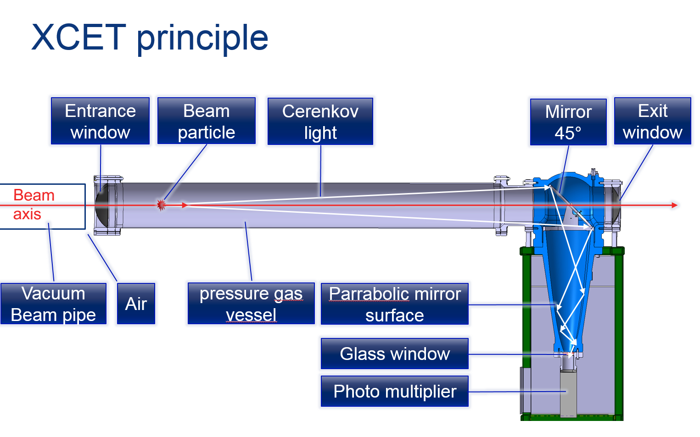
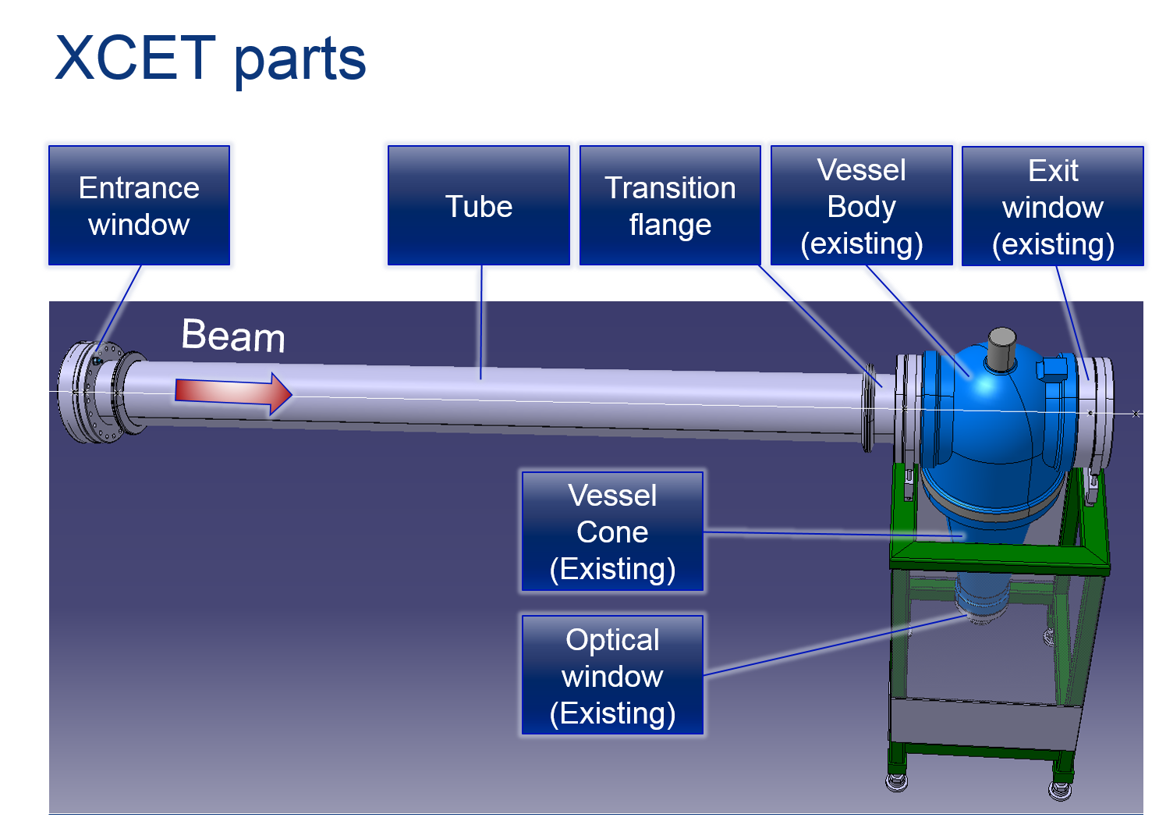
XCET - General description
A Cerenkov Counter is a gas filled detector where particles above at certain speed can be detected. For a given beam energy, light particles will have a higher velocity. Relativistic particles, that is particles with a velocity above the speed of light in the surrounding gas, will emit Cerenkov light that can be detected by a photomultiplier. The gas pressure of the Cerenkov Counter sets the threshold of the maximum particle mass to be detected.

Slide 3
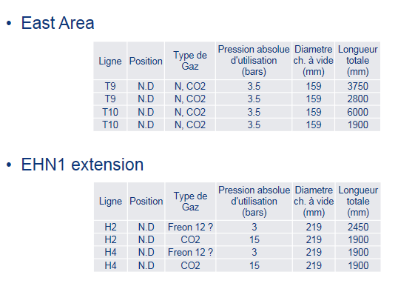
Priorities/ Objectives in LS2
Consolidation of a new gas system:
  Remote control;
  Integration of new components (pressure increased);
  Standardization.
Construction of:
  4 XCET’s for East Area;
  4 XCET’s for EHN1 extension.

Slide 4
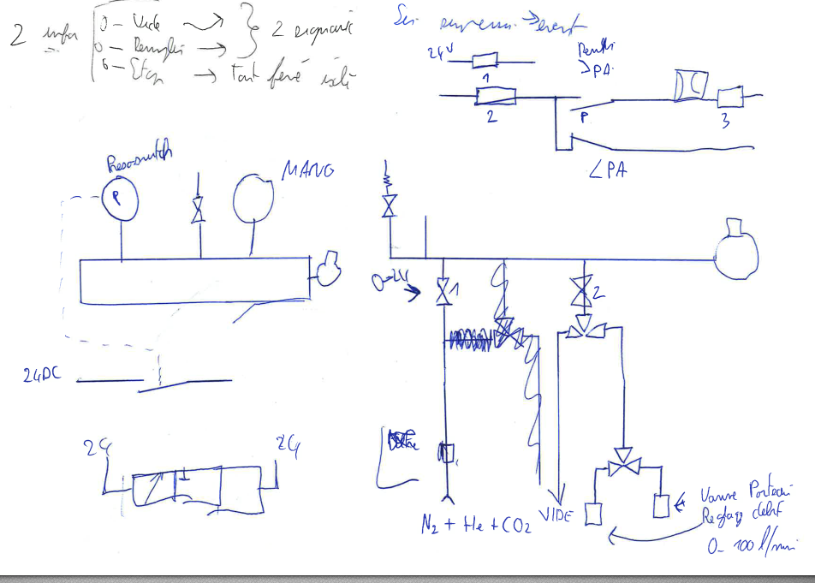
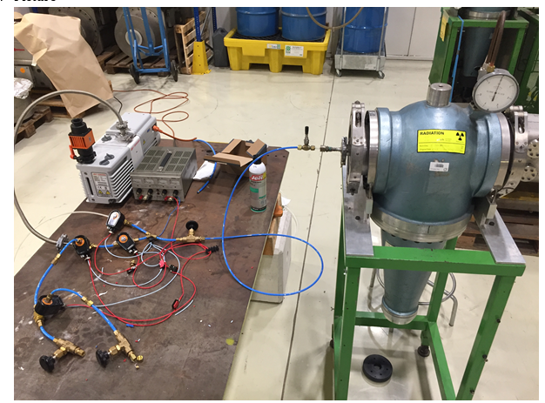
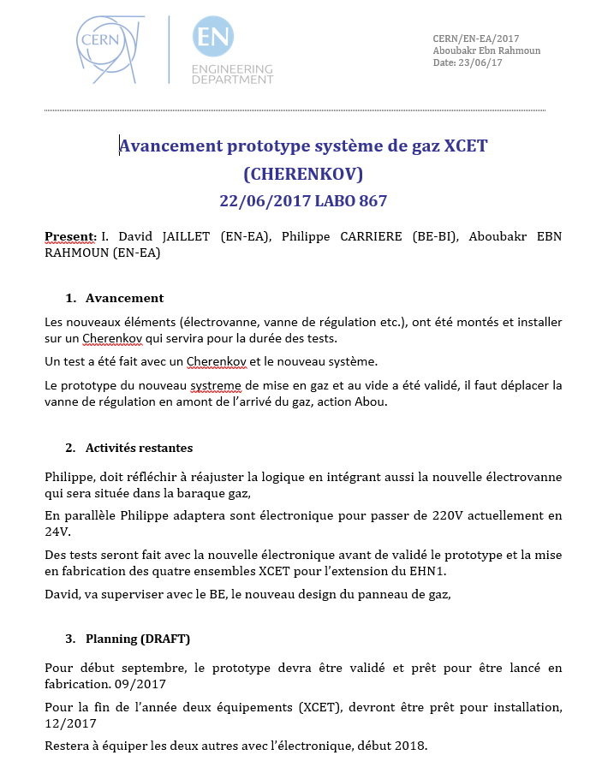
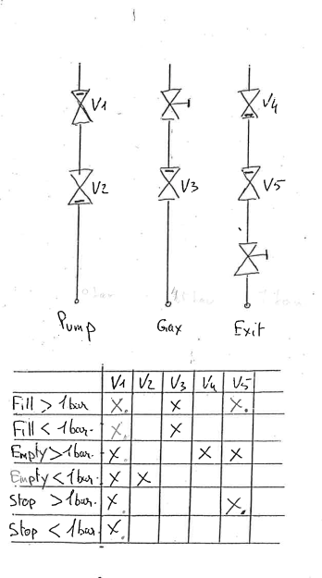
Status of the Study (done in 2017/2018)

Slide 5
Organization for the XCET
Within EN-EA:
  EN-EA equipment responsible: Michael Lazzaroni;
  Coordinator for the LS2 XCET consolidation: Serge Mathot;
  Responsible of the XCET equipment : Aymeric Bouvard;
  Physicist in charge of the XCET : Nikos Charitonidis;
  Responsible of the maintenance and logistic of EN-EA equipment : Nicolas Perez;
  Responsible of the gas system: David Jaillet;
  Engineer in charge of the XCET: Sebastien Evrard/Giulia Romagnoli;
  Planning officer: Bastien Rae.
Within BE-BI:
  Responsible: …
  Technical Responsible: …
  …

Slide 6
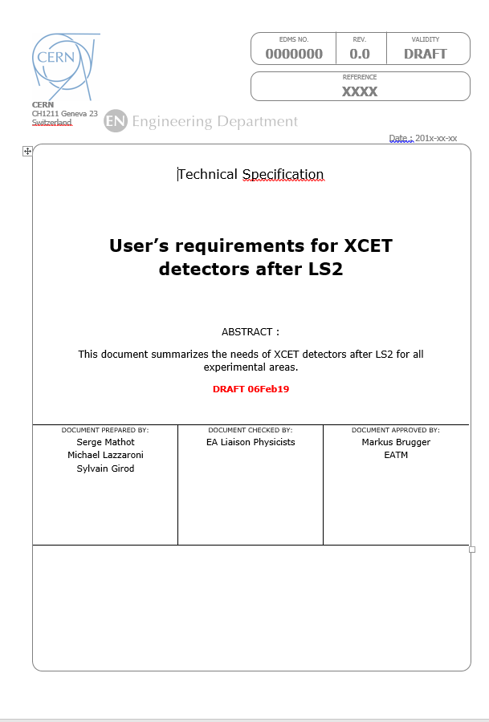
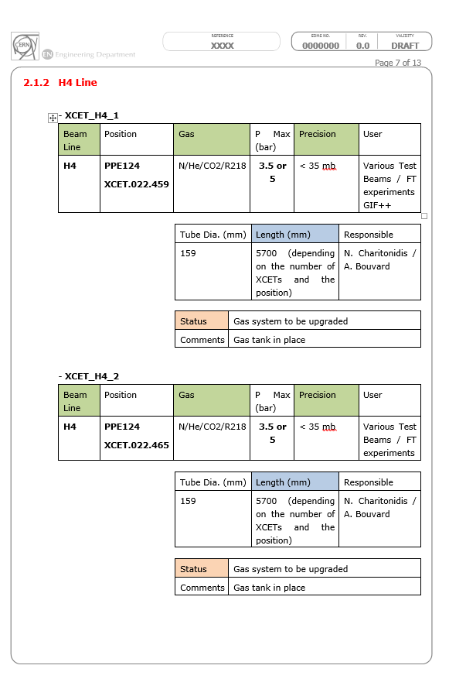
Planning 2019
Phase 1: Jan.-Febr. 2019
  User Requirements: Serge Mathot.
Phase 2: March
  Spécification de la partie électronique: Jocelyn Tan;
  Choix des composants (sondes, électrovannes, manomètres) : Jocelyn Tan.
Phase 3 : April
  Spécification de la partie gaz : David Jaillet ;
  Design du PID gaz : David Jaillet + Design Office EN-EA.
Phase 4 : May-June
  Commandes composants : Aymeric Bouvard ;
  Stockage des composants : Nicolas Perez.
Phase 5: summer
  Assembling of the proto;
  Testing.
Phase 6: September – December 2019
  Purchase for the series;
  Reception of the parts, materials;
  Assembling

Slide 7
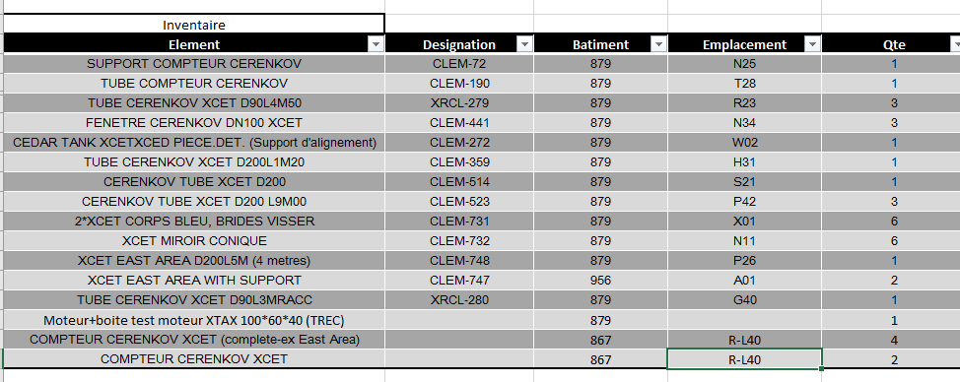
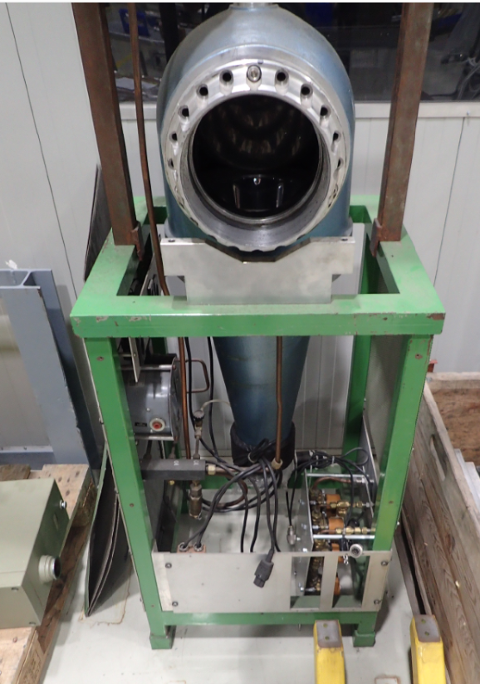
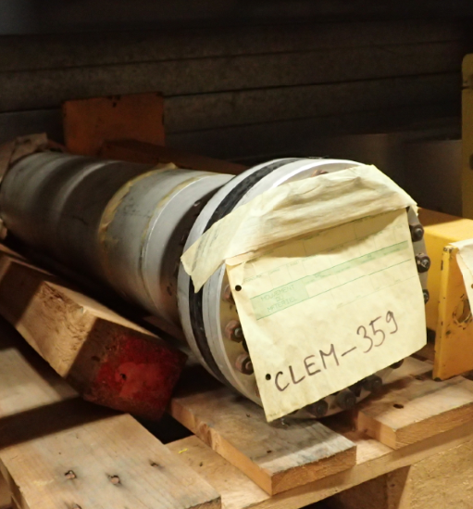
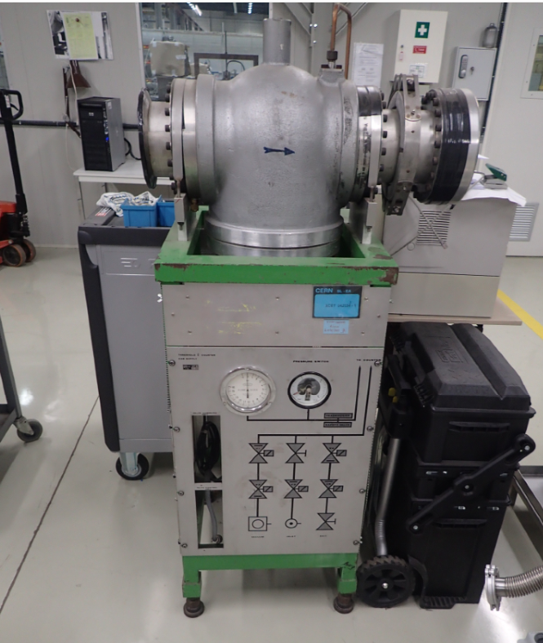
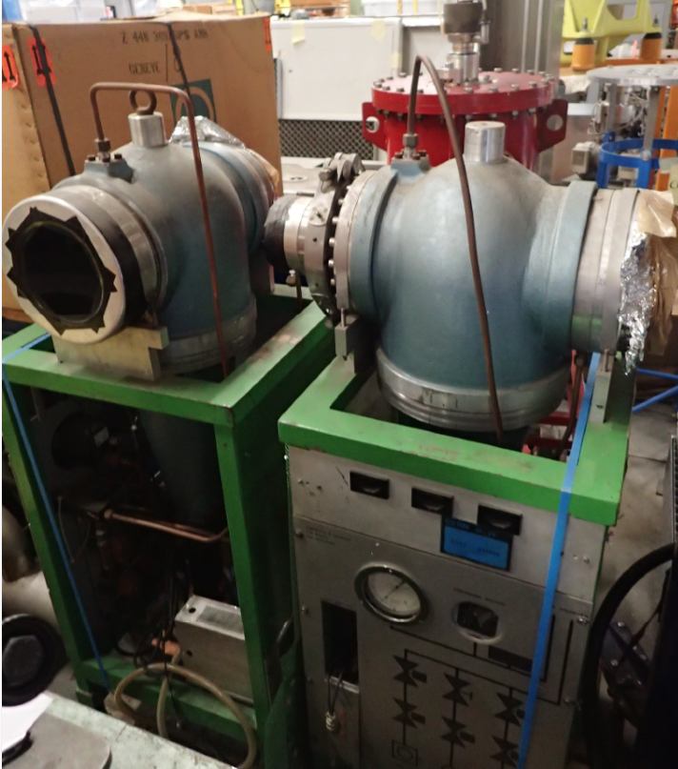
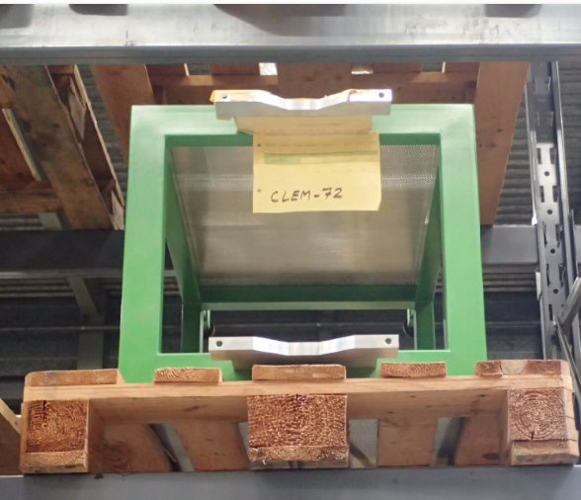
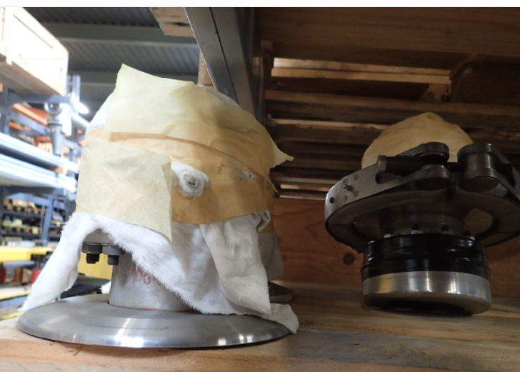
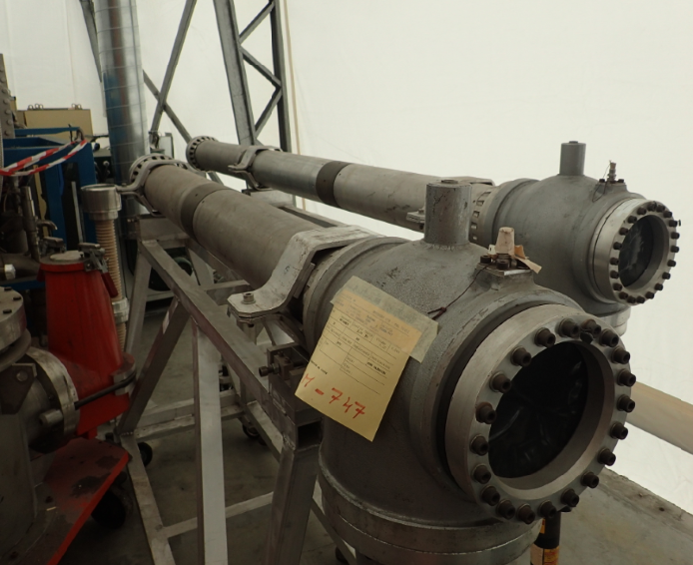
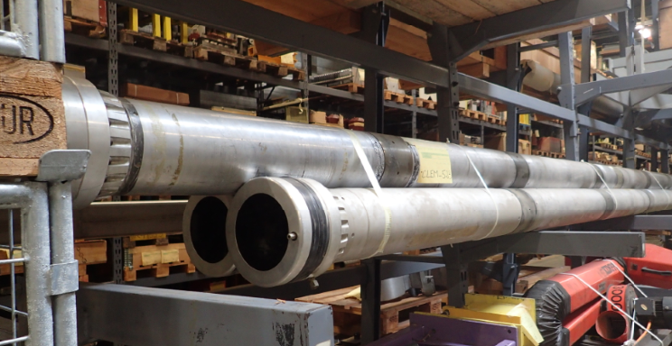
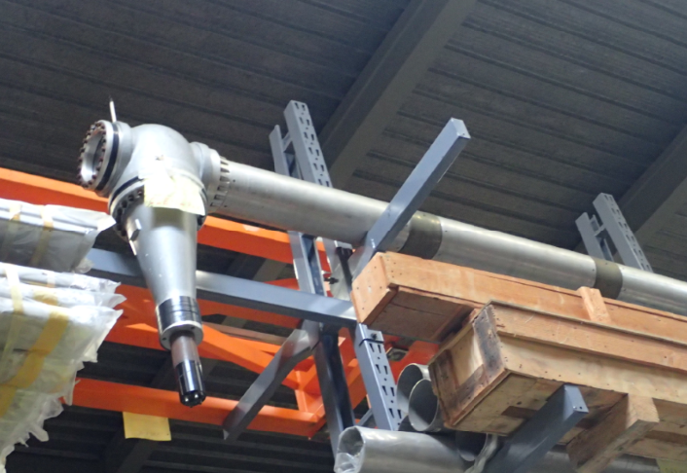
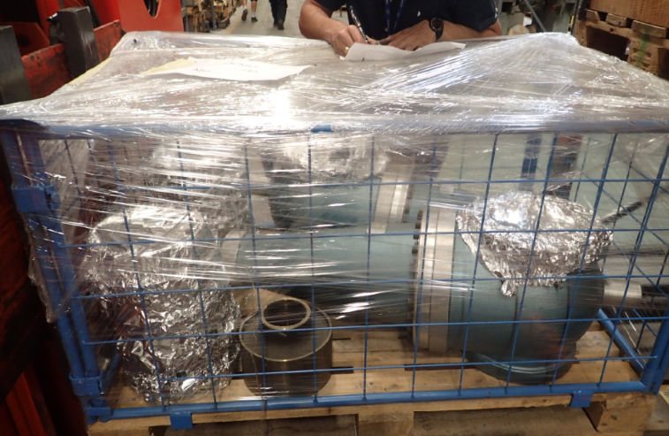
Global situation (qty) of XCET (1/2)
Spares:

Slide 8
Global situation (qty) of XCET (2/2)
In operation: in total 11 XCETs and 15 XCETs after LS2.
Zone | Location | Status | comments
North Area | H2_0 | Missing - needed | From time to time the XCET from H8 comes here. Build a new one?
 | H2_1 | Installed
 | H2_2 | To be completed in LS2 | New vacuum chambers, windows + consolidation gas system
 | H2_3 | To be completed in LS2 | New vacuum chambers, windows + consolidation gas system
 | H4_1 | Installed
 | H4_2 | Installed
 | H4_3 | To be completed in LS2 | New vacuum chambers, windows + consolidation gas system
 | H4_4 | To be completed in LS2 | New vacuum chambers, windows + consolidation gas system
 | H6_1 | Installed
 | H8_1 | Installed
 | H8_2 | Installed
 | H8_3 | Installed
East Area | T9_1 | To be construct in LS2 | New vacuum chambers, windows + consolidation gas system
 | T9_2 | To be construct in LS2 | New vacuum chambers, windows + consolidation gas system
 | T10_1 | To be construct in LS2 | New vacuum chambers, windows + consolidation gas system
 | T11_2 | To be construct in LS2 | New vacuum chambers, windows + consolidation gas system

Slide 9
Questions?

