Slide 1
Summing up of instrumentation needs for primary and secondary beams
J. Tan, I. Ortega, F. Roncarolo, L. Jensen, E. Effinger
L. Gatignon, N. Charitonidis, A. Gerbershagen, J. Bernhard
February 15th 2019
EA-BI-WG

Slide 2
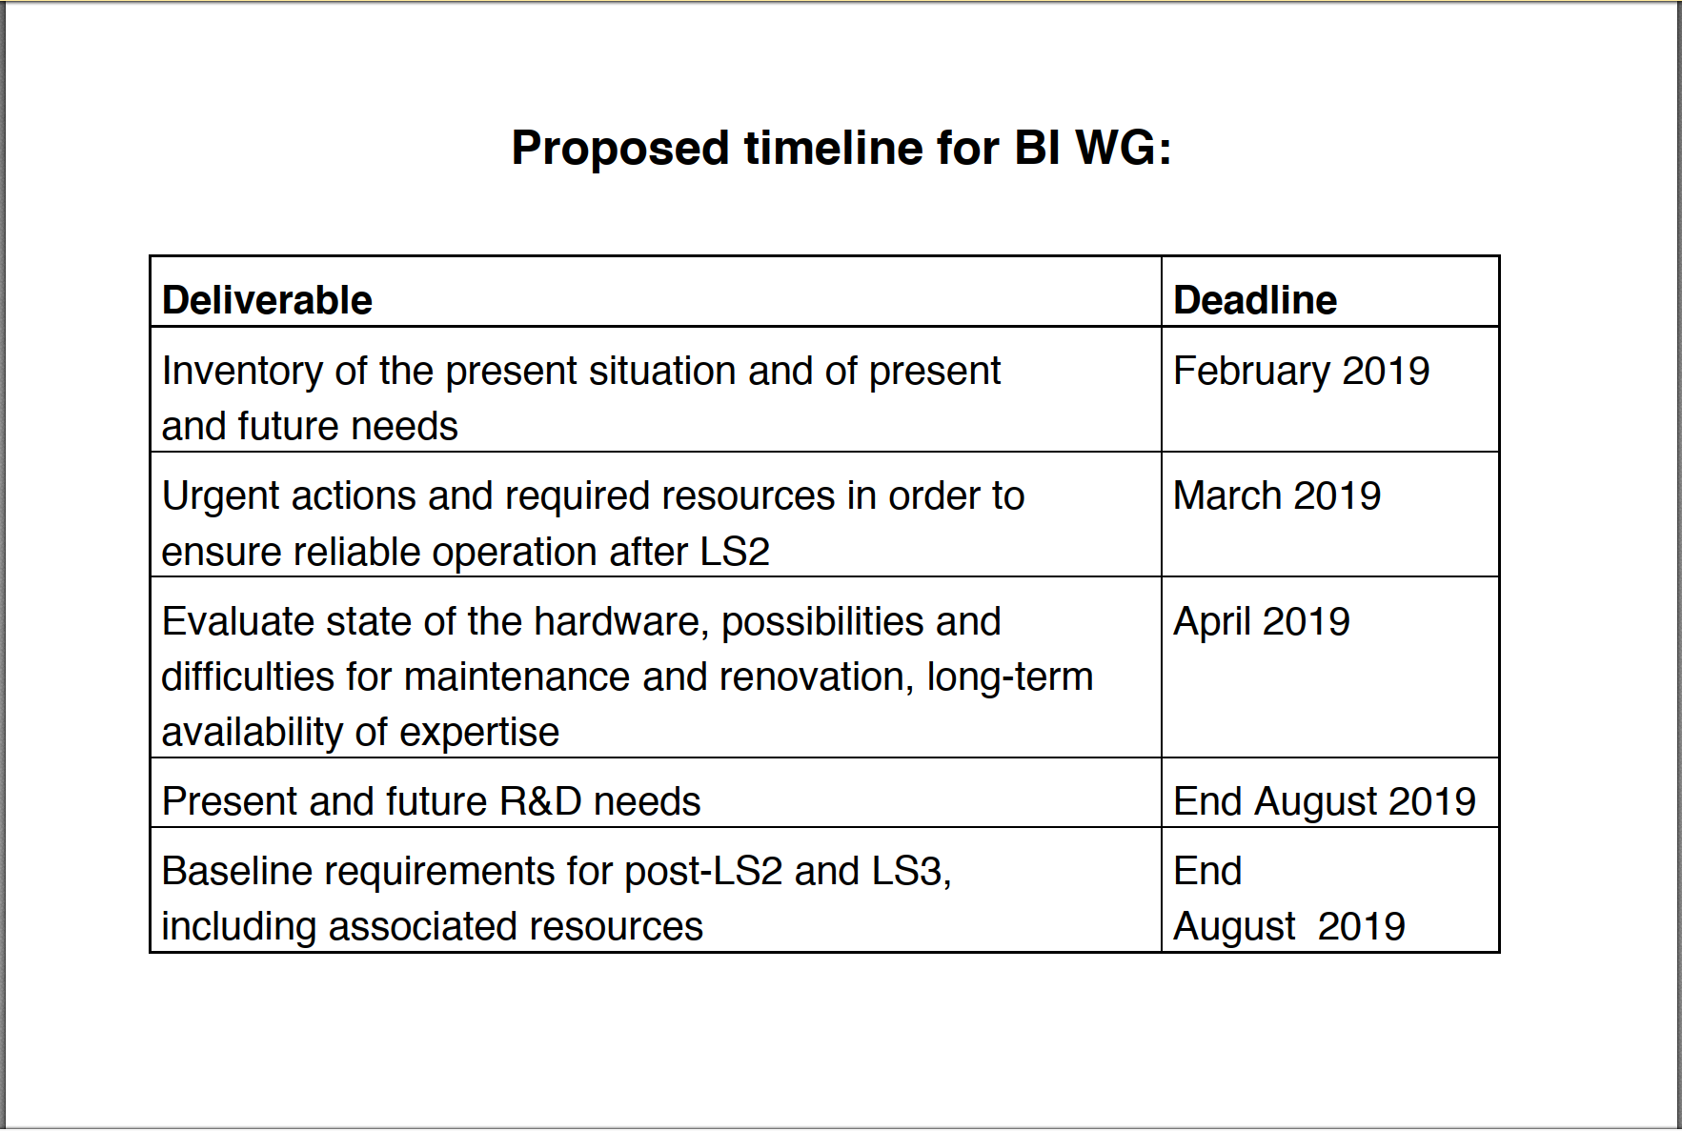
Courtesy L. Gatignon

Slide 3
Outline
East Area
North Area
Transfer lines of AD and ELENA
R&D

Slide 4
Needs for F61 line and East Area
Instrument | Location | Monitor# | Need spare monitor | To do | Priority
BCGAA (ex. LSD) | F61 | 1 | Y (1) | new monitor ?? | LS2
BCTF | F61 | 1 | Y (1) | new monitor ?? | LS2
XSEC | F61 – F62 – F63 – T08 | 5 | N (1) | Cons. with new foils | LS2
XION | T08 | 1 | N (3) | Cons. with new foils + new IFC/scaler | low
XTEL | F61 | 2 | N (1) | Upgrade with new HV divider or BLM | LS2
XSCI | T09-T10-T11 | 4 | N (15) | Upgrade with new HV divider + new board | LS2
XBPF | T09-T10-T11 | 4 | N | New monitors, T11 with 20cm x 20cm | LS2
Instrument | Location | Monitor# | Need spare monitor | To do | Priority
BLM | F61-F62-T08 | 6 | Y (1) | Get 40 kCHF for BLMs and aqn chain | LS2
Instrument | Location | Monitor# | Need spare monitor | To do | Priority
XCET | T09-T10 | 4 | Y (1) | Pipes and windows to be produced, system to be upgraded according to NA standard (gas, controls) | LS2

Slide 5
Needs for North Area – primary lines
Instrument | Location | Monitor# | Need spare monitor | To do | Priority
BLM | TT20 |  |  | Faster acquisition and interlocking | LS2
BSI | TT20 |  |  | Study of absolute calibration – precision and factors affecting it | LS2
BSG | TT20 | 5 | ? | New SEM-grid detectors to replace BSPs | LS2+
Instrument | Location | Monitor# | Need spare monitor | To do | Priority
BLM | TT20 | 10 | ? | New BLMs | LS3+
BTV | SHiP target | 1 | ? | New BTV to monitor SHiP target | LS3+
BSGV | TT20 | 1 | ? | Modify mechanics for BSGV.220075 (aperture) | LS3+

Slide 6
Needs for North Area – primary lines – SPS LSS2
Observable | Location | Monitor# | Need spare monitor | Function | Priority
Position | LSS2 |  |  | Position interlock in LSS2 – done in software. | LS2
Longitudinal BLM | LSS2, MSSBs in TT20 |  |  | R&D needed. Measure extraction efficiency and calibrate first BSI’s in TT20. 100m longitudinal coverage over MSSBs tunnel roof. | LS3
Position | LSS2 |  |  | R&D needed. Measure circulating beam position with dynamic extraction bump RF is off, beam debunched | LS3
Profile | LSS2 |  |  | R&D needed. Single shot beam profiles in/around septa (ZS, MST, MSE) | LS3
A functional specification document from OP/ABT is needed for the SPS systems upstream
of the targets.

Slide 7
Needs for North Area- secondary line
Instrument | Location | Monitor# | Need spare monitor | To do | Priority
XION | M2, K12 | 3 | N (3) | Cons. with new foils + new IFC/scaler, calibration | 2021
XSCI | H2, H4, H6, H8, P42-62, M2, K12 | 32 To be confirmed. | N (10) | Upgrade with new HV divider, add ADC/PHA (1 for each H2,H4,H8). Check light tightness, coincidence units, improve performance/calibration for ions, installation of one new monitor in PPE144. | Run 3
XBTF + XBPF | Neutrino Platform | 5 + 10 | Y (1) | Spare parts: planes + aqn chain
XWCA | H2, H4, H6, H8 | 3 in H2, 2 in H4, 6 in H6 and 4 in H8 | N (14) | Check wires + new board unless replaced by a radiation-hard version of XBPF. Add one for PPE144. Additional XWCA in H8 at secondary target. | Run 3
XWCM | M2, K12, H4 | 10/1/2 |  | See XWCA. | Run 3
XDWC | H2, H4, H6, H8 | 3/1/1/3 |  | Repair until XBPF becomes available. | 2021
Instrument | Location | Monitor# | Need spare monitor | To do | Priority
XBPF | North Area | 65 (tbc) | Y (7) | Production – replace XWCA, XWCM, XDWC, XFISC Motorised and under vacuum for pure e- beams | LS3

Slide 8
North Area – secondary : Particle identification
Instrument | Location | Monitor# | Need spare monitor | To do | Priority
XCET | H2, H4, H6, H8, Neutrino Platform | 12 | N (??) See talk of M. Lazzaroni | Mechanics, gas distribution, HV divider, sensor calibration, upgrade pressure control | Run 3
XCED North/West | H2, H6, M2, K12 | 5 | Y | Mechanics, gas distribution, HV divider, thermal housing | Run 3
XEMC | H4, H6, H8 | 3 | N (2) | New XCSI board + ADC/PHA | low

Slide 9
AD & ELENA : Profile measurement
Instrument | Location | Monitor# | Need spare monitor | To do | Priority
SEM (Hori detector) | AD and ELENA Transfer lines | 44 | Y (5) | Production | LS2

Slide 10
R&D / Upcoming
Instrument | Location | observable | To do | Project
XBPF | Dowstream NA targets | profile | Radiation hard version + motorised IN/OUT | NA cons
XBPF | EHN1 | Profile | Version for heavy ions | NA cons
??? | TT20 | 1% level of absolute intensity Long. Spill (1MHz BW) | (CCC-type?) | NA Cons
SE-CpFM | TT20 | GHz range long. spill structure |  | BDF
OTR | TT20 | GHz range long. spill structure |  | BDF
CEDAR | NA | Particle identification | High-rate upgrade | NA cons
BGP/BGM | TT20 / splitters | Position/profile monitors | Beam position for un-bunched beams. Cherenkov radiator fibres? | NA cons
BLM | TT20 / splitters | Beam loss | Cable-type BLM? | BDF

