Slide 1
Triplet string kinematics reminder
F.Micolon – 06/02/2019

Slide 2
Introduction
The supporting scheme of the triplet is not common to the rest of the LHC cells
The jacks of the triplets proposed by Survey are a modified version of the LHC jacks
The installation of the triplets was subject to several iterations until the very end
The aim of this presentation is to recall briefly what we have in the tunnel currently

Slide 3
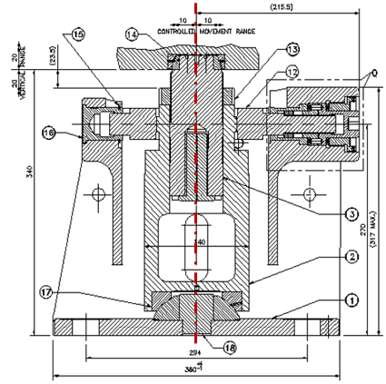
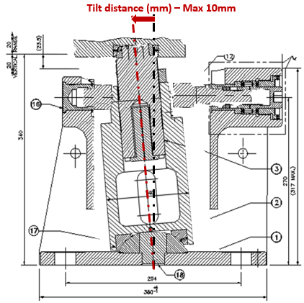
The LHC Jacks
The LHC jacks is based on a tilting column principle – with two bearing on each end.
It allows the position control in the vertical direction and one transverse direction (the other transverse direction is free by design – see next slide).
Top bearing
Jack piston
Tilting is controlled by tightening the side nut
Tilting column
Jack frame
Bottom bearing
In the LHC triplets, the side nut is removed. So this becomes a free transverse direction (no control).

Slide 4
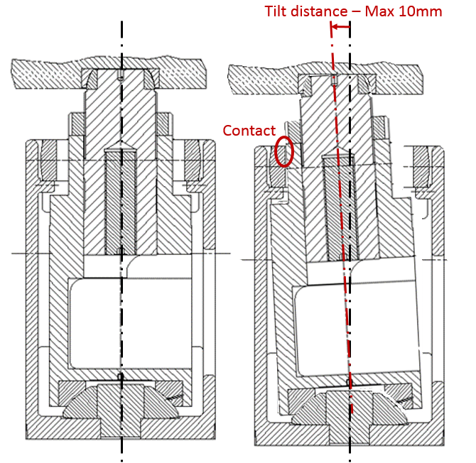
The LHC Jacks
Top bearing
Jack piston
Tilting column
Jack frame
Bottom bearing
This transverse direction is free by design with a range of +/-10mm.

Slide 5
The triplet string – general layout
DFBX
Q3
Q3DFBX Interconnection
Q2Q3 Interconnection
Q2
Q1Q2 Interconnection
Q1
~35m
IP (Atlas, CMS, Alice, LHCb)

Slide 6
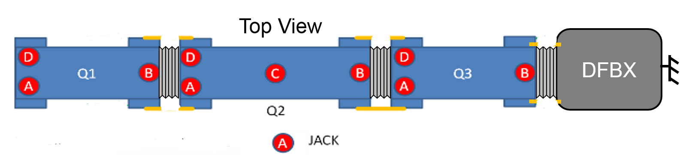
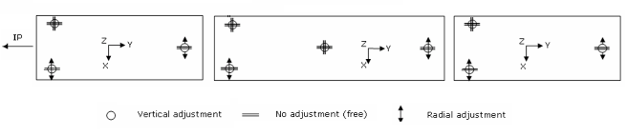
The triplet string – jack support scheme
Q2
Longitudinal jack with nut removed
Radial
Longitudinal
Jacks A&B are used to adjust the radial position of the magnet.
The magnet longitudinal position cannot be adjusted with the jacks (since the nut of jack D are removed).
All jacks can be used to adjust the vertical position of the magnet.

Slide 7
The triplet string – simplified axial kinematics
Q1/Q2
Side view
IP
Q1
Q2
Q3
DFXB
Legend
When the jack nuts are removed the longitudinal position of the magnet is indeterminate (except for bellow stiffness)
Jacks (all free in the longitudinal direction)
Fixed point
Vacuum vessel
Bellow (flexible)
Magnet cold mass
Spiders (considered free longitudinally)

Slide 8
The triplet string – simplified axial kinematics
Q1/Q2
Side view
IP
Q1
Q2
Q3
DFXB
Legend
Tie-rods are added at the interconnection level to transmit any longitudinal load to the DFBX (=longitudinal fixed point).
Jacks (free in the longitudinal direction)
Tie rods
Fixed point
Tie rod ears
Vacuum vessel
Bellow (flexible)
Magnet cold mass
Spiders (considered free longitudinally)

Slide 9
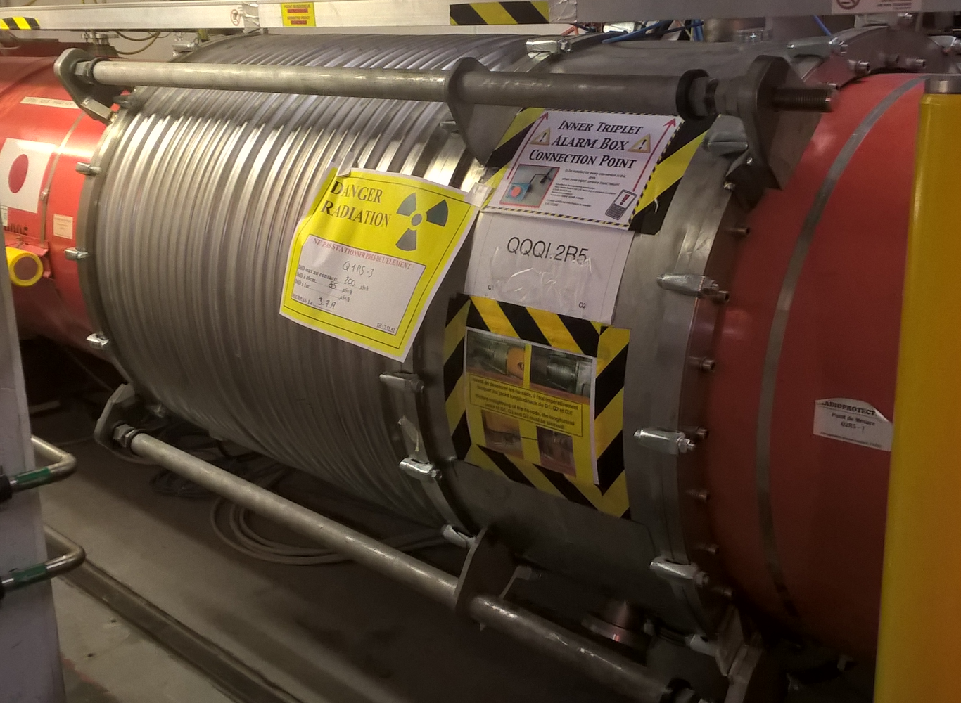
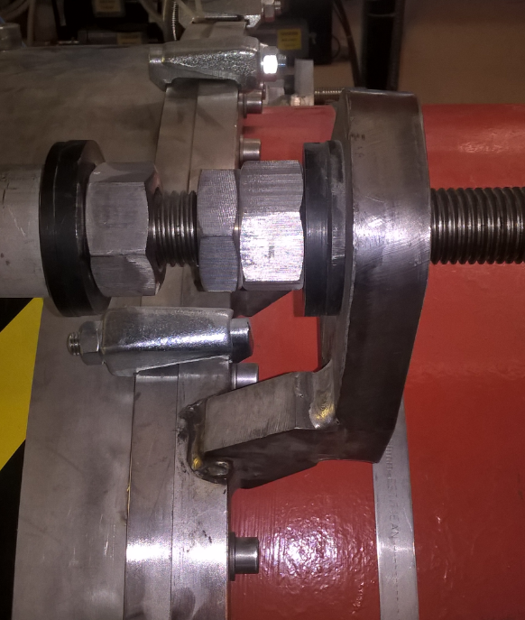
The triplet string – simplified axial kinematics
Q1/Q2
Tie-rods transmit the load in the compressive direction only (non-IP direction).
Tie-rod ear
Tie-rod
W bellow

Slide 10
The triplet string – simplified axial kinematics
Q1/Q2
IP
Q1
Q2
Q3
DFXB
Legend
Since the spiders were not strong enough longitudinally – cartridges were added to link the Q1 & Q3 cold mass to their vacuum vessel (not the case of Q2).
Jacks (free in the longitudinal direction)
Tie rods
Fixed point
Tie rod ears
Cartridge
Vacuum vessel
Bellow (flexible)
Magnet cold mass
Spiders (considered free longitudinally)

Slide 11
The triplet string – simplified axial kinematics
Q1/Q2
Vacuum force
80 kN**
Vacuum force
80 kN
IP
Q1
Q2
Q3
DFXB
Q1 non-IP motion
Q2 non-IP motion
Q3 non-IP motion
When the insulation vacuum is emptied, the vacuum force applied to Q1 is 80 kN.
This force is transmitted through the tie-rods to the DFBX.
This leads to a cumulative displacement of the vacuum vessels in the non-IP direction (with the top displacement on Q1).
** Valid at point 1 and 5 (no superconducting D1)

Slide 12
The triplet string – simplified axial kinematics
Q1/Q2
Q3 He pressure
4 kN*
Vacuum force
80 kN**
Vacuum force
80 kN
IP
Q1
Q2
Q3
DFXB
Q1 He pressure
22 kN*
Legend
When the cold mass are filled with liquid Helium under pressure (nominal) pressure forces are generated when the cold mass flanges are not symmetrical (this is the case on Q1 & Q3).
*Forces corresponding to the nominal operational conditions
** Valid at point 1 and 5 (no superconducting D1)

Slide 13
The triplet string – simplified axial kinematics
Q1/Q2
Bellow stretch
Q2Q3 – 22 kN*
Bellow stretch
Q3DFBX – 10 kN*
Bellow stretch
Q1Q2 – 22 kN*
Vacuum force
80 kN**
Vacuum force
80 kN
IP
Q1
Q2
Q3
DFXB
Q1 He pressure
22 kN*
Q3 He pressure
4 kN*
Legend
When at cold, the cold mass will shrink
→This stretches the interconnection bellows
→ Which produces a pulling force on the cold mass
When we sum up all operational forces acting on each cold mass :
Q1/Q2
Vacuum force
80 kN**
Vacuum force
80 kN
Q1 net force = ~0 kN
Q2 net force ~0 kN
Q3 net force = -8kN
IP
Q1
Q2
Q3
DFXB
Legend
* Force values corresponding to the operational conditions

Slide 14
Conclusion
The triplet kinematics results from a large set of operational factors
  Insulation vacuum
  Cryogenic parameters (pressure and temperature)
  Bellow stiffness
  Tunnel temperature
In the nominal operational conditions the cold mass pressure and bellow force cancel out – so the main contributor to the triplet kinematic is the vacuum.

Slide 15
Spare slides

Slide 16
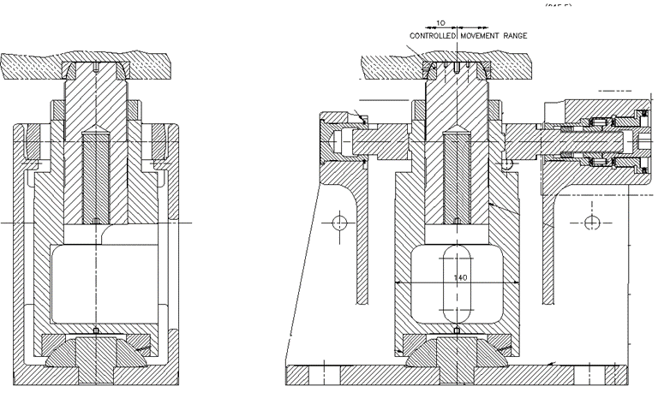

Slide 17
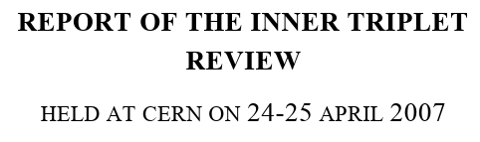
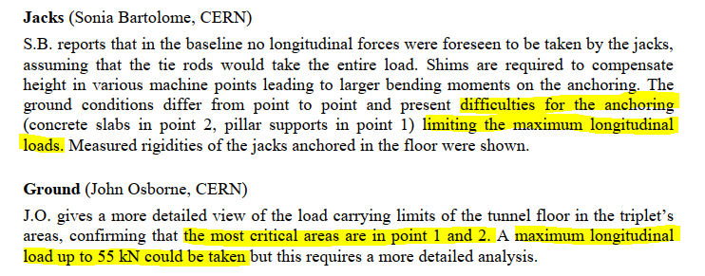
Jack fixation to ground

Slide 18
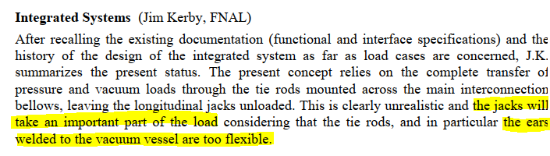

Slide 19
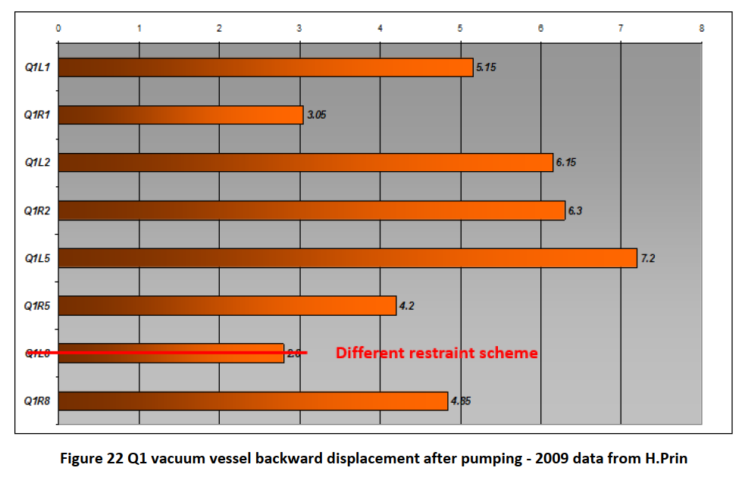

Slide 20
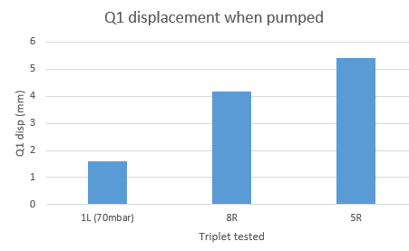
Test in 2017 - From M.Guinchard EDMS 868314

