Slide 1
Outcome from the triplet alignment task force
S. Le Naour
2019-02-06

Slide 2
Task force set-up and mandate
Following the request to re-align the triplets magnets from CMS and considering the limitation of longitudinal displacement (LMC 10/5/2017), a Triplet Alignment Task Force has been set up in June 2017 to understand the movement of the LHC triplet magnets and to define how to achieve satisfactory the alignment of the magnets.
The mandate is available on EDMS 1848902
  Chair : Sandrine Le Naour
  Scientific secretary : Frederic Micolon
Interdepartmental contribution. Thanks to
  EN-ACE : D. Missiaen, J.F Fuchs, A. Herty, M. Sosin ; M. Bernardini
  TE-MSC : H. Prin, F. Micolon, D. Duarte Ramos, V. Parma
  TE-VSC : P. Cruikshank, C. Garion
  TE-CRG : K.Brodzinski
  BE-OP : J. Wenninger

Slide 3
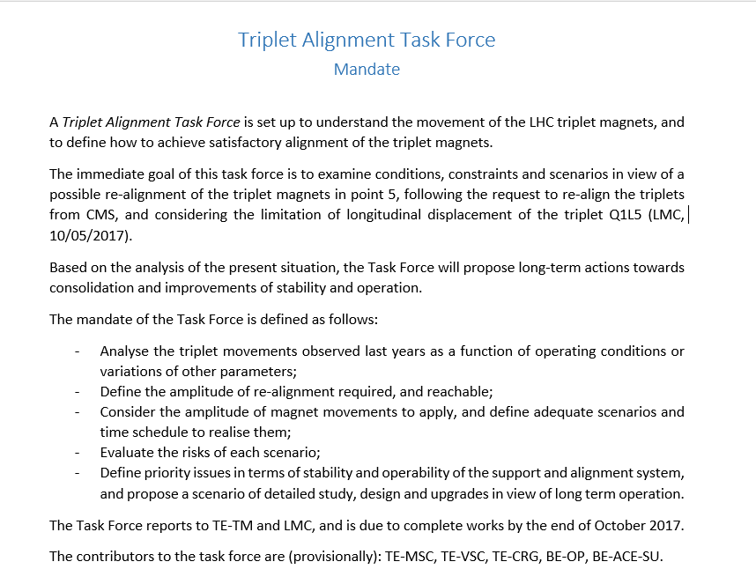
https://edms.cern.ch/document/1848902/1

Slide 4
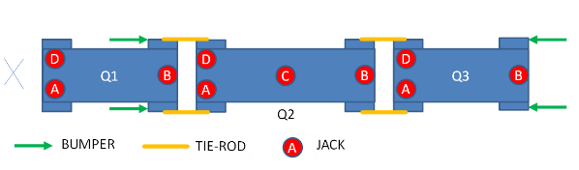
Triplet configuration : supporting system
Top View
DFBX
Vacuum force
(~ 80 kN)
Triplet is an assembly of three cryo-quadrupoles connected to a DFBX (electric and cryogenic feed box).
Each cryo-magnet sits on 3 or 4 jacks.
The DFBX is maintained anchored in the floor and represents the fixe point of the assembly
Rigid tie-rods link the vacuum vessels to limit the interconnection bellows flexibility and transfer longitudinal forces to the DFBX
Q1 and Q3 bumpers are safety end-stoppers.

Slide 5
Longitudinal displacement
After pumping in vacuum vessels, a force of 80 kN appears on Q1 and a longitudinal displacement of cryo-magnets is observed. The cryo-magnet Q1 presents the largest displacement of the assembly.
  Longitudinal movement from 3 to 9.6 mm, but a mechanical measurement report in 2007 gave a range of 4 – 5.5mm (EDMS 868314)
  Rather stable from 2009 with at least 1 warm-up in between.
DFBX
Vacuum force
(~ 80 kN)
DFBX
Longitudinal displacement of Q1 towards DFBX [mm]
 |  | L1 | R1 | L2 | R2 | L5 | R5 | L8 | R8
2009 | Q1 | 5.1 | 3 | 6.1 | 6.2 | 7.2 | 4.2 * | 2.8 | 4.9
2017 | Q1 | 5.6 | 3.6 | 8.5 | 6.7 | 7.7 | 9.6 | 1 | 4.8
* Possible error in the reference

Slide 6
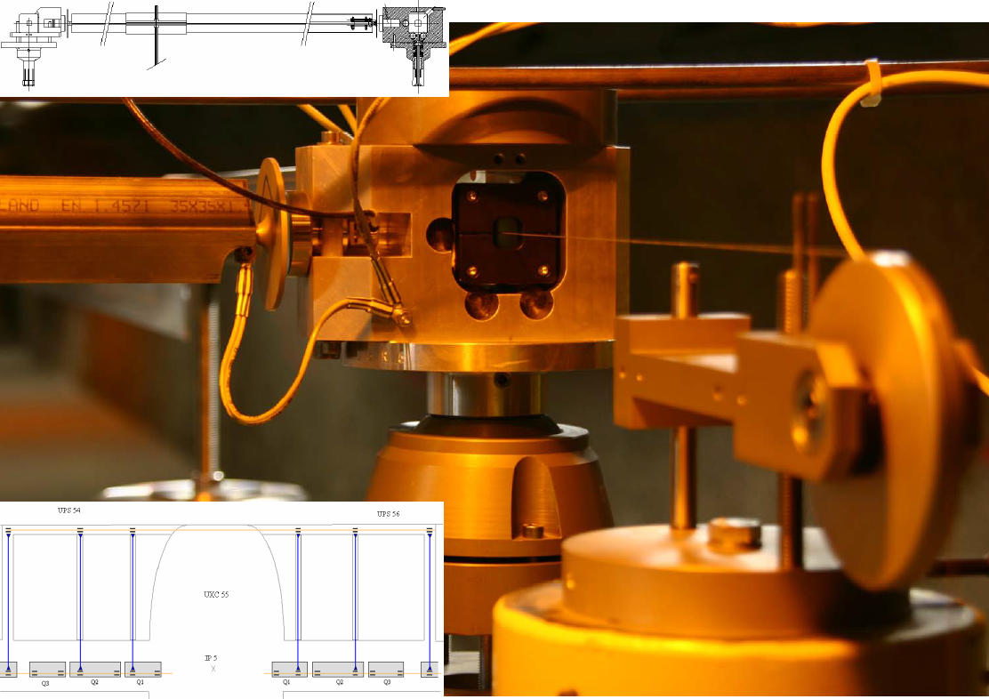
Alignment issues
During a YETS or a LS, the cryo-magnets position is measured and they are re-aligned on the best fitted curve.
An adjustment up to 0.5 mm can be performed on a jack in radial or vertical direction. This adjustment can be followed with the WPS (Wire Positioning System).
Last years, 3 issues occurred during the remote alignment
Date | Magnet | Event | Diagnostic and Action
March 2011 | Q3R5 | Large displacement measured (rad:800 µm, vert:400 µm) for a command of 25 µm (rad) | Repositionning of the load on the jacks ? → Installation of load sensors on each jack
June 2012 | Q2R5 | Measured displacement smaller than the command (vert : -170 µm) and half of the load lost. | Jack in contact on its frame (DFBX side). During LS1 (@warm), displa-cement of 2.8mm of Q2R5 toward IP
May 2017 | Q1L5 | Measured displacement smaller than the command (vert : -120 µm) and part of the load lost. | General jack inspection. Task force was set up Mandate : EDMS1848902

Slide 7
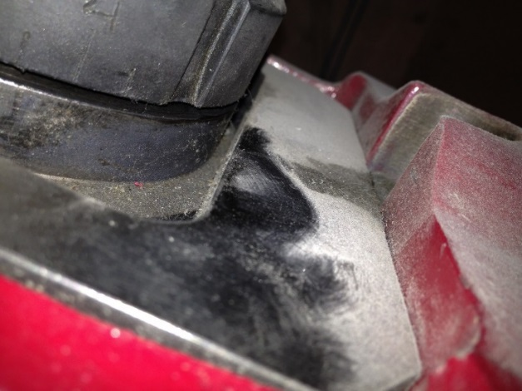
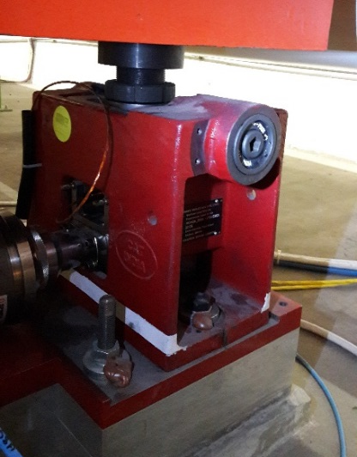
Jack issues
A general inspection of the jacks reveals that most of the jacks were stopped at the end of their longitudinal range (lying on their frame).
Present gap toward DFBX remaining on Q1 and Q2 jacks
 | 1L | 1R | 2L | 2R | 5L | 5R | 8L | 8R
Q1A | 6.6 | 1.7 | 0 | 3.5 | 2.3 | 0 | 3.9 | 0
Q1B | 4.8 | 2.5 | 2.1 | 0 | 1.7 | 0 | 3.6 | 1.6
Q1D | 1.1 | 0.5 | 1.2 | 2.7 | 0 | 0 | 6.4 | 0.5
Q2A | 4.5 | 6.7 | 2.1 | 3.2 | 8.9 | 1.3 | 14 | 1.8
Q2B | 3.5 | 9.5 | 1.3 | 7.3 | 9.5 | 1 | 12.5 | 1.8
Q2C | 22.5/25.5 | 21.6/27.1 | 19.6/26.6 | 19.3/27.7 | 20.5/26.6 | 16.5/30 | 23.5/24.7 | 18.6/29.6
Q2D | 2.2 | 6.6 | 0.6 | 2.7 | 6.3 | 0 | 10.2 | 1.6
Colour code
Q1 Jacks
< 0.5
< 2
< 3
Q2 Jacks
Jacks D in L8
In L8, the situation is different. The jacks are not allowed to move longitudinally (jack adjustement nuts still present)

Slide 8
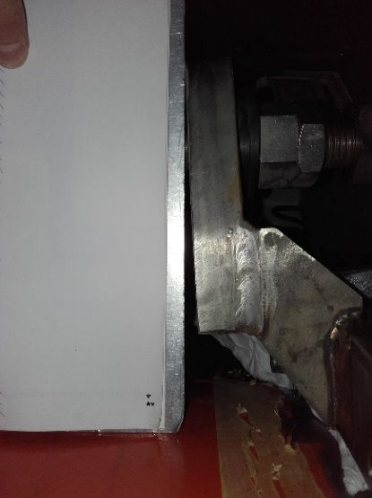
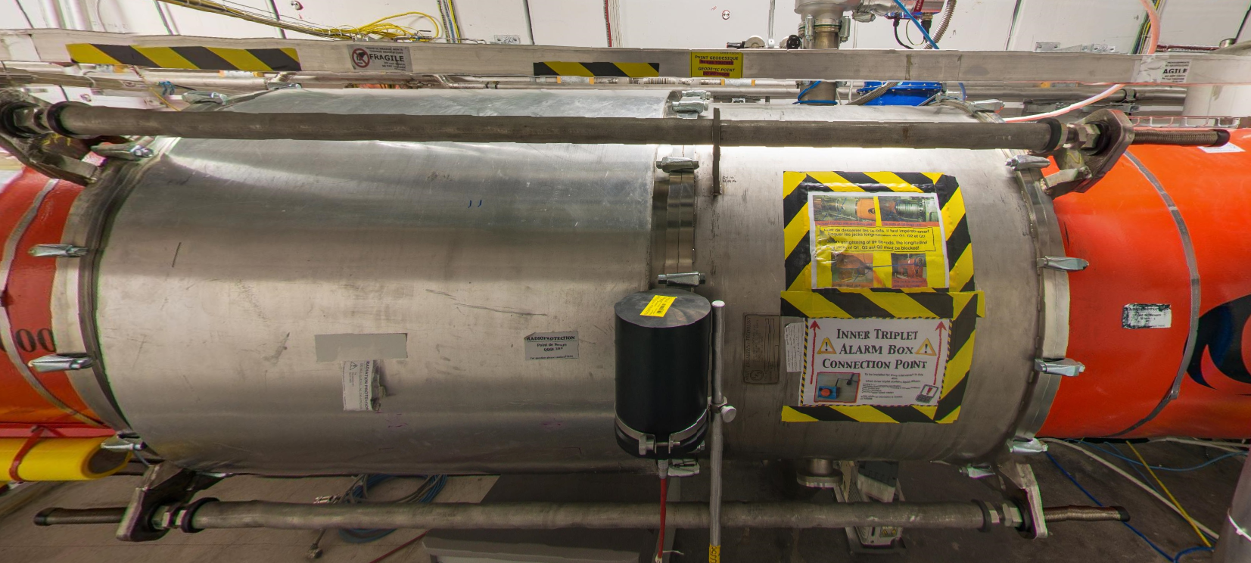
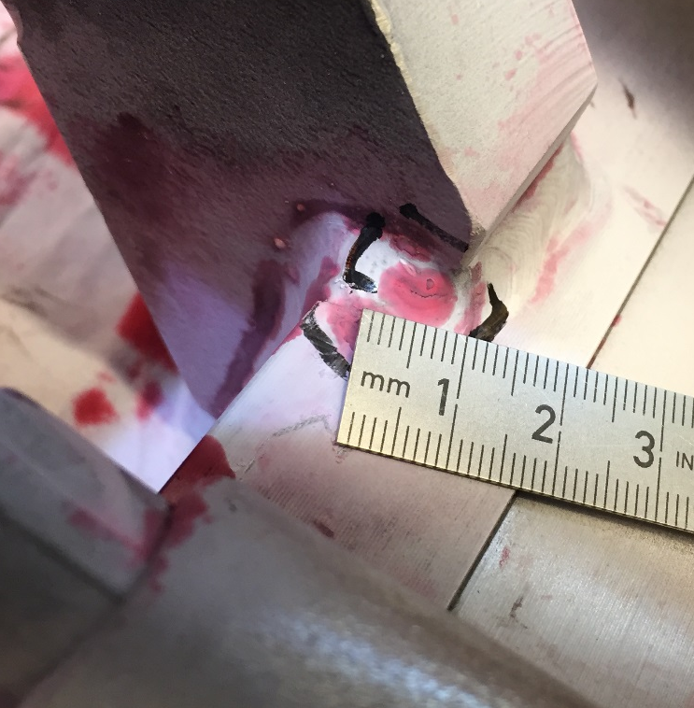
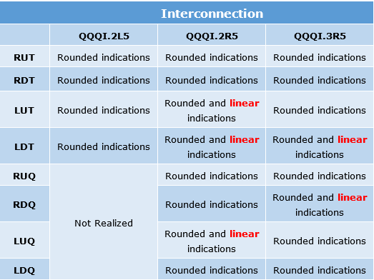
Tie-rod stiffness
The role of the tie-rods is to rigidify longitudinally the interconnections by cancelling the bellows flexibility, but the tie-rod supports slightly withstand the longitudinal forces
In point 5, a dye-penetrant test was performed (TS2-2017) on the tie-rod supports of 3 interconnections.
Rounded indications : Identified as crater pipe and surface pores – The defect comes from the welding operation
Linear indication (< 10mm) : Identified as cracks - but without initial inspection, we can not conclude if they are progressing or present from the first movement

Slide 9
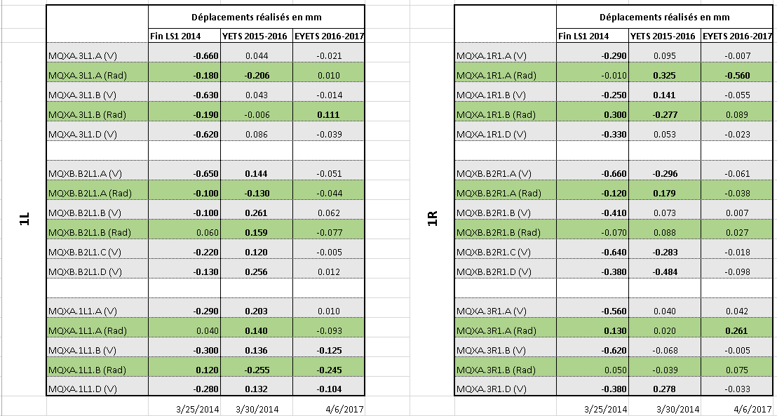
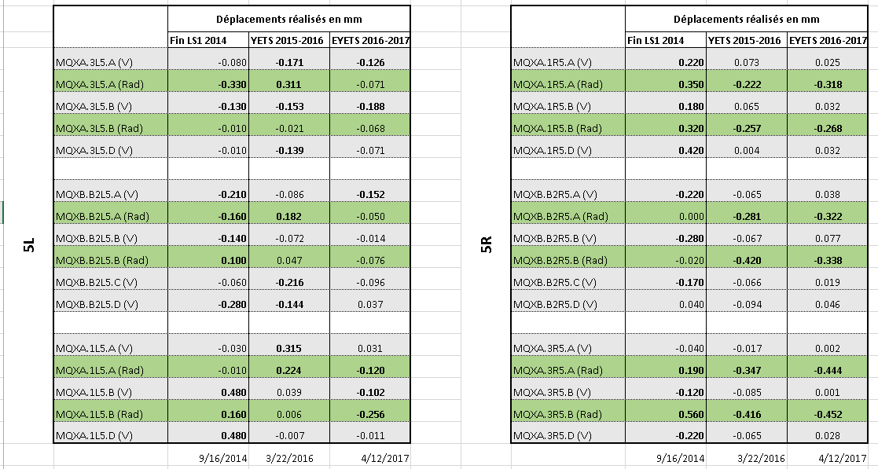
Triplet alignment range
For the last two YETS the triplet alignment range was :
Point 1
20 → 500 µm in radial direction
40 → 300 µm in vertical direction
Point 5
70 → 400 µm in radial direction
04 → 200 µm in vertical direction

Slide 10
Can we survive until dec. 2018 without a triplet re-alignment ?
Point 2 and 8 :
  Margin is big enough to continue physics without triplet re-alignment
Point 1 :
  None of the jack is in abutment (not far, but still free), so a re-alignment of the triplet can be performed during YETS 2017/18
Point 5 :
  This year a magnetic bump of -1.5 mm was applied for CMS. A total margin of -2.5 mm is available limited by the corrector strength (so it is still possible to increase the magnetic bump for CMS – J. Wenninger at LMC yesterday).
  Concerning the ground motion at the level of the LSS and the triplet, 5 µrad of deflexion was used for the last 3.5 months and we have a margin of 100-120 µrad with the Q4, Q5 correctors (even more with the MCBX)
  If the ground motion continue in the same way for the next 15 months and the number of abrupt cryo-stops or quenchs is limited, the triplet re-alignment can be cancelled in YETS 2017/18.
  CMS is not insisting on beamline re-alignement in YETS 2017-18

Slide 11
Warm-up of Inner Triplet in sector 12
Effect on cryo-magnets alignment
S. Le Naour on behalf of Triplet Alignment Task Force
LMC, 01/11/2017

Slide 12
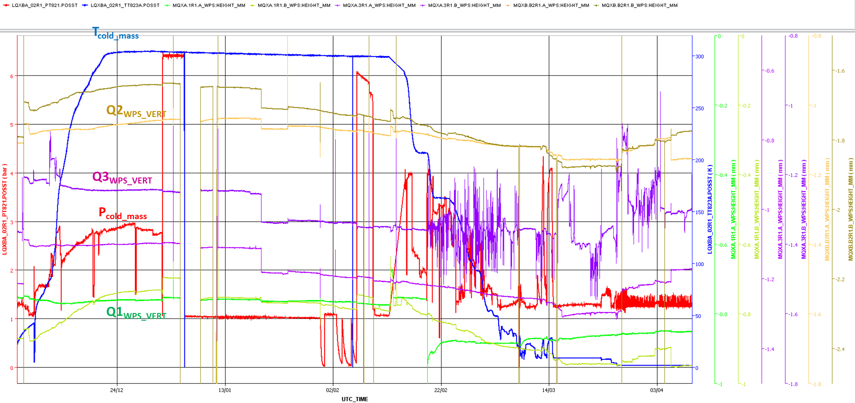
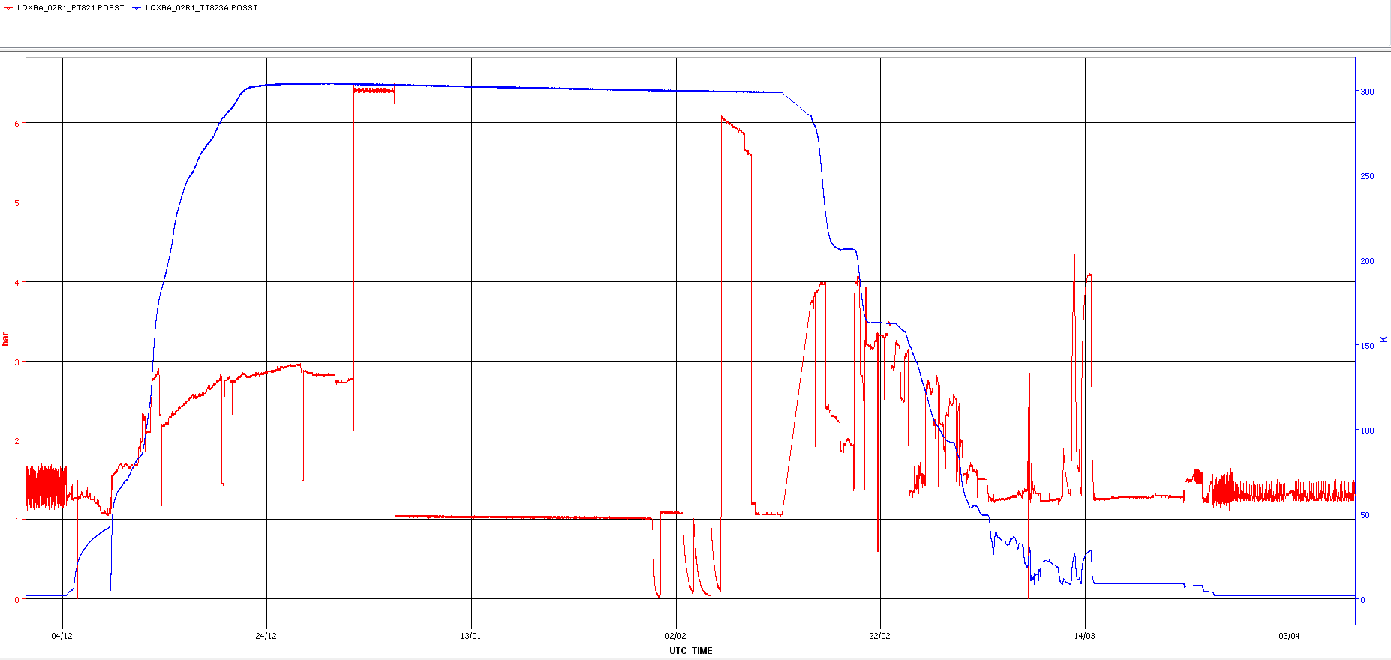
Triplet movements in R1 (eYETS16/17)
Vertical movements (Q1, Q2, Q3) from 6/12/16 to 15/04/17
300 K
6.5 bars
0.15mm
1 mm
1 bar
1.9 K
ElQA test
Survey
Maintenance
Survey
Alignment
From 1.9 K to 1.9 K ,
vertical displacement < 0.15 mm

Slide 13
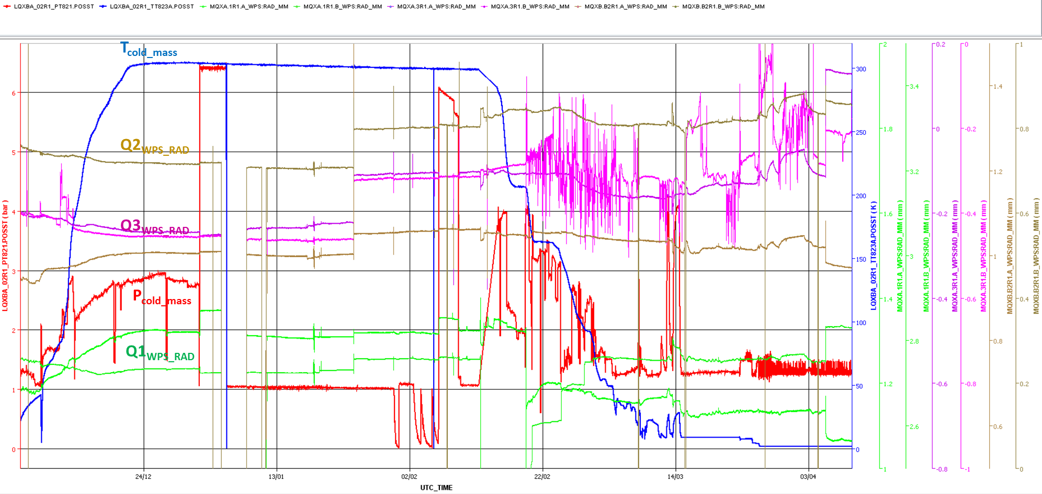
Triplet movements in R1 (eYETS16/17)
Radial movements (Q1, Q2, Q3) from 6/12/16 to 15/04/17
300 K
6.5 bars
0.15mm
1 mm
1 bar
1.9 K
ElQA test
Survey
Maintenance
Survey
Alignment
From 1.9 K to 1.9 K ,
radial displacement < 0.15 mm

Slide 14
Triplet movements (eYETS16/17)
Similar displacement amplitude (radial and vertical) occurred in L2 (graphs available on spare slides)
Corrective alignment of the triplets (smoothing with LSS magnets) was 0.26 mm for Q3.R1-rad and less than 0.15 mm for triplets in sector 12. The correction was larger after the YETS 15/16 (no warm-up). The correction was up to 0.5 mm in vertical and up to 0.4 mm in radial
No information concerning the longitudinal displacement of the cryo-magnets with the cold mass temperature or pressure.
For triplets in point 5 (T < 80K), the corrective alignment was less than 0.15 mm in vertical and less than 0.45 mm in radial.

Slide 15
Task Force Recommendations
Following the re-alignment issues of 2011 and 2017 and after the visual inspection of the jacks, it is not recommended to perform the yearly re-alignment of the triplets in YETS 2017/18
The Task Force recommends to install the “Longitudinal Monitoring System on Low Beta Triplet” (LHC-G-EC-0003 and LHC-G-EC-0006) at least on each Q1 vessel to follow the longitudinal movement of the cryo-magnets (pressure and temperature dependant)
The Task Force recommends to reconsider the cryo-magnet support system with an anchoring of the Q1 cryo-magnets in the floor, but still with a the possibility to align the magnet. The new solution needs to be implemented on all triplets before the end of LS2

Slide 17
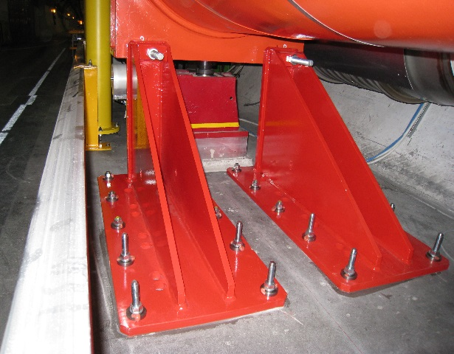
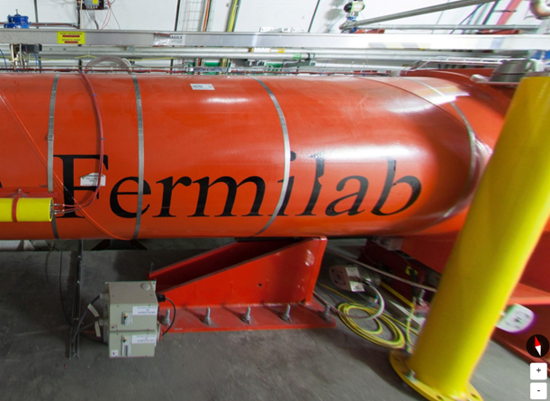
Bumpers
Only present for safety, Q1 and Q3 bumpers are installed to limit magnet movement (toward IP for Q1 or DFBX for Q3) in case of a large inner pressure variation event.
Following the incident in sector 3-4, the Maximum Credible Incident (MCI) has been re-evaluate leading to a reinforcement of the bumpers in 2009 (ECR LHC-LQX-EC-0003 and EDMS 1000582) and additional pressure relief devices.
The range of movement is given by the bumpers
For Q1 : At room temperature and atmospheric pressure in the vacuum vessel.
With a clearance on Q3 when the triplet are in operational condition (1.9K; pumped in vacuum vessels)
Note a special configuration for Q3.R5 with a bumper limiting the Q3 magnet displacement toward DFBX via a tie-rod.

Slide 18
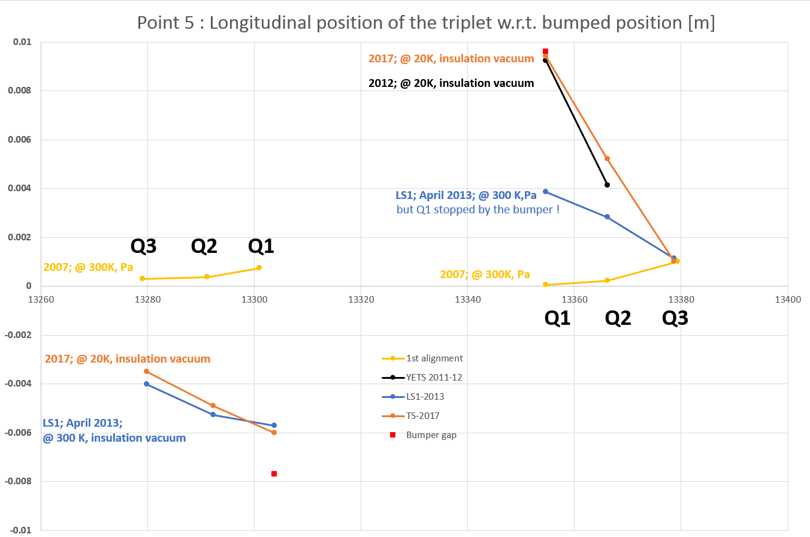
Magnets longitudinal position in point 5
Never considered as an issue, only few statements of triplet cryo-magnet position were performed.
For Q1.R5, the total displacement is 10 mm at cold compared with the initial position at warm. This situation looks to be the same in 2012 (@cold)
Left side
Right side

Slide 19

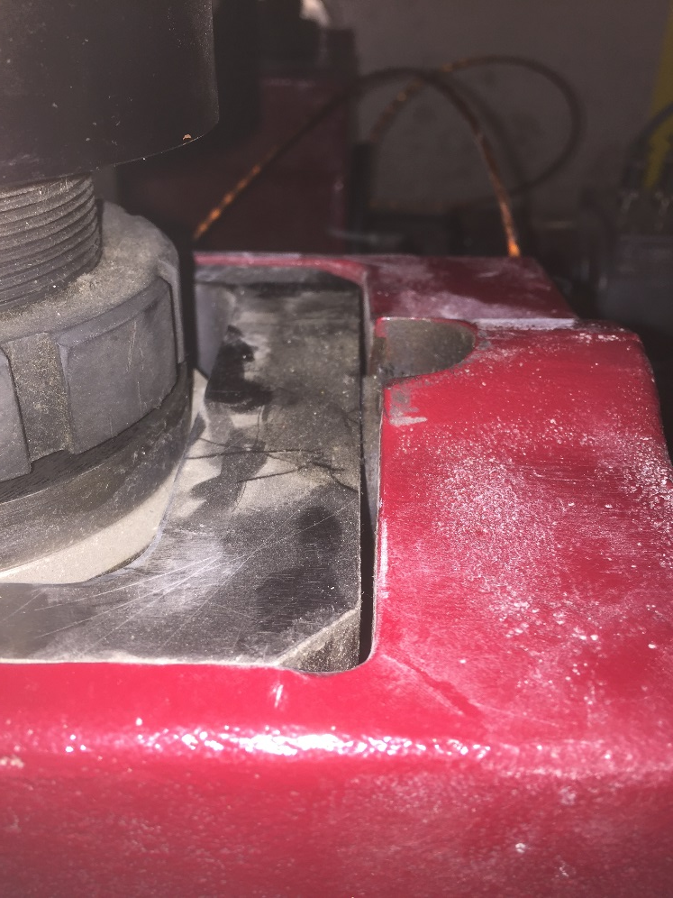
Present situation
Difficult to say since when the triplet jacks are at the end of the longitudinal range (0.5mm difference between 2009 and 2017) , but
as observed in point 5, remote movement of the triplets is now critical with several jacks (stick-slip effect on the jack in abutment).
In some cases, the tie-rods stiffness is sufficient to maintain Q1 in place, but in other cases a part of longitudinal forces are now transmitted to the jacks which stop the longitudinal progress (if any).
Bumper gap [mm] |  | L1 | R1 | L2 | R2 | L5 | R5 | L8 | R8
2009 (T?) | Q1 | -5.1 | 3 | -6.1 | 6.2 | -7.2 | 4.2 | -2.8 | 4.9
2017 (20K) | Q1 | -5.6 | 3.6 | -8.5 | 6.7 | -7.7 | 9.6 | -1 | 4.8
In L8, adjustment nuts for longitudinal movement are still inside the jacks D, so all the forces are transmitted to the jacks. This situation is not the desire one, as the jacks and jack fixations are not foreseen for that conditions

