Slide 1
Triplet string test
Understanding the issue – first investigations
F.Micolon – 02/2019

Slide 2
Open question at this stage
The triplet magnets seem to have drifted back
  Is there any clear structural weakness that could lead to a system failure ?
  Why the magnet drift (if any) ?
The realignment system is malfunctioning
  Is this an issue related to the jack or the actuators or both ?
  Should we expect any hazardous behavior of the jack when pressed in contact with its frame ?
  What does the realignment of point 8L looks like from the load cells Point of view ?

Slide 3
Is there any clear structural weakness that could lead to a system failure ?

Slide 4
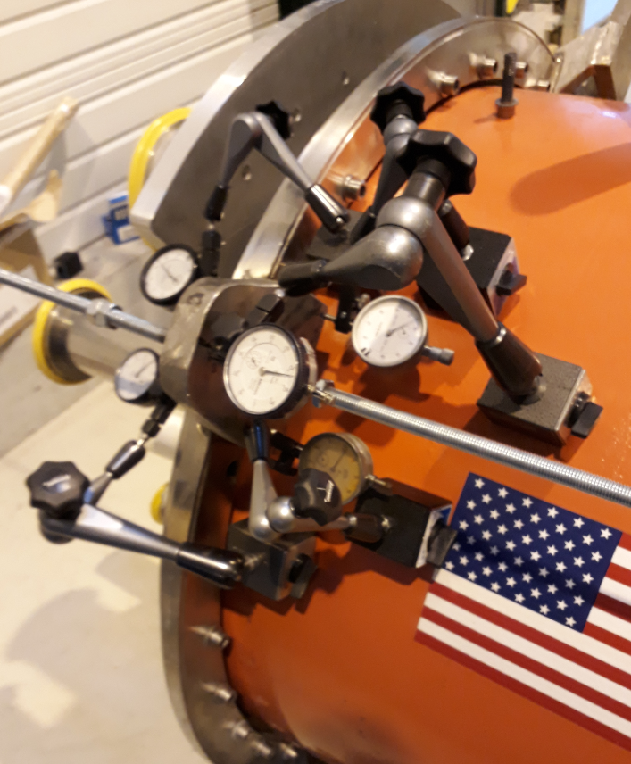
Tie-rod ears
The system longitudinal stiffness is driven by the tie-rod ears stiffness mostly. What stiffness do they have ? Could they possibly break ?
A test stand was setup in December 2017 to apply a 2T force on the tie-rod ear of the spare Q2.
At 2T pulling force (nominal case) the longitudinal deflection at the tie-rod position was in the order of 3.7mm (cycled and repeated on 2 ears).
If cumulated on all 5 successive tie-rod ear flange, this would equate to a Q1 displacement of 18,5mm before reaching a steady position.
The measured displacement when under vacuum are smaller (3 to 7mm).
Reference EDMS 1892268

Slide 5
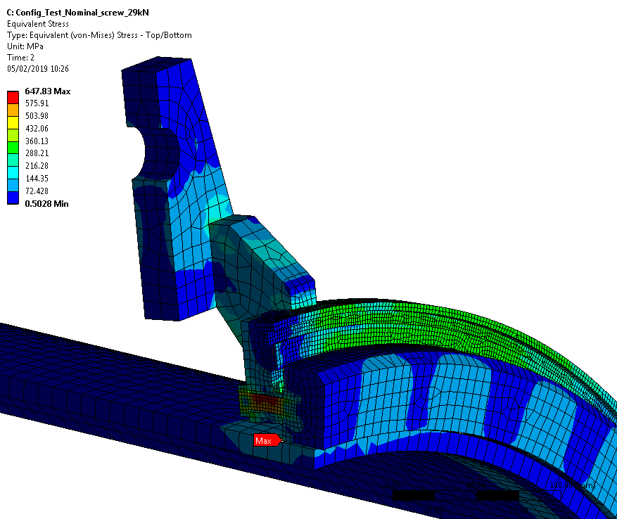
Tie-rod ears
Dedicated FE simulations show that up to a load of 4T on each tie-rod the resulting stress is marginal but still within the plastic domain (650 MPa vs. 700 MPa for the ultimate strength).
The tie-rod displacement in this case is ~20mm.
The highest stress is found on the heavily plasticized M12 flange screws.
The risk at this stage is to lose the compression of the vacuum seals however.
Note : The stiffness predicted by the FE model was 25% higher than in reality. So the actual situation may be more marginal even.
Note 2: Some tie-rod ear flange were found to be assembled with non-conformities (screw missing, M10 screws instead of M12).
Note 3: The W-bellow may add some level of stiffness to this assembly – not simulated here.

Slide 6
Why the magnet drift (if any) ?

Slide 7
Monitoring the magnets longitudinal position
Following the triplet task force – longitudinal position sensors were installed on each Q1 magnet to see the evolution of their longitudinal position.
No observable non-IP drift (several point are already blocked however)
Magnet quench leads to IP-motion between 1.5mm to 3mm (P_{cold_mass}=16bars)
Past longitudinal triplet position assessment were done without reference to the operational aspects (cryo pressure, temperature).
→ Often difficult to compare the values.
→ Was there a position drift at all ?
We hope the triplet string test will bring us more insight on this point.

Slide 8
  Is this an issue related to the jack or the actuators ?
  Should we expect any hazardous behavior of the jack when pressed in contact with its frame ?

Slide 9
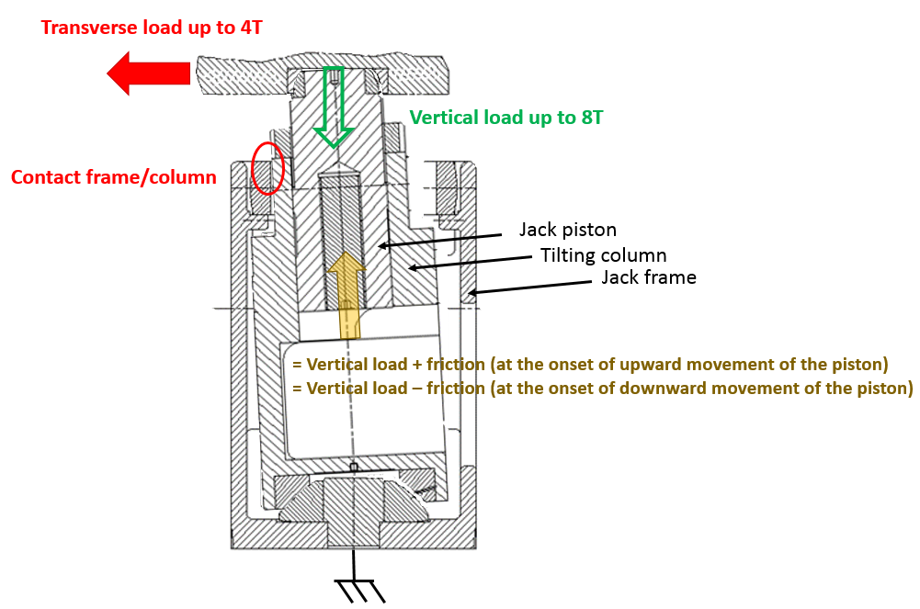
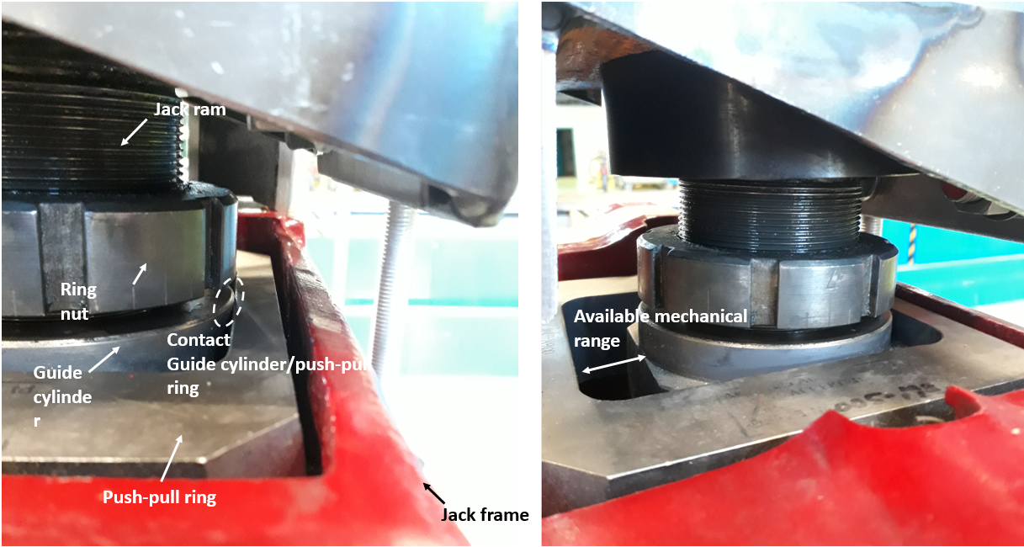
Jack test setup
In order to probe for possible malfunction of the jack itself a dedicated test bench was setup in spring 18.
Purpose: probe for possible jack malfunction when in contact with its frame and loaded transversally (outside of the specifications).
The jack could be loaded to up to 8T vertically and 4T transversally.
→ At a given force (vertical, transverse) the jack piston is moved up and down to see the load variation.

Slide 10
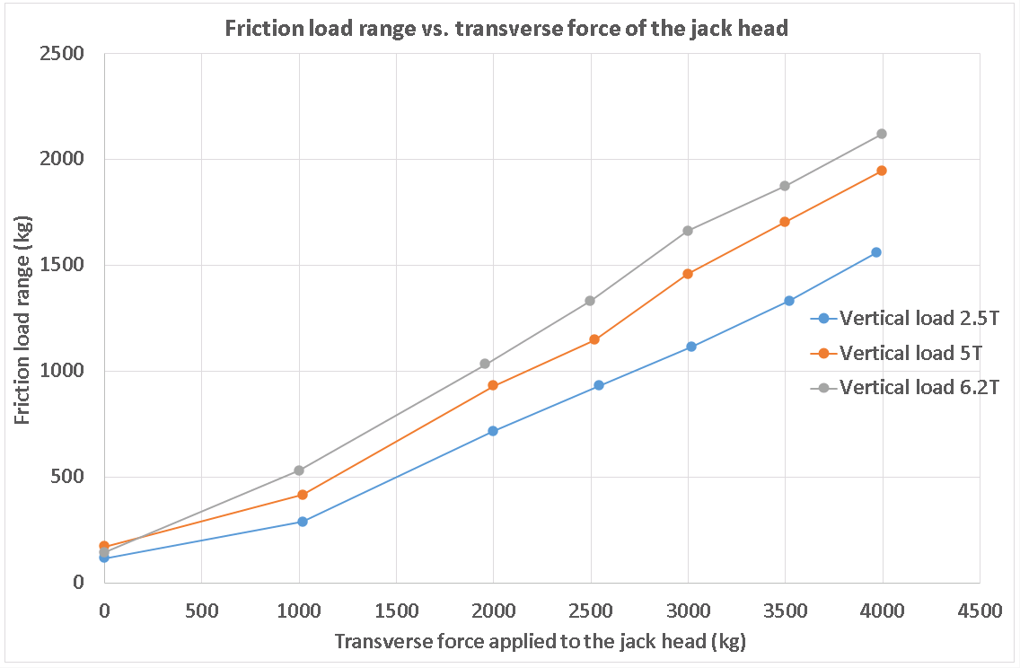
At a given setup force (vertical, transverse) the jack piston is moved up and down to see the load variation.
The load at which the jack piston starts moving up is retained.
The load at which the jack piston starts moving down is retained.
The difference between these two loads is the “friction load range” within which there is no movement of jack piston.
It is not stick-slip but friction
The jack movement is readily controllable once the friction is overcome.
A load variation in the order of 1T or more before the onset of jack movement is credible (depending on the transverse force applied).
→ Could explain the effect seen in the LHC.
Note: the load cell used for this work was not calibrated. Actual value may differ.
Detailed report EDMS: 2019573

Slide 11
What does the realignment of point 8L looks like from the load cells Point of view ?

Slide 12
Point 8L
We have seen that trying to realign with a transverse load on the jack leads to potentially high levels of friction on the jack piston.
We know that the triplet 8L is still equipped with the nuts in the longitudinal jack
→ So it must be loaded transversally
What’s the load evolution on the load cells during a realignment of 8L Q1D (longitudinal jack) ?

Slide 13
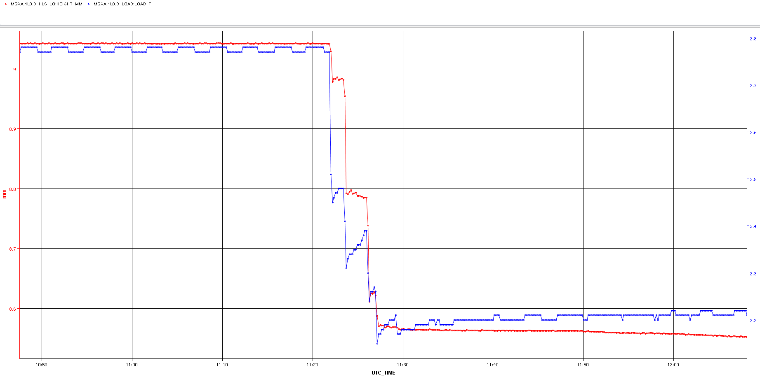
Point 8L Q1D – LS1 2014
Command: -0.470 mm
28/05/14
HLS Q1D (i.e. height of the cryostat)
2.75T
-60um
Load Q1D (i.e. load on the jack)
Pressure cold mass= N/A
Temperature cold mass = N/A
Tunnel temp = 19.1C
P&T unavailable – all other magnets had room temp and P>Pamb
Level of loading on the jack depends highly on P/T cryo
-350um
-320kg
-460kg
-420um
2.2T
-530kg
-470um
-620kg

Slide 14
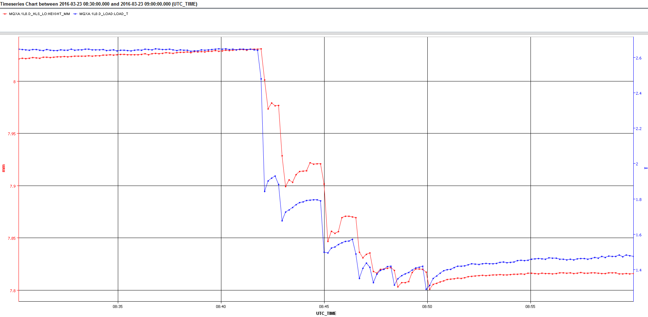
Point 8L Q1D – YETS15-16
Command: -0.250 mm
23/03/16
Load Q1D (i.e. load on the jack)
HLS Q1D (i.e. height of the cryostat)
Pressure cold mass=1.2bar
Temperature cold mass=1.9K
Tunnel temp = 19.4C
Operation conditions
-50um
-130um
-800kg
-200um
-960kg
-1150kg
-250um
-1360kg

Slide 15
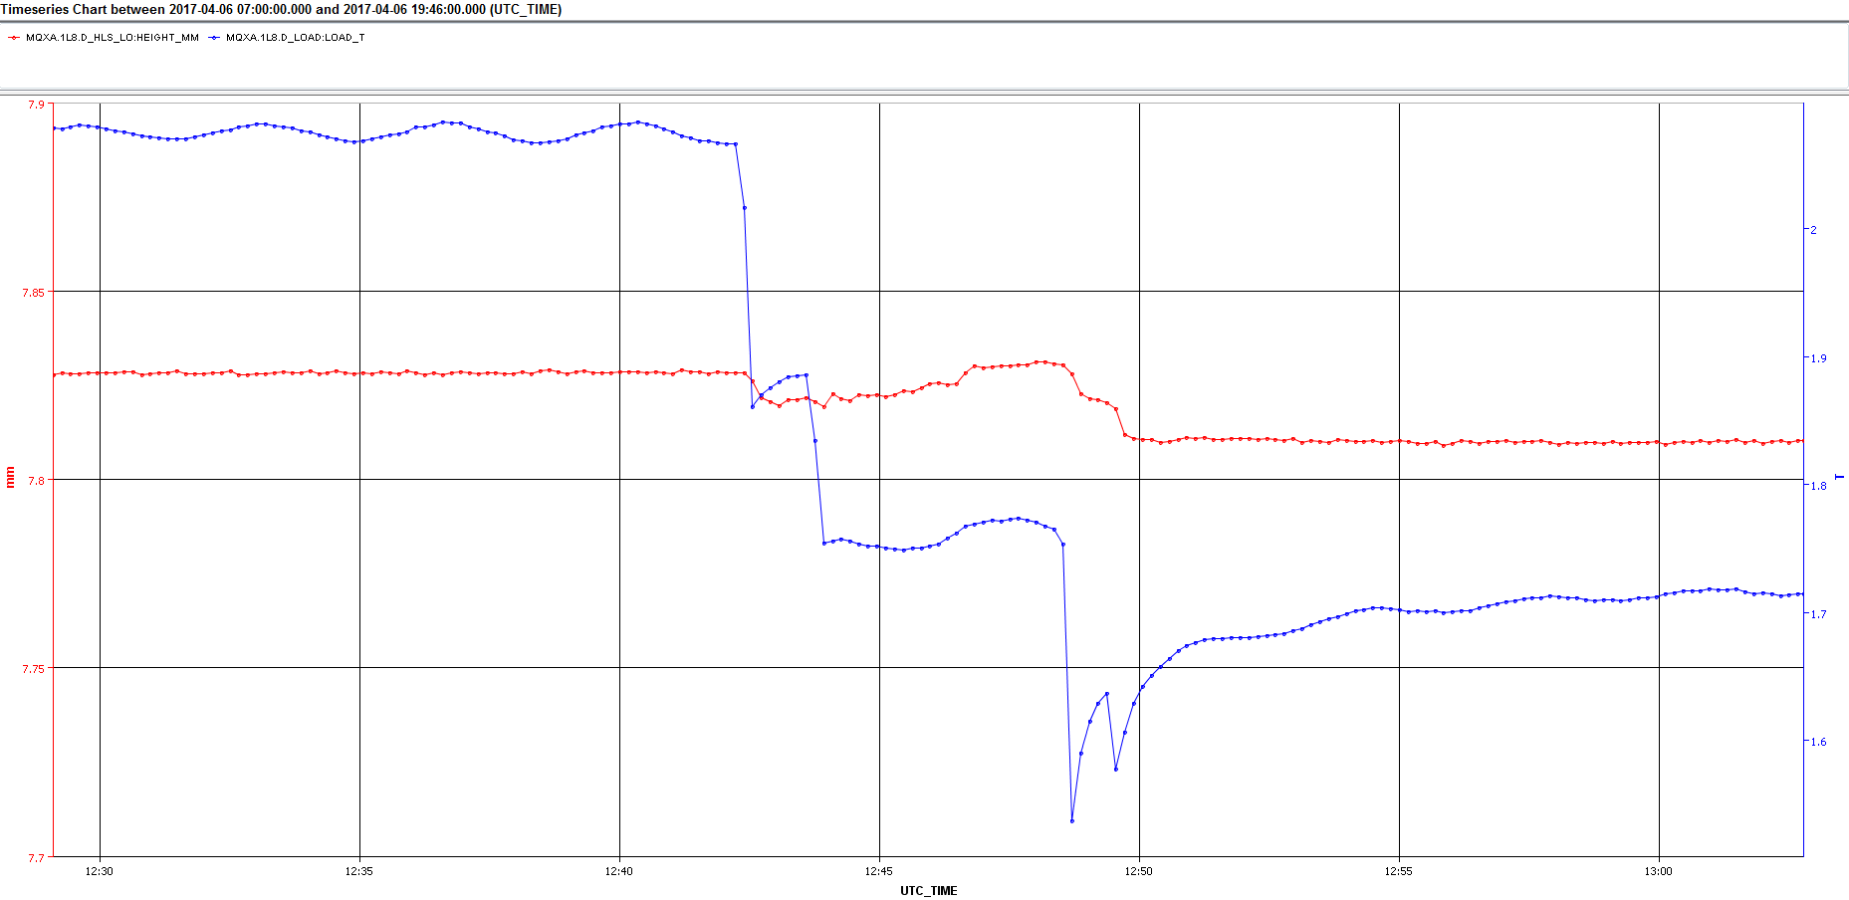
Point 8L Q1D – EYETS 1617
Command: -0.017 mm
06/04/17
2.07
Load Q1D (i.e. load on the jack)
Pressure cold mass=1.2bar
Temperature cold mass=1.9K
Tunnel temp = 18.7C
Nominal operation conditions
HLS Q1D (i.e. height of the cryostat)
V -20um
-210kg
-320kg
-350kg
1.72T
-530kg

Slide 16
Point 8L
Friction effects on the jack are visible on jack Q1D of point 8L through the realignments of run 2
After investigating of every Q1 realignment of Run 2, similar behavior has been observed in Q1 jacks of triplets 8R, 1L, 1R, 5L and 5R.
During these “forced” realignment, no sudden/uncontrolled motion of the magnet has been seen when the friction is overcome.

Slide 17
Conclusion
The stiffness of the tie-rod ears setup alone would allow a displacement of Q1 of 18mm before reaching a standstill
Note: This will be repeated with the triplet string interconnection bellows closed to confirm this stiffness value.
The strength of the tie-rod setup should not lead to a structural failure with the expected operating loads (given their intrinsic flexibility we should have a relatively good sharing of load)
Note: Actual mounting of the flange in the tunnel shows non-conformities which weaken the strength of the assembly.
When loaded transversely, the jack shows high levels of friction at the level of the piston but the movement stays readily controllable once the friction is overcome.
Investigations of past realignment show that high load variations are not uncommon on the jacks in contact and no uncontrolled magnet movement has been witnessed during run 2

Slide 18
Spare slides

Slide 19
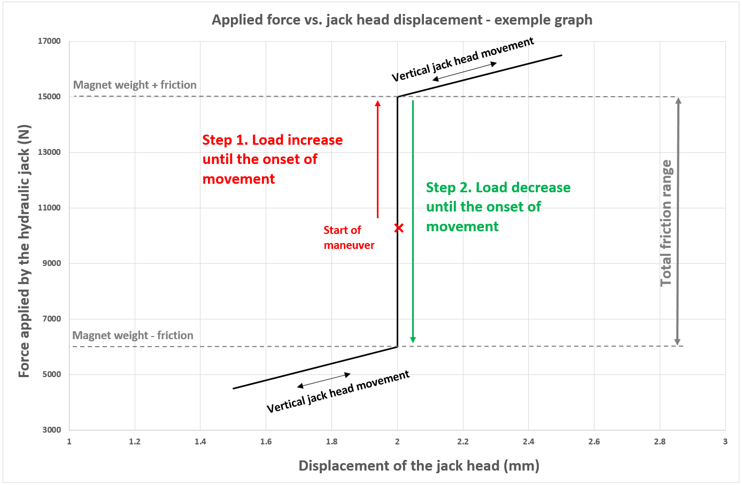
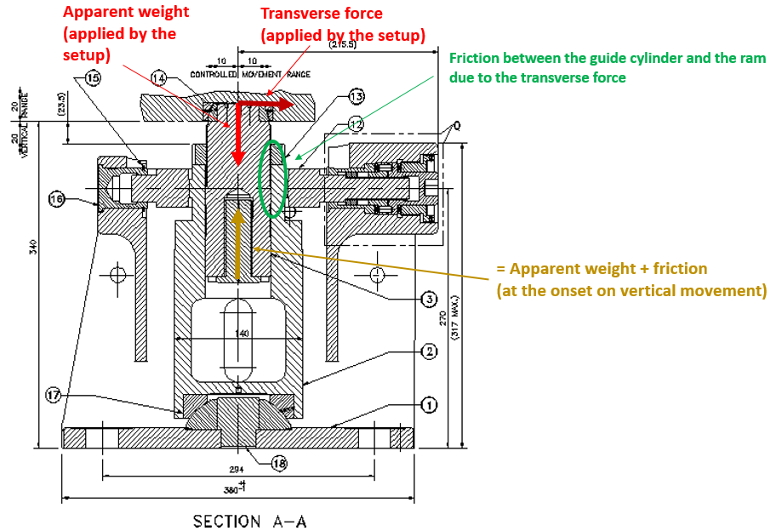
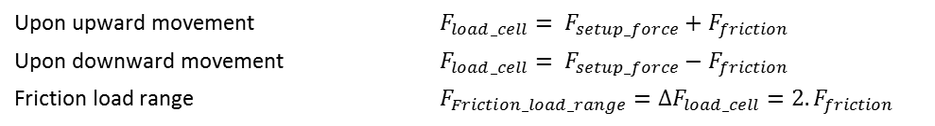
Friction load range
Step 1: The jack is loaded vertically and transversally.
Step 2: the load is increased on the auxiliary jack until the onset of jack movement.
Step 3: the load is decreased on the auxiliary jack until the onset of jack movement.
The friction load range is the difference between these two loads
Upon upward movement $F_{load_cell}= F_{setup_force}+F_{friction}$
Upon downward movement $F_{load_cell}= F_{setup_force}−F_{friction}$
Friction load range $F_{Friction_load_range}=∆F_{load_cell}=2.F_{friction}$

Slide 20
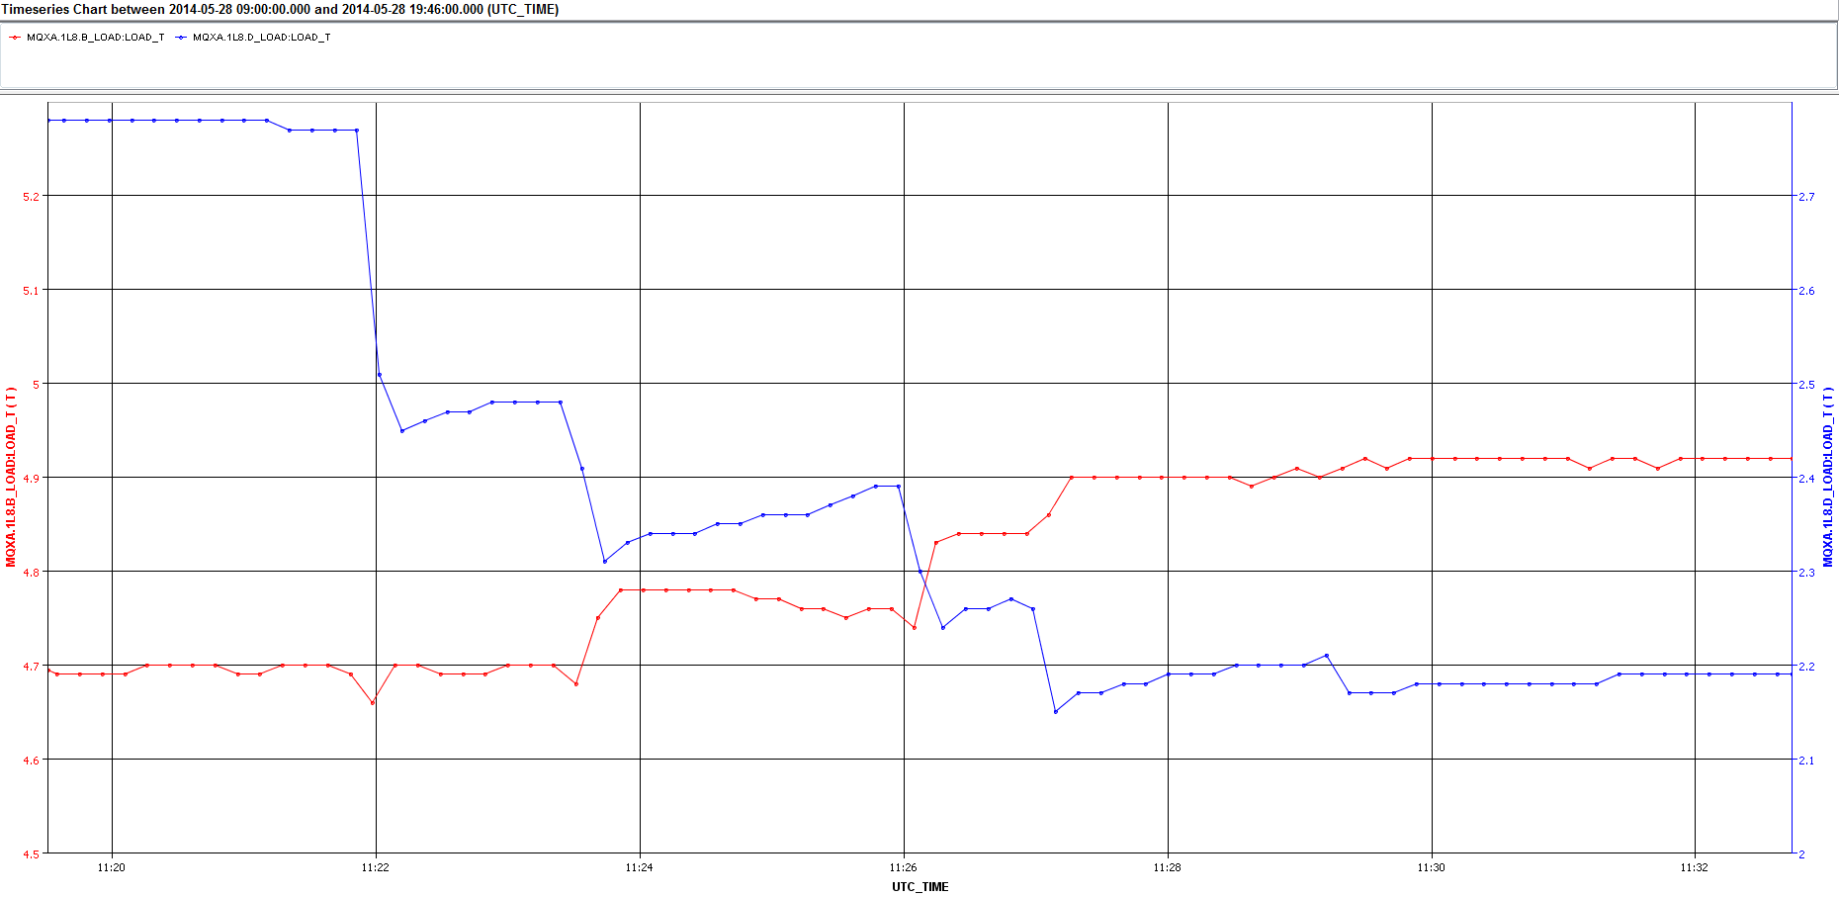
Point 8L Q1D – LS1 2014
28/05/14
Load Q1D
Load Q1B

Slide 21
