Slide 1
The triplet string test design
What it can/cannot do
F.Micolon – 02/2019

Slide 2
Introduction
The triplet string test was designed for two purpose :
To understand the issue encountered in the tunnel (without making “risky” test on the LHC hardware itself)
To study the consolidation solutions in order to mitigate the associated risks of implementation
The purpose of this presentation is to detail the main design features of the triplet string test before discussing the test program.

Slide 3
Triplet string test setup
End cover
Q3
‘DFBX’ skeleton
Q2
WPS/DOMS structure
Q1
End cover
We make a string test to try to answer the following questions :
? What are the main contributors to the triplet longitudinal Stiffness
? Why did we see a drift in the longitudinal position (if any)
? Why do we see high load variation during realignment ?
? How can we consolidate the triplet so they can be realigned in the future
WPS structure

Slide 4
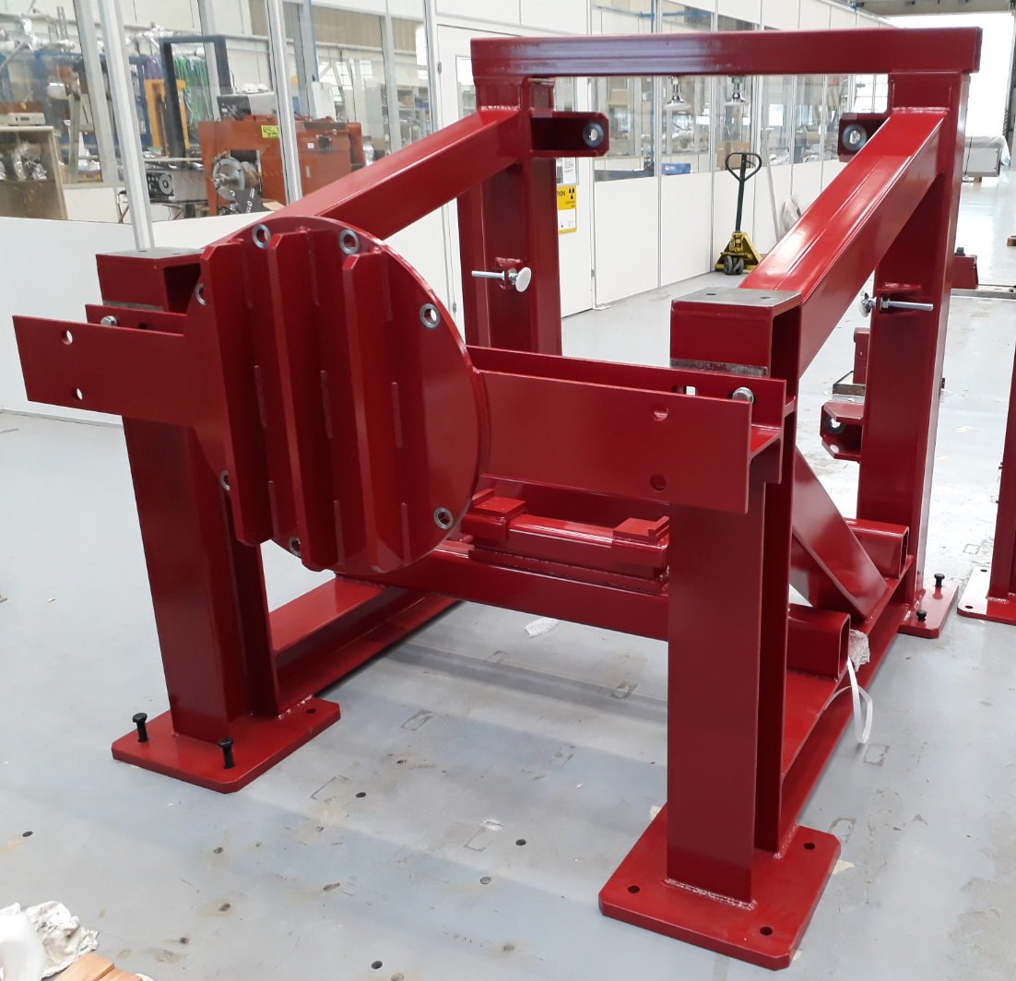
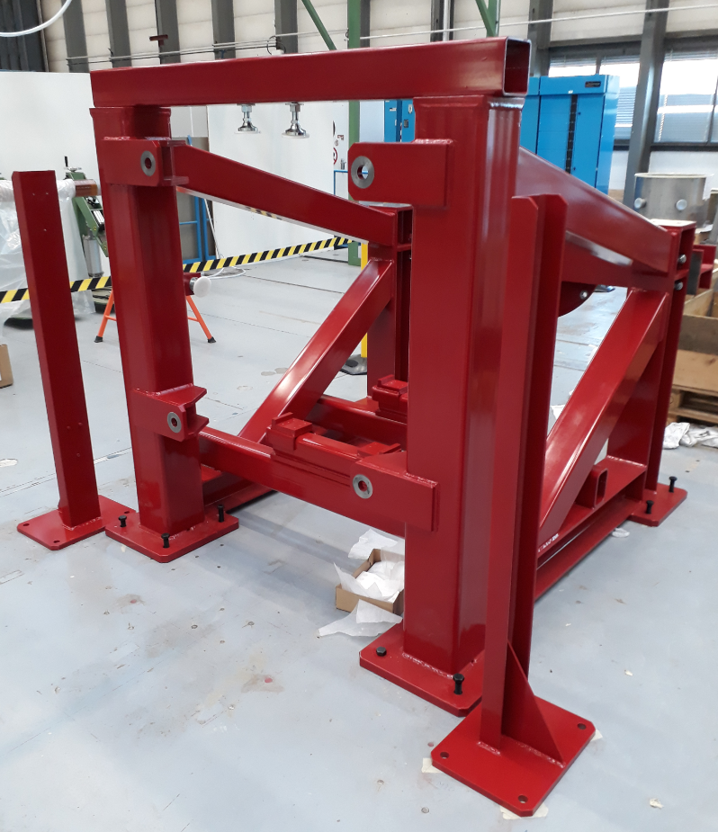
The “DFBX” skeleton
Will act as a fixed point for the triplet string test.
→ Same role as the DFBX in the tunnel
Designed so it can withstand the full 8T of vacuum force pushing on the vacuum end cover with limited deflection.

Slide 5
Magnet realignment
The Q1 magnets will be equipped with the spare motorized adapters
In order to make vertical realignment on the other magnets, simplified manual realignment systems were designed and procured.
All magnet can be realigned with precision.
  Q1 with the motorized actuators
  Q2 and Q3 with the manual actuators

Slide 6
In-situ Instrumentation
Position
Measurement of magnet vertical/radial position
At each jack plane with the WPS system (14x sensors - 2x wires) – EN/SMM
The DFBX skeleton deflection will be measured with DOMS
Measurement of magnet longitudinal position with 3x DOMS sensors (EN/SMM)
+ punctual measurements using dial gauges

Slide 7
In-situ Instrumentation
Force
Measurement of the longitudinal force transmitted by each tie-rod ear (12x)
Using strain gauges (EN/MME)
Measurement of the magnet load on each jack (EN/SMM)

Slide 8
In-situ Instrumentation
Acquisition
All data (position, load) + a vacuum gauge shall be stored on Timber through an acquisition system currently being prepared by EN/SMM (Adriaan, Kevin).
This will be highly useful for future investigation

Slide 9
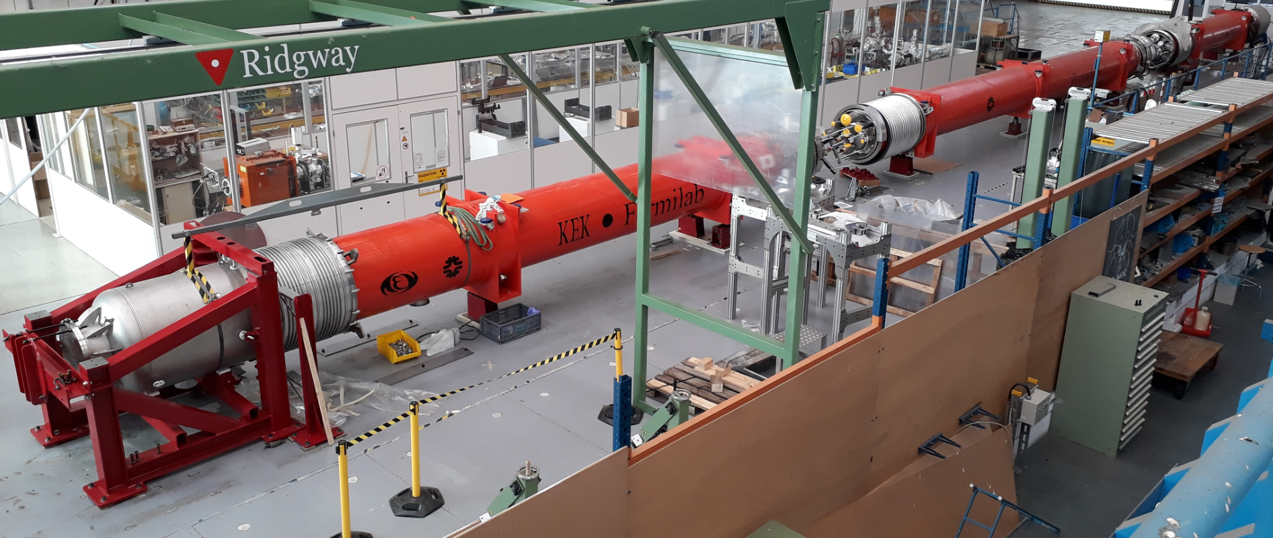
A glimpse of B181 as of today
You are welcome to come and take a look anytime in building 181 !

Slide 10
Conclusion
The triplet string test will allow a better understanding of the longitudinal load sharing in the triplets and overall triplet kinematic.
It is designed for vacuum only (no feeding of the cryogenic lines) with the idea in mind that vacuum is the main longitudinal force contributor.
This test requires multiple input from various specialist (Instrumentation, acquisition, survey, vacuum, transport).

Slide 11
Spare slides

Slide 12
The triplet string – simplified axial kinematics
Q1/Q2
Bellow stretch
Q2Q3 – 22 kN*
Bellow stretch
Q3DFBX – 10 kN*
Bellow stretch
Q1Q2 – 22 kN*
Vacuum force
80 kN**
Vacuum force
80 kN
IP
Q1
Q2
Q3
DFXB
Q1 He pressure
22 kN*
Q3 He pressure
4 kN*
Legend
When at cold, the cold mass will shrink
→This stretches the interconnection bellows
→ Which produces a pulling force on the cold mass
When we sum up all operational forces acting on each cold mass :
Q1/Q2
Vacuum force
80 kN**
Vacuum force
80 kN
Q1 net force = ~0 kN
Q2 net force ~0 kN
Q3 net force = -8kN
IP
Q1
Q2
Q3
DFXB
Legend
* Force values corresponding to the operational conditions

