Slide 1



Technical Student Programme:
February 2019 – January 2020
Author: Michał Wilczek
Supervisor: Michał Maciejewski

Slide 2

Academic Background
Currently: M.Sc. in Advanced Mechanical Engineering
B.Sc. in Mechanical Engineering and
Applied Computer Science
Engineer’s double Degree programme
in General Engineering; 2-year stay in France
Master thesis

Slide 3
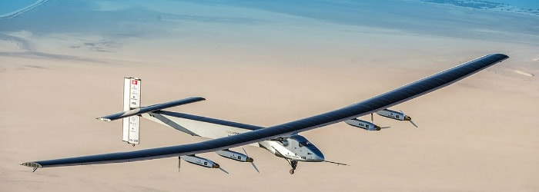
Scientific Projects
Bachelor thesis: Design of a modular apparatus for the production of nitric acid in electric discharge phenomena
Fluid-Structure Interaction modeling to estimate the lifetime of a centrifugal compressor
Experimental and theoretical modal analysis of the Solar Impulse plane model in scale
Simulation of a mechanical response to unbalanced currents in the 11T magnet protected by CLIQ system:
→ One-way coupling of ANSYS with Comsol modules via MpCCI interface
→ Project carried out in the STEAM

Slide 4

Project at CERN
Warm up task: automatic stress data extraction from ANSYS for further analysis of critical parameters during quench in Nb3Sn
MIT thesis – Quench Modelling in Cable-In-Conduit Superconducting Magnets
Based on the implementation at
make 1D heat propagation models
make 2D heat propagation models
make 3D (extruded 2D) heat propagation models
couple 2D models from Lucas Brouwer from Berkeley National Laboratory to 3D heat propagation models
validate against exsiting measurements
Rerun standalone 2D ANSYS models from Lucas Brouwer from Berkeley National Laboratory
Automatic model generation of different model types (starting from existing tests)

Slide 5
