Slide 1
Highlights from the
9th LHC Operations Evian Workshop (January 30th to February 1st, 2019)
C. Wiesner, M. Mentik, D. Wollmann
February, 28th 2019

Slide 2
9th LHC Operations Evian Workshop
Five Sessions:
  Overview of Run 2
  Systems Overview
  Systems Overview (with some beam dynamics)
  Beam Performance during Run 2
  A Preliminary Look Ahead
33 Presentations accumulating to 11 hours
6 hours of discussions
Personal, not complete, summary focusing on machine-protection relevant questions
Slides for all presentations (and proceedings/minutes) can be found at: https://indico.cern.ch/event/751857/timetable/#20190130.detailed

Slide 3
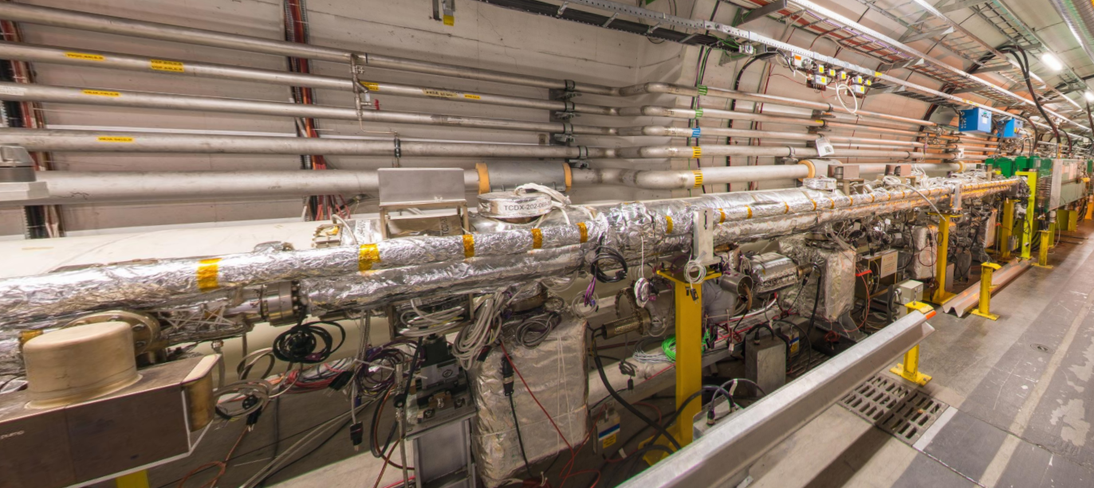
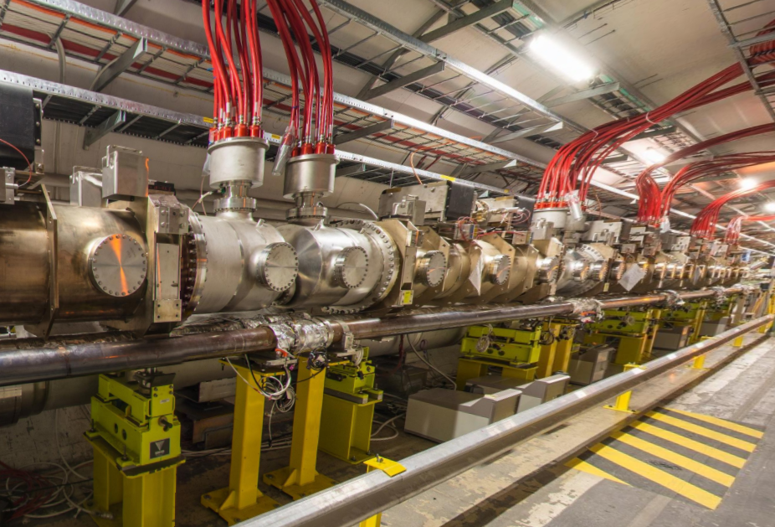
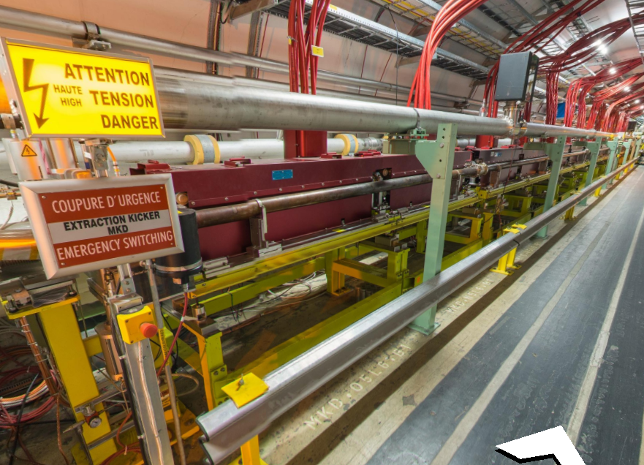
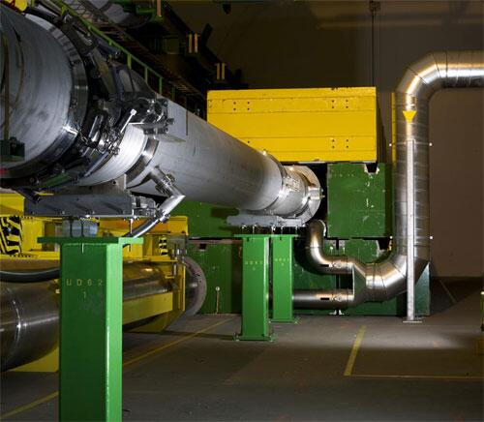
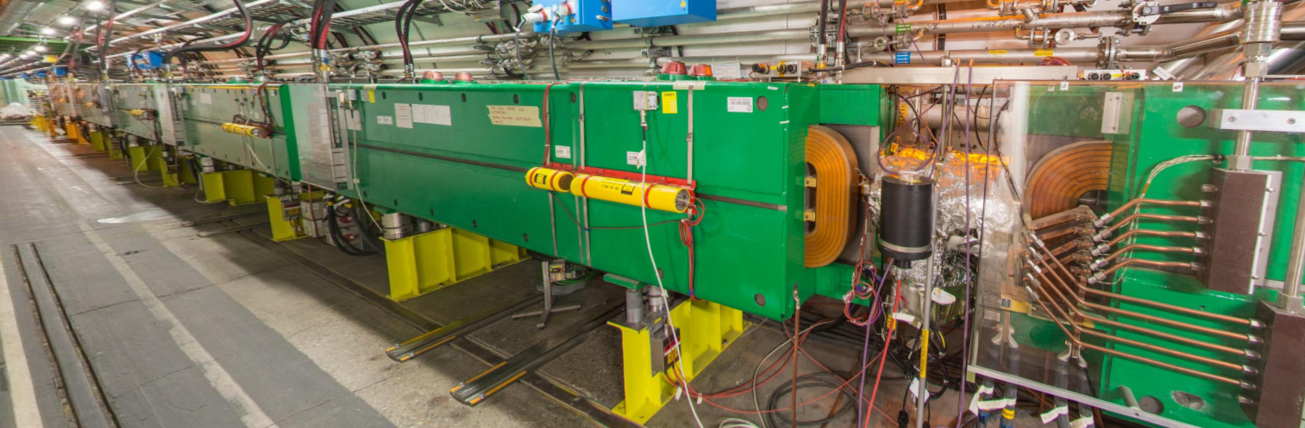
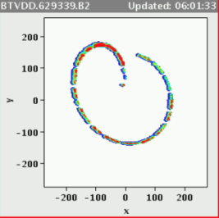
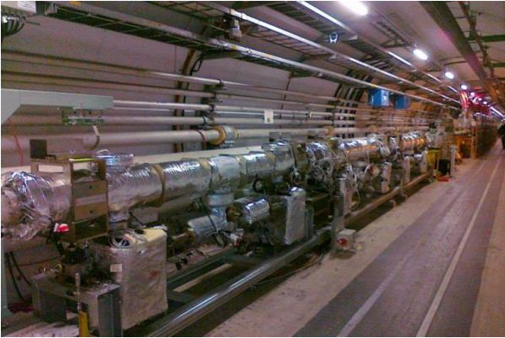
The LHC Beam Dump System
TCDS: septa protection
MKB: dilution kickers
15 MKD: extraction kickers
MSD: extraction septa
TDE: Beam dump
TCDQ: Q4 protection & TCSP
C. Bracco, LBDS Performance in Run II

Slide 4
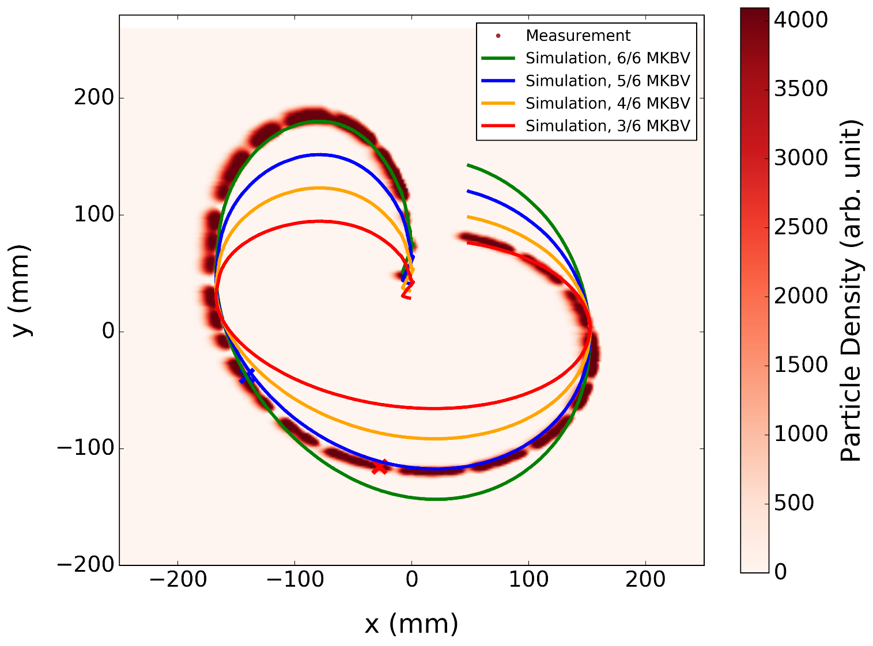
Run II Performance
MKD/MKB Erratic/Flashover with beam at top energy
LS1
A few kicker failures per year (erratics and flashover) occurred and will continue to occur, especially when operating at higher energy (higher voltage)
Weaknesses and new kicker failure types (type 2 MKD erratic, ~3 “missing” MKBs) were identified during past Runs ➔ impact on beam load for dump protection elements and TDE
31st May 2015
4th October 2016
From C. Bracco, LBDS Performance in Run II

Slide 5
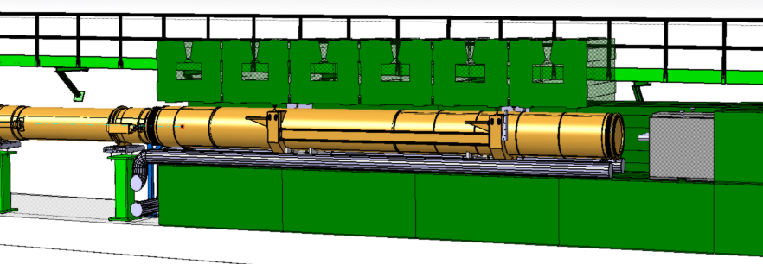
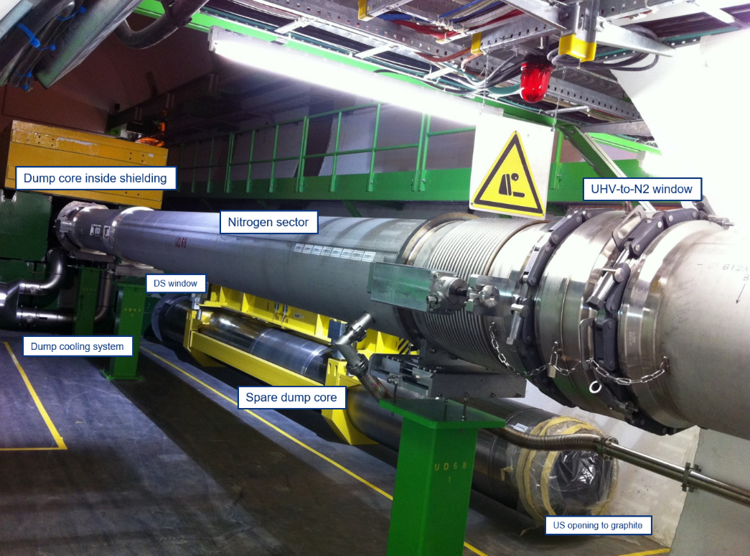
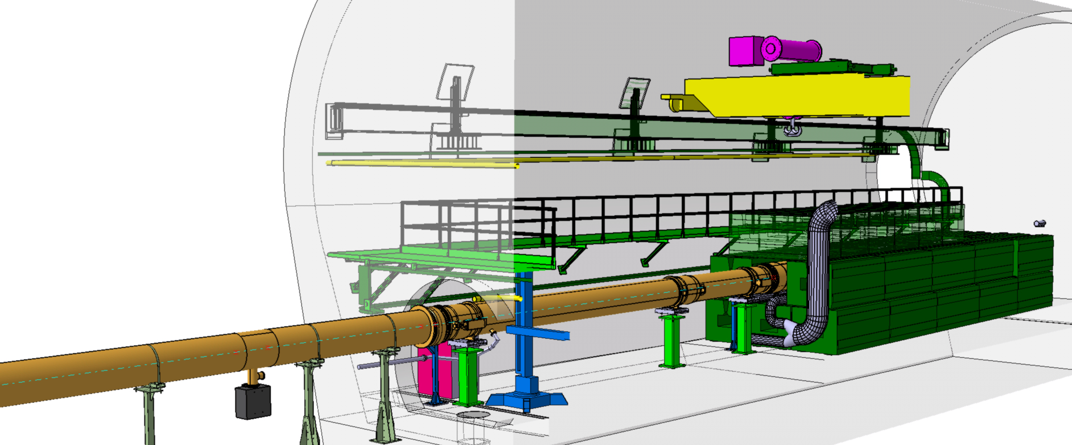
LHC Dump Layout
Downstream window (TiGr2 plate)
beam
N₂ dump sector
Dump core
LHC vacuum
beam
Upstream window (CfC + SS316L foil)

Slide 6
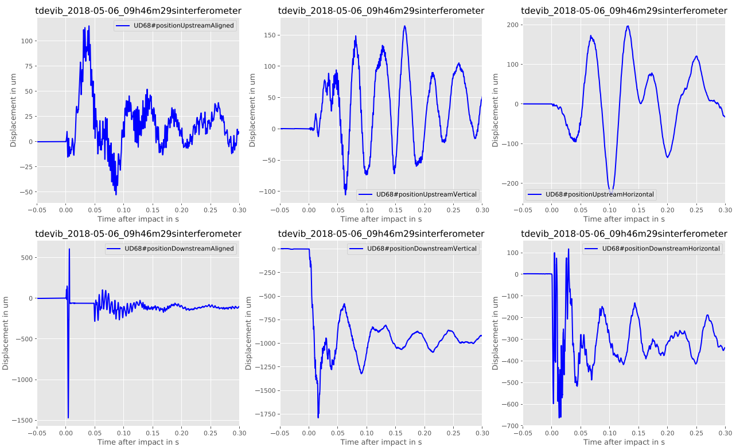
Interferometer measurements
Large displacements measured

Slide 7
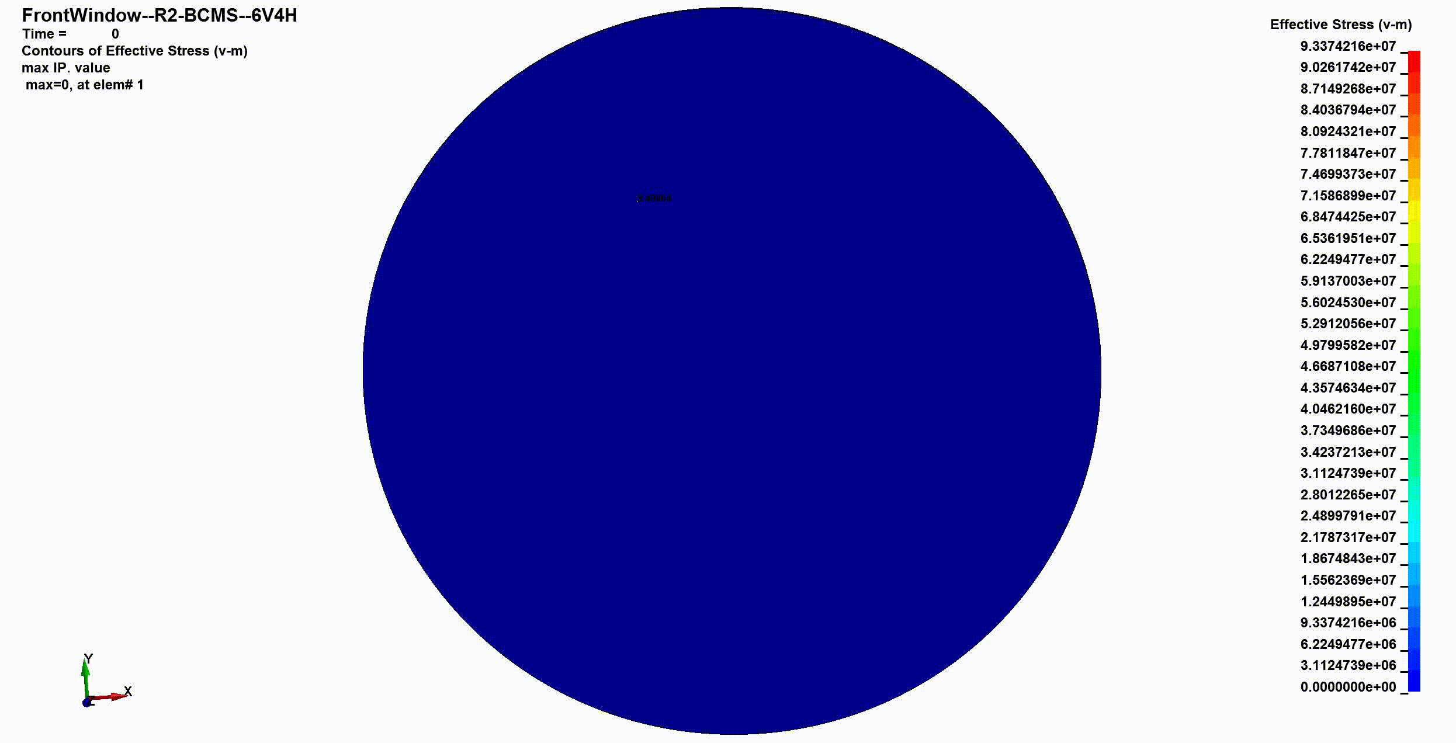

Upstream Window under 1.8E+11 ppb
Necessary Margin Below, safe operation is not guaranteed
Lower limit Below, the material deforms permanently
Energy per proton: 7TeV
Number of protons per bunch: 1.8E11
Emittance: 1.7µmrad
Bunch length: 25E-9s
Beam Pattern: HL-BCMS 6V2H with 2604 bunches
Material parameters and yield strength determination according to EDMS 2029814
LS-Dyna Version: 11.0, double precision
To be done
not before YETS 21/22
In collaboration with TE/VSC
$$S_{y}=\frac{R_{y}}{σ_{eq}}$$
Too high risk of failure!
Ti Gr5 required

Slide 8
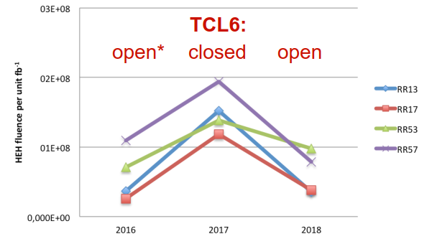
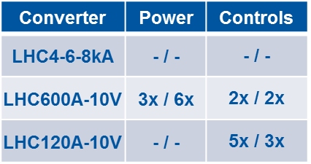
Rad-levels in RRs
Power Converters
Radiation levels in RRs in P1 & P5 dependency on TCL6 settings
R2E failures 2017 vs. 2018
Reduction of ~4x for IP1 & ~2x for IP5 in 2018 vs. 2017 but increase in P7 due to betatron losses.
The ARC rad-levels increased due to open TCL6 impacting MPE equipment in DS (increase in cell8).
From the R2E perspective: preferable post-LS2 configuration will be TCL6 closed, owing to radiation hardness of RR EPC equipment.
OP question: Replace more Power Converters affected by zero-volt crossing?

Slide 9
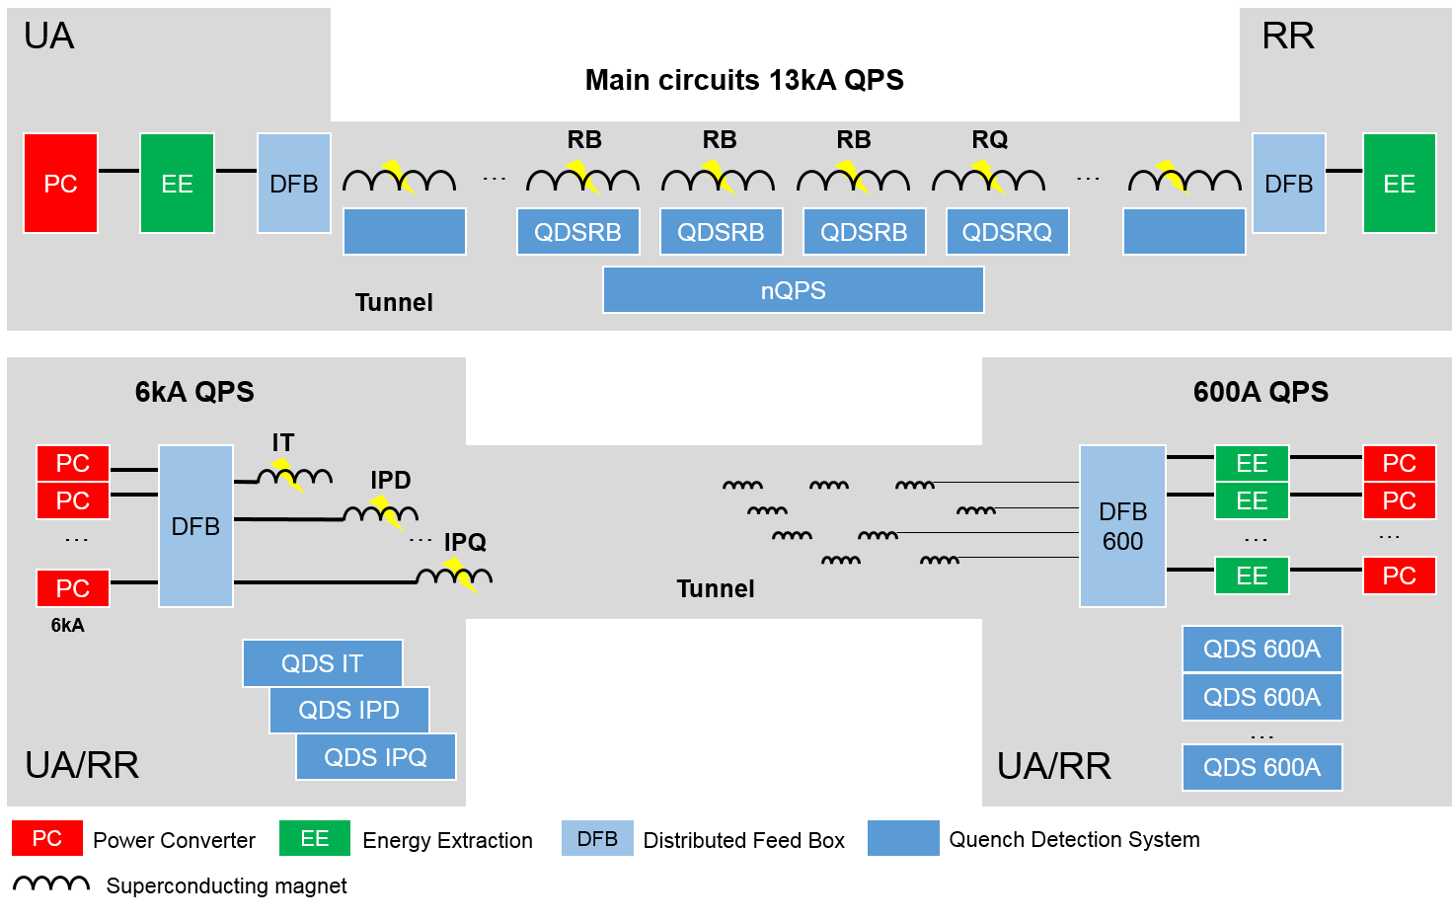
QPS Hardware
13800 hardwired means to stop LHC
Item | Count
EE13kA | 32
EE600 | 202
HDS | 6084
QDSRB | 1232
Magnet detector | 2464
QDSRQ | 392
Magnet detector | 1568
nQPS | 436
Magnet detector | 1632
Bus-bar detector | 4096
QDSIPX | 76
IP magnet detector | 360
IT magnet detector | 48
Current lead detector | 1124
QDS600 | 114
Magnet detector | 624
Rad-tol magnet det. | 212
Current lead detector | 1672
Total | 8568
Interlocking | 13800
T. Podzorny, Quench Protection System

Slide 10
QPS availability
Overall, excellent availability of QPS
TCL collimator settings in 2018 significantly affected QPS downtime
Comment Rende: “Before LS1 everybody was impressed about the number of faults now we are all impressed by the excellent availability”
From T. Podzorny, Quench Protection System

Slide 11


Collimation
Introduction
The multi-stage LHC collimation system aims to control the regular and abnormal losses to reduce the risk of quenches of the superconducting magnets.
2012
2015
2016
2017
2018
Protons
Thanks to D. Mirarchi
Tertiary halo
No magnet quenches from circulating proton beams with stored energy close to 300 MJ accommodating all machine configurations! Thanks to the good performance of the collimation system
and also to the very good beam lifetime and orbit stability!
Secondary halo
+ hadronic shower
Circulating
beam
Primary halo
Insertion
Arc
IP
Primary
Collimators
(TCP)
Secondary
Collimators
(TCSG)
Absorbers
(TCLA)
Tertiary
Collimators
(TCT)
Bottleneck
N. Fuster-Martínez, Collimation
Notes:
No quenches from circulating beamNo quenches from circulating proton beam with stored energy close to 300 MJ!
What is limiting the intensity now?

Slide 12
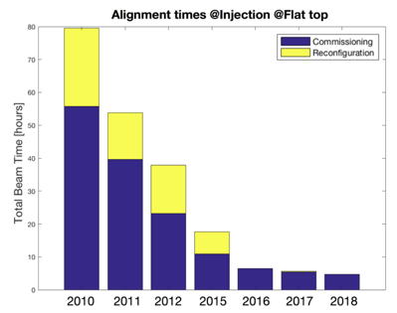
Collimation
Collimator Alignment
Crystal Collimation
Bent crystal
Deflected halo
Massive Absorber
Commissioning
Secondary halo
+ hadronic shower & Dechanneling
Circulating
beam
Primary halo
Insertion
Arc
IP
From N. Fuster-Martínez, Collimation

Slide 13
Machine Protection System
For most cases we lost only 1 protection layer
We should become more rigorous and in the future for each such case produce a “major event report”

Slide 14
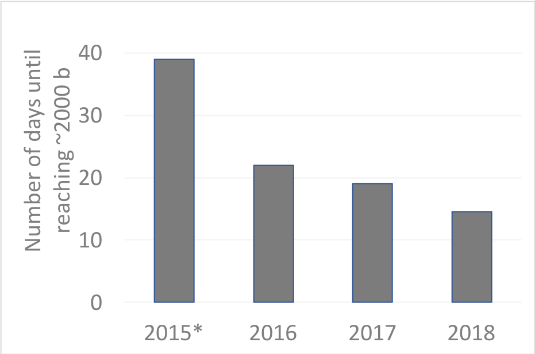
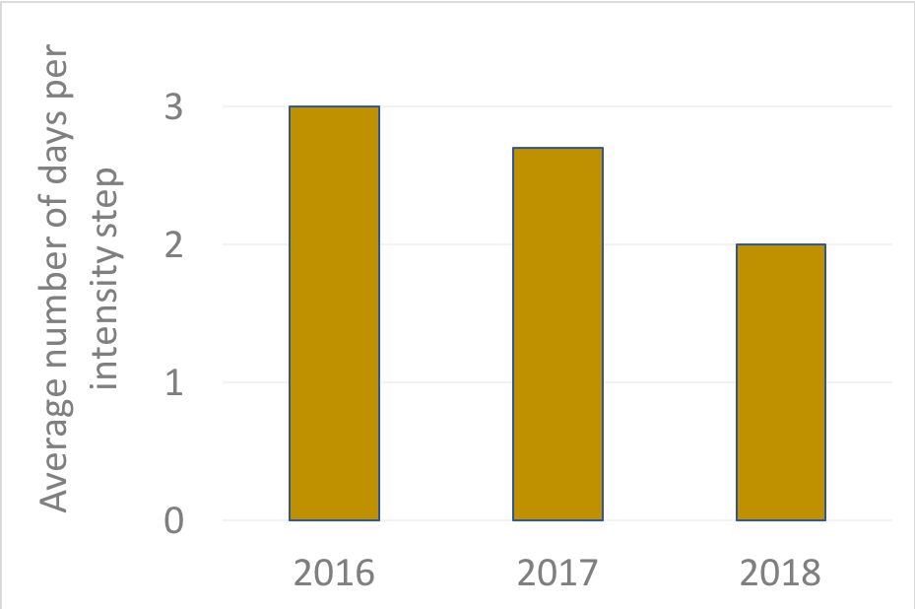
Intensity ramp-ups Run 2
2015: commissioning year
    50 ns & 25 ns ramp-up
    Increase of intensity until end of proton run
2016/17/18: 7 steps to reach 2000+ bunches
    3/12 - 75 - 300 - 600 - 900 - 1200 – 1800
    2016 → 2018: reduction ramp-up length by 35 %
Establish cycle
MP dominated
Intensity dominated
* 2015: 25 ns up to 1825 b

Slide 15
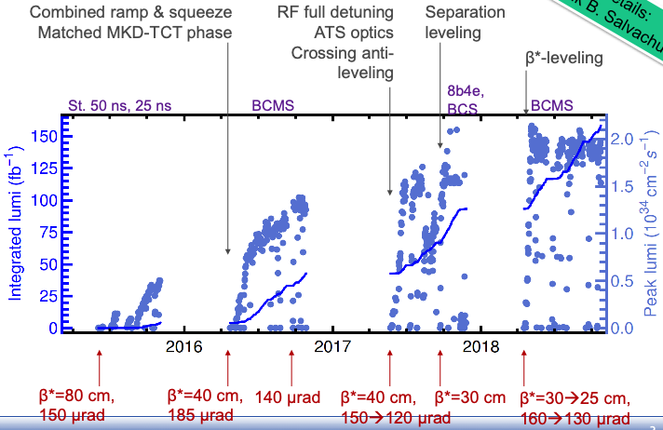
Machine Configuration
The Run 1
“Aperture Platinum Mine”
is depleted
R. Bruce

Slide 16
Comparison: 2018 vs LHC design
Some keys to good peak performance:
  Small emittance
    See talks H. Bartosik, S. Papadopoulou
  Small β* at collision point
    Focus of
    this talk
Parameter | 2018 | LHC Design
Energy [TeV] | 6.5 | 7.0
No. of bunches | 2556 | 2808
Max. stored energy per beam (MJ) | 312 | 362
β* IR1/5 [cm] | 30→25 | 55
Half crossing angle IR1/5 [µrad] | 160→130 | 142.5
Normalized beam-beam separation | 10.6→7.9 | 9.4
p/bunch (typical value) [10¹¹] | 1.1 | 1.15
Typical normalized emittance [μm] | ~1.9 | 3.75
Peak luminosity [10³⁴ cm⁻²s⁻¹] | 2.1 | 1.0

Slide 17
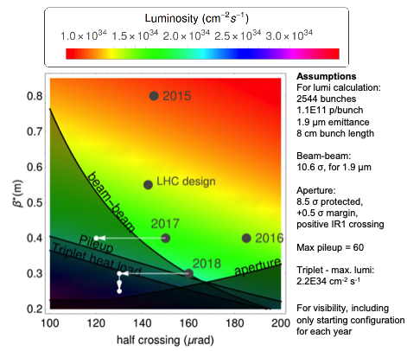
Machine Configuration
R. Bruce

Slide 18
Transverse Emittance Blow-up
Emittance growth studies well advanced as simulations and calculations can be compared to measurements. No measurement available for the ramp
Largest blow up during ramp
A potential
Lumi Gold Mine

Slide 19
Special Losses (UFO – ULO – 16L2 – 10 Hz)
What about the deconditioning and level of UFOs in 2021 ?
10 Hz: origins of phase shift identified, but real cause not yet !!!

Slide 20

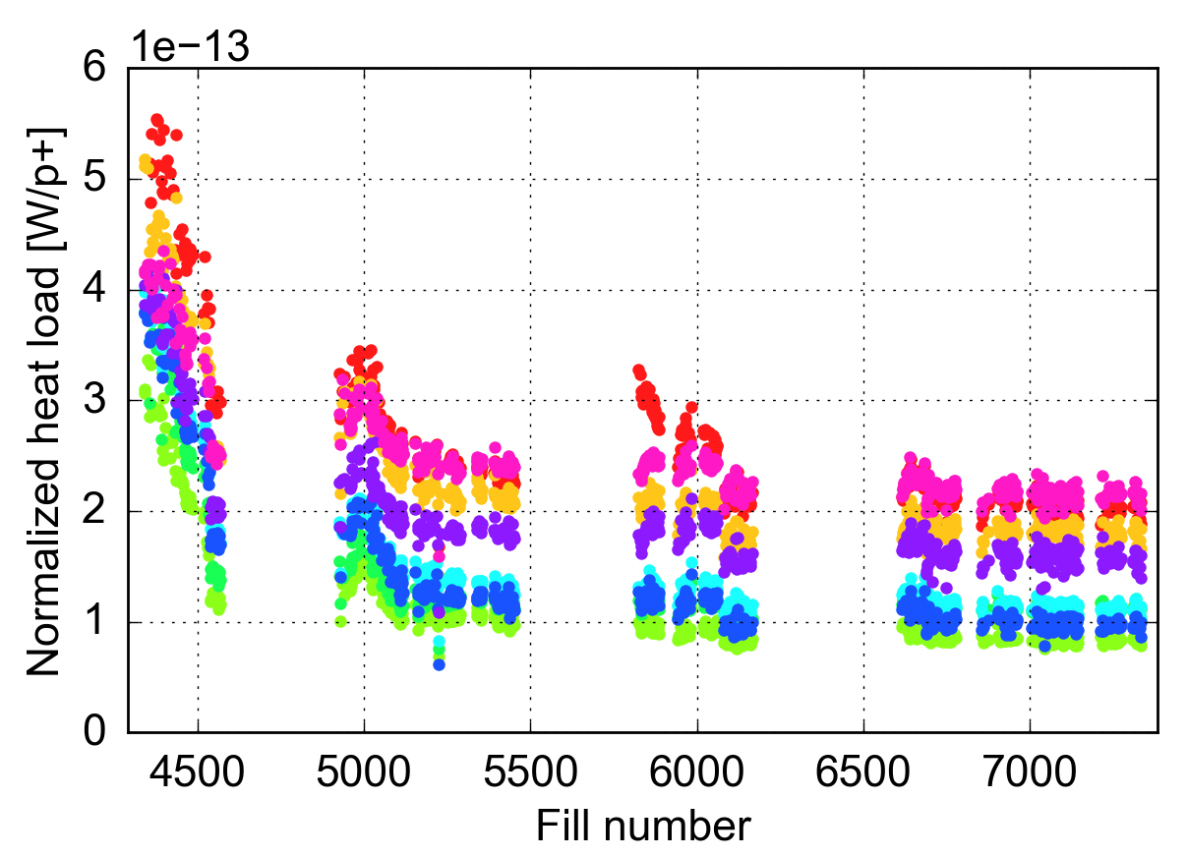
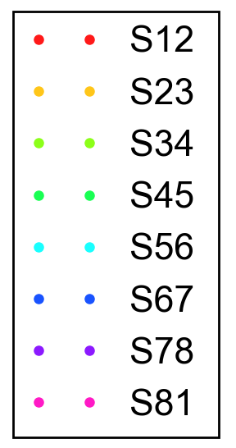
Heat loads: differences among sectors
Heat loads in S12, S23, S81 much larger than for the other sectors
  close to cryo-plant design capacity
These differences are very reproducible and were observed in all 25 ns fills over 4 years (2015-18)
25 ns physics fills with >600b
2015
2016
2017
2018
S12
vented
G. Iadarola, Electron clouds and heat loads

Slide 21
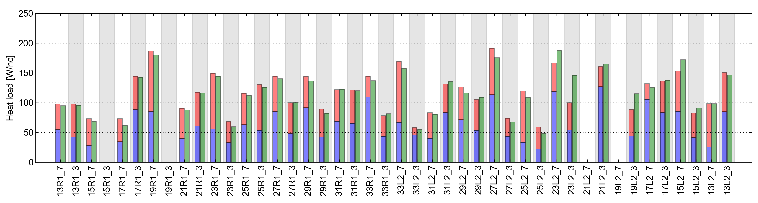
Heat loads: distribution along the ring
Especially in the high load sectors, we observe large differences from cell to cell
Heat loads can be different for the two apertures of the same cell
Differences are present even among magnets of the same cell
Sector 12 (MD 2018)
B1 alone B2 alone B1&B2
Cell 31L2 (equipped with extra thermometers)
At 450 GeV:
25 W
20 W
50 W
3 W
Q
Dipole
Dipole
Dipole
At 6.5 TeV:
5 W
30 W
70 W
8 W
G. Iadarola, Electron clouds and heat loads

Slide 22
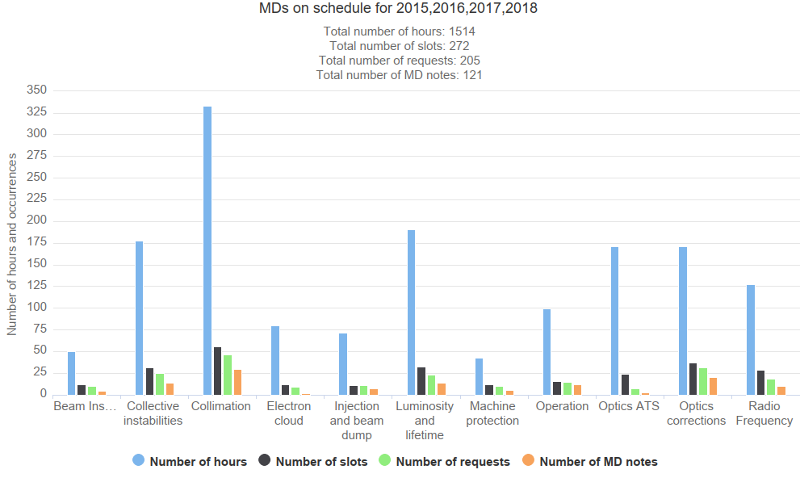
MDs per category [hours]
Comment Rende: “MDs are an excellent investment for (future) machine performance”
2015, 2016, 2017, 2018
Collimation wins – lots of new hardware in prep for HL
Followed by collective instabilities, lumi and lifetime, …

Slide 23
What to expect from the injectors during Run 3
What will the LHC and Experiments be able to swallow during run 3 ?

Slide 24
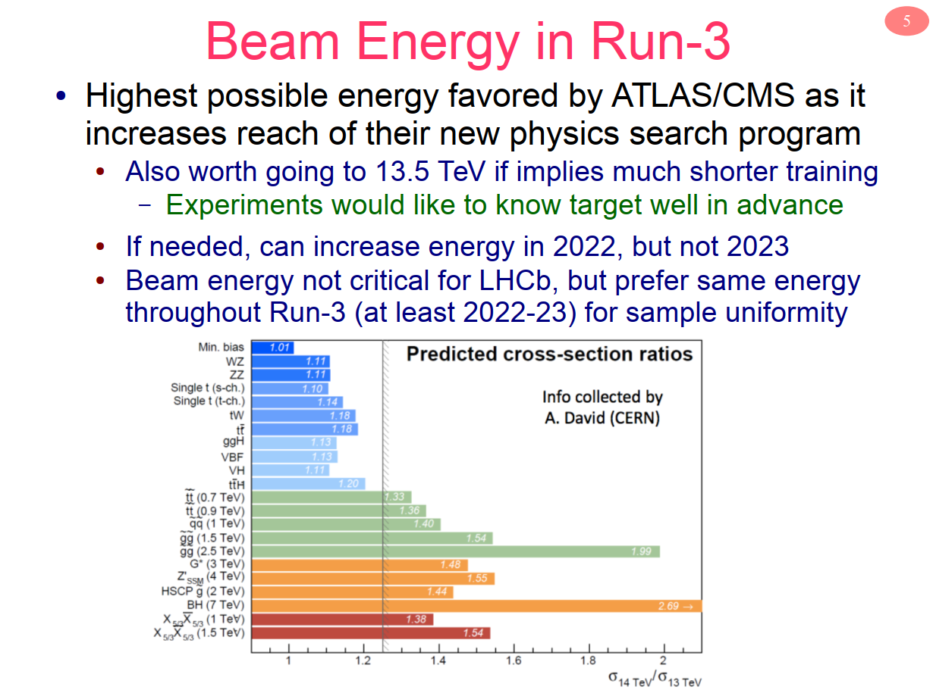
BCMS is preferred and if
necessary complement
with some 8b4e
Brian Petersen, Experiment Requests and Constraints for Run-3

Slide 25
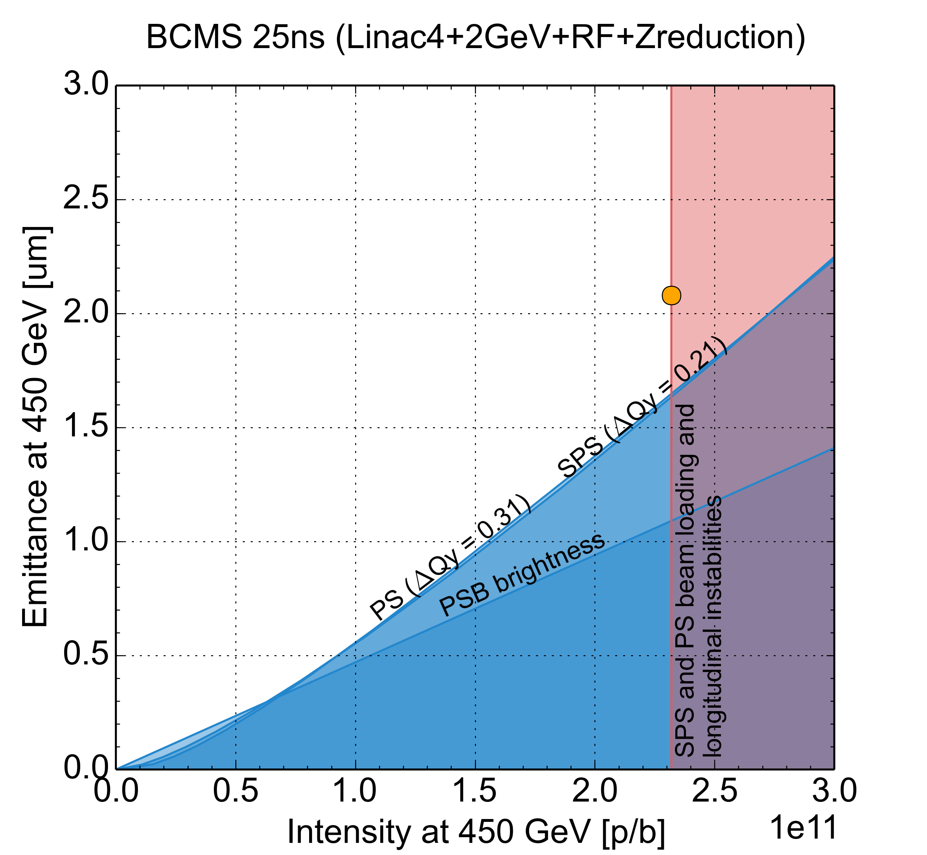
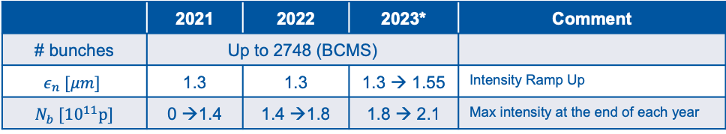
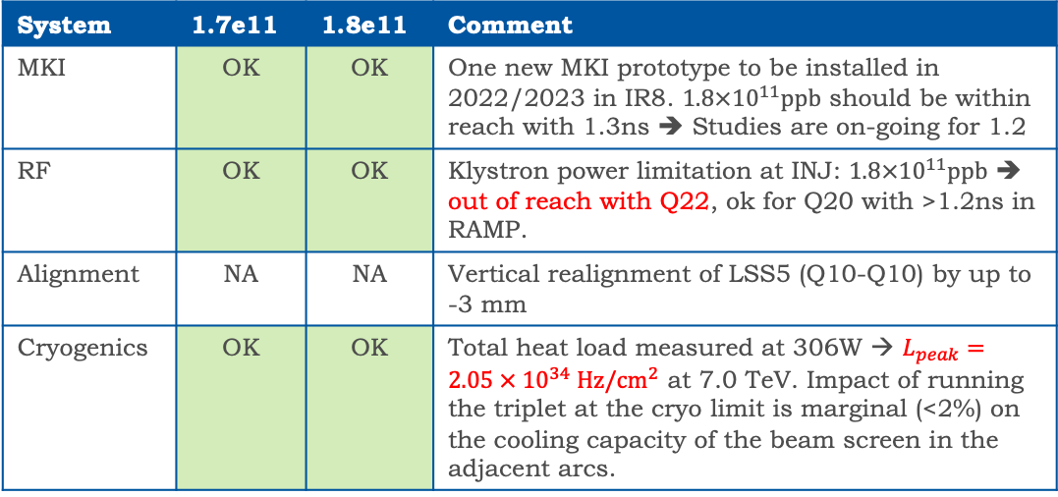
Deliverables & Equipment Group Constraints
Very clear forecast from LIU for the commissioning plan:
  Gradual intensity ramp up over Run-III.
At the LHC, can we inject, accelerate, collide and safely dump such a beam?
H. Bartosik, G. Rumolo, et al.
 | 2021 | 2022 | 2023* | Comment
# bunches | Up to 2748 (BCMS)
$$ε_{n} [μm]$$ | 1.3 | 1.3 | 1.3 → 1.55 | Intensity Ramp Up
$N_{b} [{10}^{11}p]$ | 0 →1.4 | 1.4 →1.8 | 1.8 → 2.1 | Max intensity at the end of each year
End of
2023
End of
2022
* Not including 2024 when the LHC is in shutdown but the injectors are fully operational.
End of
2021
System | 1.7e11 | 1.8e11 | Comment
MKI | OK | OK | One new MKI prototype to be installed in 2022/2023 in IR8. $1.8×{10}^{11}ppb$ should be within reach with 1.3ns ➔ Studies are on-going for 1.2
RF | OK | OK | Klystron power limitation at INJ: $1.8×{10}^{11}ppb$ ➔ out of reach with Q22, ok for Q20 with >1.2ns in RAMP.
Alignment | NA | NA | Vertical realignment of LSS5 (Q10-Q10) by up to -3 mm
Cryogenics | OK | OK | Total heat load measured at 306W → $L_{peak}=2.05 × {10}^{34} Hz/cm^{2}$ at 7.0 TeV. Impact of running the triplet at the cryo limit is marginal (<2%) on the cooling capacity of the beam screen in the adjacent arcs.
N. Karastathis, Report from the LHC Run-III Configuration Working Group
M. Barnes, K. Brodzinski, B. Goddard, A. Lechner, J. Maestre Heredia, A. Mereghetti, D. Missiaen, F.X. Nuiri, B. Salvant, H. Timko, J. Uythoven, J. Wenninger, et al.

Slide 26
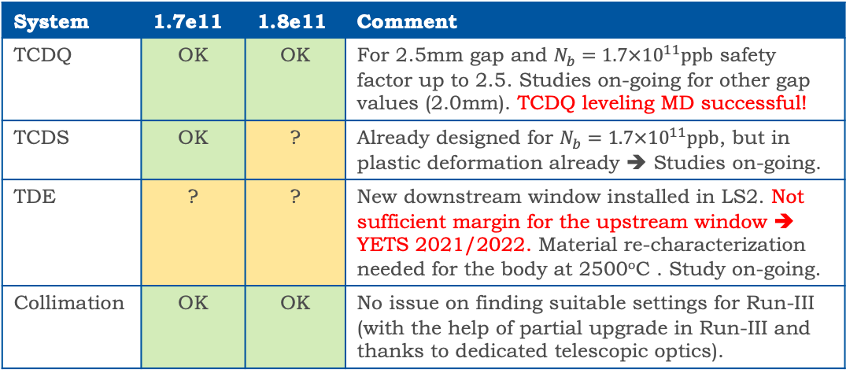
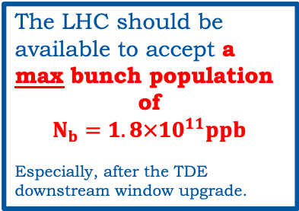
Deliverables & Equipment Group Constraints
Very clear forecast from LIU for the commissioning plan:
  Gradual intensity ramp up over Run-III.
At the LHC, can we inject, accelerate, collide and safely dump such a beam?
H. Bartosik, G. Rumolo, et al.
 | 2021 | 2022 | 2023* | Comment
# bunches | Up to 2748 (BCMS)
$$ε_{n} [μm]$$ | 1.3 | 1.3 | 1.3 → 1.55 | Intensity Ramp Up
$N_{b} [{10}^{11}p]$ | 0 →1.4 | 1.4 →1.8 | 1.8 → 2.1 | Max intensity at the end of each year
End of
2023
End of
2022
* Not including 2024 when the LHC is in shutdown but the injectors are fully operational.
End of
2021
System | 1.7e11 | 1.8e11 | Comment
TCDQ | OK | OK | For 2.5mm gap and $N_{b}=1.7×{10}^{11}ppb$ safety factor up to 2.5. Studies on-going for other gap values (2.0mm). TCDQ leveling MD successful!
TCDS | OK | ? | Already designed for $N_{b}=1.7×{10}^{11}ppb$, but in plastic deformation already ➔ Studies on-going.
TDE | ? | ? | New downstream window installed in LS2. Not sufficient margin for the upstream window ➔ YETS 2021/2022. Material re-characterization needed for the body at 2500^{ο}C . Study on-going.
Collimation | OK | OK | No issue on finding suitable settings for Run-III (with the help of partial upgrade in Run-III and thanks to dedicated telescopic optics).
The LHC should be available to accept a max bunch population
of
$$N_{b}=1.8×{10}^{11}ppb$$
Especially, after the TDE downstream window upgrade.
N. Karastathis, Report from the LHC Run-III Configuration Working Group
M. Barnes, K. Brodzinski, B. Goddard, A. Lechner, J. Maestre Heredia, A. Mereghetti, D. Missiaen, F.X. Nuiri, B. Salvant, H. Timko, J. Uythoven, J. Wenninger, et al.

Slide 27

Thank you for your attention!

Slide 28
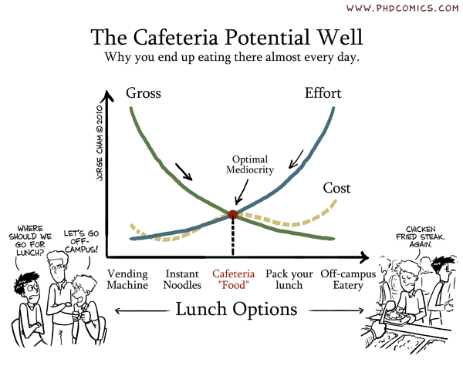
Et bon appetit !

Slide 30
Power Converters and their control
Massive FGClite deployment during LS2
Lessons learned and experience gained

Slide 31
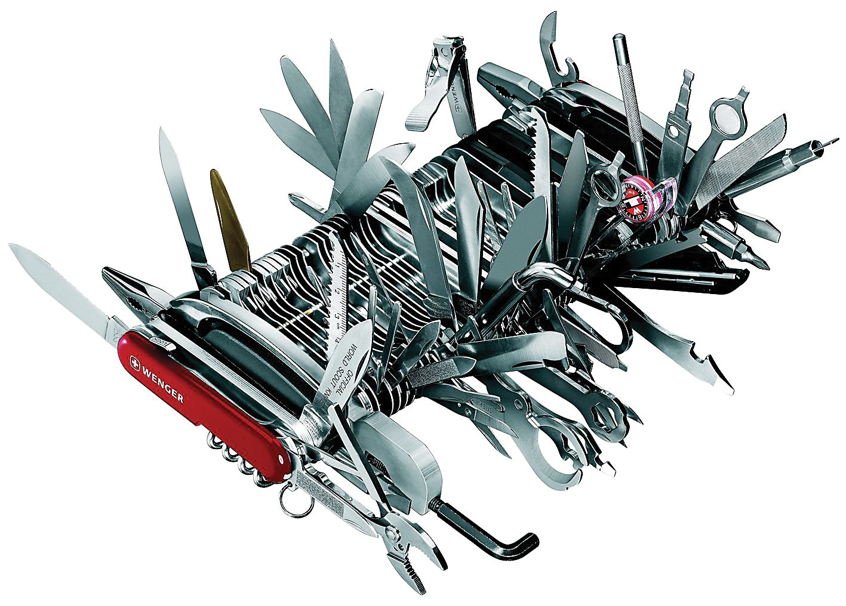
ADT and ObsBox
As well as normal operation, 15 MDs in the last 2 years relied on the ADT and ObsBox
ObsBox is instrumental for instability studies
Changes during LS2:
“Any specific new requirements have to be communicated now”

Slide 32
Luminosity, lifetime and modelling

Slide 33
Luminosity, lifetime and modelling

Slide 34
Transverse Instabilities

Slide 35
Longitudinal dynamics
Further improvement of quality and performance
Batches

