Slide 1

First results of UFO type 1 dynamics studies
Measurements and initial observations
M Väänänen, B Lindström, D Wollmann
CERN
2nd TE-MPE-PE section meeting – 28 February 2019

Slide 2
Beam-macroparticle interaction
Dust particle falls into beam
Intense Beam losses, duration ~1 ms
Premature beam dumps and superconducting magnet quenches
  -> up to 12 hours downtime!
beam loss monitor (BLM)
UFO
+
beam losses
e⁻
+
beam
e⁻

Slide 3
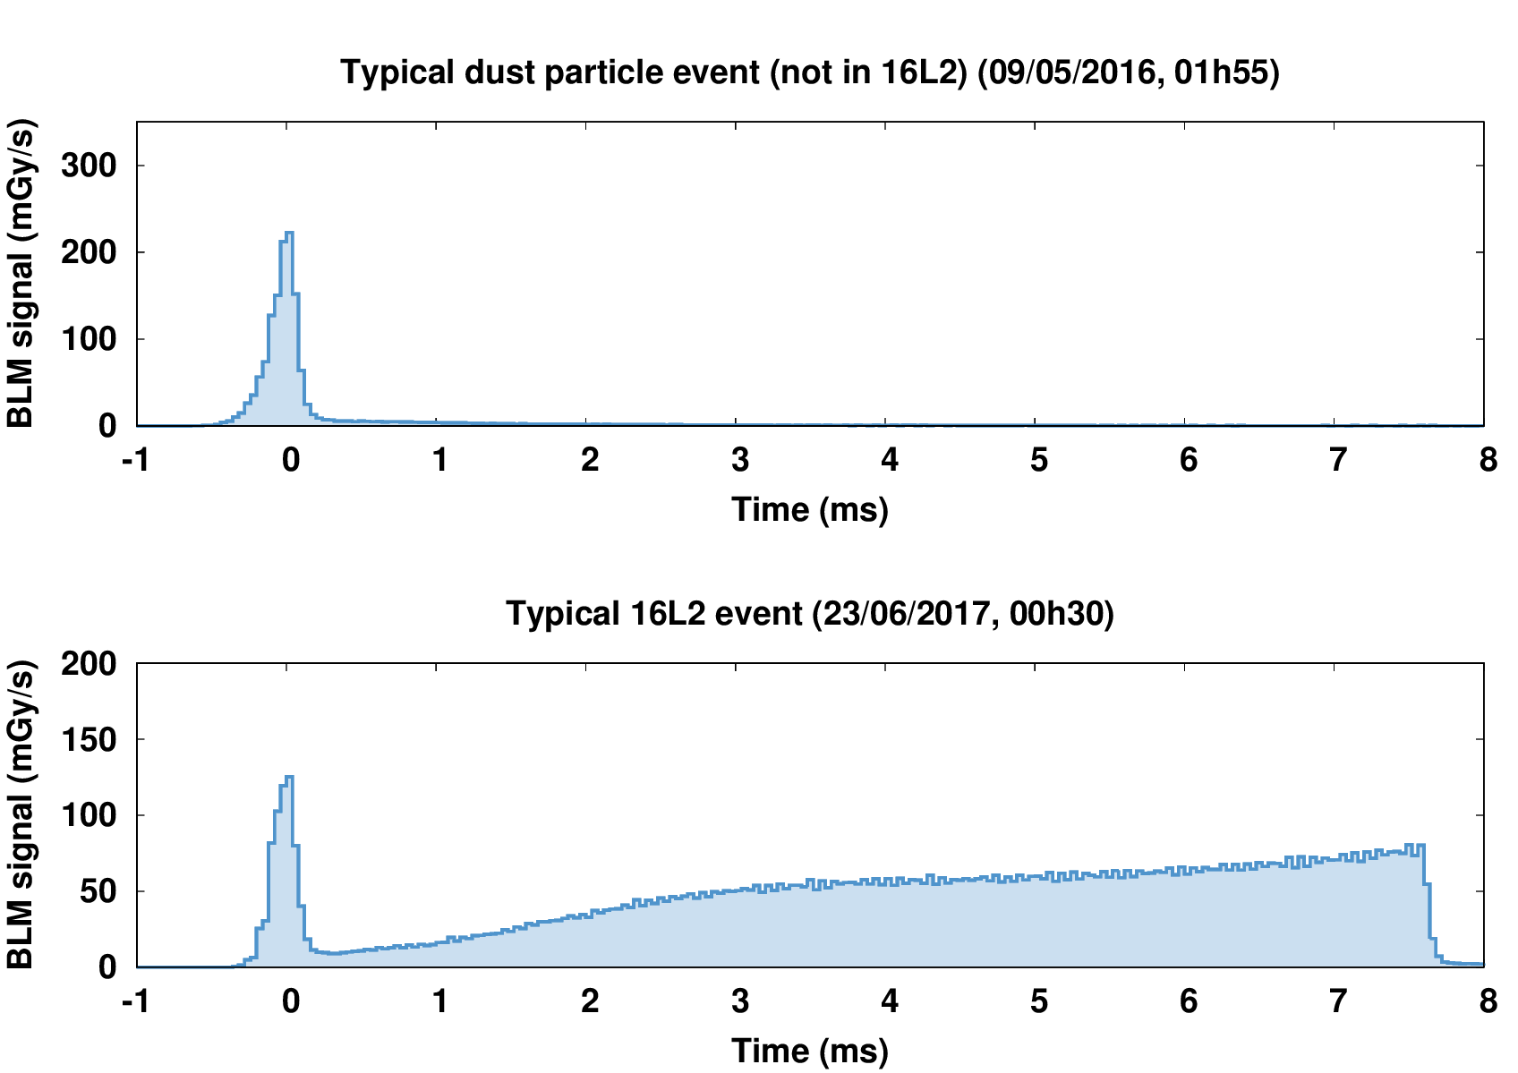
UFO induced beam losses
Dust particle falls into beam
Intense beam losses, duration ~1 ms
Premature beam dumps and superconducting magnet quenches
  -> up to 12 hours downtime!
Courtesy of A. Lechner

Slide 4
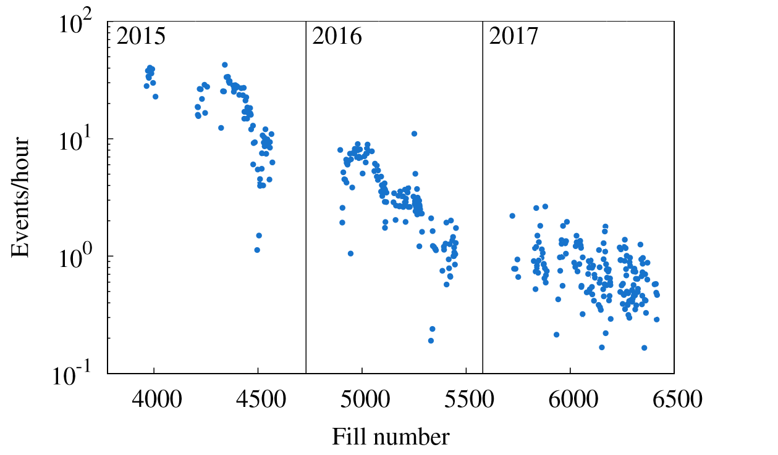
UFO impact on availability
LHC first proton accelerator to suffer from their impact
Still many unknowns, impact expected to increase in future (higher beam energy, higher beam intensity...)
In 2017, new type of UFO at specific magnet interconnect
  different loss pattern
  67 premature beam dumps (out of ~350 total)
  significant impact on availability
  Also seen in 2018
A. Lechner
Understanding their dynamics important
clue for employing countermeasures

Slide 5
UFO types
~ 1 ms
Type 1
A. Lechner
solid nitrogen
second phase ~3 to 100’s ms
beam
nitrogen gas
p+
Type 2
very fast beam instability develops

Slide 6
UFO types
Type 1
Traditional type, present since high-intensity operations
Short loss spike (~1 ms)
Sporadic
Along the entire length of the LHC
Type 2
Present at specific magnet interconnect (16L2)
Hypothesis: caused by frozen nitrogen macroparticle
  Contamination of beam vacuum by air at 16L2 confirmed
Fastest observed beam instability in the LHC

Slide 7
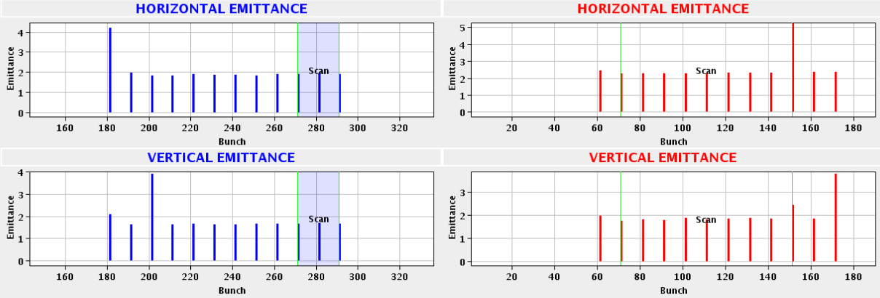
UFOs at end of run 2 proton physics
Special beam configuration during ~3 weeks of normal physics fills
  In non-colliding 12b train, two blown-up bunches: one horizontally, one vertically
Number of events during this time: 14
  Confirmed by existing UFO detection system: 7
3 at top energy, rest at 1096-4522 GeV

Slide 8
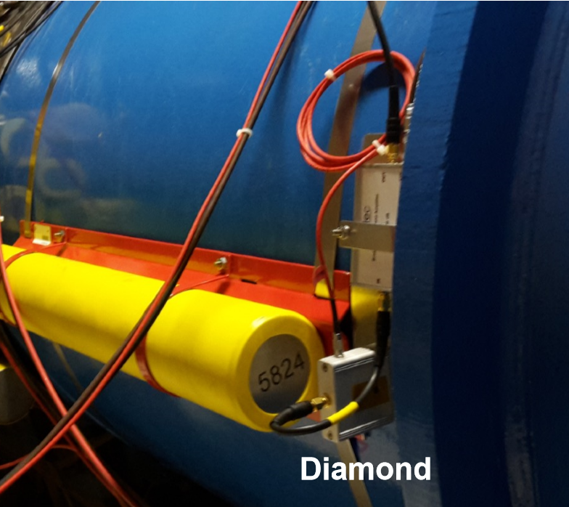
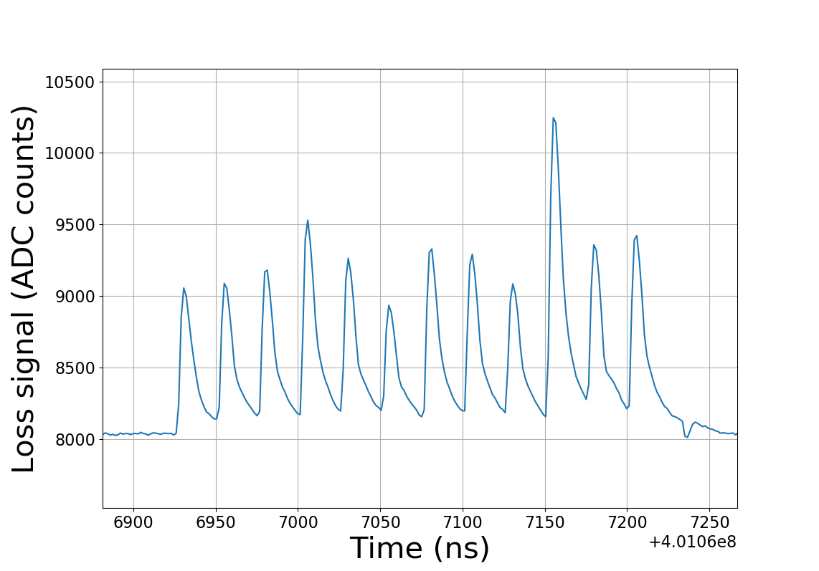
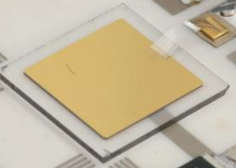
Beam loss monitors
icBLM
  Good signal to noise ratio
  3600 distributed around ring
  40 µs temporal res
icBLM
dBLM
  Low signal to noise ratio, fluctuating signal
  2 per beam at primary collimators
~1 cm²
1.5ns temporal resolution

Slide 9
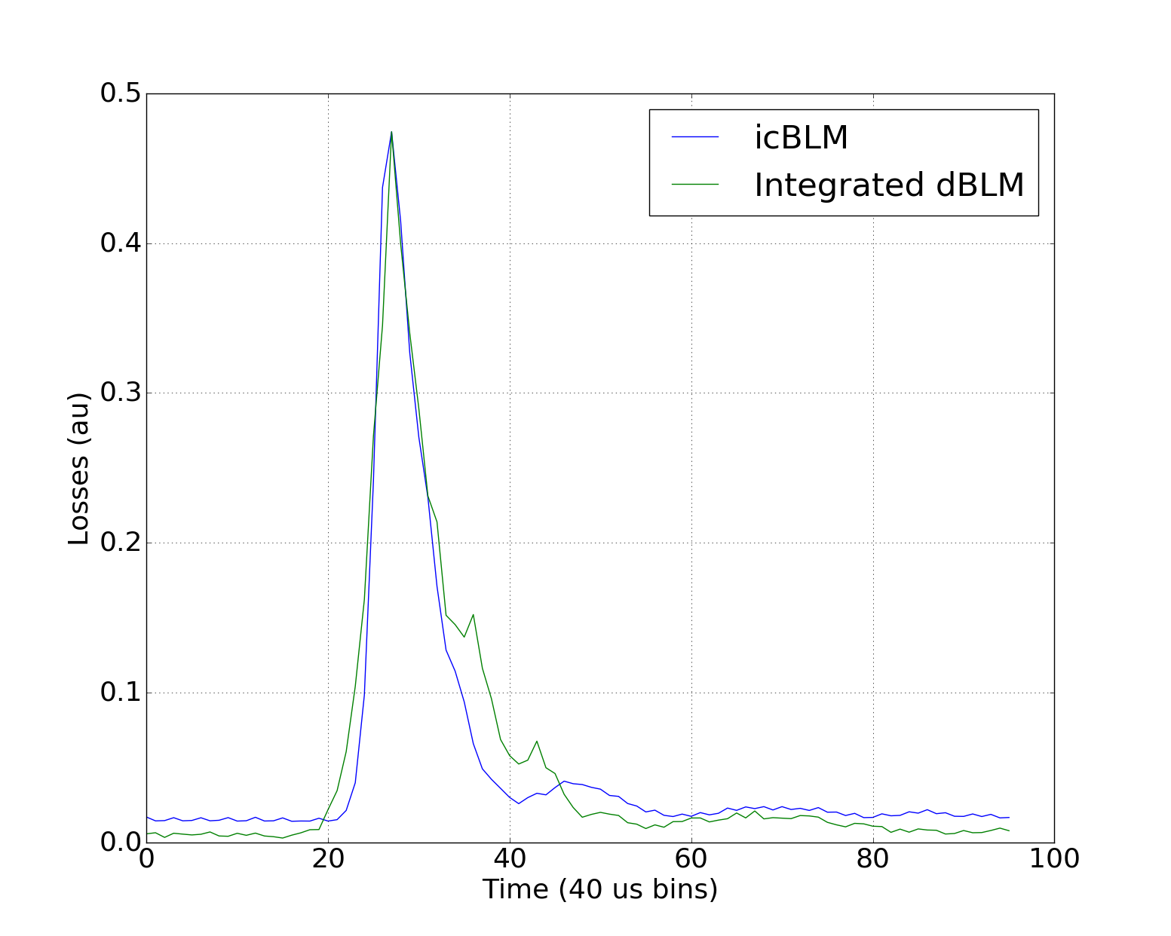
icBLM vs dBLM correlation (30 Sep 2018)
icBLMs are a trusted system
dBLM signal integrated in 40 us bins correlates well with icBLM data

Slide 10
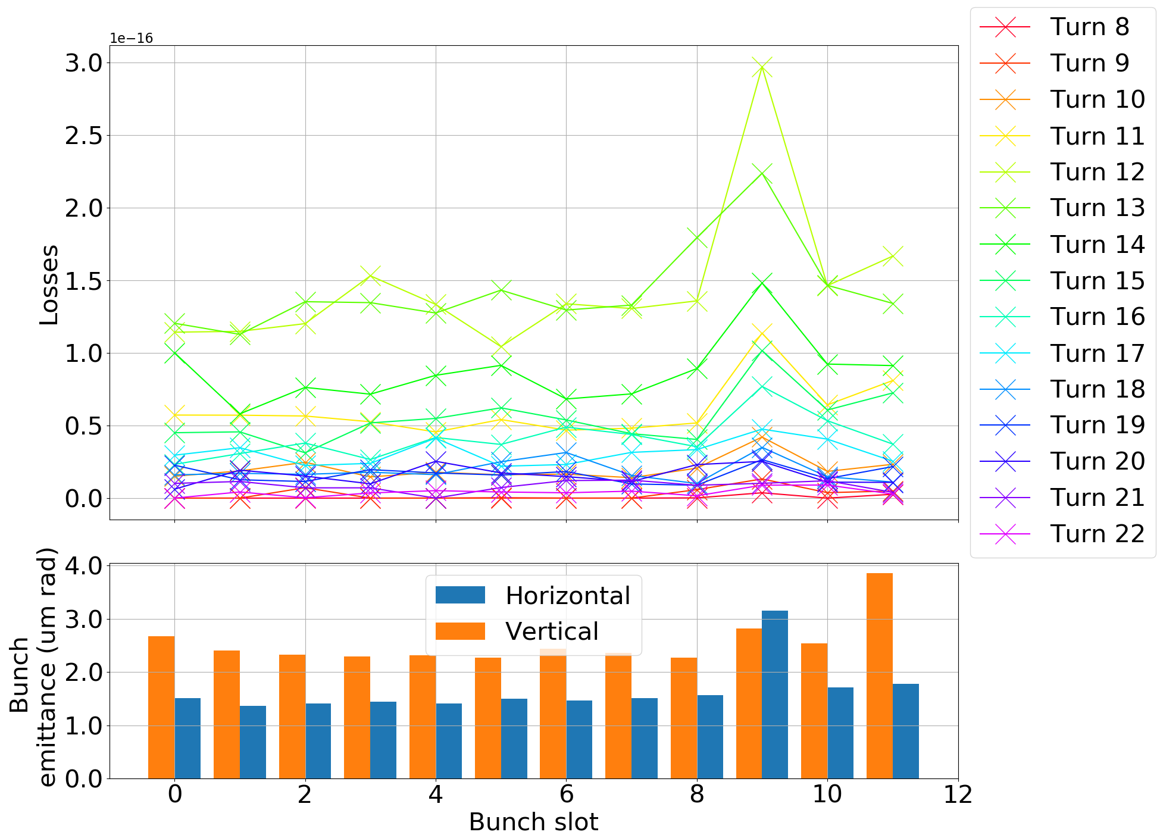
Turn by turn, bunch by bunch losses (30 Sep 2018)
Elevated losses in horizontally blown-up bunch
High amplitude, long event
Best signal we had

Slide 11
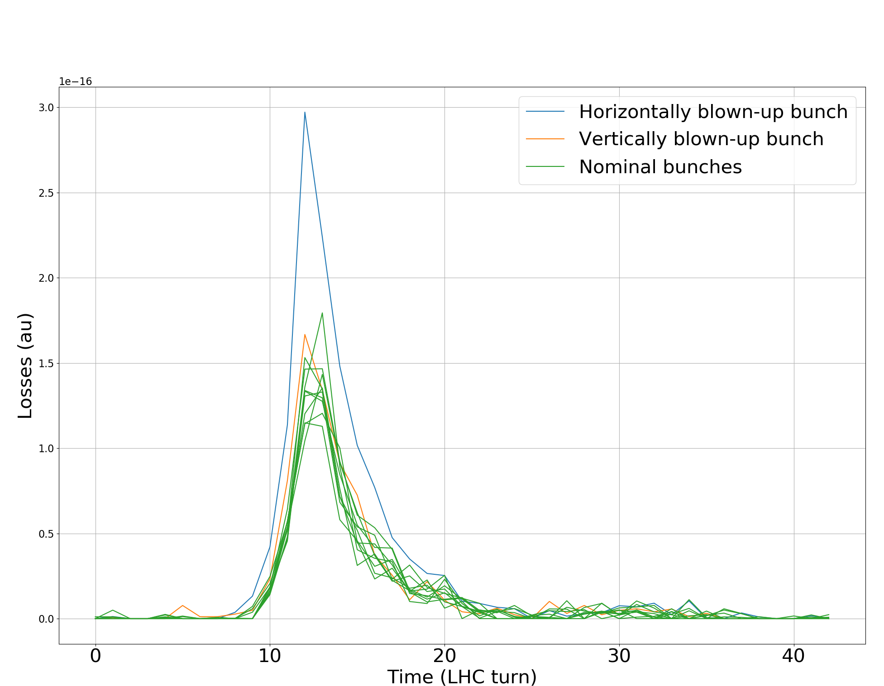
Bunch-by-bunch losses (30 Sep 2018)
Losses highest and longest-lasting in horizontally blown-up bunch

Slide 12
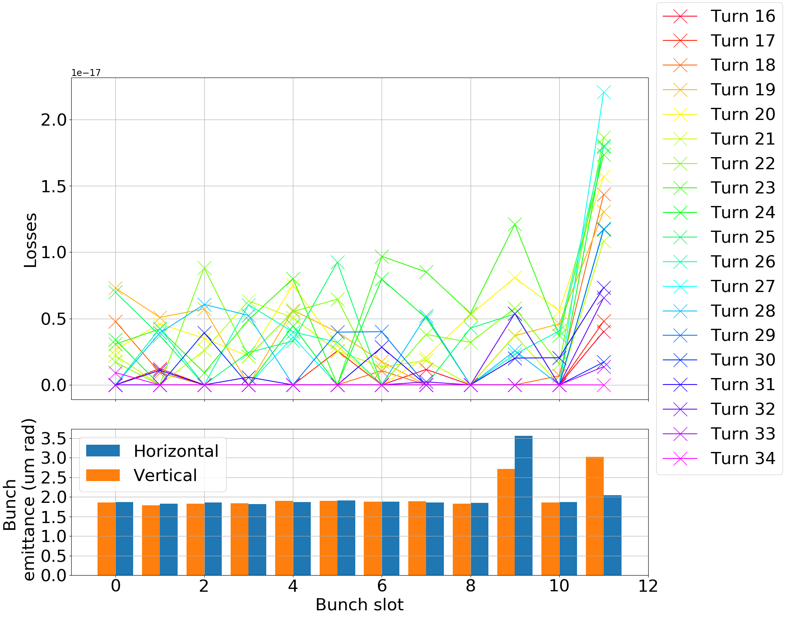
Turn by turn, bunch by bunch losses (17 Oct 2018)
Elevated losses in vertically blown-up bunch
Losses in other bunches very low
At the limit of what we can observe

Slide 13
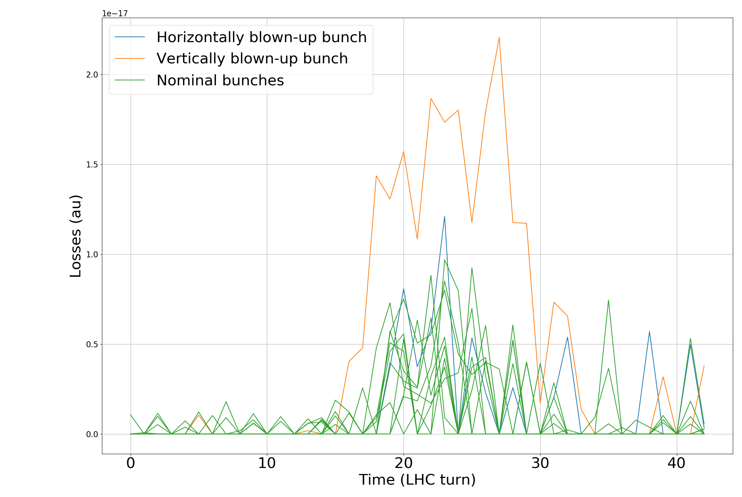
Bunch-by-bunch losses (17 Oct 2018)
Longest event with increased losses from vertically blown-up bunch
Note: factor ~10 lower signal than in previous event

Slide 14
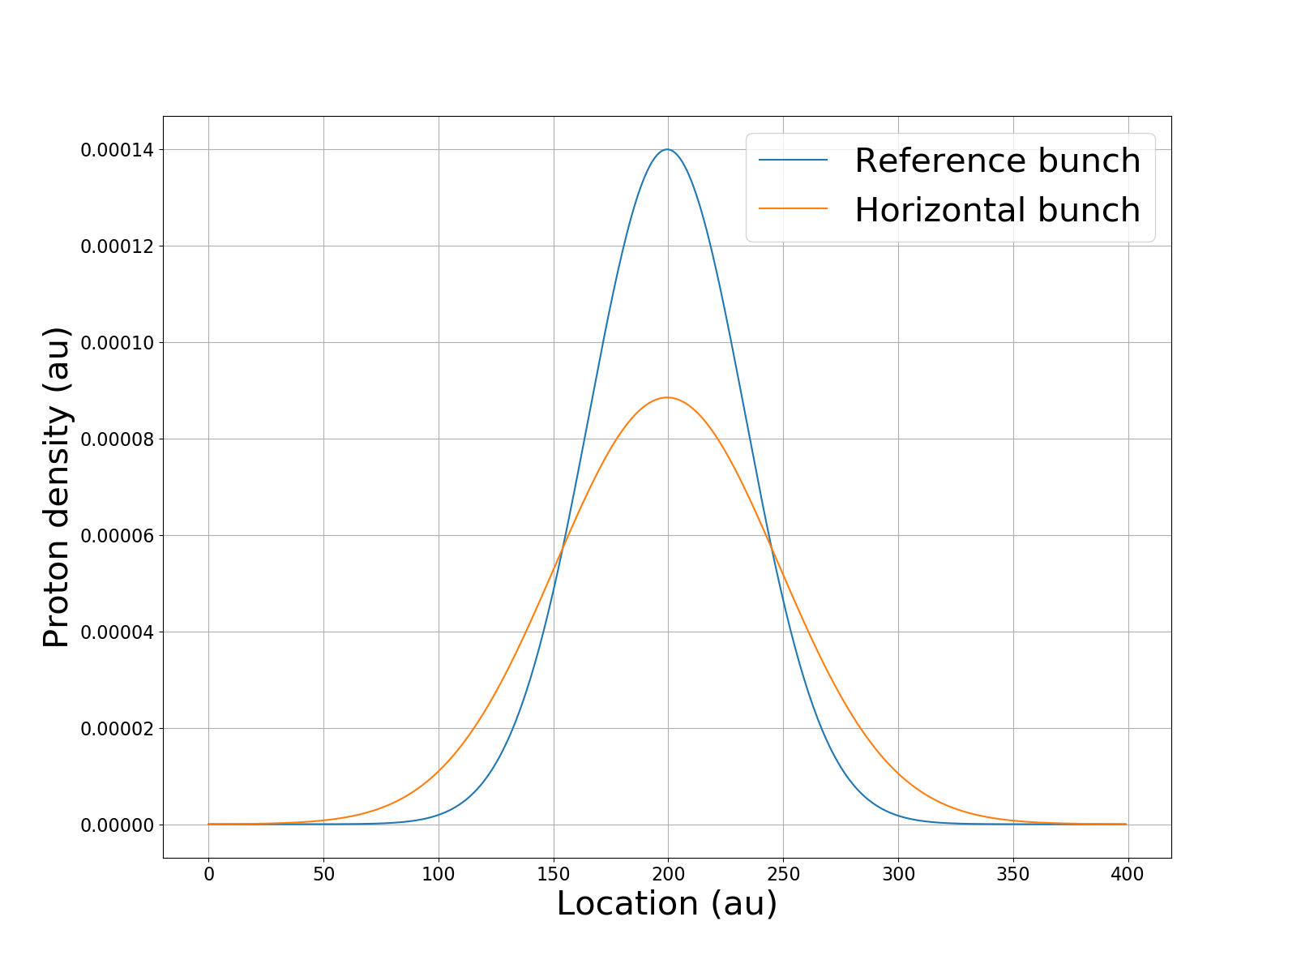
Insight into UFO dynamics
Aim is to study UFO dynamics
We want to reconstruct dust particle trajectory
Losses proportional to proton density
Proton density proportional to distance from beam center
If we know bunch-by-bunch losses and proton distributions, we can derive location of UFO

Slide 15
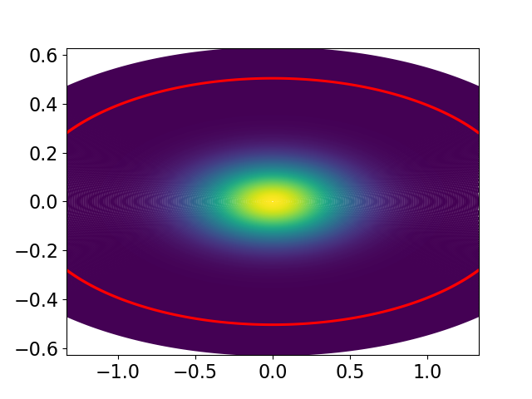
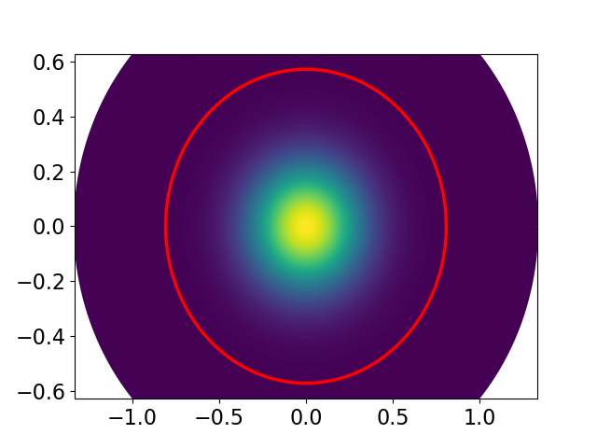
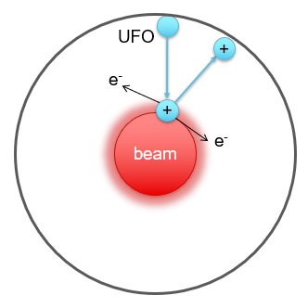
Possible locations in both planes
Location based on losses from horizontally blown-up bunch
Location based on losses from vertically blown-up bunch

Slide 16
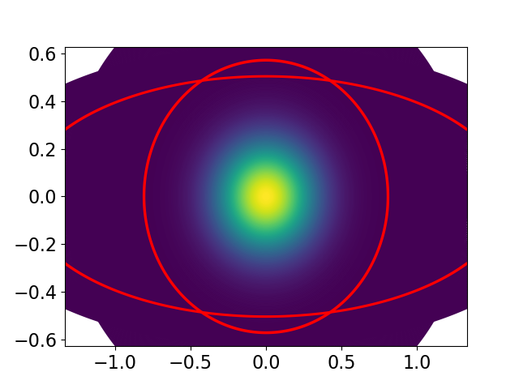
Possible locations in both planes
Intersections are possible UFO locations

Slide 17
Applying the method to measurements
Correlating BLM signal to number of protons lost difficult
A single lost proton should still always give the same signal
Thus, correlate ratio between loss signals of blown-up and nominal bunches to proton distributions of blown-up and nominal bunches
Still some challenges remain:
  Signals not clean, low signal-to-noise ratio, erratic loss spikes

Slide 18
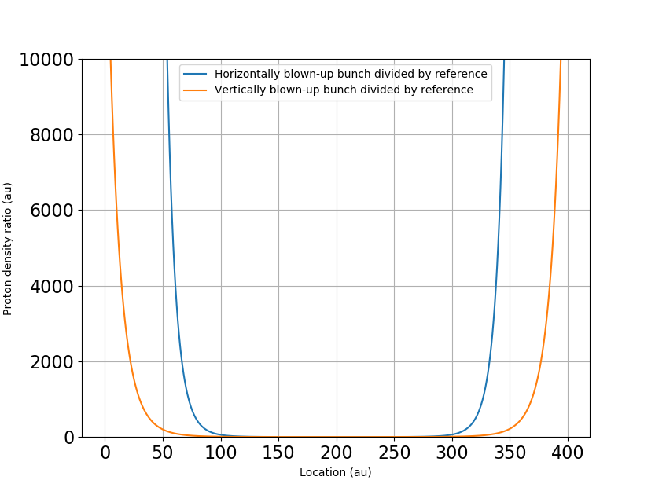
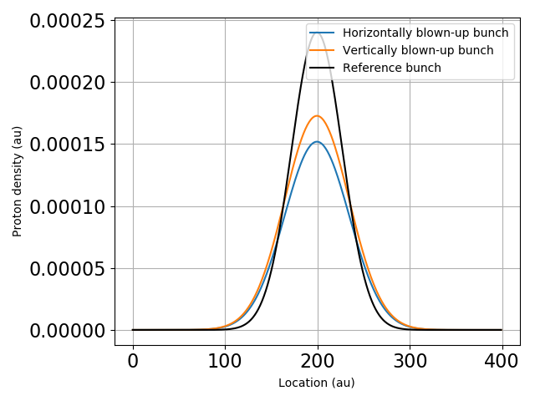
Ratio of proton densities between bunches
The ratio of losses between normal and blown-up bunches are measured
This is correlated to the ratio of the proton distributions, assuming they are Gaussian
-> allows deriving the UFO location within the beam, despite not knowing the absolute loss values from each bunch

Slide 19
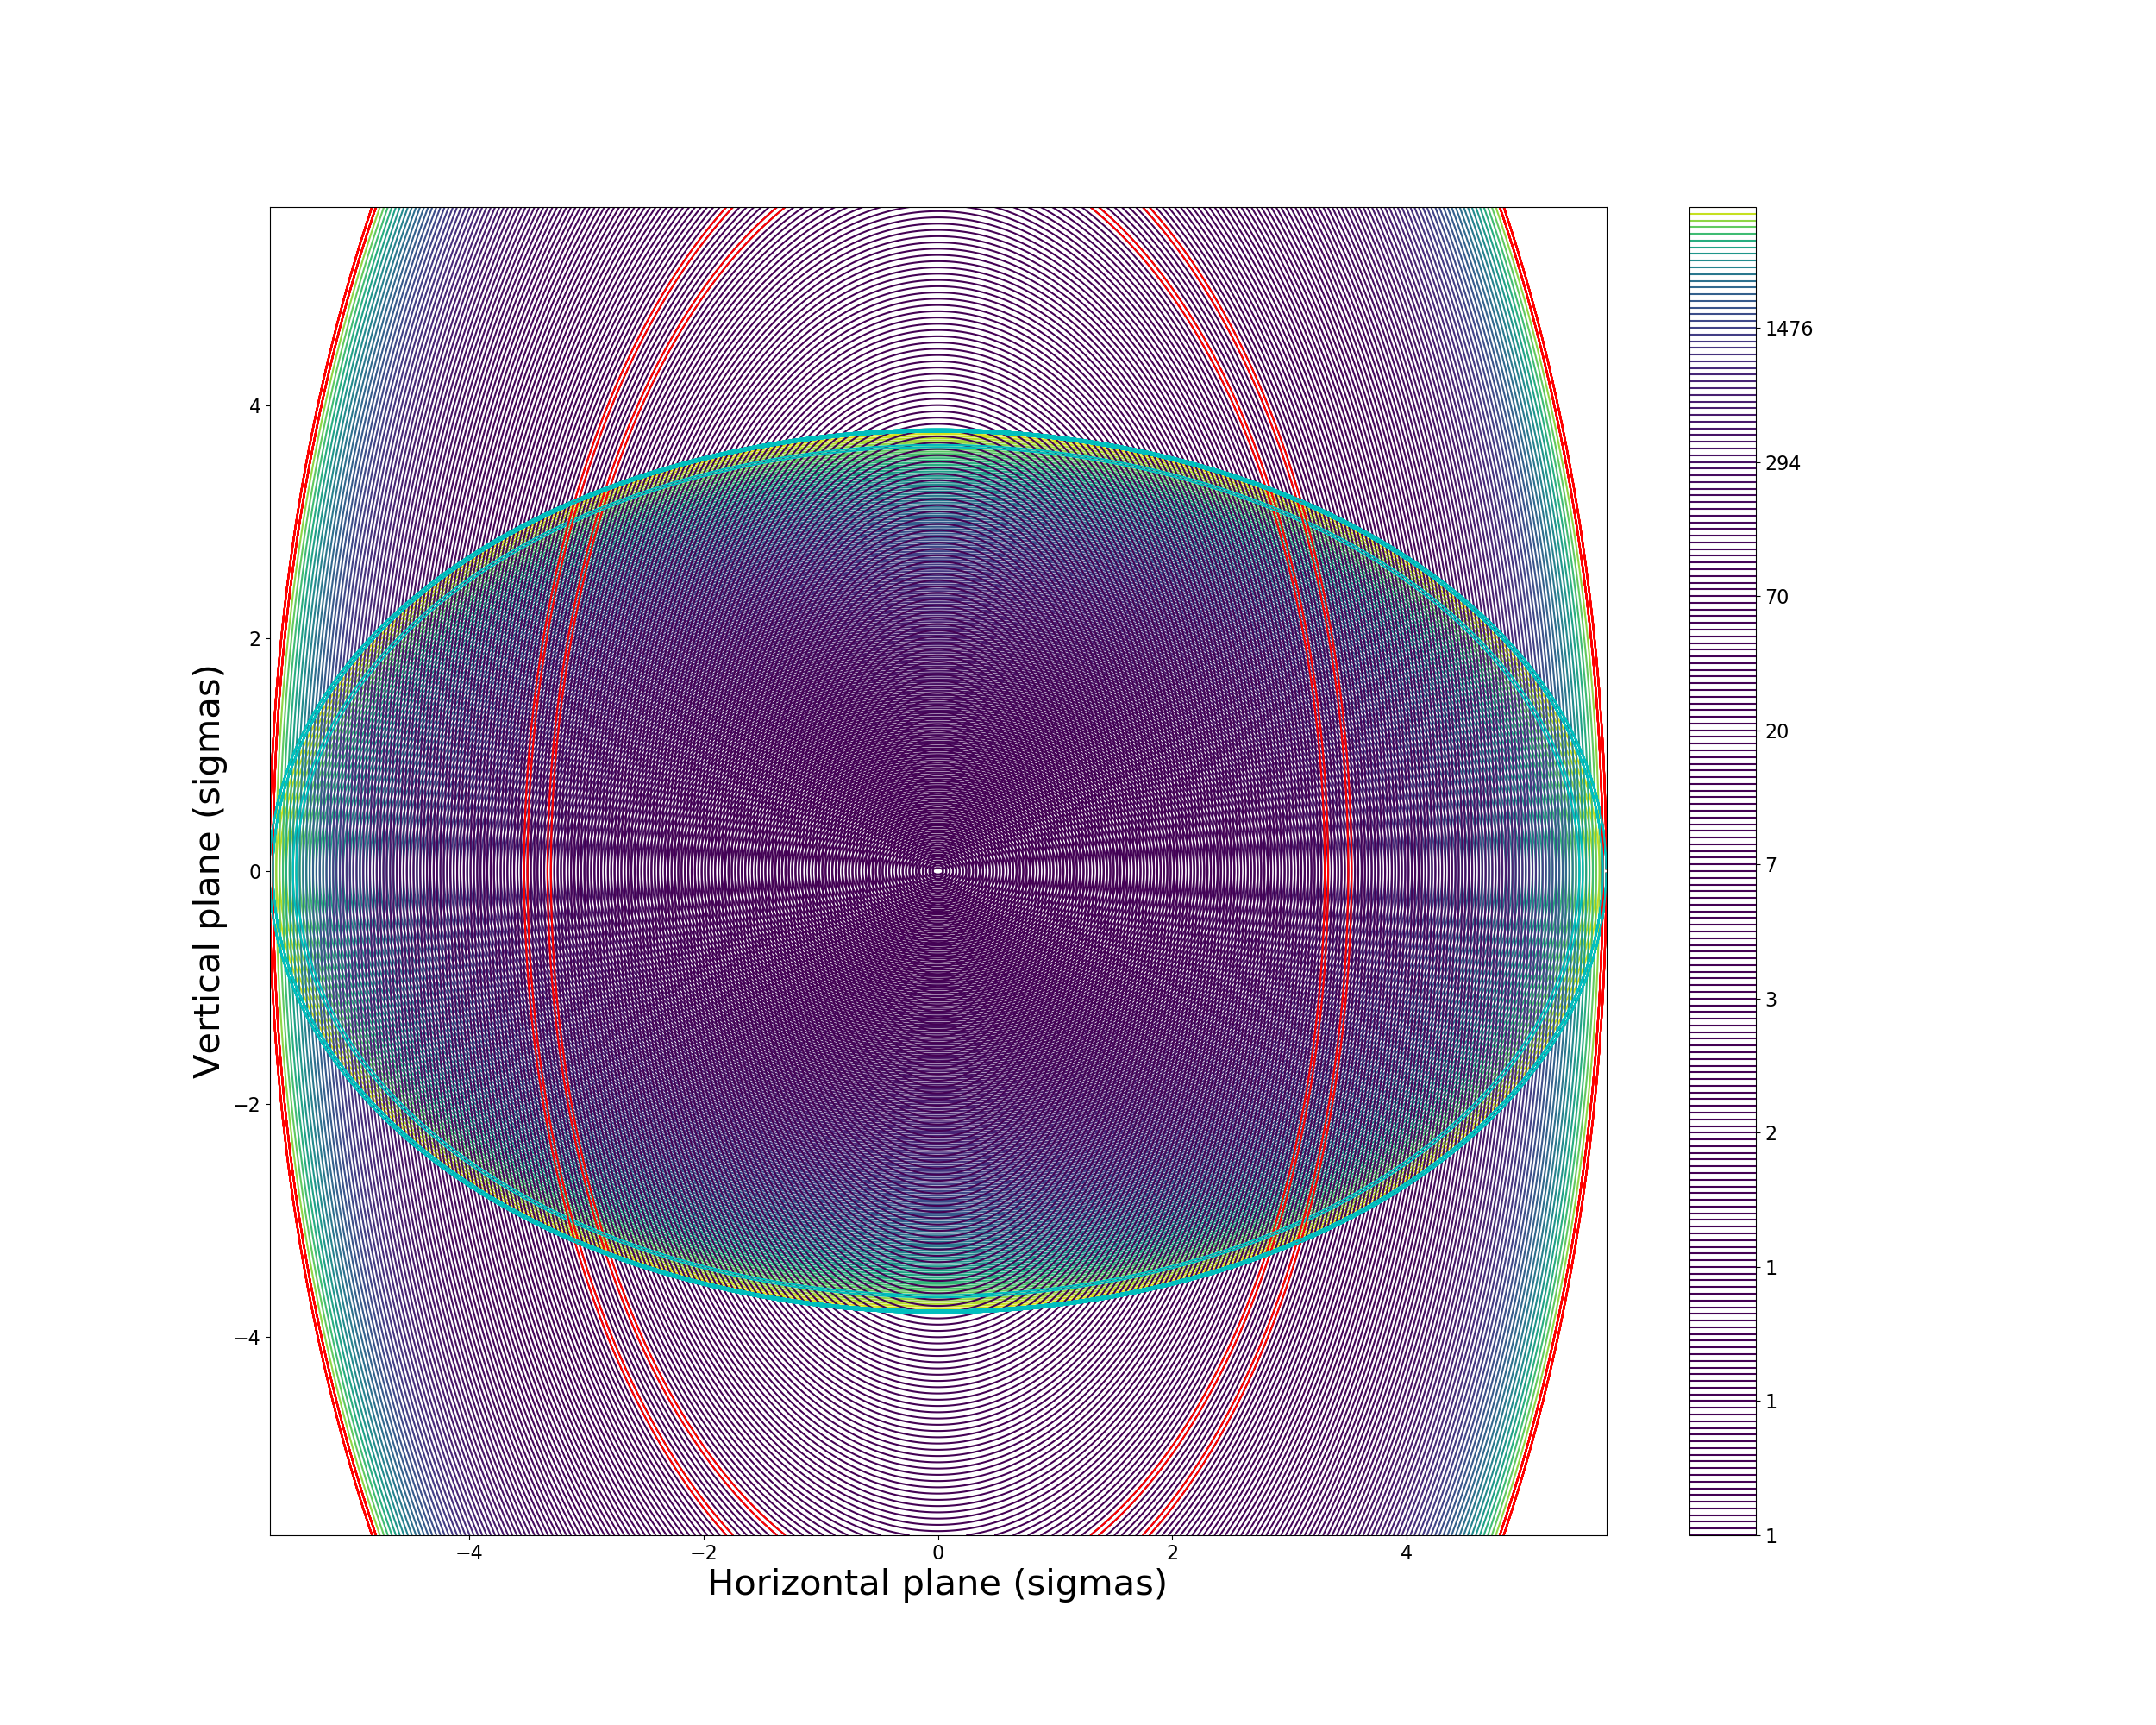
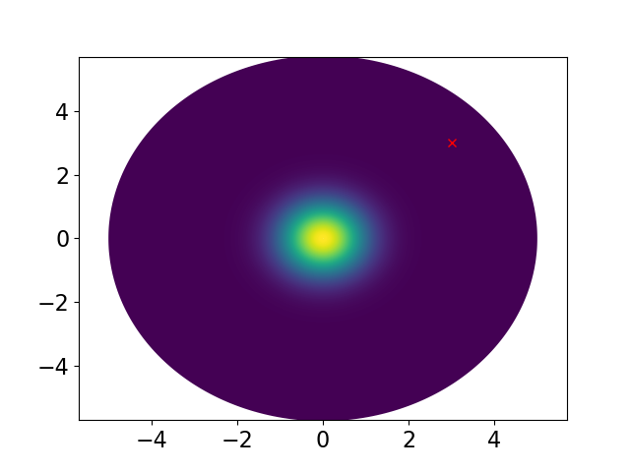
Trajectory reconstruction (30 Sep 2018)
Turn 8
Blown up proton distributions divided by nominal bunch distributions
Reference bunch proton distribution with estimated UFO location
Note: just one possible
trajectory within error bars!

Slide 20
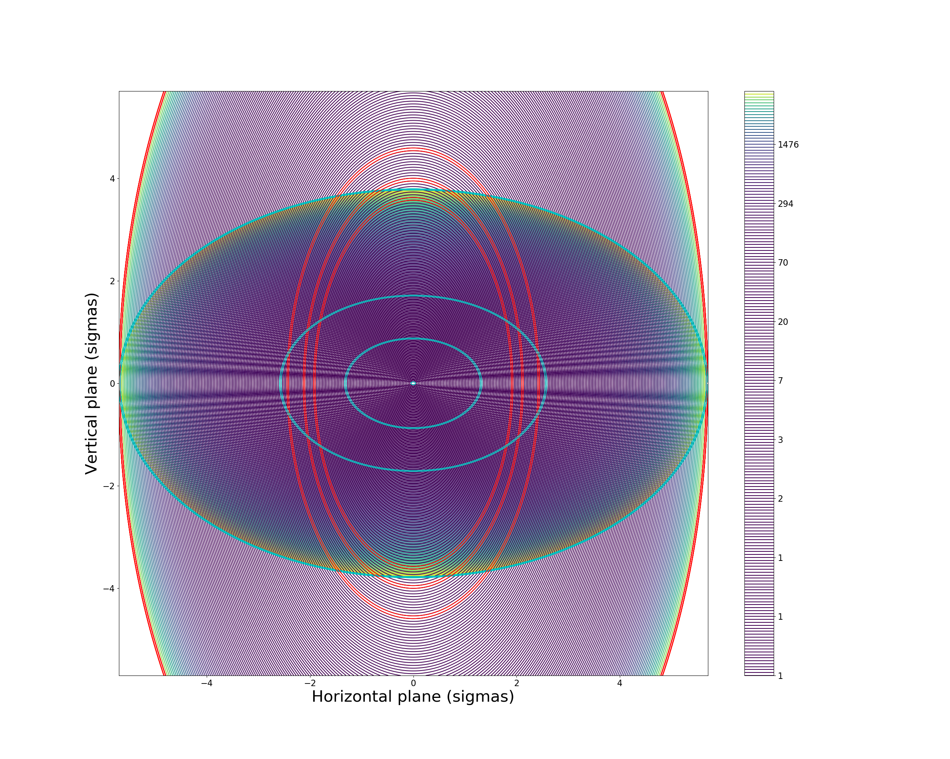
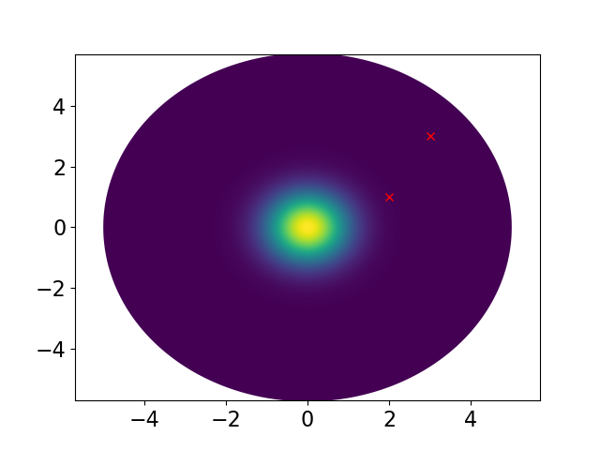
Trajectory reconstruction (30 Sep 2018)
Turn 9
Blown up proton distributions divided by nominal bunch distributions
Reference bunch proton distribution with estimated UFO location
Note: just one possible
trajectory within error bars!

Slide 21
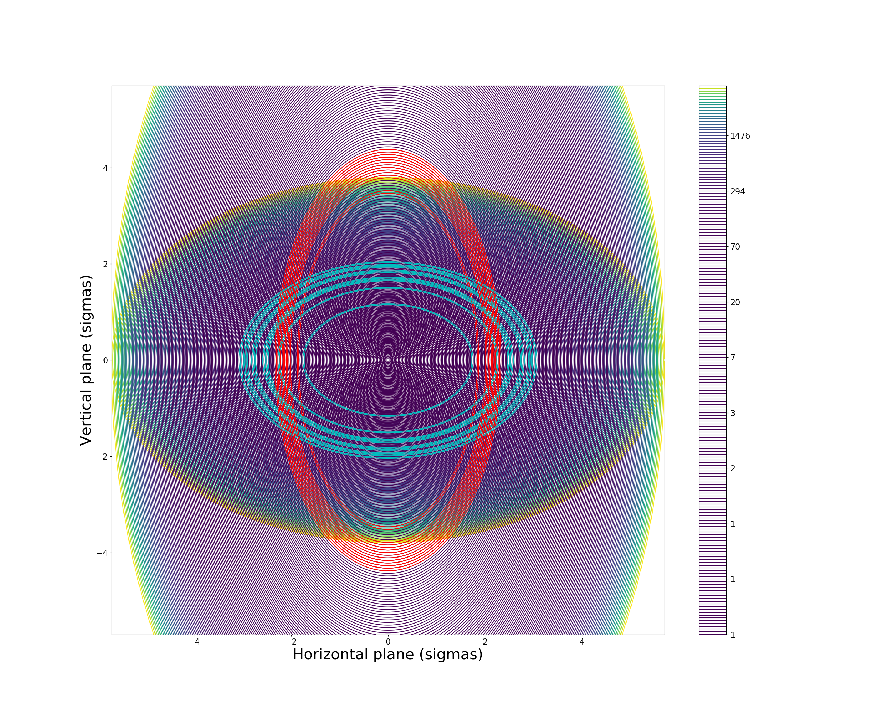

Trajectory reconstruction (30 Sep 2018)
Turn 10
Blown up proton distributions divided by nominal bunch distributions
Reference bunch proton distribution with estimated UFO location
Note: just one possible
trajectory within error bars!

Slide 22
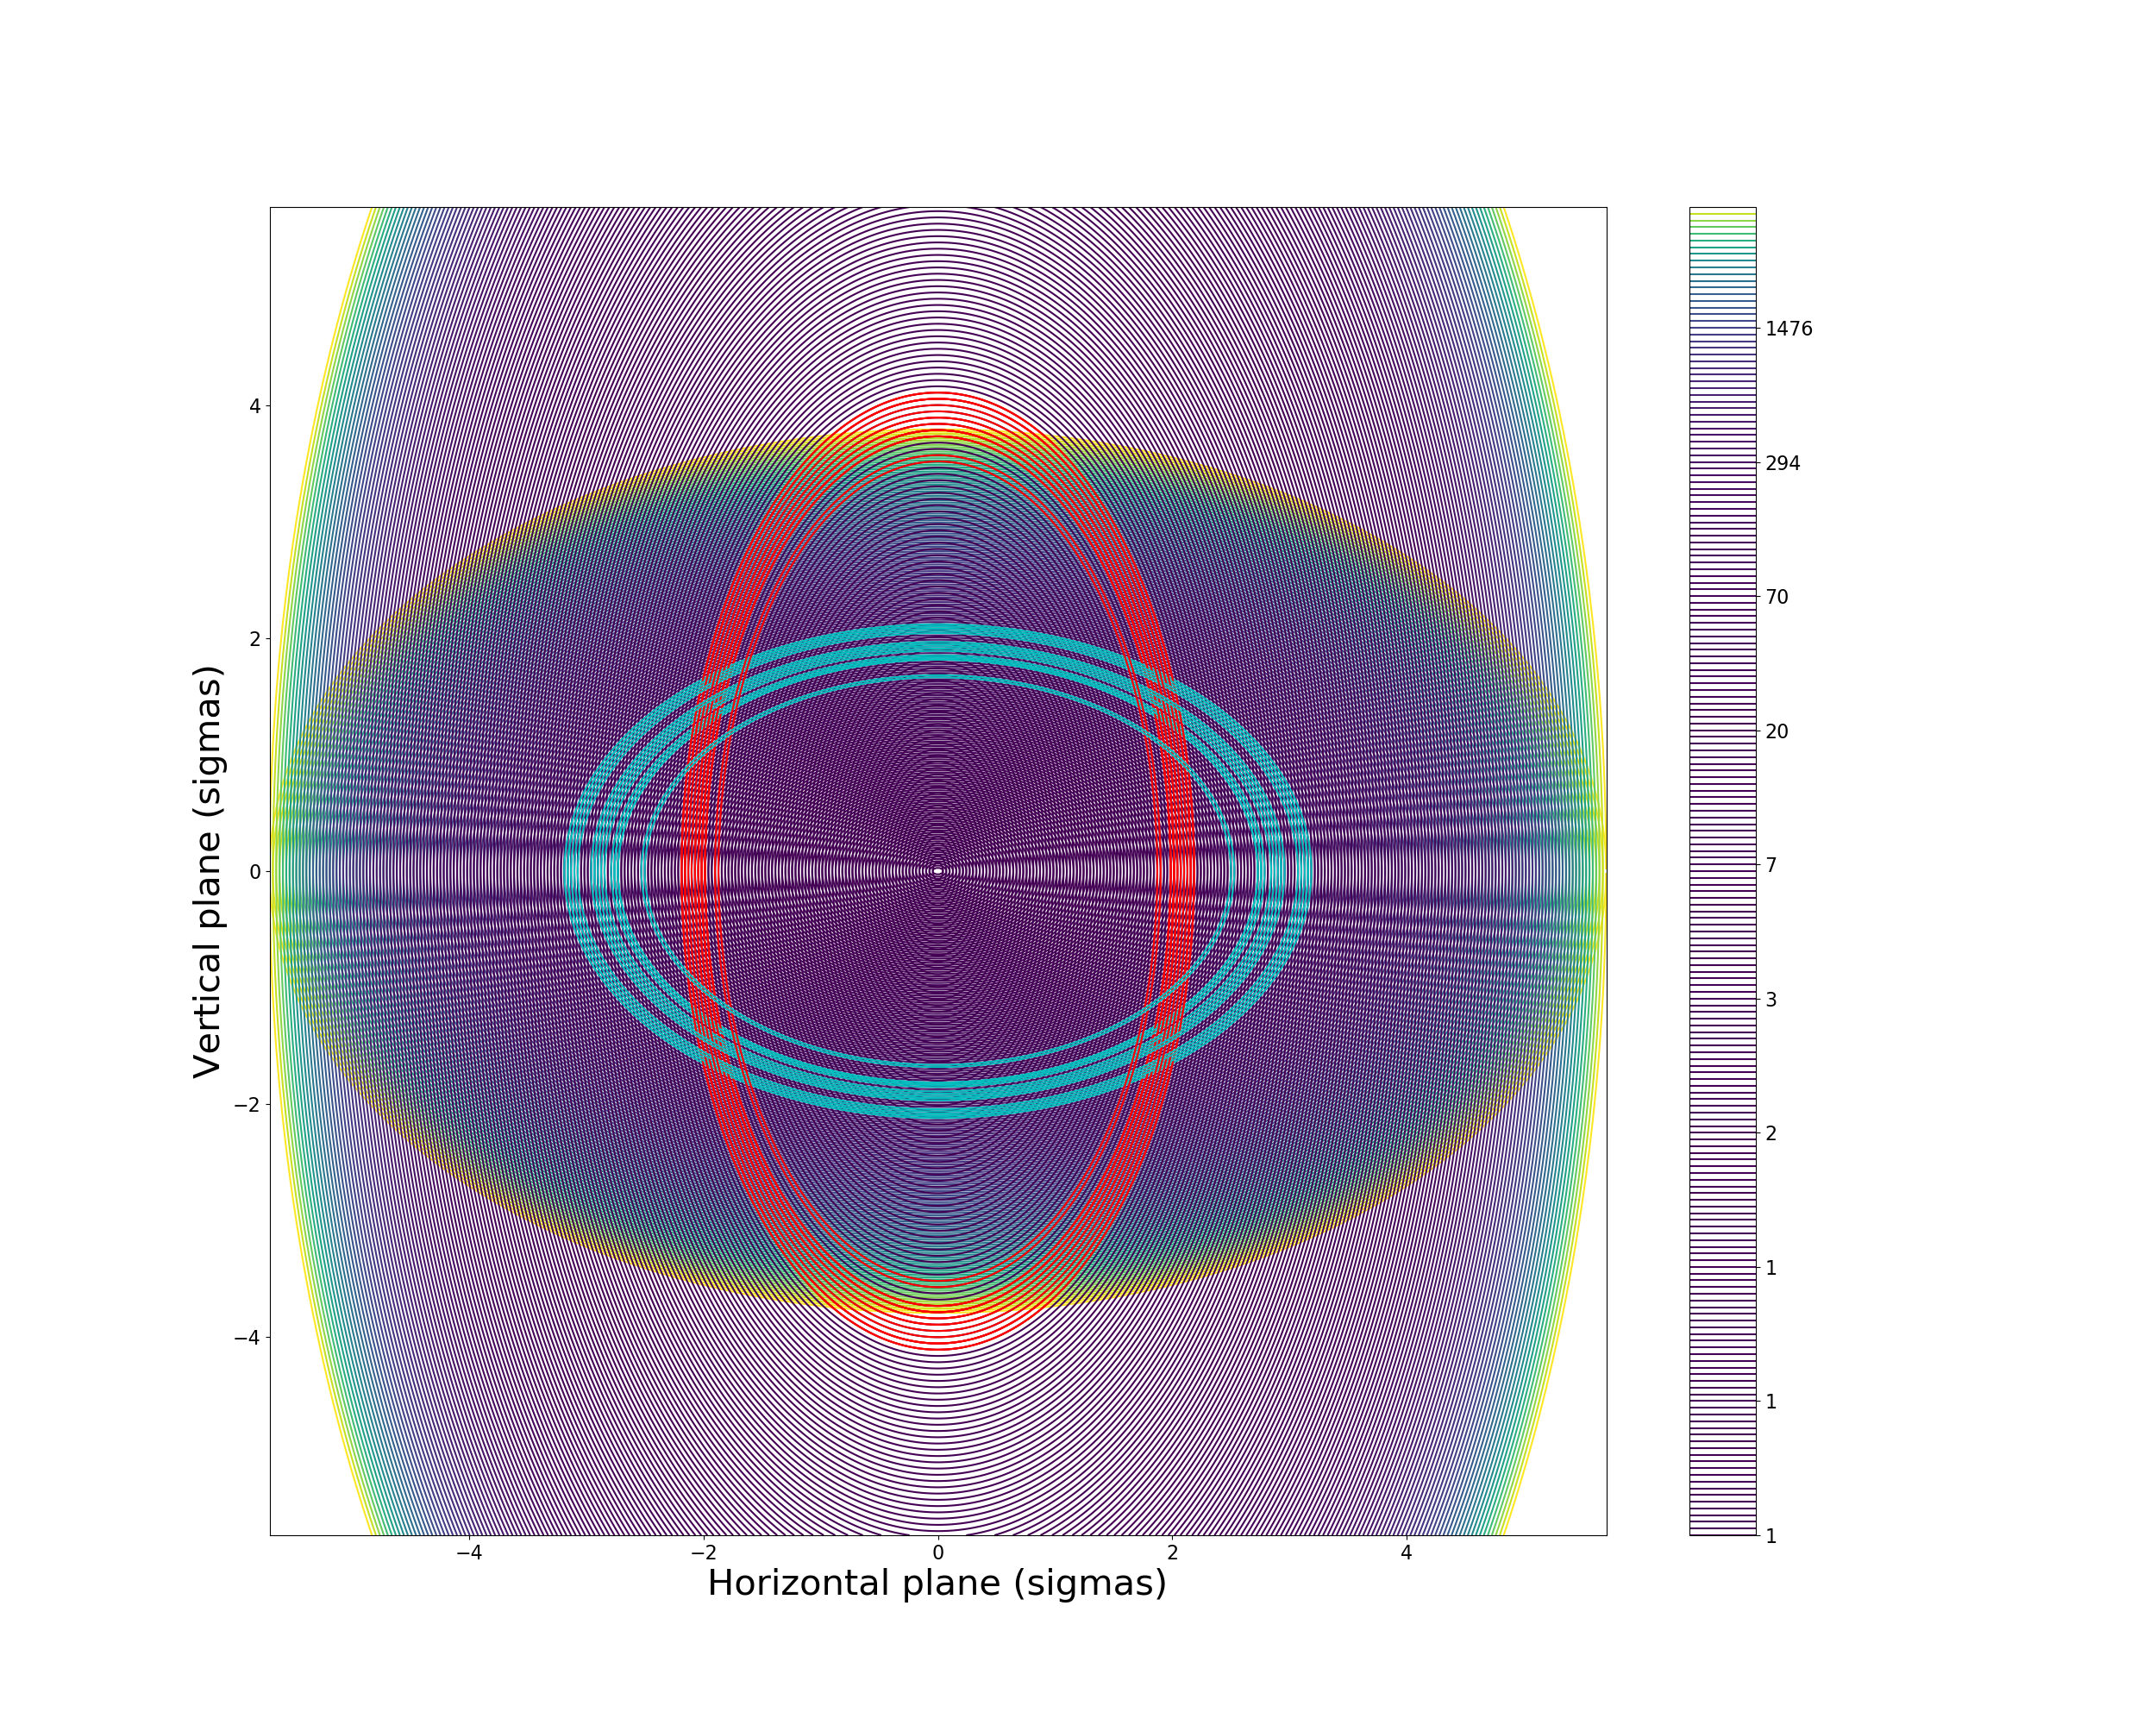

Trajectory reconstruction (30 Sep 2018)
Turn 11
Blown up proton distributions divided by nominal bunch distributions
Reference bunch proton distribution with estimated UFO location
Note: just one possible
trajectory within error bars!

Slide 23
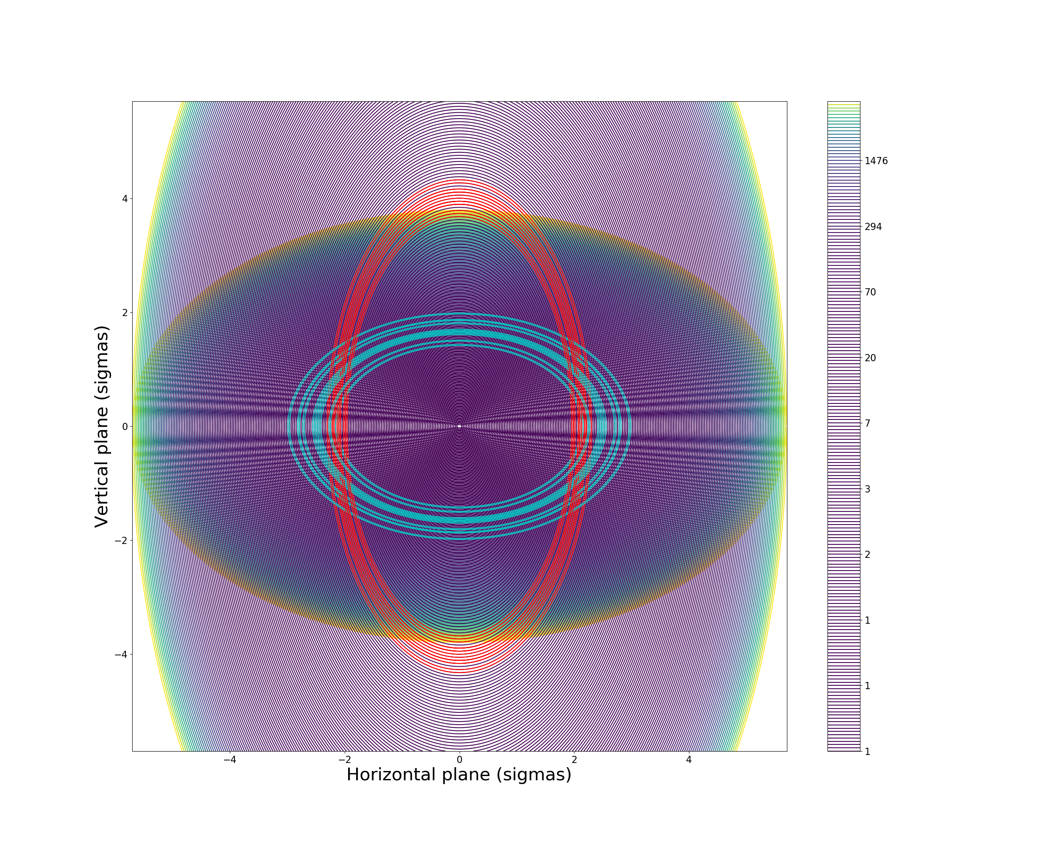

Trajectory reconstruction (30 Sep 2018)
Turn 12
Blown up proton distributions divided by nominal bunch distributions
Reference bunch proton distribution with estimated UFO location
Note: just one possible
trajectory within error bars!

Slide 24
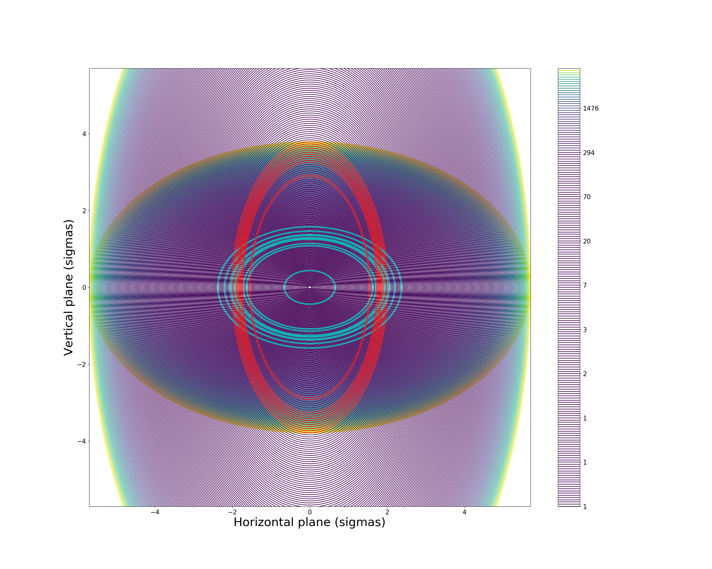

Trajectory reconstruction (30 Sep 2018)
Turn 13
Blown up proton distributions divided by nominal bunch distributions
Reference bunch proton distribution with estimated UFO location
Note: just one possible
trajectory within error bars!

Slide 25
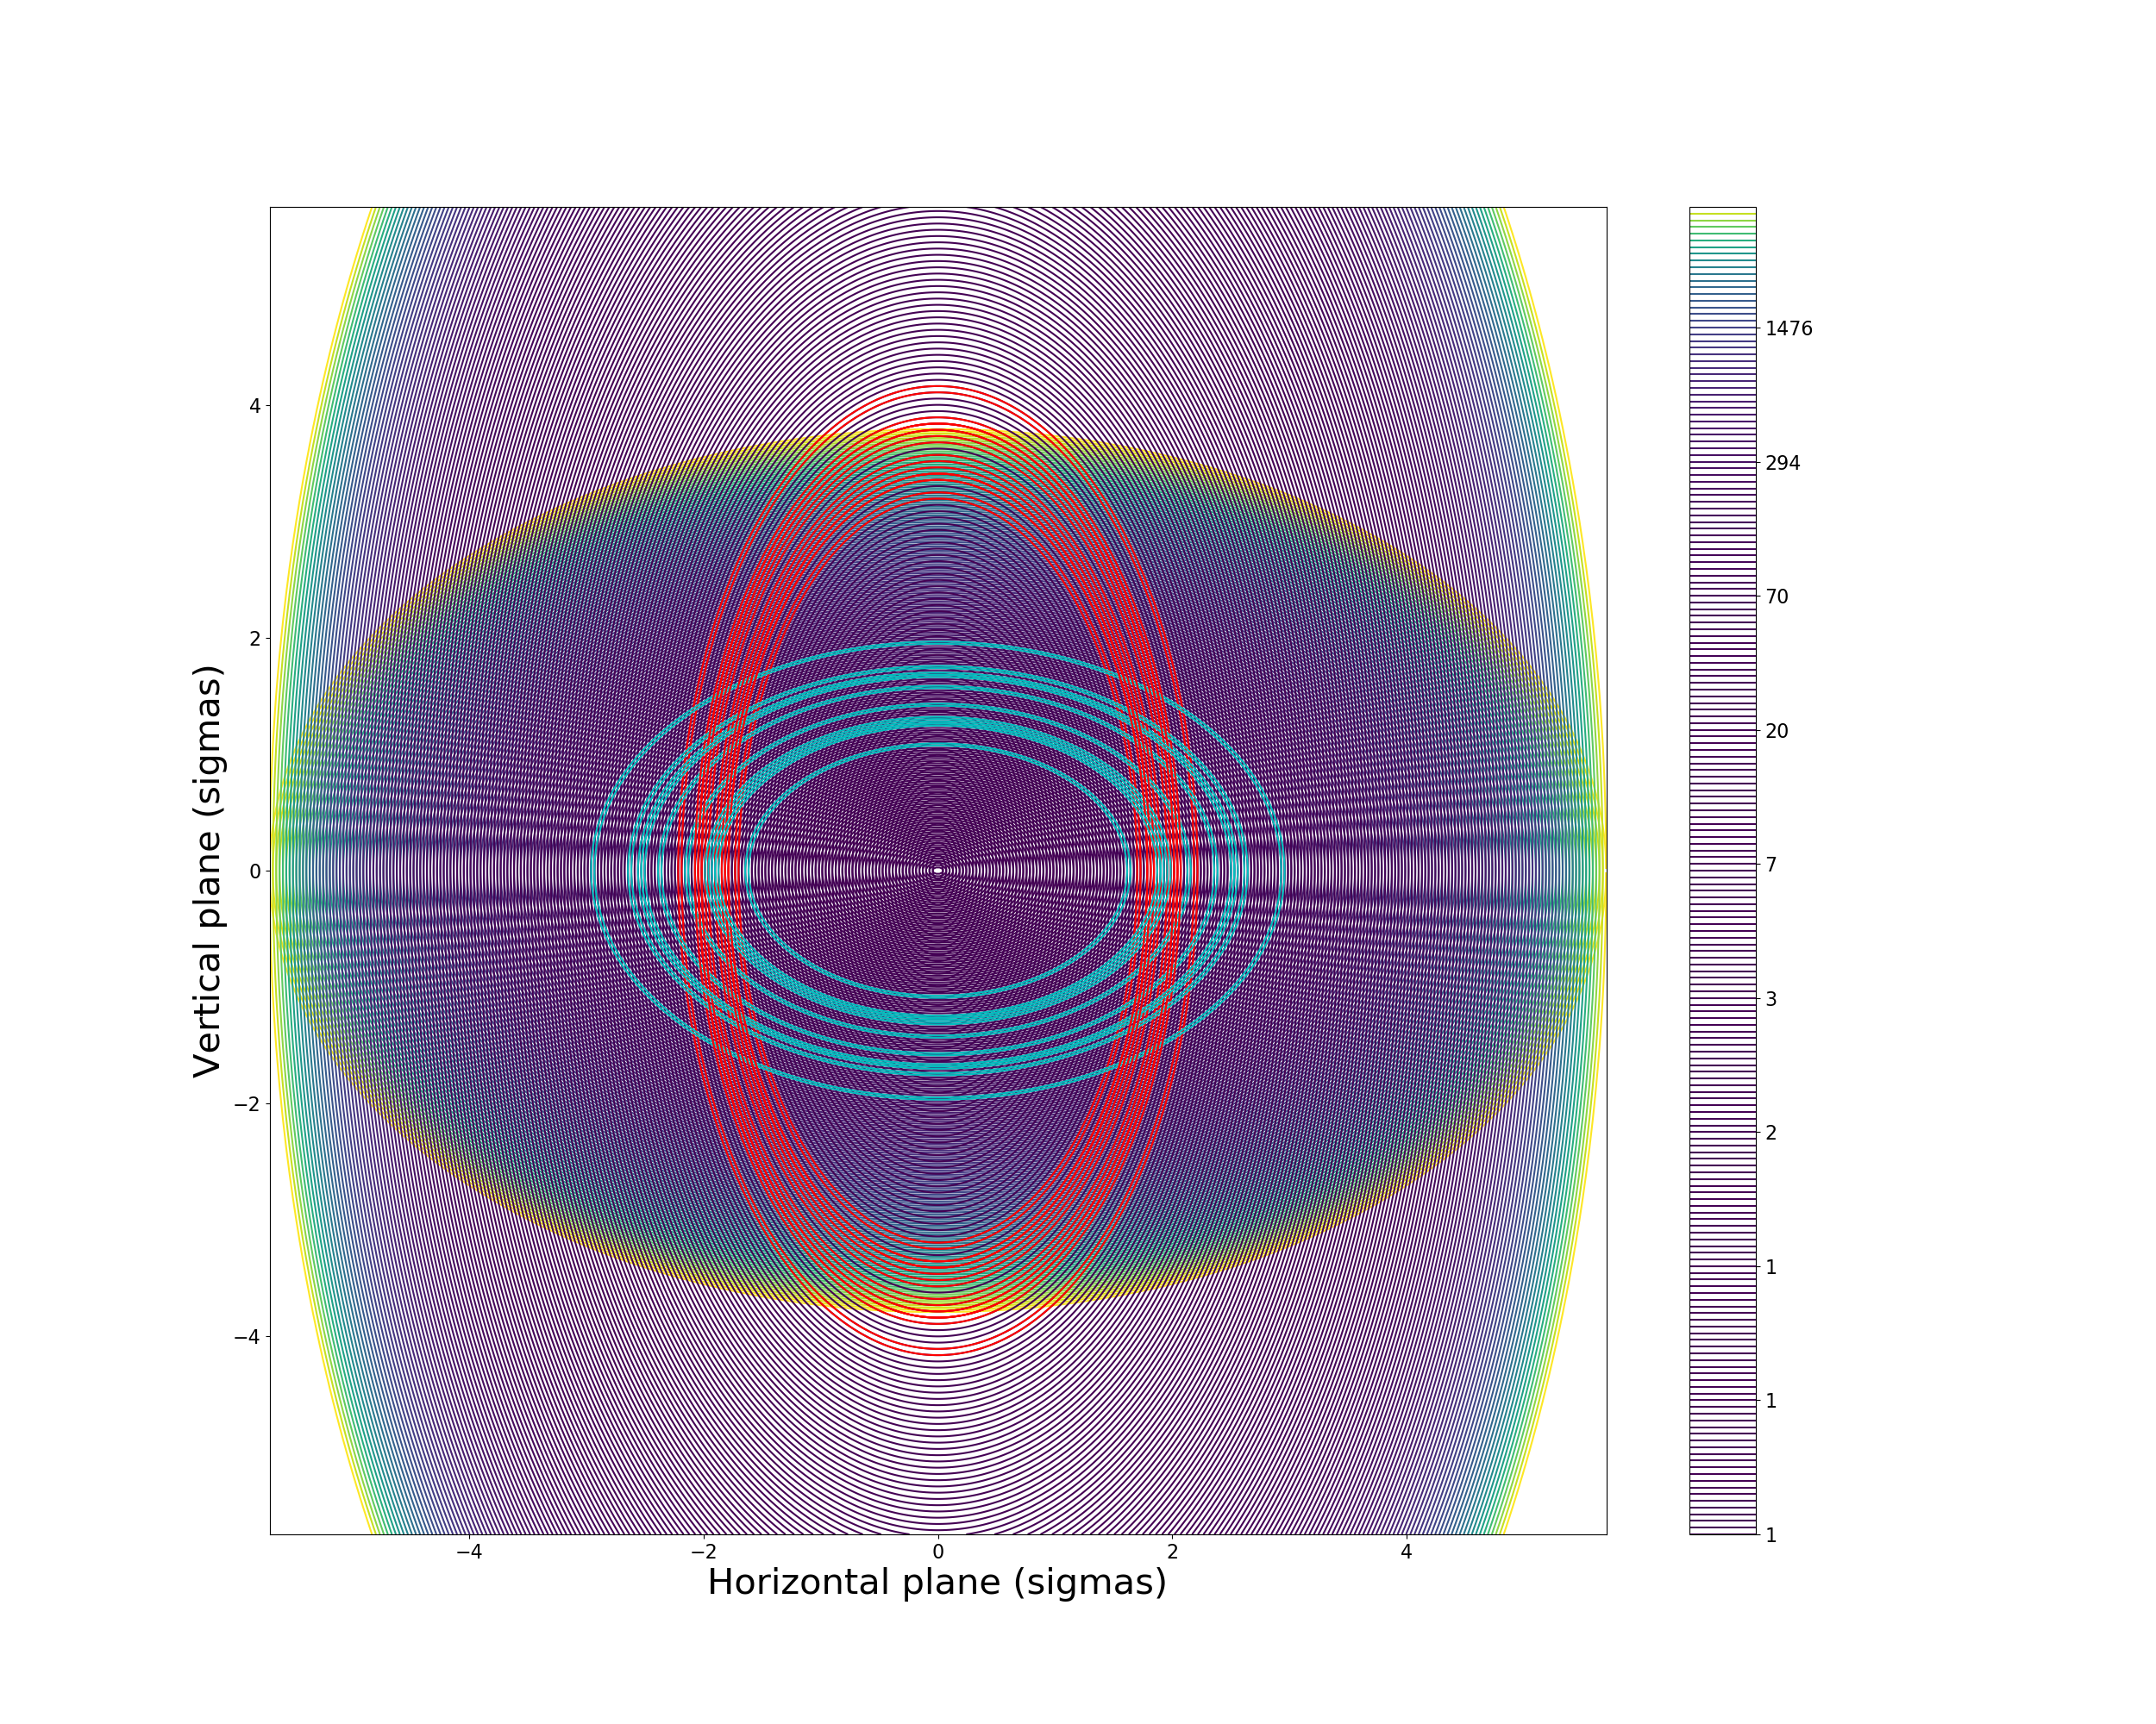

Trajectory reconstruction (30 Sep 2018)
Turn 14
Blown up proton distributions divided by nominal bunch distributions
Reference bunch proton distribution with estimated UFO location
Note: just one possible
trajectory within error bars!

Slide 26
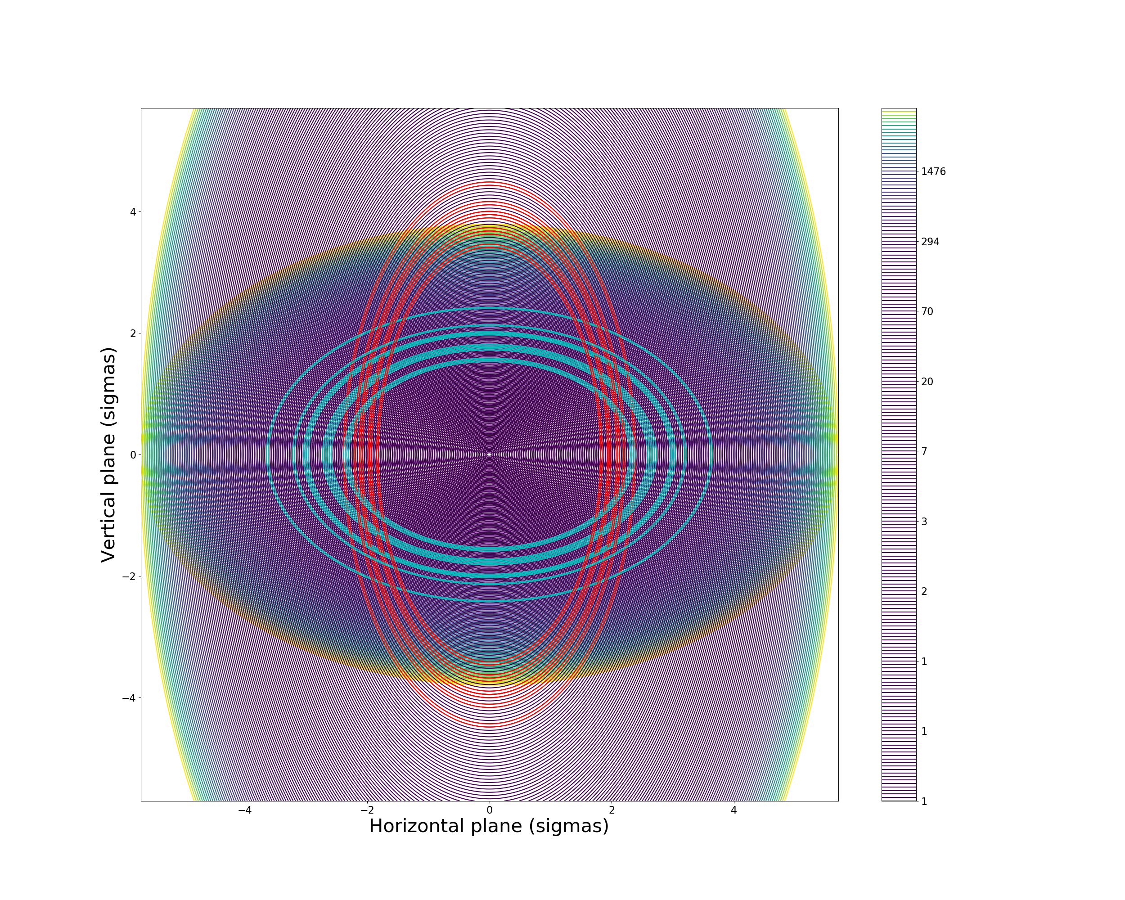

Trajectory reconstruction (30 Sep 2018)
Turn 15
Blown up proton distributions divided by nominal bunch distributions
Reference bunch proton distribution with estimated UFO location
Note: just one possible
trajectory within error bars!

Slide 27
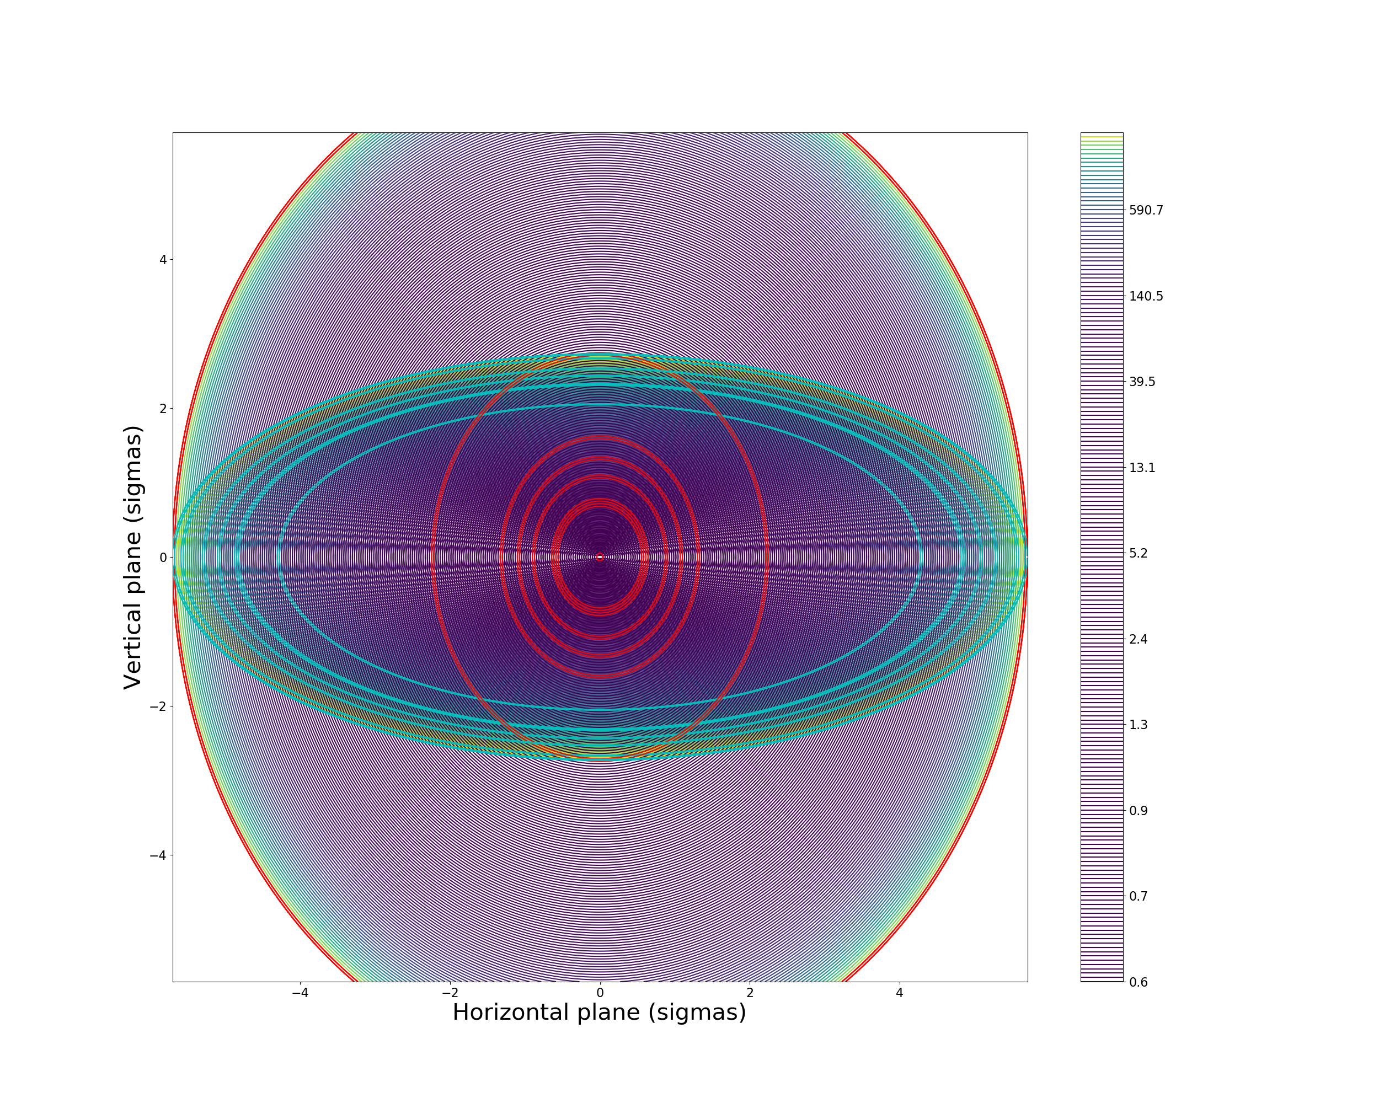
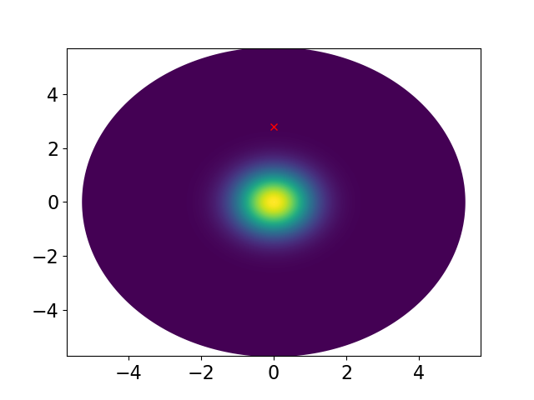
Trajectory reconstruction (17 Oct 2018)
Turn 19
Blown up proton distributions divided by nominal bunch distributions
Reference bunch proton distribution with estimated UFO location
Note: just one possible
trajectory within error bars!

Slide 28
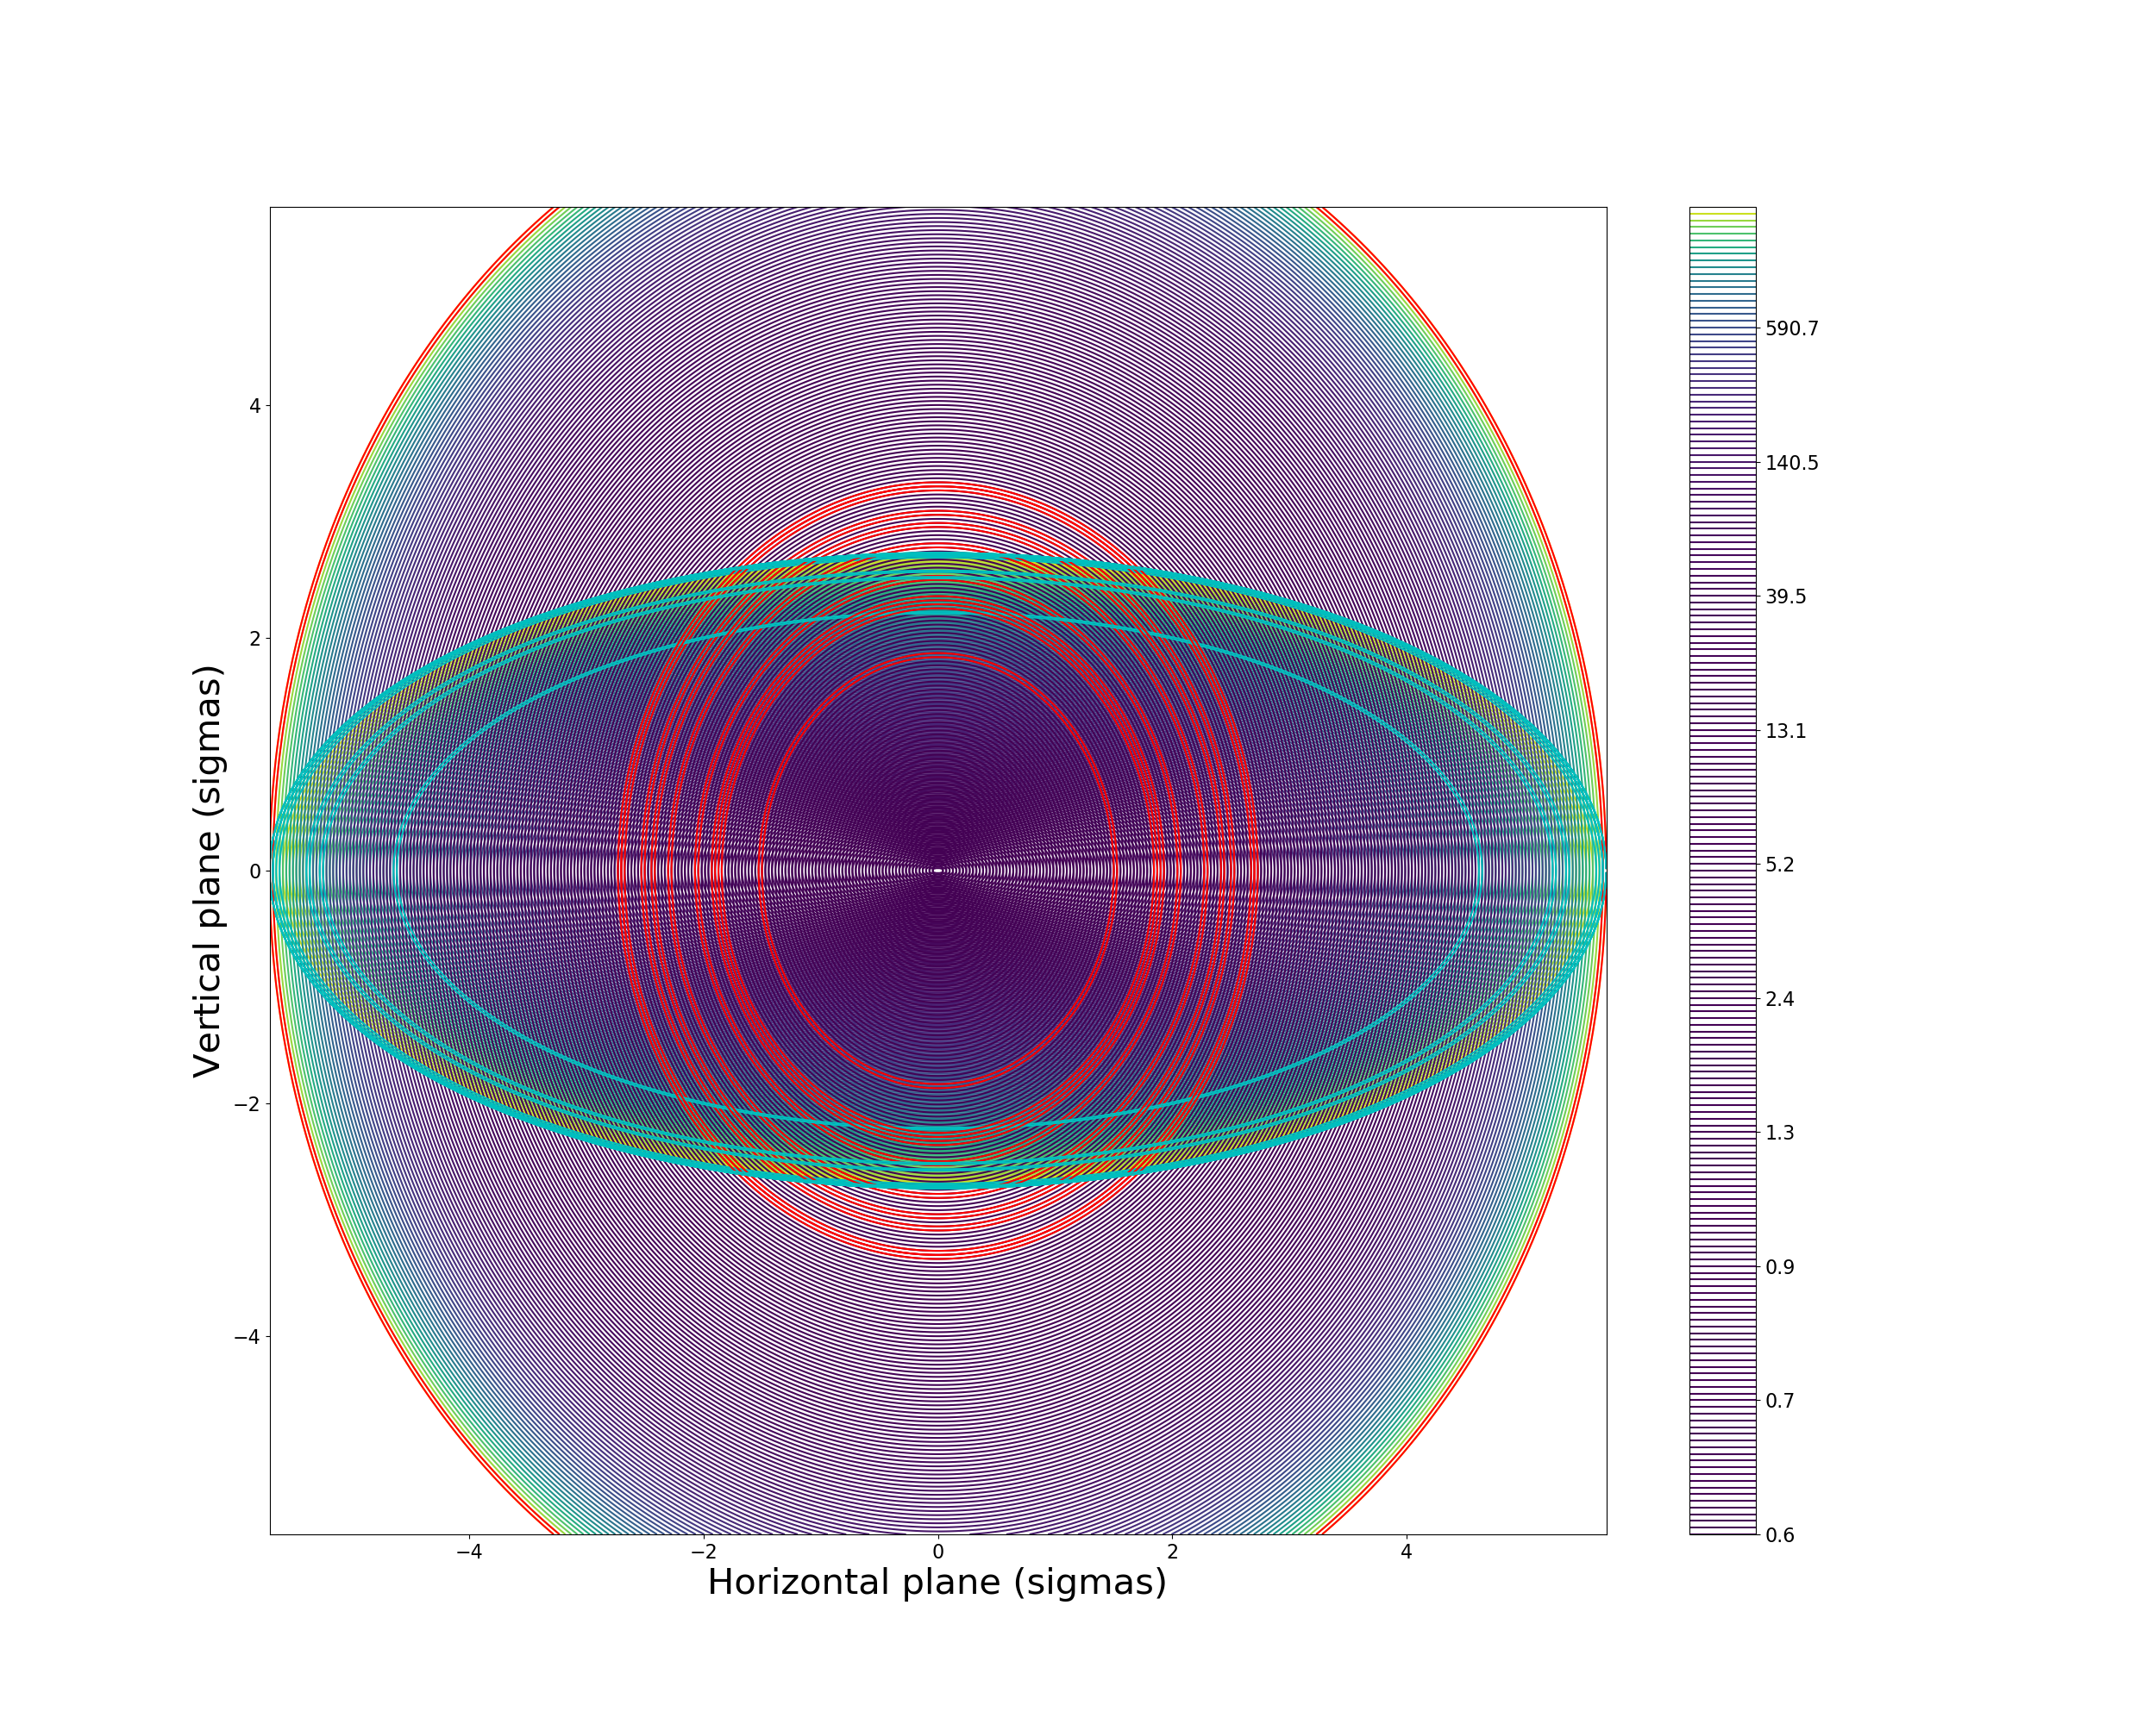

Trajectory reconstruction (17 Oct 2018)
Turn 20
Blown up proton distributions divided by nominal bunch distributions
Reference bunch proton distribution with estimated UFO location
Note: just one possible
trajectory within error bars!

Slide 29


Trajectory reconstruction (17 Oct 2018)
Turn 21
Blown up proton distributions divided by nominal bunch distributions
Reference bunch proton distribution with estimated UFO location
Note: just one possible
trajectory within error bars!

Slide 30


Trajectory reconstruction (17 Oct 2018)
Turn 22
Blown up proton distributions divided by nominal bunch distributions
Reference bunch proton distribution with estimated UFO location
Note: just one possible
trajectory within error bars!

Slide 31

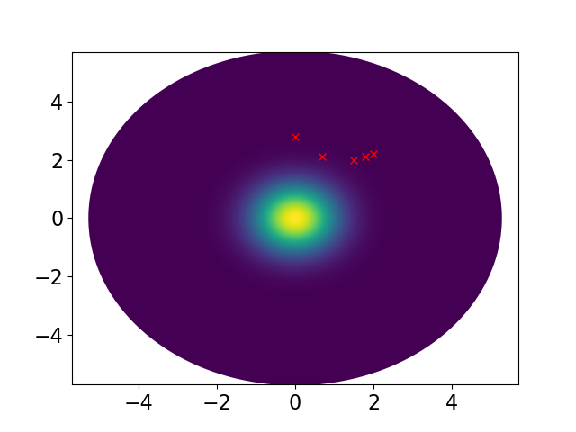
Trajectory reconstruction (17 Oct 2018)
Turn 23
Blown up proton distributions divided by nominal bunch distributions
Reference bunch proton distribution with estimated UFO location
Note: just one possible
trajectory within error bars!

Slide 32
Outlook
Comprehensive parameter scan with simulation model
  Compare with measurements
Error quantification
Look into the full beam
  Eg. PACMAN bunches with orbit offset

Slide 33
Conclusions
UFOs have an important effect on LHC
  Studied with bunch-by-bunch resolution and blown-up bunches
  14 events recorded with blown-up bunches
With bunch-by-bunch losses and knowing proton distributions and bunch sizes, we can reconstruct UFO trajectories
Large error bars from fluctuating signals, background losses, uncertainties in proton distributions
Nevertheless: observed one event with interaction mainly in the horizontal plane and one with mainly in the vertical plane
  Analysis ongoing
Gravity alone is not enough to explain the observations
  Dust particle can likely be negatively charged and attracted to the beam

Slide 34
Thank you!

Slide 35
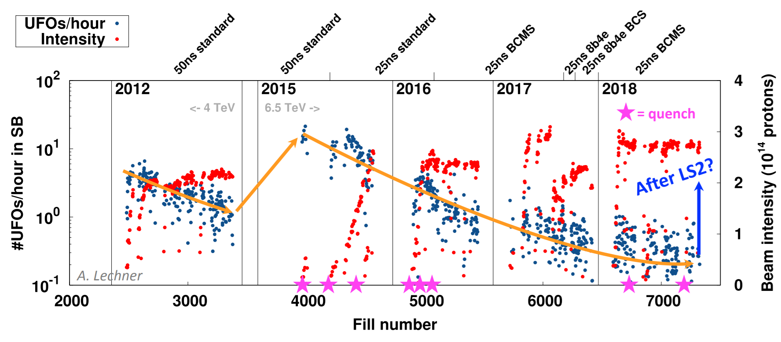
Backup slide 1: UFO rate in 2018

Slide 36
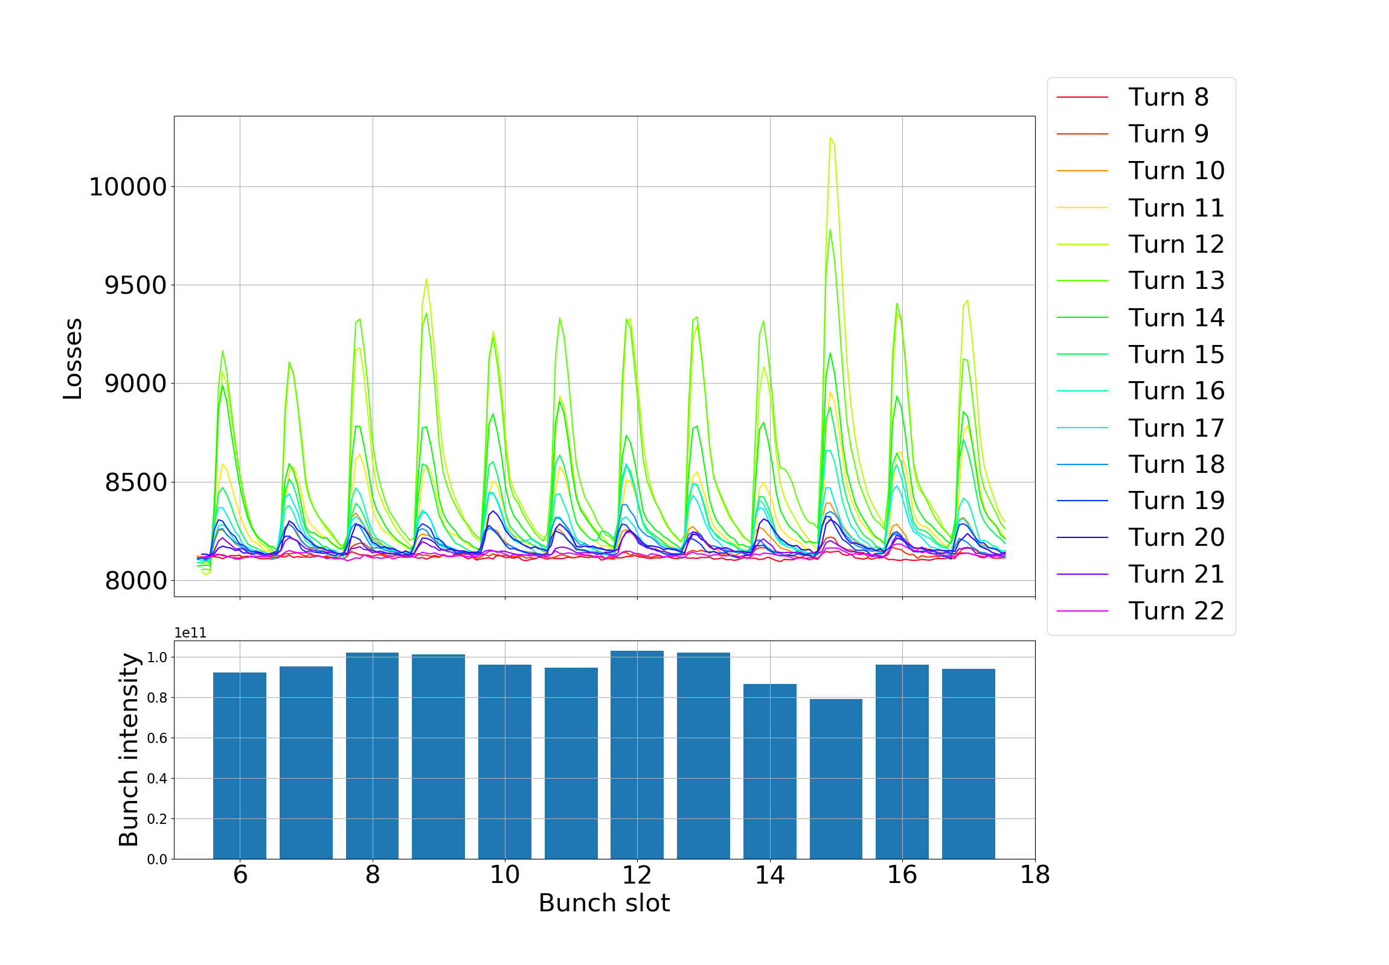
Backup slide 2: Bunch intensities

Slide 37
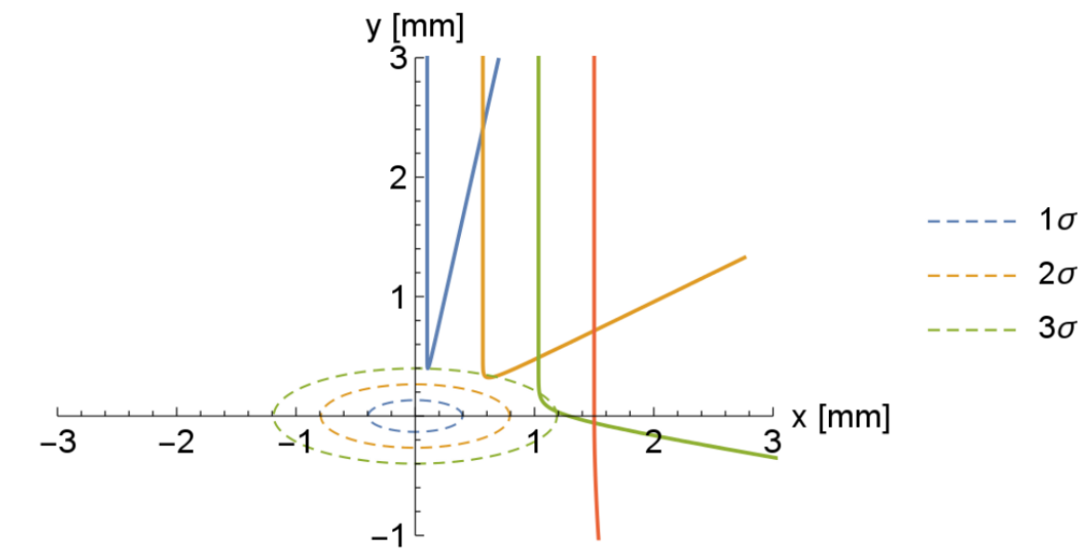

Backup slide 3: Possible trajectories
Physical model of beam-macroparticle interaction to study UFOs
  Partially validated against UFO type 1 events (temporal loss pattern, # inelastic collisions; assuming ~20-30 µm particles, Cu, C)
Comparing measured # of inelastic collisions with simulated:
  Estimate of macroparticle size -> radius 15-30 µm (nitrogen, density 1.029 g/cm^3)
B. Auchmann

Slide 38
TITLE AND TWO CONTENT WITH SUBTITLES

Slide 39
TITLE

