Slide 1


Short-Term Internship Programme:
March 2019 – September 2019
Author: Carmelo Barbagallo
Supervisor: Matthias Mentink
TE-MPE-PE section meeting, 14th March 2019

Slide 2
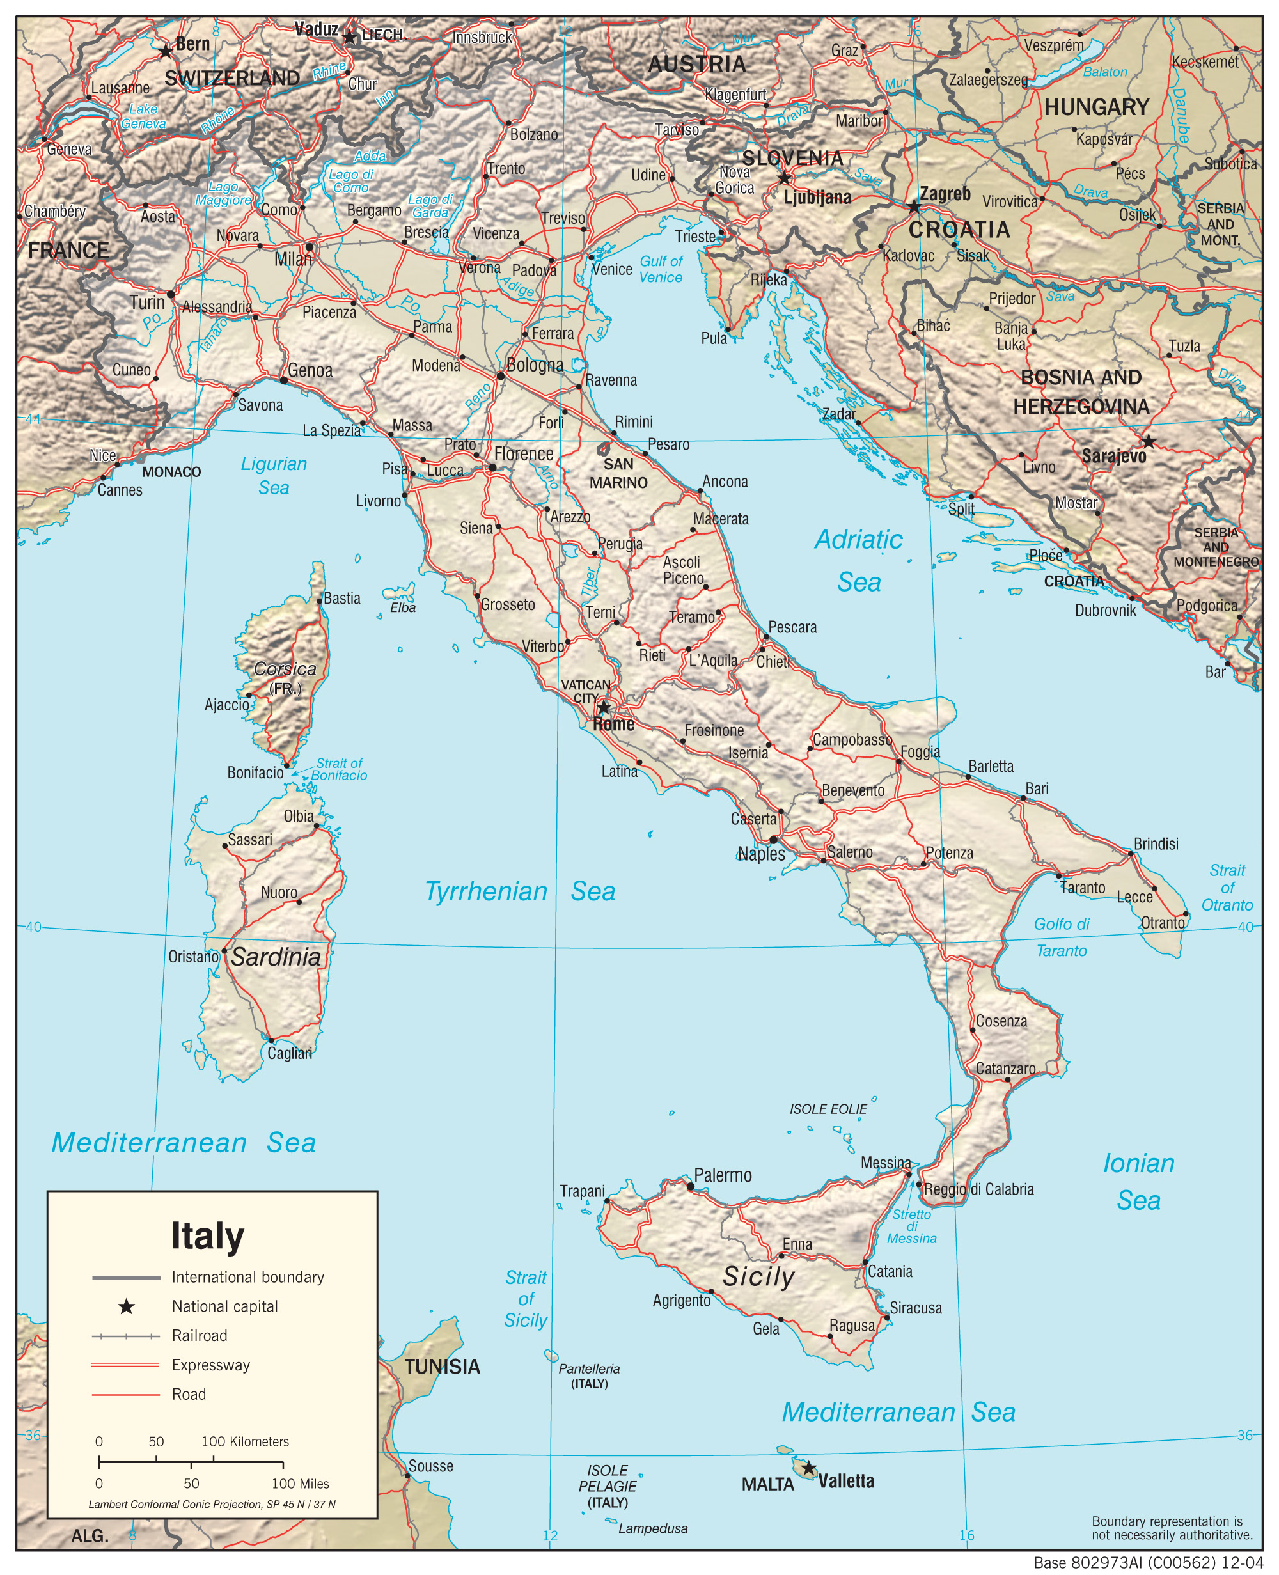
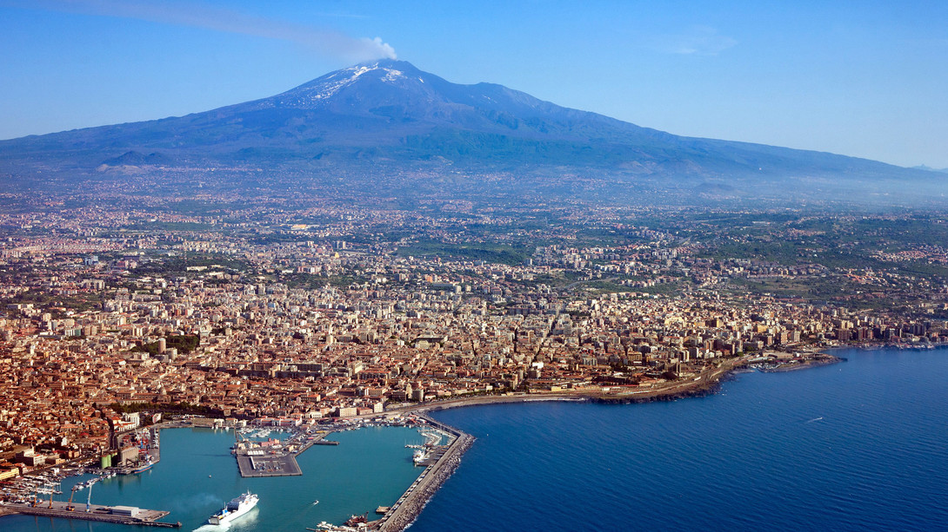




Profile
Carmelo Barbagallo
Italian
My town: Catania (Sicily)
SICILY
Catania
Academic background:
Hobbies:
Master thesis
Football
M.Sc. in Mechanical Engineering
Physics
Bachelor thesis
Cooking
B.Sc. in Mechanical Engineering
Photography

Slide 3
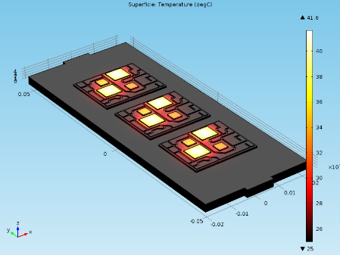
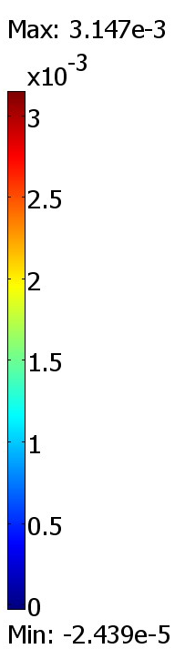
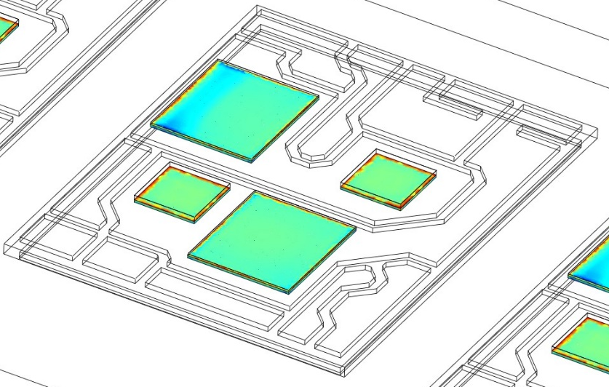
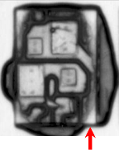
Main Scientific Projects
Bachelor thesis: FE Models for Thermo-Mechanical and Thermal Fatigue Analysis of Power Modules.
Thermal transient analysis (junction temperature and stress-strain distribution);
Thermal fatigue life prediction (number of cycles to failure under power and thermal cycles);
SAM (Scanning Acoustic Microscope) measurements to validate simulations.
Figure 1: Thermal map of power module [1].
Figure 2: Effective plastic strain distribution on dies [1].
Figure 3: SAM image after 300 thermal cycles [1].
[1] C. Barbagallo, G. L. Malgioglio, G. Petrone and G. Cammarata, 2015, Thermo-mechanical analysis of a multi-chip power module, ASME-ATI-UIT 2015 International Conference on Thermal Energy Systems, Napoli, Italy.

Slide 4
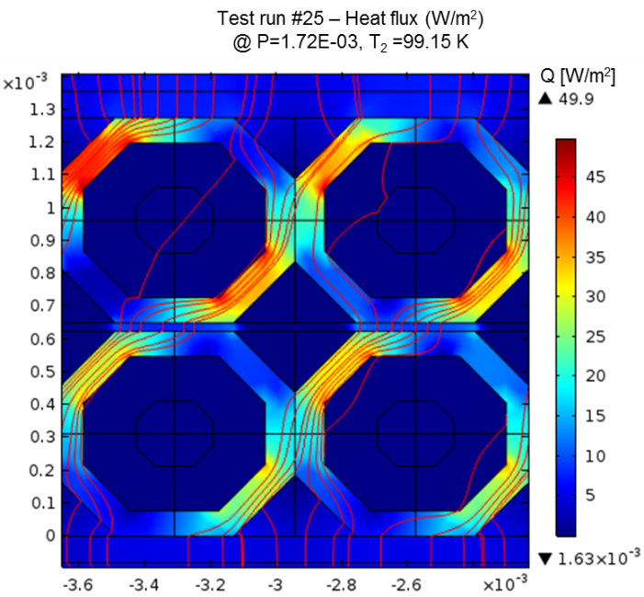
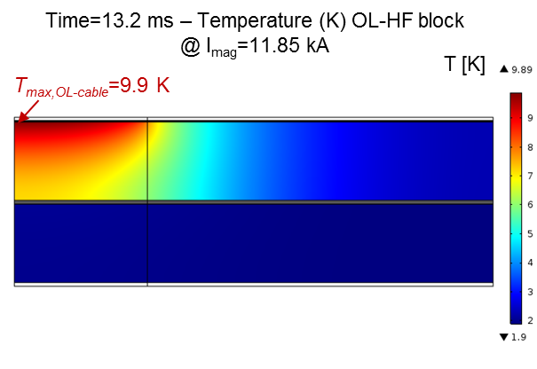
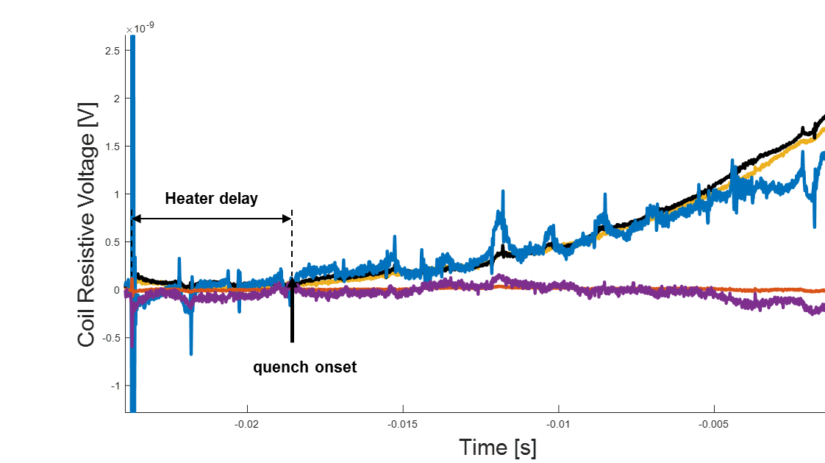
Main Scientific Projects
Master thesis: Quench Protection Heaters FE Analysis and Thermal conductivity Measurements of Nb₃Sn Cables for High-Field Accelerator Magnets
TE-MSC-MDT
Heat conduction simulation from heater to the superconducting cable (MQXF and 11 T magnet short models) [2];
Quench heater delay detection (SM18 facility) to validate simulations [2];
Steady-state measurements and numerical modelling of thermal conductivity of impregnated Nb₃Sn cable stacks [2].
Quench heater
Figure 4: Maximum temperature for HF block turns for MBHSP106 magnet [3].
Figure 5: Real coil resistive voltage signals from cold test on MBSHP106 magnet [3].
Figure 6: Heat flux magnitude and heat streamlines inside cable strands [3].
[2] C. Barbagallo, Quench Protection Heaters FE analysis and Thermal Conductivity Measurements of Epoxy-Impregnated Nb₃Sn Cables, CERN Technical Presentation, EDMS 2066640, January 2019.
Notes:
Add quench heater

Slide 5


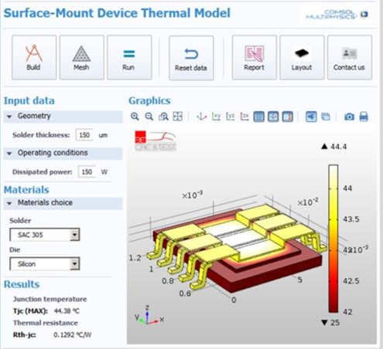
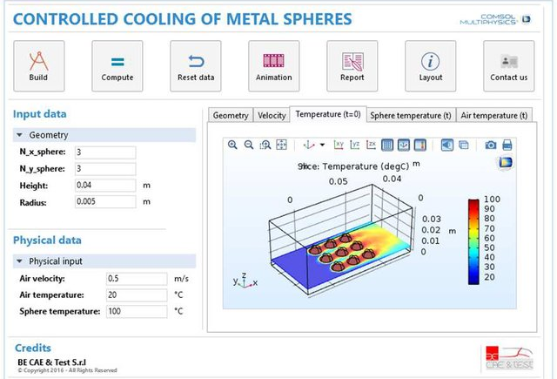
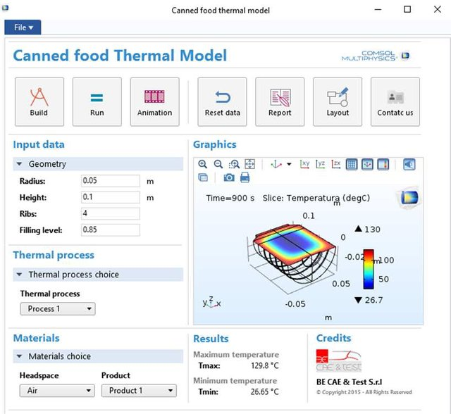
Collaborations
BE-CAE & Test – COMSOL certified consultant, Catania, Italy.
From simulation to the APP:
Thermo-Mechanical Analysis and Fatigue Life Prediction for an Electronic Surface-Mount Device (SMD);
Simulation of cooling process of metal spheres in a forced air-flow;
Simulation of thermal process inside a can packaging for food.
Figure 7: COMSOL APP for electronic devices simulation [3].
Figure 8: COMSOL APP to simulate cooling of metal spheres in a forced air-flow [4].
Figure 9: COMSOL APP to simulate temperature inside a can for food [5].
[3] G. Petrone, C. Barbagallo and M. Scionti, 2015, A COMSOL APP for thermal analysis of electronic devices, COMSOL Conference 2015, Grenoble, France.
[4] G. Petrone and C. Barbagallo, 2016, An Application Built with the COMSOL Multiphysics Software for Managing Computational Sequences in Thermal Fluid Applications, COMSOL Conference 2016, Munich, Germany.
[5] G. Petrone and C. Barbagallo, 2017, How Apps Can Support COMSOL Multiphysics Users?, COMSOL Conference 2017, Rotterdam, The Netherlands.

Slide 6

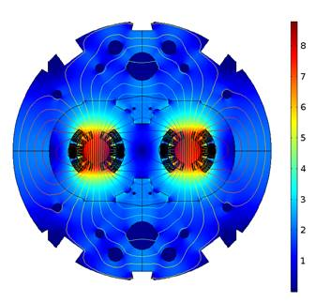
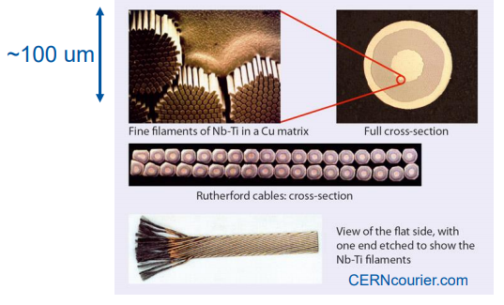
What’s next?
TE-MPE-PE Short-Term Internship Programme
FEM simulations on superconducting cables, coils and magnets;
Study of homogenization over the cross-section of Rutherford cables and its effect in transient conditions.
B [T]
Figure 10: LHC MB (main dipole) magnetic flux density [6].
Figure 11: Rutherford cable [7].
[6] L. Bortot, M. Maciejewski, M. Prioli, A. M. Navarro, S. Schöps, I. Cortes Garcia, A. B. Auchmann and A. P. Verweij, 2-D Finite-element Modelling of Electro-thermal Transients in Accelerator Magnets, CERN Technical Presentation, EDMS 591096.
[7] M. N. Wilson, Superconducting magnets. Clarendon Press Oxford, 1983.

Slide 7
Thank you for your attention

