Slide 1

Thin Channel Helium Experiment
Design 2.0
Bernhard Auchmann, Bertrand Baudouy, Jonas Blomberg Ghini, Arjan Verweij
25/03/2019

Slide 2
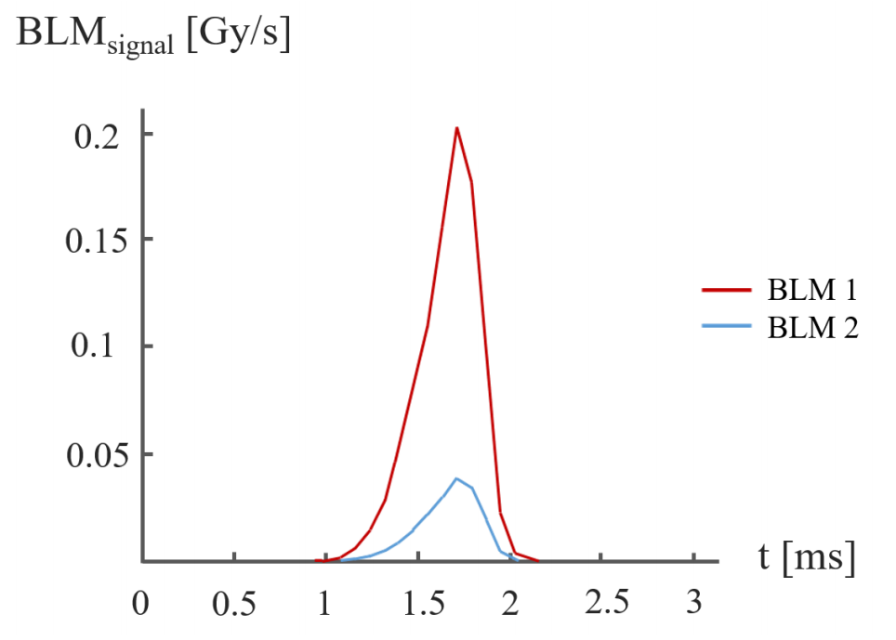
Motivation (1/3) – UFOs
Sub-millisecond beam loss event
Asymmetric Gaussian
Prevalent (thousands of smaller events per year)
Energy deposited in the magnet cable stack
[1] Fig. 3.7
2

Slide 3
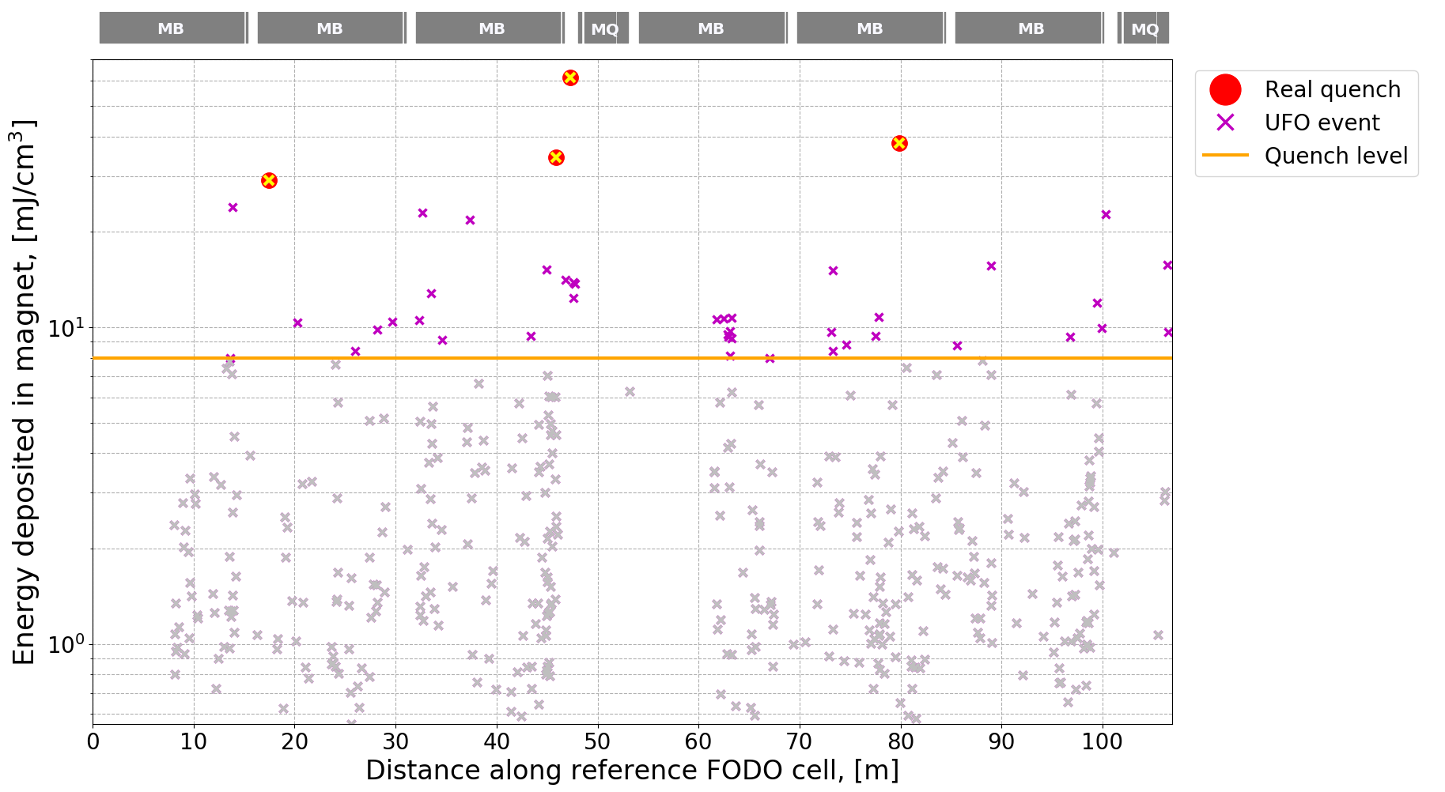
Motivation (2/3) – UFOs
Most UFOs are very small
Over the course of 2015 about 40 UFOs were above assumed quench level
Only four UFOs actually caused quenches
Will get worse at higher beam energy
Quench level determined from models based on open bath, steady state measurements
3

Slide 4
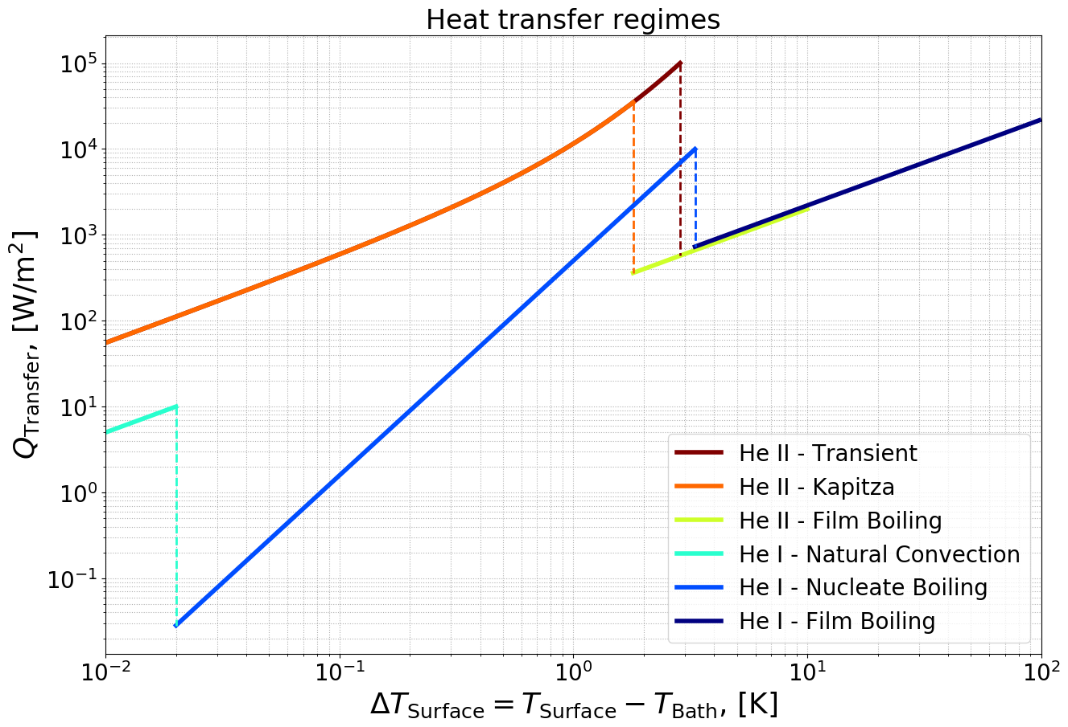
Motivation (3/3) – Modelling
Modelling approach in standard quench level calculations (such as CUDI and QP3) are power laws for the various helium cooling regimes
4

Slide 5
Moving Towards an Experiment
Diameter of an inner layer MB cable strand is ~1 mm
Circumference ~3 mm
Consider a square of 1 mm sides, with the strand in the centre – helium cross section ~0.24 mm²
Assuming 100% wetted perimeter – a rectangular channel of width 3 mm and depth ~80 µm
For practical reasons (instrumentation and mechanical tolerances) we use 3.1 mm width and 90 µm depth
Note about wetted perimeter: with the dimensions involved, a more conventional 50% wetted perimeter would be difficult to accept given the size of sensors

Slide 6
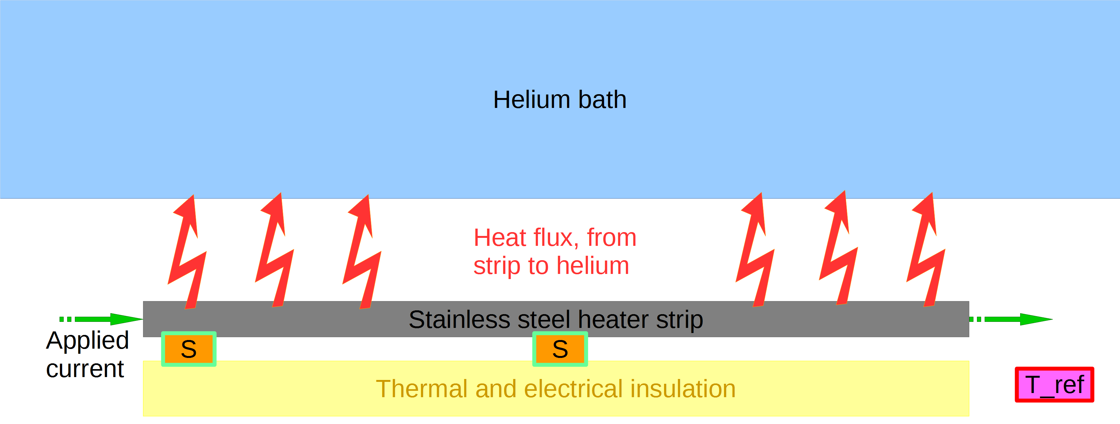
Steady State – What’s in the Cryostat
6

Slide 7
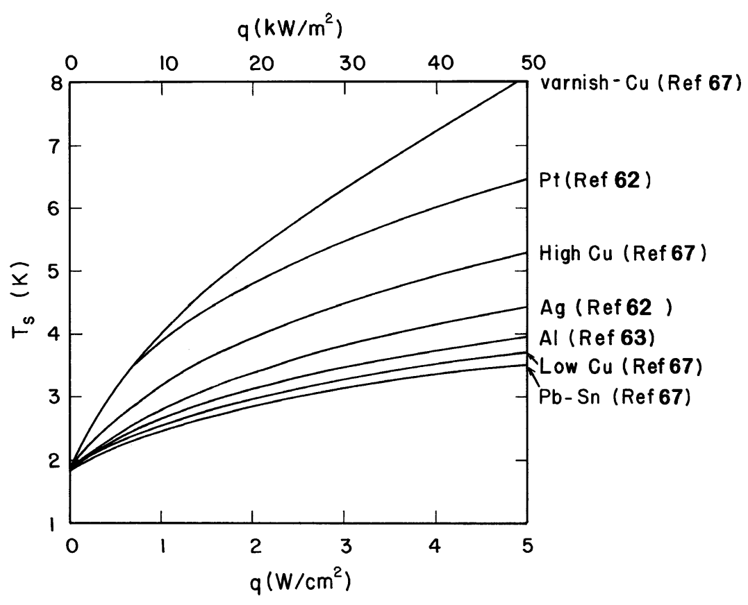
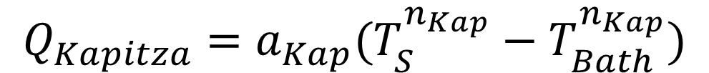
Putting on the Heat – What to Expect
Steady state, open bath
$$Q_{Kapitza}=a_{Kap}(T_{S}^{n_{Kap}}−T_{Bath}^{n_{Kap}})$$
Note: at 30 kW/m², the heater temp will be between 3 and 6 K
Note: at 7 kW/m², the heater temp will be between 2.5 and 3.5 K
[3] Fig. 7.38
7

Slide 8
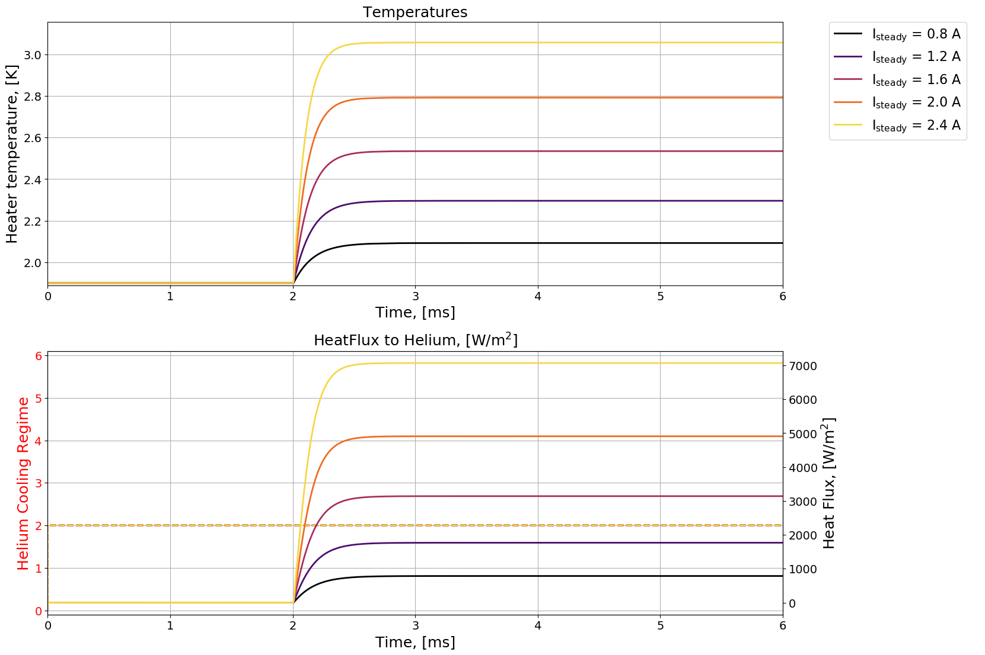
Reaching the Steady State (1/3)
Low heating power
T_{bath} = 1.9 K
8

Slide 9
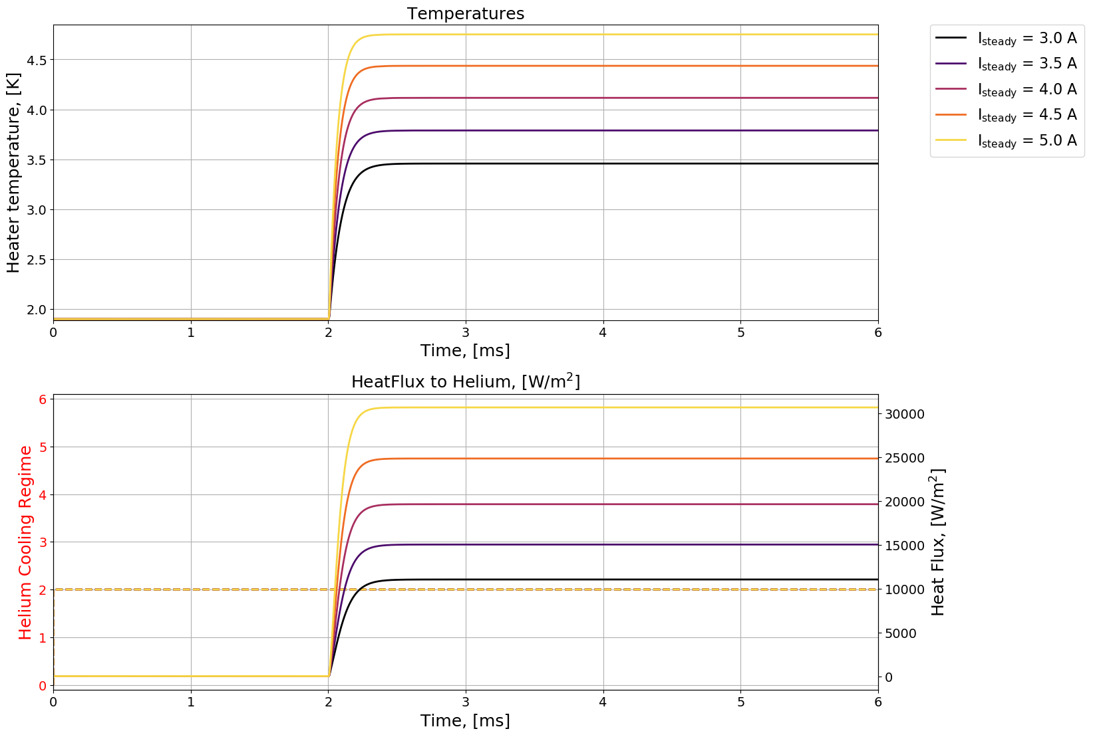
Reaching the Steady State (2/3)
High heating power
T_{bath} = 1.9 K
Standard maximum steady state heat flux: 35 kW/m²
9

Slide 10
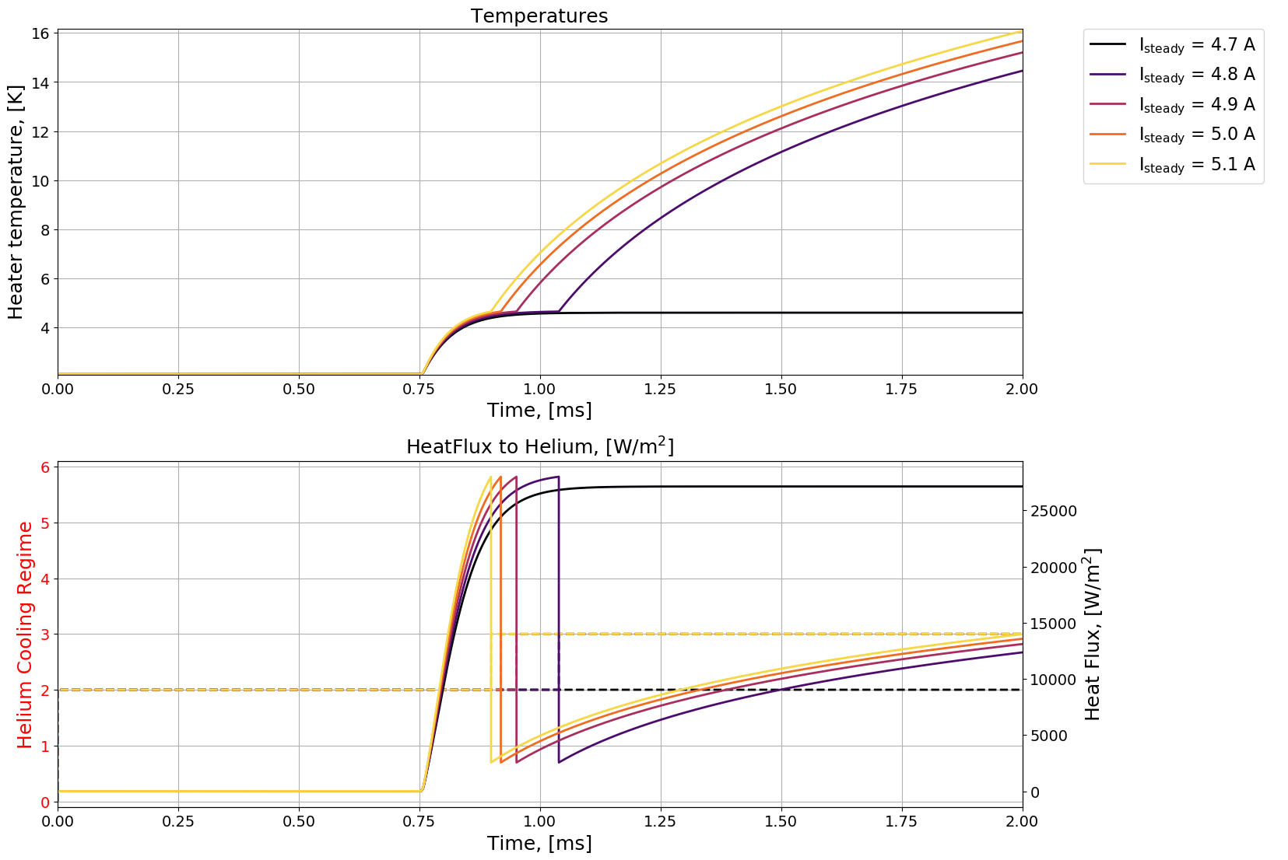
Reaching the Steady State (3/3)
High heating power and high bath temperature
T_{bath} = 2.1 K
Bath temperature dependent maximum steady state heat flux.
My experiments suggest Q_{max} ~ 28 kW/m² at 2.1 K
10

Slide 11
Pulses in Open Bath (1/3)
The steady state, open bath experiments will serve to boost our confidence in the quality of measurements
An important indication of whether or not the setup can handle transient heat pulses is if we see that all sensors show the same behaviour in time
What to expect when applying transient heat pulses?
Important to note that this step, moving to transient heating, takes us away from established theory
It is not clear at what time scale we will see a transition from slow, theoretically explained quasi-steady state pulses to fast transients not captured by current theory
11

Slide 12
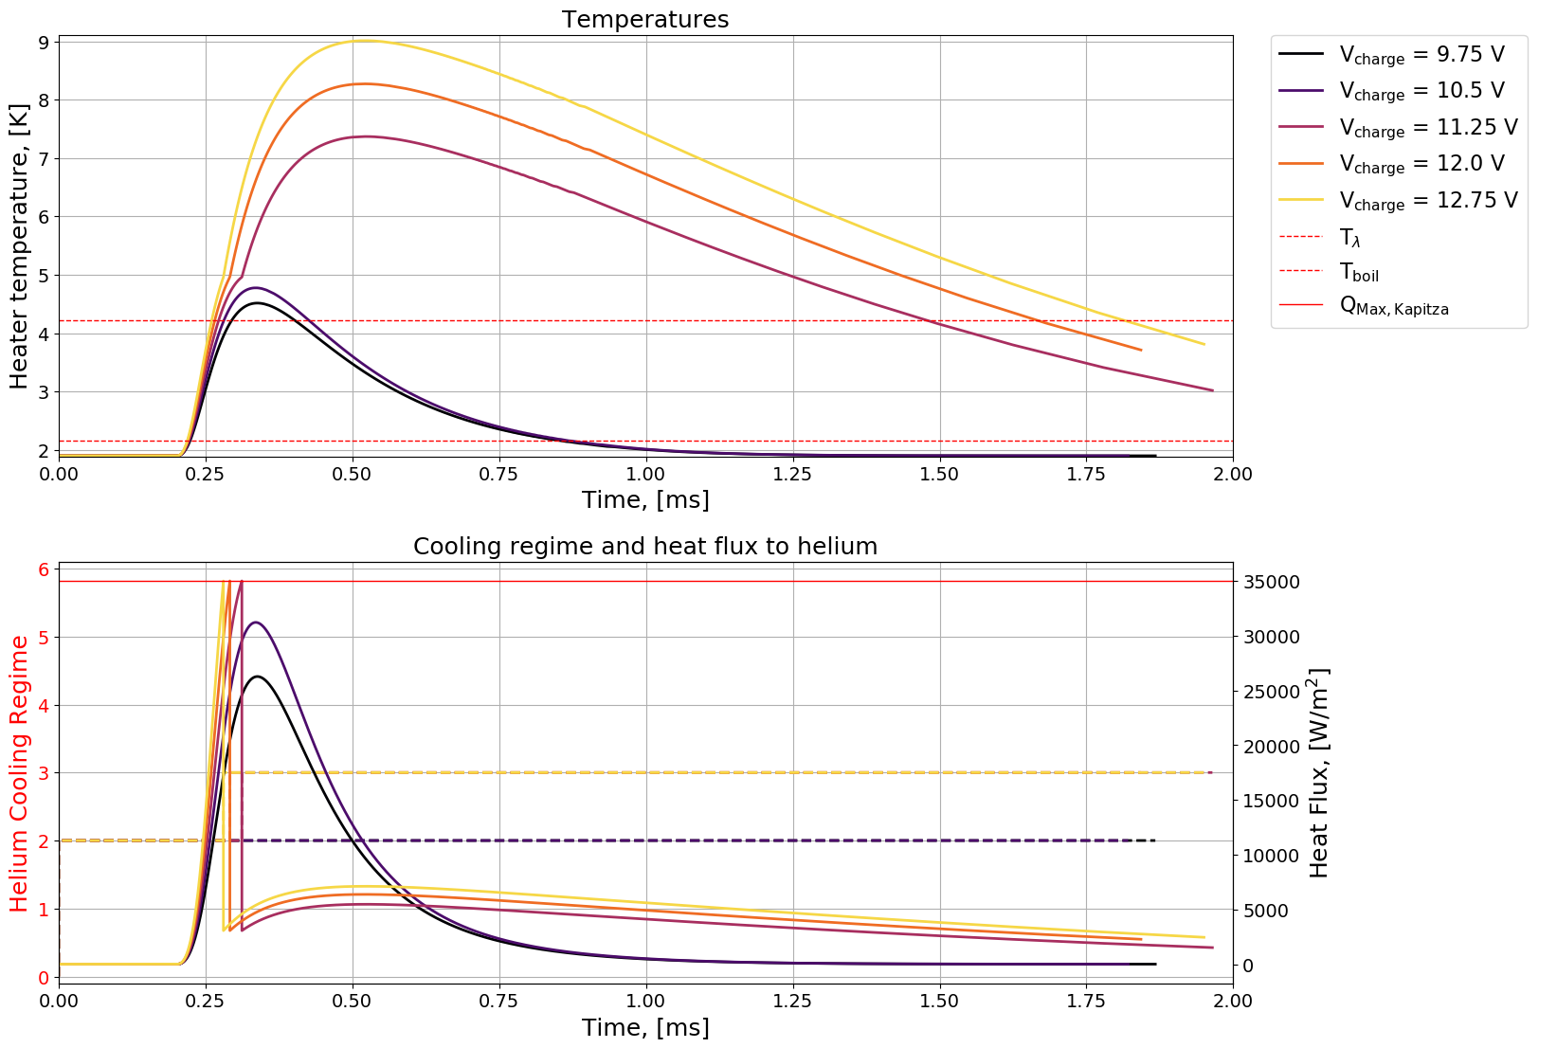
Pulses in Open Bath (2/3)
Fast – 1 ms time scale – 1.9 K bath
12

Slide 13
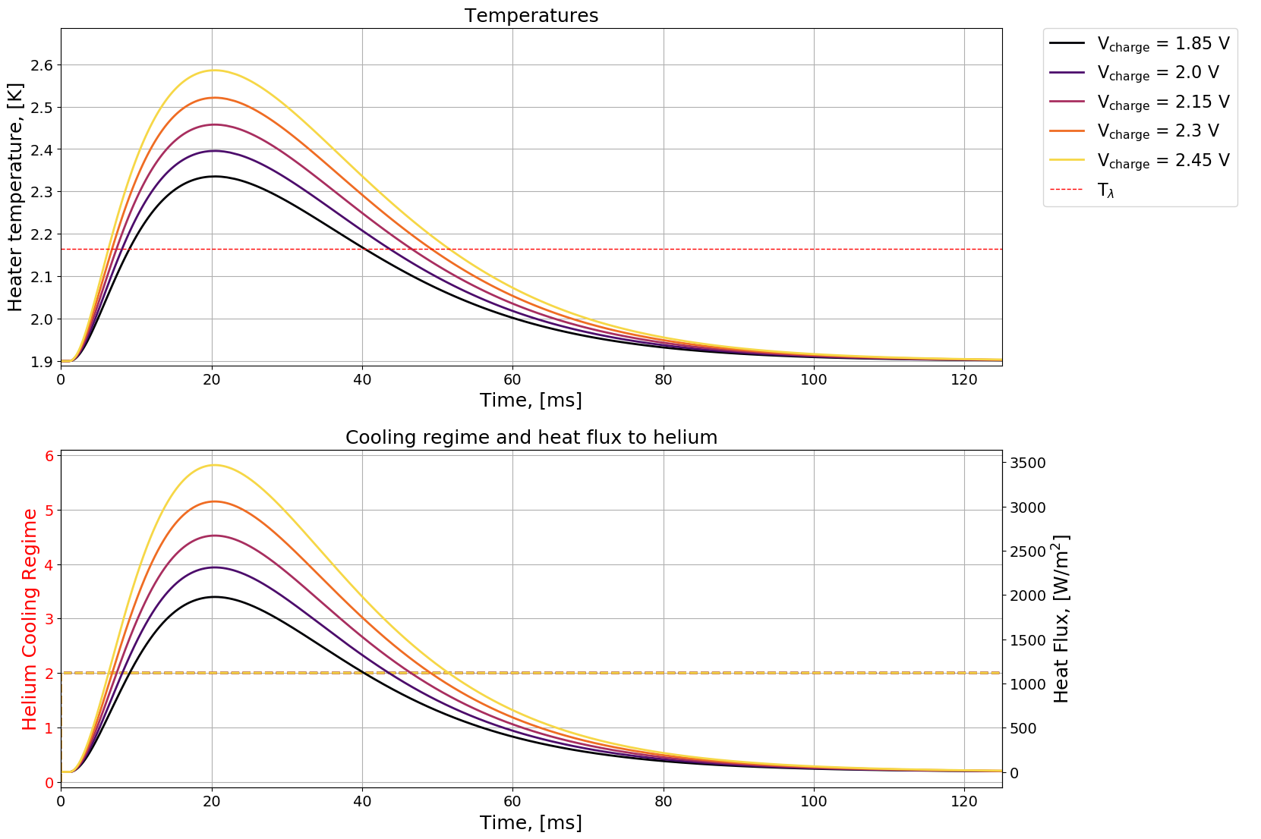
Pulses in Open Bath (3/3)
Slow – 100 ms time scale – 1.9 K bath
13

Slide 14
Steady State in Closed Channel (1/3)
Next step is to close the channel, while leaving only small pin holes for helium to enter and leave the volume
At least two important new effects will play a role:
  In the closed volume, pressure will rise as the helium heats up
  The pin holes will introduce a temperature gradient between the channel helium and the bath helium, which will drive a heat flux
Assumptions for simulations:
  The channel to bath thermal gradient falls entirely across the length of the pin hole, meaning that within the channel, the temperature is uniform
  Heat flux through the pin hole is assumed completely turbulent, meaning it is described by the Gorter-Mellink relationship
14

Slide 15
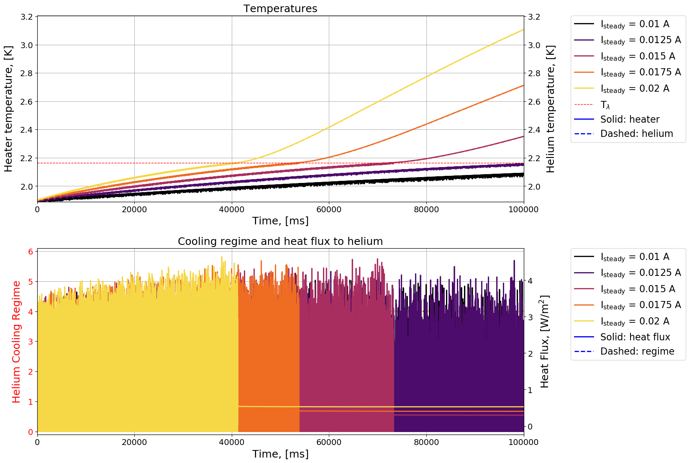
Steady State in Closed Channel (2/3)
Very low steady heating – 1.9 K bath
15

Slide 16
Steady State in Closed Channel (3/3)
An issue with numerical implementation makes it so the heat transfer regime jumps between no heat transfer and Kapitza within a few time steps
Heat flux through the pin hole is calculated based on theoretical expressions for laminar and turbulent heat flow in He II. The transition from laminar to turbulent is taken as the point when the normal fluid component for a given heat flux surpasses a critical velocity determined from the Reynolds number. The pin hole is so small that almost no heat escapes the channel.
This step, moving to steady state, closed channel, will serve to boost or weaken the confidence in the setup. However, if, as the model indicates, heating powers need be this small, it could be hard to accurately probe the relevant region (current must be supplied, and a difference of 2 mA could well be within the PS’s accuracy)
16

Slide 17
Pulses in Closed Channel (1/4)
Finally, move to pulses in closed channel (with pin hole)
In this situation, the heat flux though the pin hole is large enough that one can assume fully turbulent heat transfer
For fast pulses, the pin hole is not expected to evacuate enough heat within the time scale of the pulse to affect the results of the simulation
17

Slide 18
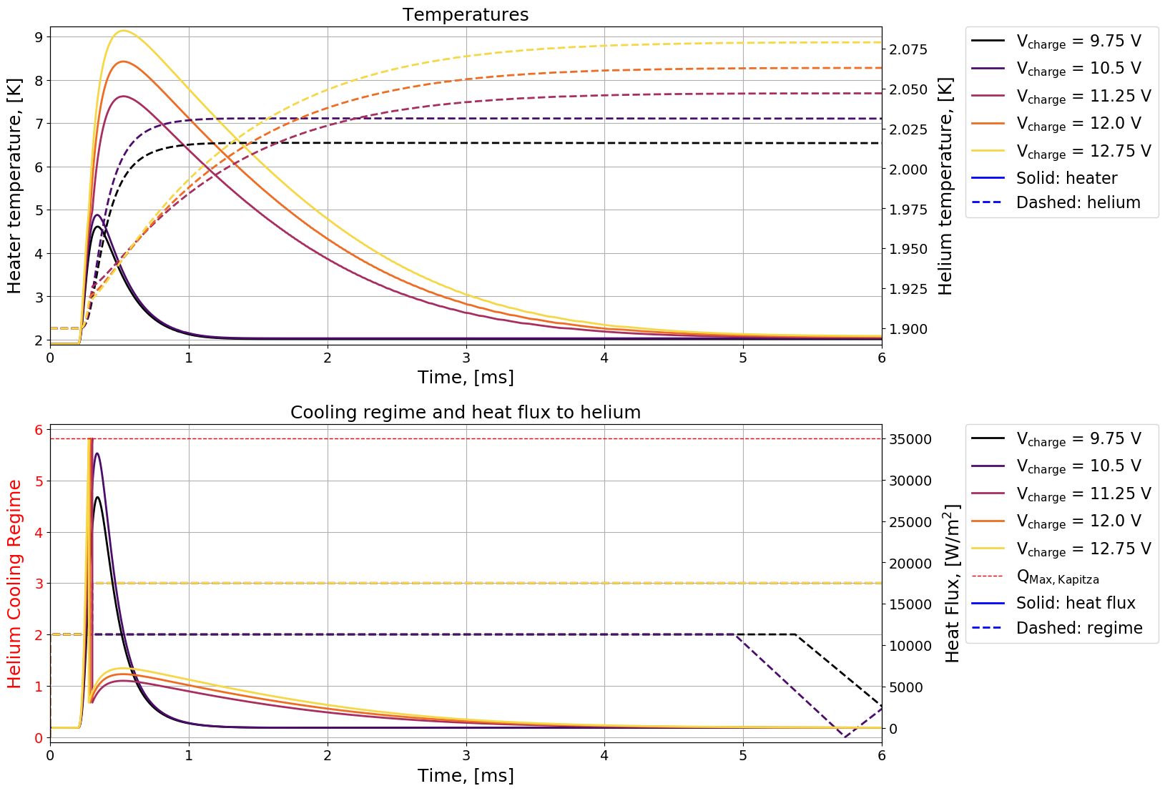
Pulses in Closed Channel (2/4)
Fast, strong heating – 1.9 K bath
Peak heater temperature goes a little above that for open bath, since the helium heats up, causing film boiling a little sooner than in open bath
Pin hole brings the channel helium temperature down to the bath temperature after about 5 seconds
18

Slide 19
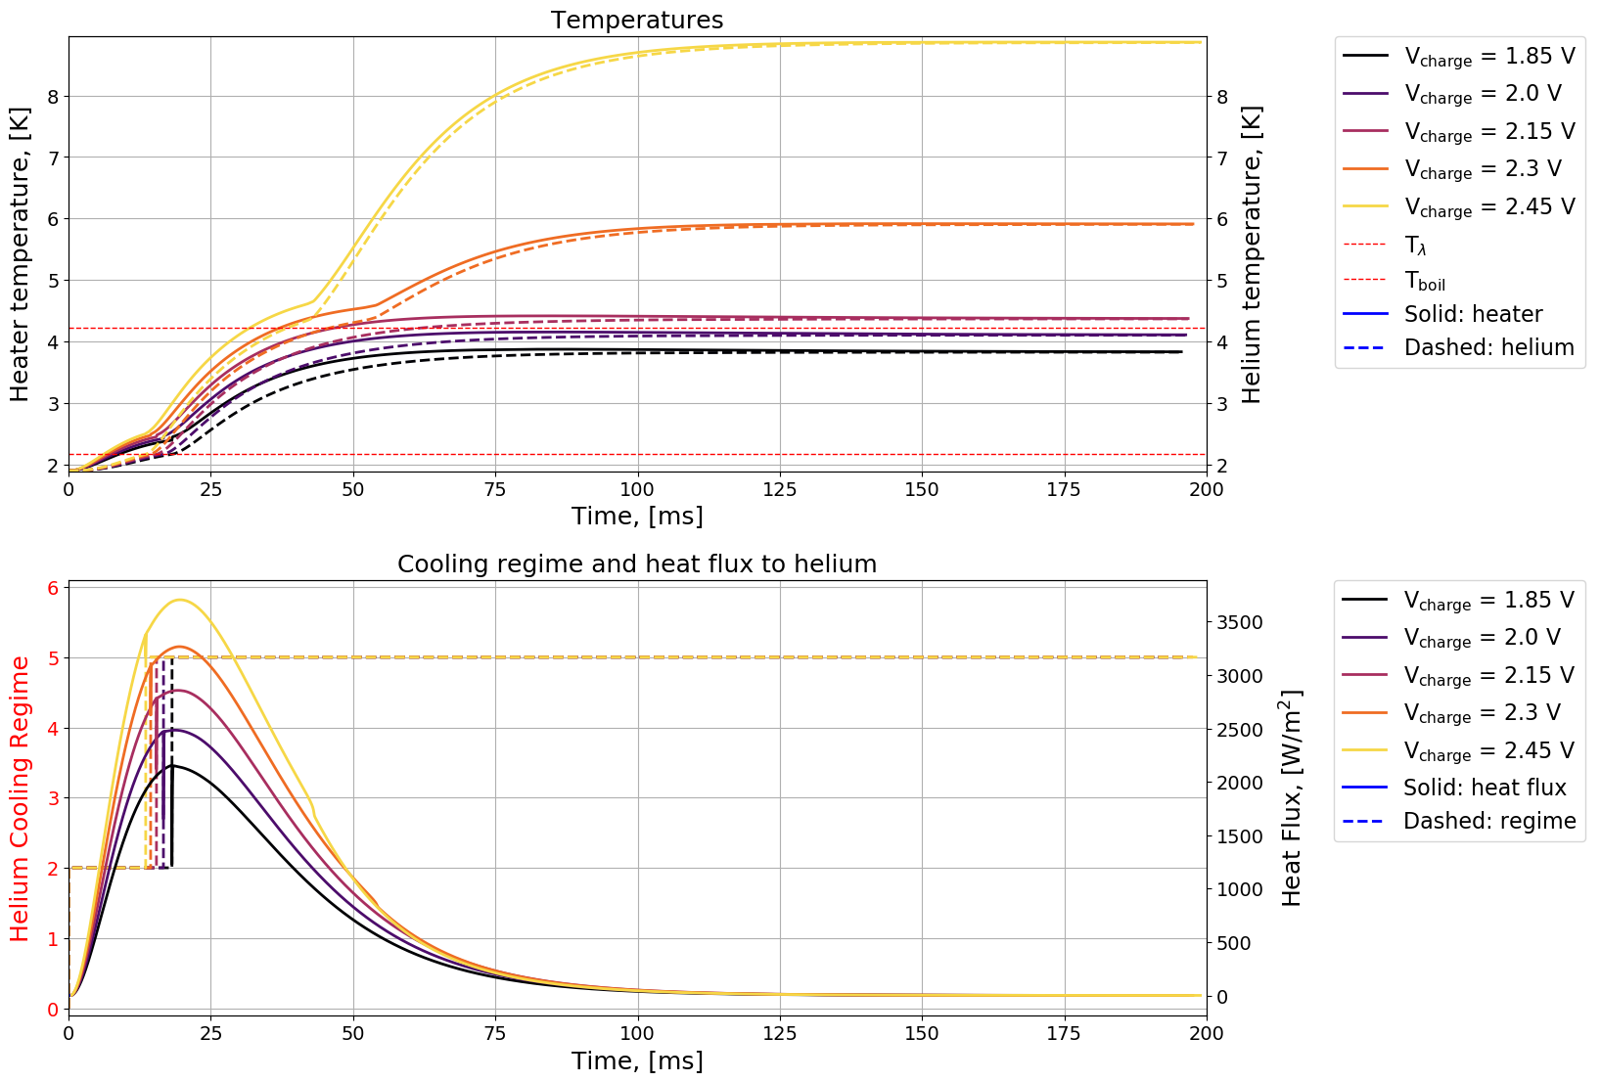
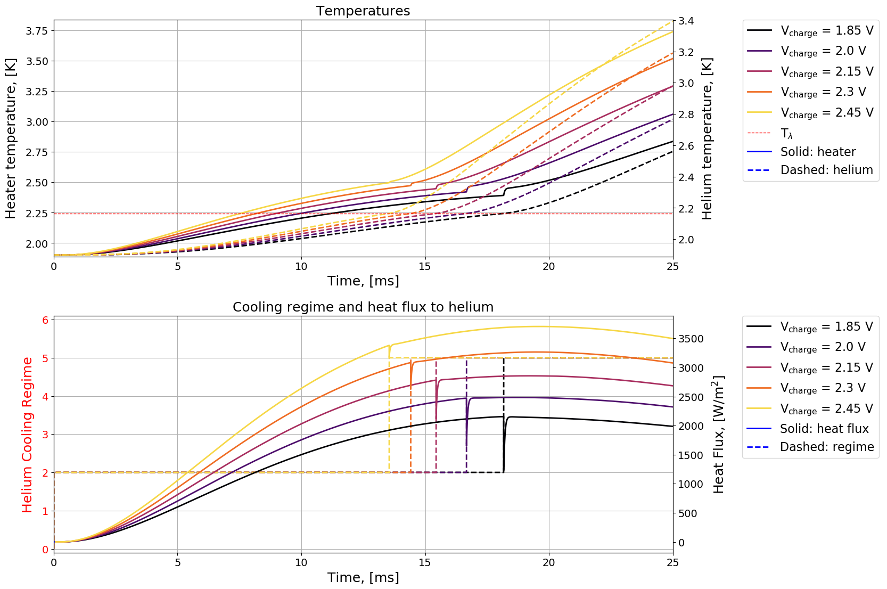
Pulses in Closed Channel (3/4)
Slow, strong heating – 1.9 K bath
After the helium temperature goes above lambda, there is no heat flux through the pin hole (in practice there is, but not on the time scale of relevance)
19

Slide 20
Pulses in Closed Channel (4/4)
At this point we have moved very far away from the range of validity of theoretical models (both in terms of the heater-to-helium heat transfer, and the heat transfer through the pin hole)
  What has been presented is the best guess, but we expect significant deviation from this
  If the measurements leading up to this point indicate that the setup is sound, the results from the pulsed heating in closed channel measurements will provide the closest approximation to the real LHC situation
In general, the expectation is that we will measure lower heater temperatures and higher helium temperatures in the channel
  Recall, the LHC is seen to withstand stronger heat input than what we expect should be enough to quench a magnet, so the metal/heater must at all times be at a lower temperature than what models predict
We also expect to see the transition between Kapitza cooling and film boiling He II occur at a higher peak heat flux than that which steady state models predict
20

Slide 21
Outlook
  Analysis of the two preceding experimental runs uncovered key weaknesses of the setup
  Solutions to the problems were found, the most important of which is that with the right glue, thermal sensors can be isolated from the helium bath
  Since I am going back to Norway it is a little unclear exactly when I can perform the new measurements, and there is also some potential issues with helium availability at CEA, but no later than July I expect to be done
21

Slide 22
Previous Measurements and What Might be Wrong With Them
Only if there is time for it

Slide 23
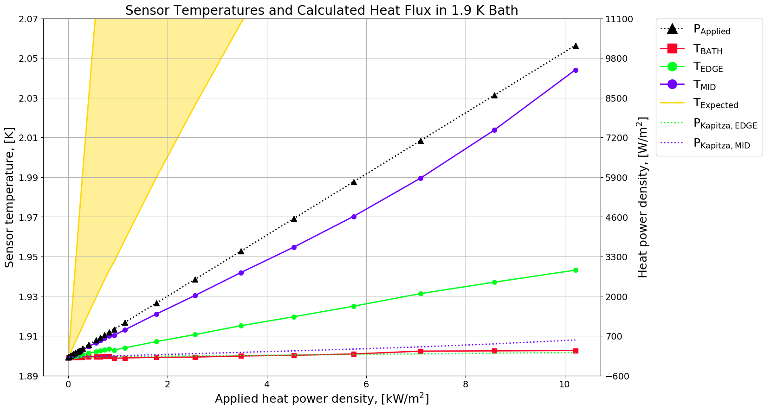
Gist of First Results
Steady state, running fixed current though the heater strip
For one, the temperatures reached are nowhere near as large as the ones expected.
For another, the heatflux calculated for the measured temperature is near insignificant compared to the applied heat power density.
23

Slide 24
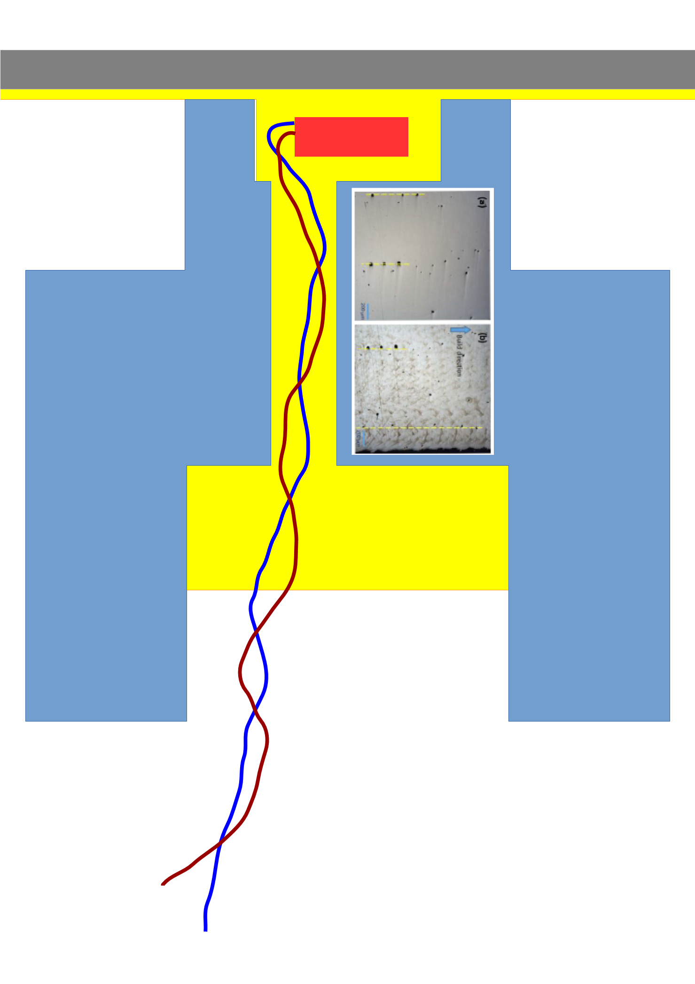
What Might be the Problem
Helium can creep in under the strip, effectively increasing the cooled area;
(Update: CT scans indicate there may be issues of this nature)
There can be complete channels though the glue (along leads, or from the top), allowing He II to cool the thermal sensor directly;
(Update: CT scans indicate there are no such channels)
The 3D printed stainless steel holders for the probes are «slightly» porous, which, according to a new look at theory, could make them very good thermal conductors, again, cooling the sensor directly
(Update: CT scans indicate there may be issues of this nature)
Image of porosity in 3D printed steel: [4]
24

Slide 25
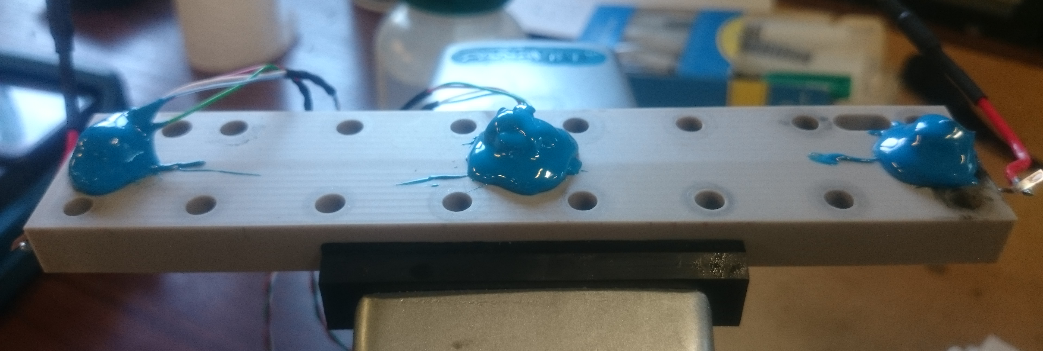
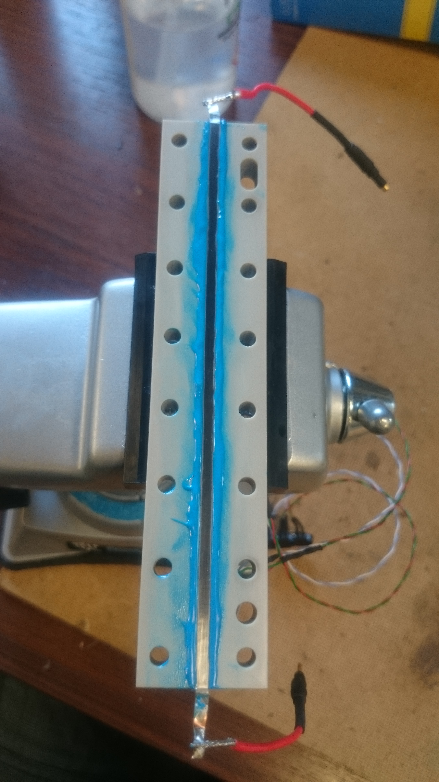
Solution: Cover With Glue (Eccobond)
Slather Eccobond on the backside of the sensor holders to plug any back channels and porosity
Glue along edge of strip to reduce chance of He II creeping under the strip
25

Slide 26
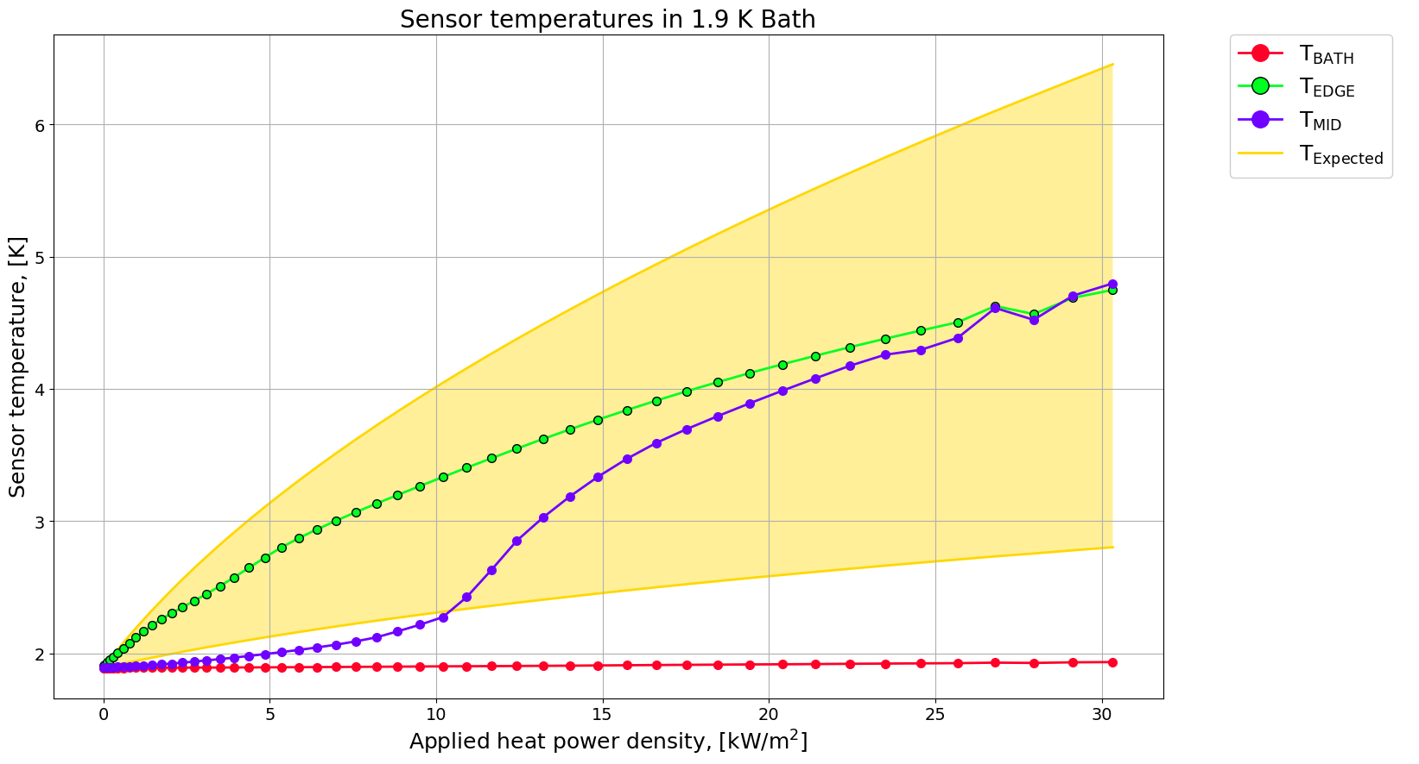
New Results (1/2)
Main conclusions at this point:
General shape is much closer to the expected result for the edge sensor
The mid sensor, although not as well isolated from the bath, behaves more like the edge sensor for high heatfluxes
26

Slide 27
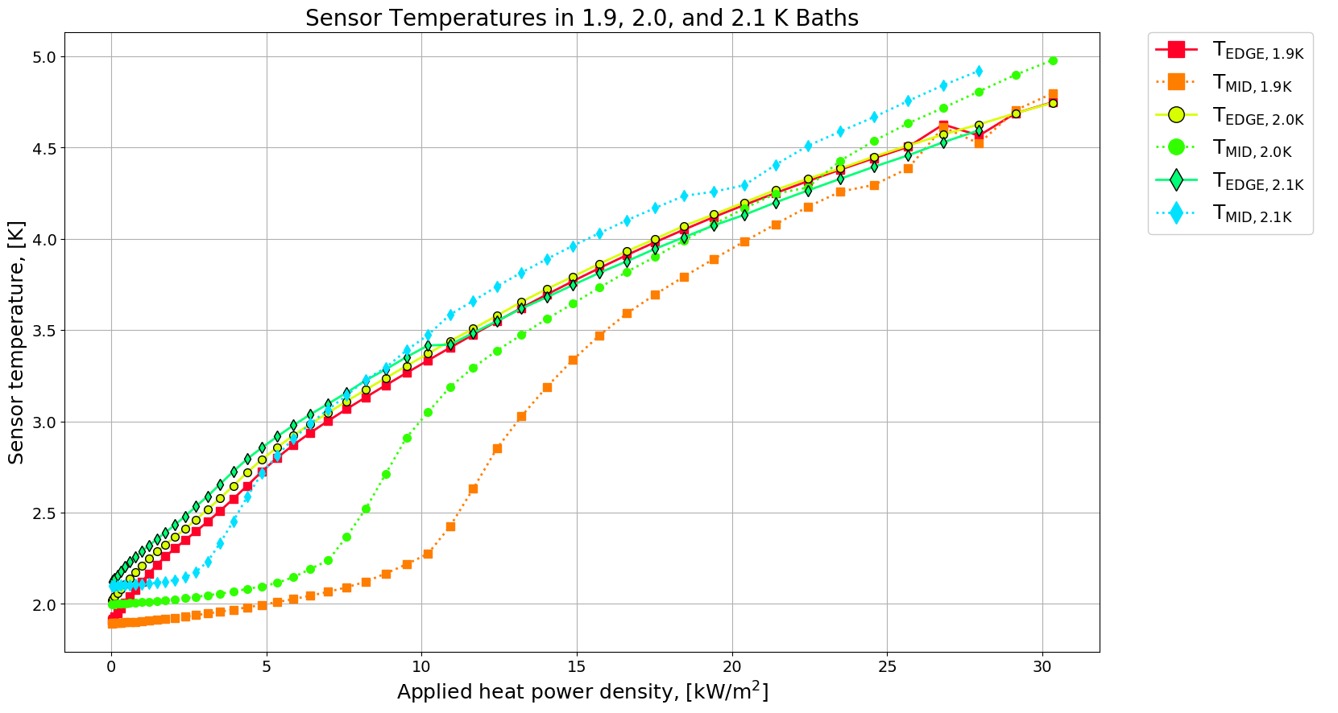
New Results (2/2)
It’s odd that the 2.1 K data (diamonds) jumps right around 10 kW/m² (could be calibration related)
It is odd that the MID sensor (dotted lines) goes higher than the EDGE for high heat fluxes (could some bath temperature dependent mechanism cool the EDGE?)
Maybe coincidental, but the inflection point where the MID sensor starts approaching the EDGE is right around the Lambda temperature
27

Slide 28
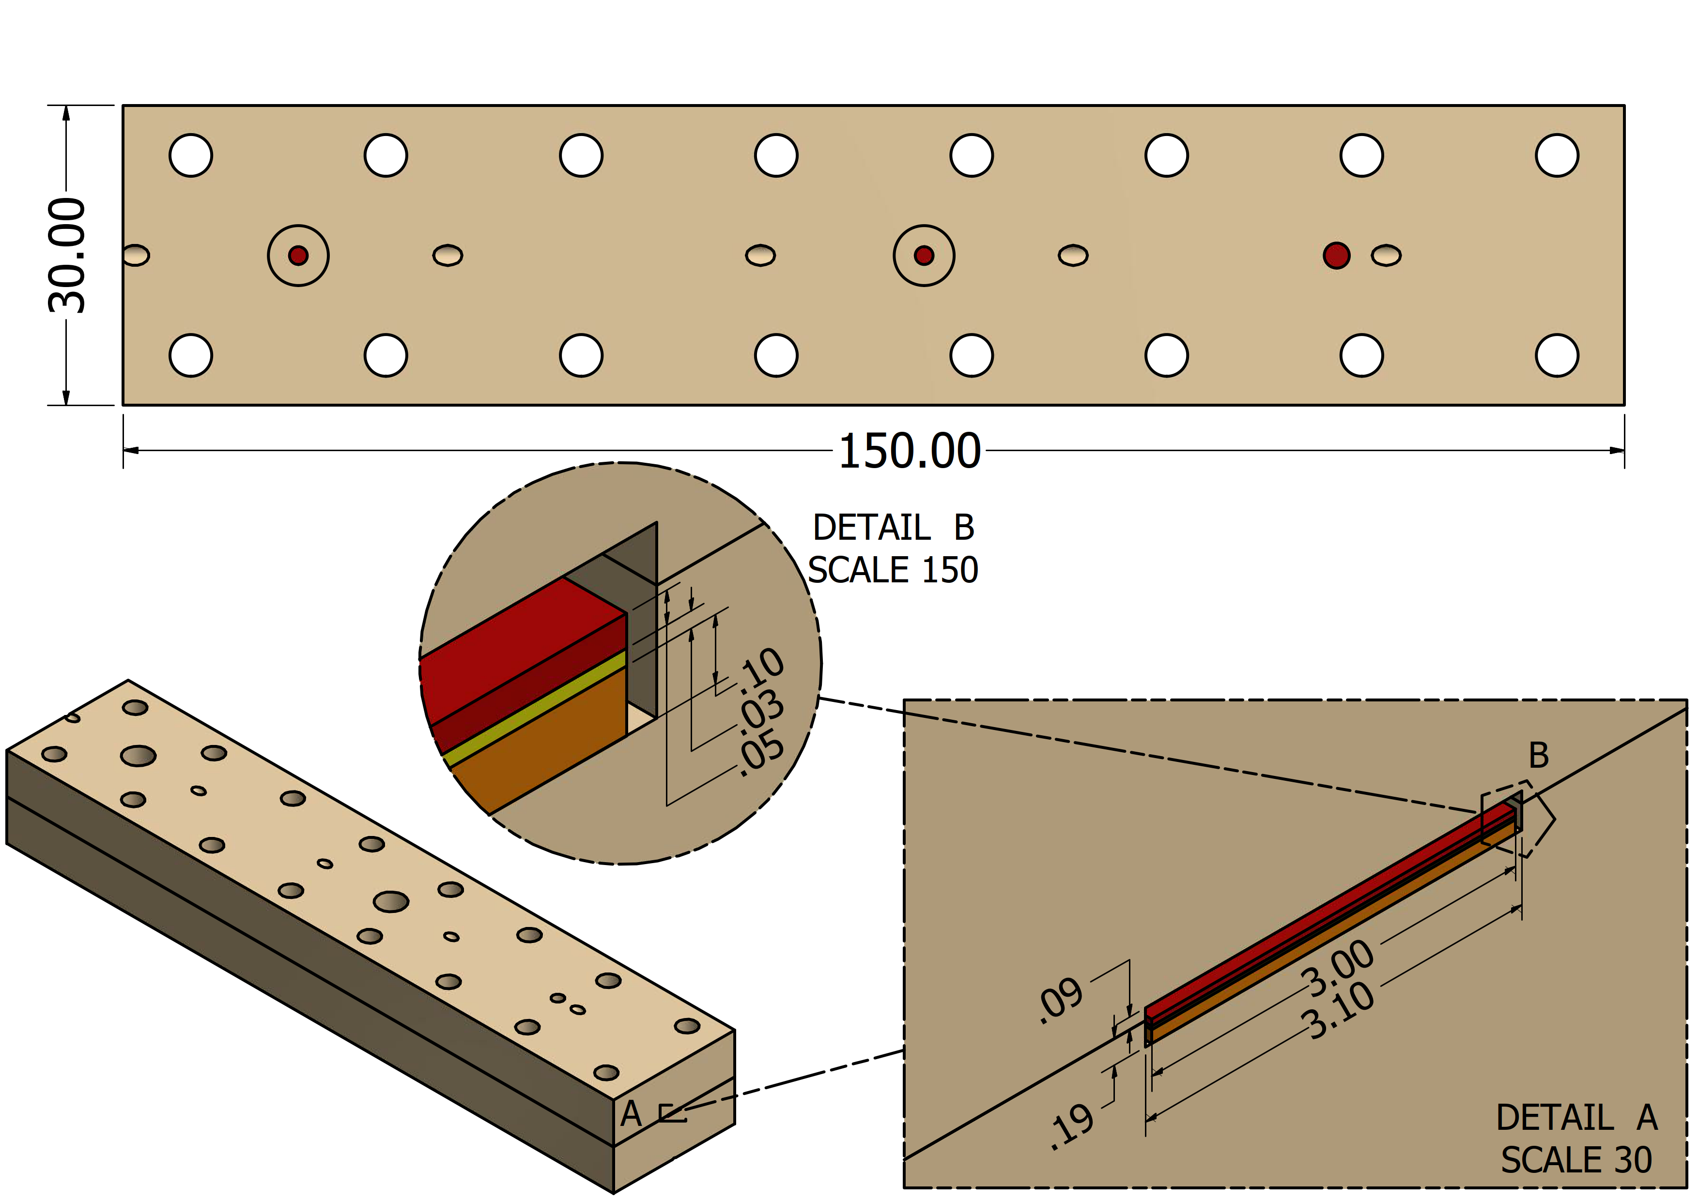
New Design (1/4)
To help with helium creeping under the strip, it is now made by taking a 100 µm Kapton strip as a base, and mating to it a 50 µm stainless steel heater strip with a layer of glue
Holes for pressure sensors
Lead holes for thermal sensors
28

Slide 29
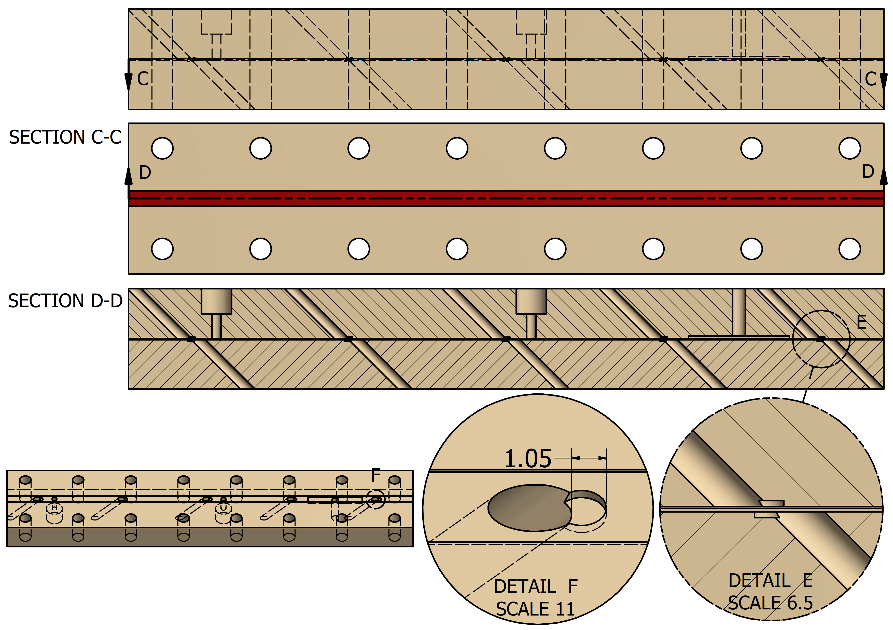
New Design (2/4)
New design avoids temperature sensor holders altogether; the sensors will be placed in the small slots seen in details E and F
The sensor leads will go out through the angled holes to minimize bending at the soldering points on the sensor
Sensors will attach directly to the heater strip from the underside, placed in cutouts/slots in the kapton
29

Slide 30
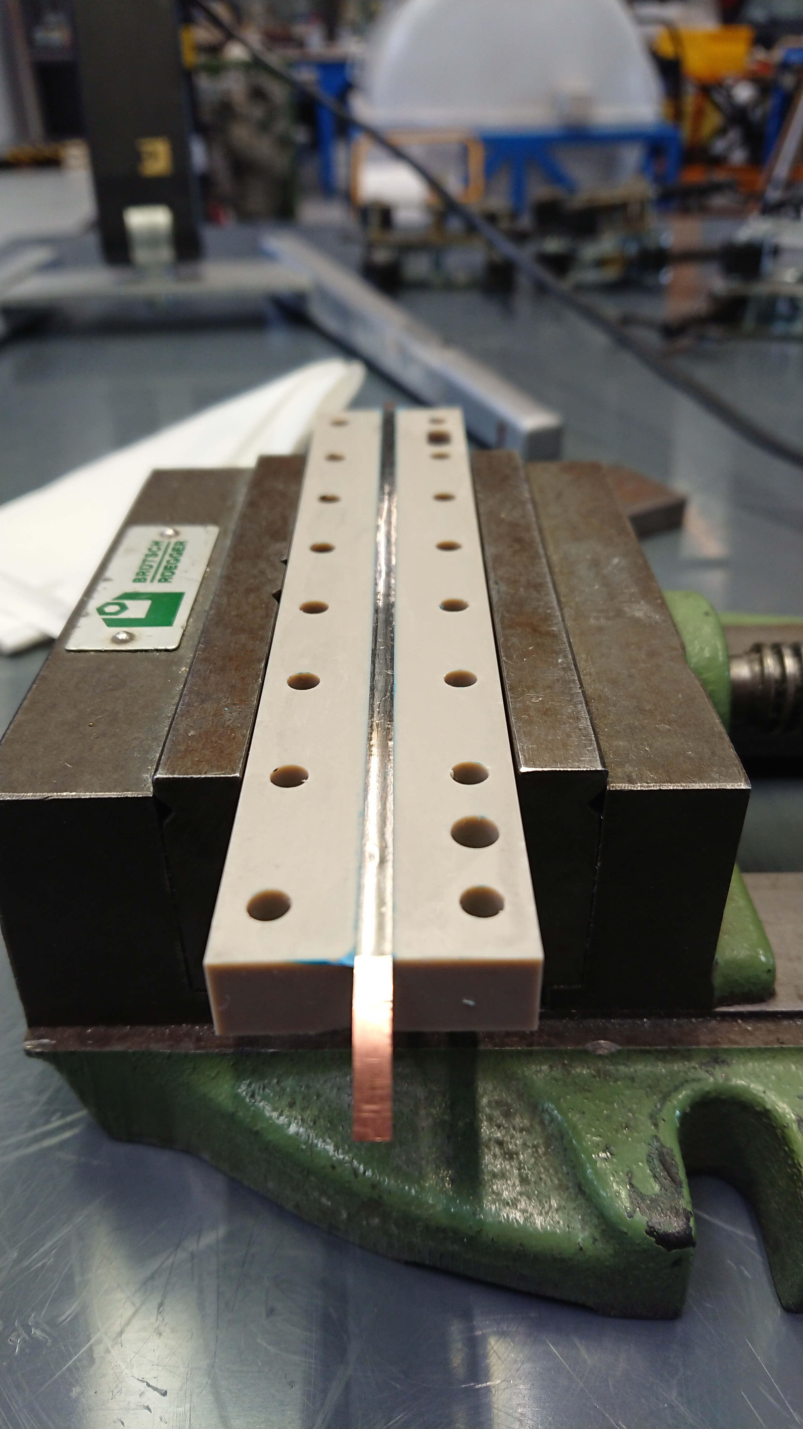
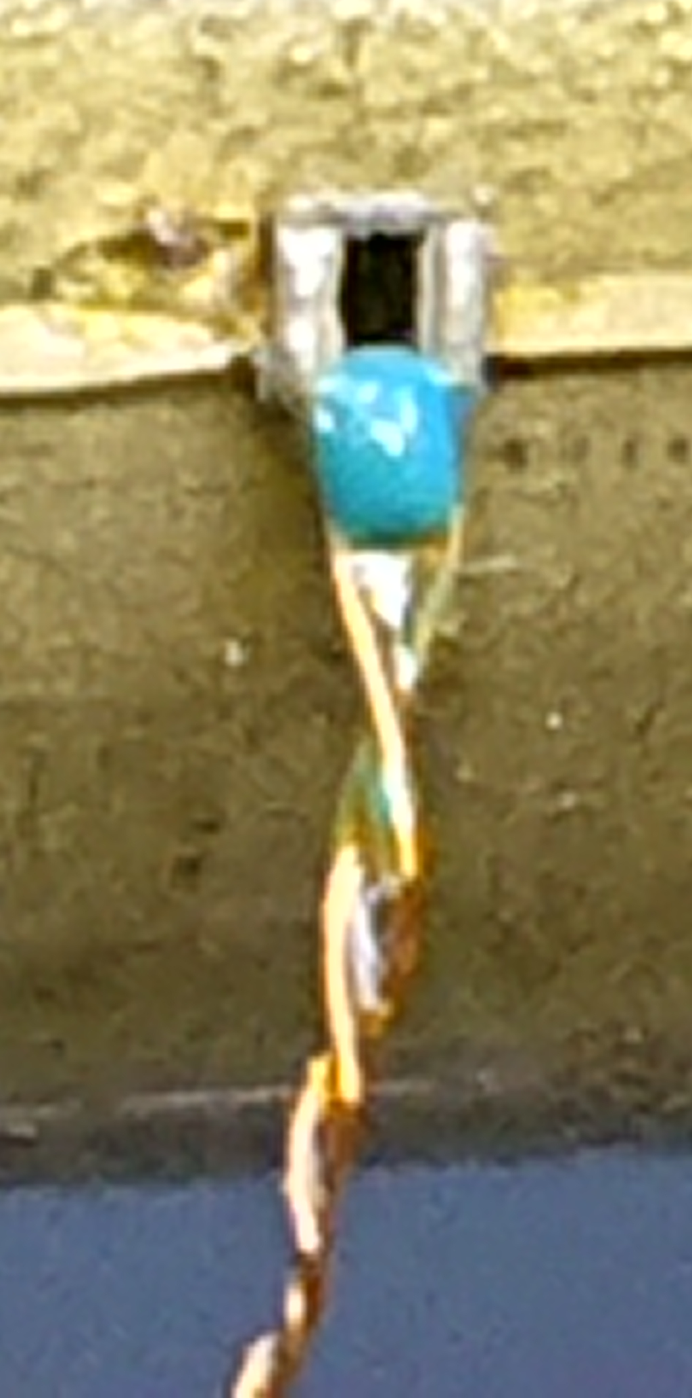
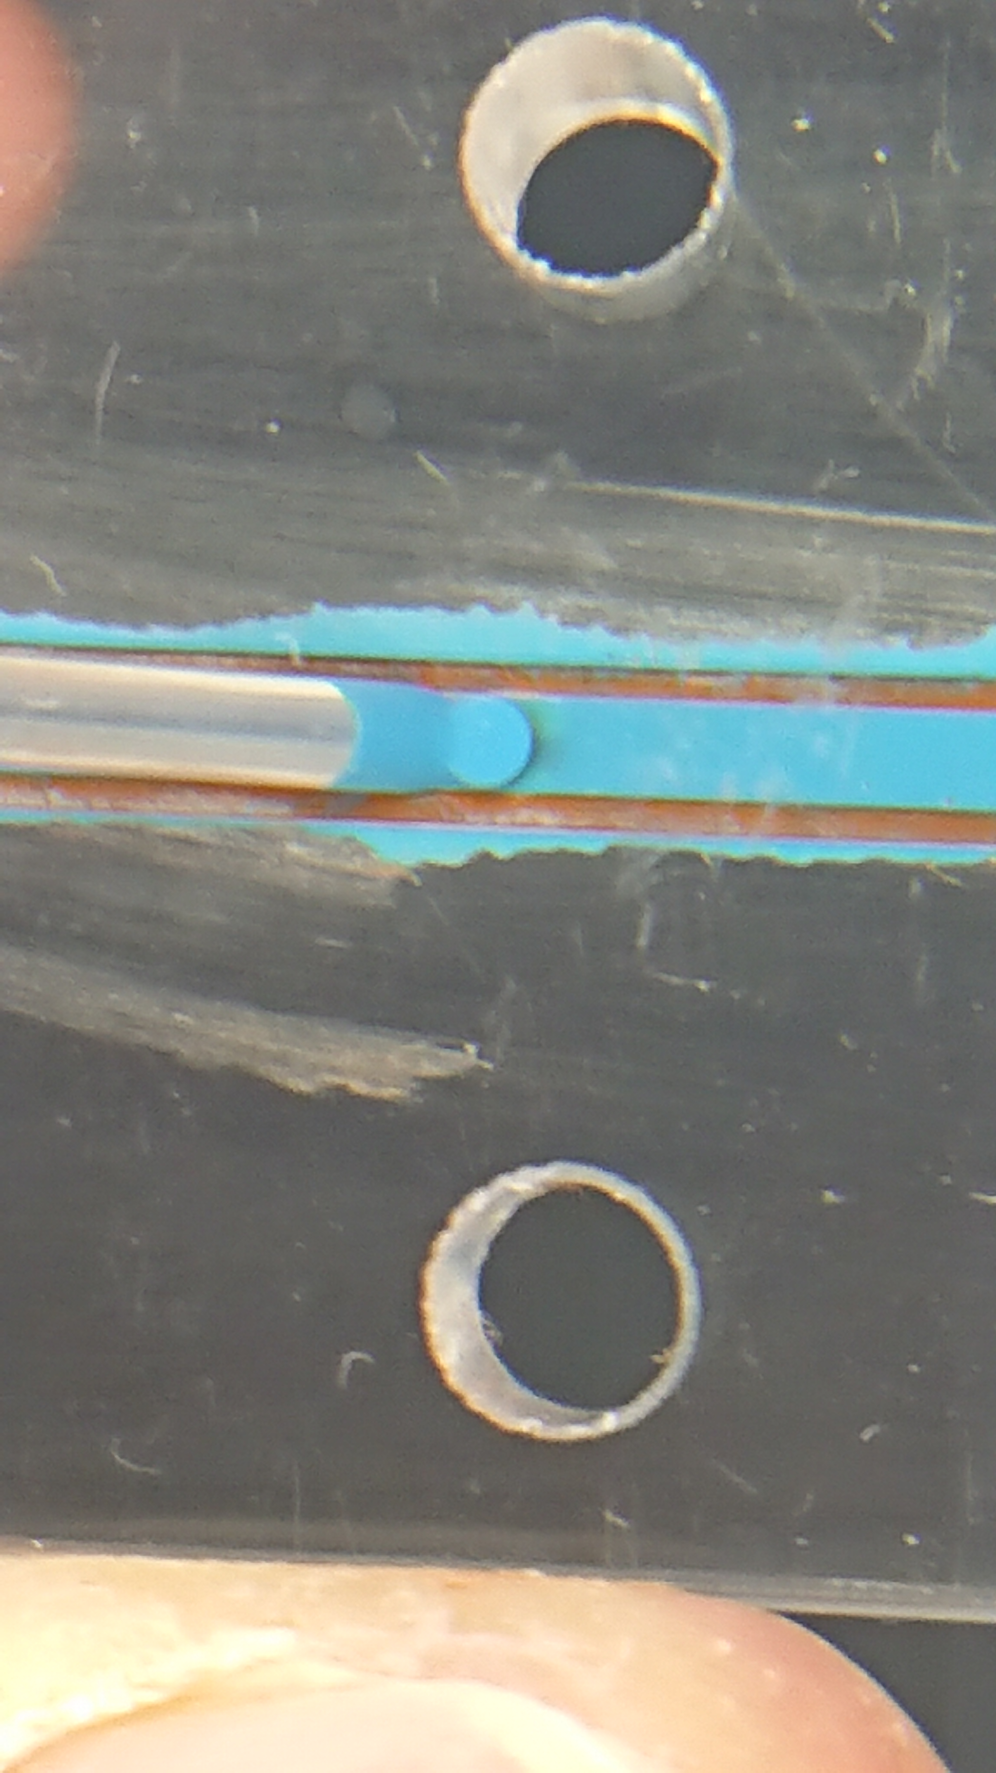
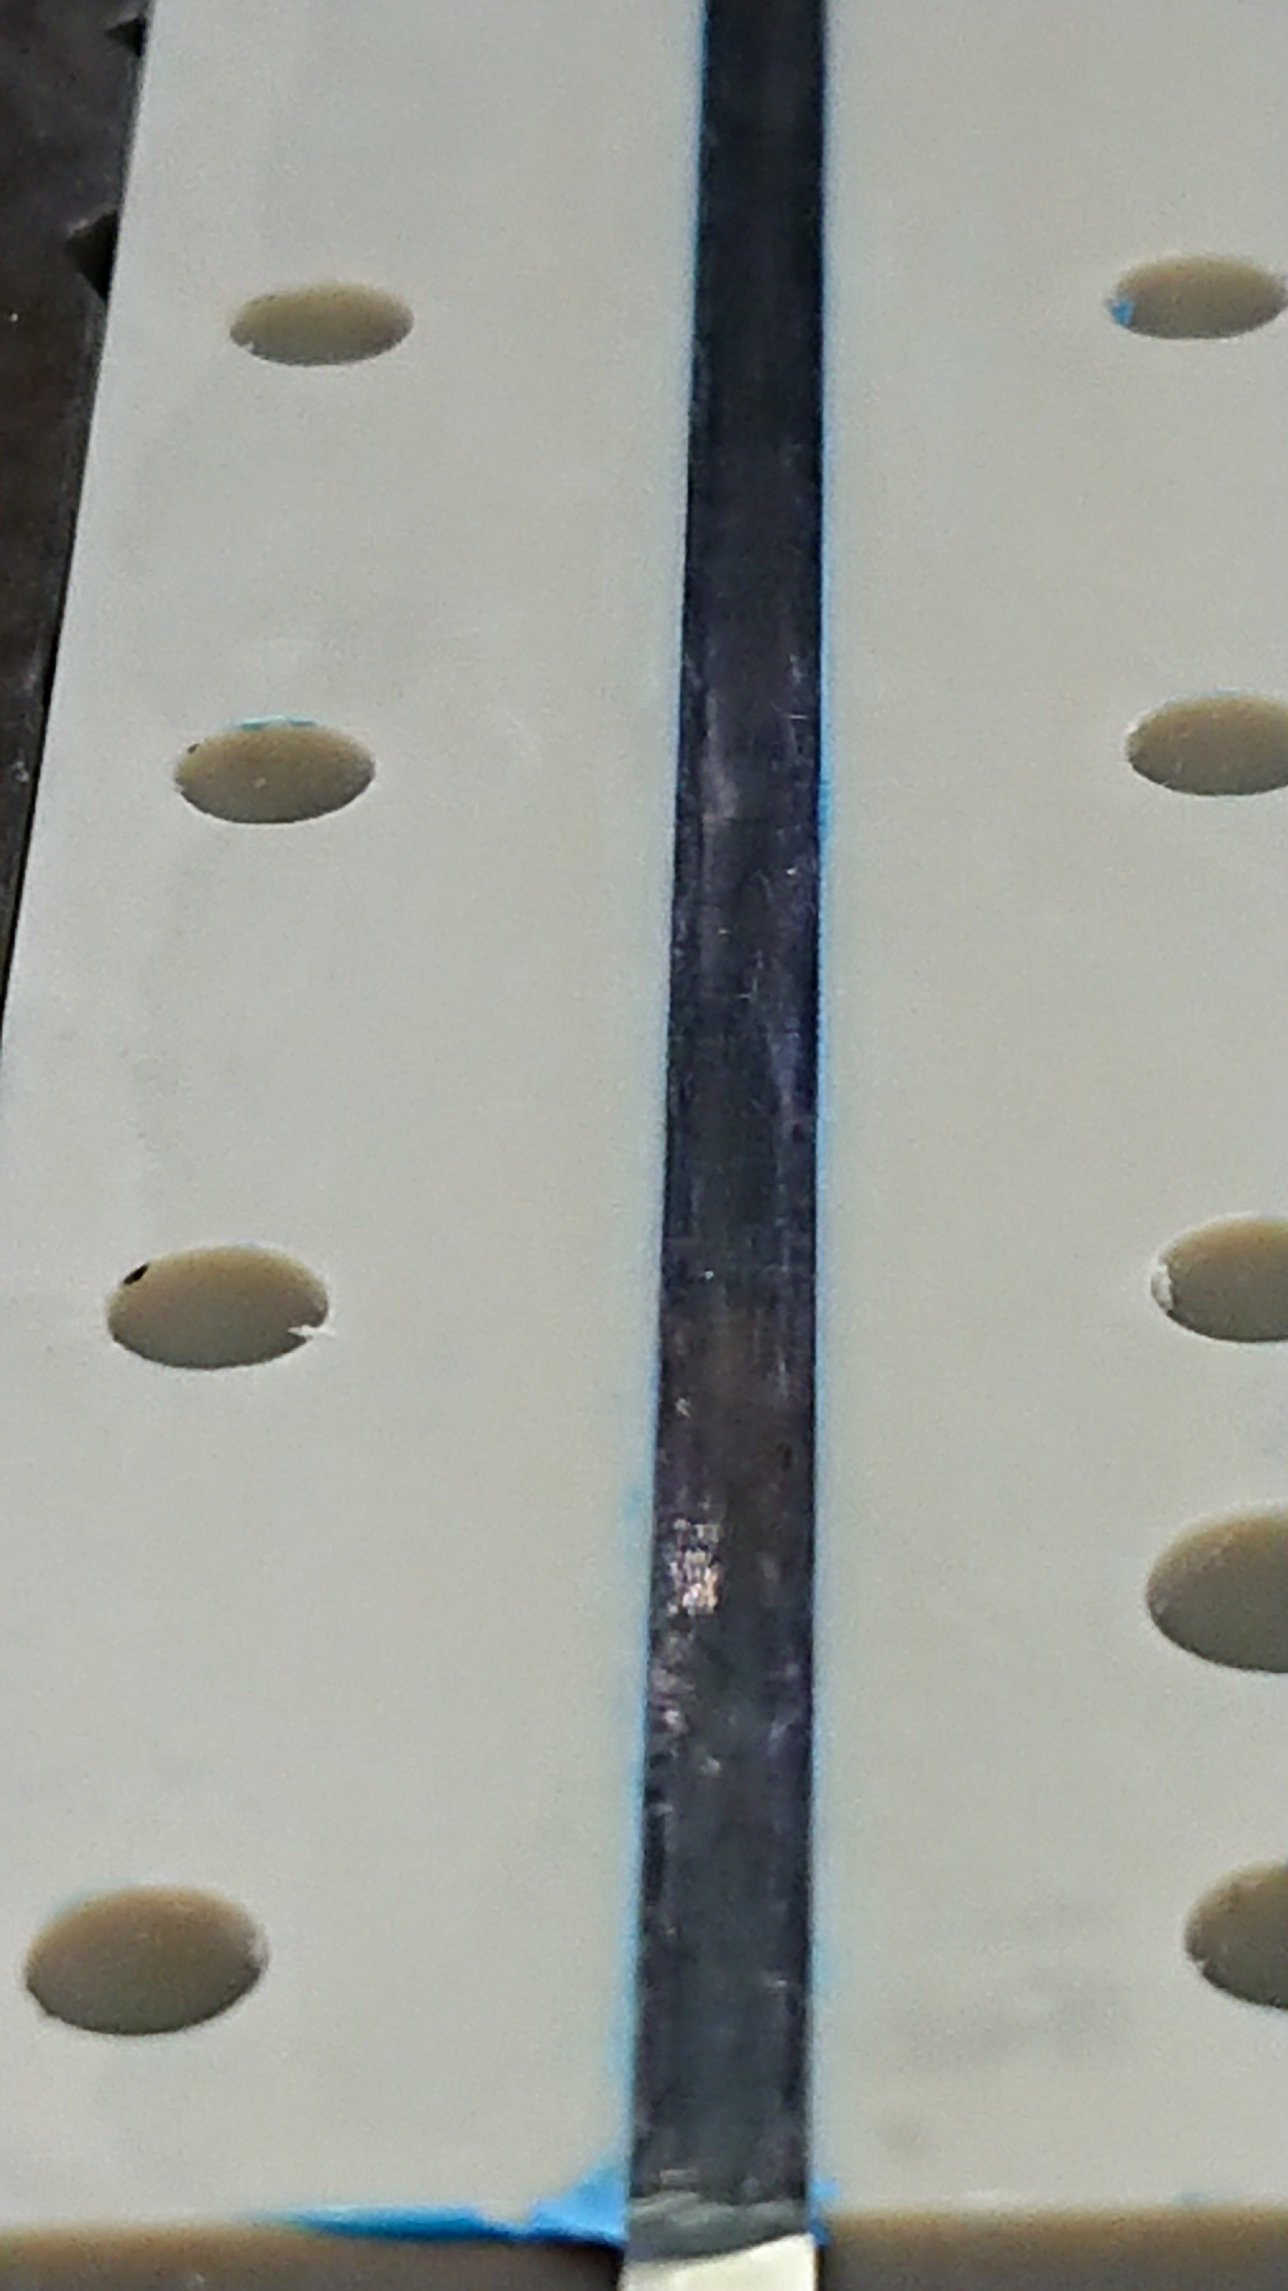
New Design (3/4)
New procedures for assembly;
  Use Eccobond as the main glue for the strip-to-PEEK mating (for its excellent helium leak-tightness)
  Use Eccobond to fill lead holes as well
  Use GE 7031 varnish to attach sensors to heater strip, and also to seat them in their slots on the helium side of the channel
  Before insulating the leads of the thermal sensors a bead of Eccobond will be applied at the soldering point for mechanical stability
30

Slide 31
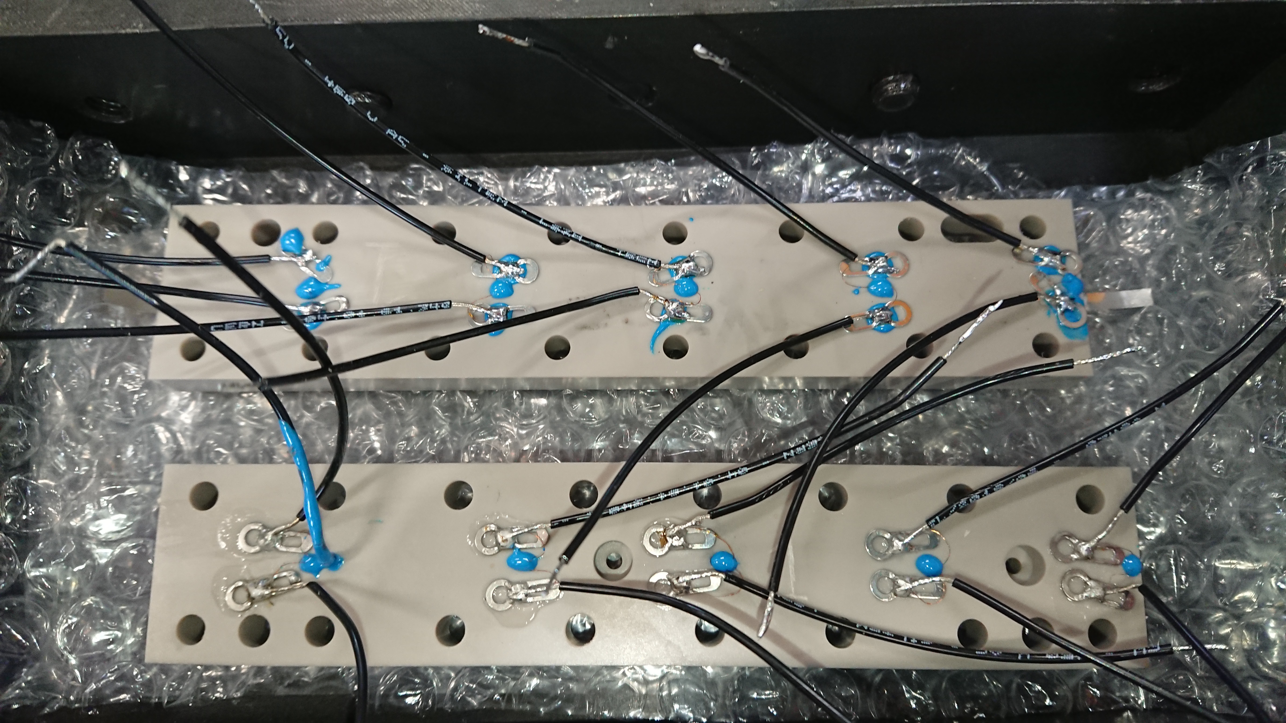
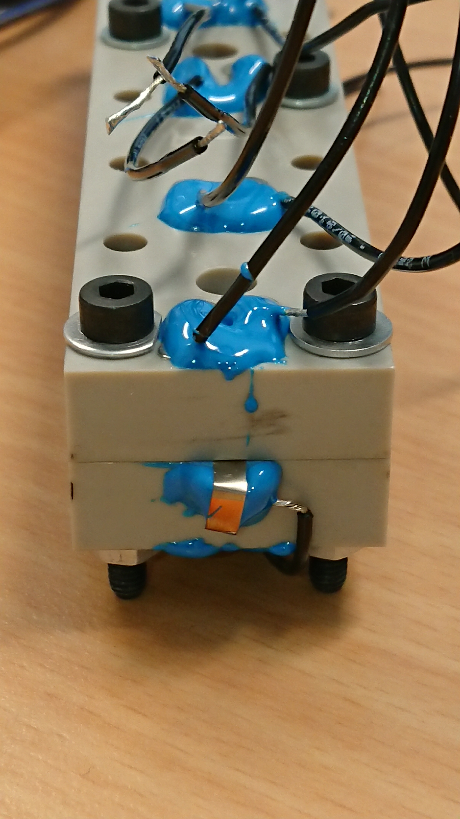
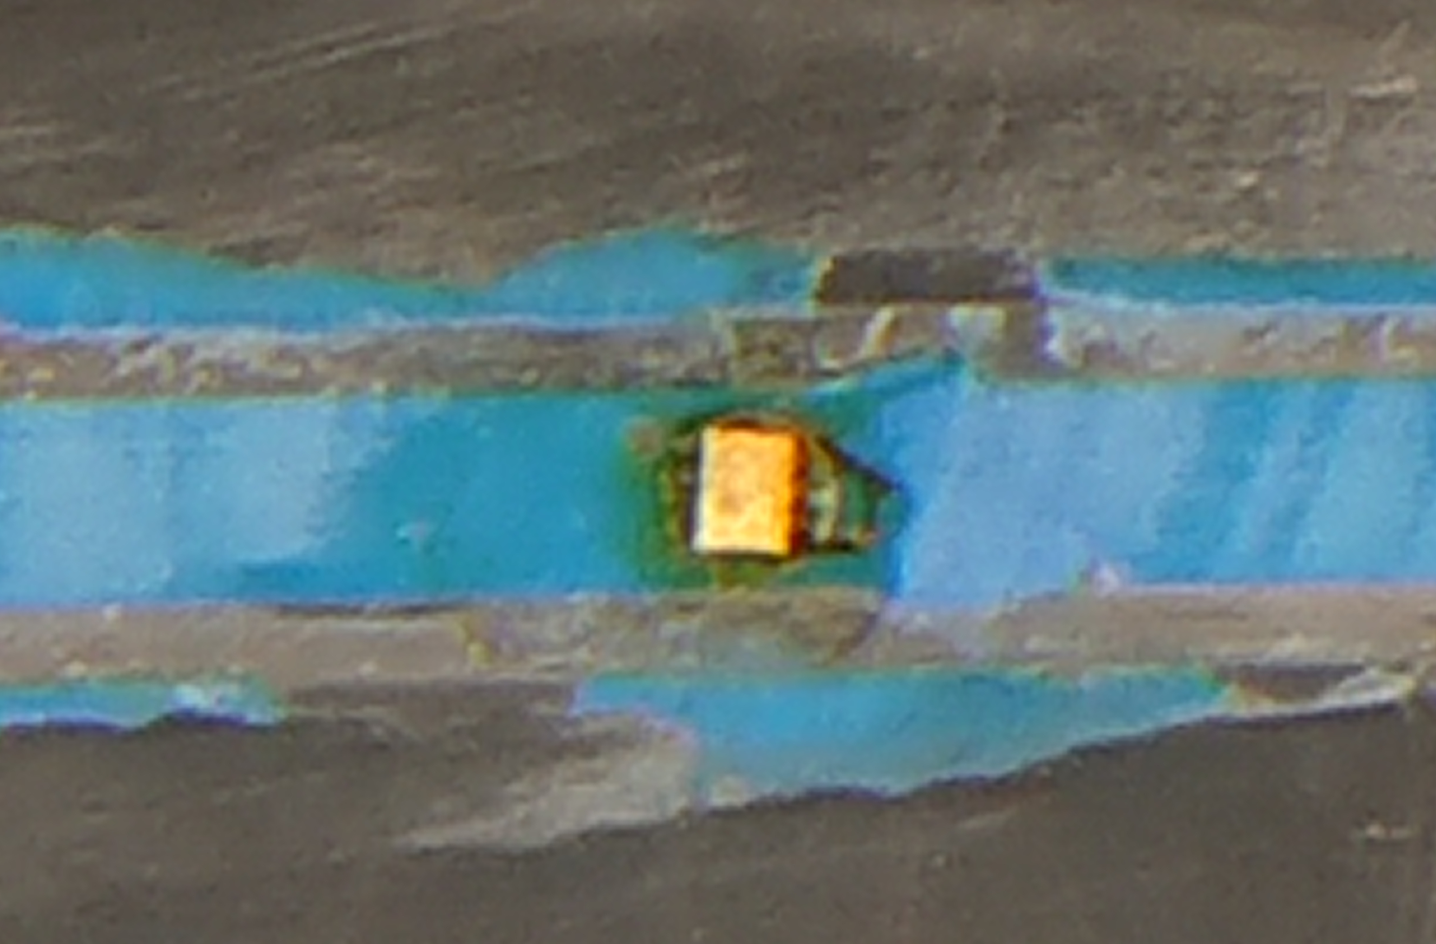
New Design (4/4)
31

Slide 32
New Features (1/2)
Pressure sensors
  Fitting two pressure sensors in the channel, one in the centre (very close to centre temperature sensor) and one at the edge
  Will at the very least be able to give a good binary indicator for whether or not helium in the channel has turned gaseous
  Could prove hard to calibrate, since the cryostat is not supposed to be used as a pressure vessel
    Between rough vacuum and up to twice atmospheric pressure is possible
32

Slide 33
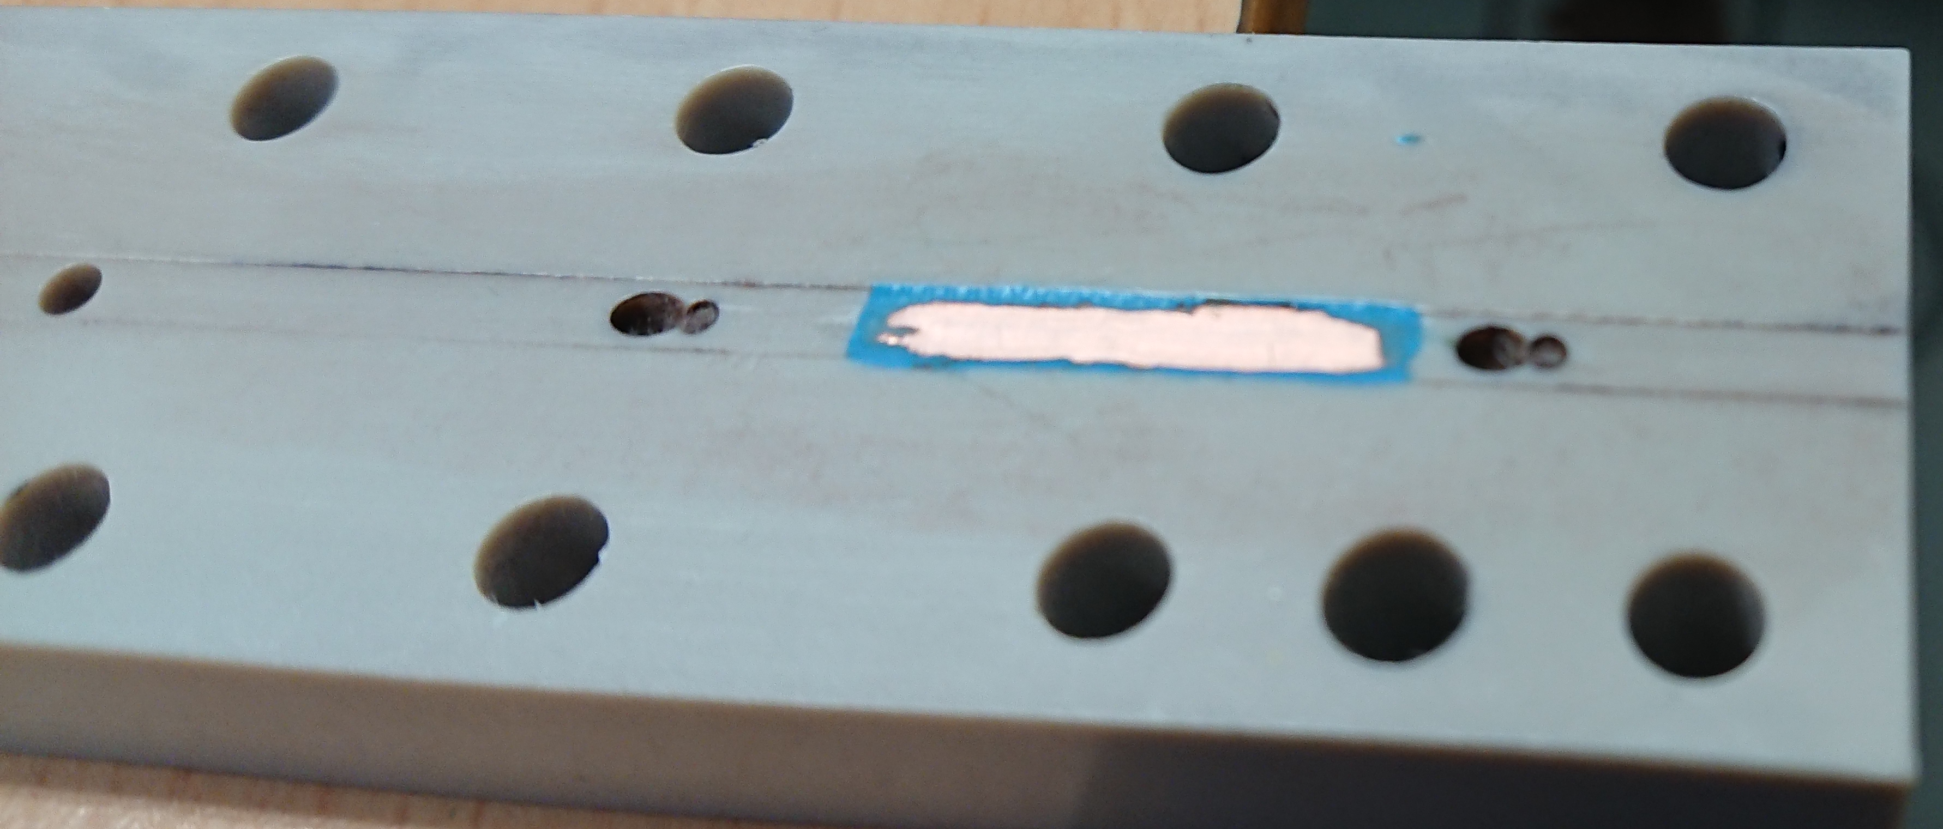
New Features (2/2)
Capacitive measurement
  The electrical permittivity of liquid helium is about 5% higher than that of gaseous helium
  By placing a copper electrode just above the heater strip it is possible to measure the capacitance of the gap (of helium), which gives yet another indicator for whether or not boiling has occurred
This is the practice piece; the real piece has a much cleaner edge
33

Slide 34
References
Scott M. Rowan. “LHC main dipole magnet circuits: sustaining near-nominal beam energies”. PhD thesis. 2016
A. Verweij. CUDI: User’s Manual. CERN. 2007
S.W. Van Schiver. Helium Cryogenics, 2nd Edition. International Cryogenics Monograph Series, Springer, 2012
Shahir Mohd Yusuf et al. “Investigation on Porosity and Microhardness of 316L Stainless Steel Fabricatedby Selective Laser Melting”. In: Metals7.2 (2017). issn: 2075-4701. doi: 10.3390/met7020064. url: http://www.mdpi.com/2075-4701/7/2/64
34

Slide 35
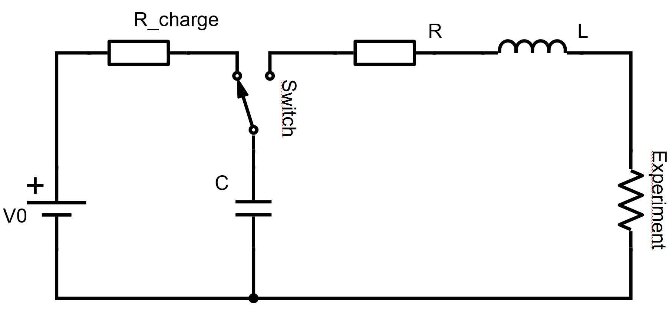
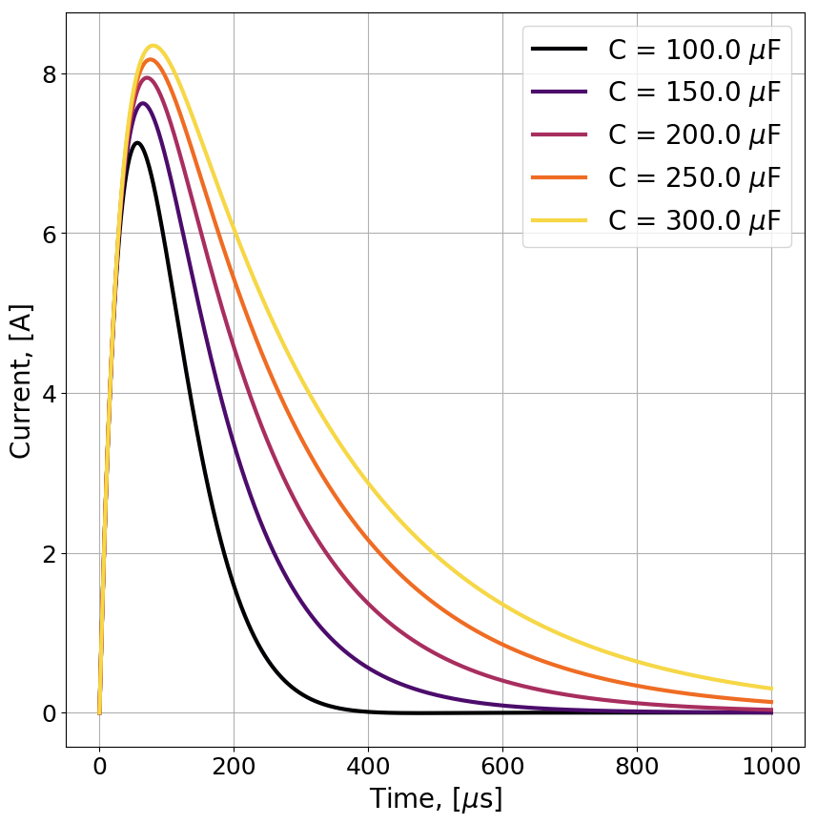
Need to Deliver Energy
“Experiment” means helium channel with heating element
Simple to get sub-millisecond pulse
We also want slower pulses, on the order of 100 ms and 500 ms to get heating similar to magnet protection events
A simplified 0D heat transfer model based on the current (faulty) models to determine circuit parameters
The selection criteria are a bit complicated, and not so interesting, but feel free to ask about it off-line – key: based on heater surface temperature reached within certain time

Slide 36
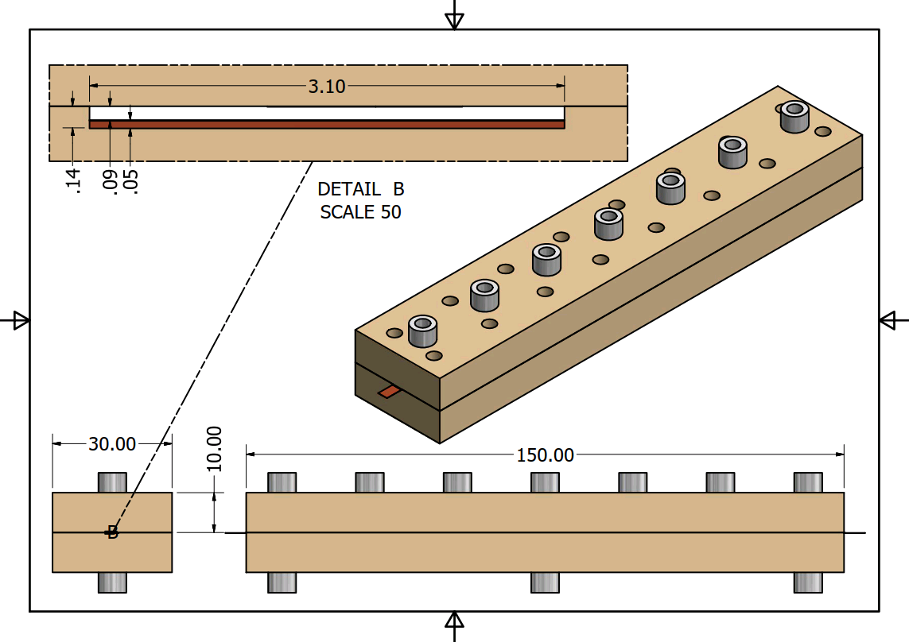
Helium Channel in PEEK
Glass fibre reinforced PEEK is used because of its
1) insulating properties (both electrical and thermal)
2) near metallic thermal contraction (to avoid heater strip detaching during cooldown)
36

Slide 37
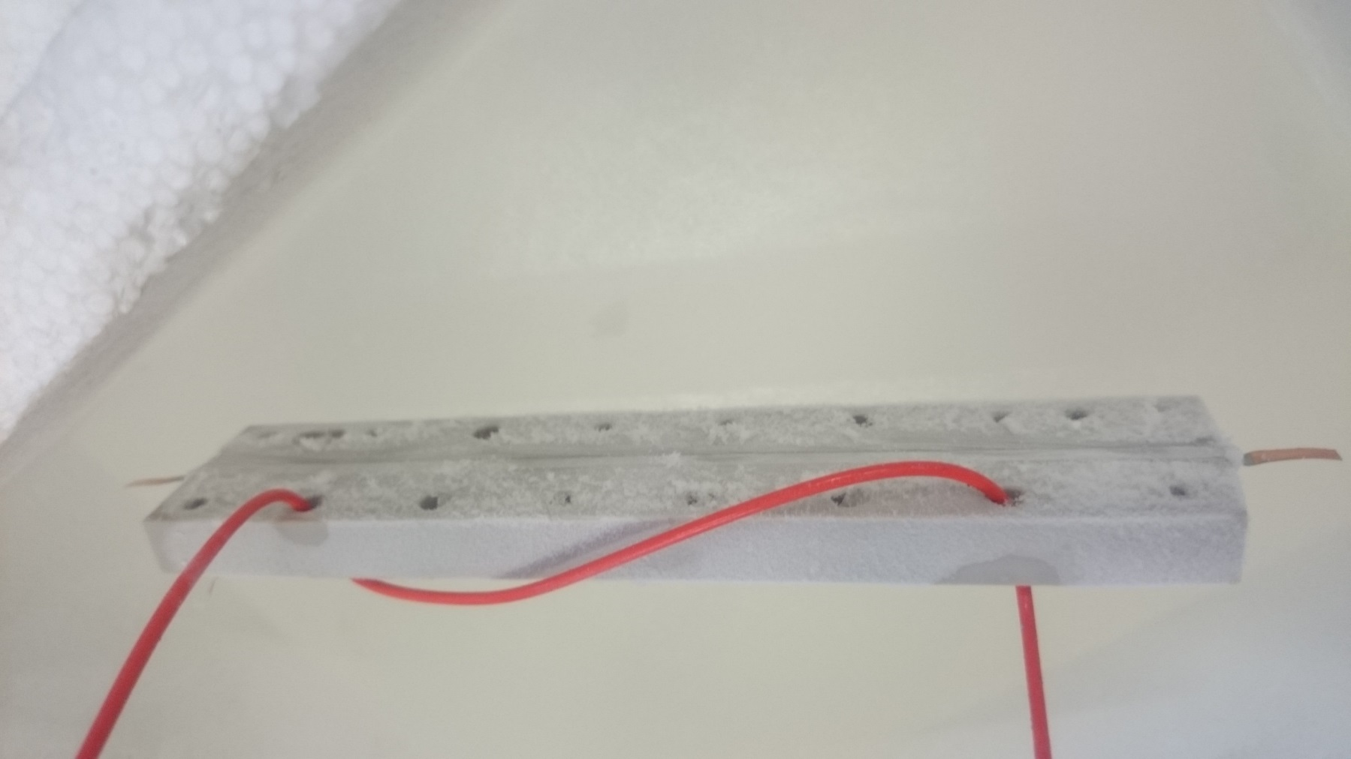
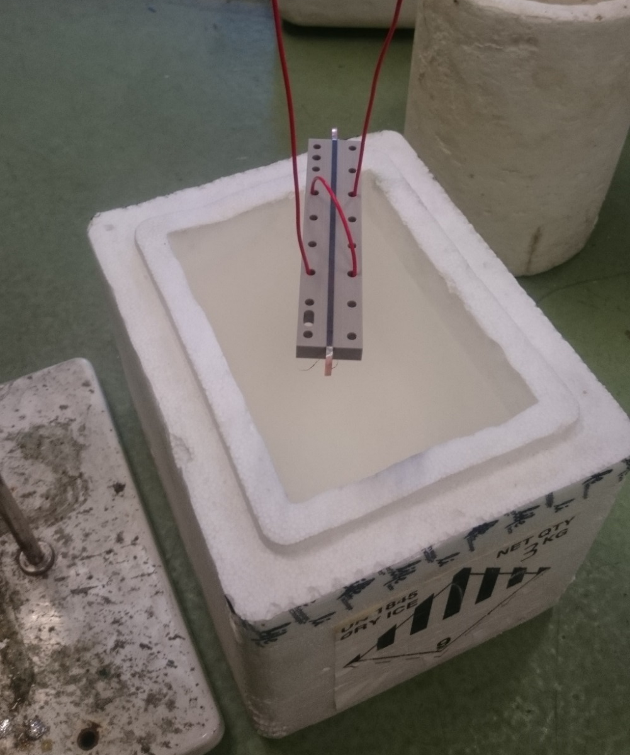
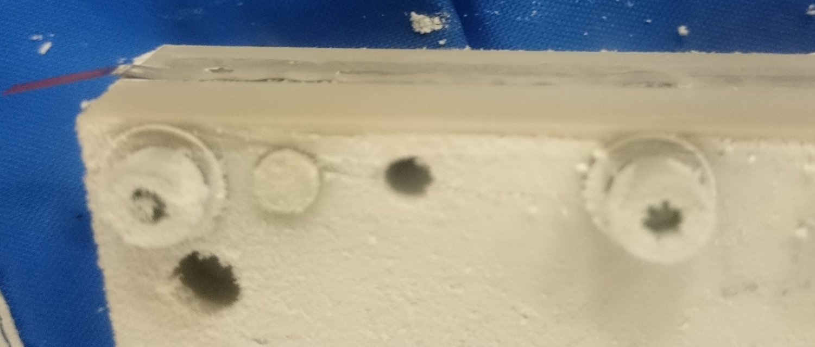
Real thing – Bottom plate
LN2 tests of strip gluing
Thermal shock may still cause the strip to detatch despite PEEK’s thermal contraction being very similar to stainless steel
37

Slide 38
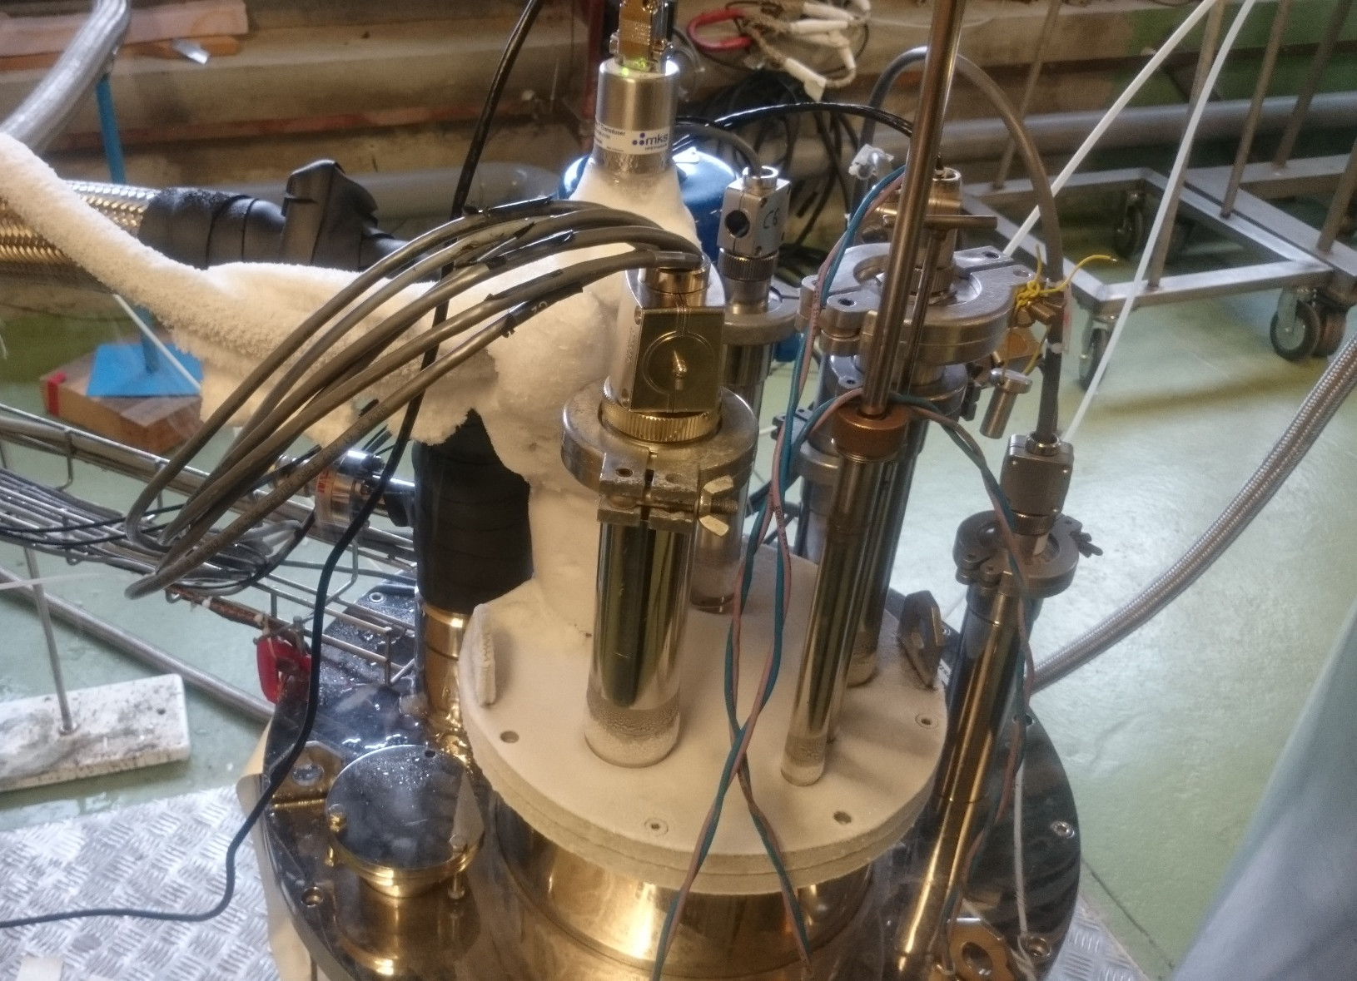
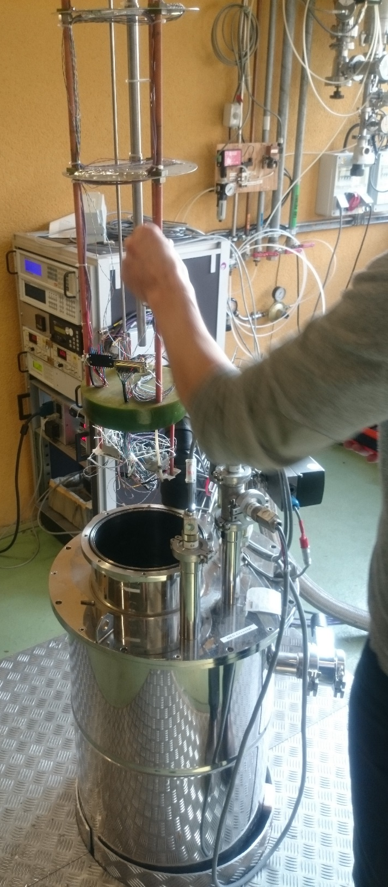
Real thing – Into cryostat
38

