Slide 1
MPE-PE Mini Lectures: Introduction
C. Wiesner, A. Apollonio
March, 28th 2019

Slide 2
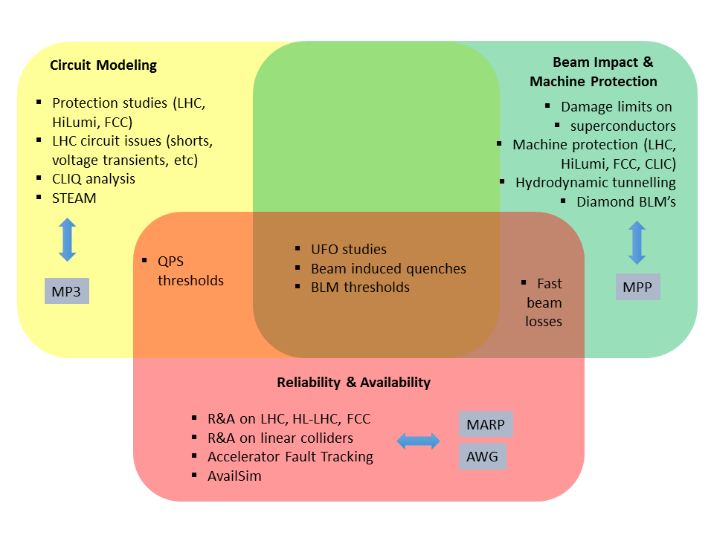
MPE-PE Section
https://twiki.cern.ch/twiki/bin/viewauth/TEMPEPE/

Slide 3
Mini Lectures: Topics
Beam & accelerator physics
Magnets
What types of magnets do we need? And how do we get them?
Dipoles, quadrupoles, and more: beam-dynamics and hardware realization
Kicker and septa
How to describe a particle beam?
Phase-space, Liouville theorem, emittance, optical functions (α, β, γ), σ
How do superconducting acc. magnets work?
Basics of superconductivity
Basics of superconducting magnet and cable design
Why use superfluid helium?
How do accelerators work?
Beams production: ion sources
Beam transport, FODO lattice
Beam acceleration: linacs and acc. cavities
Beam collision: synchrotron, collider, luminosity, β∗
Acc. hardware: beam dump, cavities, …
Why and how to protect a s.c. magnet?
How to quench a s.c. magnet?
How to protect a s.c. magnet?
Quench/damage limits
What can go wrong? Beam-related failures
Failure classification (risk, slow/fast/ultrafast failures)
Failure examples: magnet powering, injection/extraction failures, UFOs, QH firing
Failure criticality for different machines
How does the CERN accelerator complex work?
Injectors: LINACs, PSB, PS, SPS
LHC operation and cycle
LHC availability and faults
Reliability and availability
Basic definitions (for CERN and other accelerators)
Introduction to risk assessment
Lifetime distributions and bathtub curve
What happens if the beam is lost?
Beam-matter interaction
Hydrodynamic tunnelling
MP Systems
Main MP systems at LHC (BIS, PIC, WIC, QPS, LBDS, COLL)
Electronics for MP
Special Topics…
Visits…
Reliability & Availability
Machine Protection
Computational Methods
Coding conventions and good practice / Object-oriented programming
Basics of co-simulation
Introduction to machine learning
How to simulate a particle beam? How to simulate a magnetic field?

Slide 4
Mini Lectures: Topics
Beam & accelerator physics
Magnets
What types of magnets do we need? And how do we get them?
Dipoles, quadrupoles, and more: beam-dynamics and hardware realization
Kicker and septa
How to describe a particle beam?
Phase-space, Liouville theorem, emittance, optical functions (α, β, γ), σ
1)
How do superconducting acc. magnets work?
Basics of superconductivity
Basics of superconducting magnet and cable design
Why use superfluid helium?
3)
4)
2)
How do accelerators work?
Beams production: ion sources
Beam transport, FODO lattice
Beam acceleration: linacs and acc. cavities
Beam collision: synchrotron, collider, luminosity, β∗
Acc. hardware: beam dump, cavities, …
5)
Why and how to protect a s.c. magnet?
How to quench a s.c. magnet?
How to protect a s.c. magnet?
Quench/damage limits
What can go wrong? Beam-related failures
Failure classification (risk, slow/fast/ultrafast failures)
Failure examples: magnet powering, injection/extraction failures, UFOs, QH firing
Failure criticality for different machines
How does the CERN accelerator complex work?
Injectors: LINACs, PSB, PS, SPS
LHC operation and cycle
LHC availability and faults
6)
Reliability and availability
Basic definitions (for CERN and other accelerators)
Introduction to risk assessment
Lifetime distributions and bathtub curve
What happens if the beam is lost?
Beam-matter interaction
Hydrodynamic tunnelling
MP Systems
Main MP systems at LHC (BIS, PIC, WIC, QPS, LBDS, COLL)
Electronics for MP
Special Topics…
Visits…
Reliability & Availability
Machine Protection
0)
Computational Methods
Coding conventions and good practice / Object-oriented programming
Basics of co-simulation
Introduction to machine learning
How to simulate a particle beam? How to simulate a magnetic field?

Slide 5
Organization
Proposals:
Talks should be focused on the understanding of the basics concepts and ideas
Talks should be ~30 min + discussion
Ask as many questions as you want!
Thursdays, 10.30 in the week without Section Meeting (possibly with coffee/cake)?
Start: end of April/beginning of May 2019

Slide 6

It’s all about the audience (i.e. about us)…

