Slide 2
From LHC statistics to AvailSim modelling
M.Vekaria, A.Apollonio, T.Cartier-Michaud
6/06/2019

Slide 3
Introduction
Data sources
Introduction to LHC Operations
  Fault statistics in BModes
Injection Investigation
  Physics and Probe
AvailSim inputs

Slide 4
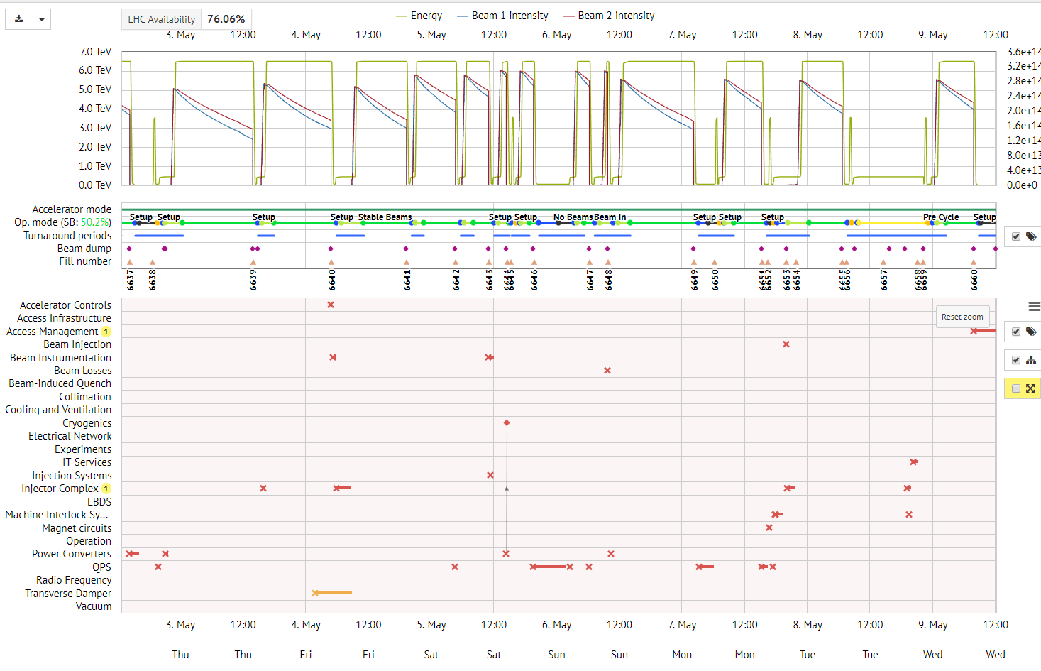
LHC Cardiogram

Slide 5
Availsim
Monte-Carlo simulation tool
  Simulate the operation of accelerators eg. LHC
Inputs based on observed performance
  Works using different reliability measures (Mean Time To Repair, Mean Time To Fail) from faults
  These change depending on the beam mode they occur in.
Also requires Beam Mode durations as an input

Slide 6
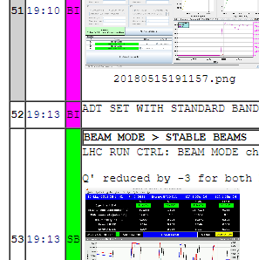
LHC Operation Breakdown
Aim is to calculate Beam Mode durations and calculate failure rates and repair times based on beam mode
OPERATIONAL MODES
BEAM MODES
No Beam
No Beam
Cycle
Setup
Pre-Cycle
Injection Probe
LHC Operations
Setup
Injection Physics
Ramp
Beam In
Pre - Ramp
Stable Beams
Squeeze
Adjust
Stable Beams
E-Logbook

Slide 7
Data Sources
Timber
  Fill number timings
  Beam modes
  Beam Intensity
AFT
  Fault data
Post Mortem
  Injection scheme

Slide 8
Injection Statistics
Tasked with looking into Injection inefficiencies.
  Looked at “injection physics” and “injection probe” for year 17-18 for AvailSim
  One of the least reproducible modes in LHC operation
    Why isn’t theoretical minima (28mins) reached?
      42*20*2/60 = 28
      Variety of discrepancies between injections that cannot be explained by faults
  Failures should be expected to correlate to beam intensity
    Looked at 25ns spaced 2556b

Slide 9
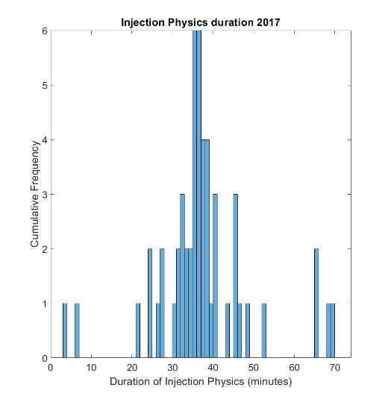
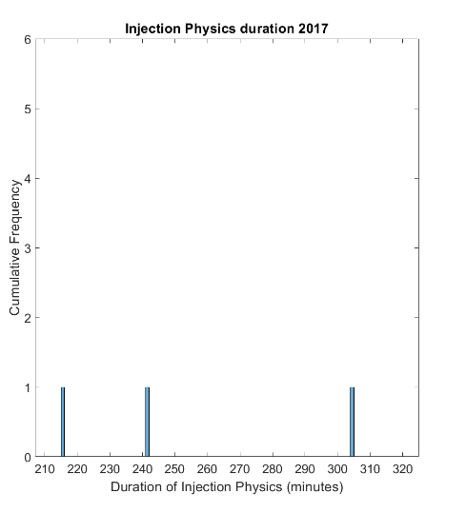
Cut-off for successful Injections
Cut-off for successful Injections

Slide 10
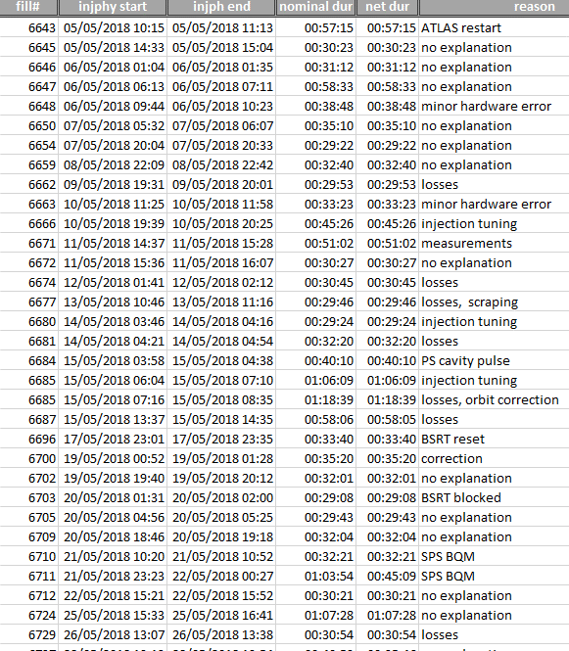
Why Categorise?
When looking through E-Logbook, these
are the most common
What is “no explanation”?
  There is no clear explanation in the logbook
All of this takes into account registered blocking faults, unregistered are noted as “minor hardware error” e.g.. Faulty QPS circuit board
(╯°□°）╯︵ ┻━┻

Slide 11
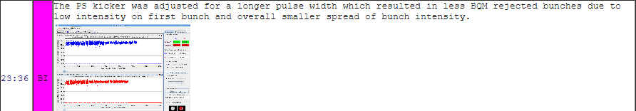

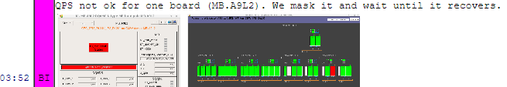
Some examples
Upstream
No explanation
Losses
Hardware
Intervention

Slide 12
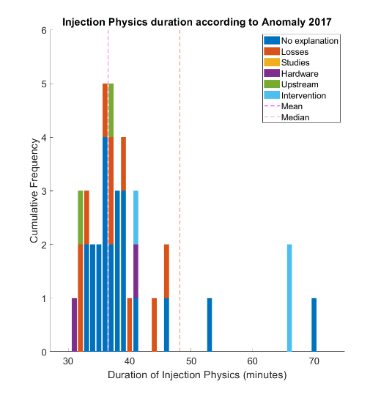
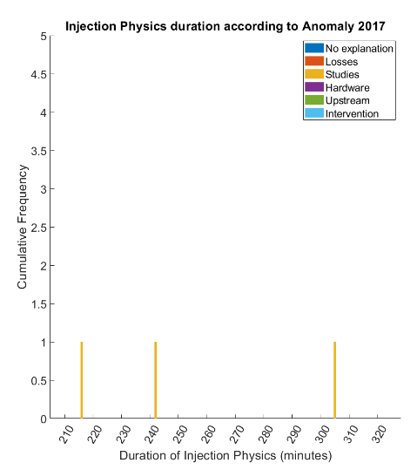
UFO, ADT Blowups
(injector complex faults or issues)
Cleaning
Steering
Tuning
Correction
16L2
Arrows are hyperlinks to E-Logbook

Slide 13
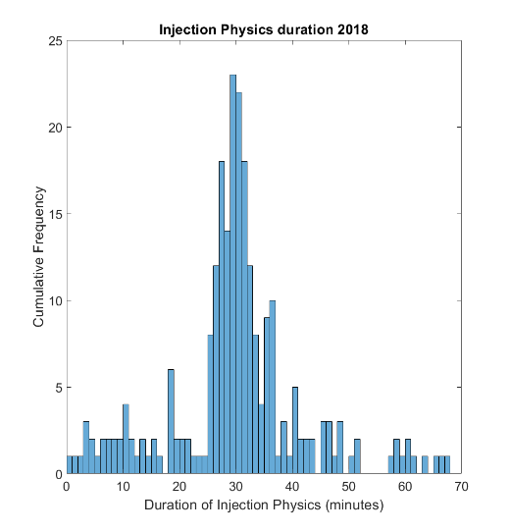
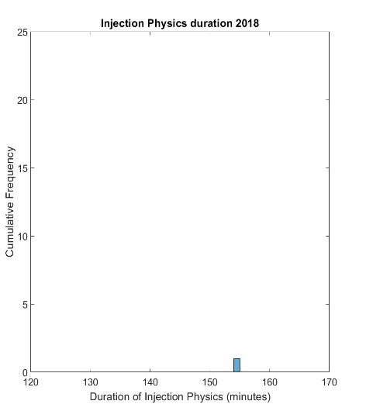
Cut-off for successful Injections
Cut-off for successful Injections

Slide 14
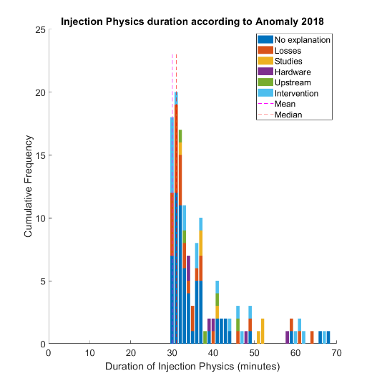
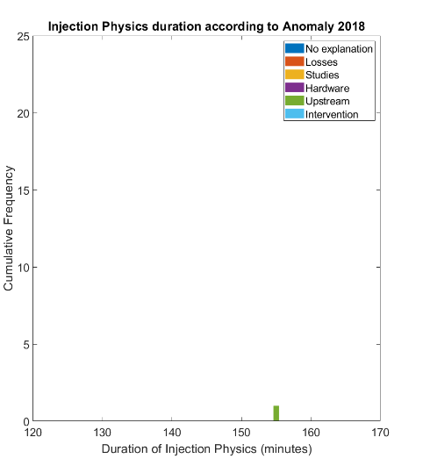
UFO, ADT Blowups
(injector complex faults or issues)
Cleaning
Steering
Tuning
Correction
LINAC2 missed shots

Slide 15
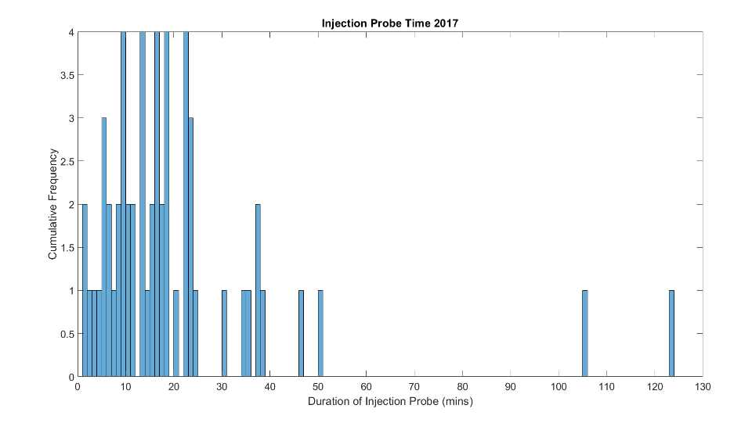
Cut-off for successful Injections
Notes:
Same binning across all graphs

Slide 16
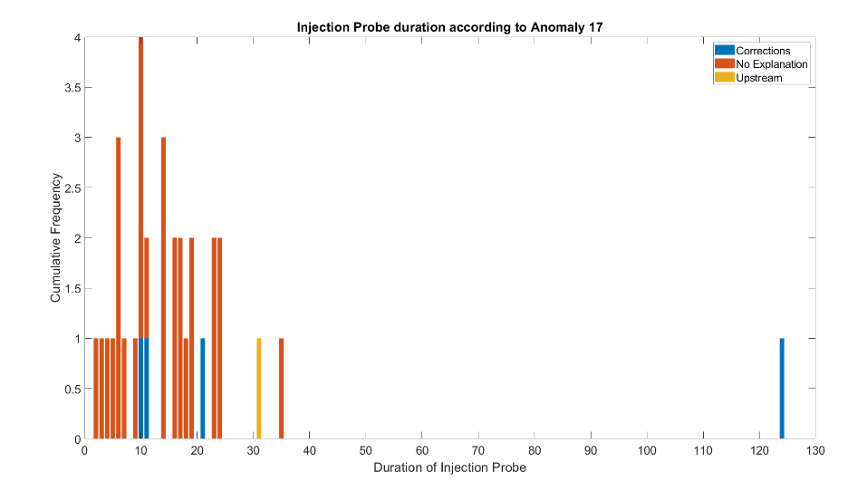
Correction
Calibrations
SPS
LINAC 2
PSB
PS
Chroma correction
Hyperlinked arrows again
mins

Slide 17
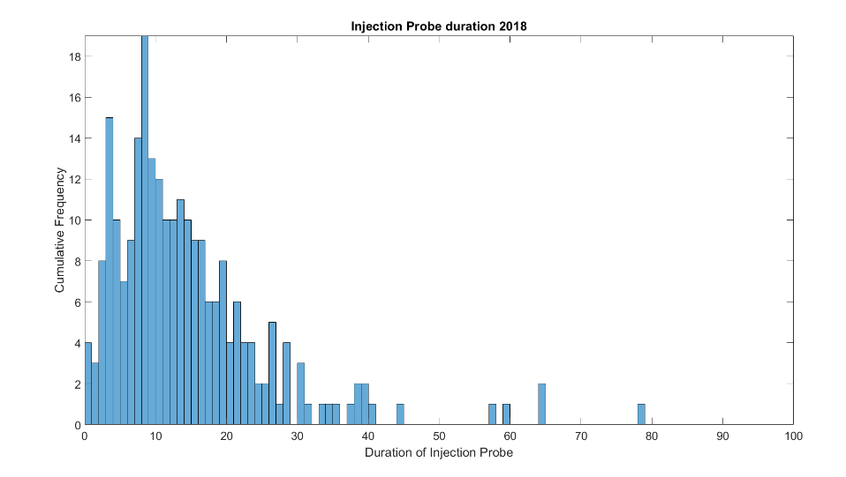
Cut-off for successful Injections
mins

Slide 18
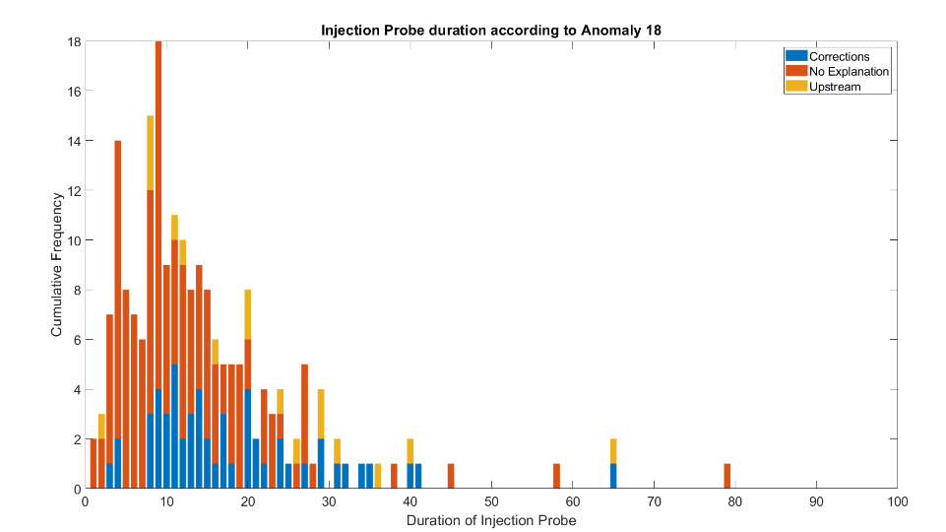
Correction
Calibrations
CPS
SPS
LINAC 2
PSB
PS
No explanation
mins
mins
Hyperlinked arrows again

Slide 19
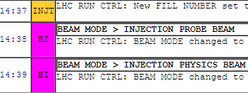
Review
There’s a lot of “no explanation”
  This isn’t necessarily a bad thing!
  This introduced a new task that would follow up from this (recommended by Bartosik and Rumolo), which is the first 12 bunch train.
  Expect largest variance because of the required synchronisations and corrections between injectors and LHC
Could not apply filter to such a large dataset, but 12b injection should be consistent across beam parameters.

Slide 20
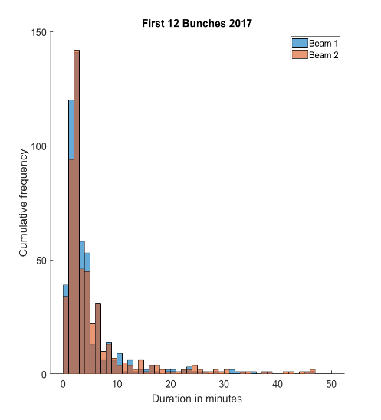
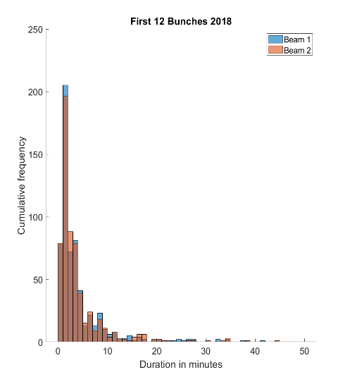


to log₁₀
This doesn’t show the variance we expected to see, next steps would be to plot the variance of the whole of the injection process
More analysis to come

Slide 21
AvailSim
Fault and beam mode statistics calculated and output into the ‘common input format’.
System Fault
Beam Mode B
Beam Mode A
Beam Mode B
Beam Mode A
Beam mode B experiences 2 faults, while A experiences 0.
MTTF given by Mode duration, ergo: MTTF in A ≡ ∑A/0 = inf
MTTF in B ≡ ∑B/2 = val
MTTR
Notes:
Include sc of common input

Slide 22
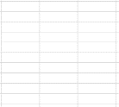
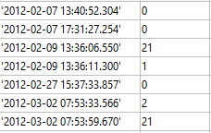
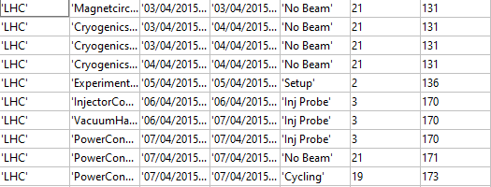
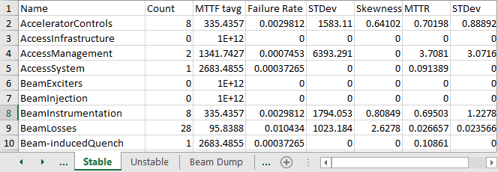
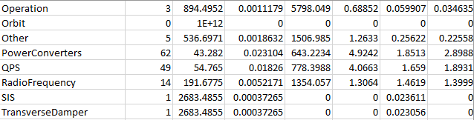
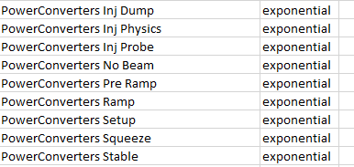

Process
AFT
Timber (LDB)
Index
Beam Mode
Attribute beam mode and Index location of beam mode using data from AFT and Timber
Mode durations must discount fault time for MTTF
Output
Notes:
Animate the bits

Slide 23
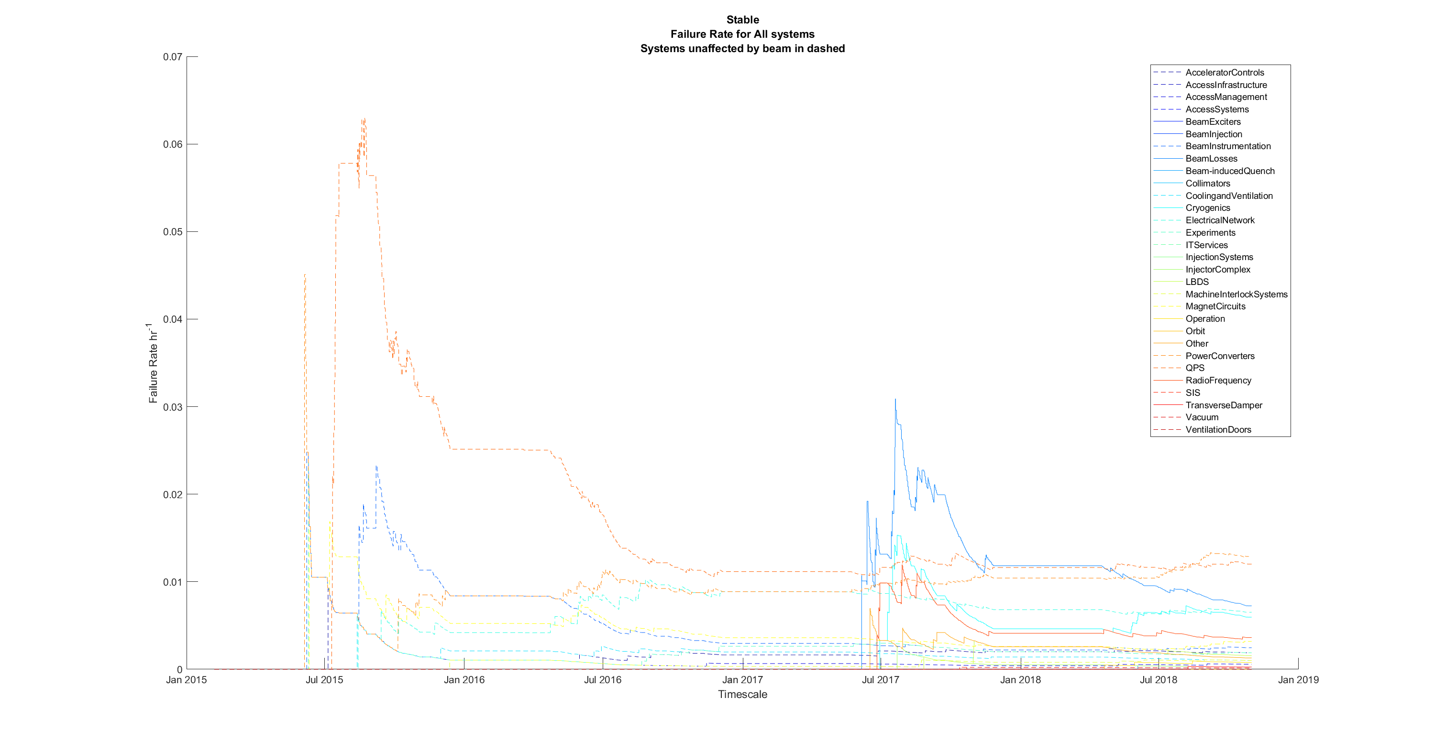
Moving Statistics
QPS CRISIS
16L2

Slide 24
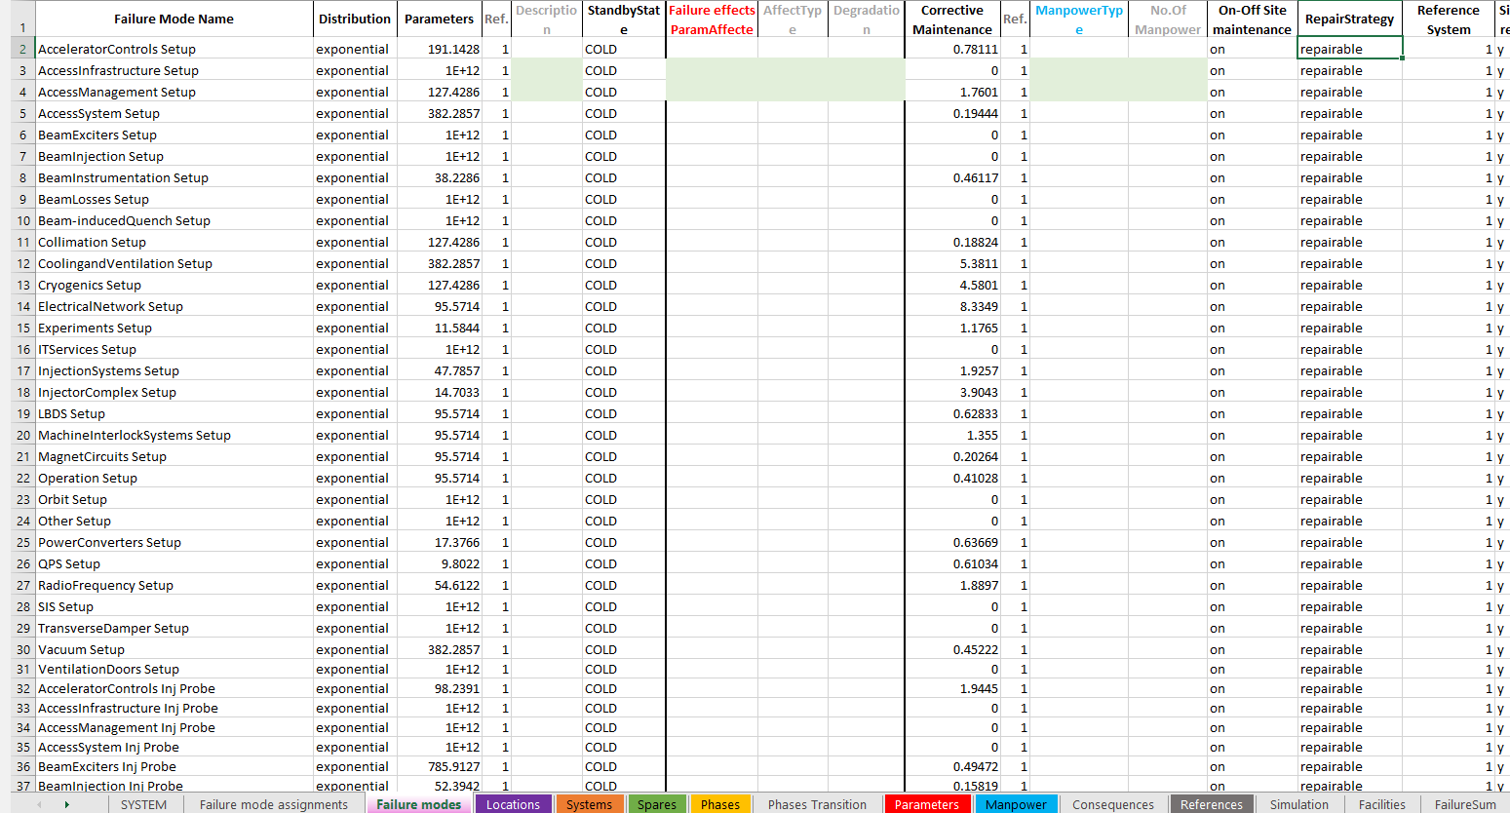
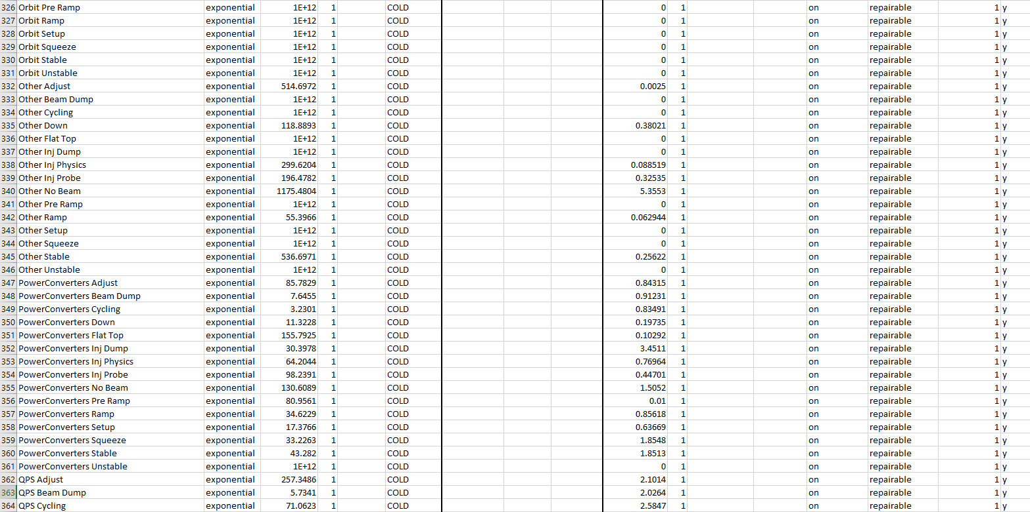

Slide 25
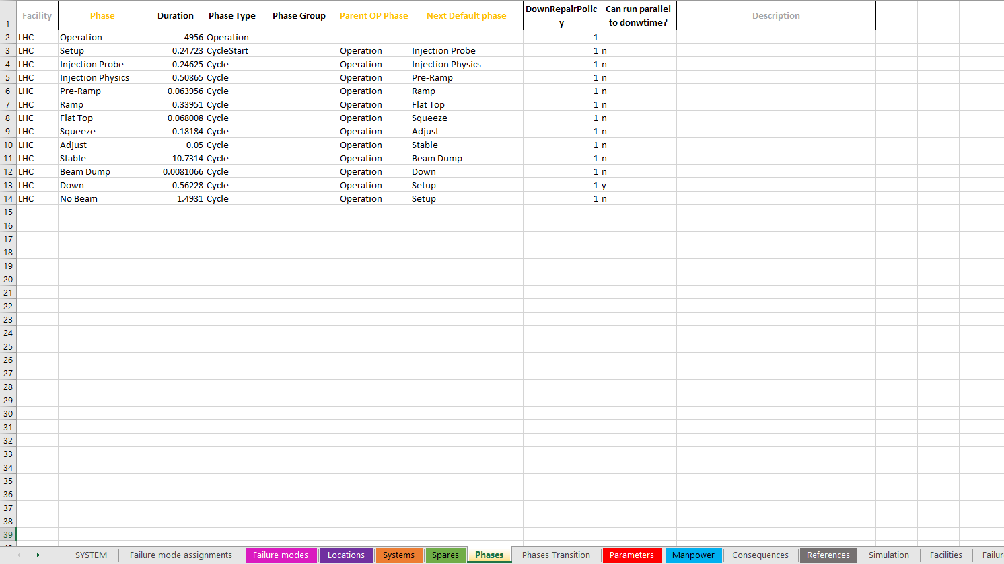

Slide 26
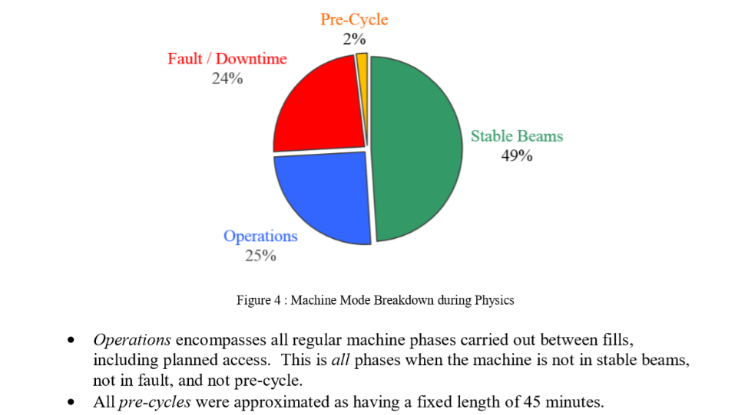
AWG Review

Slide 27
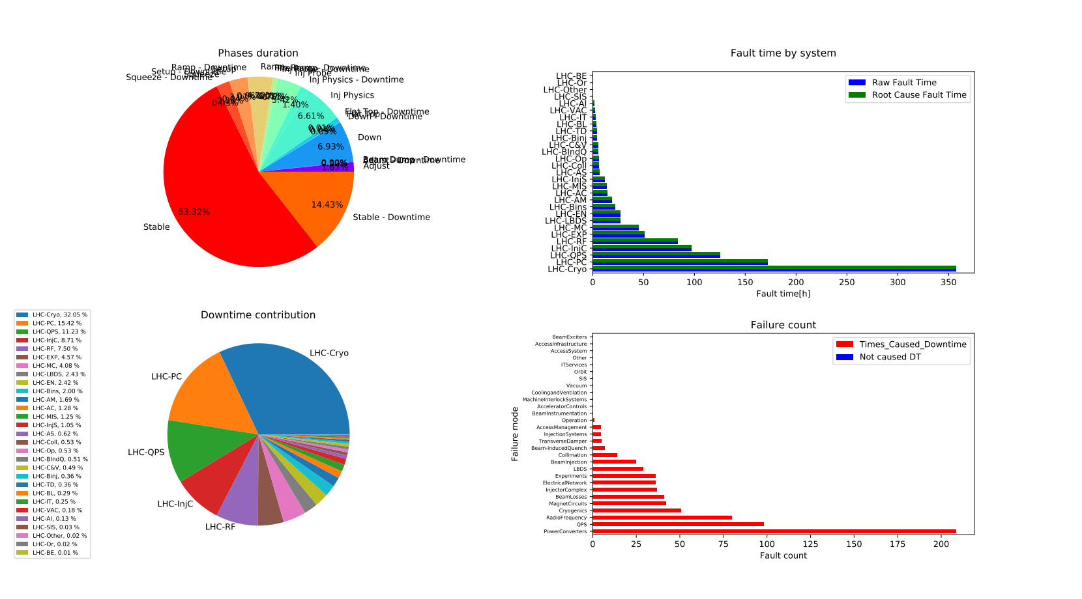
Results

Slide 28
Conclusion
Continued work on data for AvailSim
  Currently refining both Fault and Beam Mode statistics
  Ideally matching AWG reports
  Extend to other Accelerators (statistics started)
  Predictive tool for unknown scenarios (HiLumi)
  GAN Network as a pose to regular Neural Network
  Translate for SWAN package?
Goal - Complete model of CERN accelerator complex

Slide 29
┬┴┬┴┤ ͜ʖ ͡°) ├┬┴┬┴
♪~ ᕕ( ͡° ͜ʖ ͡°) ᕗ

Slide 30
Extra Slides

Slide 31
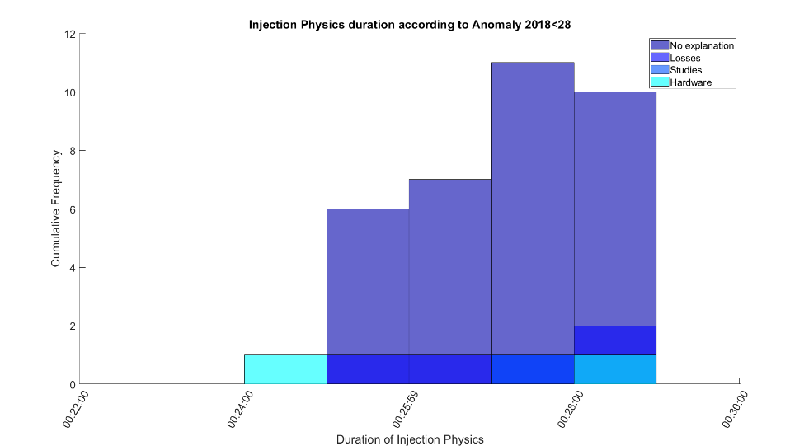
Injections reaching stable beams
How are any of these bars possible?
No other data, but we can hypothesise ¯\_(ツ)_/¯

Slide 32
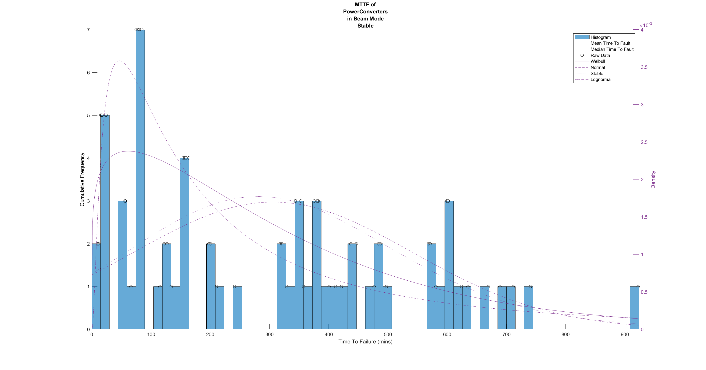
Failure distributions

