Slide 2



Short-Term Internship
Jonas Christ
24.06. – 11.10.
Supervisor Lorenzo Bortot

Slide 3


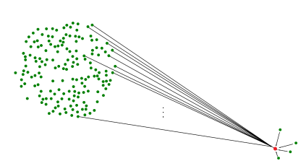
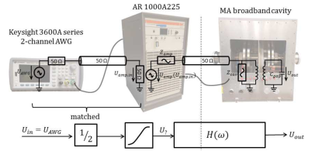
Projects I
8/18 Accelerator technology at GSI, Darmstadt
  Optimisation of software tools
  for barrier bucket cavities
3/19 Particle simulation at TEMF institute
  2D Multipole-method for space-charge interactions
(J. Harzheim – 2017)
(S. Schmid – 2018)

Slide 4
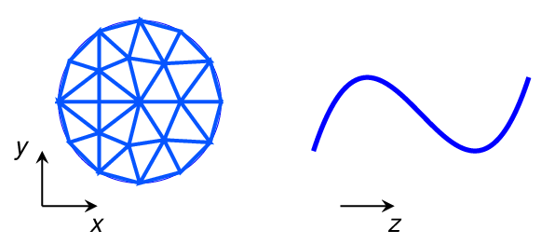
Projects II
6/19 Bachelor Thesis
  Combination of 2D FEM with polynomial basis
  functions for thermal heat conduction
Project at CERN
  Bus-bar (thermal) quench simulation with basis functions, focus on nonlinear material properties

Slide 5
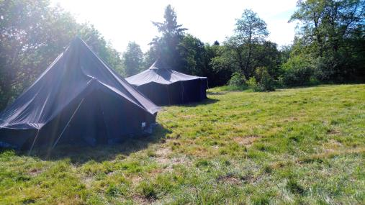


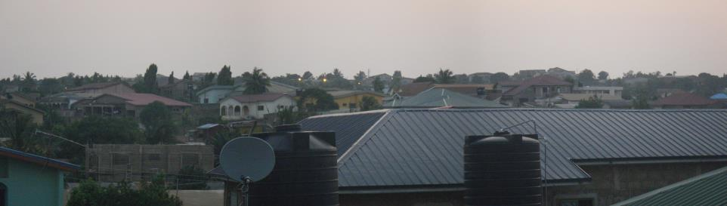
Beyond
Scouting
Development cooperation
…

