Slide 1
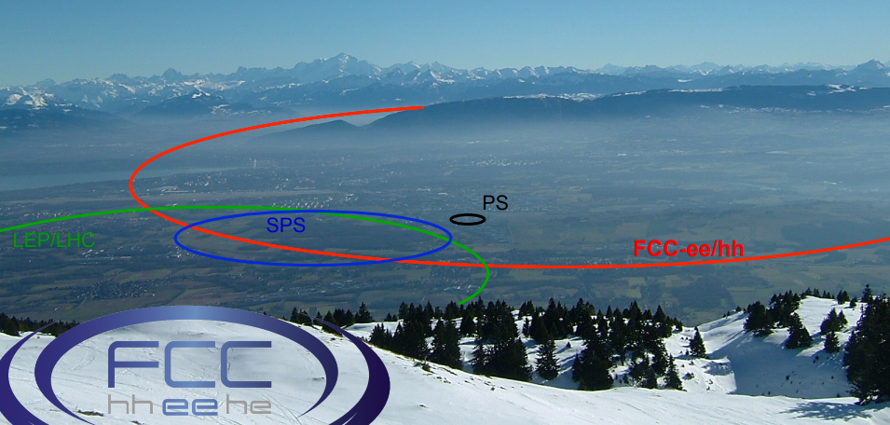
FCC week Brussels
Arjan Verweij, MPE-PE section meeting, 25 July 2019 most of the slides from the Overview talk by M. Benedikt on Monday morning
Arjan Verweij, MPE-PE secion meeting, 25/7/2019

Slide 2
European Particle Physics Strategy
The European Strategy for Particle Physics:
was initiated by the CERN council to coordinate activities across a large, international and fast-moving community with the aim to maximise scientific returns;
provides a clear prioritisation of European ambitions in advancing the particle physics science;
takes into account the worldwide particle physics landscape and developments in related fields.
The Strategy is due to be updated by May 2020 to guide the direction of the field to the mid-2020s and beyond.
Arjan Verweij, MPE-PE secion meeting, 25/7/2019

Slide 3
Summary: European Strategy Update 2013
….“to propose an ambitious post-LHC accelerator project at CERN by the time of the next Strategy update”
CERN should undertake design studies for accelerator projects in a global context,
with emphasis on proton-proton and electron-positron high-energy frontier machines;
coupled to a vigorous accelerator R&D programme, including high-field magnets and high-gradient accelerating structures;
in collaboration with national institutes, laboratories and universities worldwide.
Arjan Verweij, MPE-PE secion meeting, 25/7/2019

Slide 4
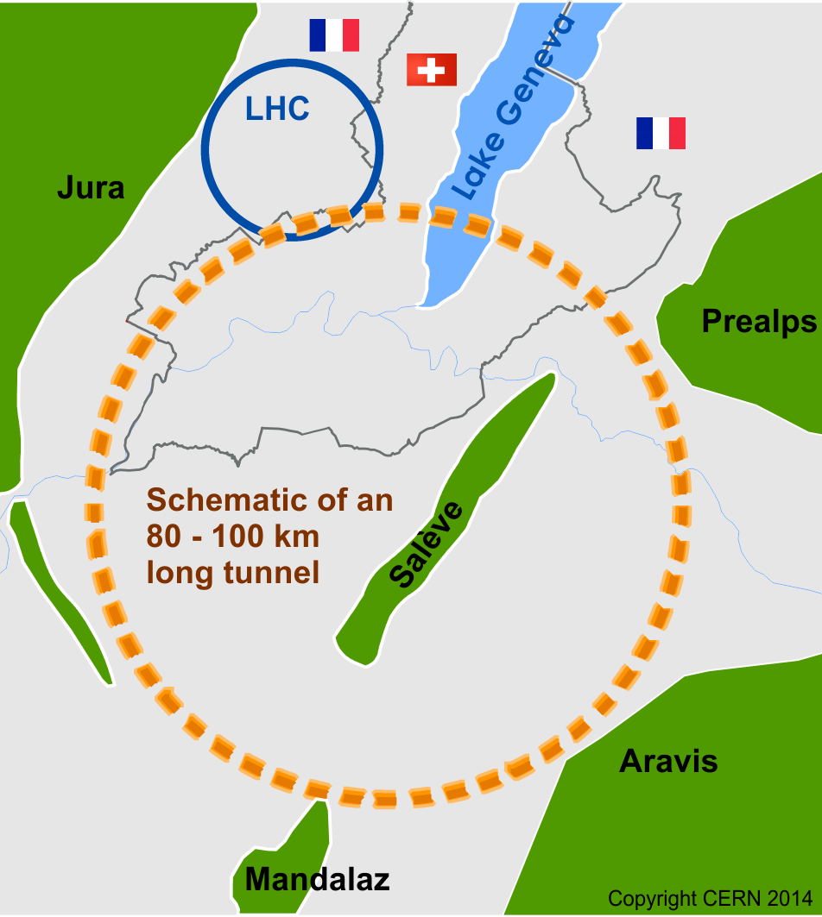
International FCC collaboration with CERN as host lab to study:
~100 km tunnel infrastructure in Geneva area, linked to CERN
e⁺e⁻ collider (FCC-ee), → potential first step
pp-collider (FCC-hh) → long-term goal, defining infrastructure requirements
HE-LHC with FCC-hh technology
Ions and lepton-hadron options with hadron colliders
HE-LHC
~16 T ⇒ 100 TeV pp in 100 km
Arjan Verweij, MPE-PE secion meeting, 25/7/2019

Slide 5
Arjan Verweij, MPE-PE secion meeting, 25/7/2019

Slide 6
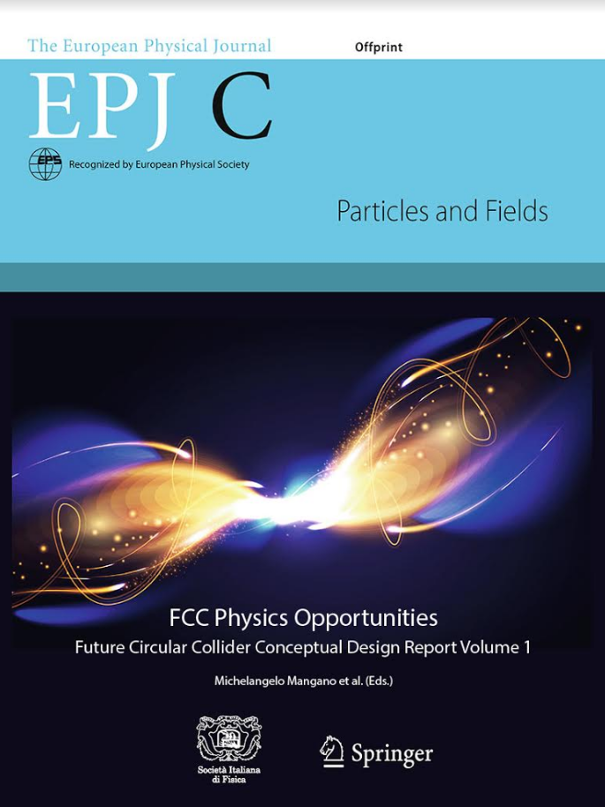

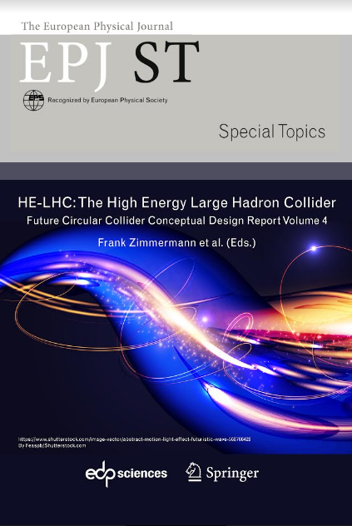
4 CDR volumes submitted to EPJ in December 2018:
  FCC Physics Opportunities
  FCC-ee
  FCC-hh
  HE-LHC
more than 1350 contributors from 350 institutes
Arjan Verweij, MPE-PE secion meeting, 25/7/2019

Slide 7
Comprehensive cost-effective program maximizing physics opportunities
Stage 1: FCC-ee
Stage 2: FCC-hh (~100 TeV) as natural continuation at energy frontier, with ion and eh options.
Complementary physics
Integrating an ambitious high-field magnet R&D program
Common civil engineering and technical infrastructures
Building on and reusing CERN’s existing infrastructure.
FCC integrated project plan is fully integrated with HL-LHC exploitation and provides for seamless continuation of HEP in Europe.
100 000 Z/sec (LEP: 1 Z/sec)
10 000 W/hr (LEP: 4 000 W/yr)
1 500 Higgs/day (10x more than ILC)
1 500 top quarks/day
Arjan Verweij, MPE-PE secion meeting, 25/7/2019

Slide 8
Aim at ~one order of magnitude performance increase in both energy and luminosity w.r.t LHC
100+ TeV cm collision energy (vs 14 TeV for LHC)
20 ab⁻¹ per experiment collected over 25 years of operation time (vs 3 ab⁻¹ for LHC).
Key technology: High-field magnets
Arjan Verweij, MPE-PE secion meeting, 25/7/2019

Slide 9
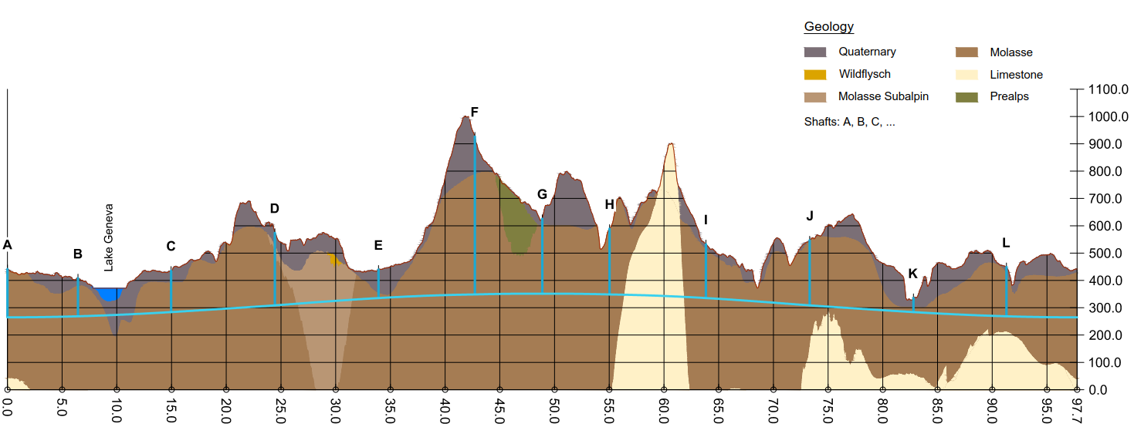
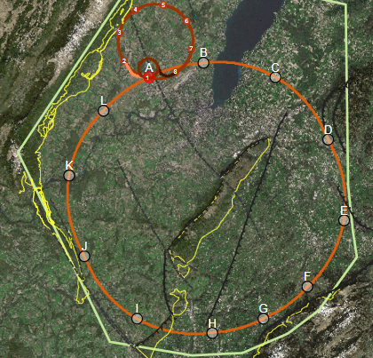
Tunnel construction estimated to take 7 years
Arjan Verweij, MPE-PE secion meeting, 25/7/2019

Slide 10
FCC integrated project plan is fully integrated with HL-LHC exploitation and provides for seamless further continuation of HEP in Europe.
Arjan Verweij, MPE-PE secion meeting, 25/7/2019

Slide 11
Construction cost phase1 (FCC-ee): 11.6 BCHF
5.4 BCHF for civil engineering (47%)
2.2 BCHF for technical infrastructure (19%)
4.0 BCHF for accelerator and injector (34%)
Construction cost phase 2 (FCC-hh): 17,0 BCHF.
13.6 BCHF accelerator and injector (57%)
  Major part for 4700 Nb₃Sn 16 T main dipole magnets, totalling 94 BCHF, ‘targeting’ 2 MCHF/magnet.
0.6 BCHF for adaptation of Civil Engineering and Technical Infrastructure of FCC-ee
- 2.8 BCHF for additional Technical Infrastructure, driven by cryogenics
Arjan Verweij, MPE-PE secion meeting, 25/7/2019

Slide 12
parameter | FCC-hh |  | FCC-hh-6T | HE-LHC | HL-LHC | LHC
collision energy cms [TeV] | 100 |  | 37.5 | 27 | 14 | 14
dipole field [T] | 16 |  | 6 | 16 | 8.33 | 8.33
beam current [A] | 0.5 |  | 0.6 | 1.1 | 1.1 | 0.58
synchr. rad. power/ring [kW] | 2400 |  | 57 | 101 | 7.3 | 3.6
peak luminosity [10³⁴ cm⁻²s⁻¹] | 5 | 30 | 10 (lev.) | 16 | 5 (lev.) | 1
events/bunch crossing | 170 | 1000 | ~300 | 460 | 132 | 27
stored energy/beam [GJ] | 8.4 |  | 3.75 | 1.4 | 0.7 | 0.36
Arjan Verweij, MPE-PE secion meeting, 25/7/2019

Slide 13
2020/21 – 2025/26 project preparation phase (if supported by EPPSU and CERN Council)
Project preparatory activities with host states (landplot identification and acquisition plan, sector plan, EIA, “debat publique”, and study management
Civil engineering site investigations and construction tender planning
Technical design towards CDR++/TDR (ATS) (Accelerators, technology, technical infrastructure)
Development of financing and governance models for project and operation phases including international in-kind contributions (CERN Council and Directorate).
Aiming for a definitive project decision by 2025/6.
Arjan Verweij, MPE-PE secion meeting, 25/7/2019

Slide 14
Program during the FFC week was a mix of mainly:
hh and ee (and eh) machine optics
hh and ee (and eh) physics potential
16 T magnet and superconductors
RF cavities
Infrastructure, civil engineering, cryogenics, vacuum, powering, other technical challenges
And one day (parallel sessions) of ‘Economics of Science’ (PS: impact not much presented in all the other talks…)
Arjan Verweij, MPE-PE secion meeting, 25/7/2019

Slide 15
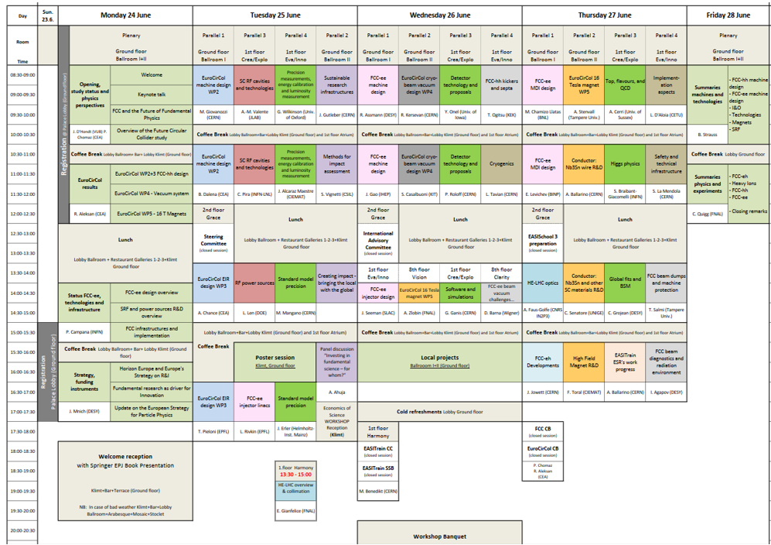
Arjan Verweij, MPE-PE secion meeting, 25/7/2019

Slide 16
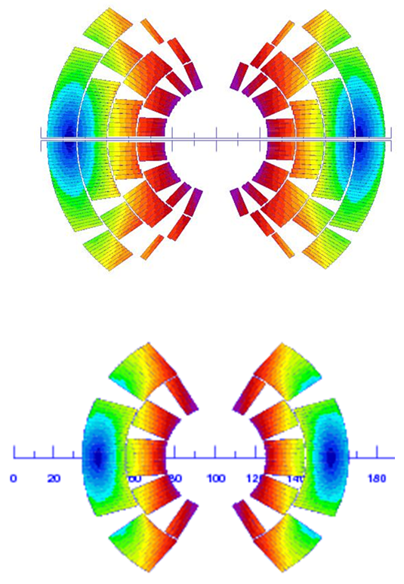
What about the field level? (D. Schoerling)
16 T (FCC spec)
Past experience with Nb₃Sn high field magnets (13 programs), and the very recent success of FNAL shows the great potential of Nb₃Sn high-field magnet technology for a next collider in the ~14 T range
With the aim to reduce the cost and complexity, a ~40 TeV FCC-hh with 6 T may be considered (see M. Benedikt’s talk)
What about 12 T to 14 T which would also considerably reduce the magnet cost and complexity for a collider in the next decades?
14 T (FCC spec)
11 T (HL-LHC spec)
Arjan Verweij, MPE-PE secion meeting, 25/7/2019

Slide 17
Economics of Science
MY
FUTURE
Circular Collider
Even better when
I participate!
Designing a new research infrastructure with creating value over long-term in a sustainable way in mind, calls first for identifying which value for society and economy is created, how it can be measured and where it comes from.
J. Gutleber, CERN
Arjan Verweij, MPE-PE secion meeting, 25/7/2019

Slide 18
Total Economic Value of Science (TEV)
  TEV = Use Value + Non-Use Value
  Use value = patents, licences, cultural visits, ….
  Non-Use Value = Option value + Bequest value + Existence Value
    Option value = A resource or service is of no use today, but maybe extremely valuable in the future….
    Bequest value = To transmit knowledge and cultural heritage to future generations…
    Existence value = Willingness to pay to preserve a resource or service that exists (blue whales…), but you may never enjoy it (not today nor tomorrow)…
Arjan Verweij, MPE-PE secion meeting, 25/7/2019

Slide 19
Why do big projects fail to get started? (J. Womersley, DG, ESS)
Arjan Verweij, MPE-PE secion meeting, 25/7/2019

Slide 20
FCC week indico page:
https://indico.cern.ch/event/727555/overview
Physics potential:
http://dpnc.unige.ch/seminaire/talks/janot.pdf
Arjan Verweij, MPE-PE secion meeting, 25/7/2019

