Slide 1

Summary of the Workshop
09-12 July 2019
L. Bortot^{1,2}, M. Maciejewski¹

Slide 2


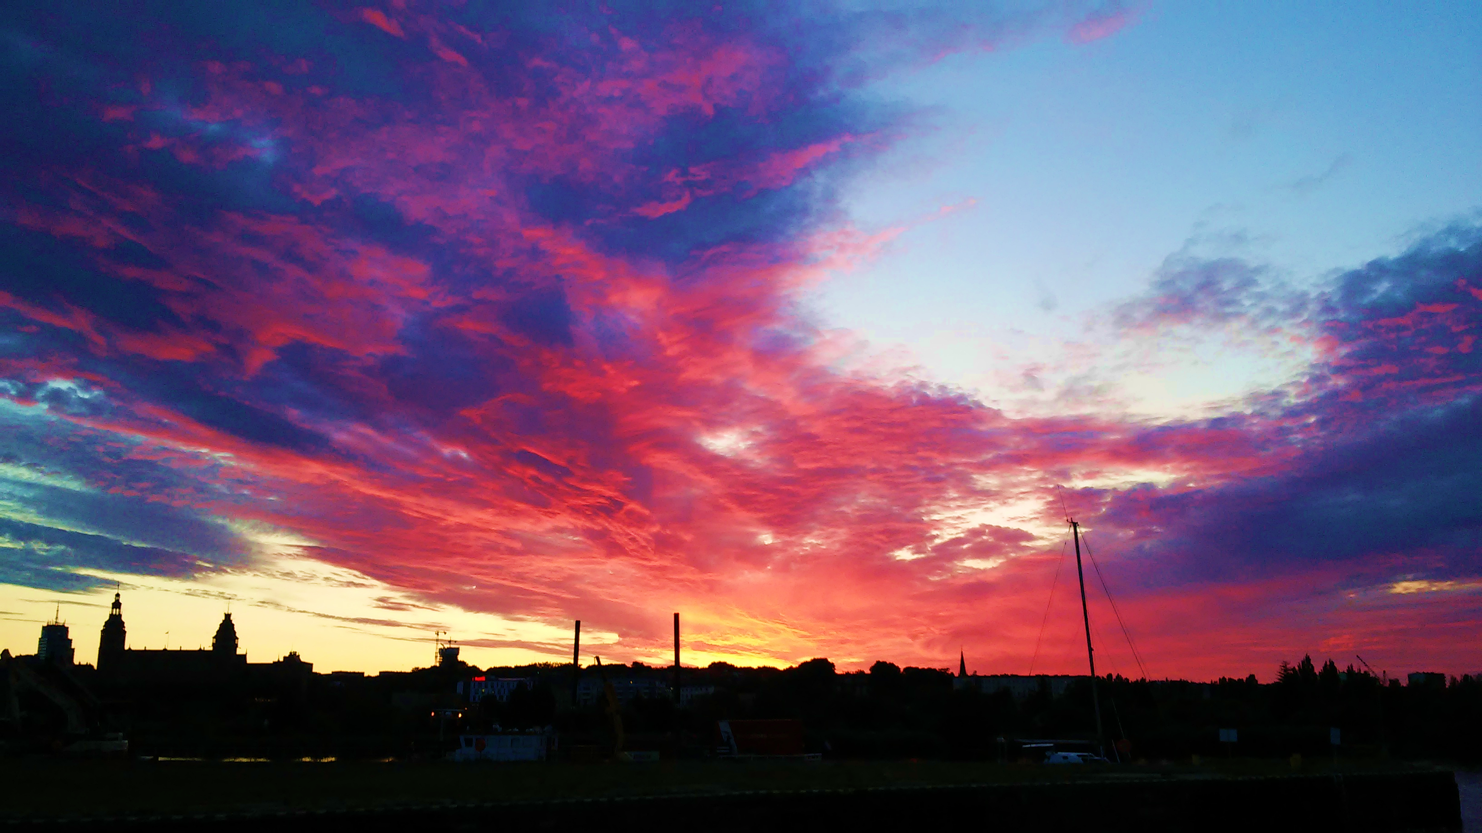
Overwiew
Presentations available at https://indico.cern.ch/event/776034/
9-12 July 2019, Szczecin, Poland
~ 40 participants
Numerical methods
Electro mechanical modelling
Electro-thermal modelling
Electromagnetics
Multiphysics modelling of superconducting devices
Experimental results for modelling
Quench Analysis
Quench in HTS conductors
Quench and thermo-hydraulic LTS
Cryogenic systems
Thermo-hydraulic and cryogenics

Slide 3
Selected contribution 01

Slide 4
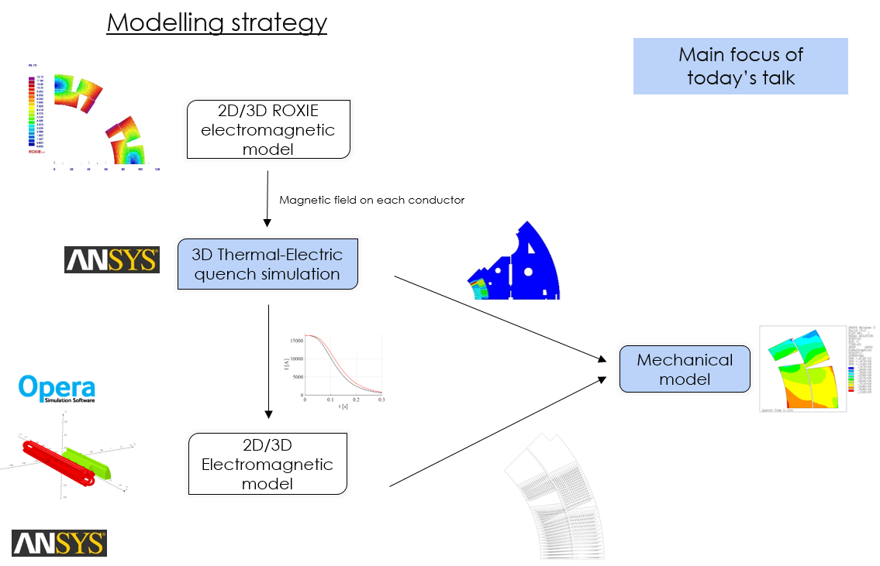
On the magnet mechanics during a quench: Three-Dimensional
Finite Element Analysis Of a Quench Heater Protected Magnet
Jose Ferradas et al. - CERN
Motivation: Analysis of thermo-mechanical stresses in conductors during quench

Slide 5
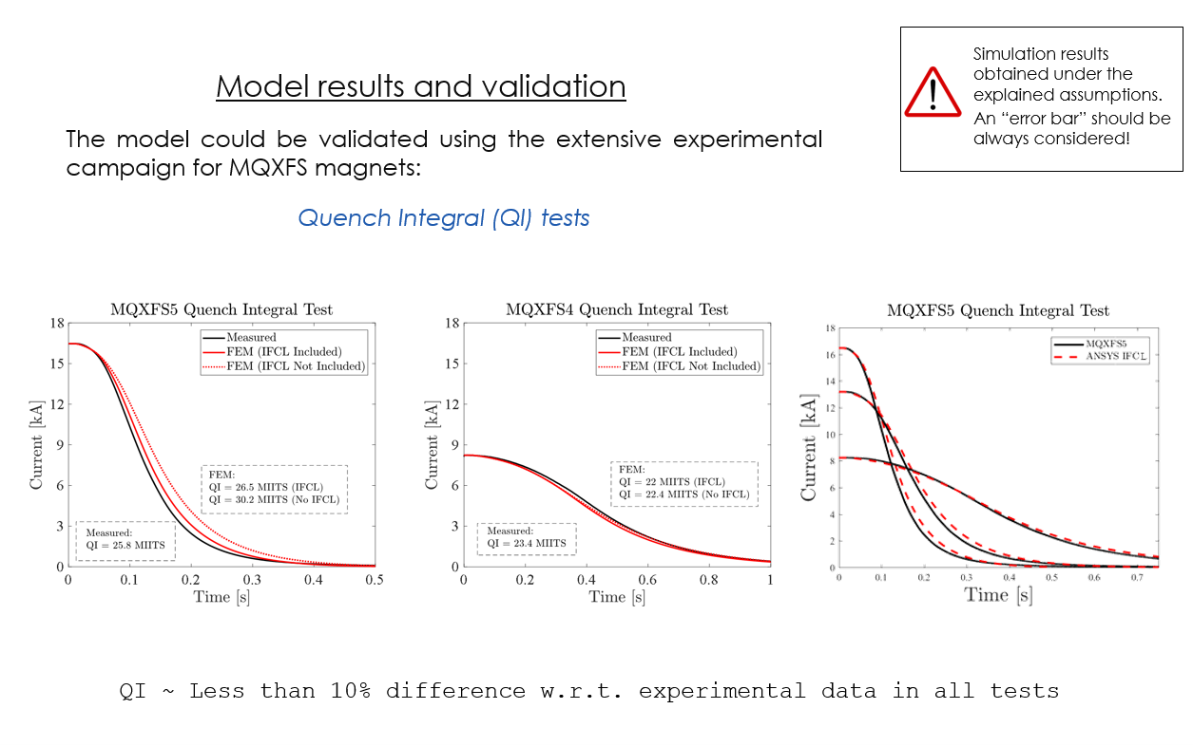
On the magnet mechanics during a quench: Three-Dimensional
Finite Element Analysis Of a Quench Heater Protected Magnet
Jose Ferradas et al. - CERN

Slide 6
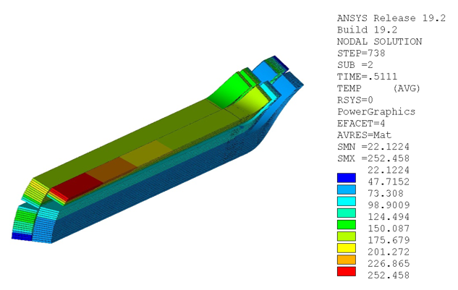
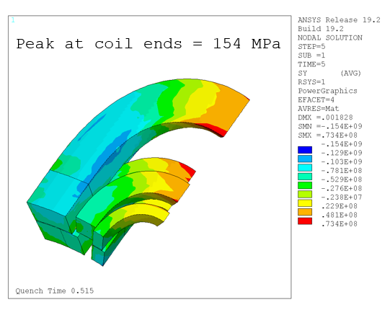
On the magnet mechanics during a quench: Three-Dimensional
Finite Element Analysis Of a Quench Heater Protected Magnet
Jose Ferradas et al. - CERN
Nominal current training quench
A methodology for the 2D and 3D study of the magnet mechanics during a quench has been presented.
It uses a combination of finite element models in ANSYS APDL with other usual tools used in the magnet community.
The different models have been validated with experimental measurements separately.
Temperature
Azimuthal stress

Slide 7
Selected contribution 02

Slide 8
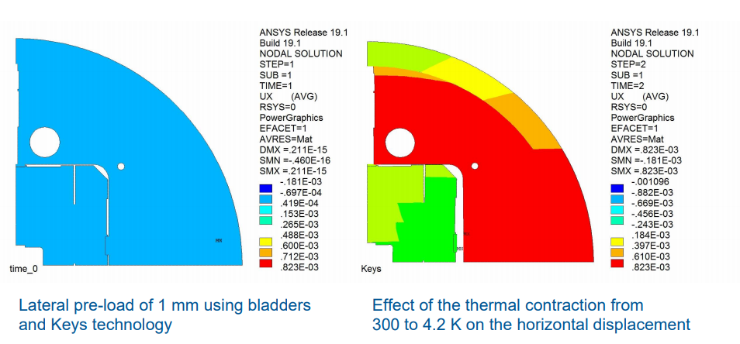
High Field Magnets: Electromechanical Modeling Taking into Account
Local Magnetic Forces with Iron Saturation
D. Martins Araujo et al. - CERN
Motivation: Influence of magnetic forces on the magnet mechanical behaviour
Calculation example (HEPdipo magnet – forces in the iron):

Slide 9
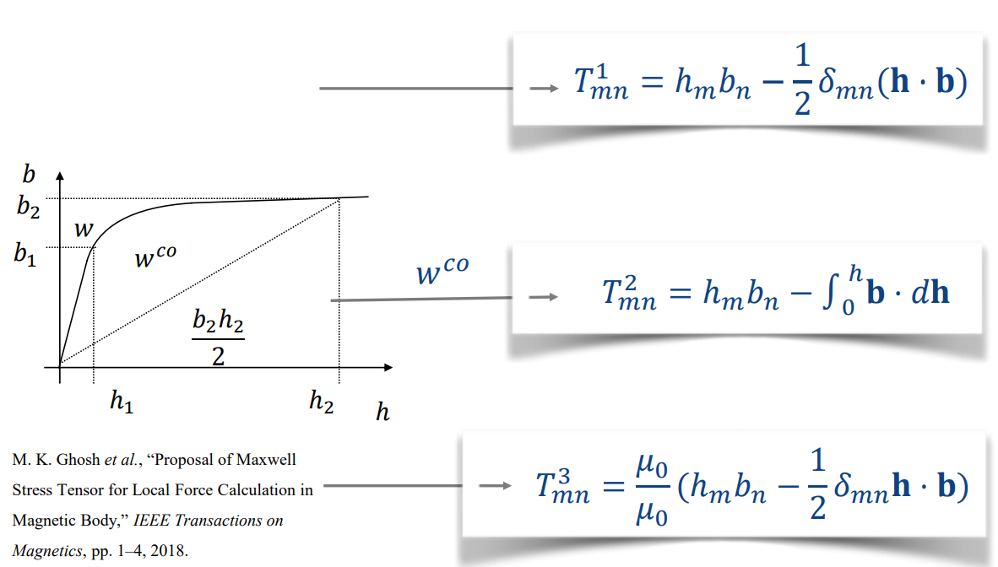
High Field Magnets: Electromechanical Modeling Taking into Account
Local Magnetic Forces with Iron Saturation
D. Martins Araujo et al. - CERN
The local distribution of magnetic forces within the iron is unknown!
Several formulas can be used to compute it:
T1 - Maxwell stress tensor
T2 - Virtual work principle, via calculation of the magnetic co-energy
T3 - M. K. Ghosh et al., IEEE Transactions on Magnetics, pp. 1–4, 2018.

Slide 10
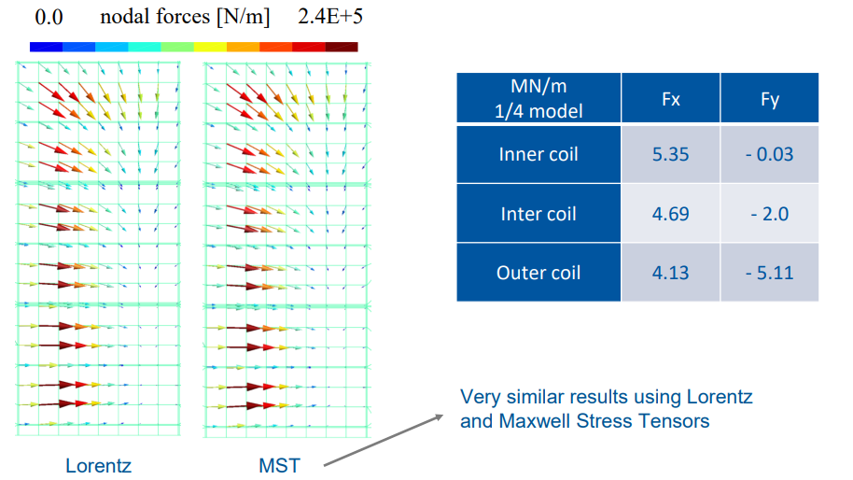
High Field Magnets: Electromechanical Modeling Taking into Account
Local Magnetic Forces with Iron Saturation
D. Martins Araujo et al. - CERN
Lorentz forces in the coils: T1 = T2 = T3 (linear magnetic material)
The compatibility between forces on coils computed by Lorentz formula and Maxwell Stress Tensor was proved.

Slide 11
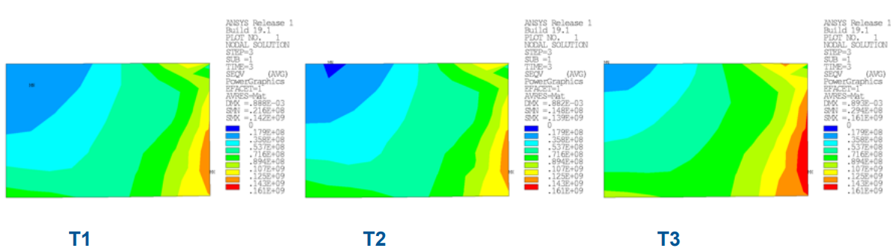
High Field Magnets: Electromechanical Modeling Taking into Account
Local Magnetic Forces with Iron Saturation
D. Martins Araujo et al. - CERN
Powering to 15 T at 4.2 K: Iron pole of the inter coil
Maximum difference of 15% on the horizontal stress for the iron pole of the outer coil
The effect on the iron stress is limited because the model is symmetric
If a free movement is allowed the stress may increase even more
Commercial software (Ansys, Opera) uses T1.
When using T2 or T3 the stress on iron poles is higher

Slide 12
Selected contribution 03

Slide 13
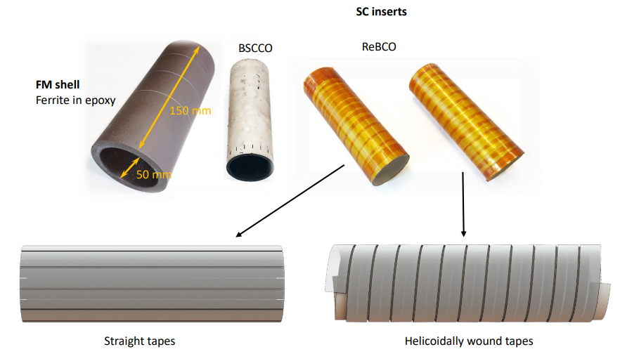
A-formulation method for full 3D FEM computation of the superconductor magnetization Solovyov Mykola et al. - Institute of Electrical Engineering Slovak Academy of Sciences
Motivation: Simulation of magnetic cloaks based on HTS superconductors

Slide 14
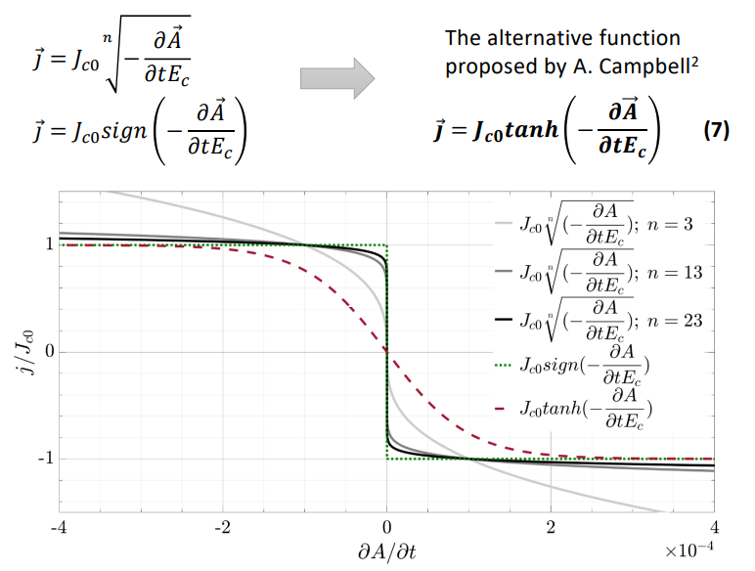
A-formulation method for full 3D FEM computation of the superconductor magnetization Solovyov Mykola et al. - Institute of Electrical Engineering Slovak Academy of Sciences
Issue: Nonlinear behavior of (E-J) characteristics
Smooth-it out!
Can we live with this gap?

Slide 15
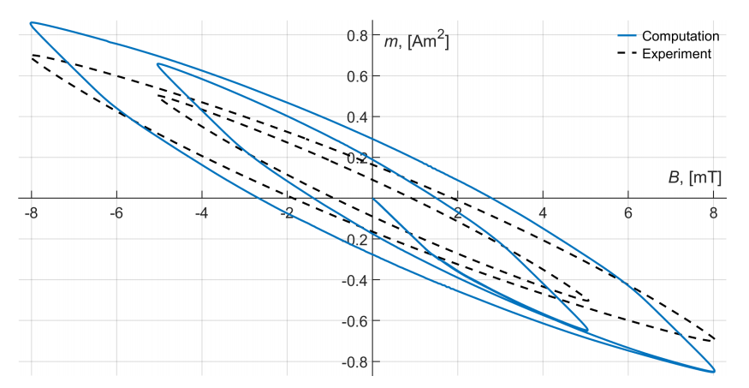
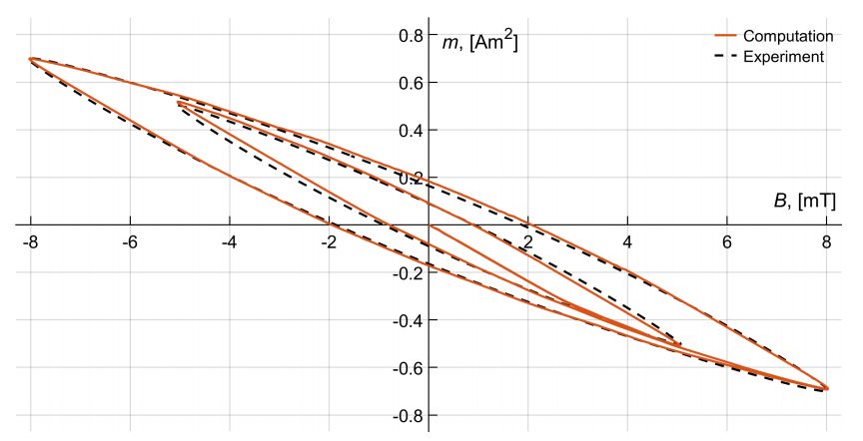
A-formulation method for full 3D FEM computation of the superconductor magnetization Solovyov Mykola et al. - Institute of Electrical Engineering Slovak Academy of Sciences
Comparable areas, peaks shifted
The model shall be:
acceptable for AC losses estimation (overestimation)
potentially not accurate for field quality analysis
Model conditioned a posteriori with measurements of current density distribution

Slide 16
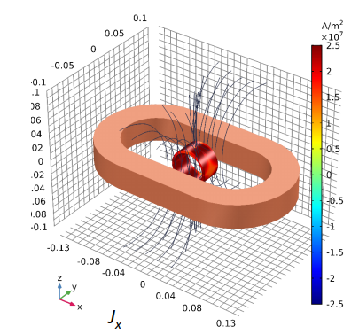
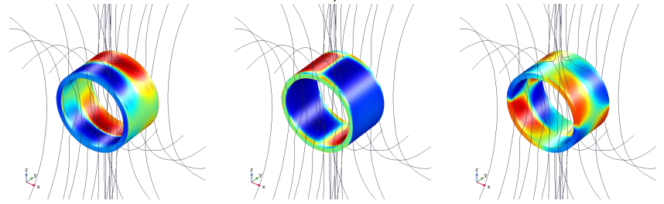
A-formulation method for full 3D FEM computation of the superconductor magnetization Solovyov Mykola et al. - Institute of Electrical Engineering Slovak Academy of Sciences
Anyway, the results are pretty nice!
Current density distribution within a BSCCO ring
External field generated by pancake coil

Slide 17
Selected contribution 04

Slide 18
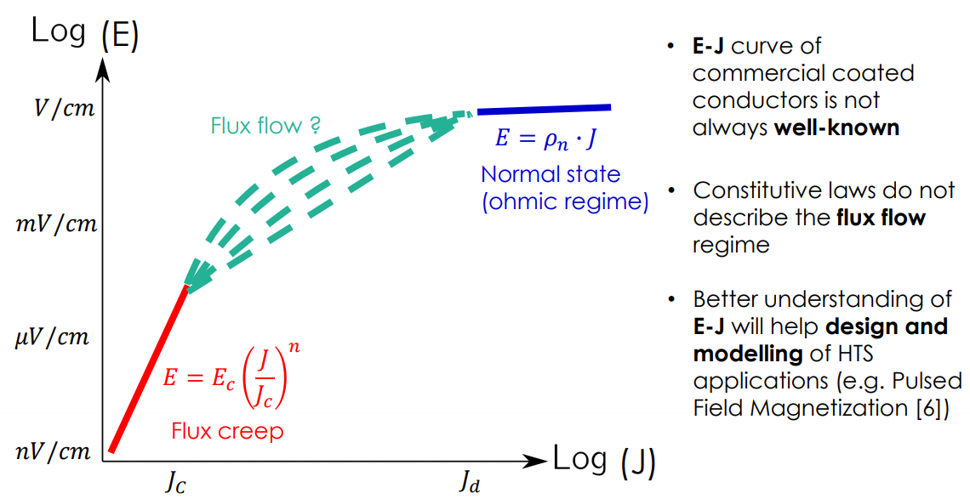
1D and 2D finite-element approaches to extract the resistivity of the superconductor material from pulsed current measurements on HTS commercial tapes
Nicolo Riva et. al. - EPFL
Motivation: a better understanding of E-J curves
Our magnets typically work here (if they do not quench..)

Slide 19
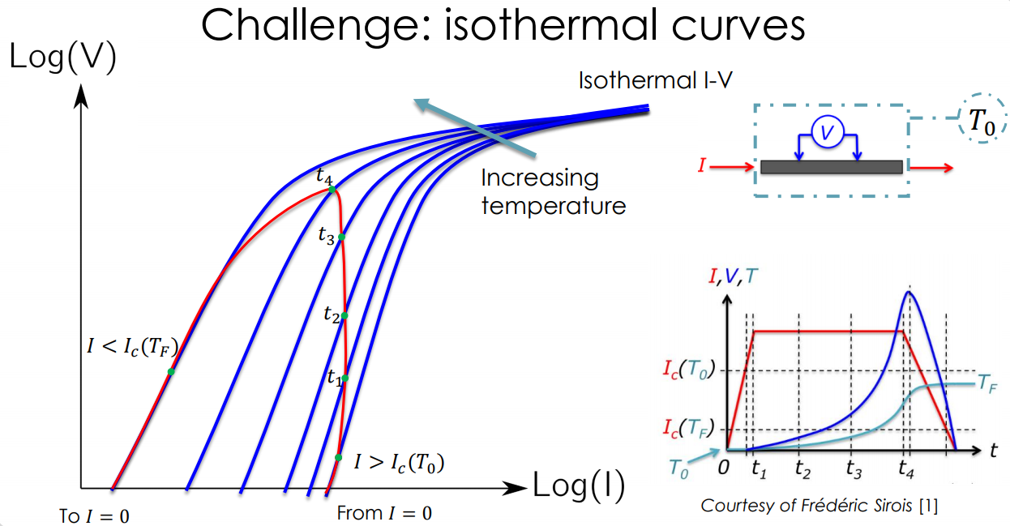
1D and 2D finite-element approaches to extract the resistivity of the superconductor material from pulsed current measurements on HTS commercial tapes
Nicolo Riva et. al. - EPFL
Joule losses associated to the measurement (we are in flux flow regime!)
A temperature-change influences the properties of the sample
If temperature changes, what are we measuring?

Slide 20
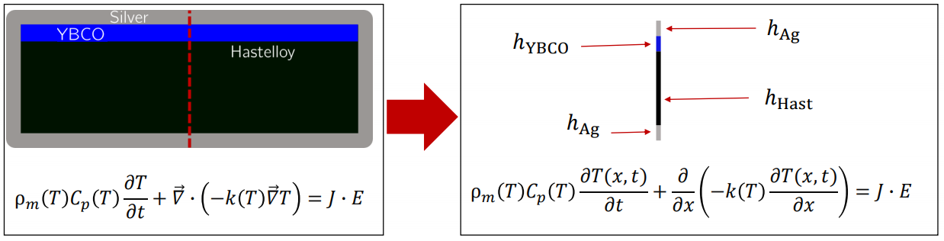
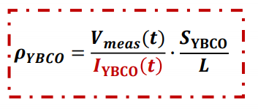
1D and 2D finite-element approaches to extract the resistivity of the superconductor material from pulsed current measurements on HTS commercial tapes
Nicolo Riva et. al. - EPFL
Model order reduction: 1D modelling
Constant resistivity across the superconducting layer.
Flux-flow regime → current already relaxed into the tape (saturation)
Thus, the 1D approach is valid, but only in the flux flow regime and beyond

Slide 21
Selected contribution 05

Slide 22
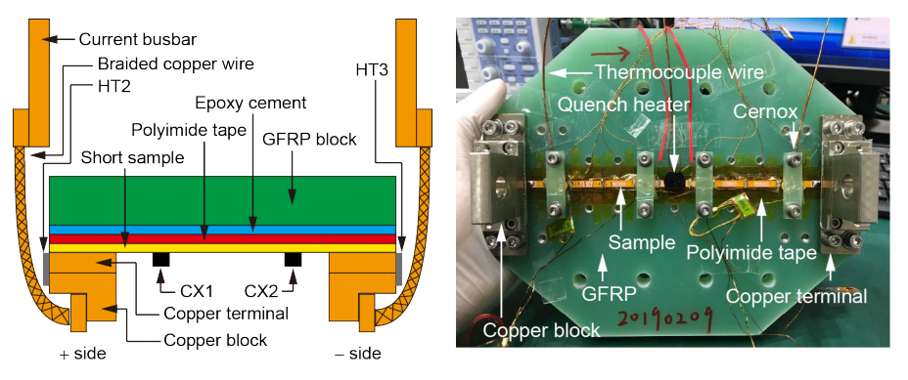
Study on conditions for successful quench protections of coils wound with coated conductors by short-sample experiments and quench simulations
Naoyuki Amemiya et. al. - Kyoto University
Motivation: Feasibility of the classical quench detection and protection of coated-conductor magnets

Slide 23
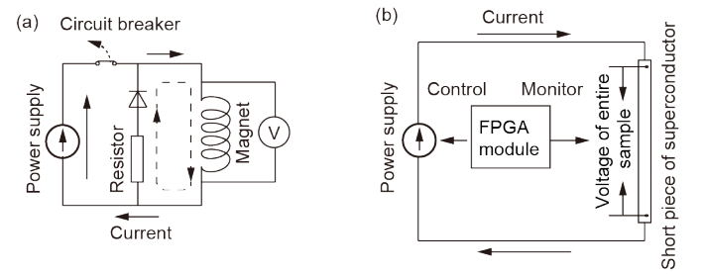

Study on conditions for successful quench protections of coils wound with coated conductors by short-sample experiments and quench simulations
Naoyuki Amemiya et. al. - Kyoto University
Protection strategy
1 $V_{th}$ is reached (= quench detection in a magnet)
2. Waiting time (= time required for quench detection and activation of circuit breaker),
3. Power supply de-energized exponentially (=dump resistor).

Slide 24
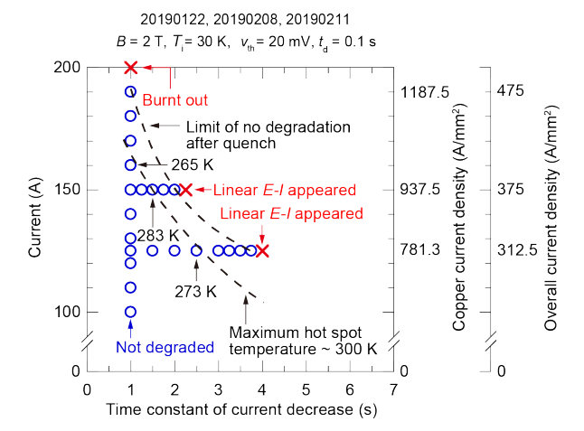

Study on conditions for successful quench protections of coils wound with coated conductors by short-sample experiments and quench simulations
Naoyuki Amemiya et. al. - Kyoto University
Results
$$V_{th}=20 mV$$
$$t_{d}=100 ms$$
$$i_{max}=79\% i_{crit}$$
Individual tapes seem to be easily protectable, even at high currents.
A time constant of 1s seems to be really conservative (PS limit?)
Shorter time constants for the current decay would allow for even higher currents.

Slide 25
Selected contributions - Miscellanea

Slide 26
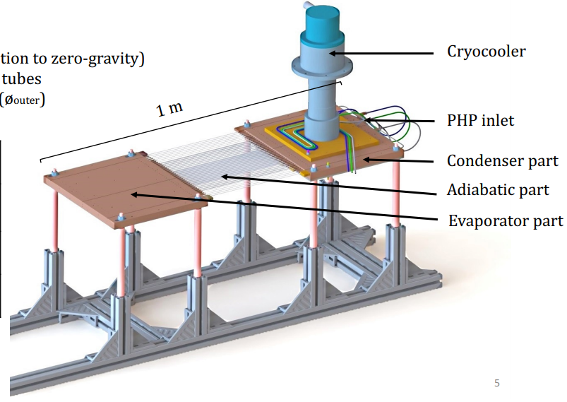
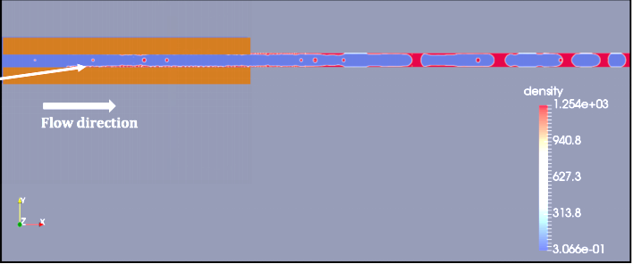
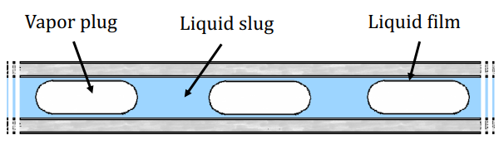
Simulation of a cryogenic capillary tube
Maria Barba et. al. - CEA Saclay
Motivation: Design of Cryogenic Pulsating Heat Pipes applied to SC magnets
Simulations performed with Pressure-based ANSYS Fluent solver, Volume of Fluid (VOF) method, 2D axisymmetric geometry
0.5 s simulation → more than one week

Slide 27
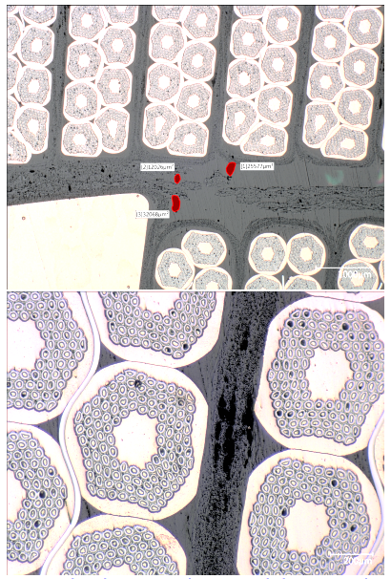
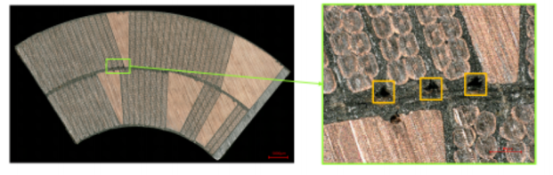
Thermal analysis of AC loss heated Nb3Sn coil samples for High Luminosity upgrade of the LHC
Kirtana Puthran et. al. - CERN
Motivation: Study of thermal behavior of D11T and MQXF samples
Experimental campaign to measure thermal behavior of D11T and MQXF samples.
Creation of a robust multi-region numerical toolkit for modeling heat transfer in complex solid-liquid systems, involving superfluid He,

Slide 28
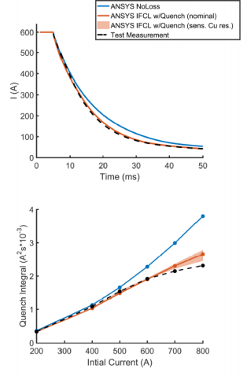
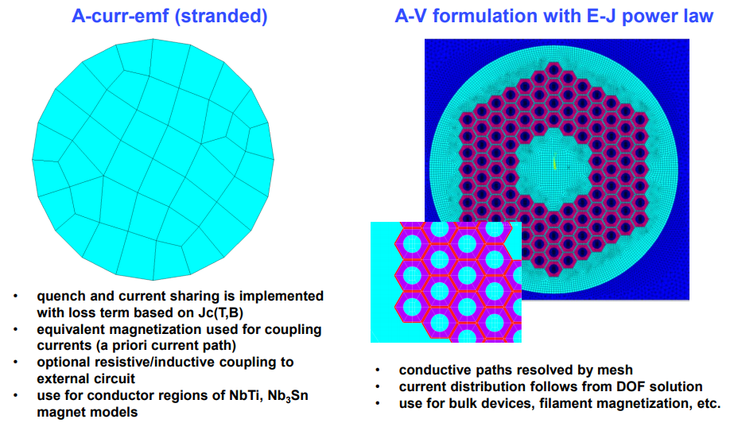
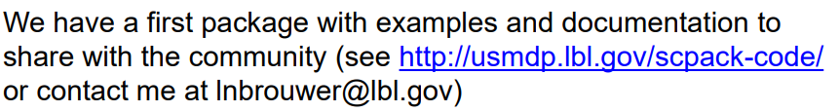
User Defined Elements in ANSYS for Multiphysics Modeling of Superconducting Devices Lucas Brouwer et. al. - LBNL
Motivation: add equivalent magnetization, quench, and material property fits to ANSYS, to run transient magneto-thermal simulations

Slide 29

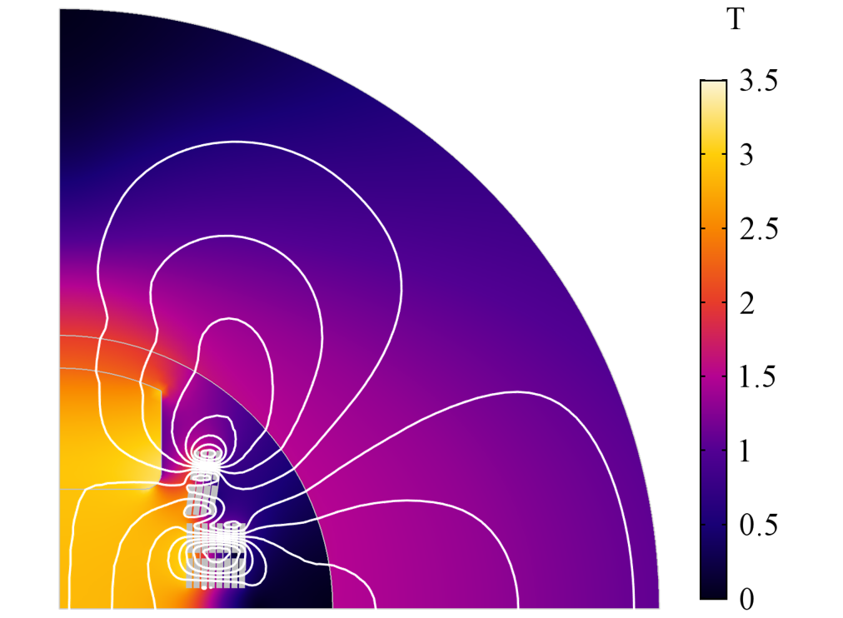
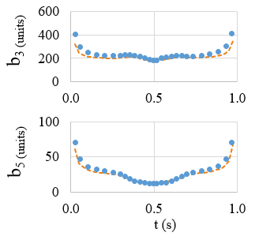












Field Quality Analysis in the HTS Dipole Insert-Magnet Feather M2 with the Finite Element Method
Lorenzo Bortot et. al. - CERN
Motivation: Characterization of screening currents in HTS tapes, coils and magnets
$$∂_{t}\vec{B}$$
Feather M2 field quality simulations
$${\vec{B}}_{screen}$$
$$\vec{A}→Ω_{A},ℝ^{3}$$
$$−$$
$$\vec{H}→Ω_{H},ℝ^{3}$$
$$v_{s}$$
$${\vec{J}}_{screen}$$
$$+$$
$ρ→0$
$$i_{s}$$
Persistent magnetization
Field quality issue, especially at low field
Joule losses
Mixed potentials
Domain decomposition
$\vec{A}$ in $Ω_{A}$ (air, iron)
$σ→0$
$\vec{H}$ in $Ω_{H}$ (conductors)
$ρ→0$

Slide 30
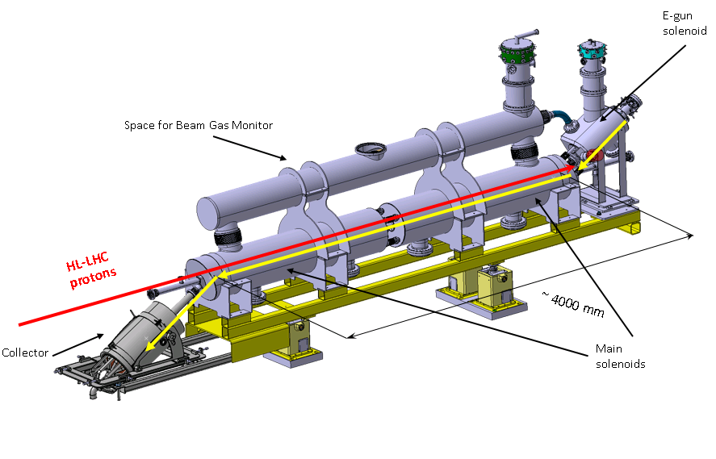
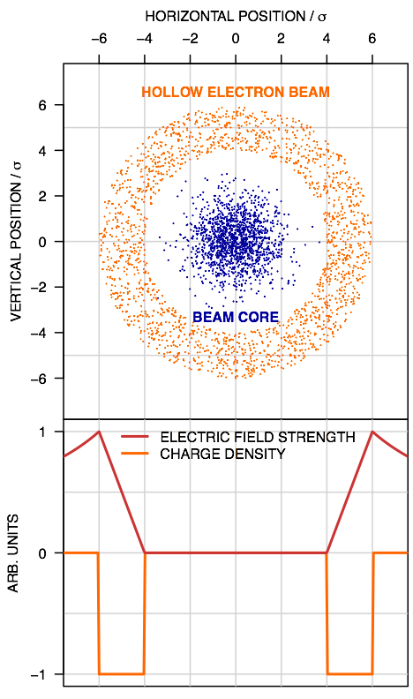
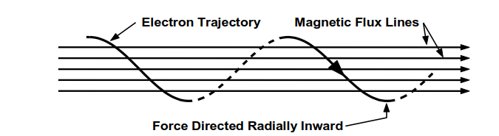
Hollow Electron Lens Quench Protection Design and Analysis status update
Michal Maciejewski et. al. - CERN
Motivation: Study the protectability of the superconducting circuits
Main Solenoid
Energy Extraction Resistance Sweep
Max T (200 K) and V to ground (500 V):
Energy extraction R from 2.46 to 3 Ω.

Slide 31
Thank you!

