Slide 2

Update on the Application of Spectral Element Methods on Quench Simulation
Jonas Christ
Supervision: Lorenzo Bortot

Slide 3
Outline
Numerical context of quench simulation
Spectral Element Method in a nutshell
Proof of concept
Implementation notes
Outlook

Slide 4
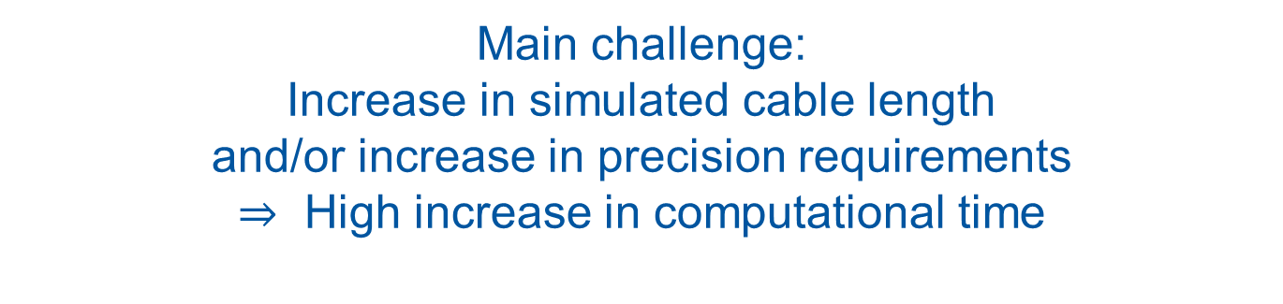
Problem
Quench propagation:
Multi-Physics
(here: reduce to thermal problem)
Magnet geometry:
Multi-Scale, 3D
(here: reduce to 1D cable simplification)
Best way to reach fast and accurate simulation?
Main challenge:
Increase in simulated cable length
and/or increase in precision requirements
$⇒$ High increase in computational time

Slide 5
Problem
Approach A:
Find reasonable simplifications or models, e.g. for Comsol
Approach B:
Optimize numerical procedure which is internally used by solving programs
Best way to reach fast and accurate simulation?
Ongoing research for finding numerical procedure
best suitable for quench propagation in magnets*
My contribution: Implement solver for 1D thermal problem using a non-standard numerical solution procedure - SEM
*

Slide 6

Reminder: Excerpt of Standard Simulation Workflow
PDE & model
Discretizing PDE as algebraic (matrix) equation
Solving
Postprocessing: physical interpretation
Temperature $θ\left(z\right)$
build matrix system
$Au=b$
find unknown $u$
plot simulated $θ\left(z\right)$
Discretization method
Comsol / Ansys

Slide 7
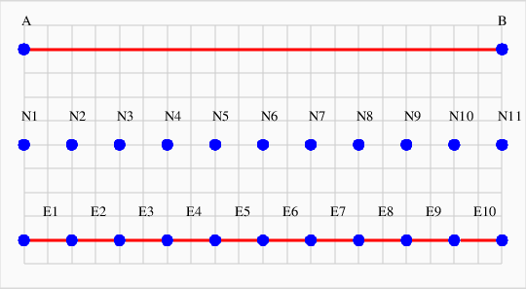
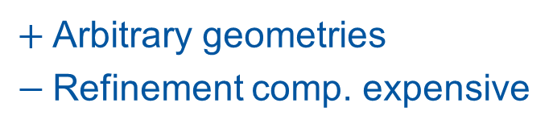

Discretization Method
Most wide-spread:
Finite Element Method (FEM)
  Discretize space by mesh nodes $z_{i}$
  Identify unknowns with temperature at nodes, i.e. $θ\left(z_{i}\right)=u_{i}$
  Define matrix entries by dense mesh, low order polynomials
$+$Arbitrary geometries
$−$Refinement comp. expensive
(Picture taken from John Burkardt, PostScript Graphics Creation PLOT_TO_PS, 2011, online: https://people.sc.fsu.edu/~jburkardt/f_src/plot_to_ps/plot_to_ps.html)
Spectral Element Method as alternative approach?

Slide 8
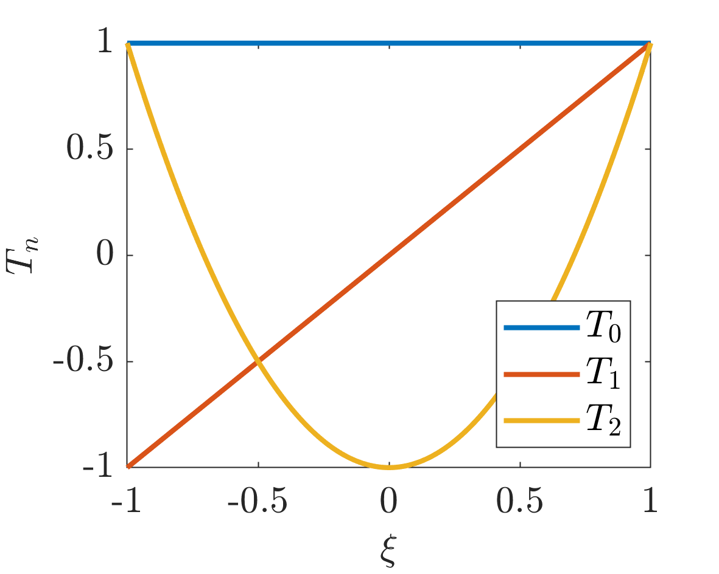

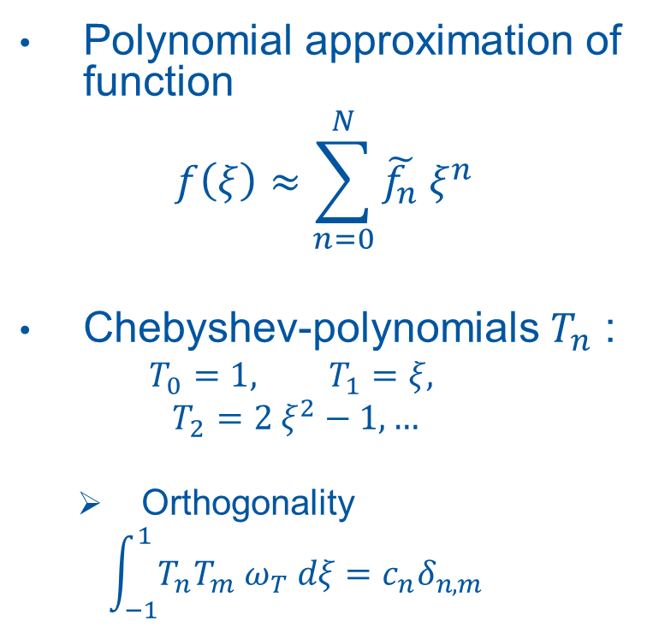
Spectral Element Method (SEM) – I
Polynomial approximation of function
$$f\left(ξ\right)≈\sum_{n=0}^{N}{\tilde{f_{n}} ξ^{n}}$$
Chebyshev-polynomials $T_{n}$ :
  $$T_{0}=1, T_{1}=ξ,$$
  $$T_{2}=2 ξ^{2}−1, …$$
  Orthogonality
  $$\int_{−1}^{1}{T_{n}T_{m} ω_{T} dξ}=c_{n}δ_{n,m}$$
Notes:
Idea: use representation in terms of a series of polynomials
Identify coefficients as ‘spectrum’ of function, compare Fourier Series
Requires sufficiently smooth function to be approx.
In general, choice of arbitrary linear combinations of powers of x, polynomials, but nice properties possible
One example among others: Chebyshev (possible others: Legendre), definition e.g. by recursion
Main property of interest: Orthogonality over fixed domain -> interesting for integration of PDE (compare with 3D vector space)
Note that choice of Cheby is unusual in SEM approach, research in Darmstadt on Legendre as well (Cheby is my baby ☺, nice for analytical calculations due to explicit definitions)
Note notation for set of polynomials over [-1,1] by colored lines and mapping of arbitrary 1D domain
So how to make use of these lovely polynomials?

Slide 9
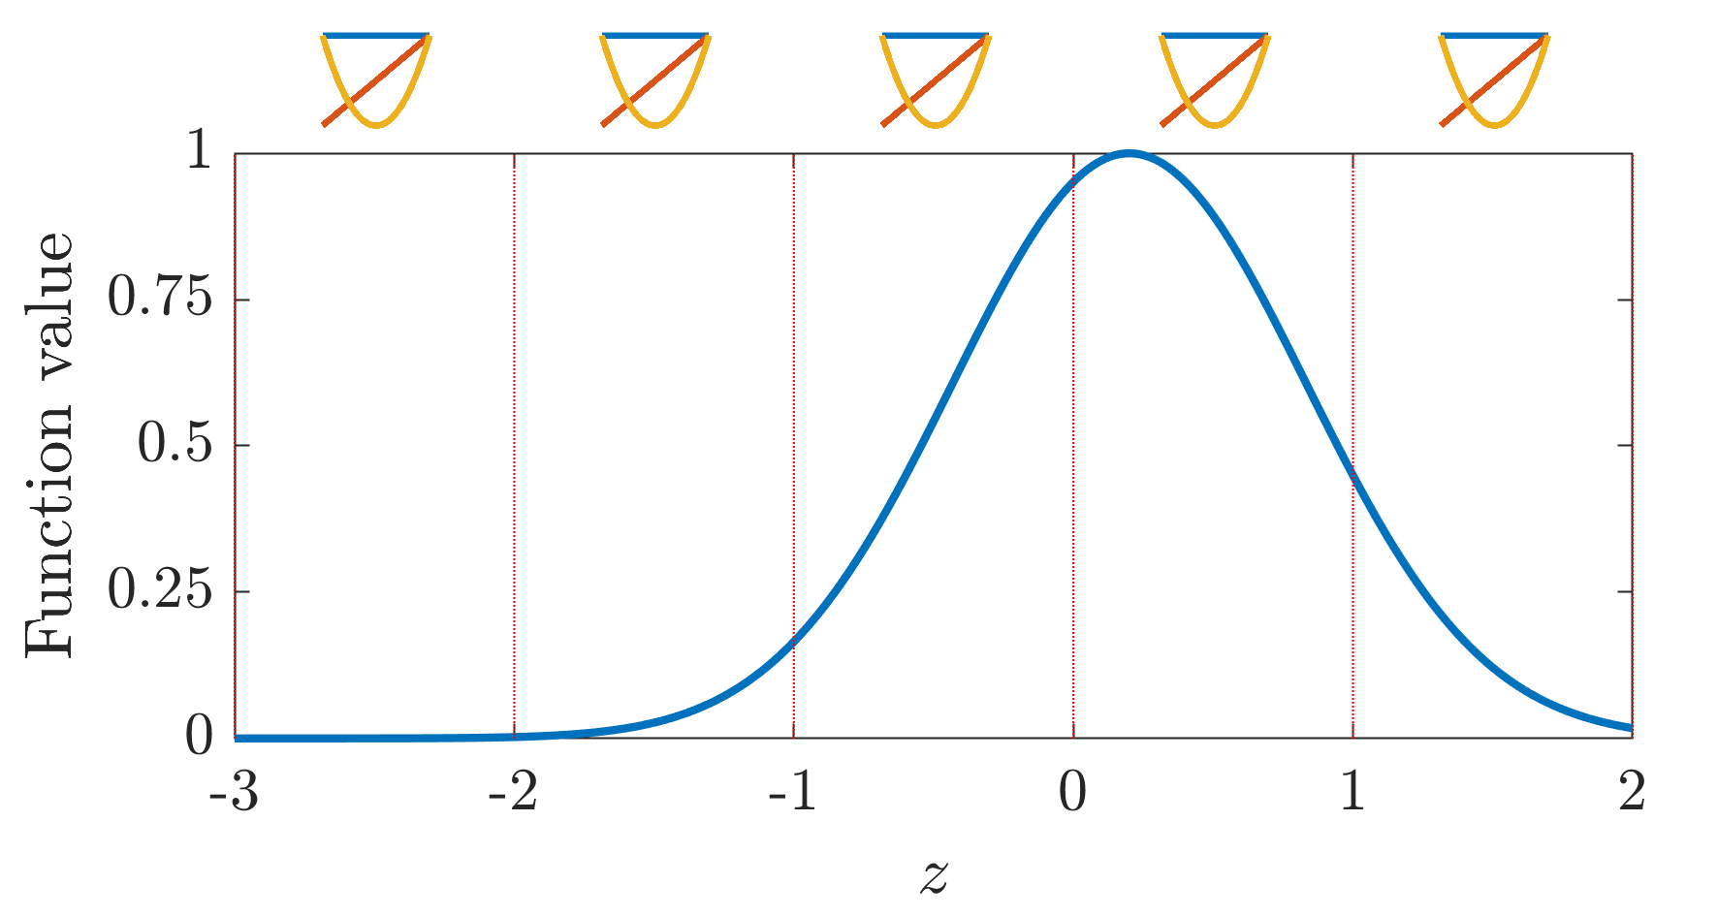
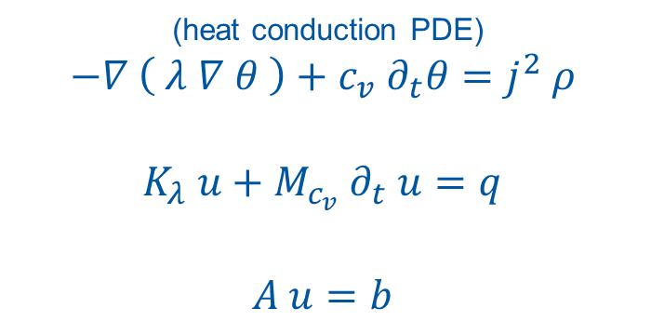
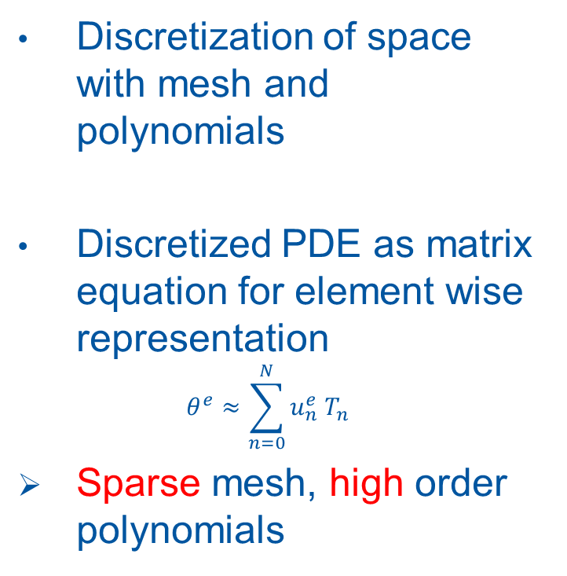
Spectral Element Method (SEM) – II
Discretization of space with mesh and polynomials
Discretized PDE as matrix equation for element wise representation
$$θ^{e}≈\sum_{n=0}^{N}{u_{n}^{e} T_{n} }$$
Sparse mesh, high order polynomials
(heat conduction PDE)
$$−∇ \left( λ ∇ θ \right)+c_{v} ∂_{t}θ=j^{2} ρ$$
$$K_{λ} u+M_{c_{v}} ∂_{t} u=q$$
$$A u=b$$
Notes:
Function is not approximated over whole domain by ‘one set’ of polynomials
But for local refinement possibilities: apply separate approximation series (spectral) in different parts (elements) of computational space domain
-> Piece-wise approximation with polynomial series
Idea of SEM approach: integrate PDE over whole computational domain and use orthogonality in each element
Obtain coefficients for each element’s polynomial representation from solving matrix equation
Does this approach work?

Slide 10
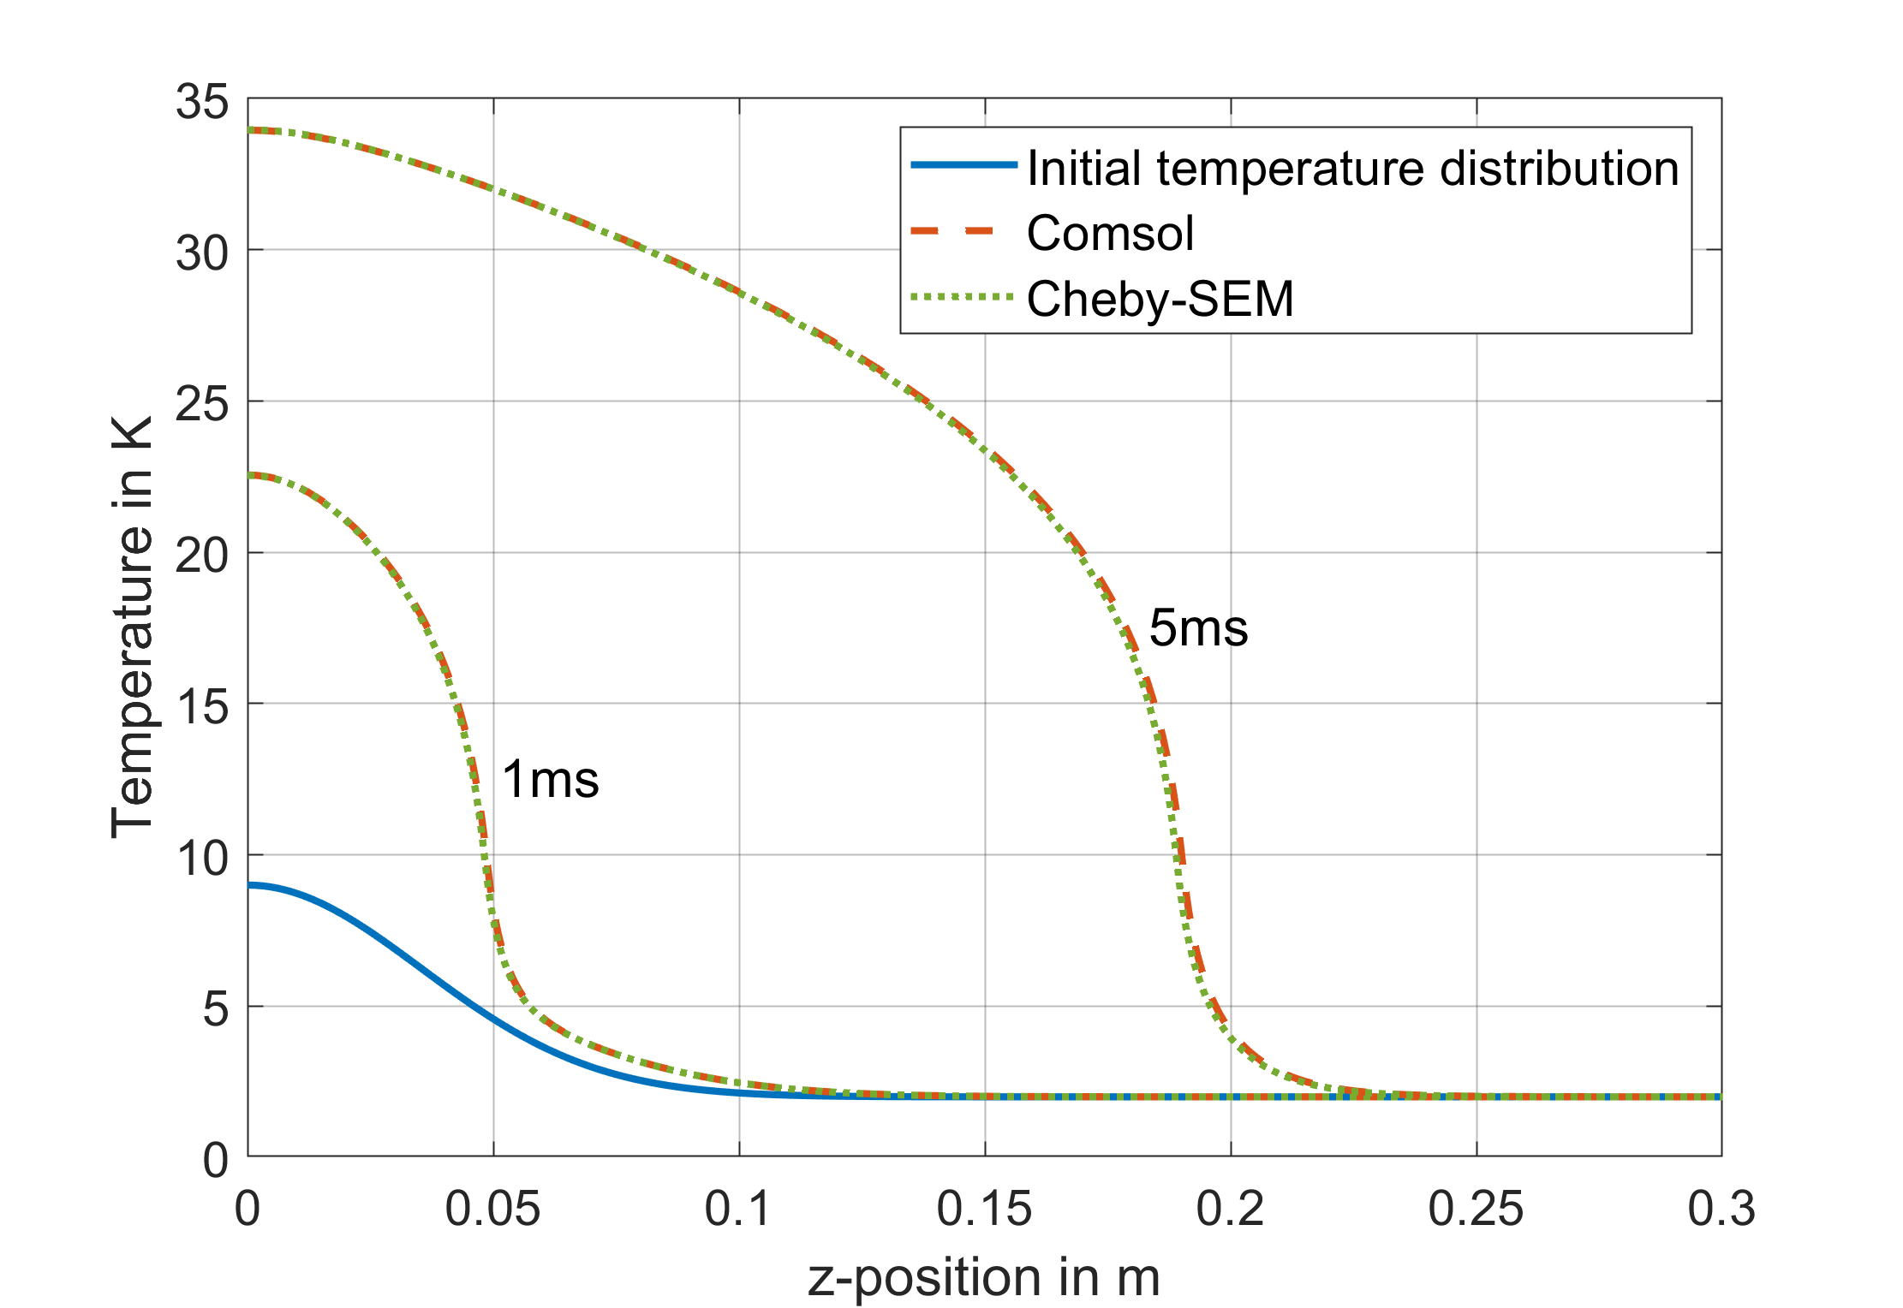
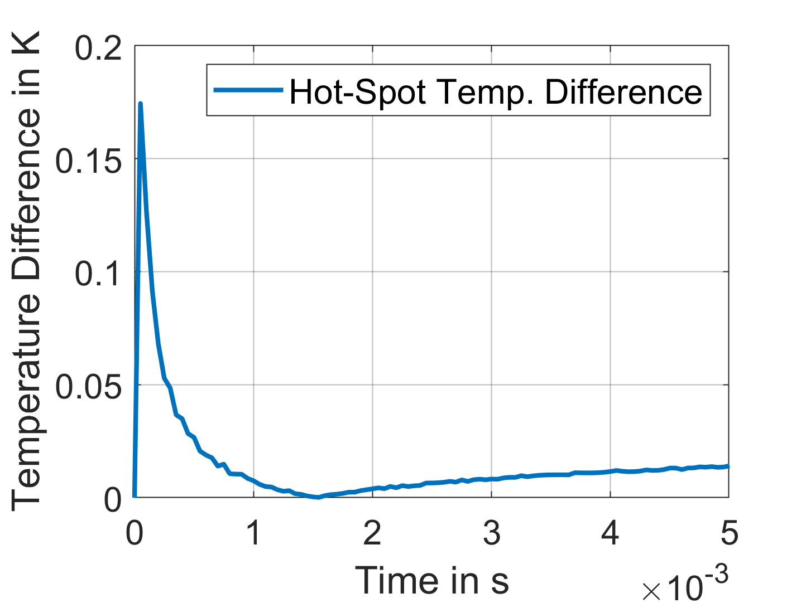
Benchmark: Proof of Concept
1D adiabatic thermal quench propagation in simplified LTS cable
Cheby-SEM in Matlab vs. Comsol
Results in good accordance
Proof of functionality
Notes:
Implementation in Matlab
Compare with Comsol, proprietary software with different discretization model: Finite Element Method
Build very simple reference model:
1D LTS simplification (cable much longer than wide)
Constant transport current, initial temperature distribution (Gaussian, see picture)
Observe quench propagation / temperature profile over time
Test setup in Comsol and Matlab
Element-size in SEM set to 5 cm
Simulation in space over [0, 0.4] m, in time up to 5 ms (arbitrarily chosen to limit computational time)
Results:
Temperature profile in good accordance
So what are the differences between the methods? -> mainly numerical issues are of interest

Slide 11
Benchmark: Proof of Concept
 | Solver | Runtime | # DoF
Comsol | FEM, standard fine mesh | 33 s | 12.000
Comsol | FEM, adaptive mesh | 15 s | 400 – 500
Matlab | SEM, adaptive polynomial order | 19 s | < 200
More general:
Pro FEM
Multi-purpose tool
Steep changes
Inhomogeneous materials
Pro SEM:
Specialized tool
Accuracy
Less storage requirements
Simple refinement
Notes:
Solver comparison:
Similar simulation runtime (! But note different implementation languages / solvers !)
Number of degrees of freedom indicates resolution of problem / determines computational effort to solve matrix equations -> crucial for refinement strategies or large geometries
Accuracy: SEM converges ‘exponentially’, meaning: faster than FEM (‘linear’) -> less DoFs necessary & refinement improves rapidly (! Computational time!)
Bookkeeping / framework / storage: SEM only few nodes & polynomial order N ------ (large) mesh size
Refinement: SEM only change polynomial order -> one coefficient! ------- remeshing & interpolation & high dependency on quality of mesh
Commonly used: FEM, very universal application (esp. due to universal mesh) esp. in prop. Software ------- lot of research as well but mainly academic applications
Steep changes: FEM simple (node-wise solution representation) ------- infinite polynomial spectrum for unsteady function
Material: FEM node-wise material ------- additional effort / numerical integration (not in my work) / element-wise full matrices
-> different focus, but esp. refinement & smooth function as argument for SEM in quench propagation & accept cost of steep change in small region
What is necessary to make such a solver work? -> give an impression of building blocks around numerical method itself

Slide 12
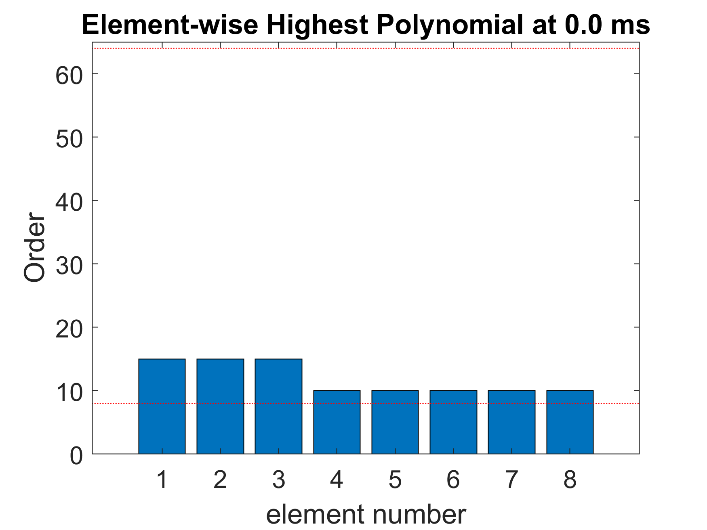
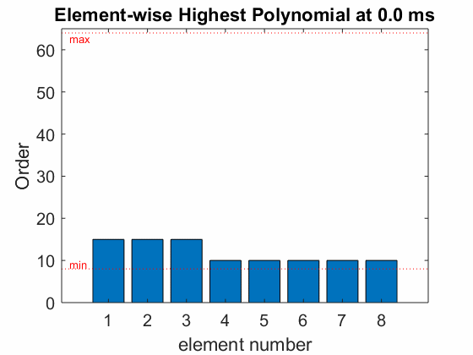
Implementation Notes
What it is:
Matlab scripts
Object-oriented:
  2 main classes
  15 methods
  30 basic unit and function tests
Simulation driver:
  Basic: ~ 50 LOC
  Framework: ~ 150 LOC
  Postprocessing: ~ 300 LOC
+ ~500 LOC in classes
Framework example:
Resolution adaption over time reflecting quench front propagation
Notes:
Framework implemented:
Matlab script based -> simple evaluation / plotting / linear algebra
Object oriented, container for similar properties
1 class tracking the polynomials (2. class) for each element
Functions for assemble matrices, discretize analytical function, bookkeeping of elements, … (each 3 – 50 LoC)
Rudimentary test coverage for main properties -> often used simple differential equation with analytically known solution
Basic commands for initial value, time-loop, assembling, solving (! Soul of method !)
Framework for nonlinear materials, several on-the-run-checks, settings, (Must-have, but not often mentioned)
PP dominant for plots -> necessary, never mentioned
So, implementation running, where to apply it?

Slide 13
Summary
Cheby-SEM and necessary framework has been implemented in Matlab
Implementation has been validated for an academic example against FEM
Clear advantages of SEM compared to FEM for quench propagation are shown:
  Simple refinement
    Obtain desired accuracy
  Less storage
    Cheaper application to larger geometries
  Local resolution
    Easy adaption to quench front

Slide 14
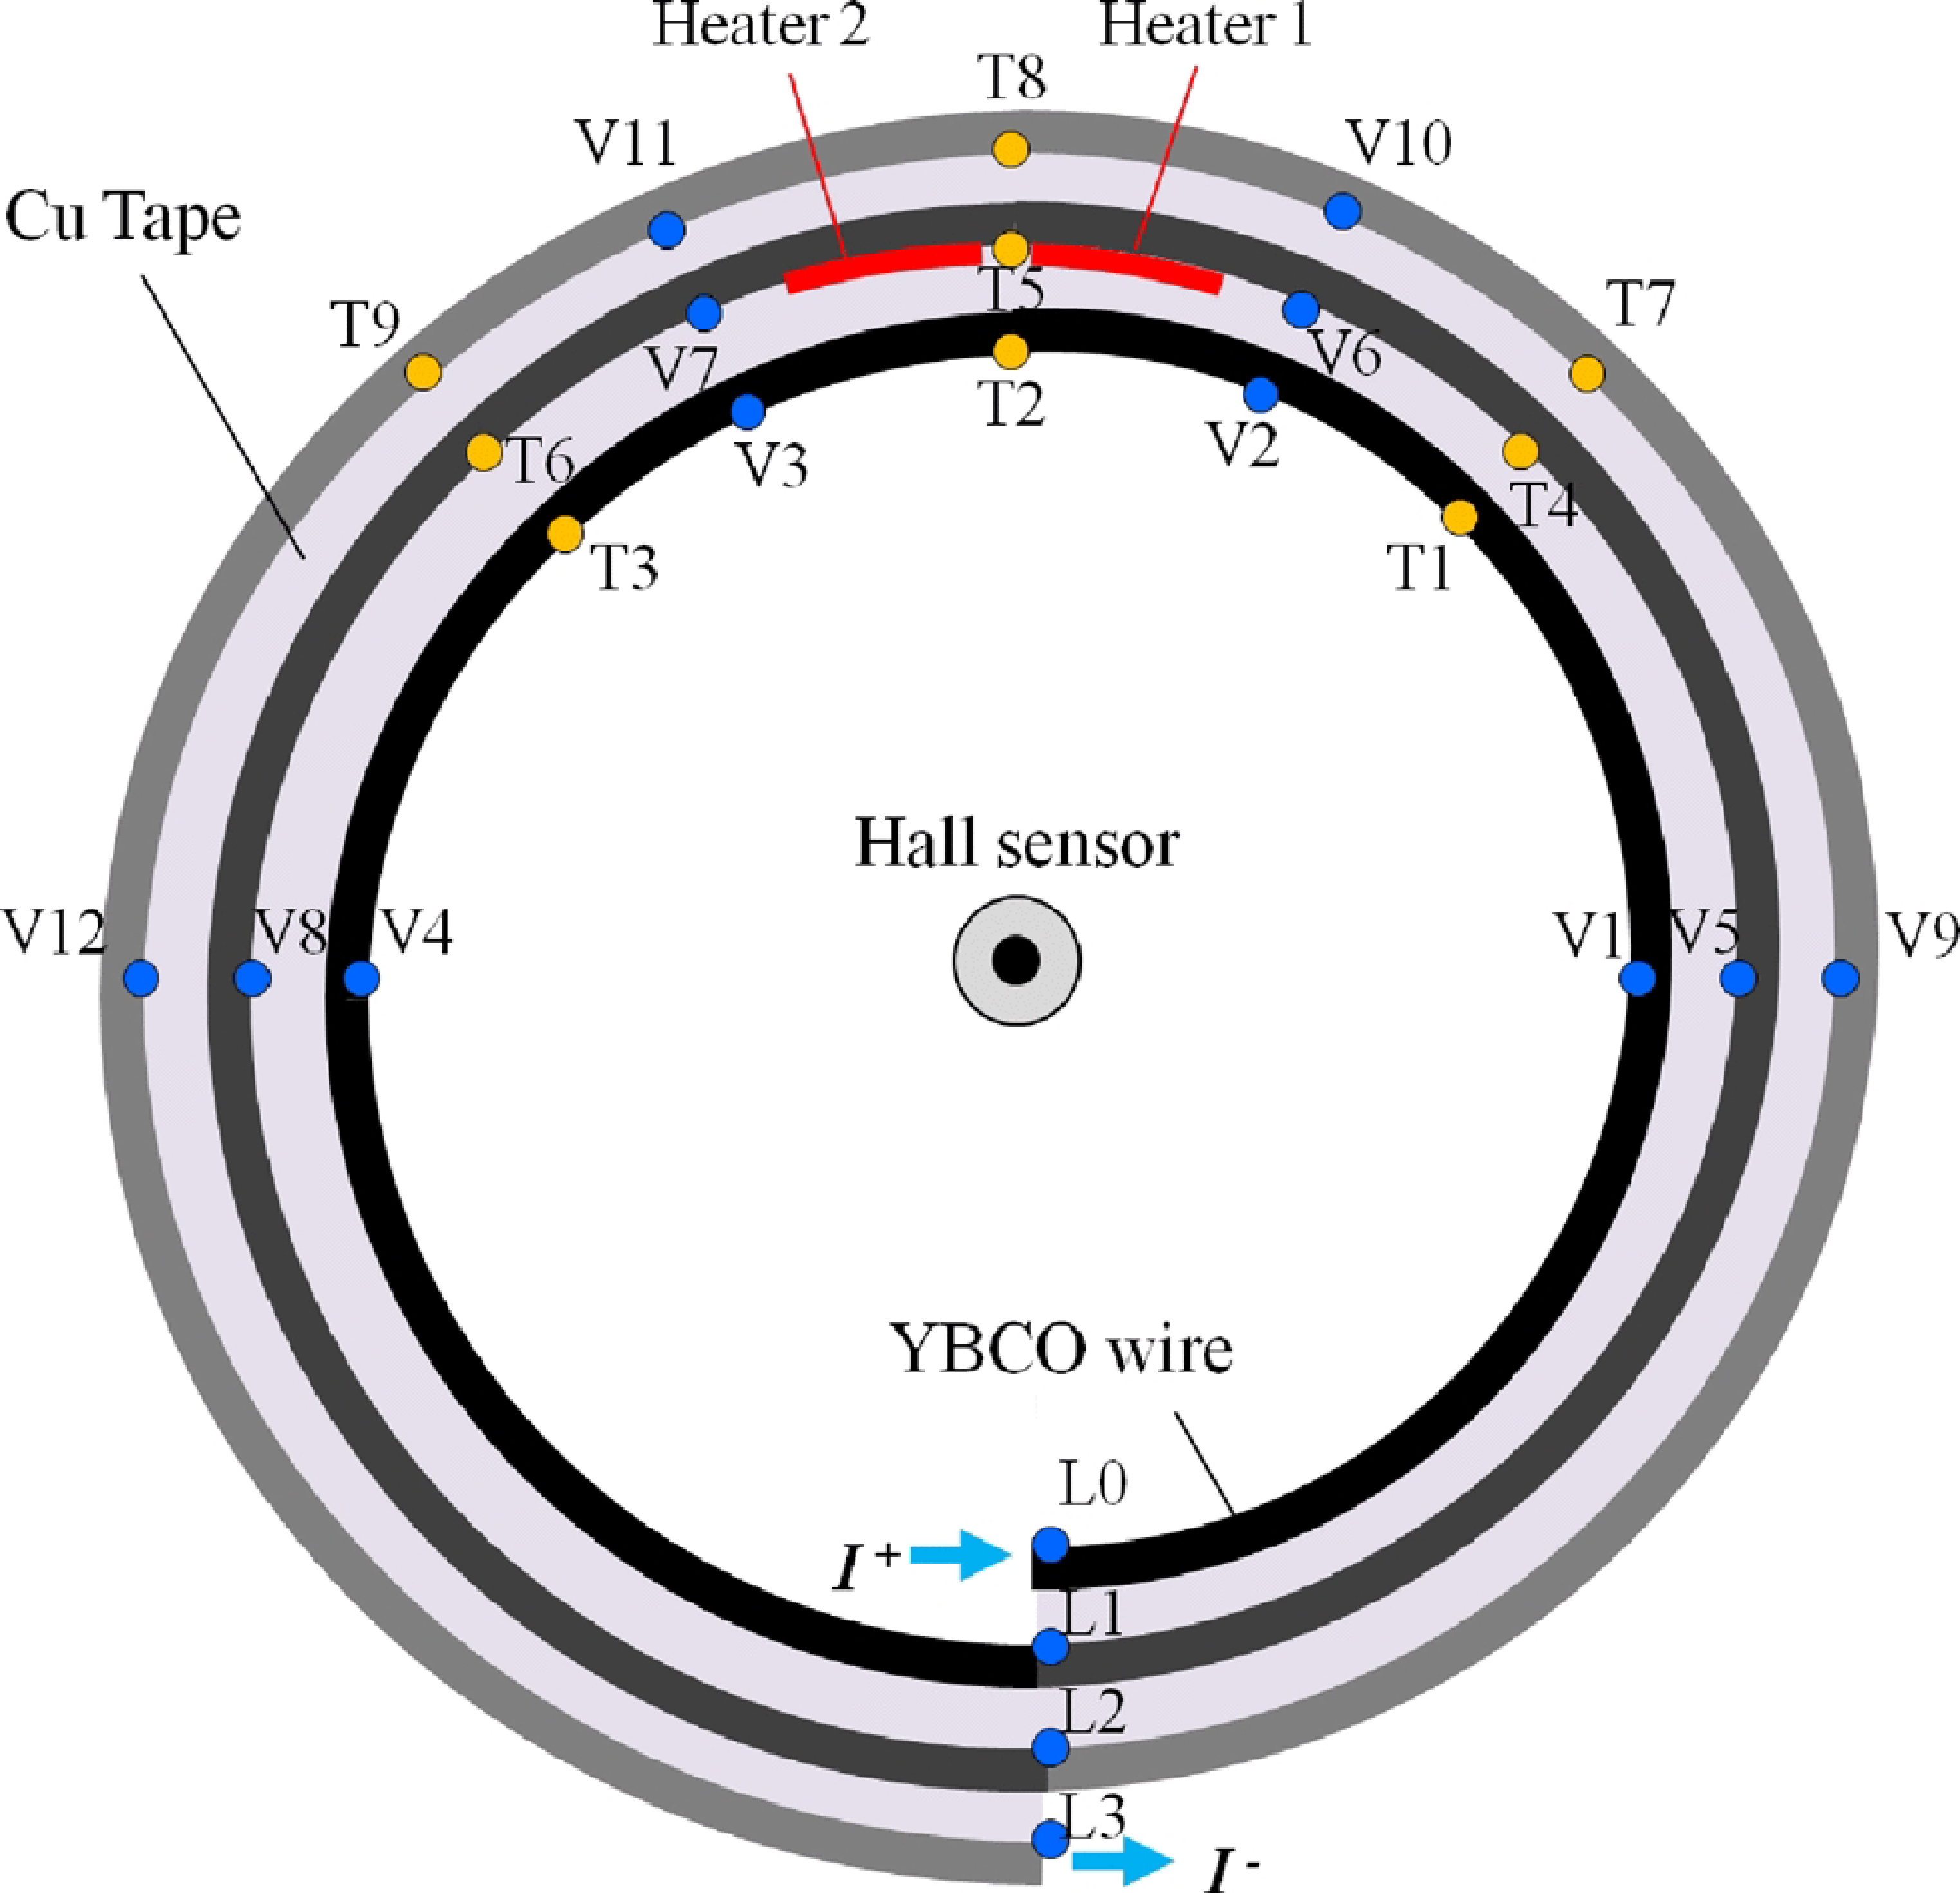
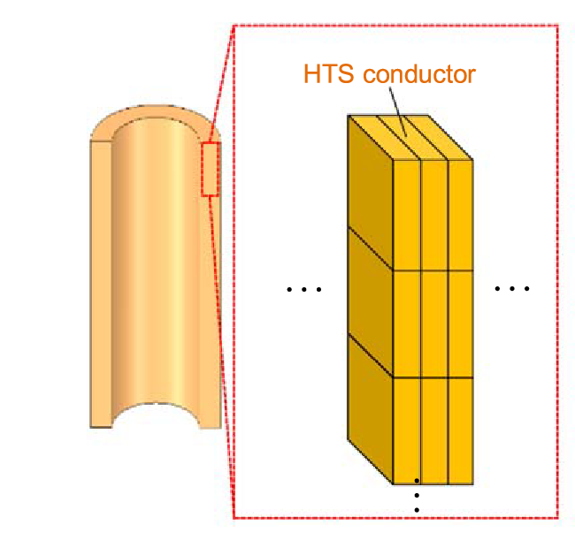
What’s next? – Background I
Non-insulated (NI) HTS coils
  Wounded tapes
  Solenoid
  Quench tolerant (Self protection)
(Picture taken from Y Suetomi, 2019, https://doi.org/10.1088/1361-6668/ab016e)
(Picture taken from Seok Beom Kim, 2012, https://doi.org/10.1109/TASC.2011.2174559)
Notes:
Context: NIC coils, HTS tape in direct contact or by conducting material
Tapes wounded in circular / spiral shape
Application solenoid field, possibilities e.g. in fusion
Quench causes current to use copper path (simplified blue in pic)
But: HTS property of finite resistance between current-sharing and critical temperature -> crucial: equivalent resistance of quenched domain?

Slide 15
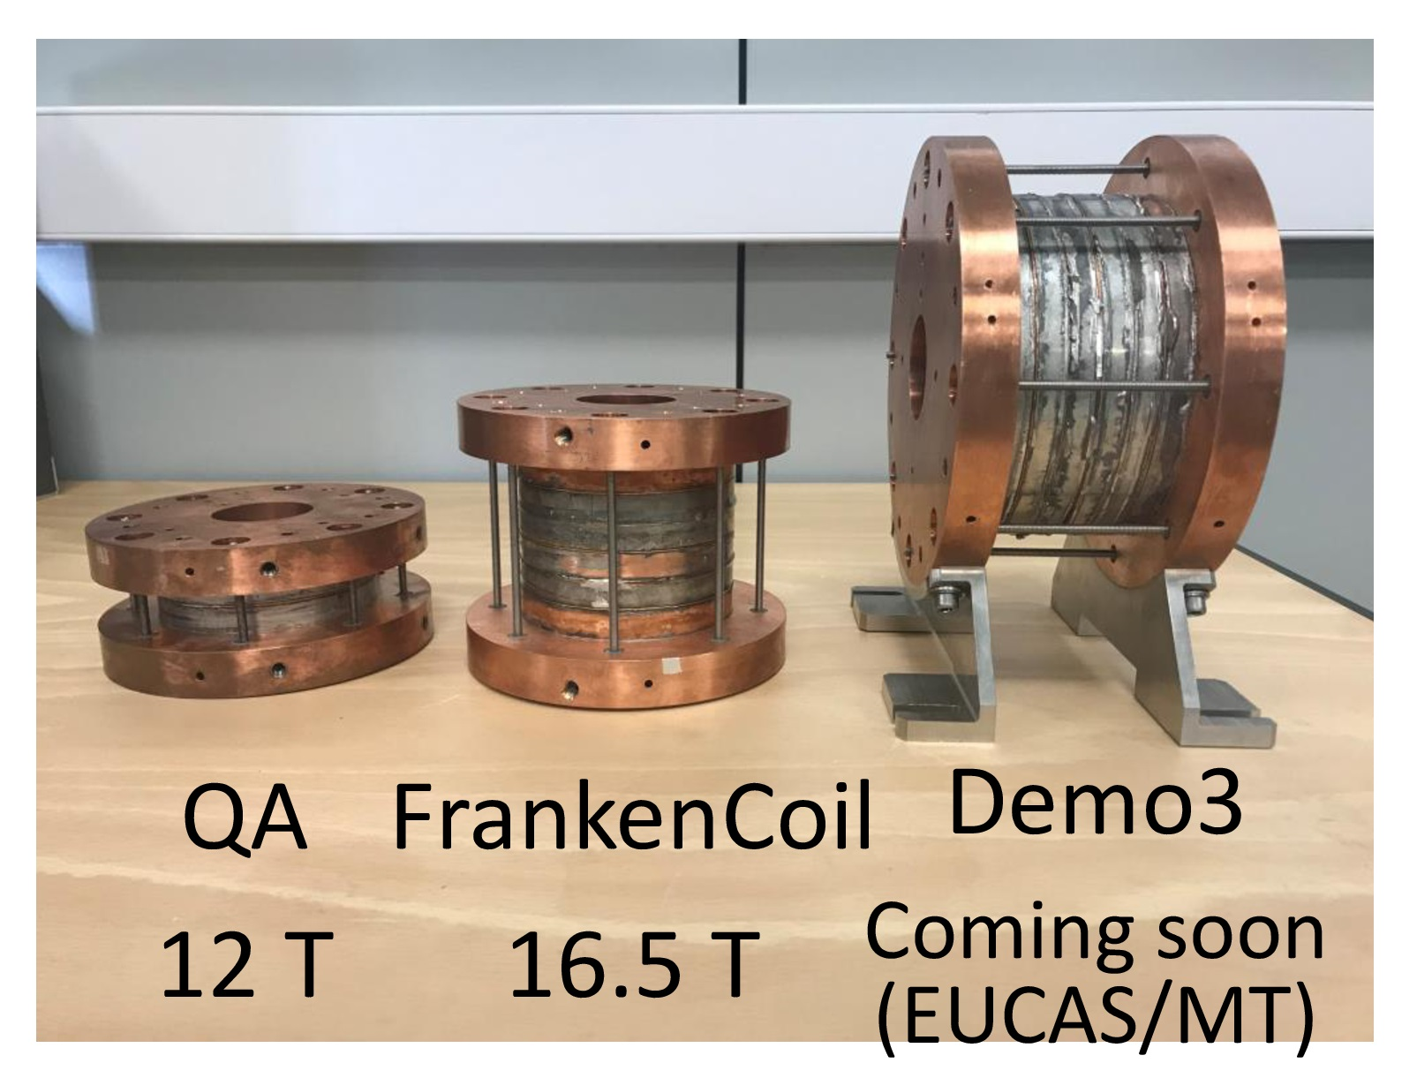
What’s next? – Background II
Non-insulated (NI) HTS coils
  Wounded tapes
  Solenoid
  Quench tolerant (Self protection)
Planned application in fusion technology (cmp. e.g. tokamak energy)
Application in accelerator technology?
(Picture taken from tokamak energy, WAM-HTS presentation, 2019, https://indico.cern.ch/event/775529/contributions/3334053/attachments/1829923/3003215/20190412_GB_Stability_and_quench_dynamic_behaviour_of_Tokamak_Energy_REBCO_QA_coils_Indico.pdf#search=van%20nugteren%20AND%20EventID%3A775529)
Notes:
Context: NIC coils, HTS tape in direct contact or by conducting material
Tapes wounded in circular / spiral shape
Application solenoid field, possibilities e.g. in fusion
Quench causes current to use copper path (simplified blue in pic)
But: HTS property of finite resistance between current-sharing and critical temperature -> crucial: equivalent resistance of quenched domain?

Slide 16
What’s next? - Task
Simulation of HTS tape peak temperature during quench
  1D simplified model
  Current sharing btw. super- and normal-conducting domains
  Equivalent resistance
Mid-term:
  Coolant (1D + 1D)
  Turn-to-turn propagation
(Picture taken from Seok Beom Kim, 2012, https://doi.org/10.1109/TASC.2011.2174559)
Notes:
Application on HTS tape
simplified, much longer than wide, averaged materials etc.
Find dependency R_eq ( T_peak, d_cu) -> choice of thickness of copper layer

Slide 17
Outlook: Numerical Aspects
Coupling with magnetic problem?
Advance to 3D simulation?
Treatment of time-domain: solutions for multi-rate problem?
Only excerpt - focused on ongoing work in Darmstadt

