Slide 1

Summary of the 26th Magnet Technology Conference
L. Bortot^{1,2} , E. Ravaioli¹

Slide 2
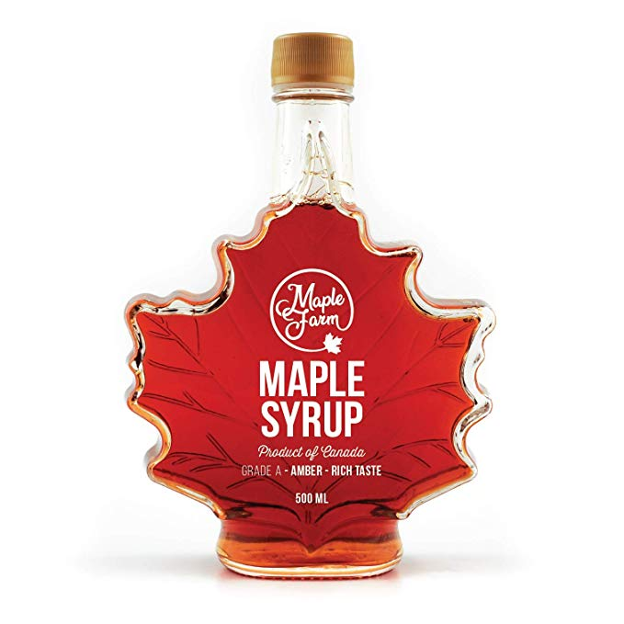

Overview
Presentations available at https://indico.cern.ch/event/763185/
22-27 September 2019, Vancouver, Canada
~ 1000 attendants
~ 1000 contributions (presentations + posters)
Broad coverage on magnet technology:
Wires, cables, coils, magnets
Design, simulation, manufacturing, test, protection
Superconducting and normal conducting
Magnets for Accelerators, Detectors, Fusion, Motors, MRI, NMR
…and the list is not exhaustive!
Remark:
Many interesting contributions are not available / locked out

Slide 3
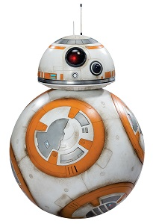
HTS: The Force Awakens (hopefully)
+38%
+31%
+300%
+166%
+142%
+114%

Slide 4
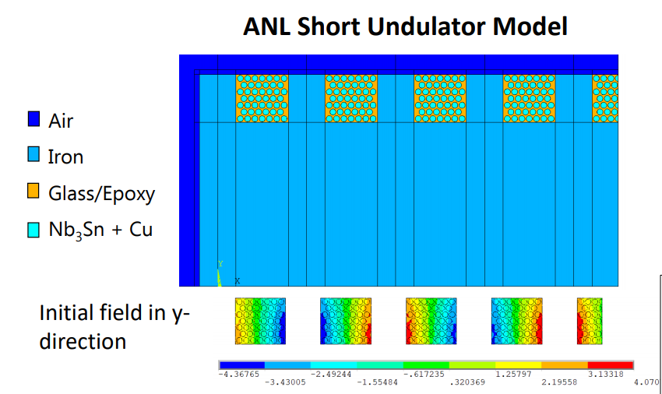
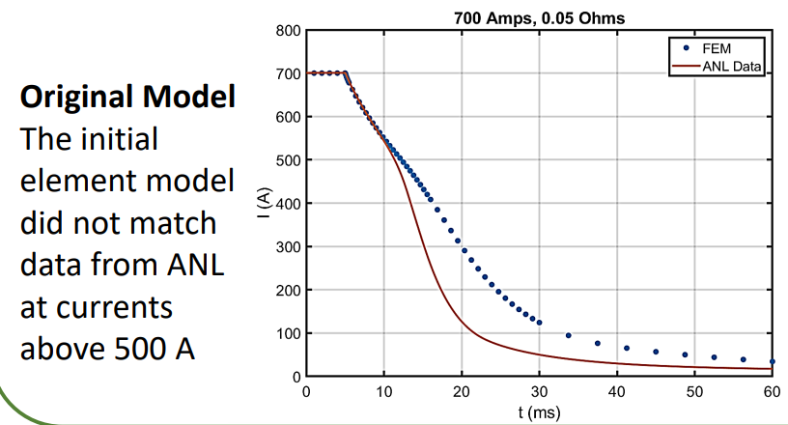
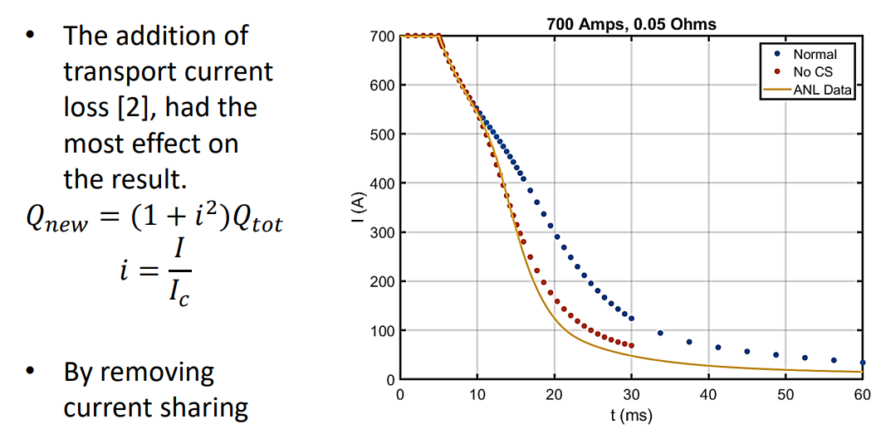
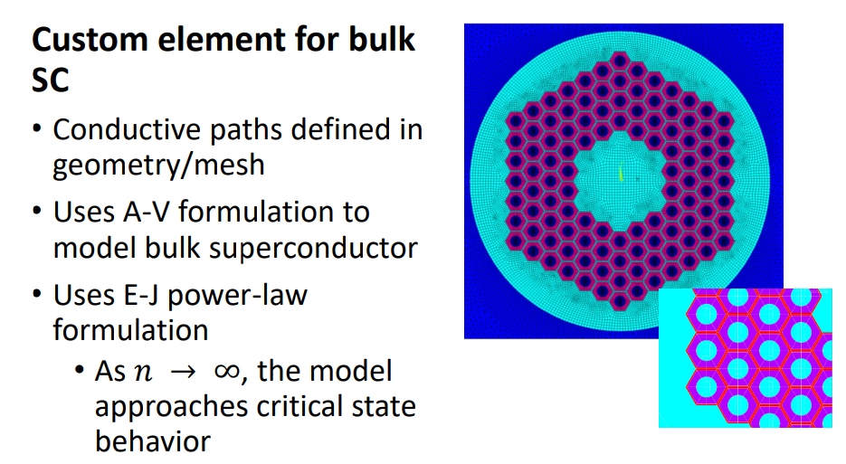
User Defined ANSYS Elements for 3D Multiphysics Modeling of Superconducting Magnets
Kathleen Edwards et. Al.

Slide 5
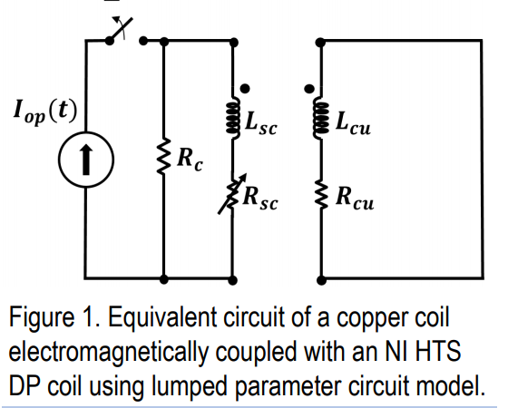
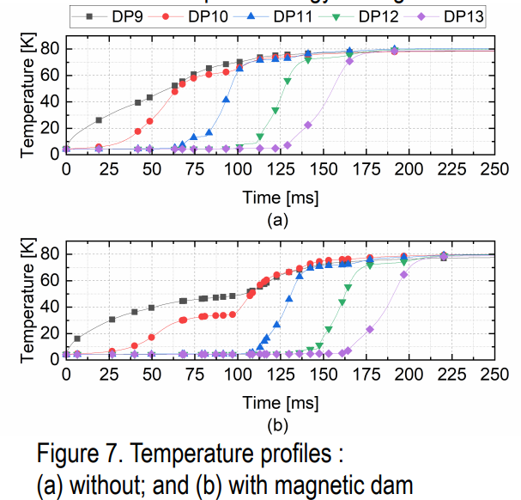
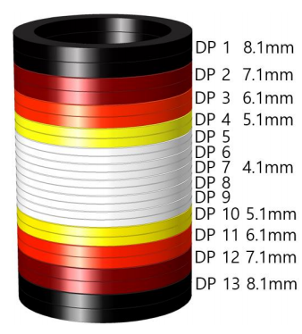
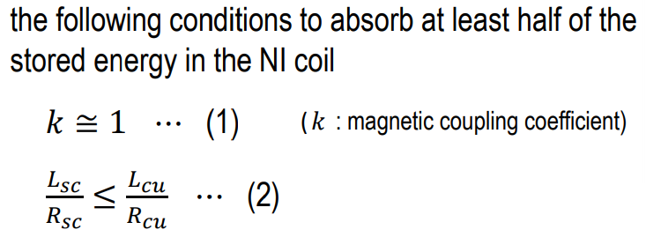
A Conceptual Study on “Magnetic Dam” to Absorb Electric Quench Energy in NI HTS Magnet
Soobin An et. Al.

Slide 6
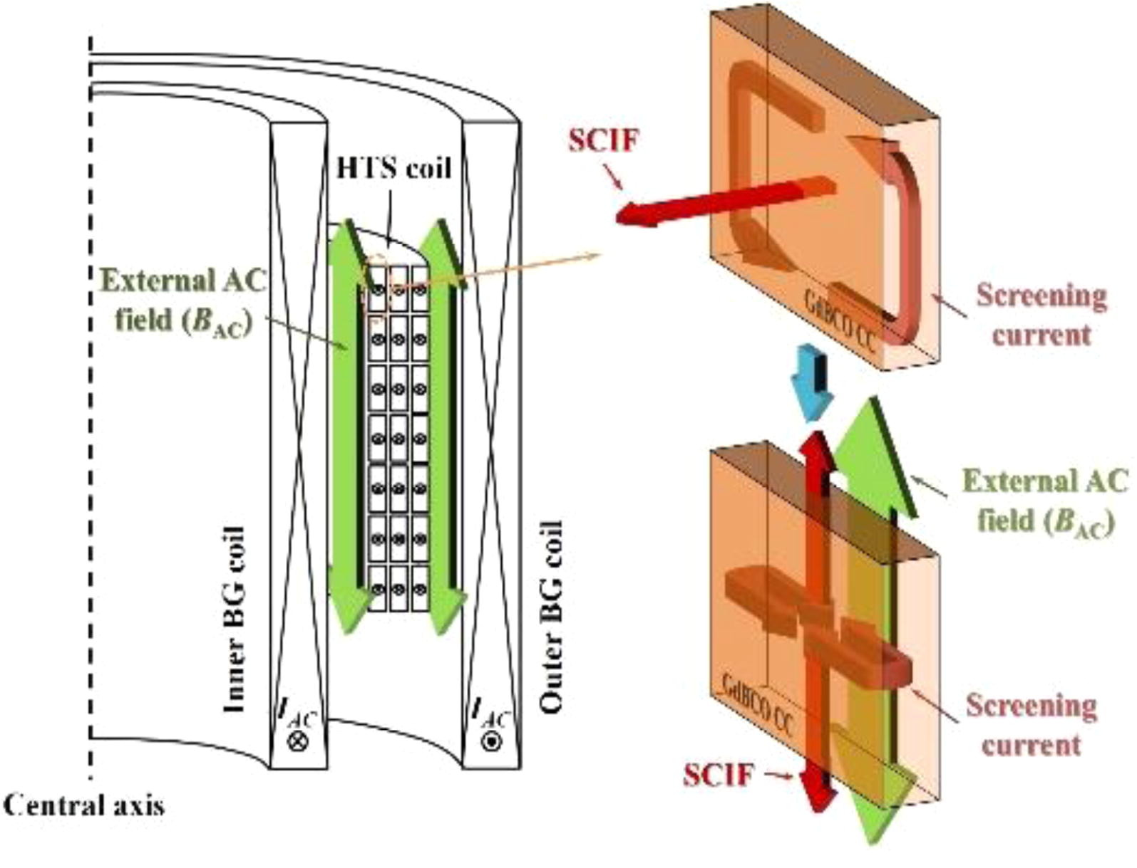
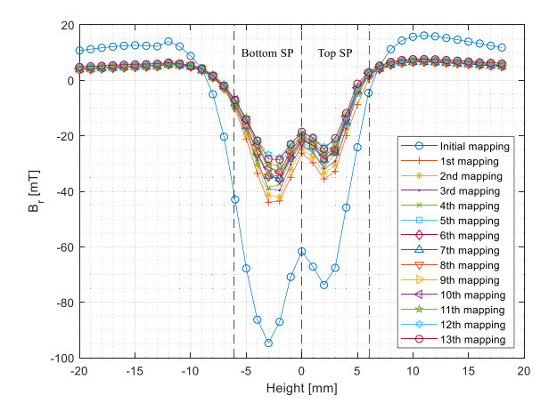
Experimental and Numerical Studies on a Method to Mitigate Screening Current-Induced Field for No-Insulation REBCO Coils
Jiho Lee et. Al.

Slide 7
Mitigation of Shielding-current induced Field
in a Magnet Wound with Coated Conductors
for Accelerator Systems
Yusuke Sogabe

Slide 8
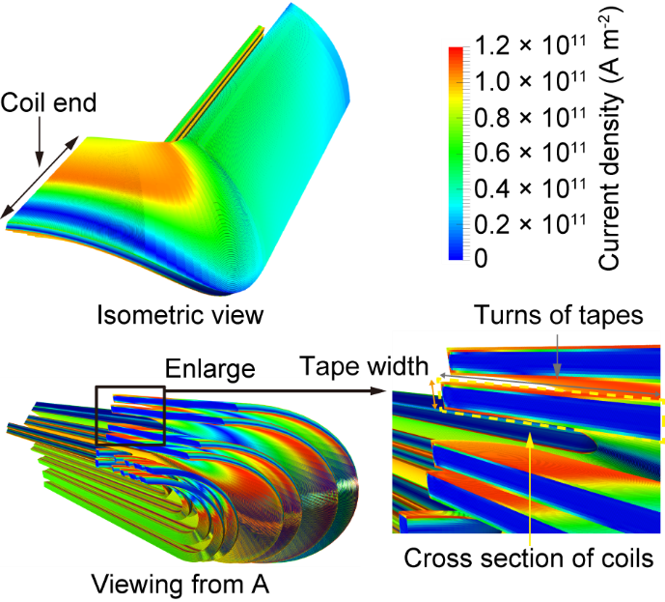
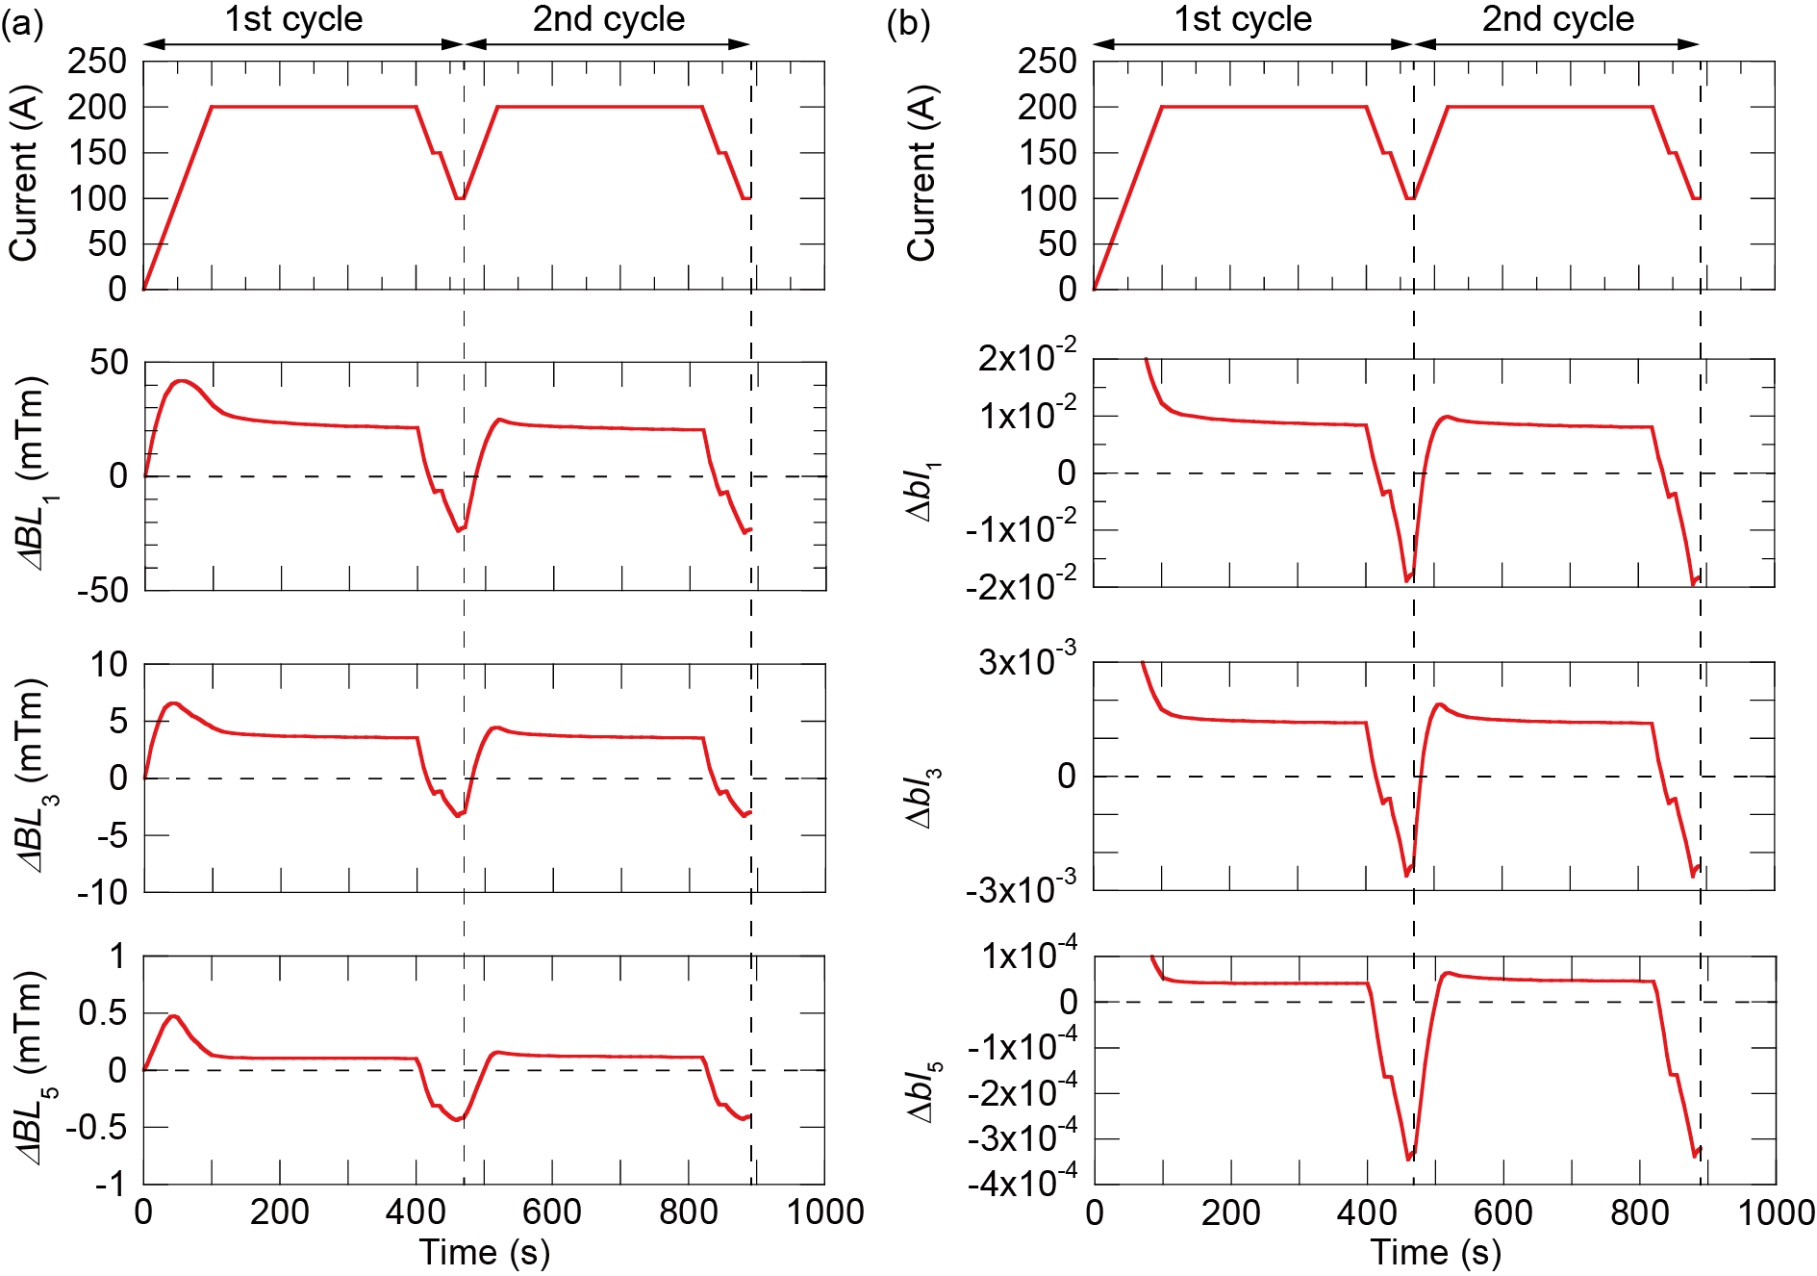
HOW does SCIF deteriorate field quality of accelerator magnets?
N. Tominaga, et. al., IEEE TAS, 28, 4900305
Dipole and sextupole components
of SCIF have to be mitigated!!
Dependence of SCIF on current
Notes:
This is a electromagnetic field analysis results. By using the three-dimensional electromagnetic field analysis model developed by our group, we can visualize shielding currents in magnets.
I show the dipole, sextupole, and decapole components of SCIF. Here, influence of SCIF on dipole and sextupole components of magnetic field is larger than criteria of required field quality to magnets for rotating gantry.
And also, it is the especially difficult point in accelerator magnets that SCIF depends on current. Because we need to mitigate SCIF for every current, mitigation of SCIF for accelerator magnets could be challenging.

Slide 9
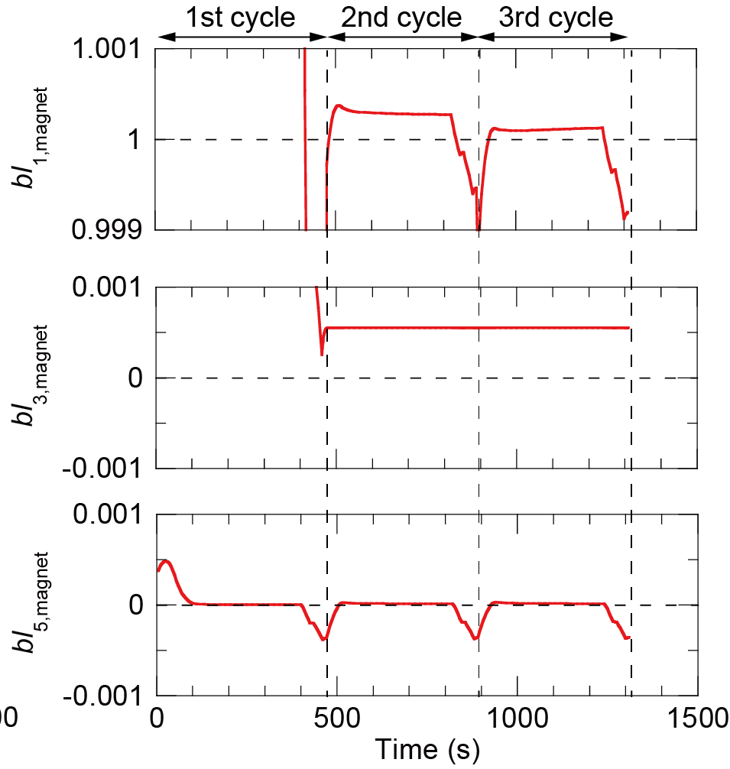
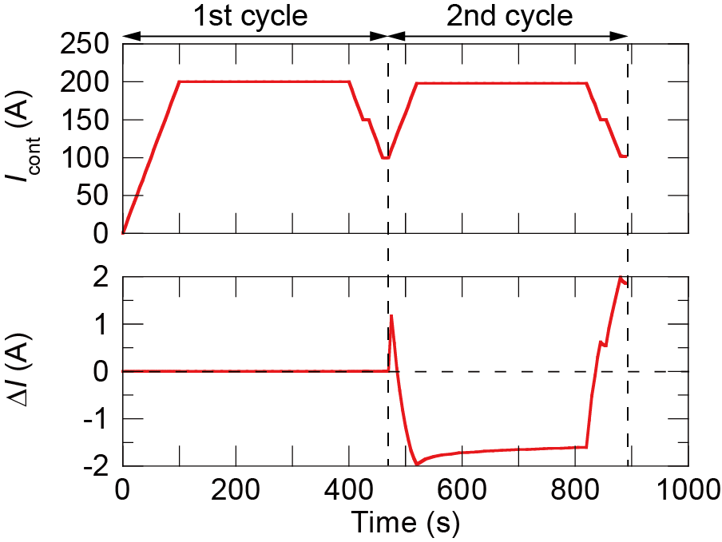
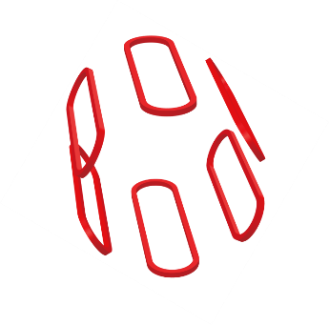
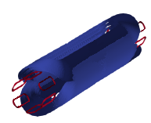
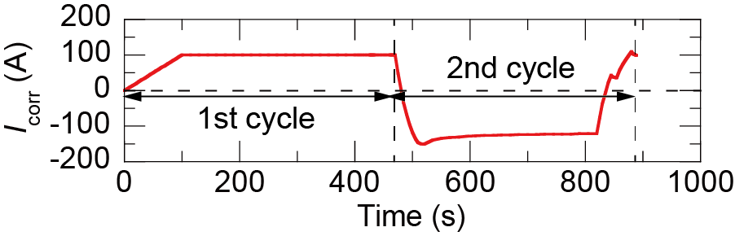
HOW can influence of SCIF be mitigated?
Current control for dipole component
Current profile is decided
based on the advance
simulation.
Correction coils for sextupole component
Operation pattern of the
correction coil is decided
based on the advance
simulation.
Error field by SCIF was
less than 1×10⁻³ of BL_{1,d}.
Notes:
I suggest two solutions to mitigate influence of SCIF on field quality. This is the main part of this work by myself.
First, for dipole component, current control is a solution because the magnet was designed to generate only dipole component linear to current. Current profile could be decided based on the advance simulation.
Second, for sextupole component, combination of collection coils and main dipole magnet is a solution. We need to have another component which have another freedom to generate sextupole component. Operation pattern of the collection coils could be decided based on the advance simulation, too.
As the effect of these solutions, it was confirmed that we could obtain sufficient precise field quality for rotating gantry magnets.

Slide 10
Key Issues in HTS Magnet and Conductor Technology Toward Various Applications
Naoyuki Amemiya

Slide 11
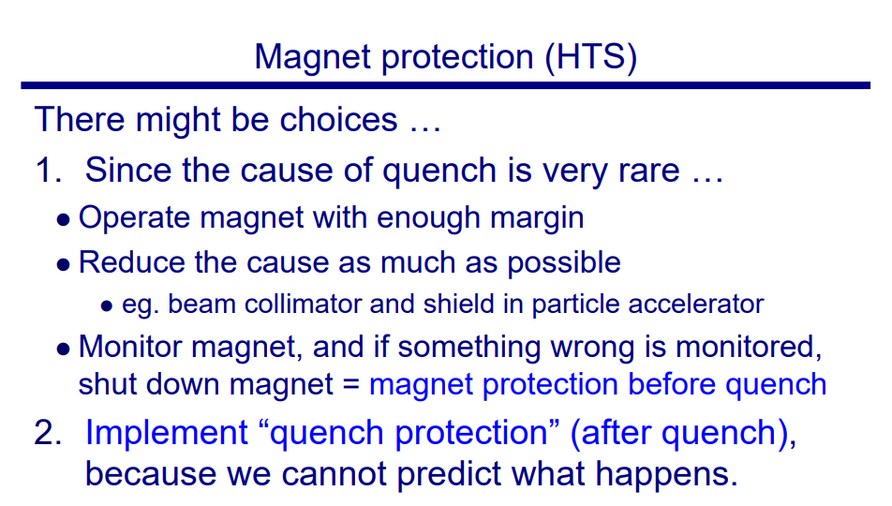
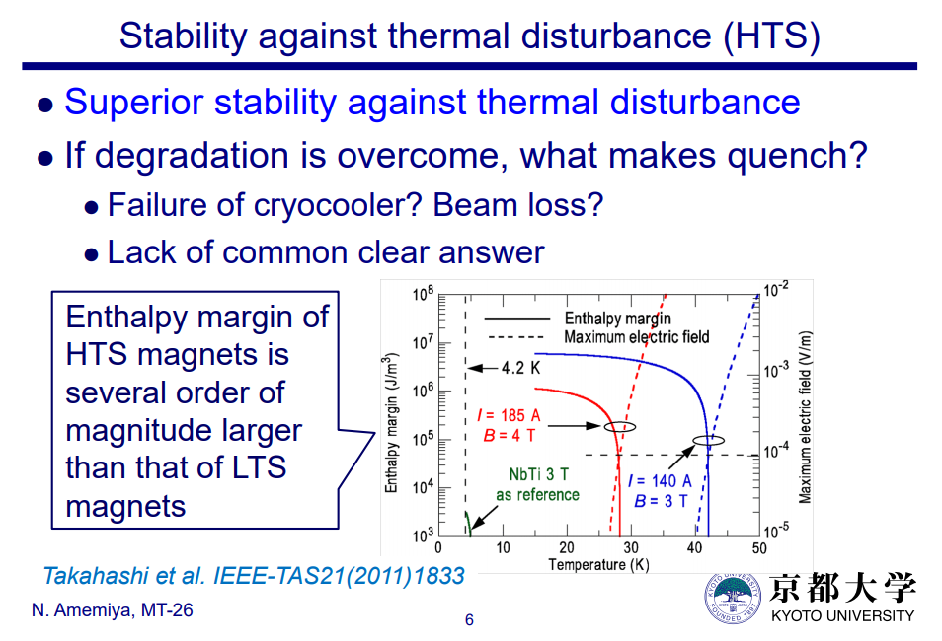

Slide 12
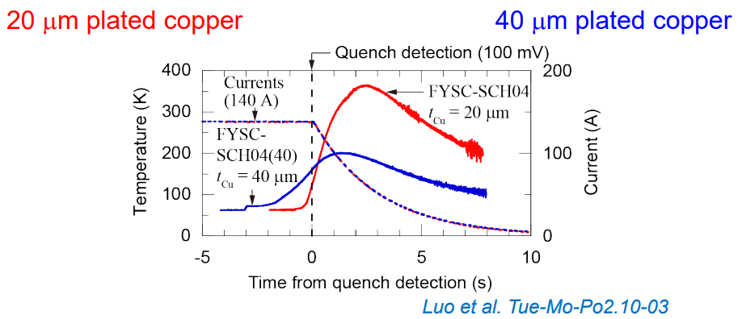
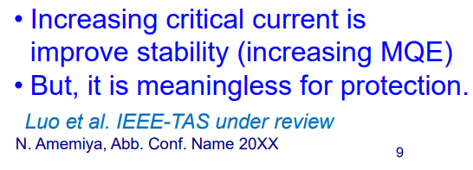
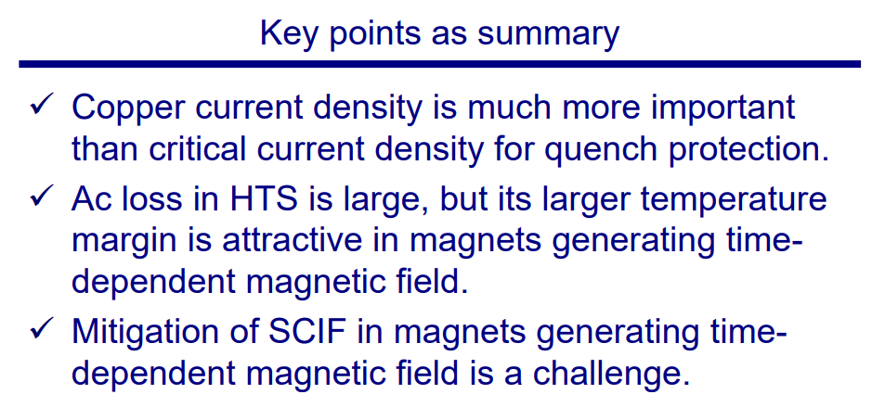

Slide 13
30 T generation using an intra-layer no-insulation (LNI) REBCO coil in a 17 T LTS magnet
Y. Suetomi et al.

Slide 14
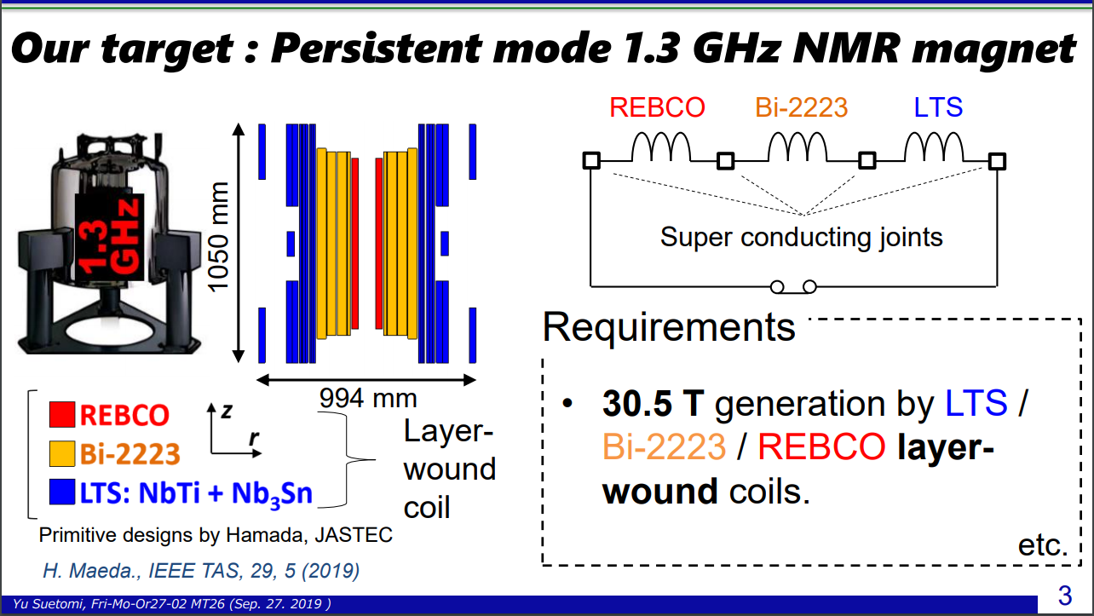

Slide 15
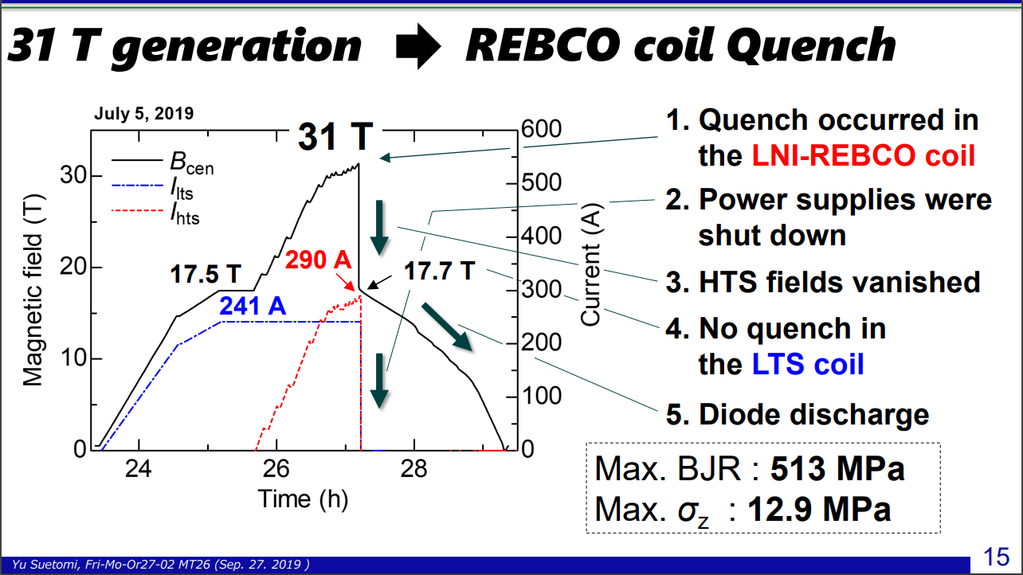

Slide 16
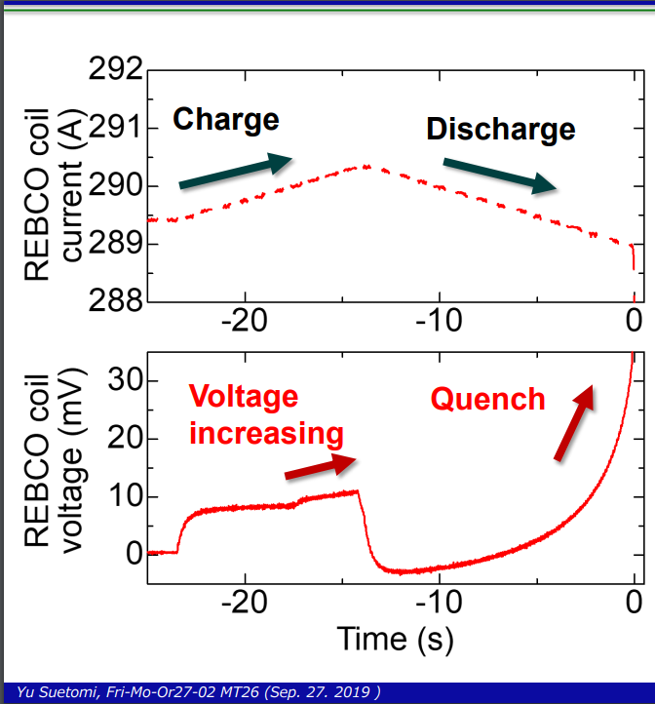
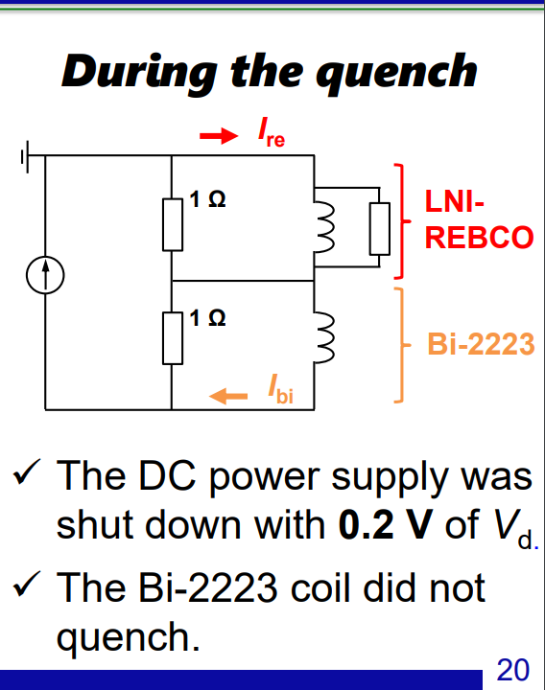

Slide 17
Advances in Ultra-High Field
Magnet Technology
Mark D. Bird

Slide 18
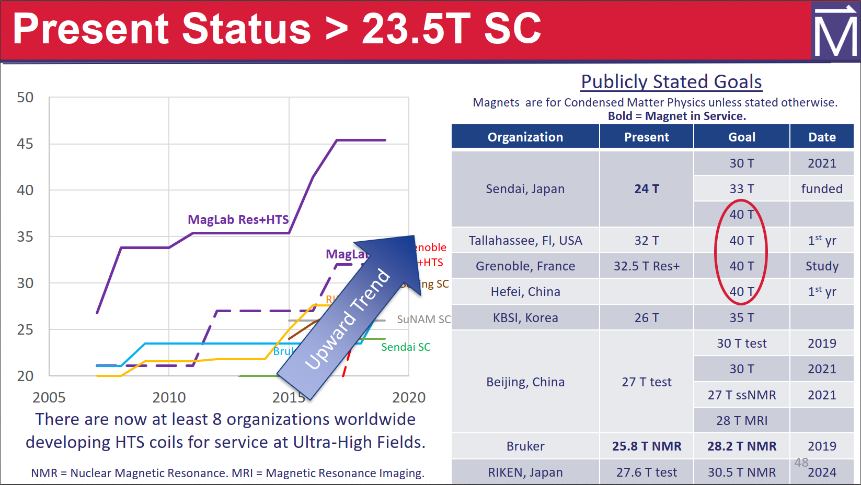

Slide 19
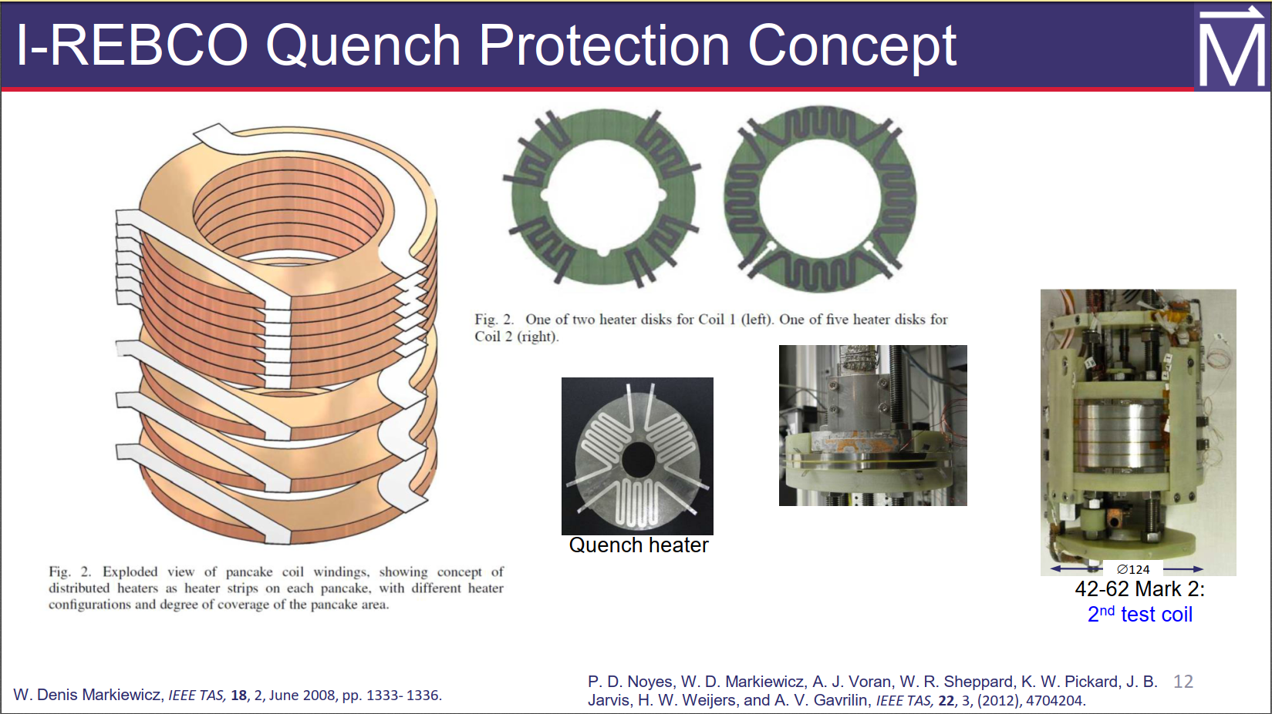

Slide 20
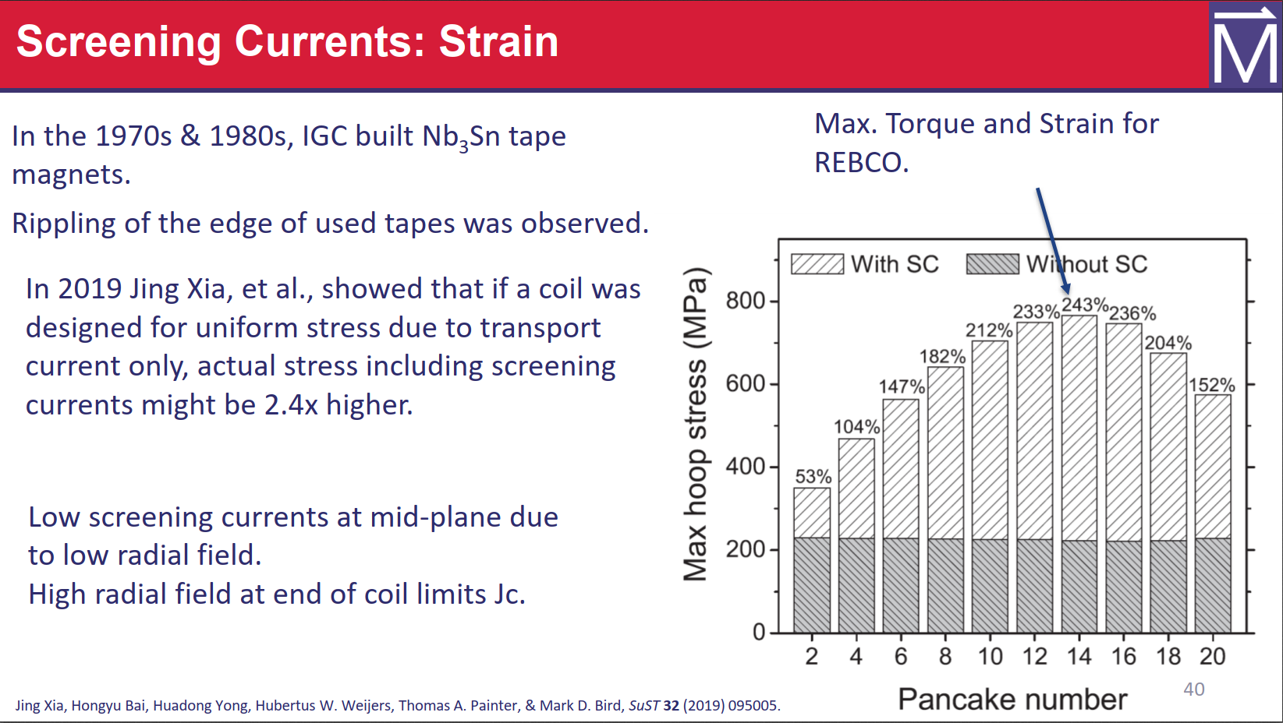

Slide 21
