Slide 1


Fast Failures in the High Luminosity LHC
Björn Lindström
CERN and Uppsala University
With input from:
L. Bortot, M. Valette, C. Wiesner, R. Schmidt, A. Verweij,
E. Ravaioli, M. Mentink, P. Bélanger, M. Väänänen
4th April 2019

Slide 2

Outline
Project definition and motivation
Failures
CLIQ
Beam Beam Kick
Triplet Quench

Slide 3
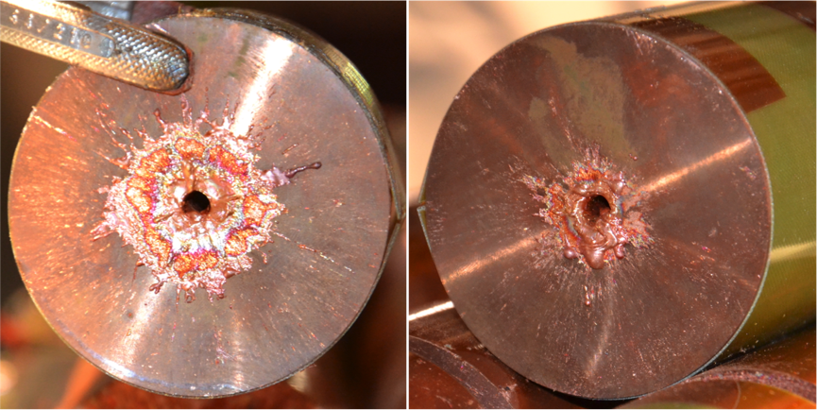
Beam induced damage
1.52 MJ deposited energy
Courtesy of F. Burkart

Slide 4
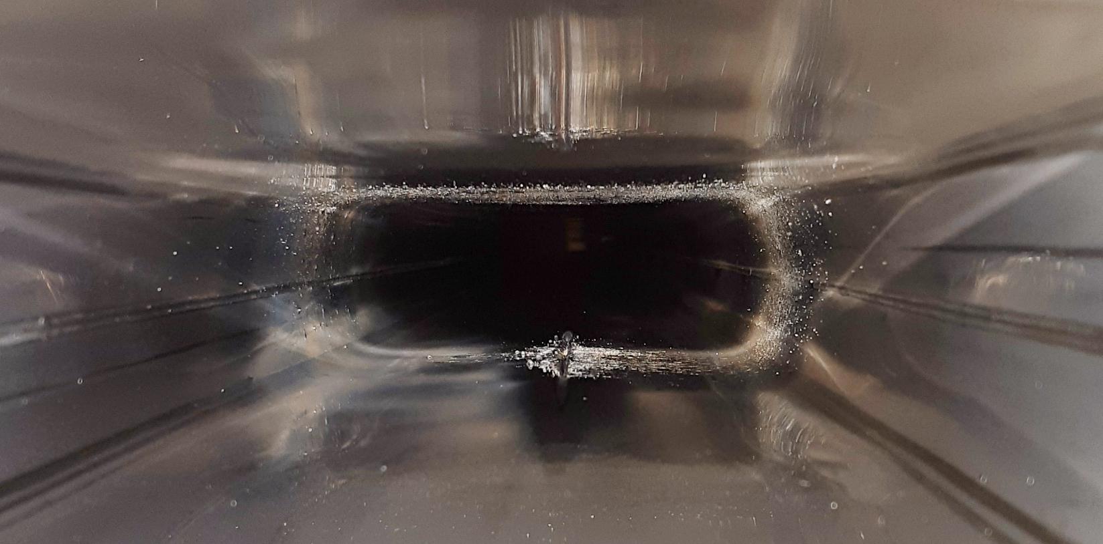
SPS vacuum leak
2 MJ lost in 15 ms
LHC is cryogenic:
SPS downtime ~3 days – LHC downtime ~3 months
K. Li – 168th MPP meeting

Slide 5
Scope of project
Study of failure scenarios causing uncontrolled beam losses
  Source of failures
  Effect on the beam
  Subsequent beam losses (intensity, location)
  Time scales
Detection of failures
  How to limit time between detection of failure and beam dump → time sufficient before critical losses occur?
Identify new failures, e.g. due to new equipment
Goal: Understand criticality of failures to determine protection strategy / how to design safer system
(current machine protection system sufficient? new interlocks required? other mitigation strategies?)

Slide 6
High Luminosity LHC (HL-LHC) changes
To attain higher luminosity, higher bunch intensity and smaller beam size in collision point
New layout and new HW (crab cavities, triplets, 11T dipoles)
 | LHC (6.5 TeV) | HL-LHC
# bunches | 2556 | 2748
Protons per bunch | 1.15e11 | 2.2e11
Beam size collision [µm] | 95 | 60
Stored Beam energy [MJ] | 306 | 678
Peak luminosity cm^-2 s^-1 | 2.2 * 10^34 | 17 * 10^34
Increased stored beam energy important parameter, but also the smaller beam size in collision point!

Slide 7
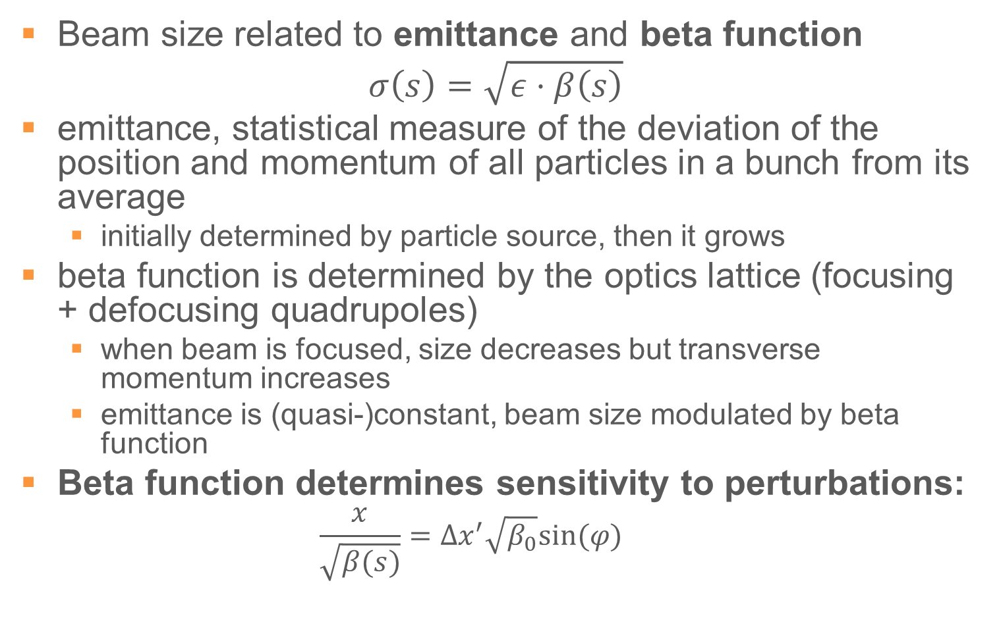
Beta function
Beam size related to emittance and beta function
$$σ\left(s\right)=\sqrt{ε⋅β\left(s\right)}$$
emittance, statistical measure of the deviation of the position and momentum of all particles in a bunch from its average
  initially determined by particle source, then it grows
beta function is determined by the optics lattice (focusing + defocusing quadrupoles)
  when beam is focused, size decreases but transverse momentum increases
  emittance is (quasi-)constant, beam size modulated by beta function
Beta function determines sensitivity to perturbations:
  $$\frac{x}{\sqrt{β(s)}}=Δx^{′}\sqrt{β_{0}}sin⁡(φ)$$

Slide 8
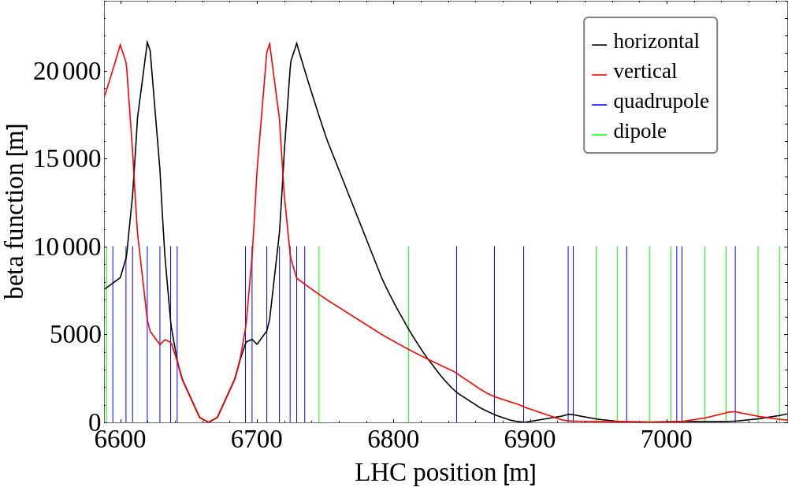

Beta function
$β\left(s\right)=β^{∗}+\frac{s^{2}}{β^{∗}}$ : $β^{∗}$ is beta function in IP
Small $β^{∗}$→ large beta function in Triplets, implying large effects on beam due to errors

Slide 9
Methodology
Observe an event in LHC
  Understand the failure
  Simulate in HL-LHC optics to determine future criticality
  Verify with experiments
New Hardware
  Study how it can malfunction and what would happen to the beam
  Simulate and determine criticality
  Verify with dedicated experiments when possible
→Determine mitigation and interlock strategies

Slide 10
Outline
Project definition and motivation
Failures
CLIQ
Beam Beam Kick
Triplet Quench

Slide 11
Overview of Fast Failures
Magnets/Circuits
Active Equipment
Others
Triplet Quench
ADT
UFO
D1, D2 power loss
Crab Cavities
UFO type 2
Quench Heaters
Beam-Beam Wire Compensator
Beam-beam Kick
CLIQ

Slide 12
Overview of Fast Failures
Failure in/due to: |  | Time to critical losses
Triplet Quench | Quench in final focusing magnets | > 50 LHC turns (4.5 ms)
D1,D2 | Power Failure in the dipoles next to the collision points | > 10 LHC turns (0.9 ms)
QH | Quench protection for magnets | > 1 LHC turn (0.1 ms)
CLIQ | Quench protection for magnets | ~1 LHC turn (0.1 ms)
ADT | Transverse beam damper | > 10 LHC turns (0.9 ms)
Crab Cavities | Required for counteracting loss in luminosity due to Xing angle | > 10 LHC turns (0.9 ms)
BBCW | Long Range Beam-Beam compensating wires | > 100 LHC turns (9 ms)
UFO | Dust-particles interacting with beam | ~3 LHC turns (0.3 ms)
UFO type 2 | Beam instability driven by remaining gas cloud after UFO interaction | > 10 LHC turns
Beam-beam kick | Loss of beam-beam kick due to dumping only one beam | ~2 LHC turns (0.2 ms)
aa

Slide 13
Failures covered below
Failure in/due to: |  | Time to critical losses
Triplet Quench | Quench in final focusing magnets | > 50 LHC turns (4.5 ms)
D1,D2 | Power Failure in the dipoles next to the collision points | > 10 LHC turns (0.9 ms)
QH | Quench protection for magnets | > 1 LHC turn (0.1 ms)
CLIQ | Quench protection for magnets | ~1 LHC turn (0.1 ms)
ADT | Transverse beam damper | > 10 LHC turns (0.9 ms)
Crab Cavities | Required for counteracting loss in luminosity due to Xing angle | > 10 LHC turns (0.9 ms)
BBCW | Long Range Beam-Beam compensating wires | > 100 LHC turns (9 ms)
UFO | Dust-particles interacting with beam | ~3 LHC turns (0.3 ms)
UFO type 2 | Beam instability driven by remaining gas cloud after UFO interaction | > 10 LHC turns
Beam-beam kick | Loss of beam-beam kick due to dumping only one beam | ~2 LHC turns (0.2 ms)
aa

Slide 14
Outline
Project definition and motivation
Failures
CLIQ
Beam Beam Kick
Triplet Quench

Slide 15
Magnet protection
High current in magnets (up to ~16 kA)
Quench – loss of superconductivity
Risk of cable damage
Need active system to protect magnet
Active system changes current – magnetic field in beam region
In LHC, magnet protection did not consider effects on beam

Slide 16
Coupling Loss Induced Quench (CLIQ)
Up to 2.5 kA discharged directly into magnet coil!
Q1 electrically same as Q3, but Q2 different
Q2: Symmetric discharge (opposite poles, same current change)
Q1/Q3: Asymmetric discharge (one pole increased current, three poles decreased)
Need circuit and beam simulations
I_nominal
I_CLIQ

Slide 17
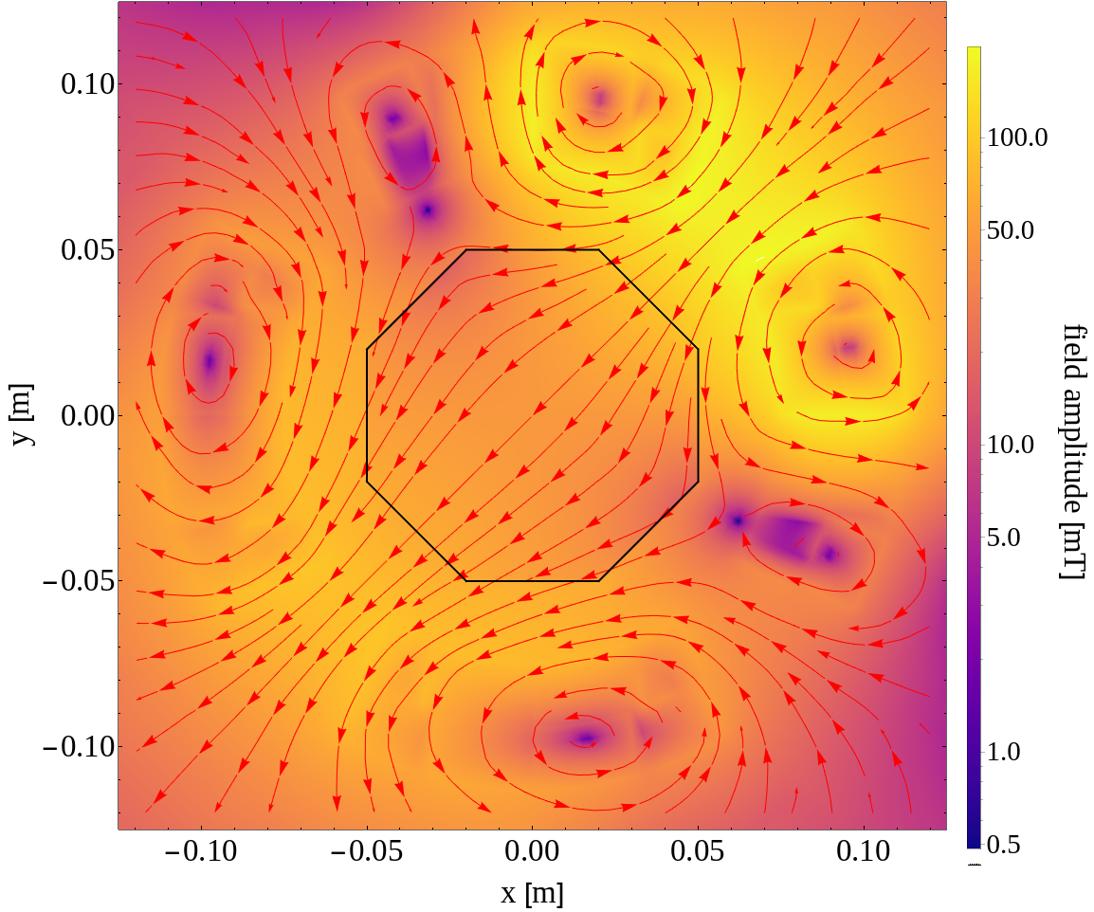
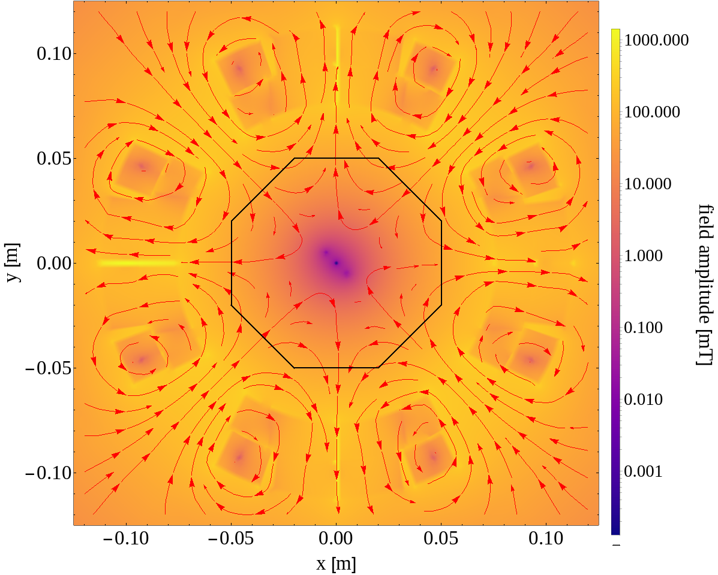
CLIQ – spurious discharge of single unit
Three magnets – two different connection schemes
Dipolar field → beam kick
Octupolar field → beam size
Beams 1 & 2
Beams 1 & 2
Courtesy of E. Ravaioli

Slide 18
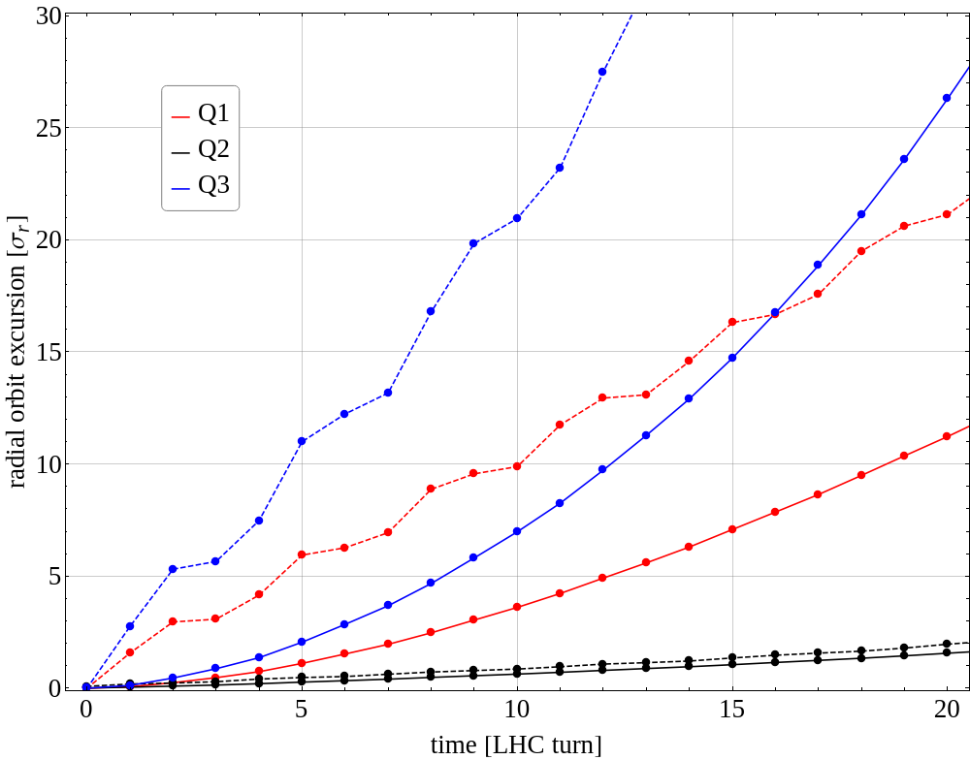
Spurious discharge – Beam orbit change
Time to dump beams: min 10 turns
Magnet protection design must take effects on beam into account!
Physical aperture (TCPs)
Beam loss threshold

Slide 19
Solution?
Ensuring CLIQ can never fire spuriously
  Cannot be 100 % failsafe, expensive, and increased complexity
Use Q2-like connection scheme
  New triplet circuit baseline
19
Courtesy of E. Ravaioli

Slide 20
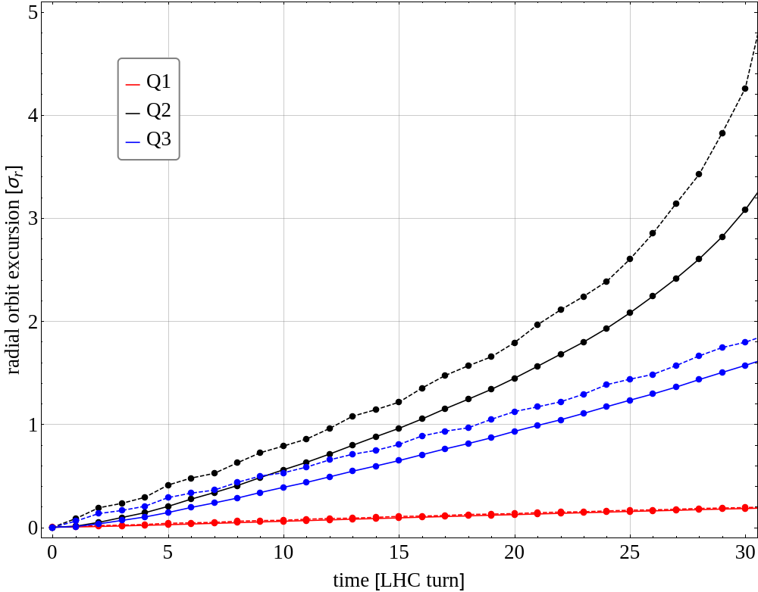
Q2-like connection – beam orbit change
17 turns until threshold
Can safely dump within 10 turns
Little margin – still critical
Beam loss threshold

Slide 21
Outline
Project definition and motivation
Failures
CLIQ
Beam Beam Kick
Triplet Quench

Slide 22
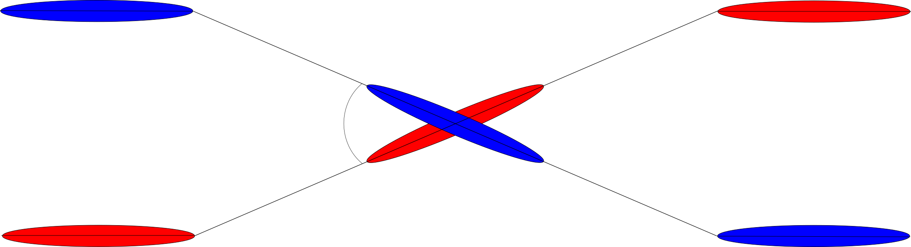
Beam beam kick
The two beams are charged and, thus, interact around collision points
  Transverse kick (orbit change, main issue for Machine Protection)
  Beam size growth
  Tune spread
  ...
.
+++++++
Collision point
Repulsive force
+++++++

Slide 23
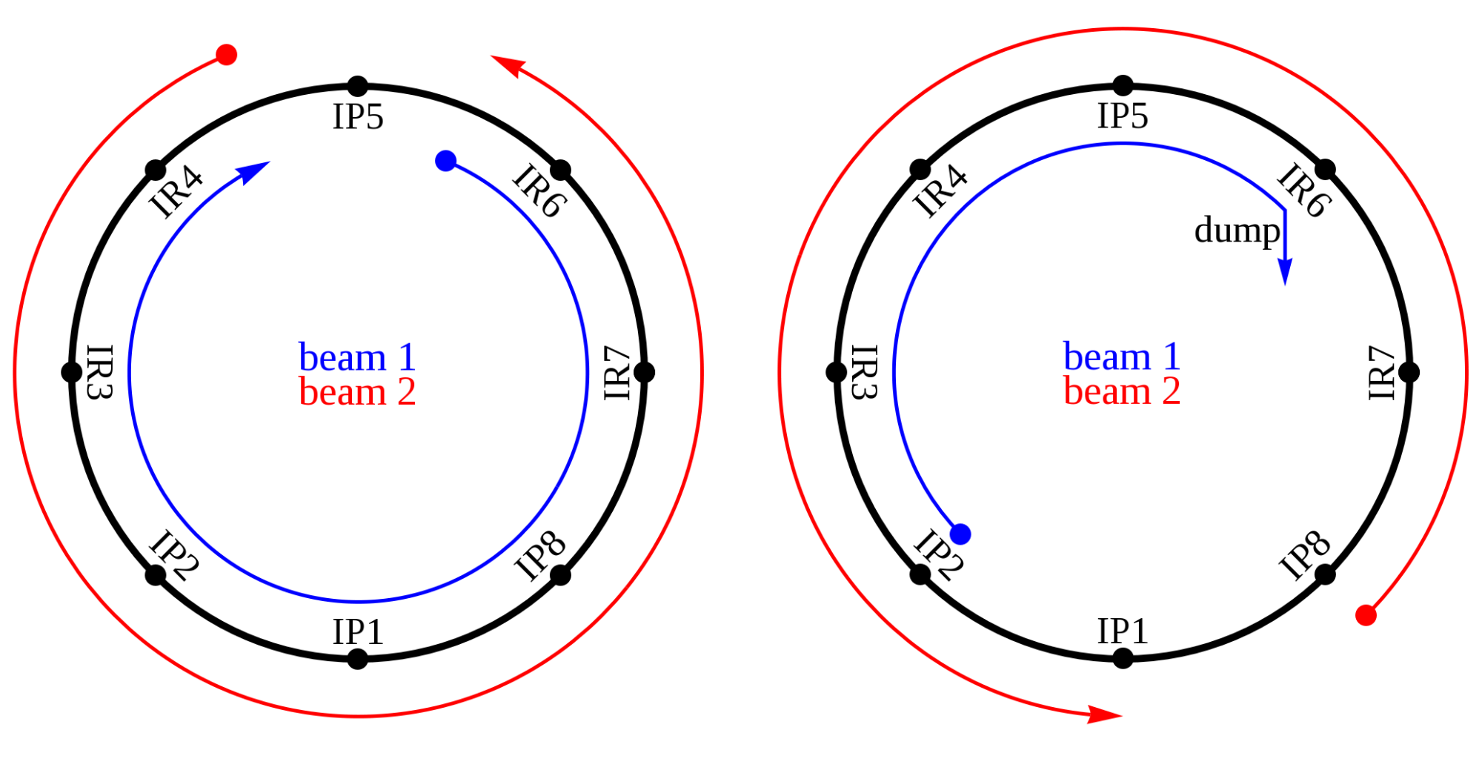
Beam beam kick
The two beams are charged and, thus, interact around collision points
  Transverse kick (orbit change, main issue for Machine Protection)
  Beam size growth
Beams cannot be dumped simultaneously:
.
Remaining beam is distorted due to loss of BBK!

Slide 24
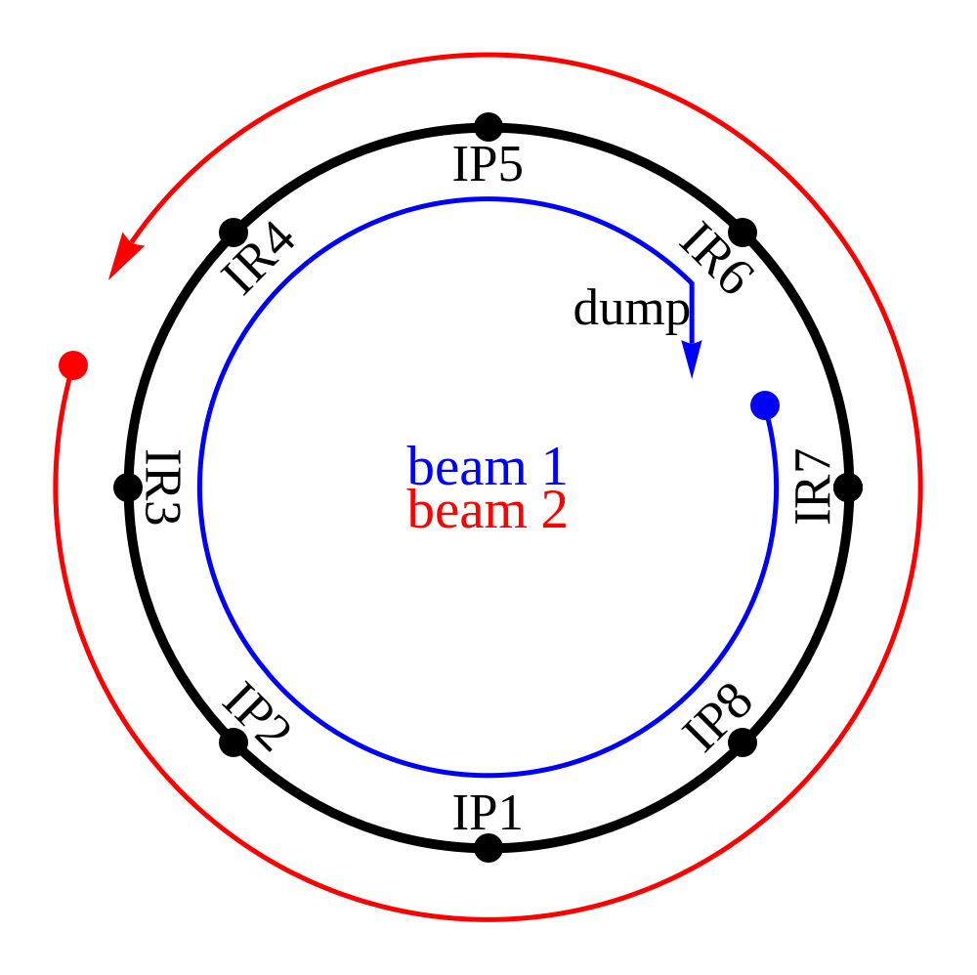
Dump animation
The order in which the BBK is lost in different IPs matter
.

Slide 25
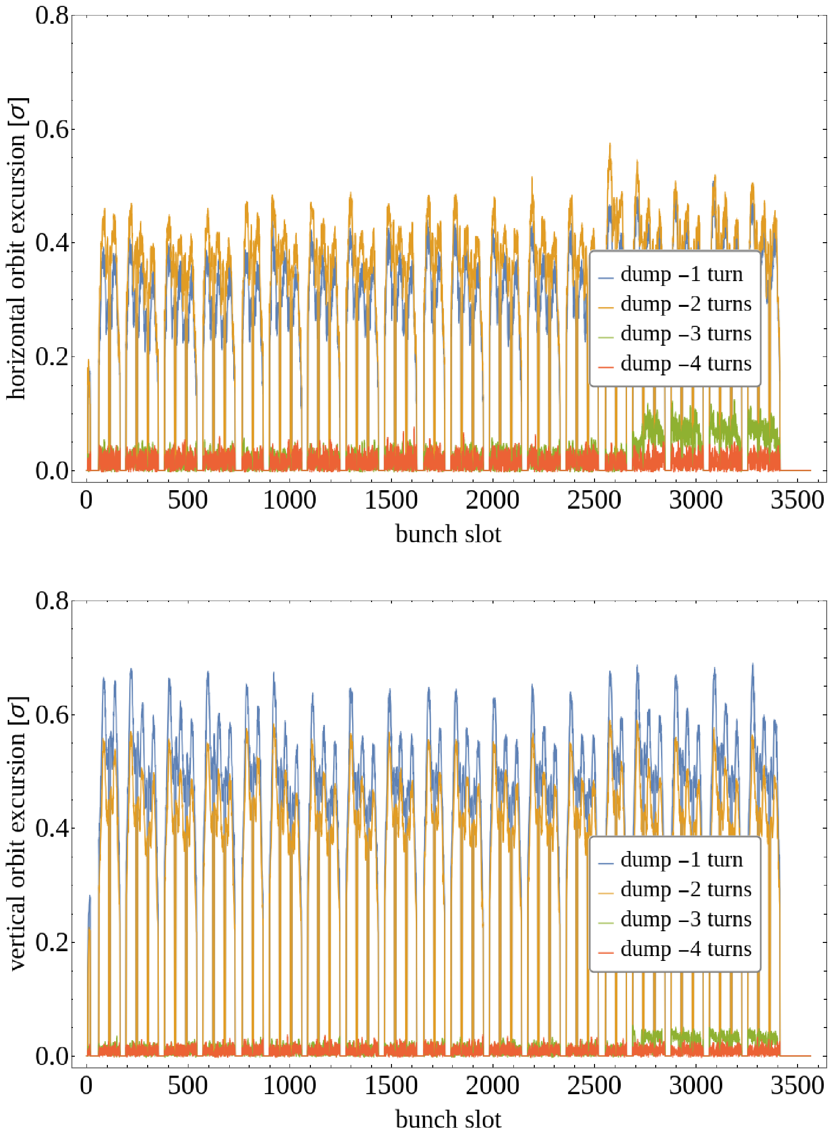
Measured BBKs
fill 7217
Since Aug 1 2017:
  b1: 27 observations
  b2: 21 observations
  Up to 3 turns of offset measured in both beams
  Dump reasons: RF trips, EOF programmed dumps, collimator temperature, SIS interlock, BPMS interlock
Beams have separate beam permits, and some systems only remove permit of one beam. Even when both permits removed, there are delays in the communication and beam synchronization.

Slide 26
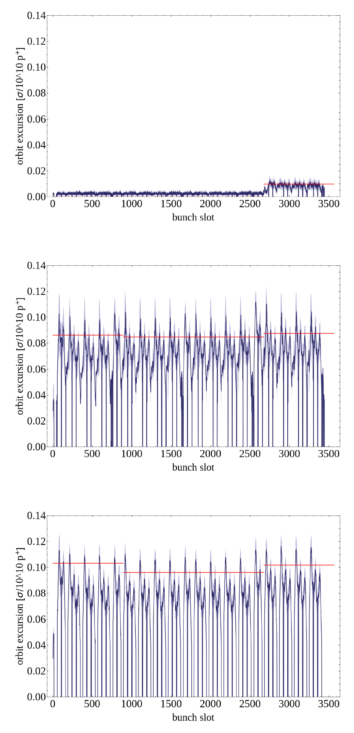
Comparison with simulations
BBK proportional to bunch intensity → normalize the measurements
Dark blue line: average of all measurements
Light blue shade: standard deviation of measurement
  all fills very consistent!
Red line: estimate from simulations
  good agreement!

Slide 27
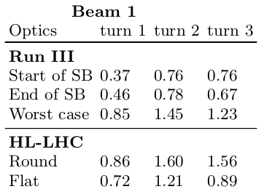
Run III and HL-LHC projections
orbit excursion [σ]
Bunch intensity increase significantly
Small beta star in HL, but increased crossing angle
In Run III worst case, kick is significant but within threshold
In HL-LHC, kick is above limit on second turn
Flat optics would be better from this perspective, but is not baseline
In HL-LHC, both beams should be dumped with minimum delay (one turn is unavoidable)

Slide 28
Outline
Project definition and motivation
Failures
CLIQ
Beam Beam Kick
Triplet Quench

Slide 29
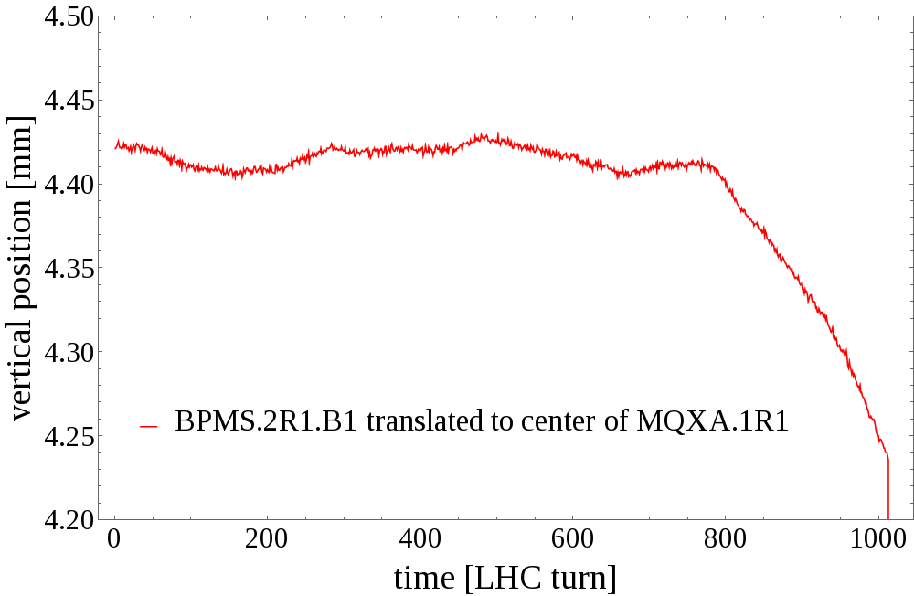
Triplet Quench observed 2018-06-03
Vertical orbit offset only in b1
~180 µm change in center of MQXA.1R1 (Q1)
~180 µm

Slide 30
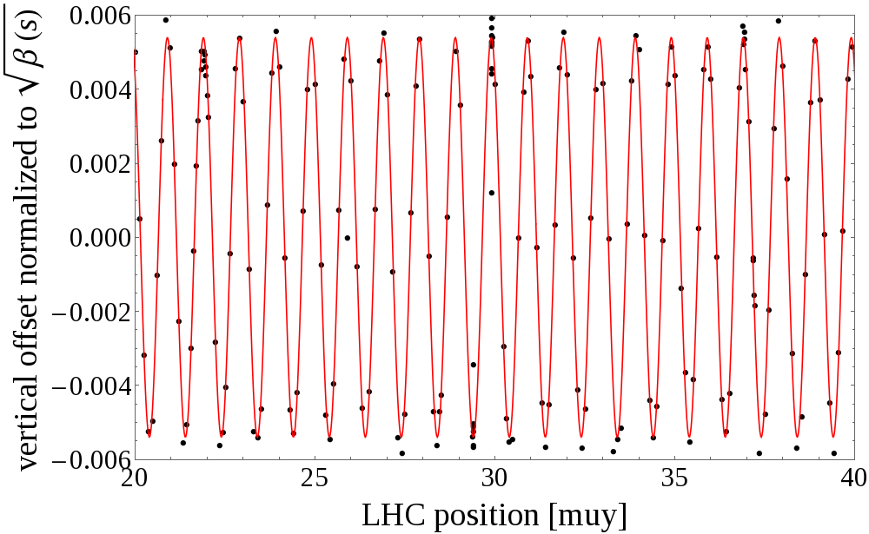
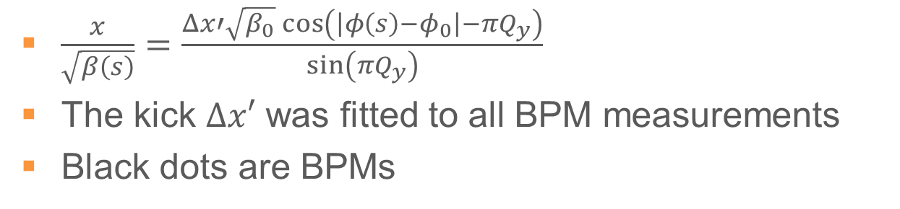
”Slow” kick – Closed orbit change
$\frac{x}{\sqrt{β\left(s\right)}}=\frac{Δx′\sqrt{β_{0}}\cos\left(\left|φ\left(s\right)−φ_{0}\right|−πQ_{y}\right)}{\sin\left(πQ_{y}\right)}$
The kick $Δx′$ was fitted to all BPM measurements
Black dots are BPMs
Two BPMs in IP5 consistently lower value, otherwise good fit

Slide 31
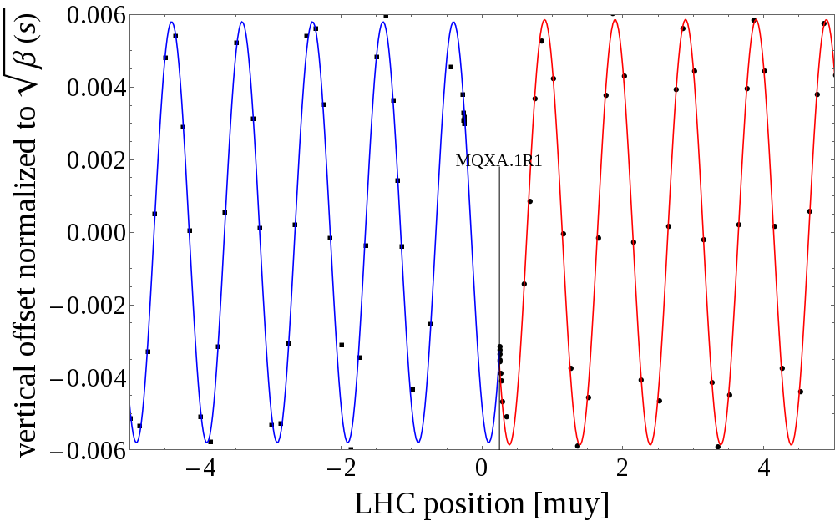
Origin of kick
Plotting two consecutive turns around IP1 shows discontinuity at Triplet location
Together with RQTX.R1 circuit data, confirm kick originates in MQXA.1R1

Slide 32
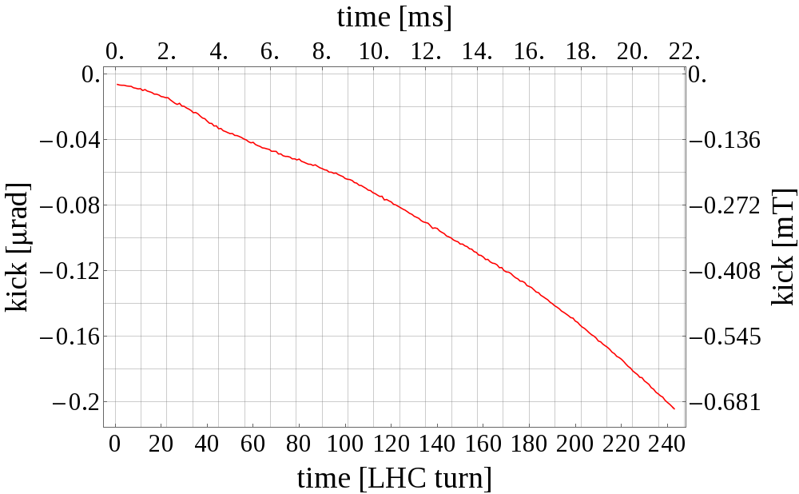
Kick time evolution
Due to cryo issue, quench propagation speed was abnormally fast
From circuit simulations, magnetic field expected to be ~0.23 mT at dump, but beam kick implies 0.7 mT
Emmanuele showed discrepancy possibly due to current redistribution in the wire
In HL-LHC, due to larger beta functions, critical limit could be reached in ~50 LHC turns
Quenches by themselves can have significant impacts on the beam but not critical due to long time-scales

Slide 33
Conclusions and Outlook
Criticality of failures in Magnets/Circuits, Active Elements, and other scenarios has been determined
CLIQ would create the fastest failure in the LHC
– mitigation method has been proposed and implemented
Simulations validated by dedicated experiments / beam observations
Proposed & validated novel method for studying UFOs
– strong indication UFO movement also horizontal
First Machine Protection experiments with Crab Cavities in a hadron beam were prepared, executed and analysed
– observations confirm expectations, fast interlocks are required
UFO dynamics studies ongoing (with Philippe)
Wrap-up failure studies
  PRAB paper summarizing most failures nearly ready for submission
  UFO paper together with Philippe in preparation

Slide 34
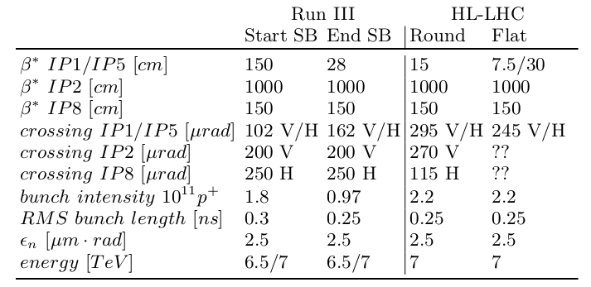
Run III and HL-LHC optics

Slide 35
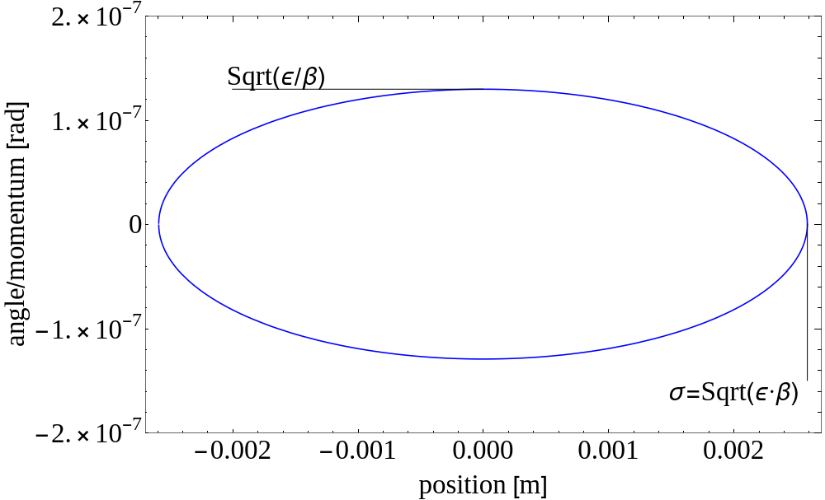

Beam sensitivity to perturbations
Constant area: $π⋅ε$

Slide 36
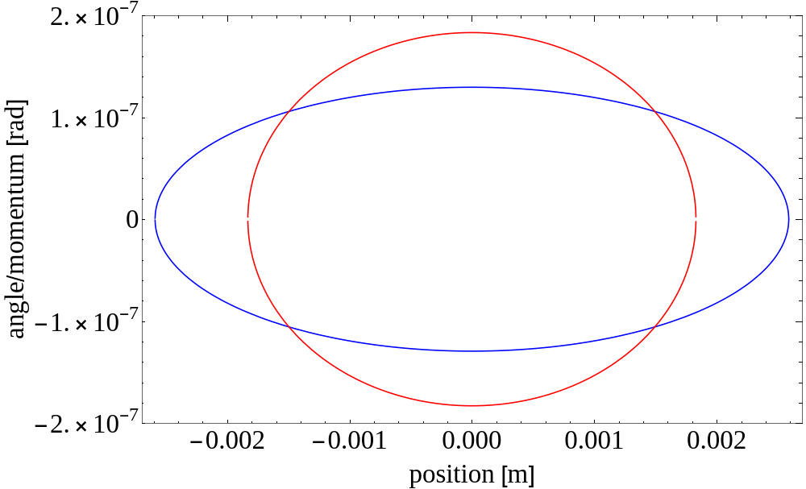
Beam sensitivity to perturbations
Ellipse at location with smaller beta function, area is the same

Slide 37
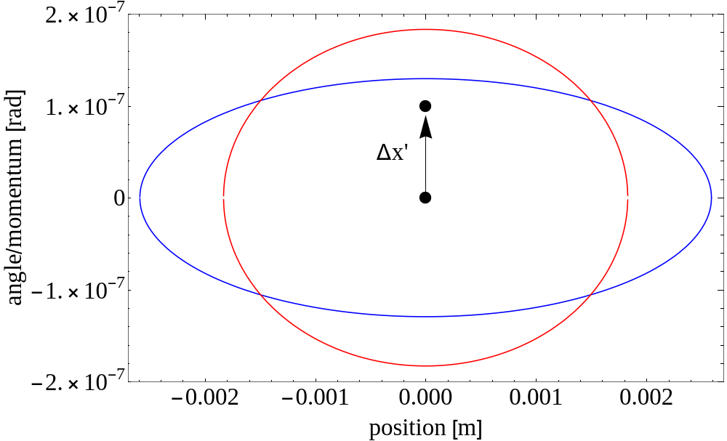
Beam sensitivity to perturbations
A particle receives a kick

Slide 38
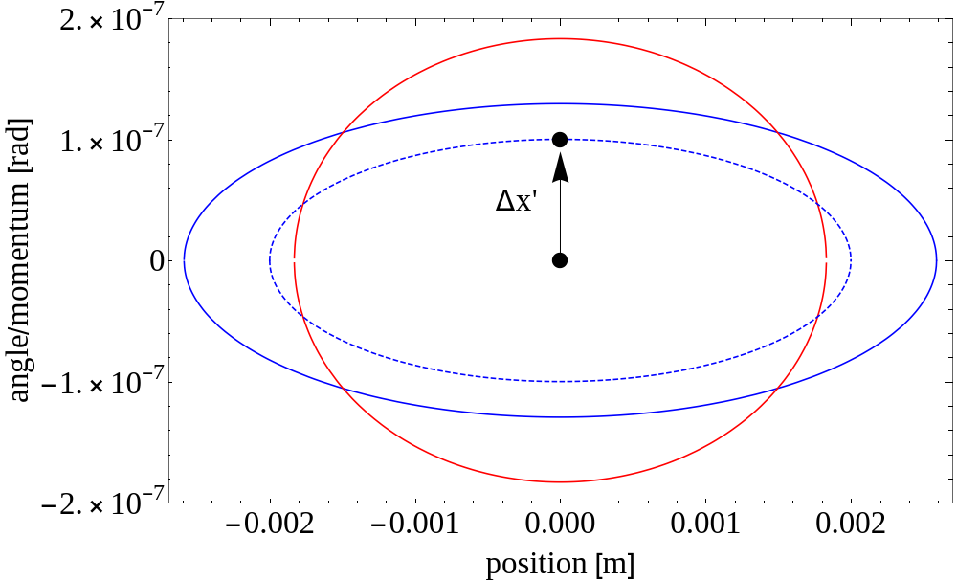
Beam sensitivity to perturbations
Particle traces out ellipse in phase space

Slide 39
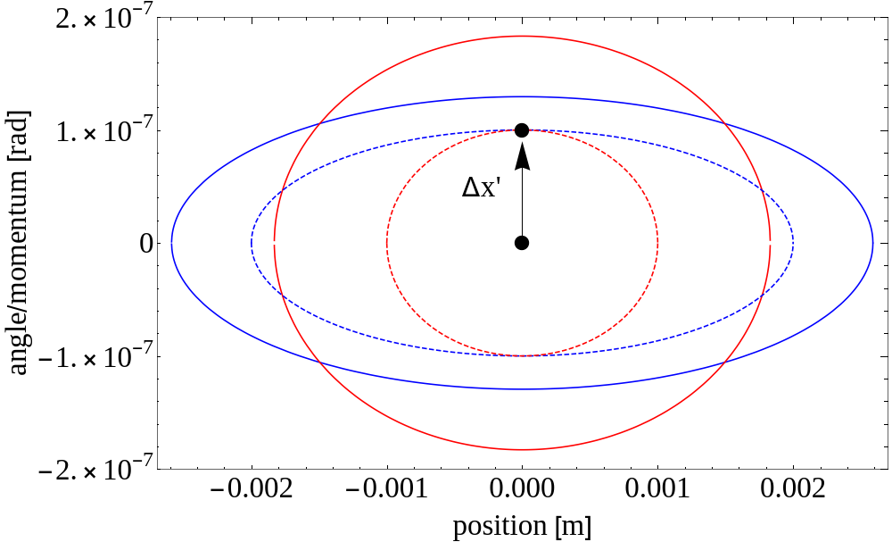
Beam sensitivity to perturbations
Particle at other location traces out different ellipse

Slide 40
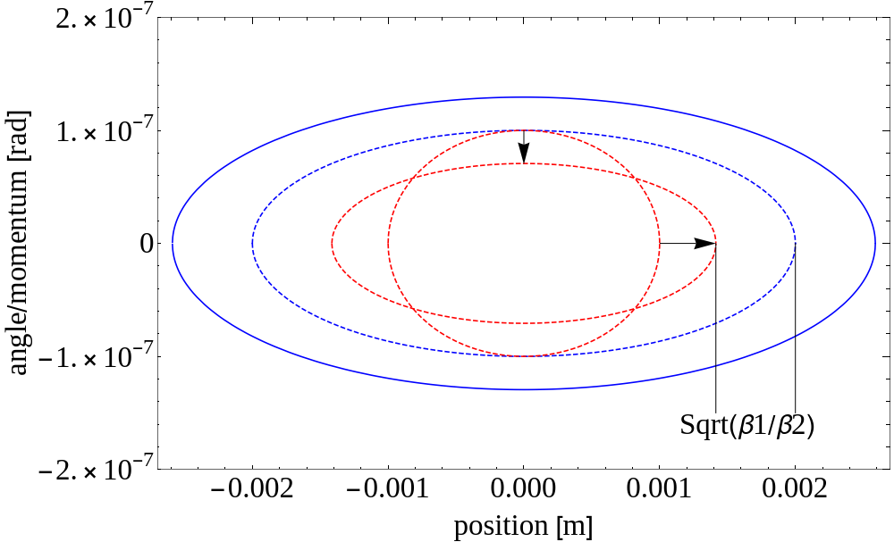
Beam sensitivity to perturbations
Observe Red particle at Blue location, transforms the ellipse
Amplitude of particle kicked at Red location smaller than particle kicked at Blue location. This is because of the beta function

