Slide 1

The Extreme Energy Events project
Despina Hatzifotiadou
INFN Sezione di Bologna
Centro Fermi – Roma
EP Department - CERN
SWEDISH TEACHERS PROGRAMME OCTOBER 2019

Slide 2



Cosmic ray physics experiment with double goal :
Educational / outreach and scientific research
hands-on activity for high-school students with the aim to stimulate their interest in science through their involvement in all stages of the project (detector construction, installation, comissioning, data-taking, analysis)
research in cosmic ray physics
A collaboration of
Centro Fermi – Roma Museo Storico della Fisica e Centro Studi e Ricerche "Enrico Fermi”
INFN Istituto Nazionale di Fisica Nucleare
MIUR Ministero dell’ Istruzione, dell’ Università e della Ricerca
CERN European Organization for Nuclear Research

Slide 3

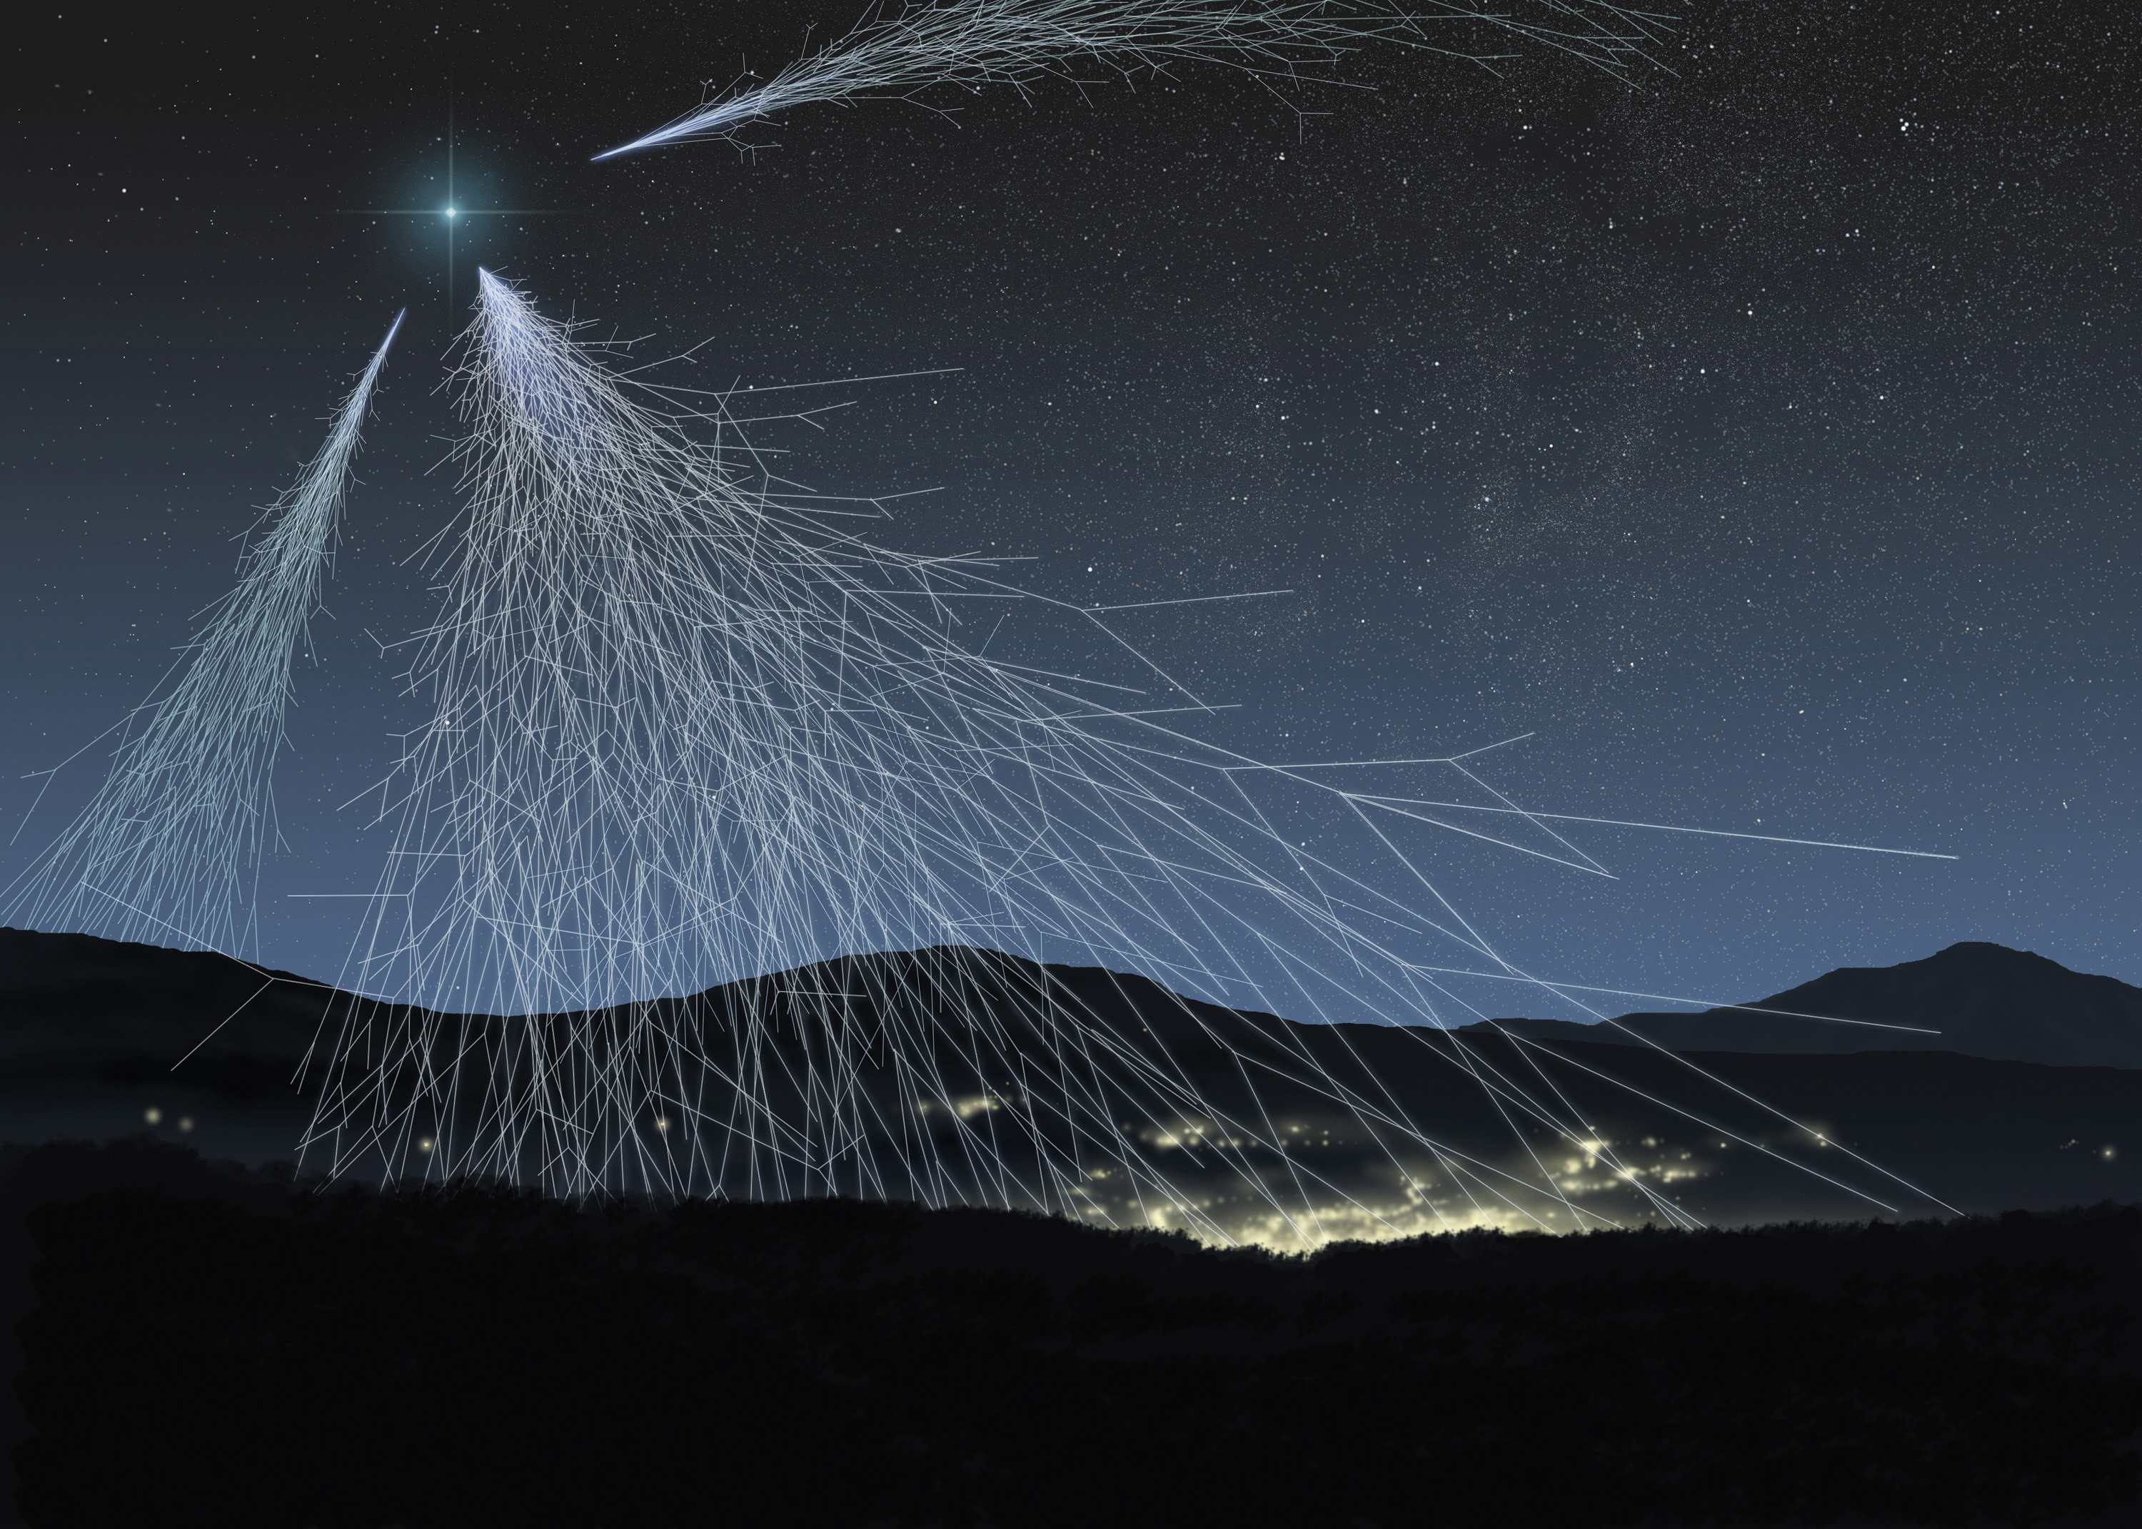
COSMIC RAYS

Slide 4
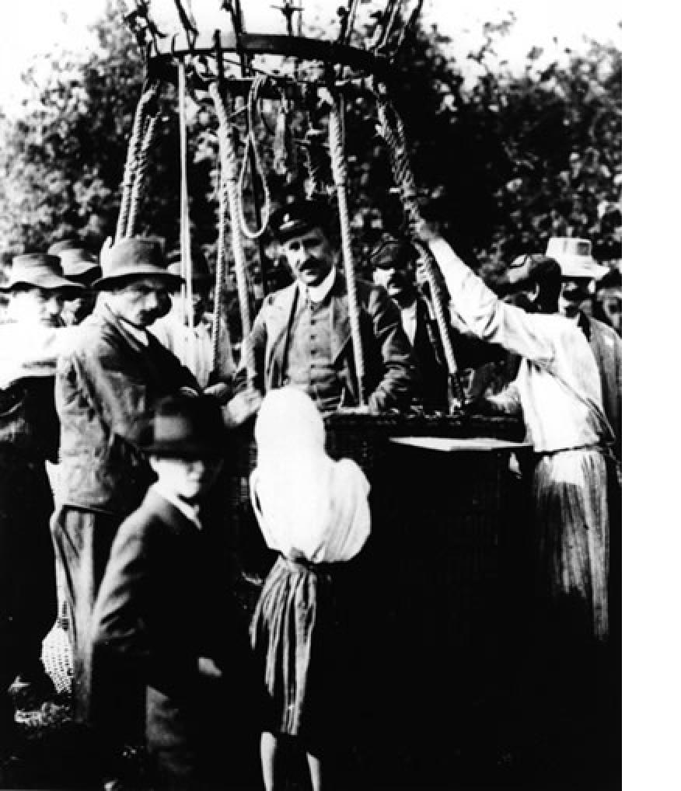
First studies of cosmic rays
In 1909 Theodor Wulf measured, using an electrometer, higher level of radiation at the top of the Eiffel Tower than at its base.
Victor Hess, using balloons, measured in 1912 atmospheric ionisation as a function of altitude. As he ascended to 5300 metres, he measured the rate of ionization in the atmosphere and found that it increased to some three times that at sea level. He concluded that penetrating radiation was entering the atmosphere from above. He had discovered cosmic rays.

Slide 5
What are cosmic rays
Very energetic charged particles coming from outer space that continually bombard the earth
Protons (hydrogen nuclei) 89%
Helium nuclei 10%
Heavier nuclei 1%
When they collide with atoms in the earth's upper atmosphere, they create a shower of lower energy secondary particles, mainly pions.
Pions swiftly decay emitting muons, which travel through the atmosphere and penetrate below ground.
A hundred of these secondary particles pass through our bodies every second.
Energies of primary cosmic rays
from 1 GeV (rate : 10 000 / m²s)
up to 10⁸ TeV (rate : < 1 /km²century )
Very high energy cosmic rays generate huge showers of up to 10 billion secondaries spreading over areas of 20 km² at the surface of the earth

Slide 6
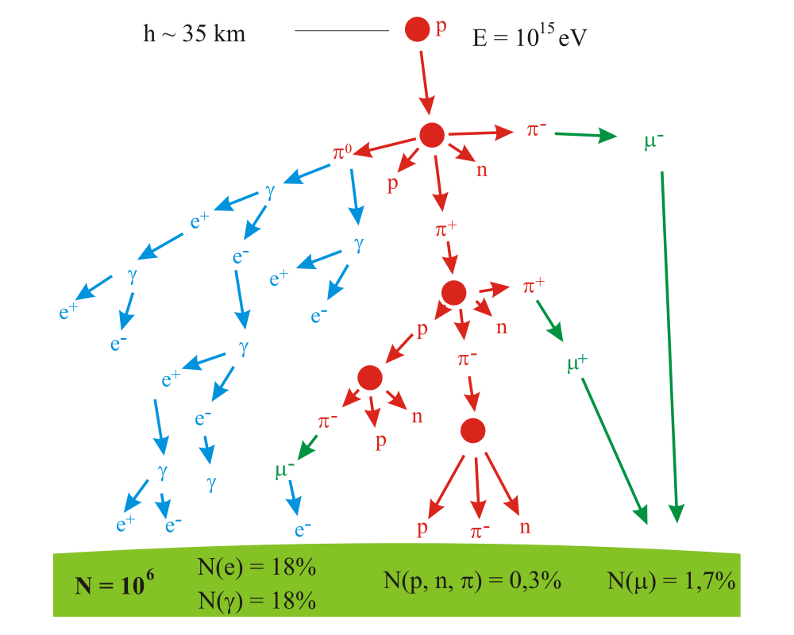

Slide 7
The project

Slide 8
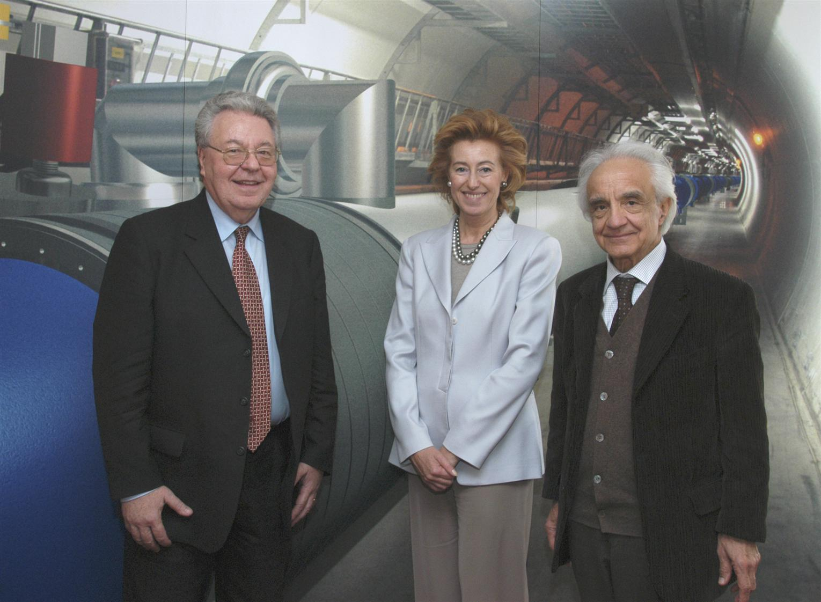
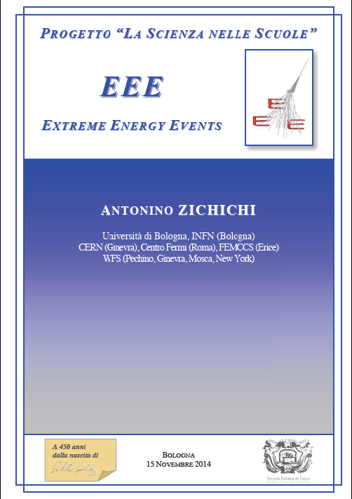
Some history..
Launch event : 3 May 2004
Webcast from CERN
Professor A. Zichichi
Minister L. Moratti
watched by many Italian schools
A. ZICHICHI, Progetto "La Scienza nelle Scuole”
EEE – Extreme Energy Events
Società Italiana di Fisica (SIF), Bologna
1st Edition 2004; 2nd Edition 2005
3rd Edition 2012, 4th Edition 2014, 5th Ed. 2017

Slide 9
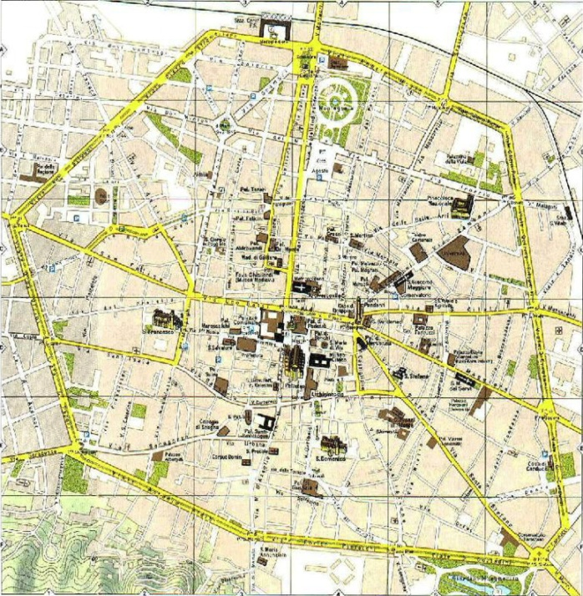
Aim of the EEE project
Look for extended air showers and extreme energy events
By detecting the muon component of the shower
Simulation of a shower induced by a 10¹⁷eV proton
At ground level 1 million muons arrive, over an area with radius at least 2 km.

Slide 10
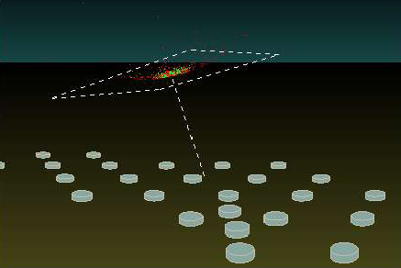
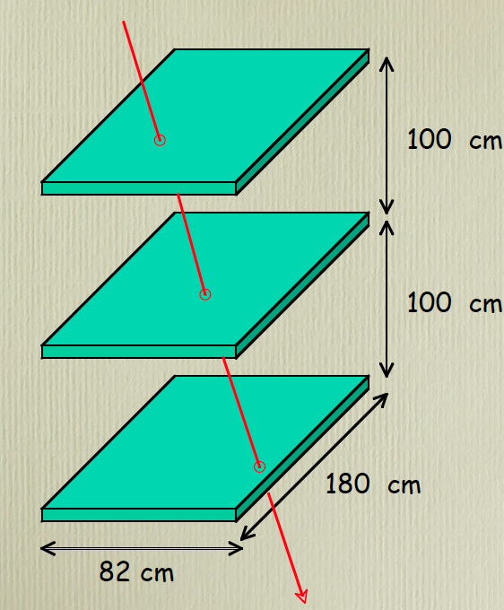
Place telescopes all over Italy
in Italian High Schools
Look for coincidences between telescopes
Key ingredient :
define direction of muon - so that we can point back to interaction point in atmosphere
check that muons belong to same shower and also get direction of incoming particle

Slide 11
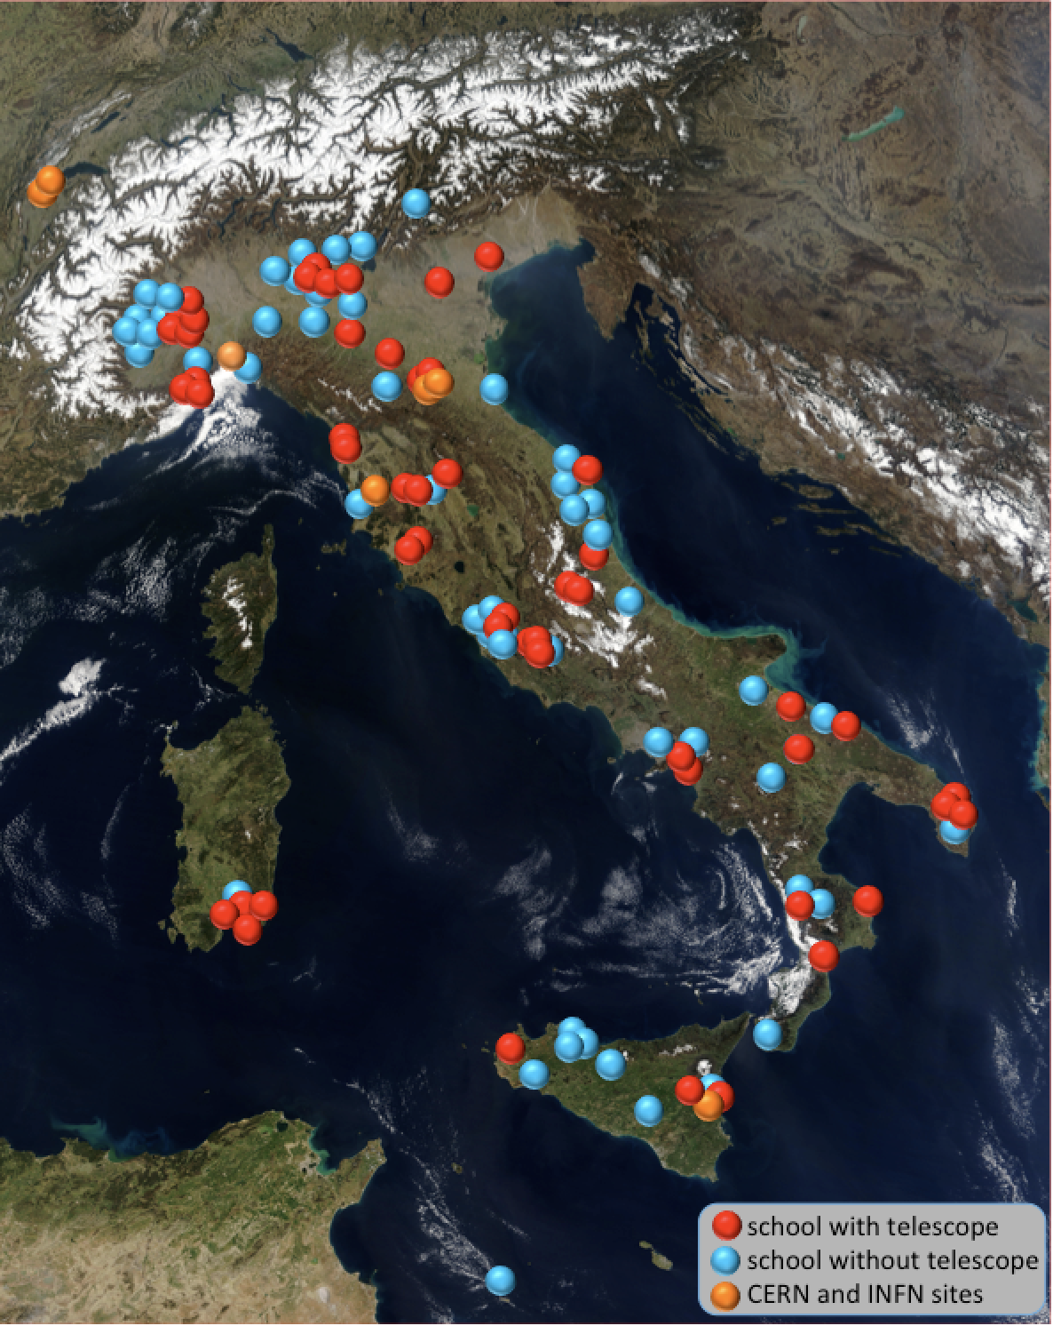
An array of muon telescopes
At present
~50 in Italian High Schools
They are mostly distributed in
clusters in the whole Italian territory
+ 2 telescopes at CERN
+4 in INFN Units or Universities
~45 schools on the waiting list

Slide 12
The experimental aparatus

Slide 13
The detector : 3 Multigap Resistive Plate Chambers (MRPC)
6 gas gaps of 300 microns each
dimensions : 82 cm x 180 cm
Requirements : reliable (long-term); easy to use; not expensive
Design based on the MRPCs of the ALICE Time Of Flight (TOF )

Slide 14
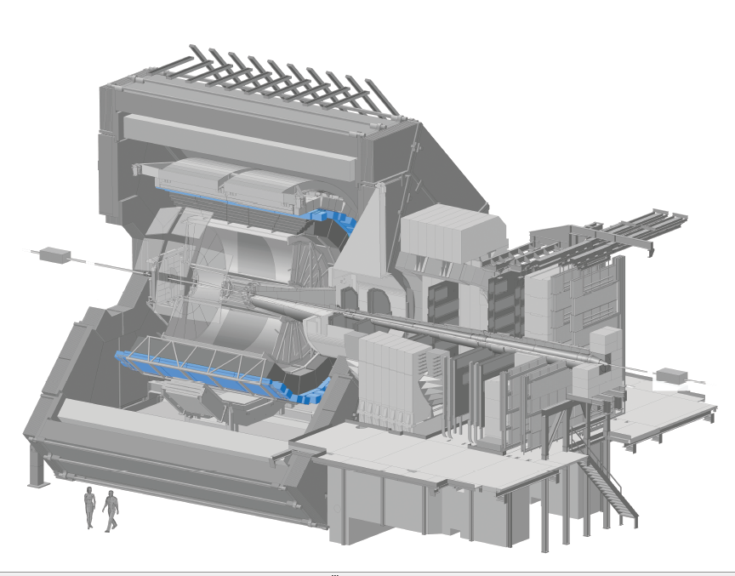
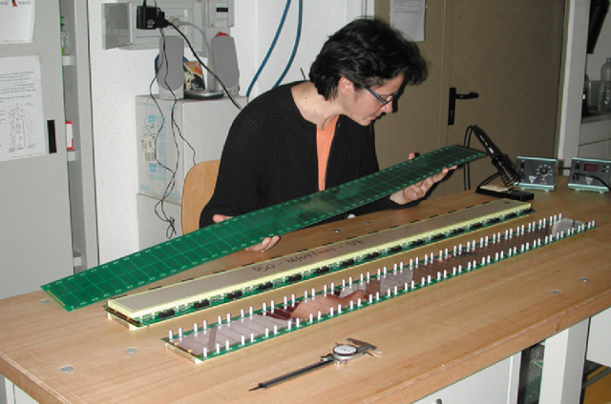
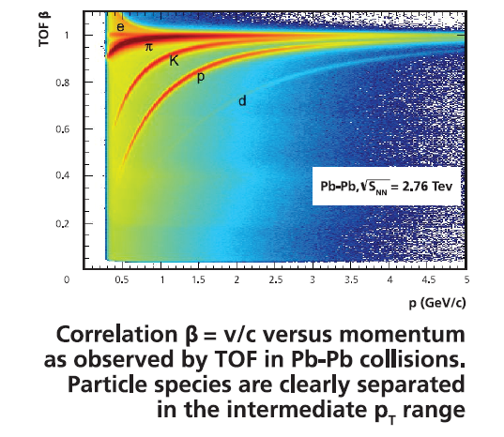
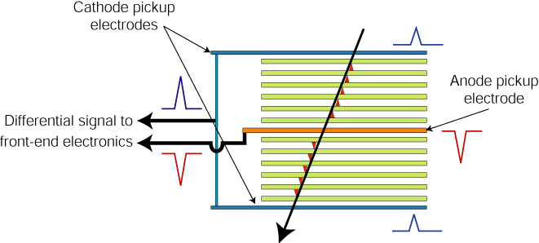
The ALICE Time Of Flight detector
Multigap Resistive Plate Chamber
10 gaps of 250 microns each
Cylindrical array of 150 m² r=3.7m 1600 MRPCs in 18 Supermodules
System time resolution σ = 70-80 ps

Slide 15
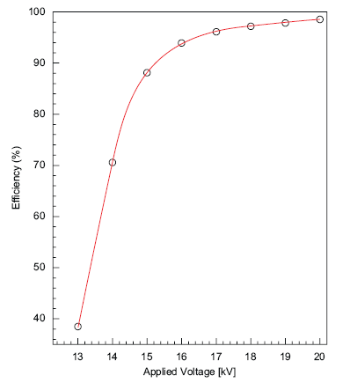
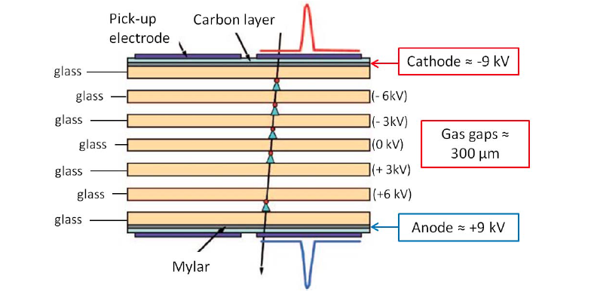
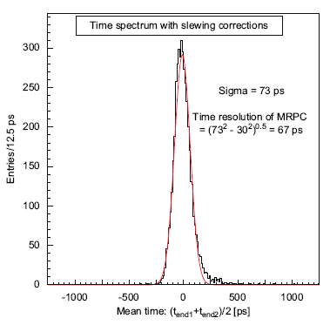
The EEE MRPC
Efficiency
(in dedicated beam tests)
Time resolution
(in dedicated beam tests)
Operated with a mixture of 98 % C₂H₂F₄ – 2% SF₆

Slide 16
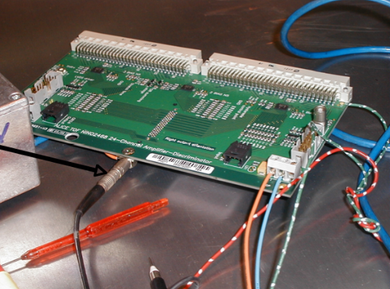
Signal readout
FEA card
3 NINO asics / 24 channels
Amplification
Discrimination
Stretching of pulse
OR of 24 signals
2 FEAs per MRPC
24 strips read out at both ends
time difference : position of hit along the strip
Anode & cathode readout plane : differential signal
adhesive copper tape on vetronite sheet
strip width : 2.5 cm; distance between strips : 0.7 cm
Space resolution in x and y : ~ 1 cm

Slide 17
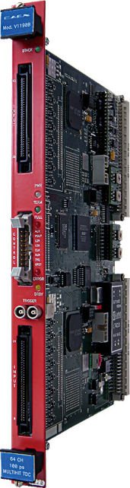
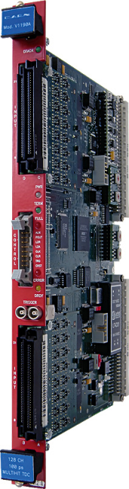

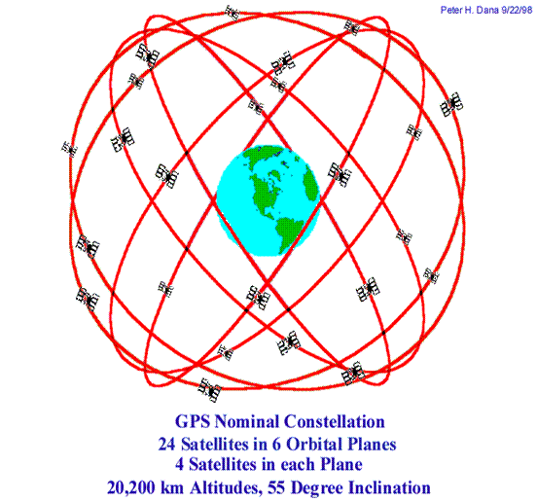
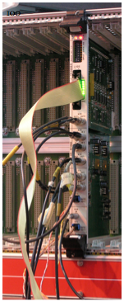
Electronics
TDC TDC VME Bridge
144 channels TDC
Trigger unit
GPS Unit
VME crate
USB connection to PC
VME Bridge
Data Acquisition and monitoring based on Labview
CAEN CAEN CAEN
V1190A V1190B V1718
Trigger card
6-fold
coincidence
Hytec (or Spectracom) GPS to generate time stamps
and synchronize stations at different location

Slide 18
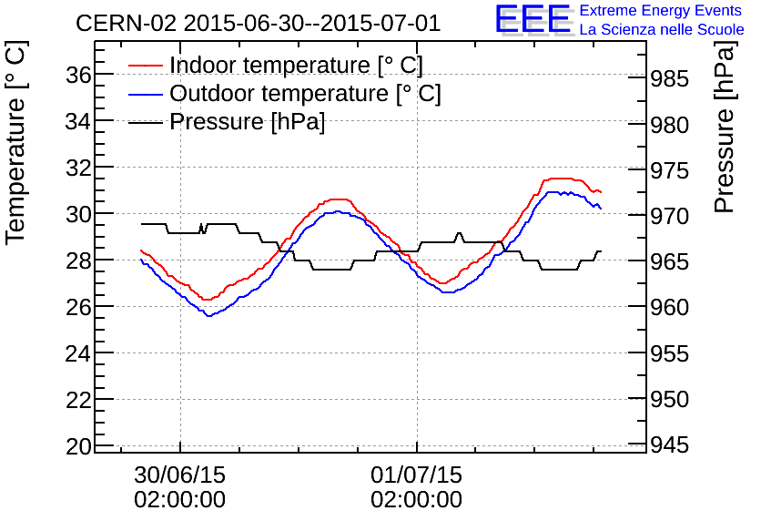
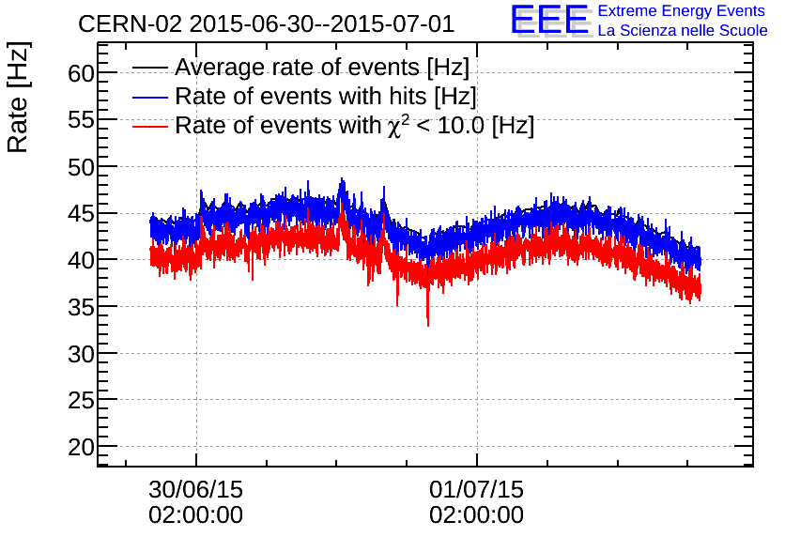
In addition
Weather station to monitor
temperature
pressure
read out by the DAQ

Slide 19
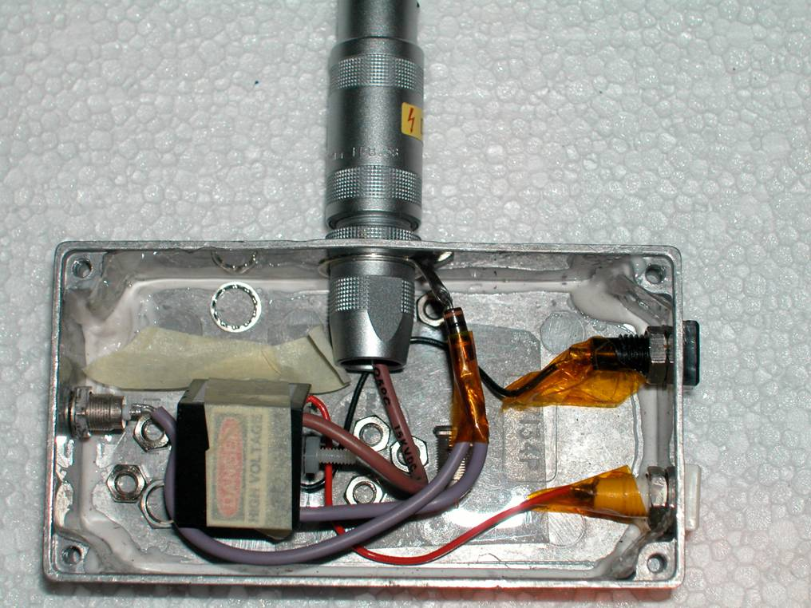
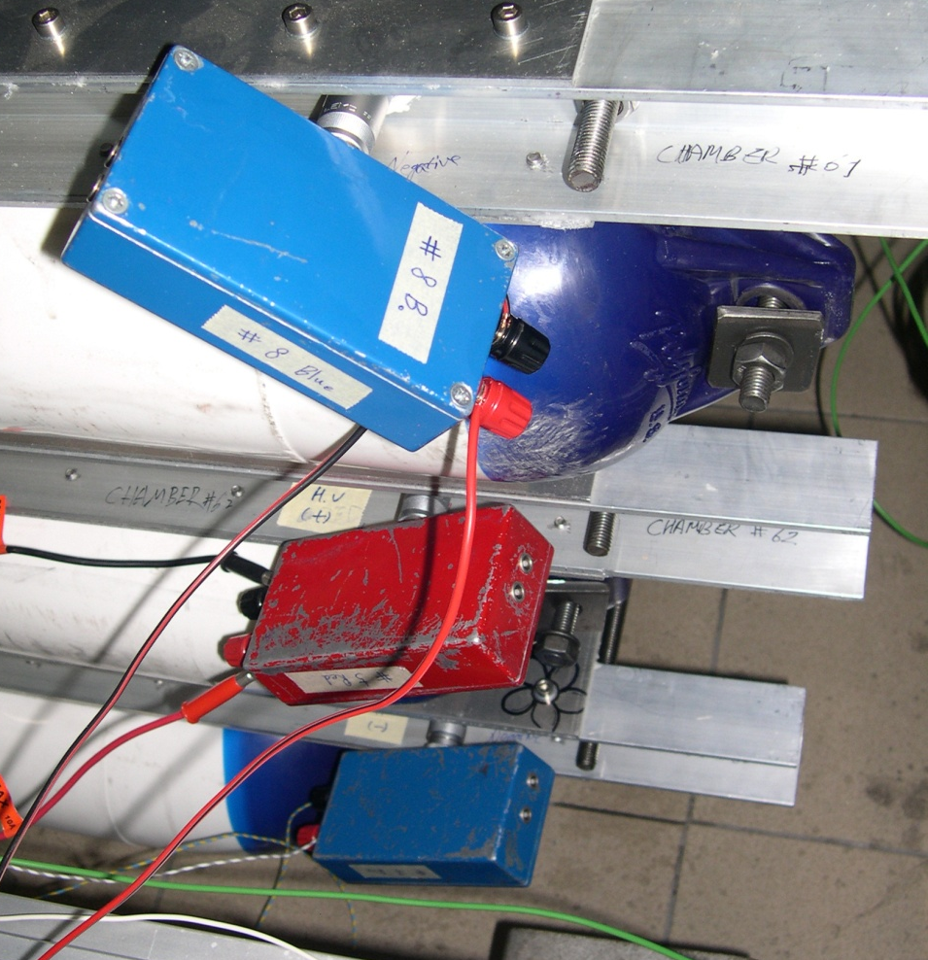
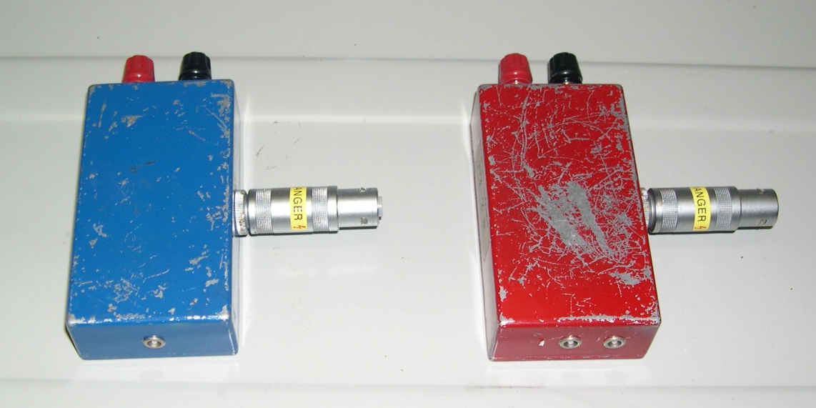
The HV system
Working voltage for MRPCs : 18 - 20 kV
DC-DC converters inside small boxes
EMCO Q series converters providing an output voltage up to ±10 kV for 0-5 V input
-HV
+HV

Slide 20
The students’ involvement

Slide 21
Phase I. Construction of muon detectors (MRPCs)
Done by high-school students and teachers at CERN supervised by researchers*
Each school sends 5-10 students accompanied by 1-2 teachers
During their week-long stay at CERN they build 3 chambers
*Special agreement with CERN to allow children <18-years old to work in CERN labs
    2005 7 schools (pilot)
    2006 14 schools
    2009 10 schools
    2012 3 schools
    2014 6 schools
    2015 6 schools
    2017 6 schools
    2019 4 schools
Total : 56 schools 300-400 students 60-90 teachers

Slide 22
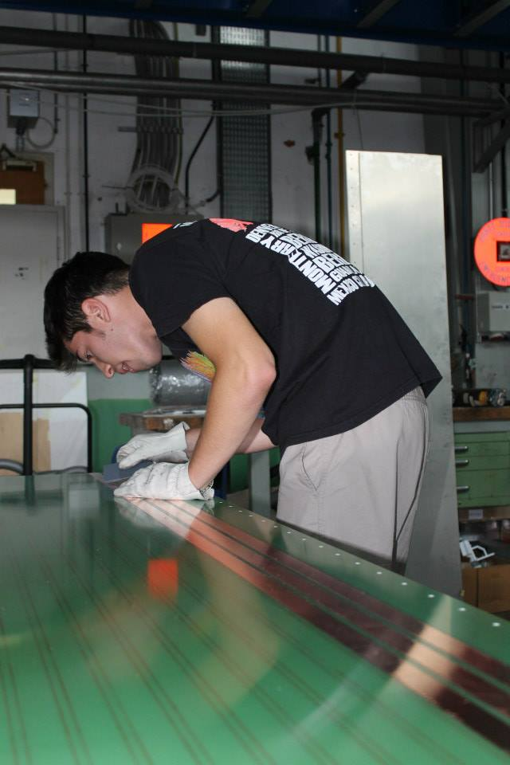
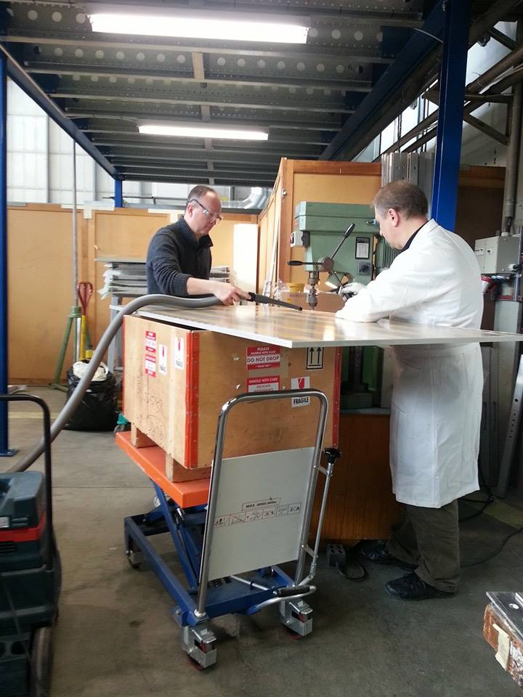
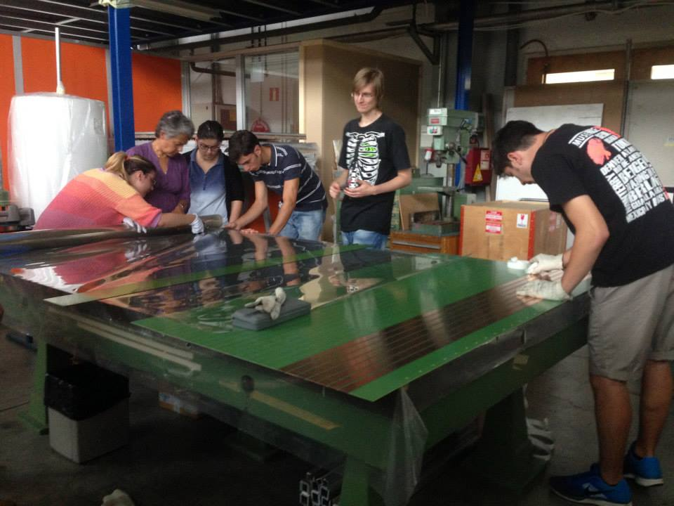
preparation of readout copper strips
preparation of honeycomb panels
Notes:
roman facendo fori sul pannello a nido d'ape
gli studenti non sono autorizzati ad utilizzare il trapano a causa di problemi di sicurezza

Slide 23
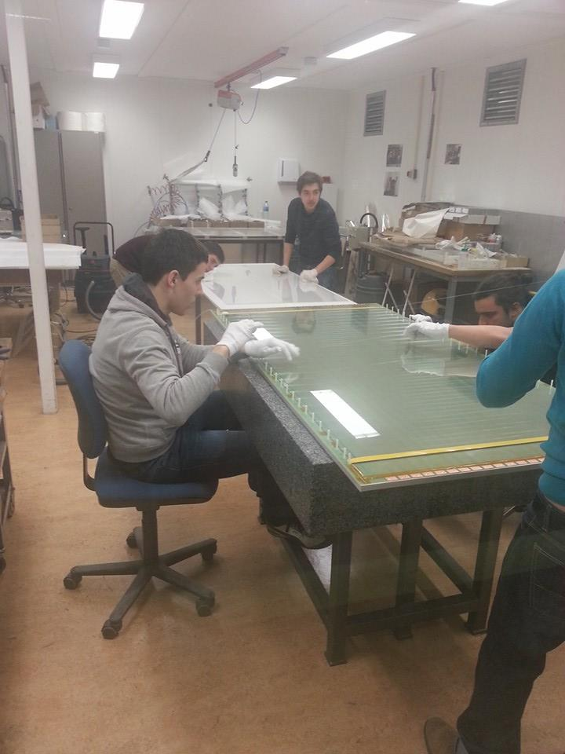
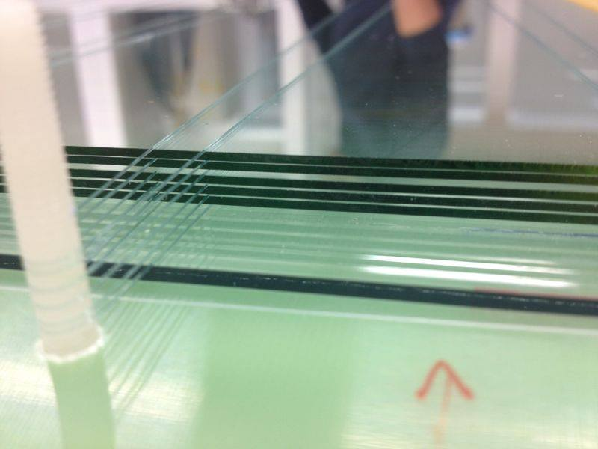
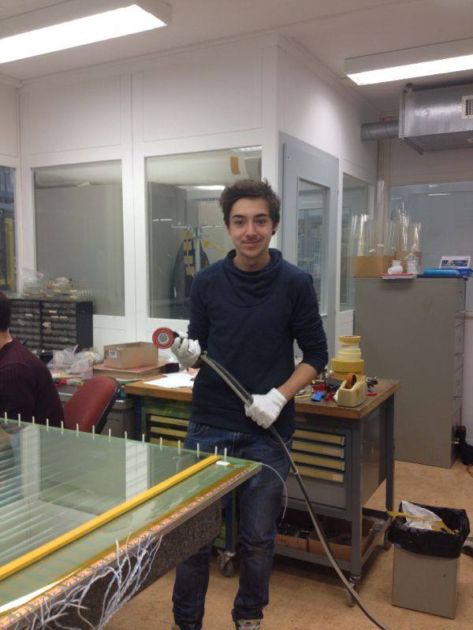
Fishing-line spacers

Slide 24
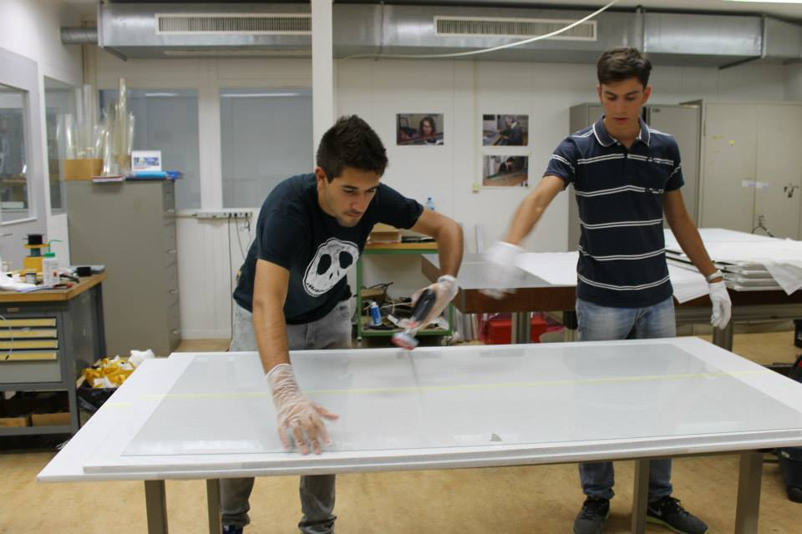
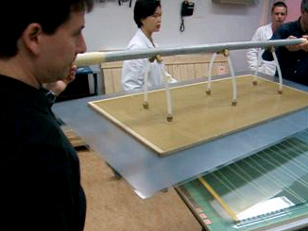
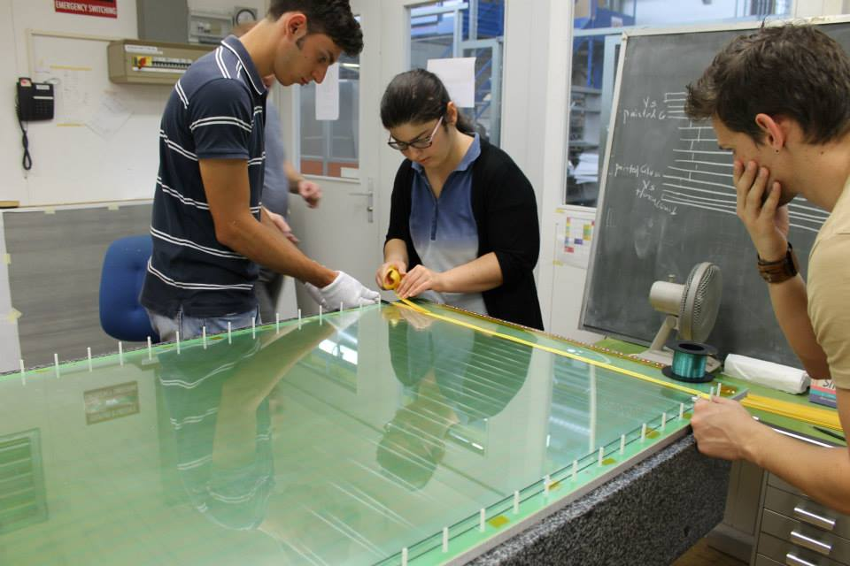
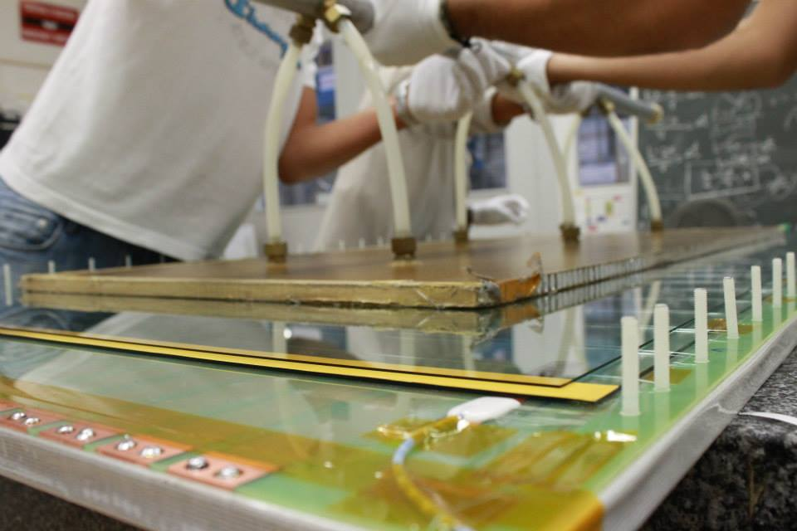
Cleaning glass panels
Lifting glass panels

Slide 25
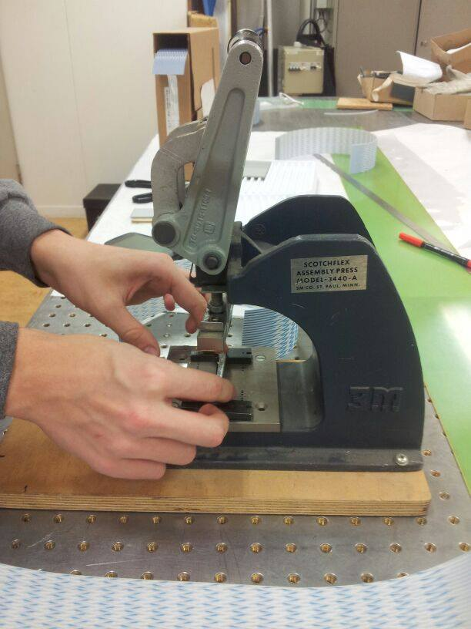
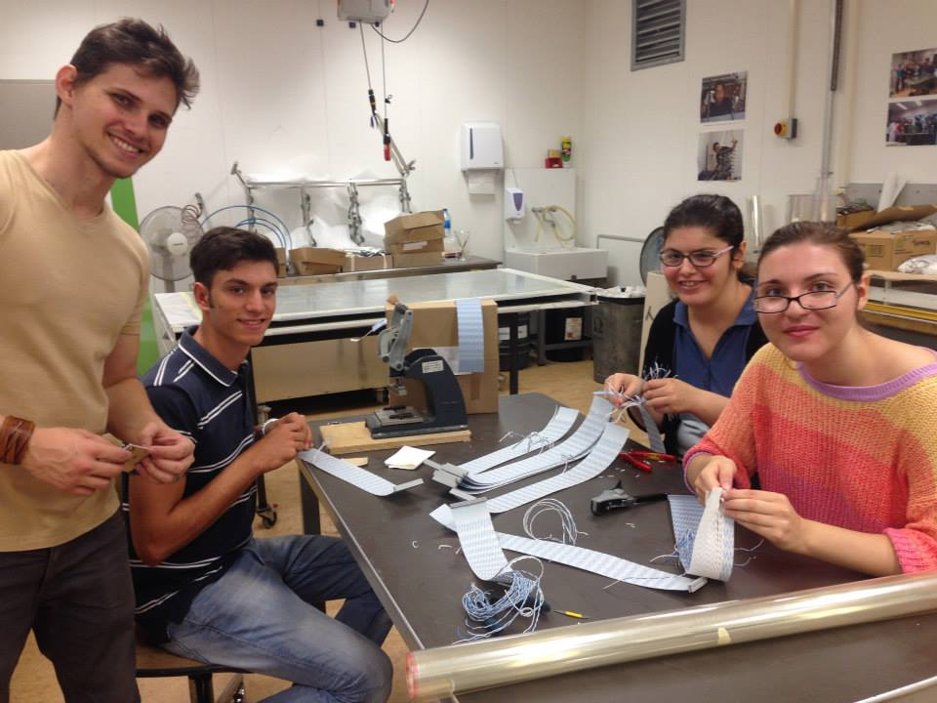
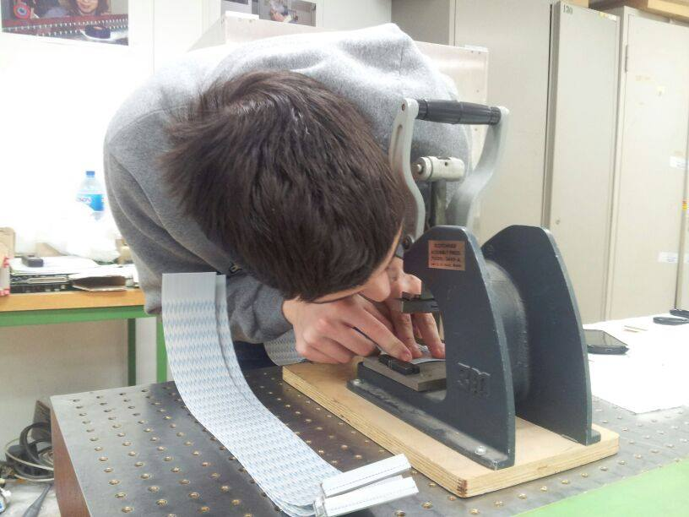
preparation of signal cables

Slide 26
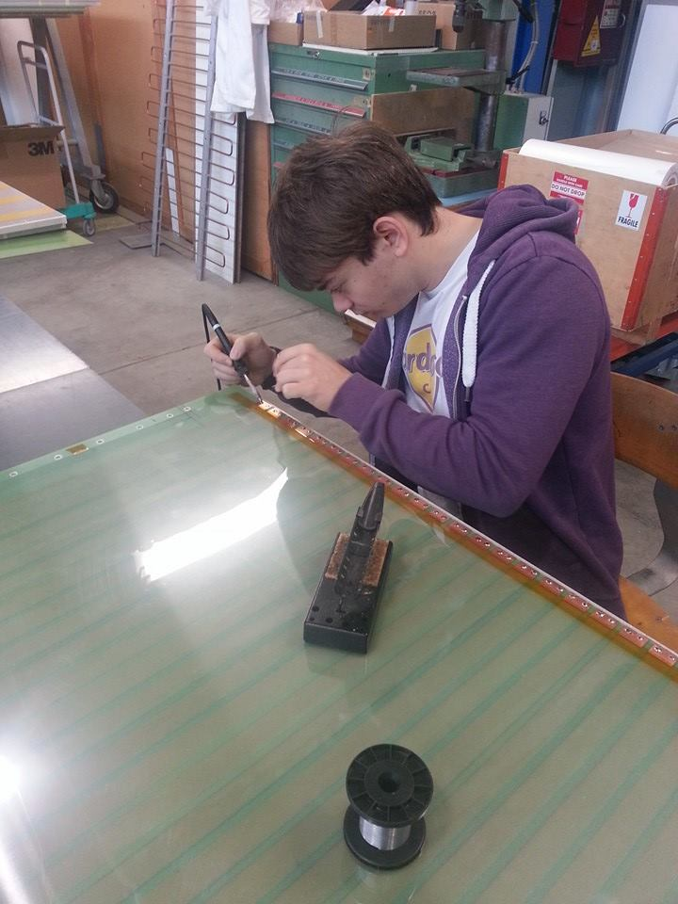
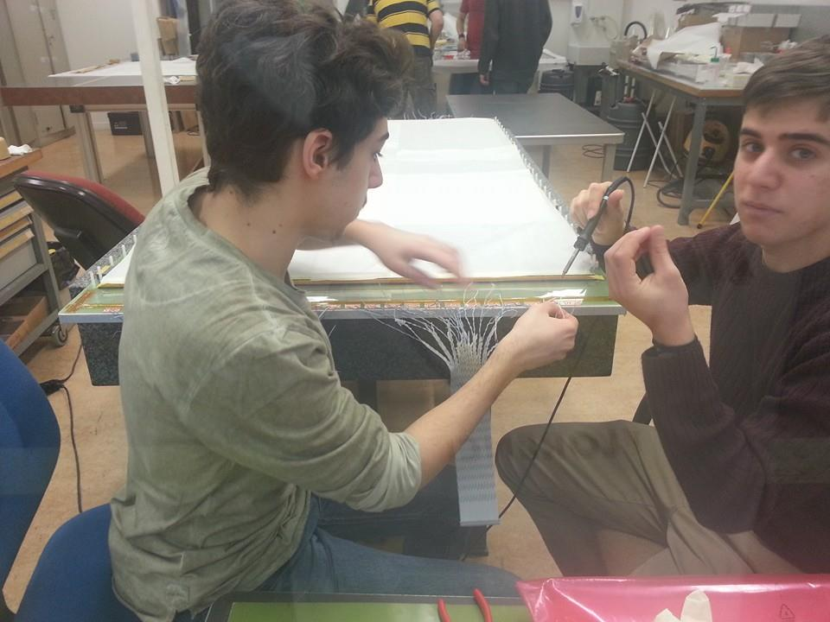
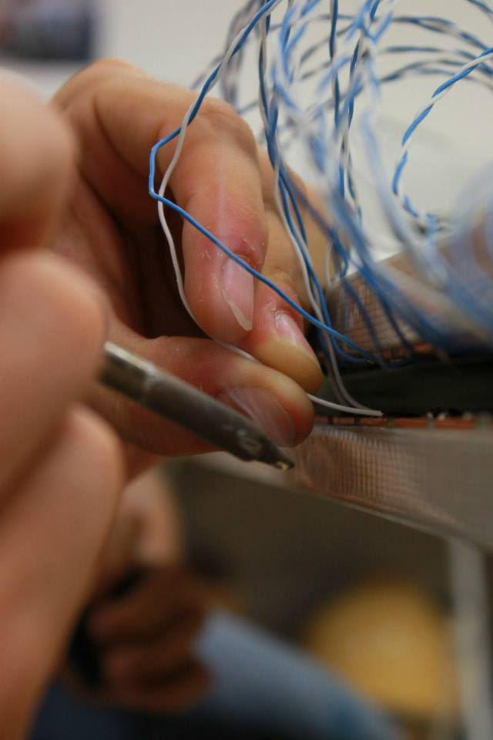
Soldering signal cables

Slide 27
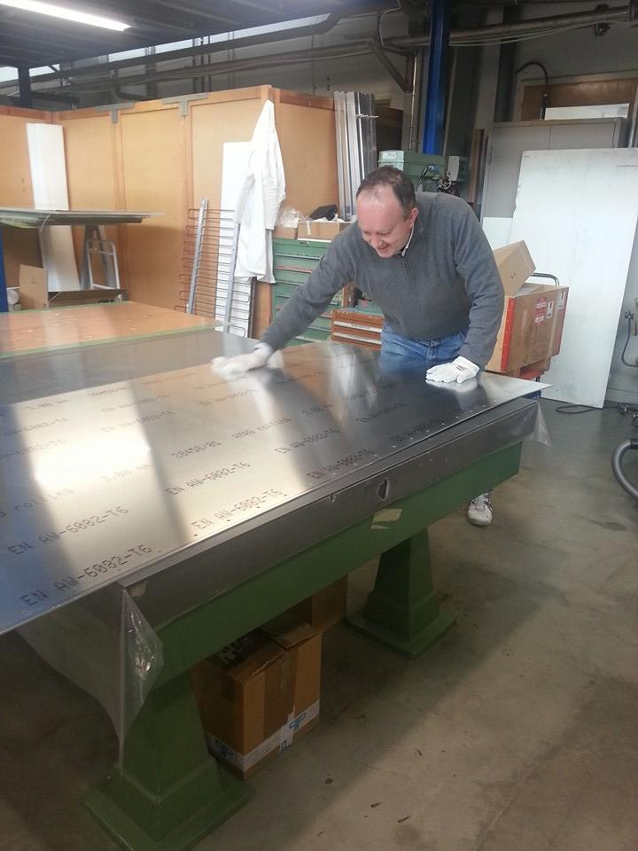
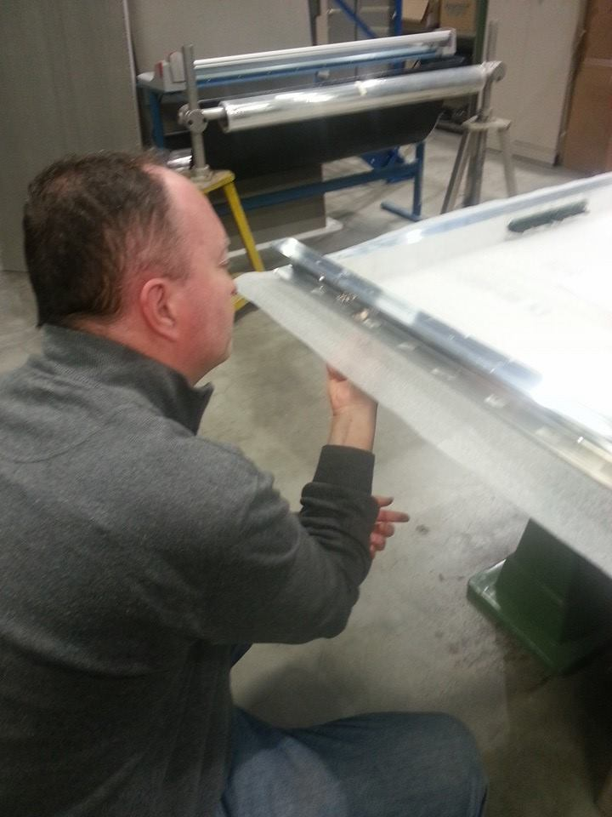
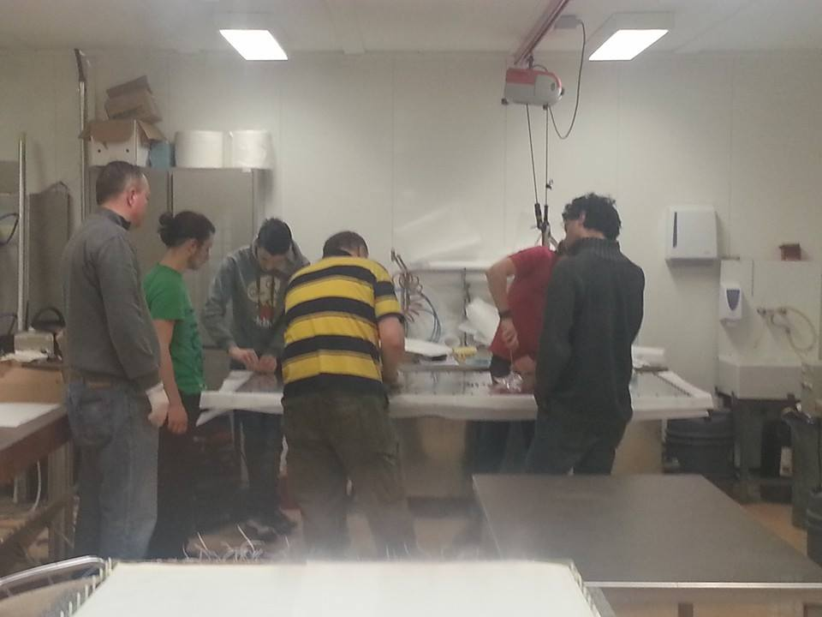
Closing the gas box with the MRPC

Slide 28
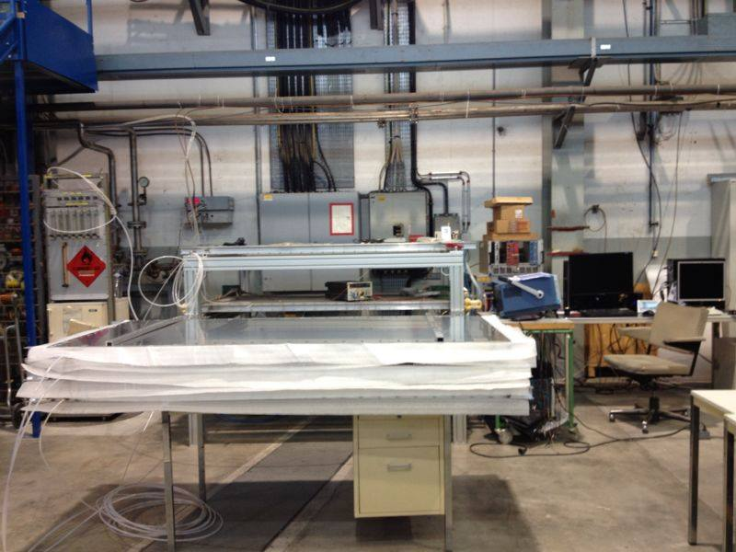
Chambers under gas flow to test for leaks
Notes:
le 3 camere collegate al flusso di gas, al fine di cercare possibili perdite di gas

Slide 29
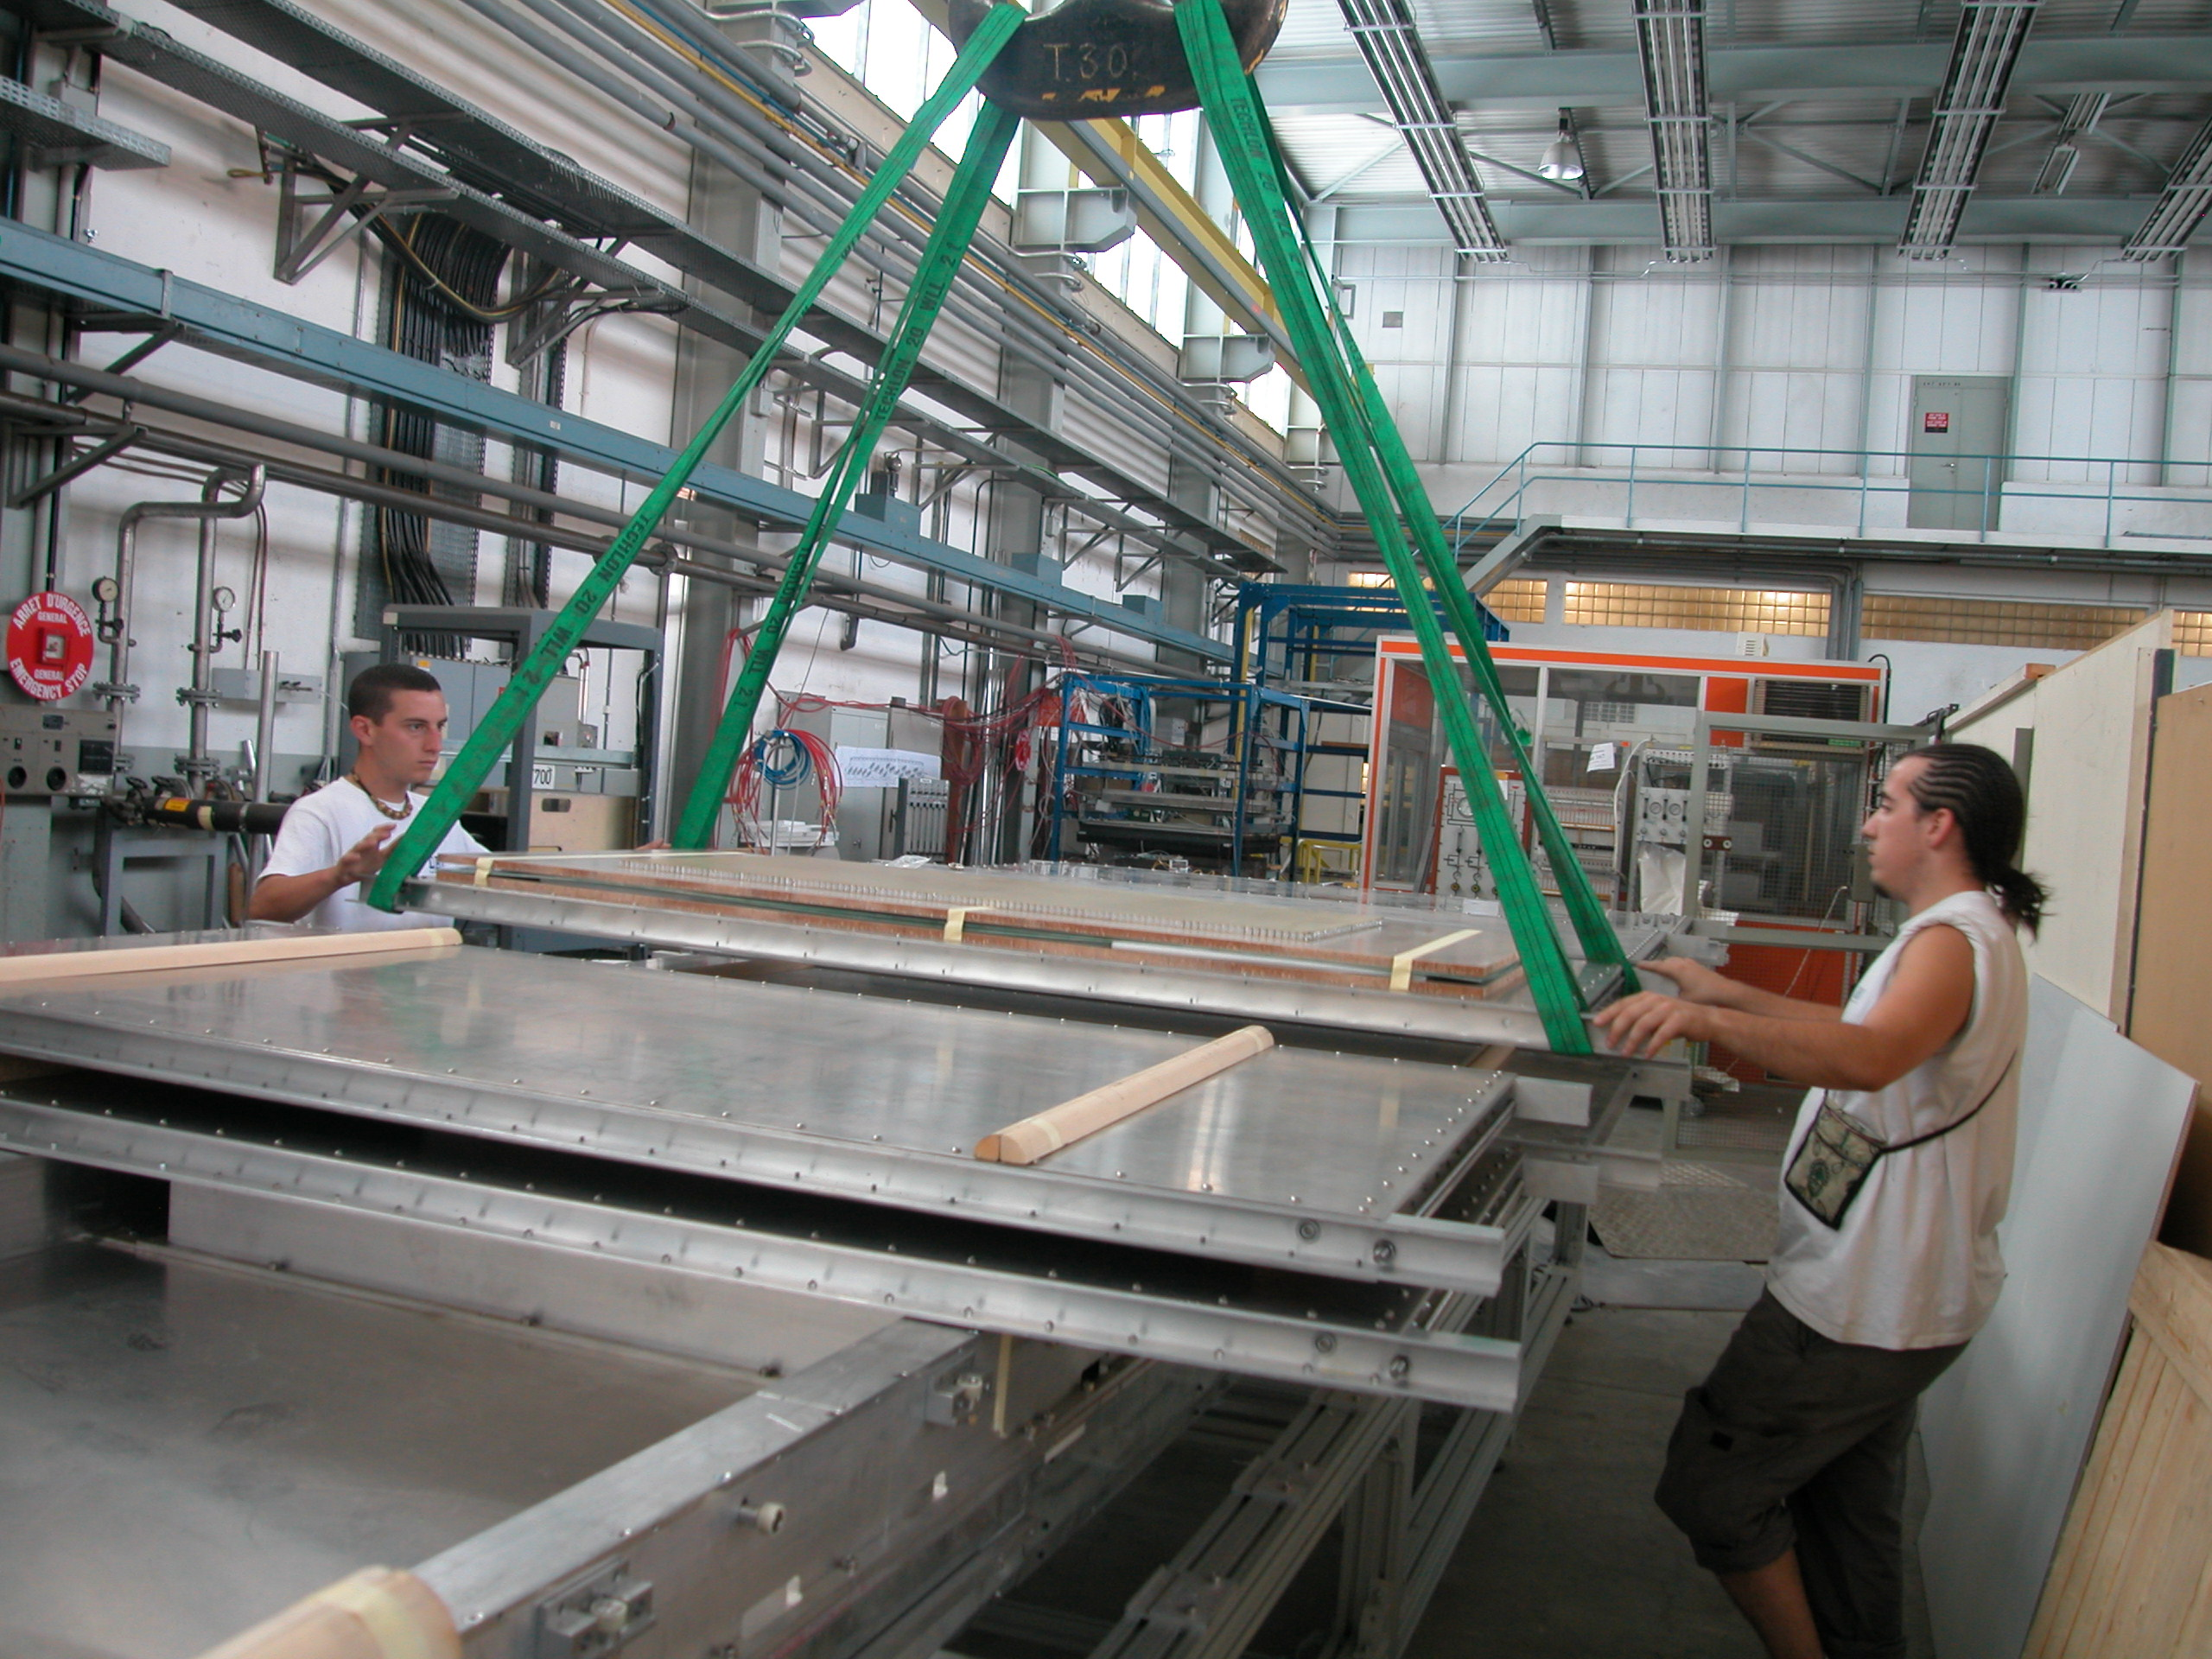
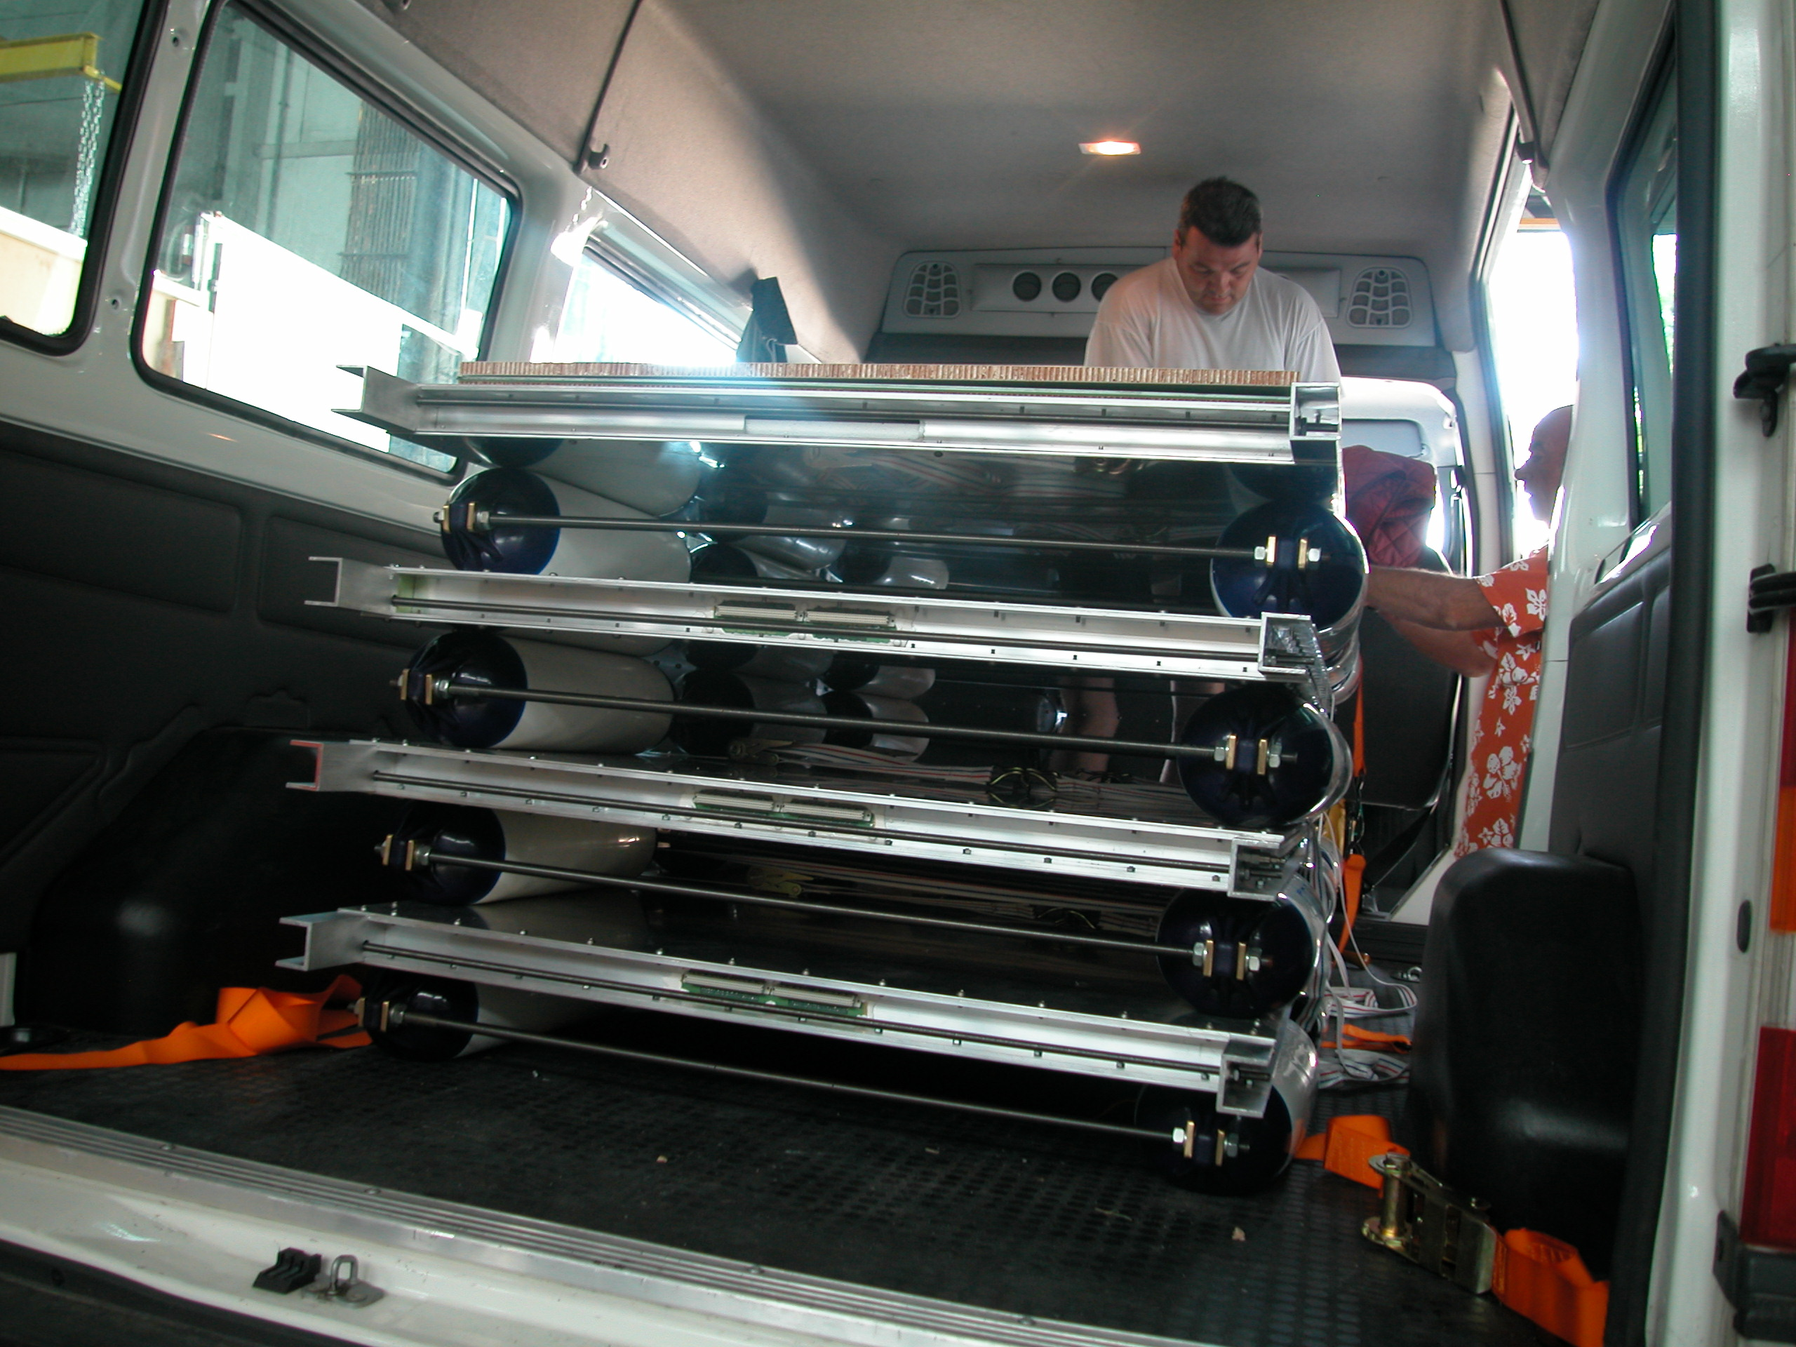
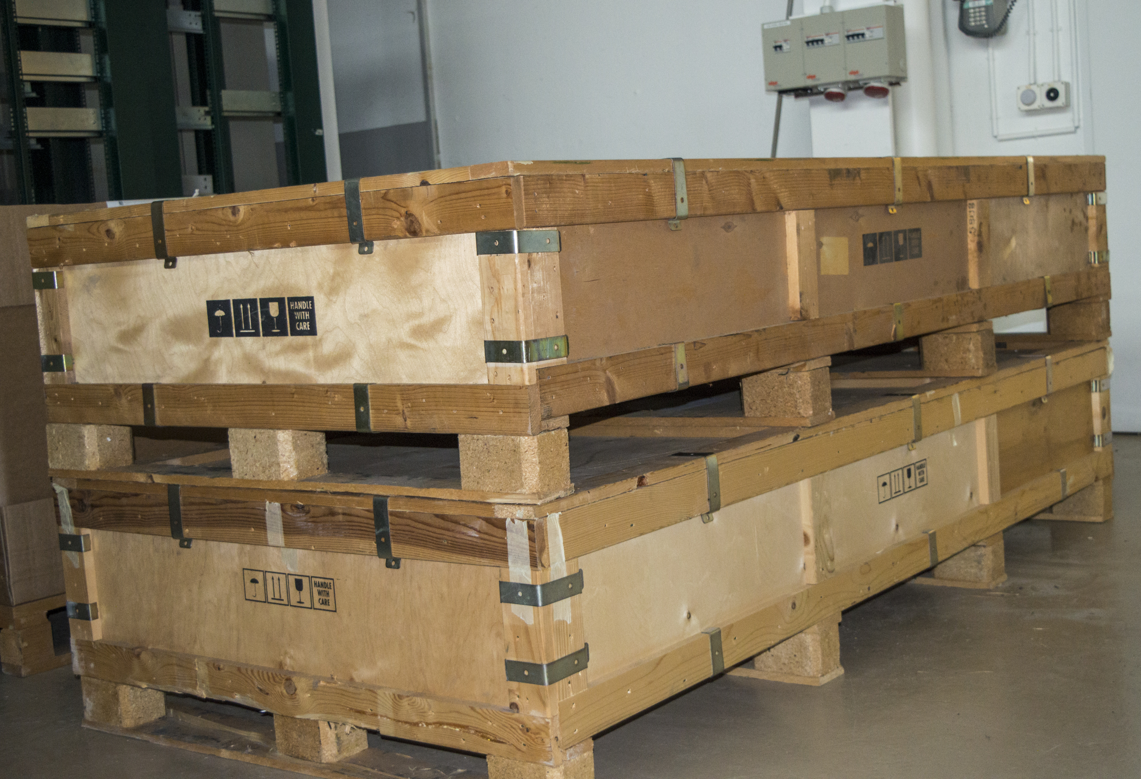
Chambers are shipped to Italy

Slide 30
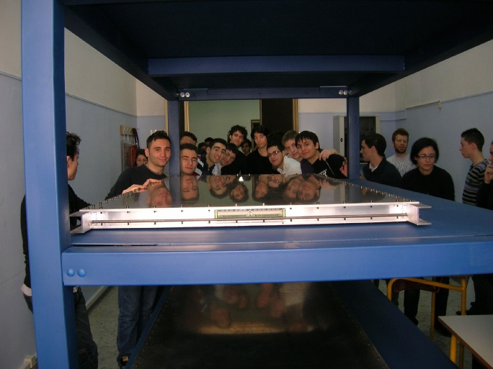








Phase II: assembling the muon telescope
readout and DAQ
The telescope assembled
Gas system
Chamber arrival

Slide 31




Phase III. Data-taking and monitoring
(empty bottle?)
Check DAQ is ON
Check GAS flow
Check chamber hit distributions

Slide 32

Data-taking
Pilot run : 27 October-14 November 2014 (23 – half of the EEE telescopes)
Run 1 : February 2015 – April 2015 (two third, 35 of the EEE telescopes)
Run 2 : November 2015 - May 2016 (almost all EEE telescopes)
Run 3 : October 2016 - May 2017 (almost all EEE telescopes)
Run 4 : October 2017 - May 2018 (almost all EEE telescopes)
Run 5 : October 2018 - May 2019 (almost all EEE telescopes)
Run 6 : October 2019 – May 2020 starting now
~95 billion tracks collected up to now

Slide 33

EEE@CNAF
centralised, coordinated data-taking; data transfered and stored at CNAF-Bologna
A complex software architecture has been set-up to reconstruct the data and provide quasi-online (few hours) histograms on the web for monitoring purposes

Slide 34

Phase IV: students’ participation in coordinated run
Fill the e-logbook

Slide 35


Check the CNAF on-line monitoring system

Slide 36

monthly run coordination video-conferences where the students present the status of their telescope / data-taking /analysis

Slide 37



National Conference of the EEE project, Erice, May 2017
How to measure the amount of gas in a bottle by means of sound frequency
Liceo F. e M. Campana (Osimo)

Slide 38



EEE in Erice 2017
Both measurements werepublished in the Giornale di Fisica with students’ signature.
Measurement of the Earth Radius
Measurement of Cosmic rays flux at different altitudes

Slide 39


EEE at International Cosmic Day 2017
47 Schools , 550 students
Liceo Galvani (BO):
data from their telescope

Slide 40


EEE outside Italy
Moscow Chemical Lyceum
Construction at CERN
Student exchanges between schools: Liceo Staffa Trinitapoli (Bari) and Moscow Chemical Lyceum
Themistokli Germenji Lyceum (Korce, Albania)
Istituto de Ciencias Nucleares UNAM (Mexico)
Oslo University (Oslo)
Liceo Galvani (BO):
data from their telescope
French HSSIP 2017, Swedish HSSIP 2018, etc..

Slide 41
Some results
Search for extended air showers
Coincidences between muon telescopes
Variation of muon flux in single EEE stations
Observation of Forbusch decreases
Study of upward-going particles
electrons from μ-decay

Slide 42
First detection of extensive air showers with the EEE experiment

Slide 43




  At L’Aquila, closest stations of the experiment
  Angular correlations between “coincidences”
  7.6 events/hour
  Signal/Noise = 2
  Angular cut
  (requiring quasi parallelism) improves S/N
  1.6 events/hour
  Signal/Noise=18
  Time difference between events at the two stations

Slide 44


First coincidences detected
Single track in one school + multiple
tracks in the other school
3.6 events / hour
Signal / Noise = 26.4
Multiple tracks in both schools
0.8 events / hour
Signal / Noise = 76

Slide 45


Coincidences up to 2012…
Number of coincidences per day, as measured by different telescope pairs of the EEE network, versus the relative distance between the two telescopes
Included in the plot: CERN-Geneva (15 m), L’Aquila (180 m), Cagliari (520 m) and Frascati (650 m)
Results consistent with Corsika and Cosmos Monte Carlo simulations
Few months to observe coincidences for distances > 1 km
Corsika Monte Carlo simulations

Slide 46



… coincidences during Run-1
Coincidences were observed for several distances between telescopes : 15 m, 100 m, 200 m, 500 m, 1200 m
Increasing the distance between telescopes the energy of the primary observed increases as well

Slide 47


Slide 48




Forbush decrease 2011
rapid variations of the cosmic rays flux over the course of a few hours
associated to solar phenomena as CME (Coronary Mass Emission) and solar flares
Decrease in muon flux reaching a minimum within hours
Recovery lasts a few days
comparison with Oulu neutron monitor station
Extensive Atmospheric Showers (EAS) Detections
The telescopes relative distances are ranging from a few hundred meters for clusters of 2, 3 and 4 telescopes in the same city, to more than 1000 km for the farthest stations. Muons from the same EAS are detected by different stations [6].
Modulation on φ
2
µ
Δφ_{station} - φ
ΔL*
ΔL_{station}
1

Slide 49


2011 Valentine’s Day Solar Flare
night between 14 and 15 February 2011
Solar flares: explosions on the sun, related to storage of energy in twisted magnetic fields -> burst of EM radiation (from radio waves to gamma rays)
Classification: according to intensity in wavelength range 0.1-0.8 nm
Flare recorded by the Solar Dynamics Observatory (SDO)
Solar flare, of category X2, followed by an important Coronary Mass Emission (CME)
Observable on earth a few days after the event
This kind of flares are constantly monitored since they may have relevant consequences on Earth

Slide 50

Forbush decrease 2012
Solar flare on March 6 2012 of category X5.4
Neutron monitors in Oulu and Rome
Liceo Gagnazzi – Altamura
Liceo Galvani, Liceo Fermi – Bologna
INFN Bologna
Department of Physics – Catania
March 2012 flux decrease
Extensive Atmospheric Showers (EAS) Detections
The telescopes relative distances are ranging from a few hundred meters for clusters of 2, 3 and 4 telescopes in the same city, to more than 1000 km for the farthest stations. Muons from the same EAS are detected by different stations [6].
Modulation on φ
2
µ
Δφ_{station} - φ
ΔL*
ΔL_{station}
1

Slide 51
Upward-going events
Time-Of-Flight (ΤΟF) :
Time Bottom Chamber - Time Top Chamber*
TOF<0 : upward-going particle
Muons from (atmospheric) neutrino interactions with the earth ?
Too many upward-going events observed
intriguing!
* Top and Bottom chambers are read out with the same TDC : same clock used

Slide 52

Upward-going events
About 1 event every 1000 observed goes in an upward direction
Some of them identified as electrons from muon decays (in the floor or in the bottom chamber), looking at their Time Difference with respect to the Previous (TDP) events
Event display (in the two projections)
Tagged downward µ + upgoing electron
Notes:
Qui i dati ottenuti ad Altamura vengono confrontati con quelli di Catania (sempre telescopio EEE, ma sito presso il dipartimento di fisica)
e quelli di OULU dove c’è un Neutro Monitor.

Slide 53


1.3 x 10⁸ good tracks
7 x 10⁴ TOF<0
β > 0 downward -going
β < 0 upward-going
Identify electrons from muon decays (in the floor or in the bottom chamber): look at Time Difference with respect to the Previous (TDP) events versus velocity
Correlate TDP with velocity of previous
particle : electrons come from decays
of (slow) muons with 0.5<β<0.8
For β~0.65 range of muons in Al / concrete is 2-3 cm
Electrons from μ-decay, E=50 MeV,
range in Al 7 cm
Notes:
Qui i dati ottenuti ad Altamura vengono confrontati con quelli di Catania (sempre telescopio EEE, ma sito presso il dipartimento di fisica)
e quelli di OULU dove c’è un Neutro Monitor.

Slide 54

Muon decay
upgoing low energy electron
good signature:
delay~2μs
large χ² (due to multiple scattering)
μ⁻→e⁻ν_{e}ν_{μ}
low energy electrons from muon decay are a robust explanation for upward-going particles

Slide 55

https://eee.centrofermi.it
despina.hatzifotiadou@cern.ch

Slide 56
Thanks a lot for your attention

