Slide 1
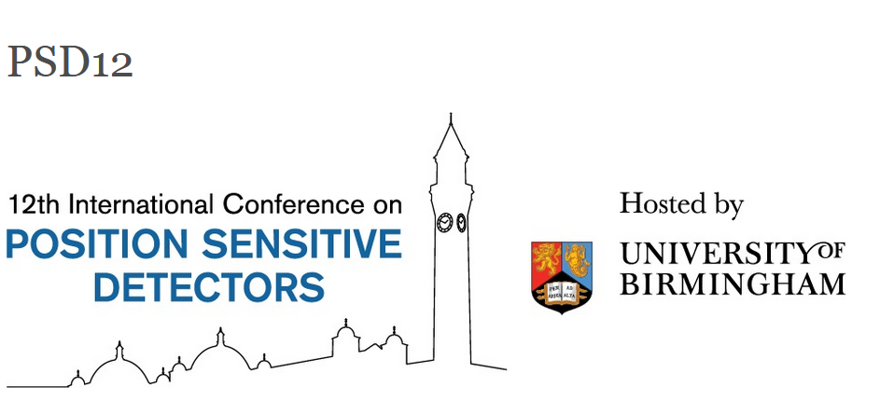
www.sd12.co.uk
Brief History of the International Conference on Position Sensitive Detectors
The conference series started as the London Conference and is the sister conference to the Vienna Conference on Instrumentation (next: 21-25 February https://vci2022.hephy.at/) with which it is normally 18 months out of phase.
The previous venues were: UCL London (1987); IC London(1990); Brunel University, London (1993); University of Manchester (1996); UCL London (1999); Leicester University (2002); University of Liverpool (2005); Glasgow University (2008); Aberystwyth University (2011); Surrey University (2014) and Open University (2017)
All sessions are run as plenary and this is the first time with virtual participation

Slide 2
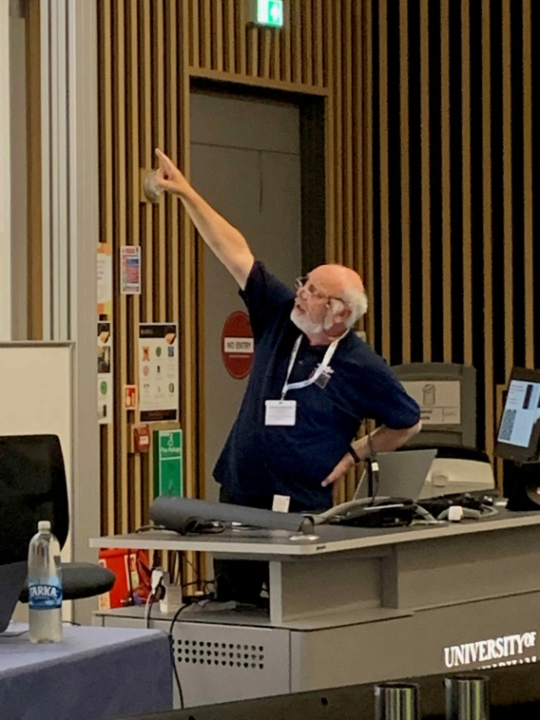
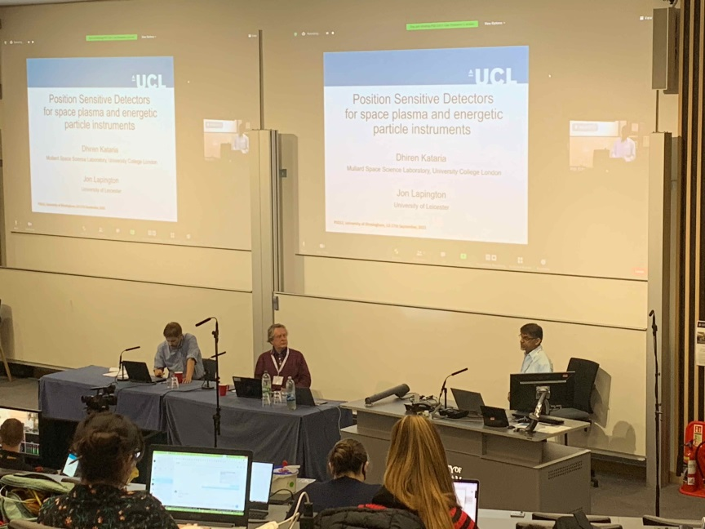
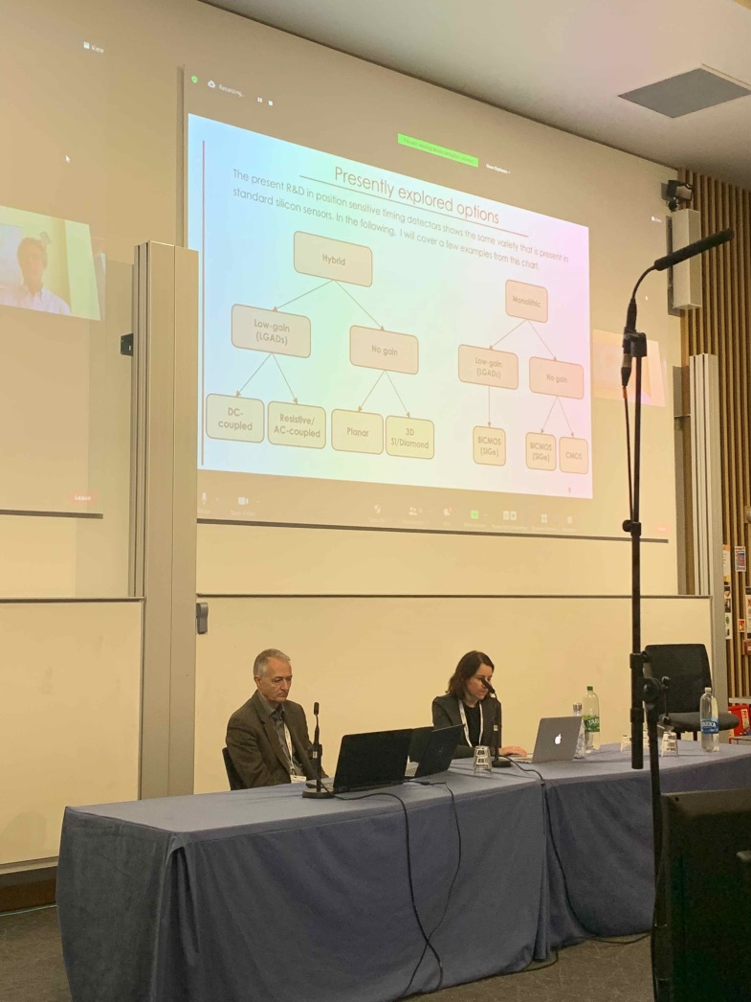
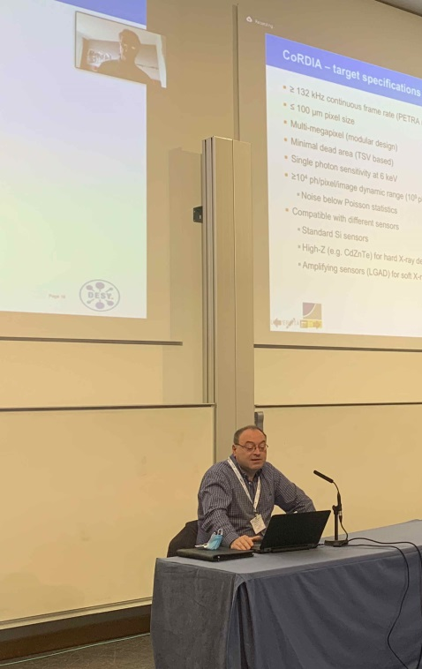
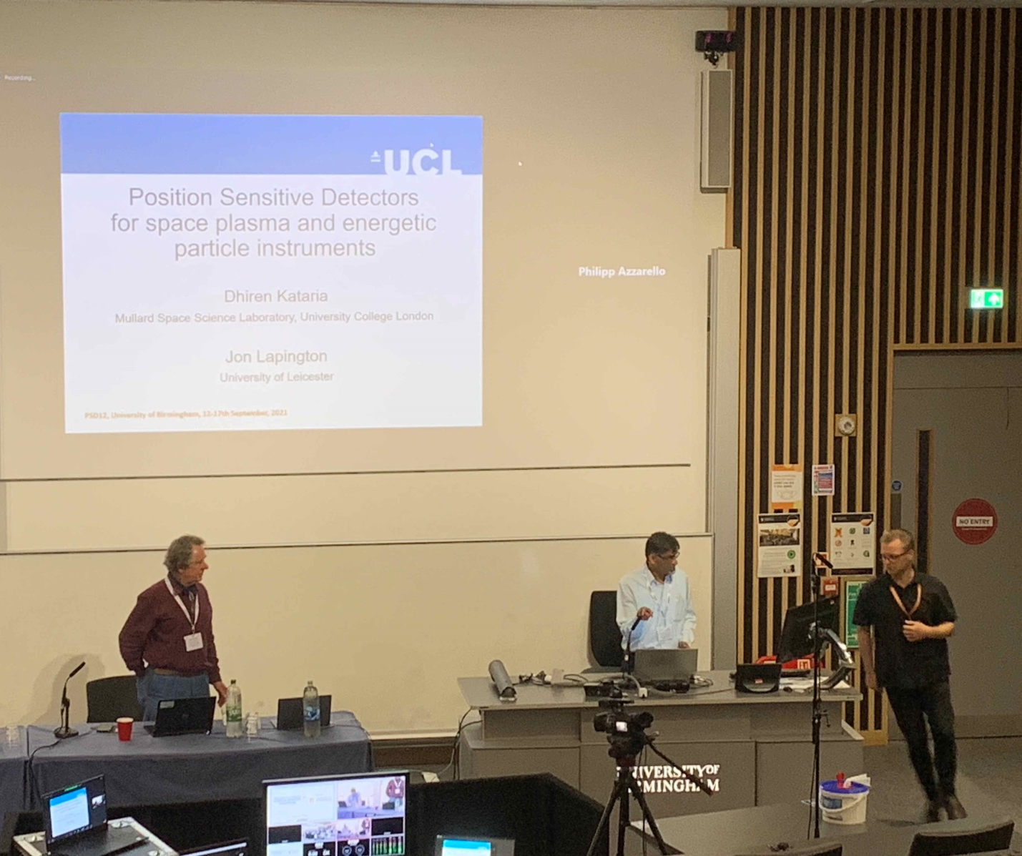
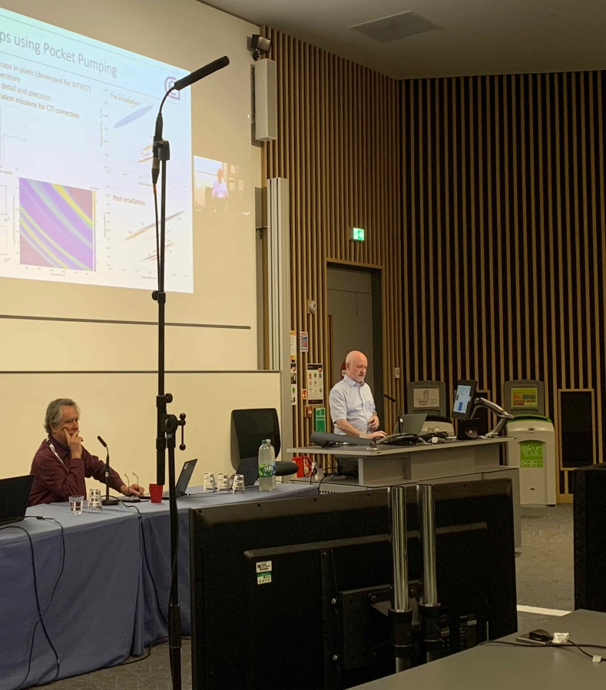
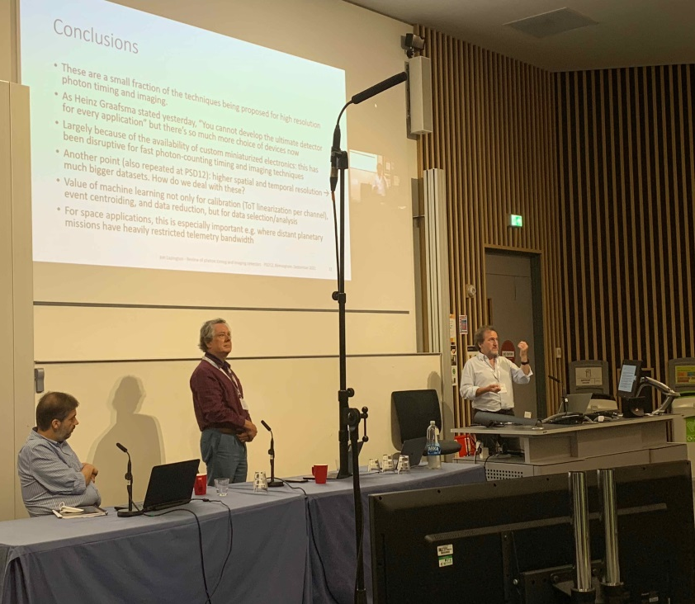

Slide 3
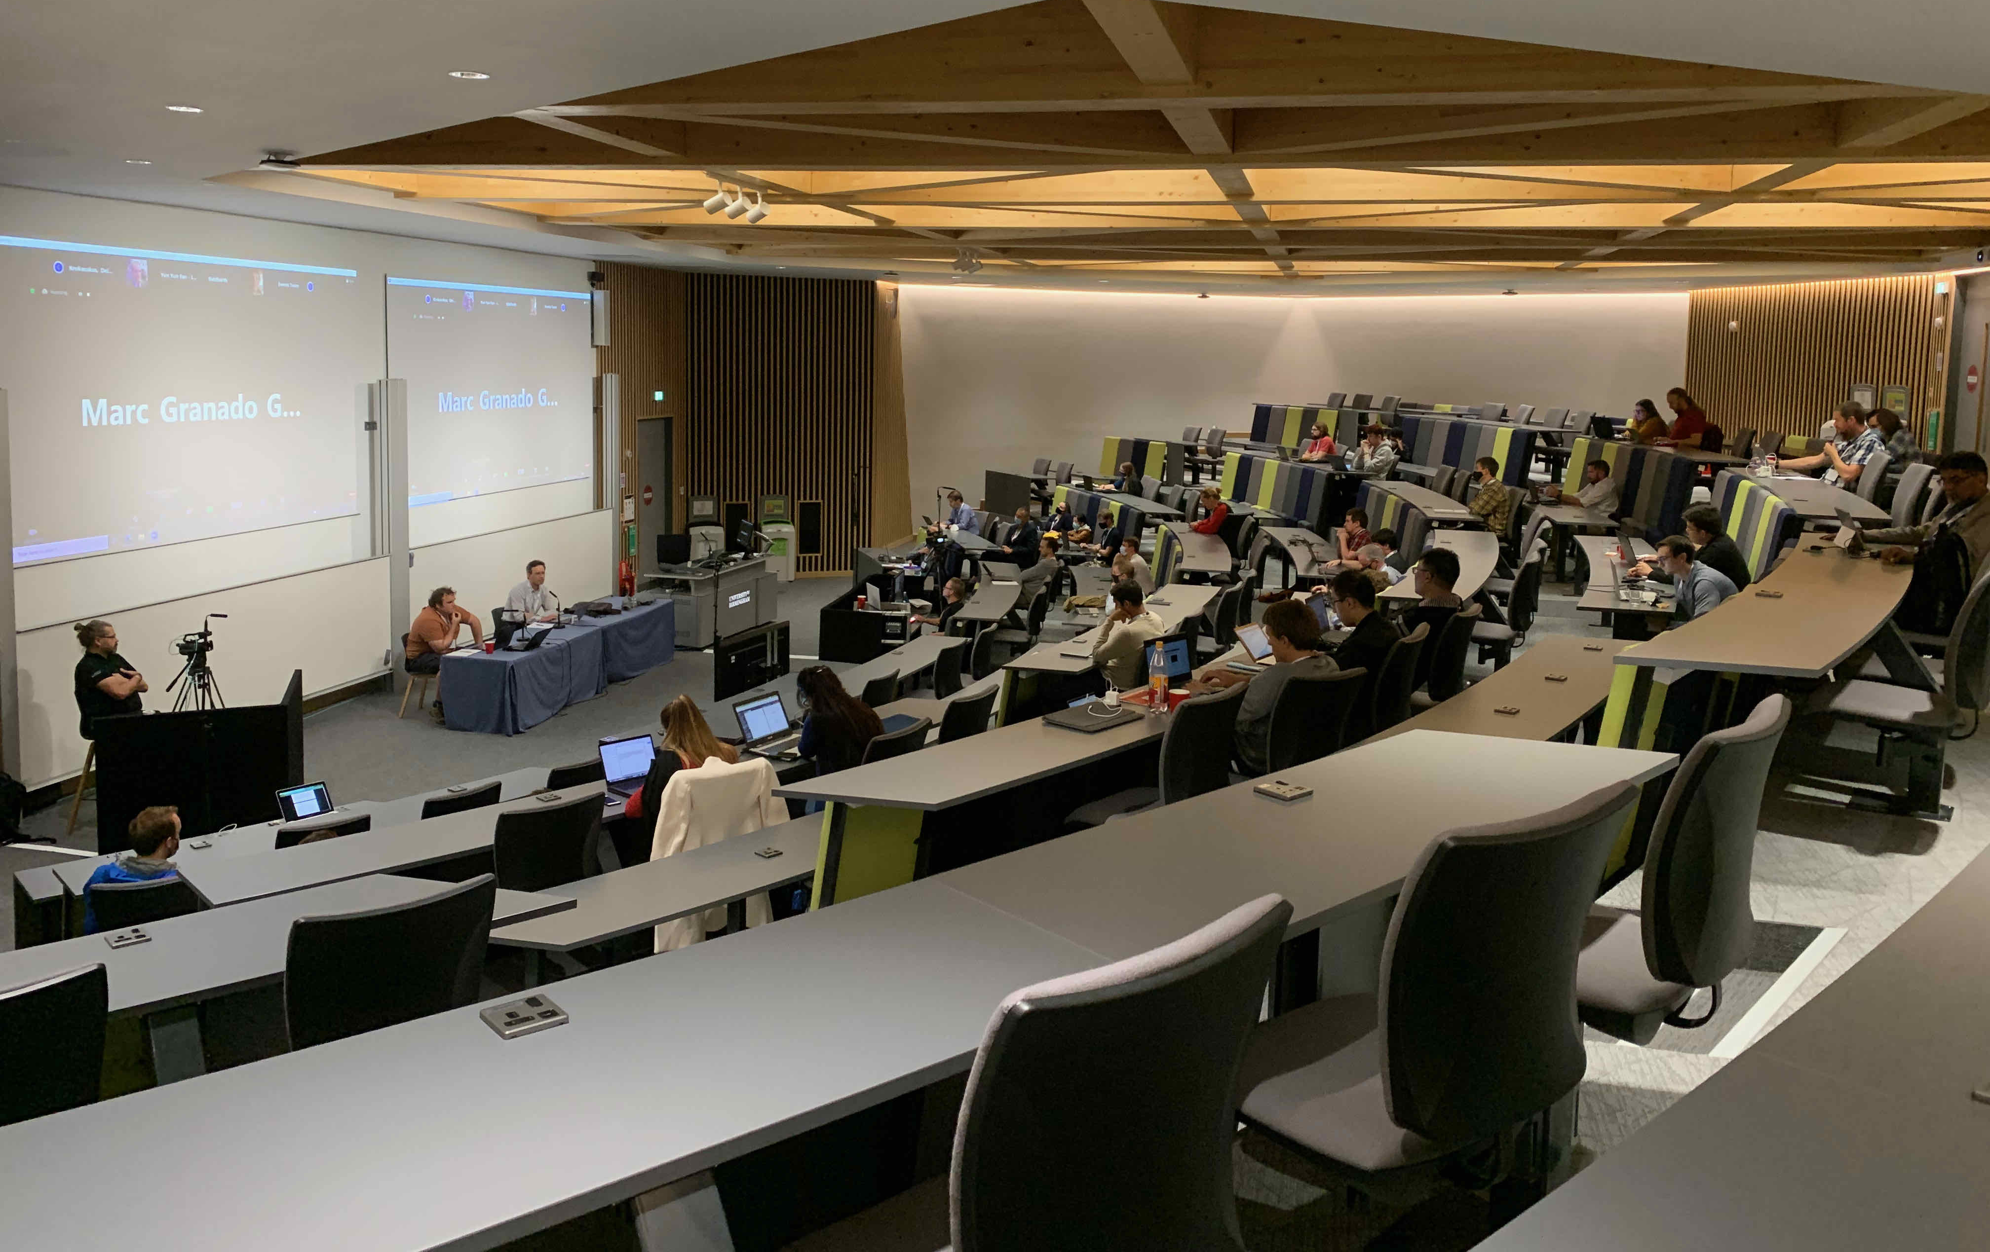
Many thanks to all delegates for giving this hybrid conferences such an exciting and varied programme
223 Registrants; 62 in person 171 online

Slide 4
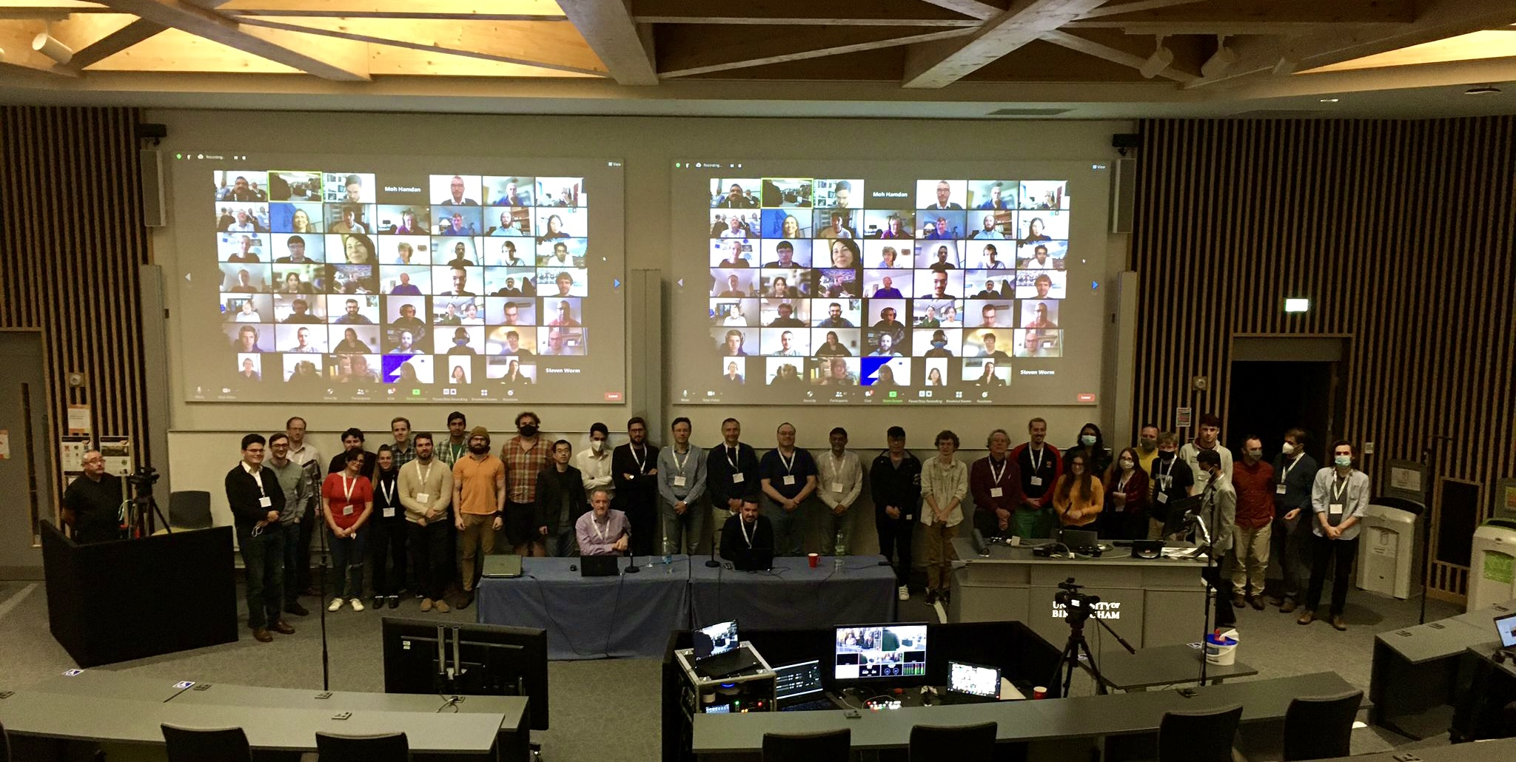
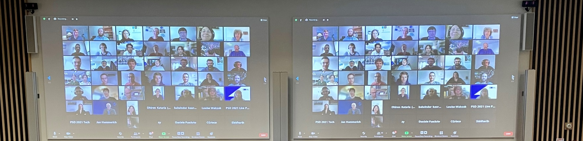
Many thanks to all delegates for giving this hybrid conferences such an exciting and varied programme

Slide 5
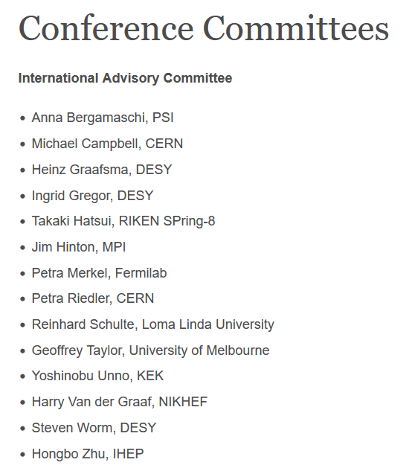
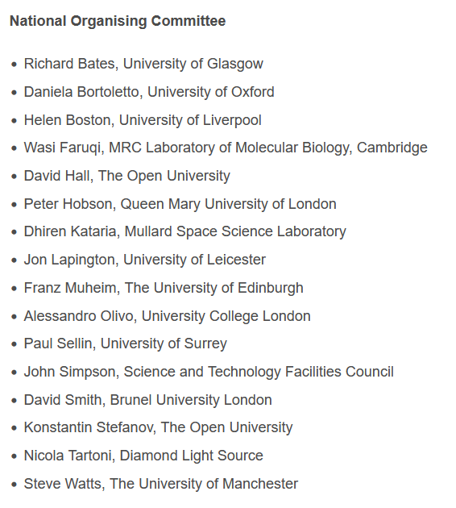
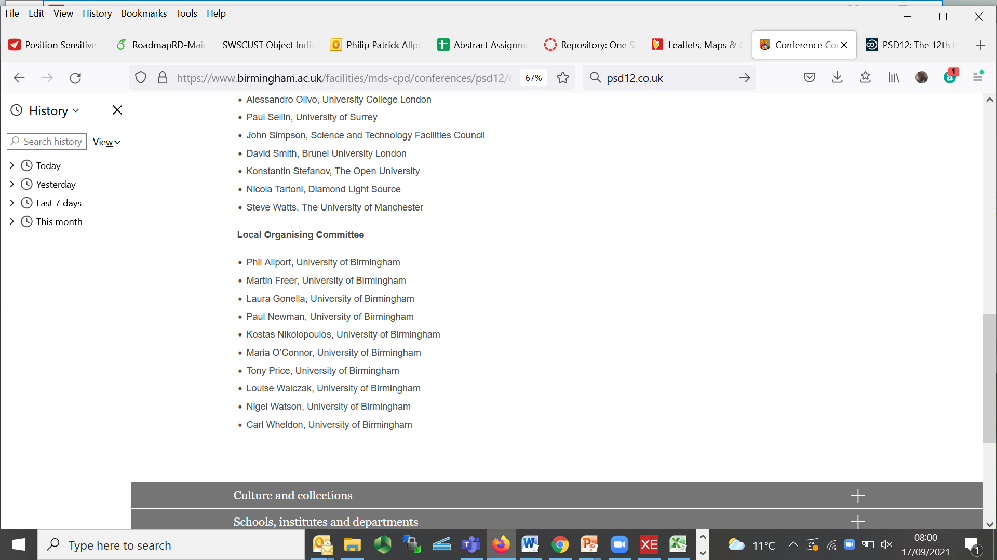

Slide 6
Abstract Grading
(>200 Submitted)

Slide 7
Venue Selection, Conference Planning
and Session Chairs

Slide 8
Organisation:
77 Oral Presentations
99 Poster Presentations
7 Industrial Exhibitors

Slide 9
Technical:
Posters, Indico
Zoom, OnAir, …
Richard Mitton and all the AV team

Slide 10

Delegates, Social Programme, Venue, Accommodation, Logistics, AV, Catering, …..

Slide 11
!
Proceedings
(It’s not over until it’s over)
!
!
!

Slide 12

Safe travel home and hope to see you all again at
PSD13
in Oxford
September 2023

