Slide 1
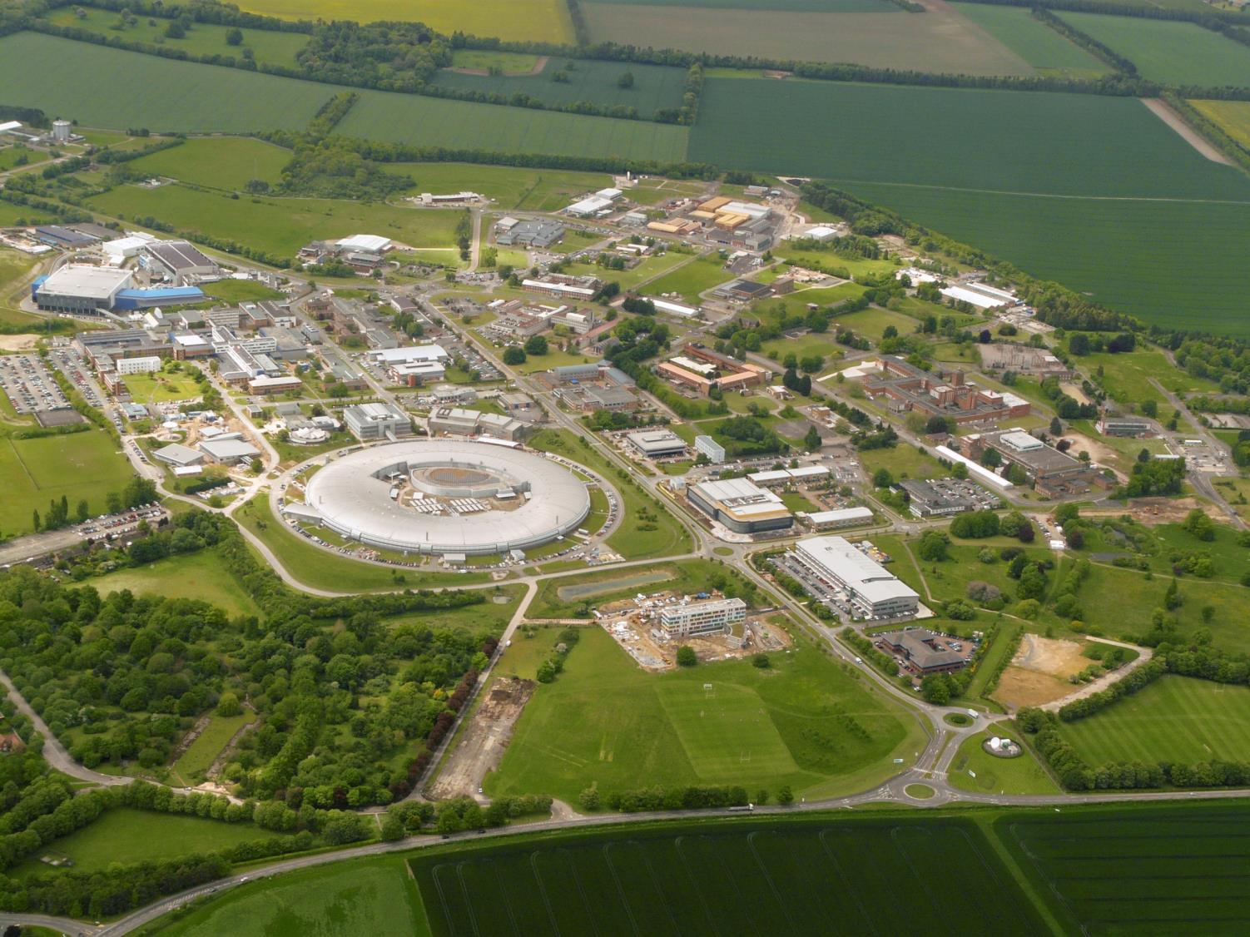
X-ray detectors at Diamond Light Source evolution and future challenges
Nicola Tartoni – PSD12 Birmingham

Slide 2
Introduction
  Synchrotrons
  The brightness challenge
  Crystallography experiments
Evolution of detectors for crystallography:
  from CCDs…
  …to photon counting detectors and…
  … their impact
Future challenges, beyond photon counting detectors
OUTLINE

Slide 3
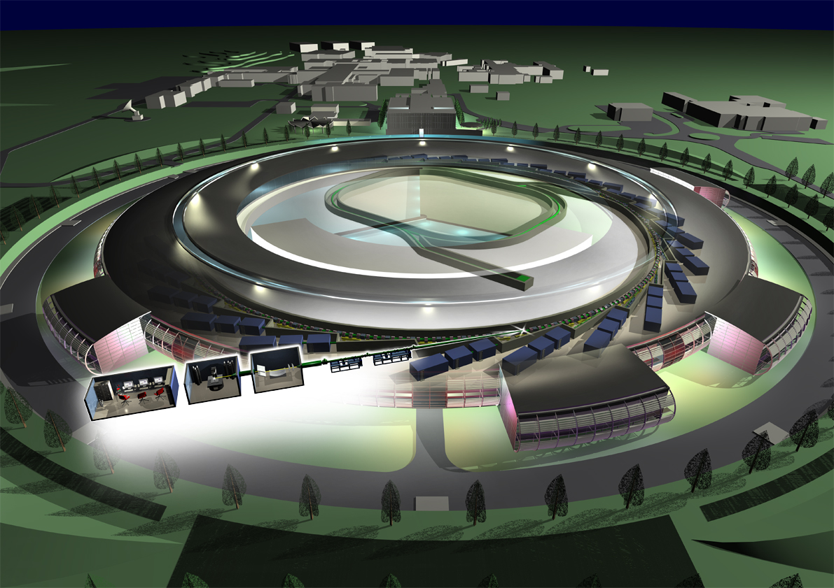

Slide 4
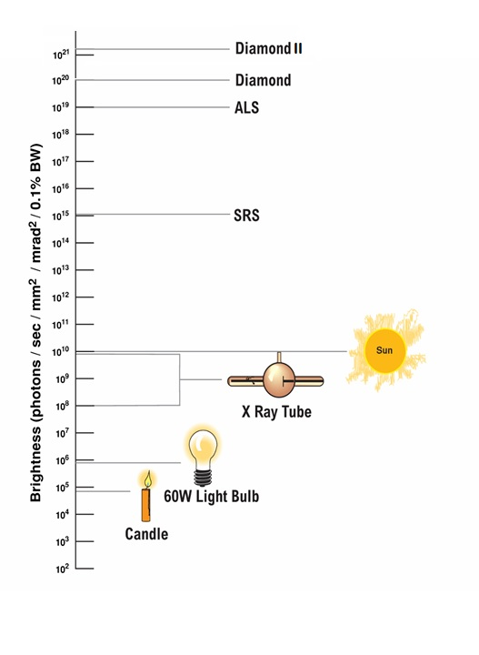
Brightness challenge
3rd generation diffraction limited
3rd generation synchrotrons
2nd generation synchrotrons
Conventional X-ray sources

Slide 5
Principle schematic of X-ray diffraction technique
Diffracted beams
X-ray beam
Crystalline
sample
Diffraction pattern
Beam stop
Area detector

Slide 6
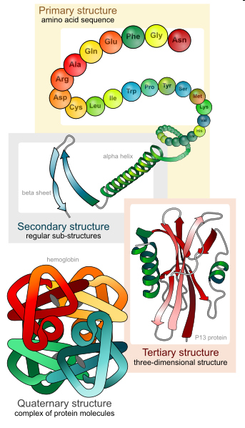
Macromolecular crystallography
Tertiary and quaternary structures are important in the development of drugs, and understanding functionality

Slide 7
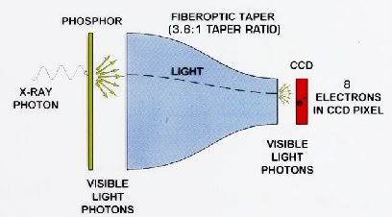
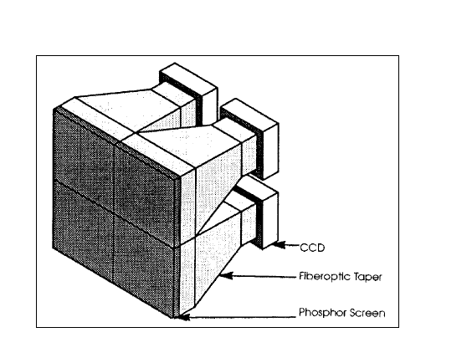
CCD X-ray Camera
Mosaic of several CCD devices to increase the sensitive area
X-ray photons converted to light
by a phosphor; light conveyed to a CCD by tapered fibre optic bundle

Slide 8
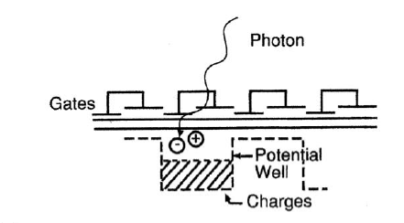
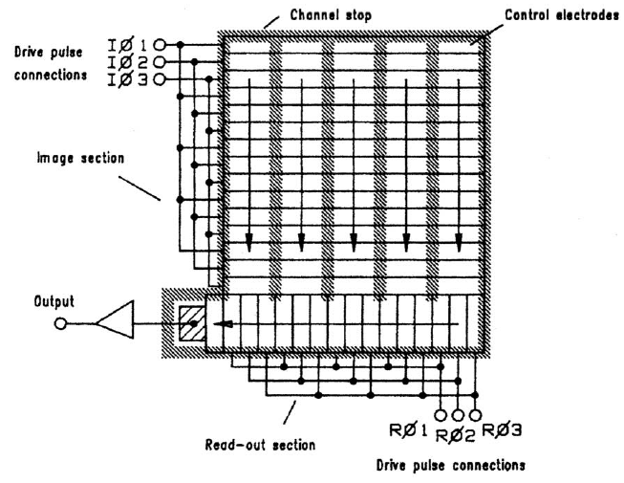
CCD sensors
At the end of the exposure the electric charge is shifted to the periphery of the device for the read-out
Accumulation of the photogenerated electric charge during the exposure

Slide 9
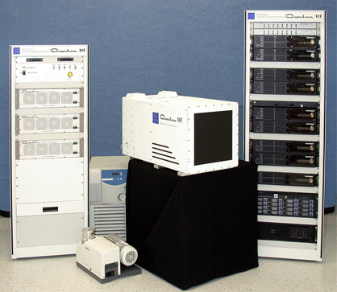
Example ADSC 315
Pixel size: 51 um x 51 um
No. of Pixels:6144 x 6144
Spatial resolution FWHM 90 um
Gain: 8.5 e⁻/X-ray photon
Full Well: 270,000 electrons (~32,000 photons)
Dark Current: 0.015 e⁻ /pixel/s
Read Noise: 13.5 electrons
Read-out time: 1.1 s
Image size: 72 MB

Slide 10
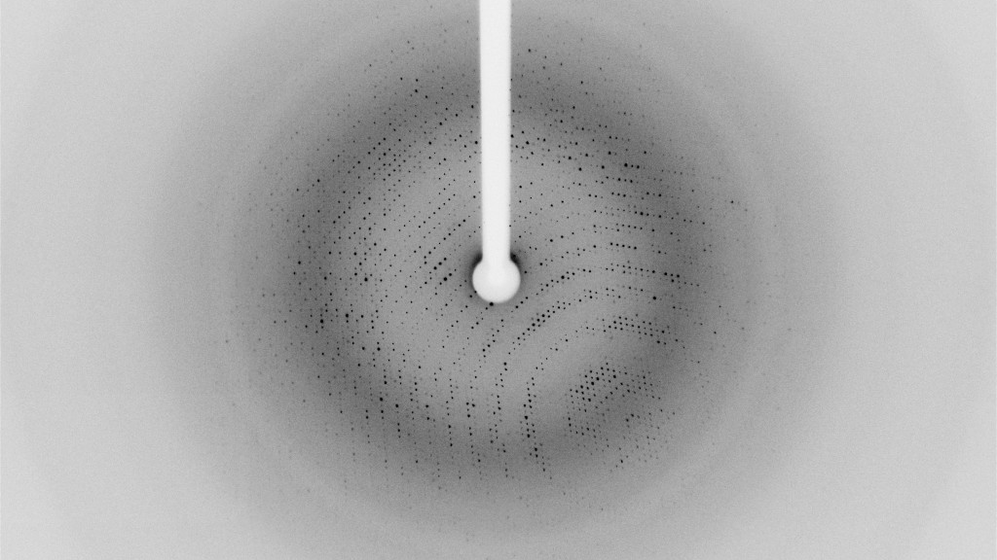

Slide 11
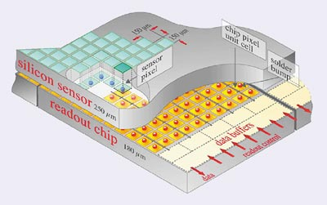
Hybrid photon counting detectors: a breakthrough

Slide 12

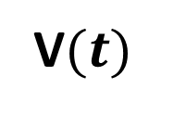
$$i(t)=Q⋅δ(t)$$
Bonding pad
V$(t)$
CSA and
shaper
Logic pulse
Counter
Discriminator
READ-OUT BUS
(data out)
Threshold adjustment

Slide 13
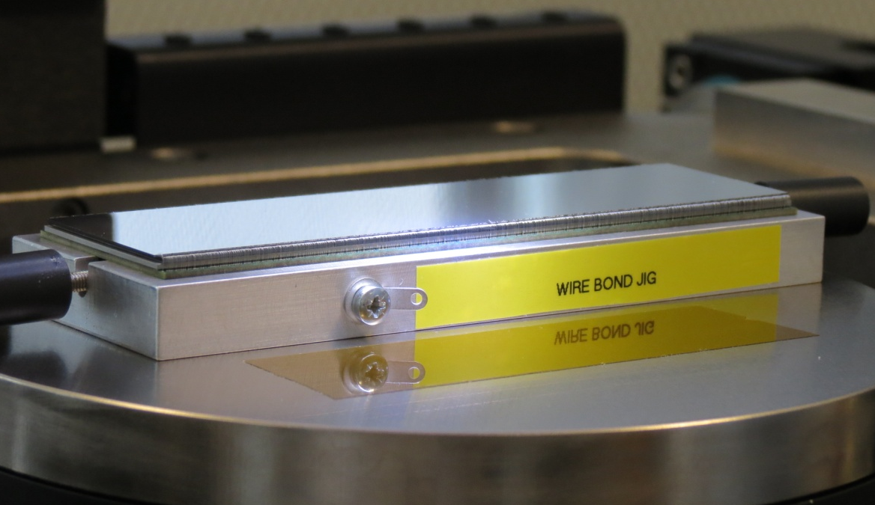
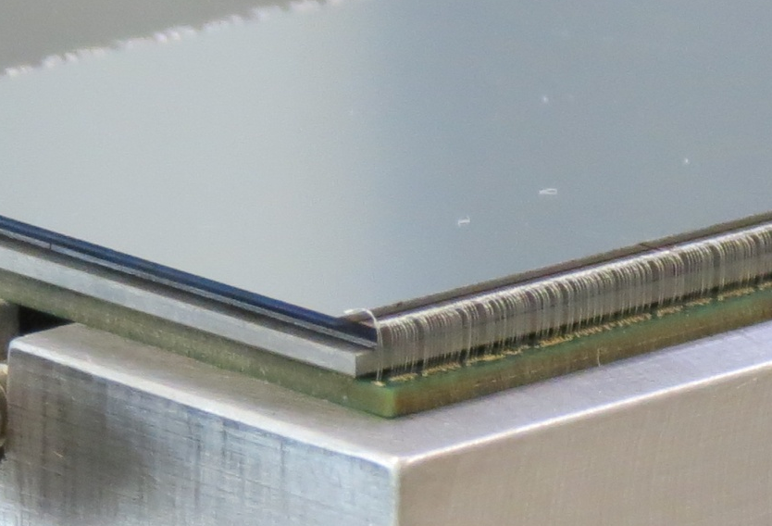
EXCALIBUR detector modules
Sensor (300μm)
Adhesive film (75μm)
MEDIPIX3 (750μm)
EXCALIBUR module under inspection
after wire-bonding
Cold-finger (1mm)
PCB (1 mm)

Slide 14
Major advantages of the hybrid photon counting detectors
Direct detection -> ~3,300e⁻/X-ray photon
Digital counters -> larger dynamic range compared to analogue memories (potential well of CCD)
Read-out of counters -> ~ms to read an entire frame
Insensitive to leakage current -> no need to operate at low temperature

Slide 15
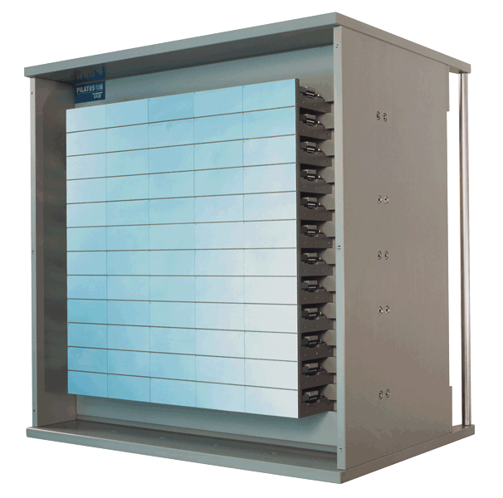
Pilatus, first commercial hybrid pixel detector
Single module
8x2 chips
172 µm x 172 µm pixels
Hybrid detector, 60 monolithic silicon sensors,
Pixel size: 172 um
No. of Pixels: 2463 x 2527
Counter depth: 20 bits (~1,000,000 photons)
Frame rate: 12 fps
Image size (Tif 32 bits): ~23 MB
Compressed image: ~ 6 MB
Data set: ~ 1800 images
“Volume” of a data set: 11 GB
P6M
5x12 modules
~ 43x45 cm²

Slide 16
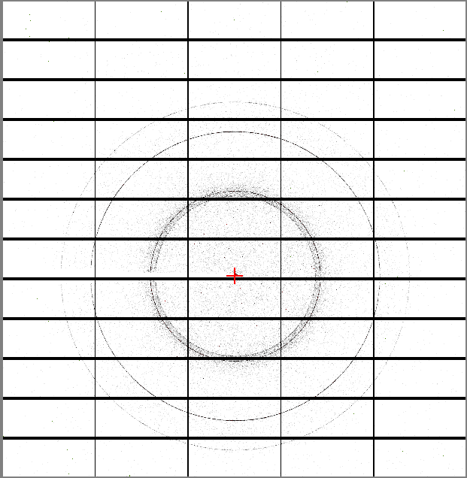
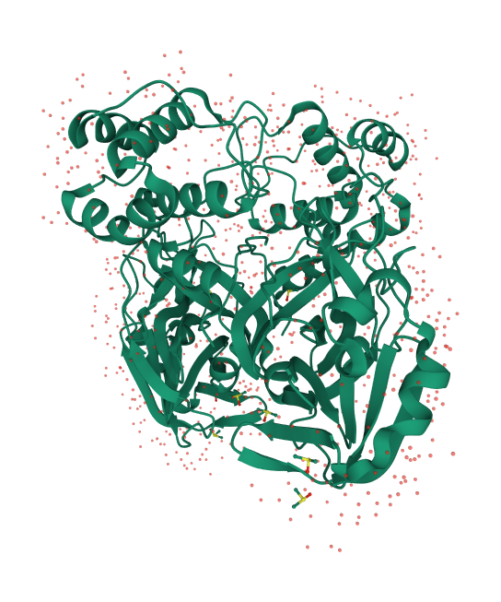
SARS-CoV-2 main protease with unliganded active site

Slide 17


Slide 18
This new generation of detectors are great but is it possible to make them still better?
Detector parameter | Questions
Frame rate 12Hz | Is it possible to increase the frame rate an order of magnitude or more?
2ms dead time due to read-out | Is it possible to reduce the dead time to zero?
172um pixel size | Is it possible to shrink the pixel size?
Silicon sensors inefficient at high photon energy | Is it possible to develop efficient sensors for high energy?

Slide 19
Enhancement | New parameters
Improved microelectronic design | 75um or 55um pixel size
Simultaneous read-out and counting and enhanced back-end electronics | 16 million pixels, 550Hz (commercial detector)
CdTe sensors | extension of the energy range of operation to 50 keV and beyond
Yes, you can have still better detectors!

Slide 20
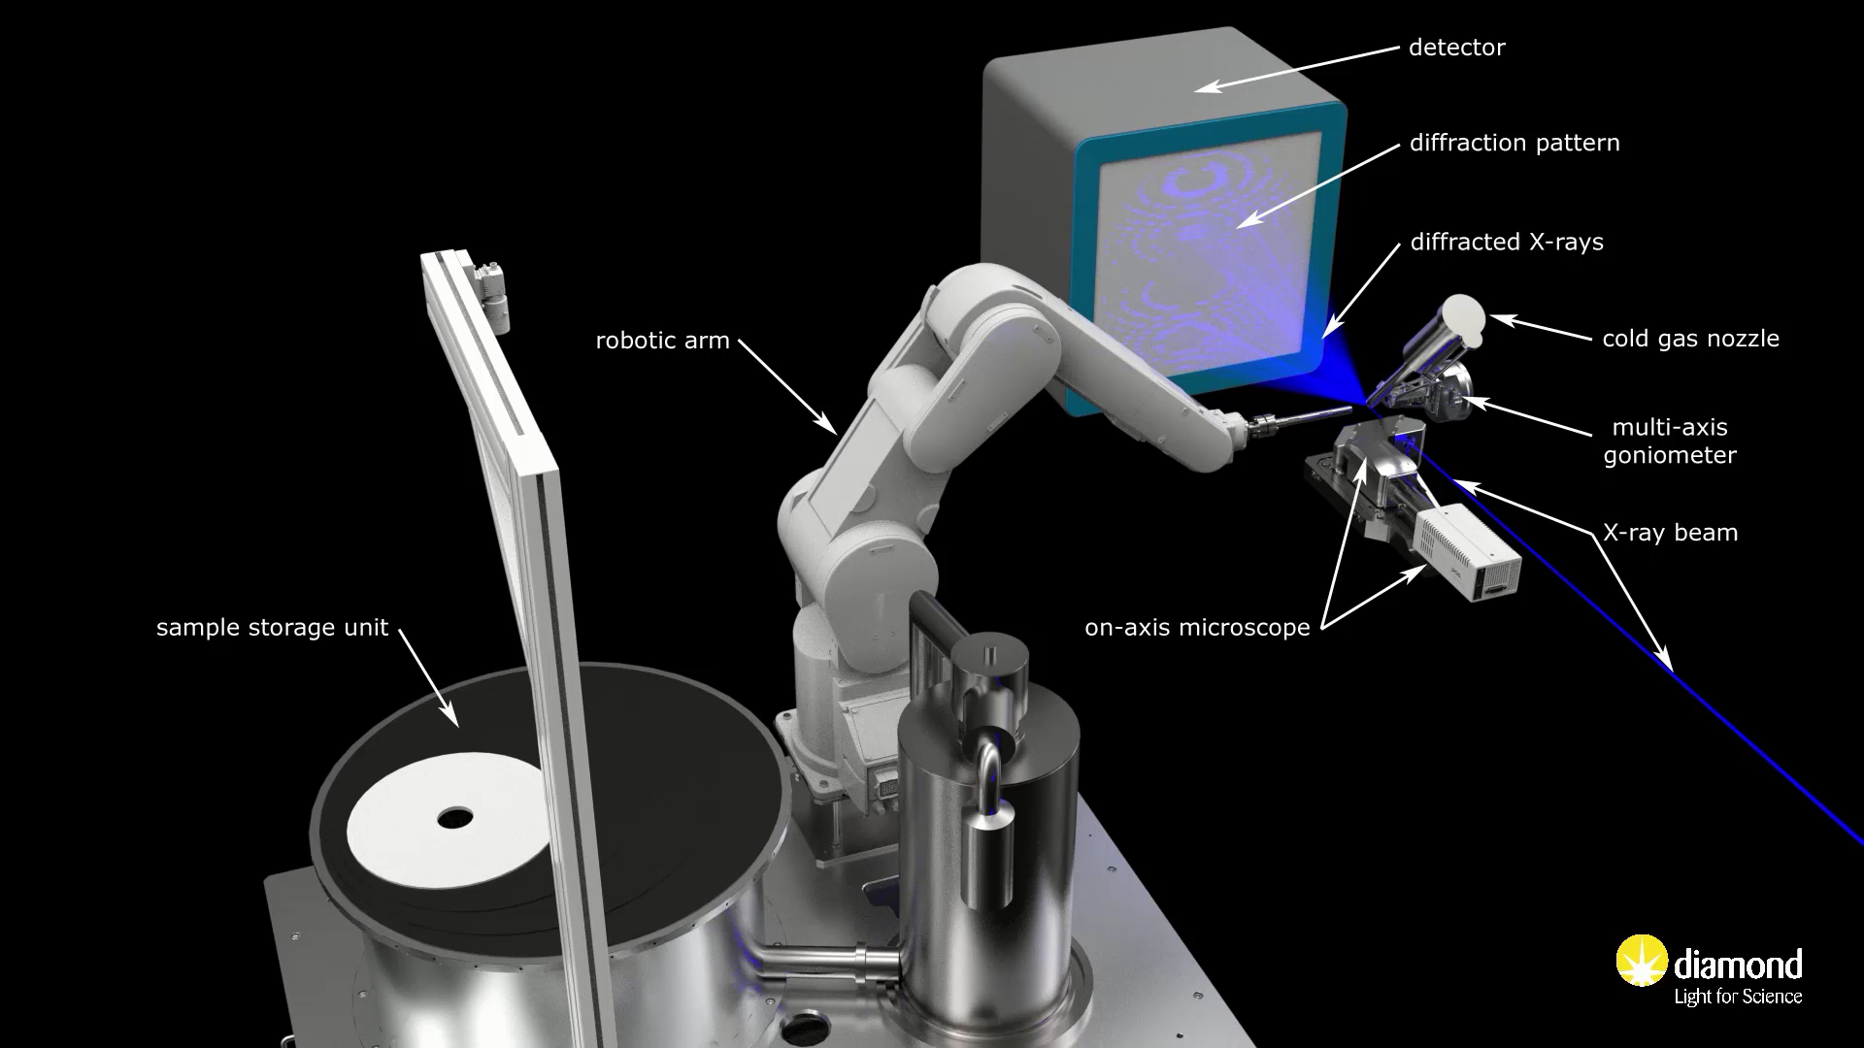
Highly Automated MX – I03, I04, I04-1, I24
Animation courtesy David Hall (MX science group leader – Diamond)

Slide 21
Hybrid pixel photon counting detector can be gated so it is possible but…
…the phenomenon must be reproducible and…
…the duty cycle is very poor.
A different concept is necessary!
What about if I want to detect dynamics down to the microsecond or below?

Slide 22
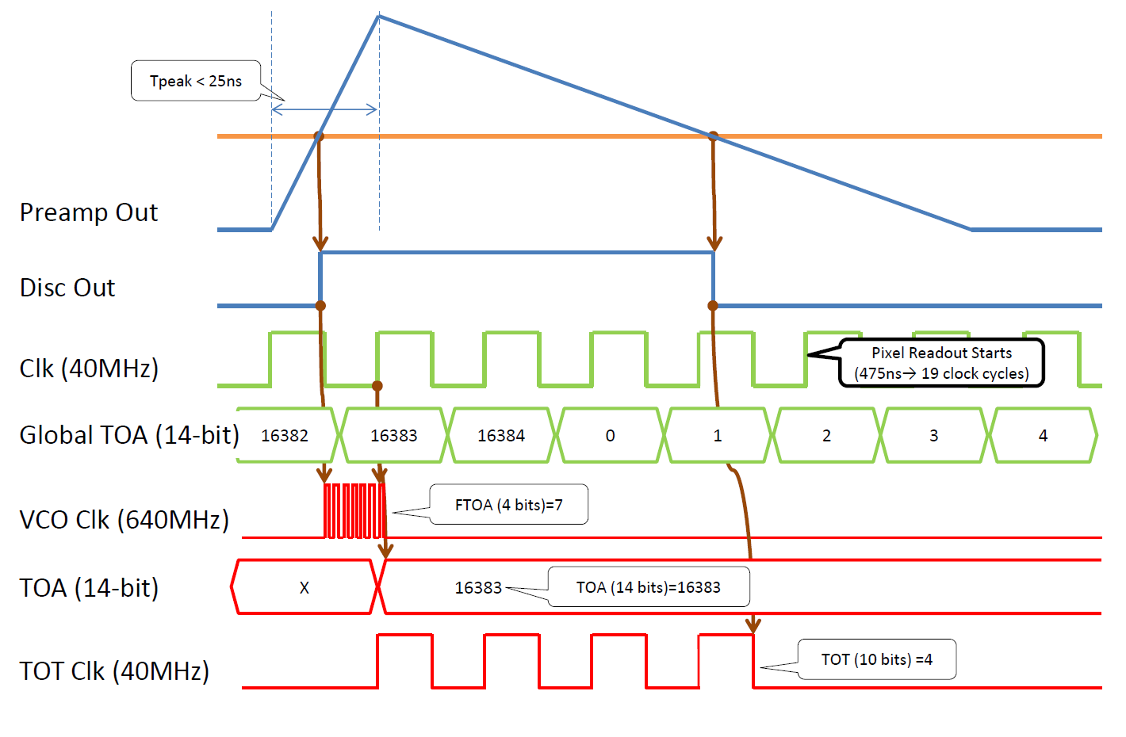
Timepix3 working principle
Diagram courtesy of X.Llopart - CERN

Slide 23
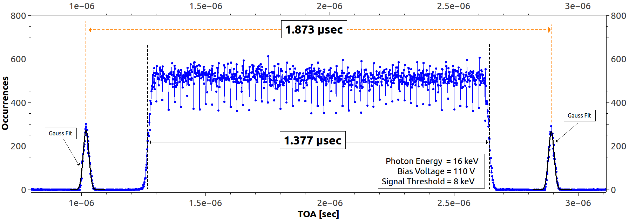
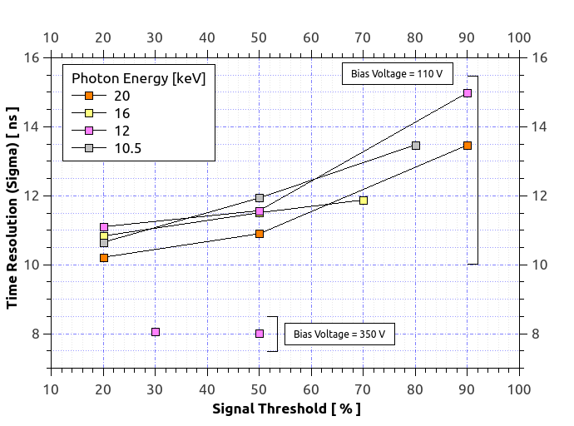
MEASURED ToA BUNCH STRUCTURE
Best achieved resolution:
8 ns (standard deviation)
Measurement taken in hybrid mode

Slide 24
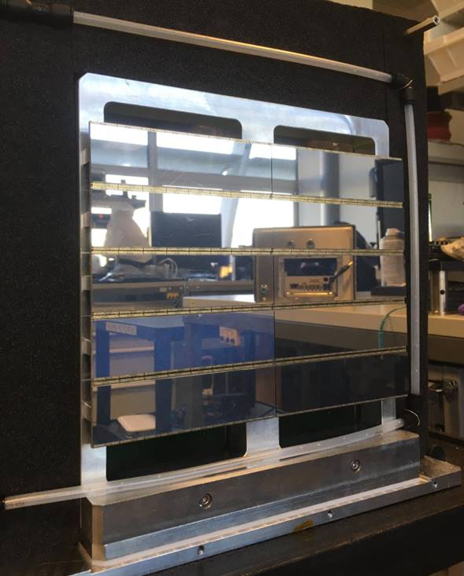
Tristan10M
Detector currently installed in I19 (small molecule crystallography) and first time resolved experiment ongoing
Experiments already carried out with prototypes and partly populate chassis
Major characteristics of Tristan10M
Detector size | 23cm x 17cm
Architecture | Modular, each module 1million pixels and 16 read-out ASICs
Number of modules and format | 10 modules arranged in a 5x2 matrix
Number of pixels | 10millions
Pixel size | 55μm
Sensor | High resistivity silicon 500μm thick
Notional accuracy of the time stamp | 1.56ns
Maximum measurable time interval | 81days
Maximum event rate per read-out ASIC (per module) | 80million events/s (1280million events/s)
Trigger signals input | Up to 2 logic signals. Signals time stamped and sent in the data stream
Data format | List of events into an HDF5 file
Data link between the Linux servers and the data storage | InfiniBand

Slide 25
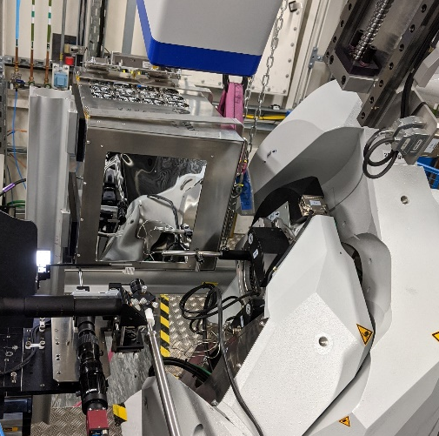
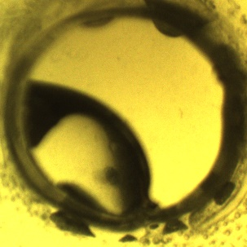

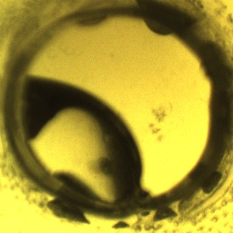
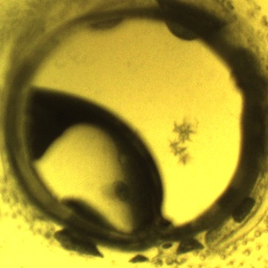
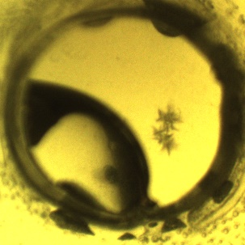

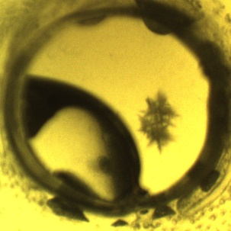
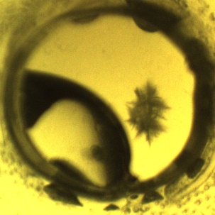
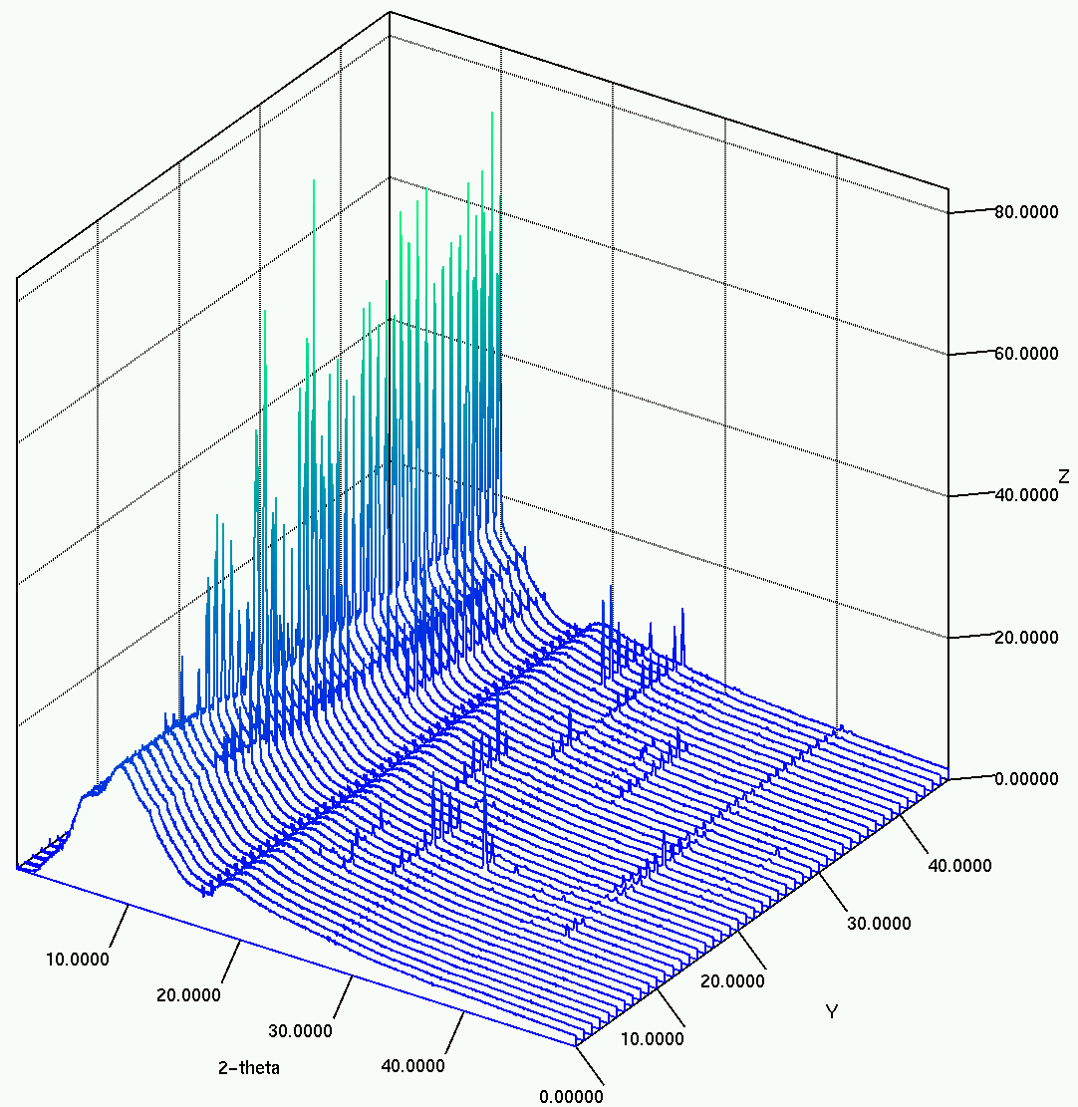
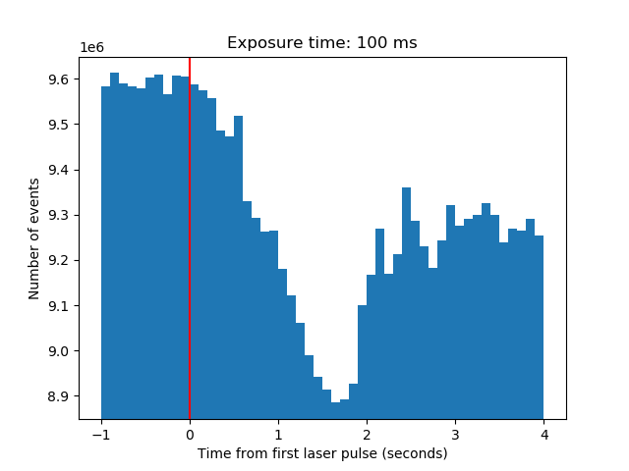
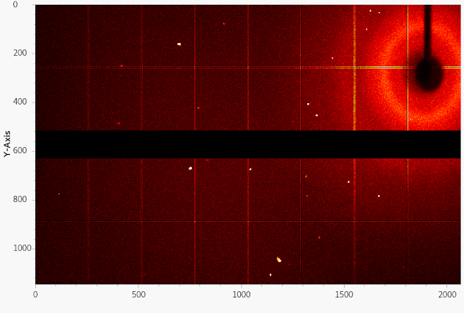
I19 Tristan (2 modules) – Laser Induced Nucleation
The aim of this proposal is to observe the dynamics of crystal nucleation from solution, on the microsecond timescale for the first time, using non-photochemical laser-induced nucleation.
Laser shot
(time zero)
time
Formation of crystals
Tristan image of diffraction from laser induced nucleation.
Slide courtesy Mark Warren (I19 beam line scientist– Diamond)
Histogram of events after single laser shot (red line) with 100 ms binning.
Diffraction peaks present within first time-bin after single laser exposure
time zero

Slide 26
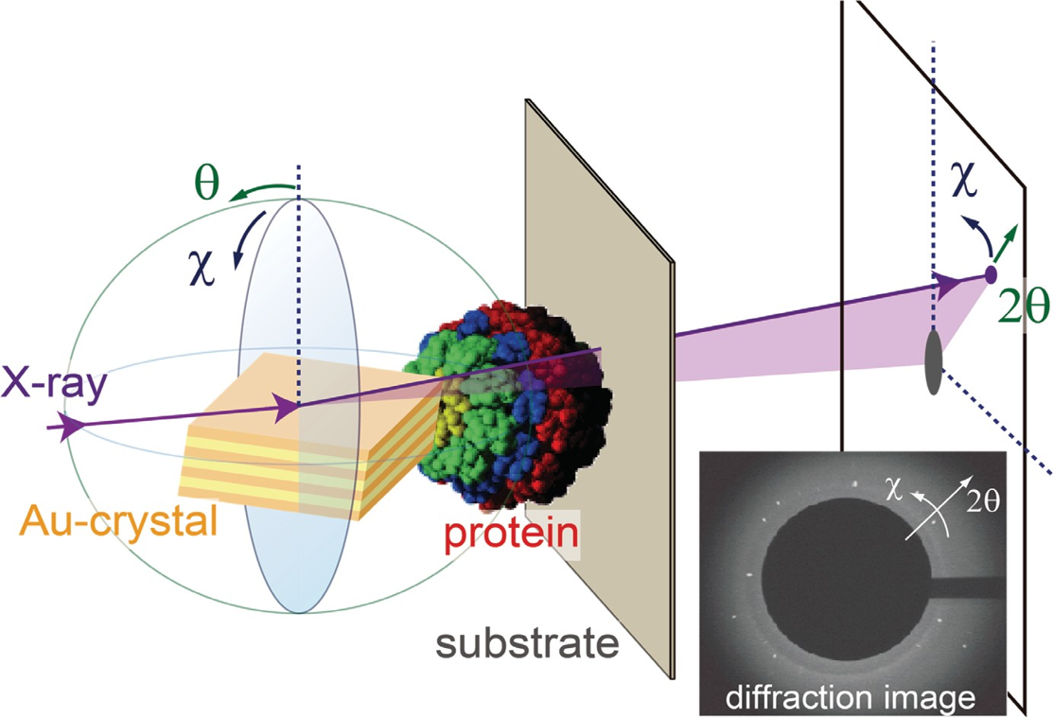
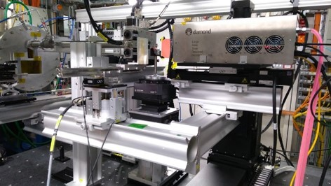
DXT- Diffracted X-ray Tracking
User experiment performed in B16 @ DLS – previously performed only at SPring-8 on a dedicated beamline
Detector positioned with sensitive area just outside the direct beam
One-shot dynamic experiment
White beam
Many thanks to Prof Yuji Sasaki (University of Tokyo) and Dr Hiroshi Sekiguchi (SPring-8)

Slide 27


DXT- Diffracted X-ray Tracking
Most of time spent to limit the background
Part of the detector sensitive area shielded
Several protein sample tested
Continuous exposures with different duration (between 1 and 10 seconds)
RESULT:
3 s exposure
Frame duration is not fixed: possibility to change frame duration using event timing without need to perform another exposure
MASKED
ASIC
FOR BACKGROUND
SUPPRESSION
60 frames of 50 ms
1200 frames of 2.5 ms

Slide 28
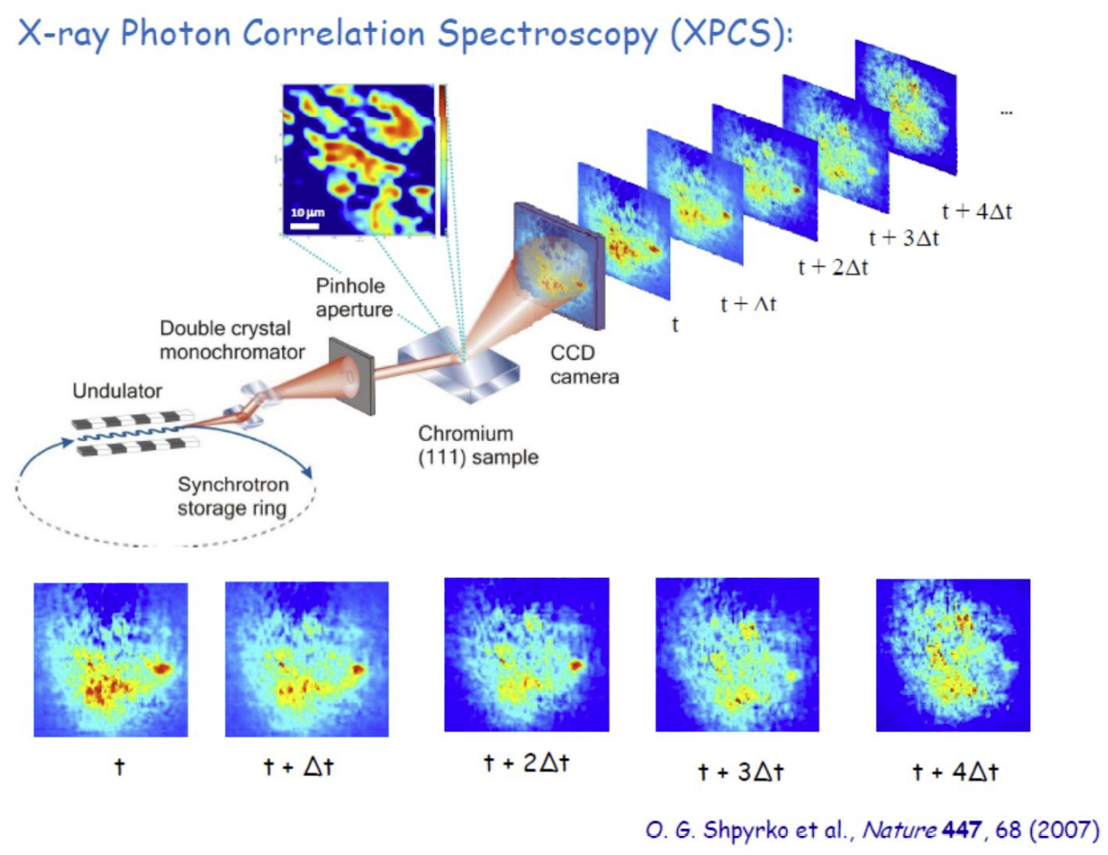

Slide 29
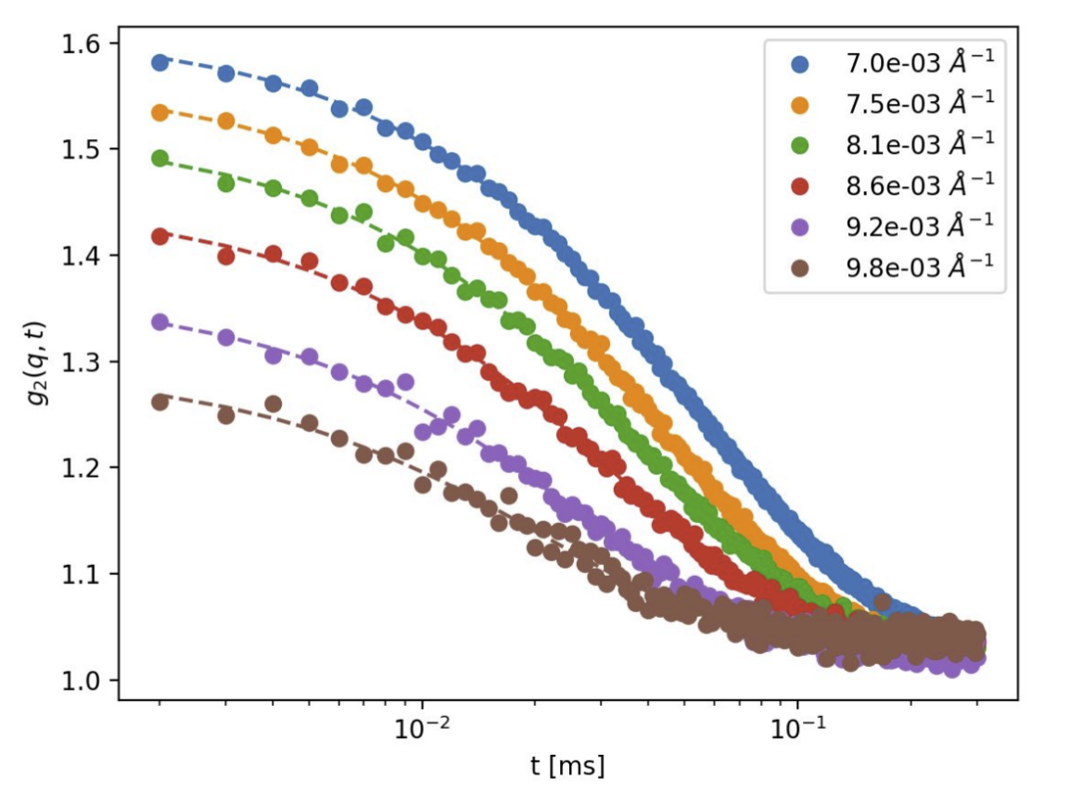
XPCS 100 nm Si particles in water
10 keV photon energy
80 nm focus size
1 us “frame time”
8x8 pixel binning
250 x 1s exposures
Fastest decay time 22 us
Plot courtesy Clemens Weninger (MaxIV)

Slide 30
DiamondII – diffraction limited source
Increase in brightness and consequently photon flux at the sample
Increase in the average photon energy
Plots courtesy Geetanjali Sharma (Insertion device group – Diamond)

Slide 31
CdTe sensors
^{Flat field image t = 0s}
Good detection efficiency but…
…limited sensor size and polarization effects.
Long run of 70 minutes without bias refresh

Slide 32
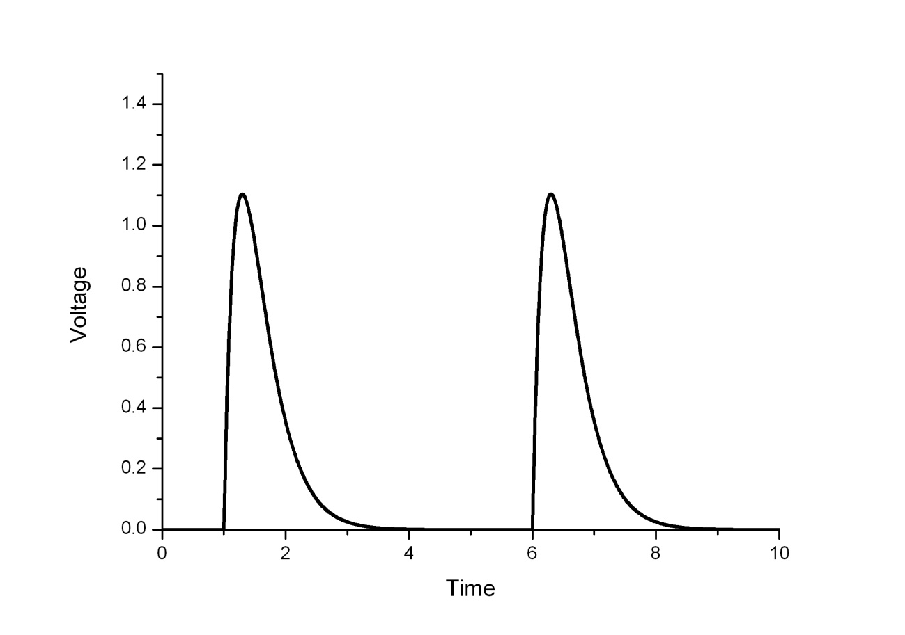
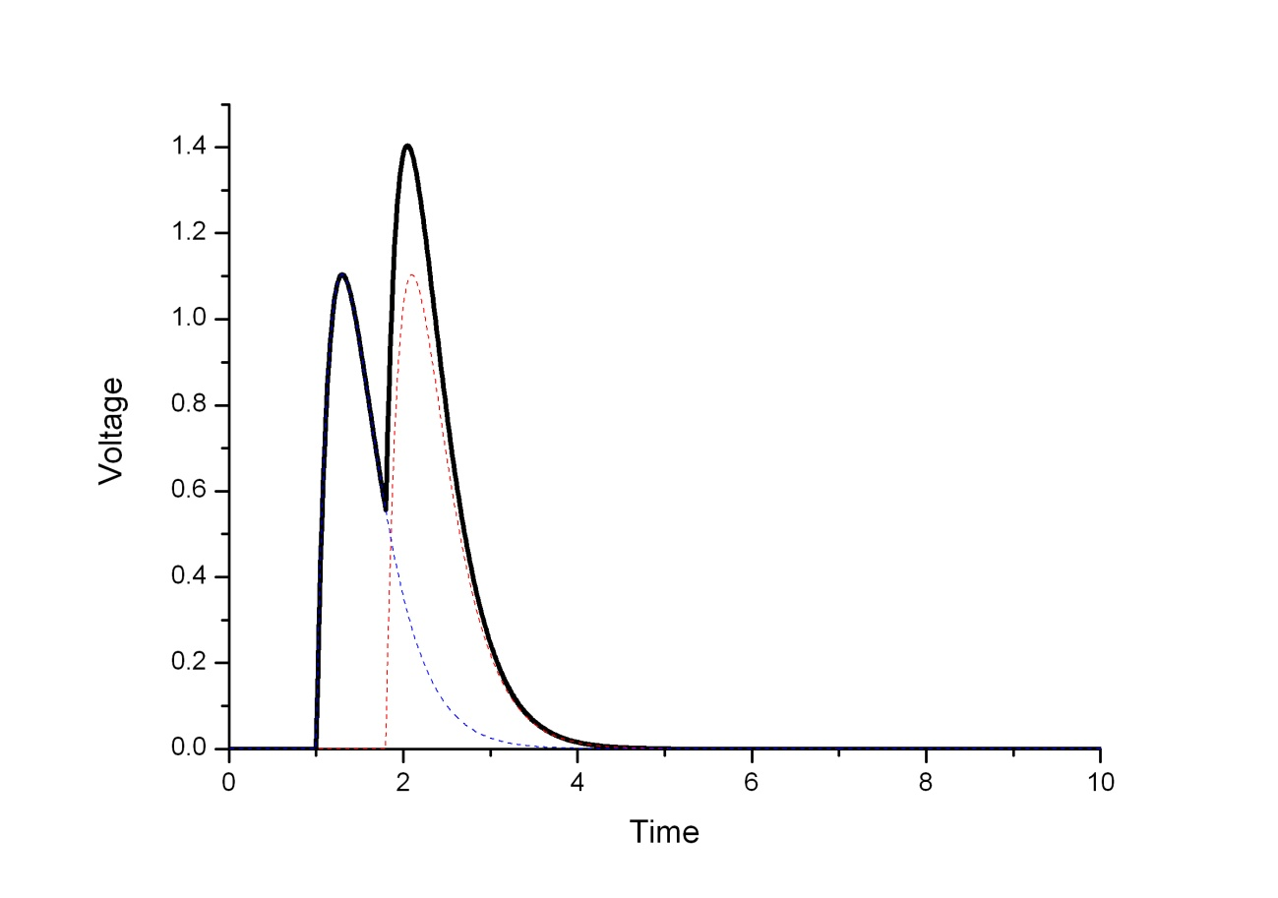
Pulses do not overlap:
Genuine counts
At very high photon flux the photon counting scheme becomes ineffective.
In order to count very high counting rate we need to go back to the integrating channel!
Pulses overlap: LOSS OF COUNTS!!!
Threshold level = 0.5
Reset switch
ANALOGUE BUS
Bonding pad
CSA
READ-OUT BUS
(data out)
ADC

Slide 33
Development of integrating hybrid pixel detectors at 4th generation sources
Facility | Detectors
EU-XFEL (DESY) | LPD, AGIPD, DSSC.
LCLS (SLAC) | ePix
Swiss XFEL (PSI) | Jungfrau

Slide 34
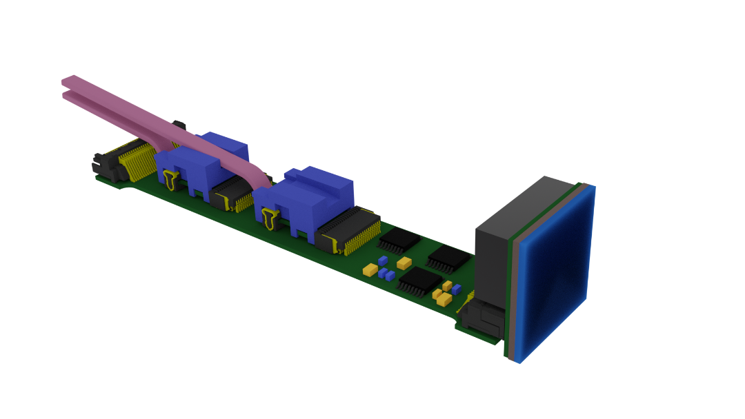

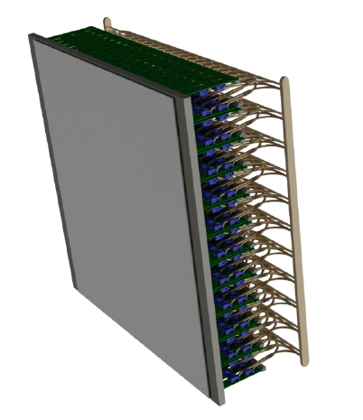

A new integrating detector for imaging
100 μm pixel pitch
200 × 200 pixels
0.5 MHz frame rate
HF-CdZnTe for high energies
Specification under discussion with DLS
A Single Dynamix Module
200 x 200 pixels
Data Rate: 240 Gbps
20 Giga Pixels Per Second
A 17M Dynamix System
4400 x 4000 pixels = 17.6M Pixels
Data Rate: 105 Tbps
8.8 Tera Pixels Per Second
Slide courtesy Matt Veale (STFC-RAL)

Slide 35
CONCLUSIONS
New detectors have been transformative for synchrotron research
Upgrade of 3rd generation sources will require still more performing detectors
Future detectors may be as transformative as the previous generations of detectors

