Slide 1

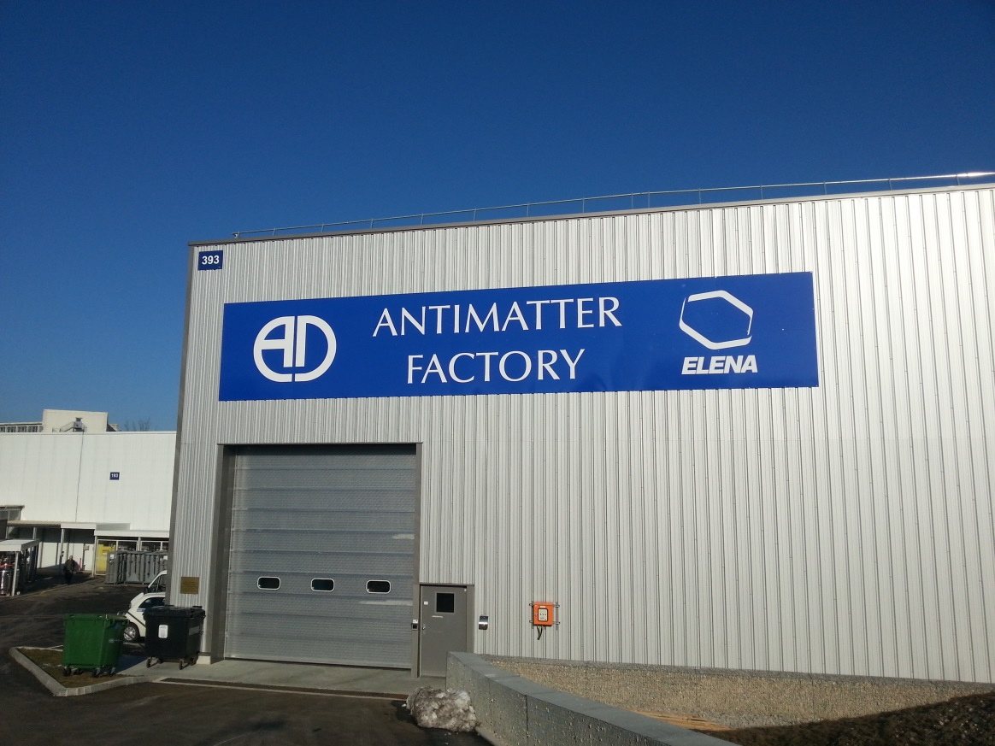

the AD electron cooler issues 2018
Lars V. Jørgensen
CERN, BE-BI-EA

Slide 2
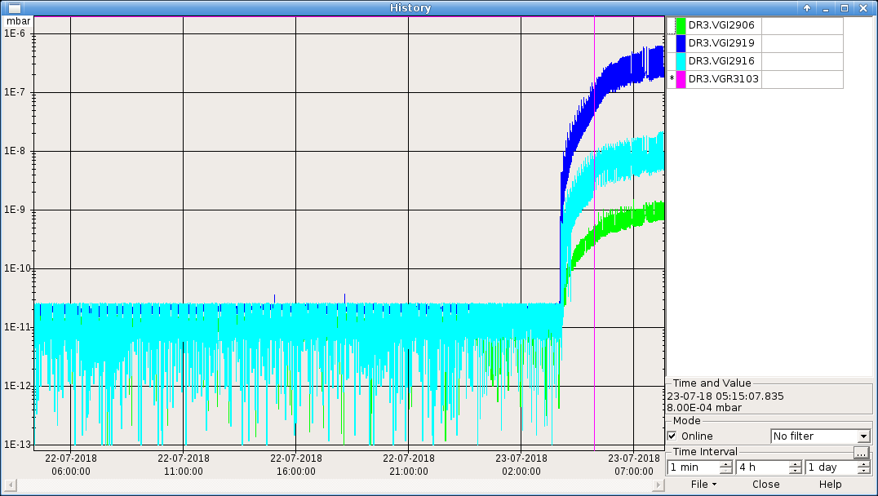
The AD electron cooler double failure
First failure:
Large vacuum leak in July from Collector water cooling circuit to vacuum.
  Started 23 July
  Fixed by switching collector to spare and bake-out of electron cooler section.
  Beam back 10 August
  Info: The spare collector was
  last used 12 years ago.

Slide 3
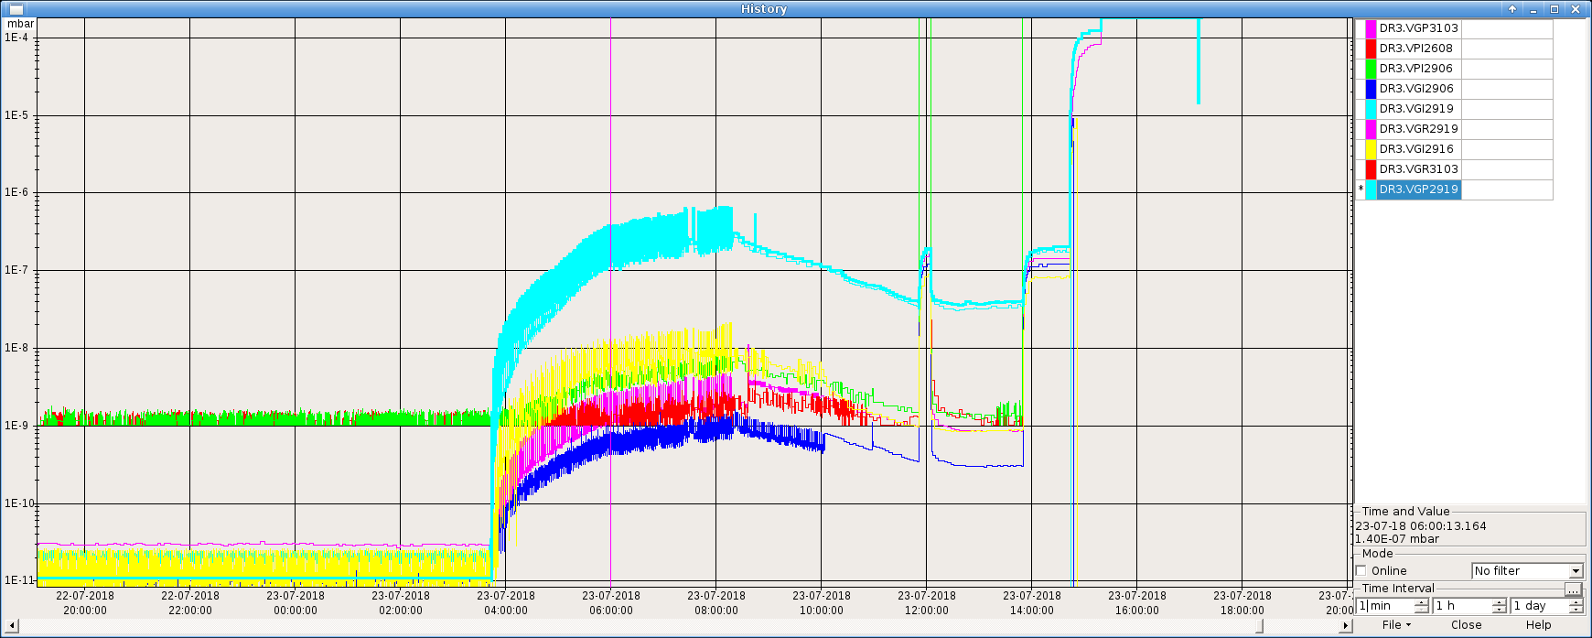
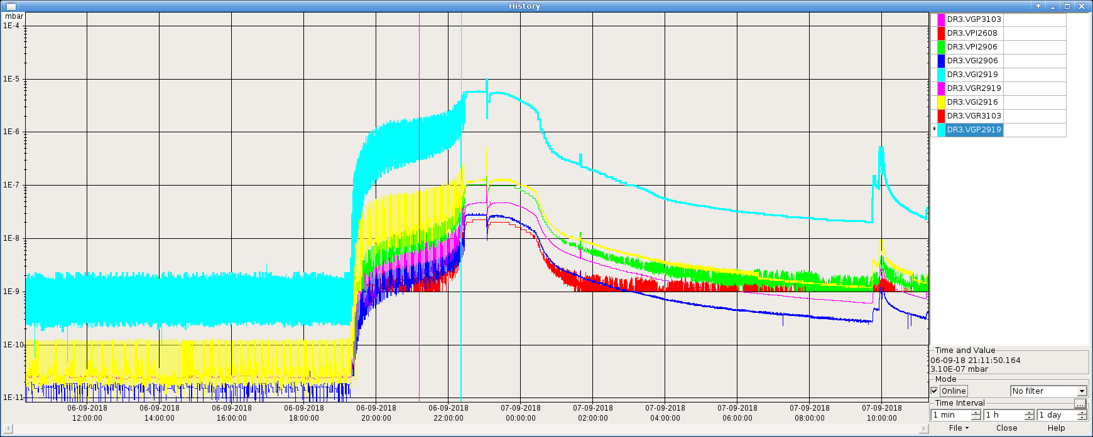
Second issue at AD-EC
Started Sept. 6
Problem in Collector water cooling system again.
Leak much smaller this time.
After pumping on the collector cooling system vacuum levels in the ring go back to normal.

Slide 4
Plan A, B and C
No more spares. The one taken off in the July incident was now sent to workshop for urgent repair, but as this would take time, changing back to it became Plan C.
This plan would take up to a month to implement.
Plan A: pumping on the collector back plate to keep it under vacuum.
Plan A failed with electron beam on due to sparking issues.
Decided to move to Plan B on Sept. 18

Slide 5
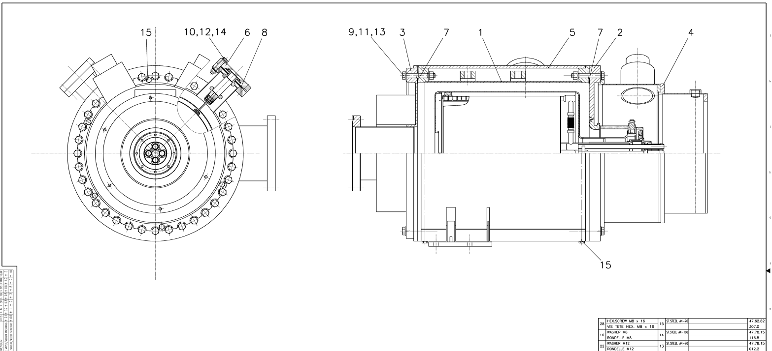
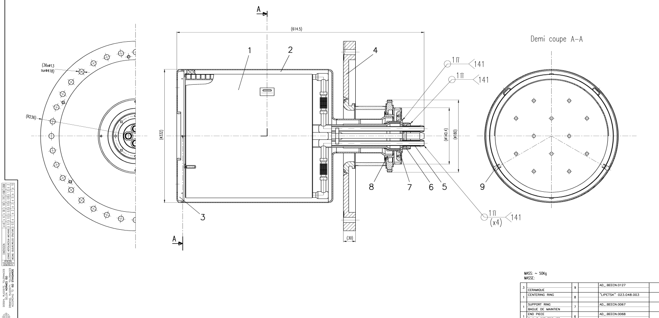
Collector design
End cover

Slide 6
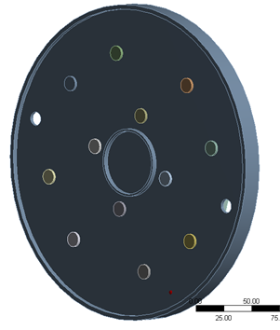
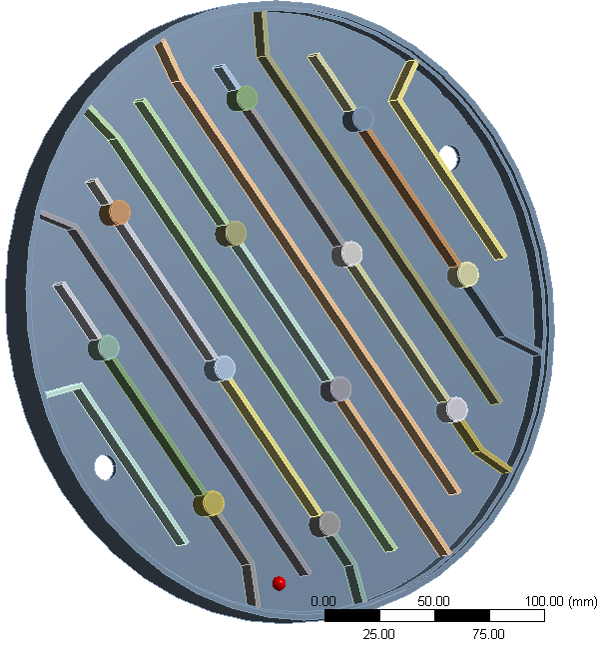
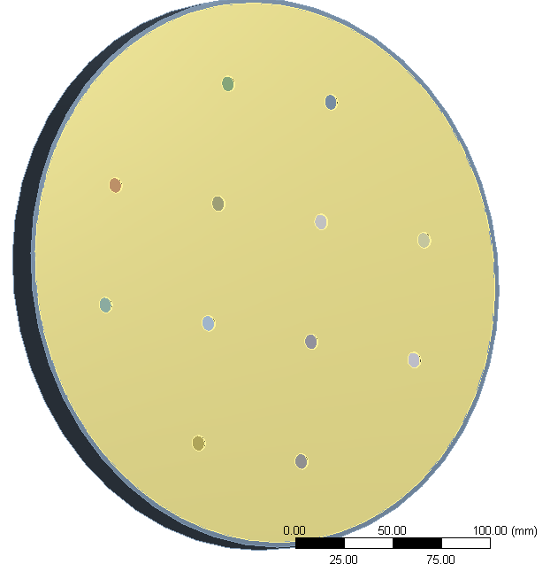
Collector design: end cover
Primary vacuum side
Back side
Two-walled cover, walls made of 316LN, welded circumferentially
Cover is water cooled, at a pressure of 3.2 bar
Cylindrical stiffeners added by electron welding to decrease stresses and deformations on the two walls

Slide 7
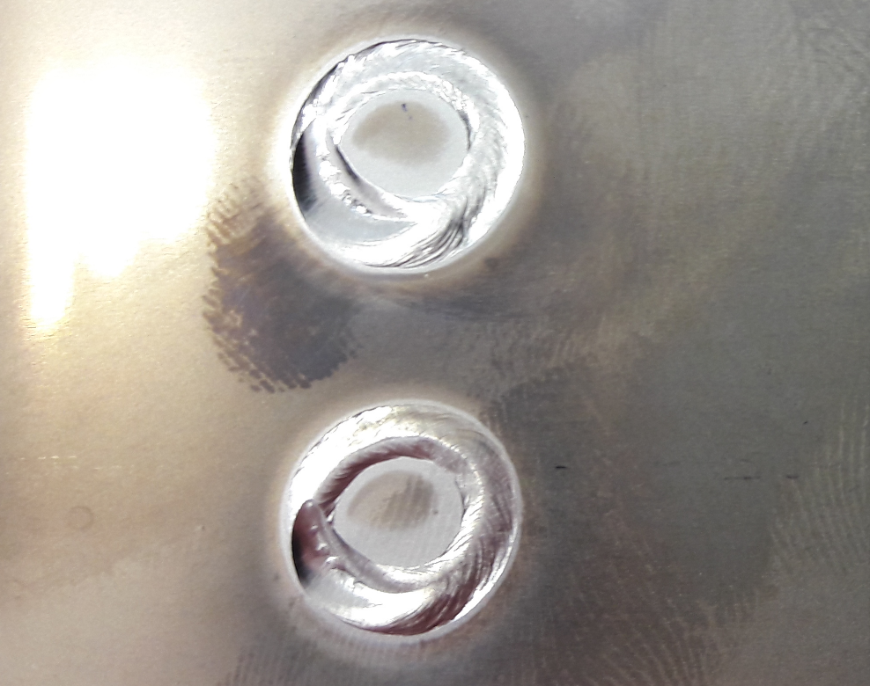
Weld repair

Slide 8
We go to Plan B
Plan B was to fix the leak by flushing the cooling circuit with a special epoxy resin and hope it closes the leak.
Plan B was executed 19 Sept and appeared to be a success as the vacuum seemed to recover.
However, the collector water cooling circuit had been contaminated – conductivity is about 2 uS/cm making it impossible to turn on the HV.
It should be below ~0.1 uS/cm
We purged the system and installed new cartridge and let it work overnight.
Thursday morning (20 Sept.) conductivity is 1.5 uS/cm.

Slide 9
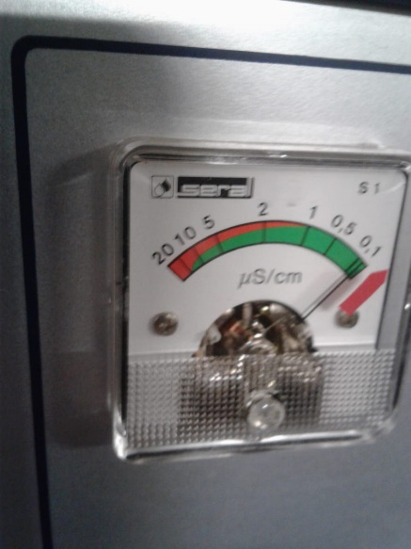
Plan B cont.
N. Roget informed us that the conductivity of primary AD cooling circuit is about 0.2 uS/cm
We decided to make multiple purges of the system to get the conductivity down.
Recently re-charged cartridge is installed after the purges.
Conductivity reduced to 0.1 uS/cm

Slide 10
Plan B cont.
With the new cartridge and the purged system, conductivity is now nominal.
We test with HV but no e-beam: All okay
Faraday cage had been grounded and transformer switched off at some point – this meant the filament was off as well!
With electron beam back on the vacuum gets worse.
We still tried it and saw cooling at 300 MeV/c, but no beam survived at 100 MeV/c.
More beam survived without electron beam than with.
Vacuum not good!
27 September we decided to go to Plan C.

Slide 11
Plan C!
Meanwhile the collector taken off in July had been sent to the workshop for urgent repairs in case Plan A and B would not be successful.
Leak was located and repaired at workshop.
Collector repaired and vacuum tested; ready ~21 sept.
Decision to implement Plan C taken on 27 Sept.
Magnets removed for exchange and bake-out!
Collectors exchanged 28 Sept.

Slide 12
Plan C cont.
Pump down over the weekend.
Bake-out started Monday 1 Oct.
Bake-out finished Friday Oct. 5
Cool down over the weekend.
Magnet re-mount Monday Oct. 8.
Monday afternoon: HV without e-beam – current leaked at 25 kV!
Covers off gun and collector – HV 28 kV okay

Slide 13
Plan C cont.
Tuesday 9 Oct. – Filament on
Cathode on – Vacuum gets worse!!!
Slowly increase cathode voltage with no beam: Electric breakdown at 12 kV - leak current!
No sparking was detected.
Water conductivity tested – all okay.
Vacuum seemed to increase more in Gun end than in Collector end.
Filament off.

Slide 14
The solution!
We try to disconnect HV cables from the collector to pin down where the problem is.
With cables hanging free in air HV on gun and collector all okay.
We re-connect. HV now okay!
Wednesday Oct. 10 –filament on – all okay
Thursday – slowly increasing electron beam with cathode HV.
Reached nominal 28 kV ~ 18h Thursday Oct. 11
Start cycling.
19h30 Okay to open valves.

Slide 15
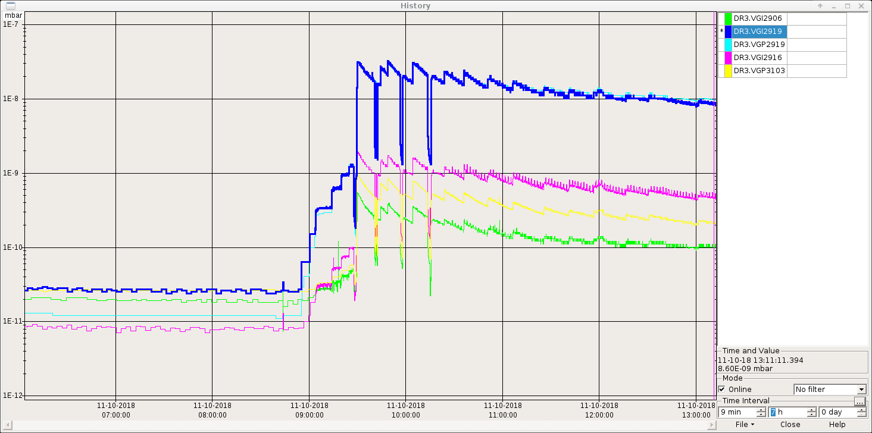

Slide 16
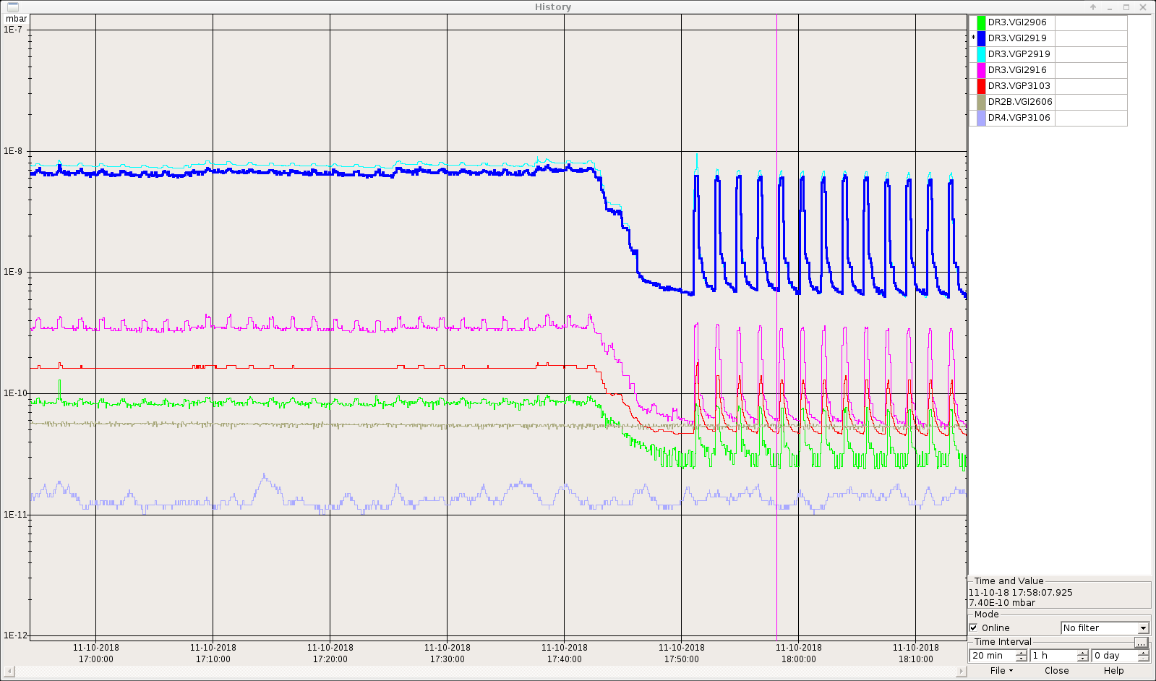
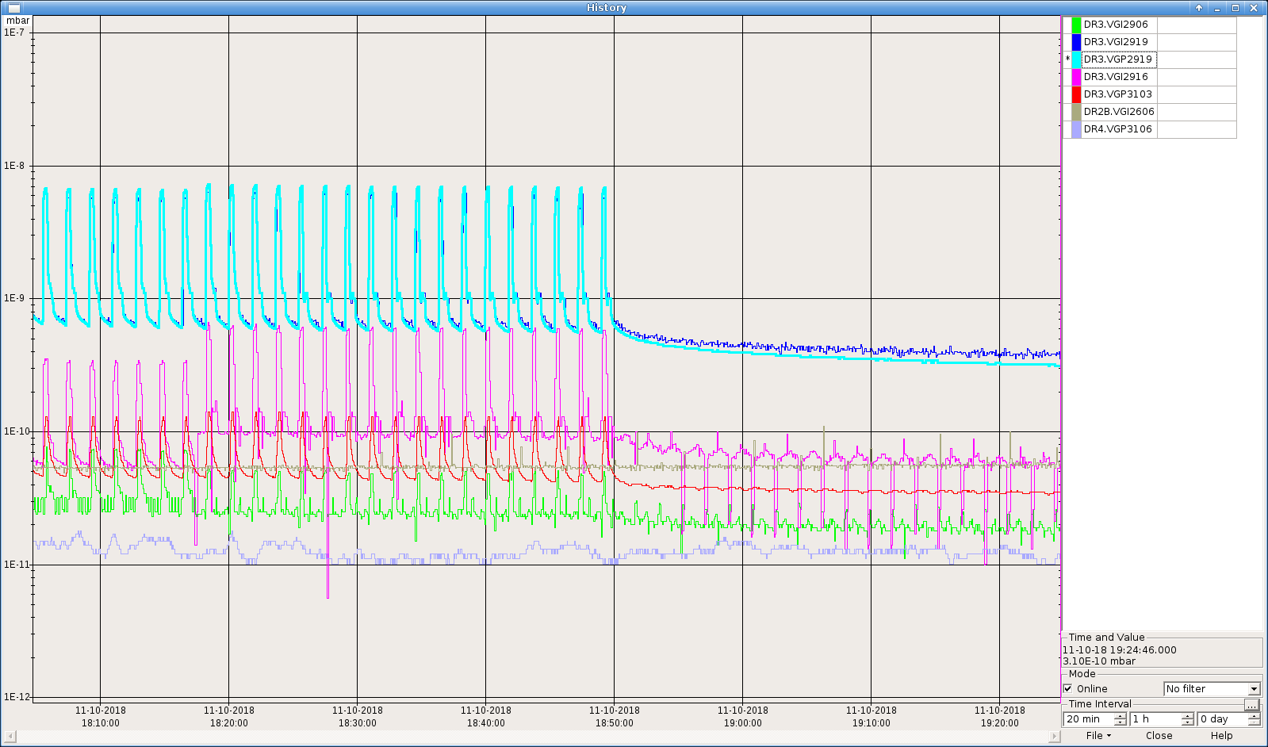
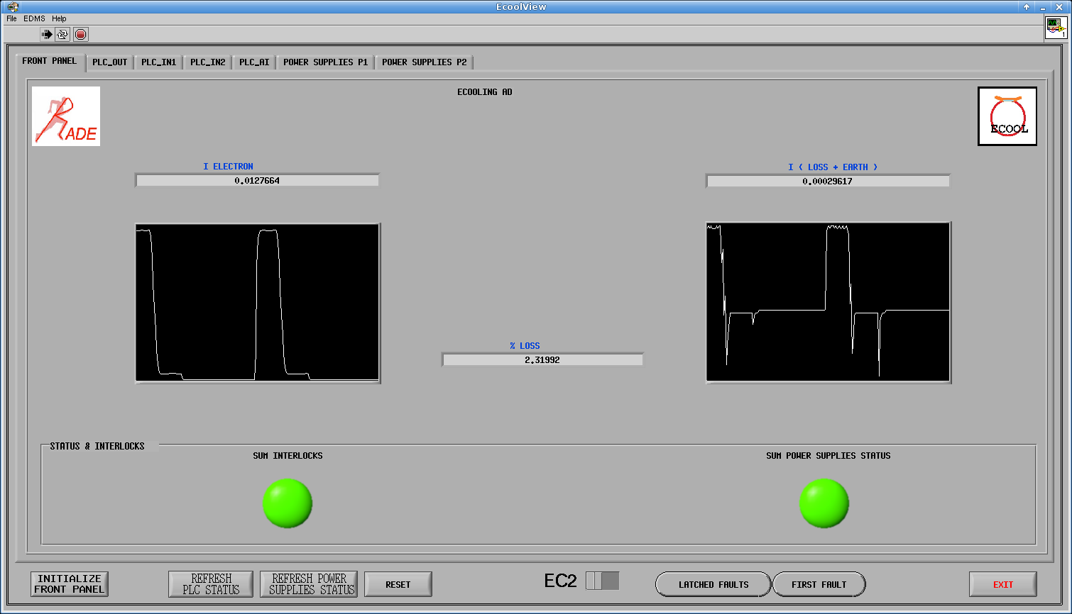

Slide 17
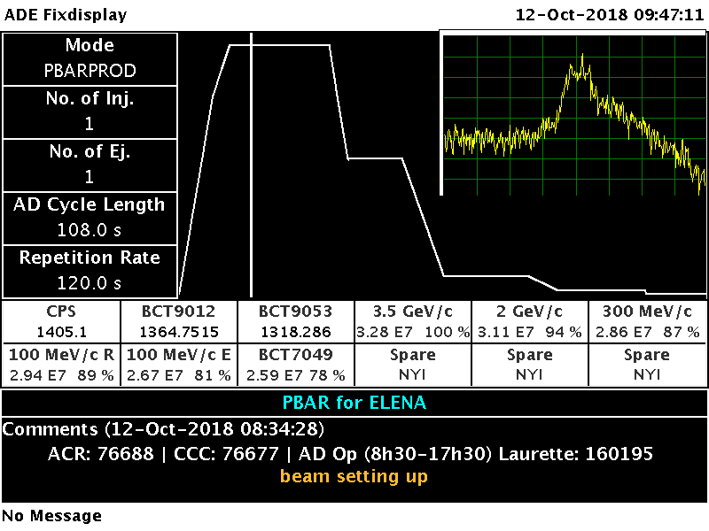
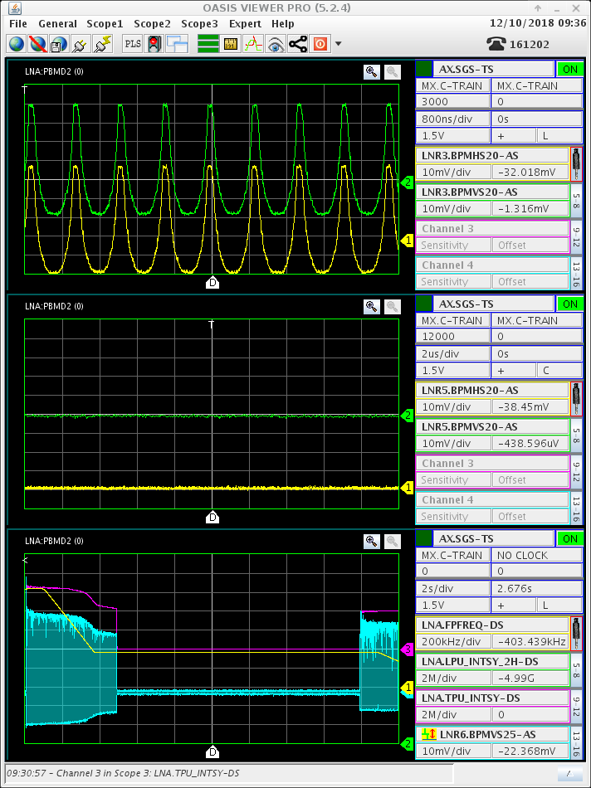
Beam back in AD!
…and 12 Oct beam back in AD and also in ELENA!

Slide 18
Reminder: Plan D !!
We now have no spare collector!
The design of the current two collectors clearly have a weak point between the water cooling system and vacuum, so design work has been commenced on a new collector that will be manufactured and installed during LS2 (to coincide with the filament replacement – i.e. one bake-out only)
The new collector design should be compatible with both the old AD ecooler and the new ecooler under design!

Slide 19
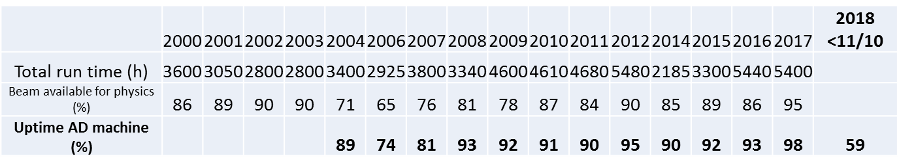
A bit of statistics

