Slide 1
AD collector: repairs in 2018 and mechanical considerations
F. Carra on behalf of EN-MME
AD Electron Cooler Consolidation Review
26/03/2019

Slide 2
Outline
Introduction
Collector design
Weld repair
Mechanical considerations
Conclusions

Slide 3
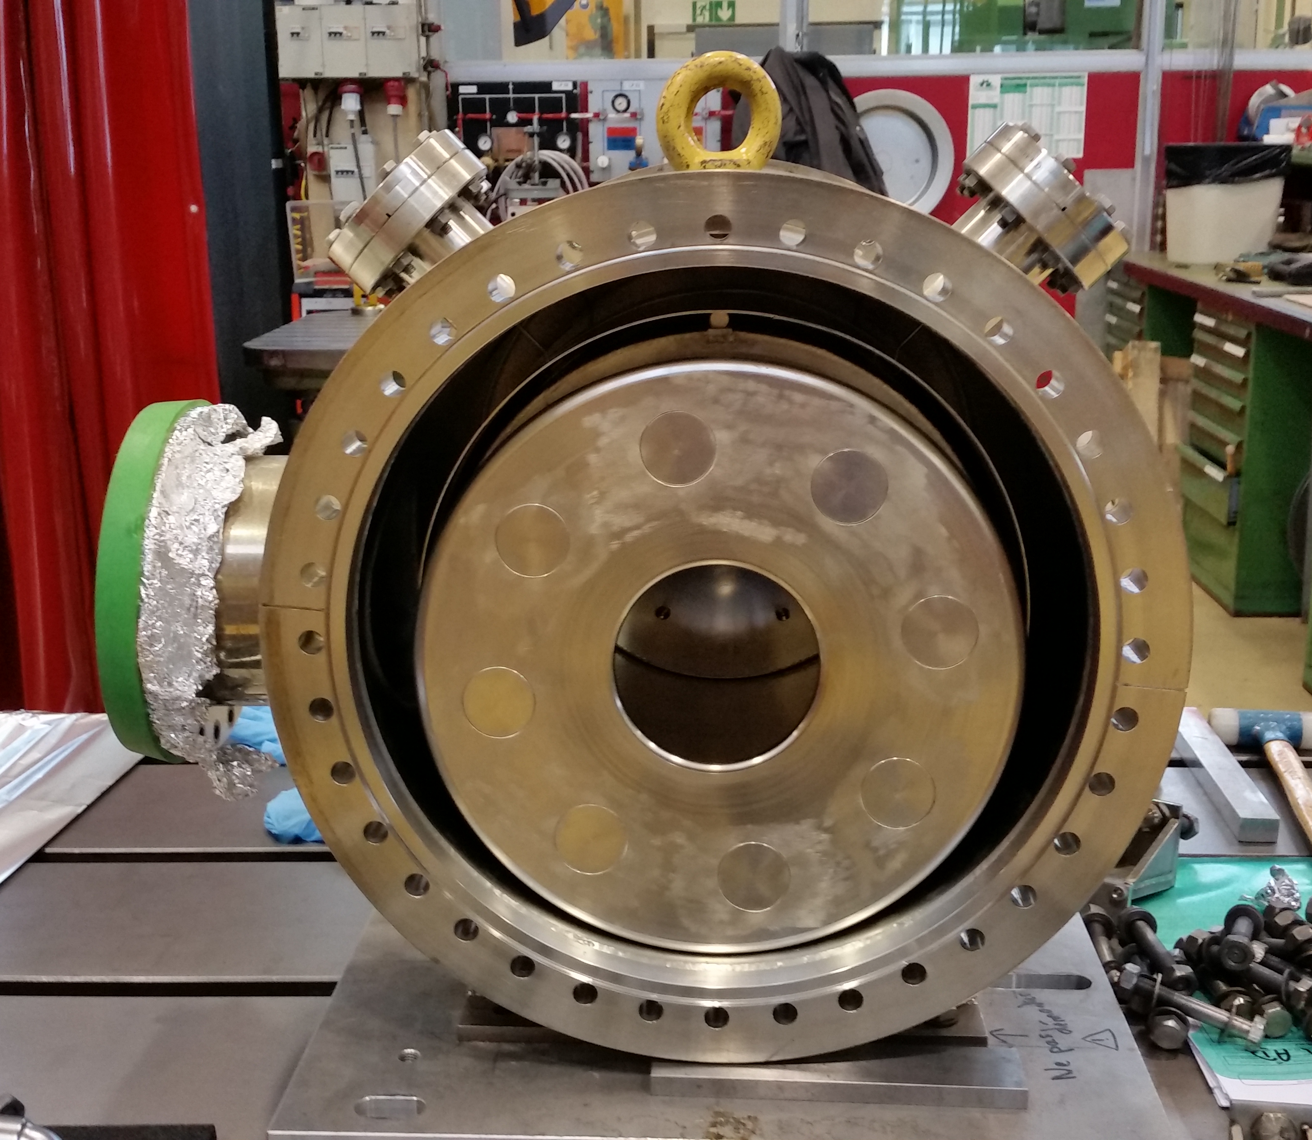
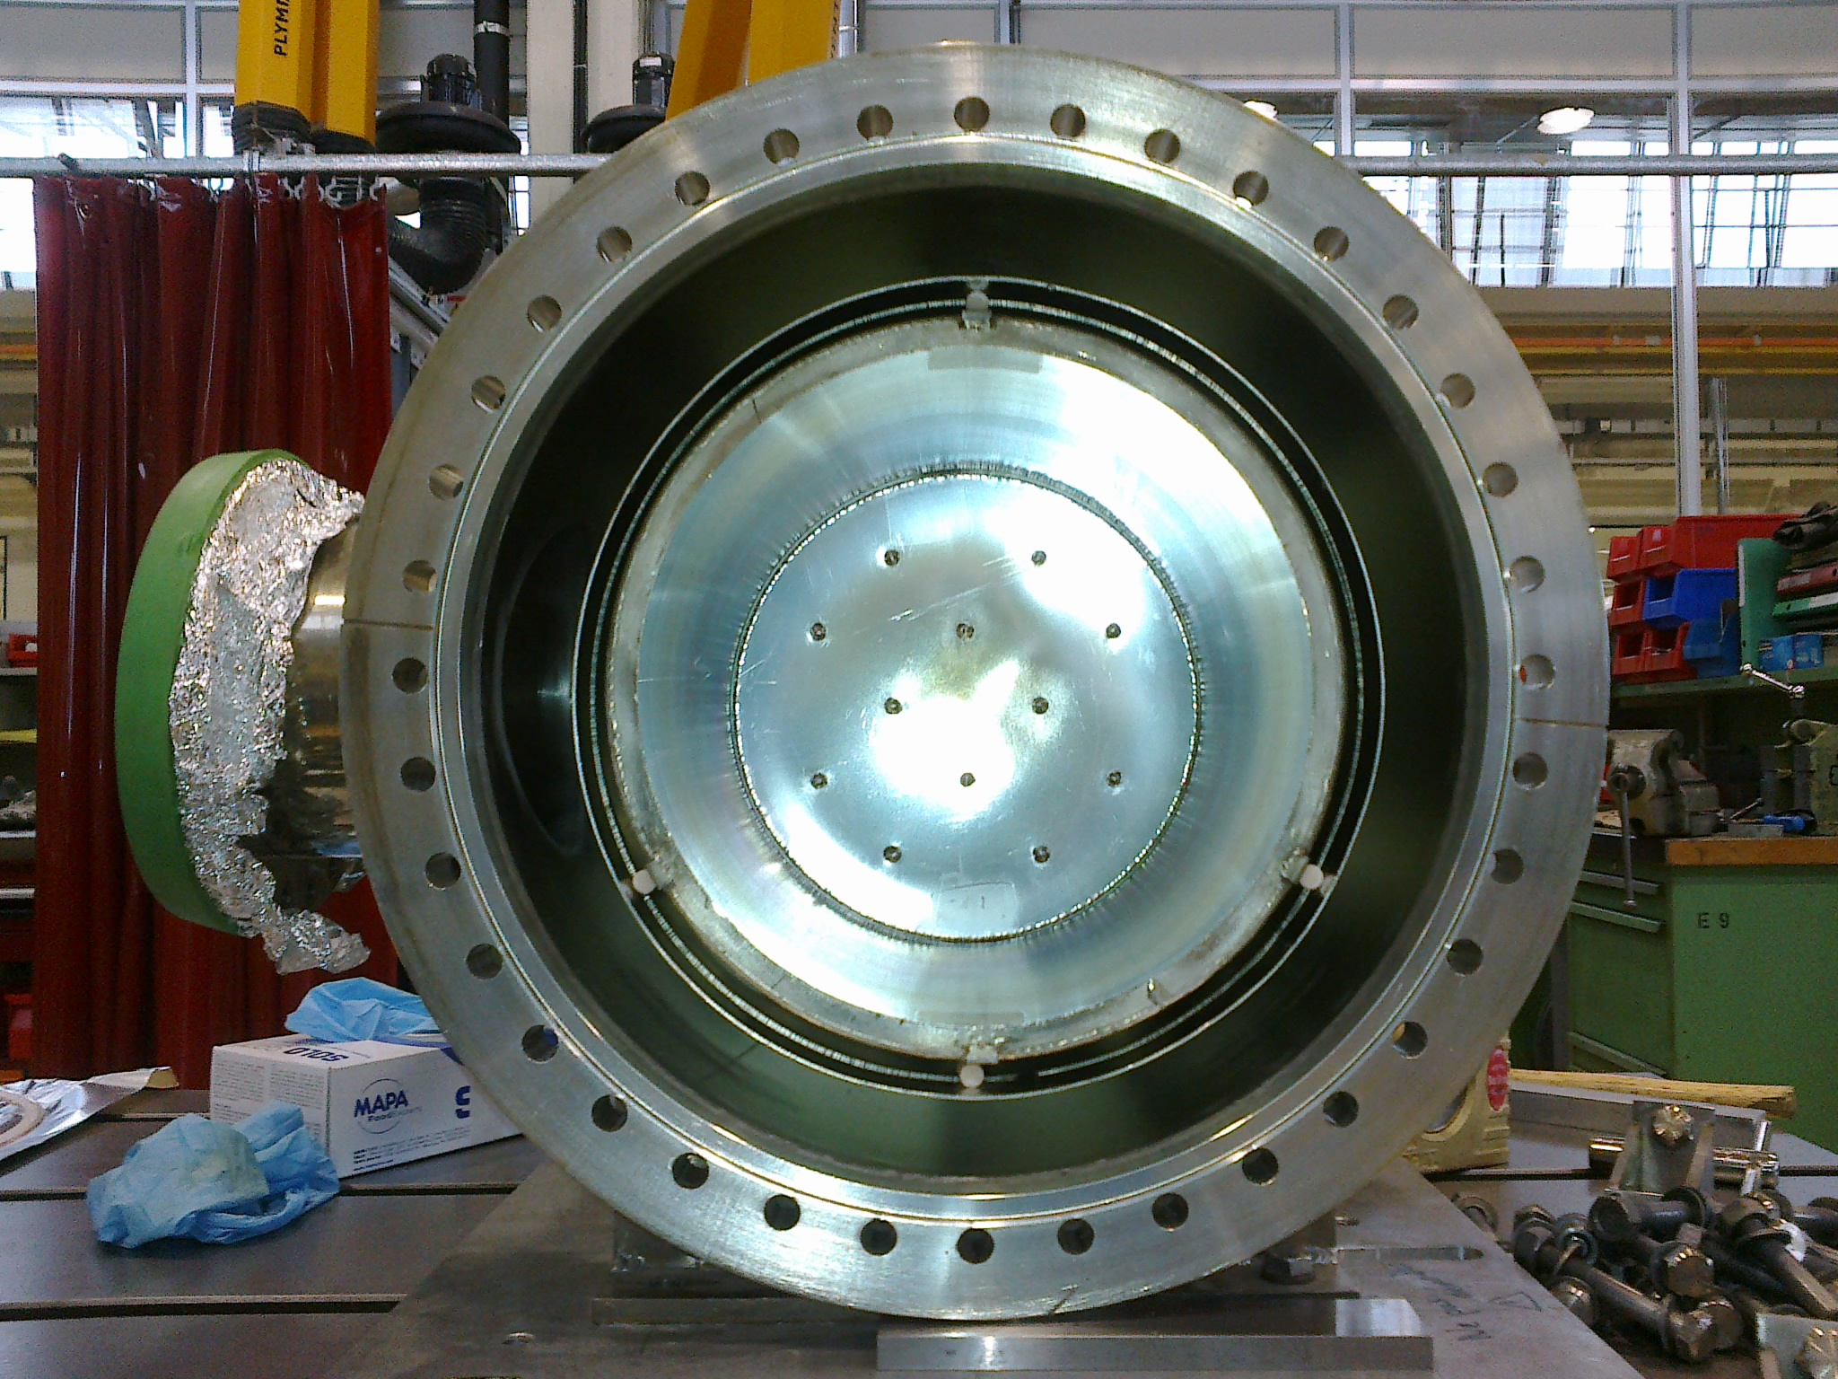
Introduction
23rd July 2018: water leak to vacuum in the AD collector, replaced with a spare unit
6th September 2018: same issue to the spare collector.
21st September 2018: original unit repaired at the EN-MME workshop and made available to BE-BI
28th September: leaking spare unit replaced with repaired original collector
Courtesy of J. Cenede

Slide 4
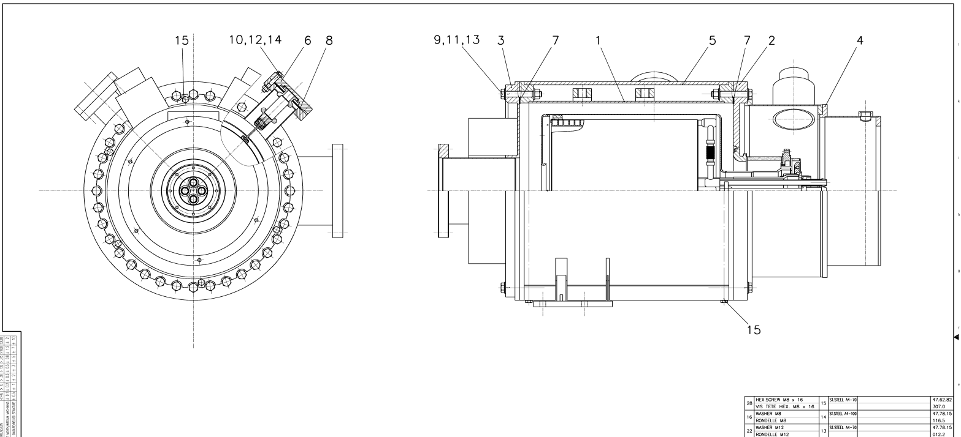
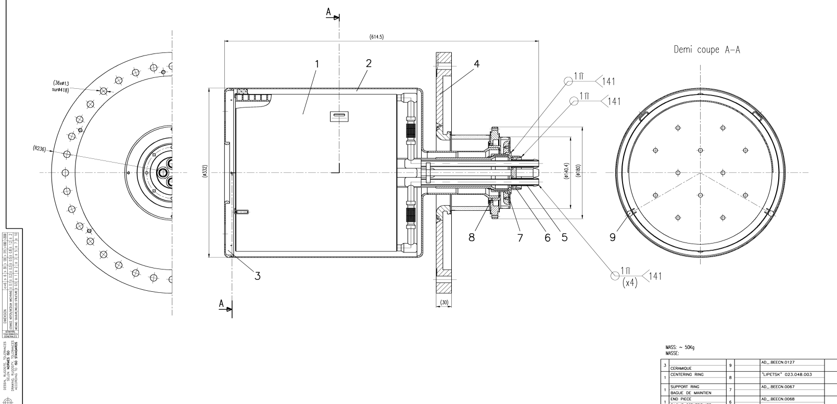
Collector design
End cover

Slide 5
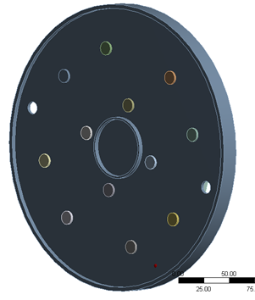
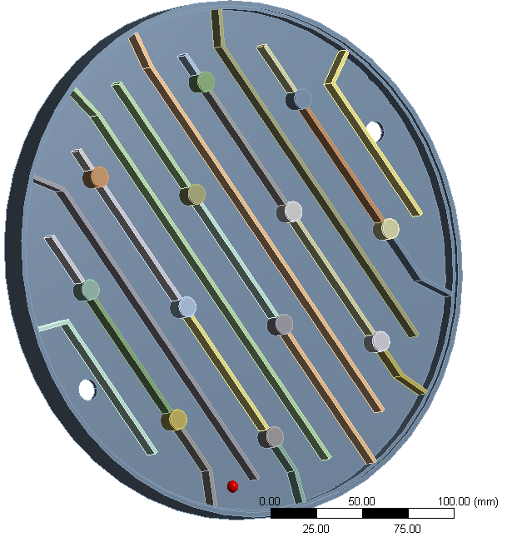
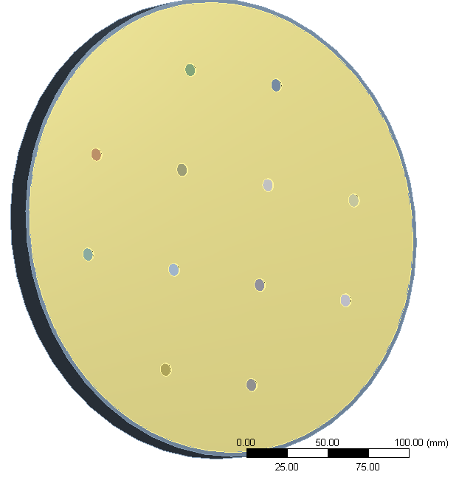
Collector design: end cover
Downstream side
Upstream side
Two-walled cover, walls made of 316LN, welded circumferentially (upstream side: impacted by the electrons; downstream side: not impacted by the electrons)
Cover is water cooled, at a pressure of 3.2 bar
Cylindrical stiffeners added to decrease stresses and deformations on the two walls
Stiffeners are EB-welded to the two sides of the cover (12 welds per side)
Material of the stiffeners could not be determined with certainty (austenitic stainless steel, but which one?)

Slide 6
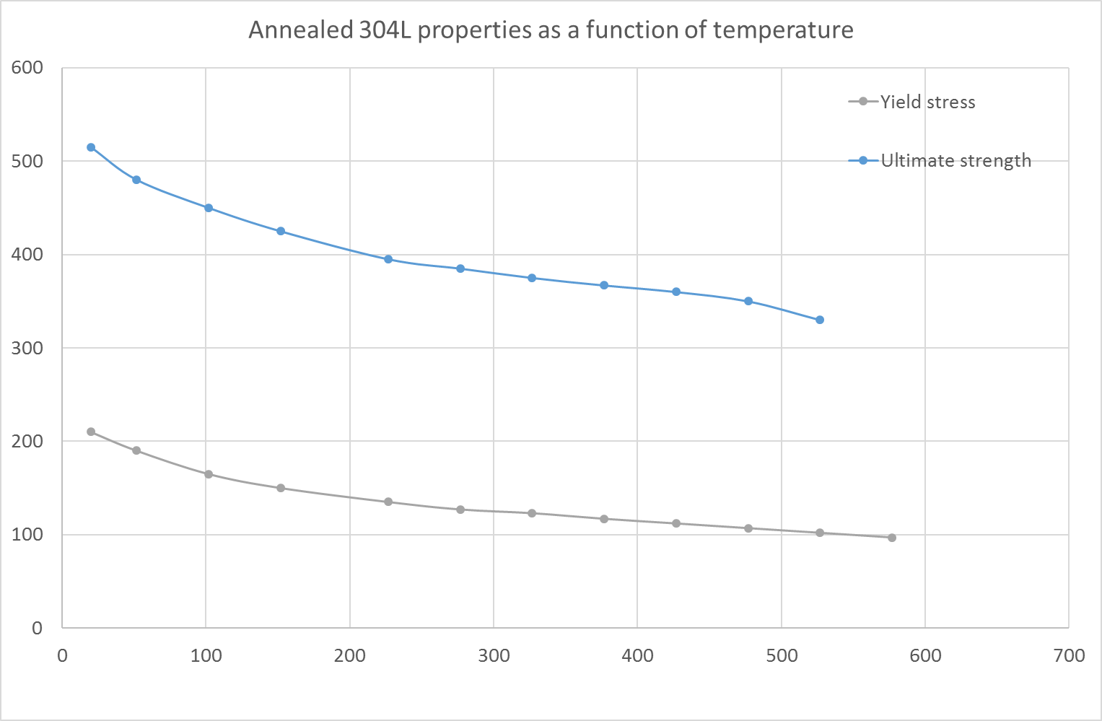
Mechanical considerations: finite elements model
Analysis were performed in the EN-MME unit to estimate the stress levels in the welds
Given the uncertainties in the materials, calculations were performed both for 304L and 316LN
Only the stresses arising from the water pressure were evaluated (no residual stresses from welding, no electron-induced stresses)
Operating temperature not known: material properties assumed at room temperature (no significant effect expected on elastic constants, but may be relevant for yield stress)
Material | Young’s Modulus E [GPa] | Poisson’s ratio v [-] | Yield Strength σ_{y} [MPa] | Ultimate Strength σ_{R} [MPa]
316LN v.p. | 200 | 0.3 | 300 | 600
304L v.p. | 200 | 0.3 | 220 | 520

Slide 7
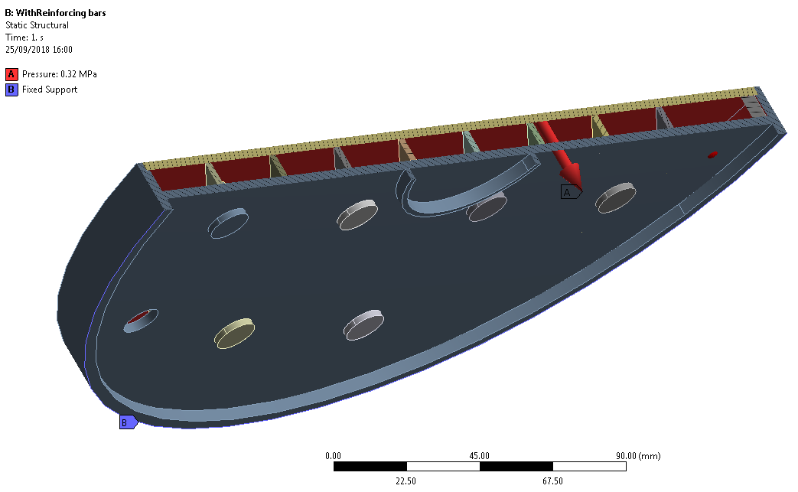
Mechanical considerations: finite elements model
Weld penetration assumed: 1.5 mm (original welds)
3.2 bar water pressure

Slide 8
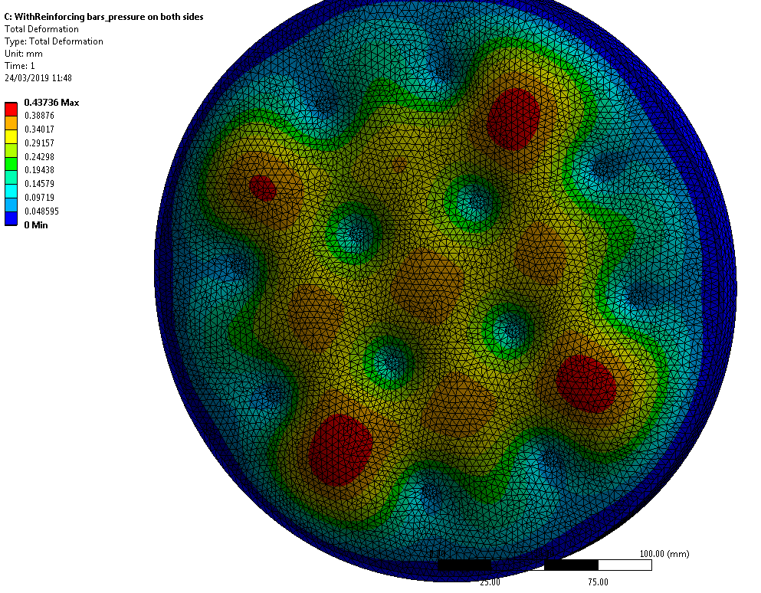
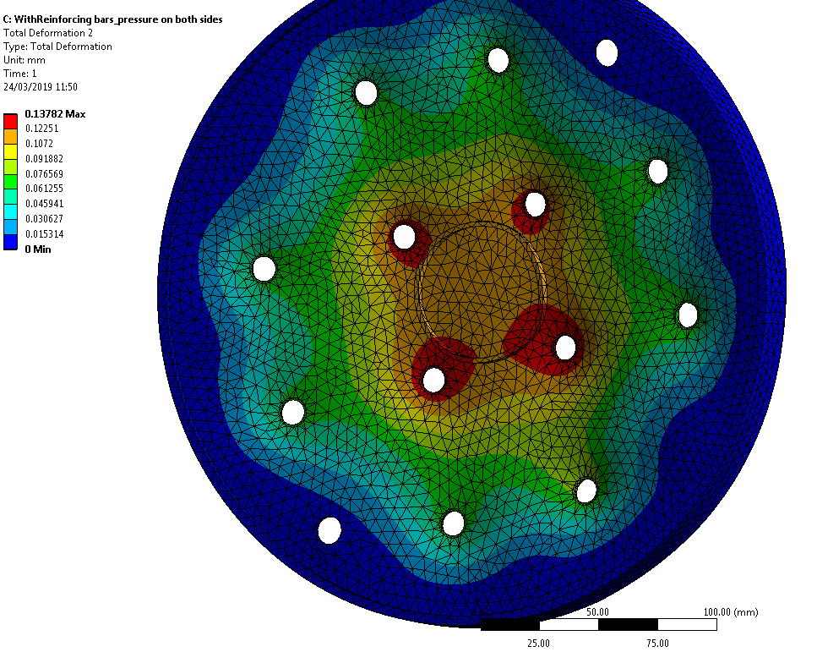
Mechanical considerations: finite elements results
Cover deformation in the order of 0.5 mm

Slide 9
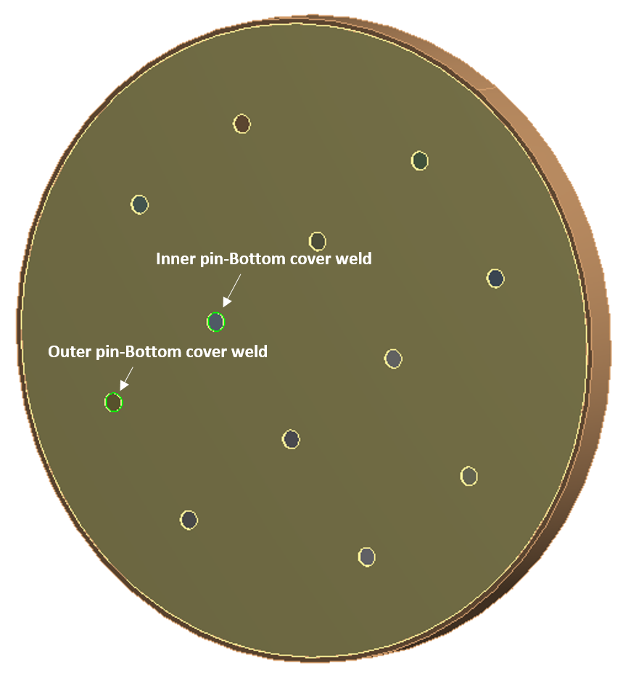
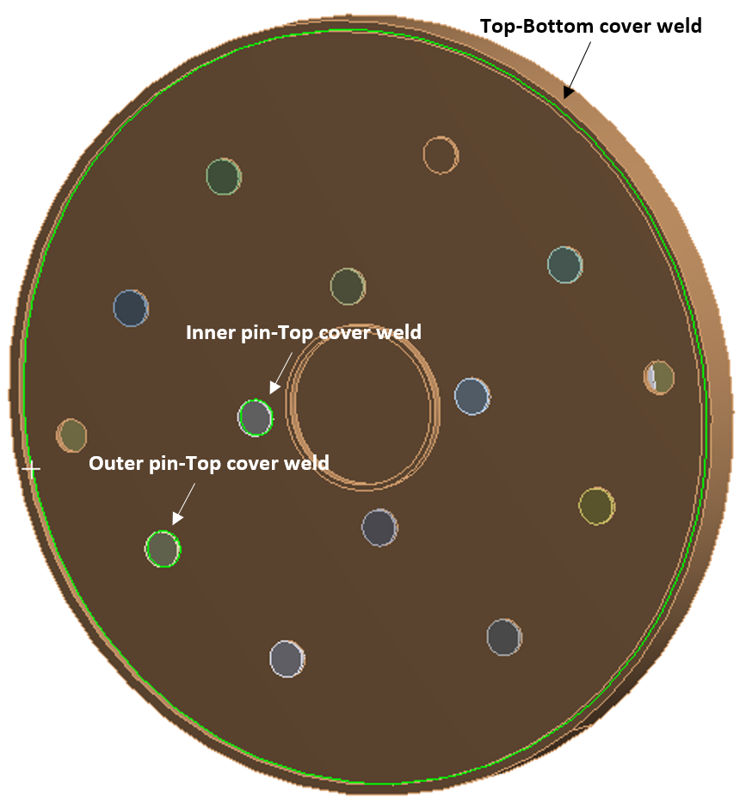
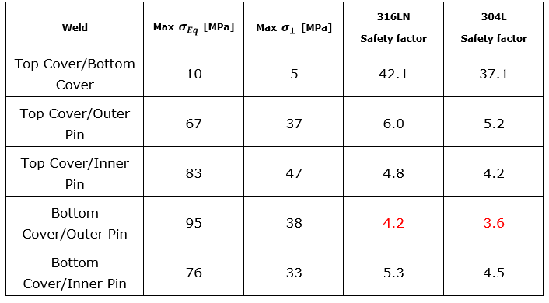
Mechanical considerations: finite elements results
Safety factors on stiffener welds not very reassuring, considering that only water pressure is taken into account and room temperature properties considered…
Comparable stresses on both cover sides and on all stiffeners
Lowest safety factor is found at the position where the leak developed

Slide 10
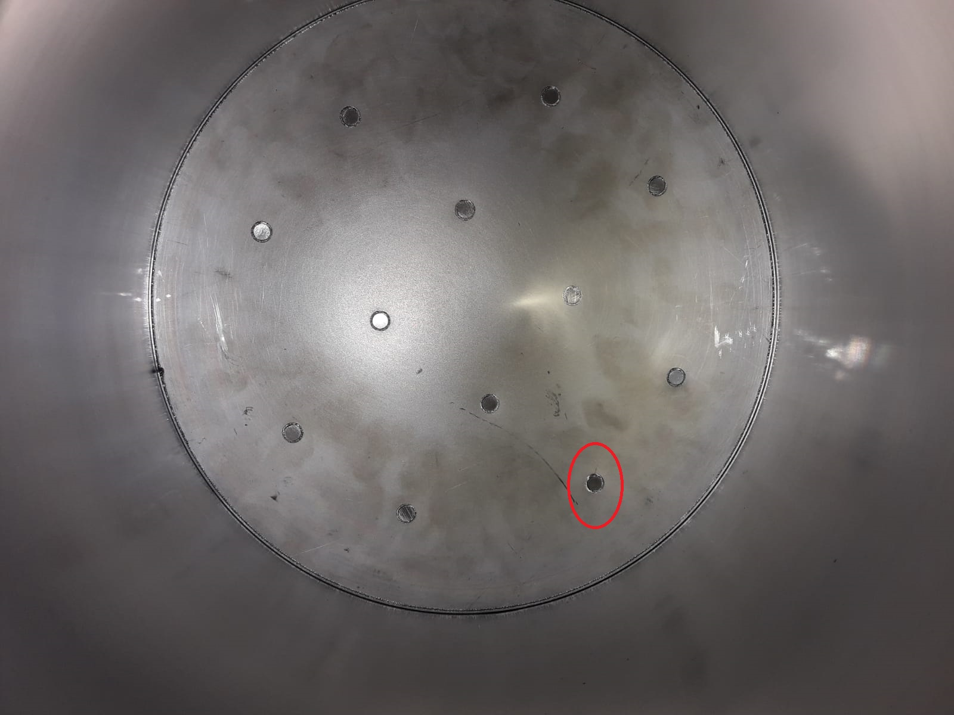
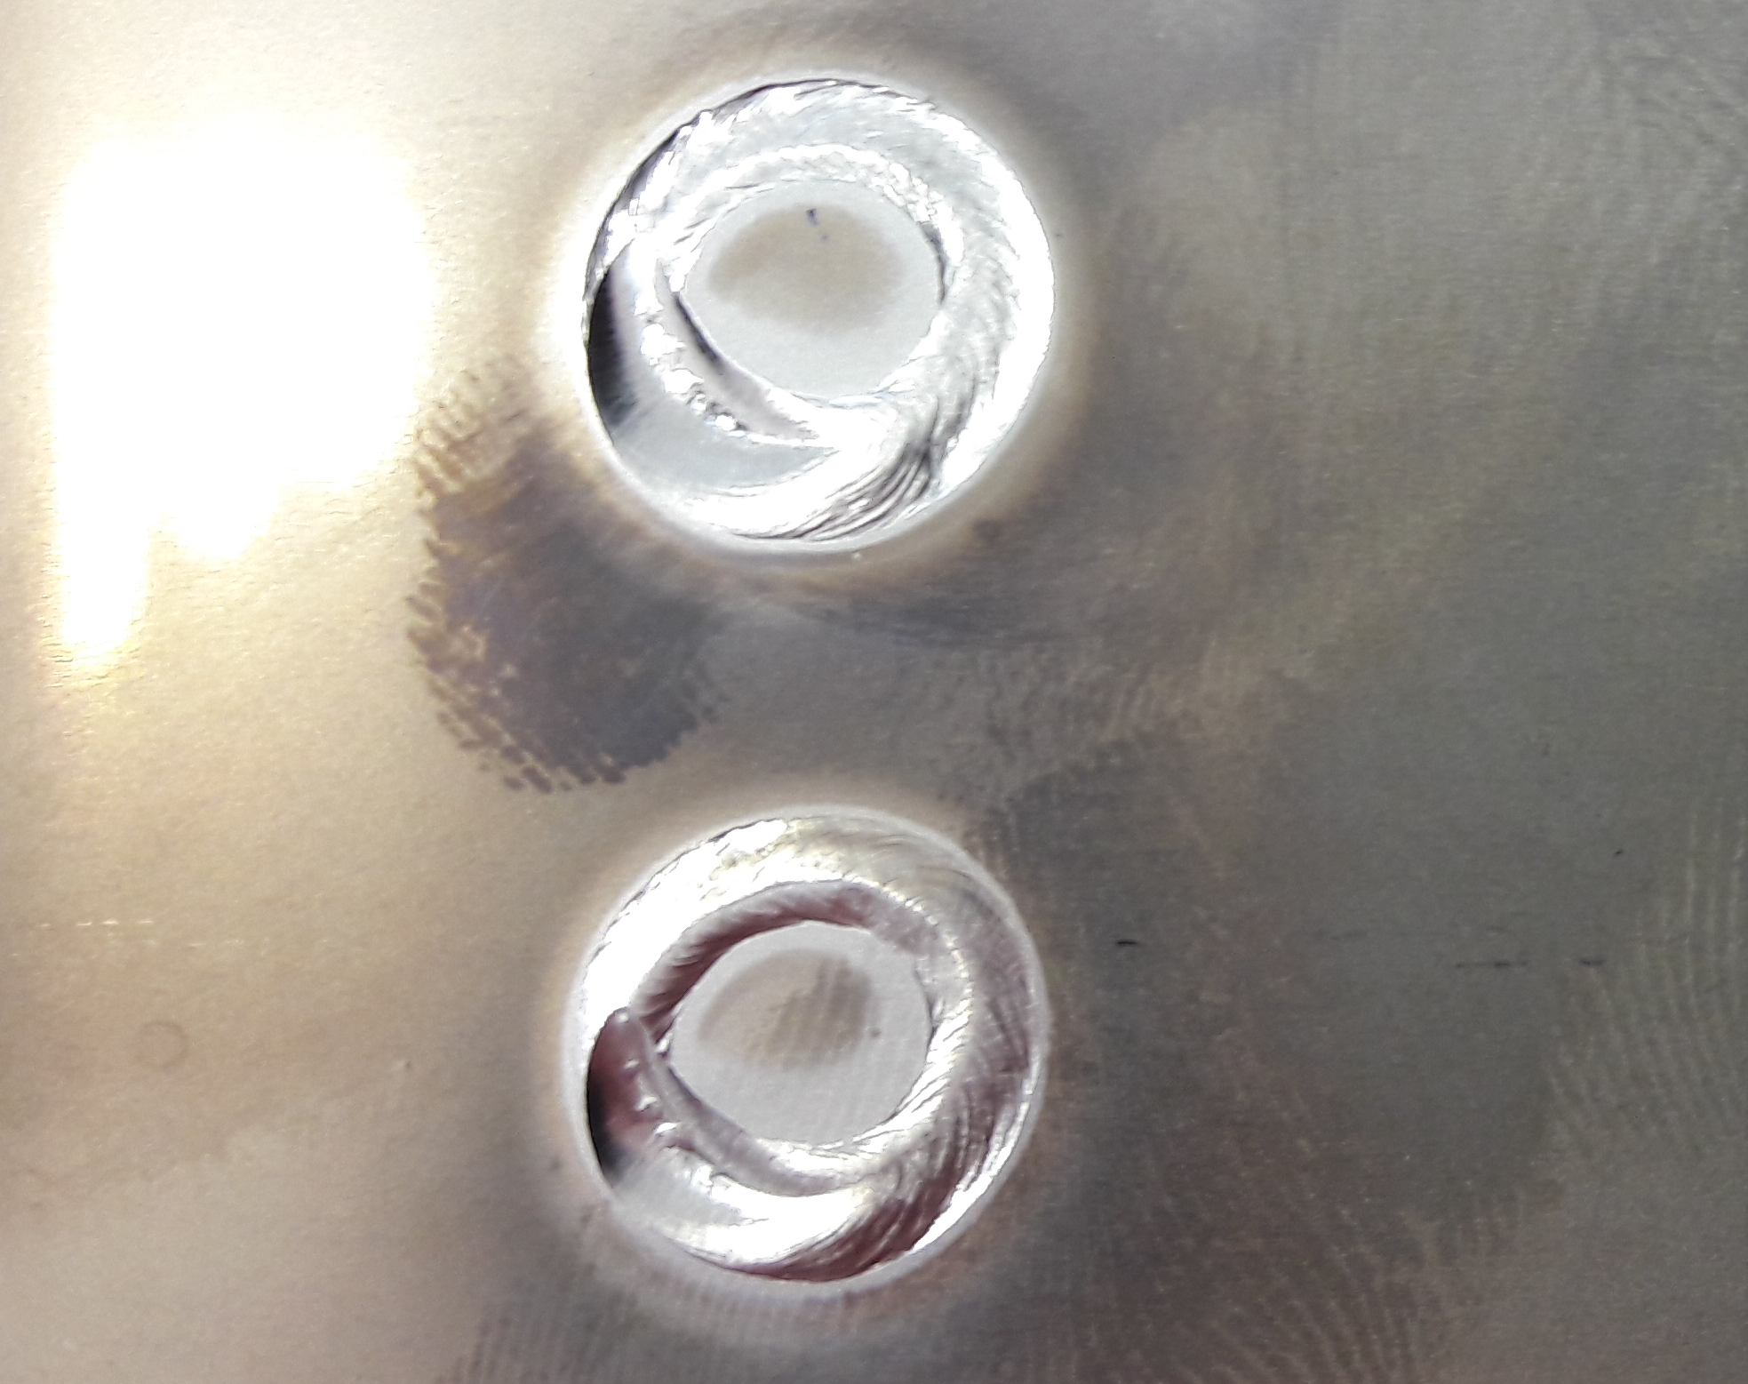
Weld repair
Leak test performed at the main workshop to identify the leaking weld
Welding parameters from the original piece were not available
New procedure developed at the workshop, with tests on samples to optimize the welding parameters
Courtesy of M. Redondas
Leaking weld
Welding tests on samples

Slide 11
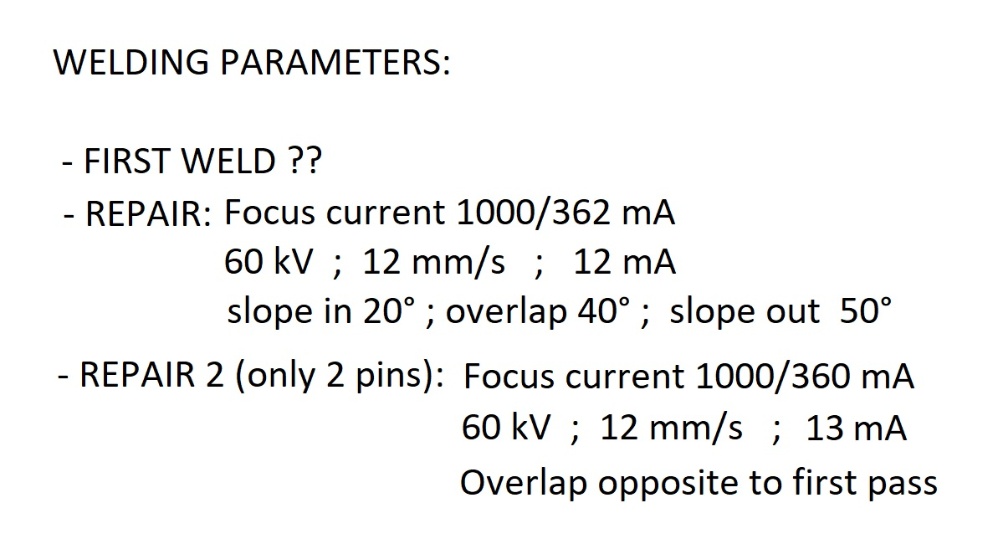
Weld repair
Decision to repair all the stiffeners/cover welds on the accessible side
Weld repair duration: 1 day (in total ~1 working week for disassembling, leak detection, welding, reassembling).
Weld penetration depth: 2.5 mm (the old one was 1.5 mm)
Electron beam welding parameters:
Courtesy of M. Redondas

Slide 12
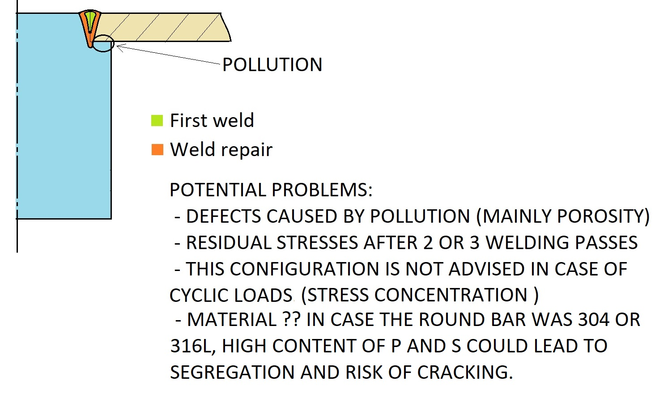
Weld repair: caveat
Courtesy of M. Redondas
Additionally: not a standard butt weld, presenting potential risks of corrosion from cooling water in the interstice
Only the accessible side of the cover was repaired! But: non negligible stresses also on the other side…
Several welds!

Slide 13
Conclusions
In September 2018, the leaking collector was repaired in the main workshop at EN-MME
The leak was detected at the weld between one of the 12 stiffeners and the side of the cover impacted by the electrons
To prepare for the repairing, two actions in parallel at EN-MME:
  Weld tests on samples at the workshop to determine the best welding parameters
  Mechanical calculations to determine the stress levels on the pin welds
The distribution of stresses is similar on several pins → it was decided to repair all the welds on the accessible side of the cover
Non negligible stress state on the welds and high number of welds between water and vacuum (25 in total for the cover) → design weak point, to be addressed in future design of the collector (e.g. take inspiration from the e-lens collector)
This weak point is not easily removable in the 2nd existing spare collector (which also developed a leak in September 2018)

Slide 14
Thanks for your attention

Slide 15
Backup slides

Slide 16
Snapshots HEL collector

Slide 17
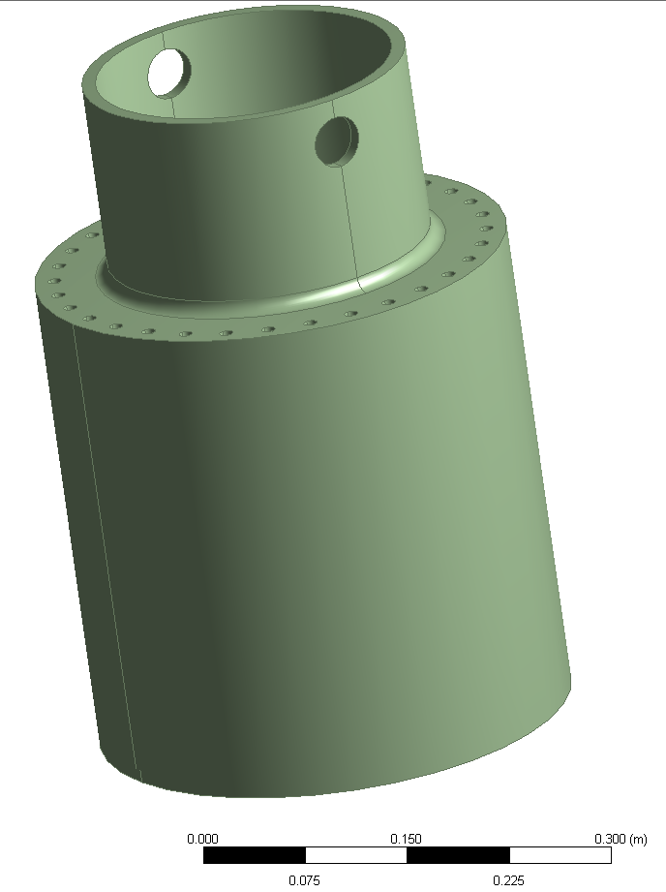
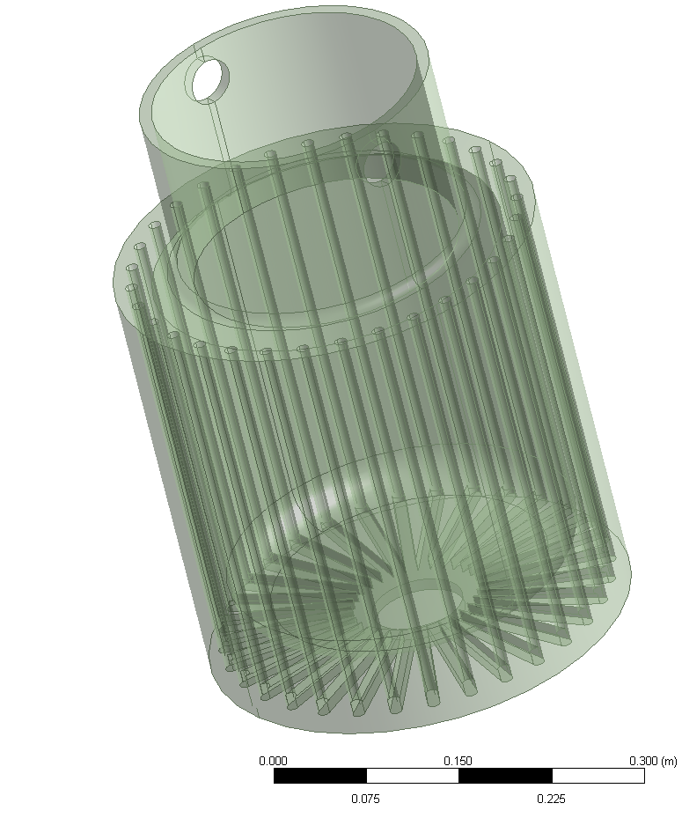
Snapshots HEL collector
Courtesy of G. Gobbi

Slide 18
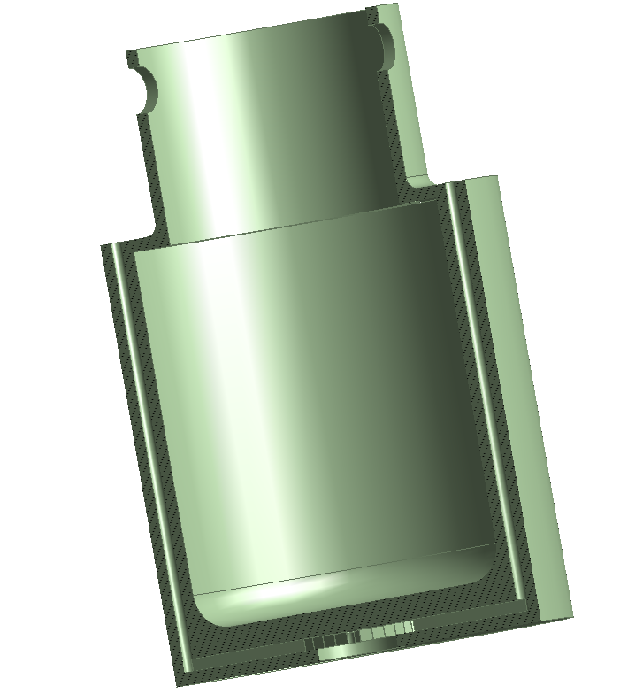
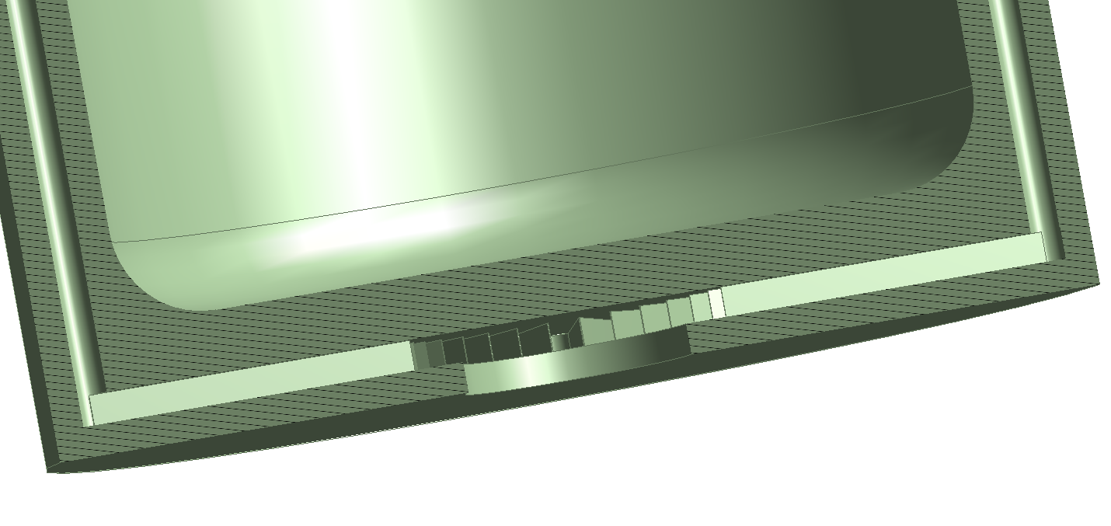
Snapshots HEL collector
20 mm
10 mm
Courtesy of G. Gobbi

Slide 19
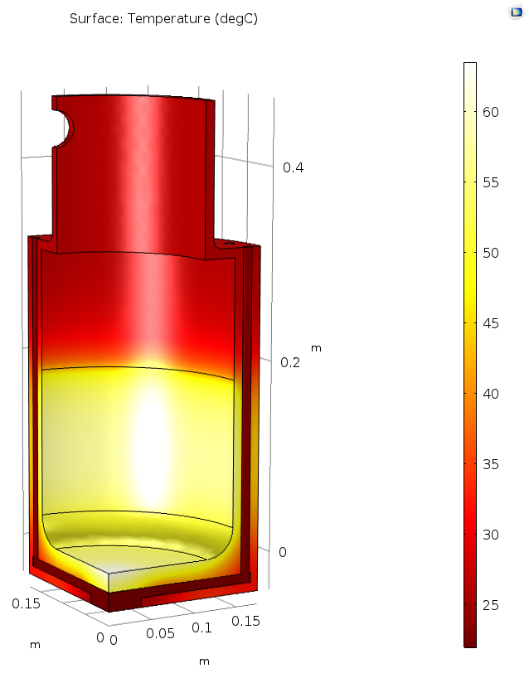
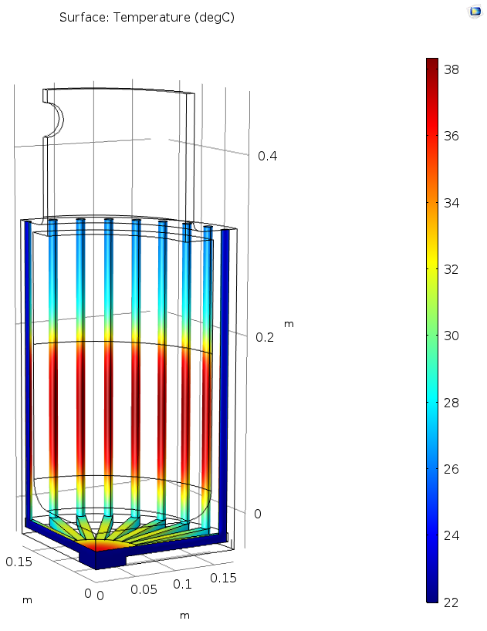
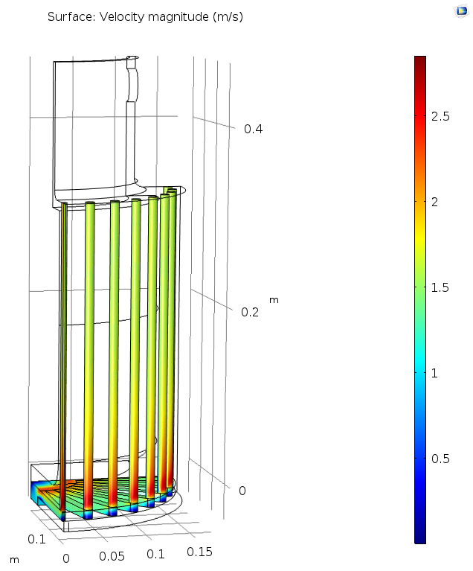
Snapshots HEL collector
Case 6 – CuCr1Zr load = 50kW
 | T max Cu | ΔT water
Cu v_{i} _{water} = 1 m/s | 57 ºC | 16 ºC
CuCr1Zr v_{i} _{water}= 1 m/s | 63 ºC | 16 ºC
Advantage : T_{lim max} = 500 ºC
Output:
T_{max} Cu= 63 ºC (bottom part of the collector)
ΔT water = 16 ºC
v_{max} water bottom= 2.7 m/s is the max reached on the back part of the tube
Courtesy of G. Gobbi

Slide 20
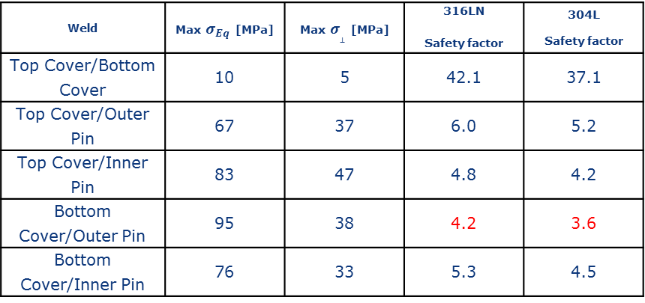
Weld | Max $σ_{Eq}$ [MPa] | Max $σ_{⊥}$ [MPa] | 316LN Safety factor | 304L Safety factor
Top Cover/Bottom Cover | 10 | 5 | 42.1 | 37.1
Top Cover/Outer Pin | 67 | 37 | 6.0 | 5.2
Top Cover/Inner Pin | 83 | 47 | 4.8 | 4.2
Bottom Cover/Outer Pin | 95 | 38 | 4.2 | 3.6
Bottom Cover/Inner Pin | 76 | 33 | 5.3 | 4.5

