Slide 1
New Collector Design
Gerard Tranquille

Slide 2
The task of this device is to collect the electrons of the cooling beam with maximum efficiency.
Due to the high power stored in the beam, the electrons have to be decelerated before hitting the surface.
The quality of a collector is defined by its lowest operation voltage and its electron collection efficiency.
Collector potential should be close to the cathode voltage to minimise the power to be dissipated.
Secondary electrons created by the impact of the primary beam on the collector can be accelerated back to the drift tube.
Primary electrons can also be reflected if the collector potential is too close to the cathode voltage.
To minimise the heat load on the collector surface the beam should be distributed over a large area.
Decrease the magnetic field.
Central electrode at cathode potential.
Coil with reverse field.
Collector surface is water cooled.
Cooling water at high potential.

Slide 3
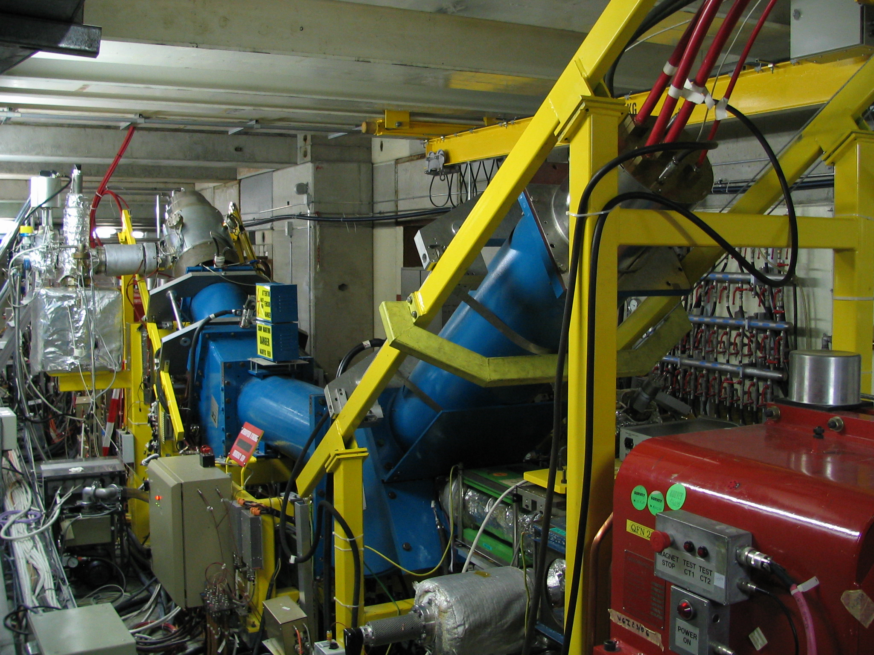
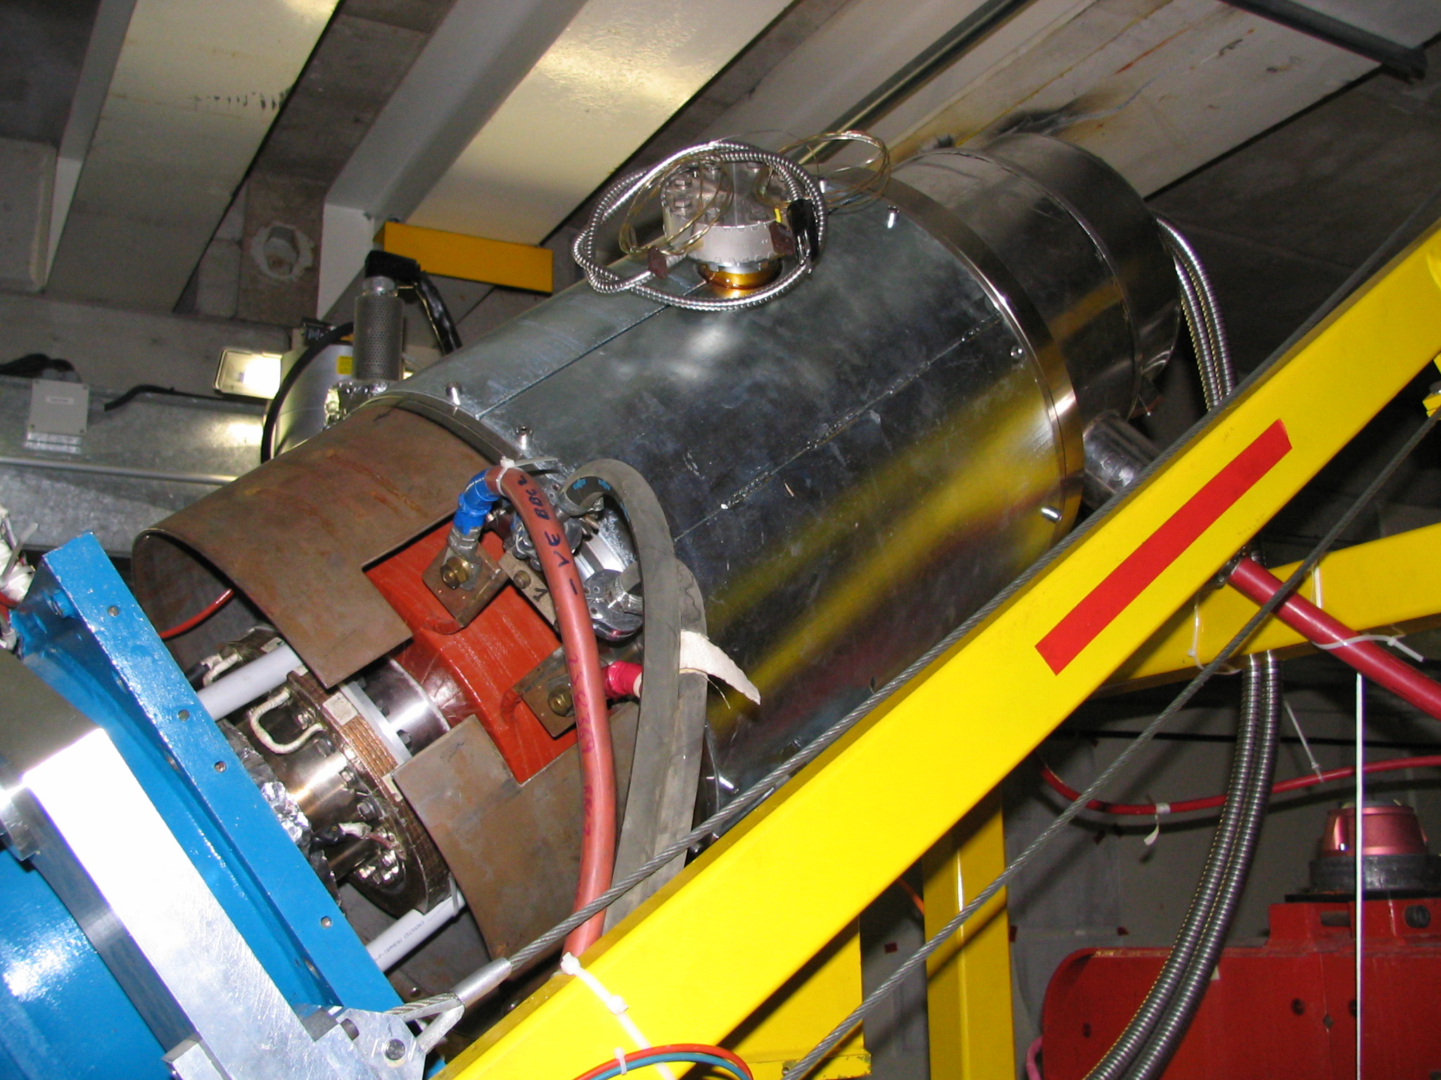

Slide 4
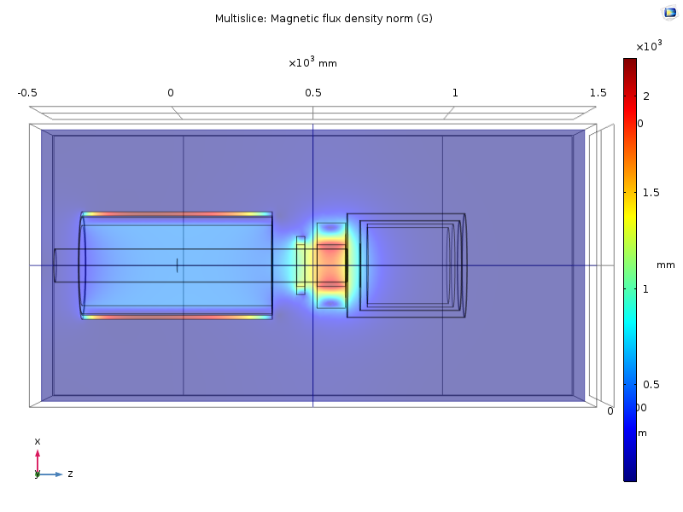
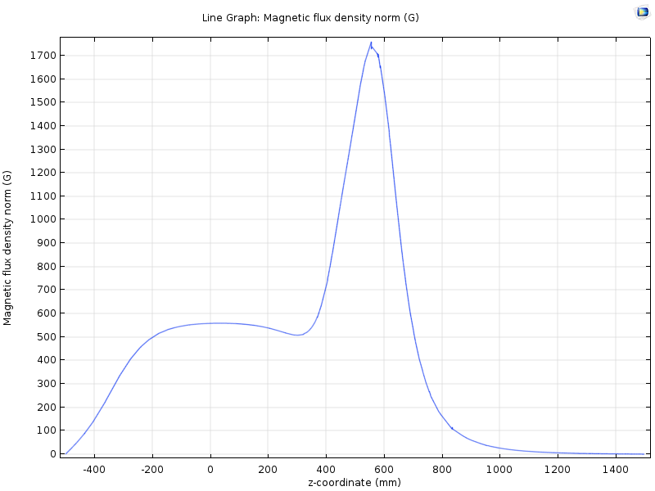
Present AD collector (26.5 keV, 2.2 A)

Slide 5
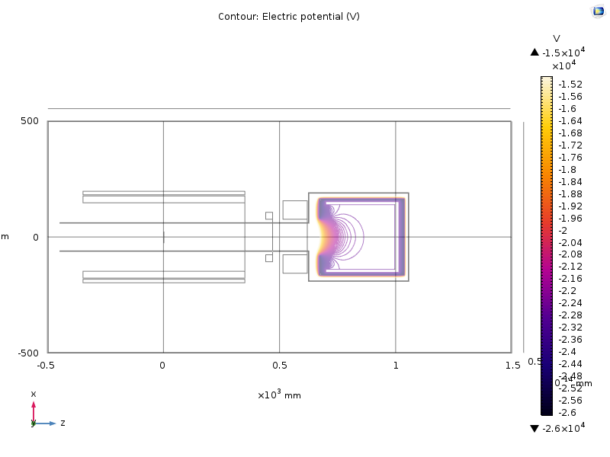
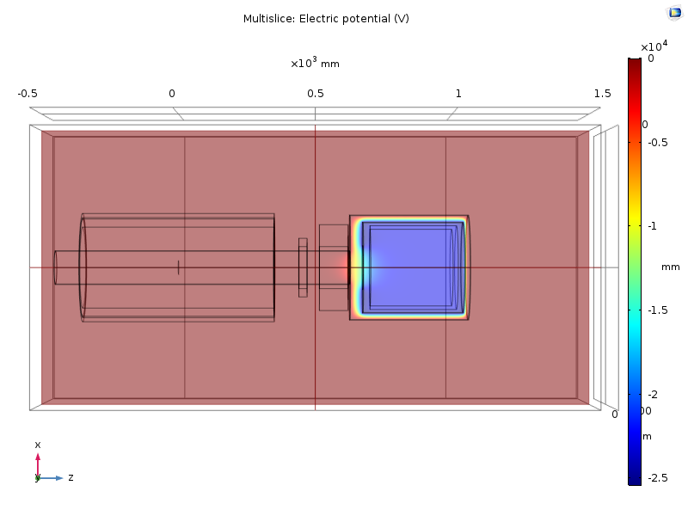
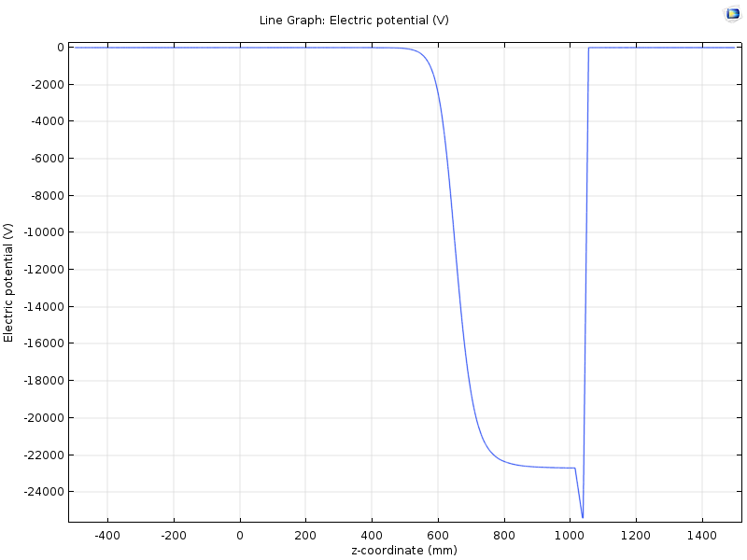

Slide 6
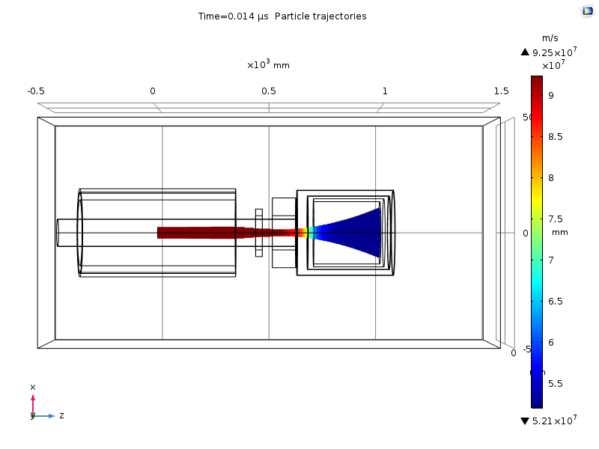
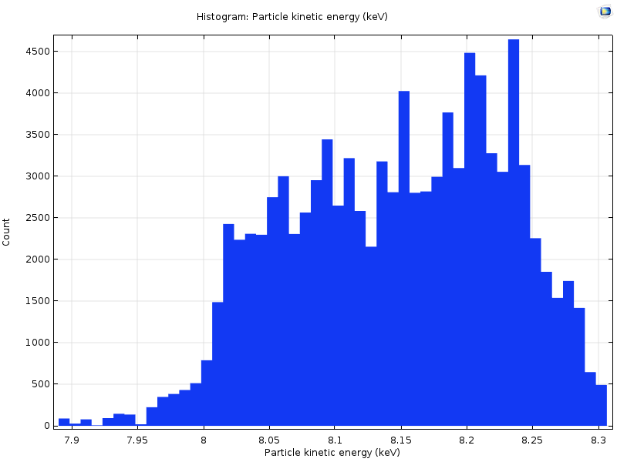

Slide 7
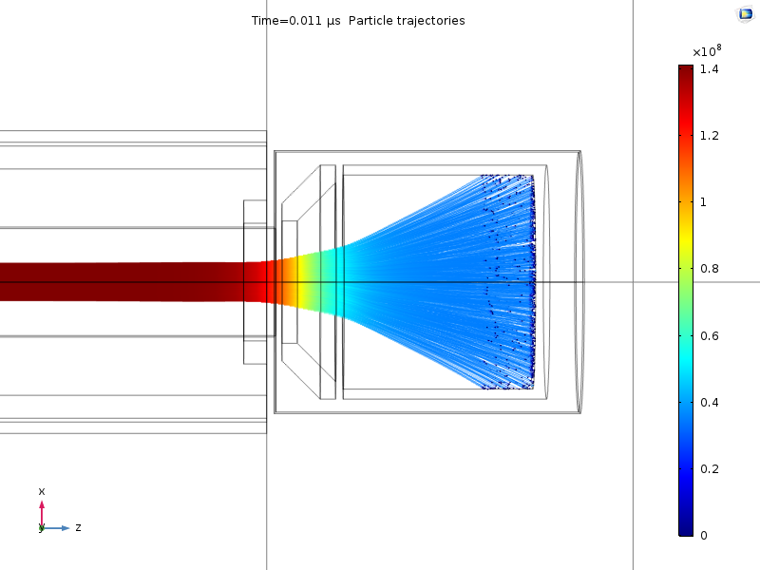
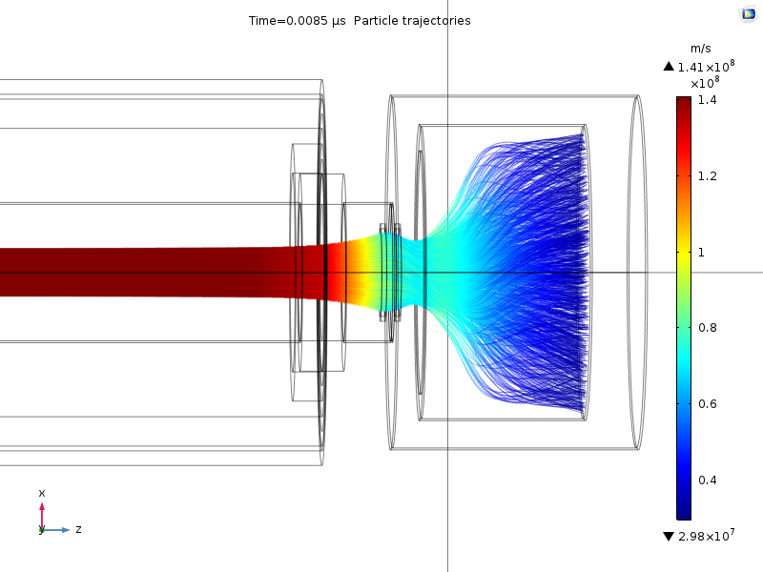
Collector studies
Electromagnetic simulations
Electrode optimisation
Electron trajectories
Cooling requirements
Try to keep the design as simple as possible
Use of standard parts
No complicated shaped electrodes
Compact design to reduce the weight

Slide 8
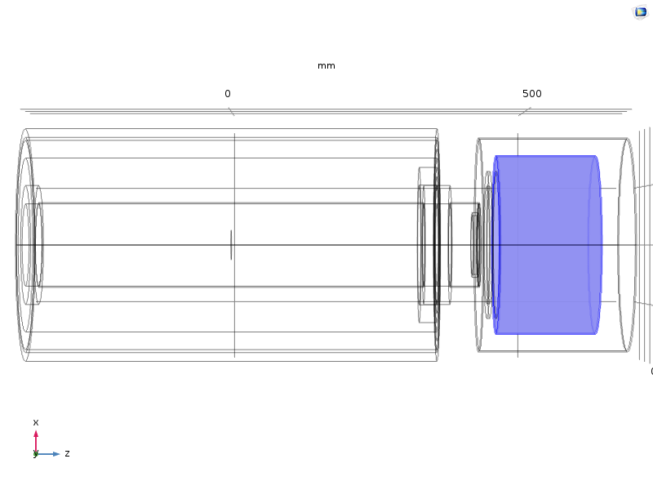
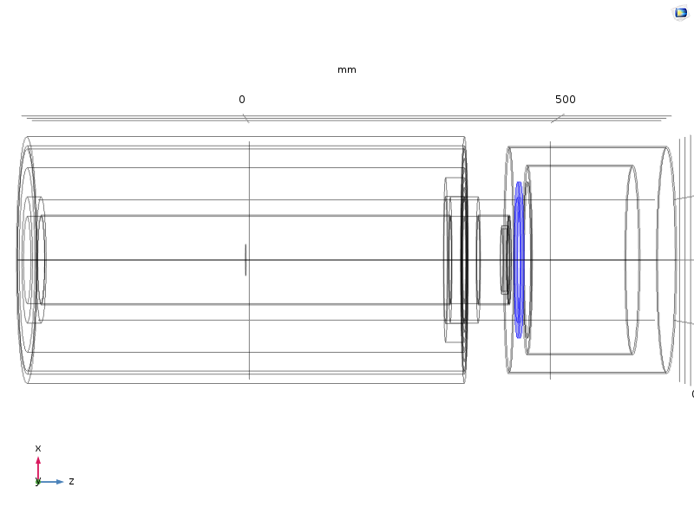
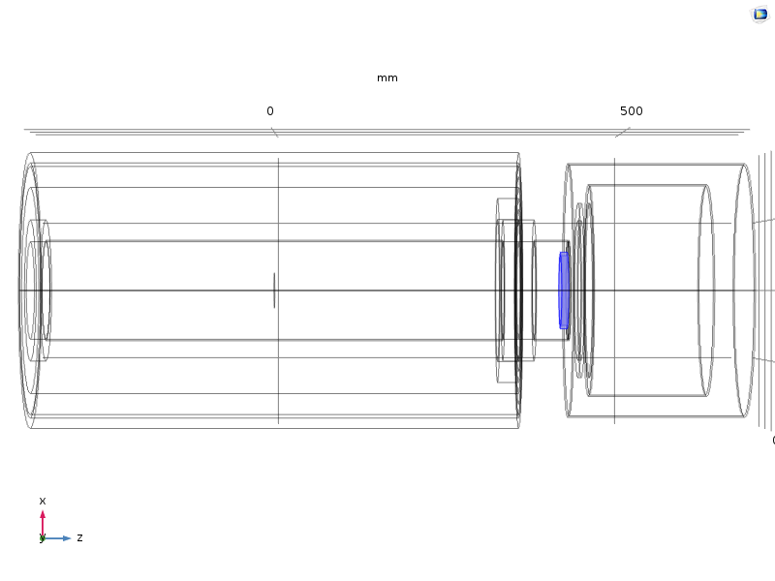
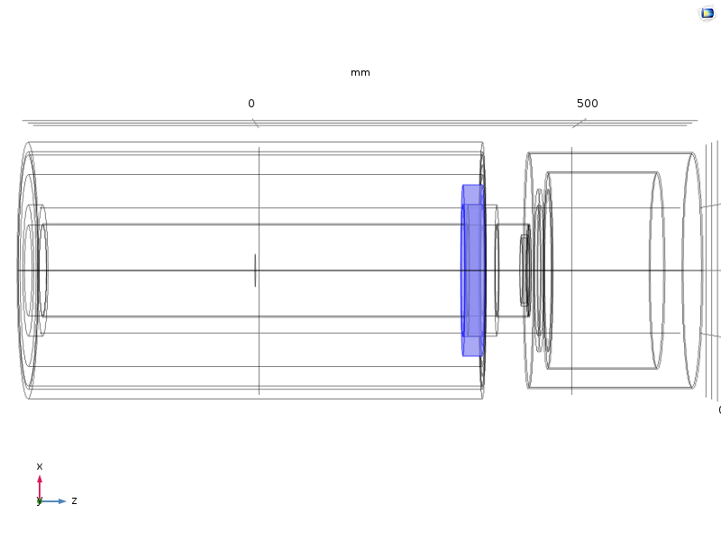
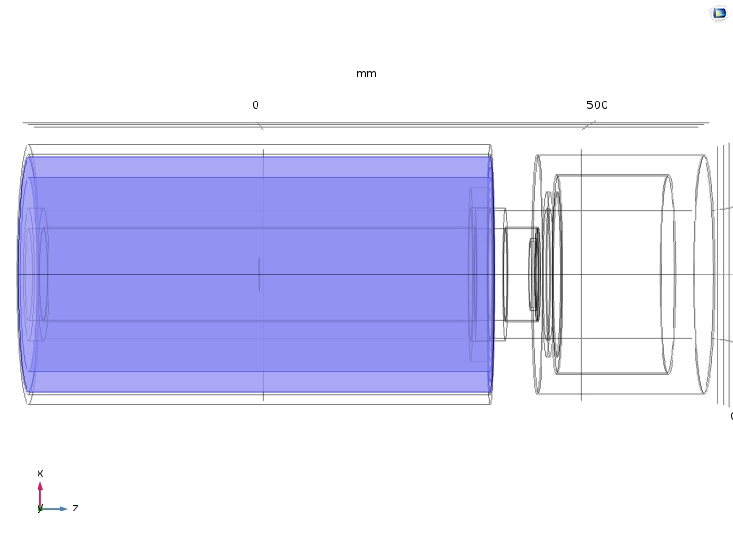
Collector under study

Slide 9
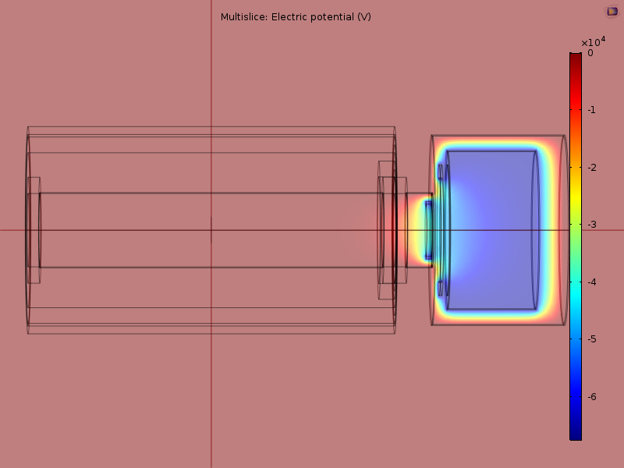
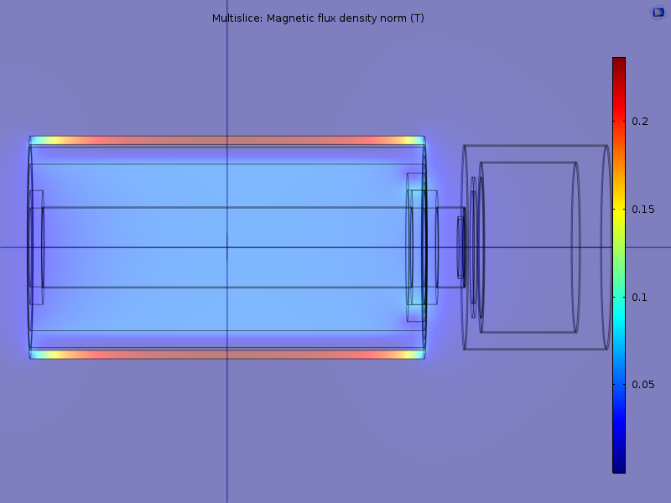
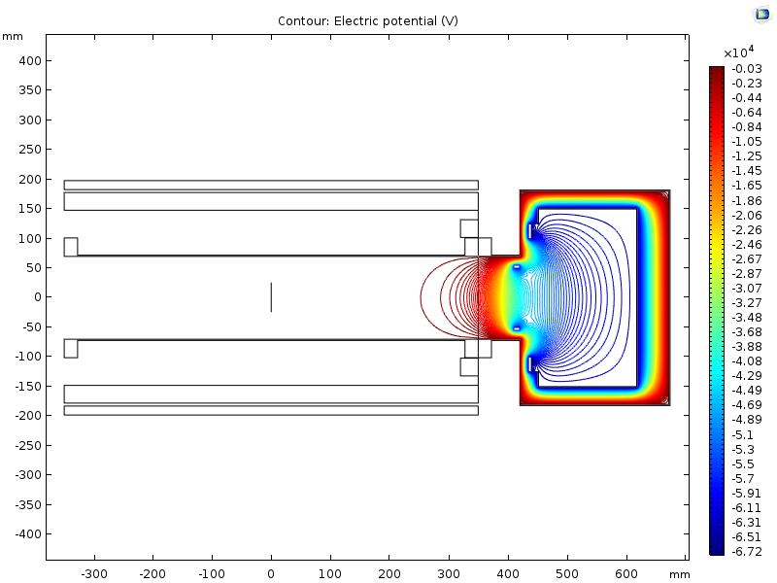
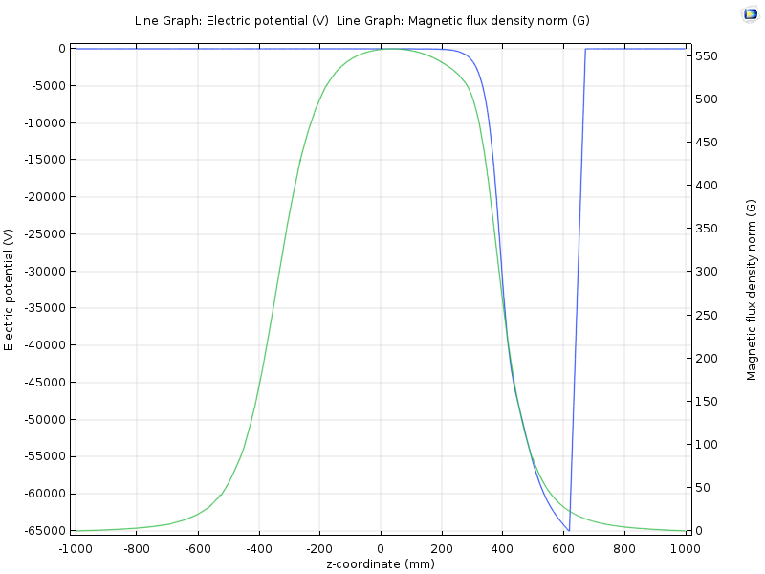
Collector studies at 65 keV, 3.5 A

Slide 10
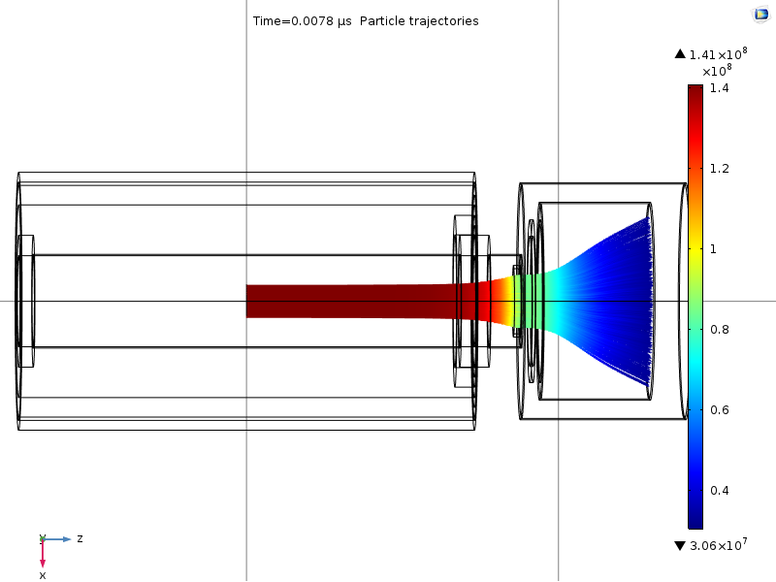
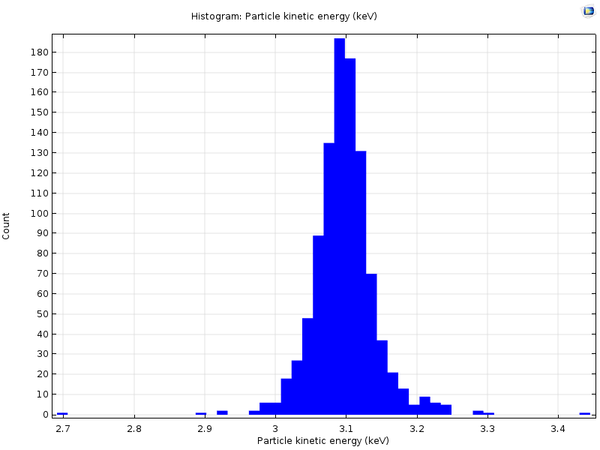

Slide 11
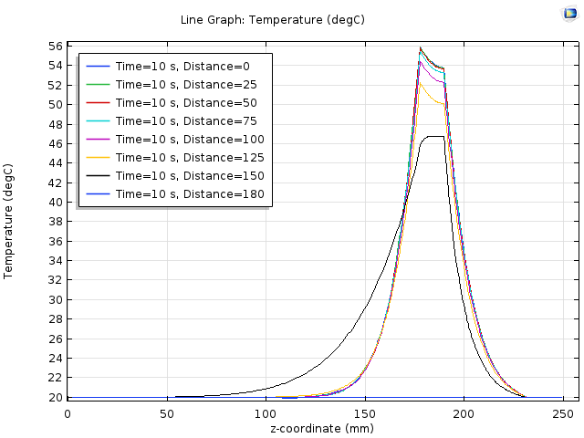
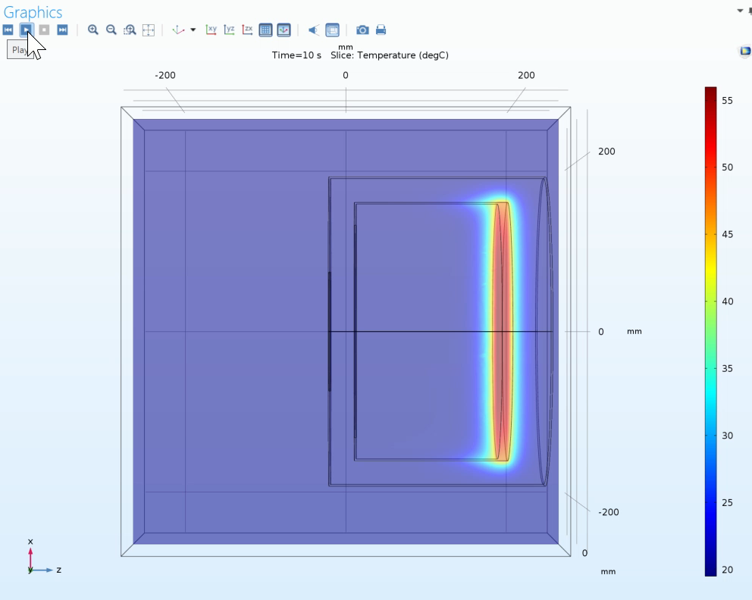
Heat dissipation of 3.1 keV, 3.5 A electron beam in the collector (without water cooling)

Slide 12
A new electron cooler collector is presently in the design stage:
This new device will be made compatible with the present AD electron cooler.
Finish simulations by mid-April.
  Check heat calculations with ANSYS (EN-MME).
  Material selection.
Investigate the implementation of a new vacuum pumping system (TE-VSC).
Full design with production drawings by autumn 2019.
1 year for production. (priority for the main workshop)
New collector should be ready for t3-2020.
Measurements on the test stand in bld 236.
Before the start-up in 2021 we have to exchange the electron gun.
The present AD ecool collector will be replaced with the new design at this time.

