Slide 1
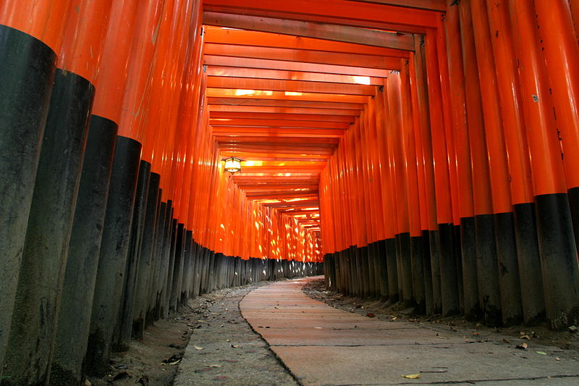
Neutrinos overview.
Dave Wark
Imperial IoP Meeting
April 8th, 2019
Advanced thanks to the many people I
stole slides from, and apologies to those
ignored as I will make no attempt to be complete.

Slide 2
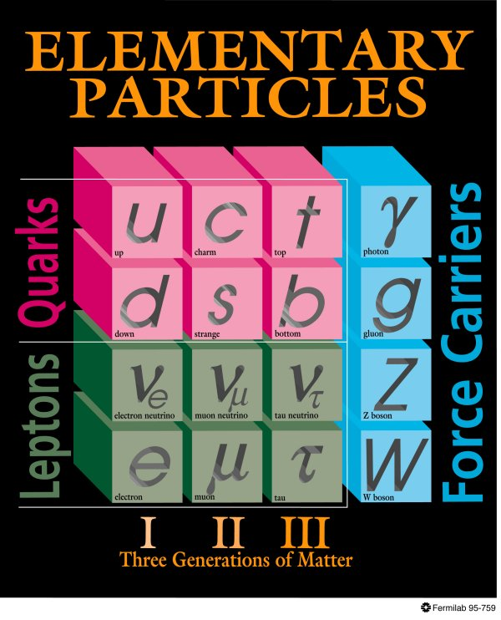
The Standard Model (~1981)
Neutrinos in the 1981 Standard:
  Three neutrinos with a conserved lepton flavour number.
  Massless.
  Strictly Left-handed.
?
??
?
??
???
H
Higgs

Slide 3
The Standard Model (~now)
Neutrinos in the 1981 Standard:
  Three neutrinos with a conserved lepton flavour number.
  Massless.
  Strictly Left-handed.
?
??
?
??
???
H
Higgs

Slide 4
The Standard Model (~now)
Neutrinos in the 1981 Standard:
  Three neutrinos with a conserved lepton flavour number.
  Massless.
  Strictly Left-handed.
  During my career, the neutrino side has been completely transformed.
  We cannot understand particle physics without understanding neutrinos, and we aren’t finished.
  We will not get this information from any other source, we must build more neutrino experiments.
H
Higgs

Slide 5
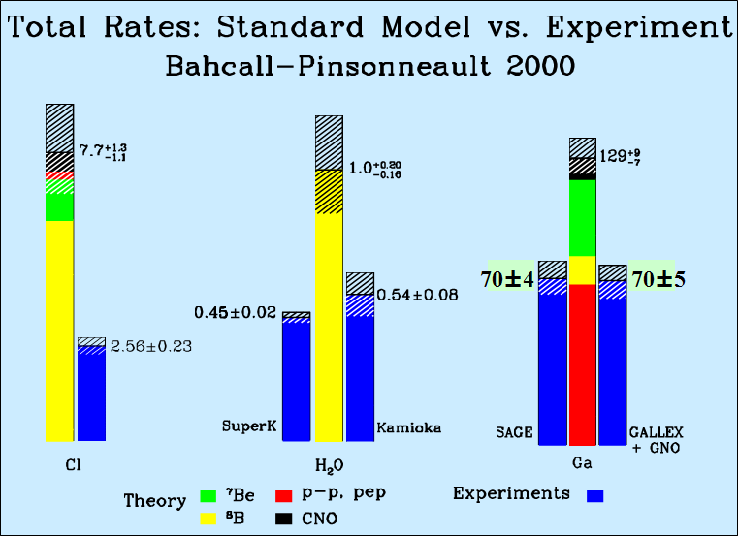
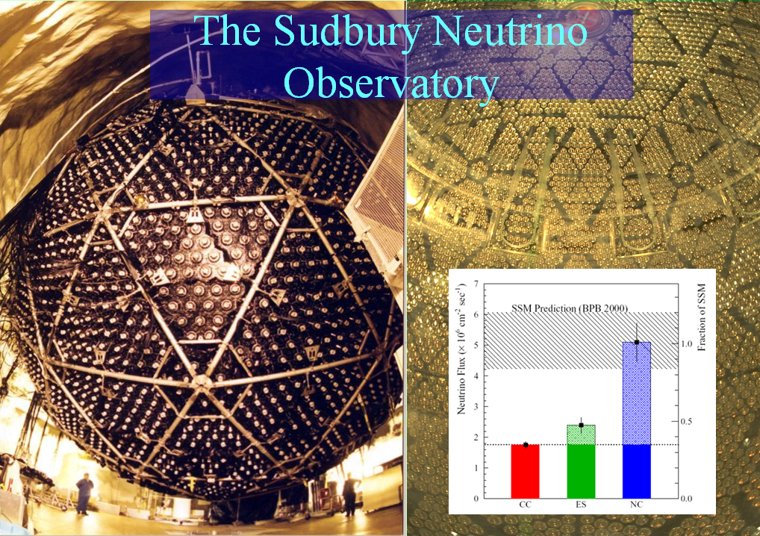
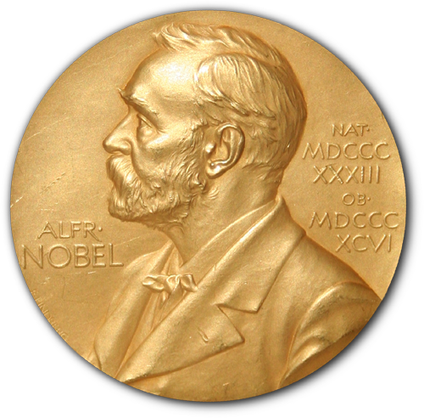
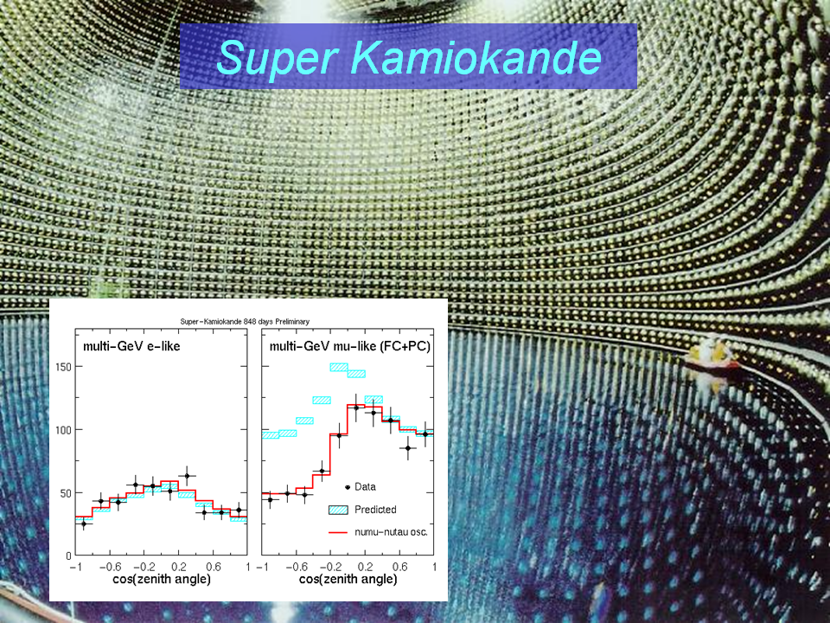
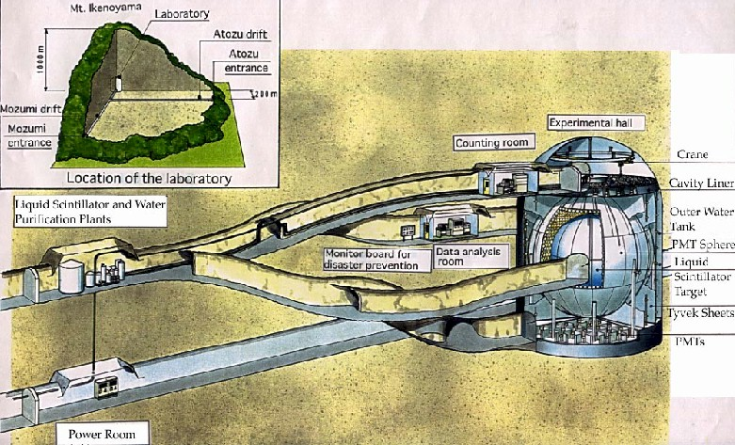

To which we now add results from Chooz, Palo Verde,
K2K, MINOS, MINOS+, T2K, NOvA, Daya Bay, RENO,
Double Chooz, BOREXINO, OPERA, ICARUS,
Icecube, ANTARES, and more. . .
We have proven that neutrinos
have mass, and mix…
… but that is only the
beginning of the story

Slide 6
Some Open Experimental Questions in Neutrino Physics
Completing the picture of neutrino oscillations.
  Parker, Nonnenmacher, Sedgwick, Pidcott, Kaboth, Vann
Neutrino masses and nature – Majorana or Dirac?
  Di Valentino, Kroupova, Nirkko, Taylor, Patrick
Are there sterile neutrinos?
  Di Valentino, Barker, Boschi, Blake, Van den Pontseele
Using neutrinos as probes.
  Katori, Malek

Slide 7
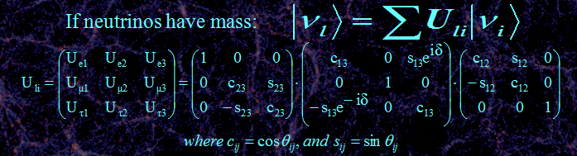
Three neutrino mixing.
If only two neutrinos contribute:

Slide 8
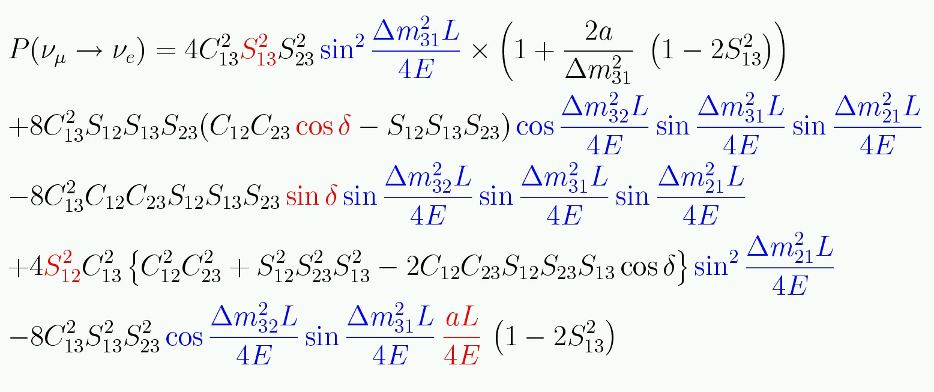
Three neutrino mixing.
Complicated equation means
covariances and degeneracies!
CP sensitivity mainly because this term flips sign for ν and anti-ν
If only two neutrinos contribute:
Can look for appearance or disappearance!
Need Matter effects to
get the signs of Δm²_{ij}
Is θ₁₃ non-zero?

Slide 9
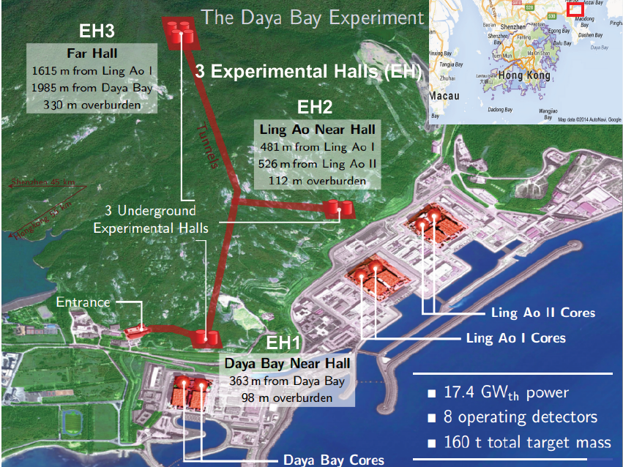
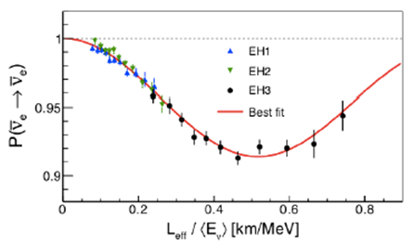
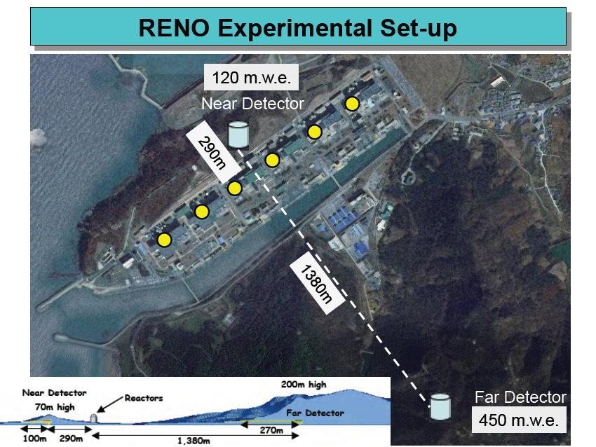
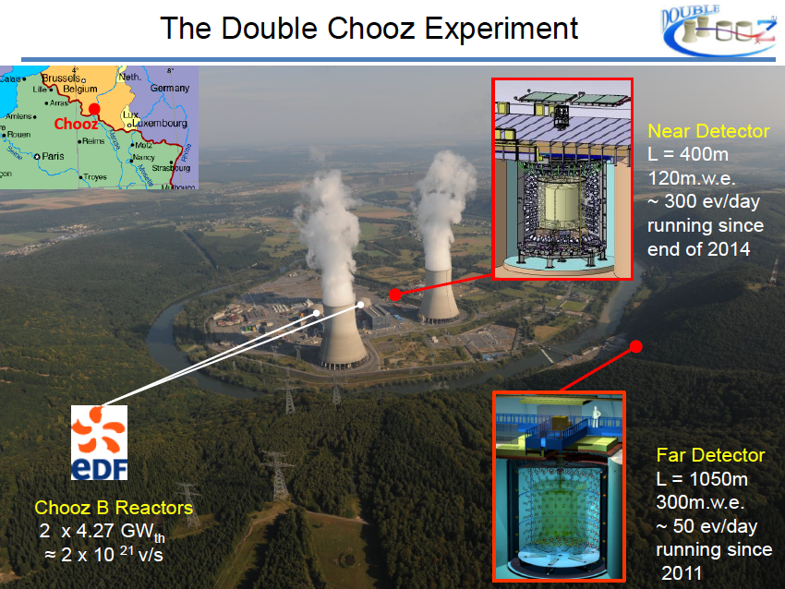
Reactor
Experiments

Slide 10
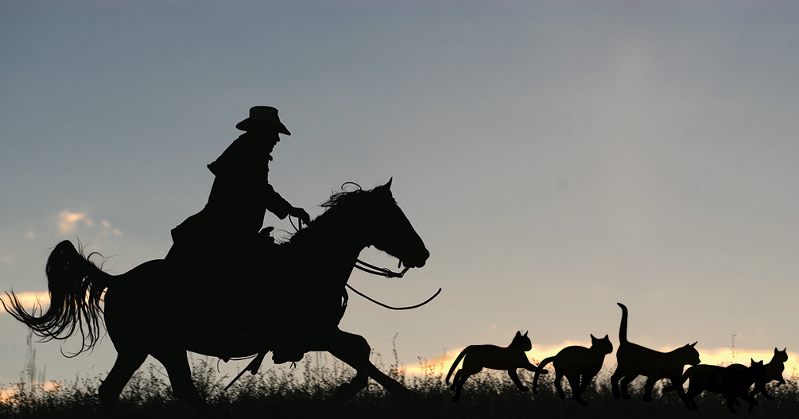
Accelerator-Based Neutrino Oscillation Experients

Slide 11
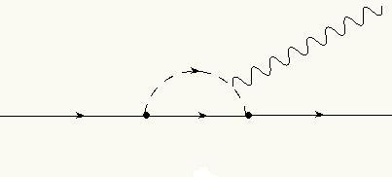
More Ancient History…
Question in the late 50’s: Are the neutrinos in these reactions the same thing?:
  n → p + e + ν π → μ + ν μ → e + ν + ν
If so, why no μ → e + γ via diagrams like?:
IVB
γ
μ
ν
e

Slide 12
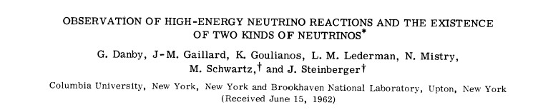
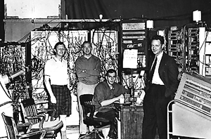
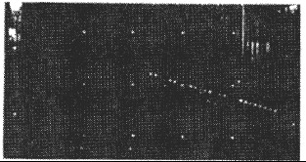
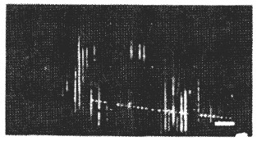
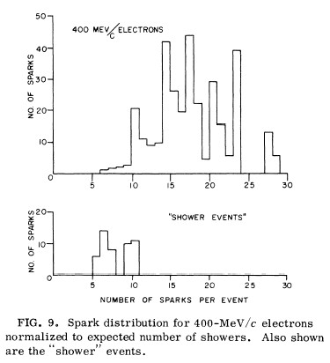
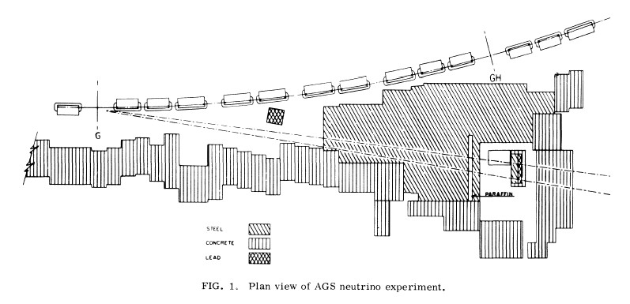
Today this would be interpreted as a neutrino oscillation experiment, and in a different world that could have confused things greatly!
μ event
e event
Fore-runner of accelerator oscillation experiments, no time to discuss them all (most notably MINOS) – jump to the current ones.

Slide 13
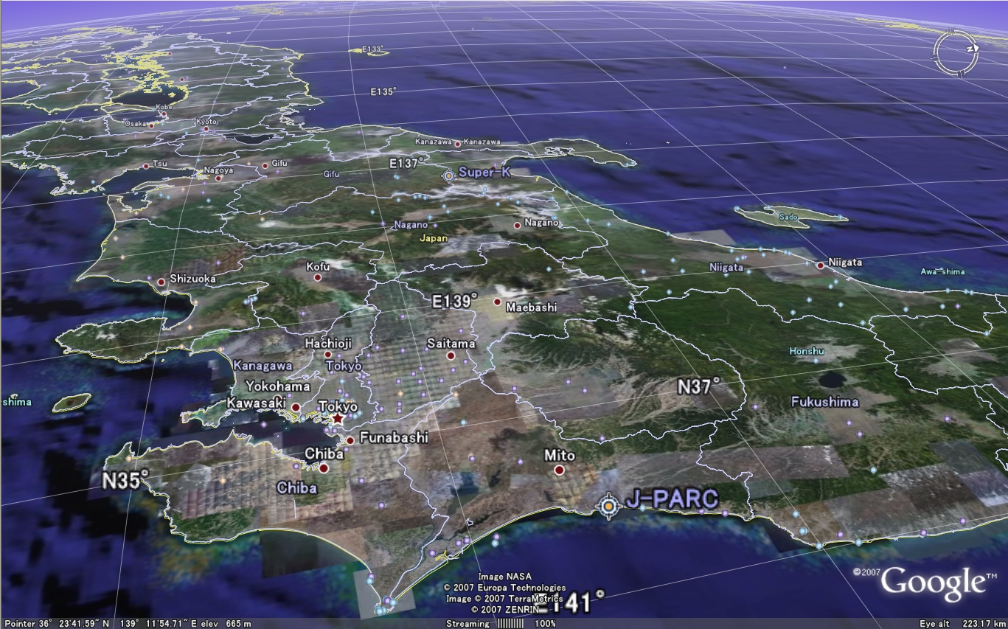

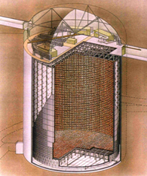
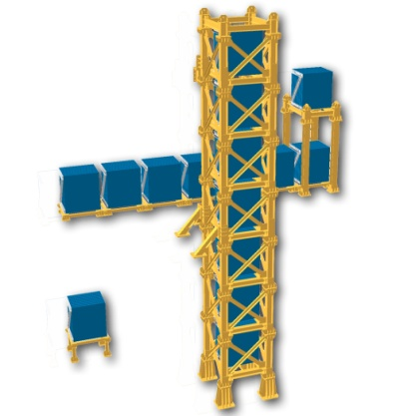
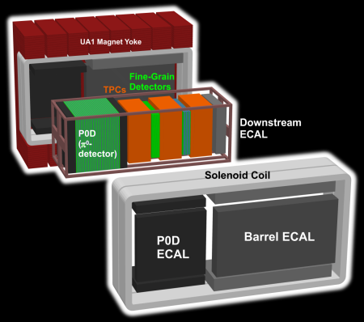
#

Slide 14
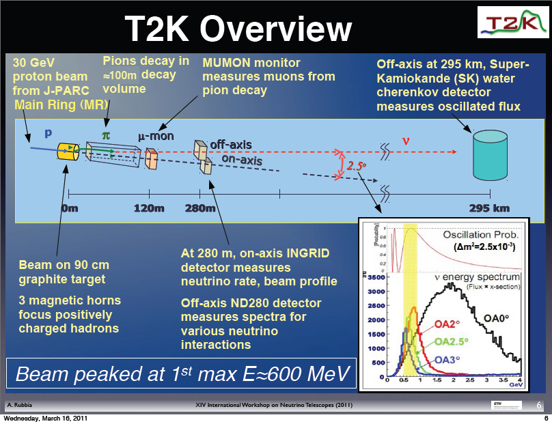

Slide 17
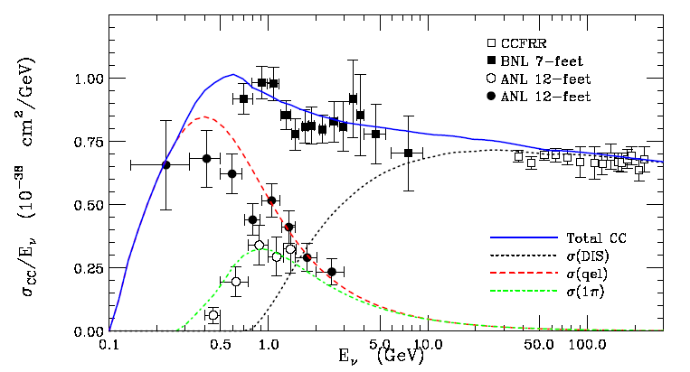
Critical σ’s poorly known in range 0.1-10 GeV.
Total ν_{μ} CC cross section
Data compiled by G.Zeller, hep-ex/0312061

Slide 18
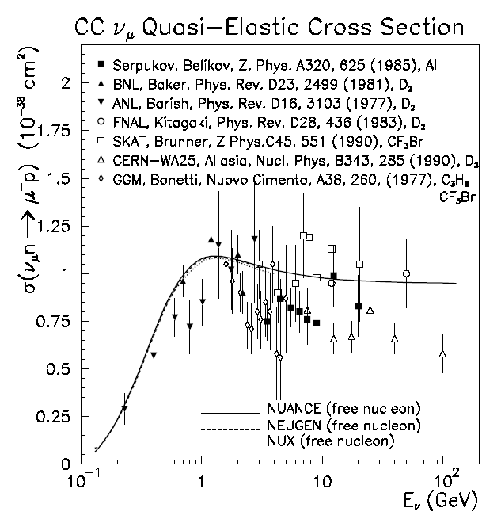
Cross sections are poorly known in range 0.1-10 GeV
Data compiled by G.Zeller, hep-ex/0312061

Slide 19
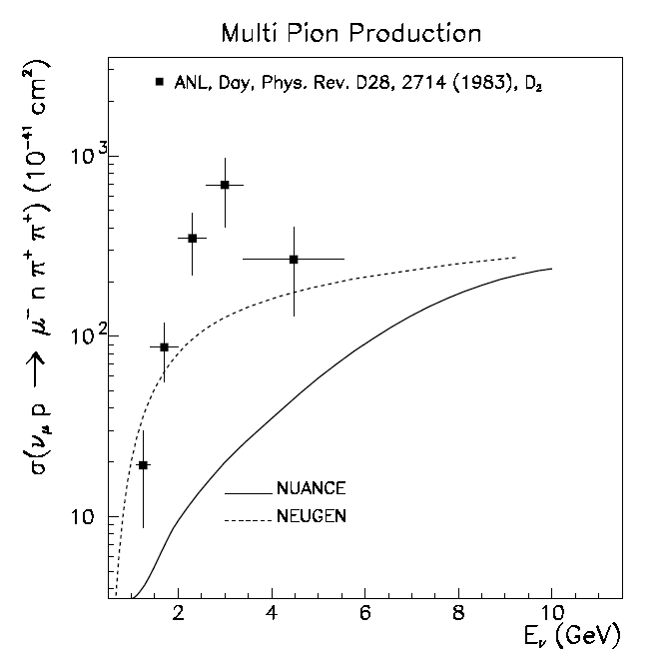
Cross sections are poorly known in range 0.1-10 GeV
Data compiled by G.Zeller, hep-ex/0312061

Slide 20
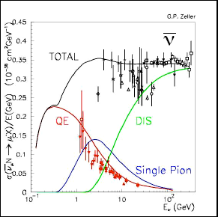
And lets not even talk about ν…
_

Slide 21
See the talk by HEPP Prize winner Asher Kaboth, who will tell you everything you need to know about near detectors!

Slide 22
The UK’s position in T2K was initially won by helping with the beamline, an ability which is threatened by the continuing squeeze on resources and on laboratory salaries.

Slide 23
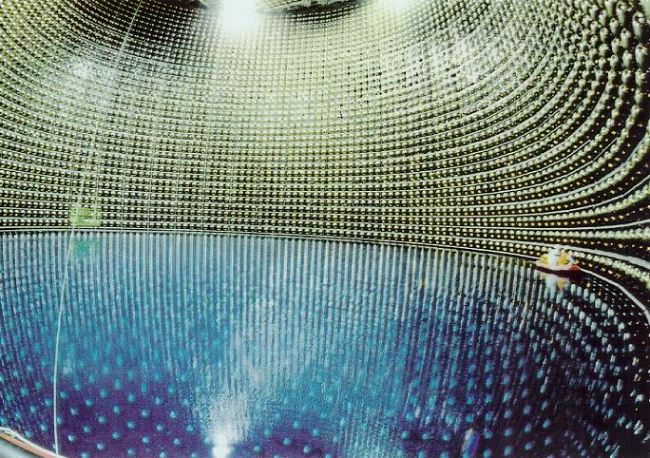
Far Detector – Super Kamiokande

Slide 24
Background
from NC
interactions
e
ν_{μ}
disappearance
signal
π⁰
ν_{e}
appearance
signal
μ
In this energy range, Super Kamiokande well understood,
Excellent for separating
electrons, μ, π⁰

Slide 25
Nuclear (gulp!) theory is important, and will only become more important, in minimizing the uncertainties which will determine the eventual sensitivity of these (and future) experiments.
Similar effect critical for ββ experiments.

Slide 27
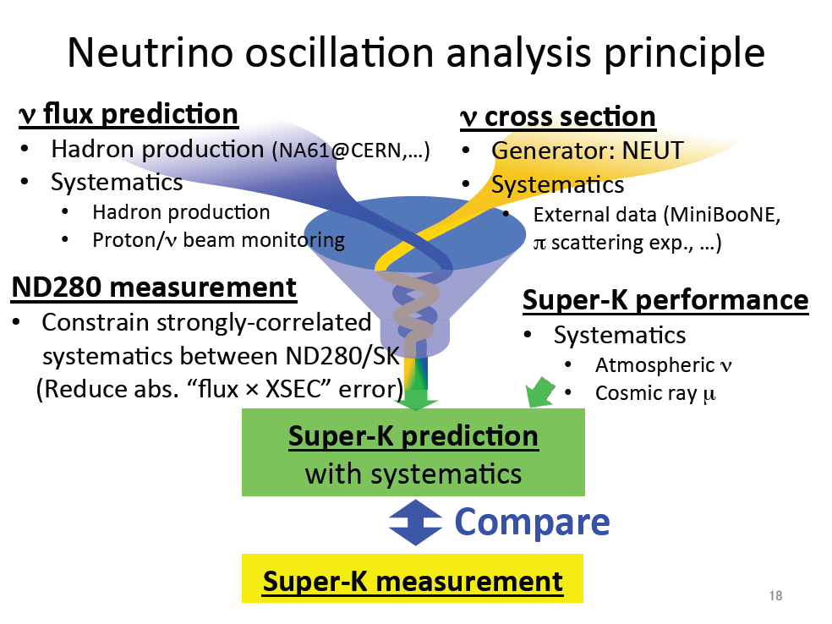

Slide 28
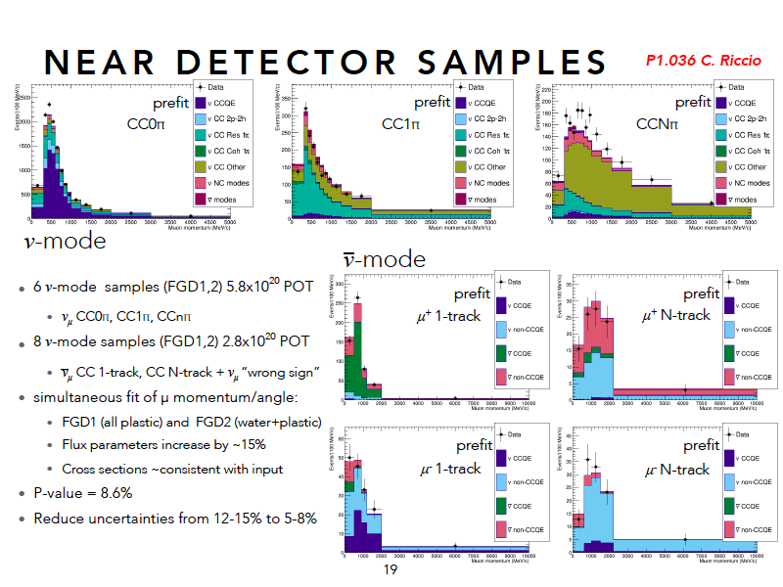

Slide 29
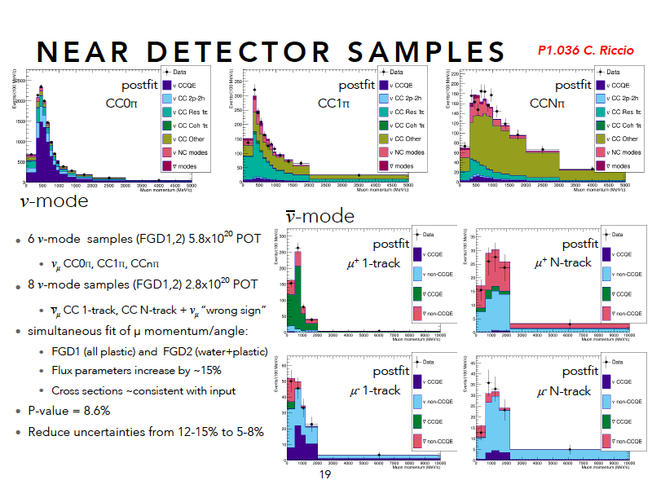

Slide 30
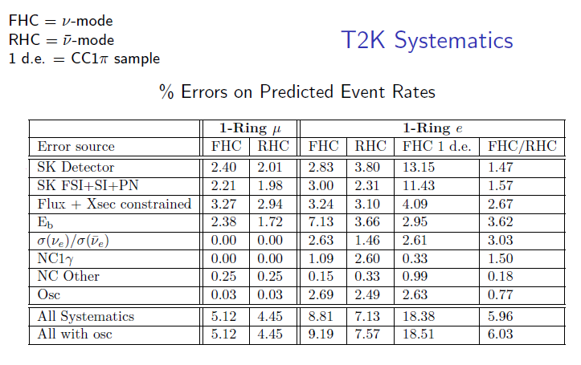
With these uncertainties would become systematics limited with ~300 appearance events.

Slide 33
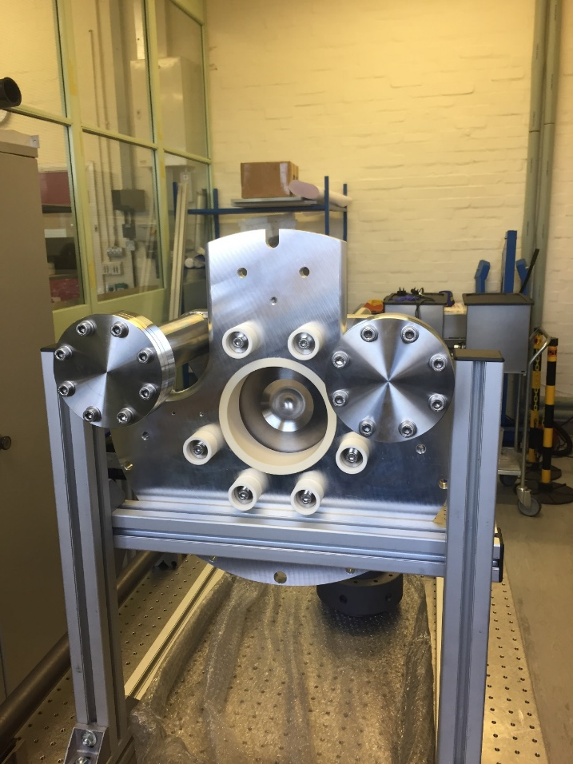
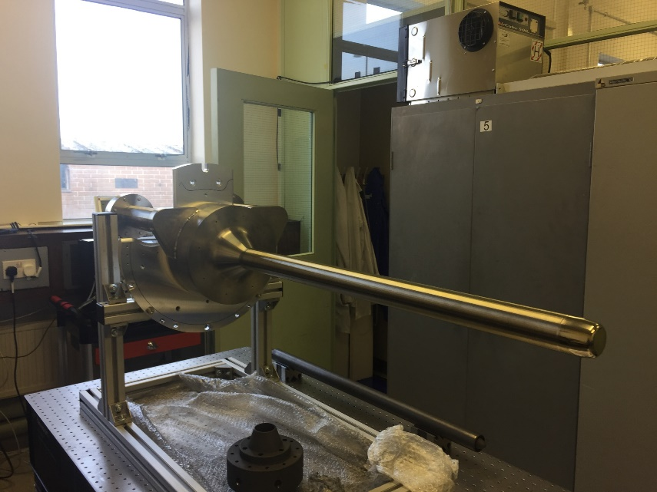

Slide 35
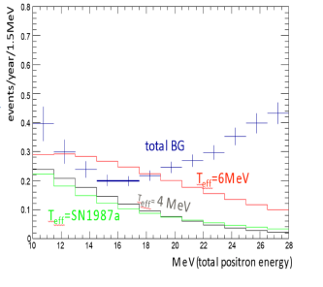
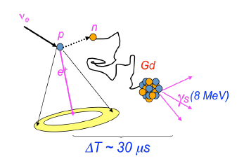
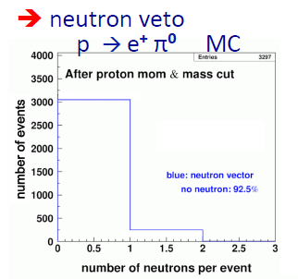
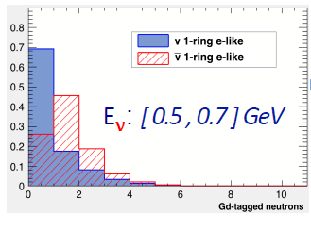
Find DSNR neutrinos. . .
Meanwhile, in Super-K…
Slash PDK background. . .
Tell ν from anti-ν. . .

Slide 36
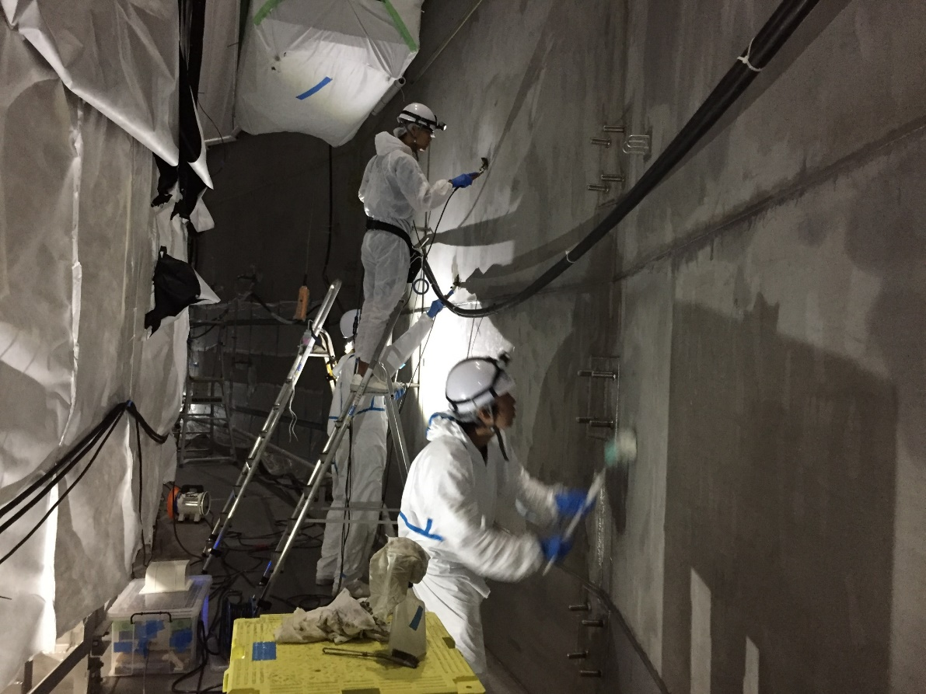
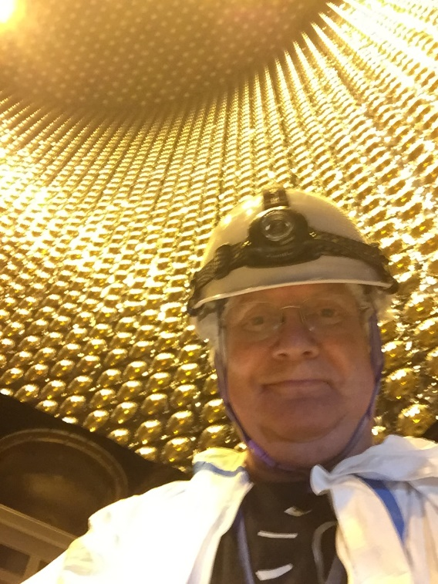
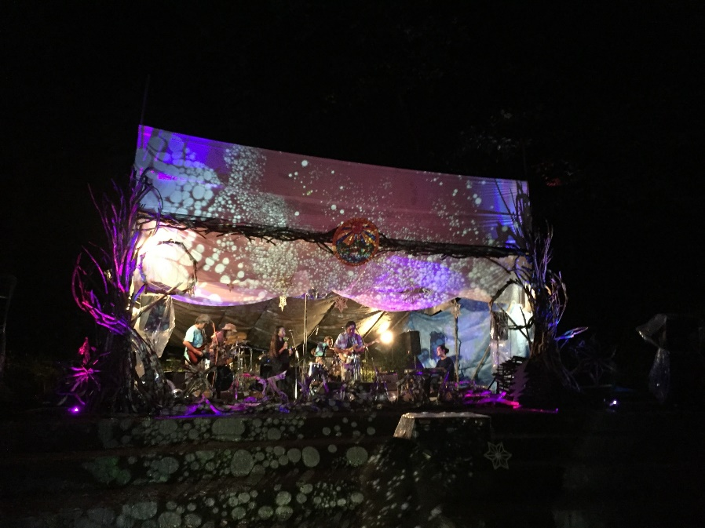

Slide 37
The first gadolinium will be added to Super Kamiokande later this fiscal year (i.e., before April 2020).

Slide 38
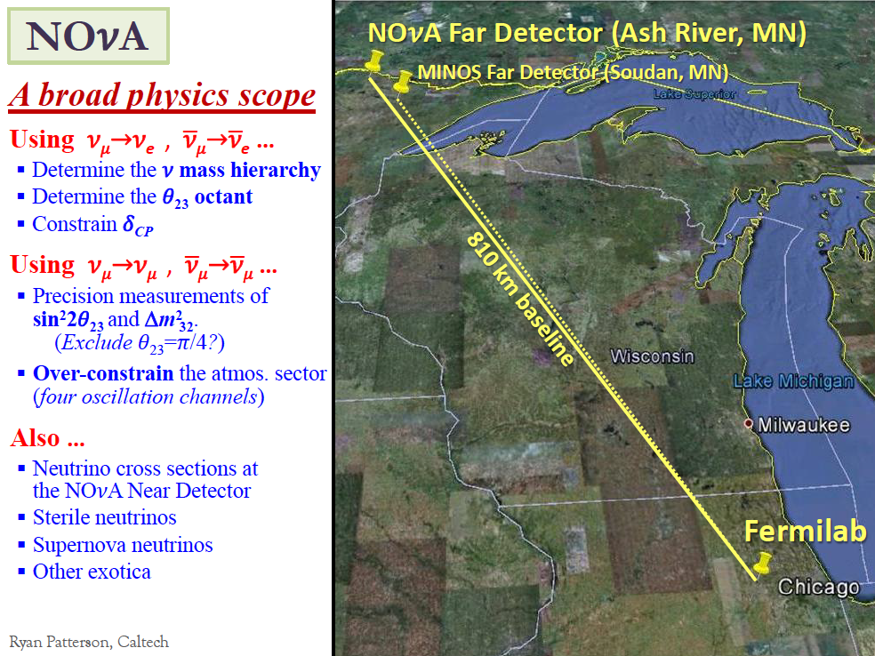

Slide 39
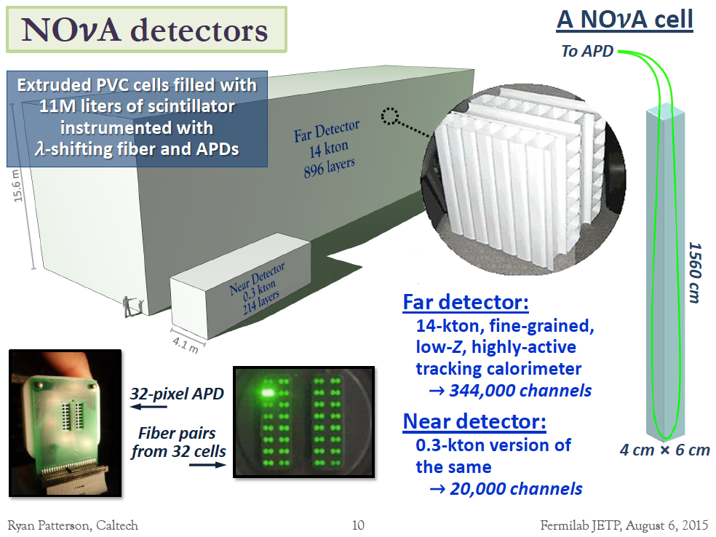

Slide 42
Both experiments continue to run, and a group of people from NOvA and T2K is meeting regularly to prepare for joint analysis of the data.

Slide 43
Normal ordering preferred at ~2σ,
CP indications much weaker.

Slide 44
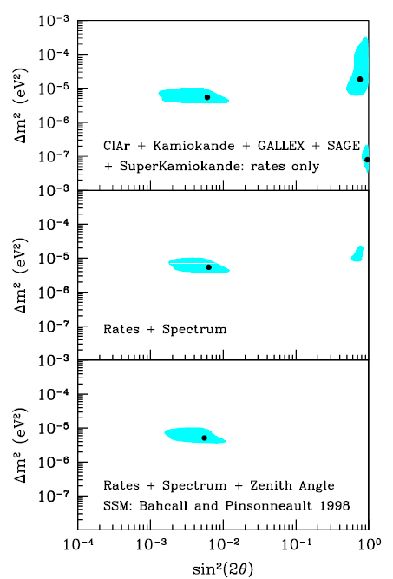
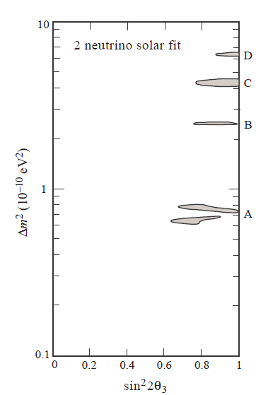
Using all data as of
Neutrinos ‘98.
These are 99% c.l. contours!
Note that these best fits would essentially rule out CP violation in terrestrial experiments.
Global fits of systematics limited experiments will not save you!

Slide 45
Wow – these experiments are great –
but even upgrades to T2K and NOvA
won’t guarantee 5σ CP sensitivity for
a significant range of values of δ.

Slide 46
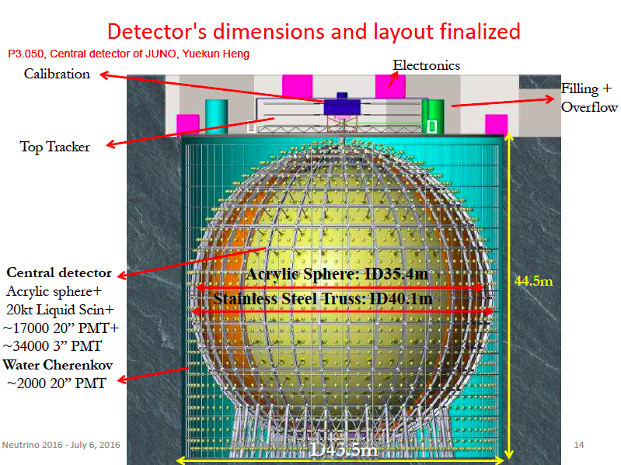
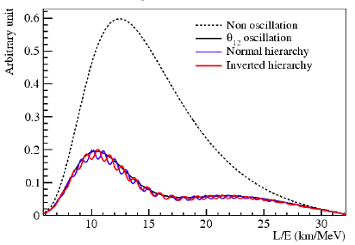
JUNO long baseline reactor experiment
My view- measurement of
θ₁₂ alone justifies the project.

Slide 47





New LBNF neutrino beamline
40 kT LAr Tracking
Calorimeter
Near Detector @ FNAL

Slide 48


Slide 49


Slide 50

Empty Cryostat
The worlds largest LAr TPC
7 x 7 x 6 m³ ~ 770,000 kg

Slide 51





Real Events

Slide 52

Moving rapidly – plan a 1.2 MW Beam in 2026

Slide 53




The Next Step in Japan
Hyper Kamiokande L=295km OA=2.5deg
J-PARC MR
→~1.3MW
520,000 ton Water Cerenkov Detector!.
In the end the sensitivity of LBL experiments
to CP will probably be systematics limited
– need NA61, MINERvA, NuStorm, etc.
T2K 280m near detectors, will be re-used,
but upgraded and enhanced
with new near detector(s) at 2km.

Slide 54


Slide 55


Slide 56


Slide 57

Why do we need both?
From Steve King’s talk at NuPhys 2016.

Slide 58

Of course the main reason we need two experiments is so that we can believe either one of them.

Slide 59

First power upgrade of JPARC accelerator approved and underway
Hyper-K recommended by Science Council of Japan and placed on MEXT Road Map
Only a tiny amount of money in this year’s budget, but U of Tokyo has announced construction will begin in April 2020.
Stay tuned. . .

Slide 60
Some Open Experimental Questions in Neutrino Physics
Completing the picture of neutrino oscillations.
  Parker, Nonnenmacher, Sedgwick, Pidcott, Kaboth, Vann
Neutrino masses and nature – Majorana or Dirac?
  Di Valentino, Kroupova, Nirkko, Taylor, Patrick
Are there sterile neutrinos?
  Di Valentino, Barker, Boschi, Blake, Van den Pontseele
Using neutrinos as probes.
  Katori, Malek

Slide 63

Sterile Neutrinos: LSND Starts it all...
Excess of electron anti-neutrinos in a “beam” from stopped pion decay…

Slide 64


LSND Starts it all...
This is a tiny effect, and systematics will be crucial. It is a pity SBND is first!

Slide 65




Slide 66




Slide 67
Conclusions
Neutrino Oscillations have gone from speculative to routine, and remain the only experimentally confirmed particle physics beyond the original Standard Model.
Every 3ν neutrino mixing (i.e., every angle) has been seen by at least two different methods and by multiple experiments – so we can believe them!
We have moved from exploration to the era of precision measurements – but that opens a window for new discoveries.
Nuclear physics matters – this will require supplementary experiments and theoretical support.
There is much more neutrino physics outside of oscillations – absolute mass, Majorana vs. Dirac, use of neutrinos as probes, astrophysical and cosmological ν, and the search for deviations.
Somebody must sort out sterile neutrinos (and there are non-accelerator experiments in that area moving as well), but it is a very subtle problem so don’t look for very rapid progress.
This is great physics, and we need more physicists!
Join us!

Slide 68


