Slide 1


Welcome
IT-4464/EN
Dismantling and Supply of Electrical Overhead Travelling Cranes with a capacity up to 10 Tonnes
19th – 20th February 2019
to Accelerating Science and Innovation
Notes:
1

Slide 2
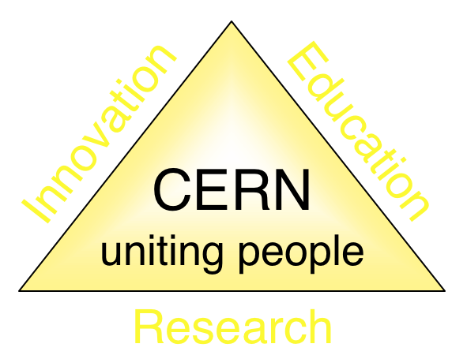
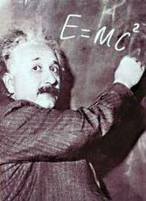



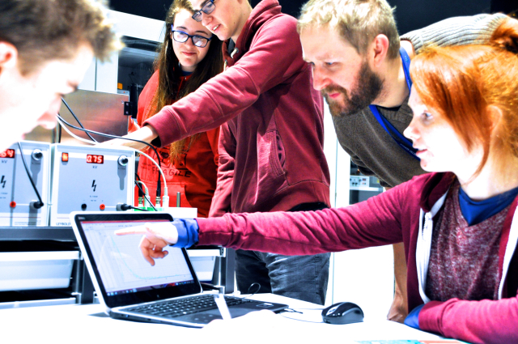

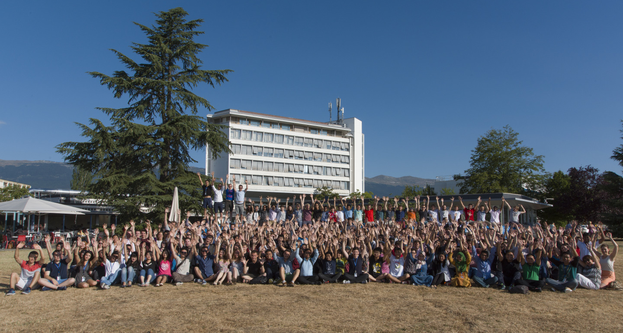
The Mission of CERN
Push back the frontiers of knowledge
E.g. the secrets of the Big Bang …what was the matter like within the first moments of the Universe’s existence?
Develop new technologies for accelerators and detectors
Information technology - the Web and the GRID
Medicine - diagnosis and therapy
Train scientists and engineers of tomorrow
Unite people from different countries
and cultures
Notes:
2

Slide 3


CERN: founded in 1954: 12 European States
“Science for Peace”
Today: 22 Member States
~ 2600 staff
~ 1800 other paid personnel
~ 13000 scientific users
Budget (2018) ~ 1150 MCHF
Member States: Austria, Belgium, Bulgaria, Czech Republic, Denmark, Finland, France, Germany, Greece, Hungary, Israel, Italy, Netherlands, Norway, Poland, Portugal, Romania, Slovak Republic, Spain, Sweden, Switzerland and
United Kingdom
Associate Members in the Pre-Stage to Membership: Cyprus, Serbia, Slovenia
Associate Member States: India, Lithuania, Pakistan, Turkey, Ukraine
Applications for Membership or Associate Membership:
Brazil, Croatia, Estonia
Observers to Council: Japan, Russia, United States of America;
European Union, JINR and UNESCO
3
Notes:
3
----- Meeting Notes (09/01/2013 14:16) -----
nnn

Slide 4
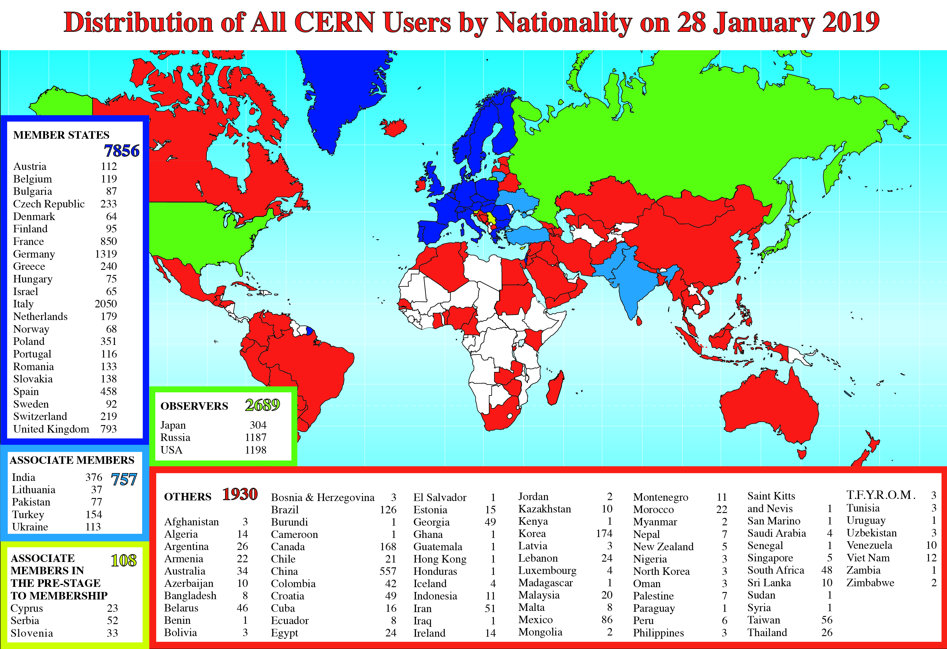
Science is getting more and more global
Notes:
4
4

Slide 5
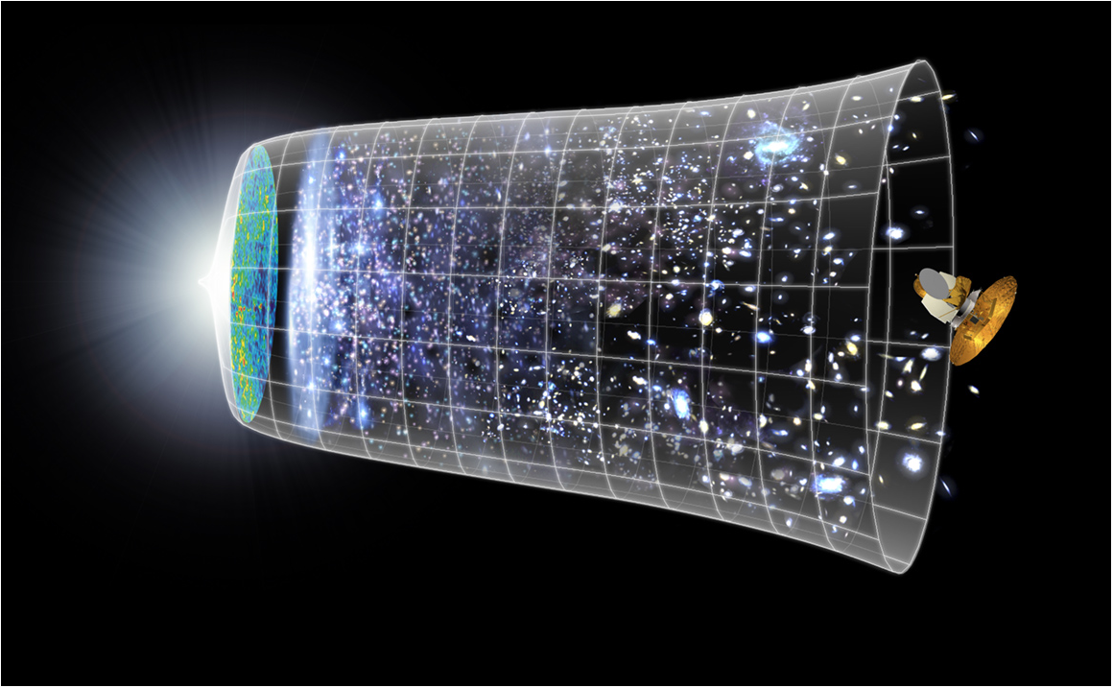
Next Scientific Challenge:
to understand the very first moments of our Universe after the Big Bang
Big Bang
WMAP
13.8 Billion Years
Today
10²⁸ cm

Slide 6
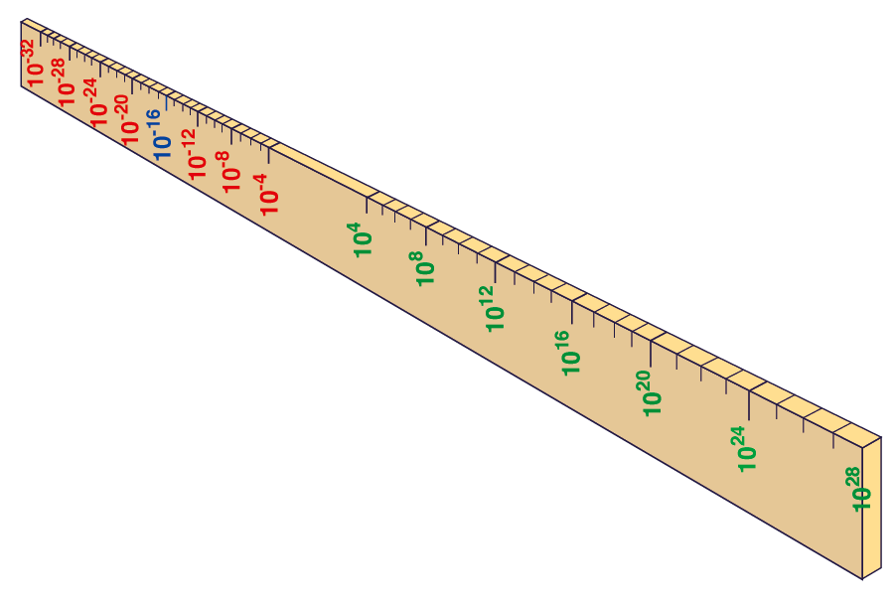
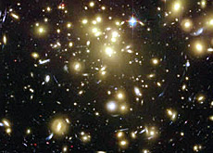
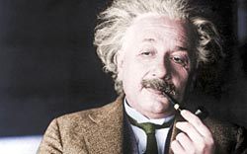
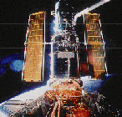
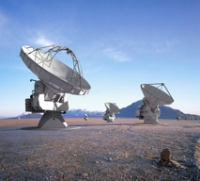
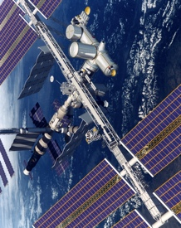
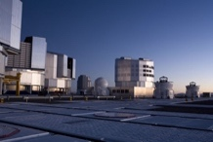
Big Bang
Proton
Atom
Radius of Earth
Earth to Sun
Radius of Galaxies
Universe
Hubble
ALMA
cm
AMS
VLT
Notes:
6
60 Grössenordnungen

Slide 7
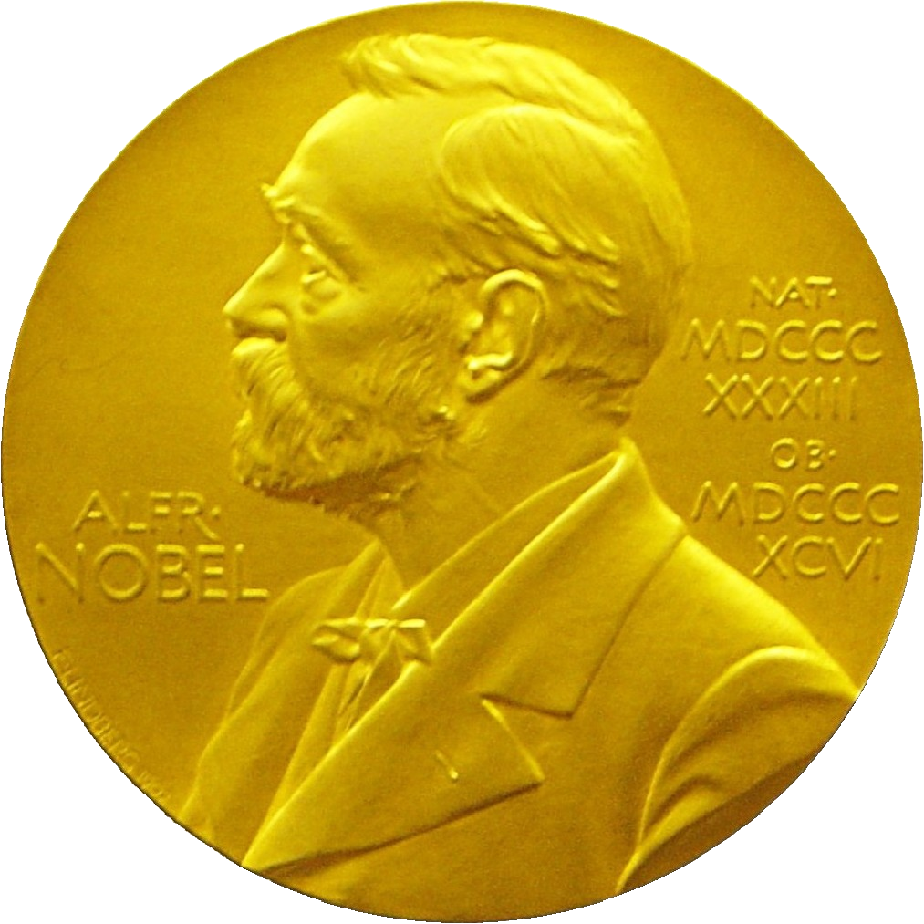
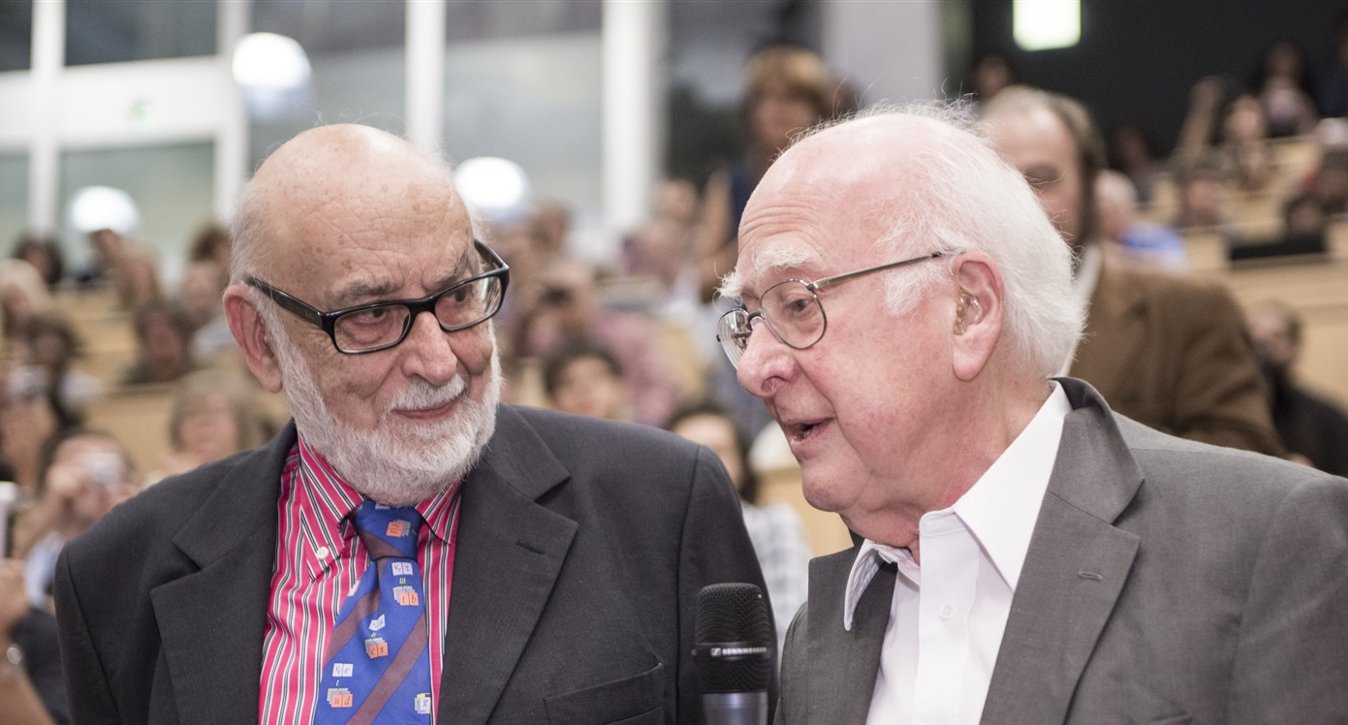
Discovery 2012, Nobel Prize in Physics 2013
The Nobel Prize in Physics 2013 was awarded jointly to François Englert and Peter W. Higgs "for the theoretical discovery of a mechanism that contributes to our understanding of the origin of mass of subatomic particles, and which recently was confirmed through the discovery of the predicted fundamental particle, by the ATLAS and CMS experiments at CERN's Large Hadron Collider”.

Slide 8
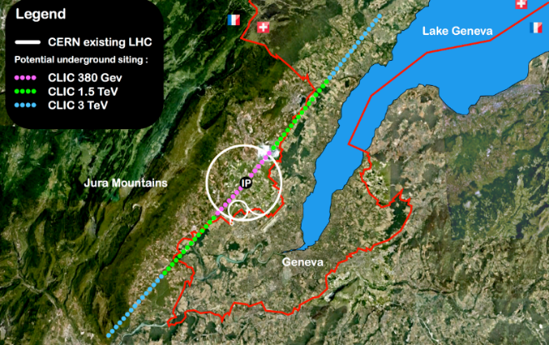


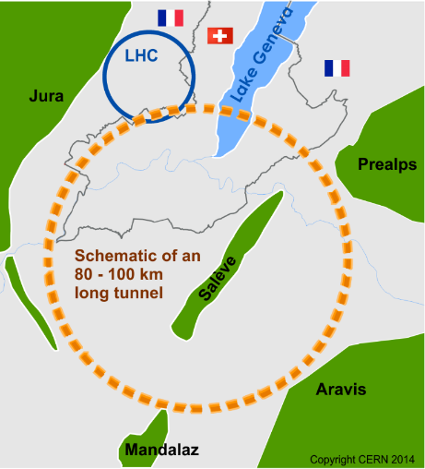
Future of particle physics
High Luminosity LHC until 2035
Ten times more collisions than
the original design
Studies in progress:
Compact Linear Collider (CLIC)
Linear e⁺e⁻ collider √s up to 3 TeV
Future Circular Collider (FCC)
New technology magnets →
100 TeV pp collisions in 100km ring
e⁺e⁻ collider (FCC-ee) as 1st step?
HE-LHC in the present LHC tunnel
with FCC-hh technology?
European Strategy for Particle Physics
Preparing next update in 2020

Slide 9


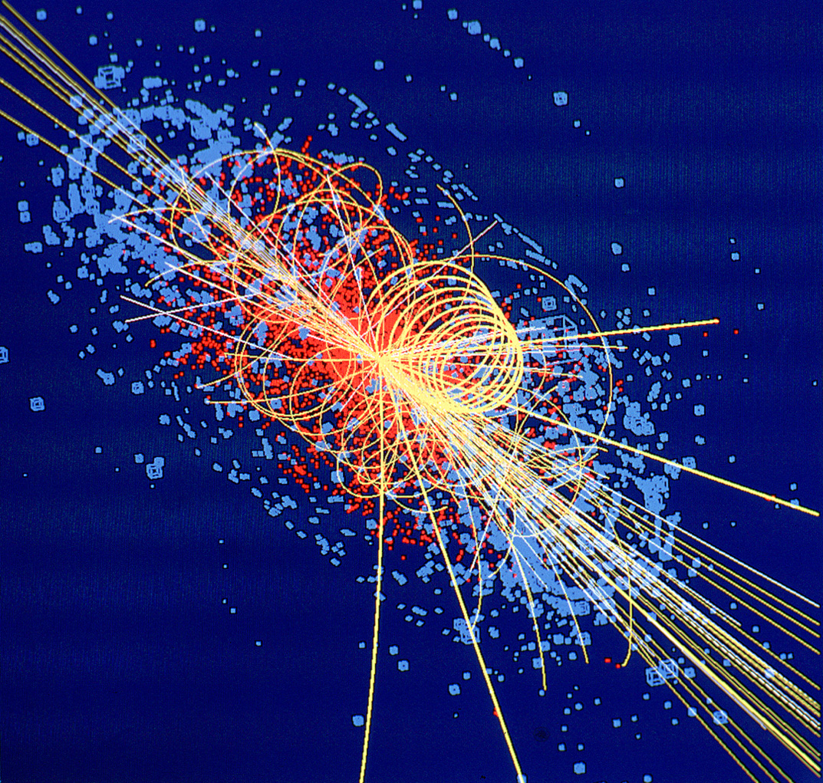
CERN: Particle Physics and Innovation
Interfacing between fundamental science and key technological developments
CERN Technologies and Innovation
Accelerating particle beams
Detecting particles
Large-scale computing (Grid)
Notes:
9

Slide 10
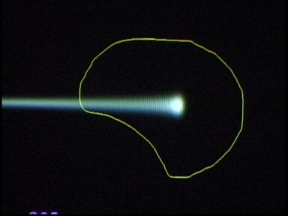
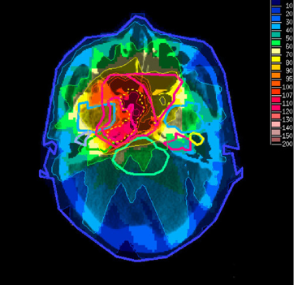
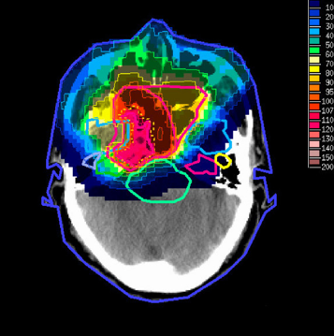
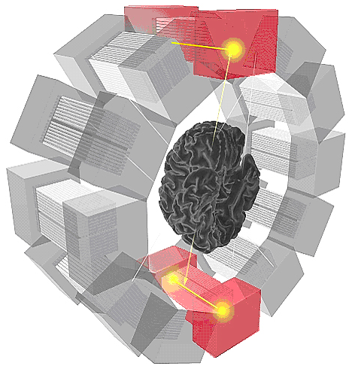
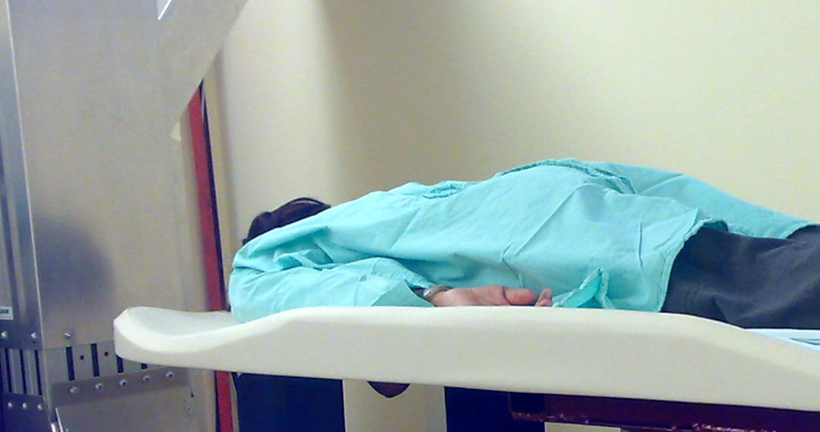
Medical Application as an Example of Particle Physics Spin-off
Combining Physics, ICT, Biology and Medicine to fight cancer
Hadron Therapy
Tumour Target
Leadership in Ion Beam Therapy now in Europe and Japan
Protons
light ions
Accelerating particle beams
~30’000 accelerators worldwide
~17’000 used for medicine
X-ray
protons
>100’000 patients treated worldwide (45 facilities)
>50’000 patients treated in Europe (14 facilities)
Imaging
PET Scanner
Clinical trial in Portugal, France and Italy for new breast imaging system (ClearPEM)
Detecting particles
Notes:
10

Slide 11
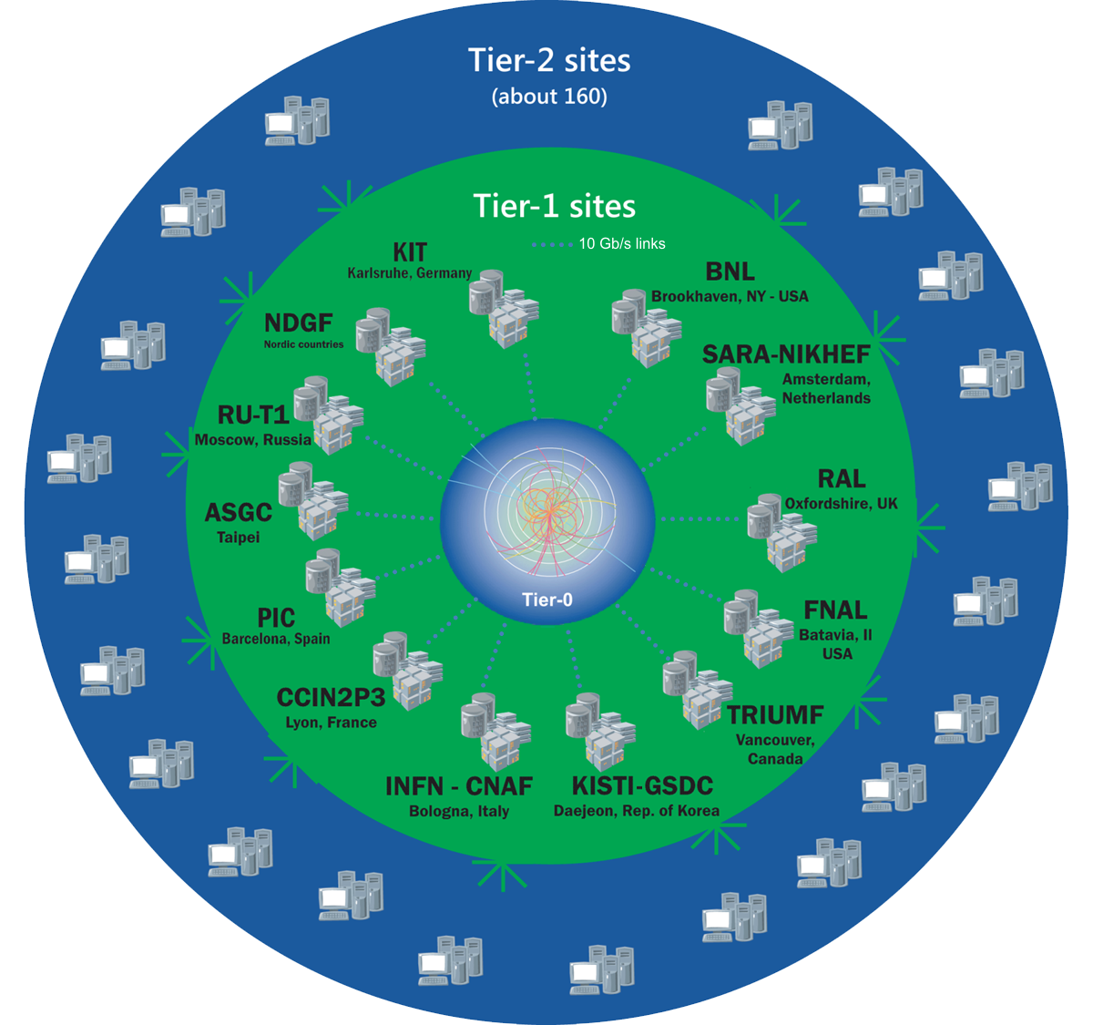
The Worldwide LHC Computing Grid
Tier-0
(CERN and Hungary):
data recording, reconstruction and distribution
>170 sites in,
42 countries
750k CPU cores
800 PB of storage
Tier-1: permanent storage, reprocessing,
analysis
> 2 million jobs/day
Tier-2: simulation,
end-user analysis
35 GB/s global transfers
WLCG:
An International collaboration to distribute and analyse LHC data
Integrates computer centres worldwide that provide computing and storage resource into a single infrastructure accessible by all LHC physicists

Slide 12
Thank You!
Accelerating Science and Innovation
Notes:
12

