Slide 1
Performance impact of crab cavity shift
R. De Maria, R. Tomas
HL-TCC meeting 14/2/2019

Slide 2
Crab Layout: update
B2(E)
1
2
B1(E)
Baseline
C
C
C
C
C
C
C
C
B2(I)
B1(I)
3
4
0.7 to 1.3 m
0.7 to 1.3 m
B2(E)
B1(E)
Proposal
C
C
C
C
C
C
C
C
B2(I)
B1(I)
Swap B1<->B2
M. Gonzalez et al., Update on Crab Cavities displacement proposal, 8/2/2019
Positions | Baseline From IP [m] | RFD (H Point 1) from baseline [m] | DQW (V Point 5) from baseline [m]
CC1 | 154.817 | +1.068 | +1.158
CC2 | 155.867 | +1.138 | +1.008
CC3 | 158.637 | +1.283 | +0.912
CC4 | 159.687 | +1.353 | +0.762
Crab cavities are slightly less efficient because further from the IP.
Marginal impact on performance (crabbing angle 380 -> 376 μrad).

Slide 3
Back-up

Slide 4
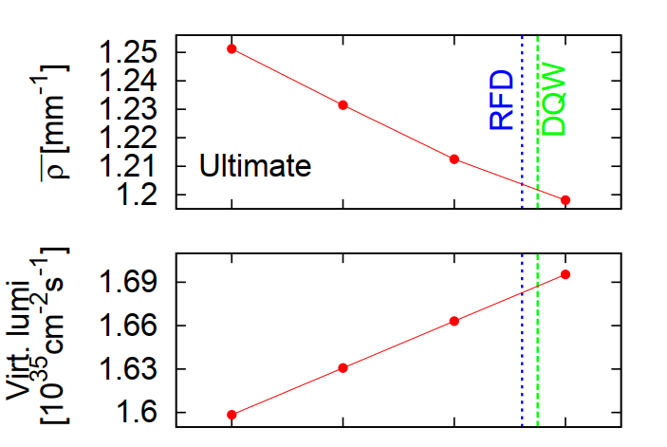
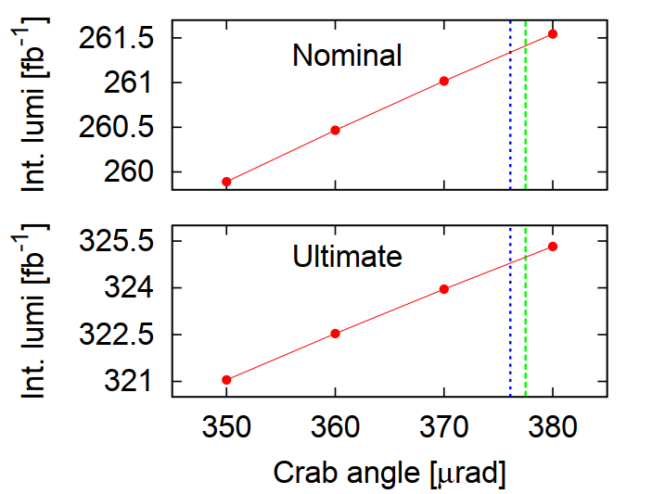

Luminosity vs Crabbing Angle
Impact | Baseline | Proposal (RFD) | Proposal (DQW)
Crabbing angle [μrad] | 380 | 376.1 | 377.5
Marginal impact on performance.
New crabbing angle 376 μrad.

