Slide 1
QXL layout for Crab Cavities
M. Sisti (TE-CRG) on behalf of WP9 team
67th HL-LHC TCC meeting
CERN, 14 Feb 2019

Slide 2
Table of contents
Requirements
Design principles
Proposed solutions
Selected configuration
Conclusion
M.Sisti (TE-CRG) - 14 Feb 2019
67th HL-LHC TCC meeting

Slide 3
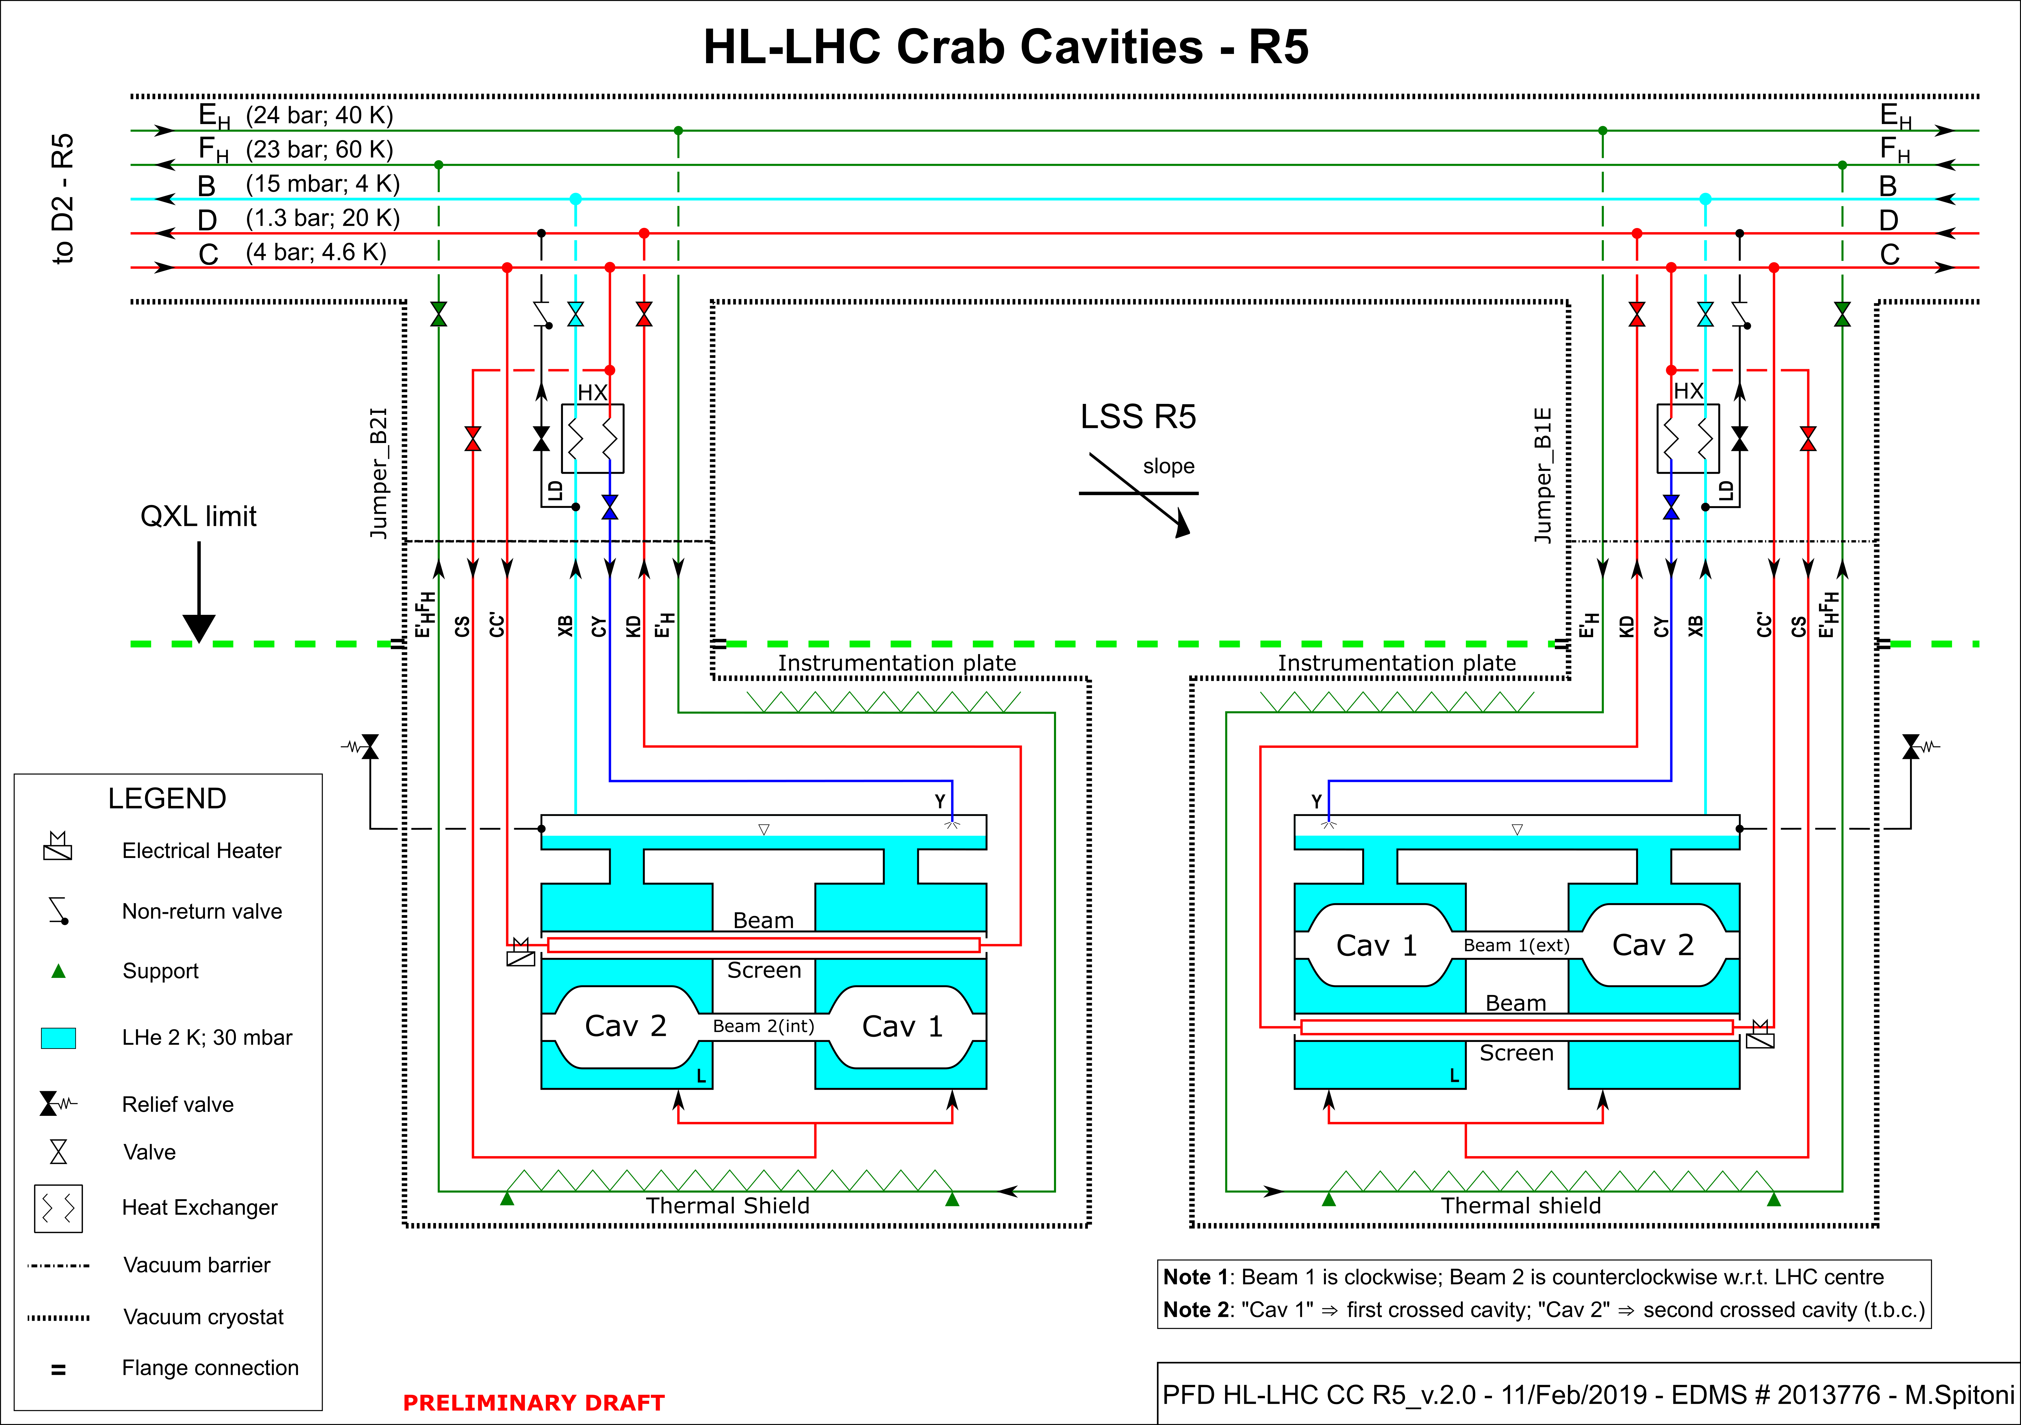
Requirements
Circuit | Requirements
Thermal shield + intercepts | 400 W (tbc)
Beam screen | 10 W (tbc)
LHe bath @ 2 K | 60 W (tbc)
Values for one cryomodule
M.Sisti (TE-CRG) - 14 Feb 2019
67th HL-LHC TCC meeting

Slide 4
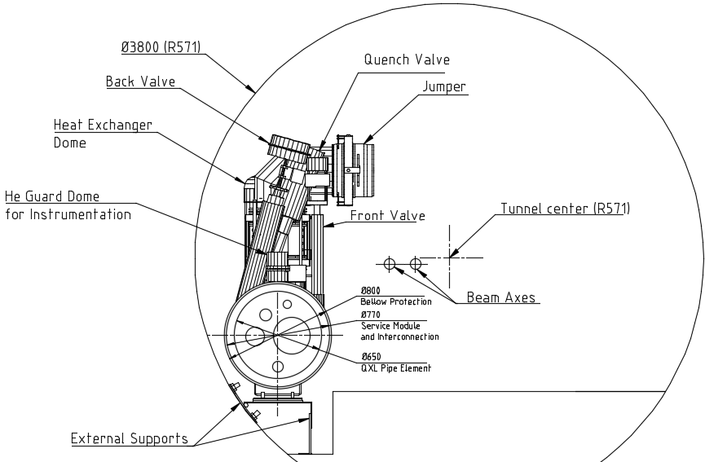
Design principles
Service Module (SM) for crab cavities:
Based on LHC QRL design
Valves (6) positioning and spacing
Inner pipes routing w.r.t. to valves and jumper
Space reservation for domes (heat exchanger and flow check valve)
Space reservation for instrumentation (some of them under He guard)
Space reservation for compressed air control panel
Additional constraints:
Access for maintenance
(even with platforms)
ALARA principle for:
  Total Ionizing Dose
  1 MeV n_{eq} fluence
  Residual Dose Rate
Maintenance
Ref. LHCQXL__0009
M.Sisti (TE-CRG) - 14 Feb 2019
67th HL-LHC TCC meeting

Slide 5
Proposed solutions R5 (ref. LHCQXL__0011_v.AB)
7.85 m
4.6 m
M.Sisti (TE-CRG) - 14 Feb 2019
67th HL-LHC TCC meeting

Slide 6
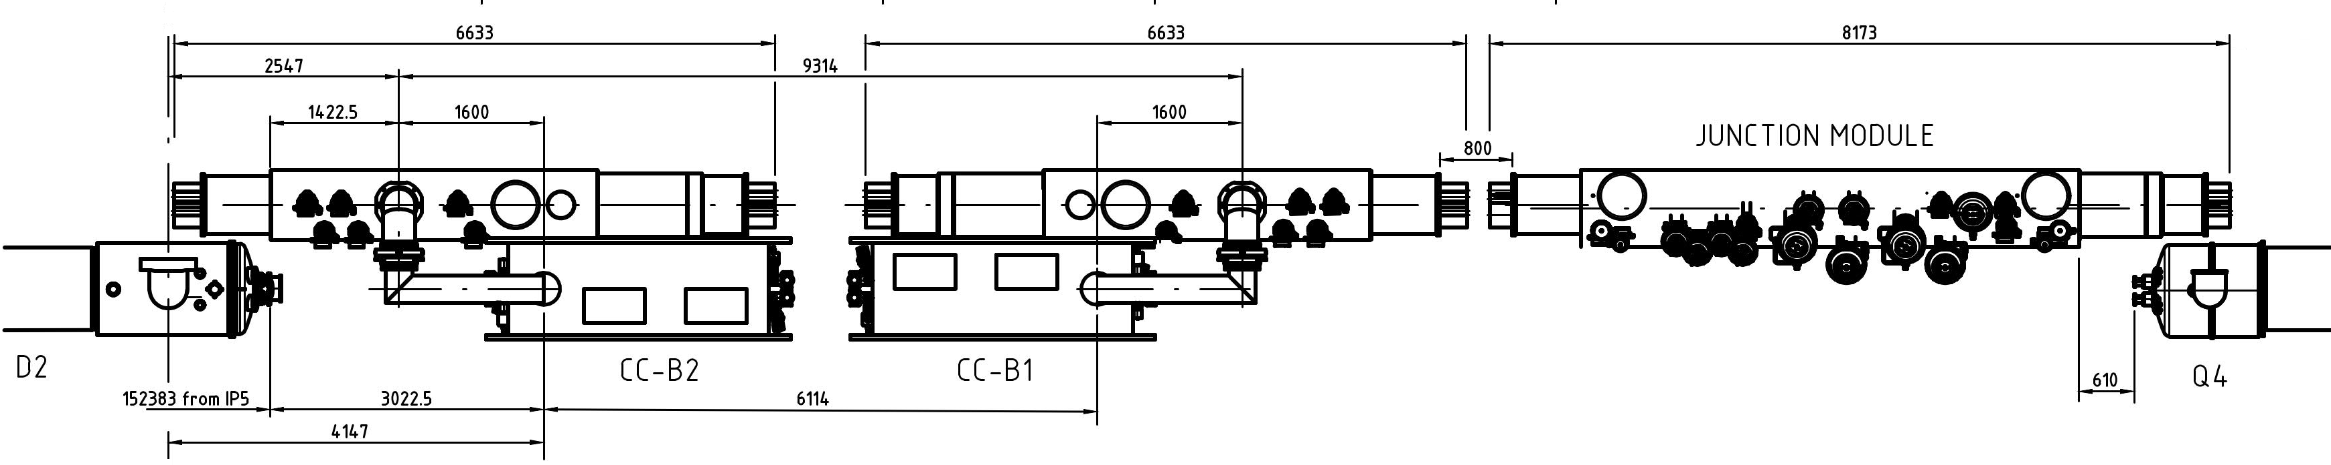
Selected configuration
Shifting from baseline position minimized (fulfilling the SM design principles)
Distance between CC modules not depending from QXL
No cryo-items behind waveguides
Jumper extensions enabling CC module interchangeability
Space reserved for the D2-DSL link crossing the SM
Available space for platform (tbc)
Impact on the QRL for Q4
M.Sisti (TE-CRG) - 14 Feb 2019
67th HL-LHC TCC meeting

Slide 7
Conclusion
Solution 3 selected and agreed with WP4-RF & WP15-Integration
Platform to be integrated
Independent warm-up and cool-down requirements to be studied:
  Impact on space reservation around CC
  No impact foreseen for SM design (and then for Optics)
M.Sisti (TE-CRG) - 14 Feb 2019
67th HL-LHC TCC meeting

