Slide 1
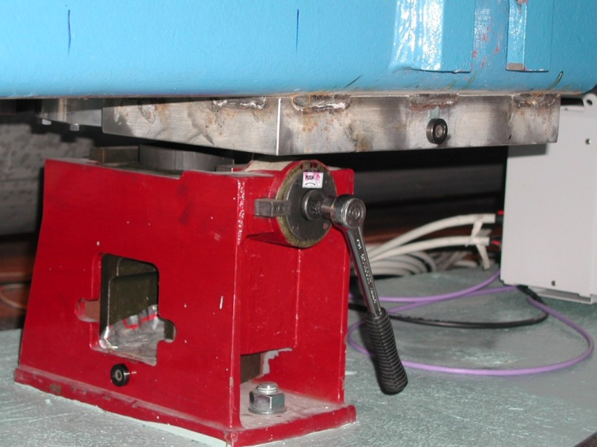

Strategy for motorized jacks of HL-LHC equipment
B. Di Girolamo, D. Duarte Ramos, H. Mainaud-Durand, V. Parma, F. Sanchez Galan, M. Sosin
67th HL-LHC TCC Meeting – 14 February 2019

Slide 2
Main points
The new jacks for HL-LHC magnets have to be motorized
They will be, most probably, not so different in design from the existing LHC ones, with some changes to adapt to different equipment
The new design has to foresee motorization as integral part and not as add-on

Slide 3
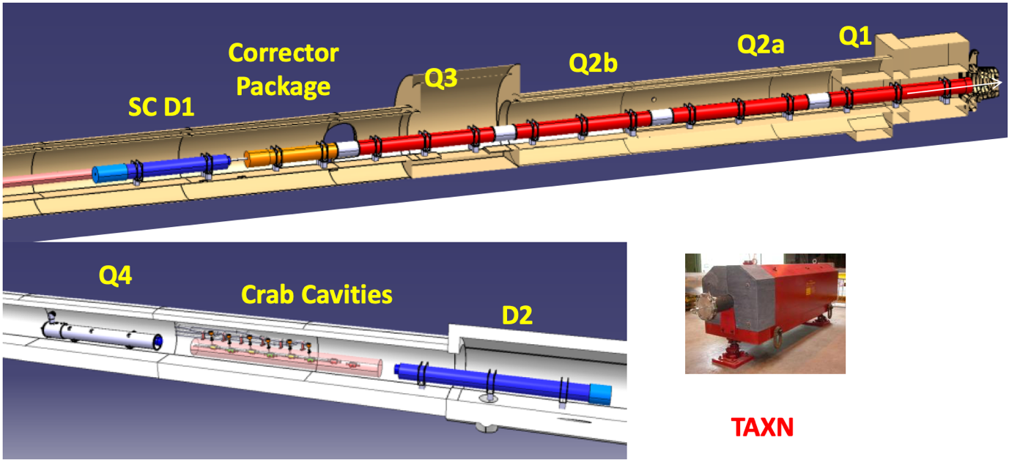
Quantity of jacks identified so far
Assuming the use of the same type (modulo interfaces) for all elements from Q1 to Q5
Assuming that each device needs 3 jacks
+ Q5

Slide 4
Quantity of jacks identified so far
Schematically
Experiment|Q1|Q2a|Q2b|Q3|CP|D1|TAXN|D2|CC1|CC2|Q4|Q5
The pattern repeats 4 times therefore
4∗(12∗3) = 144
This bare minimum needs to be complemented with:
  IT String (Q1 to D1) needs 18 jacks + 2 spares
  Spare policy: 10 units (+ IT Strings ones recovery)
Total scope of procurement: 20 pre-production + 154 production = 174 jacks

Slide 5
Procurement Strategy: collaboration + rest
We have been thinking at an in-kind contribution since long
We got two candidates in the past
We had the news of the Republic of Serbia special contribution and we jumped on it to have a full in-kind
Scope and timeline of Serbia special agreement
  Completion of design in 2019 to mid-2020
  20 mechanical jacks: pre-production aimed at mid- to end-2020
  154 mechanical jacks: production in 2022-2023 after green light from deployment in 2021 (IT String)
🇷🇸

Slide 6
Boundary conditions
Motorization and control harmonized with collimators and kept at CERN
However, asking Serbia to complete the design to take into account actual motorization as integral part: need of supplying interface details and actual sample of motorization for validation tests during production
Clear preference, from CERN, for design completion by final producer (it will most probably be a company) and our collaborator (it will be a Serbian Institute)

Slide 7
Next steps
Technical meeting at CERN in the first week of March between CERN and Serbia engineers to agree on the details
Preparation of a collaboration agreement to define better the scope of procurement (who does what, quantity, timeline) and smooth details (interval between pre-production, green light, production, delivery, possible other support)
Tendering process in Serbia
Production and follow-up

Slide 8
What else?
One of the aims of this presentation is:
  Did we count all the needs?
  What other equipment will possibly need jacks, not necessarily motorized?
Please notify us as soon as possible
  There is still room for increase the scope in the coming weeks
  Serbia would like to start the tendering process very soon to satisfy our early need (IT String) therefore the deadline is Start of Spring 2019

Slide 9
Immediate questions?
Thank you
Don’t forget the jack
Don’t forget Valentine’s day

