Slide 1


Development of SOI Monolithic Pixel Detector for Fine Measurement of Space and Time SOFIST
K. Hara (Univ. Tsukuba)
for SOIPIX Collaboration
SOFIST development:
U. Tsukuba: K. Hara, D. Yamauchi, R. Abe, S. Iwanami, H. Murayama, K. Watanabe
KEK: T. Tsuboyama, M. Yamada, S. Ono, Y. Arai, Y. Ikegami, I. Kurachi, M. Togawa, J. Haba
Tohoku U.: Li. Taohan
Project supported by
JSPS Grant-in-Aid for Scientific Research on Innovative Areas (2013-2017)

Slide 2
OUTLINE
SOI PIXEL Sensor Development – Introduction
Highlights of Achievements
SOFIST
  design & developments
  SOFIST-1 position resolution
  SOFIST-2 timestamp resolution
  SOFIST-3 quick evaluation
SOFIST-4 3D stacking
Summary

Slide 3
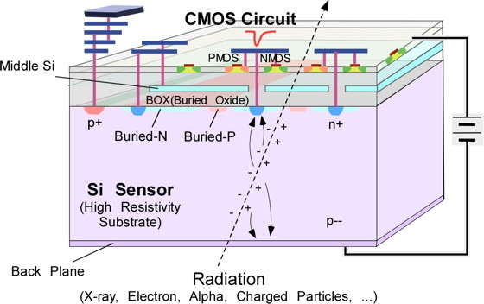
SOI pixel devices
SOI: Silicon-On-Insulator
CMOS circuitry fabricated on buried oxide(BOX)
LAPIS 0.2um FD-SOI
Features:
Monolithic (no metal bumps)
SOI-CMOS (FETs fully isolated)
Can choose* substrate of optimum resistivity (fully depleted CMOS sensors possible)
*SOITEC SmartCutTM
many excellent features
Material budget
S/N
power dissipation
single event effects
latch up
Operation temp. (0.3K～570K)
speed
cost
Pixel size
TID tolerance improved to 1MGy by introducing double SOI wafer (HSTD11)

Slide 4
Grant-in-aid (fy2013-17) interdisciplinary research on quantum imaging opened with 3D semiconductor detector

Slide 5
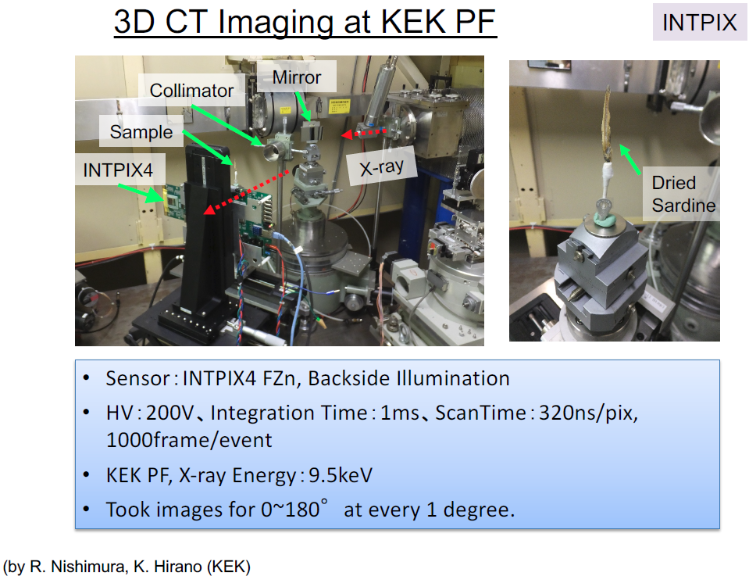
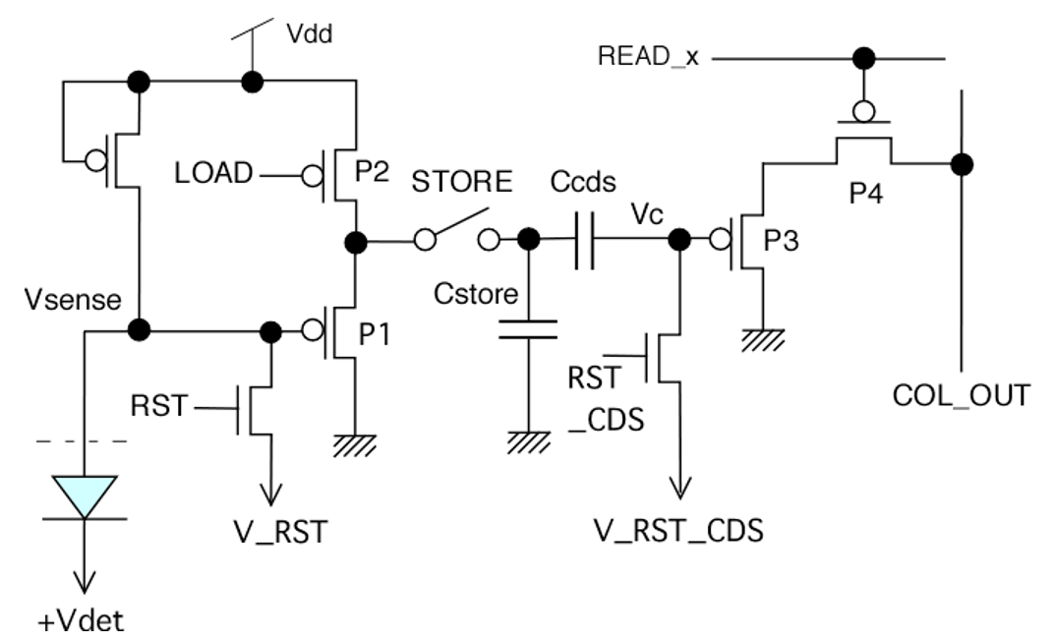
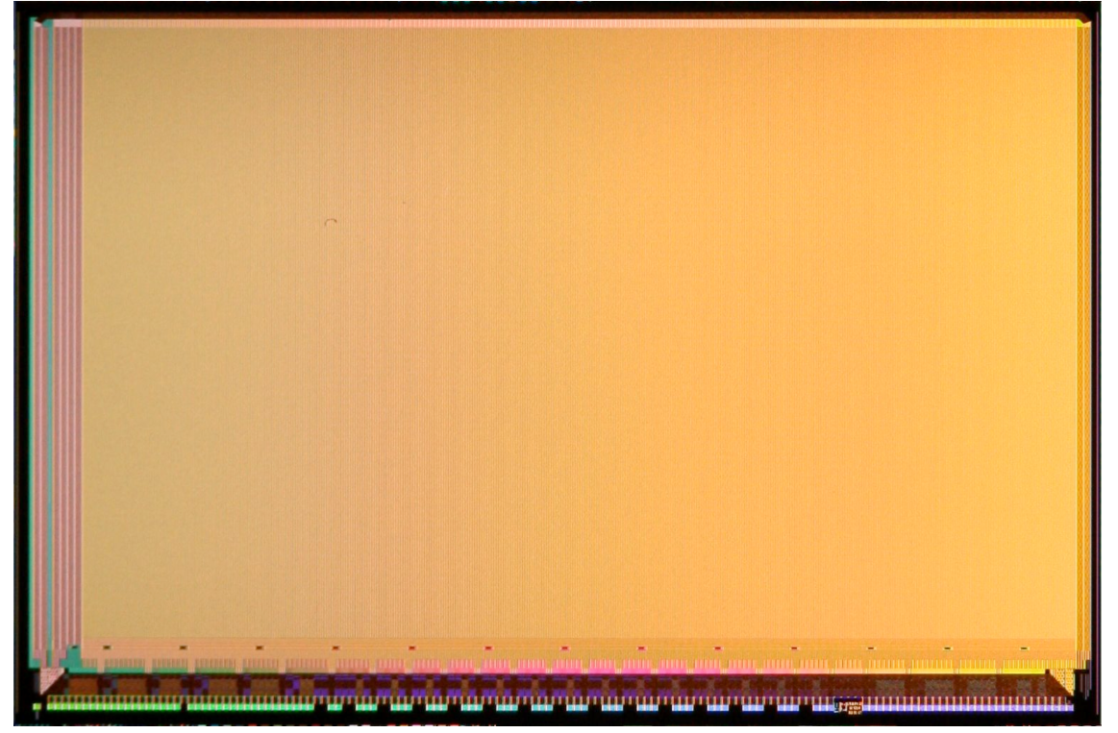
highlight-2 (INTPIX4)
Integration &global shutter
Fe-55
10.2x15.4mm

Slide 6
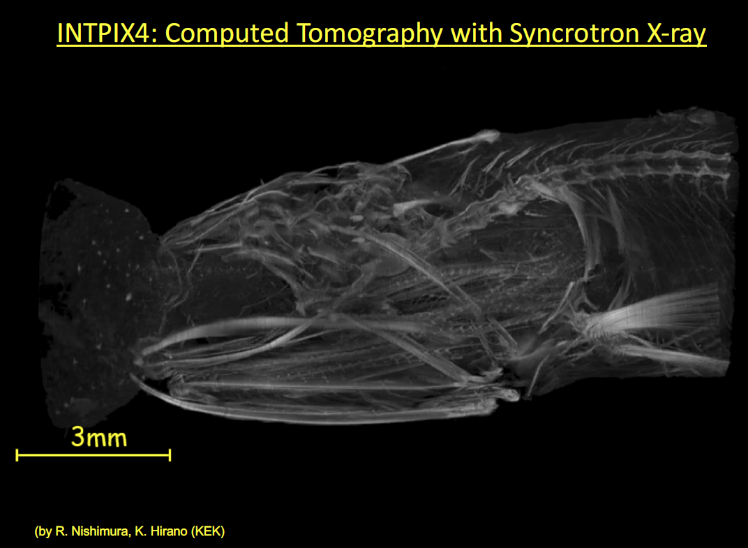
highlight-2 (INTPIX4)

Slide 7
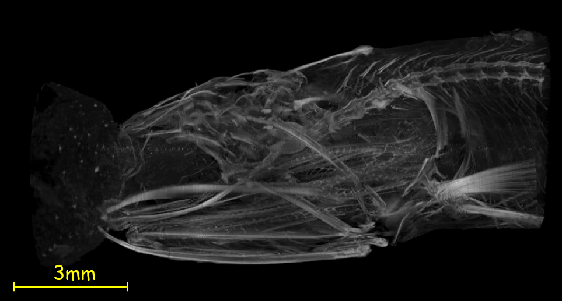
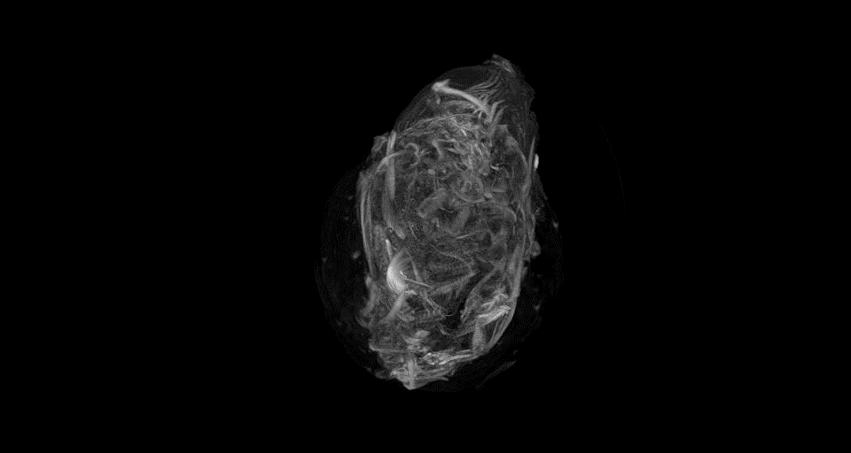
INTPIX4: Computed Tomography with Syncrotron X-ray
3mm
(by R. Nishimura, K. Hirano (KEK)
Notes:
煮干しを0〜180度まで回転させたときの
それぞれの角度での積分画像を1度刻みでを取得しています。
全181枚のデータをRA=255の軸を中心に
1度ずつずらして配置した形に再構成したものが
お送りした動画になります。
再構成時にスケールの修正は特に行っていないとのことですので、
再構成後の画像の1ピクセル＝1um角となります。
なお、
波紋状のもの
については背景減算後に残ったビームプロファイルの痕跡によるものと考えられ
ます。
(すべての画像でほぼ同じ位置に痕跡が残っているので回転像では円形に映りま
す)

Slide 8
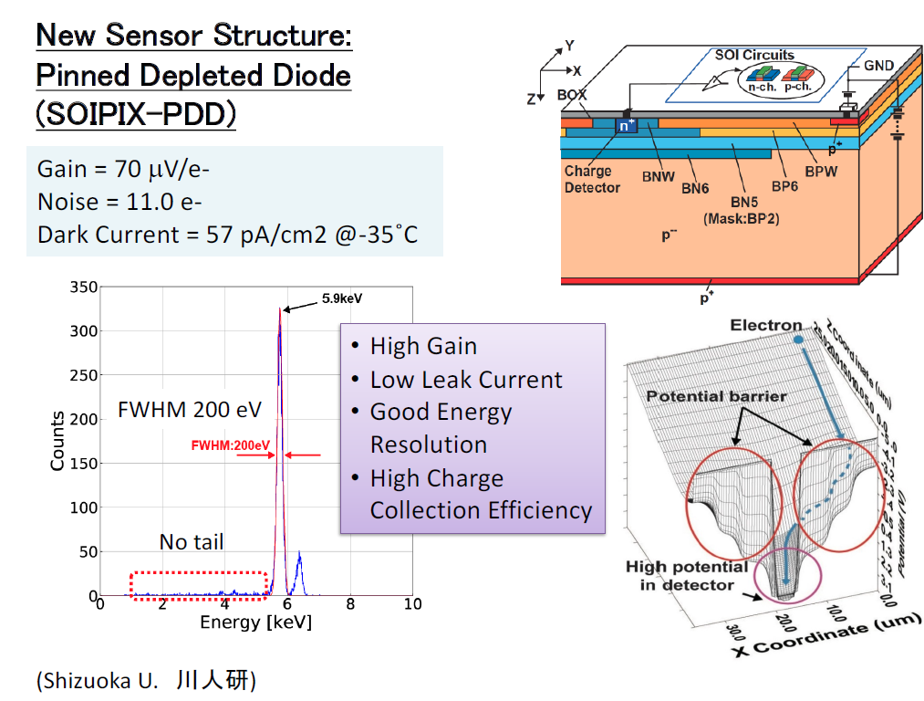
highlight-1 (SOIPIX-PDD)
Fe-55

Slide 9
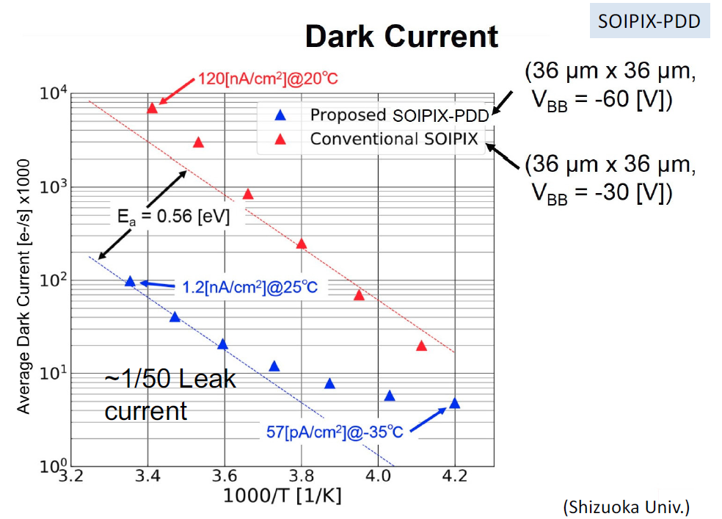
highlight-1 (SOIPIX-PDD)
Fe-55

Slide 10
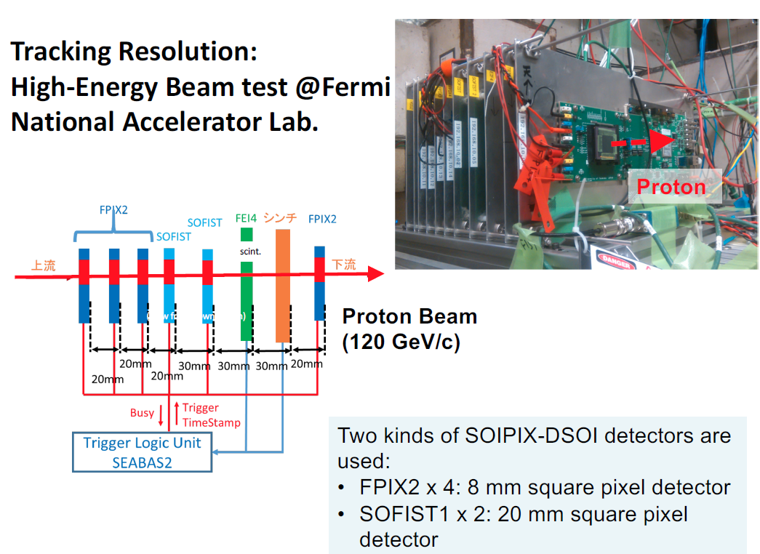
highlight-3 (FPIX2)
μm
μm
U Tsukuba/KEK

Slide 11
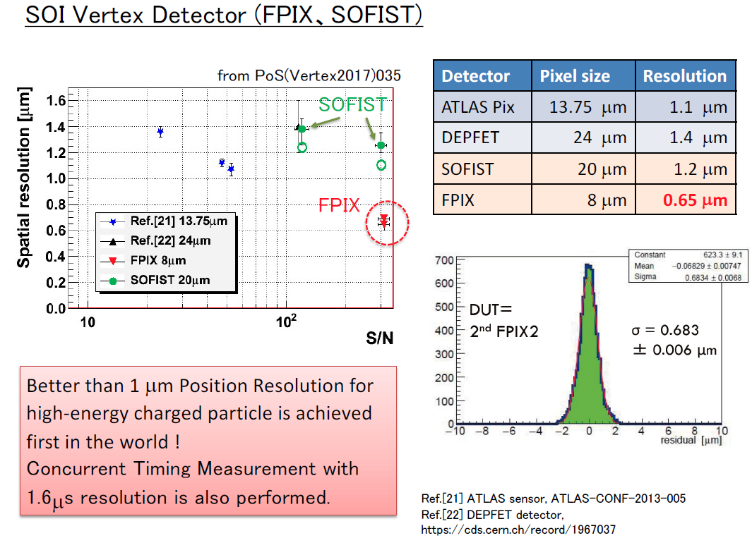
highlight-3 (FPIX2)
1.9
U Tsukuba/KEK

Slide 12
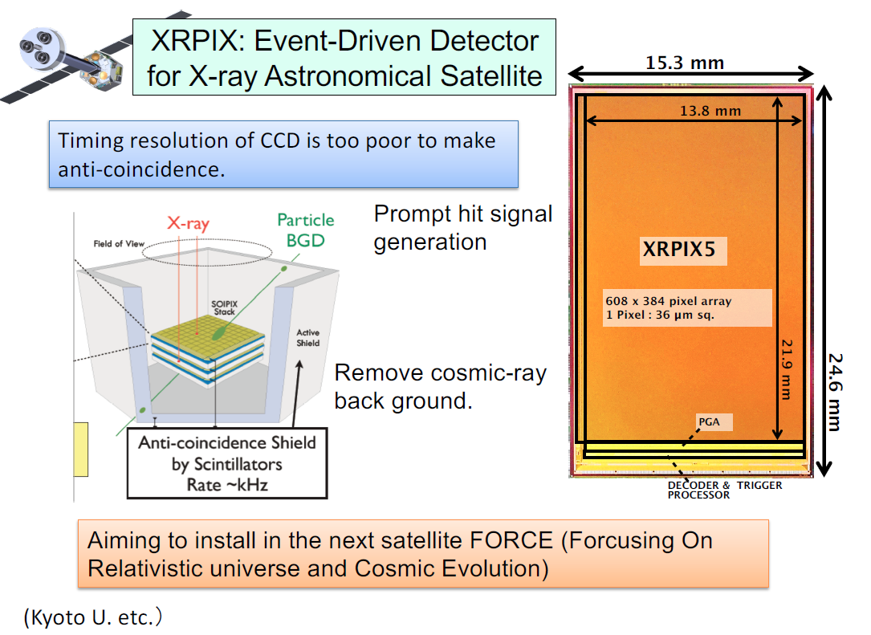
highlight-4 (XRPIX5)

Slide 13
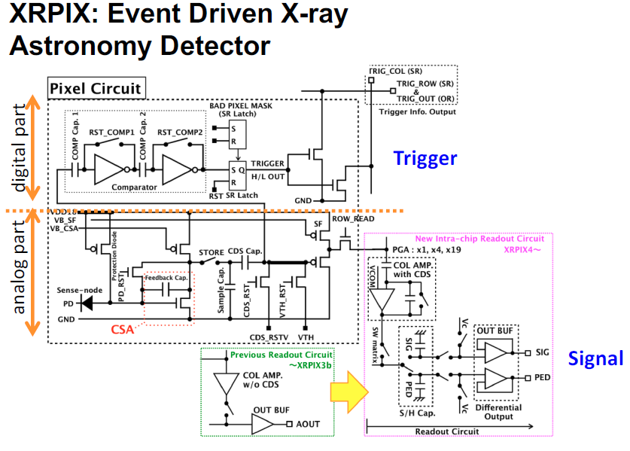
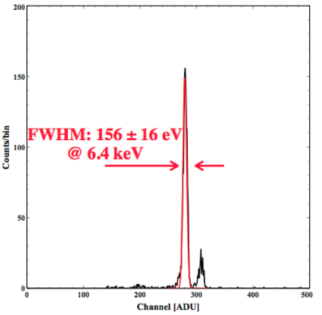
highlight-4 (XRPIX5)

Slide 14
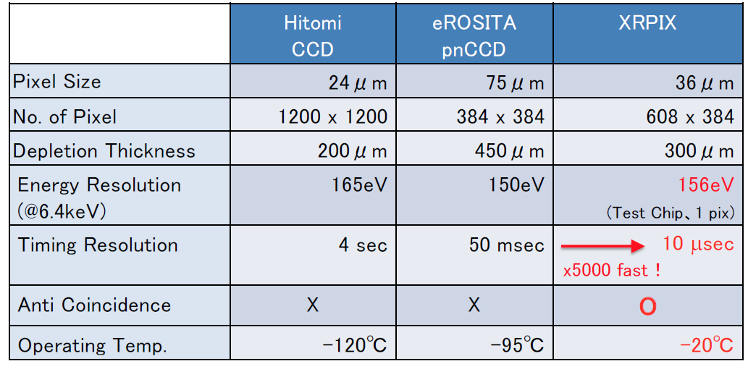
highlight-4 (XRPIX5)
Energy resolution as good as CCD’s
Much faster!
Muon veto possible

Slide 15
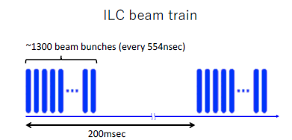
sofist SOI Monolithic Pixel Detector for Fine Measurement of Space and Time
Allows time and space point measurement
Design specified to meet the requirements for the ILC experiment
Main requirements:
Position resolution <3um
Low material <0.2%Xo/layer
TID~1kGy/year
NIEL ~10¹¹n_{eq}/cm²/year
Readout between trains
bunch ID highly preferred
Power dissipation: <50mW/cm²
The goal is a sensor with both good spatial resolution of <3um and time resolution <1us.
pixel size ~20um-sq with analog readout
timestamp recording the ramping voltage
store the data allowing multiple hits on the same pixel
on-chip ADCs &zero-suppression for fast data transfer

Slide 16
Sofist pixel architecture
Start Vramp per beam train
Signals exceeding Vth
shift-register chooses* memory cell to record
analog signal recorded
timestamp voltage recorded
Recorded memories are digitized by column ADCs (8bit has been implemented)
Zero-suppression applicable
Main requirements:
Position resolution <3um
Low material <0.2%Xo/layer
TID~1kGy/year
NIEL ~10¹¹n_{eq}/cm²/year
Readout between trains
bunch ID highly preferred

Slide 17
SOFIST – in development
FNAL
Beamtested
(both but in separate pixels)
Under evaluation (both in same pixel)
FNAL
Beamtested
(only analog)
delivered
Under 3D

Slide 18
soFist-1 spatial resolution
SOFIST residual to FPIX track (σ_track~0.57/0.65μm)
Bias=130V (~500um depletion) =>15V (~200μm depletion)
Readout: external 12-b ADCs =>on-chip 8-b ADCs
SOFIST#1(BPW14x14)
SOFIST#2(BPW16x16)
plots for “black case”
Residual X
1.50 ± 0.05 μm
1.37 ± 0.04 μm
1.57 ± 0.08 μm
1.49 ± 0.06 μm
1.58 ± 0.05 μm
1.33 ± 0.03 μm
Residual Y
1.38 ± 0.05 μm
1.35 ± 0.04 μm
S/N~300 (130V)
~120 (15V)
1.55 ± 0.08 μm
1.38 ± 0.05 μm
1.54 ± 0.04 μm
1.32 ± 0.03 μm
Ono (KEK)

Slide 19
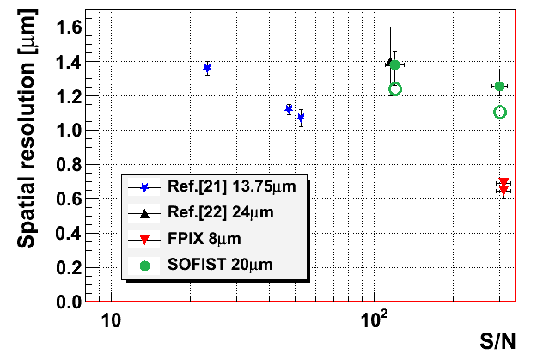
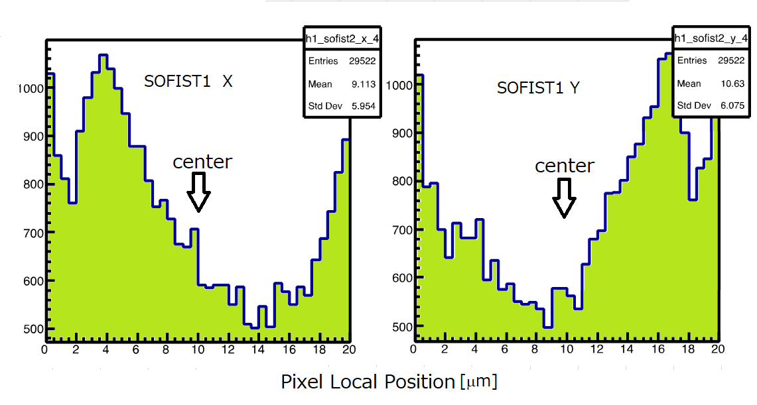
soFist-1 spatial resolution
depletion
~200um
~500um
Track uncertainty (0.6um) subtracted
Compatible with DEFFET ([22])
η correction may improve further
~400um
1000
500
Ono (KEK)

Slide 20
soFist-2 beam test 2018mar
Beamline Setup
scint.+MPPC
SOFIST
INTPIX4
(17um□, 8.7x14.1mm)
(2mm□)
RoI(2,3,,mm□)
adjustable
120GeV p
event tag
BUSY
Timing Chart
INTPIX4
RO
RO
space
SOFIST
RO
RO
space&time
timestamp
Vramp
1ms
BUSY
RO with external 12-bit ADCs
STORE
500μs
spill
event tag
4.2s

Slide 21
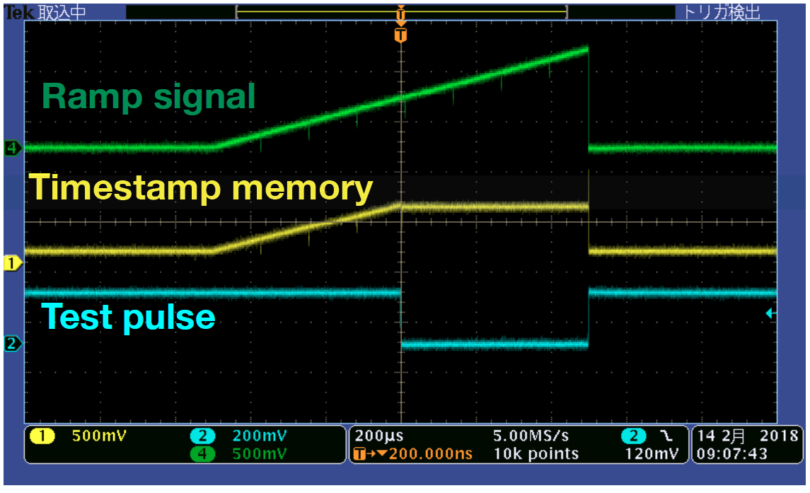
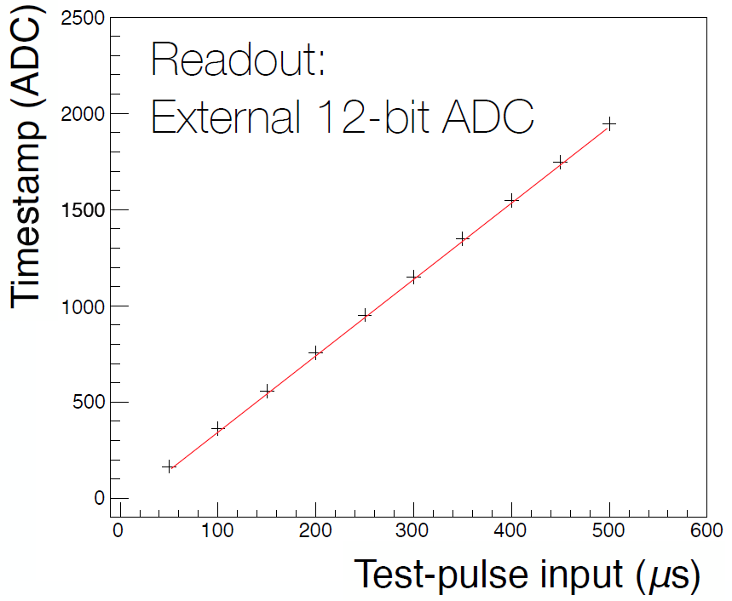
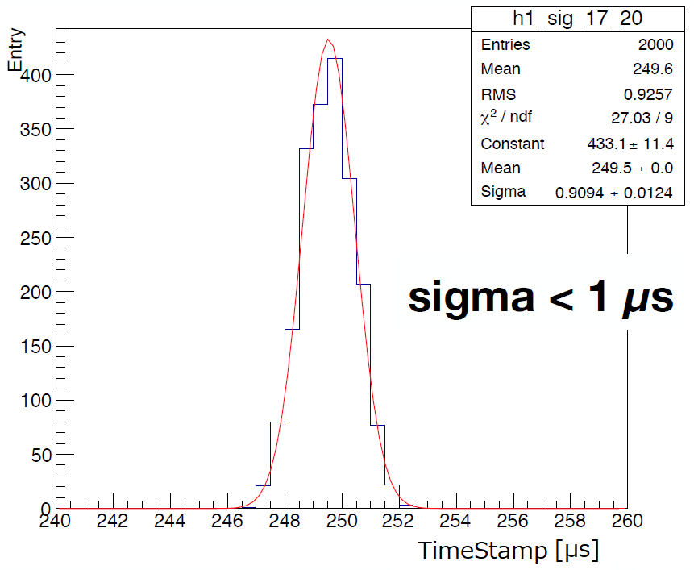
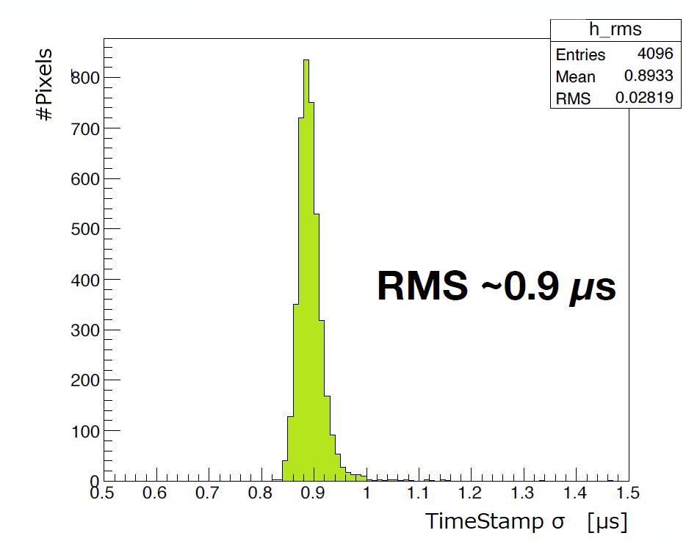
soFist-2 timestamp calibration
conducted on site
1ms
1V
linear correlation
assumed
All pixels
T_{test}=250us
conducted on site
Ono (KEK)
Ono (KEK)

Slide 22
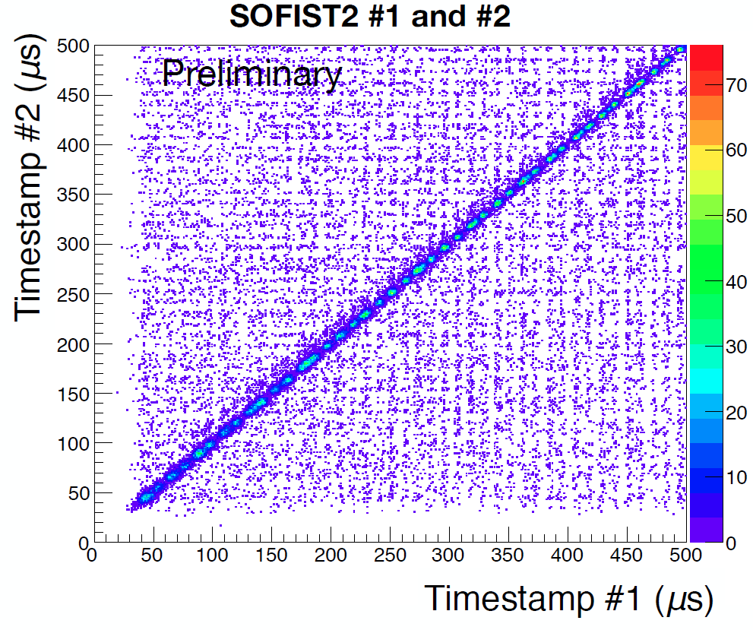
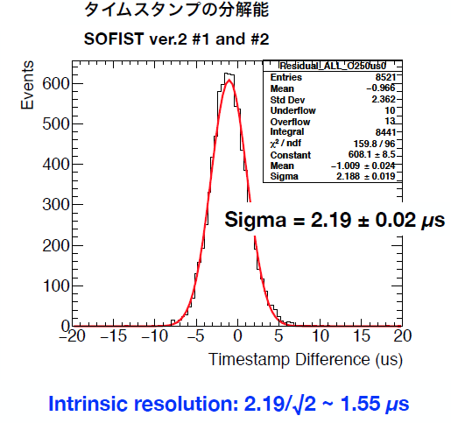
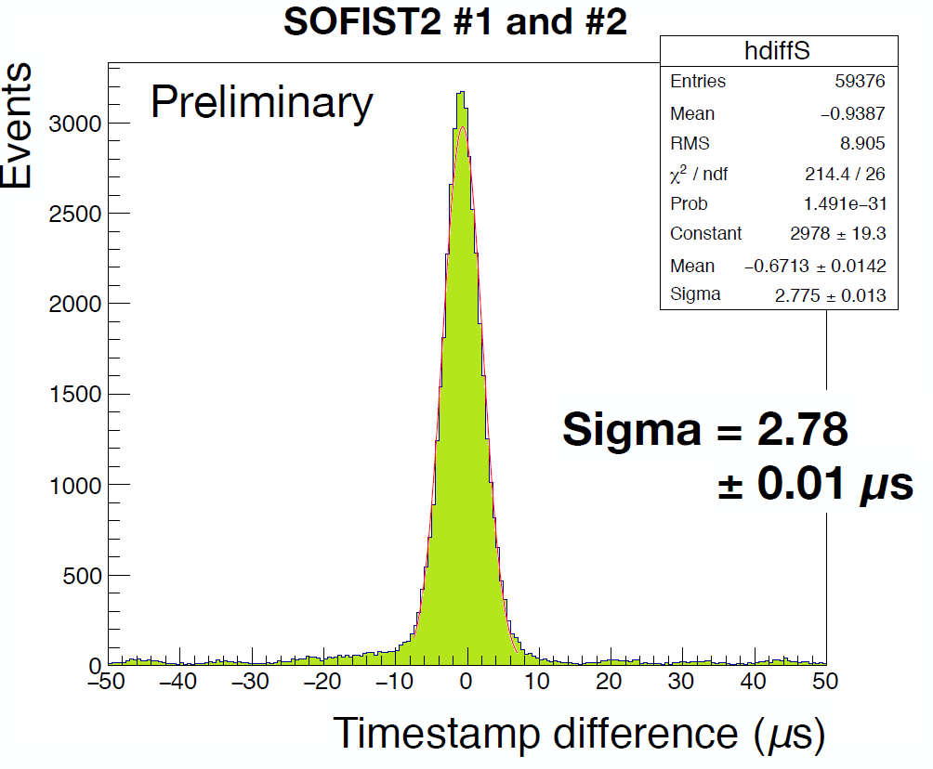
soFist-2 timestamp correlation
Correlation of timestamps in two SOFISTs
Overlapping events in same 500us gate
Ono (KEK)
Periodic clusters?
Ono (KEK)

Slide 23
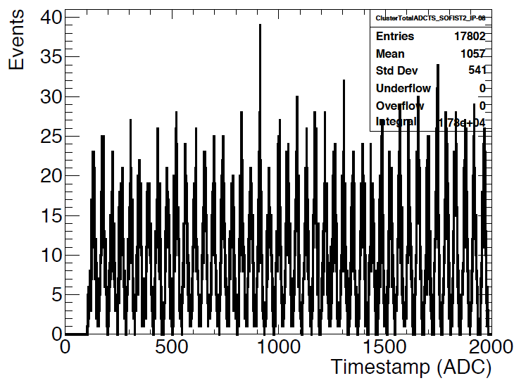
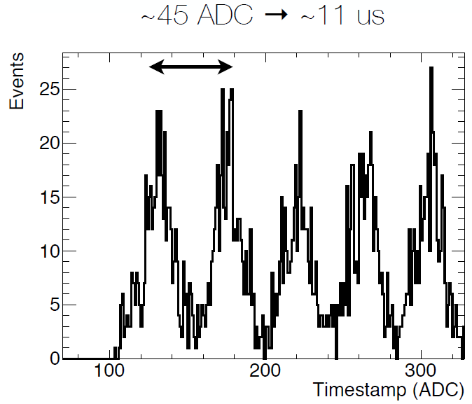
Size of FNAL Main injector (MI)
Yamada (KEK)
Beam structure due to bunch rotation in the MI: 11us→3.3km (3319m actual)
Yamada (KEK)

Slide 24
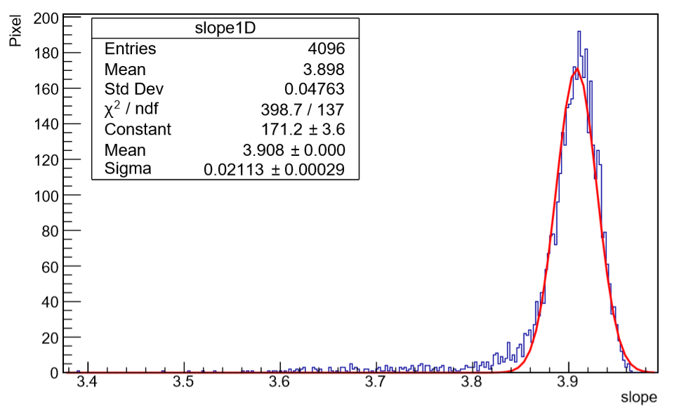
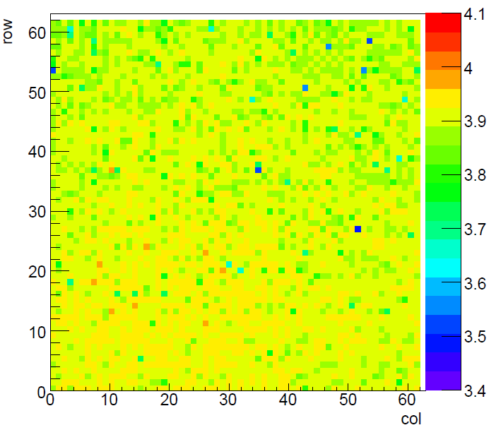
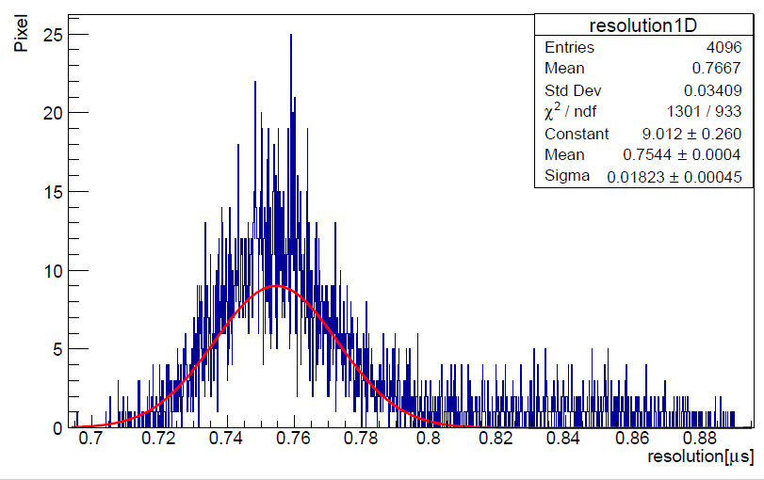
SOFIST-2 timestamp precision
ΔADC/Δdelay[us]
conducted on testbench
(0,0)
linearity
ADC counts
Test pulse delay [us]
Murayama (Tsukuba)
Time spread for 500us delay pulses
Slight row dependence
resolution
~0.75us(~2.9ADC)
No notable position dependence

Slide 25
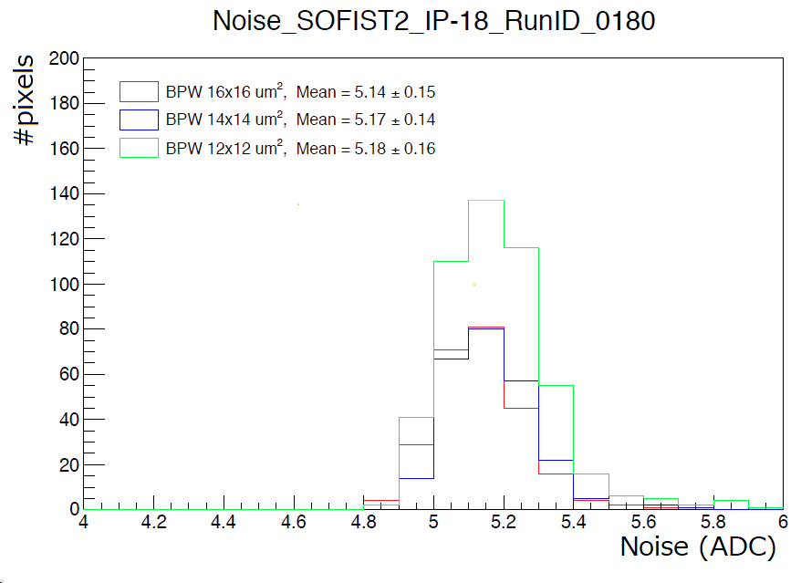
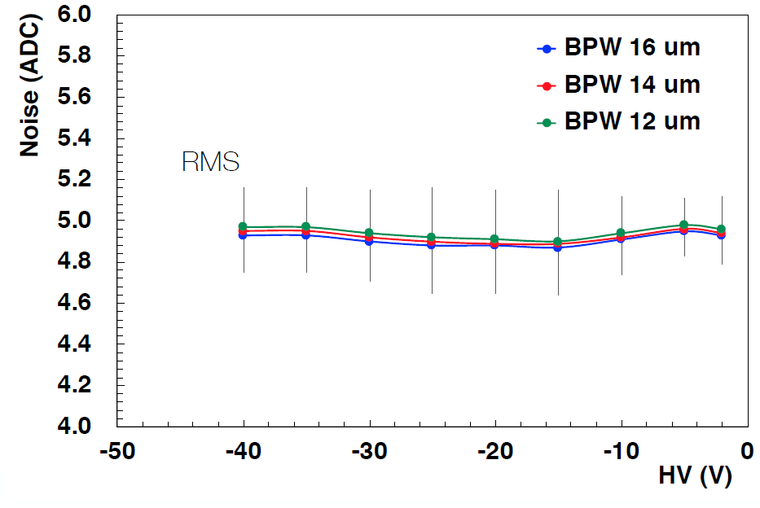
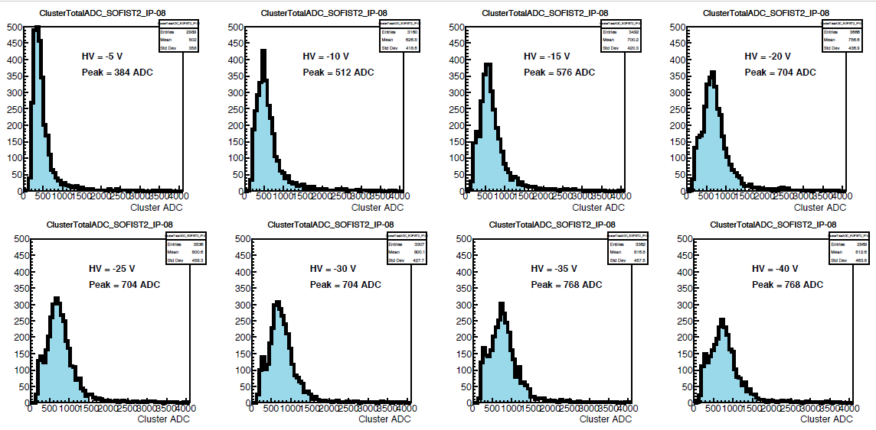
SOFIST-2 analog signal
8
BNW
67
p
25um
Yamada (KEK)
-5V
Cluster charge
(HV dependence)
-20V
-40V
Yamada (KEK)

Slide 26
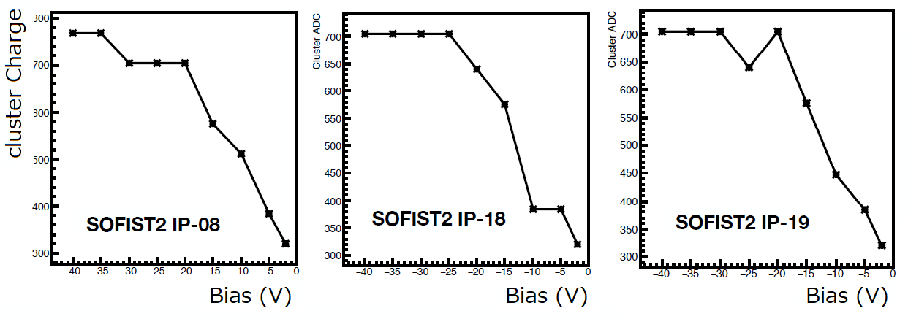
Sofist-2 full depletion
Yamada (KEK)
Full depletion expected ~30V for 9x10¹²/cm³ (0.5kΩcm) concentration (measured)
S>700 ADC (N~5 ADC) for 67um thickness

Slide 27
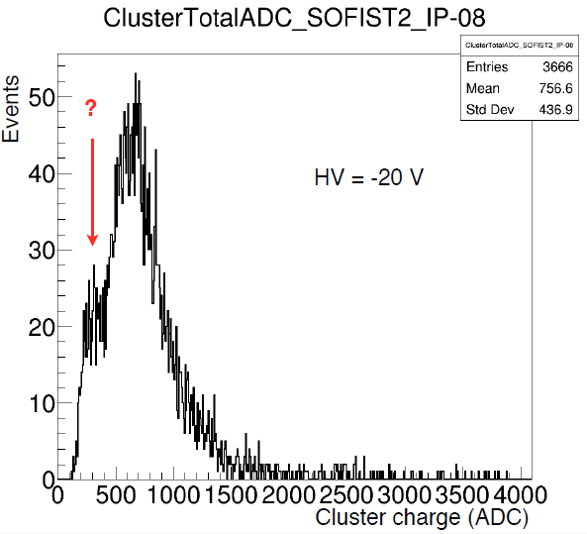
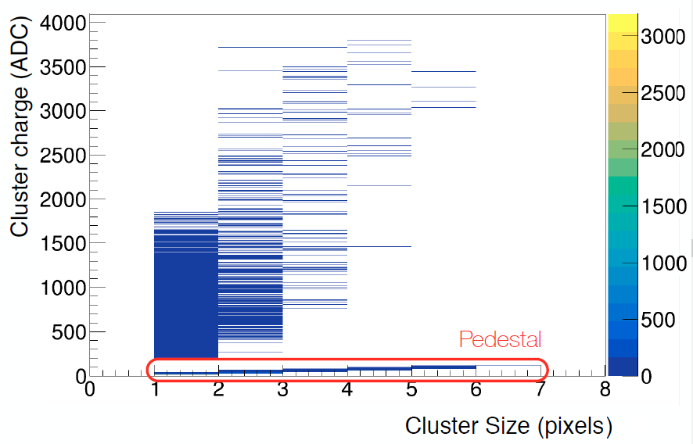
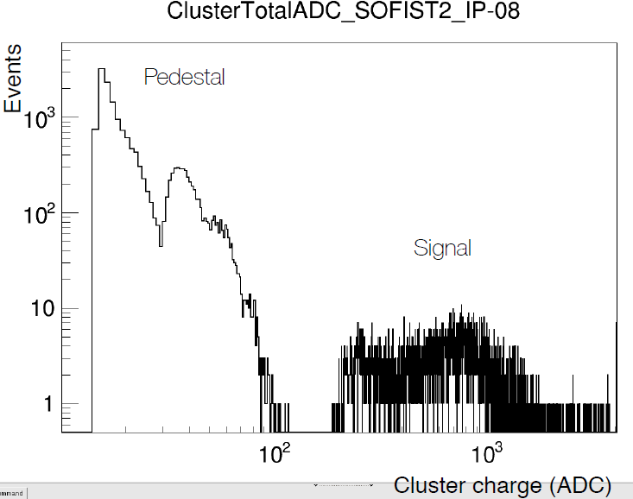
Sofist-2 cluster charge
Mostly one-cluster events
Vth ~1/2 mip
peak~300ADC: X-talk at Comparator ON
Seed>10σ
3x3 cluster
events
Seed>3σ
Vth ~1/4 mip should be possible…
Yamada (KEK)
Yamada (KEK)

Slide 28
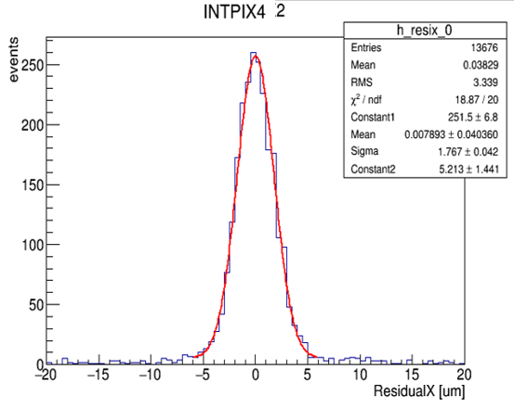
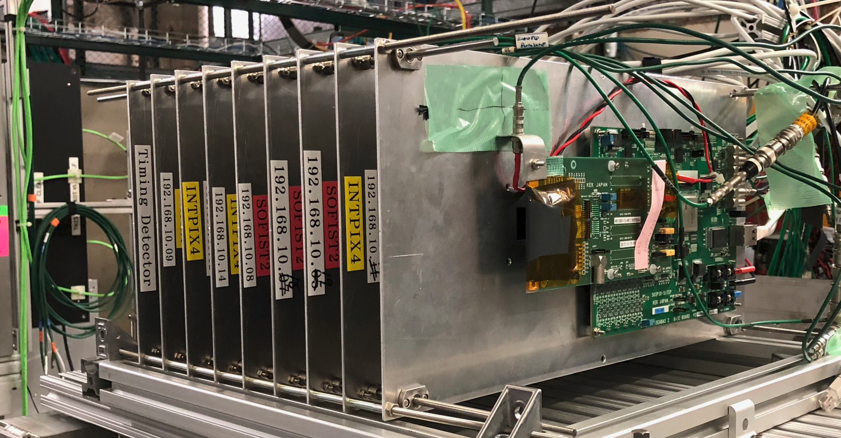
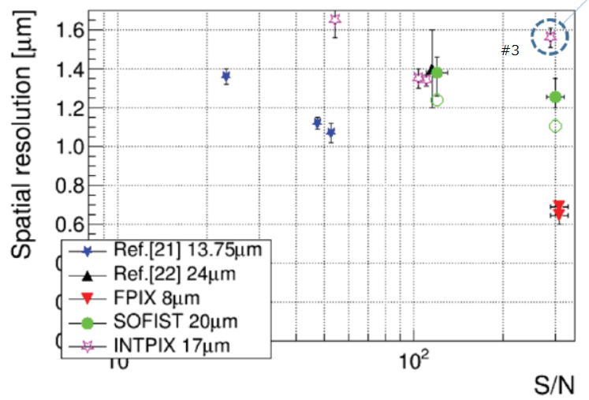
SOI Testbeam@FNAL
(2018 Feb/Mar)
Tracker for SOFIST testbeam
Using 4 plaes of large-area INTPIX4
σ=1.77um
σint=1.37um
Pixel size : 17x17um
Sensitive area (8.7x14.1mm)
（山内, 修論)
Hit residuals of 2nd to tracks (1st,3rd,4th)
13 parallel readout
64x512
64x512
64x512
512x832 pixels
-> 300 fps
faster by RoI selection

Slide 29
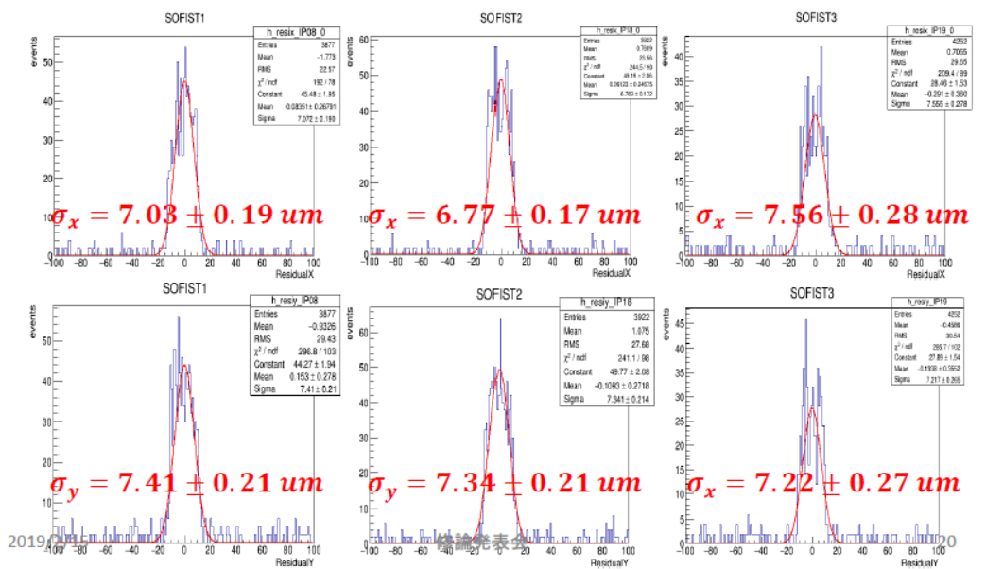
SOFIST2 spatial resolution
7.03 6.73 7.50
7.03 7.30 7.16
Due to a high Vth applied in the testbeam, hits are with ~single cluster ⇒25um/√12~7.2um expected

Slide 30
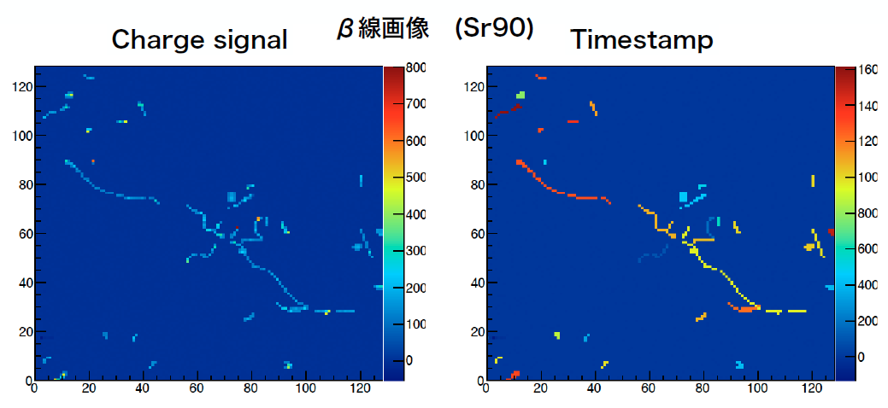
SOFIST-3 – quick test
Both functions implemented on 30um pixels
Under testbeam @ FNAL
S. Ono(KEK)

Slide 31
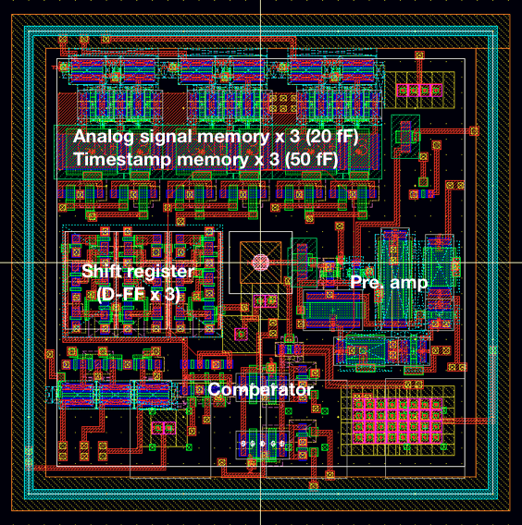
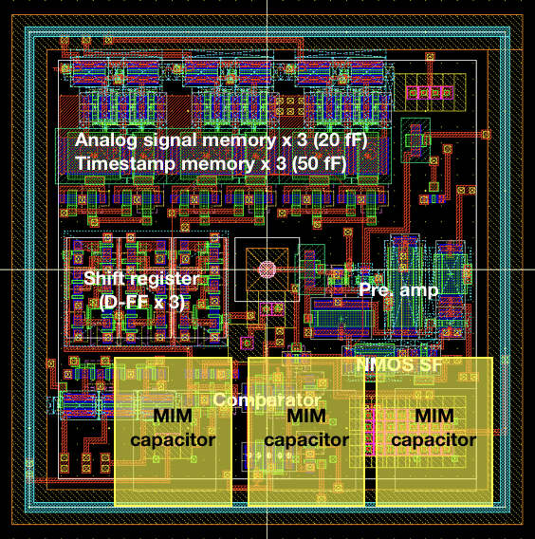
SOFIST-3 – pixel layout
..
SF
analog
..
X2 for timestamp
MIM(50fF, 1.5fF/um²)
1 for CDS
2 for comparator
Yamada (KEK)
30um

Slide 32
SOFIST Ver.4
Lower pixel
Upper pixel
Up to comparator
Shift-registers
3 Memory cells each

Slide 33
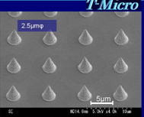
SOFIST-4: pixel layout
Upper pixel
Shift-register
Analog memory x3
Timestamp x3
Lower pixel
Pre-amp
Comparator
Cone-Bump pad(5x5um)
3 bumps/pixel
Au cone bump
20um
20um
Reported LAST YEAR

Slide 34
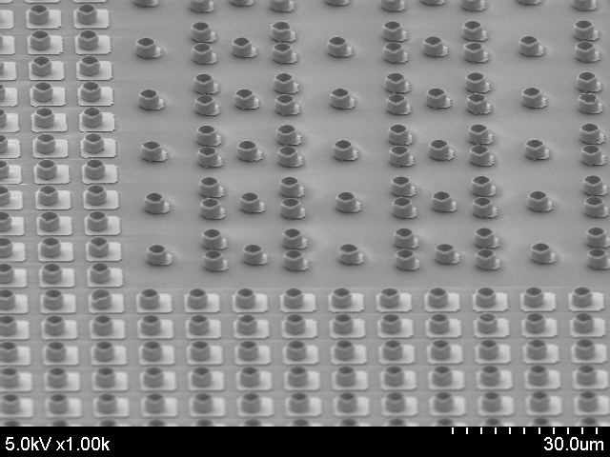
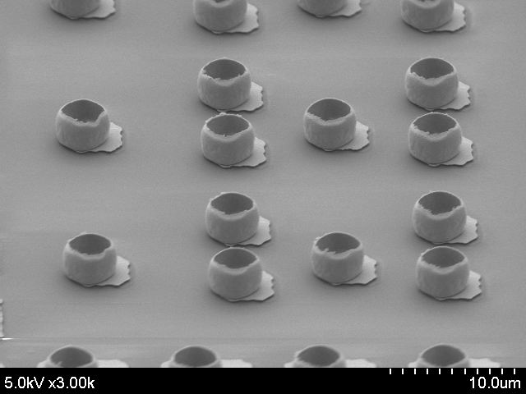
3D is coming (SOFIST-4)
Cylinder-type is more reliable
T-Micro
slight mis-alignment to UBM ⇒corrected
Upper&lower bumps are stacked well
(peel off one sensor layer)
Bonding<200degC

Slide 35
Remaining processes (SOFIST-4)
etching
(d) Bulk-Si removal
8μm
glue injection
High R-Si
Bond Pad
Passivation
Back gate adjust electrode
(e) Pad patterning
and passivation
T-Micro
High R-Si

Slide 36
summary
5-year Grant-in-Aid (2013-2017) accelerated development/application of various SOI devices.
SOFIST has been tested in FNAL beam
SOFISTv1 <20um pixel size>
spatial resolution:
1.3 um(500um)-1.4 um (200um) with no η-correction applied
SOFISTv2 <25um pixel size>
time resolution: 1.89us (linear calibration)
good S/N~120 for 67um thickness
cluster size~1 (Vth was set slightly high)
- spatial resolution ~8um as expected from pixel si
SOFISTv3 is beam tested
SOFISTv4 fabrication is underway

Slide 37
spares

Slide 38
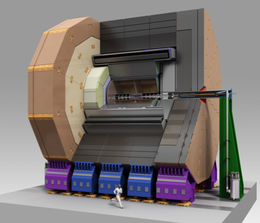
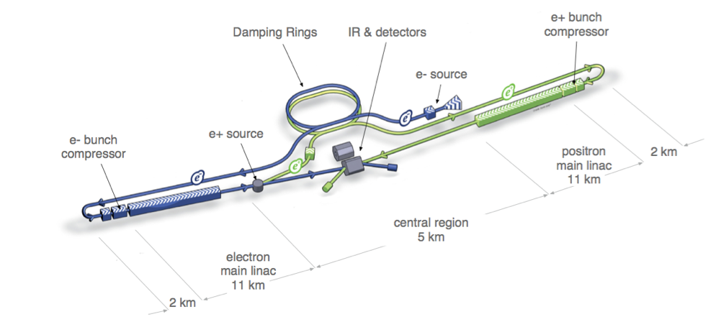
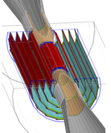
International Linear Collider
ILC detector concept (ILD)
ILC Experiment
  e+e− linear collider
  Center of mass energy: 250 - 500 GeV
  Precise measurement of the Higgs boson
  Search for beyond the Standard Model
Vertex detector system

Slide 39

Double SOI wafer
Courtesy of Lapis semiconductor

Slide 40

Issues to overcome
In application of SOI to pixel devices …..
+++++++++++
BNW
Tied to pixel node conventionally
-> area need to be optimized
( coverage of FETs/capacitance )
DSOI solves all
p⁻
E-field
-

Slide 41

Wafer types
Lapis Semiconductor: 0.20um FD-SOI process
Optimum wafer selectable (single p/n, various resisitivities):
One type for double: getting better!
On-going MPW

