Slide 1
From RHIC to the EIC
Berndt Mueller (BNL)
QEIC Workshop
Mumbai, India
January 4, 2020

Slide 2
EIC Science

Slide 3
Answering four deep questions
Requires high energy and luminosity
How do quarks and
gluons form nuclei?
How does the proton
get its spin?
How does the proton
get its mass?
What is the nature of
dense gluon matter?
Requires large energy range
3

Slide 4
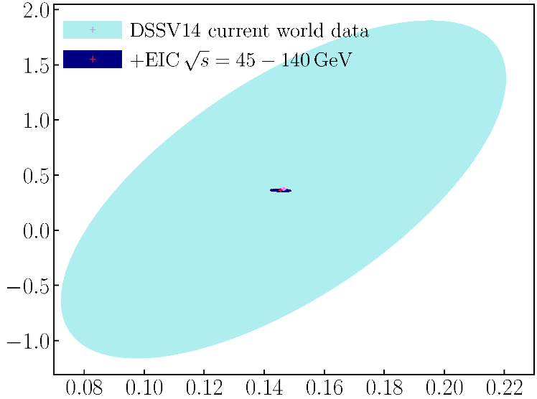
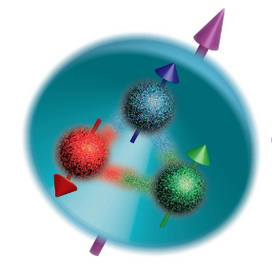
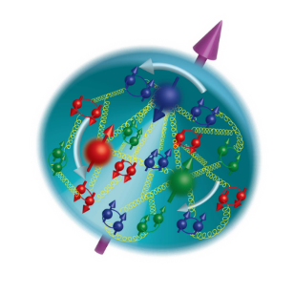
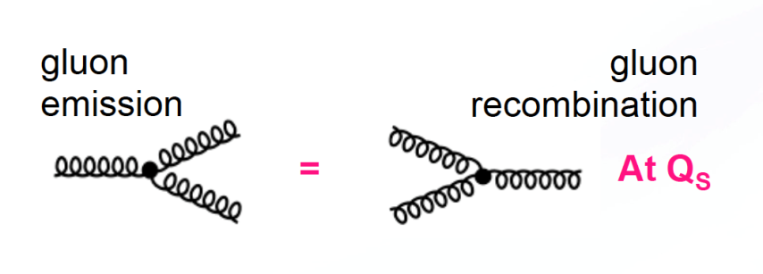

EIC science questions (1)
How does the proton get its spin?
Gluons
High E_{CM} for low momentum fraction ‘x’
Quarks
What is the nature of dense gluon matter?
Low energy
High energy
Onset scales
with (A/x)^{1/3}

Slide 5
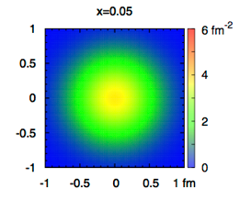
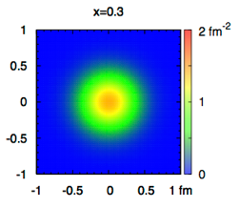
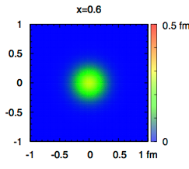
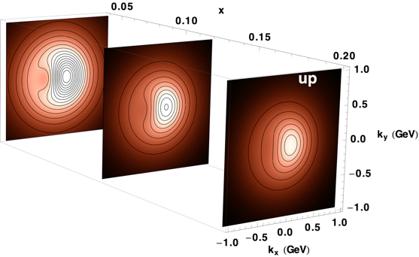
EIC science questions (2)
How does the proton get its mass?
  Requires detailed understanding of
  QCD dynamics
How do quarks and gluons form nucleons and nuclei?
Spatial images
Momentum space images
x
The EIC will answer these questions!
Tomographic Imaging

Slide 6
EIC Requirements
The EIC science case drives the technical requirements for the EIC, the Key Performance Parameters (KPPs), which were developed by NSAC and endorsed in the NAS Study of the EIC Science Case:
  Highly polarized (70%) electron and nucleon beams
  Ion beams from deuteron to the heaviest stable nuclei
  Variable center of mass energies from 20 to 100 GeV, upgradable to 140 GeV
  High luminosity of 10³³ - 10³⁴ cm⁻²s⁻¹
  Possibility of having more than one interaction region.
  The BNL EIC design achieves these goals, without the need for an energy upgrade, with only minor modifications to RHIC by adding an electron accelerator and storage ring in the RHIC tunnel.

Slide 7
Relevance of the KMPs
  High polarization: Required for studies of the origins of the spin of proton and neutron
  Heavy ion beams: Required for the study of gluons at high densities
  CM energies up to 140 GeV: Full energy range required for maximum discovery potential (gluon density grows with CM energy)
  High luminosity (10³⁴ cm⁻²s⁻¹): Required for efficient imaging of nucleon structure by exclusive measurements
  Possibly more than one interaction region: Desirable to efficiently perform measurements that require different detector optimization, to provide experimental checks, and to accommodate a large user community

Slide 8
BNL’s EIC Design

Slide 9
The BNL EIC design
  Meets all required machine parameters without the need of a future energy upgrade
    NSAC requirements to carry out the science are included in base design
  Is cost effective – repurposes RHIC
    RHIC complex in excellent condition
    Accelerator at peak performance
    Satisfies hadron beam requirements for EIC
Requires minimal new civil construction
  Only utilities, utility buildings, and access roads needed
Is low-risk
    Proven accelerator science and technology
Is versatile and flexible
  Can optimize luminosity for the science
  Staging possible with physics running

Slide 10
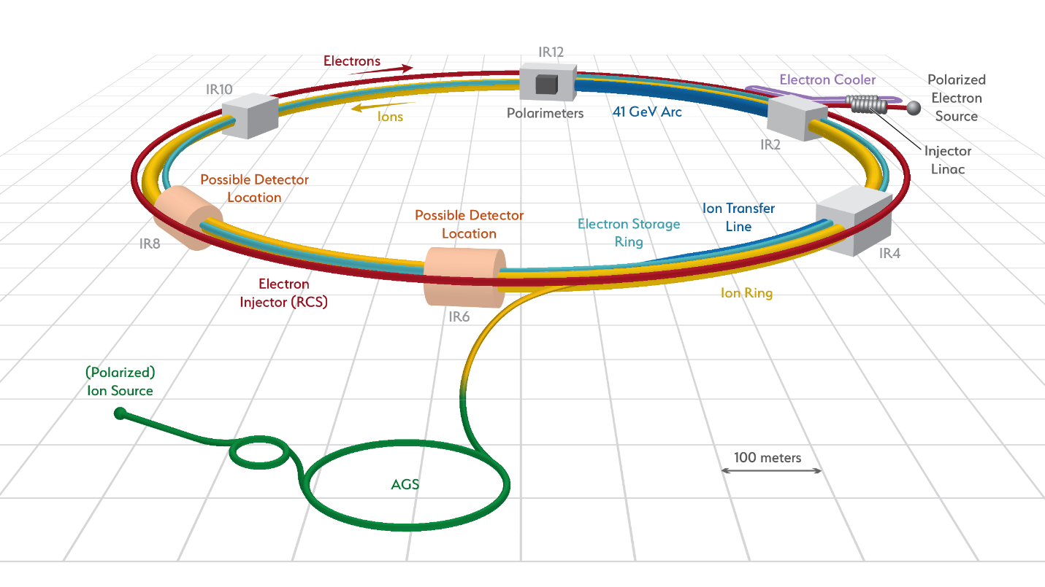
EIC @ BNL
The design aims at the construction of an Electron-Ion-Collider (eRHIC) leveraging the existing RHIC accelerator complex and its infrastructure.

Slide 11
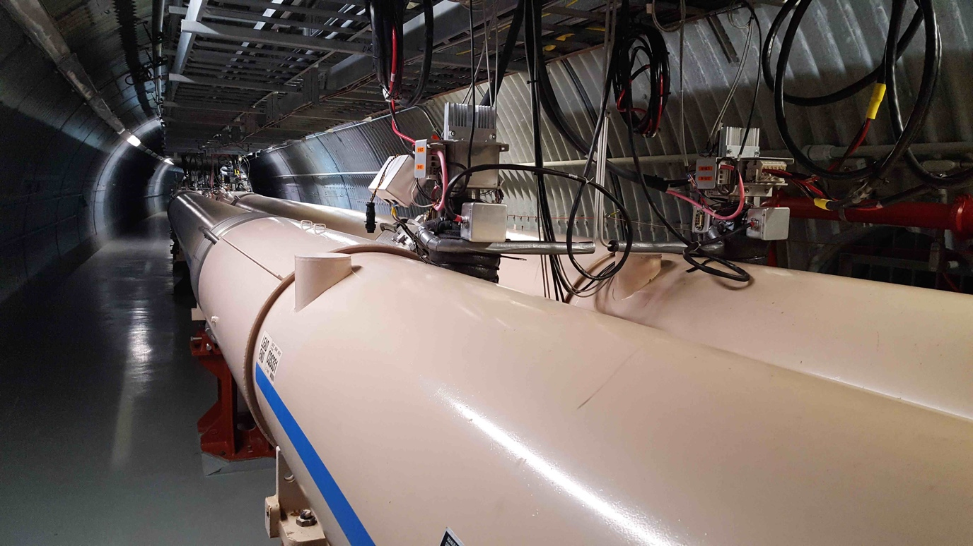
Building on RHIC
  High-performance hadron collider (the only one in the U.S.) with a superb record of scientific results, transformative discoveries, S&T innovations.
  Continuously upgraded, infrastructure with a history of major performance improvements (>40x the luminosity of the original design)
  Established portfolio of accelerator-based applications (isotopes, NSRL, …)

Slide 12
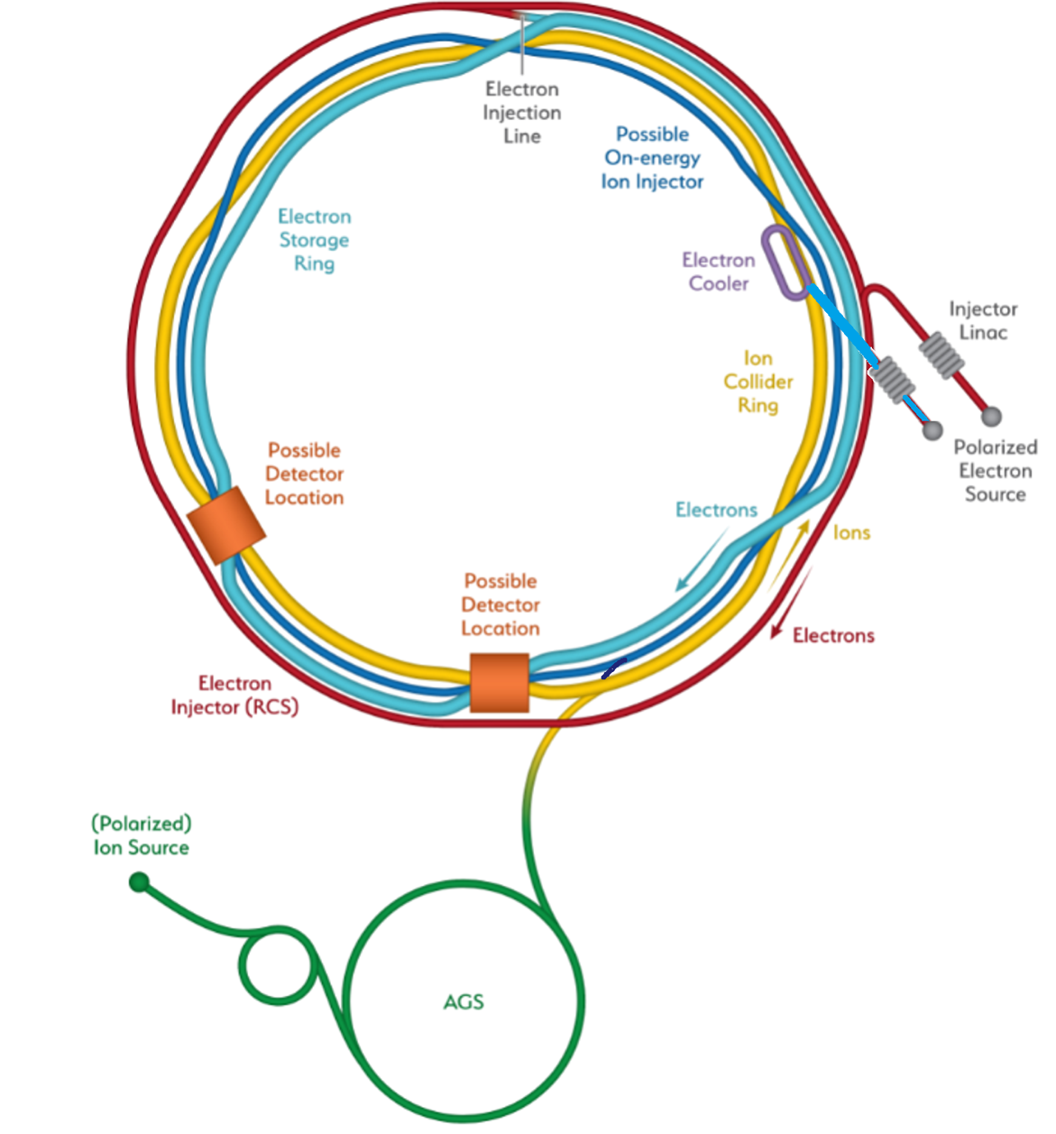
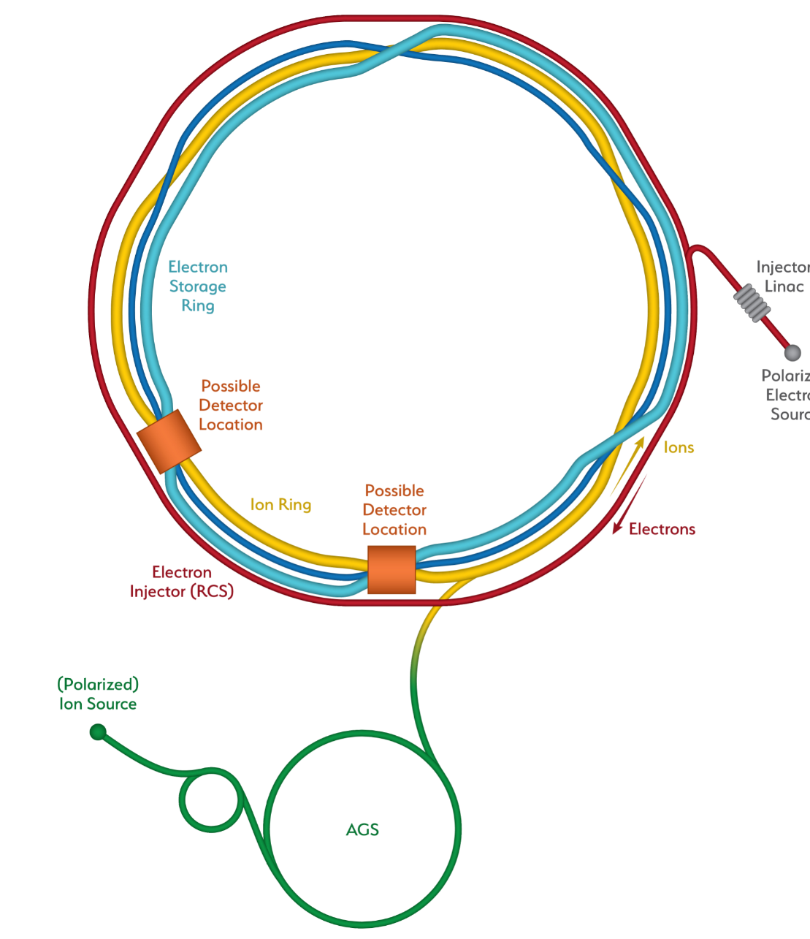
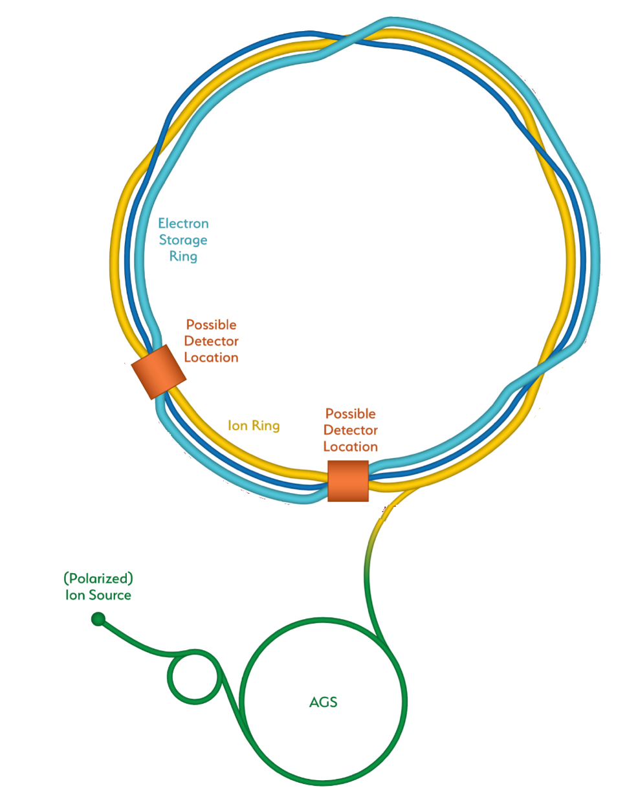
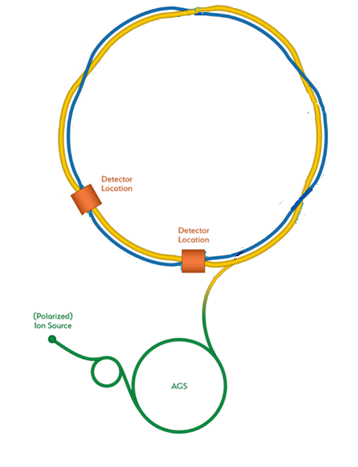
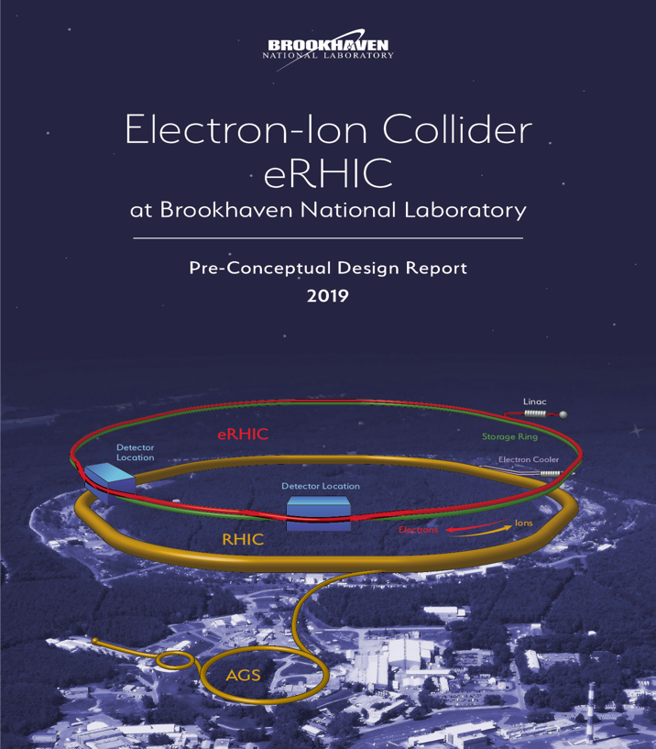
How RHIC is transformed into an EIC
Hadron Storage Ring
Electron Storage Ring
Electron Injector Synchrotron
Possible on-energy Hadron
injector ring
Hadron injector complex
BNL-EIC

Slide 13
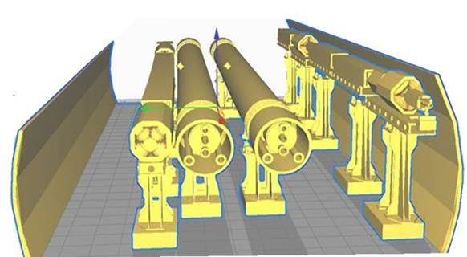
Major additions fit in RHIC tunnel
  Rapid Cycling Synchrotron (RCS) for electrons and Electron Storage Ring (eSR) fit into the existing RHIC tunnel
  Two detector halls available for interaction regions and detectors; one was included in independent cost review
eSR
RHIC
RCS
Existing
RHIC
tunnel

Slide 14
Robust, mature design
EIC based on established concepts
  storage ring collider
  unequal species collision concepts taken from experiences at HERA, B-Factories, and RHIC
Design
  parameters are ambitious, but demonstrated at other machines
  design choices based on studies of alternative solutions
  studies of lattice sensitivity to imperfections confirm robust solutions
Technology
  implementation based on established technology
  state-of-the-art hardware development by extensive R&D program
Few challenges (e.g. strong hadron cooling) are backed up by more conservative alternatives that compare well in terms of cost and performance

Slide 15
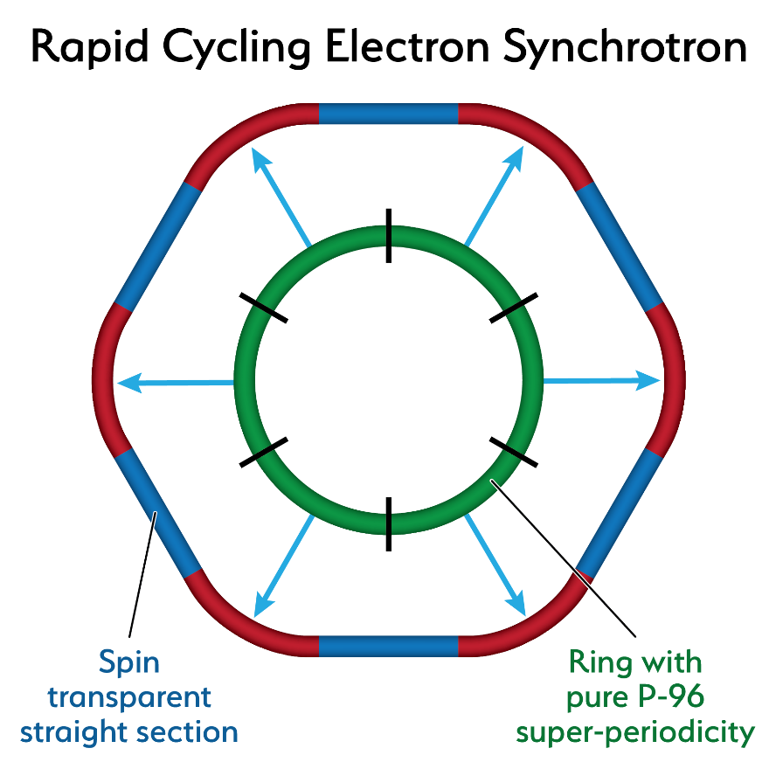
Electron beam polarization
85% polarized electron source injects into 18 GeV, 1-2 Hz Rapid Cycling Synchrotron (RCS) using conventional magnets
Highly symmetrical RCS avoids
depolarization during acceleration
Residual depolarization effects in the RCS due to deviations from ideal symmetry will be corrected
with partial Siberian snakes
Frequent injection of fresh bunches into storage ring maintains >80%
polarization for all spin orientations for the duration of the store

Slide 16
Light ion beam polarization
Existing polarized proton source delivers protons with >80% polarization
New polarized ³He source (developed with MIT) has demonstrated 85% polarization
Protons stored in RHIC have reached 60% polarization
80% polarization of protons, deuterons, and ³He in RHIC storage ring will be achieved by:
  Adding four Siberian snakes to the RHIC ring
  Adding stronger snakes and skew quadrupoles to the AGS
  Introducing a tune jump for polarized deuterons in RHIC

Slide 17
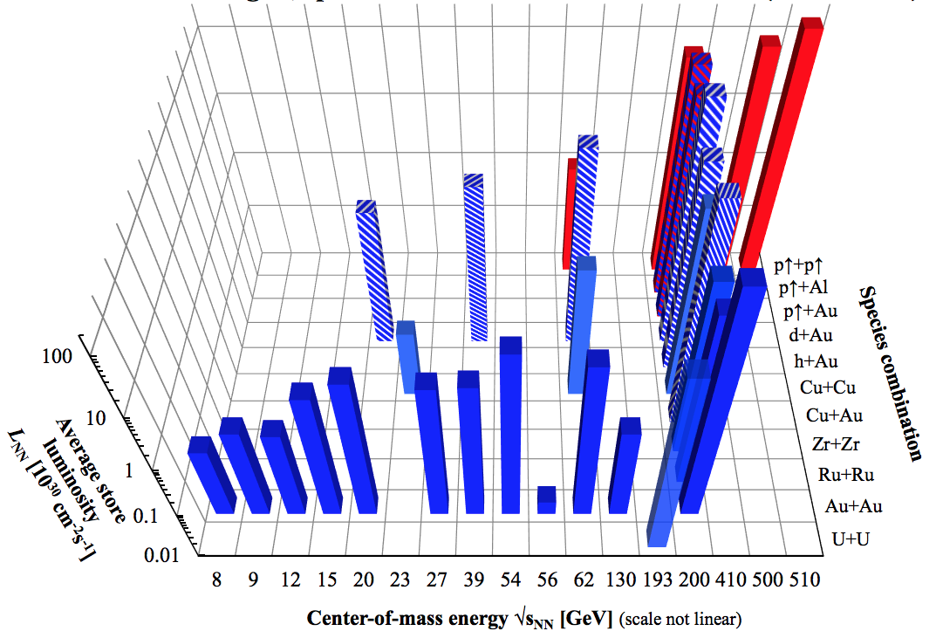
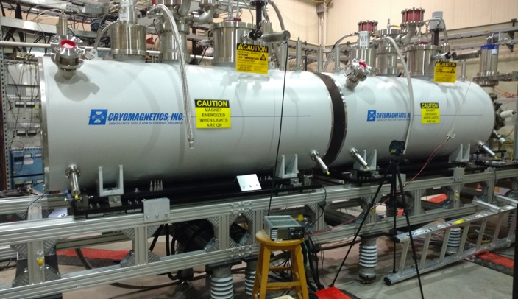
Full range of ion species
  RHIC accelerates ions from protons, deuterons, ³He to Au and ²³⁸U over a wide range of energies. All will be available at the EIC.
  Enabled by two decades of technological innovation
Complete set of collision systems and energies studied at RHIC
The electron beam ion source EBIS can produce virtually any desired ion species including polarized ³He

Slide 18
Full range of beam energies
No energy upgrade needed
Protons up to 275 GeV
  Existing superconducting magnet yellow ring with EIC interaction region magnets allows for protons up to 275 GeV
Electrons up to 18 GeV
  18 GeV electron storage ring installed in the RHIC tunnel is readily achievable with
    large ring circumference of 3.8 km
    well established superconducting RF technology
Electron energy range (2.5–18 GeV) and proton energy range (41–275 GeV) combine to make full EIC CM energy range accessible (20–140 GeV)

Slide 19
BNL design: Full luminosity
BNL EIC design achieves full peak luminosity with:
  Bunch charges N_{e} ≤ 1.7·10¹¹, N_{p} ≤ 0.7·10¹¹
  Stored bunches, n_{b}=1160, requiring:
    crossing angle collision geometry (25 mrad)
    e-beam current limited by installed RF power compensating for synchrotron radiation losses (<10 MW)
  Beam size at interaction point (7 μm)
Beam size at final focus can be maintained by either
  Option A: strong hadron cooling to prevent emittance growth due to intra-beam scattering
  or
  Option B: regular on-energy hadron replacement
Selection between these two baseline alternatives by CD-1

Slide 20
Average Luminosity: Option A
Long, uniform beam stores optimal for precision measurements
Peak luminosity maintained over many hours by hadron cooling
Heavy ions: existing stochastic cooling system preserves low beam emittance
Protons: average luminosity is maximized by strong cooling
  Coherent electron Cooling (CeC) using an intense electron beam provides high-bandwidth amplification
  Conceptually designed using only existing technologies
  Validated by simulations
  Proof-of-Principle experiment under way at RHIC

Slide 21
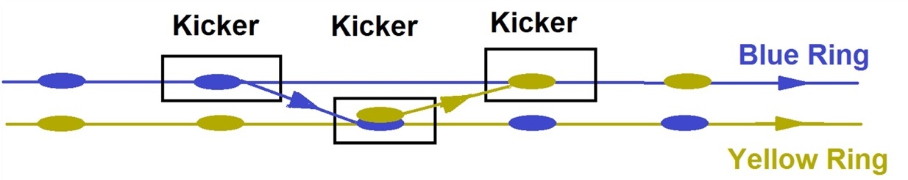
Average Luminosity: Option B
Low-risk alternative to CeC
  Regular on-energy injections using existing blue RHIC ring restore average luminosity to >90% of peak luminosity
  Moderate emittance growth requires replacing the stored proton beam only once per hour
  Transfer takes only 13 μs, preserves the total charge stored in both rings, avoids transient injection effects
Cost neutral to Option A, but less attractive for experiments, which prefer longer stores

Slide 22
BNL EIC covers full science range
Collider capability envelope
Based on design choice of 10 MW synchrotron radiation
Annual Integrated Luminosity [fb⁻¹]
Peak Luminosity [cm⁻²s⁻¹]
10³⁴
10³³
10³²
100
10
1
Tomography (p/A)
Spin and Flavor Structure of
the Nucleon and Nuclei
Internal
Landscape of the Nucleus
QCD at Extreme Parton Densities-
Saturation
150
Center of Mass Energy E_{cm} [GeV]

Slide 23
BNL EIC can be optimized for science
BNL EIC
Baseline
Optimization for high E_{cm}
BNL EIC
Optimization for low E_{cm}
Annual Integrated Luminosity [fb⁻¹]
Peak Luminosity [cm⁻²s⁻¹]
10³⁴
10³³
10³²
100
10
1
Tomography (p/A)
Spin and Flavor Structure of
the Nucleon and Nuclei
Internal
Landscape of the Nucleus
QCD at Extreme Parton Densities-
Saturation
150
Center of Mass Energy E_{cm} [GeV]
23

Slide 24
EIC Detectors

Slide 25
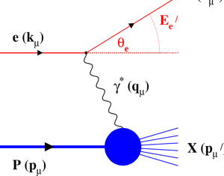
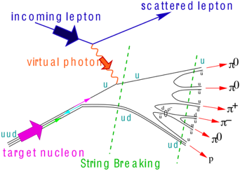
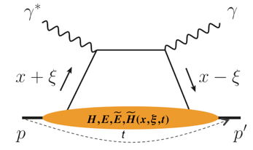
EIC Measurement Categories
∫Ldt
Inclusive DIS
Fine multi-dimensional binning
→ x, Q²
Reach to lowest x, Q² impacts
distance of machine elements to IP
1 fb⁻¹
machine & detector requirements
Semi-inclusive processes
5-dimensional binning
→ x, Q², z, p_{T}, φ
Needs to reach pT > 1 GeV
10 fb⁻¹
Exclusive processes
10 - 100 fb⁻¹
4-dimensional binning
→ x, Q², t, θ, low proton p_{T}
Strong impact on IR design
Outside main detector elements
25

Slide 26
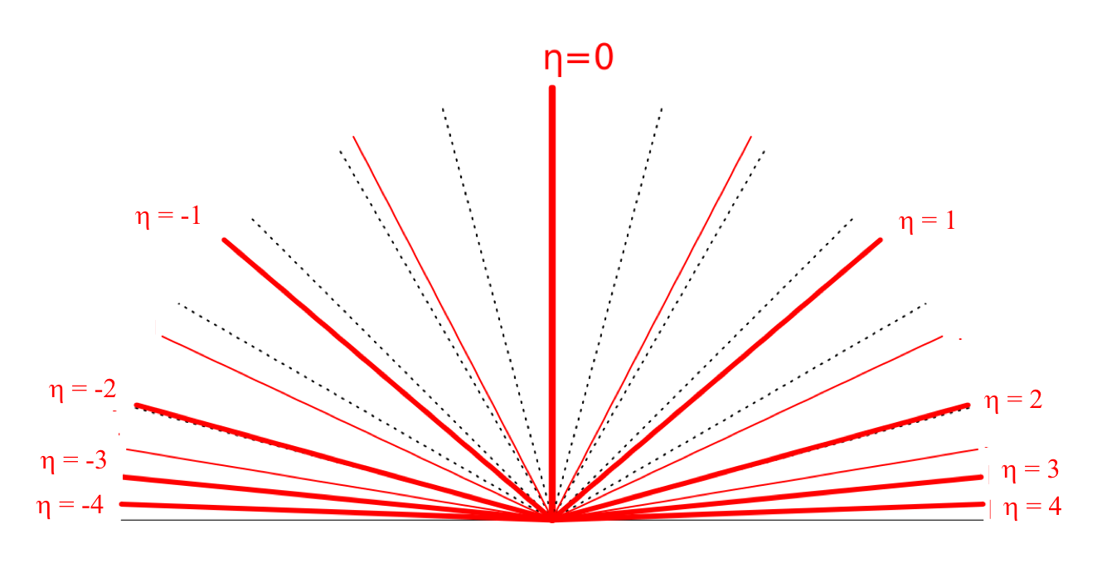
EIC General Detector Principles
hadrons
leptons
Backward-h
Forward-η
Lepton
Endcap
Central
Detector
Hadron
Endcap
z
low Q2 scattered leptons
particles from nuclear breakup and ions from diffractive reactions
For a high luminosity collider like the EIC control of systematics needs to be integrated into the detector from the start
Accelerator, interaction region, and detector must be designed together
26

Slide 27
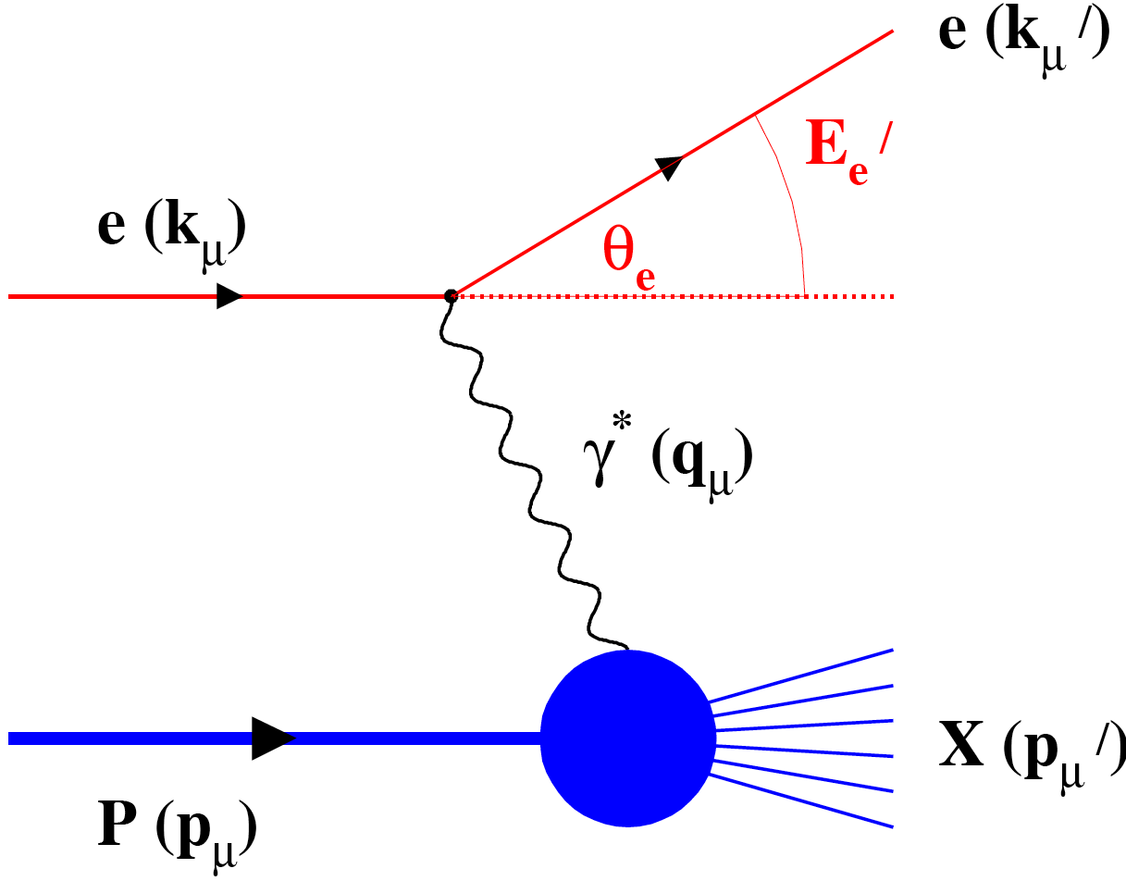
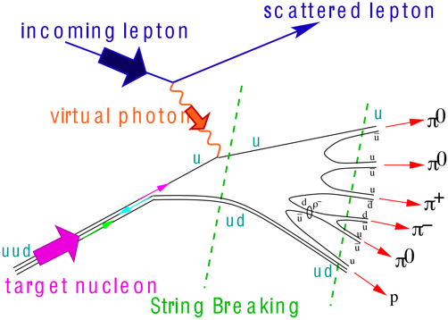
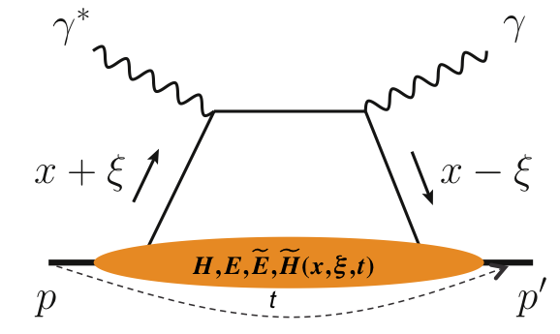
EIC Detector Functions
hadrons
leptons
Backward-h
Forward-η
Inclusive DIS
Semi-inclusive DIS
Lepton
Endcap
Central
Detector
Hadron
Endcap
HCAL
Magnet
HCAL
ECAL
HCAL
ECAL
ECAL
Tracking
PID
PID
PID
Tracking
Tracking
low Q2 scattered leptons
Exclusive DIS
particles from nuclear breakup and ions from diffractive reactions
Luminosity Detector
Low Q2-Tagger
Zero Degree Counter
Polarimetry
Roman Pots & fwd tracking
27

Slide 28
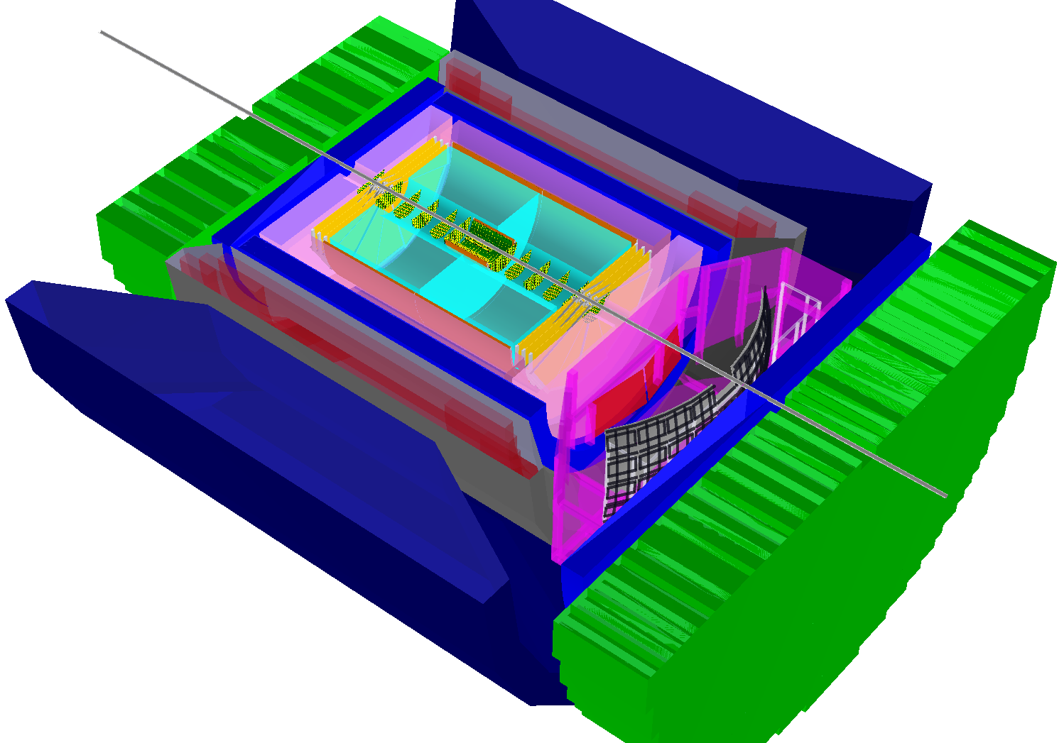
EIC Detector (Schematic)
Hadronic calorimeters
e/m calorimeters
RICH detectors
9.0m
Hadron PID:
-1<η<1: RICH/DIRC + TPC
1<η<3: Dual-radiator RICH
-1<η<-3: Aerogel RICH
Lepton-ID:
-3 <η< 3: e/p
1<|η|<3: HCal & tracking
|η|>3: ECal+Hcal & tracking
-4<η<4: Tracking (TPC+GEM+MAPS)
hadrons
electrons
Silicon trackers
TPC
GEM trackers
3 T solenoid coils
28
Electron Ion Collider – EIC @ BNL

Slide 29
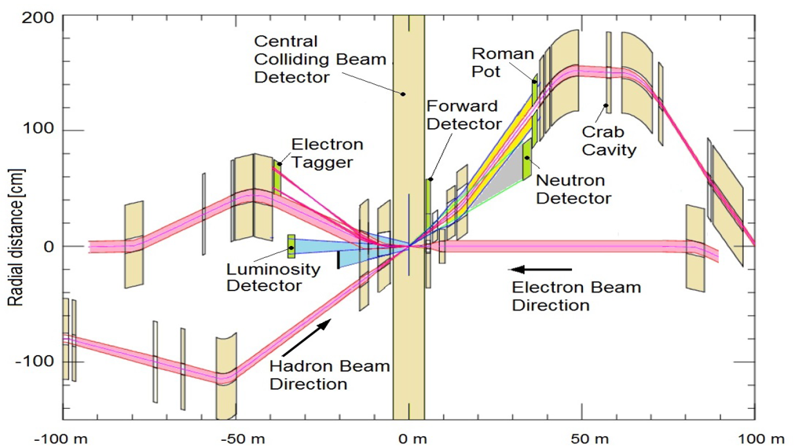
EIC Interaction region
IR design requirements:
Small β* for high luminosity
Large Detector acceptance
Accommodate dipole spectrometer
No accelerator magnets +/-4.5 m
Crossing angle with crab cavities
Minimize synchrotron radiation
Accommodate spin rotators
Space for luminosity monitor, neutron detector, “roman pots”
REAR
Forward
  BNL design meets all requirements by incorporating novel types of magnets

Slide 30
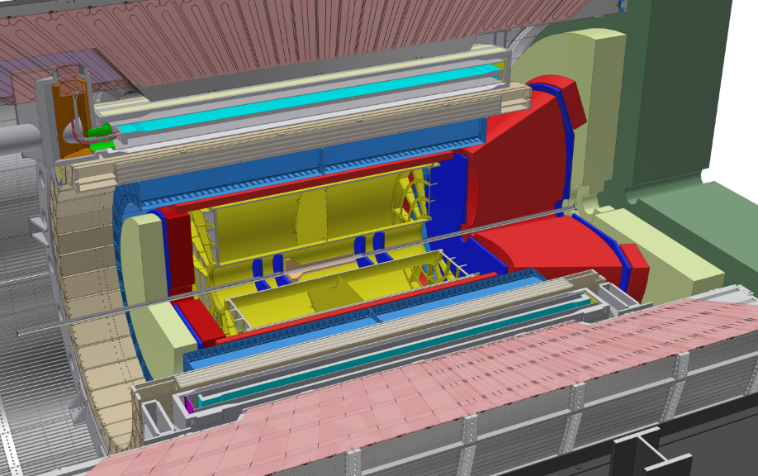
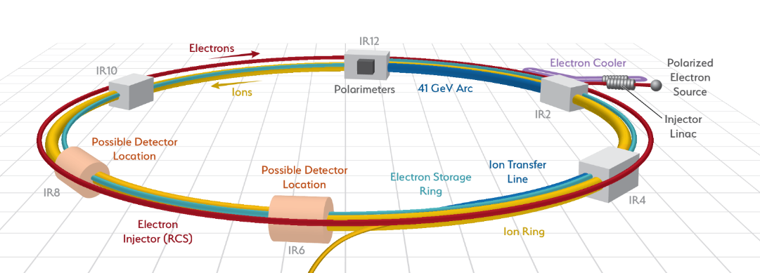
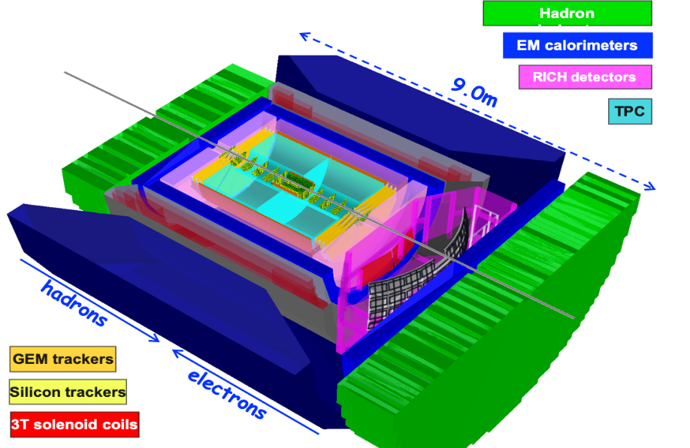
BNL design: Detector concepts
Pre-conceptual design for EIC detector covers the full range of science in EIC white paper, NSAC long range plan and NAS report
A second, possibly differently optimized detector could be built with international and/or inter-agency funding in existing Hall 2

Slide 31
EIC Schedule
(Notional)

Slide 32
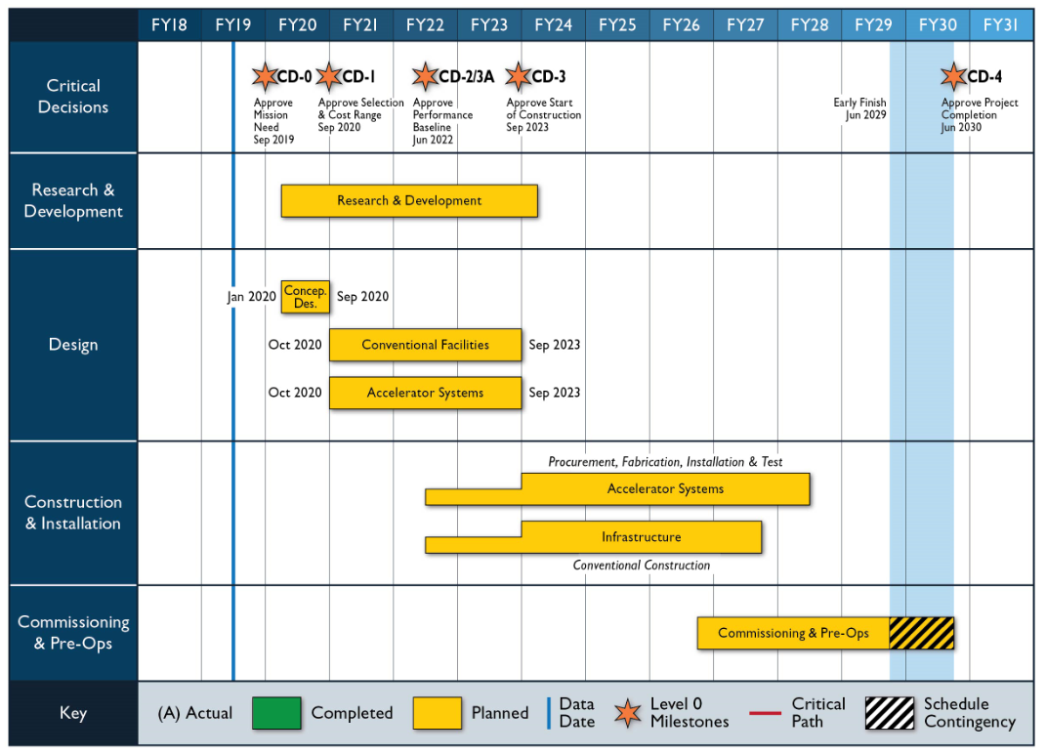
Notional Schedule
Commissioning and Operations
sPHENIX
RHIC
Beam Energy Scan
EIC
Operations
eRHIC
Access to RHIC Tunnel
32

Slide 33
Summary
BNL has developed a (pre-conceptual) design for an EIC that is:
  Comprehensive
  Cost-effective and low-risk
  Meets all requirements
  Dovetails on completion of RHIC program
  Ready to proceed to the project stage
There is wide room for international contributions:
  Accelerator components
  Detector design and construction
With timely agency decision and adequate funding, an EIC at BNL could start taking data in 2030

