Slide 1
Jefferson Lab’s Pursuit of Nuclear Femtography – from 12 GeV to EIC
aka “From JLab12 to EIC”
aka “Prospective Science and Status of the EIC – JLab View”
Rolf Ent
QCD with Electron-Ion Collider (QEIC)
IIT Bombay, January 4-7, 2020, Mumbai, India

Slide 2
Outline
The Quest to Understand the Fundamental Structure of Matter
Towards 3D Sub-Atomic Structure: Nuclear Femtography
Nuclear Femtography starts at Jefferson Lab 12-GeV
The US-Based Electron-Ion Collider (EIC)
  Why an EIC?
  Why its Parameters?
EIC Science Examples
  Femtography
  Mass
  Spin
  Hadronization
  Dense Gluon States
EIC Status – A Portal to a New Frontier

Slide 3
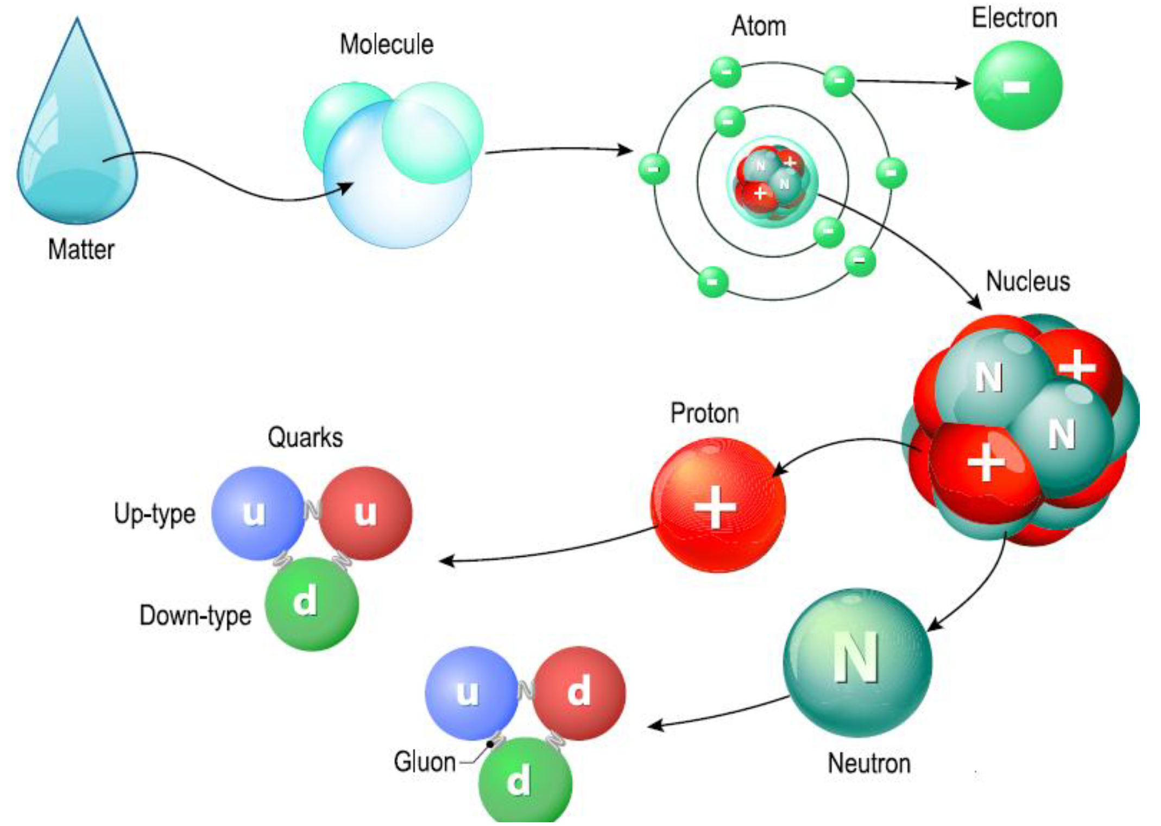
The Quest to Understand the Fundamental Structure of Matter
1808
1874
1911
1913
1968
1932
1978

Slide 4
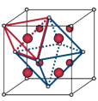
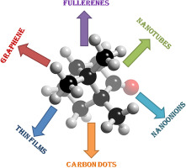
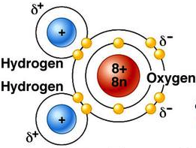
Nuclear Femtography – Subatomic Matter is Unique
Localized mass and charge centers – vast “open” space:
Molecule:
Crystal:
Nanomaterial:
“Water”
Rare-Earth metal
Carbon-based
Interactions and structure are mixed up in nuclear matter: Nuclear matter is made of quarks that are bound by gluons that also bind themselves. Unlike with the more familiar atomic and molecular matter, the interactions and structures are inextricably mixed up, and the observed properties of nucleons and nuclei, such as mass & spin, emerge out of this complex system.
Not so in proton structure!

Slide 5
Nuclear Femtography - Imaging
In other sciences, imaging the physical systems under study
has been key
to gaining new
understanding.
Structure mapped
in terms of
b_{T} = transverse position
k_{T} = transverse momentum

Slide 6
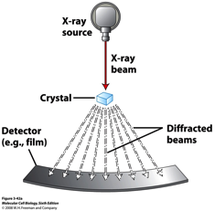
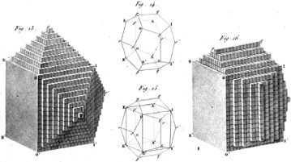
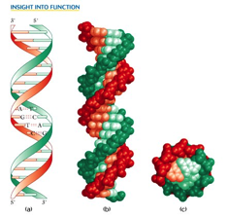
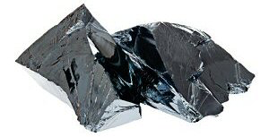
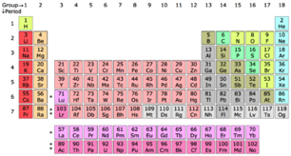
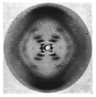


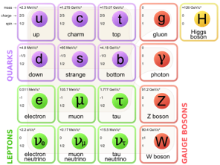

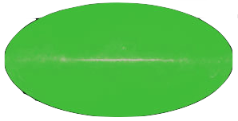
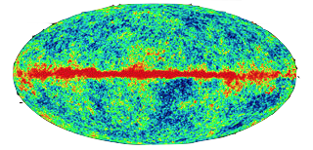
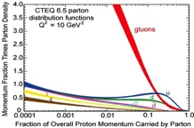
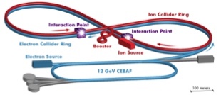
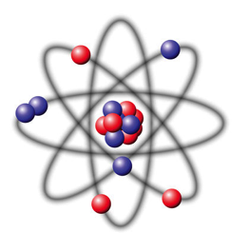


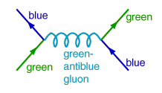

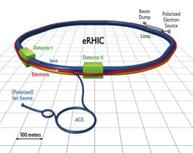
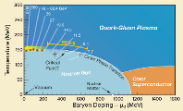


Imaging Physical Systems is Key to New Understanding
Dynamical System | Fundamental Knowns | Unknowns | Breakthrough Structure Probes | New Sciences, New Frontiers
Solids
Electromagnetism
Atoms
Structure
X-ray Diffraction
(~1920)
Solid state physics
Molecular biology
1801
DNA
Universe
General Relativity
Standard Model
Quantum Gravity,
Dark matter, Dark
energy. Structure
Large Scale Surveys
CMB Probes
(~2000)
Precision
Observational
Cosmology
CMB 1965
Nuclei
and Nucleons
Perturbative QCD
Quarks and Gluons
Non-perturbative QCD. Structure
Electron-Ion Collider
(2025+)
Structure & Dynamics in QCD
2017

Slide 7
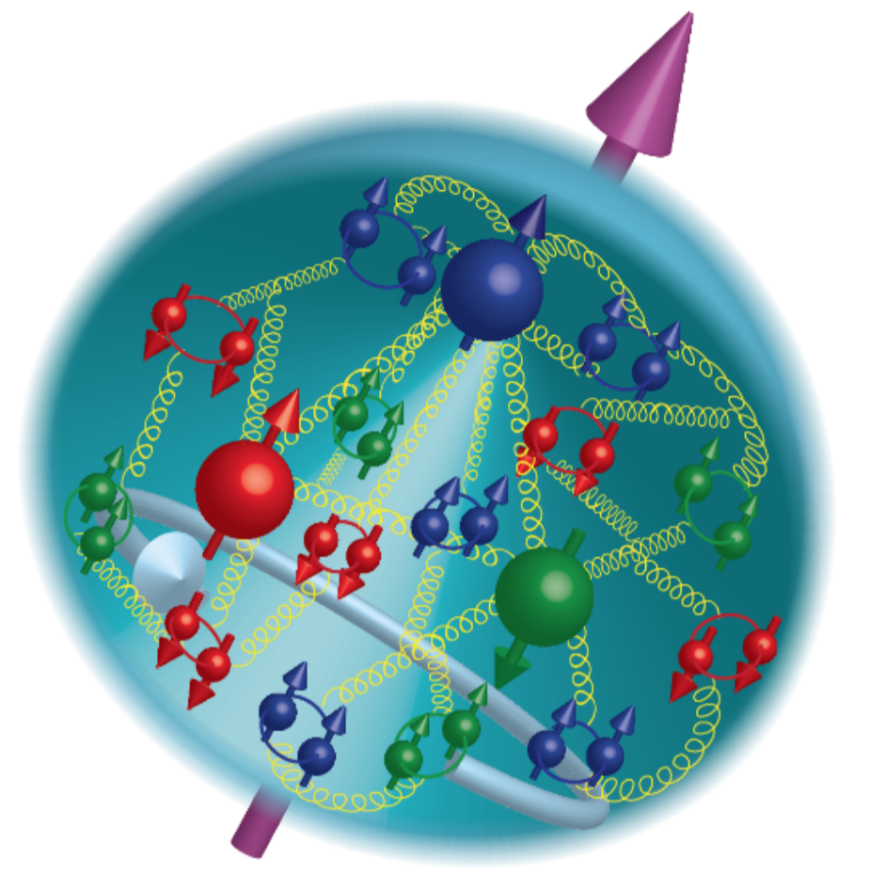

21st Century View of the
Fundamental Structure of the Proton
Elastic electron scattering determines charge and magnetism of nucleon
Approx. sphere with <r> ≈ 0.85 Fermi
The proton contains quarks,
as well as dynamically
generated
quark-antiquark pairs
and gluons.
Quark and gluon
momentum fractions
(in specific Infinite
Momentum Frame)
well mapped out.
The proton spin
and mass have large
contributions from
the quark-gluon
dynamics.
1961

Slide 8
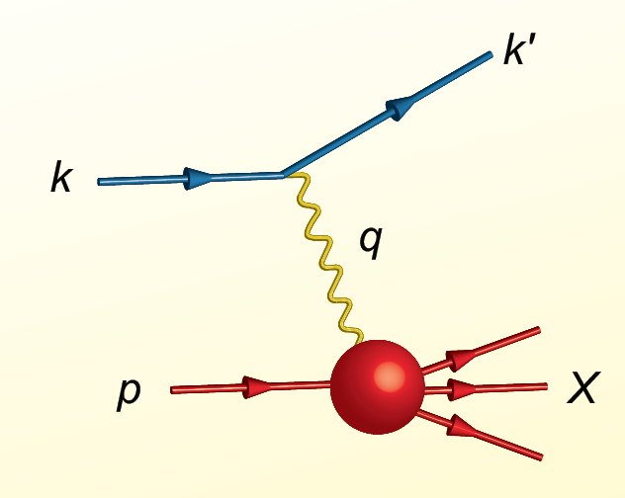
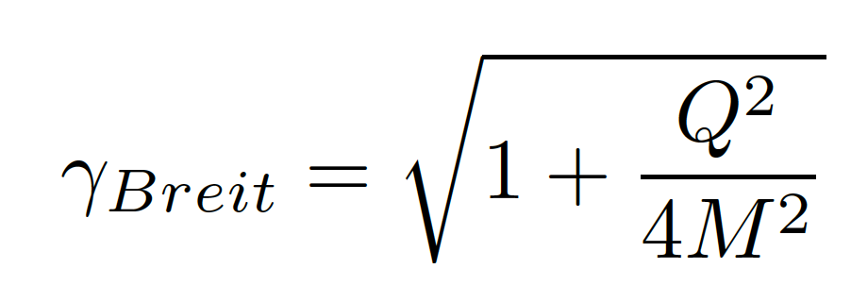
Proton Viewed in High Energy Electron Scattering: 1 Longitudinal Dimension
Viewed from boosted frame,
length contracted by
Internal motion of the proton’s constituents is slowed down by time dilation – the instantaneous charge distribution of the proton is seen.
In boosted frame x is understood as the longitudinal momentum fraction
valence quarks: 0.1 < x < 1
sea quarks: x < 0.1
Lorentz Invariants
E²_{CM} = (p+k)²
Q² = -(k-k’)²
x = Q²/(2p•q)
J. Bjorken, SLAC-PUB-0571
March 1969

Slide 9

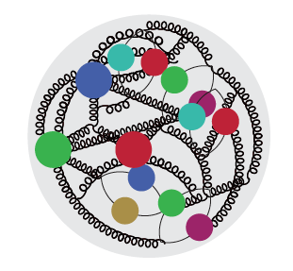
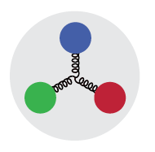

High Energy Electron Scattering
Snapshots where 0 < x < 1 is the shutter exposure time
x ≈ 10⁻⁴
Probe non-linear dynamics
short exposure time
x ≈ 10⁻²
Probe rad. dominated
medium exposure time
x ≈ 0.3
Probe valence quarks
long exposure time
R. Milner

Slide 10
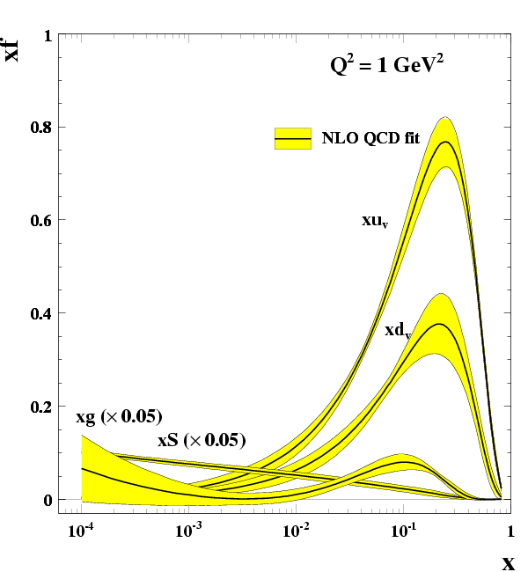
1 Longitudinal Momentum Distributions
1/Q ~ spatial resolution
What about the
Nucleus?
g – gluons
S – quark sea
u, d – up, down
valence quarks
R. Yoshida
C. Gwenlan

Slide 11
Proton Viewed in High Energy Electron Scattering: 1 Longitudinal Dimension

Slide 12

Nuclear Femtography: 2 New Dimensions Transverse to Longitudinal Momentum
Structure mapped in terms of
b_{T} = transverse position
k_{T} = transverse momentum
Spin!
Nuclei!
Goal:
Unprecedented
21st Century Imaging
of Hadronic Matter
Direction of longitudinal
momentum normal to
plane of slide
Valence Quarks: JLab 12 GeV
Sea Quarks and Gluons: EIC

Slide 13
The Quest to Understand the Fundamental Structure of Matter
1808
1874
Discovery
1911
1913
1968
Application
Understanding
1932
1978

Slide 14
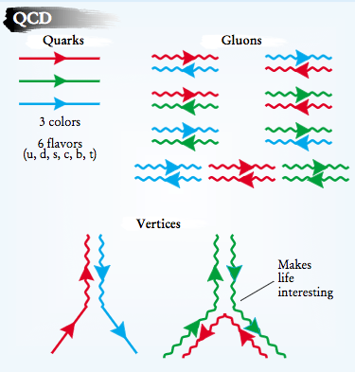
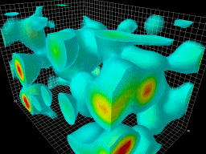
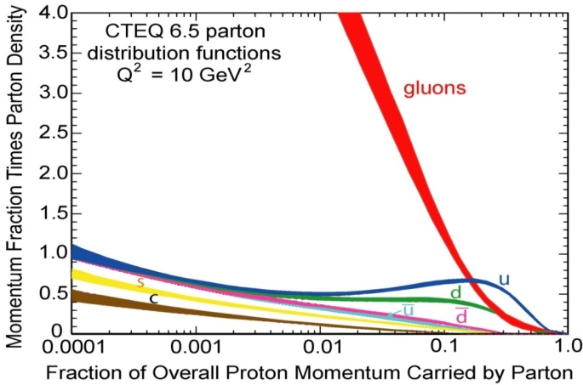
Subatomic Matter is Unique
Interactions and Structure are entangled
because of gluon self-interaction.
Observed properties such as mass and spin emerge from this complex system.
EIC needed to explore the gluon dominated region
JLAB 12 to explore the valence quark region
Longitudinal (1D) Momentum Fraction x

Slide 15

Overview of Jefferson Lab
Created to build and operate the Continuous Electron Beam Accelerator Facility (CEBAF), world-unique user facility for Nuclear Physics
Jefferson Lab Stats: Located in Newport News, Virginia 169 acre site In operation since 1995 ~700 employees 1,691 Active Users (FY19) 1/3 of Users are from non-US Institutions, from 37 countries >650 PhDs granted to-date On average 30% of US PhDs in nuclear physics FY2016 Costs: $184.1M (~2/3 operations, ~1/3 new construction)
What is the role of gluonic excitations in the spectroscopy of light mesons? Can these excitations elucidate the origin of confinement?
Can we reveal a novel landscape of nucleon and nuclear substructure through measurements of new multidimensional distribution functions?
Can we discover evidence for new physics beyond the Standard Model?
15

Slide 16
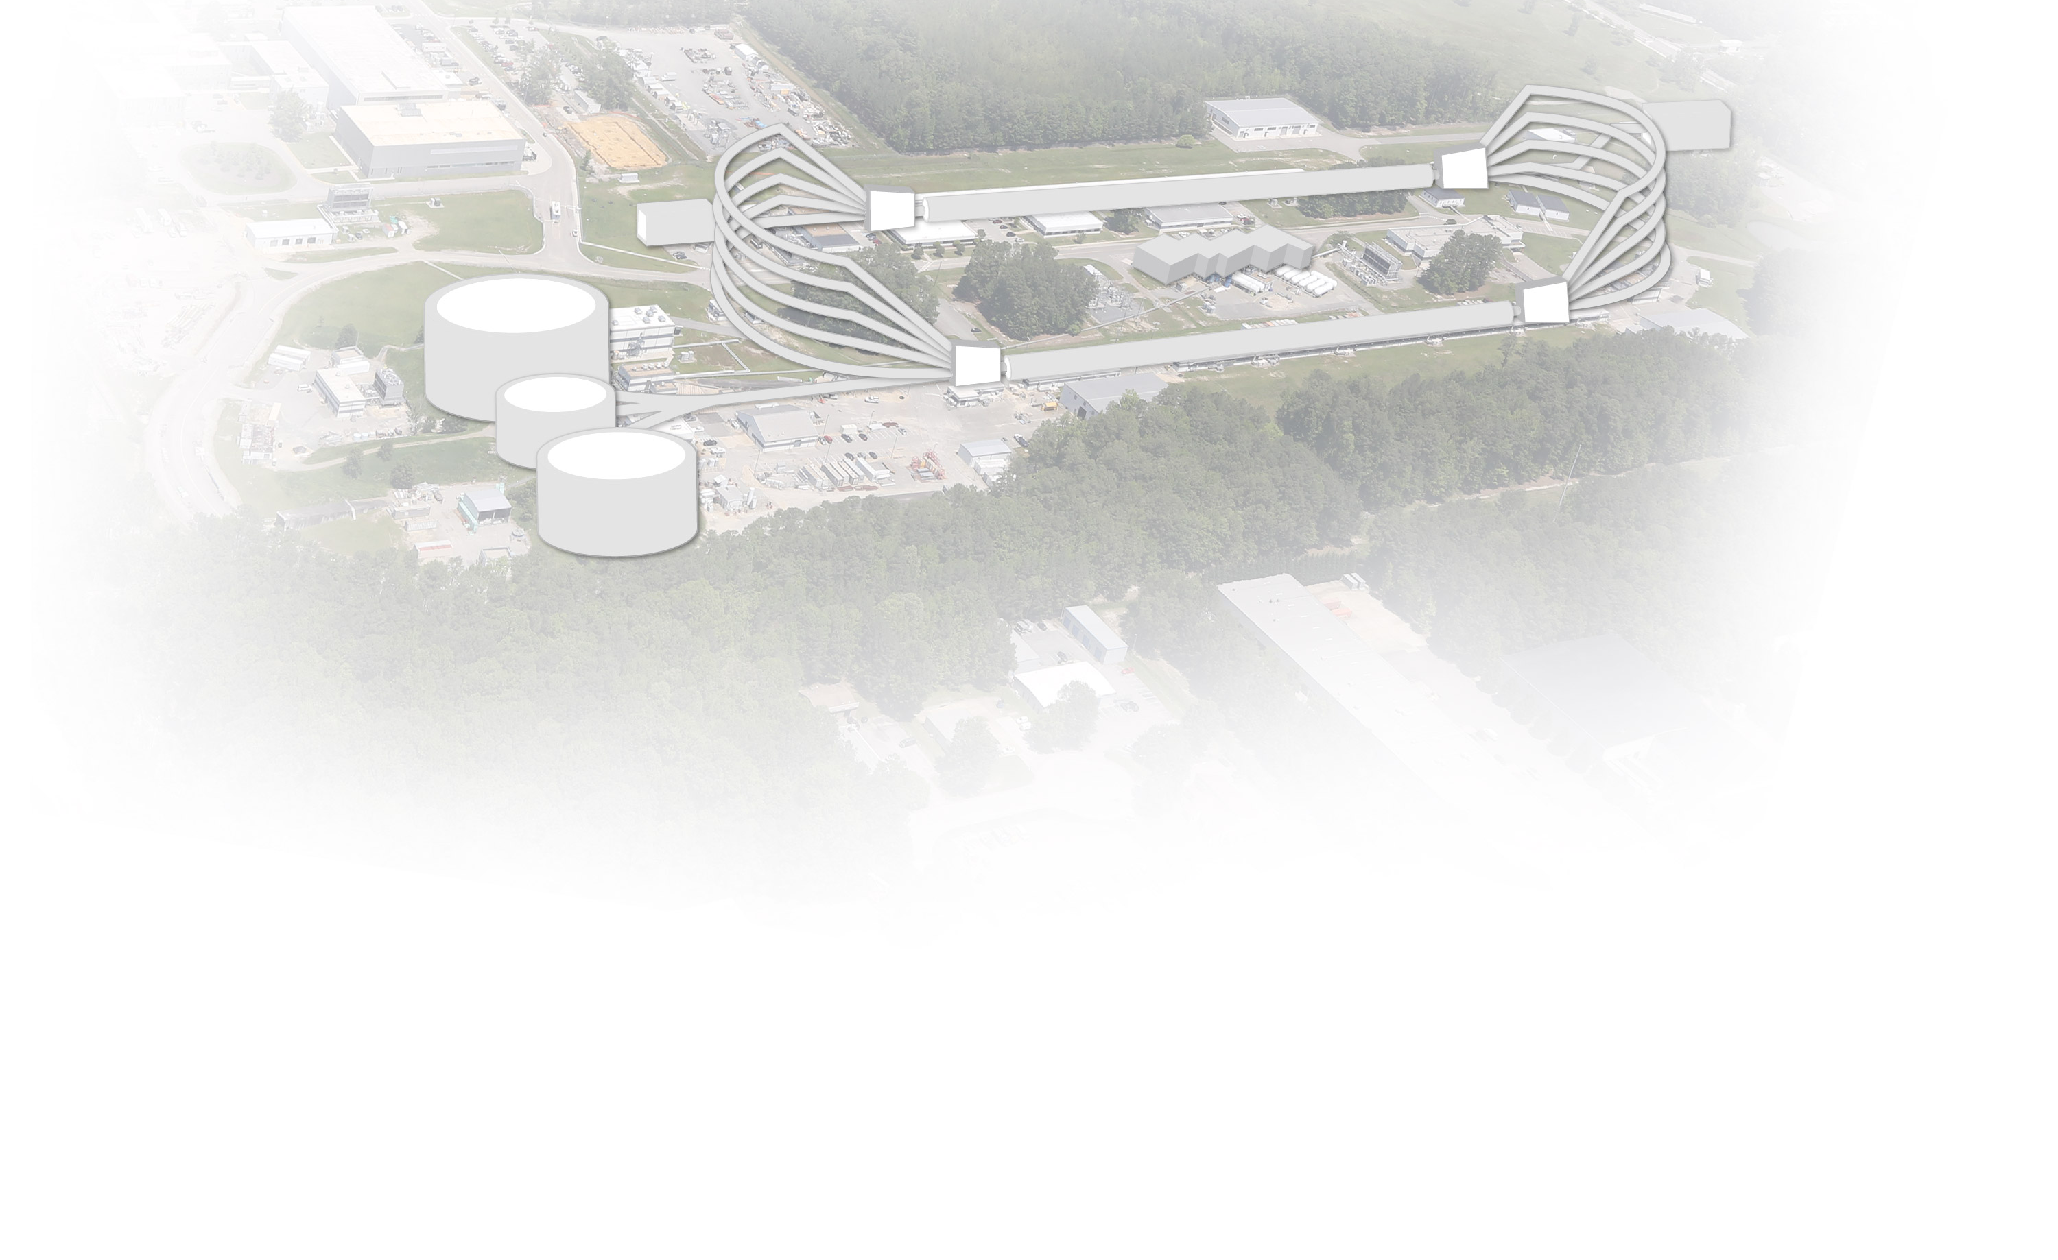
CEBAF at Jefferson Lab
INJECTOR
LINAC
RECIRCULATION ARCS
D
2
1
3
A
3
2
B
C
CEBAF Upgrade completed in September 2017
  CW electron beam
  E_{max} = 12 GeV
  I_{max} = 90 μA
  Pol_{max} = 90%
Nuclear experiments at ultra-high luminosities, up to 10³⁹ electrons-nucleons /cm²/ s
World-record polarized electron beams
Highest intensity tagged photon beam at 9 GeV
Ability to deliver a range of beam energies and currents to multiple experimental halls simultaneously
Unprecedented stability and control of beam properties under helicity reversal
CEBAF World-leading Capabilities
Commissioning:
  April 2014: hall A
  October 2014: hall D
  February/March 2017: halls C & B

Slide 17
Exploring the 3D Nucleon Structure
After decades of study of the partonic structure of the nucleon we finally have the experimental and theoretical tools to systematically move beyond a 1D momentum fraction (x_{Bj}) picture of the nucleon.
    High luminosity, large acceptance experiments with polarized beams and targets.
    Theoretical description of the nucleon in terms of a 5D Wigner distribution that can be used to encode both 3D momentum and transverse spatial distributions.
Deep Exclusive Scattering (DES) cross sections give sensitivity to electron-quark scattering off quarks with longitudinal momentum fraction (Bjorken) x at a transverse location b.
Semi-Inclusive Deep Inelastic Scattering (SIDIS) cross sections depend on transverse momentum of hadron, P_{h⊥}, but this arises from both intrinsic transverse momentum (k_{T}) of a parton and transverse momentum (p_{T}) created during the [parton → hadron] fragmentation process.
Nuclear Femtography

Slide 18
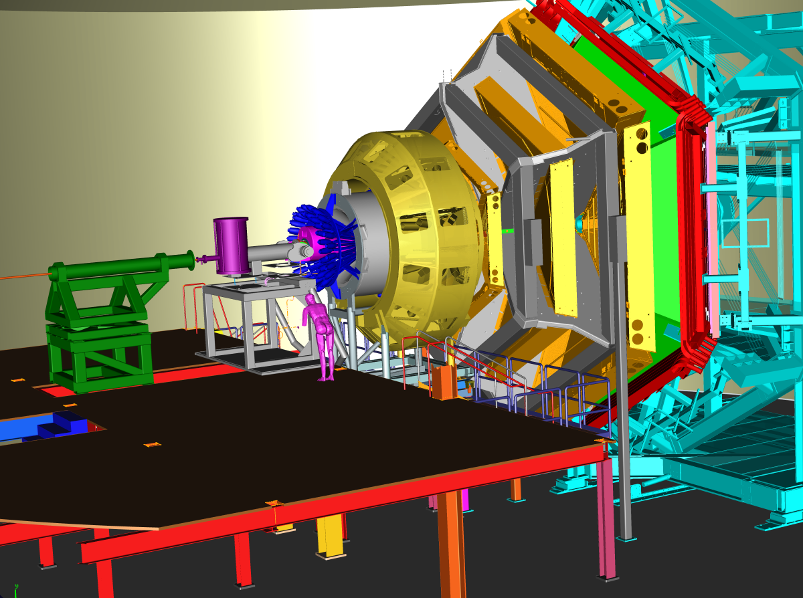
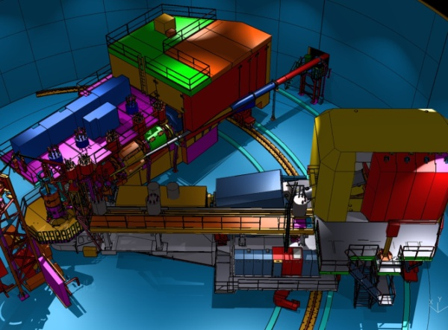
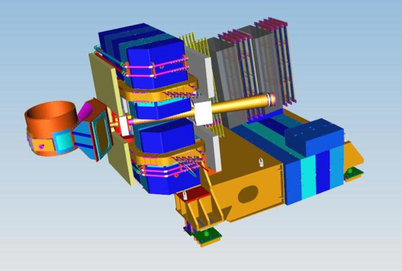
3D Imaging With JLab @ 12 GeV
Generalized Parton Distributions (GPDs) and Transverse Momentum Distributions (TMDs)
CEBAF Large Acceptance Spectrometer (CLAS12) in Hall B: general survey experiments, large acceptance and medium luminosity
SHMS, High Momentum Spectrometer (HMS) and Neutral-Particle Spectrometer (NPS) in Hall C: precision cross sections for L-T studies and ratios, small acceptance and high luminosity
Super Bigbite Spectrometer (SBS) in Hall A : dedicated large-x TMD study
medium acceptance and high luminosity
Future: Solenoidal Large Intensity Device (SoLID) in Hall A: large acceptance and high luminosity

Slide 19
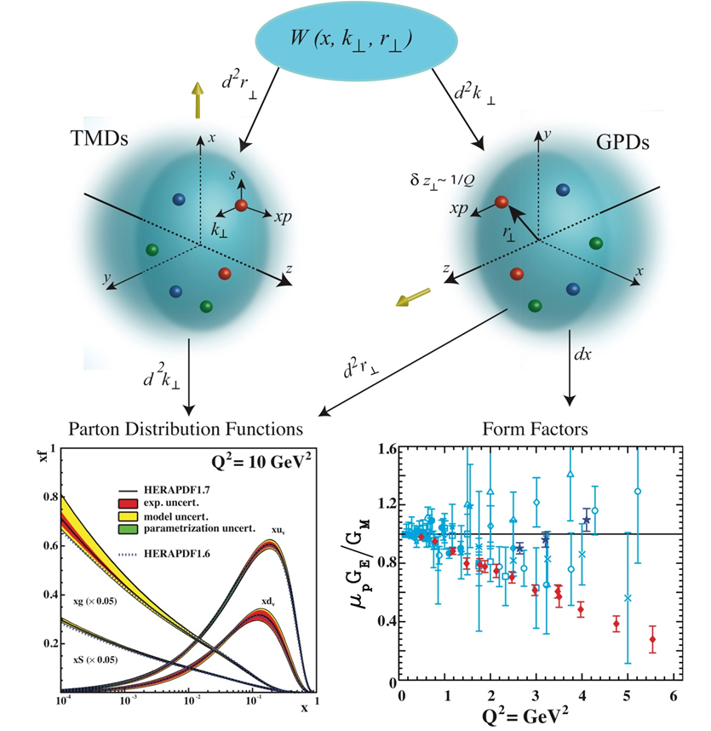
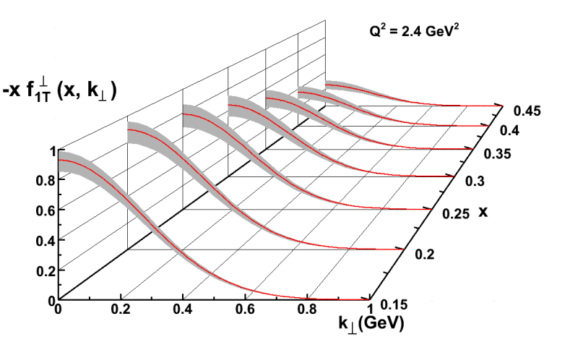
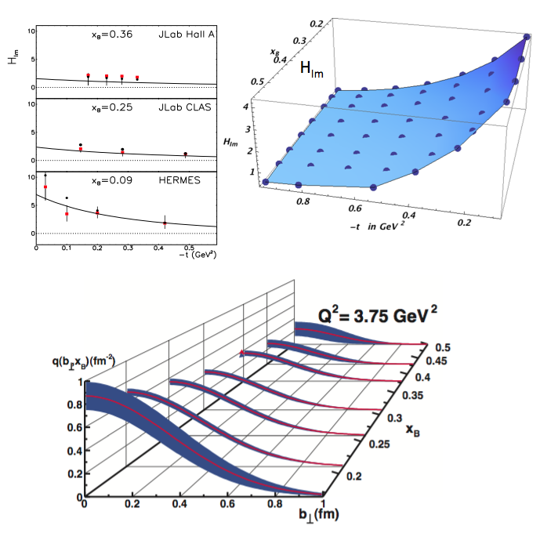
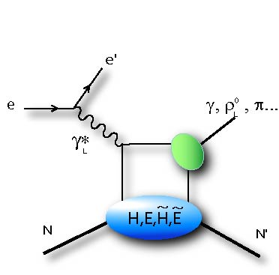
12 GeV: 3D imaging of the Nucleon
TMDs: Longitudinal momentum fraction x and transverse momentum k
GPDs: Longitudinal momentum fraction x at transverse location b
Transverse Momentum Imaging
Transverse Spatial Imaging
e
Q²
e’
γ∗
h
P
X
t

Slide 20
Jefferson Lab User Growth
“Other Users” include US National Labs and Industry
1691 users in 278 institutions from 38 countries worldwide

Slide 21
PhDs based on Jefferson Lab Research
2019 is artificially low due to reporting date 07/19

Slide 22
Introduction: Why an Electron-Ion Collider
Interactions and structure are mixed up in nuclear matter: Nuclear matter is made of quarks that are bound by gluons that also bind themselves. Unlike with the more familiar atomic and molecular matter, the interactions and structures are inextricably mixed up, and the observed properties of nucleons and nuclei, such as mass & spin, emerge out of this complex system.
Gaining understanding of this dynamic matter is transformational: Gaining detailed knowledge of this astonishing dynamical system at the heart of our world will be transformational, perhaps in an even more dramatic way than how the understanding of the atomic and molecular structure of matter led to new frontiers, new sciences and new technologies.
The Electron Ion Collider is the right tool: A new US-based facility, EIC, with a versatile range of beam energies, polarizations, and species, as well as high luminosity, is required to precisely image the quarks and gluons and their interactions, to explore the new QCD frontier of strong color fields in nuclei – to understand how matter at its most fundamental level is made.

Slide 23
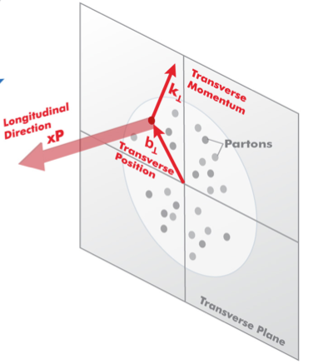

3D Structure of Nucleons and Nuclei
EIC is a machine to completely map the 3D structure of the nucleons and nuclei
We need to measure positions and momenta of the partons transverse to its direction of motion.
These quantities (k_{T}, b_{T}) are of the order of a few hundred MeV.
Also their polarization!
k_{T}, b_{T} (~100 MeV)
Proton and Ion Beam
Need to keep [100 MeV]_{T}/E_{proton,Ion} manageable (~ >10⁻³) ➔ E_{proton} ~< 100 GeV
Electron-Ion Collider: Cannot be HERA or LHeC: proton energy too high

Slide 24

Findings of the NAS committee
Finding 1: An EIC can uniquely address three profound questions about nucleons — neutrons and protons — and how they are assembled to form the nuclei of atoms:
  How does the mass of the nucleon arise?
  How does the spin of the nucleon arise?
  What are the emergent properties of dense systems of gluons?
Finding 2: These three high-priority science questions can be answered by an EIC with highly polarized beams of electrons and ions, with sufficiently high luminosity and sufficient, and variable, center-of-mass energy.
Finding 3: An EIC would be a unique facility in the world and would maintain U.S. leadership in nuclear physics.
Finding 4: An EIC would maintain U.S. leadership in the accelerator science and technology of colliders and help to maintain scientific leadership more broadly.
EIC science is compelling,
timely and fundamental
Developed by NAS committee with broad science perspective

Slide 25
Growing Relevance of Accelerators Worldwide
From: Dr. Robert W. Hamm

Slide 26
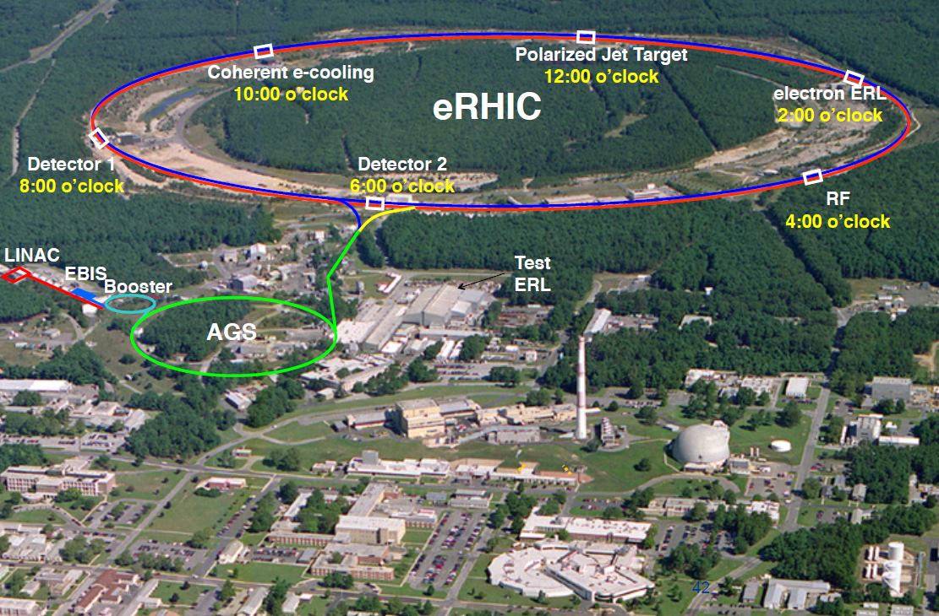
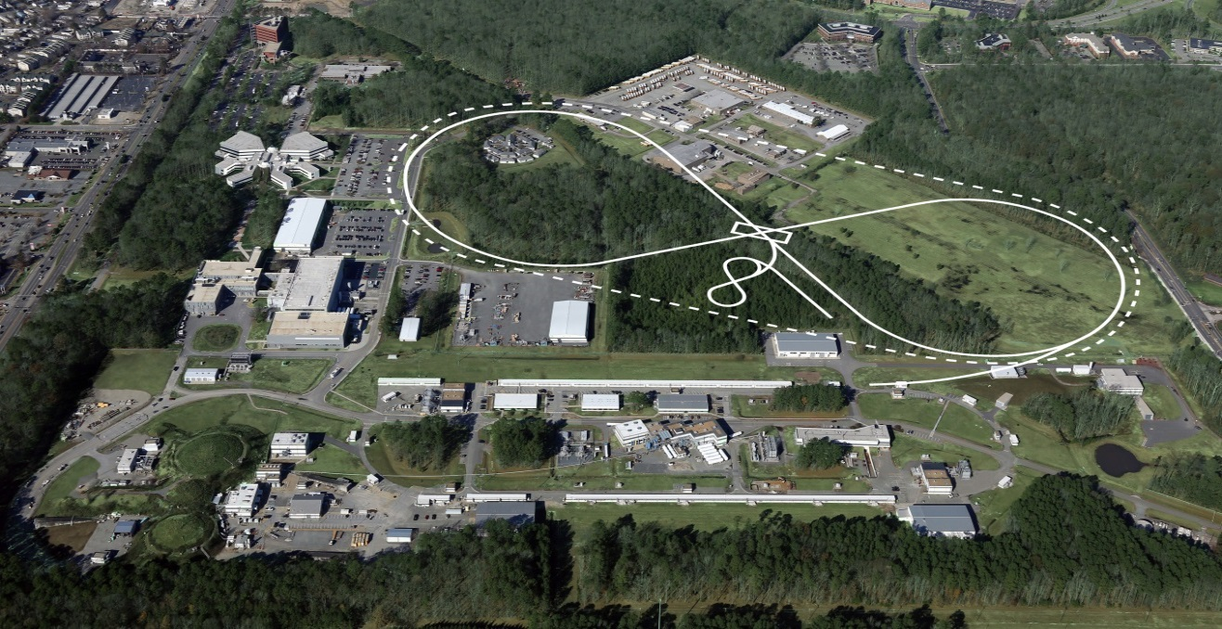
US-Based EIC PROPOSALs
Brookhaven Lab
Long Island, NY
JLEIC
Jefferson Lab
Newport News, VA

Slide 27
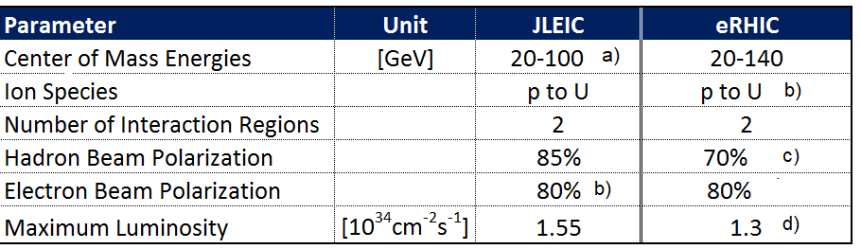
Key EIC Machine Parameters
as required by the NSAC LRP & NAS
80%
b) c)
f)
80%-85%
a) upgradable to 140 GeV
F. Willeke, BNL, July 2019

Slide 28
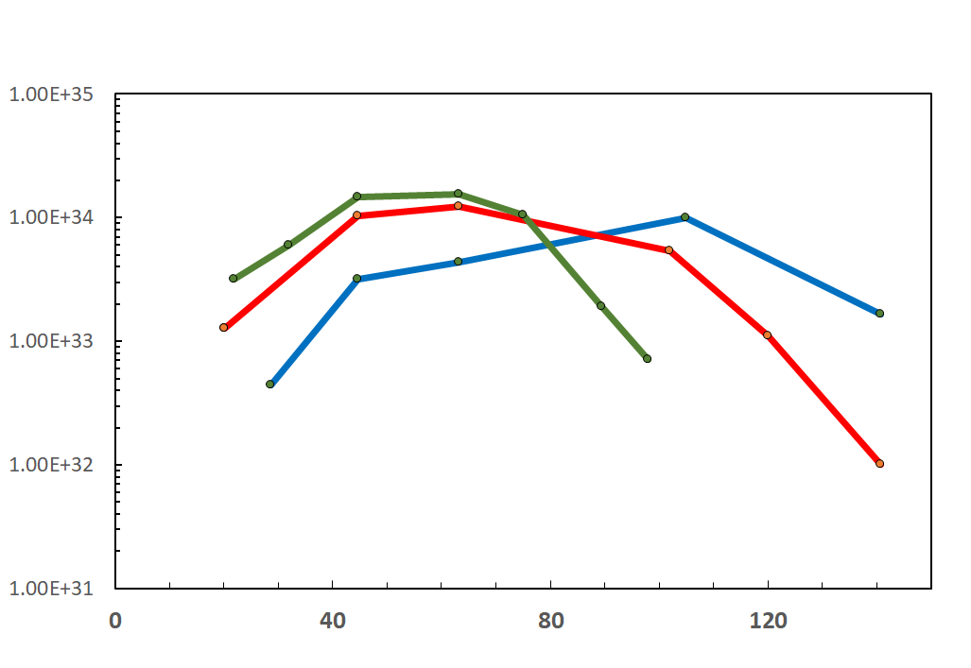
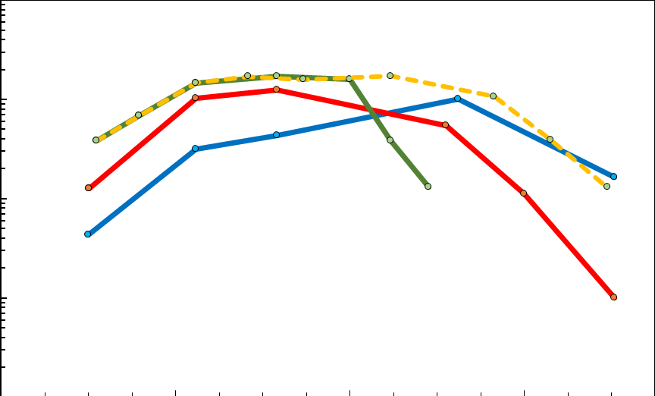
EIC Luminosity
F. Willeke, BNL, July 2019
IR Designs can be adjusted to obtain peak luminosity at different center of mass energies. The curves below show luminosity vs E_{cm} with IRs optimized for high or low center of mass energy. With two IRs, in principle both optimization can coexist in the same machine
10³⁴
10³³
10³²
10³¹
Accumulated Luminosity [fb⁻¹y⁻¹]
Luminosity [cm⁻²s⁻¹]
Tomography (p/A), Transverse Momentum
Distribution and Spatial Imaging
JLEIC
eRHIC
Optimization for high E_{cm}
-
-
-
-
100
10
1
Spin and Flavor Structure of
the Nucleon and Nuclei
eRHIC
Optimization
for E_{cm}=45 GeV
JLEIC Energy Upgrade
Internal
Landscape of the Nucleus
QCD at Extreme Parton Densities-
Saturation
Center of Mass Energy [GeV]
Note: For electron ion collisions, the E_{cm} scale needs to be reduced by a factor (Z/A)^{1/2}

Slide 29

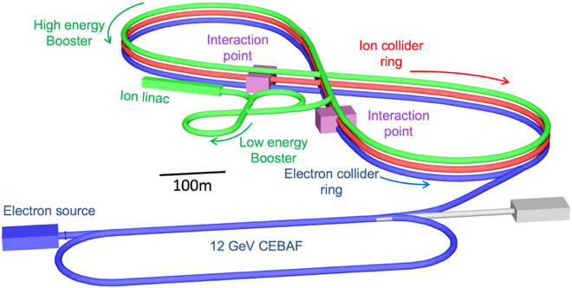
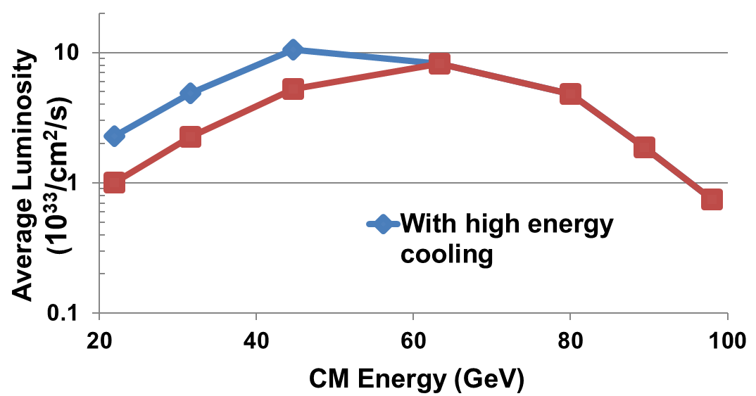
Jefferson Lab Electron Ion Collider
JLEIC Design Concept:
  Existing CEBAF serves as a full-energy electron injector
  Optimized for high luminosity and high polarization, well-matched to luminosity requirements
  Innovative figure-8 design guarantees high polarization, including deuteron
  Full acceptance detector and interaction region
  Energy Range:
√s : 20 to 100 - 140 GeV (magnet technology choice, 6T (NbTi) vs 12 T (Nb₃Sn) field)
  Cut-and-cover tunnel configuration compatible with future upgrade to E_{CM} = 140 GeV
Assumes 6T (peak field) magnets
100 fb⁻¹/yr
JLEIC offers an appropriate balance between performance and risk

Slide 30
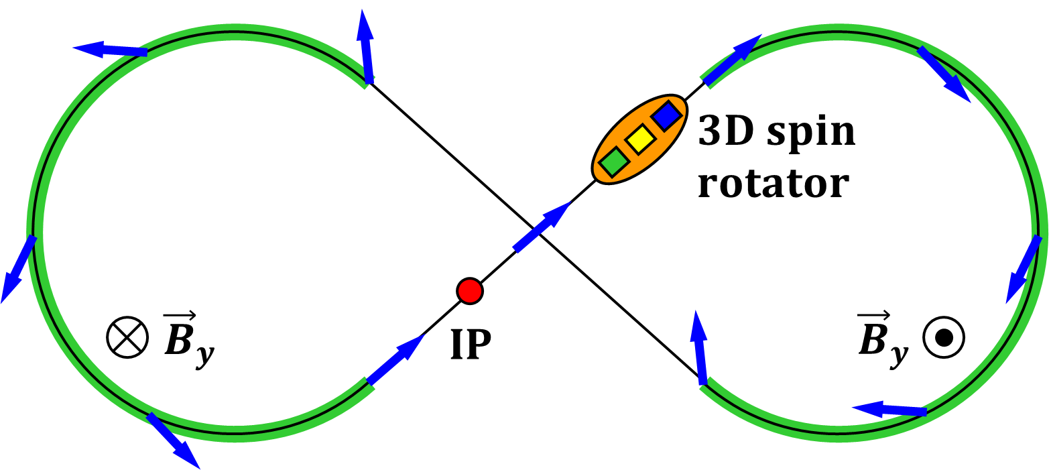
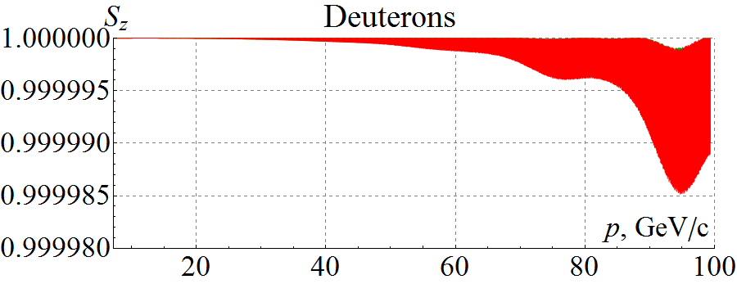
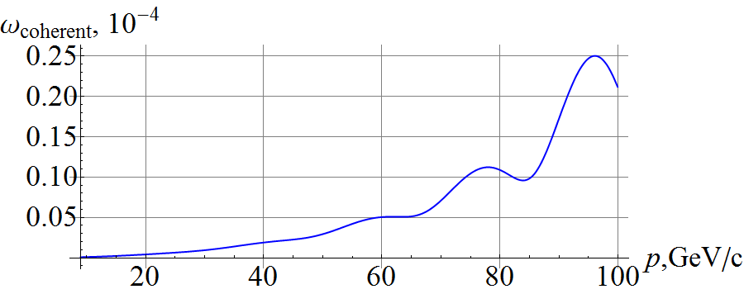
Figure 8 Design Ensures High Ion Polarization
Properties of a figure-8 structure enables preservation of injected 85% polarization
  Spin precessions in the two arcs are exactly cancelled
  In an ideal structure (without perturbations) all solutions are periodic
  The spin tune is zero independent of energy
A figure-8 ring provides unique capabilities for polarization control
  Local spin rotator determines spin tune and local spin direction
  B||L of only 3 Tm provides deuteron polarization stability up to 100 GeV
  A conventional ring at 100 GeV would require B||L of 1200 Tm or B⊥L of 400 Tm
Recent progress:
  Start-to-end deuteron acceleration (folding in analytic-calculated spin tune requirement and orbit excursion due to magnet misalignments)
  Deuteron spin is highly stable in figure-8 rings
(Zgoubi simulation)
3 T/min ramp rate
100 µm rms orbit excursion
Analytic prediction

Slide 31
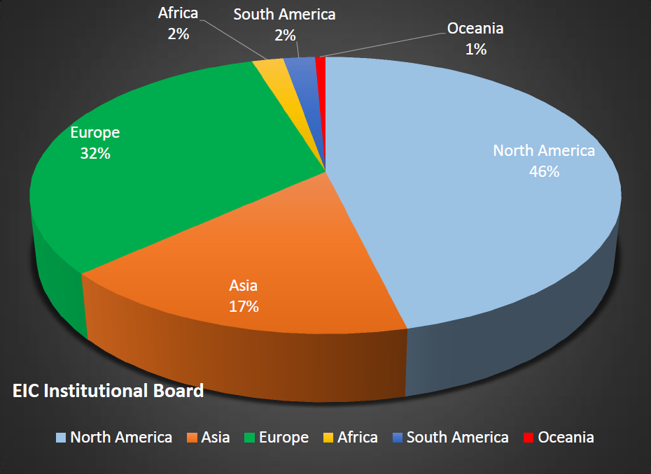
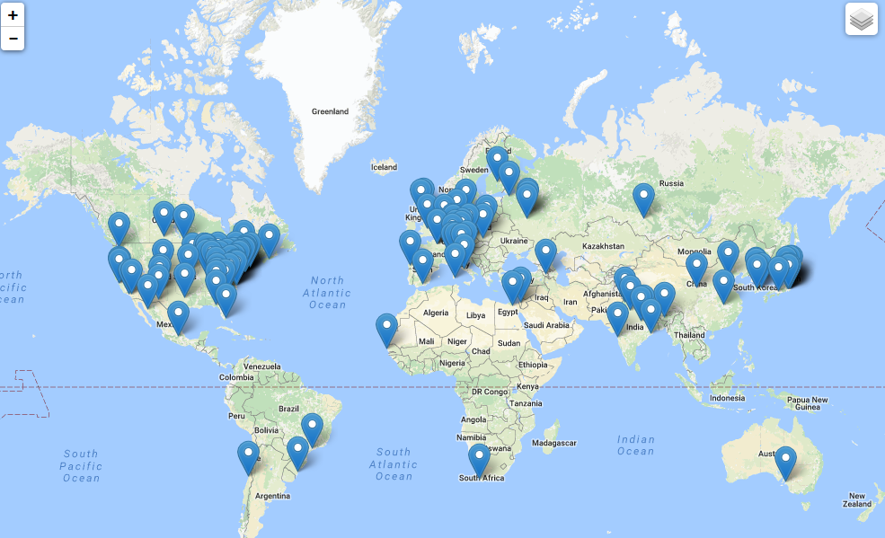
Worldwide Interest in EIC Physics
The EIC Users Group: EICUG.ORG
Formed 2016 – 969 collaborators, 30 countries, 197 institutions as of Dec. 31, 2019
Map of institution’s locations
Annual EICUG meeting
2016 UC Berkeley, CA
2016 Argonne, IL
2017 Trieste, Italy
2018 Washington, DC
2019 Paris, France
2020 Miami, FL
2021 Warsaw, Poland

Slide 32
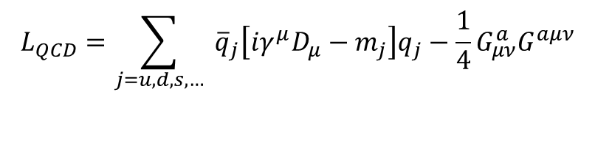

EIC: 21st Century QCD Laboratory
To explore the fundamental structure and dynamics of the matter in the visible world
Interactions arise through fundamental symmetry principles
Properties of the visible universe emerge through complex structure of the QCD vacuum
The proton is a highly relativistic system described by QCD, a fully relativistic quantum field theory.
Lattice QCD is an increasingly powerful means to carry out ab initio QCD calculations of hadron structure in the rest frame.
The goal of the EIC is to provide us with an understanding of the internal structure of the proton and more complex atomic nuclei that is comparable to our knowledge of the electronic structure of atoms themselves, which lies at the heart of modern technologies.
$$L_{QCD}=\sum_{j=u,d,s,…}{ {\overline{q}}_{j}\left[iγ^{μ}D_{μ}−m_{j}\right]q_{j}−\frac{1}{4}G_{μν}^{a}G^{aμν}}$$
$$D_{μ}=∂_{μ}+ig\frac{1}{2}λ^{a}A_{μ}^{a}, G_{μν}^{a}=∂_{μ}A_{ν}+∂_{ν}A_{μ}+igf^{abc}A_{μ}^{b}A_{ν}^{c}$$

Slide 33


Transverse Spatial Distribution of Gluons
How are gluons spatially distributed in a proton or a nucleus?
Is the distribution smooth?
How does it differ from the charge distribution?
First ever tomographic images of ocean of gluons within matter !

Slide 34

Transverse Momentum Distributions
Spin and the ability to look at transverse momentum together give a powerful new window into QCD
TMDs directly related to orbital motion
For example, we can explore for the first time interference in quantum phases due to color force – impossible with purely 1D/longitudinal experiments

Slide 35


The Incomplete Hadron: Mass Puzzle
“Mass without mass!”
Proton: Mass ~ 940 MeV
  constituents acquire mass by DχSB,
  most of mass generated by dynamics
Kaon: Mass ~ 490 MeV
  boundary between emergent-mass and Higgs-mass generation mechanisms
Pion: Mass ~ 140 MeV
  exists only if mass is dynamically generated
EIC’s expected contribution in:
In the chiral limit, for the pion (m_{π} = 0):
$$\left\langle π\left(q\right)\left|Θ_{0}\right|π\left(q\right)\right\rangle =−q_{μ}q_{μ}=m_{π}^{2}=0$$
Quark-gluon energy:
quark-gluon momentum fractions
Sometimes interpreted as that in the chiral limit the gluons disappear and thus contribute nothing to the pion mass: is the pion empty or full of gluons?
On the other hand, from phenomenological view, at a given scale, there is far less glue in the kaon than in the pion. All measurable at EIC.
For π and K with Sullivan process
A.C. Aguilar et al., Pion and Kaon structure at the EIC, arXiv:1907.08218, EPJA 55 (2019) 190.

Slide 36
EIC – Versatility and Luminosity is Key
Why would pion and kaon structure functions, and even measurements of pion structure beyond (pion GPDs and TMDs) be feasible at an EIC?
L_{EIC} = 10³⁴ = 1000 x L_{HERA}
Detection fraction @ EIC in general much higher than at HERA
Fraction of proton wave function related to pion Sullivan process is roughly 10⁻³ for a small –t bin (0.02).
Hence, pion data @ EIC should be comparable or better than the proton data @ HERA, or the 3D nucleon structure data @ COMPASS
If we can convince ourselves we can map pion (kaon) structure for –t < 0.6 (0.9) GeV², we gain another decade.
Ratio of the F₂ structure function related to the pion Sullivan process as compared to the proton F₂ structure function in the low-t vicinity of the pion pole, as a function of Bjorken-x (for JLab kinematics)

Slide 37




EIC Science: Deuterons and neutron targets
Figure-8 design enables polarized (vector and tensor)
deuteron beams (>80% polarization).
Collider → allows a precision measurement of the spectator nucleon.
First precision measurement of polarized (and unpolarized) neutron is possible at EIC
Extrapolation
from bound to
free neutron
under control
Polarized
Neutron
Structure
F₂^{n} can be extracted at % level accuracy
Investigate nuclear effects at the level of partons with Tensor Polarization Observables
Polarized Deuteron Structure Function b₁
Are quarks sensitive to the shape of the nucleus?
-

Slide 38



World Data on F₂^{p}
World Data on g₁^{p}
World Data on h₁^{p}
Similar for F₂^{n}
Similar for g₁^{n}, g₂^{p}, g₂^{n}
(and b₁^{d})
Similar for h₁^{n}
F_{UT}^{sin(φh+φs)}(x,Q²) + C(x) $∝h1$
Note: need to update plots for COMPASS data
An EIC makes it possible!
EIC coverage
COMPASS
HERMES
transverse spin ~ angular momentum
momentum
spin

Slide 39

Exotic Glue in Nuclei
Exotic Glue in Nuclei =
gluons not associated with individual nucleons in nucleus
operator in nucleon = 0 & operator in nuclei ≠ 0
Targets with J ≥ 1 have leading twist gluon contribution
Δ(x,Q²): double helicity flip (Jaffe and Manohar, 1989)
Changes both photon and target helicity by two units…
Measurable in unpolarized Deep Inelastic Scattering with a transversely polarized J ≥ 1 target like the deuteron as azimuthal variation.
Parton model interpretation:
Δ(x,Q²) informs how much more momentum of a transversely polarized particle is carried by a gluon with spin aligned rather than perpendicular to it in the transverse plane.
Shanahan, Detmold, et al.
LQCD calculation: gluon transversity distribution in the deuteron, m_{π} = 800 MeV → First evidence for non-nucleonic gluon contributions to nuclear structure

Slide 40

Timeline of the Universe
In Steven Weinberg’s seminal treaty on The First Three Minutes, a modern view of the origin of the universe, he conveniently starts with a ‘first frame” when the cosmic temperature has already cooled to 100,000 million degrees Kelvin, carefully chosen to be below the threshold temperature for all hadrons. Two reasons underlie this choice, the first that the quark-gluon description of hadrons was not universally accepted yet at that time, the second that the choice evades questions on the emergence of hadrons from quarks and gluons.

Slide 41

Towards a QM Description of the Final State
Balancing the transverse momentum – candles of space-time
D_{a}^{h}(z, p_{t}²; Q²)
From 1D to 3D fragmentation:
Many more variables,
  Many more angles
Multi-dimensional data
Fine binnings
Many spin correlations
Understanding of the 3D structure of fragmentation into a hadron requires studies of transverse momentum, spin and hadron species dependence
First step is always unpolarized cross sections → JLab/12 GeV (but limited in kinematics)

Slide 42

QCD Dynamics in Nuclei
Hadronization: the process that connects QCD with experiment
Nuclear PDFs: we know ~nothing about gluons in nuclei
Particle transport, color neutralization and propagation
Diffraction: no net color exchange
Jets
1/x
Hadronization
Salvatore Fazio, arXiv:1709.00076

Slide 43


GLUON SATURATION – WHAT TO MEASURE?
Many ways to get to gluon distribution in nuclei, but diffraction most sensitive:
Diffractive event
No activity in proton direction
A 7 TeV equivalent electron bombarding the proton … but nothing happens to the proton in 10-15% of cases
Predictions for eA for such hard diffractive events range up to: 25-30%... given saturation models
(EIC: utilize g ~ A^{1/3} x s^{0.3} to hunt for c.q. map onset of saturation)

Slide 44




Exposing different layers of the nuclear landscape with electron scattering
History:
Electromagnetic
Elastic electron-nucleus scattering → charge distribution of nuclei
Present/Near-future:
Electroweak
Parity-violating elastic electron-nucleus scattering (or hadronic reactions e.g. at FRIB) → neutron skin
Future:
Color dipole
φ Production in coherent electron-nucleus scattering → gluon spatial distribution of nuclei
Fourier transform gives unprecedented info on gluon spatial distribution, including impact of gluon saturation

Slide 45


New Avenues
Nature, 557, May 17, 2018
Pressure in the Proton
  First determination using DVCS (Deeply Virtual Compton Scattering) data
  Interior pressure in proton is > pressure inside a neutron star! Who knew that!
  Lattice calculation motivates determination of gluon GPDs at EIC
Polarized Deuteron Structure
  Inclusive Deep Inelastic Scattering on Vector- and Tensor-Polarized Deuterons
  Leading-twist gluon contribution Δ(x,Q²): Is there exotic glue in nuclei?
  Structure fn b₁: Are quarks sensitive to the doughnut or dumbbell shape of the nucleus?
Hot Spots in the Nucleus
  Simulated proton density fluctuations x = 10⁻³
  Accessible with 3D tomography
  Responsible for ridge behavior found in Heavy-Ion reactions at high energies?
-

Slide 46



Nuclear Femtography
Science of mapping the position and motion of quarks and
gluons in the nucleus.
Artist’s Conception
of Quark and Gluons
in a proton and nucleus
12 GeV
REQUIRES:
High beam polarization
High electron current
High target polarization
Large solid angle spectrometers
.. is just beginning
EIC
46

Slide 47
Summary
EIC Program aim: Revolutionize the QCD understanding of nucleon and nuclear structure and associated dynamics. Explore new states of QCD.
EIC will enable nuclear femtography of the nucleon and the nucleus at the scale of sea quarks and gluons, over all of the kinematic range that are relevant. JLab12 will have set the foundation at the scale of valence quarks!
What we learn at JLab12 and later EIC, together with advances enabled by experiments elsewhere, QCD phenomenology and LQCD studies, may open the door to a transformation of Nuclear Science, and Hadron Structure in particular.
Outstanding questions raised both by the science at RHIC/LHC and at HERMES/COMPASS/Jefferson Lab, have naturally led to the science and design parameters of the EIC
There exists world wide interest in collaborating on the EIC
Accelerator scientists at RHIC and JLab, in collaboration with many outside interested accelerator groups, can provide the intellectual and technical leadership to realize the EIC, a frontier accelerator facility.
The future of QCD-based nuclear science demands an Electron Ion Collider (and the wind seems in our sails!)

Slide 49
EIC Timeline and
EICUG Yellow Report Activities

Slide 50
Activity Name |  | 2014 | 2015 | 2016 | 2017 | 2018 | 2019 | 2020 | 2021 | 2022 | 2023 | 2024 | 2025 | 2026 | 2027 | 2028
 | NSAC Long Range Plan
 | NAS Study
 | CD0 – assumed
 | CD1 (Down-select)
 | CD2/CD3
 | NSAC LRP – assumed
 | EIC construction
 | EIC physics case
 | EICUG formation
 | EICUG meetings
 | Expression of Interest
 | Physics/Detector book I
 | Call for Detectors/ Collaboration Formation
 | Design of Detectors
 | Down-select to Two Full-Size Detectors
 | Detector/IR TDRs, Detector/IR Construction
Timeline as shown at the 2019 EIC Users Group Meeting in Paris for discussion of Future Planning of user-group driven activities accompanying DOE-driven activities.
DOE Driven
2030
User Group Driven
2030
CD0 = DOE “Mission Need” statement; CD1 = design choice and site selection
CD2/CD3 = establish project baseline cost and schedule

Slide 51
Physics and Detector Conceptual Development Study
“EIC Yellow Report(s) Exercise”
Initiated by the EICUG Steering Committee
Purpose
  Advance state of documented physics studies and detector concepts in preparation for the EIC.
  Provide basis for further development of concepts for experimental equipment best suited for science needs, including complementarity of two detectors
  Input towards future Technical Design Reports (TDRs)
Approach
  Two WG: Physics requirement and Detector concepts - 4 conveners each
  Several sub-groups each, ~2 conveners/sub-group
  Time limited effort: ~1 year
Meetings
  December 12-13, 2019, MIT: Kick-off organizational meeting
  Workshops
    March 19-21, 2020, Temple U., Philadelphia
    May 22-24, 2020, U. of Pavia, Pavia, Italy
    September 17-19, 2020, CUA, Washington D.C.
    November 19-21, 2020, UCB/LBNL, Berkeley, CA
It is essential, EIC activities in DOE seem to proceed fast. Let’s get going !!!

Slide 52

U.S. Electron-Ion Collider Planning 2007-18
2007 Nuclear Science Advisory Committee (NSAC) Long-Range Plan
“An Electron-Ion Collider (EIC) with polarized beams has been embraced by the U.S. nuclear science community as embodying the vision for reaching the next QCD frontier”
2013 Electron Ion Collider White Paper
(Writing committee convened by Jefferson Lab and BNL)
2013 NSAC Subcommittee on Future Facilities
Identified EIC as absolutely central to the nuclear science program of the next decade
2015 NSAC Long-Range Plan
“We recommend a high-energy high-luminosity polarized EIC as the highest priority for new facility construction following the completion of FRIB.”
2018 National Academy of Sciences (NAS) – Assessment of U.S. Based Electron-Ion Collider Science
“…the committee finds a compelling scientific case for such a facility. The science questions that an EIC will answer are central to completing an understanding of atoms as well as being integral to the agenda of nuclear physics today.”

Slide 53


EIC Scientific Program: White Paper Science Goals
The total integrated luminosity to complete whitepaper program is ~700 fb⁻¹
This made some assumptions, e.g., that wherever the EIC White Paper assumed spin-polarized runs with e-p, there likely also would be similar spin-polarized e-d or e-³He runs, both longitudinal and transverse.
At L_{avg} = 10³⁴ cm⁻²s⁻¹ this program requires 7 years of operation.
Luminosity, polarization and versatility of the EIC is key

Slide 54
Physics vs. EIC Design Requirements
What the nuclear physicists dream off and drives the EIC designs, with upgrade paths included either in luminosity or in CM energy
EIC range – with 100% acceptance
10³⁴
Flexibility in energies
Polarization – e⁻ and p/d/³He
Range of nuclei – H to Pb/U
Excellent acceptance
Good particle identification and resolution
100
Luminosity (cm⁻² sec⁻¹)
10³³
Integrated Luminosity (fb⁻¹/yr)
10
10³²
1
Polarized luminosity and the capability to measure physics of interest is what counts
40
80
120
√s (GeV)

Slide 55

EIC Final State Particles
Possible to get 100% acceptance for the whole event
Scattered electron
Ion beamline
Electron beamline
Particles Associated with Initial Ion
Particles associated with struck parton
Beam elements limit forward acceptance
Central Solenoid not effective for forward
Central
Detector
Beam Elements

Slide 56

EIC – World’s First Polarized eN Collider
A spin factory of polarized electrons and polarized protons/light nuclei:
imaging the quarks and gluons
How are the sea quarks and gluons, and their spins, distributed in space and momentum inside the nucleon?
How do the nucleon properties emerge from them and their interactions?

Slide 57
World Data on F₂^{p}
World Data on g₁^{p}
World Data on h₁^{p}
F_{UT}^{sin(φh+φs)}(x,Q²) + C(x) $∝h1$
Note: need to update plots for COMPASS data
An EIC makes it possible!
EIC coverage
COMPASS
HERMES
transverse spin ~ angular momentum
momentum
spin

Slide 58




THE INCOMPLETE HADRON: SPIN PUZZLE
EIC projected measurements:
Precise determination of polarized PDFs of
quark sea and gluons ➔ precision ΔG and ΔΣ
➔ Determination of L_{q} + L_{g}

Slide 59


Mass of the Visible Universe
Gluon mass-squared function
Visible world: mainly made of light quarks – its mass emerges from quark-gluon interactions. Higgs mechanism hardly plays a role
The strange quark is at the boundary - both emergent-mass and Higgs-mass generation mechanisms are important.
Emergent mass of the visible universe

Slide 60

The Incomplete Hadron: Mass Puzzle
“Mass without mass!”
Bhagwat & Tandy/Roberts et al
Proton: Mass ~ 940 MeV
  constituents acquire mass by DχSB,
  most of mass generated by dynamics
Kaon: Mass ~ 490 MeV
  boundary between emergent-mass and Higgs-mass generation mechanisms
Pion: Mass ~ 140 MeV
  exists only if mass is dynamically generated
EIC’s expected contribution in:
In the chiral limit, for the pion (m_{π} = 0):
$$\left\langle π\left(q\right)\left|Θ_{0}\right|π\left(q\right)\right\rangle =−q_{μ}q_{μ}=m_{π}^{2}=0$$
Quark-gluon energy:
quark-gluon momentum fractions
Sometimes interpreted as that in the chiral limit the gluons disappear and thus contribute nothing to the pion mass: is the pion empty or full of gluons?
On the other hand, from phenomenological view, at a given scale, there is far less glue in the kaon than in the pion. All measurable at EIC.
For π and K with Sullivan process
A.C. Aguilar et al., Pion and Kaon structure at the EIC, arXiv:1907.08218, EPJA 55 (2019) 190.

Slide 61

EIC – Versatility is Key
EIC: A Versatile Collider with a Hermetic Detector
How do color-charged quarks and gluons, and colorless jets, interact with a nuclear medium?
How do the confined hadronic states emerge from these quarks and gluons?
How do the quark-gluon interactions create nuclear binding?

Slide 62
Emergence of hadrons from partons
Nucleus as a Femtometer sized filter
Unprecedented ν, the virtual photon energy range @ EIC : precision & control
Energy loss by light vs. heavy quarks:
Control of ν by selecting kinematics;
Control the medium by selecting ions
Colored quark emerges as color neutral hadron ➔ What is nature telling us about confinement?
Identify π vs. D^{0 (charm)} mesons in e-A collisions: Understand energy loss of light vs. heavy quarks traversing nuclear matter
Need the collider energy of EIC and its control on parton kinematics

Slide 63

Twist-2 3D Fragmentation Functions
D_{a}^{h}(z, p_{t}²; Q²)
Unpolarized
Spin-spin correlations
Polarizing FF
Polarizing FF
Spin-momentum correlations
Collins
Collins

Slide 64

EIC – World’s First eA Collider
gluon
emission
gluon recombination
?=?
The Nucleus:
A laboratory for QCD
How does a dense nuclear environment affect the quarks and gluons, their correlations, and their interactions?
What happens to the gluon density in nuclei? Does it saturate at high energy, giving rise to a gluonic matter with universal properties in all nuclei, even the proton?

Slide 65
Nuclear Parton Distributions
What do we know of gluons in nuclei? Essentially nothing!
Ratio of Parton Distribution Functions of Pb over Proton:
Without EIC, large uncertainties in nuclear (light) sea quarks and gluons
An EIC with projected F_{L} and F_{L}^{CC} will significantly reduce uncertainties
Impossible for current and future pA data at RHIC & LHC data to achieve
From: Salvatore Fazio talk at INT 2017-3 program, also arXiv:1709.00076
Similar findings for impact of charm at large x by Weiss et al, arXiv:1610.08536

Slide 66
The Technical Foundations for EIC: Accelerator R&D
  The EIC will be one of the most complex and sophisticated collider accelerators ever built. The machine requirements push the state-of-the-art on many fronts including the high degree of beam polarization, high luminosity, beam cooling, beam dynamics, crab cavities for both beams, and an interaction region with complex magnets. EIC will be unique facility in the world and will maintain leadership in accelerator science and technology of colliders.
    NP Community Panel Review: Panel review charged with identifying high priority accelerator R&D aimed at technical risk reduction. Dr. Kevin Jones of SNS chaired this international panel. Panel Report published February 2017 (https://science.energy.gov/np/community-resources/reports/ )
    Bi-Annual FOA : Competitive accelerator R&D based on priorities established in EIC panel report. Funding level: ~$9-11 M per year for FY18 and FY19.
    Strong collaborations formed at the labs and with universities to advance different EIC concepts with collaborative common R&D effort.
T. Hallman – DOE Nuclear Physics
EICUG meeting, July 2019

Slide 67
The International Foundation for EIC: Meeting at IUPAP
DOE encourages international cooperation in EIC activities, including nuclear and accelerator sciences, detector and accelerator R&D, computing, engineering and construction efforts.
DOE-led EIC meeting with international funding agency and government representatives during the 5th IUPAP nuclear science symposium has been scheduled on August 3 at the University of Notre Dame London.
Attending are representatives of Australia, Brazil, Canada, France, Germany, Japan, Korea, India, Italy, Russia, UK and South-Africa.
Invitations are also being sent to CERN, Poland, Sweden, Romania
T. Hallman – DOE Nuclear Physics
EICUG meeting, July 2019

Slide 68
T. Hallman – DOE Nuclear Physics
NSAC meeting, October 2019

