Slide 1

DFX Conceptual Design review
Introduction to open topic
Amalia Ballarino for the WP6a
CERN, 12/02/2019

Slide 2
Introductory remarks
DFX design: weekly meeting (chaired by Y. Yang) as from Nov. 2018. Participants: Y. Yang. W. Bailey, A. Ballarino, R. Betemps, S. Claudet, J. Fleiter, I. Falorio, V. Parma, A. Perin, D. Perini
DFX vertical concept elaborated in July 2018, after in-depth study of (two) other options, and adopted after in-depth evaluation of pro and cons. At the time, the MgB₂ to Nb-Ti splices have been taken out from the DFX (they are now part of the SC Link, with only Nb-Ti cables entering the DFX)

Slide 3
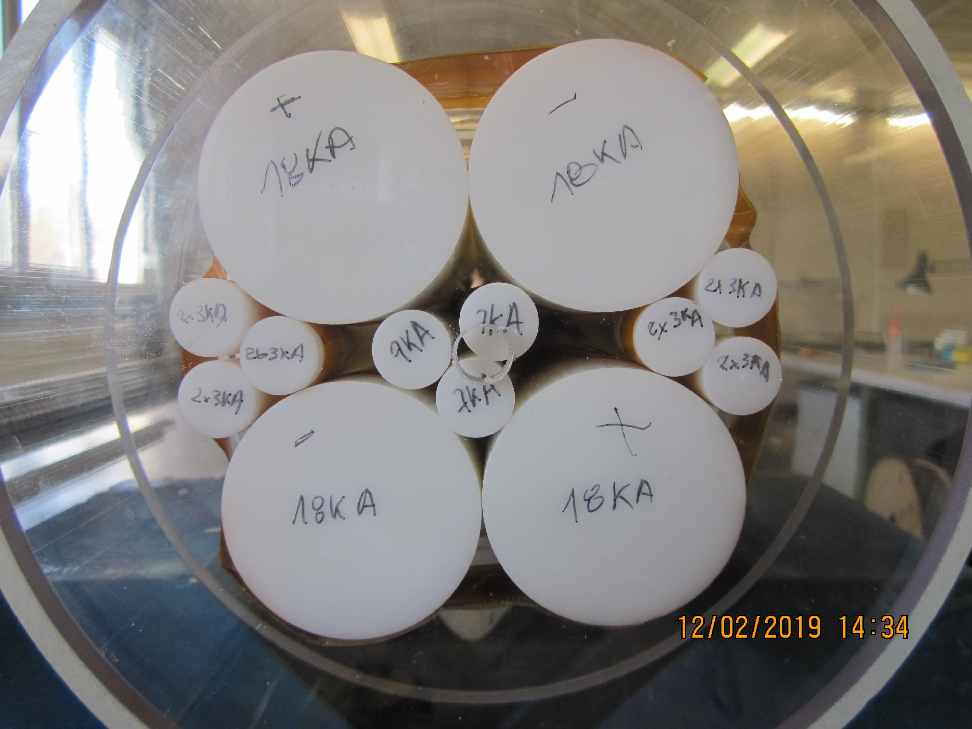
Introductory remarks
Boundary conditions for the electrical termination of SC Link (diameter and length for splices) were defined in July 2018, and then confirmed via validation mock-up(s)
Cryogenic operating conditions were questioned during the review meeting
DFX vertical concept has been maintained, and discussed cryogenic requirements incorporated in the same concept (last week, showing some flexibility in the design)

