Slide 1


MED014
Labeling of heat-sensitive biomolecules with terbium radionuclides:
selecting the optimal match between chelator and radiometal
F. Cleeren¹, I. Cassells¹, M. Ooms², A. Burgoyne², H. Derradji³, A. Aerts³, S. Baatout³, T.E. Cocolios⁴, K. Dockx⁴, S. Stegemann⁴, L. Popescu⁵, C. Deroose⁶, T. Cardinaels^{2,7}, G. Bormans¹
¹ KU Leuven & University Hospital Leuven, Laboratory for Radiopharmaceutical Research, 3000 Leuven, Belgium
² SCK•CEN, Radiochemistry Group, 2400 Mol, Belgium
³ SCK•CEN, Radiobiology Unit, 2400 Mol, Belgium
⁴ KU Leuven, Institute of Nuclear and Radiation Physics, 3001 Leuven, Belgium
⁵ SCK•CEN, Proton Target Research Unit, 2400 Mol, Belgium
⁶ KU Leuven & University Hospital Leuven, Nuclear Medicine & Molecular Imaging, 3000 Leuven
⁷ KU Leuven, Department of Chemistry, 3001 Leuven, Belgium
radiopharmacy.be

Slide 2
Overview presentation
Radiopharmaceutical research at KU Leuven/UZ Leuven
Radiometal-based radiopharmaceuticals
Objectives
Initial complexation results using stable ¹⁵⁹TbCl₃ and LC-HRMS
Initial radiolabeling results with terbium-161

Slide 3





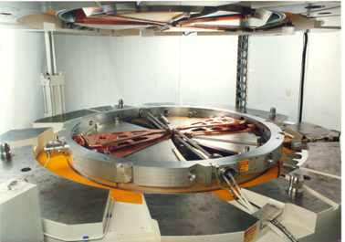
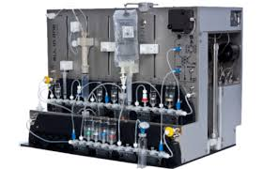
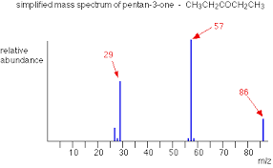
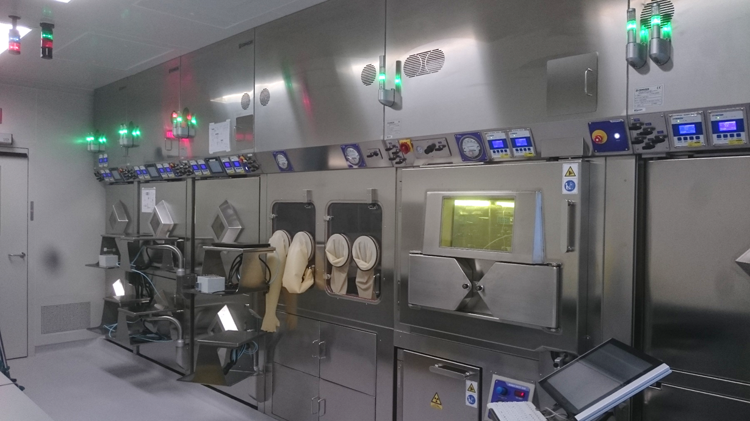

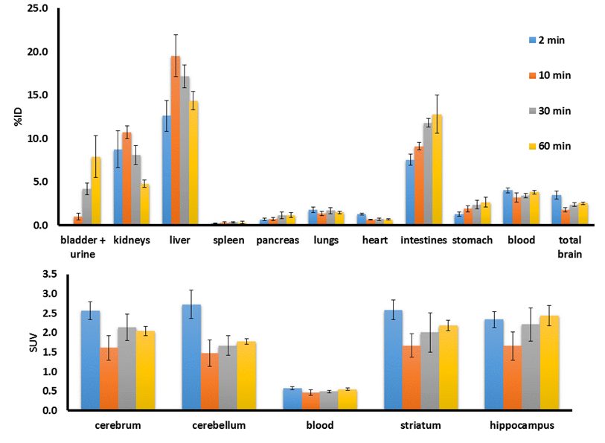
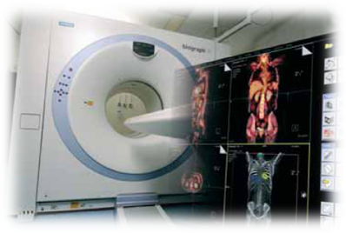


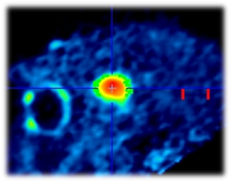

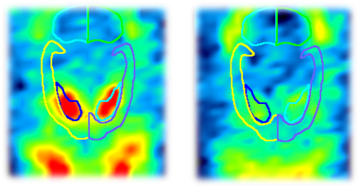
Full chain for development & evaluation of new radiopharmaceuticals
Design of tracer molecule
Organic Chemistry & characterisation
Radiochemistry
In vitro / in vivo evaluation
Translation to clinical application
Targeting molecule
+
Targeting molecule
Radiopharmaceutical
- Quality control
- Stability testing
Guy Bormans
Validation runs
IMPD, CTA,...
Christophe Deroose
Koen Van Laere

Slide 4
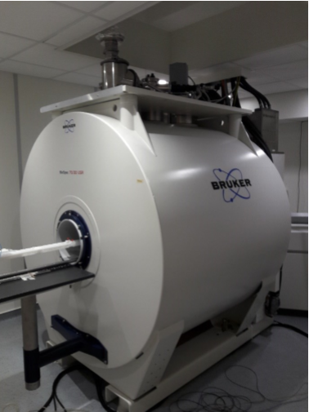
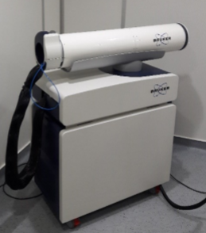

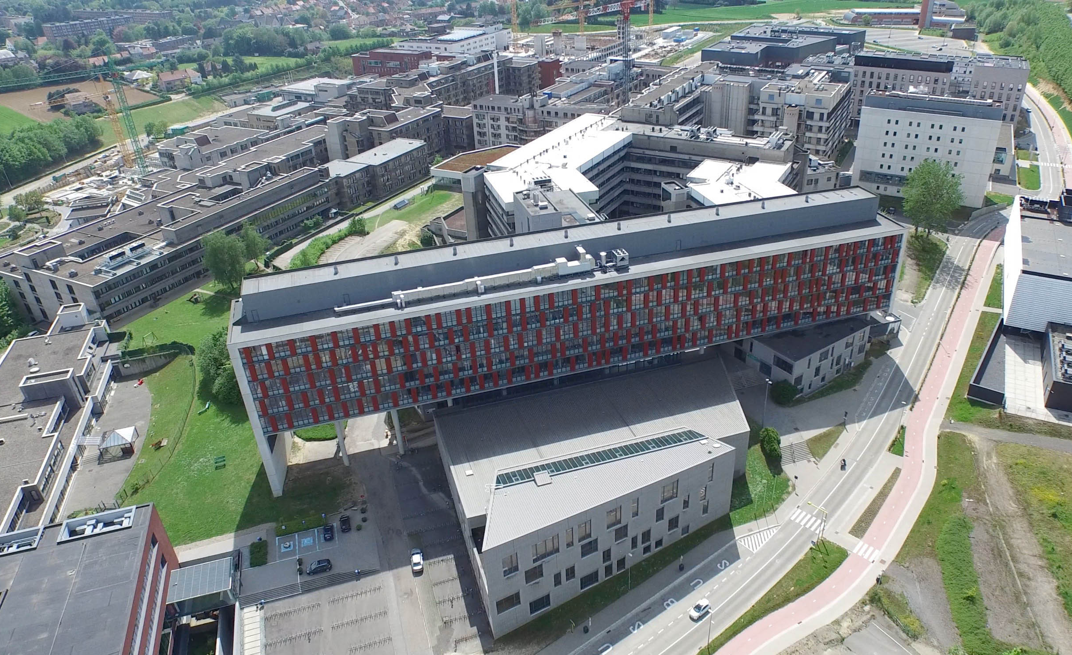
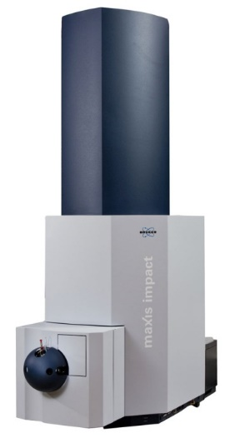
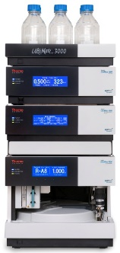
Working on three locations
UZ Gasthuisberg
Nuclear Medicine department
Cyclotron; ⁶⁸Ga gen; ^{99m}Tc gen
Radiochemistry (R&D and GMP)
O&N1
moSAIC
Molecular small animal imaging centre
Animal experiments
µPET-µPET/MR-MR-CT-
Biolumin &fluorescence
Radiochemistry lab:¹²⁵I, ⁸⁹Zr, ¹⁵⁵Tb, ¹⁶¹Tb, ²¹³Bi/²²⁵Ac,…
O&N2
Offices Radiopharmaceutical Research
Organic synthesis lab, bioconjugation chemistry, SDS-page, autoradiography
Radio-LCHRMS

Slide 5
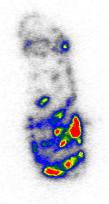

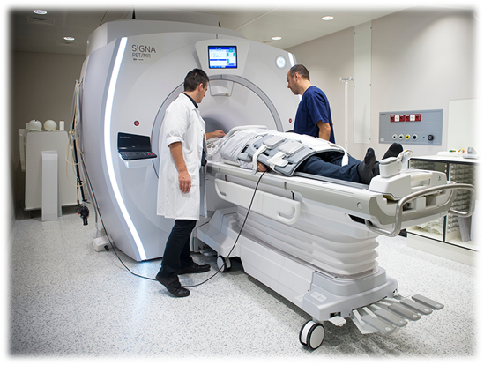
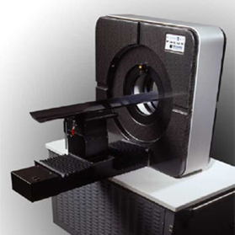
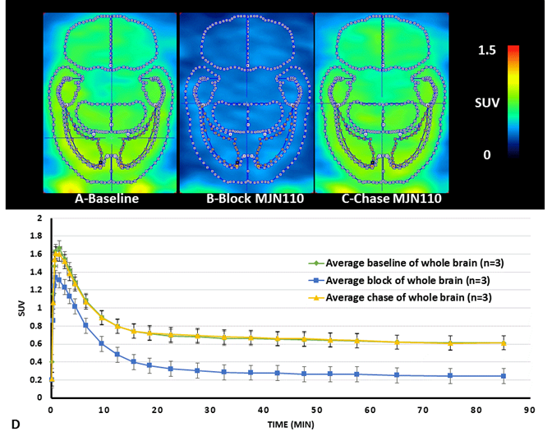
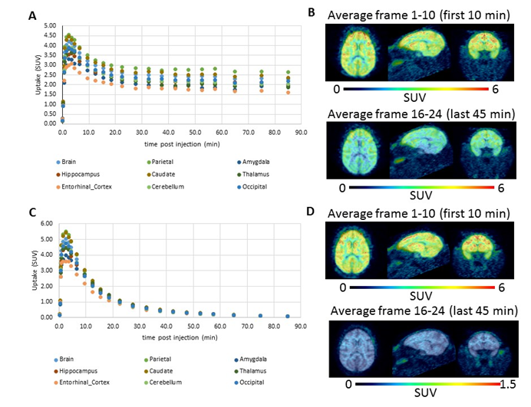
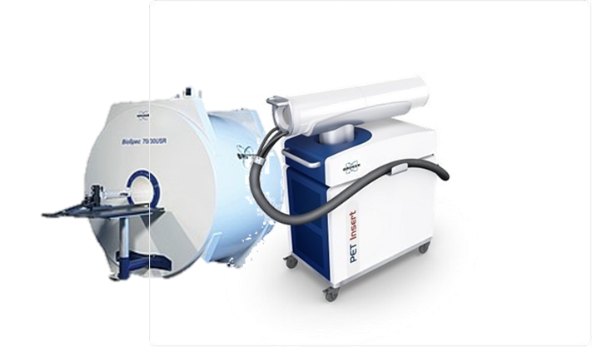
Preclinical evaluation
In vitro
Cell & tissue homogenate binding/binding inhibition
Autoradiography (mouse, rat, human tissue)
Stability studies
Max
Min
In vivo/ex-vivo
Mouse and rat biodistribution-plasma&tissue radiometabolite analysis
µPET/(MR) mouse/rat/rhesus monkey: baseline-blocking-displacement studies

Slide 6
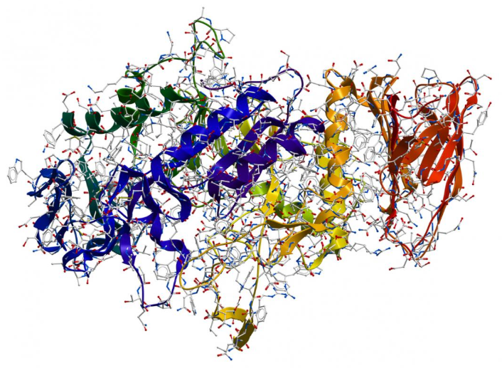

Radiopharmaceutical
Targeting molecule
Target
Radiometal or radiohalogen
Decay characteristics:
- Diagnostic imaging (SPECT/PET)
- Targeted radionuclide Therapy (TRNT)
High affinity for target (in nM range)
High selectivity for target
Different sorts of targeting molecules:
- Radionuclides as such (e.g. ¹³¹I)
- Small organic molecule (e.g. sugar derivative)
- Peptide (e.g. exendin-4, octreotide)
- Antibody fragments (e.g. FAB, scFv, Nanobody)
- Protein (e.g. albumin, IL-2)
- Antibody
Low expression in healthy tissue
High expression in target tissue
Physical T_{1/2}
Minutes
Hours
Days
Biological T_{1/2}
Minutes
Hours
Days
¹¹C
²¹³Bi
¹⁸F
Enzymes (e.g. MAO-A)
Transporters (e.g. GLUT-1)
¹⁴⁹Tb
¹³¹I
⁴⁷Sc
¹⁶¹Tb
¹⁷⁷Lu
¹⁵⁵Tb
Temperature sensitive?
Stable in organic solvents?
Receptors
(e.g. HER-2)
→ Physical T_{1/2} radionuclide should match biological T_{1/2} of targeting molecule

Slide 7


Radiometal-based radiopharmaceutical
Targeting molecule
Chelator:
Conjugation method:
Properties of ideal chelator:
Quantitative chelation yields in short reaction time (15 min) (no purification required-kit preparation)
High in vitro and in vivo stability of radiometal complex
Does not interfere with affinity of targeting molecule
Does not increase kidney retention/liver uptake
Conjugation with biological vector molecule?
Mild conditions: mild pH (pH 4-9) and aqueous medium
Quantitative yields at room temperature (max 40°C)
Low concentration of chelator-targeting molecule construct (µM range)
→ high production costs of biologicals
→ high apparent molar activity (important for receptor system)
Random conjugation method:
Bifunctional chelators functionalised with reactive group towards lysine residues (e.g. activated ester, -NCS)
Advantage: no modification of targeting molecule is required
Disadvantage: Heterogeneous product (batch-to-batch variability), functionality/affinity remains intact?
Site-specific conjugation method?
Thiol-maleimide chemistry (cysteine residues)
Sortase method
His-Tag radiolabeling
Advantage: Homogeneous product, no loss of functionality/affinity
Disadvantage: modification of targeting molecule is required

Slide 8

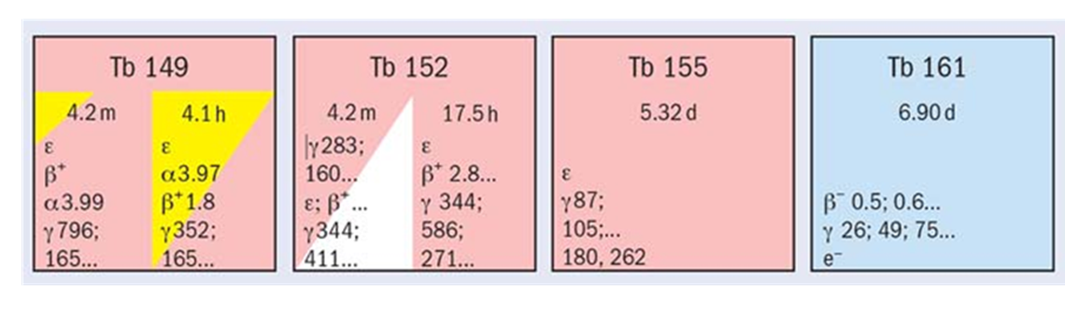

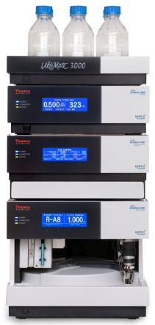

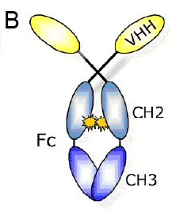


Labeling of heat-sensitive biomolecules with terbium radionuclides:
selecting the optimal match between chelator and radiometal
Tb-IRMA-V
Four medical interesting Tb isotopes
Targeting molecule
!
!
PhD student Irwin Cassells
Heat-sensitive biomolecules
E.g. antibodies, antibody fragments (e.g. scFv, nanobodies)
Stable Terbium-159 is available (TbCl₃)
Same chelator-targeting molecule construct can be used for different terbium isotopes
¹⁵⁹Tb will be used for “cold” coordination chemistry
  LC-HRMS (ESI-TOF) available at radiopharmaceutical research
    First screening of potential chelators (commercial available and “home-made”)
    Optimization of complexation conditions
    Characterization of terbium-chelator complex (charge?)
    Stability tests

Slide 9
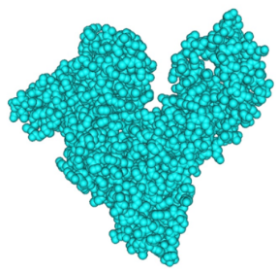
Phase 1: Selecting the optimal match between chelator and radiometal
Objectives:
Find optimal bifunctional chelators for terbium radionuclides
Characterization of cold terbium-complexes (HRMS, NMR, …)
Optimize radiolabeling conditions compatible with heat-sensitive biomolecules
Evaluate in vitro and in vivo stability of Terbium-complexes
Optimize dissolution and purification steps to obtain ¹⁵⁵Tb at SCK.CEN, test radiolabeling method
Transportation of Terbium-155 to KULeuven (Tb-IRMA-V)
- Radiolabel HSA with Terbium-155 using optimized radiolabeling conditions
Human serum albumin (HSA)
Most abundant protein in human plasma (3.5-5 g/dl)
66.5 kDa, thermolabile
High solubility and stability
Plasma half life of 16-18 h
  Ideal vector to optimize radiolabeling conditions
  Ideal vector to evaluate stability and kinetic inertness of ¹⁵⁵Tb-chelate in vivo
  Ideal vector for blood pool imaging applications
Human serum albumin (HSA)*
Biodistribution study comparing free ¹⁵⁵TbCl₃ and ¹⁵⁵Tb-HSA in healthy mice
- Whole body µSPECT imaging free ¹⁵⁵TbCl₃ and ¹⁵⁵Tb-HSA
*PDB ID :1E7H created with MarvinSpace 5.11.3
Cleeren, F., Lecina, J., Ahamed, M., Raes, G., Devoogdt, N., Caveliers, V., McQuade, P., Rubins, D.J., Li, W., Verbruggen, A., Xavier, C. and Bormans, G. (2017) Al¹⁸F-Labeling Of Heat-Sensitive Biomolecules For Positron Emission Tomography Imaging. Theranostics. 11, 2924-2939

Slide 10
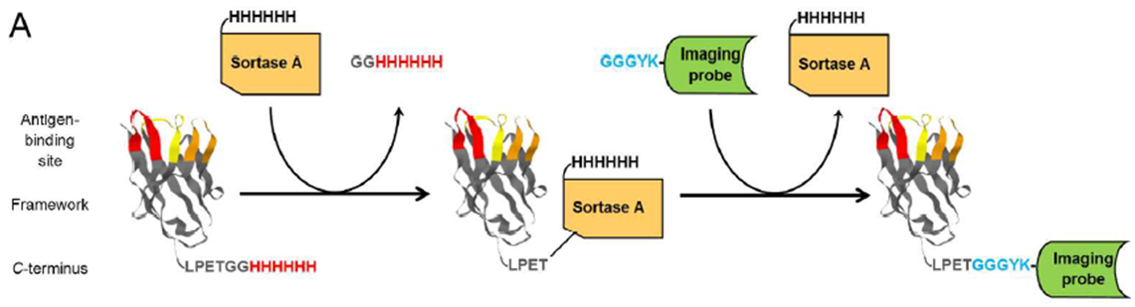
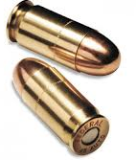



Phase 2: Theranostics using ¹⁵⁵Tb/¹⁶¹Tb anti-CEA nanobodies
Objectives:
A) Site-specific conjugation of chelator to Nanobody via Sortase-A method
site-specifically radiolabel heat-sensitive anti-CEA nanobodies for imaging and treatment of (micro)metastatic CEA-positive colorectal cancer
Antigen-
binding site
C-terminus
Nb-sortag
Acyl intermediate
Site-specifically conjugated Nb
Nanobody= The “Magic bullet” for molecular imaging and targeted radionuclide therapy ?
B) Direct radiolabeling in mild conditions
¹⁵⁵Tb/ ¹⁶¹Tb
If possible, terbium-149 (alpha therapy) and terbium-152 (PET) will also be considered in a later phase
25°C
Aqueous medium
Previous successful collaborations with ICMI Brussels:
Blykers, a., Schoonooghe, S., Xavier, C., D’hoe, K., Laoui, D., D’Huyvetter, M., Vaneycken, I., Cleeren, F., Bormans, G., Heemskerk, J., Raes, G., De Baetselier, P., Lahoutte, T., Devoogdt, N., Van Ginderachter, J. a., and Caveliers, V. (2015) PET imaging of MMR-expressing macrophages in tumor stroma using ¹⁸F-radiolabeled camelid single-domain antibody fragments. J. Nucl. Med. 56, 1265-1271
Cleeren, F., Lecina, J., Ahamed, M., Raes, G., Devoogdt, N., Caveliers, V., McQuade, P., Rubins, D.J., Li, W., Verbruggen, A., Xavier, C. and Bormans, G. (2017) Al¹⁸F-Labeling Of Heat-Sensitive Biomolecules For Positron Emission Tomography Imaging. Theranostics. 11, 2924-2939
C) In vitro and in vivo preclinical evaluation
CEA⁺ subcutaneous and orthotopic colorectal tumor mouse model
*PDB ID :1E7H created with MarvinSpace 5.11.3

Slide 11
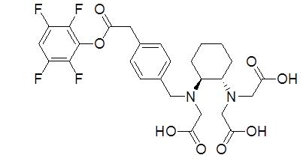

Selecting the optimal match between chelator and radiometal
-
p-NO₂-Bn-DOTA (CN8)
p-NO₂-Bn-DOTA (CN7)
p-NCS-Bn-CHX-A”-DTPA (CN8)
Expertise in this field is available (Al¹⁸F-RESCA):
Cleeren, F., Lecina, J., Billaud, E. M., Ahamed, M., Verbruggen, A., and Bormans, G. M. (2016) New chelators for low temperature Al¹⁸F-labeling of biomolecules. Bioconjugate Chemistry 27, 790–798.
Cleeren, F., Lecina, J., Bridoux, J., Devoogdt, N., Tshibangu, T., Xavier, C., and Bormans, G. (2018) Direct fluorine-18 labeling of heat-sensitive biomolecules for positron emission tomography imaging using the Al¹⁸F-RESCA methodology. Nature Protocols, 13, 2330-2347
p-NO₂-Bn-DOTA-GA (CN8)
p-NO₂-Bn-H₄octapa (CN8)
(±)-H₃RESCA-TFP
(±)-[¹⁸F]AlF(RESCA)-NbV4m119
Restrained Complexing Agent

Slide 12
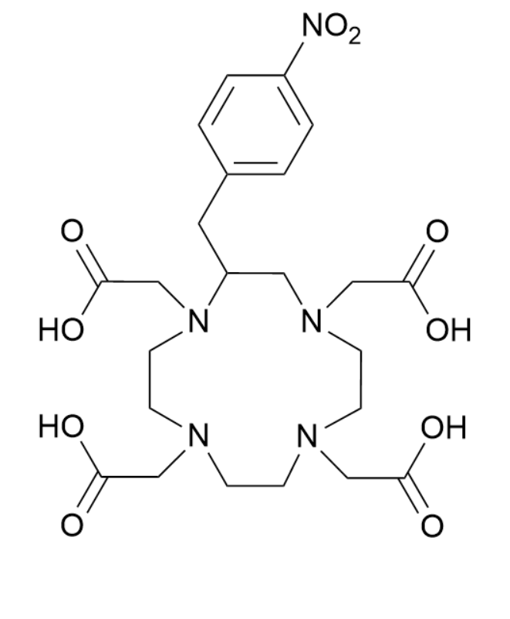
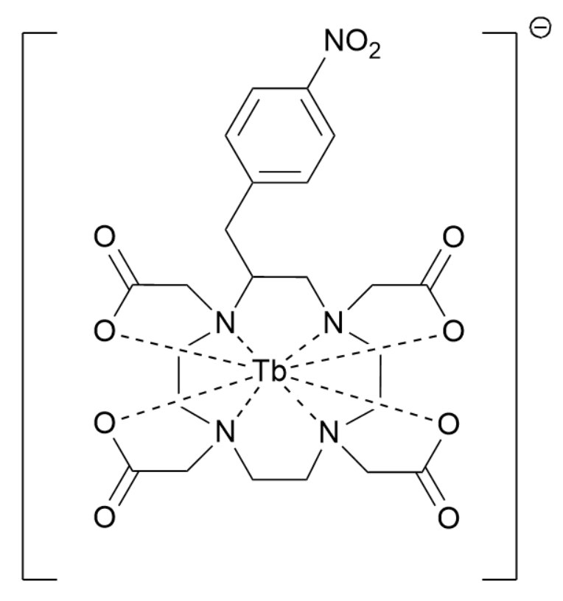
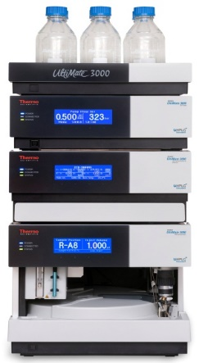

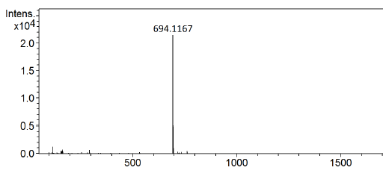
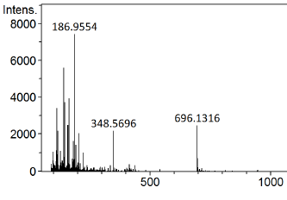
Initial complexation results using ¹⁵⁹TbCl₃ and LC-HRMS
Reactions in 0.1M acetate buffer at pH 4.7 (chelex treated)
Various temperatures (25 °C, 40 °C, 60 °C, 80 °C, 100 °C)
Various times (30 min, 60 min)
Reaction stopping (pH 2.0 using acetic acid)
Ligand to metal ratio – 2:1
¹⁵⁹TbCl₃ .6H₂O
p-NO₂-Bn-DOTA (CN8)
[Tb-p-NO₂-Bn-DOTA]⁻
Dionex Ultimate 3000 LC
Brukers impact maXis™
impact ESI-TOF HRMS
Negative mode
Positive mode
→ Quantitative conversion at 25°C in 30 min
LC-HRMS
Characterization of terbium complex
Determination charge of complex
Quantification using UV signal @ 254 nm
Stability tests
694.1160 (calc.)
696.1324 (calc.)

Slide 13


Initial complexation results using ¹⁶¹TbCl₃
BR2
Free ¹⁶¹Tb
[[¹⁶¹Tb]Tb-p-NO₂-Bn-DOTA]⁻
¹⁶⁰Gd (n,γ) ¹⁶¹Gd ➔ ¹⁶¹Tb
Reaction conditions (n=3):
- Reaction volume: 1 ml
- p-NO₂-Bn-DOTA: 0.1-10µM
- Sodium acetate 0.1M pH 4.7 (chelex treated)
- ¹⁶¹TbCl₃ solution
- Reaction time: 60 min
- iTLC Varian-SG (75% acetonitrile/25% H₂O)
¹⁶¹TbCl₃
25°C
→ Quantitative yields obtained using mild radiolabeling conditions compatible with heat-sensitive targeting molecules
p-NO₂-Bn-DOTA (CN8)
[[¹⁶¹Tb]Tb-p-NO₂-Bn-DOTA]⁻

Slide 14
Thank you for your attention!

Slide 15
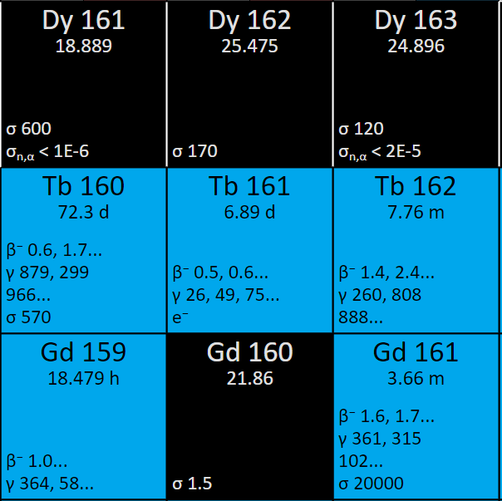
Terbium-161
Production
Processing
¹⁶⁰Gd (n,γ) ¹⁶¹Gd ➔ ¹⁶¹Tb
¹⁶¹Tb
¹⁶⁰Gd/¹⁶¹Tb
¹⁶¹TbCl₃ ready to radiolabel
¹⁶¹TbCl₃
Radionuclidic Purity >99.99%
Isotopic Purity – ICPMS underway
Radiochemical - Underway
Slide from Maarten Ooms, SCK.CEN

