Slide 1

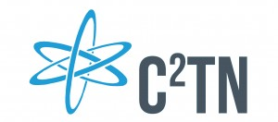
MED 021
¹⁵⁵/¹⁶¹Tb-labeled radioconjugates for cancer therapy with Auger electrons
Team: Lurdes Gano, Célia Fernandes, Alice d’Onofrio, Joana Guerreiro, António Paulo,
Radiopharmaceutical Sciences Group
Centro de Ciências e Tecnologias Nucleares, IST, Universidade de Lisboa, Estrada Nacional 10, 2686-953 Bobadela, Portugal

Slide 2
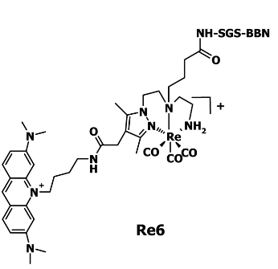
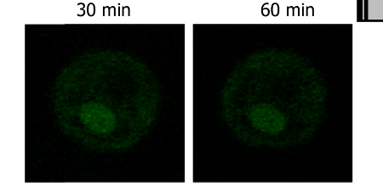
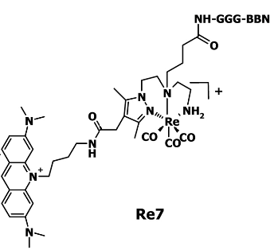
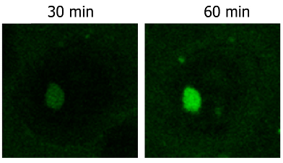
Previous Results: Cell Specific DNA targeting
Multifunctional Complexes: BBN analogues
Marked influence of the linker/ GGG can be cleaved by cathepsin B
TIME–LAPSE CONFOCAL MICROSCOPY: PC3 cells,15 µM
SINGLE CELL FLUORESCENCE DISTRIBUTION
4
5
A. Paulo et al., J. Biol. Inorg.Chem. 2011, 16, 1141-1153

Slide 3
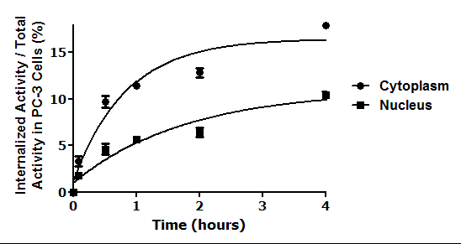
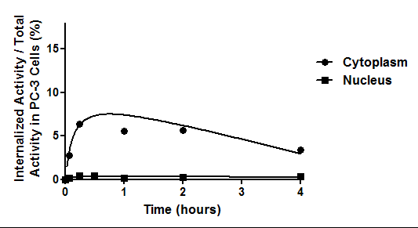
Previous Results: Cell Specific DNA targeting/^{99m}Tc congeners
5a

Slide 4
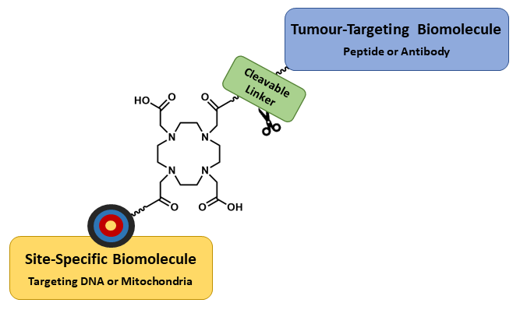
Our Proposal: Apply a Similar Approach to ¹⁵⁵Tb/¹⁶¹Tb Radioconjugates
Design and preclinical evaluation of DOTA-based ¹⁵⁵Tb/¹⁶¹Tb complexes of macrocyclic chelators of the type [4] carrying:
i) a bioactive vector (e.g. a BBN analogue)
ii) a cleavable linker (e.g. cathepsin B substrate)
iii) a DNA-targeting moiety (e.g. intercalator)
or a mitotropic moiety (e.g. TPP derivative)
We expect enhanced and more selective radiotoxic effects by augmented accumulation of the radiocomplexes in the nucleus and mitochondria of tumor cells.
The ^{155/161}Tb-radioconjugates will be firstly evaluated in human cancer cell lines to assess their cellular uptake, as well as their subcellular localization and radiotoxic effects.
At a later stage, studies will be also conducted in appropriate animal models.

