Slide 1
Project proposals to the MEDICIS collaboration board
Zeynep Talip, Nick Van der Meulen, Cristina Müller
zeynep.talip@psi.ch
CERN-MEDICIS, 20/03/2019

Slide 2
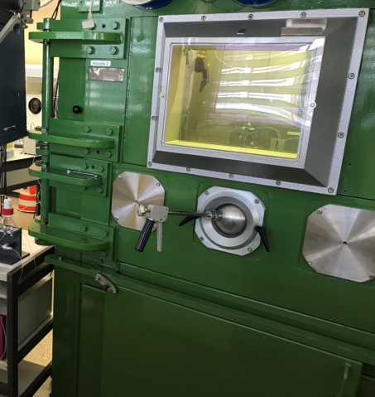
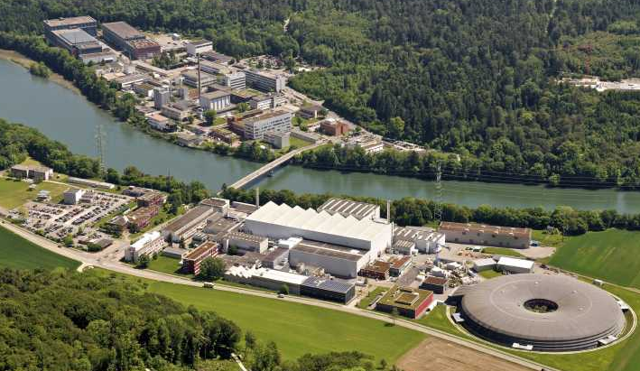
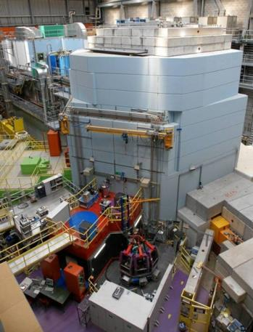
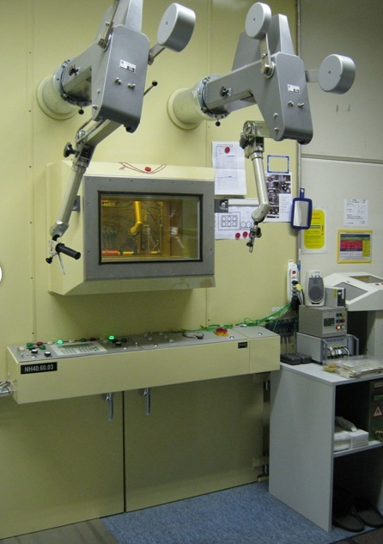
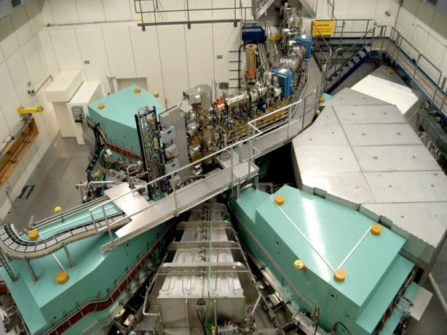
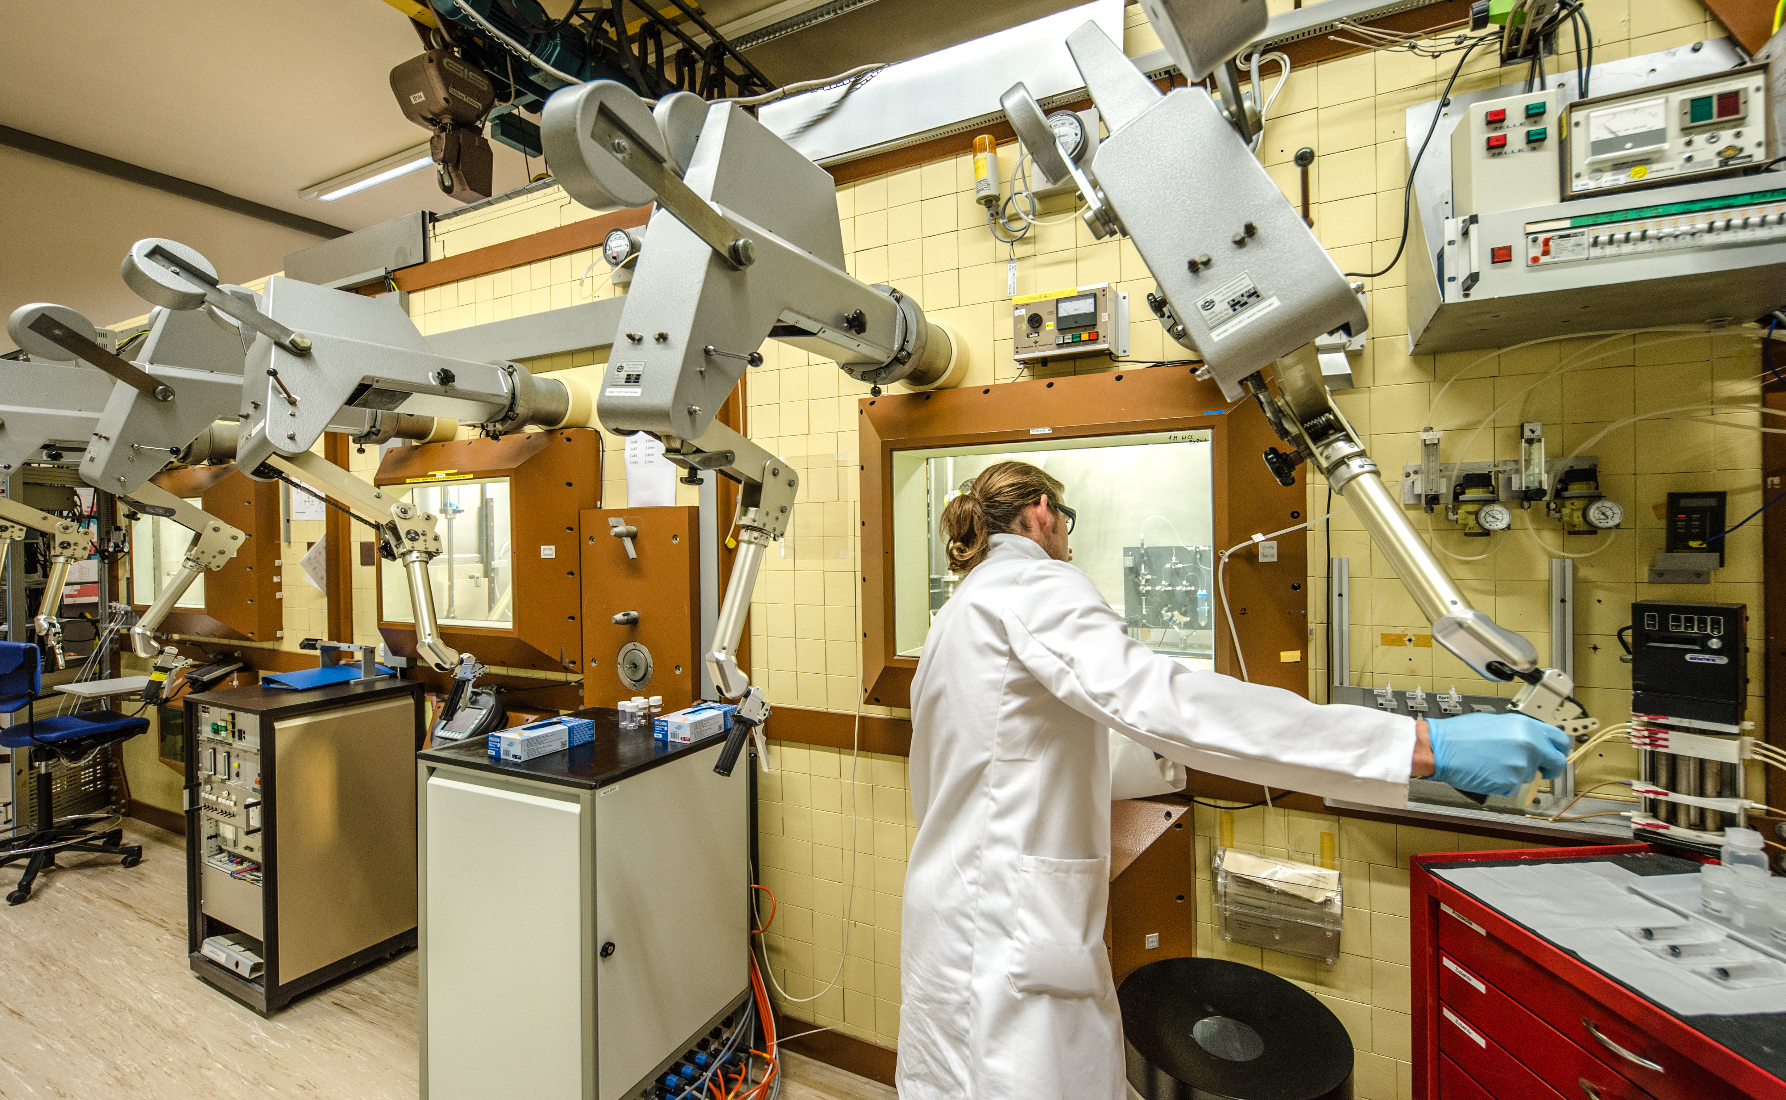
CRS
PSI Large Scale Facilities
CRS
Radiochemistry
Preclinical research labs
SINQ 2·10¹³ n/cm²/s
IP2
72 MeV
WILA

Slide 3

¹⁶⁷Tm production at MEDICIS from external target
Potential of new radionuclides for nuclear medicine applications
No-carrier added ¹⁷⁵Yb production at
MEDICIS from external ILL irradiated target
No-carrier added ¹⁶⁹Er production at
MEDICIS from external ILL irradiated target

Slide 4
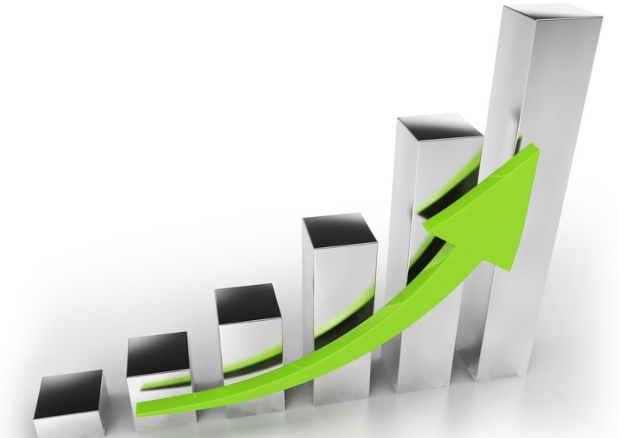
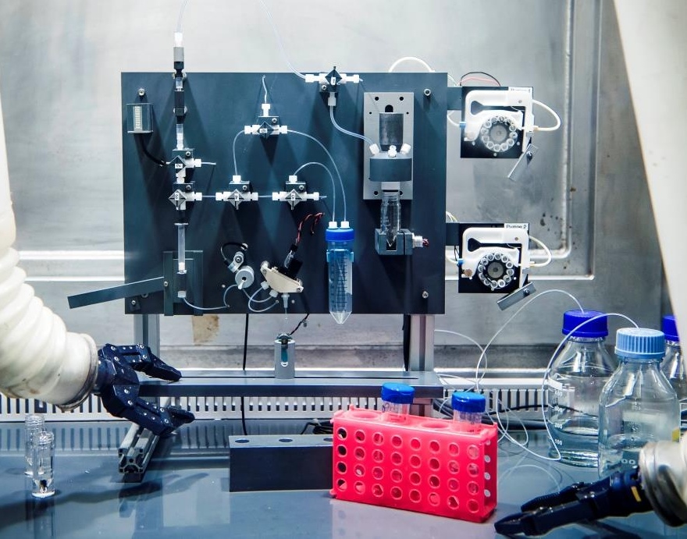


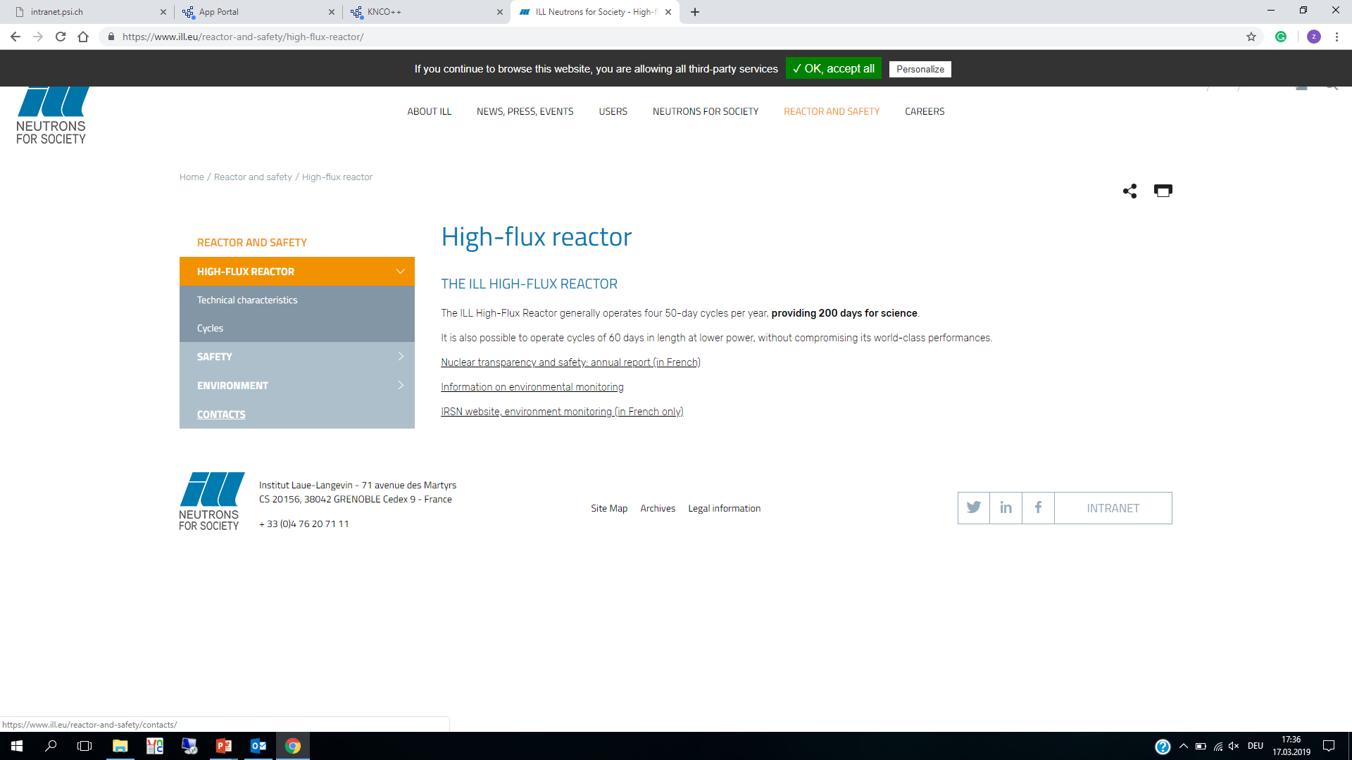
3
?
2
Preclinical
studies
Quality
Control
1
Chemical
separations
Hotcells
Mass
separation
Irradiations

Slide 5
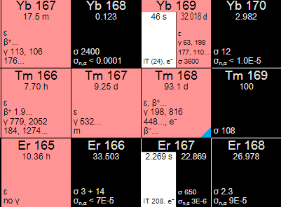
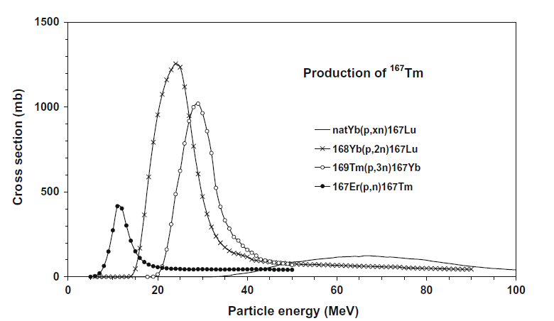
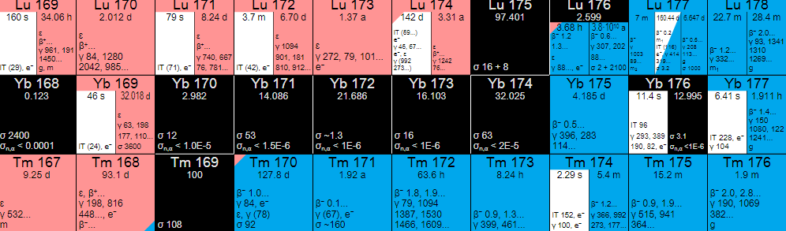

¹⁶⁷Tm production
¹⁶⁹Tm(p, 3n) ¹⁶⁷Yb → ¹⁶⁷Tm
Irradiation Tm₂O₃ targets at PSI
Isobar: ¹⁶⁷Er
¹⁷⁵Yb production
¹⁷⁴Yb(n, γ) ¹⁶⁵Yb
Yb₂O₃ target irradiation at ILL
Isobars: ¹⁷⁵Lu
¹⁶⁹Er production
¹⁶⁸Er(n, γ) ¹⁶⁹Er
Er₂O₃ target irradiation at ILL
Isobars: ¹⁶⁹Yb, ¹⁶⁹Tm

Slide 6
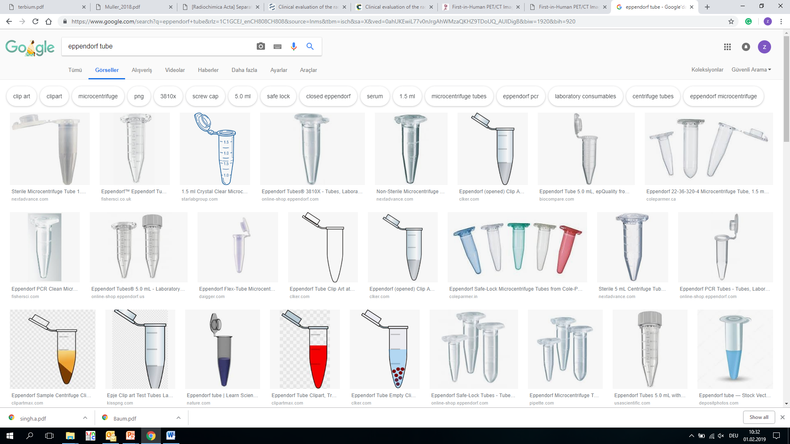
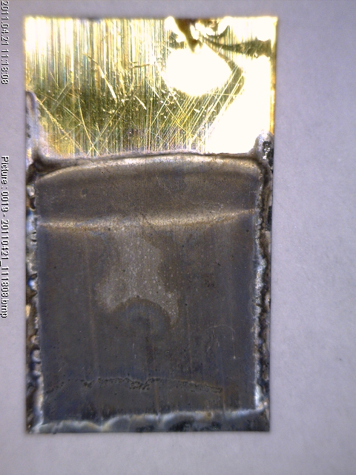


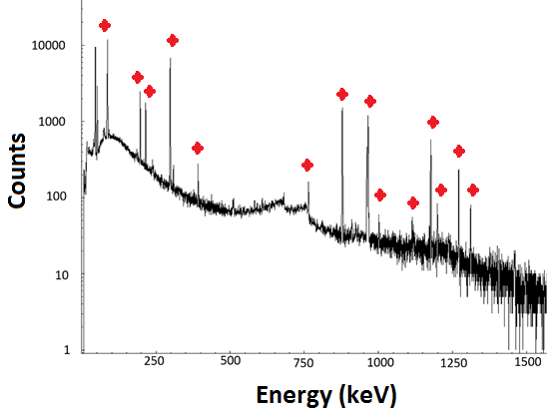
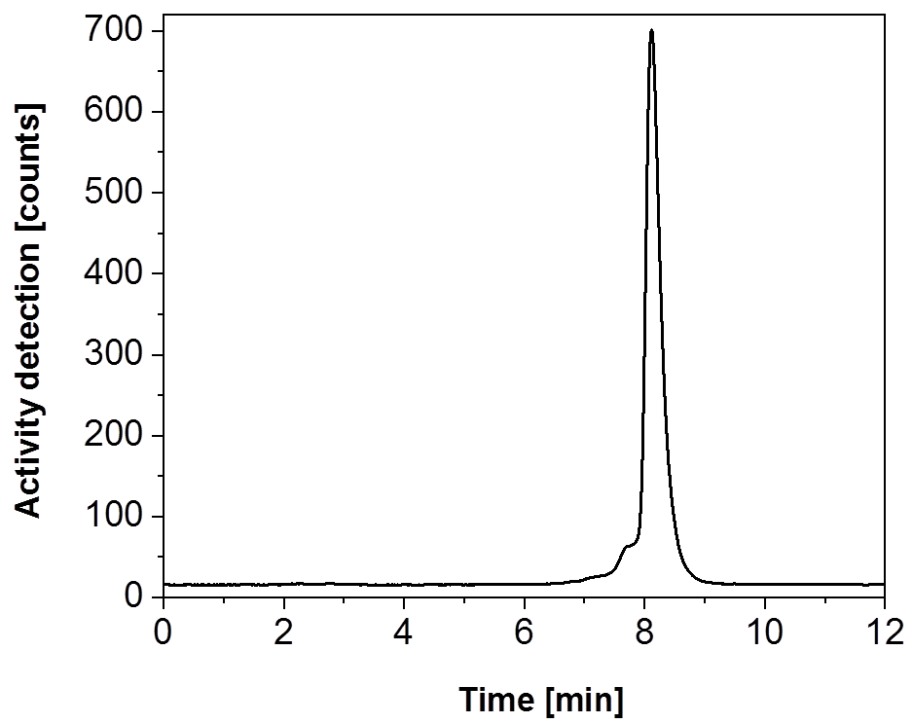
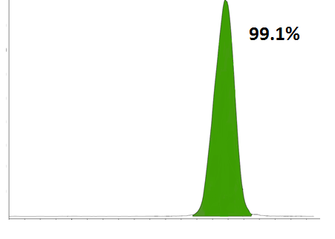
Chemical Separation/Quality Control
High radionuclidic purity - High chemical purity - High specific activity
Zn separation
Lns separation
Pre-clinical
studies
Zn coated
gold foil
Quality control
Quality control
Radionuclidic purity
Labelling efficiency
γ-spectrometry
HPLC
Radiochemical purity
Chemical purity
Radio-TLC
ICP-OES (PSI-CRS)
ICP-MS (PSI-Hot-lab)

Slide 7
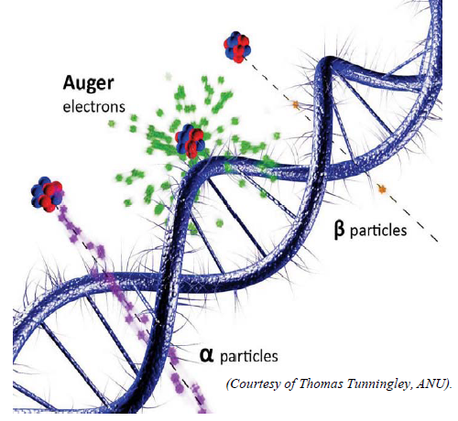
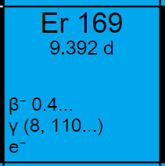
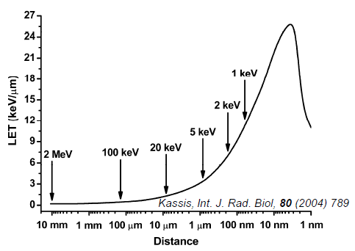
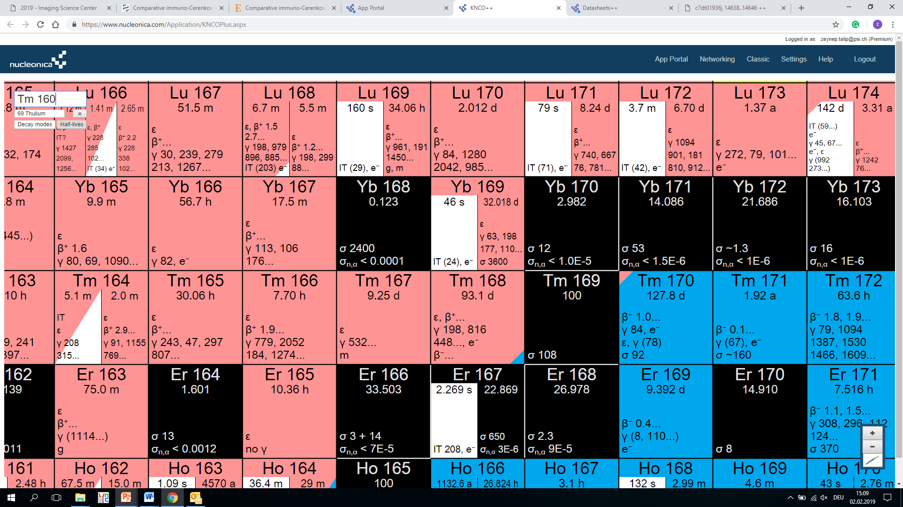
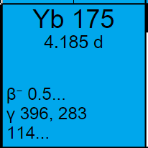
Preclinical Studies
Auger-e⁻ Therapy
β-Therapy
¹⁶¹Tb E_{βav}: 154 keV
¹⁷⁷Lu E_{βav}: 134 keV
¹⁷⁵Yb E_{βav}:113 keV
¹⁶⁹Er E_{βav}: 219 keV
¹⁶⁵Er pure Auger electron emitter
¹⁶⁷Tm conversion/Auger electron emitter
In vitro and in vivo studies
Preclinical spect imaging with use of phantoms

Slide 8
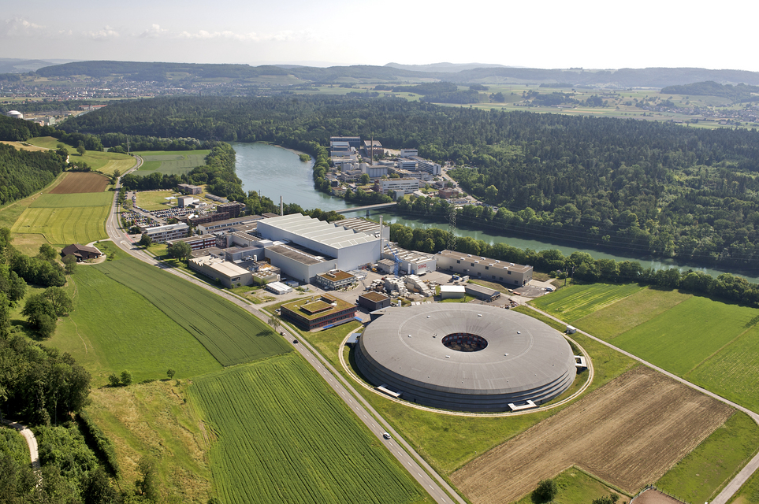
Thank you for your attention

