Slide 1
Initial discussions
INFRA-2-2020 call
Kirsten Leufgen, SCIPROM – Thierry Stora, CERN

Slide 2
Overview
Overview
Call info
Funded activities
Project idea
SCIPROM
Next steps
Call info INFRA-2-2020
Funded activities
Project idea
SCIPROM support
Proposal preparation: Next steps

Slide 3
Call info INFRA-2-2020
Overview
Call info
Funded activities
Project idea
SCIPROM
Next steps
To open key national and regional research infrastructures to all European researchers
Ensure their optimal use and joint development
Emphasis on sustainability, widening, skills, innovation and data management in compliance with the European open science cloud (EOSC)
2020: Integrating activities for starting communities
Max funding per project ca 5 M€
Tight competition, many re-submissions expected
Call not yet published

Slide 4
INFRA-2-2020: Activities funded
Overview
Call info
Funded activities
Project idea
SCIPROM
Next steps
Networking activities, to foster a culture of co-operation between research infrastructures, scientific communities, industries and other stakeholders as appropriate, and to help develop a more efficient and attractive European Research Area;
Trans-national access or virtual access activities, to support scientific communities in their access to the identified key research infrastructures;
Joint research activities, to improve, in quality and/or quantity, the integrated services provided at European level by the infrastructures.

Slide 5



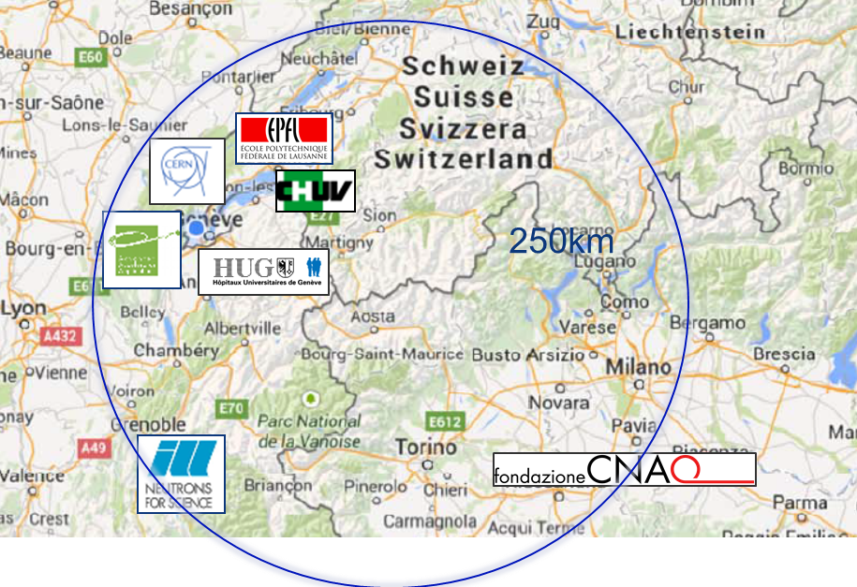

Project idea
Overview
Call info
Funded activities
Project idea
SCIPROM
Next steps
Create a community around facilities for medical isotopes by mass separation
Based on the MEDICIS PROMED network (ITN)
CERN, HUG, CHUV, EPFL
AAA, ILL, CNAO

Slide 6
Project idea f
Overview
Call info
Funded activities
Project idea
SCIPROM
Next steps
Innovative medical isotopes obtained with/combined with mass separation in Europe:
INFN-ISOLPHARM (IT 2021) ? 40 MeV mass separation
ILL (FR/EU)? high flux reactor
ARRONAX (FR)? 70MeV no mass separation
Institute for Energy Technology (NO)? cyclotron, no mass sep
Poland (not asked, but likely to accept)
JRC-Karlsruhe (EU)? alpha isotopes generators

Slide 7
SCIPROM support
Overview
Call info
Funded activities
Project idea
SCIPROM
Next steps

Slide 8
SCIPROM basics
Overview
Call info
Funded activities
Project idea
SCIPROM
Next steps
founded in 2005
when CH was fully associated to EU FP
to stimulate participation in EU projects and disburden researchers
SCIPROM supports researchers in management and communication

Slide 9
SCIPROM Services
Overview
Call info
Funded activities
Project idea
SCIPROM
Next steps
Proposal preparation
Grant negotiations with EC
Project management
Web & print design
Consulting & courses
Event management

Slide 10
Project execution
SCIPROM project commitments
Overview
Call info
Funded activities
Project idea
SCIPROM
Next steps
Project office & contact point
Project reporting, progress monitoring
Contractual, legal, ethics and financial management
Website & print products
Collaboration platforms
Organisation of project meetings

Slide 11
Our projects
Overview
Call info
Funded activities
Project idea
SCIPROM
Next steps
>30 research projects accompanied in 14 years; about 10 at a time
Different funding instruments and project types
A large variety of topics
Consortia of 6-110 partners, worldwide

Slide 12























Slide 13





Our team
Kirsten
Leufgen
Executive director, PhD
DE, EN, FR etc
Biology-Physics-Chemistry
Véronique
Gobry
Project manager, PhD
FR, EN etc
Food, Chemistry
Dominique
Stücker
Accountant
FR, DE, EN etc
Finances
Peter
Ulrich
Technical direktor, PhD
DE, EN, FR
Biology-Physics-Chemistry,
IT, web design
Filippo Gander
Webmaster & Designer
IT, FR, EN
Social sciences

Slide 14
Our philosophy
Overview
Call info
Funded activities
Project idea
SCIPROM
Next steps
Research and its application is our driver
“Jedem Tierchen sein Pläsierchen” - we adapt to the needs of our partners
Communication is most important, multilingualism a prerequisite

Slide 15
Proposal preparation: Next steps
Overview
Call info
Funded activities
Project idea
SCIPROM
Next steps
Call to be published soon, probably in May (draft to be circulated before)
Initial feedback EC officer is positive
Probably one stage procedure with submission deadline in March 2020
Kick-off meeting Erice/Sicily (30 April 2019)

Slide 16

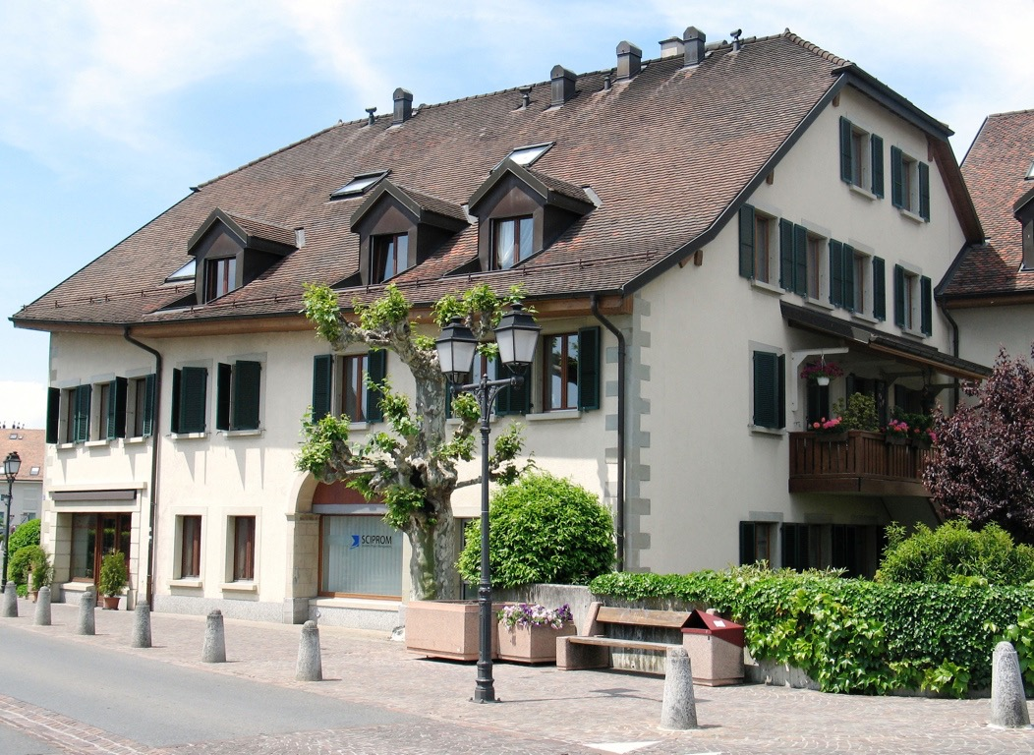
Thank you!
SCIPROM Sàrl
Rue du Centre 70
1025 St-Sulpice
Switzerland

