Slide 1

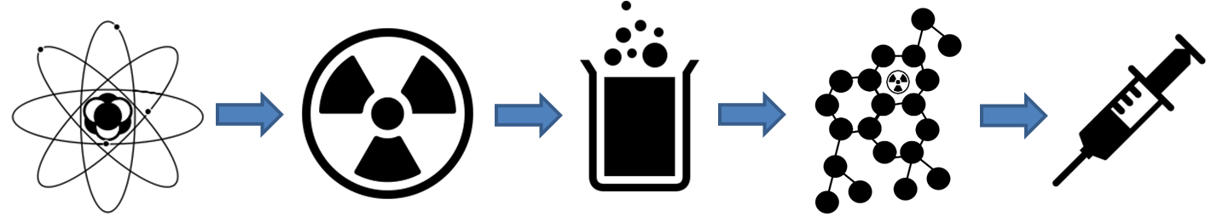
Stefano Corradetti
National Institute for Nuclear Physics– National Laboratories of Legnaro (Italy)
stefano.corradetti@lnl.infn.it

Slide 2

ISOLPHARM Project
Main objective of the ISOLPHARM project:
Production of carrier-free radionuclides
Production of non conventional radioisotopes (difficult to produce with traditional techniques)
Same target, different radionuclides (flexibility)

Slide 3
Overview
⚛ The SPES project at LNL
⚛ The ISOLPHARM Project: SPES radionuclides for medicine
⚛ ISOLPHARM experimental activities
⚛ ISOLPHARM_Ag: a case study
⚛ Conclusions

Slide 4
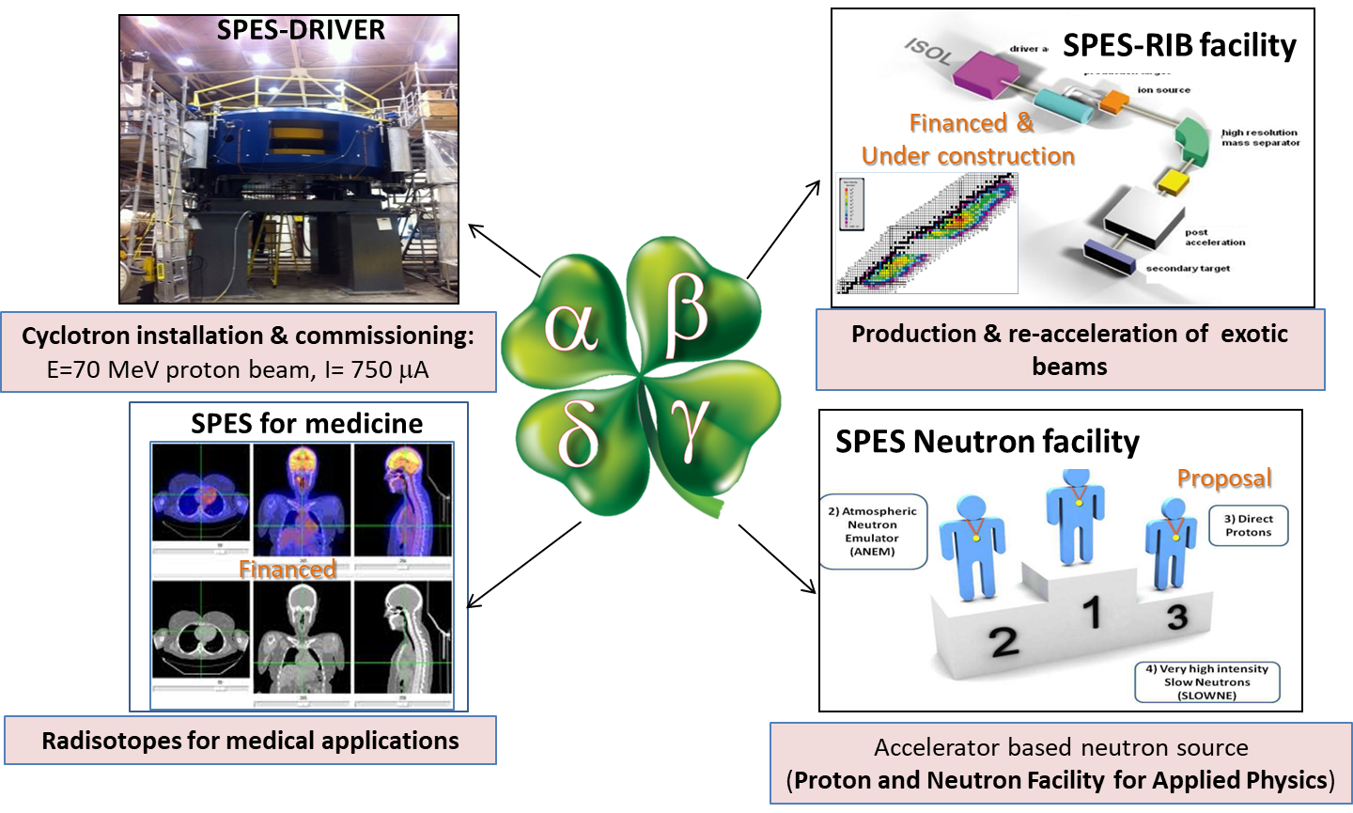
The SPES project at LNL-INFN
SPES is: 1) A second generation ISOL facility (for neutron-rich ion beams)
2) An interdisciplinary research center (for p,n applications)

Slide 5
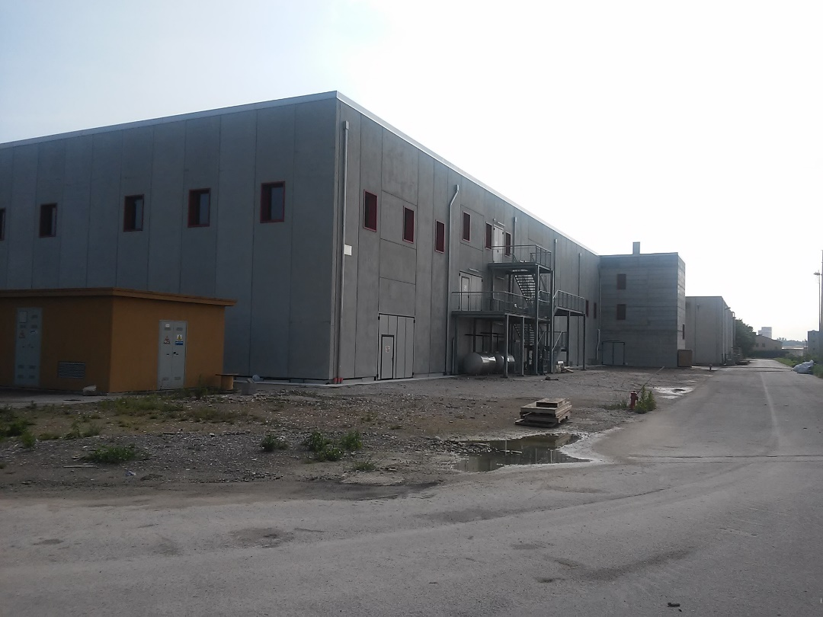
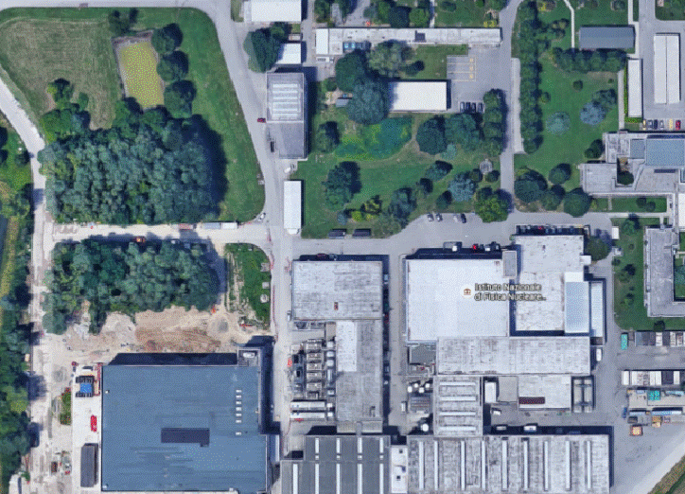
The New SPES/ISOLPHARM
Infrastructure
New Building:
Bunker layout
Laboratory layout
Project financied by INFN
New infrastructure for:
Application Facility
Cyclotron
RIB facility (2th generation ISOL)

Slide 6
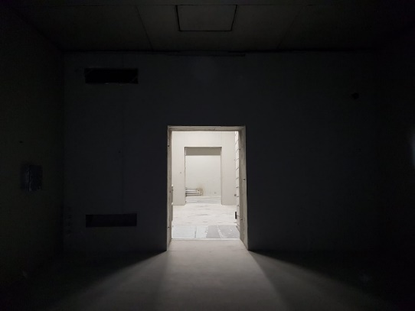
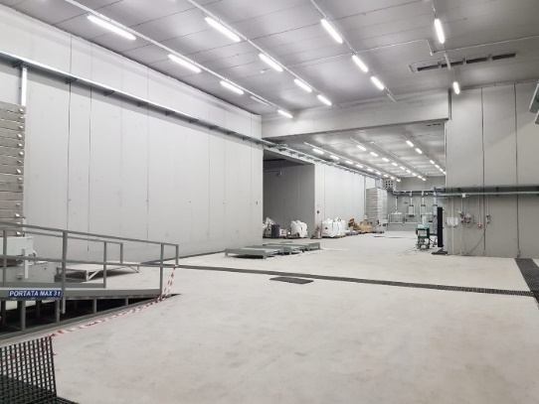
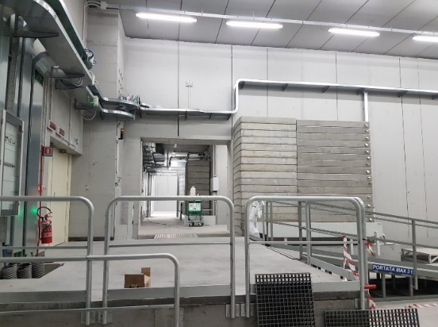
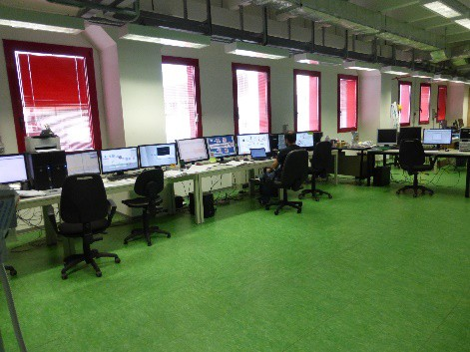
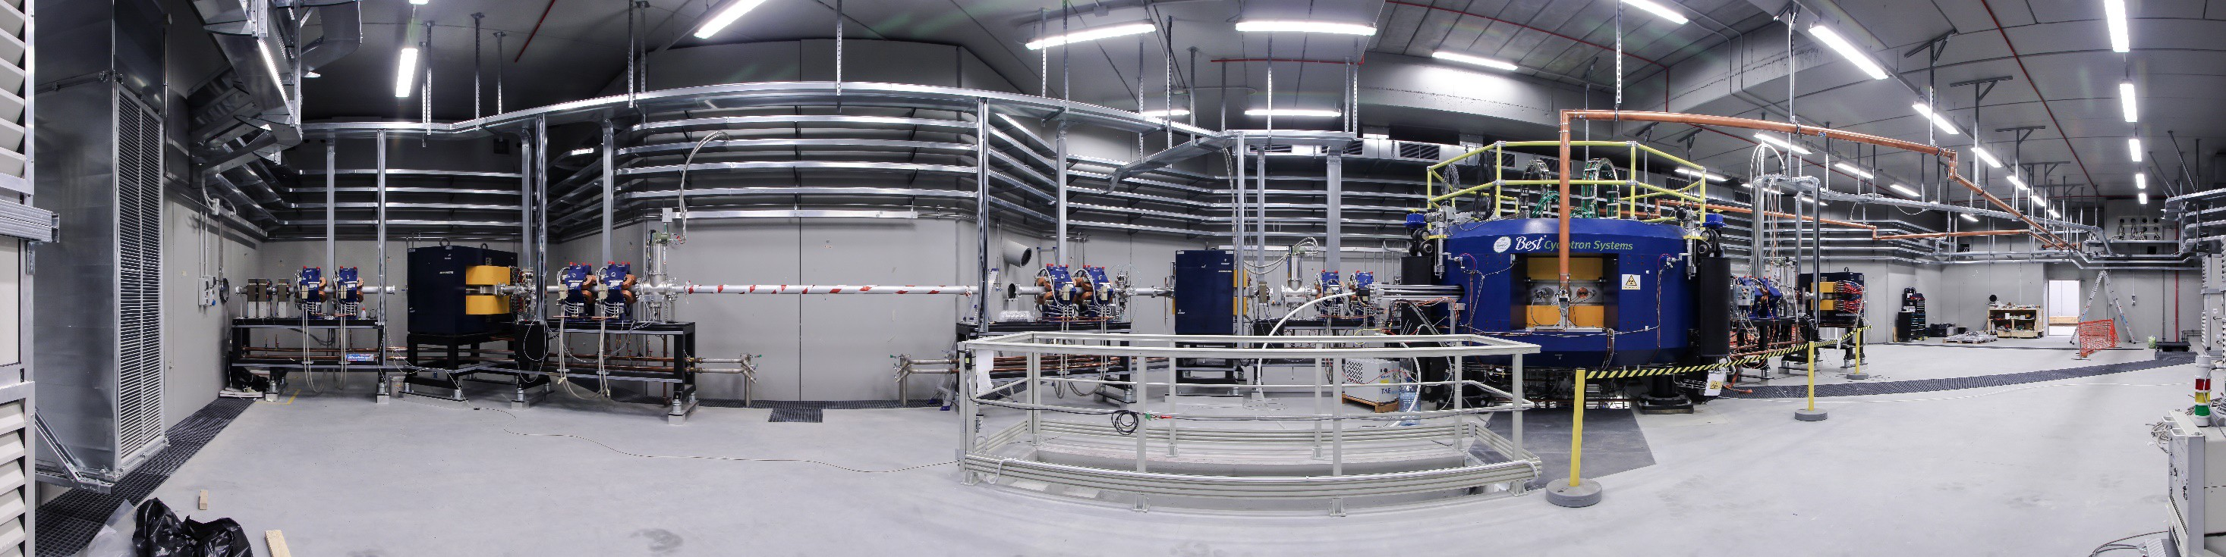
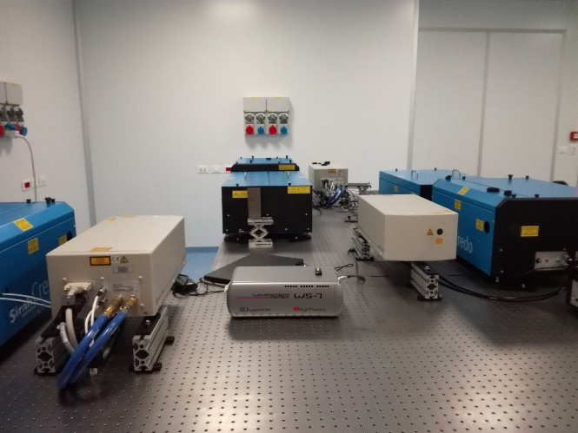
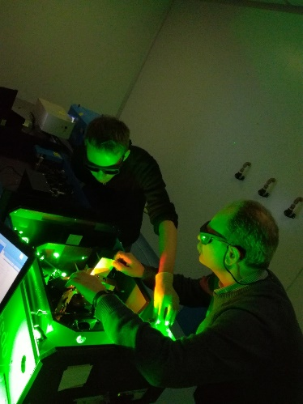
The New SPES/ISOLPHARM
Infrastructure
Production bunker
Experimental halls
Control room
Cyclotron
Resonant Ionization
Laser Ion Source

Slide 7


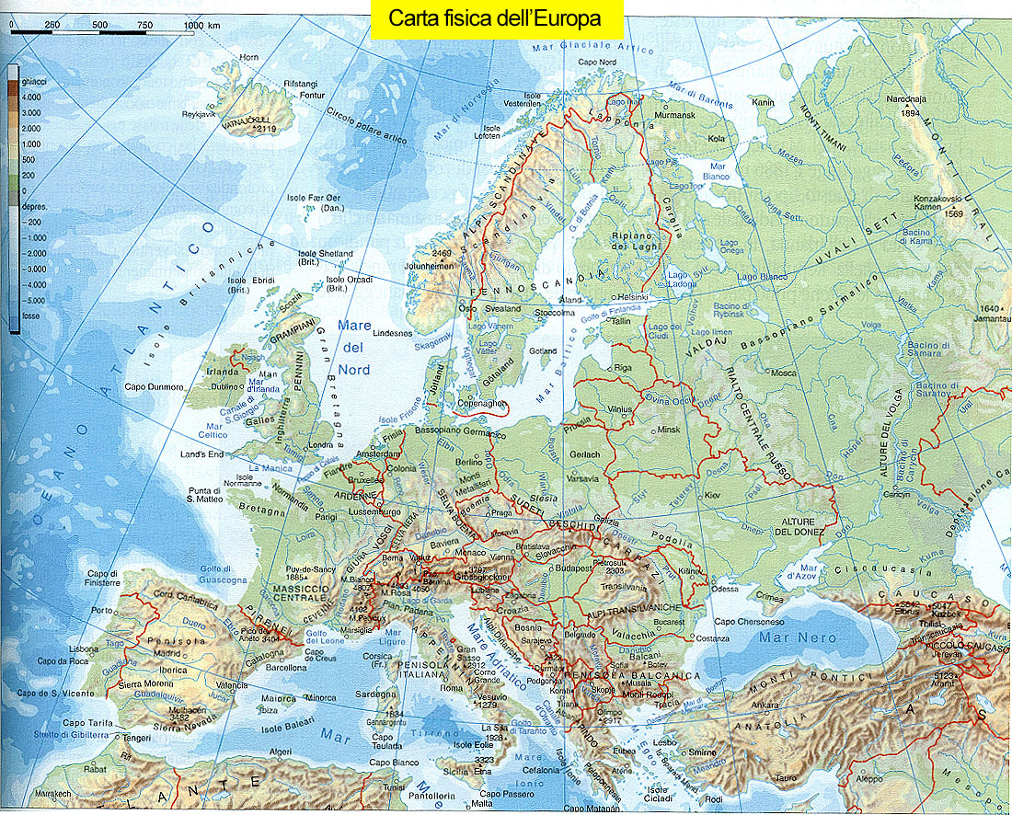
RIBs facilities in the word
The ISOL method is a technique to produce Radioactive Ion Beam for Nuclear Physics, Nuclear Astrophysics, Physics of Solid State and Nuclear Medicine
ISAC @ TRIUMf
RIKEN
FRIB
Main RIB facilities :
ISOLDE (CERN)
ISAC (TRIUMF)
RIKEN
SPIRAL1 (GANIL)
FAIR now under construction: (GSI)
SPES now under construction: (LNL)
SPIRAL2 now under construction: (GANIL)
FRIB now under construction: (MSU)
SPIRAL2
FAIR
ISOLDE @ CERN
SPES @ LNL

Slide 8
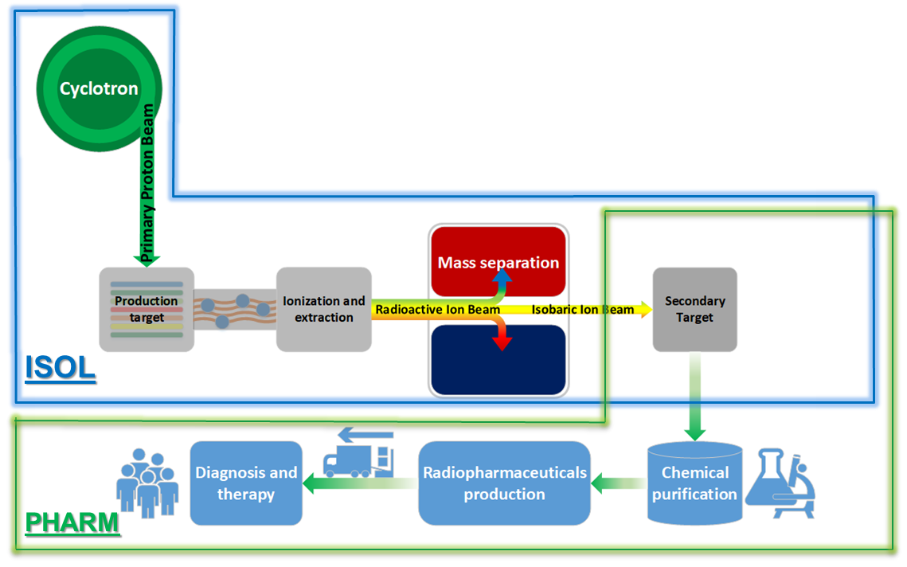


The ISOLPHARM method
The ISOLPHARM method is capable of selecting and isolating a
SINGLE RADIO-ISOTOPE
Borgna et al, Appl. Radiat. Isot., 2017, 127: 214–226
Borgna et al, Molecules., 2018, 23, 2437
Step 1
Secondary target development and ions recovery
Step 2
Chemical Purification Processes
Development
Step 3
(Radio)pharmaceutical development

Slide 9
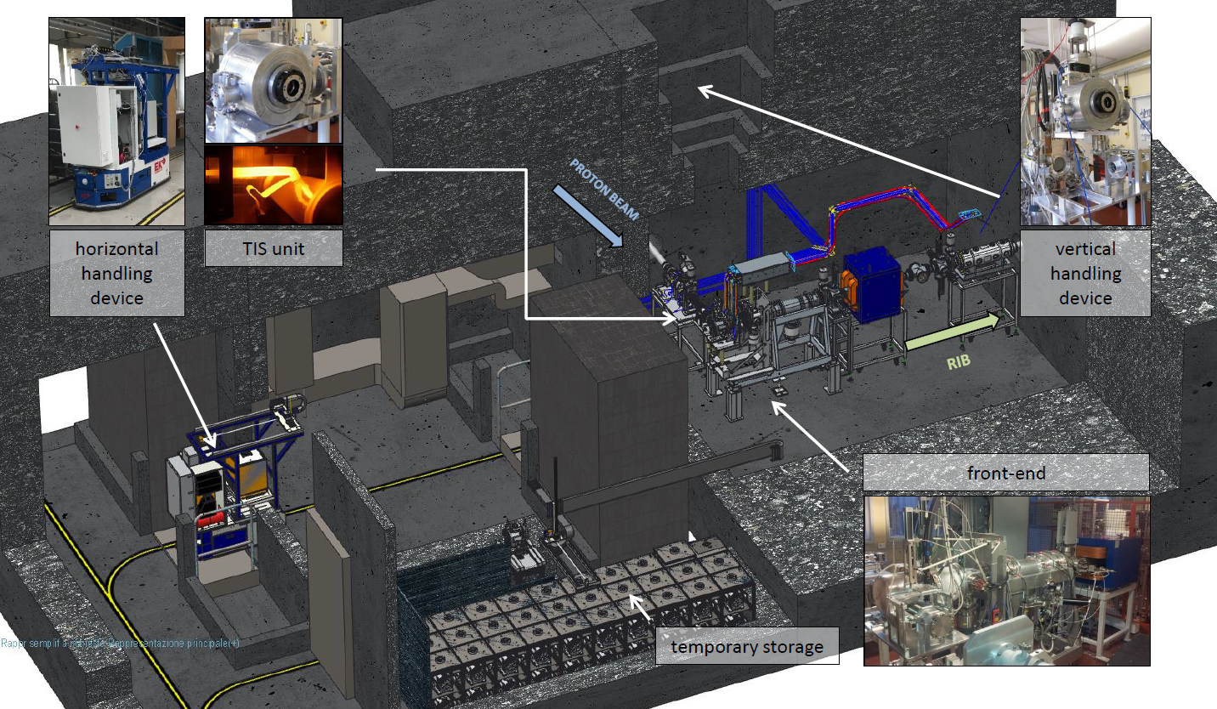
RIB Source

Slide 10
Radionuclides that will be produced
at LNL-INFN
Instrinsecally carrier-free radionuclides can be produced
With the same target numerous radionuclides can be produced only by changing the mass separator settings
Designing specific targets a wide range of radionuclides can be prodcued, including radionuclides which can be hardly produced with the traditional techniques
Production yields are lower than those of cyclotrons and nuclear reactors

Slide 11


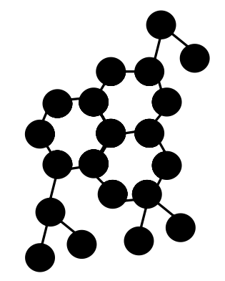


ISOLPHARM
Experimental activities

Slide 12
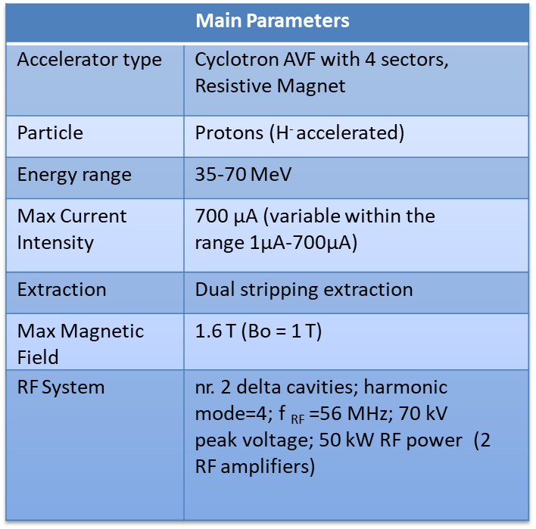
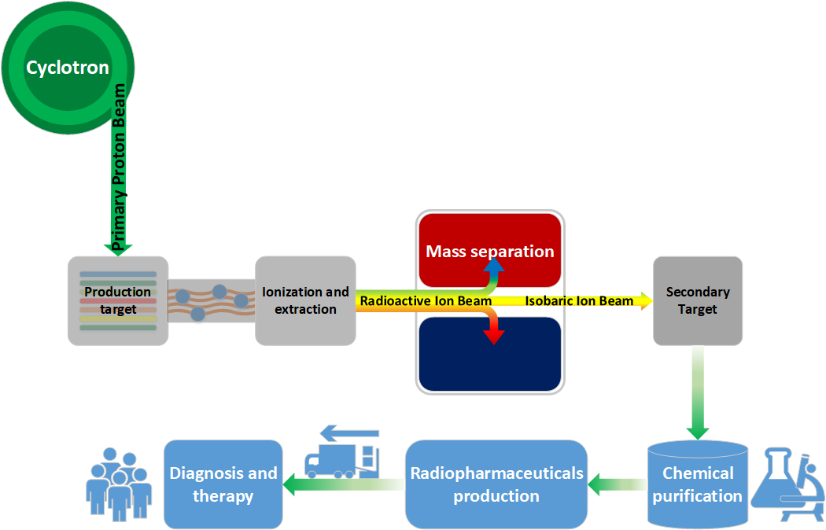
Experimental activities:
The proton driver
At SPES the chosen primary driver is the 70p commercial cyclotron manufactured by the BEST Cyclotron Systems Inc., a member of TeamBest™. Such machine is able to deliver up to two simultaneous energetic proton beams (maximum energy 70 MeV – 49 kW) with a maximum overall intensity of 700 μA .

Slide 13
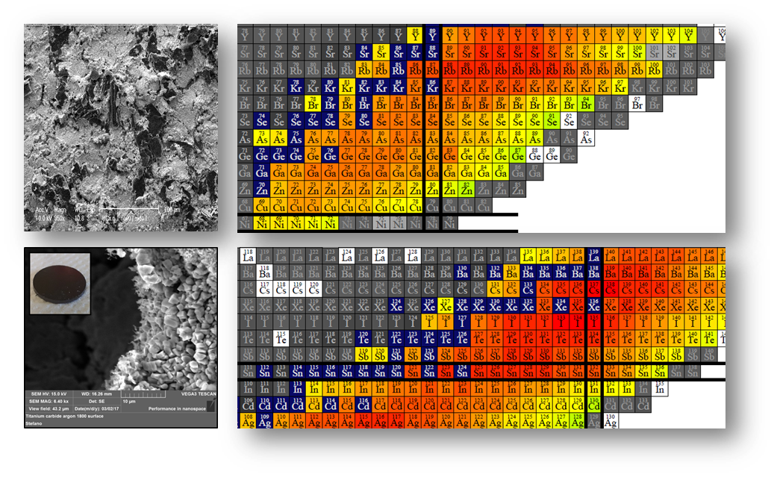

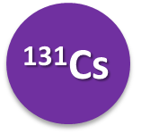

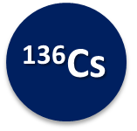
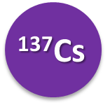
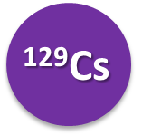
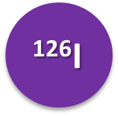
Experimental activities:
Production targets development
UC_{x} target
UC_{x} target already developed and tested on-line
One material, many radioactive ion beams (fission)
Neutron-rich nuclides
UCx

Slide 14
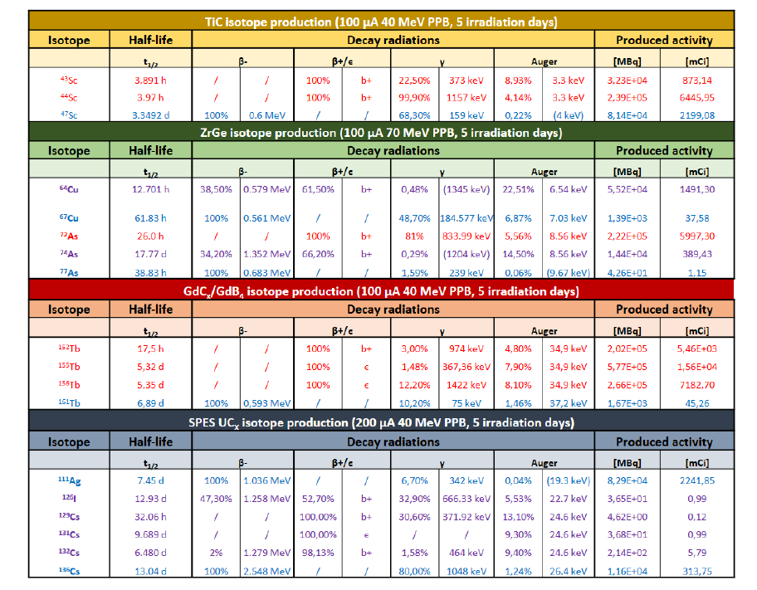
In target production

Slide 15

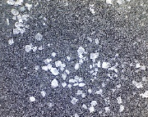
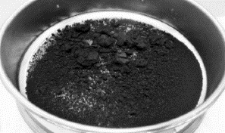
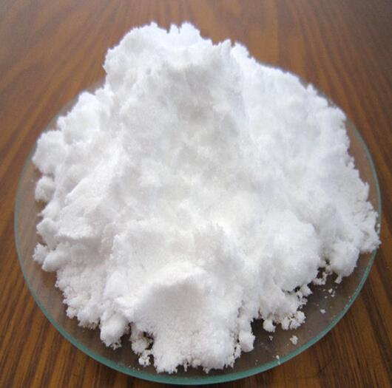
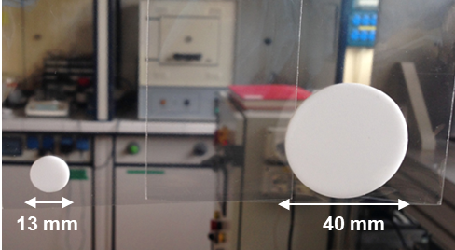
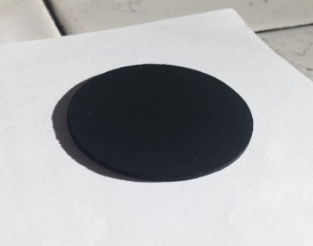
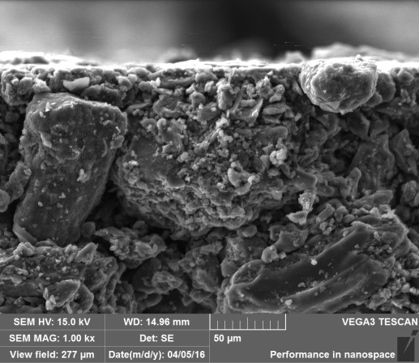
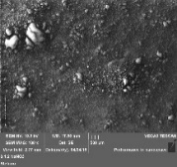
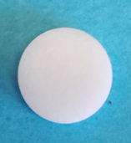
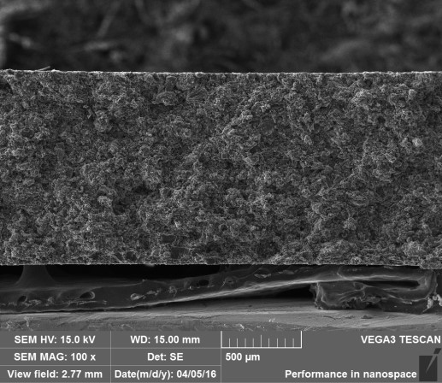
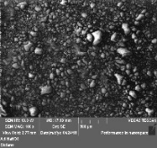
Experimental Activities:
Secondary Target
Secondary target requirements
Chemical compatibility with the element
Absence of metal contaminants
No incompatibilities with the production of a radiopharmaceutical for human administration
No intereference with purification processes
Sodium Chloride
Activated Carbon
Sodium Nitrate
Powder compression
AC/PVA blend 50% w/w
Granulation process
Drying and sieving (<300 μm)
Powder compression
Used for Sr, Y and Cu
Used for I₂
Used for Ag

Slide 16
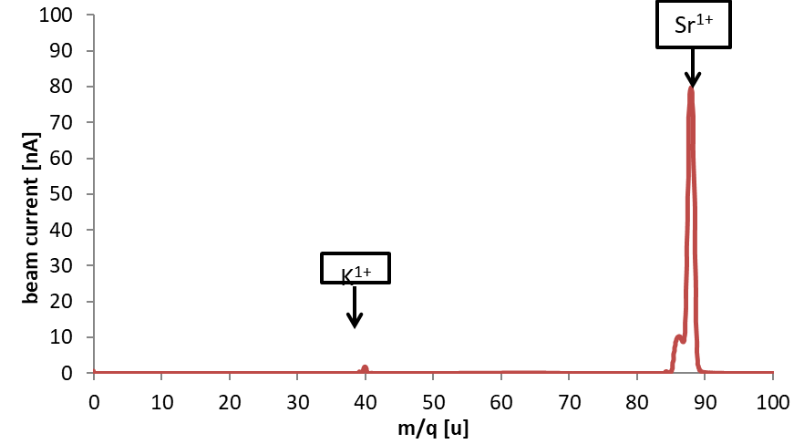
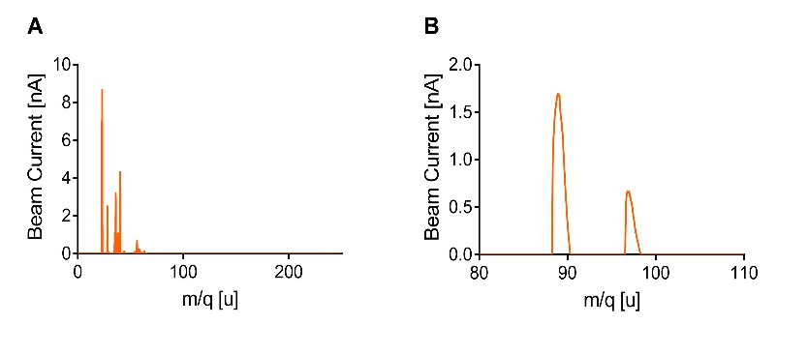
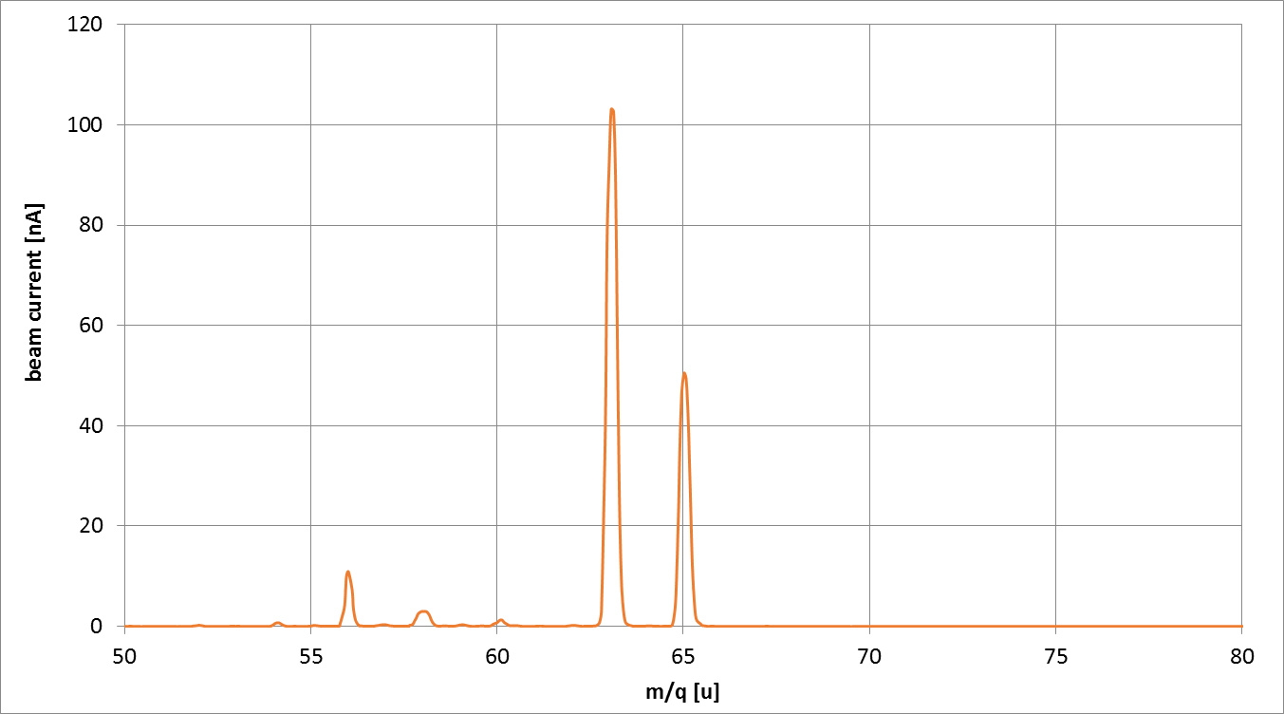
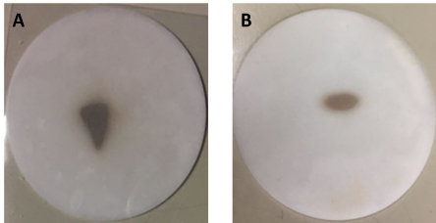
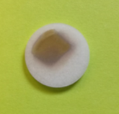
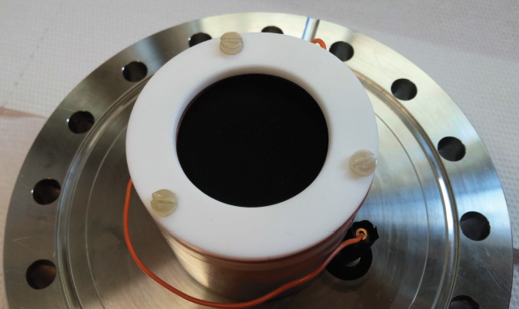
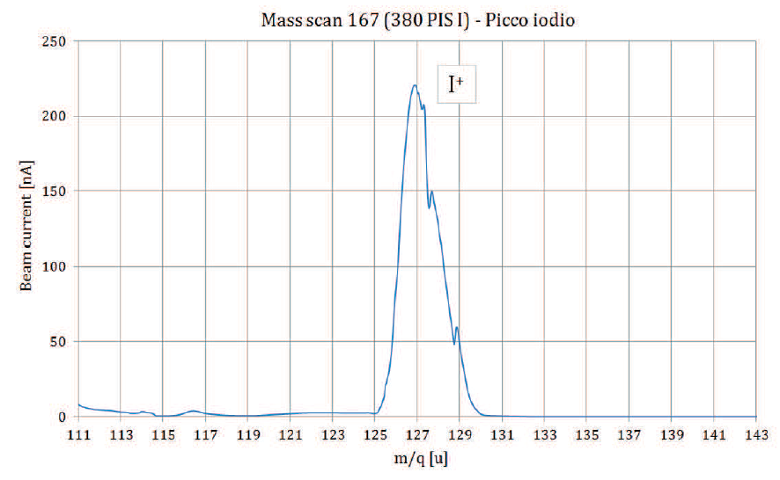
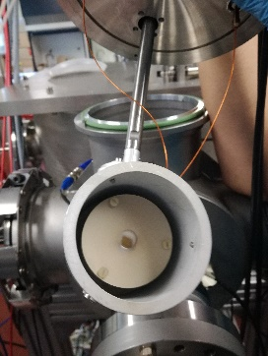
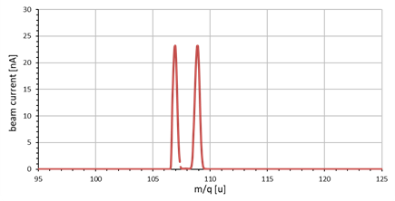
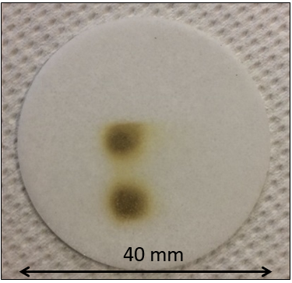
Experimental Activities:
Stable ion beams production and recovery
Sr, Y and Cu deposition
Sr
Y
Cu
GF-AAS
ICP-OES
Analysis
GF-AAS
Sodium Chloride disk
Current research activities:
Terbium ionization and deposition
Iodine deposition
Silver deposition
Titration
AC/PVA disk
GF-AAS

Slide 17
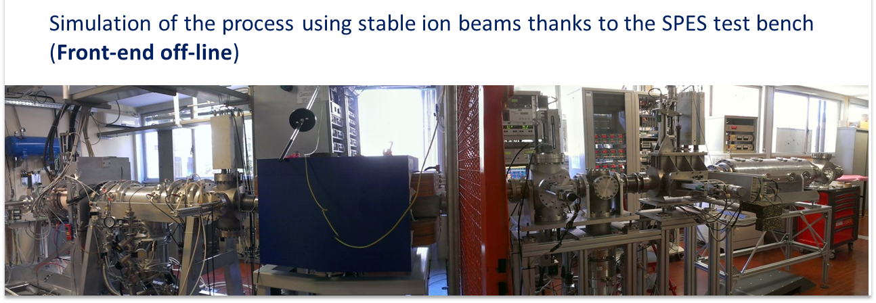
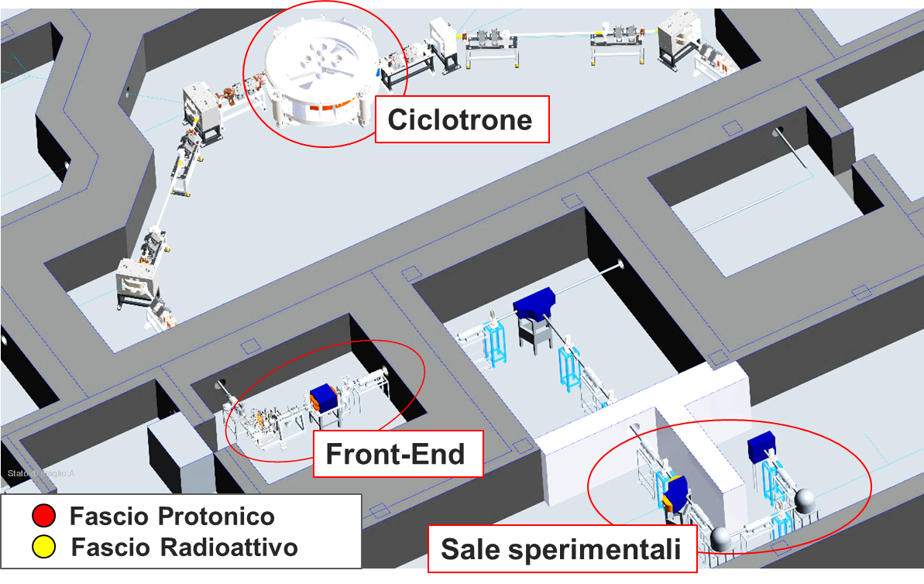

ISOLPHARM Production
Cyclotron
Front-End
Proton beam
Radioactive beam
Experimental halls

Slide 18

ISOLPHARM_Ag:
A case study

Slide 19
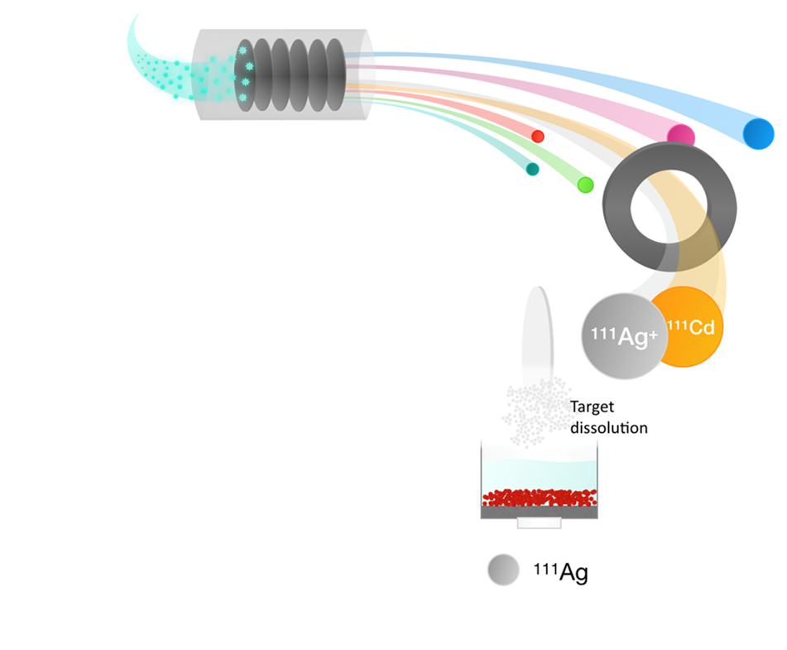
ISOLPHARM_Ag
¹¹¹Ag
β⁻ emitter (average energy 360 keV)
Medium half-life (7.45 days)
Medium tissue penetration (1.8 mm)
Low energy γ rays (245 (1.24%) and 342 (6.7%) keV – SPECT
The ISOLPHARM_Ag collaboration project is aimed to evaluate the feasibility of the production of a ¹¹¹Ag-based radiopharmaceutical according to the ISOLHARM method.

Slide 20
Traditional production Routes for ¹¹¹Ag
Neutron irradiation of Palladium target
production of carrier-free ¹¹¹Ag is not possible except the case in which enriched ¹¹⁰Pd is used as a target:
¹¹⁰Pd (n, γ) ¹¹¹Pd (β─) ¹¹¹Ag
Expensive target cost
Low yield (1 GBq/mg)
Associated γ radiation (1 week to short lived co-produced activities decay)
Sideproduct during ²²⁵Ac production by proton induced spallation reactions on thorium targets

Slide 21
Production Routes for ¹¹¹Ag:
ISOLPHARM Method
¹¹¹Ag can be produced not only at high purity, but also with high production rate: up to 2 Ci in target after 5 days (SPES UC_{x} target)
All the isotopic contaminants with a different mass number will be removed thanks to the on-line mass separation.
Only ¹¹¹Ag and low amounts of its stable daughter ¹¹¹Cd, mostly produced by the decay of silver, will be collected on the secondary target.
Isotopes | t_{½} | Decay | Stable isotope
¹¹¹Cd | Stable |  | ¹¹¹Cd
¹¹¹Ag | 7.45 days | β─ | ¹¹¹Cd
¹¹¹Pd | 23.4 min | β─ | ¹¹¹Ag → ¹¹¹Cd
¹¹¹In | 2.8 days | Electron capture | ¹¹¹In → ¹¹¹Cd

Slide 22
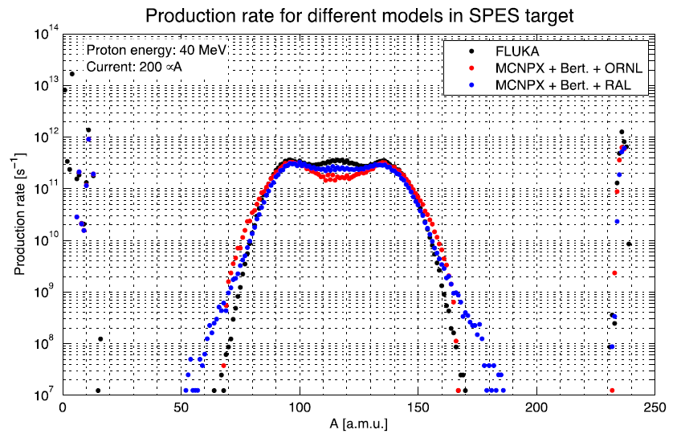
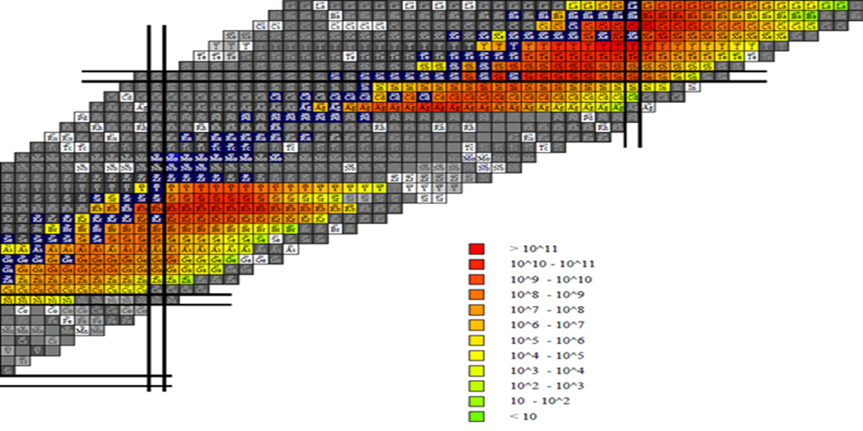
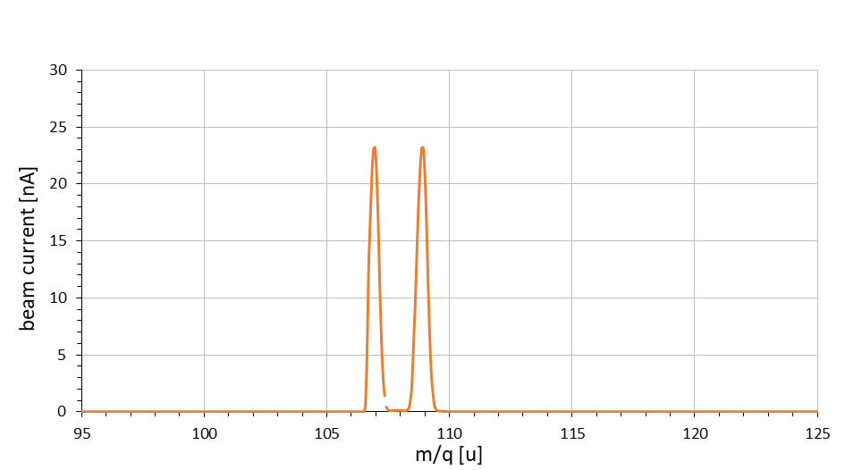




ISOLPHARM_Ag
TASK1 (Physics/Computing)
Simulations of production, release and transport of ¹¹¹Ag produced with the SPES target using the Monte Carlo codes.
μ
TASK2 (Chemistry/Ag production):
Study of silver production (ionization and acceleration) & purification from ¹¹¹Cd²⁺ using stable isotopes.
Development of possible chelators for silver. Characterization of complexes produced.
Task 3 (Molecular Biology):
Development of targeting agent for Cholecistochine (small molecule-based ligands and linker moiety) and development of targeting agent for calreticulin as potential target for proton therapy combined with targeted radionuclide therapy

Slide 23


Ionization and deposition of stable Ag⁺
Ionization and acceleration of stable Ag⁺ using the SPES Front End in off-line modality.
107
109
Ionization efficiency:
15 %
^{nat}Ag (51.84/48.16)

Slide 24




Ag⁺ deposition tests
Deposition tests were performed collecting the silver ions in a proper secondary target made of sodium nitrate.

Slide 25








Development of novel bifunctional chelators for Ag(I)
Derivative1
DOTETE
Development of a library of potential bifunctional chelators for ¹¹¹Ag
DOTETE
Ag(I)-BFCs complexes studies:
Thermodynamic
characterization
DOTETE Derivatives
Chiral derivatives

Slide 26





Development of novel bifunctional
chelators for Ag(I)
NMR measurements:
¹H, ¹³C
NOESY, COESY, HMQC
Derivative1
X-ray
DFT calculations

Slide 27




Targeting agents development
CCK2R
New ligands for activate targeting of CCK2R
Due to the lipophilic nature of the targeting agent Z-360, appropriate spacers were chosen and synthesized in order to enhance the solubility of ligands and improve their biodistribution.
Radiolabeling of new synthesized ligands with ⁶⁸Ga
Stability in PBS buffer solution and blood over time
IP1_1 hour in blood
IP2_1 hour in blood

Slide 28


Targeting agents development
CALRETICULIN (CRT)
Evaluation of the translocation of CRT in cell membrane after radiation exposure (immunofluorescence)
Realization of a suitable 3D scaffold for in vitro tissue mimiking

Slide 29



Conclusion
At SPES it will be possible soon to produce radionuclides for medical purposes using the ISOL technique.
The ISOLPHARM method is focused on the production of radiopharmaceutical precursors with high specific activity using a proton beam ad intermediate energies.
The ISOLPHARM collaboration has started 4 years ago. An increasing experimental activity is under development.
Some radionuclides (as ¹¹¹Ag , ⁴³Sc, etc) are extremely interesting and could be used as precursors for new radiopharmaceuticals.

Slide 30






































ISOLPHARM
People
THANK YOU

Slide 31



