Slide 1

Radiochemistry Developments at MEDICIS
Moazam Mehmood KHAN
EN-STI-RBS

Slide 2


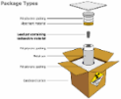

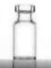
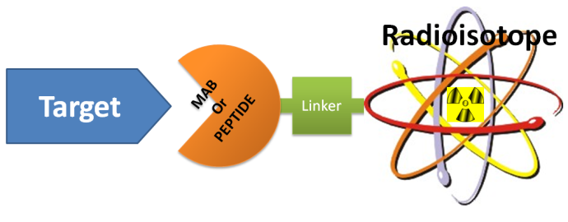
CERN/MEDICIS to Hospital
Radiochemistry Steps

Slide 3
Prerequisites for radiochemistry at MEDICIS
Purchase of Chemicals/resins, accessories (Pipettes, Pumps, Lab Centrifuge etc.)
Inactive Zinc Dissolution
Documentation
  Radiochemistry Procedure for Lanthanide separation for Zn/Au Foils
  Radiochemistry Procedure for Lanthanide Separation for salt/Al Foils
  Safety Analysis and Risks Assessment
  Radioactive Liquid Waste Management / Handling at MEDICIS
Fume hood Installation (Installed in January, 2019)
Experiments below 1 LA (on going)
IRA Audit (April 2019)
Operational Radiochemistry (April 2019)

Slide 4
Isotope Collection Foils
Radiochemistry
Zinc/Au Foils
Salt/Al Foils

Slide 5
Radiochemistry Recipe for salt/Al foils
Dissolution
Salt will be dissolved in few drops of water
Spectro analysis will measure the efficiency of dissolution
Column Conditioning
Conditioning of the column with 0.1 M ammonium chloride
Elution
Elution will be carried out with 0.1-0.5 M a-HIBA
Each drop will be collected for analysis initially for procedure optimization
Spectroscopy
Shipping
Purified isotope will be shipped to research centers/medical centers.
Spectroscopy will measure the efficiency of the separation
Pour the dissolved activity into the column

Slide 6
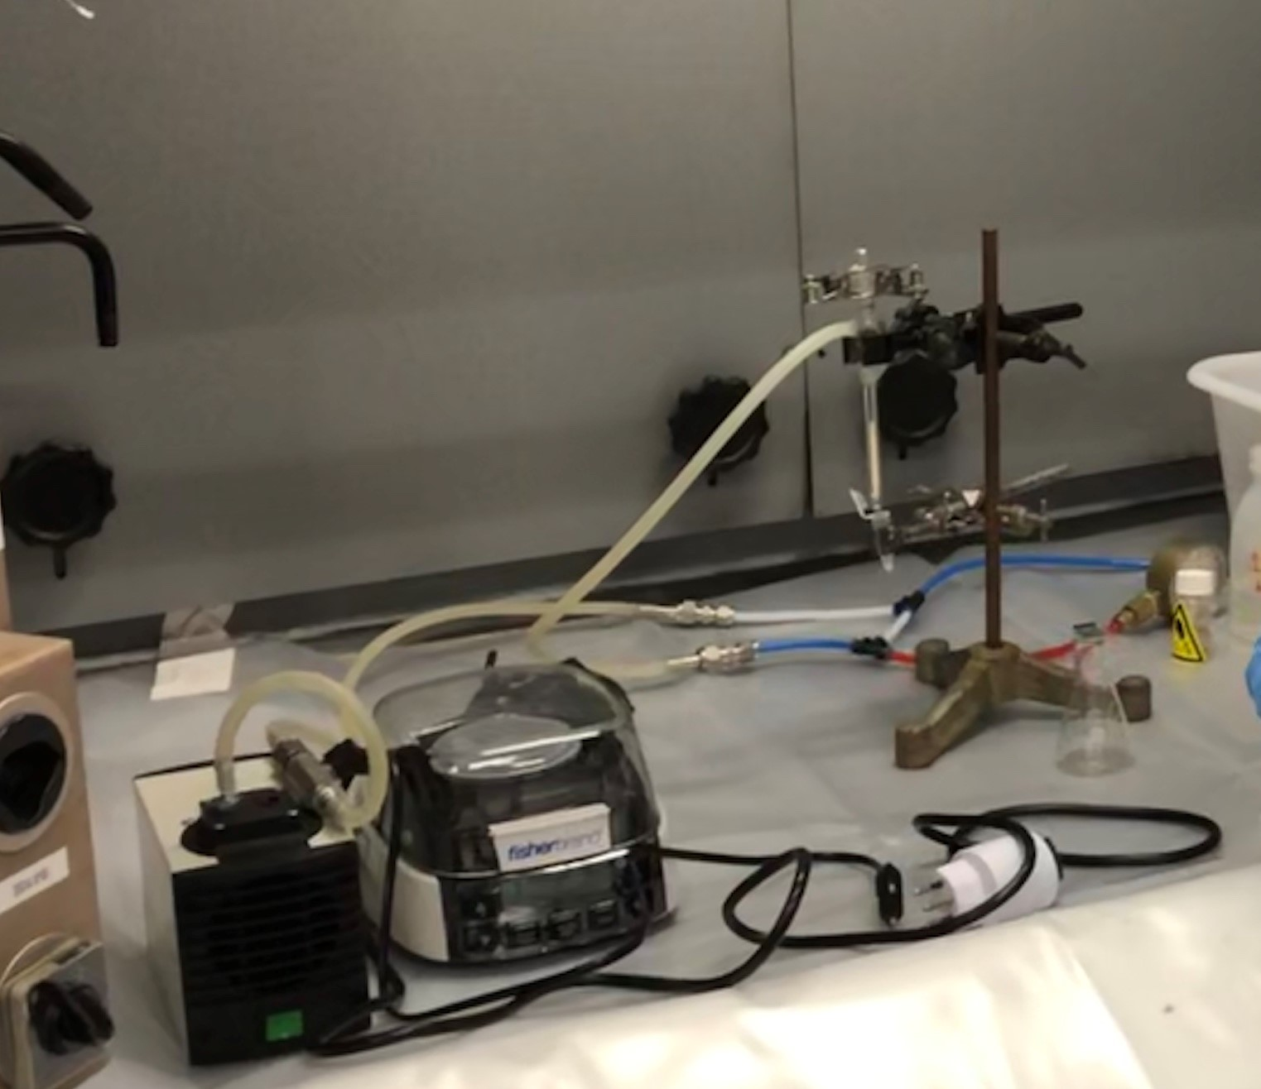
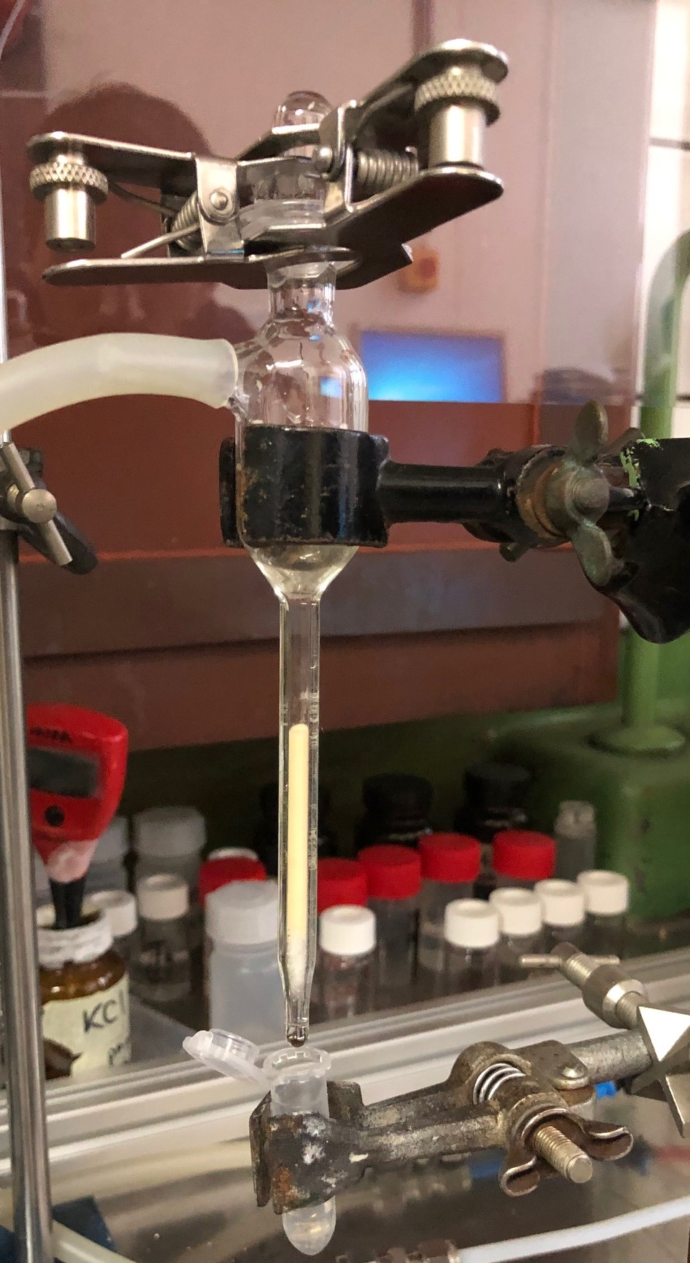
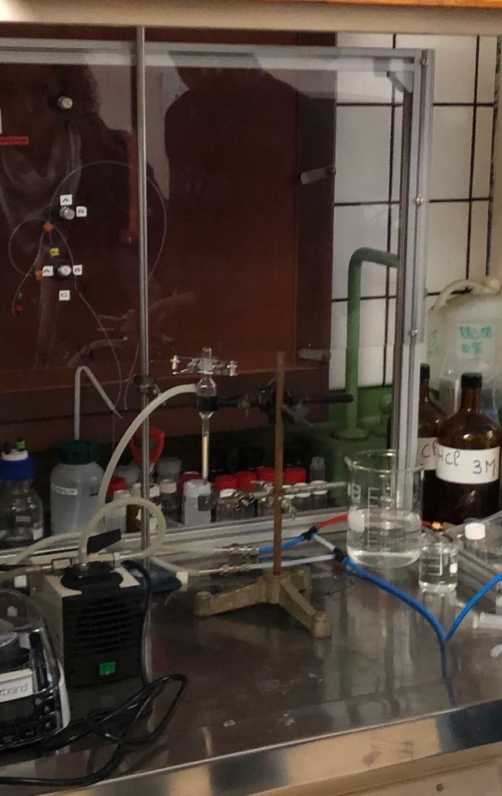

Slide 7
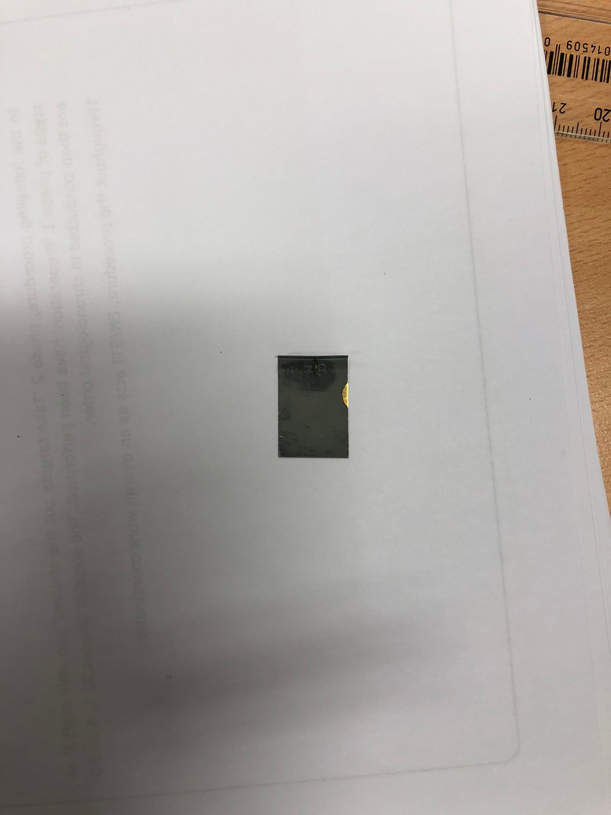
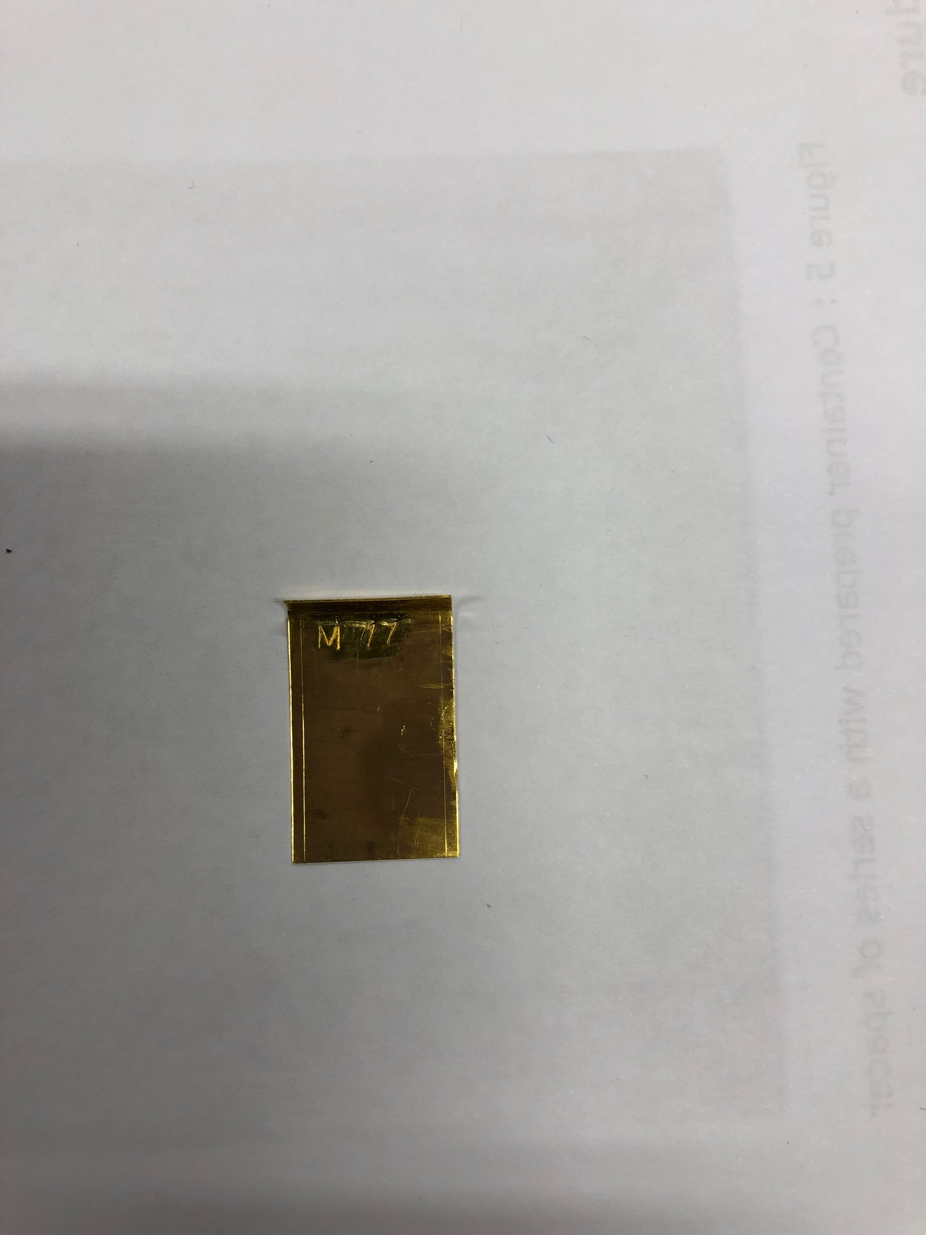
Radiochemistry Recipe for Zn/Au foils
Dissolution
Zn will be dissolved in few drops of half conc. HCl
Spectro analysis will measure the efficiency of dissolution
Column Conditioning
Aminex with absorbed lanthanides will be transferred to the long column containing conditioned Aminex
Elution
Elution will be carried out with 0.1-0.5 M a-HIBA at a certain pH
Each drop will be collected for analysis initially for optimization
Spectroscopy
Waste Handling
Spectroscopy will measure the efficiency of the separation
Liquid waste generated during radiochemistry steps will be analyzed
Short lived / long lived liquid waste will be stored delicately
Zinc
Removal
Zn will be removed by precipitating out lanthanides
Lanthanides will be adsorbed on AMINEX resin.

Slide 8
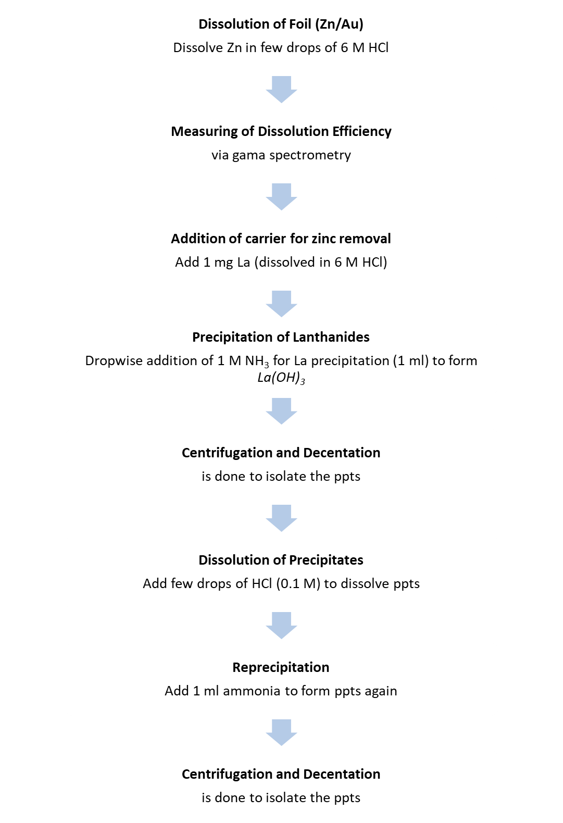
Radiochemistry Flow

Slide 9
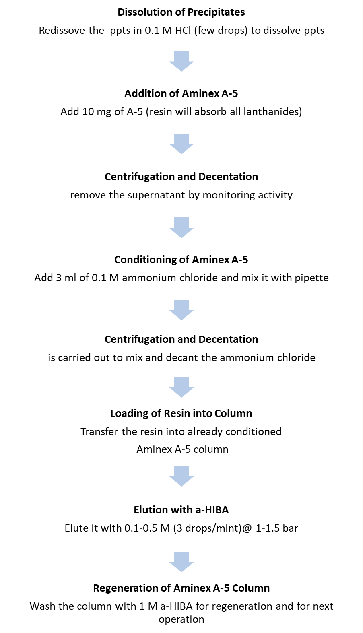
Radiochemistry Flow

Slide 10
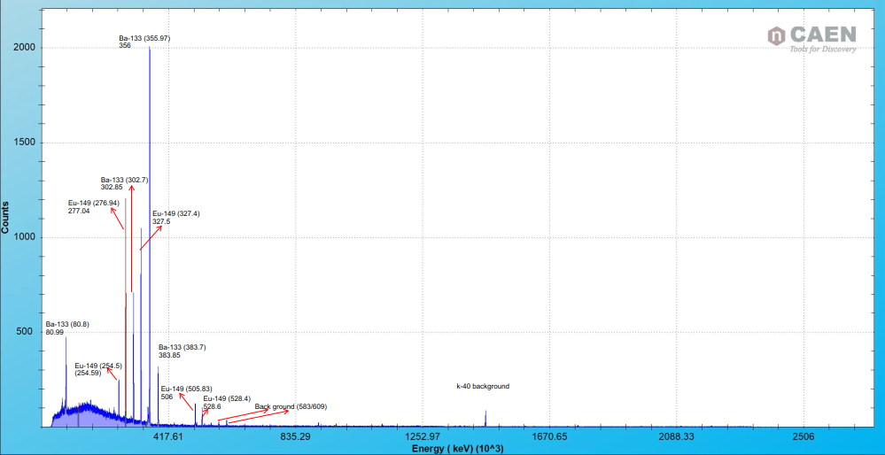
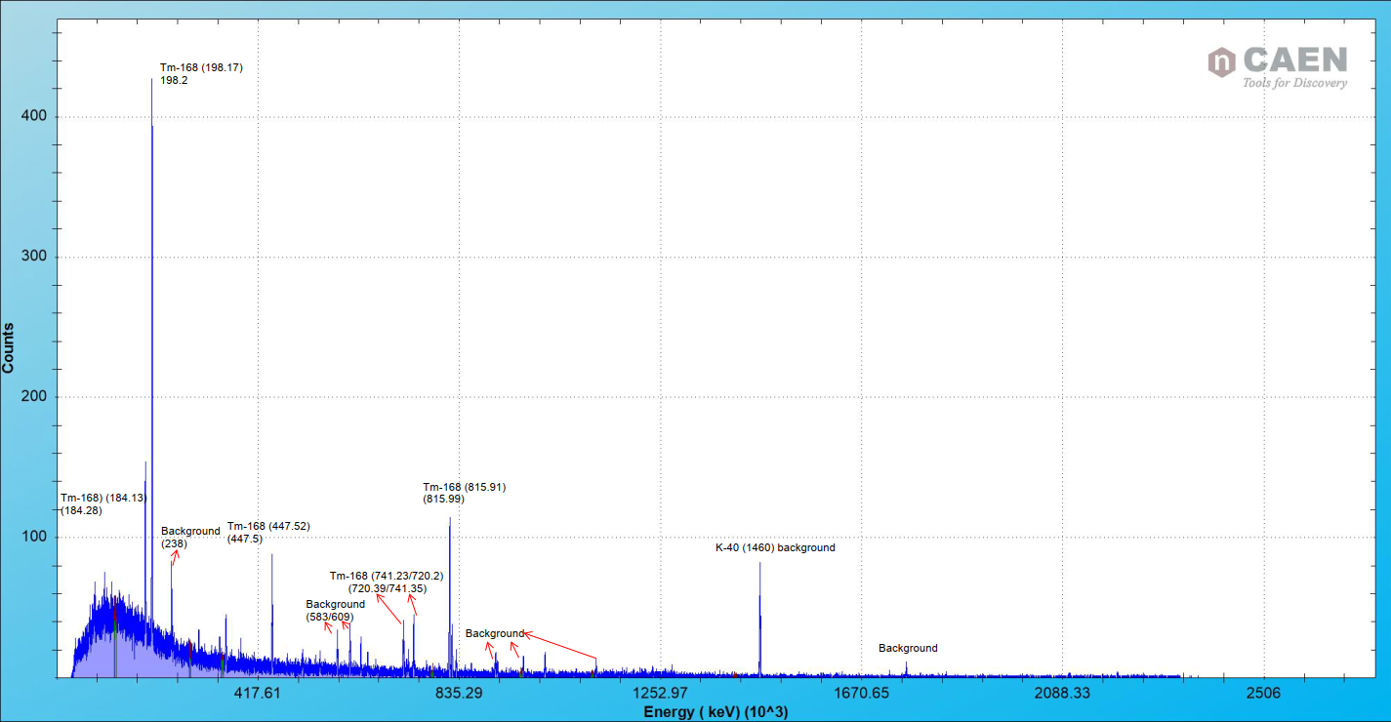
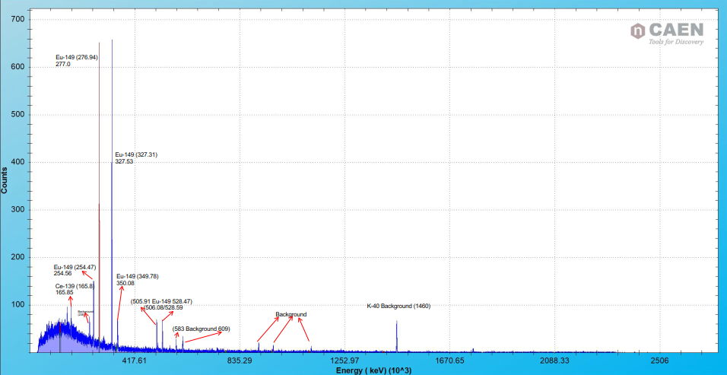
Gamma Spectrum of Zn/Gold Foils
M 40
M 12
M 36

Slide 11
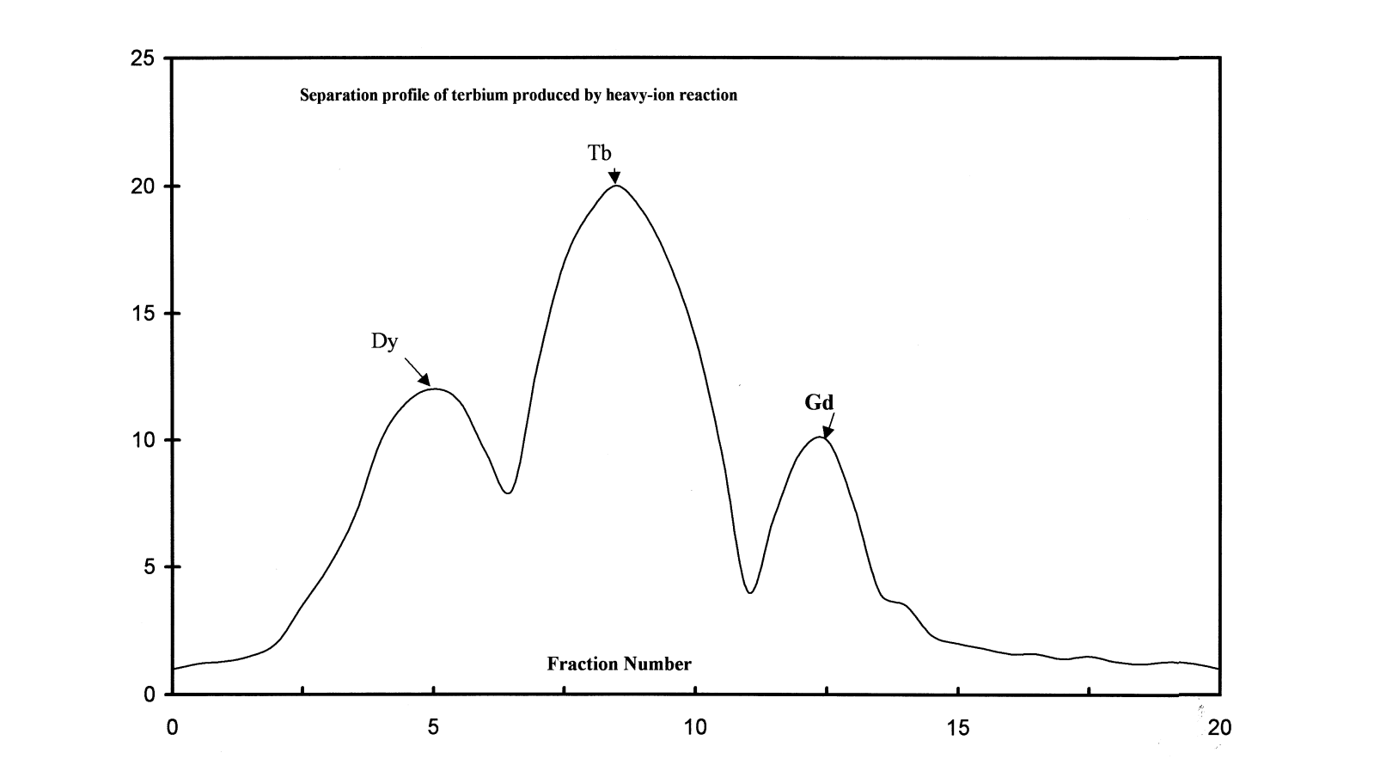
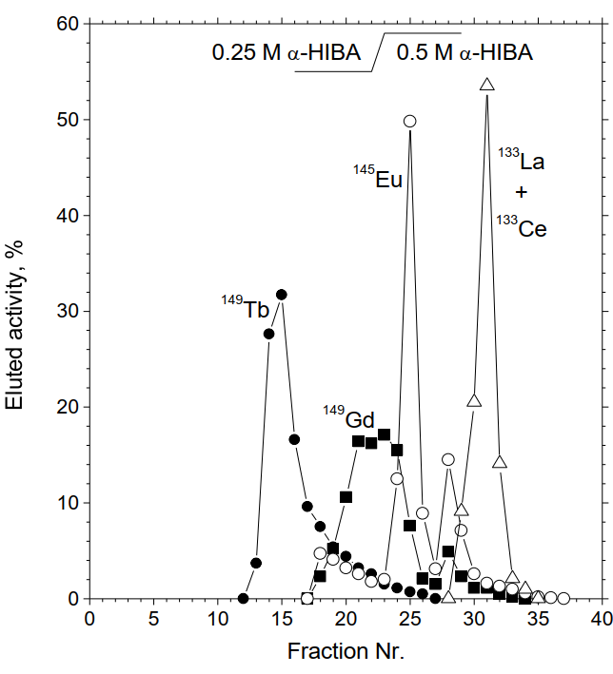
Elution Profile (Example)
Production of terbium-152 by heavy ion reactions and proton induced spallation
B.J. Allen, G. Goozee, S. Sarkar, G. Beyer, C. Morel, A.P. Byrne
Production routes of the alpha emitting 149Tb for medical application
Article in Radiochimica Acta · January 2002
Gerd J Beyer, Jožef J. Čomor, Daković Marko, Dmitry Soloviev

Slide 12
Results
After performing radiochemistry procedures, one will have the quantitative figure on the following,
Dissolution efficiency of Salt/Al and Zn/Au foils
Elution efficiencies of Lanthanides
Pointing out the required Parameters to be optimized
Operational ease during Radiochemistry
Areas of improvements w.r.t radiochemistry, Handling of radioactivity and dose/work planning

Slide 13
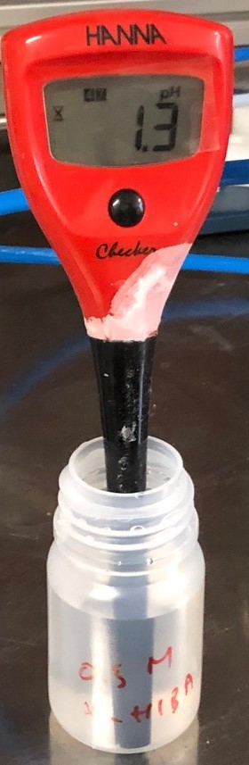
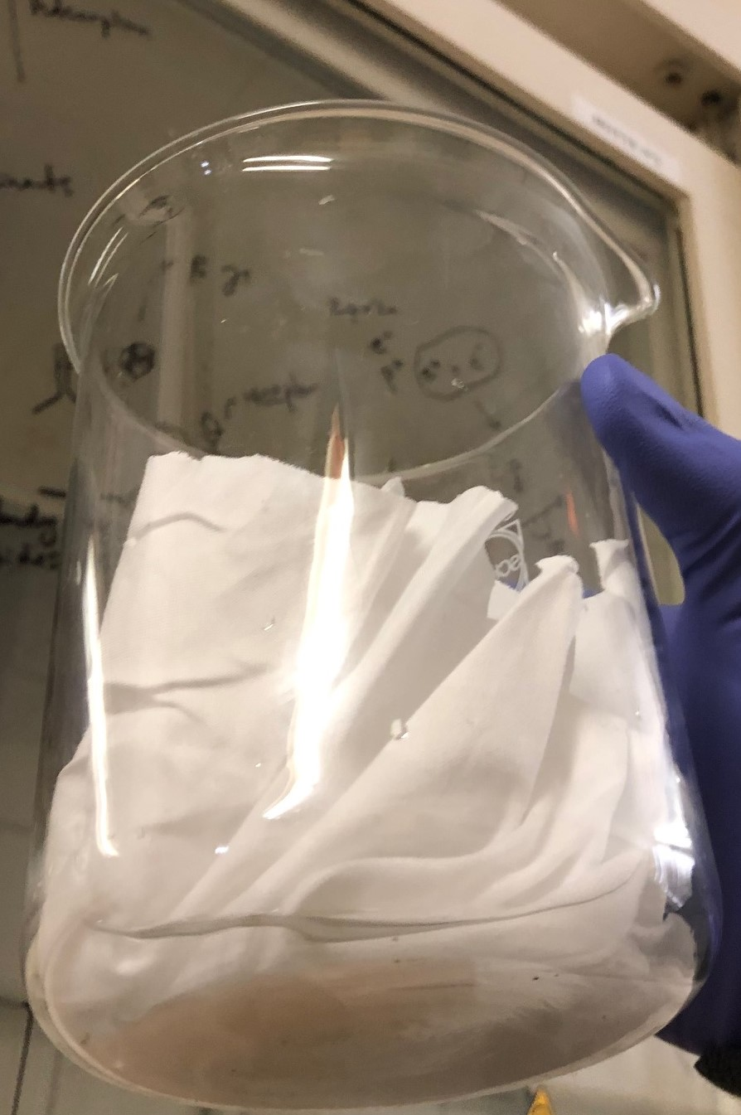
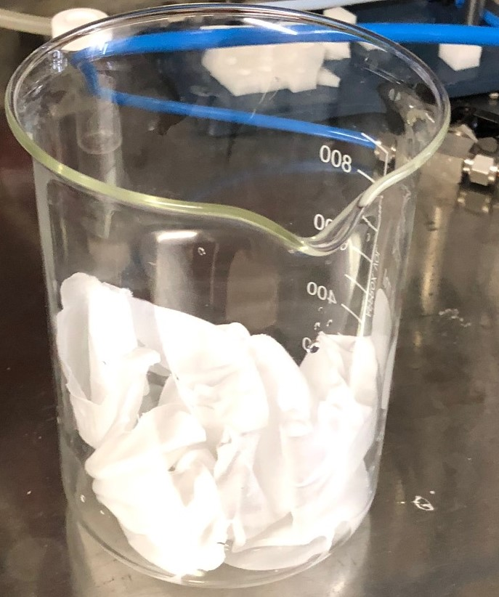
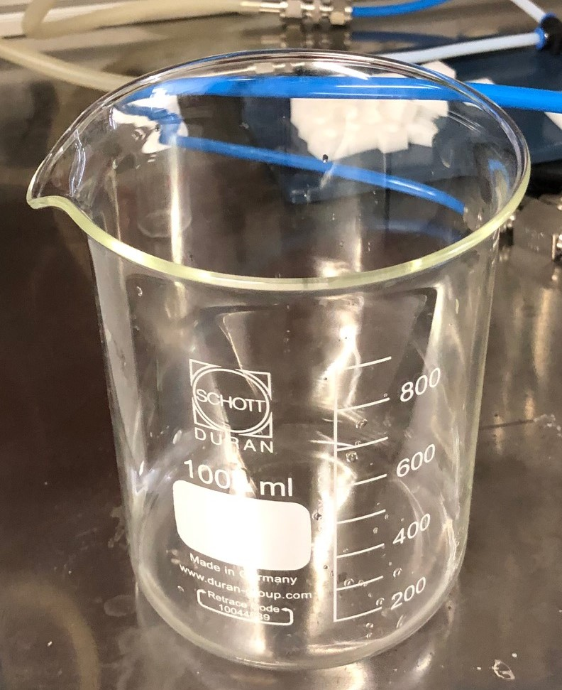
Radioactive Waste Handling
For experiments under 1 LA, rad liquid waste will be dried
Radiation Protection, CERN will validate this strategy for operational radiochemistry upon successful demonstration during < 1 LA experiments

Slide 14
Radiochemistry Summary
Sr. No | Document |  | Status | Remarks
1 | Procedures | Salt/Al Foils | Submitted | Final Approval
 |  | Zn/Au Foils
2 | Risk Analysis Safety Assessment |  | Submitted | Final Approval
3 | Cold Test (internally) |  | Completed | Successful
4 | Work and Dose Planning |  | Not Required | < 1 LA
5 | Fume hood Installation |  | January-February (2019) | Installed
6 | Cold Test in front of RP |  | Performed | Successful
7 | Dissolution of Zn/Au Foils |  | Performed | Successful
8 | Radiochemistry of 2018 foils |  | March 2019 | To optimize the procedures
9 | Low Level Radiochemistry |  | April, 2019 | Tb-155 Purification
10 | Liquid Waste Handling |  | February, 2019 | Successful
11 | Audit by IRA |  | April, 2019 | To get the license for operational Radiochemistry

Slide 15
THANK YOU ALL

